Slide 1
Conveyance of Water Rights by Dana Dredge & Sue Glenn
Shares vs Water Rights
Utah Code 73-1-10;
Utah Code 73-1-11
Maps/Standards
Report of Conveyance (ROC’s)
Processing the ROC
Conflicts

Slide 2
Water rights vs. Water shares
State of Utah
State of Utah
Water Right
Water Right
Water Right Owner
Irrigation Company
Shares
Water Right:
Issued by the State of Utah, Division of Water Rights
Water Share:
Share Certificate issued by irrigation company
Shareholder
Shareholder
Shareholder
Shareholder
Shareholder

Slide 3
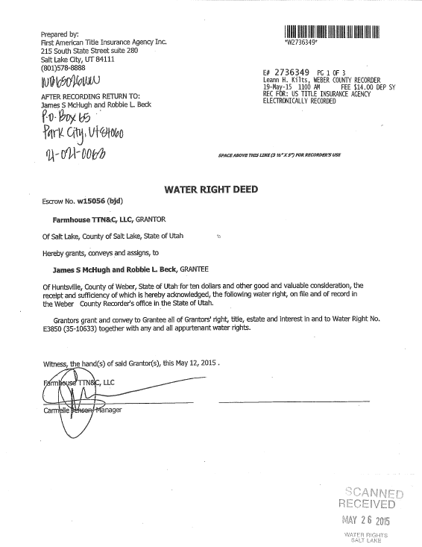
73-1-10 (1)(a) Deeds

Slide 4
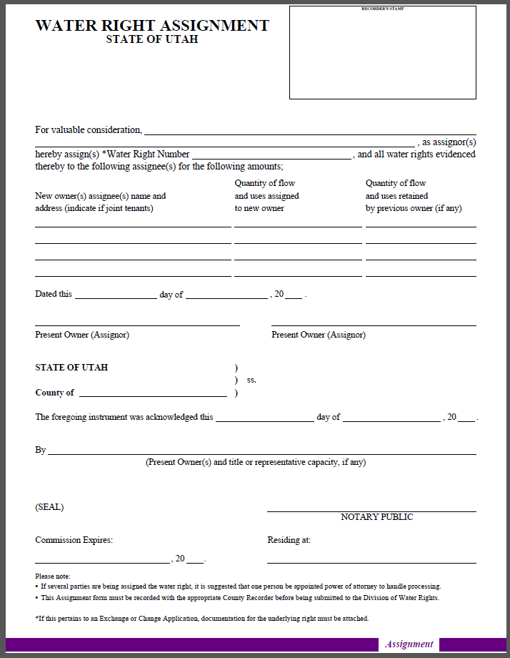
Assignment
When?
Approved/unapproved
May 13, 2014

Slide 5
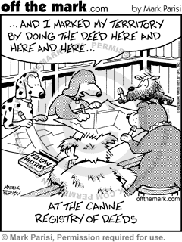
73-1-10 (1)(b)&(c)
County Recorder
Recorded in the County
Point of diversion location
Place of Use location
Constitutes notice
May 13, 2014

Slide 6
Addendum
73-1-10 (d)(i)(ii) as provided by Real Estate Code 57-3-109
Identifies water rights
July 1, 2011
All grantors sign.
All grantees sign.
The grantees current mailing address
County recorder submits to SE

Slide 7
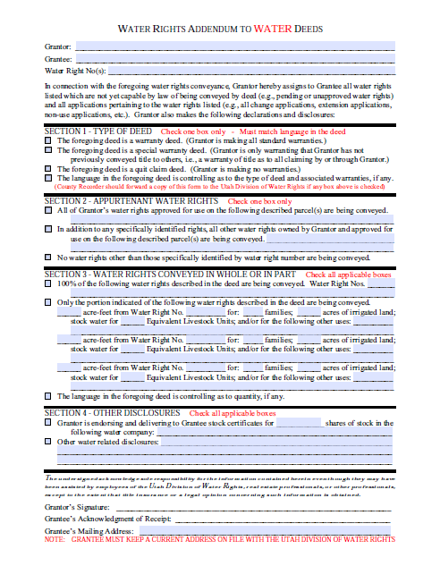
Addendums

Slide 8
WHO?
Water Right Owner
Deed conveys 100% by WATER RIGHT NUMBER.
PORTION
ALL owners sign the deed
water right number identified
sole supply established
All deeds identify WATER RIGHT NUMBER and COMPLETE CHAIN OF TITLE

Slide 9
Name Changes
Marriage
Divorce
Joint Tenancy (May 4, 1997)
Corporations

Slide 10
73-1-10 (3)(c)
Professional licensed in Utah
An attorney
A professional engineer
A title insurance producer
A professional land surveyor
Why?
Why?
Why?

Slide 11
73-1-11
Appurtenance
Definition: All water is the property of the public until a right for its diversion and use is properly established

Slide 12
73-1-11(1)(a)
Exceptions:
Reserves the water right or any part
Conveys a part of the water right in land conveyance document.
Conveys separate conveyance prior to or contemporaneously with the execution of the land conveyance document.

Slide 13
May 4, 1998
WHY?
Before May 4, 1998
Only perfected water rights
After May 4, 1998
All perfected documents
All APPROVED

Slide 14
Example
Your first deed recorded April 28, 1976 for land only – no water rights mentioned on the deed.
Certificate issued March 15, 1970 (perfected water right)
Does the deed convey the water right by appurtenance?
March 15, 1985

Slide 15
Example
Farmer Jones takes out a Deed of Trust for Lot 10 on 2/5/1980.
His land goes into default and a Trustee’s Deed was Recorded on 5/10/2001
The Water Right was Certificated on 3/15/1970 to be used on Lot 10
Change Appl. Approved on 4/10/1999, changing the Place of Use to Lot 5
Does the Trustee’s Deed convey the water right?

Slide 16
73-1-11 (1)(b)
County recorder records a document that conveys a water right appurtenant to and relies on the document the state engineer shall rely on the document as a conveyance of a water right appurtenant to land.
Unity in Title
Copy of tract index
Affidavit endorsed by professional affirming no severance of water right.

Slide 17
Mapping Standards
When a Map is Required
When a Water right is conveyed by appurtenance
A map depicts the place of use of the water right overlain by the metes and bounds description in the deed.
WHY?
It easily determines that the water right is appurtenant to the property described in the deed.

Slide 18
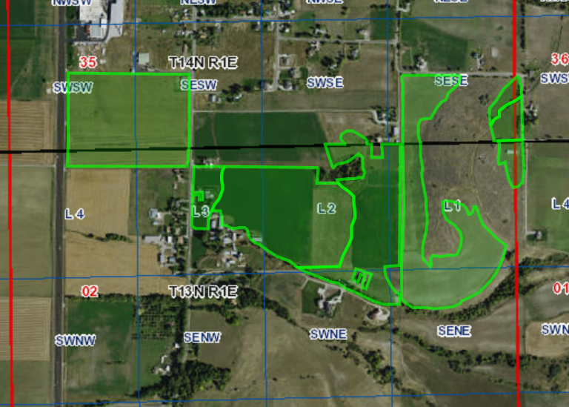
Sections 35 T14N, R1E & Section 2, T13N, R1E
Section, Township and Range
Section Corner
Water Right #
Parcel 1
28.1 acres
SE Corner
North Arrow
Scale
Parcel
Parcel 2
63.3 acres
Acreage
Legends
25-6734
N
Parcels 1 (28.1 acres) & 2 (63.3 acres) (Deed # 7240)
POU for water right # 25-6734
Less & excepting are to be identified
Property description changes need a new map for that deed

Slide 19
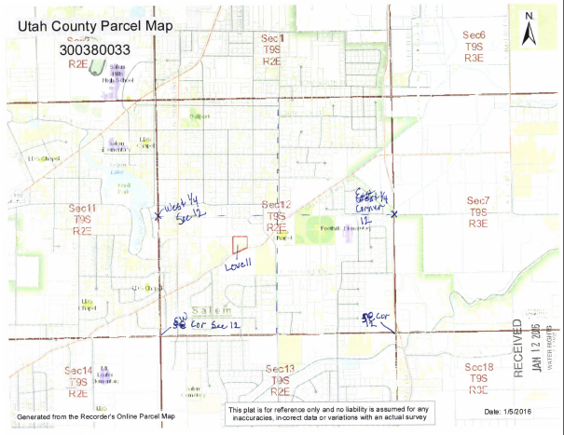
51-4693

Slide 20
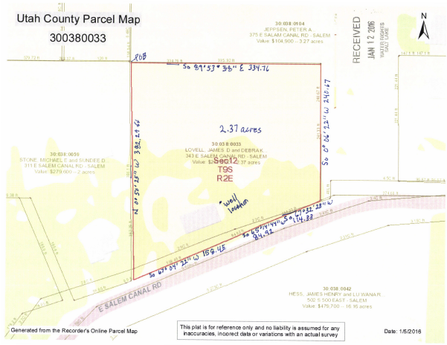
51-4693

Slide 21
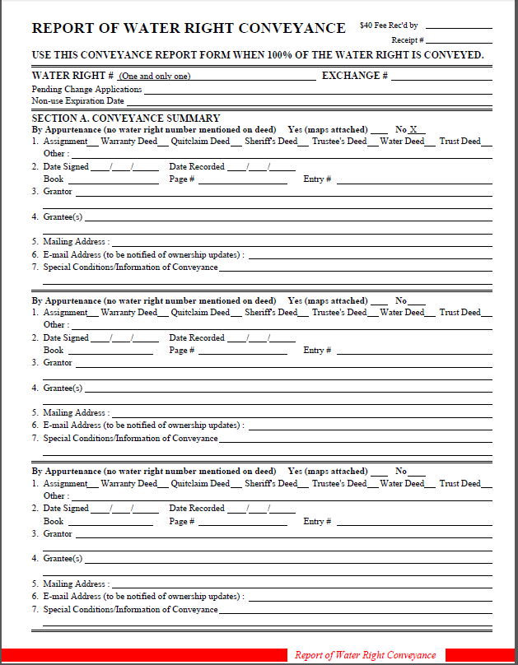
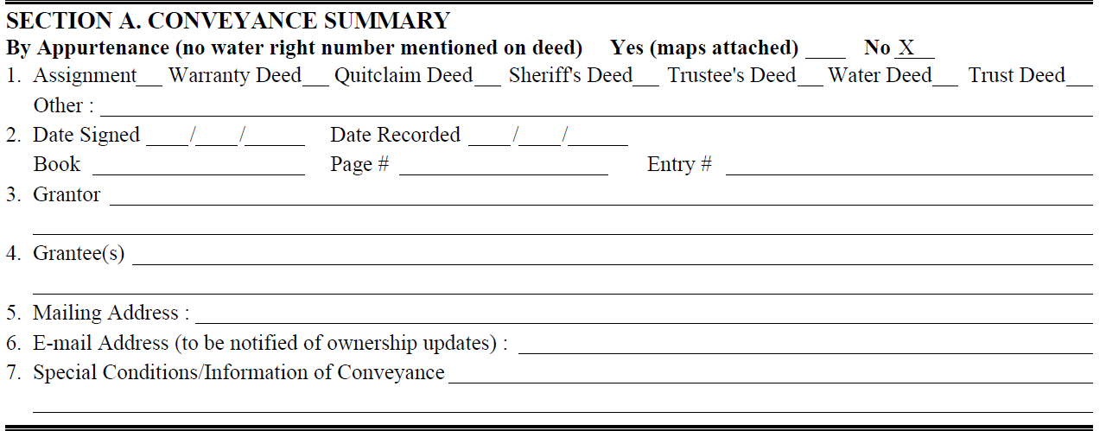
Report of Conveyance (ROC)
100%

Slide 22
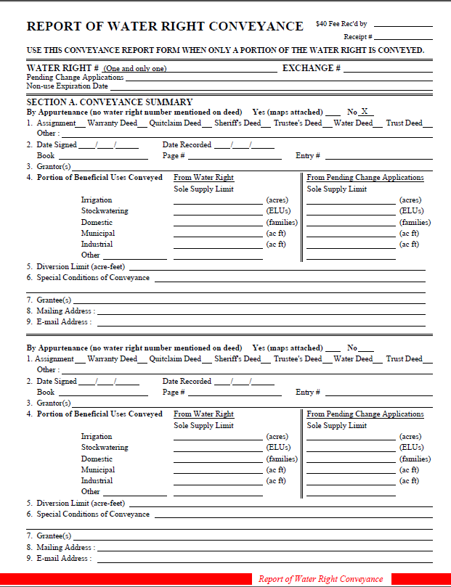
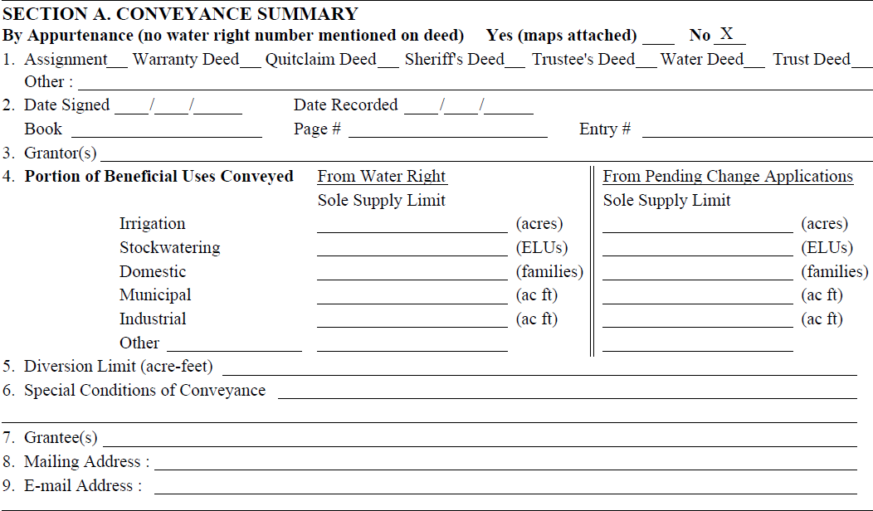
Report of Conveyance (ROC)
Portion

Slide 23
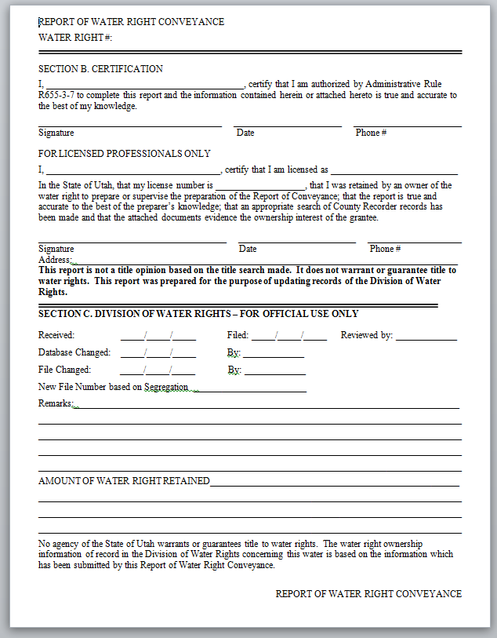
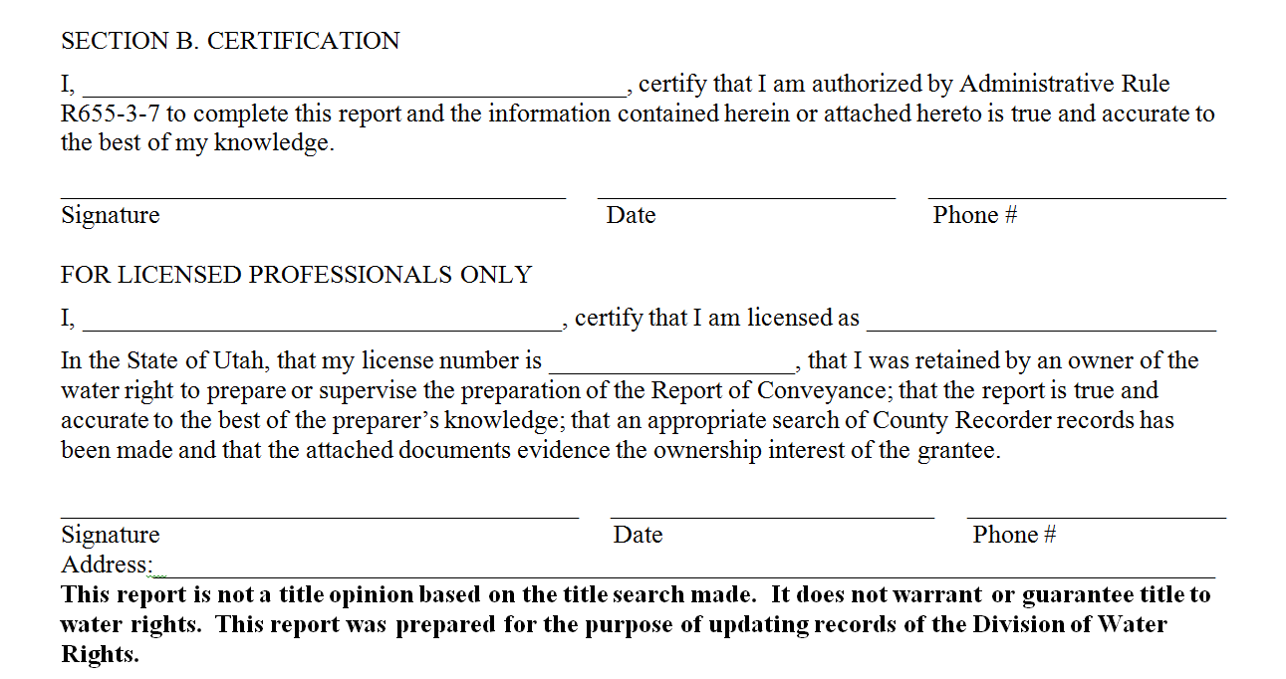
Signature page of both 100% & Portion ROC forms.
Grantee
Grantee’s Signature
Profession: Title Agent, Engineer, Land
Surveyor, or Attorney
Professional’s name
License #
Professional’s signature
Phone #
Professional’s address

Slide 24
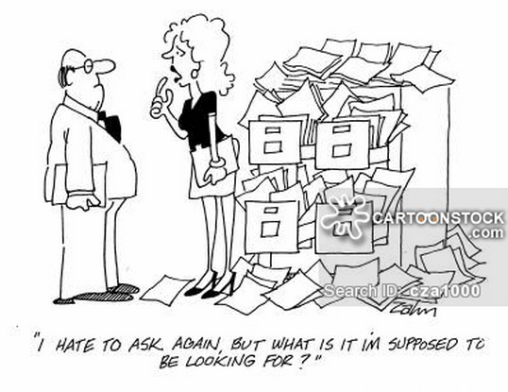
Checklist
Owner of record
Chronological order
ROC signed by water user and/or professional
Does it have a mailing address for new owner?
Maps
All documents
Fee

Slide 25
Processing the ROC
State Engineer assesses form State Engineer assesses substance
Acceptable complete Not Acceptably complete - 90 Days
Sole responsibility of submitter

Slide 26
CONFLICT
Not Processed/returned
Disputing parties notified
No administrative action
Resolution:
Documents to resolve title question
County Recorder
Must directly address title conflict
Exception:
Deed take precedence

Slide 27
Water Rights Website
www.waterrights.utah.gov

