Slide 1


Proposed Amendment to Article IV Paragraph 5
UTAH/GOSHEN VALLEY GROUND-WATER MANAGEMENT PLAN
James Greer P.E.
S. Ross Hansen P.E., L.S.
November 1, 2018
Public Meeting
Notes:
Good Afternoon,
My name is Ross Hansen, I currently serve as the Weber River and West Desert Regional Engineer for the Division of Water Rights

Slide 2
Current Groundwater Management Plan Language

Slide 3
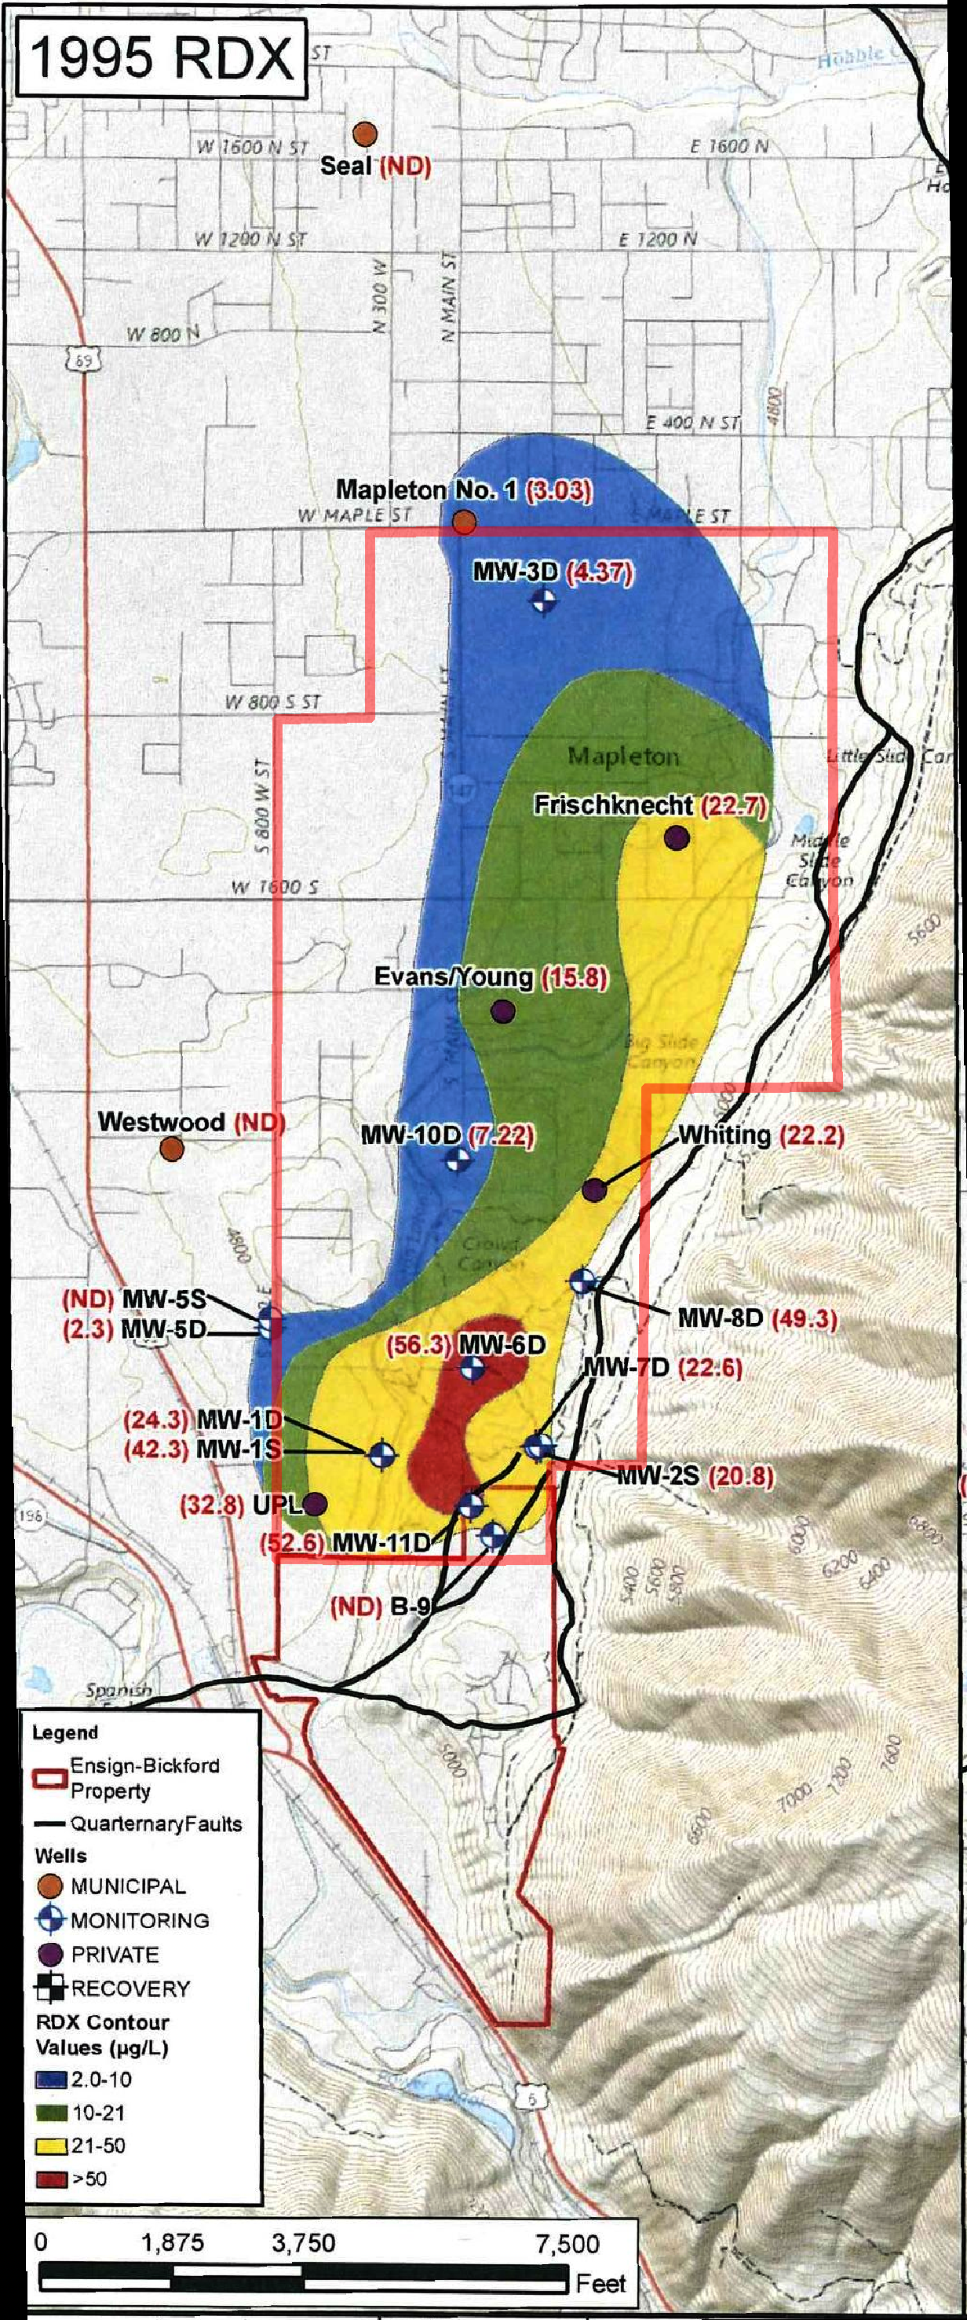
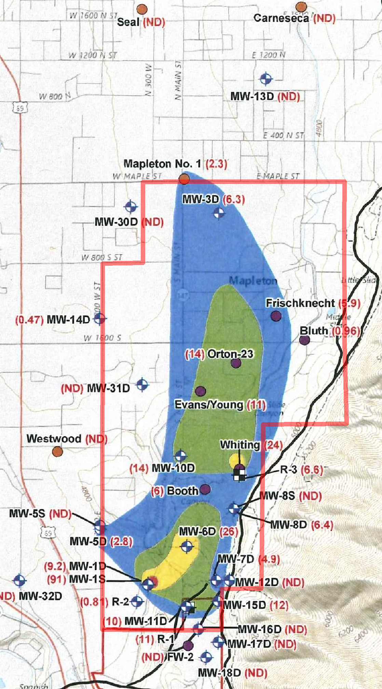
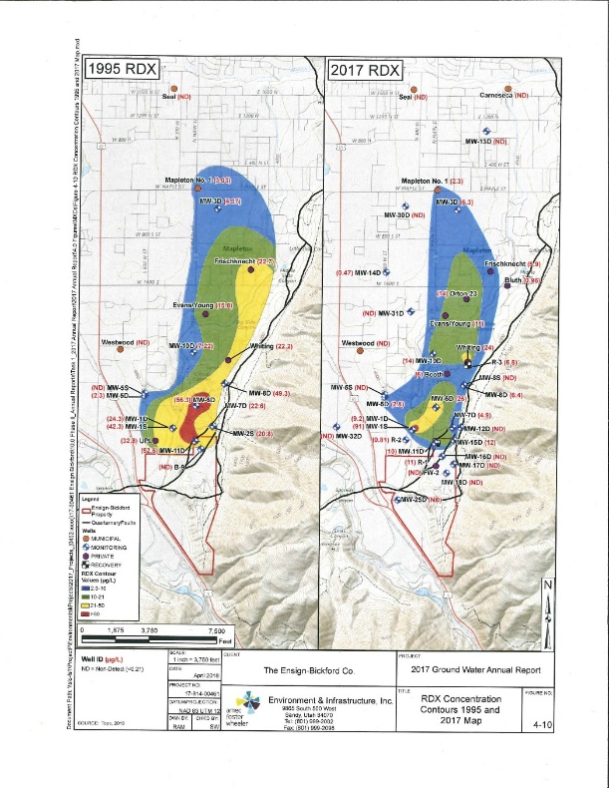
1995 RDX
2017 RDX
From Ensign-Bickford’s 2017 Ground Water Annual Report (Figure 4-10)

Slide 4
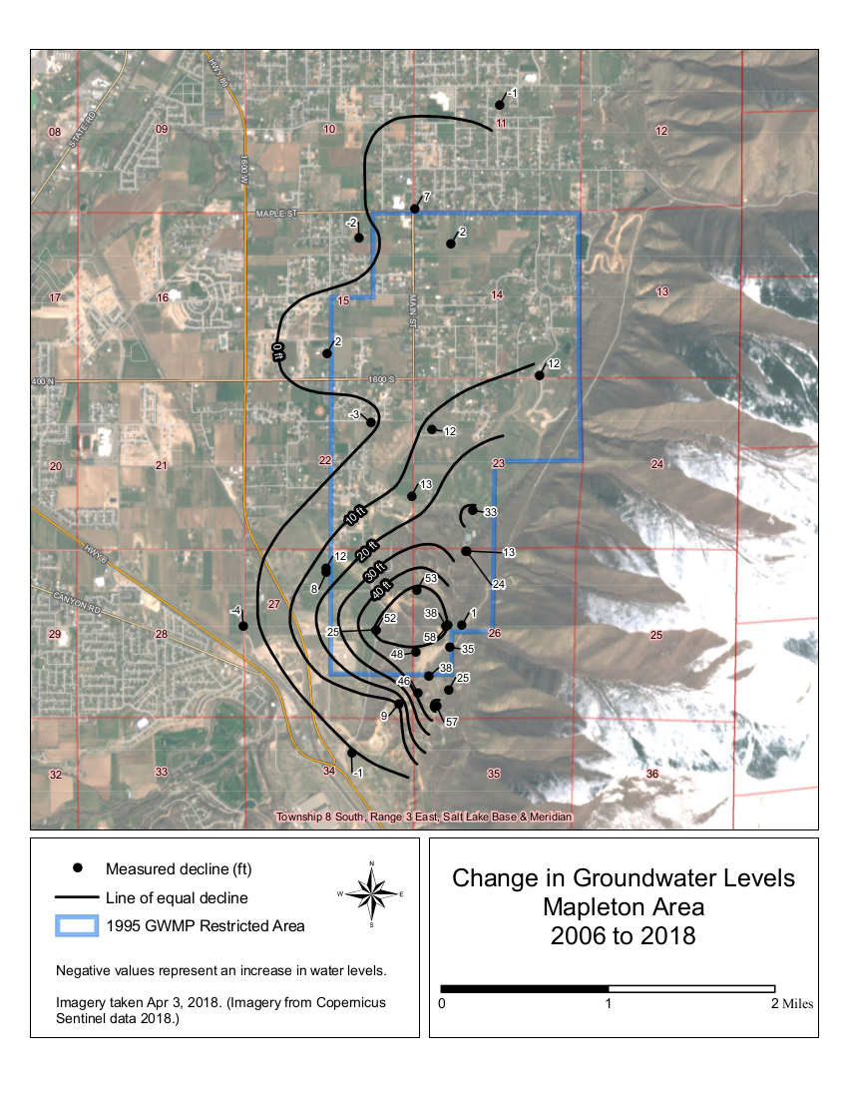
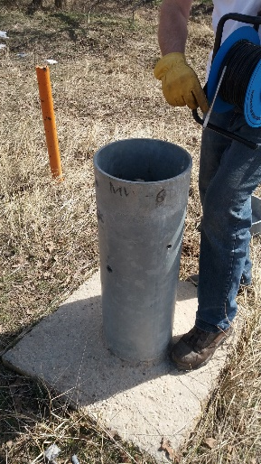
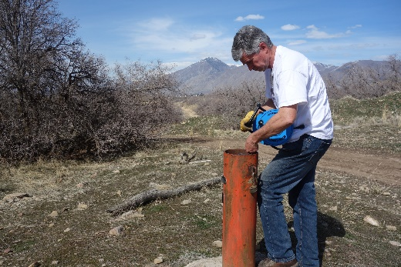
Change in Groundwater Levels
2006 to 2018
Data from Ensign-Bickford
Measurements made in spring
In spring of 2018, a Water Rights engineer accompanied the water level monitoring done by Ensign-Bickford
The year 2006 was selected as a starting point because the number of measurements for this year exceed the number of measurements made in 1991 (as part of a USGS study)

Slide 5
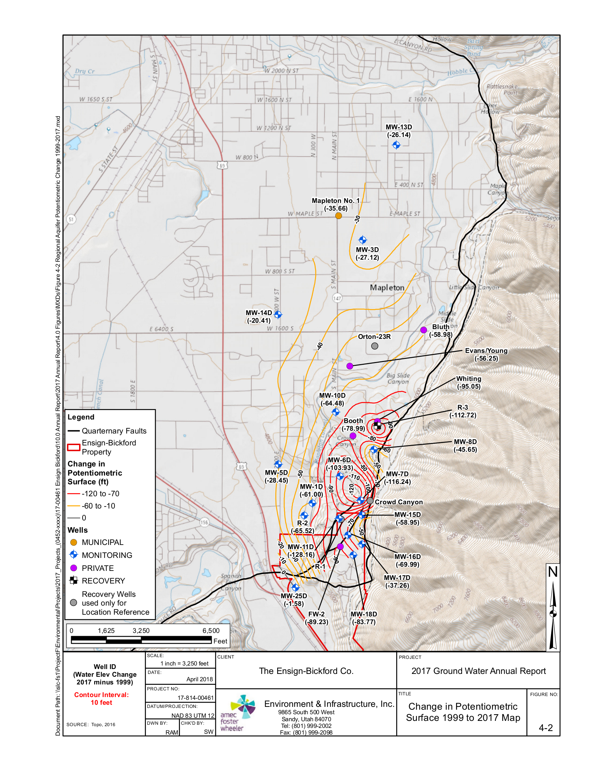
Change in Groundwater Levels
1999 to 2017
From Ensign-Bickford’s 2017 Ground Water Annual Report (Figure 4-2)

Slide 6
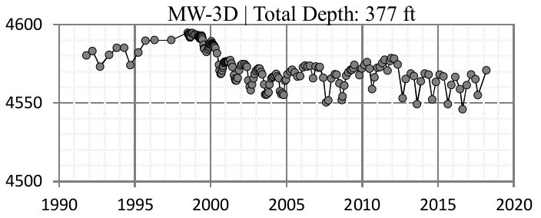
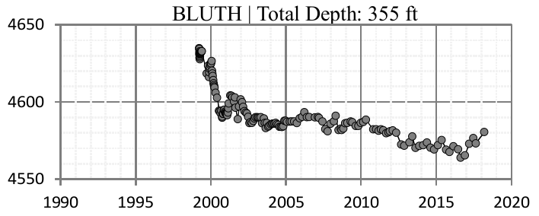
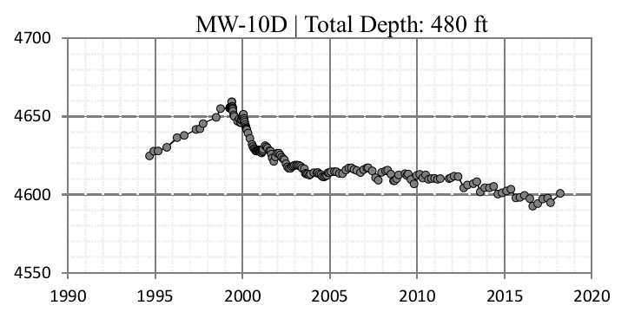
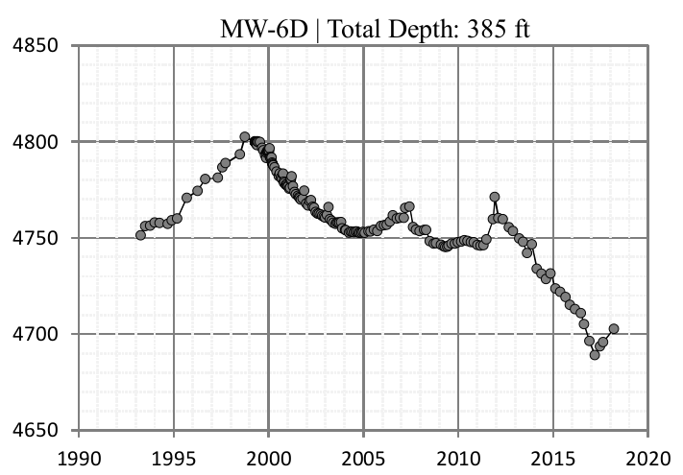
2006 to 2018
1999 to 2017

Slide 7
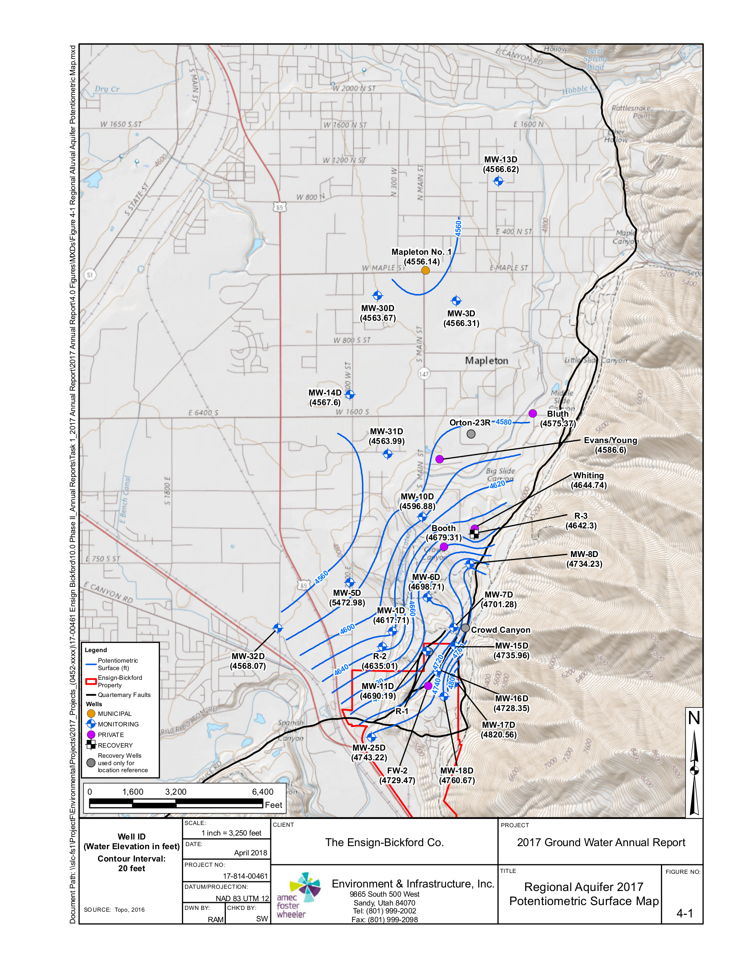
Potentiometric Surface
2017
From Ensign-Bickford’s 2017 Ground Water Annual Report (Figure 4-1)

Slide 8
Current Groundwater Management Plan Language

Slide 9
2016 Settlement Agreement
3. Upon dismissal of the Judicial Review Action, the State Engineer shall proceed with modifying the Utah/Goshen Valley Ground-water Management Plan dated November 15, 1995 and will propose removing the provision in Article IV, paragraph 5 prohibiting the State Engineer from granting “change applications which propose to transfer water into [the] restricted area.” The State Engineer’s proposal may include other alterations or replacements. This process is governed by Utah Code Section 73-5-15.

Slide 10
Proposal To Remove Paragraph
Remove Article IV paragraph 5 prohibiting the state engineer from granting change applications which propose to transfer water into [the] restricted area.
X

Slide 11
Proposed Groundwater Plan Language
Through consent agreement the state of Utah has given certain assurances to the entity responsible for cleaning up the contamination which insures the remediation process can succeed.
Replace paragraph 5 with the following alteration:
“A contaminated site has been identified near the mouth of Spanish Fork Canyon with high levels of nitrate and explosive compounds. The contamination plume is dynamic and the restricted area defining its location will be updated on the Division of Water Rights website periodically as needed. The restricted area boundary will be defined as the area inside the contamination concentration contour derived from water sample data where the explosive compound commonly referred to as RDX is found in concentrations greater than 2.0 ppb.
Through consent agreements the state of Utah has given certain assurances to the entity responsible for cleaning up the contamination which insures the remediation process can succeed. Applicants seeking to move water rights into the contaminated area are cautioned that the water within this area must be adequately treated before the water is used and shall demonstrate in the change application filing that the future withdrawal of water will not interfere with the clean-up process or be detrimental to public welfare.”

Slide 12
Possible language suggested by Ensign-Bickford Industries, Inc.

Slide 13
Possible language suggested by Ensign-Bickford Industries, Inc.

Slide 14
What’s Next Governed by Utah Code 73-5-15
Receive and consider comments until December 3, 2018.
If State Engineer deems necessary additional public meetings may be scheduled.
If second public meeting is not necessary:
  60 days prior to adoption we will publish and send notice of draft.
  After 60 days; publish and send notice of adoption.
Persons aggrieved may file a complaint in district court within 60 days after notice of adoption is published and sent.

Slide 15
Questions and Comments
Please send your written comments to:
Division of Water Rights 1594 West North Temple
Suite 220 P.O. Box 146300
Salt Lake City, Utah 84114-6300
Comment Deadline is December 3rd, 2018.
Information from the meeting will be posted on the Utah Division of Water Rights website at http://waterrights.utah.gov as a resource for those who are unable to attend the meeting or require additional information.

