Slide 1


Utah Division of Water Rights
Water Use Program
Water Users Workshop – February 2018
James Greer, P.E.
Assistant State Engineer – Technical Services
June 21, 2004

Slide 2
What is the
Water Use Program?

Slide 3
DWRi
Water Rights
Source Data
DWRe
Water Resources
Conservation
DDW
Drinking Water
Water Use Data & System Sizing
State Planning
Studies
Deficiency Points
National Reports
Water
Systems
USGS

Slide 4
Water Use Data is Used for:
USGS studies
Water Resources Planning Programs and Efforts
Water Rights Water management policy development
State financial assistance programs
Assessment of water supply and water use.
Water Rights Proof processing
Systems to evaluate the efficiency of their own systems

Slide 5
73-5-8
Reports by users to engineer.
Every person using water from any river system or water source, when requested by the state engineer, shall within 30 days after such request report.

Slide 6
Rule R655-17. Water Use Data Reporting and Verification.
4.3 If A Public Water Supplier Does Not Return The Water Use Data Form Or Knowingly Reports Inaccurate Data The System Will Be Reported To The Division Of Drinking Water
5.2 To facilitate the collection of water use data, the state engineer may require a water user install telemetry equipment on any measurement required under 73-5-4 in circumstances where conflicts among water users has been demonstrated.

Slide 7
Program Timeline
When | Action | Who
October – December: | Prepare For Upcoming Year (Active Systems, System Boundaries, Population) | DDW, DWRi, DWRe
January: | Send Forms Requesting Previous years Data | DWRi
January - March: | Assist / Visit Systems | DWRi
March 1st: | Deadline to submit the form | DWRi
March | Systems who have not reported are Identified | DDW
April – July: | Continue to Assist / Visit Systems | DWRi
July: | 50 deficiency points are assessed to PWS that fail to submit the completed form | DDW
July – August: | Review and Validate Data | DWRe
August - December: | Contact/Visit Systems identified by DWRe to validate data | DWRi
December: | Publish data | DWRi
Ongoing | Remove assessed points from PWS that report | DDW
Ongoing | Utilize data in re-evaluating sizing standards | DDW

Slide 8
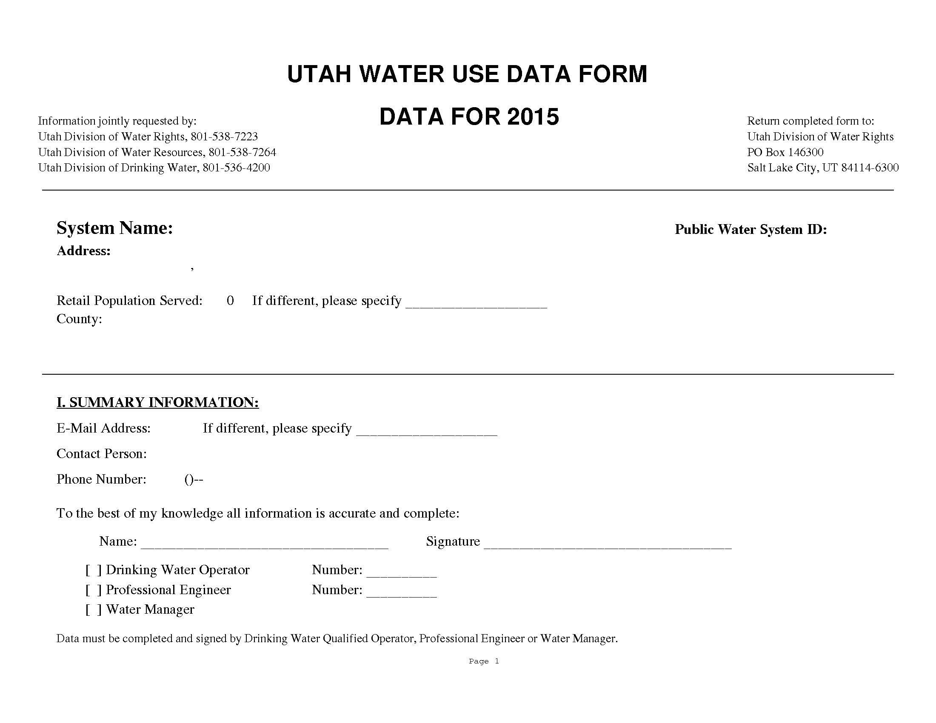
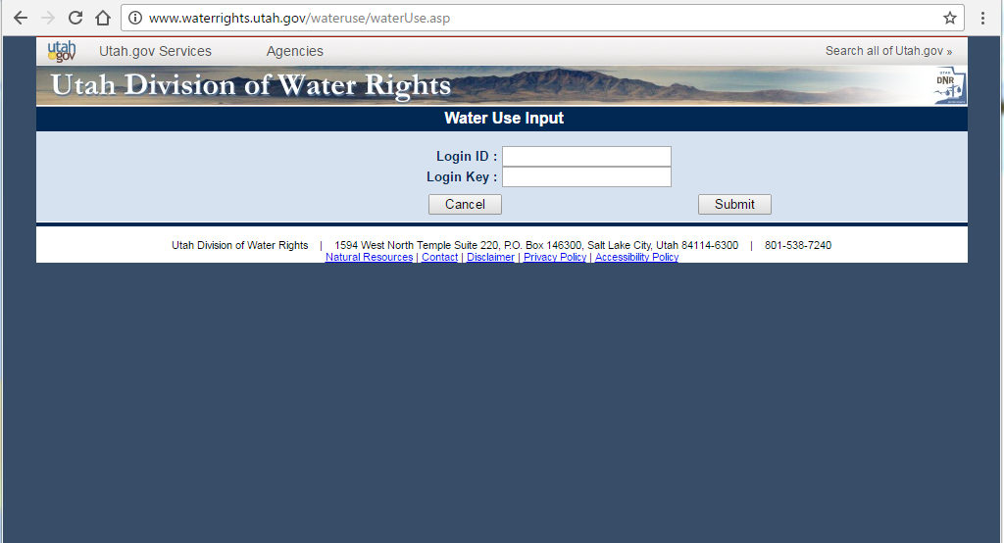
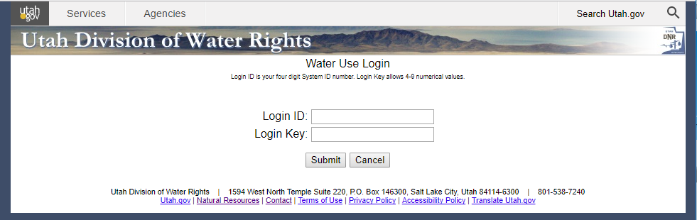
How is the water use data collected?
Annual Survey Paper / Electronic

Slide 10
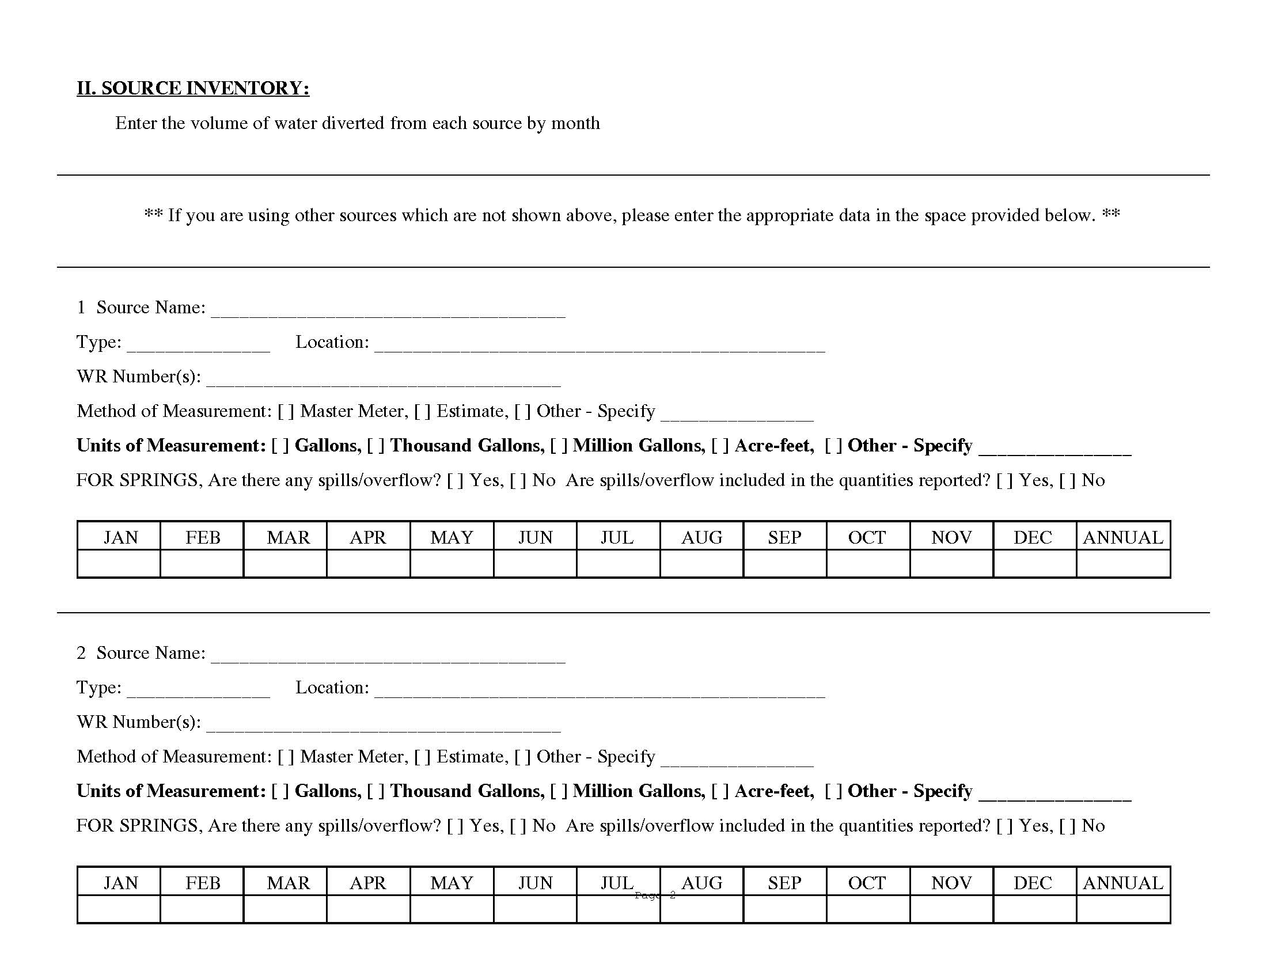

Slide 11
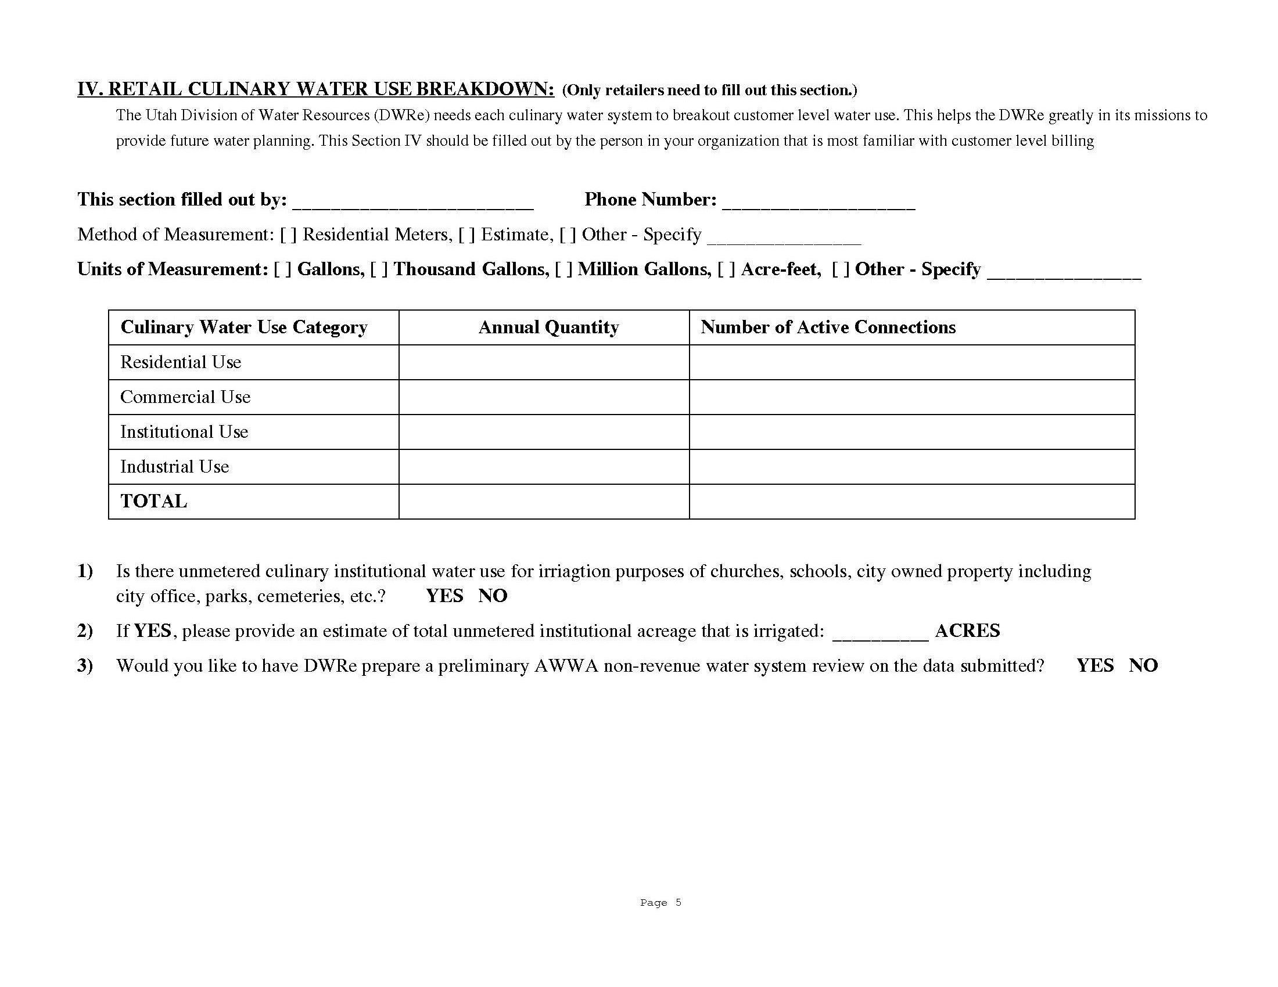

Slide 12
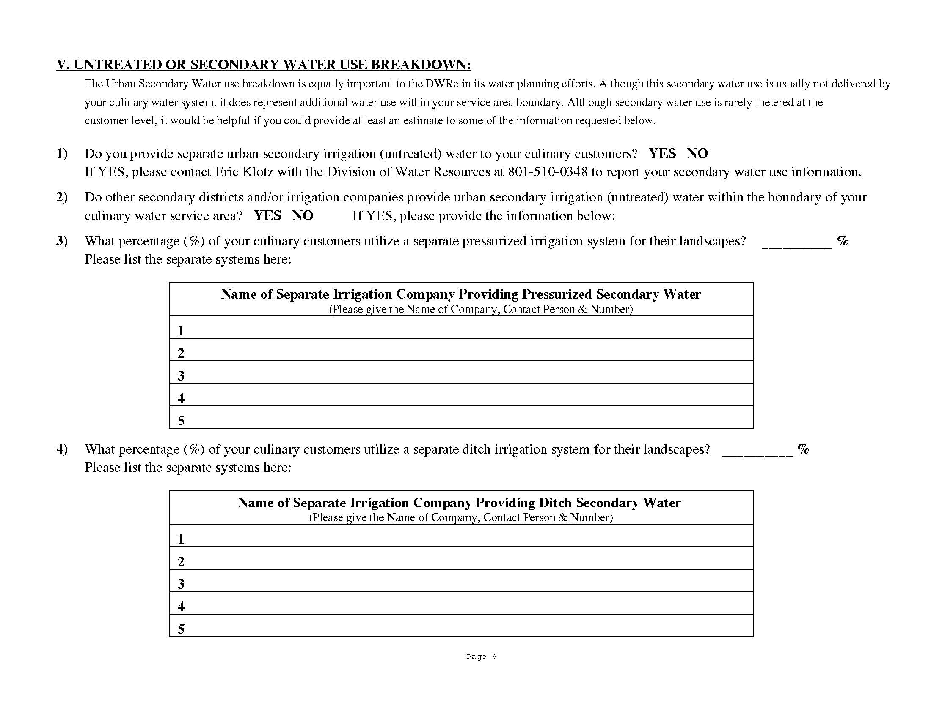

Slide 13
H.B. 305 – 2016 Legislative Session
Water Rights and Resources Amendments
Deals With The Accuracy Of Water Use Data
Requires Certified Operator Or Professional Engineer To Verify Accuracy Of Submitted Water Data
Required To Draft Administrative Rule
Provided New Funding

Slide 14
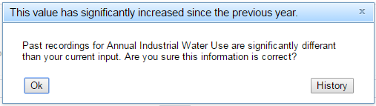
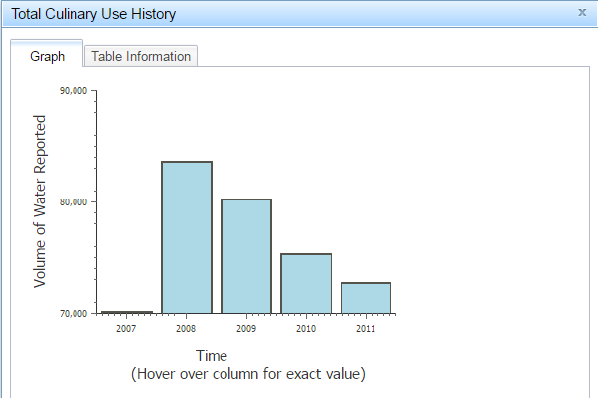
New Online Reporting System
Demo

Slide 15
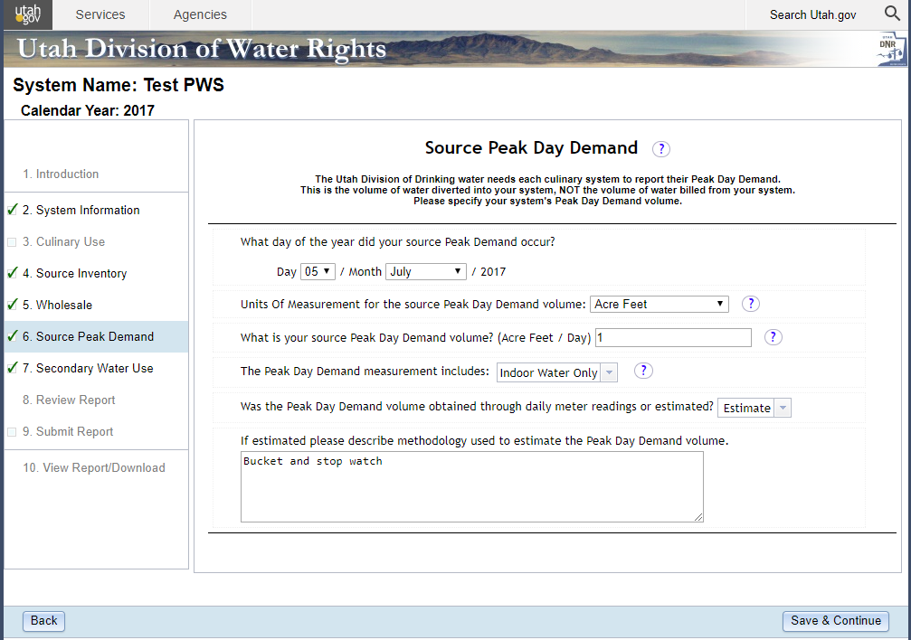

Slide 16
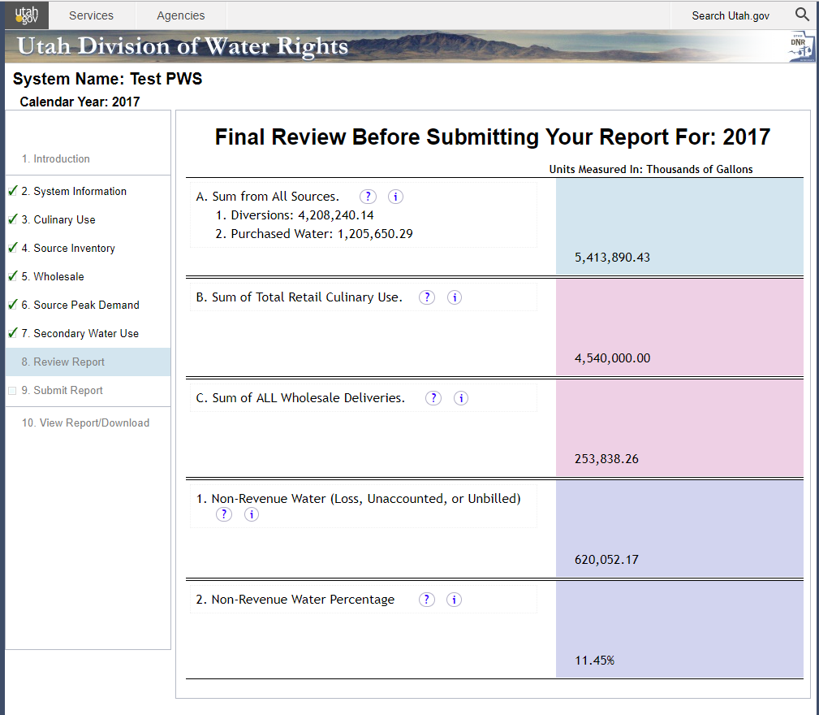

Slide 17
Non Revenue water
    Overflows
    Fire Flow
    Losses
    Unmetered Use
    Recording Errors
Peak Demand
    Estimates
    DDW
Secondary systems
    Separate Form
    Increasing

Slide 18
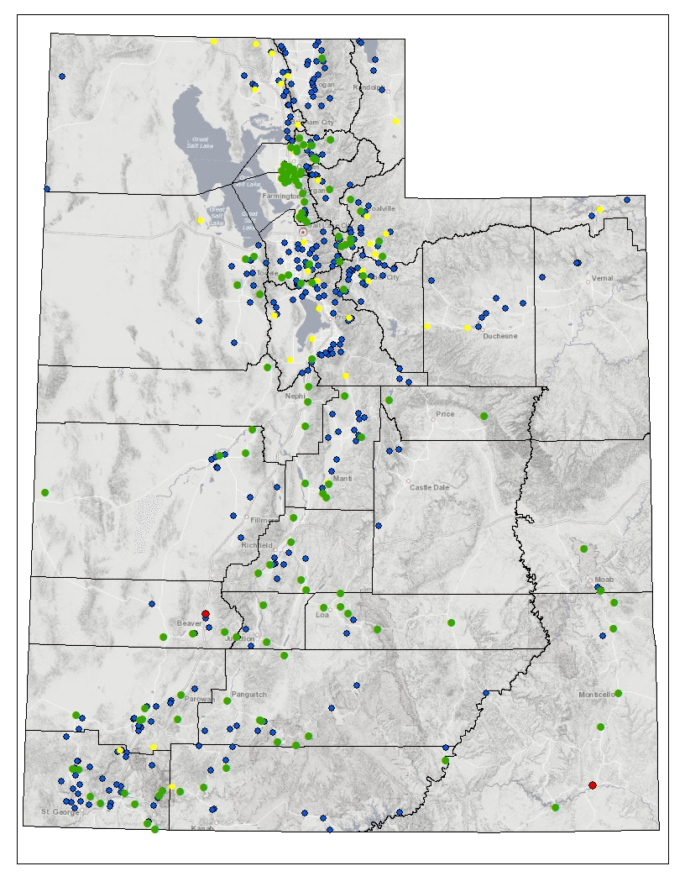
Public Water Suppliers
Water Use Data
Systems Visited
Systems Reported
Systems Not Reported
Systems Unwilling to Report
Notes:
Interior page
Headline and body copy left justified
This background should be used for all interior pages

Slide 19
2014 | Total | Percentage
Site Visits | 10 | 2 %
Systems Reporting | 393 | 73 %
Quality of Data |  | ~ 50 %
2016 | Total | Percentage
Site Visits | 533 | 98 %
Systems Reporting | 537 | 99 %
Quality of Data |  | ~ 90 %
Notes:
Interior page
Headline and body copy left justified
This background should be used for all interior pages

Slide 20
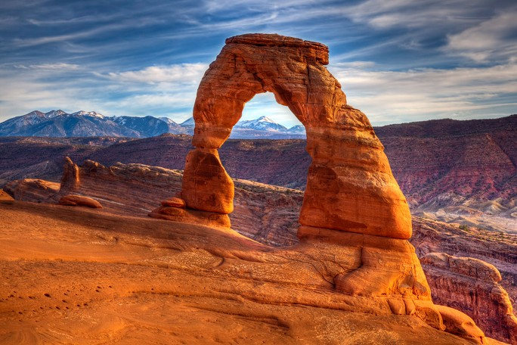

Questions
James Greer, P.E.
Assistant State Engineer
Utah Division of Water Rights
jamesgreer@utah.gov

