Slide 1
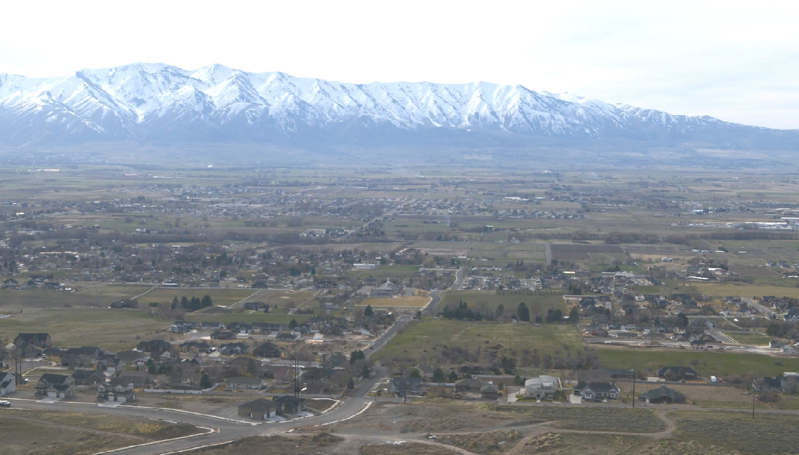
Aquifer Storage & Recovery Pilot Projects
Paul Inkenbrandt

Slide 2
Background- Experience
The Weber River Basin Aquifer Storage and Recovery Pilot Project
  Hurlow and others
  Surface application of water to recharge aquifer
  https://ugspub.nr.utah.gov/publications/special_studies/SS-136/ss-136_booklet.pdf
Cache Valley Aquifer Storage and Recovery - Phases I and II
  Inkenbrandt and Thomas
  https://ugspub.nr.utah.gov/publications/open_file_reports/OFR-615.pdf
Aquifer Storage and Recovery in Millville, Cache County, Utah
  Inkenbrandt
  Injection of water to recharge aquifer
  https://ugspub.nr.utah.gov/publications/reports_of_investigations/ri-275.pdf

Slide 3
Background- Questions you should address
Questions to answer with a pilot study:
Impact to other water rights?
  Quantity?
  Quality?
Where will the water go?
  Aquifer of interest
  Some person’s basement?
Change in groundwater chemistry?
  What is the baseline chemistry?
  Will you mobilize contaminants?
Amount added, extracted, and recovered?

Slide 4
Background- Outline
Steps for a successful pilot study:
Draft Design of Pilot Test
Compile existing information
Meet with regulators
Measure background conditions
Modify and build infrastructure
Conduct pilot test
Measure recovery conditions
Examine and share results

Slide 5
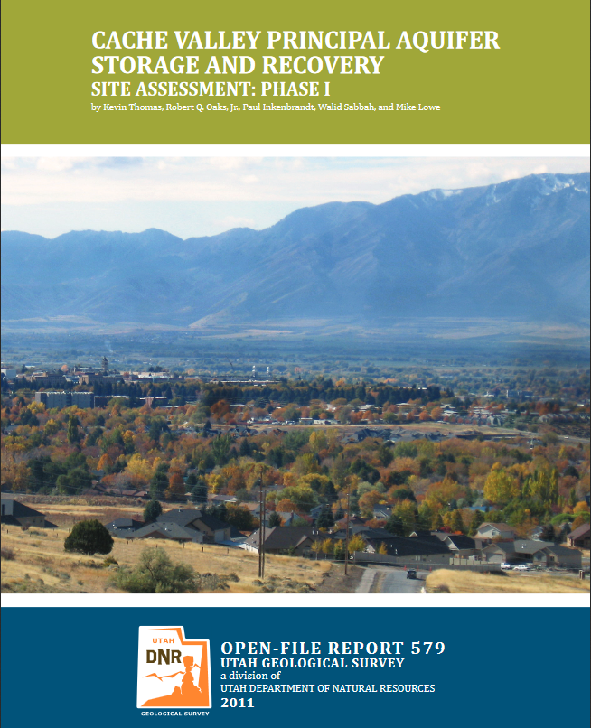
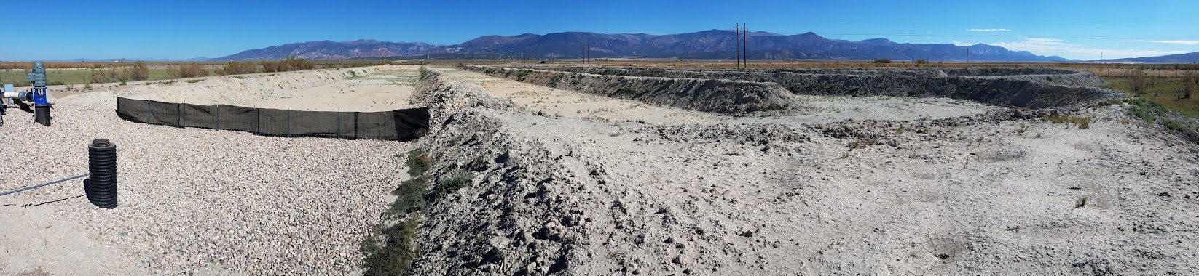
Draft Design of Pilot Test
A feasibility study is often necessary
Find an adequate place for ASR
  Availability of recharge water
  Location to recharge water
  Location to recover water
Determine method of delivery
  Injection
  Surface application
Determine quantity of water to use in pilot test
  enough to measure changes
  unique to each situation
  may depend on water availability
Good Guidance: http://www.ngwa.org/Advocacy-Awareness/Documents/BSP26-ASR.pdf

Slide 6
Compile existing information
Compiling existing info will tell you what data you have and help you figure out what data you will need
Existing Studies
UGS Online Publications https://geology.utah.gov/map-pub/publications/
USGS Online Publications https://pubs.er.usgs.gov/
Utah Water Rights Online Publications https://www.waterrights.utah.gov/techinfo/default.asp
Water Chemistry Data
EPA and USGS https://www.waterqualitydata.us/portal/
Water Level Data
UGS https://apps.geology.utah.gov/gwdp/
USGS https://maps.waterdata.usgs.gov/mapper/index.html
Water Well Data
Utah Division of Water Rights WRPOD file https://waterrights.utah.gov/gisinfo/wrcover.asp

Slide 7
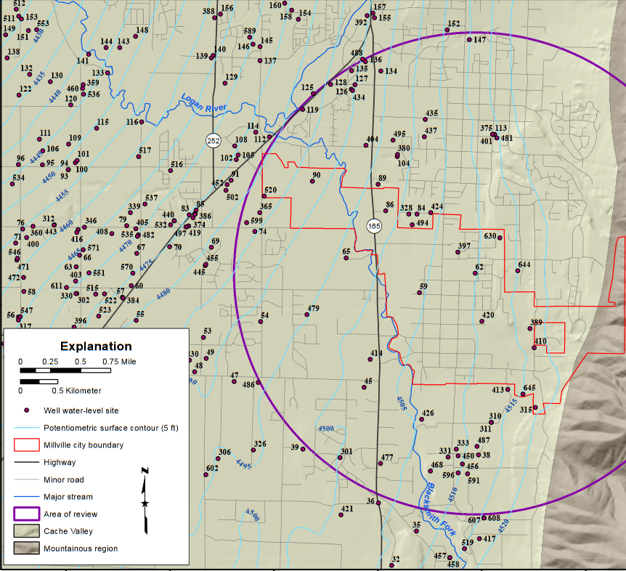
Compile existing information
Water Well Data
Utah Division of Water Rights WRPOD file https://waterrights.utah.gov/gisinfo/wrcover.asp
Water Level Data
UGS https://apps.geology.utah.gov/gwdp/
USGS https://maps.waterdata.usgs.gov/mapper/index.html

Slide 8
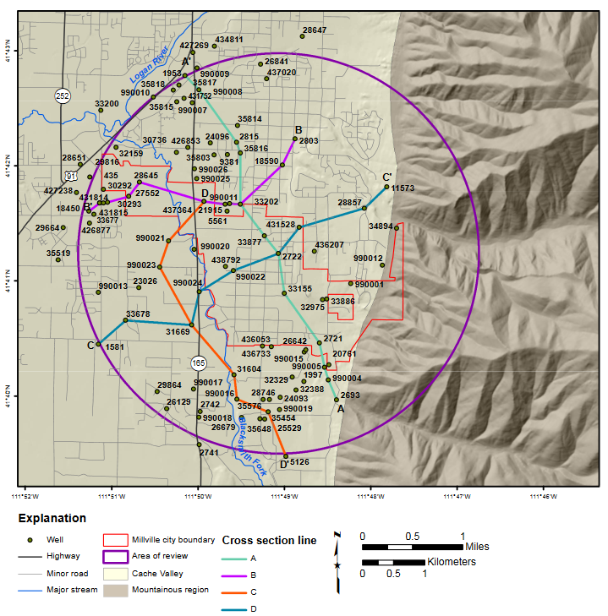
Compile existing information
Water Well Data
Utah Division of Water Rights WRPOD file https://waterrights.utah.gov/gisinfo/wrcover.asp

Slide 9
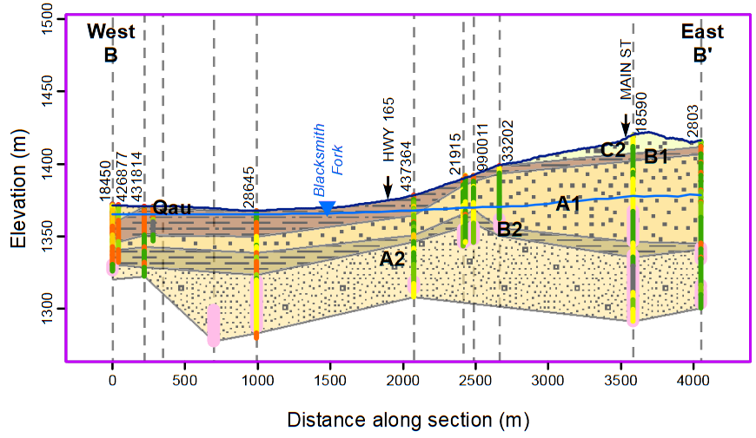
Compile existing information

Slide 10
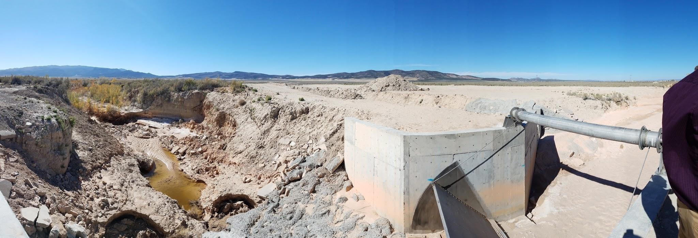
Meet with regulators
Purpose = inform regulators of your intentions
you need permission to conduct a pilot test
Pilot test needed for a permit (most cases)
The public works official and the scientists or engineers conducting the study should start by meeting with:
  Utah Division of Water Rights (73-3b-201j)
  Utah Division of Water Quality

Slide 11
Meet with regulators
Injection well:
  Utah Underground Injection Control (Class V ASR Well)
Public water supply:
  Utah Division of Drinking Water
Also the Utah Division of Water Resources is interested in and sometimes supports these projects

Slide 12
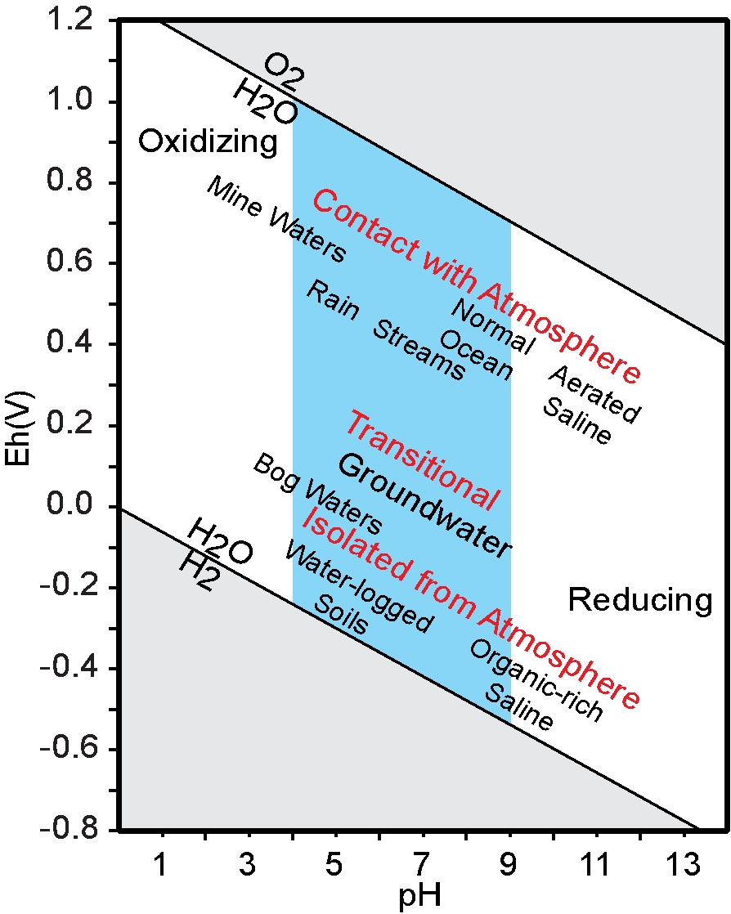
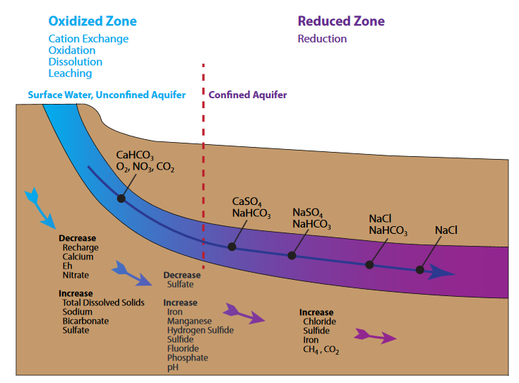
Measure background conditions
Redox State
  Best measured with
    pH,
    dissolved oxygen, and
    oxidation-reduction potential
  Indicates if ions will dissolve or precipitate
  Think Flint Michigan

Slide 13
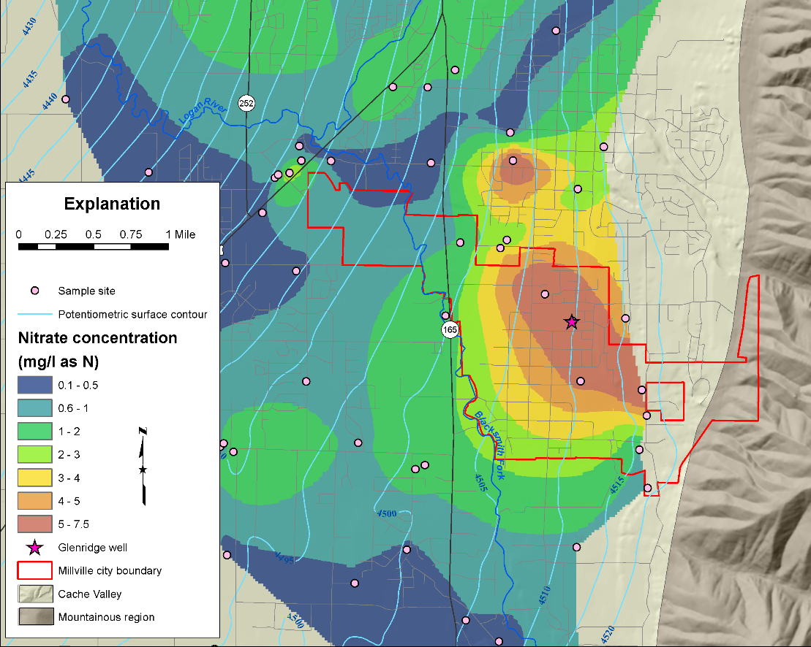
Measure background conditions
Notable contaminants
  Arsenic, lead, uranium and other metals
  Nitrogen and other nutrients
GW Flow

Slide 14
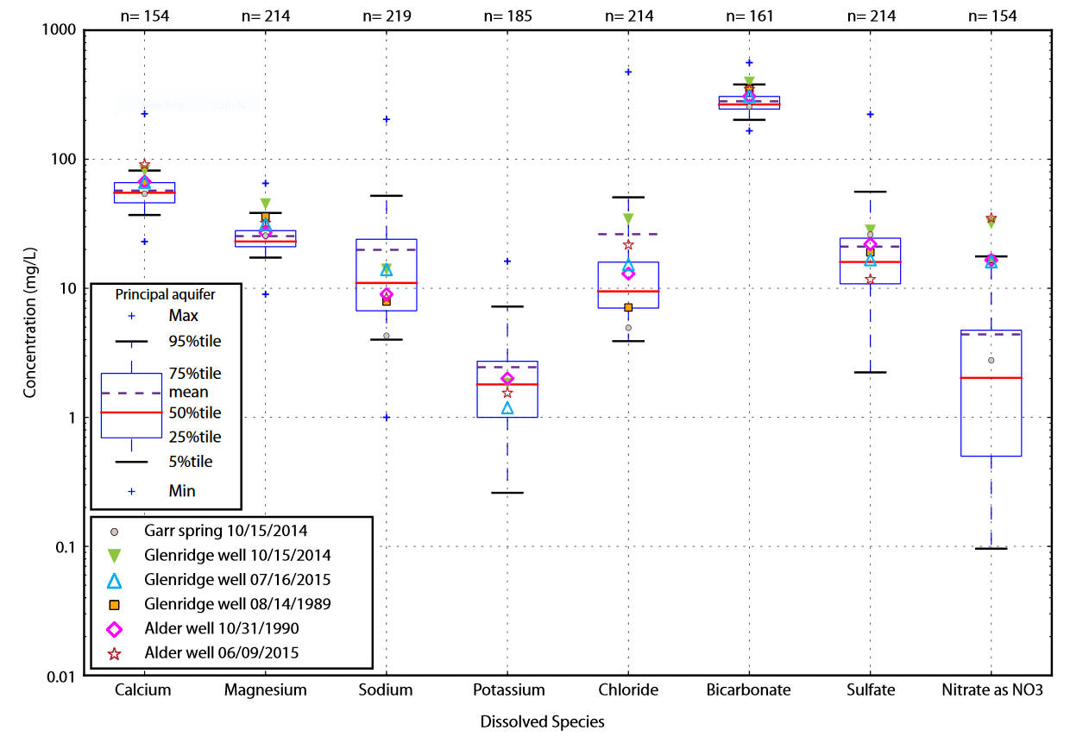
Measure background conditions
General Chemistry
  Field parameters:
    Conductivity
    pH
  Ca, Mg, Na, K,
  Cl, HCO3, SO4
Good for:
  models
  detection of changes
  comparison to other water

Slide 15
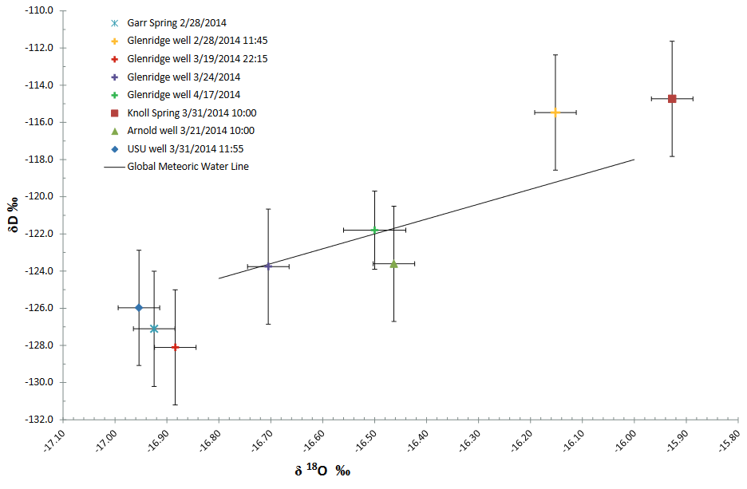
Measure background conditions
Stable Isotopes
  Inexpensive and easy to use
  calculates mixing
  can infer temperature of recharge

Slide 16
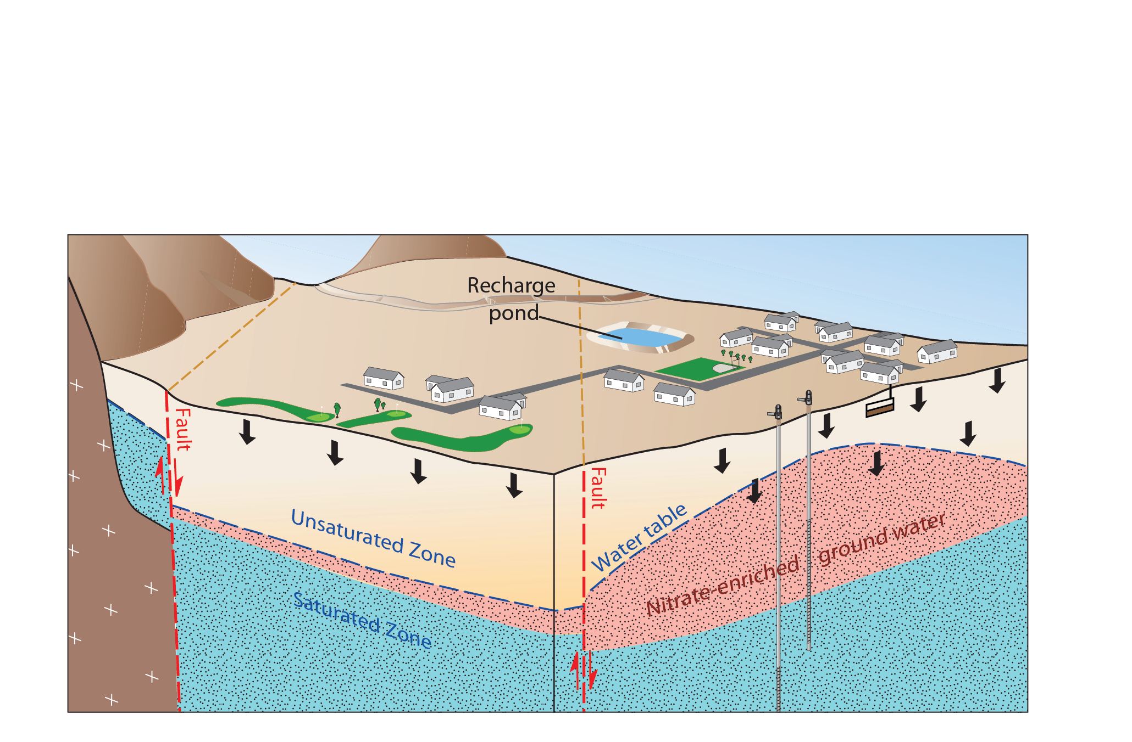
Measure background conditions
Groundwater Levels
Higher groundwater can mobilize contaminants previously in the unsaturated zone
cause flooding or other shallow groundwater hazards

Slide 17
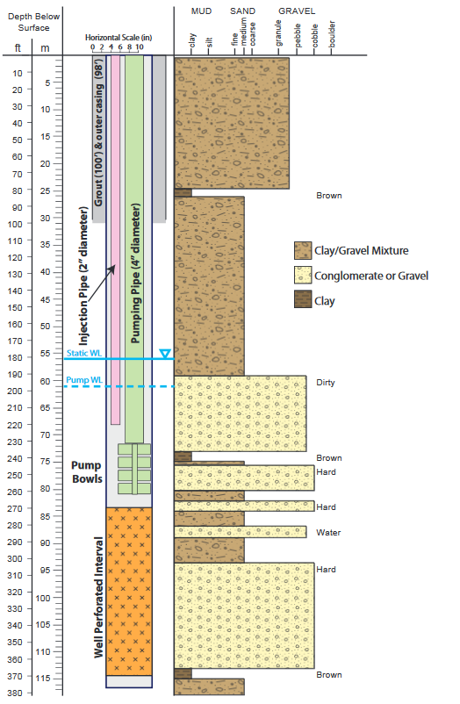
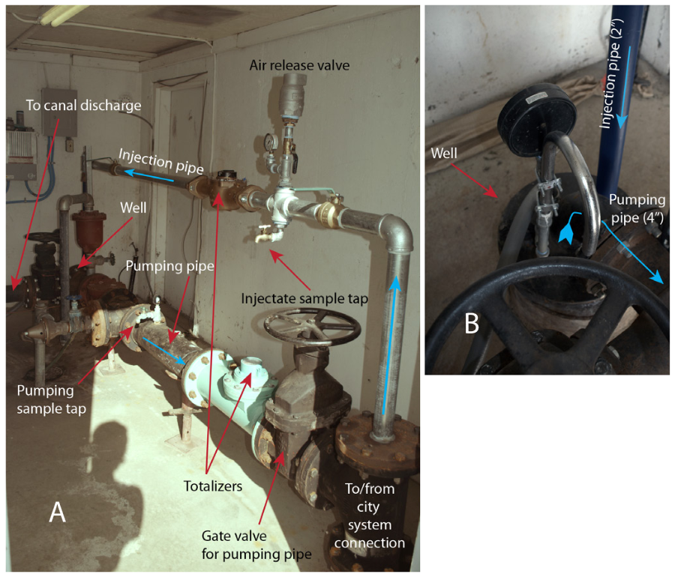
Modify and build infrastructure
Notes:
Delivery Method
Volume Measurement
Sub-aqueous injection point

Slide 18
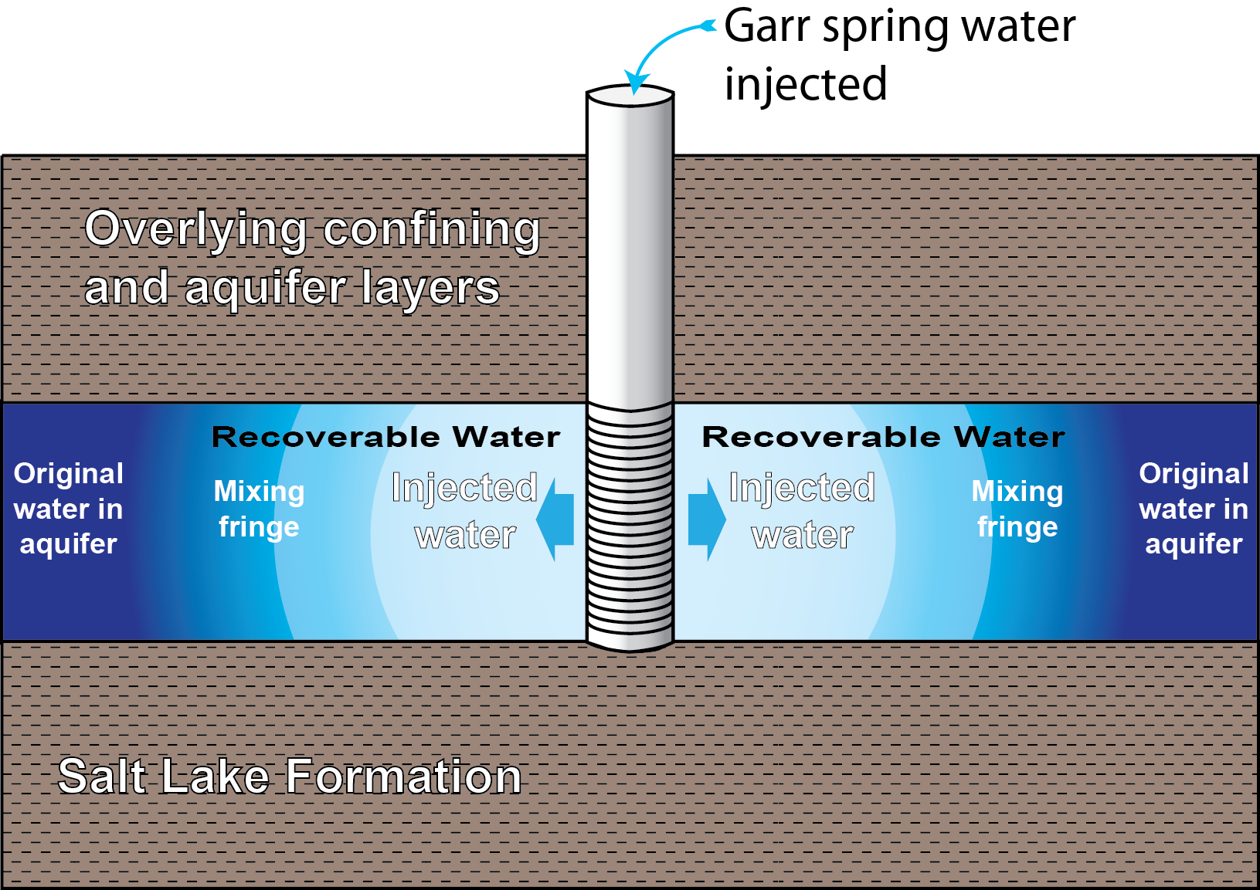
Conduct pilot test & Measure recovery conditions
Aquifer storage and recovery can treats the aquifer like a reservoir.
Saves “bubble” of spring water in the aquifer.

Slide 19
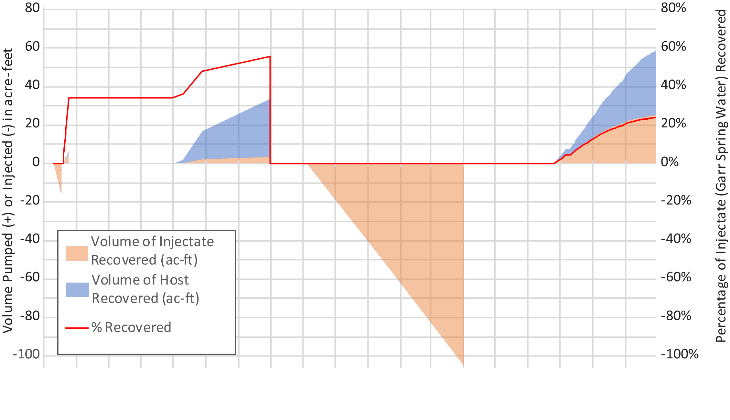
Conduct pilot test & Measure recovery conditions
Pump
Injection

Slide 20
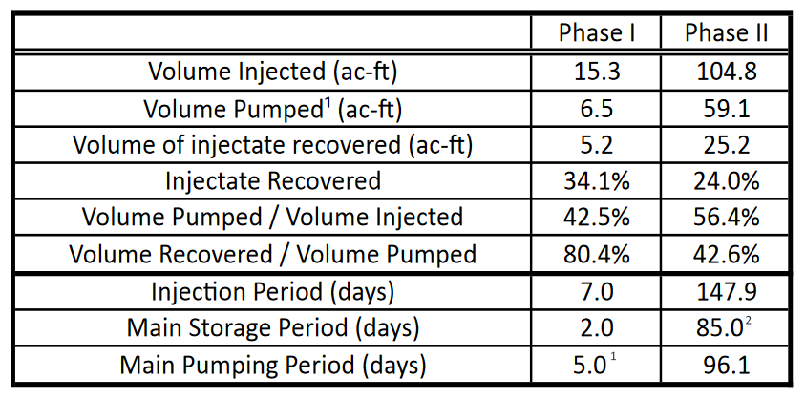
Conduct pilot test & Measure recovery conditions

Slide 21
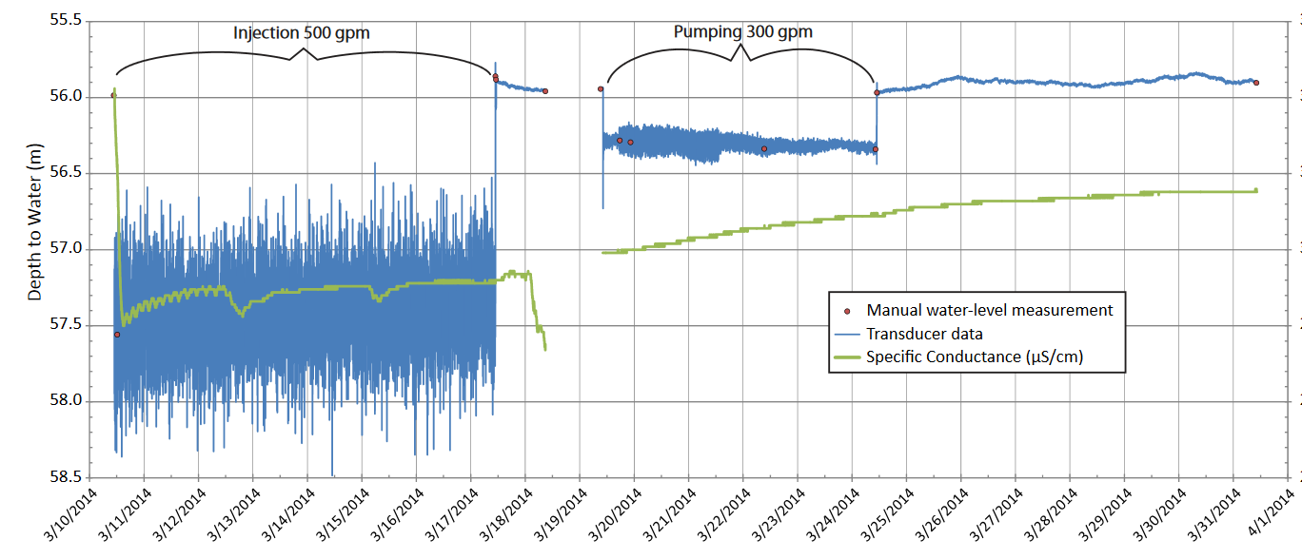
Conduct pilot test & Measure recovery conditions

Slide 22
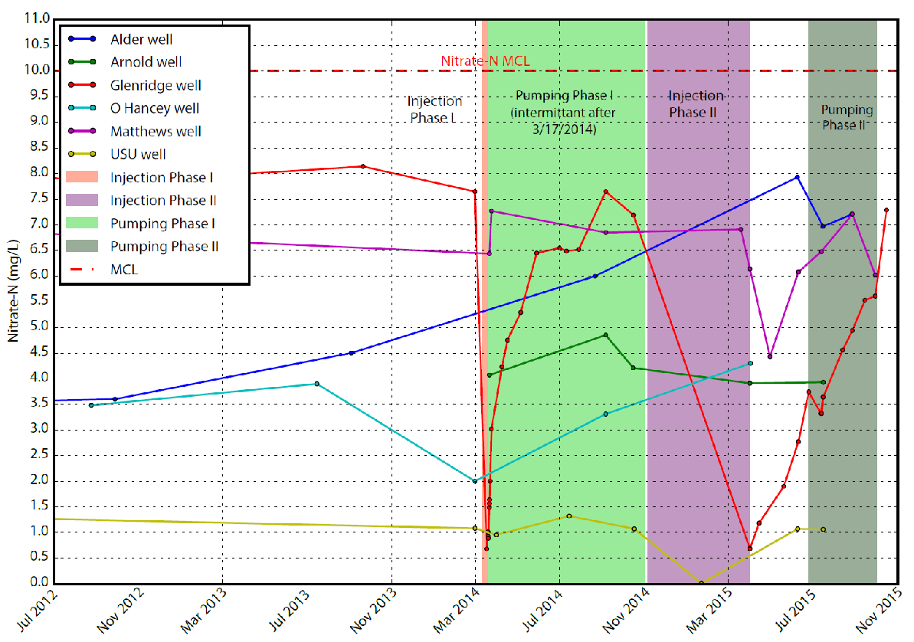
Conduct pilot test & Measure recovery conditions
6/7/2016 Alder well nitrate concentration is 8.6 mg/L
Notes:
6/7/2016 Alder well nitrate concentration is 8.6 mg/L

Slide 23
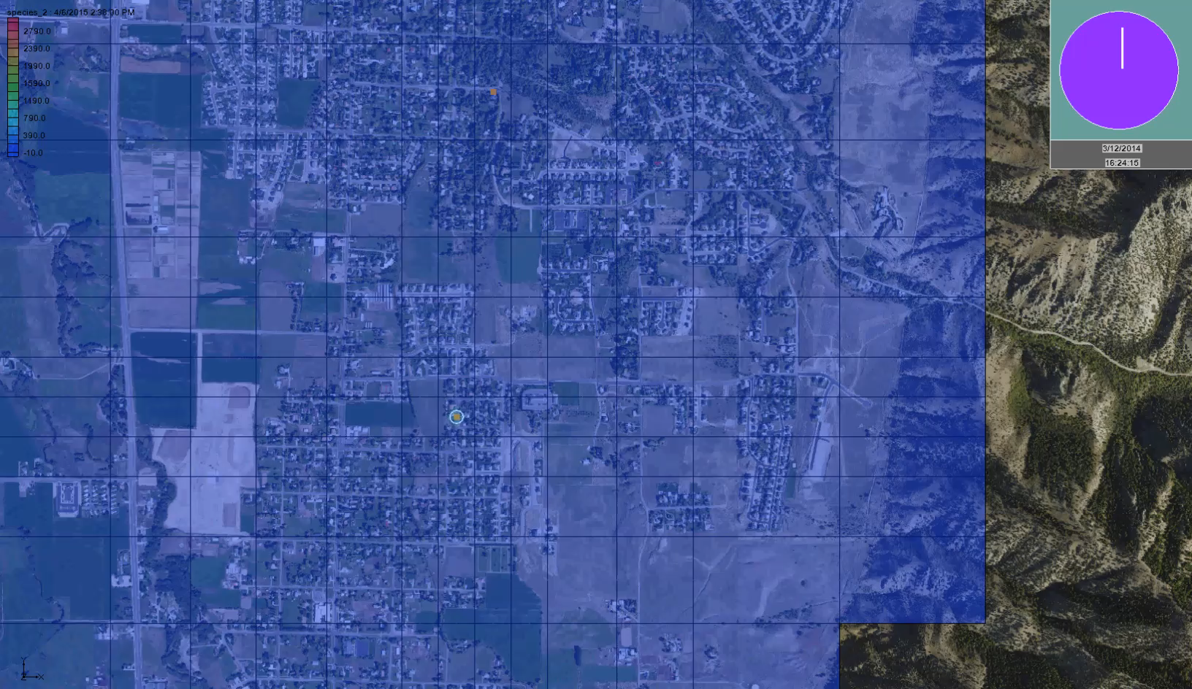
Modeling - Injection

Slide 24
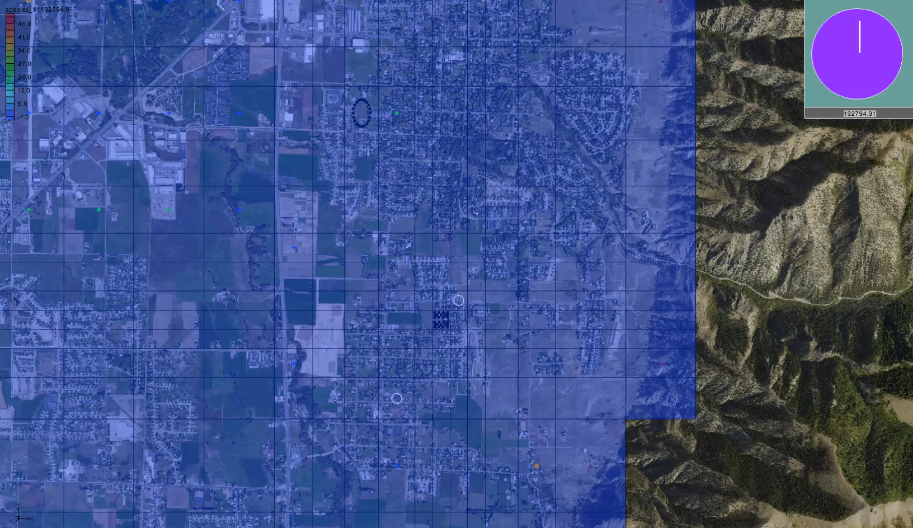
Modeling - Nitrate

Slide 25
Summary
Summary:
Background data are essential
Key things to measure can be measured in the field (pH, ORP, conductivity, dissolved oxygen)
Good well coverage is important (may need a monitoring well)
Stable isotopes can be useful for calculating mixing

Slide 26
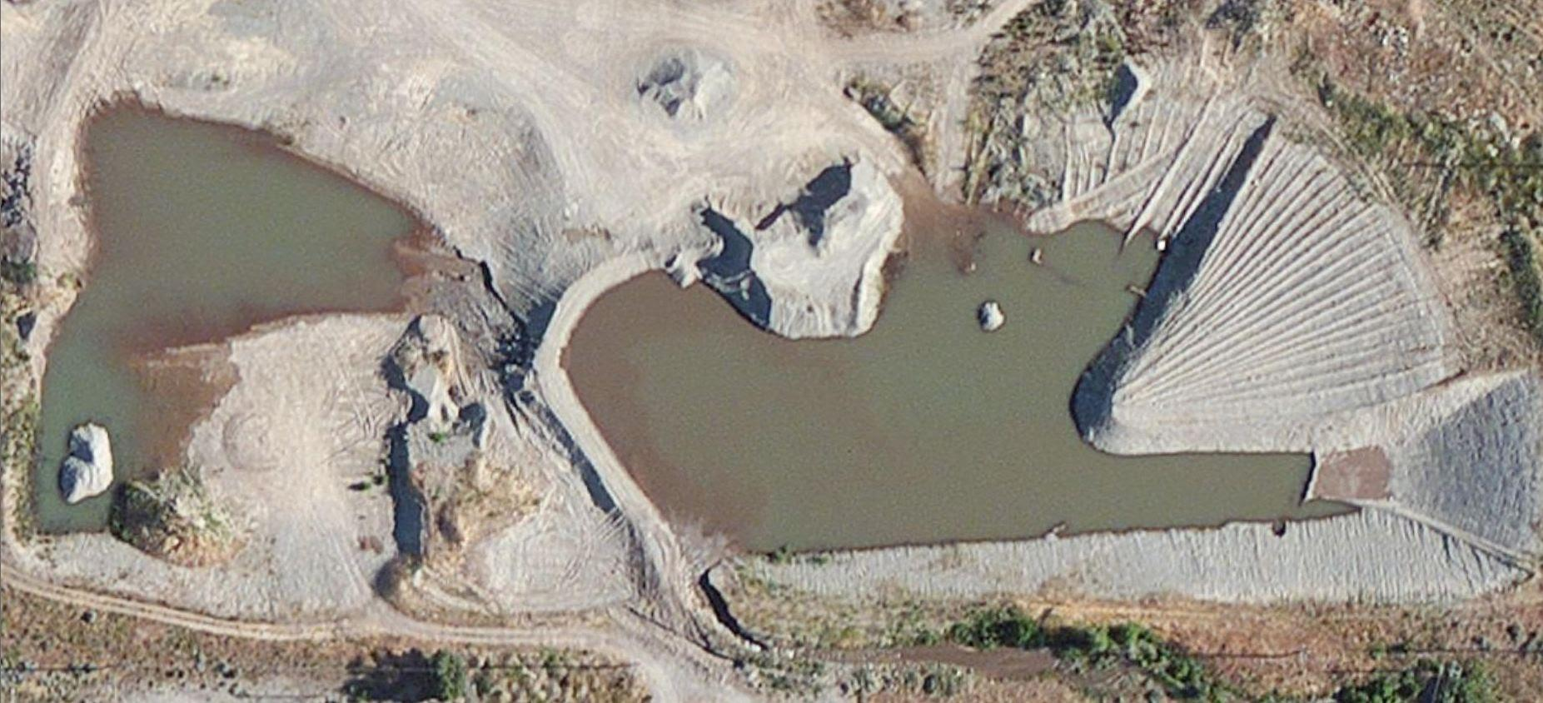
Questions?

Slide 28
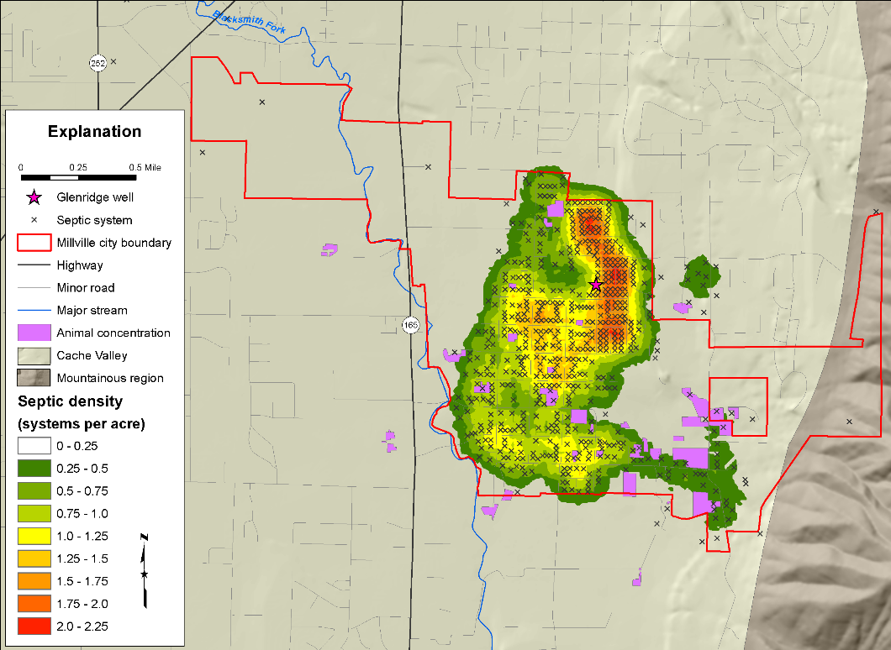
Background - Nitrate
Distribution of septic systems in the area.
High concentration of systems up gradient of Glenridge Well
GW Flow

