Slide 1

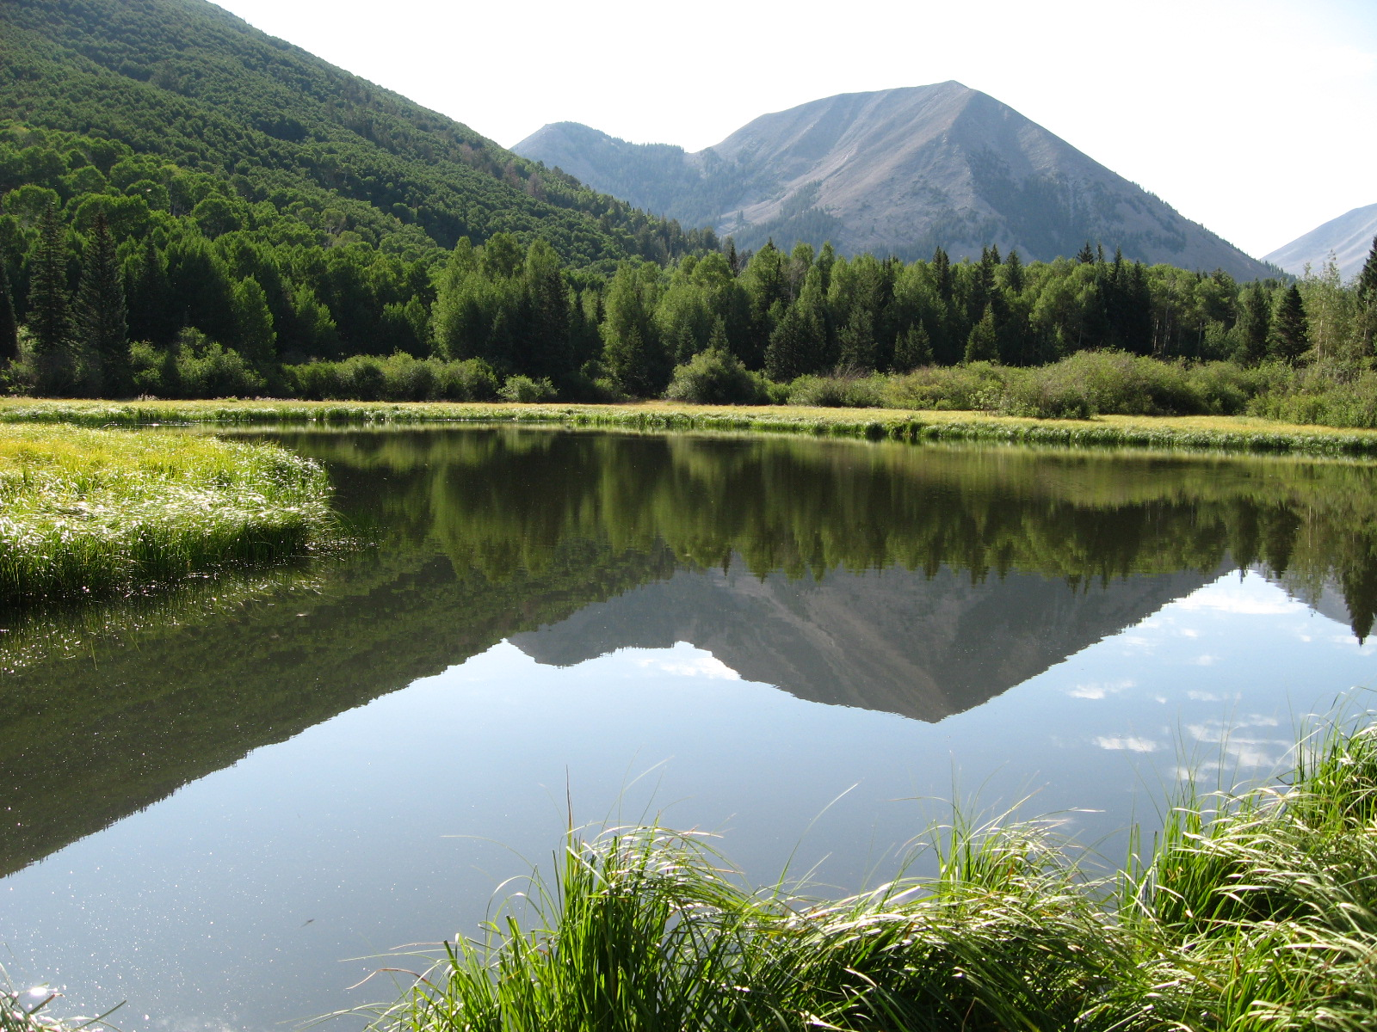

Declarations of Beneficial Use
Utah Division of Water Rights
Supplemental Water Rights and Database Groups
November 2017

Slide 2
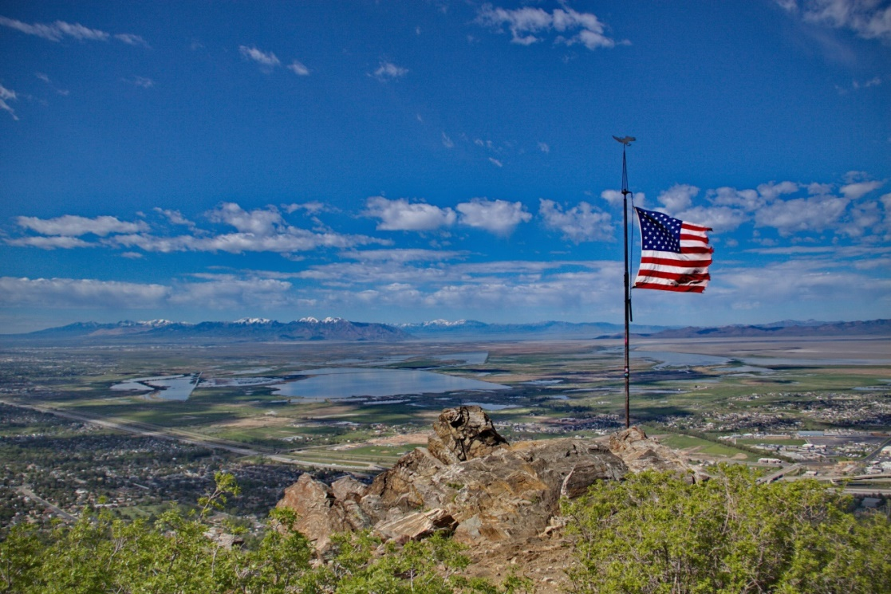
Overview
Declaration of Beneficial Use
DOBU Basics
Database Corrections
Apportionment of Beneficial Use
Examples

Slide 3
Declaration of Beneficial Use
A Declaration of Beneficial Use Amounts declares the beneficial use amount on one or more of the water rights in a water use group aka ‘DOBU’
Beneficial Use is the measure and limit of all water rights (73-1-3)

Slide 4

Rules
Rule R655-16 Administrative Procedures for Declaring Beneficial Use Limitations for Supplemental Water Rights
April 7, 2010

Slide 5
Authority
Utah Code 73-2-1(3) The State Engineer shall be responsible for the general administrative supervision of the waters of the state…
Utah Code 73-2-1(5)(g) The State Engineer may make rules…[for] the determination of water rights

Slide 6

Justification and Purpose
This rule provides for a DOBU form to enable Water Right Holders to declare the beneficial use information and document agreement with the holders of supplemental water rights.

Slide 7
Application of Rule
This rule applies to all Water Use Groups defined in the State Engineer’s water right records for which Beneficial Use Amount of each of the individual water rights has not been established.
If a water right is of record with the State Engineer, in a water use group and not evaluated

Slide 8
DOBU Basics

Slide 9
DOBU Basics
Prepared by Water Right Holders on the provided form or an alternative document containing the same information
Must be signed by all Water Right Holders in the Water Use Group
and include documentation supporting the Beneficial Use Amounts declared

Slide 10
DOBU Basics
The DOBU shall apportion the beneficial use amount of a water right in the Water Use Group
All parties must acknowledge that the beneficial use amounts declared are not a general adjudication of the water rights

Slide 11

DOBU Basics
Let’s Practice!
Water Use Group 420187 is comprised of Water Right 57-1, 57-2, and 57-3 for irrigation of 2.0 acres, 3 EDUs and 15 ELUs how can you apportion these rights?

Slide 12
DOBU Basics
WR# | Document | Date | Uses
57-1 | App to App Certificate Signed WUC | 8/16/1956 9/30/1960 10/31/1978 | 3 EDUs and 5 ELUs 3 EDUs and 5 ELUs 2.0 acres, 3 EDUs and 15 ELUs
57-2 | Diligence Claim Signed WUC | / /1895 10/31/1978 | 1.0 acre and 5 ELUs 2.0 acres, 3 EDUs and 15 ELUs
57-3 | Signed WUC | 10/31/1978 | 2.0 acres, 3 EDUs and 15 ELUs

Slide 13

DOBU Basics
The State Engineer may require additional documentation to support the Beneficial Use Amounts declared

Slide 14

DOBU Basics
When do you need to file a DOBU?

Slide 15

DOBU Basics
The following applies when you want to file a change application or proof of beneficial use

Slide 16
DOBU Basics
is filed on fewer than all of the water rights in a Water Use Group
The Change application seeks to remove a water right from a Water Use Group
The Beneficial Use Amount of said water right to be acted upon has not been quantified
The nature of the change requires a quantification of the Sole Supply of the water right being changed

Slide 17
DOBU Basics
Shall be prepared for each Water Use Group to which the water right or the portion of the water right has been assigned.
May quantify only the Beneficial Use Amount of the water right that would be the subject of an action.

Slide 18
DOBU Basics
Must, together with any other Declarations required by the Change Application, if the water right has been assigned to more than one Water Use Group, declare the Sole Supply of the water right or the portion of the water right to be changed.

Slide 19

Random DOBU Question
Can you use one DOBU form for more than one Water Use Group?

Slide 20
DOBU Evaluation
Staff looks to make sure the DOBU is signed by all parties
Consistency with the water right information in the State Engineer’s records
Inconsistent, DOBU will be returned
Consistent, State Engineer’s records will be updated and memo will be written and placed on all affected water rights

Slide 21

Random DOBU Question
If you find an error on our database, what can be done to correct the error?

Slide 22
Database Corrections
Submit request in writing identifying the error
Offer a solution on how you believe the database should be adjusted
The State Engineer shall complete a review of the water rights and make corrections if consistent with records

Slide 23

Database Corrections
The State Engineer may make corrections to the database any time to resolve errors

Slide 24
Database Corrections
For Example Change application review of two water rights
WRNUM 1
Certificated 1979 for
Irrigation, ELUs, and EDU
Not Supplemental
WRNUM 2
Certificated 1981 for Irrigation and
ELUs Supplemental with WRNUM 1
Database had one water use group for Irrigation, ELUs, and EDU
Database now has two water use groups Group 1 for WRNUM 1 & 2 Irrigation, ELUs and Group 2 for WRNUM 1 EDU
Notes:
Talk about change application review

Slide 25

Random DOBU Question
Do you have to have all parties sign if you want to declare a zero for the water right held in your name?

Slide 26
DOBU Basics +
So you filed or tried to file a DOBU and just couldn’t make it work
Reasons why
  One of the water right holders is deceased
  One of the water right holders don’t want to sign
  Any other reason(s)
Must document attempts and provide justification

Slide 27

Apportionment
Application for Apportionment of Beneficial Use shall be made on a form provided by the State Engineer and shall comply with Chapter 63G-4-201
Commencement of adjudicative proceedings

Slide 28
Apportionment
Applicant shall provide
  All information requested
    All affidavits and documentation gathered in effort to file the DOBU
  Acknowledgement that this action is not a general adjudication
  Notice to other parties pursuant to Chapter 63G-4-201(3)(b)

Slide 29

Apportionment
The State Engineer shall
  Review the application
  If incomplete or does not meet the criteria, will return the form
  If complete, will accept the form

Slide 30

Apportionment
The process
The State Engineer shall
  Notify all parties
  30 days
  Review all information received
  Based on all information a preliminary apportionment
  Notify all parties of preliminary apportionment
  30 days

Slide 31
Apportionment
The State Engineer may hold a hearing
The State Engineer shall
  Review any further information
  Issue an Order setting forth the beneficial use amounts of each water right apportioned
Orders shall be subject to the applicable law
Once opportunity for review has passed the database is updated

Slide 32
Exceptions
Public Water Suppliers
During the Change Application or Proof Process
Water Right Holder wishes to declare zero
Beneficial use amounts determined by a court order
Administratively cancel the assignment
Temporary change application

Slide 33

Examples
This is a true story. The events depicted in this example took place in Utah. At the request of the survivors, the names have been changed. Out of respect for the dead, the rest has been told exactly as it occurred.

Slide 34

Example
WRNUM 51-2098
2 Water Use Groups
Wanting to file change application

Slide 35
Example
Water Use Group 228375
Supplemental with 51-2097 for 46.0 ELUs
Water Use Group 228376
Supplemental with Lake Shore Irrigation Company for 0.25 acre

Slide 36

Example
WRNUM 51-3682
3 Water Use Groups
Wanting to file change application

Slide 37
Example
Water Use Group 229952
Supplemental with 51-3683 and 51-3684 for 116.0 ELUs
Water Use Group 636844
Supplemental with Spanish Fork West Irrg. Co. for 22.1 acres
Water Use Group 637003
Supplemental with Strawberry and Spanish Fork West Irrg. Co. for 9.0 acres

Slide 38


