Slide 1


Utah Division of Water Rights
Applications: Approval Criteria & Hearings
RWAU Training – April 2017
Teresa Wilhelmsen, P.E.
Assistant State Engineer – Applications and Records
June 21, 2004

Slide 2

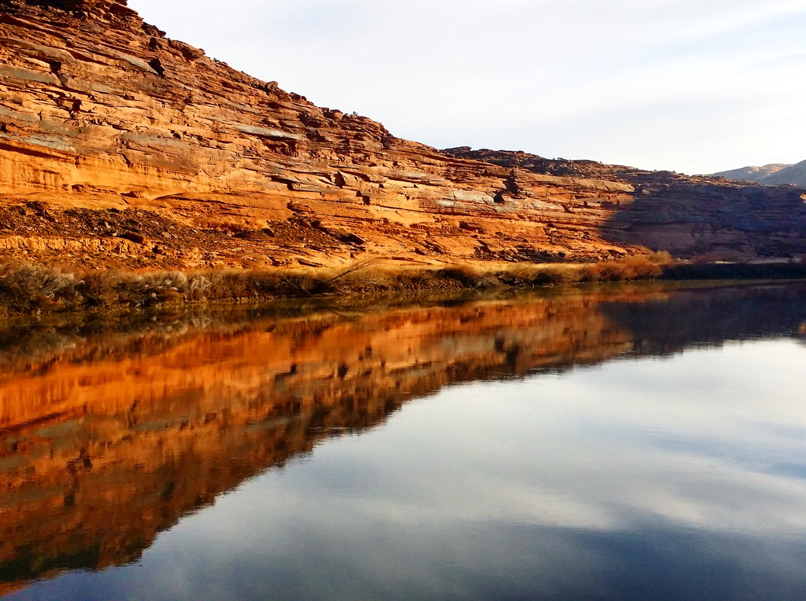
APPLICATIONS

Slide 3
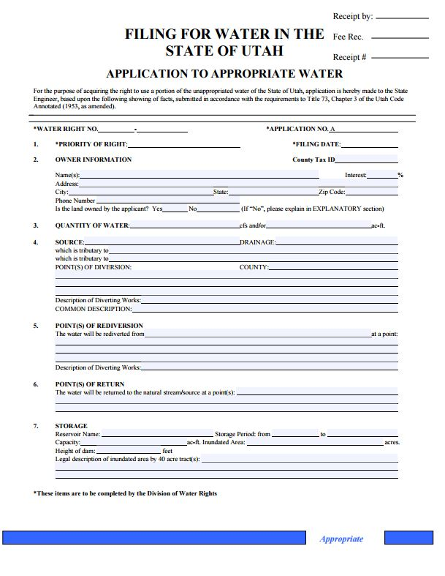
APPLICATIONS:
        Application to Appropriate
        Change Applications
        Temporary Applications
        Fixed Time Applications
        Exchange Applications

Slide 4
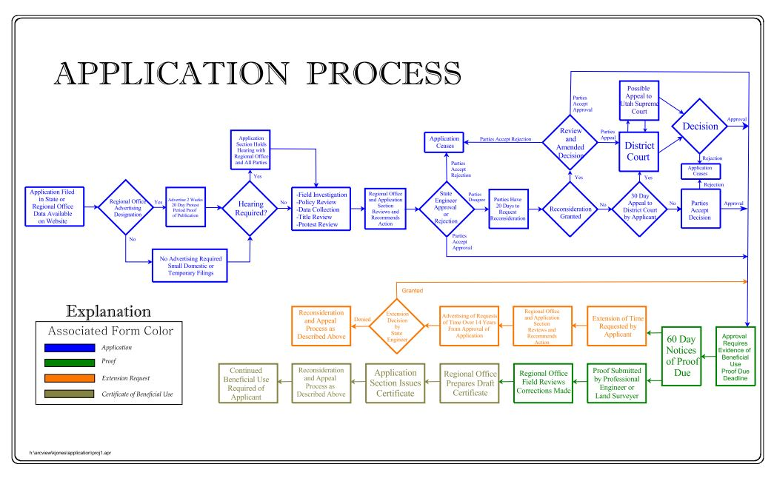
Hell

Slide 5
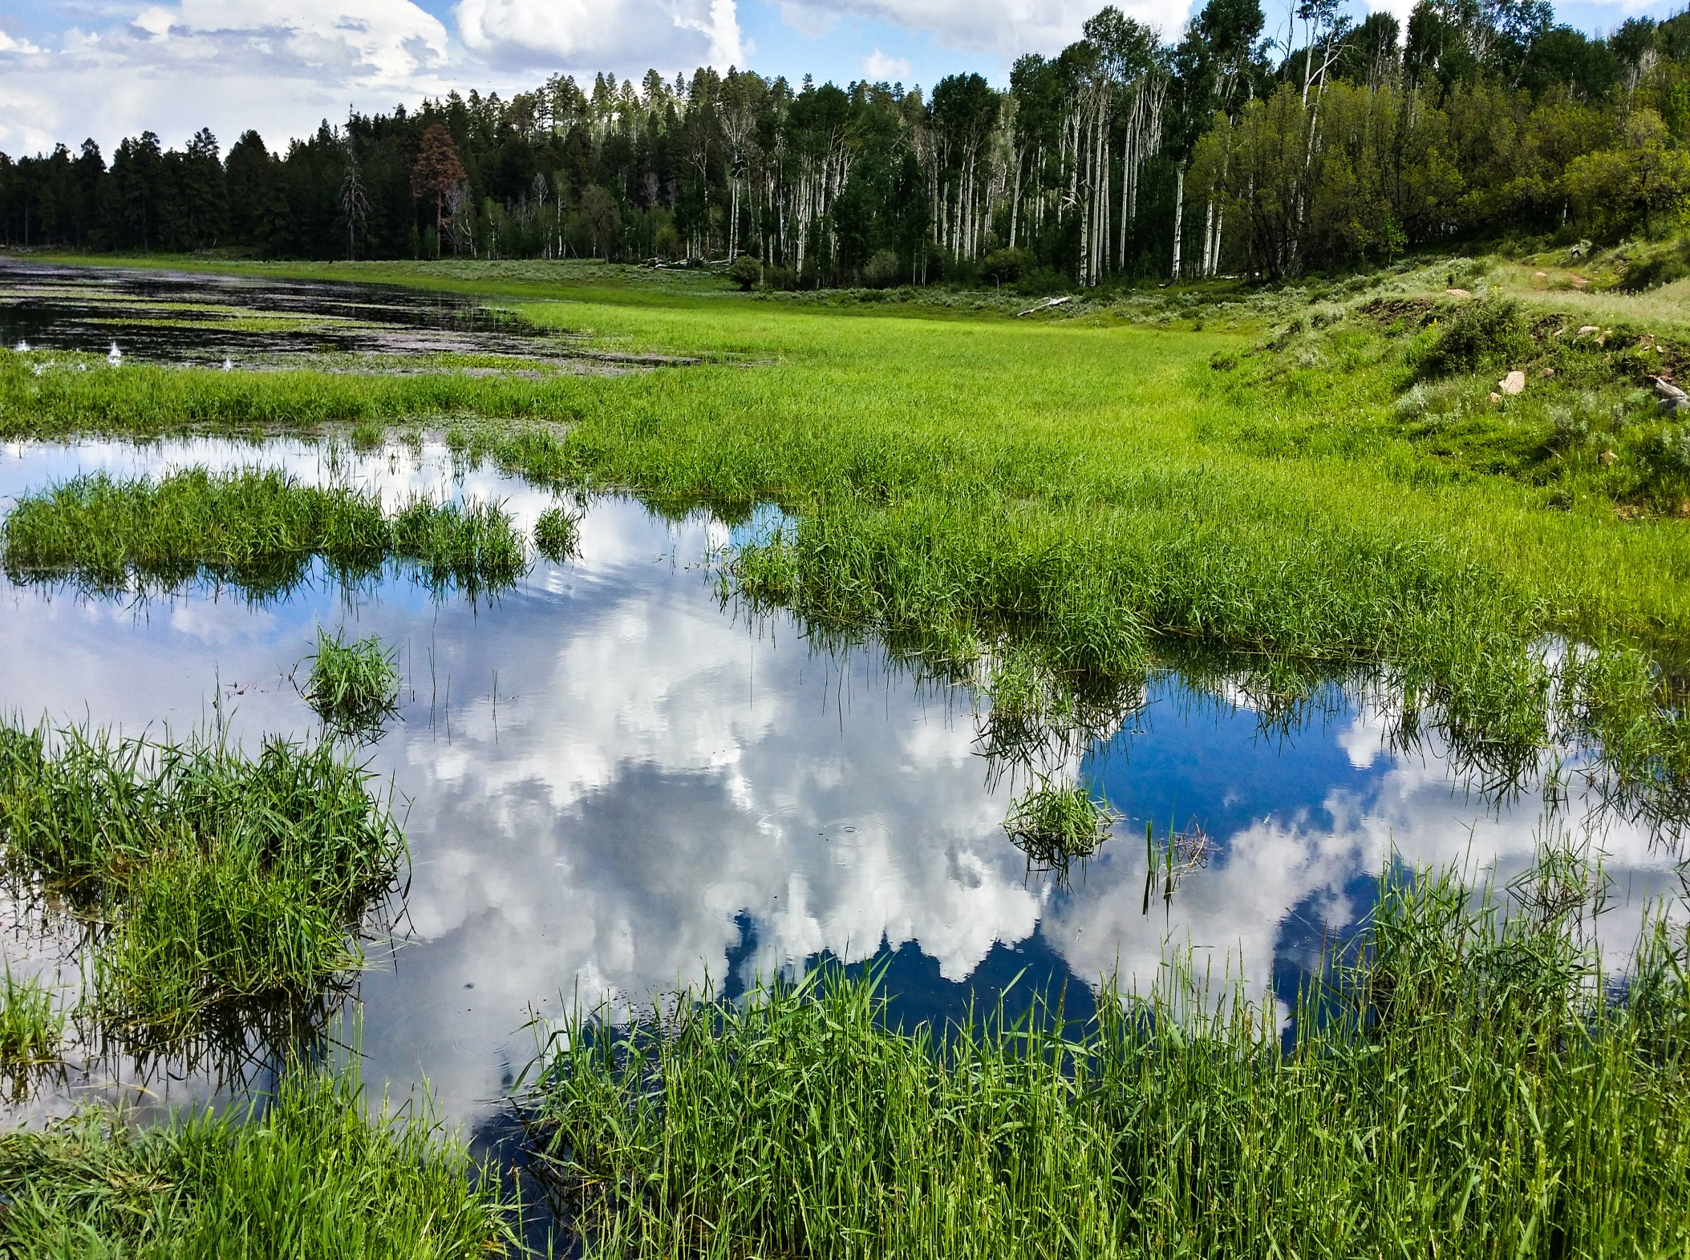
APPROVAL CRITERIA
APPLICATIONS

Slide 6
APPROVAL CRITERIA:
The Standard by which the State Engineer evaluates applications seeking approval is the “reason to believe standard” outlined in Searle v. Milburn Irrigation Co, (2006)
“placing a fairly low burden on a party seeking approval”

Slide 7
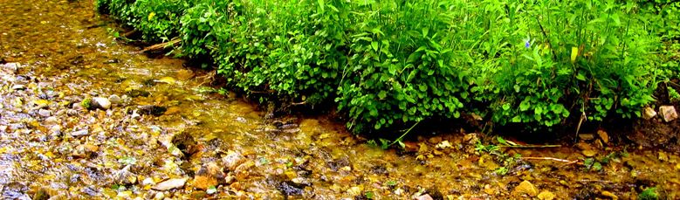
APPROVAL CRITERIA:
Utah Code Ann. §73-3-8
(1)(a) It shall be the duty of the State Engineer to approve an application if there is reason to believe:
(i) for an application to appropriate,
there is unappropriated water in the proposed source;

Slide 8

APPROVAL CRITERIA:
Utah Code Ann. §73-3-8
(i) for an application to appropriate…
unappropriated water in the proposed source;
Sowards v Meagher (1910)
“…until the actual application of the water is made for a beneficial purpose, no valid appropriation has been effected.”

Slide 9
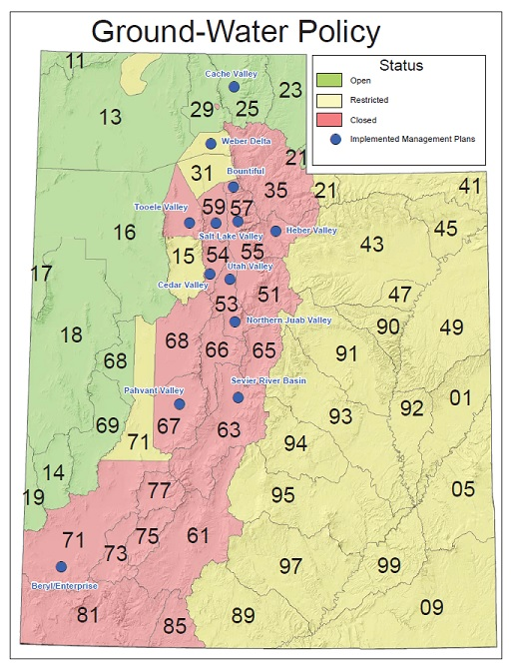
APPROVAL CRITERIA:
Utah Code Ann. §73-3-8
(i) for an application to
appropriate…
unappropriated water
in the proposed source;

Slide 10
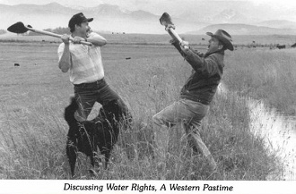
APPROVAL CRITERIA:
Utah Code Ann. §73-3-8
(1)(a) It shall be the duty of the State Engineer to approve an application if there is reason to believe:
(ii) the proposed use will not impair existing rights or interfere with the more beneficial use of the water

Slide 11

APPROVAL CRITERIA:
(ii) will not impair existing rights or interfere with the more beneficial use of the water
For Temporary Change Applications (May 12, 2015):
- Not Advertised / No Hearings -
Utah Code Ann. §73-3-8(4)(b)
(i) approve if reason to believe it will not impair
(ii) deny if reason to believe it will impair

Slide 12
APPROVAL CRITERIA:
(ii) will not impair existing rights or interfere with the more beneficial use of the water
For Permanent Change Applications:
Utah Code Ann. §73-3-3(3)(a)
(ii) except as provided in 73-3-30, the change does not impair an existing right without just compensation or adequate mitigation
Utah Code Ann. §73-3-3(5) (2015)
(a) will not cause a specific existing right to experience quantity impairment

Slide 13
APPROVAL CRITERIA:
For Exchange Applications:
Utah Code Ann. §73-3-20
(1) …the original water in such stream, body of water, or reservoir must not be deteriorated in quality or diminished in quantity
(2)(a)(iii)(B) …has a legal interest in the underlying water right used as the basis for the exchange
Often Accomplished via Contract with the Water Right Owner

Slide 14
APPROVAL CRITERIA:
Utah Code Ann. §73-3-8
(1)(a) It shall be the duty of the State Engineer to approve an application if there is reason to believe:
(iii) the proposed plan is physically and economically feasible, unless the application is filed by the U.S. Bureau of Reclamation, and would not prove detrimental to the public welfare

Slide 15
APPROVAL CRITERIA:
Utah Code Ann. §73-3-8
…proposed plan is physically and economically feasible,
Does not require final design, only, that the plan be physically feasible
Does not require the applicants to prove their entire project will be economically feasible by expending all of the require monies at this stage of the process…merely a reasonable probability that the project can be built

Slide 16
APPROVAL CRITERIA:
Utah Code Ann. §73-3-8
(1)(a) It shall be the duty of the State Engineer to approve an application if there is reason to believe:
(iv) the applicant has the financial ability to complete the proposed works

Slide 17
APPROVAL CRITERIA:
Utah Code Ann. §73-3-11
Statement of Financial Ability of Applicants
(for an incorporated company):
Articles of Incorporation
Names and Places of Residence of its Directors and Officers
Amount of authorized and paid-up capital

Slide 18
APPROVAL CRITERIA:
Utah Code Ann. §73-3-8
(1)(a) It shall be the duty of the State Engineer to approve an application if there is reason to believe:
(v) the application was filed in good faith and not for purposes of speculation or monopoly

Slide 19
APPROVAL CRITERIA:
Utah Code Ann. §73-3-8
…filed in good faith and not for purposes of speculation or monopoly
W. Water, LLC v. Olds (2008)
“…the State Engineer concluded that the Original Application was filed for speculation or monopoly because the only proposed beneficial use for the water was a plan to sell it to others. Indeed, the applicants had ‘no lands, facilities, customers, or contracts.’”

Slide 20
APPROVAL CRITERIA:
Utah Code Ann. §73-3-8
(1)(a) It shall be the duty of the State Engineer to approve an application if there is reason to believe:
(vi) if applicable, the application complies with a groundwater management plan adopted under Section 73-5-15

Slide 21
APPROVAL CRITERIA:
Utah Code Ann. §73-3-8
(1)(b) If the State Engineer…has reason to believe that an application will interfere with the water’s more beneficial use for irrigation, municipal and industrial (2015), domestic or culinary, stock watering, power or mining development or manufacturing or will unreasonably affect public recreation or the natural stream environment, or will prove detrimental to the public welfare, the State Engineer shall withhold approval or rejection of the application until the State Engineer has investigated the matter.

Slide 22

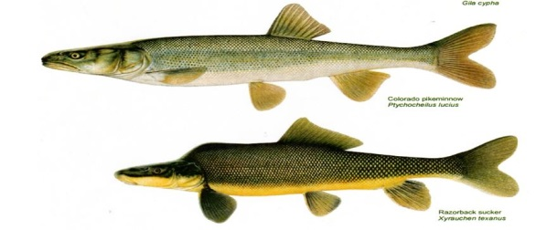
APPROVAL CRITERIA:
Utah Code Ann. §73-3-8
…public recreation or the natural stream environment, or will prove detrimental to the public welfare,
Recreational Opportunities
Riparian Areas / Wildlife
Endangered Species (animal / plant)
Public Health / Infrastructure
Large Taxpayer Funded Water Projects

Slide 23
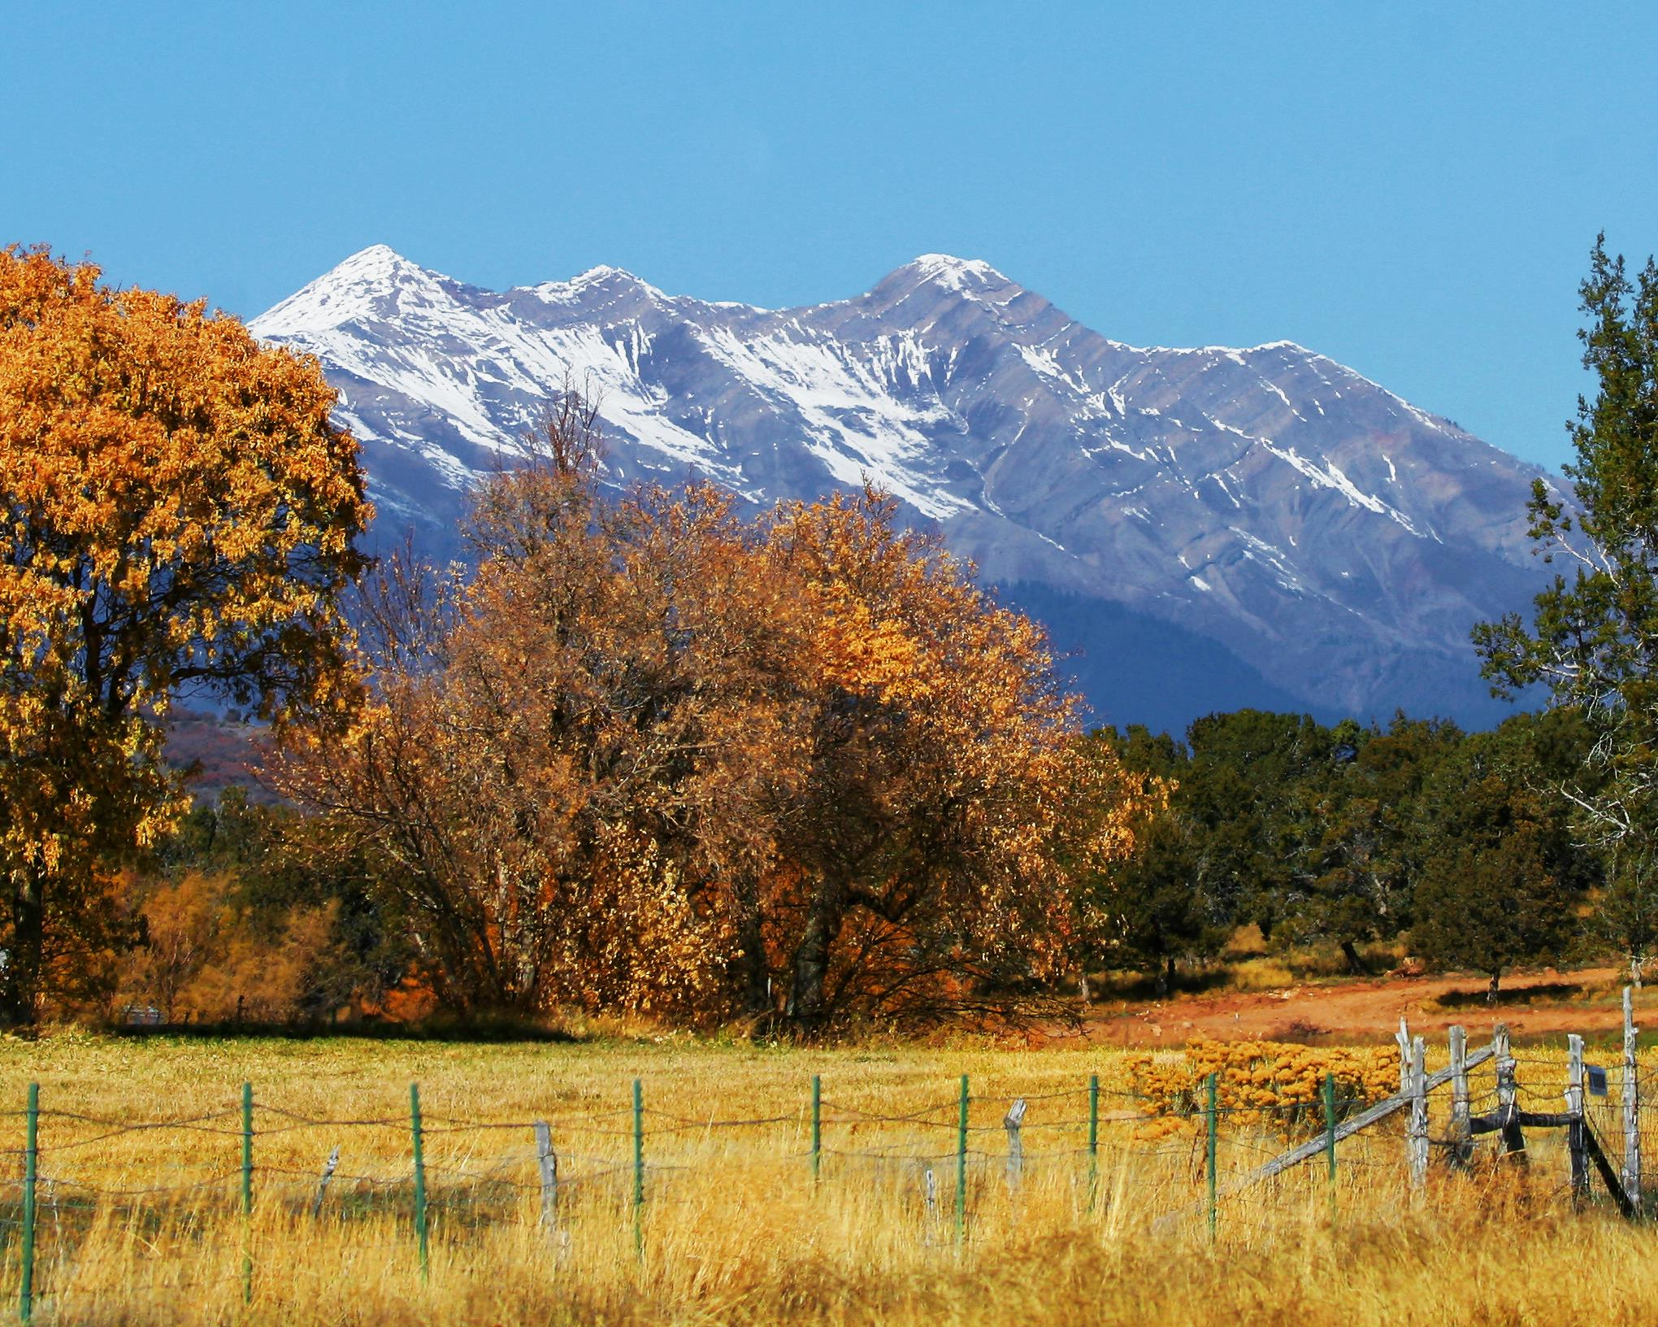
Quantity impairment

Slide 24
APPROVAL CRITERIA:
For Change Applications:
Utah Code Ann. §73-3-3(1)(c)(i)
Quantity Impairment: means any reduction in water…
(A) diminishing the quantity of water
(B) change in the timing of availability of water
(C) enlarging the quantity of water depleted by the proposed nature of use

Slide 25
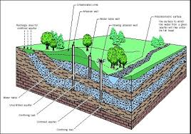
APPROVAL CRITERIA:
For Change Applications:
Utah Code Ann. §73-3-3(1)(c)(ii)
Quantity Impairment: does not mean a decrease in the static level of water in an underground basin or aquifer…if the volume of water necessary to satisfy an existing right otherwise remains reasonably available

Slide 26
APPROVAL CRITERIA:
For Change Applications:
Applicant has the burden of…
Utah Code Ann. §73-3-3(5)(a)
…will not cause a specific right to experience quantity impairment, or
Utah Code Ann. §73-3-3(5)(b)
…rebutting the presumption of Quantity Impairment described in Subsection 73-3-8(6)(c)
Utah Code Ann. §73-3-8(6)(c)(i)
For a period of at least seven consecutive years:
Not diverted from the approved point of diversion; nor
Beneficially used at the approved place of use

Slide 27
APPROVAL CRITERIA:
For Change Applications:
Utah Code Ann. §73-3-8(6)(c)(ii)
Rebuttable presumption does not apply if excused by:
Subsection 73-1-4(2)(e)
Approved nonuse under Subsection 73-1-4(2)(b)
Subsection 73-3-30(7); or
The passage of time under Subsection 73-1-4(2)(c)(i)

Slide 28
APPROVAL CRITERIA:
For Change Applications:
Utah Code Ann. §73-3-8(6)(d)
May not be considered unless raised in a:
Timely protest identifying the rights that may be impaired, or
Written notice from the State Engineer within 90 days from the filing of the application and identifying the rights that may be impaired
  The notice shall (73-3-8(6)(e):
    Identify a specific existing right(s)
    Mailed to the owner of the identified right

Slide 29
APPROVAL CRITERIA:
For Change Applications:
Utah Code Ann. §73-3-8(6)(f)
Not required to include all rights that may be impaired
Utah Code Ann. §73-3-8(6)(g)
The owner of the right identified may not become a party to the
administrative proceeding if the owner has not filed a timely protest
Utah Code Ann. §73-3-8(6)(h)
Written agreement between applicant, protestants, and persons identified
Terms may be incorporated into a change application approval

Slide 30
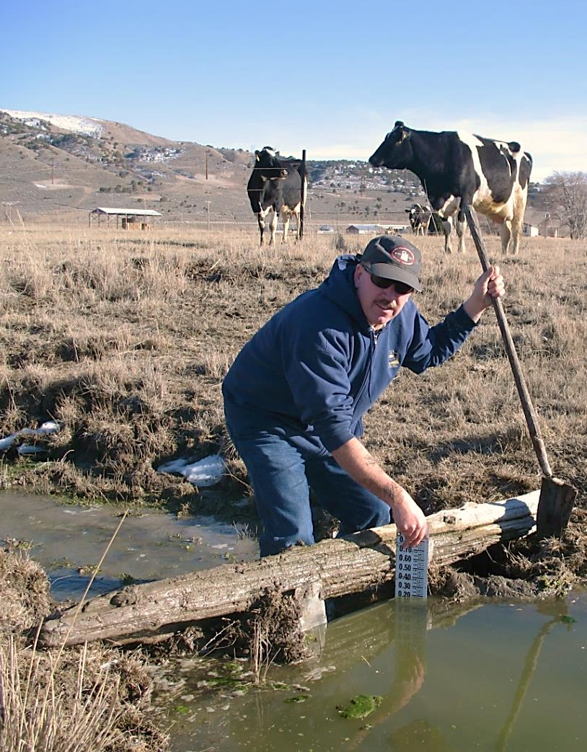
APPROVAL CRITERIA:
For Change Applications:
Utah Code Ann. §73-3-8(6)(a)
State Engineer shall reject a permanent
change application if the person proposing
to make the change is unable to meet
the burden in Subsection 73-3-3(5)

Slide 31
APPROVAL CRITERIA:
For Change Applications:
Utah Code Ann. §73-3-8(6)(b)
State Engineer may approve a permanent or temporary change upon
one or more of the following conditions:
    For part of the water involved;
    Applicant acquires a conflicting right; or
    Applicant provides and implements a plan approved by the state engineer to mitigate impairment of an existing right

Slide 32
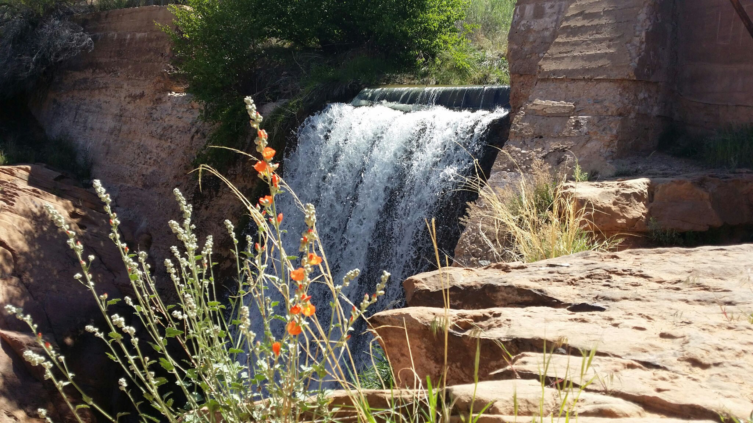
HEARINGS
APPROVAL CRITERIA

Slide 33
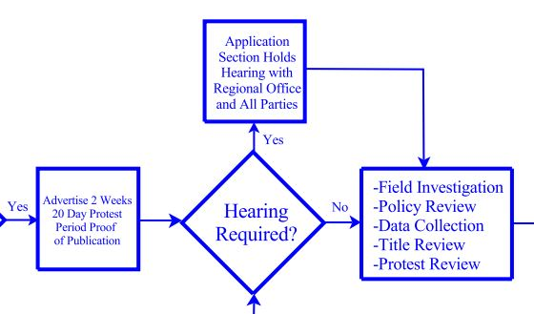
ADMINISTRATIVE HEARINGS:
Purpose – Gather additional information and data relative and pertinent to the application(s) before the State Engineer

Slide 34
ADMINISTRATIVE HEARINGS:
Utah Code Ann. Rule R655-6
May be held if requested in a timely filed protest
May be held at the discretion of the Division even if a protest has not been filed
Informal Proceeding (attorney not required)

Slide 35
ADMINISTRATIVE HEARINGS:
Utah Code Ann. Rule R655-6
Open to all Parties – introduce evidence, examine and cross-examine witnesses, make arguments and fully participate in the proceeding
“Party” – person commencing an adjudicative proceeding, all respondents, all protestants, all persons permitted to intervene, all persons authorized by statute or agency rule to participate as parties

Slide 36
ADMINISTRATIVE HEARINGS:
Utah Code Ann. Rule R655-6
Non-Party participation – person acting as a witness for a party or participating as part of the Division’s investigative and fact finding powers
Such a person is not a party to the proceeding and may not seek judicial review

Slide 37
ADMINISTRATIVE HEARINGS:
Utah Alunite Corporation v. Jones (2016)
“Therefore, although Appellants are aggrieved persons, they lack standing because only persons that are both aggrieved and qualify as parties – aggrieved parties – have standing under section 73-3-14 and UAPA to contest a decision of the State Engineer.”

Slide 38
ADMINISTRATIVE HEARINGS:
Purpose – Gather additional information and data (evidence) relative and pertinent to the application(s):
  unappropriated water in the proposed source
  not impair existing rights or interfere with the more beneficial use of the water / quantity impairment
  physically and economically feasible; not prove detrimental to the public welfare
  financial ability to complete the proposed works
  filed in good faith and not for purposes of speculation or monopoly
  unreasonably affect public recreation or the natural stream environment
  the application complies with a groundwater management plan*

Slide 39
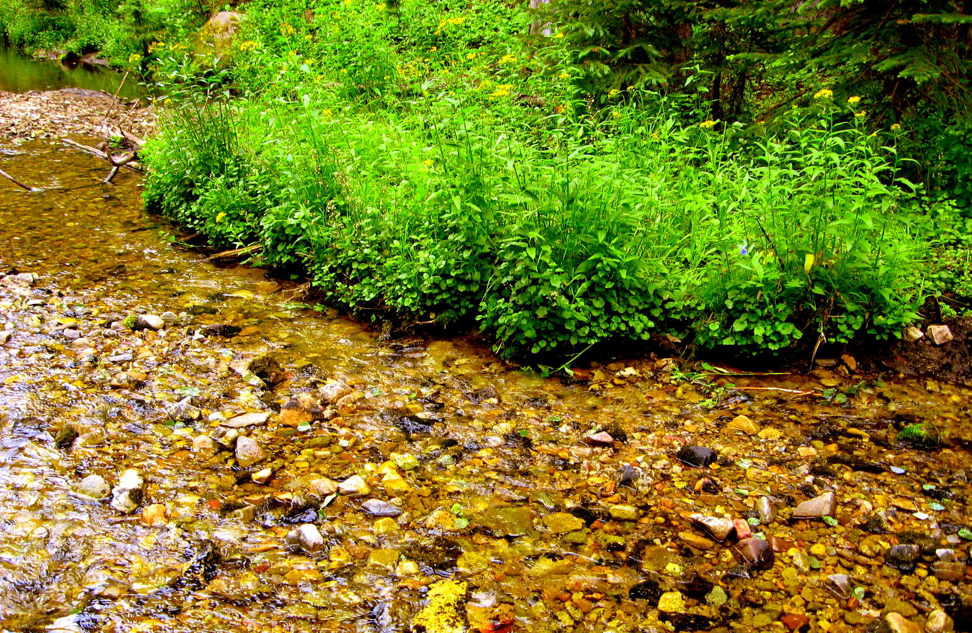
DIVISION POLICY

Slide 40
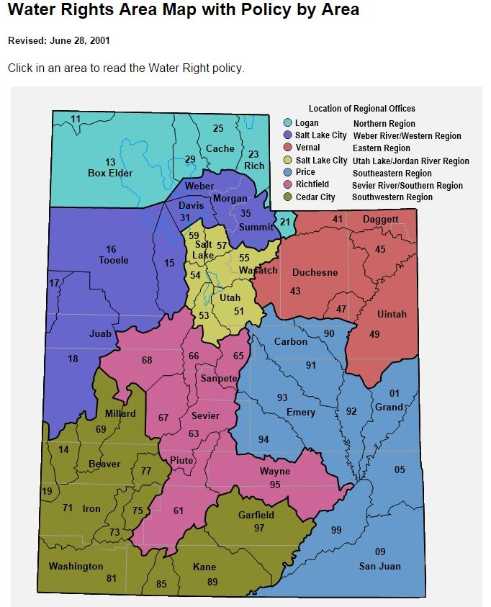
SITE SPECIFIC
POLICY:

Slide 41
SITE SPECIFIC POLICY:
Statewide there are site specific policies:
  Salt Lake Valley Groundwater Management Plan
  Colorado River Policy
  Endangered Fish Policy
  Weber Delta Sub-Area of the East Shore Area
  Milford and Black Rock Policies
  Water Rights Policy, Sevier River Basin
  Willow Basin Watershed Policy

Slide 42
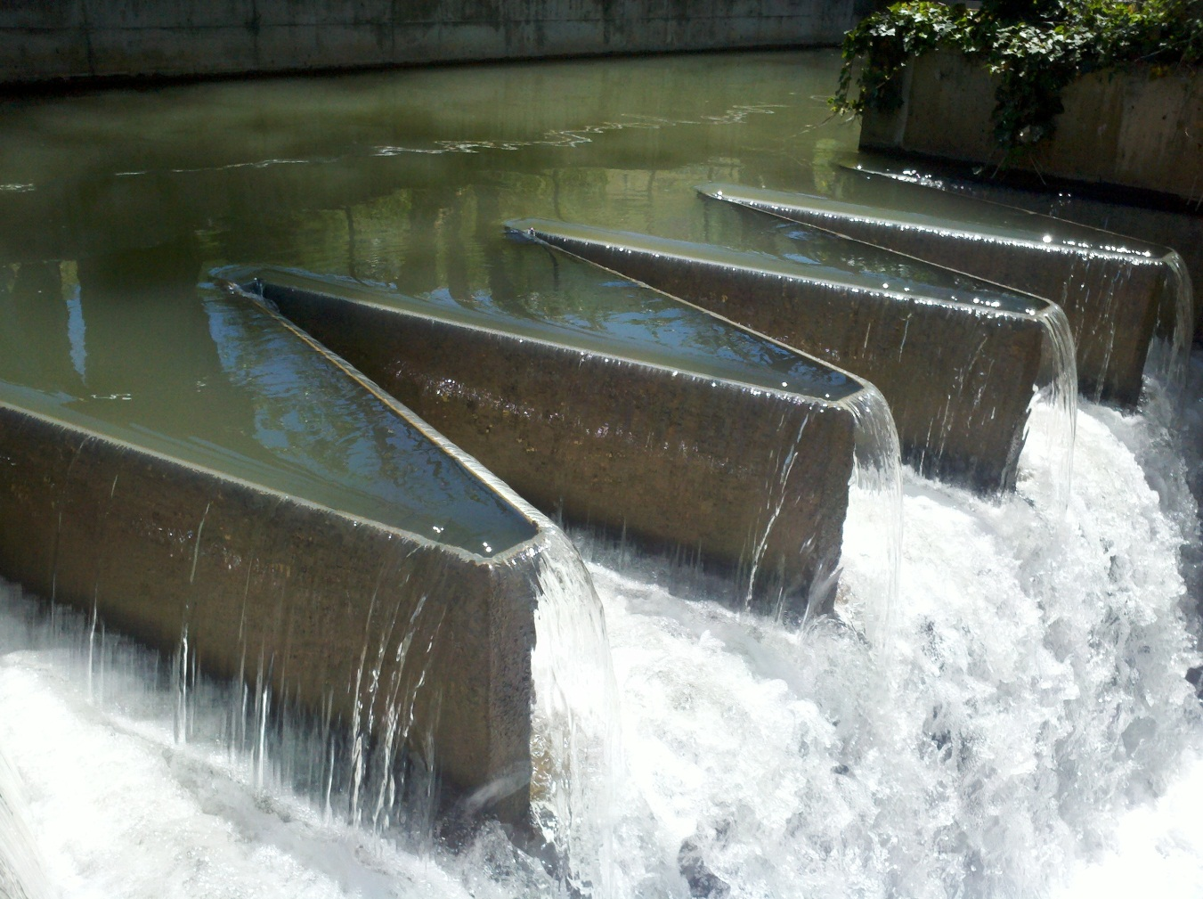
WITH CONDITIONS

Slide 43
ADDITIONAL CONSIDERATIONS:
  Diversion. Depletion. Reduction.
    The total diversion of water under this application for municipal uses by Lehi City is limited to the amount of water reasonably necessary to deplete 132.94 acre-feet up to a maximum diversion of 294.12 acre-feet. The applicant shall maintain records to demonstrate uses under the right do not exceed the depletion limitation.
  Meter, Measure, and Report
    Each source developed under this application must be individually metered and the diversions of water reported annually under the Utah Water Use Program.

Slide 44
ADDITIONAL CONSIDERATIONS:
  Well Abandonment
    Inasmuch as this change application leaves the historical well without a valid water right, the historical well must be permanently abandoned and sealed according to the requirements of R655-4-12 of The Administrative Rules for Water Well Drillers.
  Maintaining Shares
    The two shares of stock in the East Jordan Irrigation Company must remain dedicated to this use of water and maintained in good standing by the applicants under this application. If the stock is not held in the applicant’s name the application is invalid. If you fail to do so, Utah Code Section 73-3-3.5(12) provides the water company may petition the State Engineer for an order reversing this approval.

Slide 45
ADDITIONAL CONSIDERATIONS:
  Retiring Prior Use
    To accommodate the approval of this Permanent Change Application, the use of 0.98 acre-foot of water for the irrigation of 0.196 acre at the historical point of diversion and place of use must cease.
  Municipal Right Considerations
    Proof of Beneficial Use may only be submitted by a qualified public water supplier. A Certificate of Beneficial Use will not be issued unless ownership of the right is in the name of Lehi City.

Slide 46
ADDITIONAL CONSIDERATIONS:
  Distribution regulation
    The priority of the water right is 1957 and the Provo River commissioner may regulate it as needed. Any additional expenses incurred by the commissioner in distributing water under this application shall be borne by the applicants.
  Use of facilities not owned
    This approval is limited to the rights to divert and beneficially use water and does not grant any rights to access nor use of land or facilities not owned by the applicant.

Slide 47

APPROVAL CRITERIA:
Utah Code Ann. §73-3-8
(1)(a) It shall be the duty of the State Engineer to approve an application if there is reason to believe:
WITH CONDITIONS

Slide 48

APPROVAL CRITERIA:
Utah Code Ann. §73-3-8
(1)(c) If an application does not meet the requirements of this section, it shall be rejected.

Slide 49
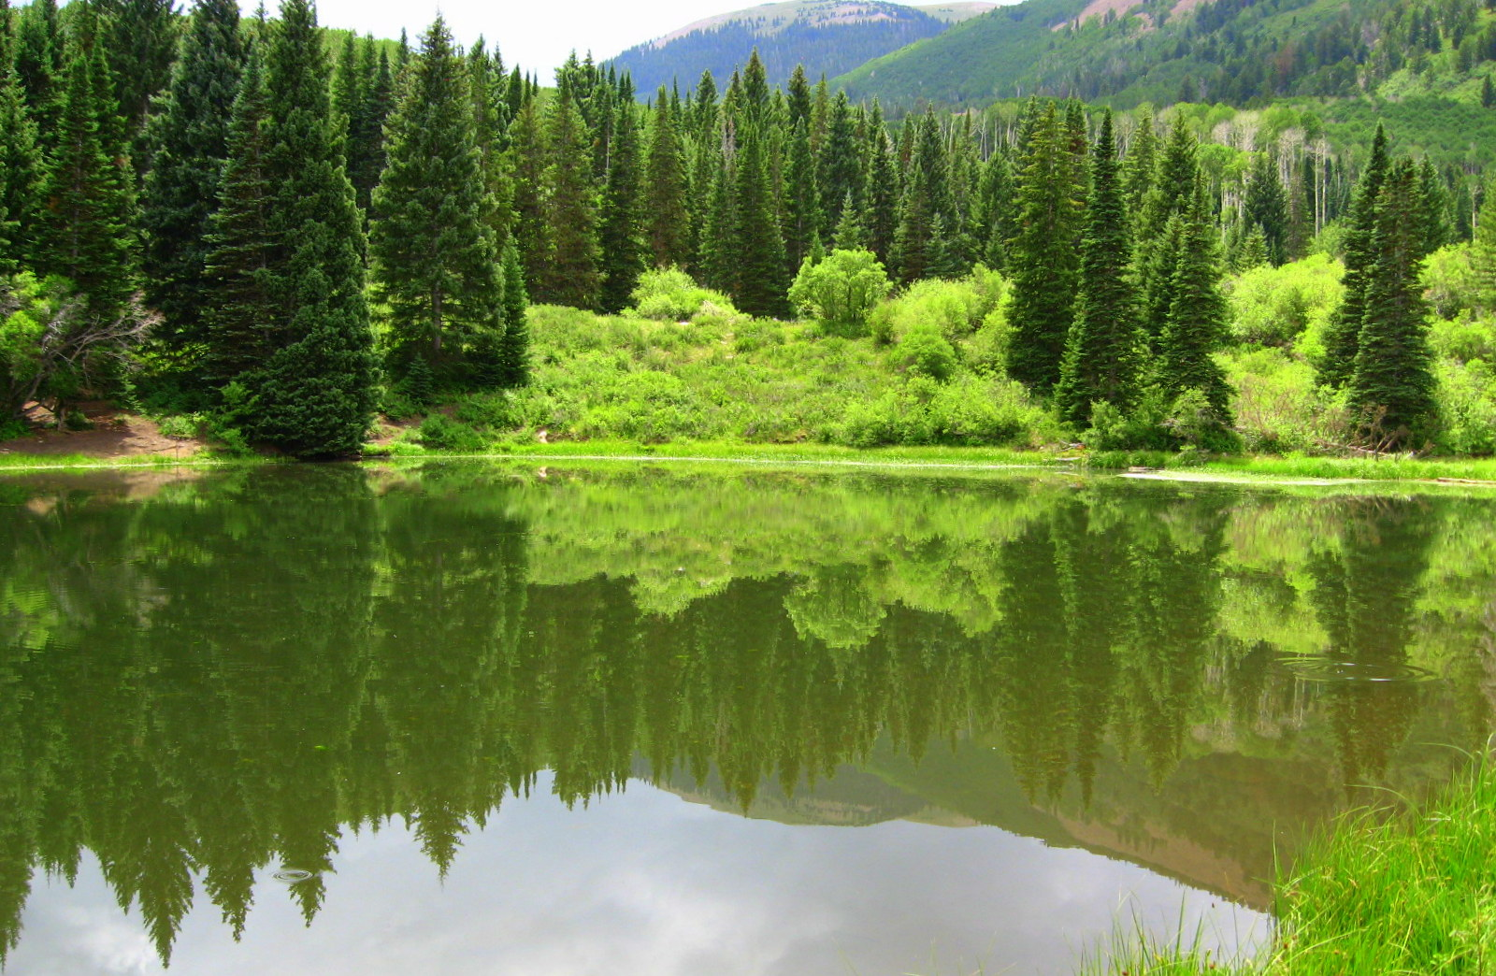
Thank You
– Any Questions?

