Slide 1


Utah Division of Water Rights
Proof, Certification & Title
RWUA Training—April 2017
Chris York P.E.
Application and Records, Assistant Manager
June 21, 2004

Slide 2


Overview
Extension request
Proof of beneficial use
Proof affidavit
Certificates
Title

Slide 3
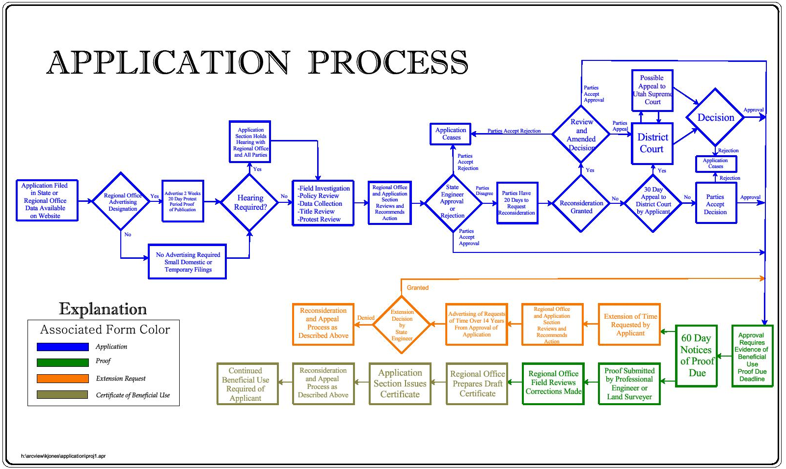

Slide 4
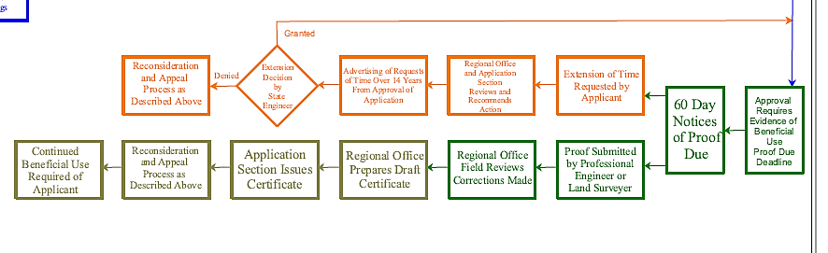
APPROVING, USING AND PROOFING
Notes:
This third section addresses development of actual physical beneficial use under an approved application and the perfection of the application by issuance of a certificate.

Slide 5
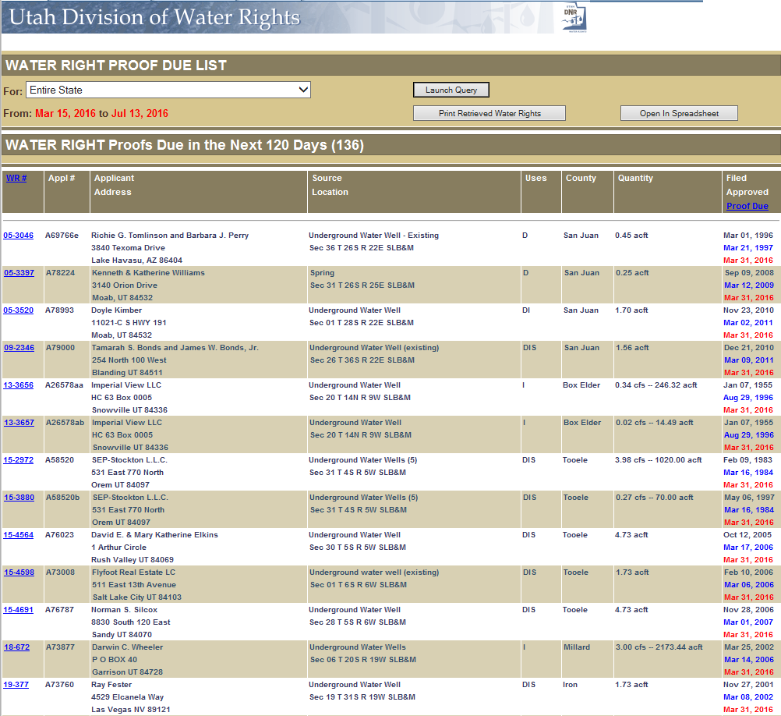
APPROVED APPLICATION
Due date for beneficial use
  Usually five years from date of approval
Sixty-day notice
Timely submission or application lapses
Permanent lapsing
  Final notice of lapsing
  60 days to reinstate
  Can lapse even if water is being used
Request for more time to develop
Notes:
-Place on new applications list
Approval of an application is based in part on the understanding that the applicant has the intention and the means to pursue timely development of the proposed project. Otherwise, an application could be considered speculative and thus, under statute, not approvable. The approval order requires proof be submitted that water has been placed to beneficial use within a specified time-frame. The period varies depending on the scope of the proposed project.
Sixty days prior to the deadline, the applicant of record at the address of record is notified that proof is due and is provided an extension of time request form to facilitate possible need for more time.
If the applicant has completed as much of the project as intended (up to the limits as described in the approval of the application), the applicant can file proof of beneficial use on or before the due-date. The applicant or the applicant’s agent can file an extension of time request explaining the diligent progress made in pursuing the project and citing justifiable causes for delay. This must be done prior to or on the due-date. If neither proof of use nor an extension request is filed by the deadline, the application lapses. Documents can be filed within sixty days after the notice of lapsing, but the priority of the application will be reduced to the date the proof or request for more time is submitted. If neither proof documents nor an extension request is filed within a sixty-day period after the notice of lapsing, the application permanently lapses. Authority for the proposed use of water terminates, and any use of water as proposed under the application is not legal.

Slide 6
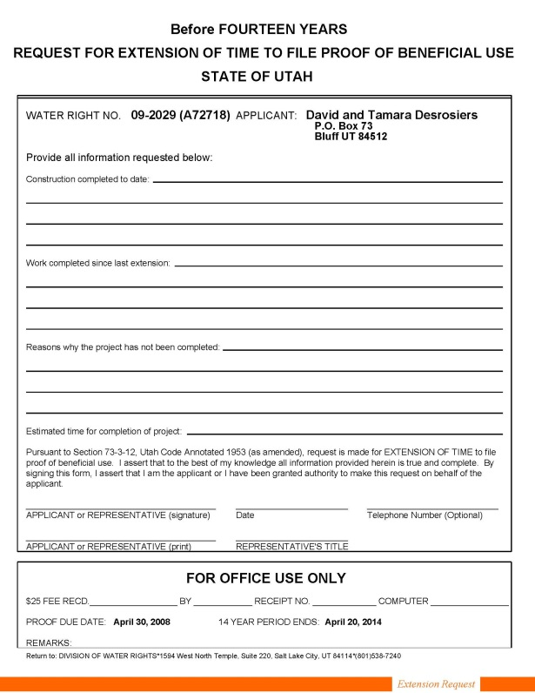
EXTENSION REQUEST
Must show diligence in completing proposed application
  For example
    Home built
    Well drilled
Forms and fees
Advertising after fourteen years
Review and recommendation
Granted or denied
Reconsideration and/or appeal
Notes:
Request forms are available on the website or by mail or office visit. For requests for time within 14 years from the date of application approval, a $50 fee is required. For requests for time exceeding 14 years from the date of application approval, a $150 fee is required. Payment can be made by check or cash.
If over fourteen years have passed since approval of the application, any request for additional time to place the water to the proposed beneficial use must be advertised and is subject to protest. (See advertising and protest process described above.)
The request is reviewed by the regional office staff, and a recommended action is made through a draft order. The draft order is reviewed by the applications/records section for completeness, accuracy and consistency with division practices and policies. Complex issues may be reviewed with Attorney General’s staff. Section 73-3-12 of the Utah Code states that construction of the works and the application of water to beneficial use shall be diligently prosecuted to completion within the time fixed by the State Engineer. Extensions of time may be granted by the State Engineer only on proper showing of diligence or reasonable cause for delay.
If the request is granted, the applicant has an extended proof due-date, at the end of which either proof or a further request for extension is required.
If the request is denied, the application is lapsed.
The order of the State Engineer addressing extension of time is subject to request for reconsideration and appeal to district court as described for initial action described above.

Slide 7
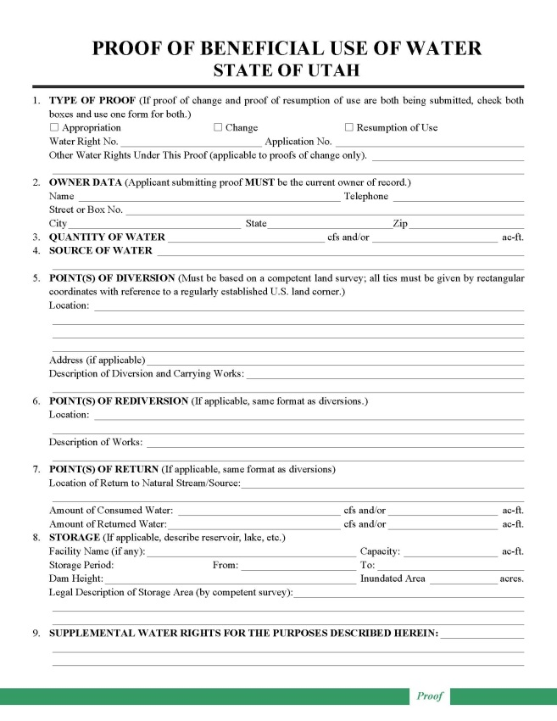
PROOF OF BENEFICIAL USE
Forms
Professional preparation
  Survey/map POD
  Obtain Measurement
  Credibility
Reviewed by regional office
  Field/Aerial Review
Amendments
Accepted or rejected
Notes:
Forms for preparing proof of beneficial use are available by visit to division offices, by mail, or on the division website.
Proof must be prepared by a professional engineer or land surveyor, who is licensed in Utah and is responsible for accuracy in depicting the completed project and use of water.
The proof form is field examined and reviewed by regional office personnel.
If significant corrections are needed, the proof is returned to the engineer or surveyor for amendment. If the constructed project is considerably different than as proposed under the application, a change application may be required to describe the differences and to advertise them to the public. (See application process described above.)
If the proof is acceptable, a draft certificate of beneficial use is prepared. The regional office staff transfer it to the Applications/Records section.
If the proof is not acceptable due to errors, lack of data or signatures, or lack of physical evidence to support the written information, it is rejected, and the application is lapsed by order of the State Engineer. This action is subject to reconsideration and appeal as described above.
If the proof document was inappropriately submitted, the applicant could potentially file a late extension request to ask for more time to address further development of the project or legal issues. This could result in reduction of the priority of the application.
If the proposed project under the application has been completed as desired by the applicant (and as limited by the application itself), the applicant of record can file evidence of this development through proof of beneficial use forms. These forms are available by visit to division offices, by mail, or on the division website. Only the applicant of record can file proof. If title has changed since the initiation of the application process, ownership documentation must be accomplished through filing of a report of conveyance to update the public record.
Proof must be prepared by a professional engineer or land surveyor, who is licensed in Utah and is accountable for accuracy in depicting the completed project and use of water.
After submission, the proof form is field examined and reviewed by regional office personnel.
If significant corrections are needed, the proof is returned to the engineer or surveyor for amendment. If the constructed project is considerably different than as proposed under the application, a change application may be required to describe the differences and to advertise them to the public. For example, sometimes the drilled well is a considerable distance away from the location proposed in the application. Sometimes all of the proposed uses have not been developed, and the remaining uses have been enlarged over the original filing in order to utilize all of the water. The amending change application must be processed in the same manner as any other application. However, if approved, it does not carry a proof-due date inasmuch as the proof documents have already been submitted.
When and if the proof is acceptable, a draft certificate of beneficial use is prepared by regional office staff for review by the Applications/Records section.
If the proof is not acceptable due to errors, lack of data or appropriate signatures, or lack of physical evidence to support the written information, it is rejected by order of the State Engineer, and the application is lapsed. No further diversion and use of water are authorized under the application and they must cease until appropriate water rights are obtained. This action is subject to reconsideration and appeal as described above.
If the proof document was inappropriately submitted, the applicant could potentially file a late extension request to ask for more time to address further development of the project or legal issues. This could result in reduction of the priority of the application.

Slide 8
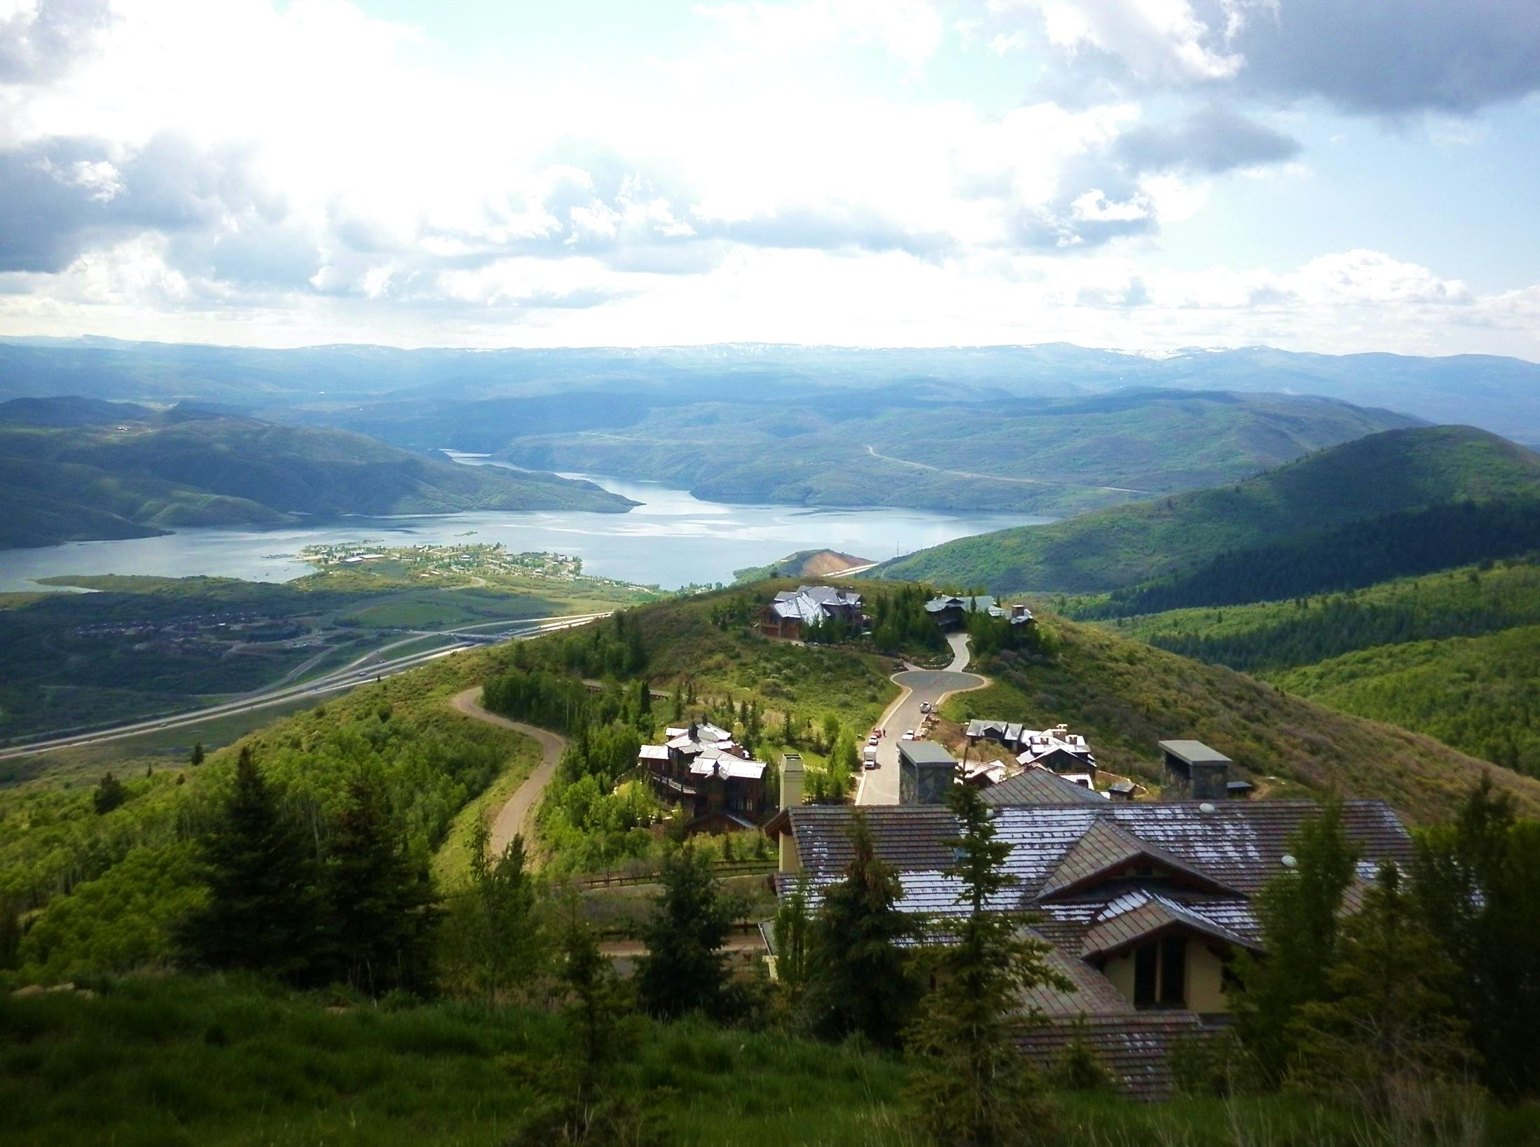
Affidavit of Beneficial Use
Perfecting small domestic water rights

Slide 9
Affidavit of Beneficial Use (PROOF AFFIDAVIT)
Section 73-3-5.6 made effective May 12, 2009
Water right must be associated with a residence, either full- or part-time. The residence may receive water under another water right or from a municipal connection. Irrigation or stock use on the affidavit must be associated with the residence.
The water use is for a quarter-acre of irrigation or less.
The water use is for the watering of ten head of livestock (or equivalent) or less.
The water use does not include any uses in addition to the three listed above.

Slide 10

PROOF AFFIDAVIT
Documentation and mapping submitted by an applicant testifying that a small domestic use application has been developed and placed to beneficial use.
Easy Definition
Applicant does all the work.

Slide 11
PROOF AFFIDAVIT
Required Documents
Affidavit of Beneficial Use of Water
  This document must be filled out by the applicant and signed before a notary public.
Plat Map
  This is a map of the property that can be obtained from the County Recorder's Office, usually for a nominal fee.
Certificate of Occupancy
  This document can usually be obtained from the city, county, or other municipality that issued the building permit for the residence. Can accept tax notice showing home on the notice.
Map of Beneficial Use
  This map is created by the applicant and shows the beneficial uses and source of water.

Slide 12
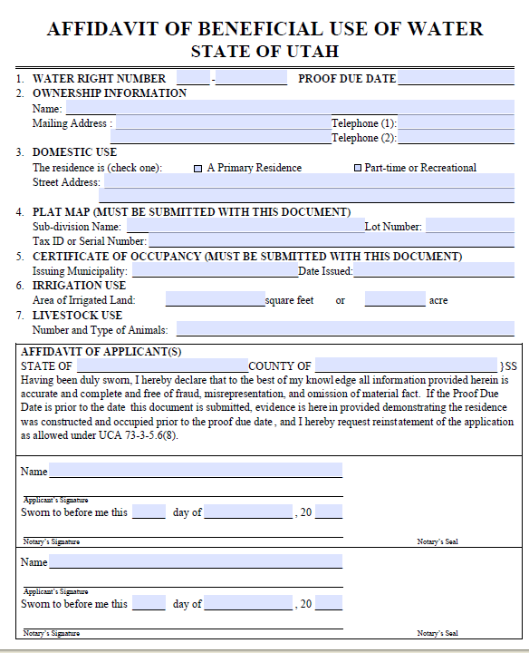
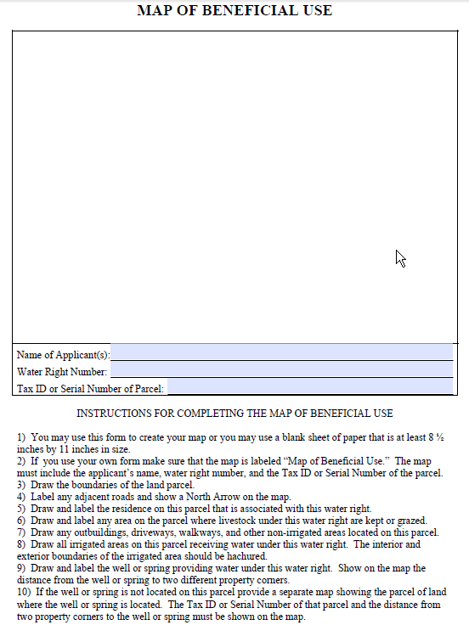
PROOF AFFIDAVIT FORM

Slide 13
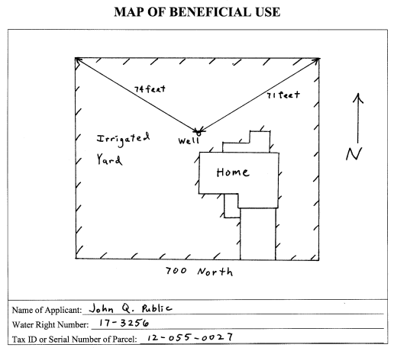
PROOF AFFIDAIVT
Map of Beneficial Use Example
0.21 acres

Slide 14
PROOF AFFIDAVIT
Frequent Questions
Proof Affidavit gets a “Certificate of Beneficial Use”
You can hire a proof professional (surveyor, engineer or consultant) to help you file the Affidavit
Certificate of Occupancy - residence is ready to be occupied
  Tax Records showing a residence is being taxed or a letter from municipality
Submitted on a Application to Appropriate, Change Application, or an Exchange Application
If water right is based on shares of stock in an irrigation company, the irrigation company also needs to sign the Affidavit

Slide 15
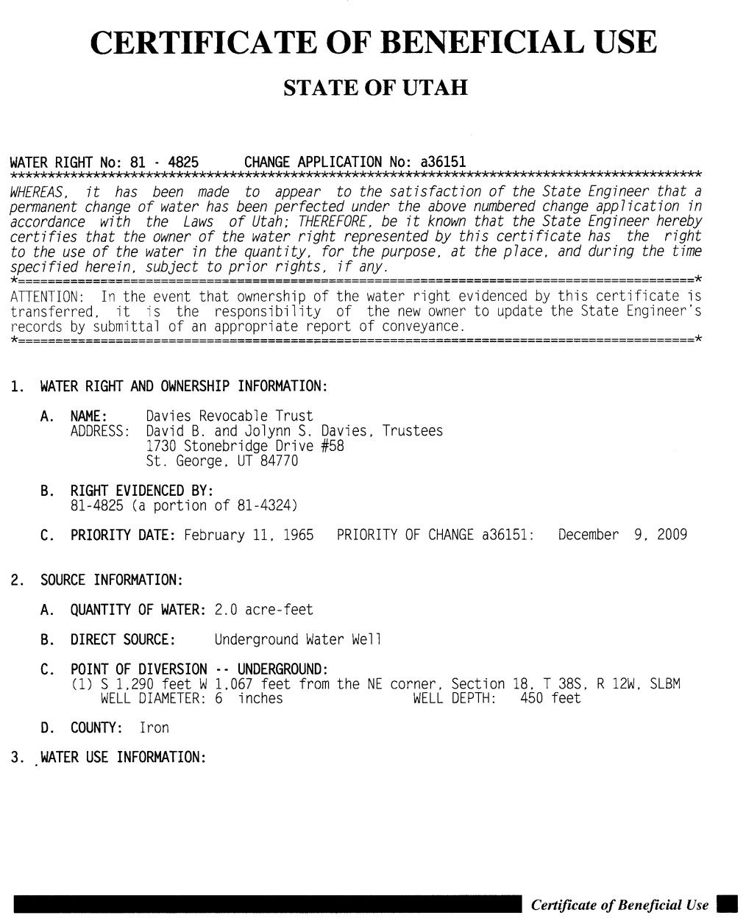
CERTIFICATION
State Engineer’s review and signature
Issued on same day as signed
Review for correctness
Record with county
  Is optional
Reconsideration and appeal
Notes:
Draft certificates are reviewed by the applications/records section for accuracy and completeness. The final certificate is submitted to the State Engineer for review and signature. If amendments are needed, it is returned to applications/records section and/or regional engineer for additional work.
When signed by the State Engineer, the certificate is sent to the applicant on the date of signature and then scanned for internet access. This is the final step in the process and is often referred to as “perfecting” the right.
If the applicant accepts the certificate, it should be recorded with the appropriate county recorder to associate the water right with the land upon which it is used.
If the applicant disagrees with it, a request for reconsideration and/or an appeal to district court can be pursued as described earlier.

Slide 16
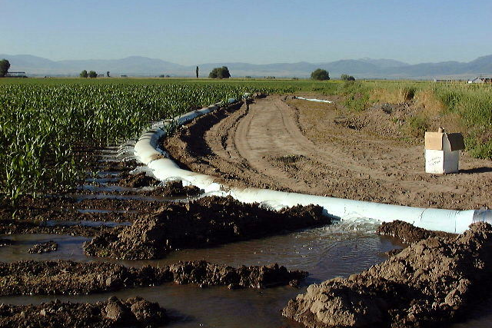
Beneficial Use
Continued use as authorized
Amendments by change application
Prolonged non-use
Notes:
Once beneficial use has been certified, water rights should continue to be used as authorized.
Because water resources are limited in Utah and there is considerable competition for the available supply, state statutes provided for challenge to perfected rights if there are prolonged periods of nonuse even though the water supply is accessible to the right owners. Other water users could argue that the idle rights have been forfeited from such nonuse and that their allocation should be made available to others who have diligently continued their projects as allowed under their rights.
Also continued use of perfected rights should occur as approved. Rights used in excess of or differently than the authorized project can be challenged by other users. Such concerns could involve impairment and damages to other rights and result in litigation. If projects are later to be changed, amending change applications should be filed and processed to authorize new uses, sources, etc. and retire historical ones.
Perfected rights must then be used as authorized. Rights used in excess of the authorized project can be challenged by other users as impairment to the system due to said enlargement.
If projects are later to be changed, amending change applications should be filed and processed to authorize new uses, sources, etc. and retire historical ones.
Prolonged periods of nonuse even though the water supply is available could result in challenge by water users that the right has been forfeited.

Slide 17
QUESTIONS ABOUT PROOFS & CERTIFICATES?

Slide 18

Updating ownership
Water Right Title

Slide 19

How Water Right Conveyance Works
Water Rights transfer by deed in substantially the same manner as real estate.
Appurtenant water rights transfer silently with land.
  Unless specifically reserved from transfer in land deeds!
Deed conveying water right must be recorded:
  In county where water is used (place of use)
  County where water is diverted (if the two are different)

Slide 20

Water Right Record Keeping
Records maintained by County Recorder
  Deeds (conveyance of water right)
  Certificate
  Index of water deeds
  Assignments (Transfer unapproved/unperfected WR)
Records maintained by the State Engineer
  Water Right Applications
  Certificate
  Use Records
  Owner of record

Slide 21
Water Right Record Keeping
Records maintained by County Recorder
  Deeds (conveyance of water right)
  Certificate
  Index of water deeds
Records maintained by the State Engineer
  Water Right Applications
  Assignments (Now recorded at County Recorder)
    Update unapproved or unperfected right
  Certificate
  Use Records
  Owner of record
Discrepancies , Discrepancies, Discrepancies , Discrepancies Discrepancies , Discrepancies, Discrepancies , Discrepancies Discrepancies , Discrepancies, Discrepancies , Discrepancies Discrepancies , Discrepancies, Discrepancies , Discrepancies Discrepancies , Discrepancies, Discrepancies , Discrepancies Discrepancies , Discrepancies, Discrepancies , Discrepancies Discrepancies , Discrepancies, Discrepancies , Discrepancies Discrepancies , Discrepancies, Discrepancies , Discrepancies Discrepancies , Discrepancies, Discrepancies , Discrepancies Discrepancies , Discrepancies, Discrepancies , Discrepancies Discrepancies , Discrepancies, Discrepancies , Discrepancies Discrepancies , Discrepancies, Discrepancies , Discrepancies
Discrepancies , Discrepancies, Discrepancies , Discrepancies Discrepancies , Discrepancies, Discrepancies , Discrepancies Discrepancies , Discrepancies, Discrepancies , Discrepancies Discrepancies , Discrepancies, Discrepancies , Discrepancies Discrepancies , Discrepancies, Discrepancies , Discrepancies Discrepancies , Discrepancies, Discrepancies , Discrepancies Discrepancies , Discrepancies, Discrepancies , Discrepancies Discrepancies , Discrepancies, Discrepancies , Discrepancies Discrepancies , Discrepancies, Discrepancies , Discrepancies Discrepancies , Discrepancies, Discrepancies , Discrepancies Discrepancies , Discrepancies, Discrepancies , Discrepancies Discrepancies , Discrepancies, Discrepancies , Discrepancies

Slide 22
Updating Ownership with the Division of Water Rights
Who Can Update?
How are the Records Updated?
  Owner if all submitted deeds convey by water right number
  Attorney
  Professional engineer
  Title insurance producer
  Professional land surveyor
  Report of Conveyance (ROC)
    One ROC for each water right to be updated
    Shows the Division who the current owner is
    ROC chain of ownership begins with the owner on the Division’s records

Slide 23
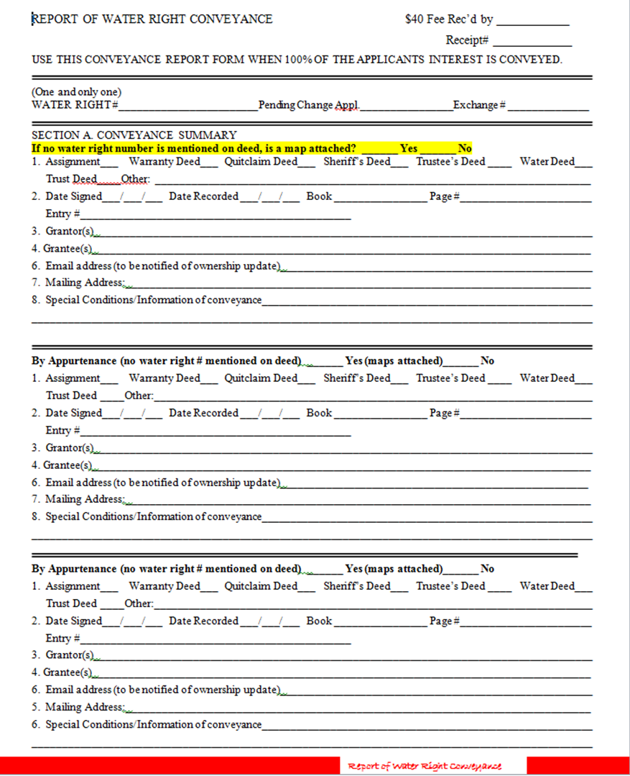

Slide 24
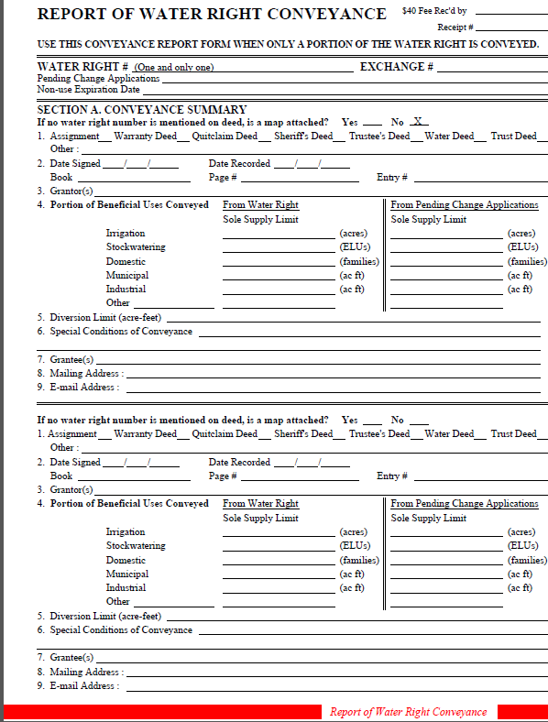
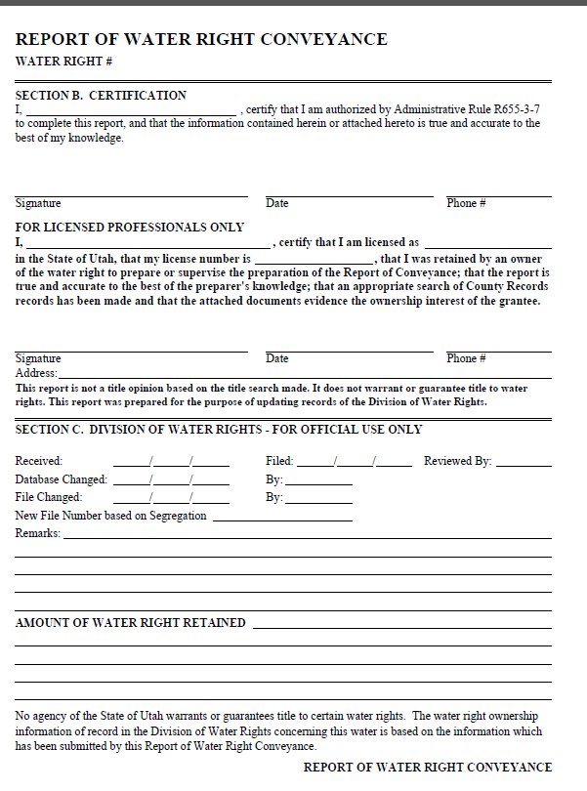

Slide 25
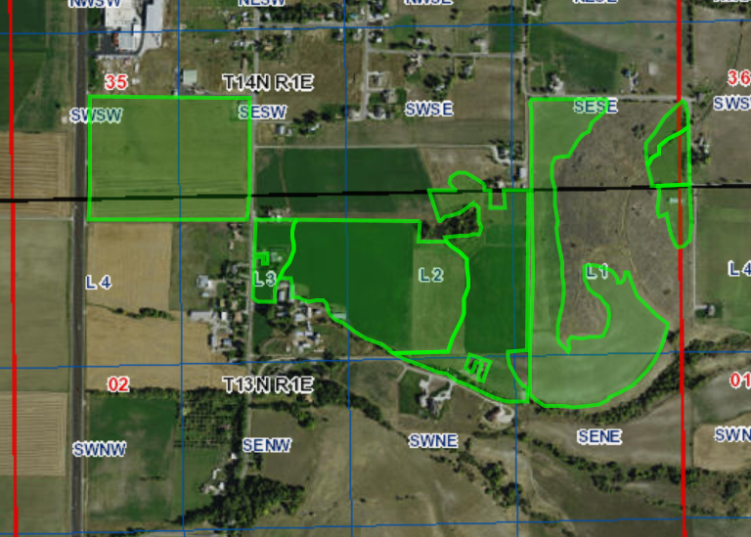

Section 35, T14N, R1E and Section 2, T13N, R1E
Section Corner
Water Right #
Parcel 1
28.1 acres
North Arrow
Scale
SE
Corner
Parcel 2
63.3 acres
Parcel
Acreage
Legends
WR# 25-6734
N
Parcels 1 (28.1 acres) & 2 (63.3 acres) (Deed # 7240)
POU for water right # 25-6734
*Map MUST clearly show property described in deed

Slide 26

Land and water deed
Addendums

Slide 27
Addendums
Utah Code Ann. §73-3-8
(d) (i) Beginning July 1, 2011, a deed under Subsection (1)(a) may include a water rights addendum as provided in Section 57-3-109.
(ii) The state engineer shall consider a water rights addendum that is recorded and forwarded to the state engineer by a county recorder, in accordance with Section 57-3-109, as a submitted report of water right conveyance under Subsection (3).
County recorder submits to SE
Attachment to deed
All grantors/grantees sign
Creates dialogue about what water rights are conveyed
The grantee must keep current mailing address with DWRi

Slide 28

Title Takeaways
Report of Conveyance (ROC)
  Report of Conveyance normally requires professional (Attorney, Engineer, Surveyor, or Title Insurance Agent)
  Transfers by appurtenance requires a map
  Simple transfers can be done by owner (deeds list wr number)
  ROCS are declaratory not decision documents
  Competing ROCs are a title controversy
    State Engineer does not resolve
The mere purchase of a water right does not guarantee: (1) that the water right is in good standing with the Utah Division
of Water Rights; (2) that the owner has clear title to the water right: (3) that the Division will recognize the ownership change;
or (4) that the Division will approve any proposed changes or extensions regarding the water right. You are encouraged to
conduct proper “due diligence” research into any water right before purchasing it.
Are you still awake?
The mere purchase of a water right does not guarantee: (1) that the water right is in good standing with the Utah Division
of Water Rights; (2) that the owner has clear title to the water right: (3) that the Division will recognize the ownership change;
or (4) that the Division will approve any proposed changes or extensions regarding the water right. You are encouraged to
conduct proper “due diligence” research into any water right before purchasing it.

Slide 29
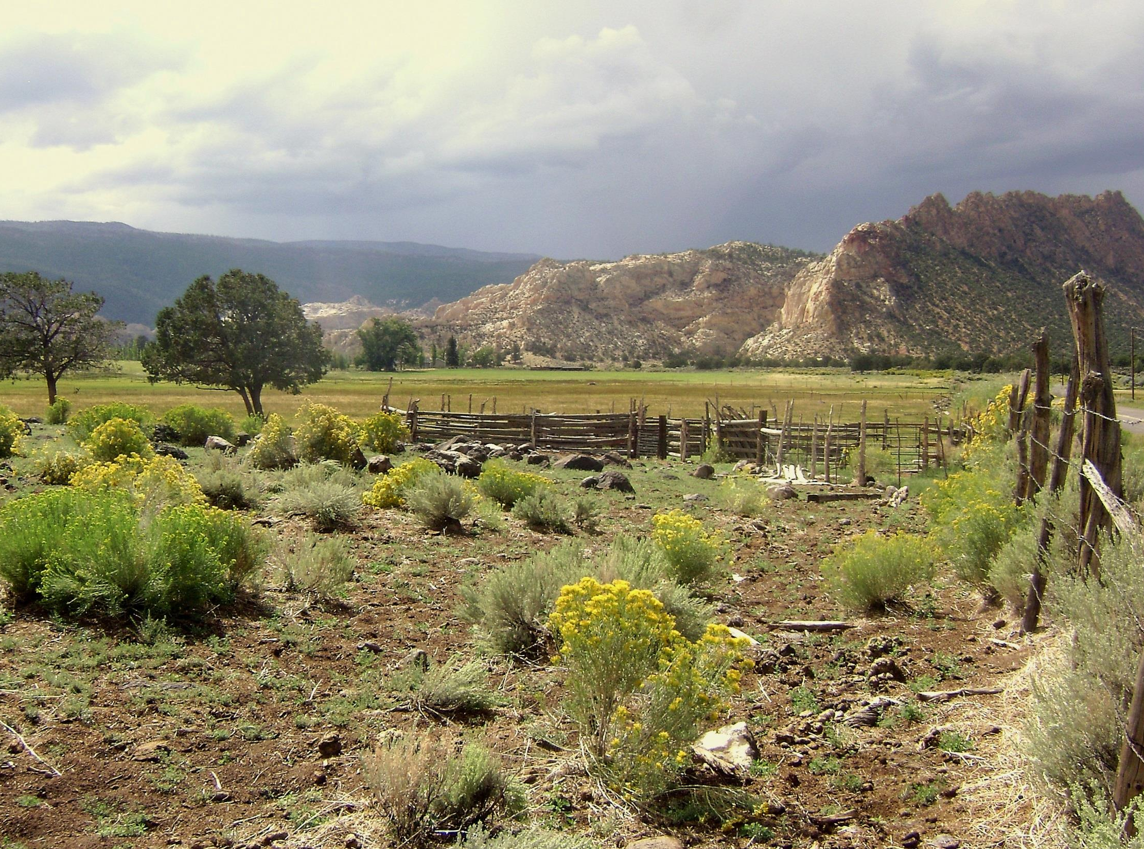
Questions?
NO? Great!
Please keep ownership and contact information updated with DWRi

