Slide 1


Utah Division of Water Rights
The Application Process
From Application to Certification
Clark Adams--April 2017
June 21, 2004
Notes:
As we go through this, please feel free to ask questions to clarify any point….I might even answer them.

Slide 2


HOW DO I GET A WATER RIGHT?
Filing for a water right
  Application to Appropriate
  Diligence Claim
Purchasing property with existing rights
  Appurtenance
Purchasing all or portion of an existing right
  Change application
Notes:
Several ways to obtain a water right
These will be covered here very briefly.
I will discuss later the “why” you would want to file several of the most common applications and the “how” will be discussed in a later presentation
Filing for a water right:
When we talk about filing for a water right, it is done through the State Engineers Office or the Division of Water Rights.
Filing for water in an area of the state that is open for appropriation.
Filing Diligence claims showing that the water has been in continuous use prior to when the state legislation created the process for applying for surface and underground water.
Purchasing property with existing water rights
If the selling party does not reserve or keep the existing water rights then the water rights can transfer to the buyer by appurtenance.
Purchasing all or portion of an existing water right
Can purchase a valid water right without the land on one piece of property and then transfer it to another property. Transfer is subject to administrative policies of where the water originates and to where it is being proposed to be transferred to.
Purchasing water or land is a private transaction that our office would not be involved in.
Our office is usually notified after the deeds transferring title to the water right has been recorded and then the new owner provides copies of those deeds with a Report of Water Right Conveyance to our office to update the ownership records of the water right.

Slide 3
PERFECTED vs UNPERFECTED
What is a perfected water right?
  Certificated application
    “Proved” up on
  Water right awarded in court decree
    Adjudication
    Water User’s Claim
    Civil action or dispute
  Water User’s Claim issued after an Election
  Acceptably filed Diligence Claim
Notes:
We are discussing the application process.
A couple of terms that describe the status of water rights, I will try to define here:
Perfected Water Right, the term perfected is used interchangeably with:
Certificated
Proved up on
Decreed
When a water right has been included in a Proposed Determination through an Adjudication process
The water right would be considered perfected
A Water User’s Claim issued after an Election has been filed and processed, then the water right would be considered perfected
A Diligence Claim that has been accepted

Slide 4
PERFECTED vs UNPERFECTED
What is an unperfected water right?
  An approved Application to Appropriate
  An unapproved Application to Appropriate
  Unpublished Water User’s Claim
  An unacceptably filed Diligence Claim
Notes:
Then an UNPERFECTED water right would be opposite of those:
It is not certificated
Proof has not been filed
Not decreed
An Approved Application to Appropriate, is unperfected until proof has been filed and a certificate issued
An UNAPPROVED Application to Appropriate, is unperfected and is only considered a filing and the water cannot be used until approved
A water user’s claim that has NOT been published in a Proposed Determination
A Diligence Claim that is not acceptably filed

Slide 5
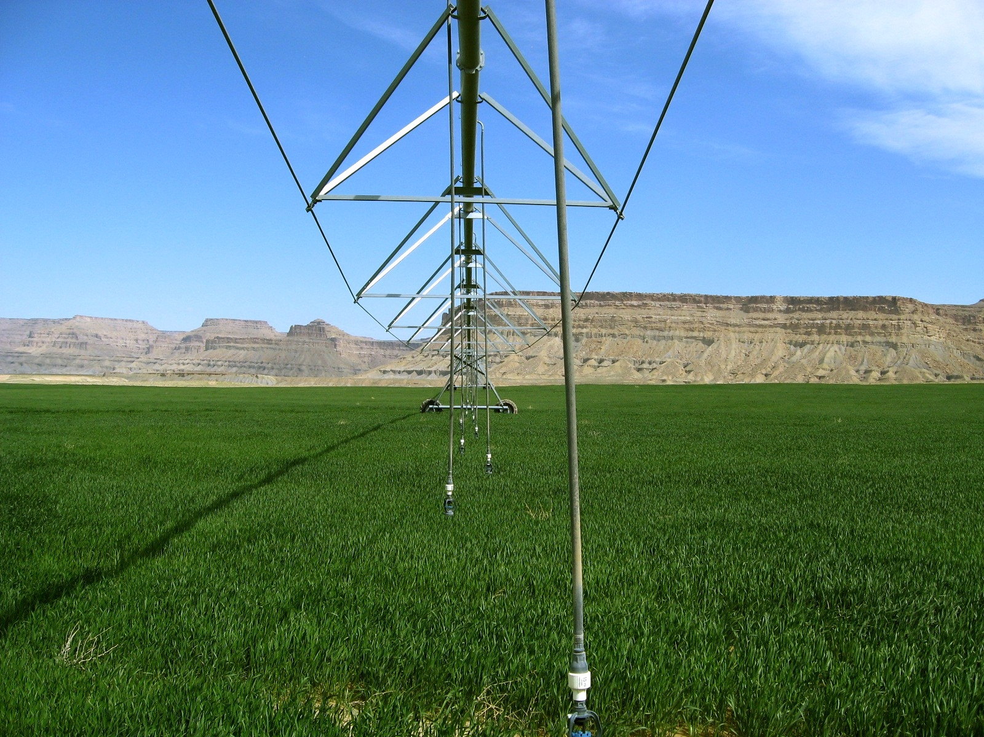
Applications
Types of Water Right
Notes:
We are going to discuss some of the most common applications that we deal with.

Slide 6

COMMONLY FILED APPLICATIONS
Application types we will discuss
  Diligence Claims
  Applications to Appropriate
  Change Applications
  Exchange Applications
  Temporary and Fixed Time Applications
There are others too
Notes:
These are the applications that we will discuss:
We will cover each application and the WHY file these
Diligence Claims
Applications to Appropriate
Change Applications
Exchange Applications
Temporary and Fixed Time Applications
This is not a complete list of applications or forms that we deal with, just some of the most common.
As with any good bureaucratic agency, we are always coming up with more.

Slide 7
WHAT AN APPLICATION NEEDS
(Acceptably Complete)
  Applicant/owner’s name, address and ownership interest
  Source of water (specific spring, stream, underground well)
  Flow (cfs) or volume (acre-feet) of water to be diverted
  Point of diversion (POD) or where the water is diverted
  Existing or intended beneficial use of the water
  Place of use (POU) or location of the beneficial use
  Application map to identify where beneficial use will occur
  Signatures of all applicants/owners or legal agents
  Filing fee
Notes:
Each application needs some basic information to be complete so that is can be processed. The term we commonly use is “Acceptably Complete”.
Applicant/owner’s name, address and ownership interest
Source of water (specific spring, stream, underground well)
Flow (cfs) or volume (acre-feet) of water to be diverted
Point of diversion (POD) or where the water is diverted
Existing or intended beneficial use of the water
Place of use (POU) or location of the beneficial use
Application map to identify where beneficial use will occur
Signatures of all applicants/owners or legal agents
Filing fee

Slide 8
DILIGENCE RIGHTS aka “PIONEER RIGHTS”
Filed to document beneficial uses that have been in continuous use since:
  Surface water prior to March 12, 1903
  Underground water prior to March 22, 1935
Filed with Division of Water Rights for review
Statutory procedures found in 73-5-13
Notes:
Diligence (sometimes called pioneer) rights are established by making beneficial use of water prior to March 12,1903 for surface water sources and prior to March 22, 1935 for underground water sources.
These dates represent the time when the state legislation created the process for applying to appropriate water under the administration of the State Engineer. The application process was not made a retroactive requirement for prior water users.
Water use that had started and had been continuously occurring prior to the legislation would be recognized without having to file an application. Diligence rights can be made public record as part of the State Engineer’s records by filing diligence claim forms.
Statute 73-5-13 of Utah Code addresses the filing of diligence claims.
Extra Notes
They can also be made of record in court documents regarding water right litigation. In order to resolve conflicts, judges issue decrees determining the rights of the involved parties. Some of the decrees are detailed in their description of the rights; others are very limited in the information provided. While many of these litigations involve rights established prior to 1903 or 1935, such rights may not be specifically called diligence rights. Following the issuance of the judges’ decisions, they are commonly referred to as decreed awards. Some diligence rights were defined in past adjudication proceedings in which the State Engineer was directed by the district court to provide a proposed determination of water rights in an area. During his investigations and mapping, water users were contacted about their use of water and how such use was authorized. Users filed water user’s claims based on diligence rights for inclusion in the water right compilation. Then these claims were published in proposed determination books, which were submitted to the court. The determination books were also provided to other water users, who could protest any of the rights if they disagreed with the information. The court eventually issues judicial orders and decrees addressing the rights.

Slide 9
DILIGENCE RIGHTS
Must be prepared by Professional Engineer or Land Surveyor
Must provide the following:
  Who first put water to use
  How is claimant the successor in interest
  When was water first used
  Flow measurement
  Map of beneficial use
  Evidence of continuous use (affidavits, records, etc.)
Notes:
Diligence Claims filed today must be prepared a Utah licensed Professional Engineer or Land Surveyor
The Claim must provide the following:
Who first put water to use
How is claimant the successor in interest
When was water first used
Flow measurement
Map of beneficial use
Evidence of continuous use (affidavits, records, etc.)
There is a filing associated with filing a Diligence Claim

Slide 10
DILIGENCE RIGHTS
Incomplete claims may be returned to claimant for additional information
After Filing
  Claim is advertised in local newspaper
  Protests must be filed with District Court
  Field investigation
  Report of diligence claim investigation prepared
  Limitations of right outlined in report
Notes:
If all the required information is not included or if the claim is incomplete, it may be returned to the claimant to provide all the required information.
After the claim has been filed
Claim is advertised in local newspaper
Protests must be filed with District Court
(this is different from protesting other applications)
Field investigation
(Done by regional office where the claim is located)
Report of diligence claim investigation prepared
(This is unique to Diligence Claims, done to investigate the evidence of continuous beneficial use)
Limitations of right outlined in report
(The limitations will be based on evidence found of continuous use)
IMPORTANT:
Diligence Claims can (should) only be filed when there is evidence/proof of continuous use of water
1903 or before for surface water
1935 or before for underground water

Slide 11
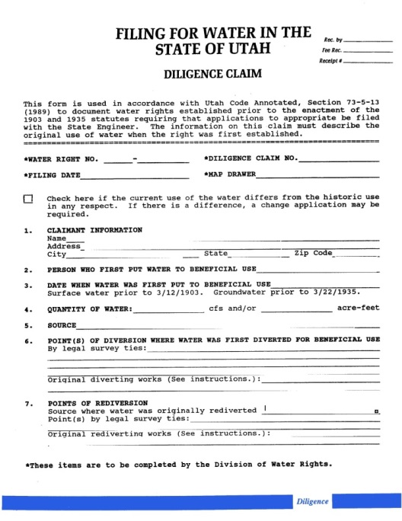
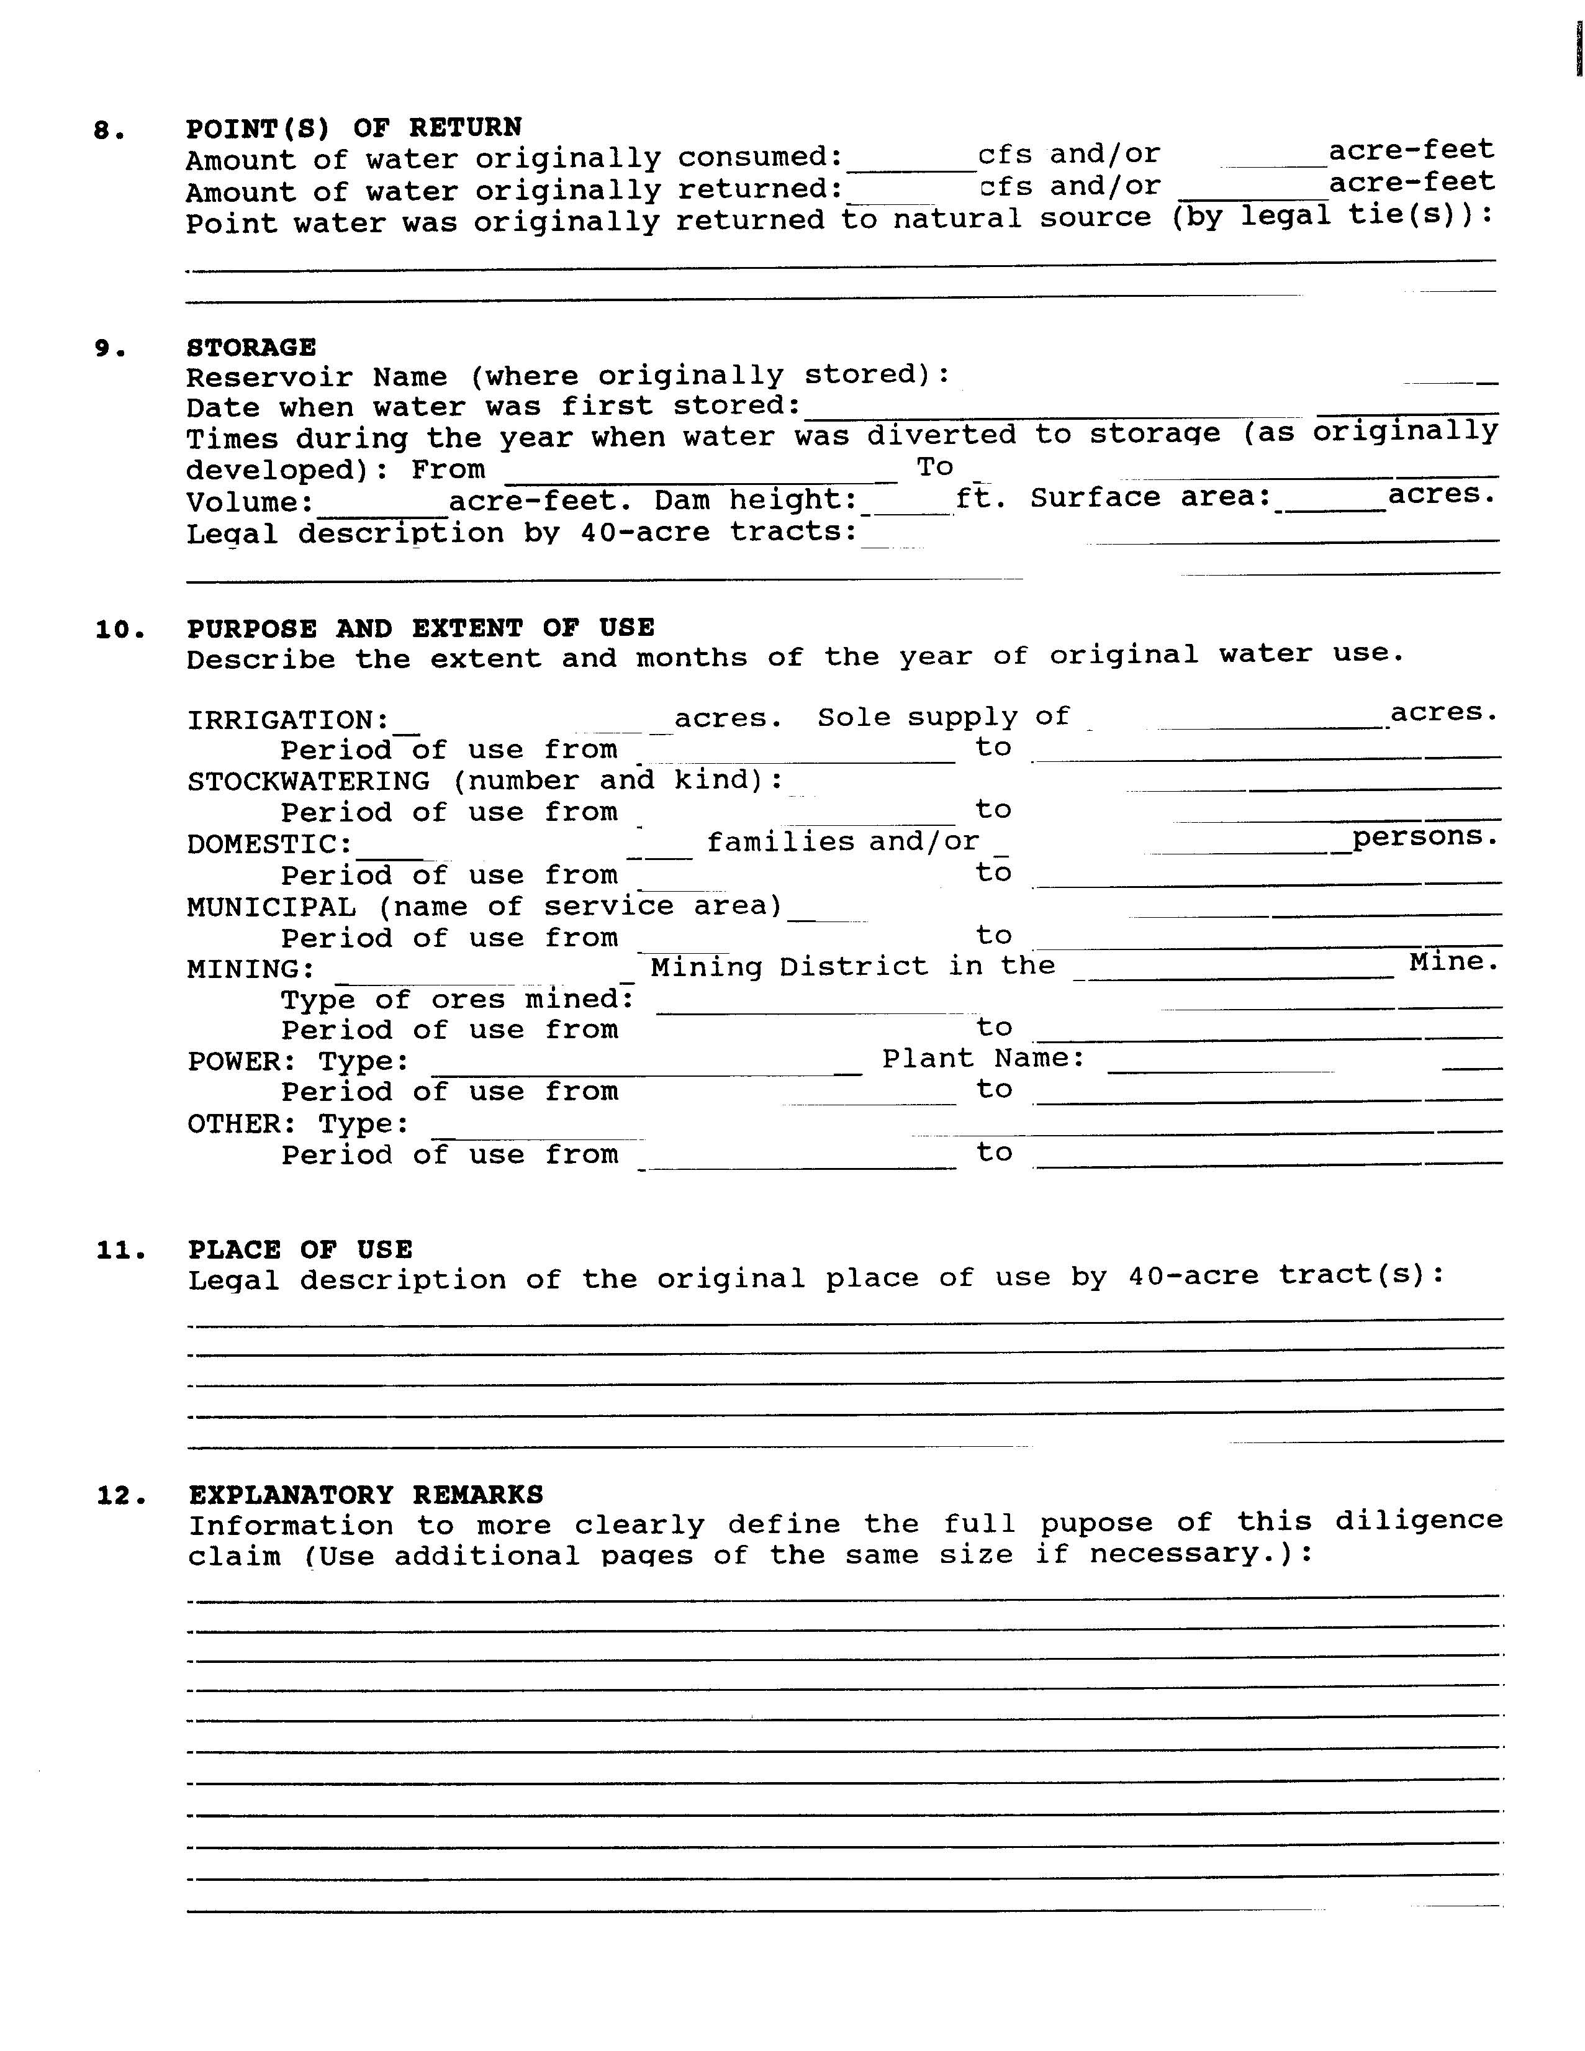
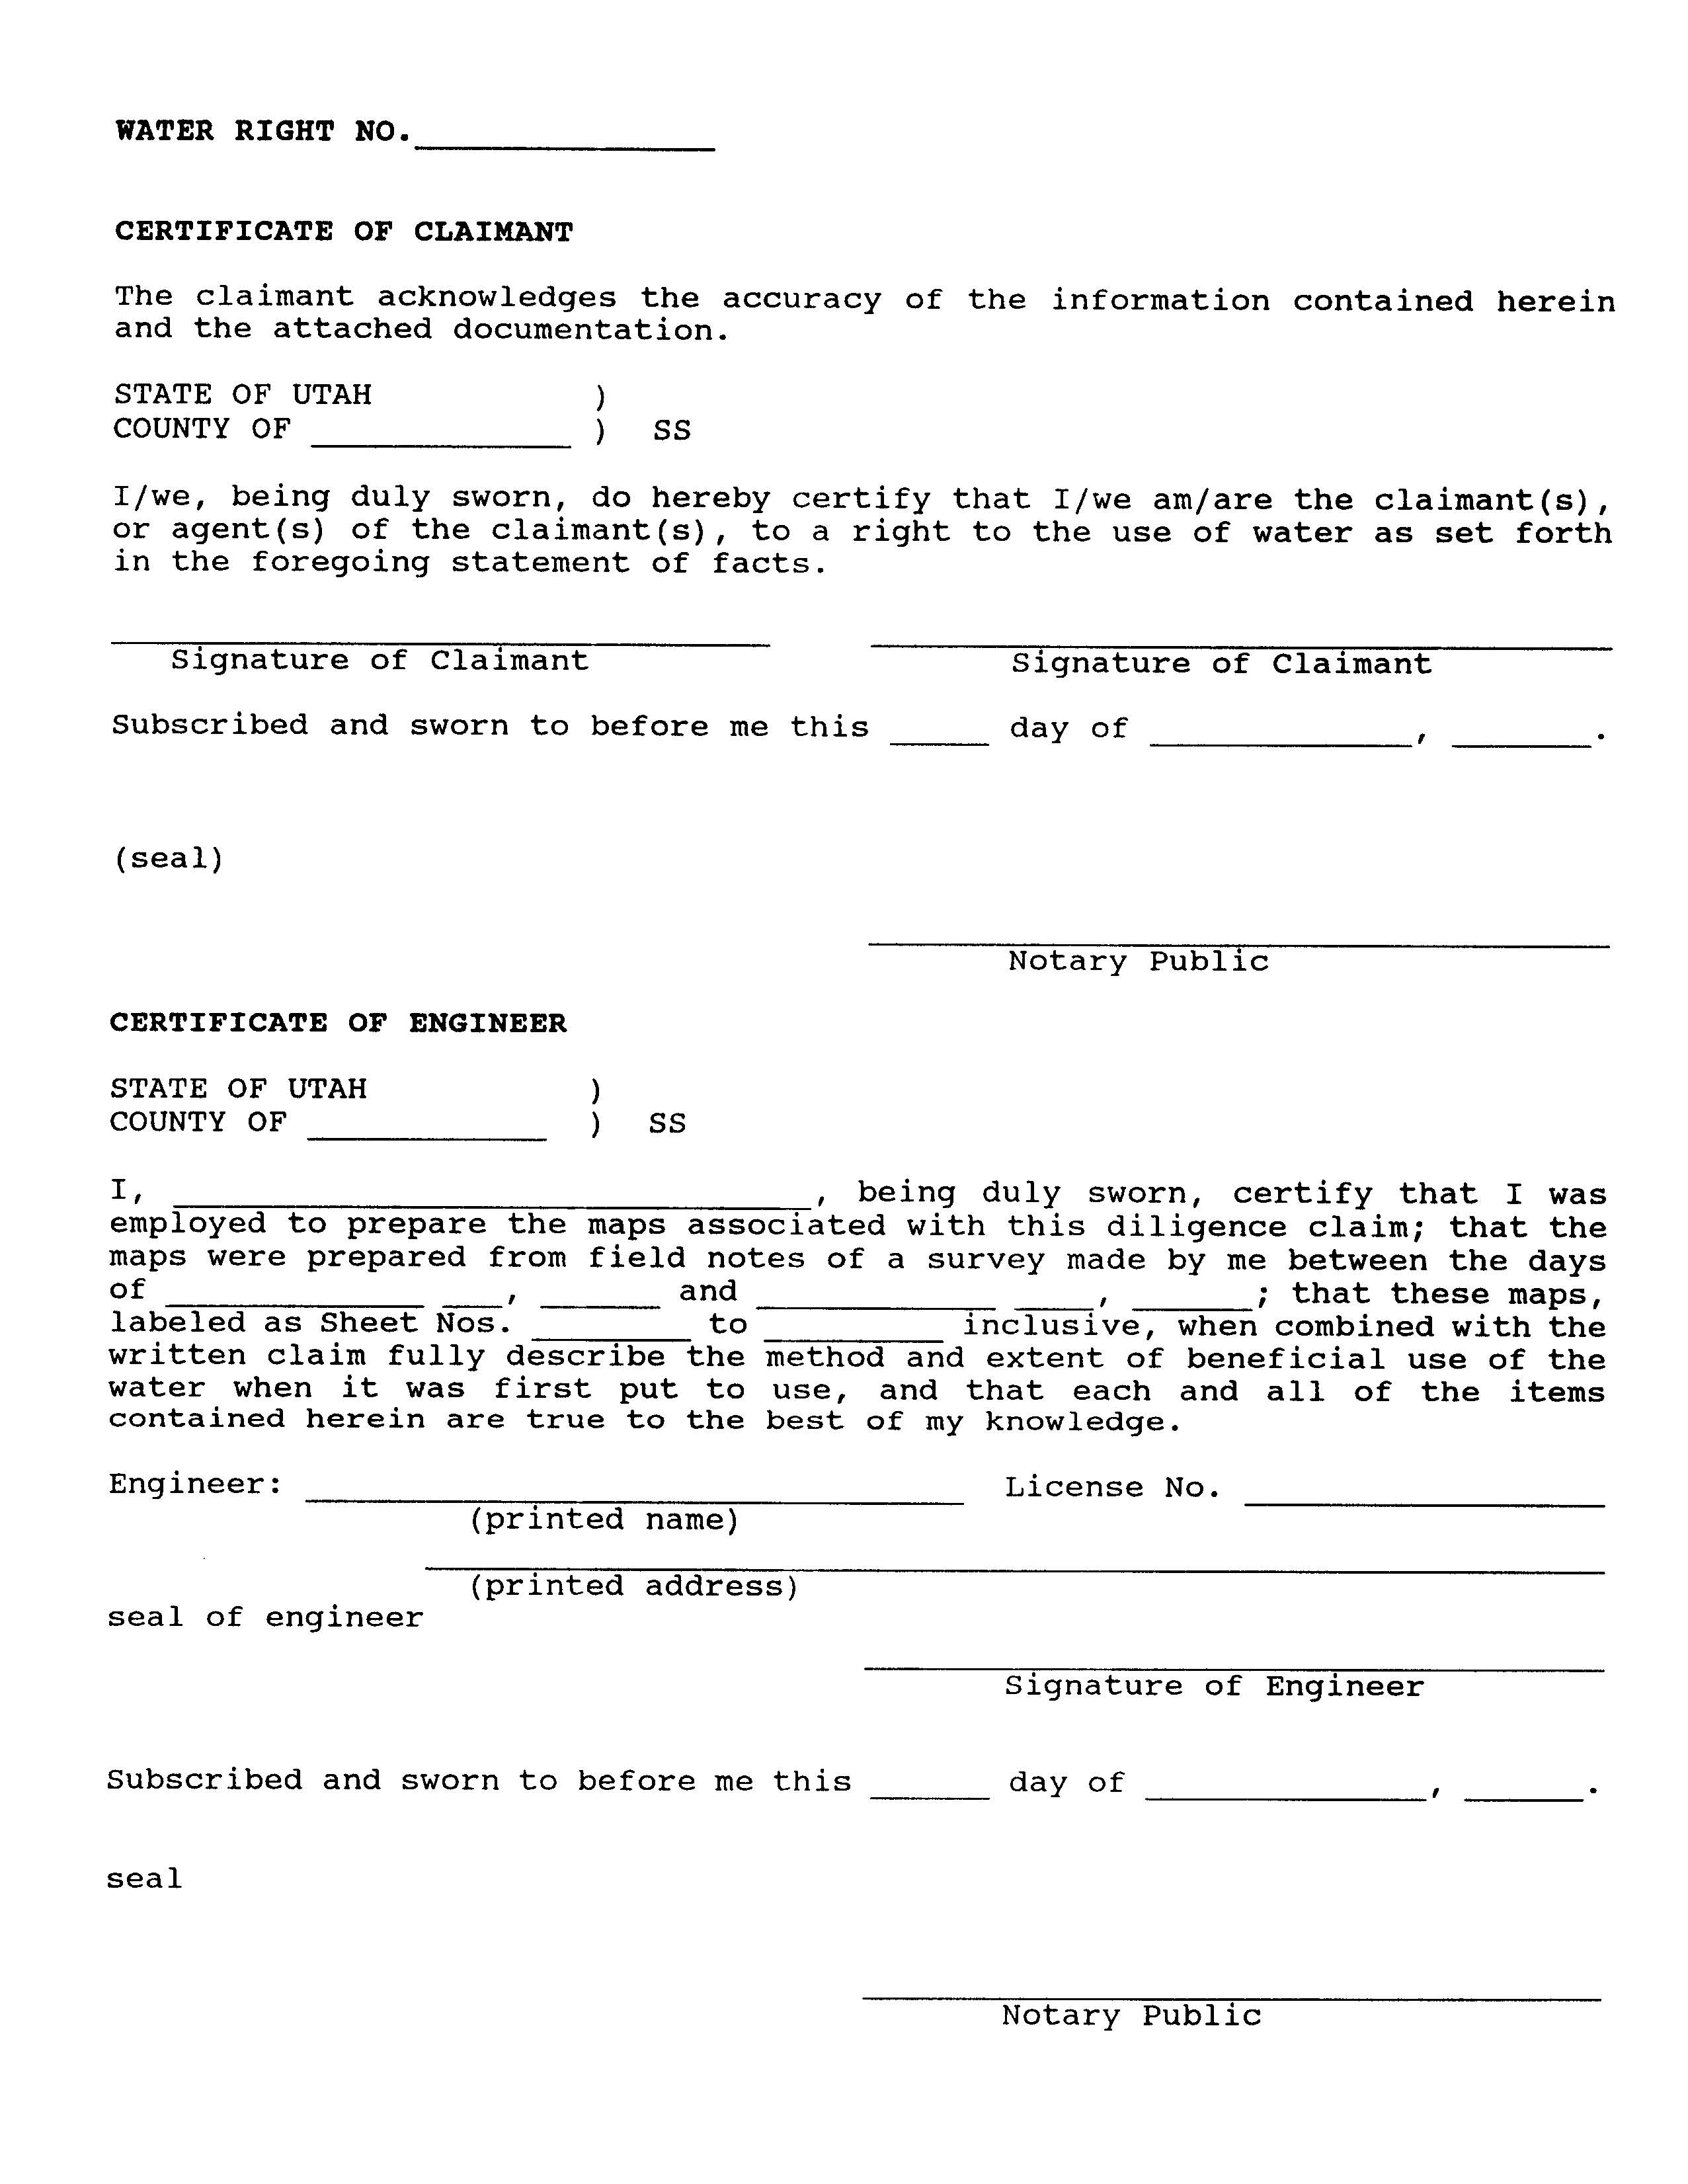
Notes:
These forms can be obtained by website, by mail, or by personal visit. Assistance in preparing the applications is also provided by the State Engineer’s staff.

Slide 12
APPLICATIONS TO
APPROPRIATE WATER
Filed to create a new water right
Much of Utah now closed or limited
Each water right area has unique policies
  Some open for large appropriations
  Some open for small domestic filings
    1 home, 10 livestock, 0.25 -1.0 acre irrigation, depending on area
  Most areas closed for new appropriations
Notes:
Applications to appropriate are filed to create a new water right in areas of the state that are still open to appropriate water.
Many drainage areas of the state are now closed to or limited in new applications to appropriate due to the lack of available unappropriated water.
Each water right area has unique policies:
Some may be closed for any appropriations
Some may be open for large appropriations
Some are open for small domestic filings
Which is enough water for one domestic use, 10 livestock and between 0.25 acre to 1.0 acre of irrigation (lawn, garden, pasture, etc., anything that is being watered outside) depending on the area….or for an equivalent amount of livestock.
However, even in closed areas, proposals for projects that will not consume water and will return it to the hydrologic system (such as hydropower or heat transfer) can still be considered.
Extra Notes:
Applications to Appropriate Water are submitted to the State Engineer. They are subject to a process of public notice, possible protest by other users, review of the proposal and available data on water resources and other rights in the area, meetings, etc. Then, the State Engineer may approve or reject the applications. Those filings that are approved have time frames in which the water must be placed to beneficial use. Upon making such use, proof of beneficial use is filed. Upon review by the State Engineer, proof is accepted or rejected. If accepted, certificates of beneficial use are issued Larger applications to appropriate can be segregated to accommodate separate rates of development, ownership by separate parties, or modification of parts of the original project.
Section 73-3 of the Utah Code addresses applications to appropriate. Applications to appropriate involving transport and use of the water in whole or part in another state must meet the special conditions required by state statutes concerning water exports (Section 73-3a, Utah Code). Applications to appropriate that involve geothermal fluids must meet the special conditions required by state statutes and rules regarding such projects (Section 73-22 of Utah Code and Rule 655-1 of Administrative Rules).

Slide 13
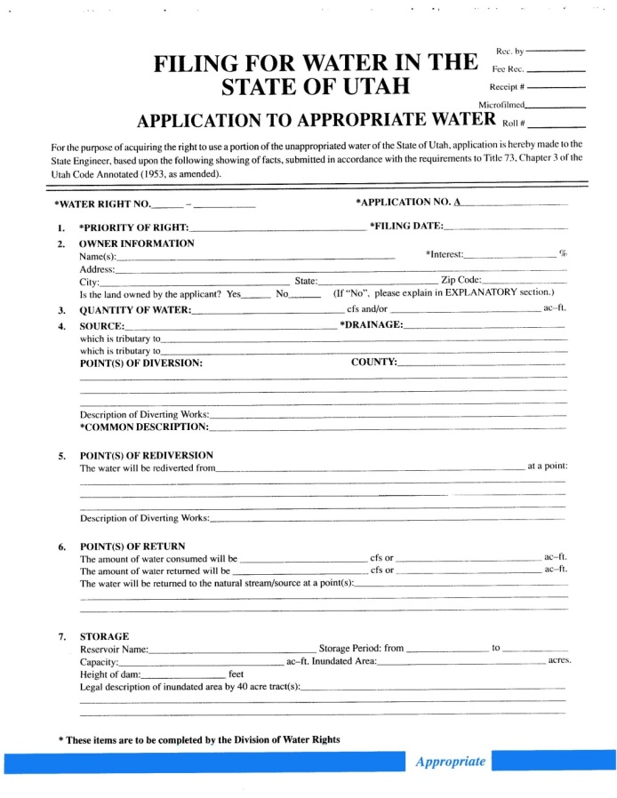
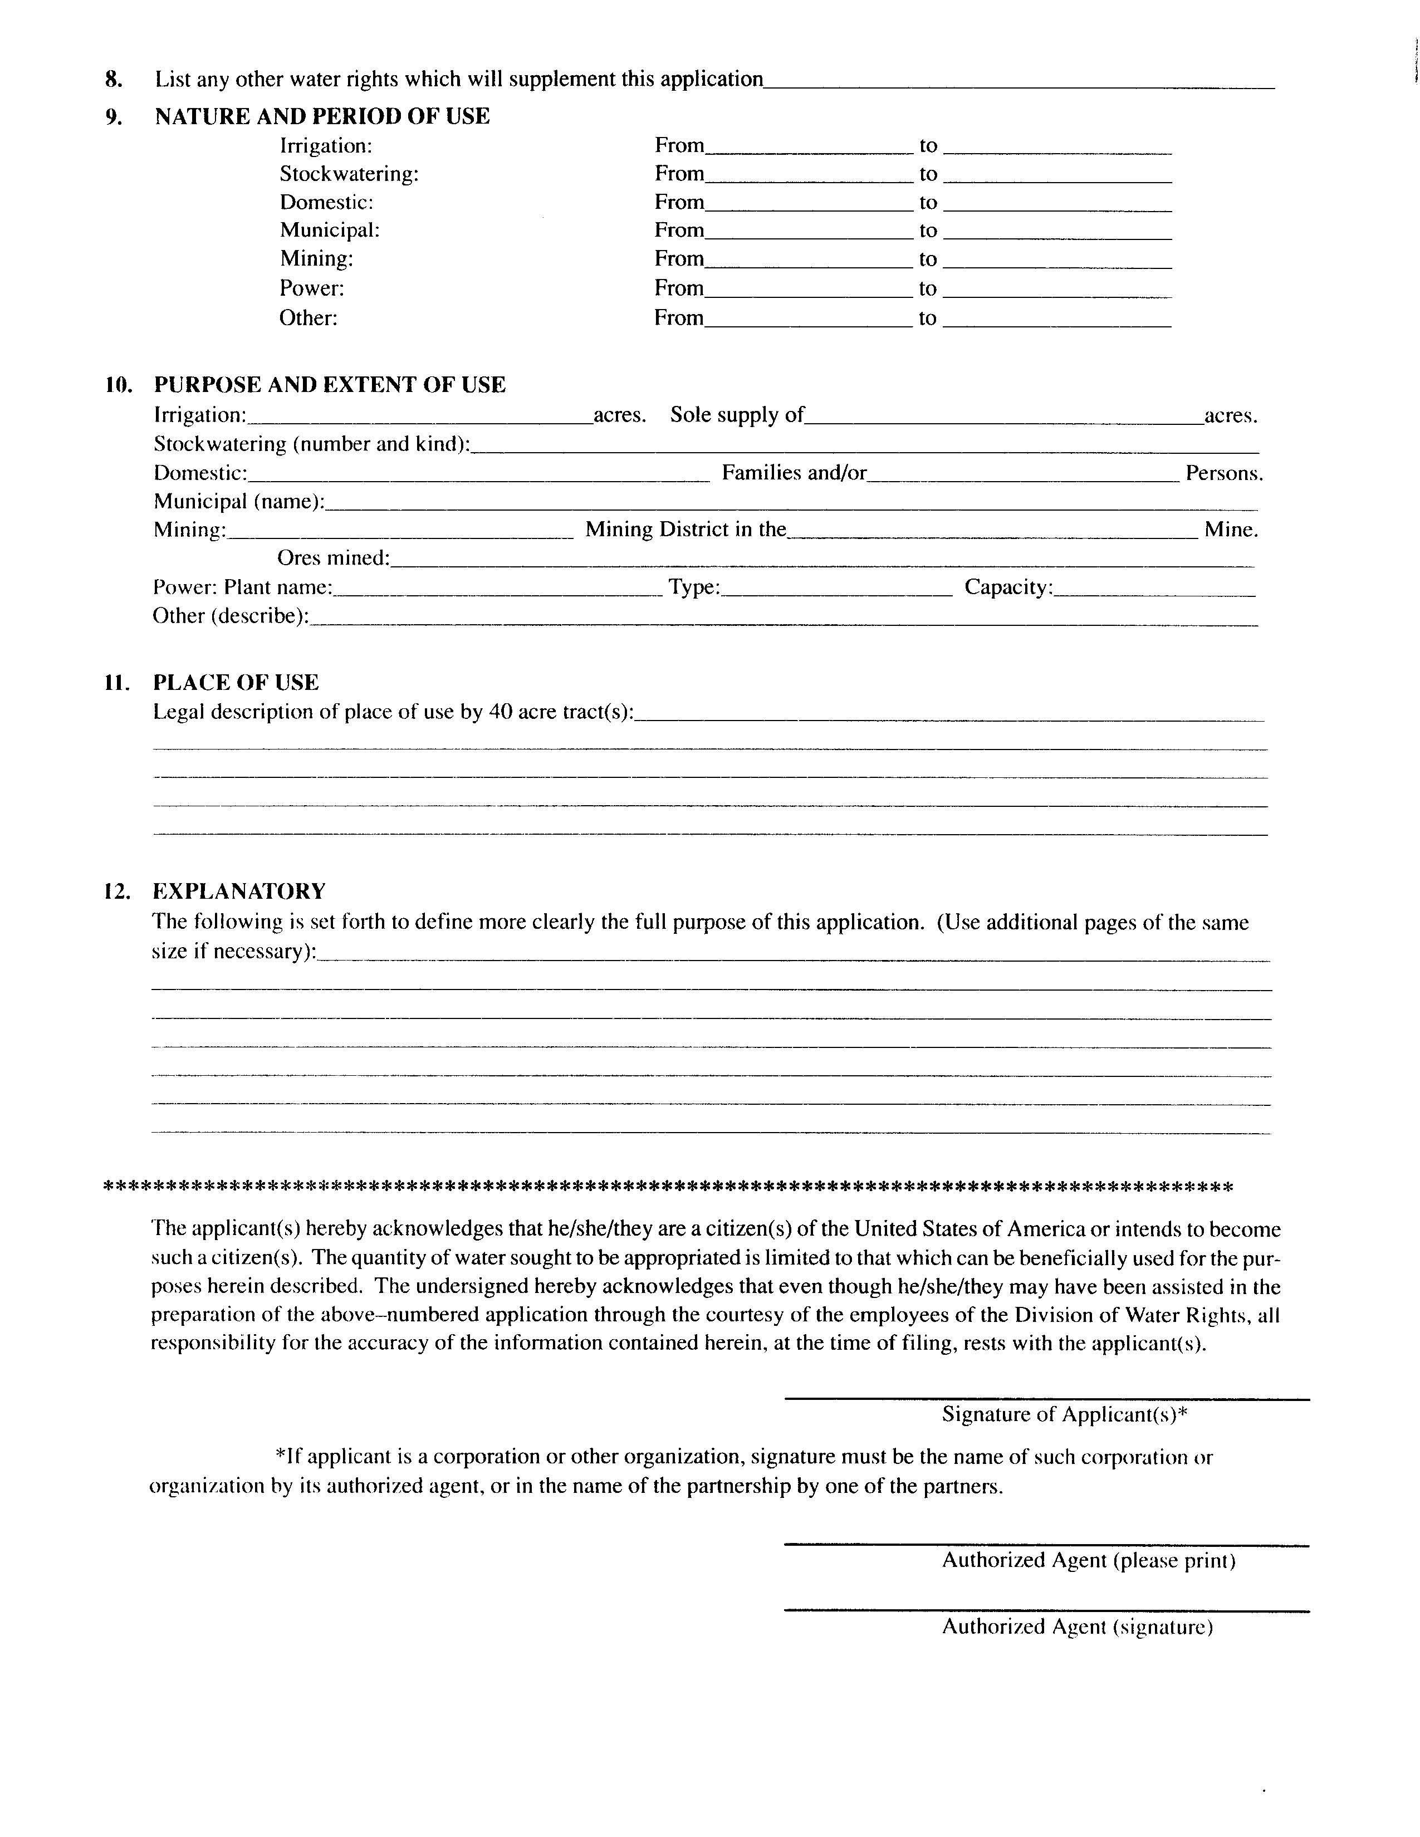
Notes:
Forms to apply for appropriation of water are available from the Division of Water Rights. They can be obtained by website, by mail, or by personal visit. Assistance in preparing the applications is also provided by the State Engineer’s staff.

Slide 14
CHANGE APPLICATIONS
Permanent changes
  Filed on established water rights to transform the parameters of original right(s):
    Point of diversion (moving more than 150 feet)
    Place of use
    Nature of use
    Period of use
Change application filed on approved applications to appropriate
  Amends the original to the proposed changes
  Does NOT extend the original proof due date
Notes:
Because so many water sources and drainage areas are closed or limited for new appropriations, change applications on existing rights are a large and increasing percentage of filings with the State Engineer.
Rights or portions of rights can be amended by permanent change applications.
These filings can modify:
point of diversion
nature of use
place of use
storage of rights.
Change applications can be filed on approved applications to appropriate to change any aspect of the application.
This will amend the original application to the proposed changes
However, filing a change on an application to appropriate does NOT extend the original proof due date of the original application
Extra Notes:
They are subject to the same processes and review as applications to appropriate. Certificated permanent change applications can transform the parameters of their associated rights and thus accommodate new water projects by the retirement of original water uses. Approved temporary change applications can authorize the use of permanent rights for different projects on a short-term basis. They expire after a maximum of one year from approval, and the rights return to their original parameters. Changes involving diversion or use of water in another state must meet the special conditions required by state statutes concerning water exports. Statute 73-3-3 of the Utah Code deals specifically with change applications.

Slide 15
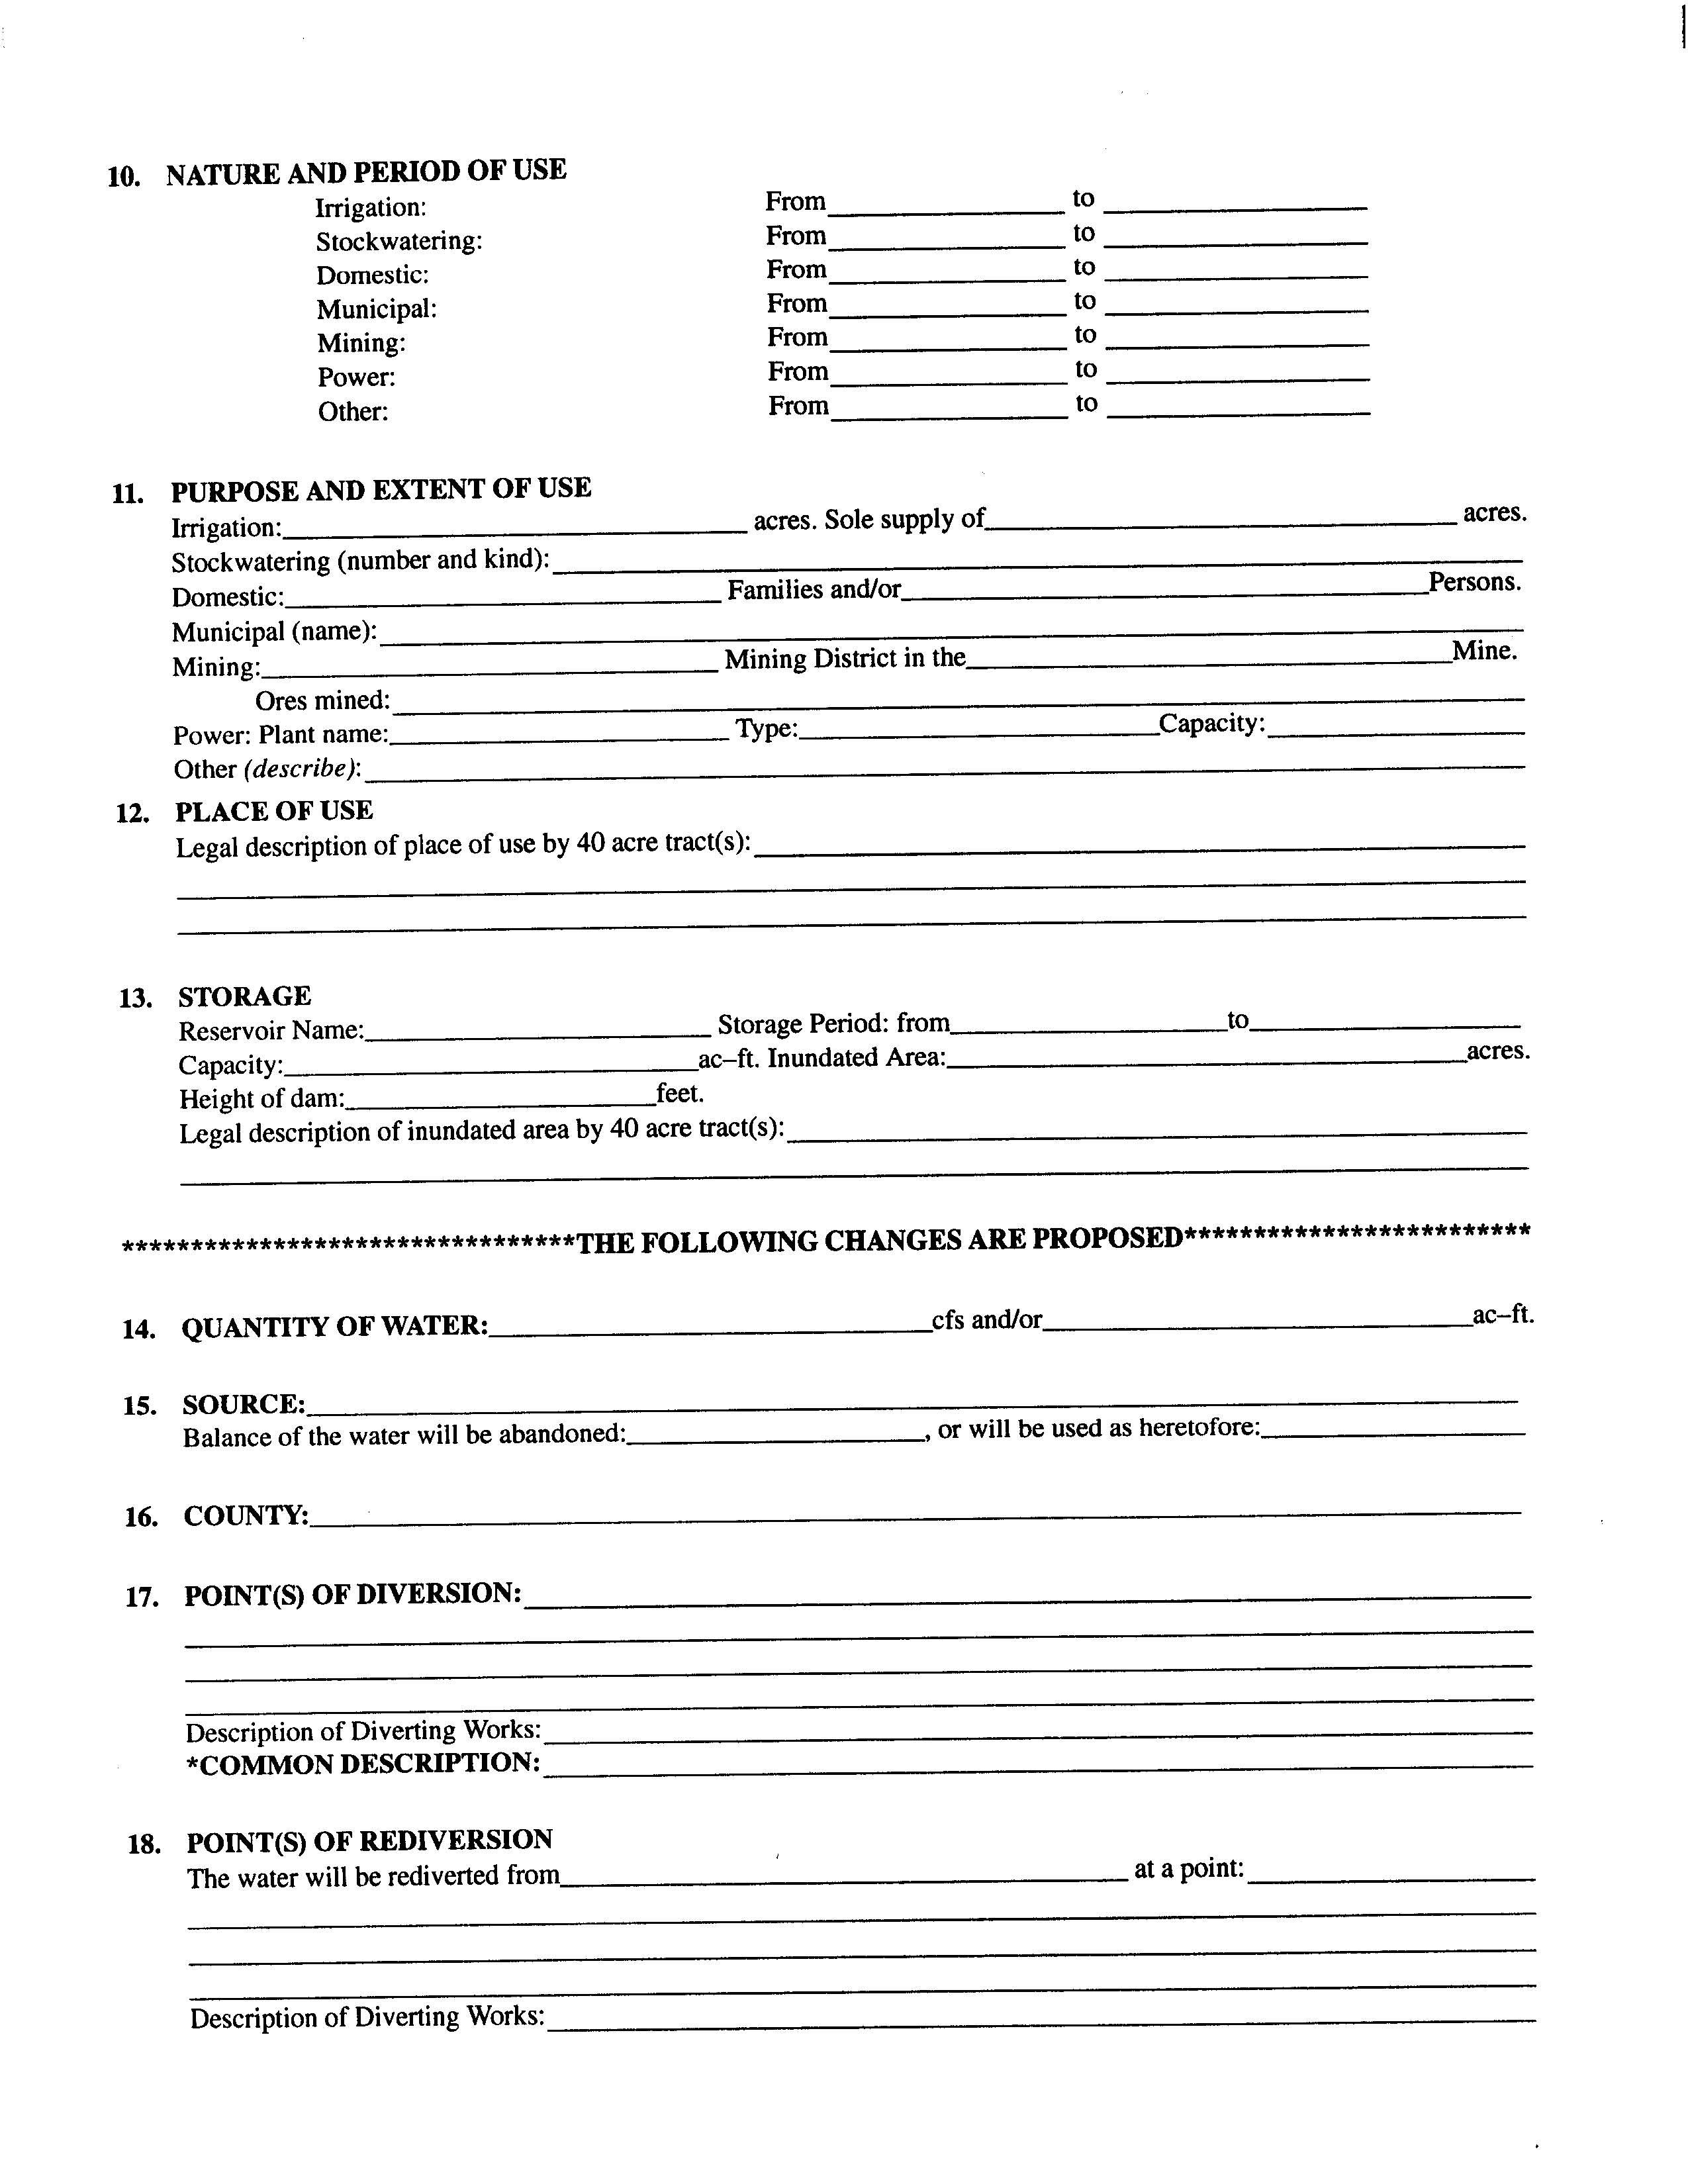
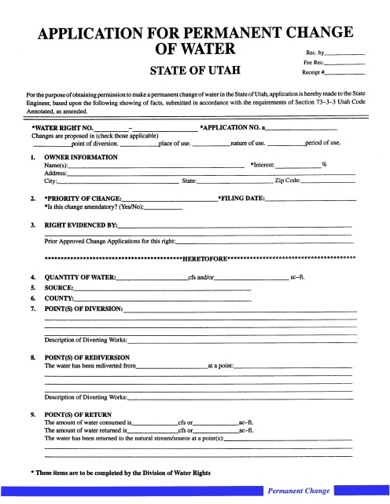
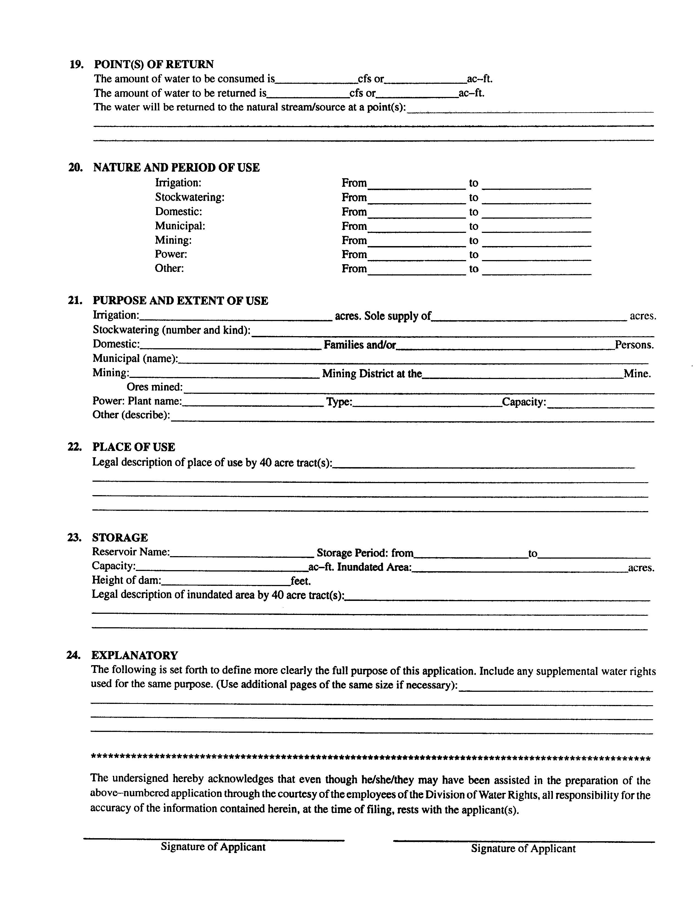
Notes:
Forms to apply to change water rights are available from the Division of Water Rights. They can be obtained by website, by mail, or by personal visit. Assistance in preparing the applications is also provided by the State Engineer’s staff.

Slide 16
EXCHANGE APPLICATIONS
Filed to exchange one source of water for another
Generally involve storage water owned by a conservancy district
Thru a contract with a district an amount of water is transferred to another source (well or spring)
Equivalent amount water released from storage
Potential reversion to original right
Notes:
Water rights can be modified by exchange applications.
Exchange applications address relocation of points of diversion and uses of water rights on a conditional basis, which usually means it is based on a contract to exchange water with a conservancy district.
In the event the applicants do not meet the conditions in which they hold interest in the water rights or the conditions of approval of the exchange applications, the exchanges cease;
And the underlying water rights revert back to their original parameters.
Generally exchange applications address rights in storage reservoirs where water is released to compensate other water users in exchange for water taken and used by applicants at new locations.
Extra Notes:
However, some exchange applications address flexibility in diverting water from differing locations to accommodate weather conditions, distribution issues, or facility maintenance. Statute 73-3-20 of Utah Code addresses exchange applications.

Slide 17
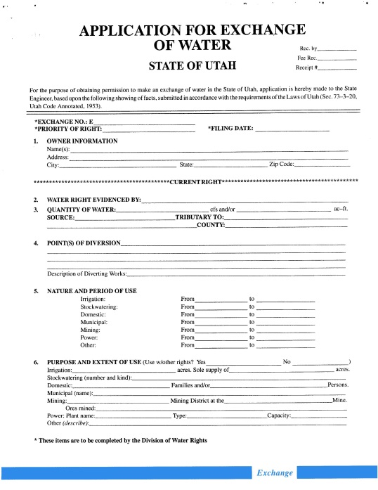
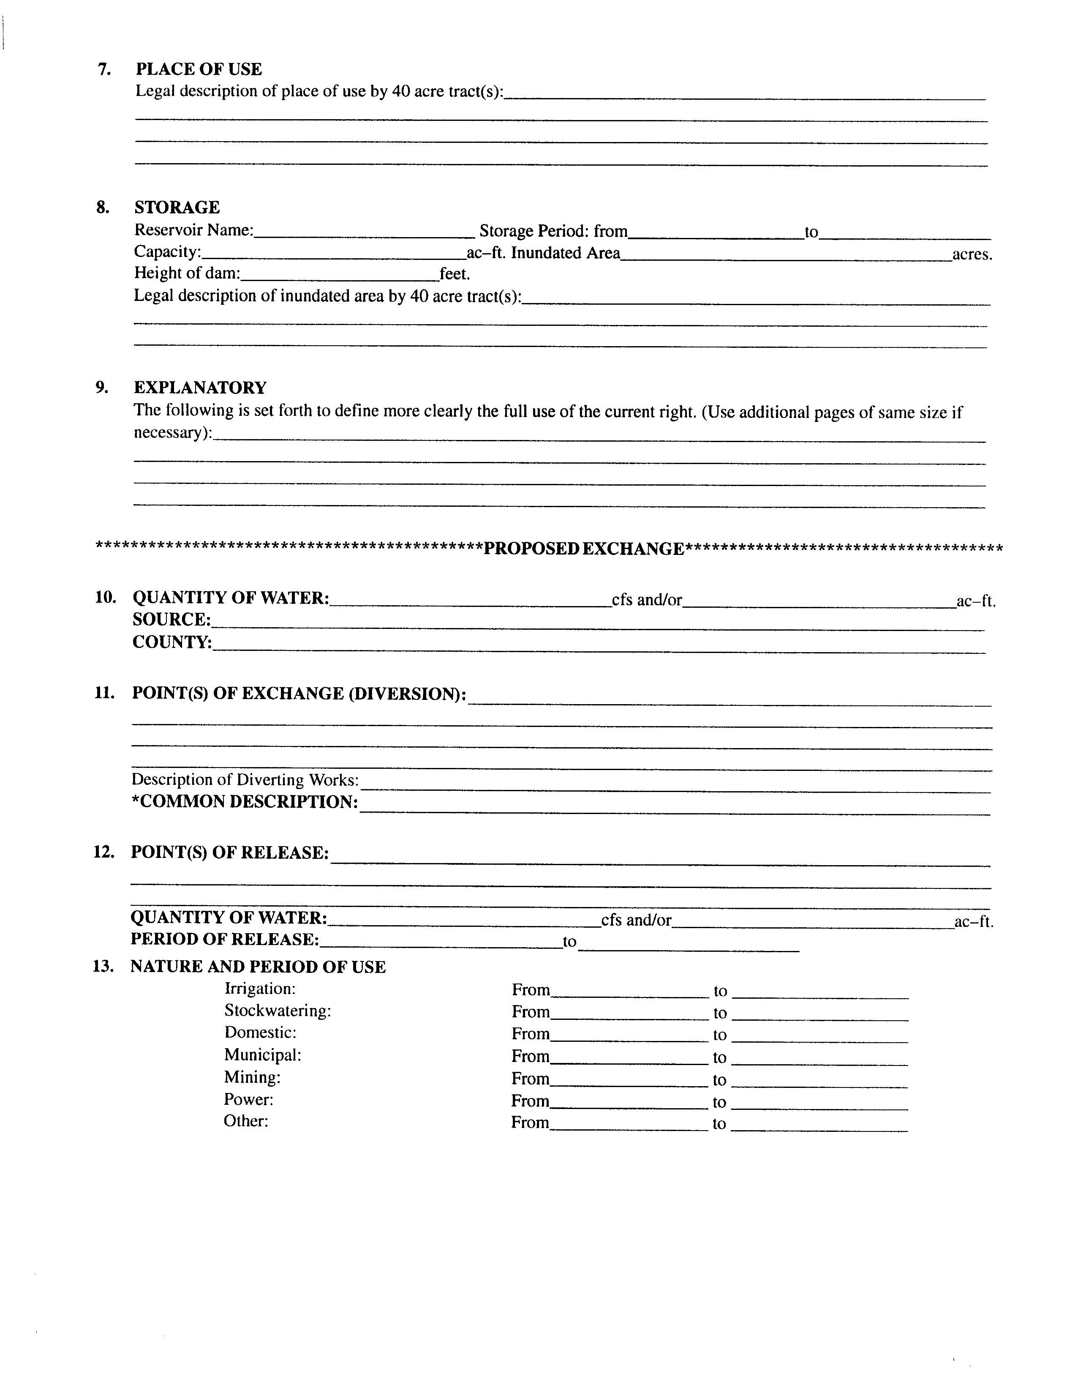
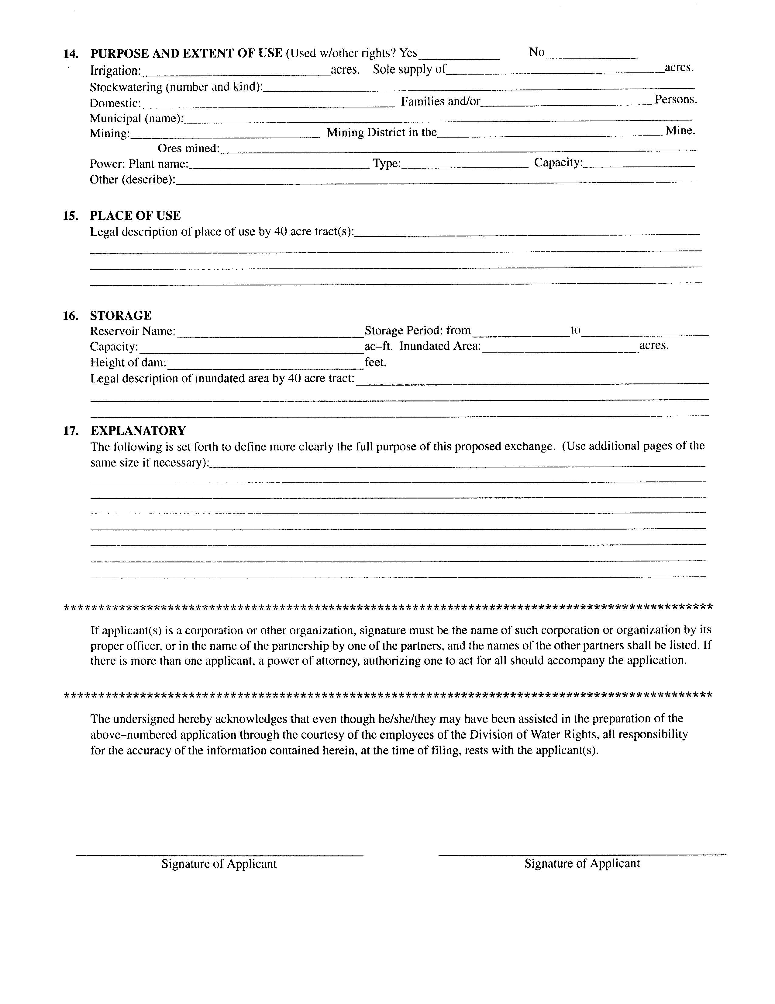
Notes:
Forms to apply to exchange water rights are available from the Division of Water Rights. They can be obtained by website, by mail, or by personal visit. Assistance in preparing the applications is also provided by the State Engineer’s staff.

Slide 18
TEMPORARY APPLICATIONS
Not many filed due to limited water availability
Temporary applications terminate after a maximum of one year
  Cannot be extended
Used for smaller, limited-life projects
  Road construction, oil or mineral exploration, etc.
Temporary Changes to lease water to other users
  To ensure continued use of water
  Cover additional use
  Water moved by Temporary Change cannot be used at the historic place of use and the proposed place of use during the time of temporary transfer
Notes:
Temporary Applications to Appropriate and Temporary Change Applications
Temporary Applications to Appropriate
Can be obtained to address limited-time projects for periods when water is available and/or to authorize use of water for a period of time while other water supply options are being pursued. Due to rather tight water supplies in several parts of the state, these filings are somewhat rare.
Generally they occur in areas where there are large appropriations of water for projects that will not be completed for several years.
During the time of development, water may be available on a temporary basis for smaller, limited-life projects such as road construction, oil or mineral exploration, etc.
Temporary applications expire within a maximum of one year after approval.
Temporary Change Applications
Approved temporary change applications can authorize the use of permanent rights for different projects on a short-term basis.
Some areas of the state, temporary change applications are done as part of leasing water rights on a year-to-year basis to cover additional uses where the leasee of the water does not have sufficient water to cover all their anticipated uses.
They expire after a maximum of one year from approval, and the rights return to their original parameters.
If all or a portion of a water right is transferred by a temporary change application, that portion transferred, can only be used where the temporary change proposes it to be used…you have to give up something, to get something.
Extra Notes:
Changes involving diversion or use of water in another state must meet the special conditions required by state statutes concerning water exports. Statute 73-3-3 of the Utah Code deals specifically with change applications.

Slide 19
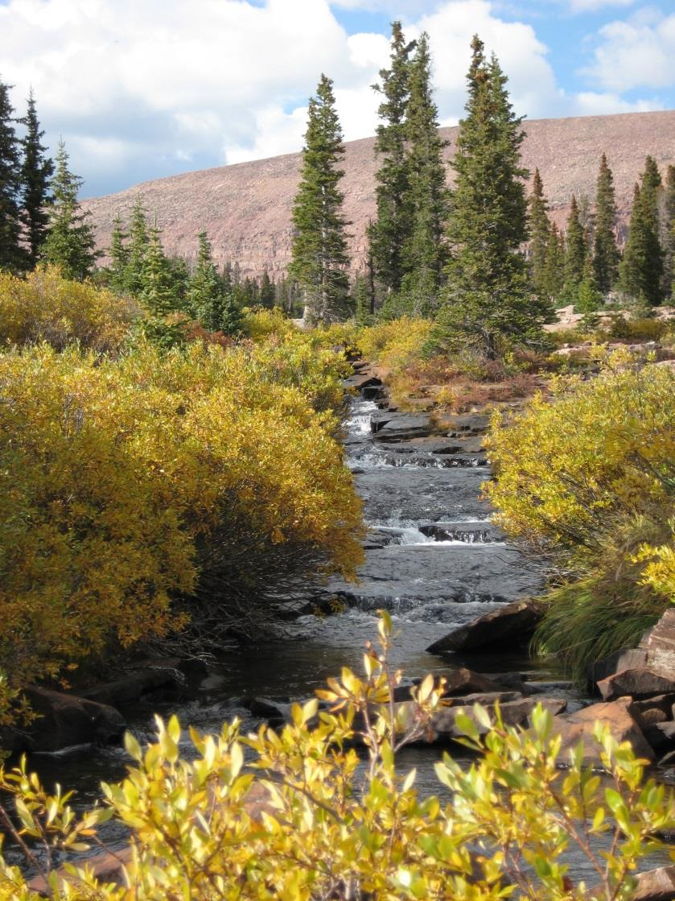
FIXED TIME APPLICATIONS
Filed for specific amount of time as determined by State Engineer
“Proof” not required
Contact with applicant and monitoring of development thru Water Use Program
Can be filed for all uses, except domestic use
Can be extended
Notes:
Fixed Time Applications
Are filed on proposed projects that are usually time limited and greater than one year; and limited to the amount of time as determined by the State Engineer
Such as, mining, mineral exploration
Filing proof is not required
Applicants are required to keep water diversion and use records and submit those records annually to our Water Use Program
Can be filed for all uses, except for domestic use (usually)..there have been exceptions
Fixed time applications can be extended or refiled if the life of the proposed project extends past the original expiration date
Extra Notes:
Fixed-time applications terminate at the time described in approval documents. An extension of the fixed-time period can be requested and approved under certain conditions prescribed by state statute. Statues 73-3-5.5 and 73-3-8 of the Utah Code address temporary applications and fixed-time applications.

Slide 20
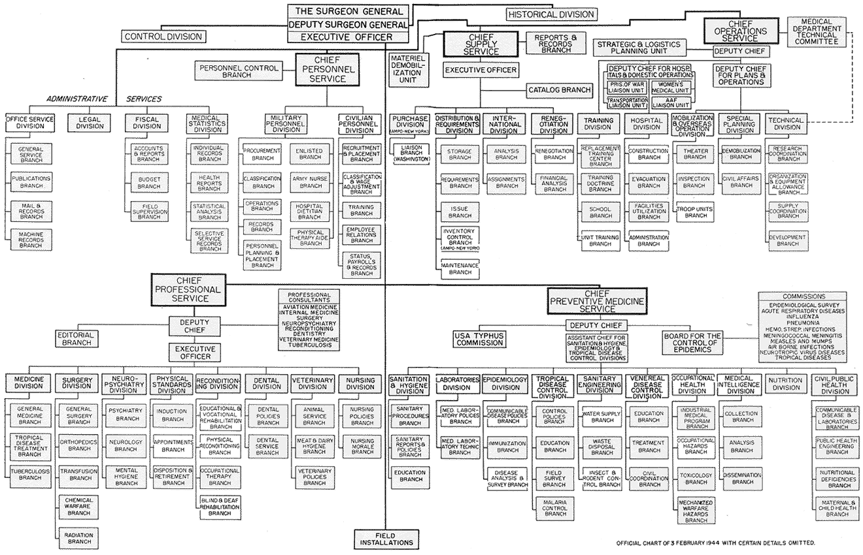
THE APPLICATION PROCESS
Me !?
Notes:
Now we will go over the process that most applications go through

Slide 21

THE APPLICATION PROCESS:
IT IS JUST THAT EASY!
Notes:
Now we will go over the process that most applications go through

Slide 22
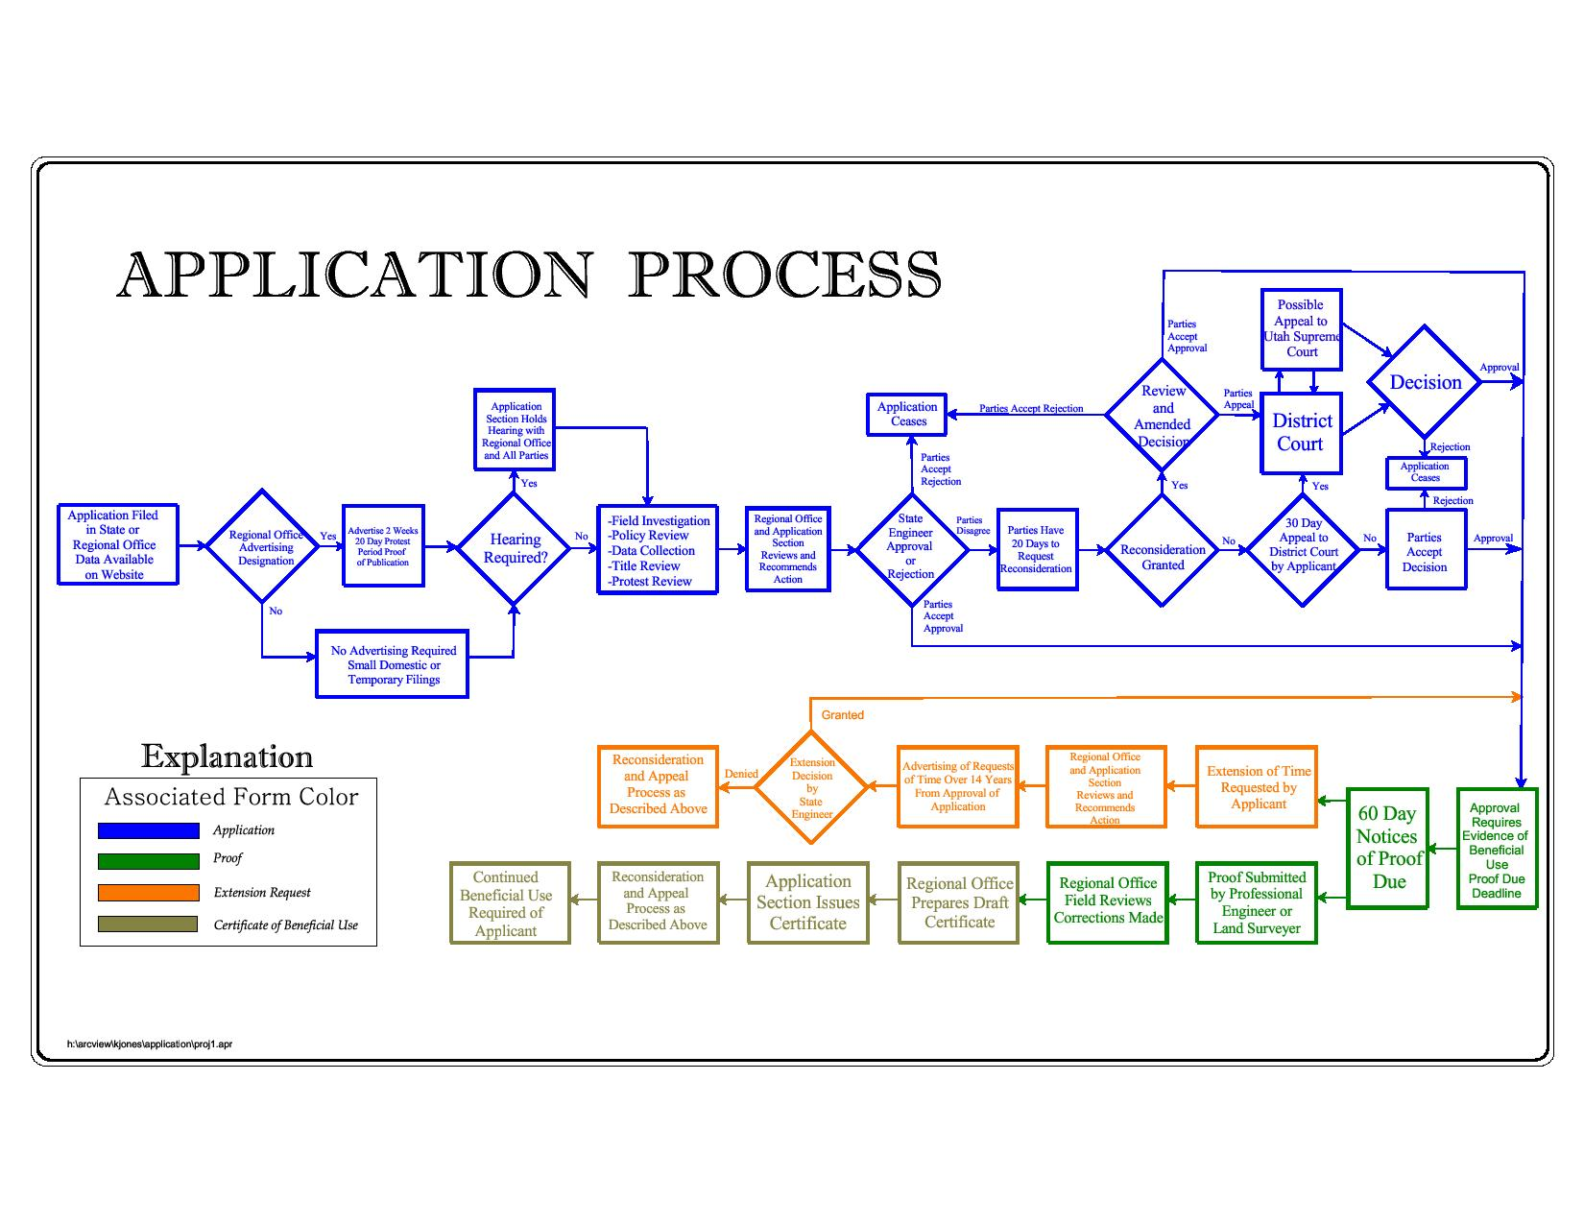
Notes:
What is a process without a flow chart?
This is the application process flow chart.
We will break up this process into three areas and discuss each area separately and completely

Slide 23
Notes:
This first part of the process is the Filing and Review of the Application

Slide 24
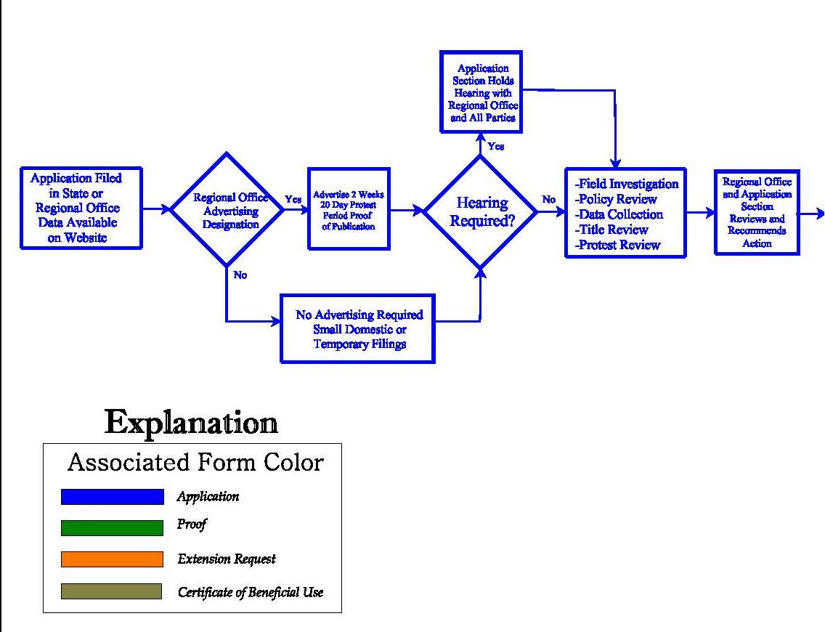
FILING AND REVIEW OF THE APPLICATION
Notes:
The first section shows:
the initial filing of the application
notifying the public
addressing any protests
reviewing the proposal and its relationship to other water rights
making an initial recommendation for the State Engineer’s action
Much of this activity heavily involves the regional offices of the Division and their personnel. The division has seven regional offices administering the different river basins in Utah.
Extra Notes:
This diagram showing the various steps in the application process is available at the Division of Water Rights Internet website at http://waterrights.utah.gov/wrinfo/policy/apschem.pdf. I have separated it into three parts for the purposes of this discussion.

Slide 25
PROCESSING APPLICATIONS AND STAFF CONSULTATIONS
Consultation has always been part of our process
73-3-3 amended in May 2015 to acknowledge that all have rights to consultation
In change statute, but we have applied it to all applications as we have in the past
Pre-filing consultations are non-binding and are not part of the permanent record
Notes:
Consultation has always been part of our process
Meet regularly with the public concerning water right issues
Helpful when gathering information for an application
Discussion and consultation with our office as always been welcomed
73-3-3 amended in May 2015 to acknowledge that all have rights to consultation
before filing the application in order to:
review the requirements of the change application process,
discuss potential issues related to the change,
and provide the applicant with information.
In change statute, but we will apply it to all applications as we have in the past
This is only in the statute for change applications, but we have applied it to all applications that we accept and process
Pre-filing consultations are non-binding and are not part of the permanent record
Statements made and information presented in the consultation are not binding on the applicant or the state engineer.

Slide 26
PROCESSING APPLICATIONS AND STAFF CONSULTATIONS
Post-filing consultations should be documented and made part of the record and available to ALL parties
No Ex Parte consultation or communication
  Information and documentations provided to all parties
Consultations can occur in Salt Lake office or in the regional offices
Notes:
Post-filing consultations should be documented and made part of the record and available to ALL parties
Especially when an application has been protested, it is important that all parties are informed
Not appropriate for an applicant or protestant to request discussion of the application without all the parties represented
No Ex Parte consultation or communication
Ex Parte means “For One Party”
We try to avoid consultation or communication after filing that would give the appearance of favoritism
Information and documentations provided to all parties
If discussions drift into specifics of an application, our staff is directed to and will document discussion and have provided letters to parties who were not present during the discussions
Consultations can occur in Salt Lake office or in the regional offices
Consultations are not limited to just meeting with our staff in the Salt Lake offices
They can take place in one of our five outside regional offices
The staff in the regional offices are our local experts for the areas they cover

Slide 27
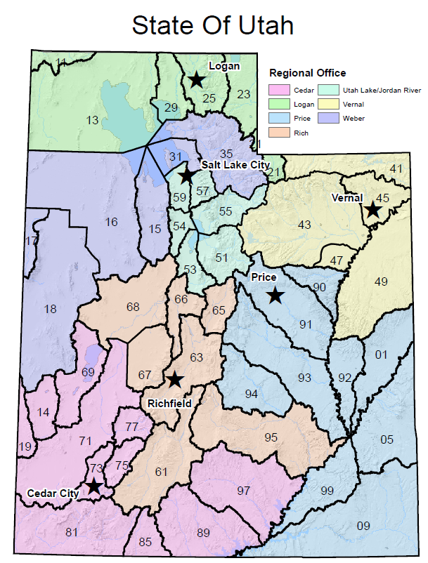
FILING AN APPLICATION
By mail or visit
Fee required
Establishes initial priority
Placed on the New Filing List
Notes:
Applications can be submitted by mail or by visit to division offices.
They must be acceptably complete before they can be designated as officially filed.
A filing fee is required based on the amount of water involved. The minimum amount is $150.00 and must be provided via check, cash or by credit card if paying in person in the Salt Lake Office.
The date that the application is accepted as officially filed establishes the initial priority of the application.
The application is numbered, jacketed, scanned, and placed on the division’s website new filing list.
The water right number places the application in a specific drainage area so that it can be related to other rights in the same hydrologic resource.
The map shows the various drainage areas and the regional offices that oversee Division of Water Right activities in these drainages.
How to file an application will be covered in another section….this is only covering the process

Slide 28
ADVERTISING DESIGNATION
Newspaper with local circulation
  Public notice of applications being filed
Regional office action
Waiving advertising
  Temporary applications are usually not advertised
  Advertising for small domestic filings can be waived in some areas
  Application to move point of diversion less than 660 feet, the advertising can be waived
  Can still be protested if not advertised
Notes:
After an application is determined to be acceptably complete it is considered officially filed; the Region Office will then designate the application to be advertised to give public notice of the application
Applications are generally published in the legal notice section of the newspapers with local circulation in the area of the proposed diversion point(s) and place(s) of use.
More complex proposals may be published in more than one newspaper.
Applications are designated by regional office personnel as complete and requiring advertising.
Some small filings, temporary applications, or limited changes of point of diversion may have advertising waived.
If the advertising is waived, it can still be protested (and we will discuss protests soon).
All new applications (advertised or not) are put on the new applications list and can be reviewed there through the Division’s website

Slide 29
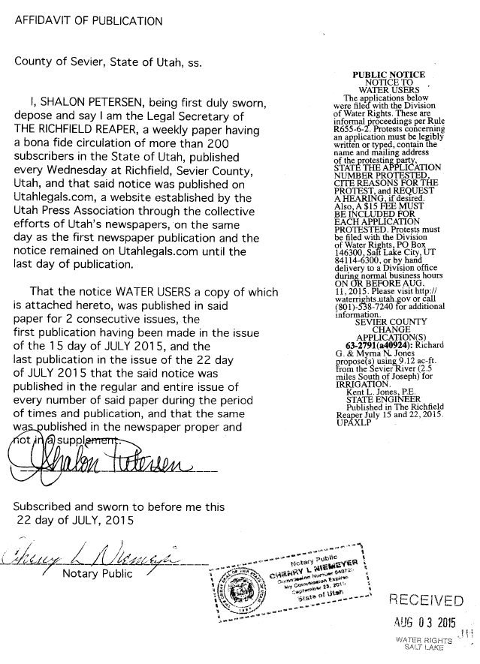
ADVERTISING PERIOD
Permanent filings
  Once a week for two weeks
Temporary filings
  Not advertised
Notices drafted by division
Proof of publication
  From Newspaper
  Required to move forward
Notes:
Permanent filings are advertised twice with a one week interval between publications;
there is a statutory 20-day protest period following the second publication for informal proceedings and a 30-day period for formal proceedings.
All proceedings before the State Engineer are informal unless otherwise designated.
Temporary filings (for projects lasting only one year) are advertised at the discretion of the regional engineer based on experience with water rights concerns in the area of the proposal and whether there is potential impairment of other water rights or not. If advertised, publication generally occurs once with a following protest period of ten days.
After advertising, the involved newspapers provide proof of publication documents to the State Engineer. The State Engineer must receive this proof of publication before further action can be taken. The newspaper bills are then paid by the division.
Extra Notes
Notices to water users are drafted by the applications/records section and contain information as directed by statute. They are e-mailed to the appropriate newspapers, and the applications are placed on the division’s website advertising list. Advertising is generally placed in the legal notices section of the newspaper. Many local papers are weekly editions which circulate on Wednesday or Thursdays. For larger daily newspapers, the notices occur on Thursday editions.

Slide 30
PROTESTS
Filed by interested or affected parties
Must provide water right/application number that is being protested
Timeliness, within 20 days of advertising
Protestant information (name and address)
Relevant information
Protestant standing
Filing fee $15.00 per protestant(s)
Notes:
Protests are filed with the division by interested parties; generally these are other water users in the area who believe their supply may be impaired by the new project or affected in some way.
However, sometimes title or property access or environmental concerns may be the issues raised.
Protests should NOT be based on how you like or dislike your neighbor who is filing the application
A protest should be related to how the protestant would be affected if the application is approved and not the applicants questionable parentage or genealogy
It really gets down to statutory requirements for approval and why the application shouldn’t be approved. Protests should focus on that kind of discussion.
General concerns about lessening water supplies throughout a basin or encroaching urbanization and its potential effects or need for a water management plan in a valley would be considered as correspondence to the division and not as a protest to any or all new filings in the area.
A protest must:
Indicate the water right(s)/applications being protested.
Must be timely submitted within the appropriate period (usually 20 days after the last day of advertising) and be considered timely in order to establish legal standing of the party in subsequent application procedures and potential court involvement. Must be submitted to one of the offices of the Division of Water Rights with the proper filing fee, by the last day of the protest period….post mark dates do not count.
The protest must provide the name and address of each protesting entity and be signed by the protesting party or its authorized representative or power of attorney.
In addition to the signature, it is important to print the name of the protestant so that we know exactly who is submitting the protest. If the name and address aren’t readily readable, standing as a legal protestant may be jeopardized.
There is filing fee of $15 per protestant. If a group of individuals sign a protest letter, but only pay $15, then usually the first person on the list will be considered to be the official protestant. If all individuals want to be listed as a protestant, then each will need to pay the fee. A husband and wife may be both listed as a protestants with only one filing fee.
The protestant may indicate whether or not they wish a hearing to be held. May only want to submit letter of concern to address specific issues with an application
The only exception on protests is with Diligence Claims. Any official protest contesting the validity of a diligence claim MUST be filed with the appropriate District Court where the claim has been filed.
Extra Notes:
Some people who protest applications are recent applicants themselves. Once they have their filings approved, they suddenly turn somewhat environmentalist. Even though their application was approved, they don’t think anyone else should have their proposals authorized. It’s interesting to talk through the situation of why it is okay for them but not for others. It is also interesting to see how much more water use by others will impair rights when such use is made by people without local roots as compared to those who do have a history in the area.

Slide 31

HEARINGS
Generally held locally
Usually held to address protest or to gather additional information
Usually informal proceedings
May be waived
Recorded
Notes:
Hearings are generally held in the county seats of the counties where water is to be diverted and used. However, if parties agree to some other location for greater convenience or if no facilities are available to accommodate meetings, the locations may be in other towns or in conference rooms at division offices.
The usual schedule is to try and visit each county several times each year or as needed; the dates are about six months apart. There may be several hearings per trip.
Generally hearings are held to address protests, but they can be held to gather additional information if the applicant’s proposal is not sufficiently clear.
If parties desire to have a hearing before the State Engineer, they should request the hearing. The determination as to whether a hearing should be held or not is at the discretion of the State Engineer.
Almost always, these hearings are informal proceedings.
The Assistant State Engineer for Applications and Records and the regional office personnel are hearings officers who direct the meetings.
Applicants are asked to provide information in support of their filings. Protestants discuss their concerns. Other interested parties may provide additional information. In some cases, hearings can also involve witnesses, consulting experts, attorneys, etc., especially in large or complex projects or where property, title, or other legal issues are involved or geologic and engineering information is helpful.
Hearings are recorded, and the proceedings are made available on the division’s Internet website.
Hearings may be waived if sufficient information is available and/or if parties indicate that no hearing is needed.
Once the hearing is completed, the responsibility for the processing of the water right is assigned to the regional office to perform a review of the file.
Information gathered in hearings is used in the decision making process for the application.

Slide 32
REGIONAL OFFICE REVIEW
Regional engineer and staff assist State Engineer in administering water rights in particular regions of the state
Examine all available information
  Field examinations
  Policy analysis
  Scientific reports, etc.
Consider protest concerns
Recommend decision to State Engineer
Notes:
This review by regional office personnel can involve:
possible field inspections
policy analysis
study of available hydrologic information including scientific reports and water measurements and data on other rights in the area
examination of title documents
possible requests for further information from parties.
The regional staff may discuss relevant issues with the State Engineer and the Application/Records staff and may involve staff from the Attorney General’s office to help formulate recommendations.
Personnel also assess the concerns raised in any protests.
This process results in recommended action on the application that is given to the State Engineer

Slide 33
Notes:
We will now discuss the second part of the application process.

Slide 34
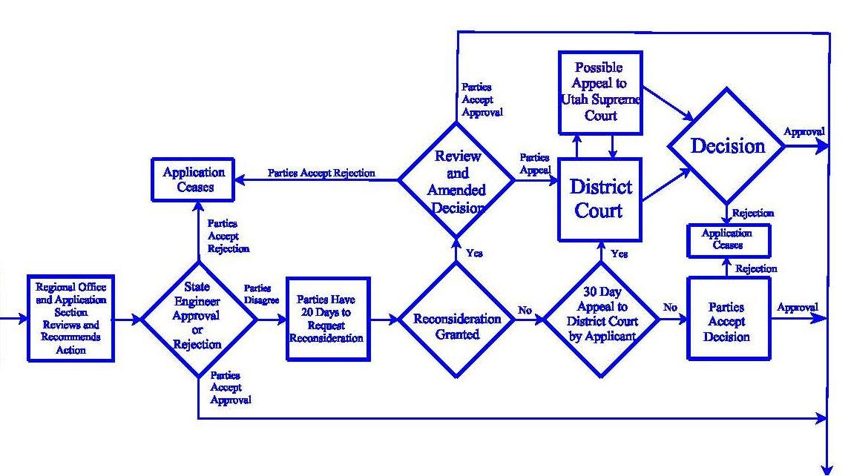
DECISION ISSUED
Notes:
In this part of the process, a Decision has been issued as to the status of a filed application.

Slide 35

RECOMMENDED ACTIONS
Approval
Rejection
Deferral
Notes:
There are three actions that the Region Office could recommend to the State Engineer, they are: Approval, Rejection or Deferral
If approval is recommended, an initial draft of the order for this action is prepared for a final review and State Engineer’s signature.
Approval can only be considered if the application meets statutory criteria.
If the application doesn’t meet statutory requirements and rejection is recommended, an initial draft of the order for this action is prepared for a final review and State Engineer’s signature.
If deferral is designated, action on the application is held pending until further information is received. This could involve the applicant’s request for additional time to submit supporting data or address other legal issues, the desire by interested parties to negotiate among themselves to address concerns, or actions concerning other rights or studies or policies in the area need to be addressed before a decision can be made.
Once the regional office has completed their recommendations, the application is designated to be reviewed by the Applications/Records section.
Extra Notes:
Section 73-3-8 of the Utah Code states that for applications to appropriate, there must be unappropriated water in the proposed source, the proposed use will not impair existing rights or interfere with the more beneficial use of the water, the proposed plan is physically and economically feasible and would not prove detrimental to the public welfare, the applicant has the financial ability to complete the proposed works, the application was filed in good faith and not for purposes of speculation or monopoly, and the application will not unreasonably affect public recreation, the natural stream environment, or prove detrimental to the public welfare. Concerning change applications, the same criteria must be applicable, but under Section 73-3-3 of the Utah Code is a further direction that the change may not be made if it impairs any vested right without just compensation.

Slide 36
APPROVAL CRITERIA (73-3-8)
Unappropriated water in source
Will not impair existing rights
Physically and economically feasible
Not for purposes of speculation or monopoly
In the public interest / welfare
Notes:
As noted earlier, approval criteria is governed by statute. These are some of the criteria outlined in statute that applications must meet in order to be approved.
These will be covered in more detail in a later presentation so we will not go over them here.

Slide 37
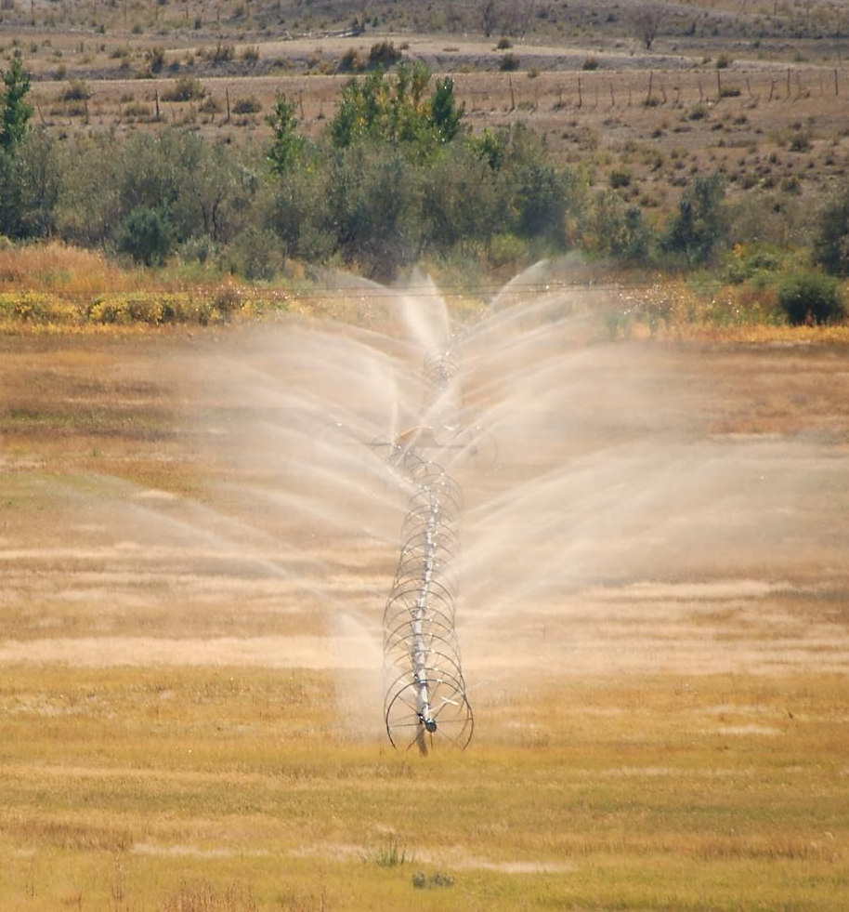
APPLICATIONS/RECORDS
SECTION REVIEW
Recommendation from regional office is reviewed for completeness, accuracy and consistency
Legal counsel
Final draft to State Engineer
Notes:
The initial draft of the order for the State Engineer is reviewed by the staff in the Applications and Records section for completeness, accuracy, and consistency with statutes, division practices and policies
More complex issues may be reviewed with staff of Attorney General’s office.
Regional offices may be contacted with questions, suggested language, etc. and additions or amendments are made.
Any corrections are made and then the final draft is submitted to the State Engineer.

Slide 38

STATE ENGINEER’S ACTION
Reviews final draft
Signed orders sent to all parties
Approval listed on Division of Water Rights website
  www.waterrights.utah.gov
Rejection terminate filings
Scanned documents on website
Notes:
The final draft order is given to the State Engineer for his review:
The State Engineer may require more information and changes to the order.
The draft is then returned to involved staff for further review and any possible amendments.
If the final draft order is signed, copies are sent to all involved parties (applicants, protestants, etc.) on the same day of signature.
Approval information is placed on the new approvals list on Internet website.
Under Section 73-3-10 of the Utah Code, if the application is approved, the applicant is authorized to proceed with construction of necessary works (subject to any conditions set forth in the State Engineer’s order) and to take any steps required to apply the water to use named in the application (subject to any other permits required such as rights of way, local health and building codes, etc.).
Rejections result in the termination of the application. The applicant cannot take any steps toward the prosecution of the proposed work or the diversion and use of the public water under the application.
The orders are scanned on the water right computer file for view at the Internet website.

Slide 39
20-DAY RECONSIDERATION PERIOD
Request changes to order
Parties with legal standing
Must be timely
If granted, order is rescinded
If denied, order remains in place
  No action on reconsideration means denied
  Can appeal to District Court
Notes:
20 Day Reconsideration Period
All parties with legal standing (applicants and timely protestants) can request reconsideration if they believe the decision was arrived at incorrectly or that a condition or explanation contained in the order is not adequately or correctly addressed or that an important issue is not covered.
The request must be filed within the twenty-day period.
If granted, the decision under the order of the State Engineer is rescinded and reviewed.
A later amended order is issued addressing the reconsideration request.
The amended order may change requirements or quantifications in the first decision.
It may indicate that review of the additional information or concerns from the reconsideration request does not indicate a need to change the original decision and thus the language in the amended order is essentially the same.
In some unusual cases, the information supplied via the reconsideration request could alter negatively or positively the ability of the application to meet statutory criteria, and the original decision could be reversed.
If significantly altered, the amended order would once again be subject to reconsideration and appeal. If not altered, the amended order would no longer have provisions for further reconsideration.
If the parties do not agree with the amended order, timely court appeal could be pursued.
If a request for reconsideration is denied, the decision under the original order remains in place. Parties not agreeing with the original order would then pursue timely court appeal.
The State Engineer receives approximately 100 requests for reconsideration each year.

Slide 40
30-DAY APPEAL PERIOD
Appeal to District Court
  De Novo review
Parties with legal standing
Must be timely
  30 days of original order
  30 days of a denied reconsideration
Judge can uphold, deny, or amend the order
Utah Supreme Court
Notes:
30 Day Appeal Period or De Novo Review
Parties with legal standing can appeal the State Engineer’s order to the District Court having jurisdiction in the area of the water right.
Appeal must be timely. The appeal must be made within thirty days of the issuance of the original decision or thirty days after the request for reconsideration is denied or thirty days after the amended decision is issued after granting of reconsideration.
A De Novo review can be done by the District Court. Which means that they will start from the beginning and review the application, and the whole application process is done by the District Court.
De Novo Review is NOT a process to find fault in the State Engineers decision or the process whereby that decision was made; but rather it is a new look at the application and how it applies to statute and policies and this new review is done by the court, rather than the State Engineers Office.
The District Court can:
Uphold the original order
Deny the appeal or deny the order
Amend the Order
It can and has been remanded back to the State Engineer to look at it again or to try again
If parties do not agree or like the decision issued by the District Court, they can still appeal it to the Utah Supreme Court

Slide 41

APPROVED APPLICATIONS
Notes:
I think this is what the State Engineer thinks each time he approves an application

Slide 42
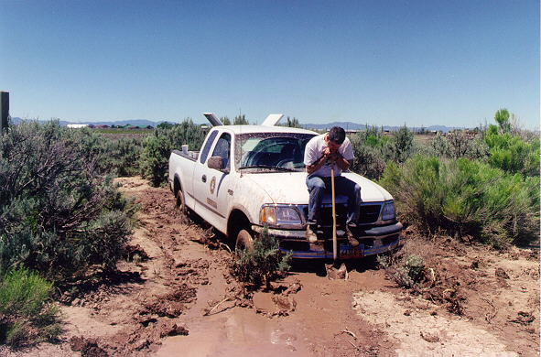
Consider yourself delayed, not stuck
Notes:
A few lessons learned that day
Never let all four wheels go into the mud
Sometimes the mud is deeper than it appears…even on a nice clear day
Do not trust a Ford in the mud
Know who to call to get you out…even if they will hang it over your head for the next 20 years
Consider yourself…delayed…not stuck
And never let your co-worker bring a camera to field to document your “delays”
Applying this to water right applications
We get a lot of inquiries as to the status of an application
If you have any questions on an application (and may feel that is stuck in the process), no matter where it is in the process, you can call the regional offices or the public inquiry section
If there are problems with the water right or the application, feel free to contact our office and we will try and give you direction to move the application forward
In most cases, the help we give, we will not hang it over your head…for very long
We really do try to do our best to not have any “Stuck” applications…but we are governed by specific statutes and administrative rules as we review and process applications; There may be legal considerations and proceedings that would prevent an application to be approvable

Slide 43
QUESTIONS?

