Slide 1

Cedar Valley Public Meeting
December 8, 2016

Slide 2
Topics
Safe Yield
Solutions
Website Resources
Water Rights Policy

Slide 3
Safe Yield

Slide 4
Utah Code Section 73-5-15
(1) As used in this section:
  (a) “Critical management area” means a groundwater basin in which the groundwater withdrawals consistently exceed the safe yield.
  (b) “Safe yield” means the amount of groundwater that can be withdrawn from a groundwater basin over a period of time without exceeding the long-term recharge of the basin or unreasonably affecting the basin’s physical and chemical integrity.

Slide 5
Utah Code Section 73-5-15
(2)(b) The objectives of a groundwater management plan are to:
  (i) limit groundwater withdrawals to safe yield;
  (ii) protect physical integrity of the aquifer; and
  (iii) protect water quality

Slide 6
Safe Yield
Safe Yield: 21,000 AF/yr
Current Well Depletion:
28,000 AF/yr
Potential (approved) Well Depletion: 50,000 AF/yr

Slide 7
Sub Basins
Should valley be split into smaller sub-basins for safe yield?
What boundaries could be used?
What would the safe yield amounts for those sub-basins be?

Slide 8
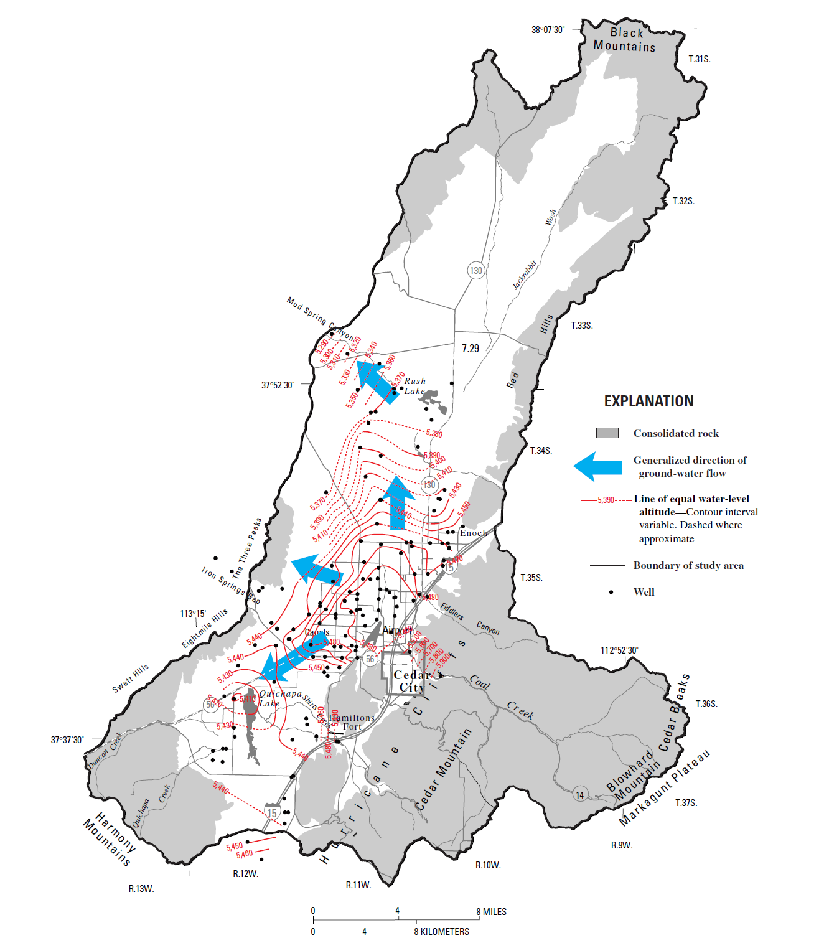

Slide 9
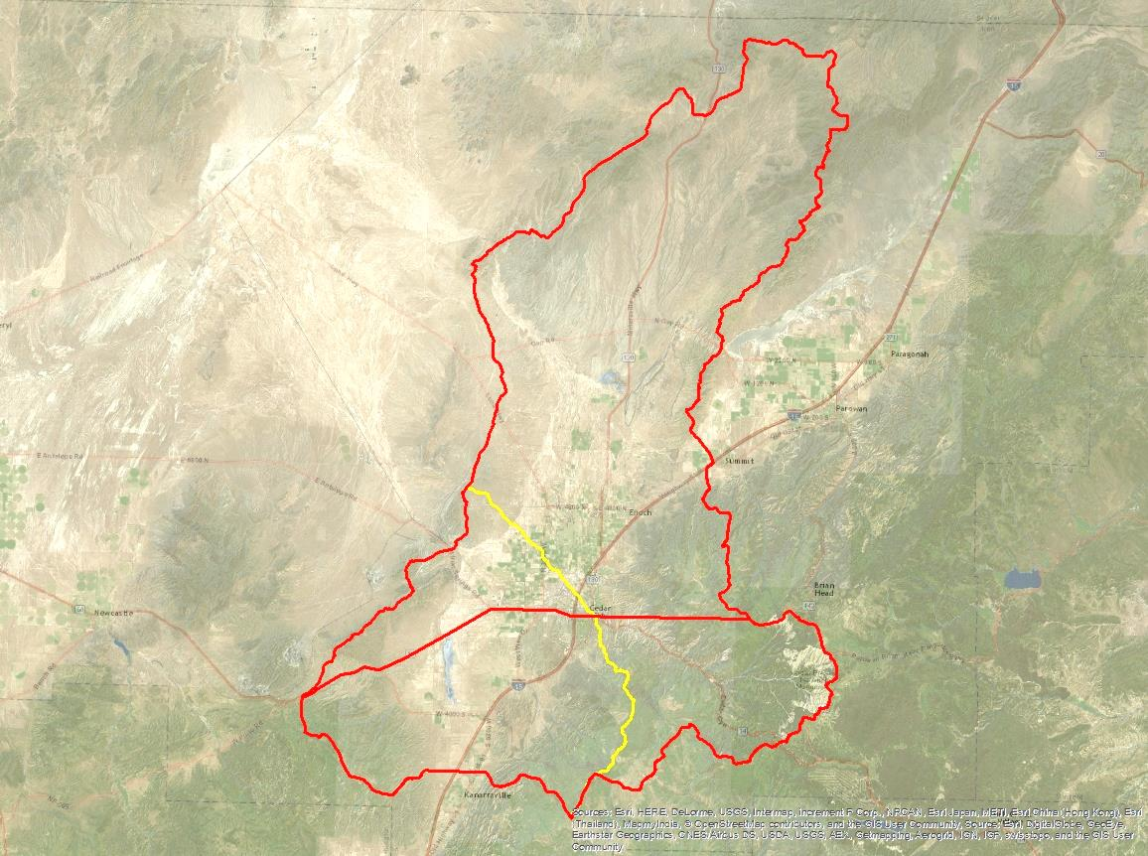
Priority Regulation with
Sub-Basins
Current change policy boundary – Hwy 56
Watershed boundary

Slide 10
Priority Regulation with Sub-Basins
Higher levels of uncertainty in determining safe yield for individual sub-basins
Hydrologic connection
Water rights ultimately affected by regulation would be the same without sub-basins or with either of the sub-basin divisions considered
Regulation based on entire valley rather than sub-basins

Slide 11
Potential Solutions

Slide 12
Approaches
Augment groundwater supply
Decrease depletions
Groundwater management plan
  Priority regulation
  Other voluntary arrangements

Slide 13
Utah Code Section 73-5-15
(3)(b) The state engineer shall base the provisions of a groundwater management plan on the principles of prior appropriation
(4)(a)(iii) If groundwater withdrawals exceed safe yield, the state engineer shall regulate groundwater rights based on the priority date of the water rights, unless a voluntary arrangement exists

Slide 14
Utah Code Section 73-5-15
(4)(b) For critical management areas, the State Engineer shall allow for gradual implementation of the groundwater management plan
(4)(c) but may consider voluntary arrangements

Slide 15
Priority Regulation Option
List water rights and associated depletion amounts in order of priority
Create a schedule of when water rights will no longer be distributed groundwater
Start with most junior rights until depletion amounts for remaining rights equal safe yield

Slide 16
Website Resources

Slide 17
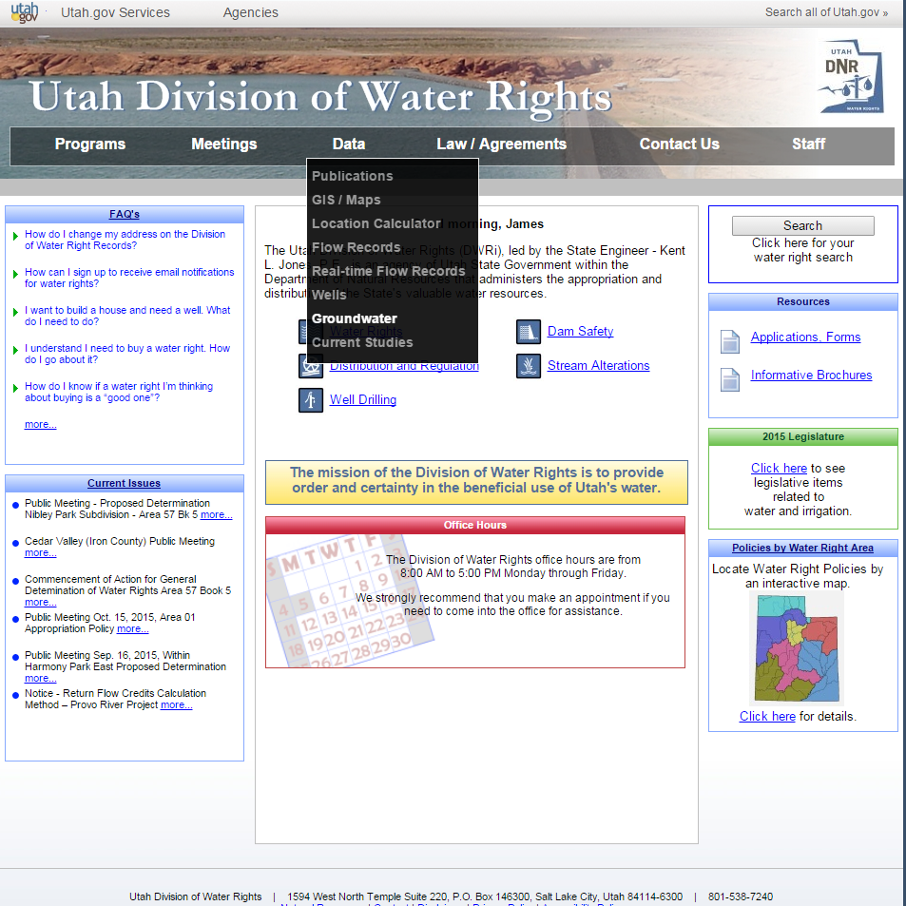

Slide 18
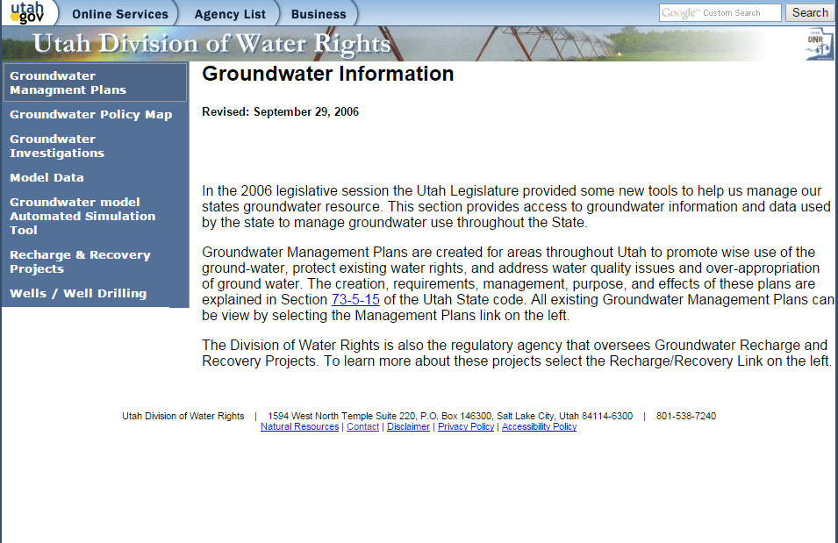

Slide 19
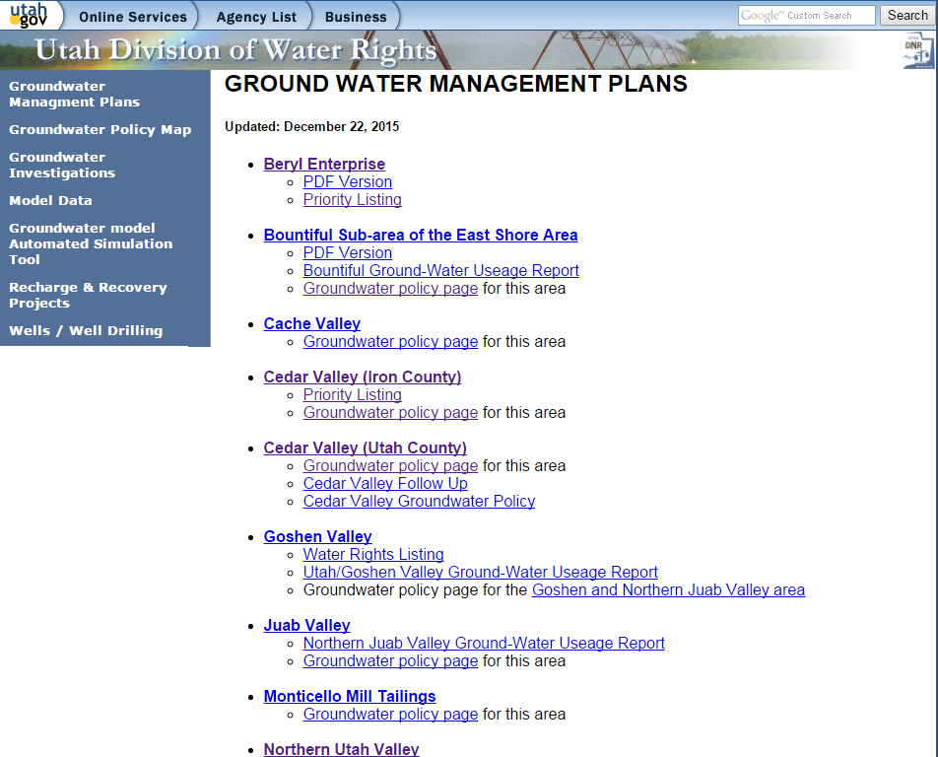

Slide 20
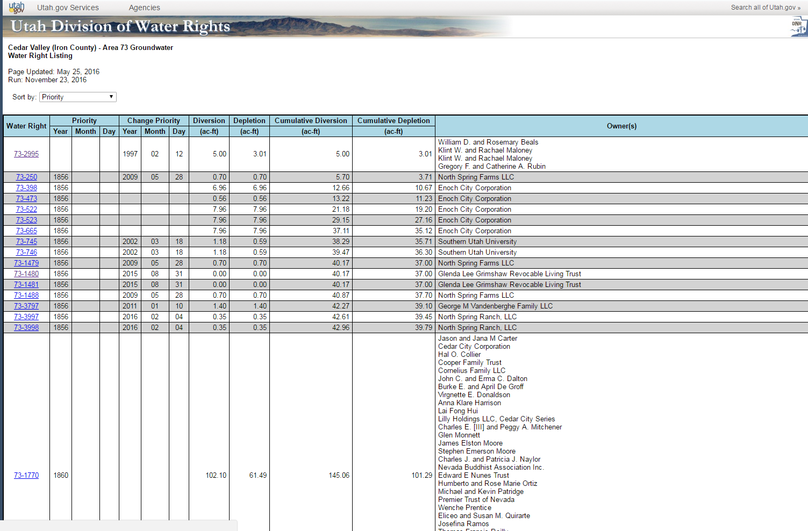

Slide 21
Water Rights Policy

Slide 23
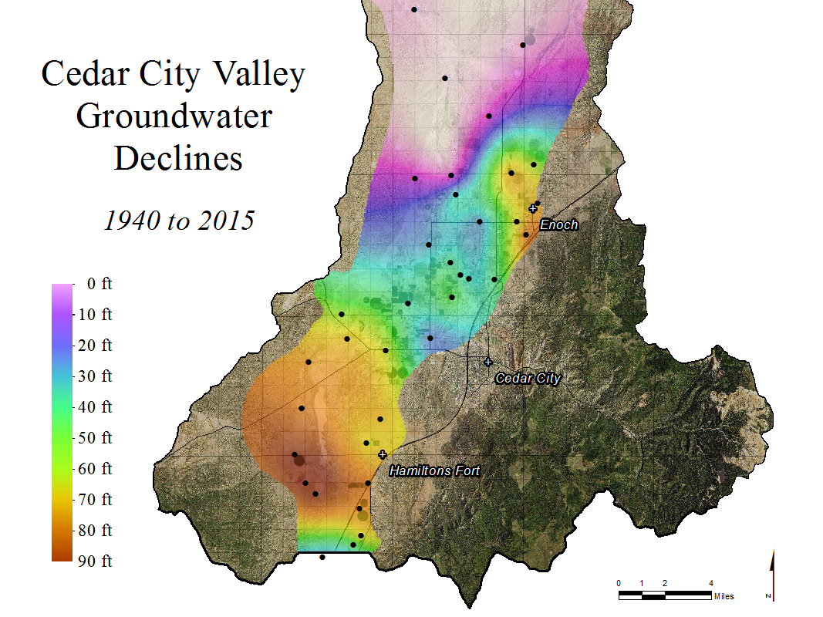

Slide 24
Water Rights Policy
Changes to policy on future change applications being considered:
  Rescinding current policy of not allowing change applications across Hwy 56
  New policy restricting changes to areas of greater groundwater level decline
    Quichipa Lake, Enoch – what would we use for boundaries?
    Should we continue to allow changes to restricted areas for small domestics (1 family, 10 ELUs, 0.25 ac)?

Slide 25
Summary

Slide 26
Summary
Water Rights Policy (changes) – Should current policy be modified? Should policy be implemented to restrict changes to areas of greater water level decline?
Safe Yield – 21,000 AF
Current Depletion – 28,000 AF
Regulation options–
  State Engineers Role(Priority, implemented gradually, identified entire basin)
  Voluntary arrangements

Slide 27
Questions/Comments
Send written comments to:
Utah Division of Water Rights
646 North Main St
PO Box 506
Cedar City UT 84721-0506
waterrights@utah.gov
60 day comment period

