Slide 1
Utah Division of Water Rights
Advanced Water Right Topics
Rural Water Training—April 2016
John Mann, P.E.
Assistant State Engineer
June 21, 2004

Slide 2
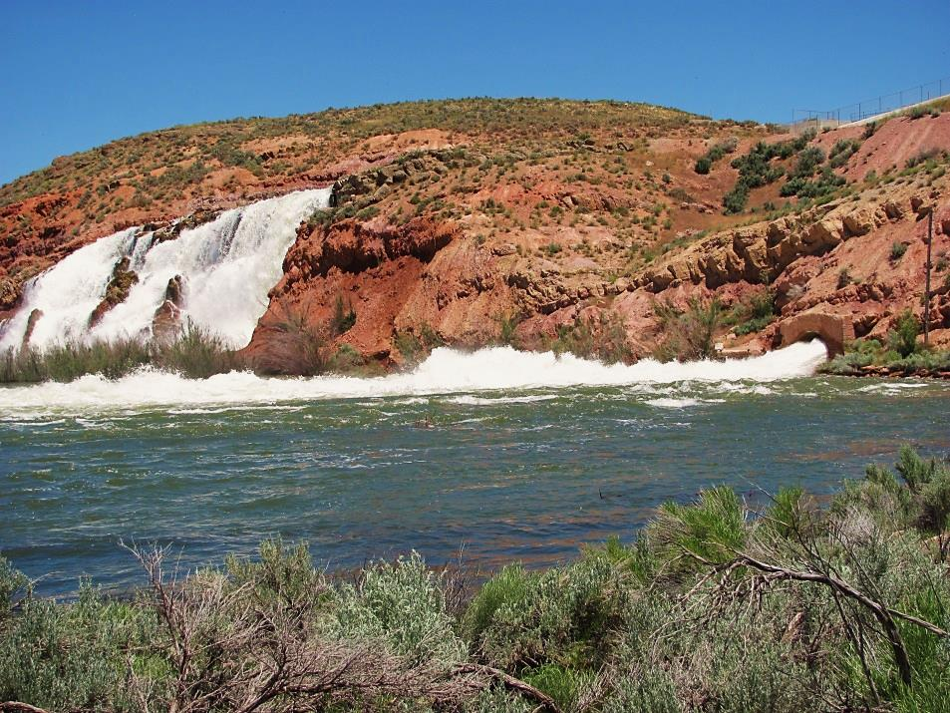
Advanced Water Right Topics
Not the day-to-day

Slide 3
Topics to be Covered:
Recap of Water Right Basics
Forfeiture
Quantity Impairment
Shares vs. Rights
Water Reuse
Groundwater Recharge and Recovery

Slide 4
Basics - Refresher
Acre-foot is a measure of volume. It is 1 foot in depth of water on 1 acre of land.
CFS is a measure of flow. It is 1 cubic foot of water moving at 1 foot per second.
Duty is an estimate of the amount of water reasonably required for specific purposes such as irrigation or domestic use.
State Engineer is the individual who is responsible for administering water rights. He is the director of the Utah Division of Water Rights (sometimes also referred to as the State Engineer’s Office) and is appointed by the Governor for a four year term.
Aquifer is a below ground geologic structure containing water.
All water, whether above ground (in streams and springs) or below ground in aquifers, originates as precipitation.

Slide 5
How are Water Quantities Measured?
UCA 73-1-2
Flow is measured in cfs.
Volume is measured in acre-feet.
How does this come into play in water rights?
Why is it important to consider both flow and volume?
What if the right is for an ephemeral stream?
Is it feasible to use --
.5 cfs to irrigate 10 acres?
.5 cfs to irrigate 200 acres?
Notes:
1 cfs flowing for 24 hours will deliver a volume of approximately 2 acre-feet.
As we go through this training other presenters will talk about issues involving flow, volume and supplemental rights. EG if you have a water right that has a flow of .5 cfs and the use of water is to irrigate 10 acres, can it be done? What if the use is 200 acres? .5 cfs x7/12x2x365= 200 acre-feet +/-. Using a 4 af/ac irrigation duty .5 cfs can irrigate about 50 acres. Don’t think that a right for irrigation with a flow rate has the ability to divert a volume = the flow rate x 2 x 365. Account for the seasonal nature of the use.

Slide 6
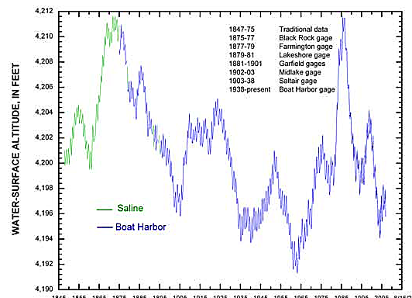
Great Salt Lake Water Levels Through 2008
Notes:
Why are water rights important?

Slide 7
Beneficial Use is the Measure and Limit
of All Water Rights. UC 73-1-3
All water rights have:
a point of diversion,
a source of supply,
use(s) of water,
diversion and depletion,
a priority,
a period of use, and
an owner(s).

Slide 8
Change Applications:
UC 73-3-3 and 73-3-3.5
A Primer
Permanent – for an indefinite length of time
Temporary – for a maximum of one year
Point of Diversion
Place of Use
Use
Give up one to Get one.
Notes:
Permanent change applications usually seek to facilitate new development of some sort or a change to municipal use.
Temporary changes are usually for activities such as construction.
Point of Diversion
a) surface to underground issues.
b) ephemeral surface source.
c) impacts to other rights.
d) Division policies.
Place of Use not usually an issue but it could be if trying to establish a right within the service area of an irrigation company or city.
Use
a) Diversion and depletion. No increase with proposed uses.
b) Period of Use. Going from part year to full year use?
c) Type of right. Perfected vs unperfected.
d) Priority of the right.
e) Sole supply or supplemental?
f) Nonuse?
Title to the right. Signatures of all owners. Trust deed issues.
Approvals by other entities mainly if a well is to be used for a public water supply – Drinking Water.

Slide 9
Diversion and Depletion
Diversion is the amount of water that can be taken from a source and applied to beneficial use. It can be limited by either the flow (by cfs) or volume (acre-feet). The diversion of water and the beneficial use are limited by the water right. When a diversion amount is determined for change applications, they are usually based on a duty for the use(s).
Depletion is the amount of water consumed in the process of
beneficially using the water. It is considered lost to the system.
The difference between the diversion and depletion is returned to the system and should be available to other users.
Notes:
Either amount can limit a water right. Even for municipal uses on change applications both the diversion and depletion amounts for the rights being changed are considered in approval of the change application.
Example? Haircut?

Slide 10
DIVERSION DUTIES OF WATER
Domestic Use
0.45 acre-foot per residence
0.25 acre-foot if part time (cabin)
Stockwatering
0.028 acre-foot per elu
(25 gallons per day for 365 days)
Irrigation
Ranges from 3 – 6 acre-feet per acre

Slide 11
DEPLETION VALUES
Domestic
20% = 0.09 ac-ft
Stockwatering
100% = 0.028 ac-ft
Irrigation
Approximately 50%
www.waterrights.utah.gov/automm/calculator.asp

Slide 12
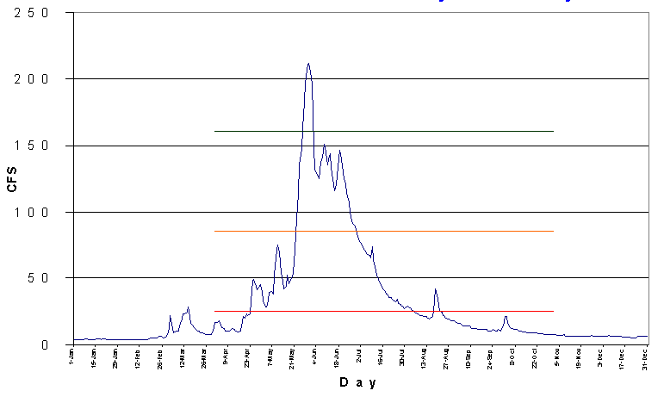
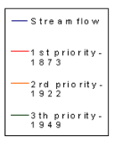
Water Distribution By Priority Date

Slide 13
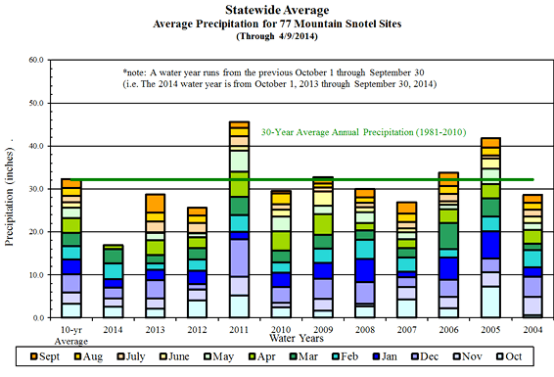
Average Precipitation for MOUNTAIN sites

Slide 14
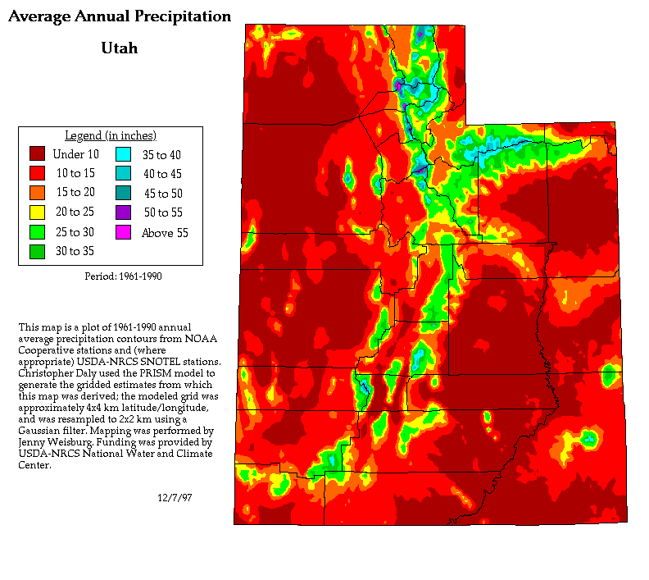
Notes:
The majority of the state only gets around 10 inches of precip each year. The locations that get more are those at elevation and near the GSL.

Slide 15
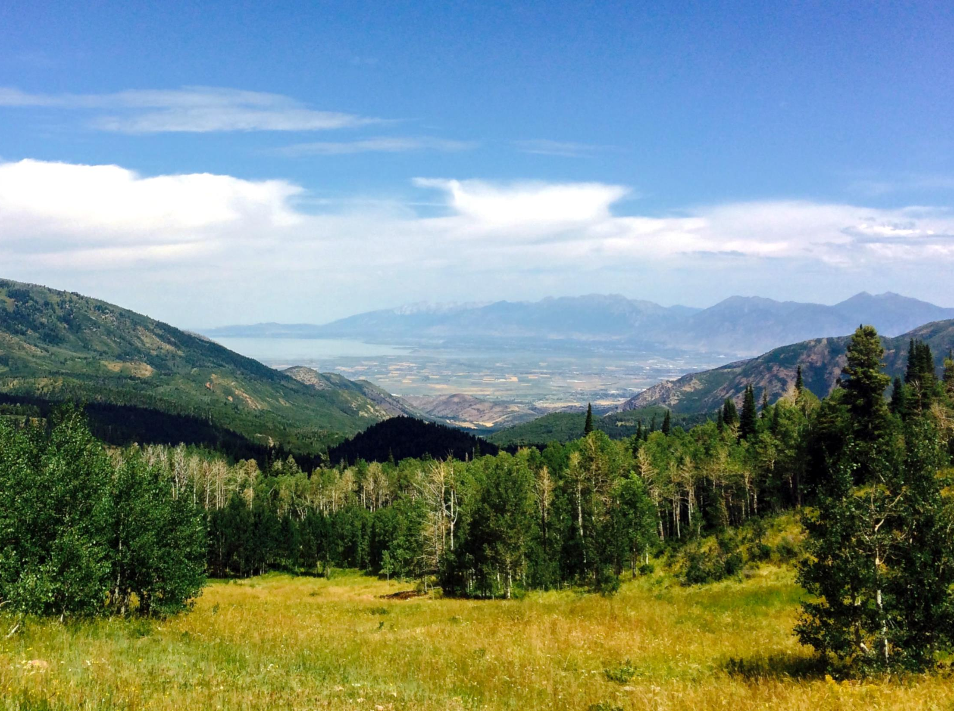
Forfeiture
What it is, and what it means

Slide 16
Forfeiture
UC 73-1-4(2)(a) When a water user ceases to use all or a portion of a water right for a period of seven (7) years, the portion not used is subject to forfeiture…
The State Engineer does not declare water rights forfeited.
Forfeiture is an adjudicative process in which an action is brought by a party, usually a water user but it could also be the state engineer, in District Court and the judge decides if a right has been forfeited due to nonuse.
During general adjudications, rights can be recommended to the court to be disallowed. After a decree is issued, the net effect will be the same – the right will be invalid.

Slide 17
The judicial action required to forfeit a right must be filed within15 years of the latest period of nonuse of at least 7 years.
Adjudication – A decree bars claims of forfeiture for prior nonuse for rights determined to be valid in the decree. Nonuse after the decree is fair game.
This section of the Utah Code applies if the water runs to waste or if it is used by others without right.

Slide 18
This Section Does Not Apply If:
There is a lease or other agreement with the appropriator (a change application is needed);
The land is in a government fallowing program;
For periods of time when the source of supply does not provide adequate water;
For the periods of time that the user is not entitled to divert water due to priority restrictions;
The water is used in an approved ground water recharge project; or
If there is an approved change application on the right.

Slide 19
Forfeiture, Continued
73-1-4(2)(a) …Unless the appropriator or the appropriator’s successor
in interest files a nonuse application with the state engineer.
Nonuse applications can be filed by the appropriator or the appropriator’s successor in interest on all or a portion of the right.
A shareholder may file a nonuse application on the water represented by the stock owned after giving written notice to the company.
Information required on a nonuse application form:
Name and address of the applicant;
a description of the water right (point of diversion, place of use, and priority);
the quantity of water;
period of use;
the extension of time sought;
a statement of the reason for nonuse;
and such other information required by the state engineer.

Slide 20
73-1-4(4) The state engineer shall grant a nonuse application…if the applicant shows a reasonable cause for nonuse.
A reasonable cause could be:
Demonstrable financial hardship or economic depression;
Water conservation or efficiency practices or a groundwater
Recharge / recovery program;
Operation of legal proceedings;
Water held by a public water supplier for the reasonable future needs of the public;
Loss of capacity due to deterioration of the water supply or
Delivery equipment if a plan to resume full use of the water by replacing, restoring or improving equipment.

Slide 21
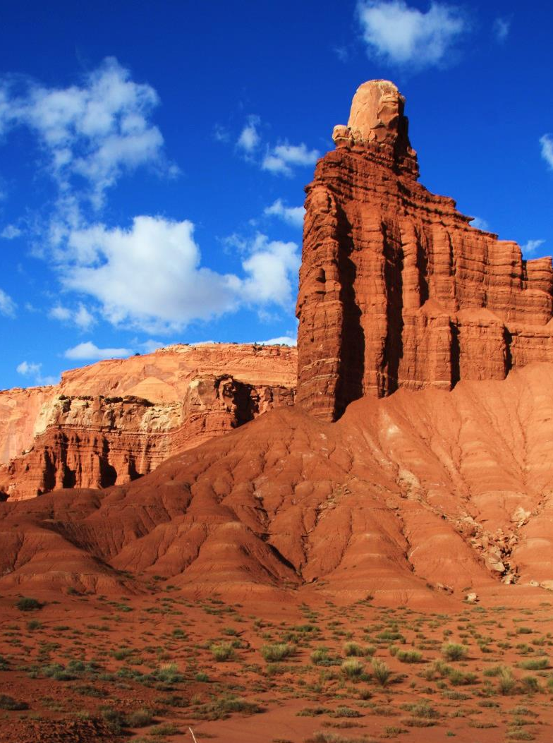
Nonuse applications may be either approved or rejected by the State Engineer.

Slide 22
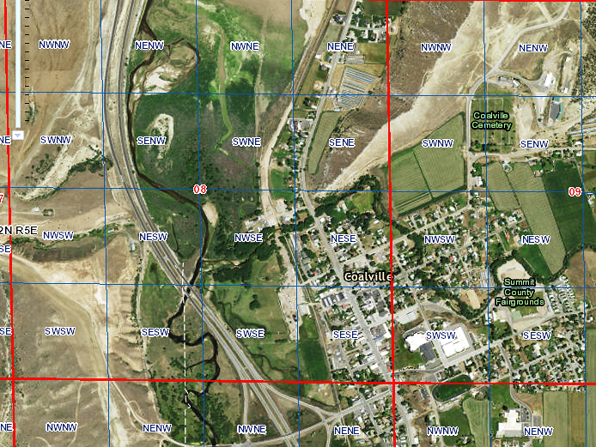

Slide 23
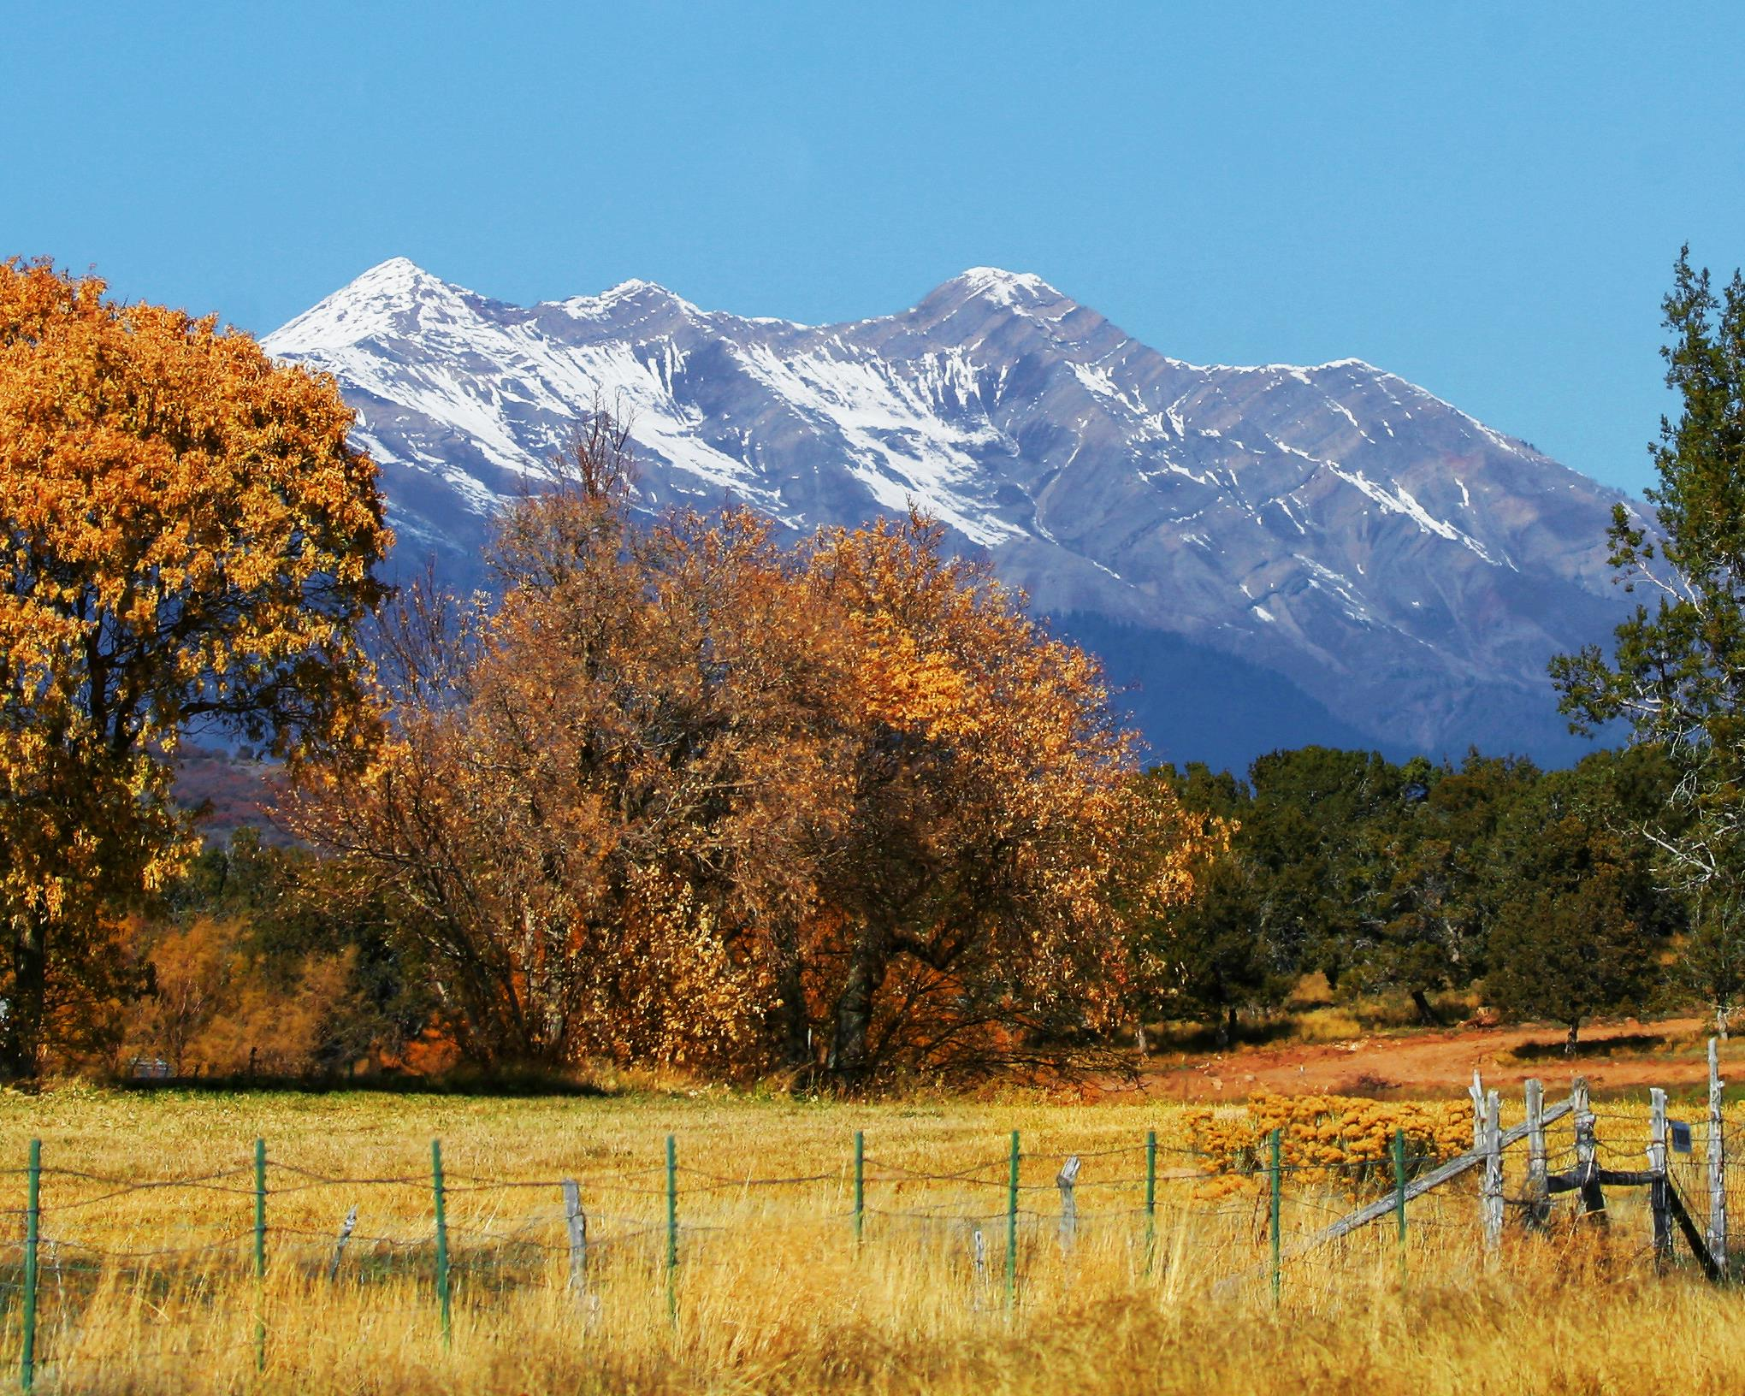
Quantity Impairment
Will anyone notice?

Slide 24
Quantity Impairment 73-3-3(1)(c)
(i) "Quantity impairment" means any reduction in the amount of water a person is able to receive in order to satisfy an existing right to the use of water that would result from an action proposed in a change application, including:
(A) diminishing the quantity of water in the source of supply for the existing right;
(B) a change in the timing of availability of water from the source of supply for the existing right; or
(C) enlarging the quantity of water depleted by the nature of the proposed use when compared with the nature of the currently approved use.
(ii) "Quantity impairment" does not mean a decrease in the static level of water in an underground basin or aquifer that would result from an action proposed to be taken in a change application, if the volume of water necessary to satisfy an existing right otherwise remains reasonably available.

Slide 25
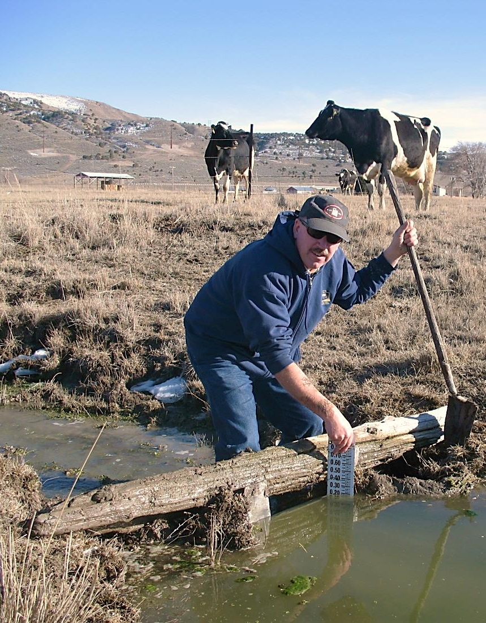
Quantity Impairment 73-3-3(5)
In a proceeding before the state engineer, the applicant has the burden of producing evidence sufficient to support a reasonable belief that the change can be made in compliance with this section and Section 73-3-8, including evidence:
that the change will not cause a specific existing right to experience quantity impairment; or
if applicable, rebutting the presumption of quantity impairment described in Subsection 73-3-8(6)(c).

Slide 26
Quantity Impairment 73-3-8(6)
(a) Except as provided in Subsection (6)(b), the state engineer shall reject a permanent change application if the person proposing to make the change is unable to meet the burden described in Subsection 73-3-3(5).
(b) If otherwise proper, the state engineer may approve a permanent or temporary change application upon one or more of the following conditions:
(i) for part of the water involved;
(ii) that the applicant acquire a conflicting right; or
(iii) that the applicant provide and implement a plan approved by the state engineer to mitigate impairment of an existing right.

Slide 27
Quantity Impairment 73-3-8(6)(c)
There is a rebuttable presumption of quantity impairment, as defined in Subsection 73-3-3(1), to the extent that, for a period of at least seven consecutive years, a portion of the right identified in a change application has not been:
diverted from the approved point of diversion; and
beneficially used at the approved place of use.
(ii) The rebuttable presumption described in Subsection (6)(c)(i) does not apply if the beneficial use requirement is excused by:
Subsection 73-1-4(2)(e);
an approved nonuse application under Subsection 73-1-4(2)(b);
Subsection 73-3-30(7) (for instream flow); or
the passage of time under Subsection 73-1-4(2)(c)(i).
Notes:
1-4(2)(e) This section does not apply to:
(i) the use of water according to a lease or other agreement with the appropriator or the appropriator's successor in interest;
(ii) a water right if its place of use is contracted under an approved state agreement or federal conservation fallowing program;
(iii) those periods of time when a surface water or groundwater source fails to yield sufficient water to satisfy the water right;
(iv) a water right when water is unavailable because of the water right's priority date;
(v) a water right to store water in a surface reservoir or an aquifer, in accordance with Title 73, Chapter 3b, Groundwater Recharge and Recovery Act, if:
(A) the water is stored for present or future use; or
(B) storage is limited by a safety, regulatory, or engineering restraint that the appropriator or the appropriator's successor in interest cannot reasonably correct;
(vi) a water right if a water user has beneficially used substantially all of the water right within a seven-year period, provided that this exemption does not apply to the adjudication of a water right in a general determination of water rights under Chapter 4, Determination of Water Rights;
(vii) except as provided by Subsection (2)(g), a water right:
(A) (I) owned by a public water supplier;
(II) represented by a public water supplier's ownership interest in a water company; or
(III) to which a public water supplier owns the right of use; and
(B) conserved or held for the reasonable future water requirement of the public, which is determined according to Subsection (2)(f);
(viii) a supplemental water right during a period of time when another water right available to the appropriator or the appropriator's successor in interest provides sufficient water so as to not require use of the supplemental water right; or
(ix) a period of nonuse of a water right during the time the water right is subject to an approved change application where the applicant is diligently pursuing certification.
Passage of time assumes the water is placed back to beneficial use and remains unchallenged for 15 years.

Slide 28
Quantity Impairment 73-3-8(6)
(d) The state engineer may not consider quantity impairment based on the conditions described in Subsection (6)(c) unless the issue is raised in a:
(i) timely protest that identifies which of the protestant's existing rights the protestant reasonably believes will experience quantity impairment; or
(ii) written notice provided by the state engineer to the applicant within 90 days after the change application is filed.
(e) The written notice described in Subsection (6)(d)(ii) shall:
(i) specifically identify an existing right the state engineer reasonably believes may experience quantity impairment; and
(ii) be mailed to the owner of an identified right, as shown by the state engineer's records, if the owner has not protested the change application.
Notes:
(d)(i) Timely protest – remember the previous presentation that discussed processing applications? The filing is advertised and protests are to be filed within 20 days of the final publication of notice otherwise they are late.
(d)(ii) Division staff are to review the change application filings for obvious indications that nonuse may have occurred and send the written notice within 90 days of the date the application is filed.

Slide 29
Quantity Impairment 73-3-3(5)
Utah Code Section 73-3-3(5) provides that in a change application proceeding before the state engineer, the applicant has the burden of producing evidence sufficient to support a reasonable belief that the change can be made in compliance with this section and Section 73-3-8, including rebutting the presumption of quantity impairment.
There is a rebuttable presumption of quantity impairment, to the extent that, for a period of at least seven consecutive years, all or a portion of the right identified in a change application has not been diverted from the approved point of diversion; and beneficially used at the approved place of use. The state engineer may not consider quantity impairment based on the above conditions unless the issue is raised by a protestant, or written notice is provided by the state engineer to the applicant within 90 days after the change application is filed.
This communication is your written notice that the state engineer is raising the issue of quantity impairment on your change application xxx based upon an office review of the historic use of the water right(s) underlying the change application. The state engineer believes the following water right(s) would experience quantity impairment if use is resumed as proposed in the change application: 55-295, 55-4494.
Utah Code Section 73-3-3(5) provides that in a change application proceeding before the state engineer, the applicant has the burden of producing evidence sufficient to support a reasonable belief that the change can be made in compliance with this section and Section 73-3-8, including rebutting the presumption of quantity impairment.
There is a rebuttable presumption of quantity impairment, to the extent that, for a period of at least seven consecutive years, all or a portion of the right identified in a change application has not been diverted from the approved point of diversion; and beneficially used at the approved place of use.
The state engineer may not consider quantity impairment based on the above conditions unless the issue is raised by a protestant, or written notice is provided by the state engineer to the applicant within 90 days after the change application is filed.

Slide 30
Quantity Impairment 73-3-3(5)
This communication is your written notice that the state engineer is raising the issue of quantity impairment on your change application xxx based upon an office review of the historic use of the water right(s) underlying the change application. The state engineer believes the following water right(s) would experience quantity impairment if use is resumed as proposed in the change application: 55-295, 55-4494.
The rebuttable presumption does not apply if the beneficial use requirement is excused by nonuse exemptions described in Subsection 73-1-4(2)(e); an approved nonuse application; water remaining in a stream under an approved change application for instream flow; or the passage of time under Subsection 73-1-4(2)(c)(i).

Slide 31
Quantity Impairment 73-3-8(6)
(f) The state engineer is not required to include all rights the state engineer believes may be impaired by the proposed change in the written notice described in Subsection (6)(d)(ii).
(g) The owner of a right who receives the written notice described in Subsection (6)(d)(ii) may not become a party to the administrative proceeding if the owner has not filed a timely protest.
(h) If a change applicant, all protestants, and all persons identified by the state engineer under Subsection (6)(d)(ii) come to a written agreement regarding how the issue of quantity impairment shall be mitigated, the state engineer may incorporate the terms of the agreement into a change application approval.

Slide 32
What Constitutes Impairment of a Water Right?
When filing a nonuse application, what is considered reasonable cause for nonuse?
A nonuse application only protects a water right from the date of filing the application into the future.
Can a nonuse application be filed for a period of nonuse from 1976 to 1986? If a nonuse application were filed would it protect the right from forfeiture?
When filing a nonuse application, what is considered
reasonable cause for nonuse?
A nonuse application only protects a water right from the
date of filing the application into the future.
Can a nonuse application be filed for a period of nonuse
from 1976 to 1986? If a nonuse application were filed
would it protect the right from forfeiture?

Slide 33
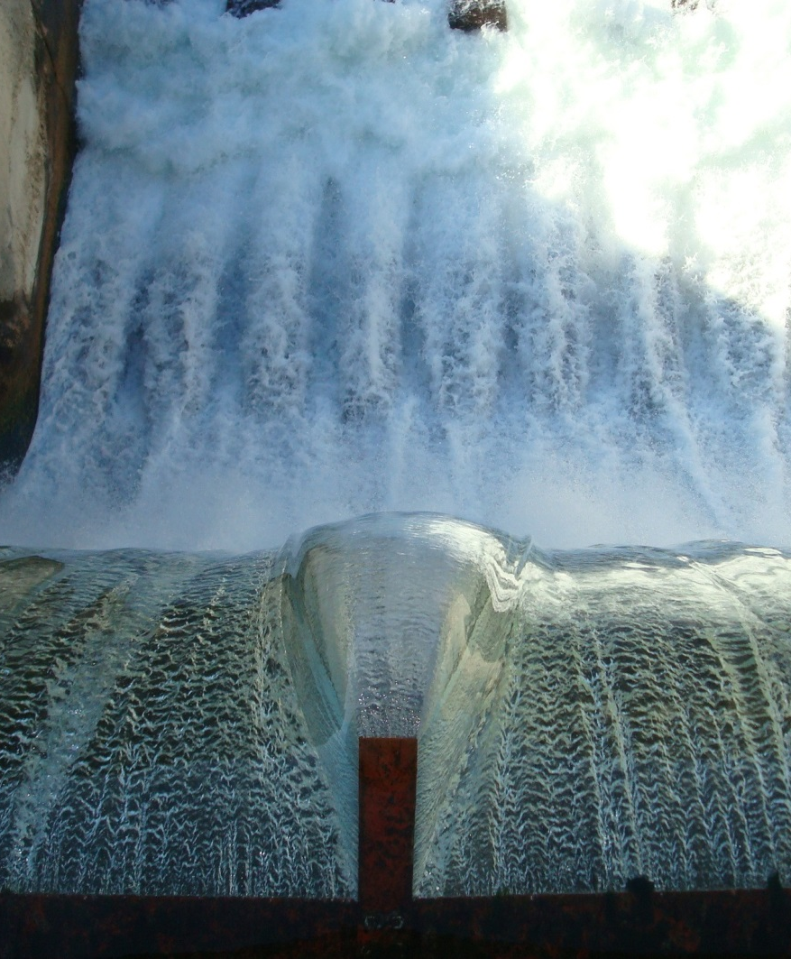
When is a Water Right Not Subject to Forfeiture?
A water right may not be forfeited unless a judicial action is commenced with how many years from the latest period of nonuse?
What protects a water right from forfeiture?

Slide 34
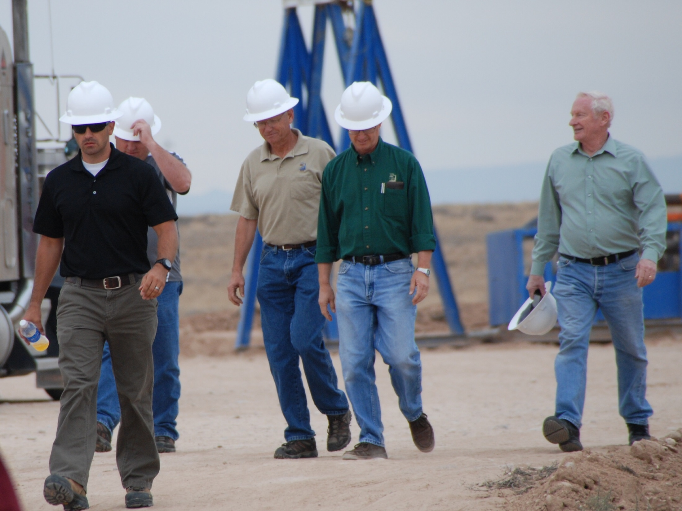
Shares vs. Rights
Is there a difference?

Slide 35
Share vs. Water Right
Share is a share of stock usually in an irrigation company. Stock represents the right of a shareholder to be delivered water on a proportionate basis by the company in accordance with its water rights.
Water right is a property right created within Title 73 of the Utah Code. The irrigation company owns the water rights which are the basis for its diversion and use of water.
Notes:
Application to Appropriate
Decree
Diligence or Underground Water Claim
Reserved Right.

Slide 36
Change Applications on Shares of Stock Applicant’s Responsibilities, UC 73-3-3.5
Change Applications on Shares of Stock
UC 73-3-3.5
Submit a written request for the change to the company.
details of what is to be changed.
the quantity of water.
number of shares of stock and the certificate number.
if applicable, the irrigated land to be retired.
agree to pay all applicable corporate assessments for the stock including future assessments.
With the state engineer, file a change application bearing the company’s signature or a written authorization from the company assenting to the change.
If the change application is approved, the shareholder may file requests for extension of time.
Applicant (shareholder) responsibilities:

Slide 37
Change Applications, Continued Company’s Responsibilities
Change Applications on Shares of Stock cont.
Company responsibilities:
Company has 120 days to make a decision on the request and provide written notice of its decision. It can:
Approve as submitted.
Approve subject to conditions.
Deny the request
No response by the company within 120 days is deemed an approval.
If a shareholder fails to comply with the conditions imposed by the company, it may withdraw its approval of the application and petition the State Engineer to cancel the change application.
Once the water is placed to use under the change application, the company is to either have prepared or endorse the proof for project.
The Certificate issued by the Division will bear the Company’s name and the Shareholder’s name.

Slide 38
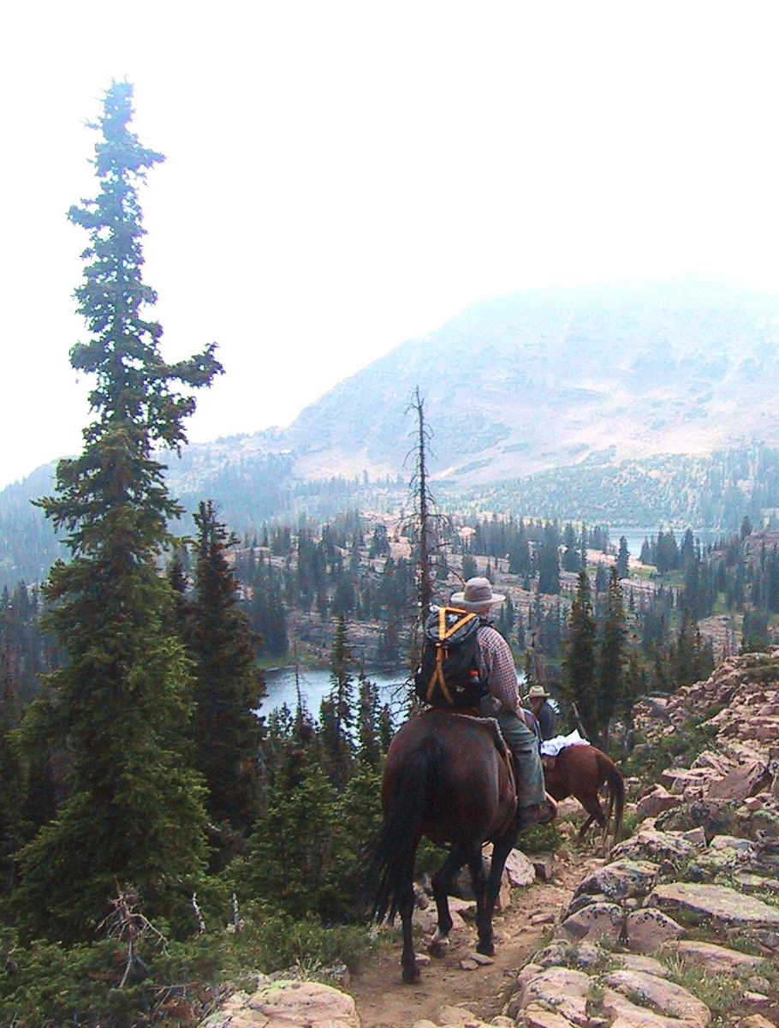
When an individual wants to file a change application based on shares of stock in an irrigation company – what must he do?
When an irrigation company receives a request to file a change from a shareholder what should it do?
An irrigation company could incur liability by…???
Is a share the same as a water right?

Slide 39
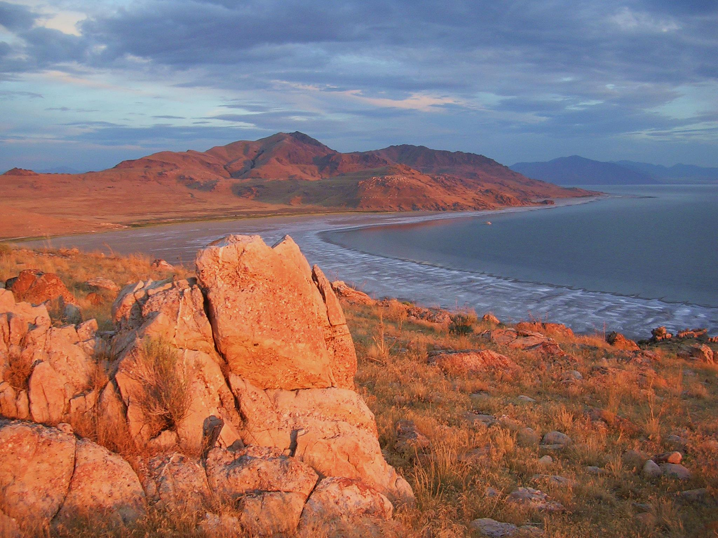
Wastewater Reuse
Gray and Black Water

Slide 40
Wastewater Reuse UC 73-3c
What approval(s) are needed to do a water reuse project?
State Engineer 73-3c-302
Water Quality Board 19-5-104
Is a change application needed to do a water reuse project?
Only if the reuse project is not consistent with the water rights proposed to be reused.
What water rights may be used for a reuse project?
A water right, whether evidenced by a decree, a certificate of appropriation, a diligence claim to the use of surface or underground water.
A water user's claim filed in general determination proceedings; or an approved application to appropriate, change or exchange water.
The water right must be administered for municipal use.

Slide 41
Wastewater Reuse 73-3c-302
An application for water reuse shall be made upon forms furnished by the state engineer and shall include:
The name of the applicant;
A description of the underlying water right;
An evaluation of the underlying water right's diversion, depletion, and return flow requirements;
The estimated quantity of water to be reused;
The location of the Publically Owned Treatment Works (POTW);
The place, purpose, and extent of the proposed water reuse;
An evaluation of depletion from the hydrologic system caused by the water reuse; and
Any other information consistent with this chapter that is requested by the state engineer.

Slide 42
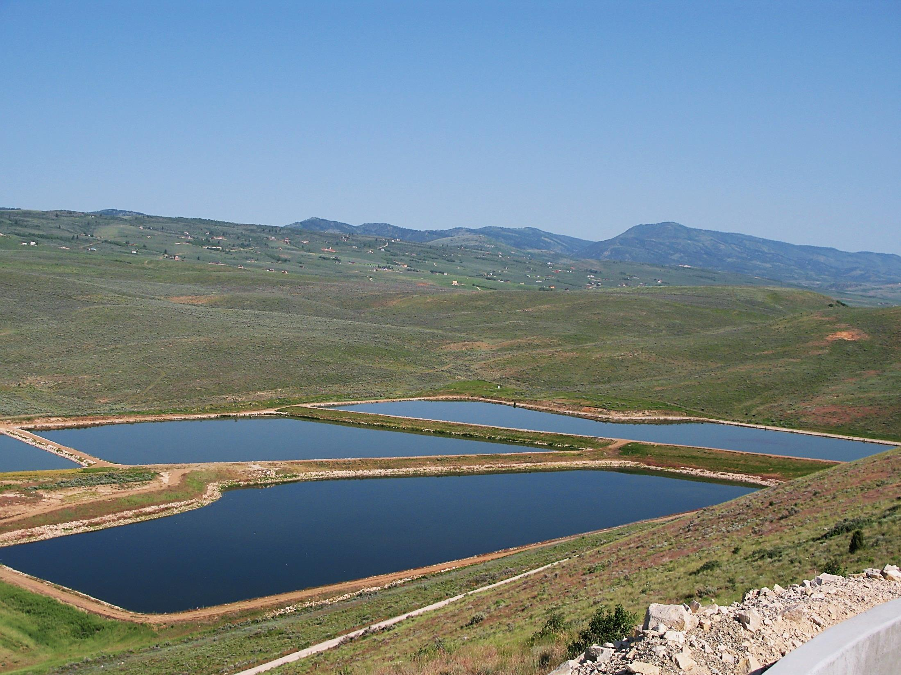
Recharge and reuse
Groundwater

Slide 43
Groundwater Recharge & Recovery UC 73-3b Two Step Process—Recharge Application and Recovery Application
The application for a recharge permit includes the following:
Name and mailing address of the applicant;
Name of the groundwater basin or groundwater sub-basin in which the applicant proposes to operate the recharge project;
Name and mailing address of the owner of the land on which the applicant proposes to operate the recharge project;
Legal description of the location of the proposed recharge project;
Source and annual quantity of water proposed to be artificially recharged; Evidence of a water right or an agreement to use the water proposed to be artificially recharged;
Quality of the water proposed to be artificially recharged and the water quality of the receiving aquifer;
Evidence that the applicant has applied for all applicable water quality permits;

Slide 44
Recharge & Recovery, Continued
A plan of operation for the proposed recharge project, which shall include:
Description of the proposed recharge project;
Design capacity;
Detailed monitoring program; and
Proposed duration of the recharge project;
Copy of a study demonstrating:
Area of hydrologic impact of the recharge project;
Recharge project is hydrologically feasible;
Recharge project will not:
Cause unreasonable harm to land; or
Impair any existing water right within the area of hydrologic impact;
The percentage of anticipated recoverable water;
Evidence of financial and technical capability; and
Any other information that the state engineer requires.

Slide 45
Recovery Permit Application, 73-3b-204
A person may file a Recovery Permit Application with a recharge permit application.
The application for obtaining a recovery permit shall include the following information:
Name and mailing address of the applicant;
Legal description of the location of the existing well or proposed new well from which the applicant intends to recover artificially recharged water;
Written consent from the owner of the recharge permit, if the applicant does not hold the recharge permit;
Name and mailing address of the owner of the land from which the applicant proposes to recover artificially recharged water;
Name or description of the artificially recharged groundwater aquifer which is the source of supply;
Purpose for which the artificially recharged water will be recovered;
Depth and diameter of the existing well or proposed new well;
Legal description of the area where the artificially recharged water is proposed to be used;
Design pumping capacity of the existing well or proposed new well;
Other information including maps, drawings, and data that the state engineer requires.

Slide 46
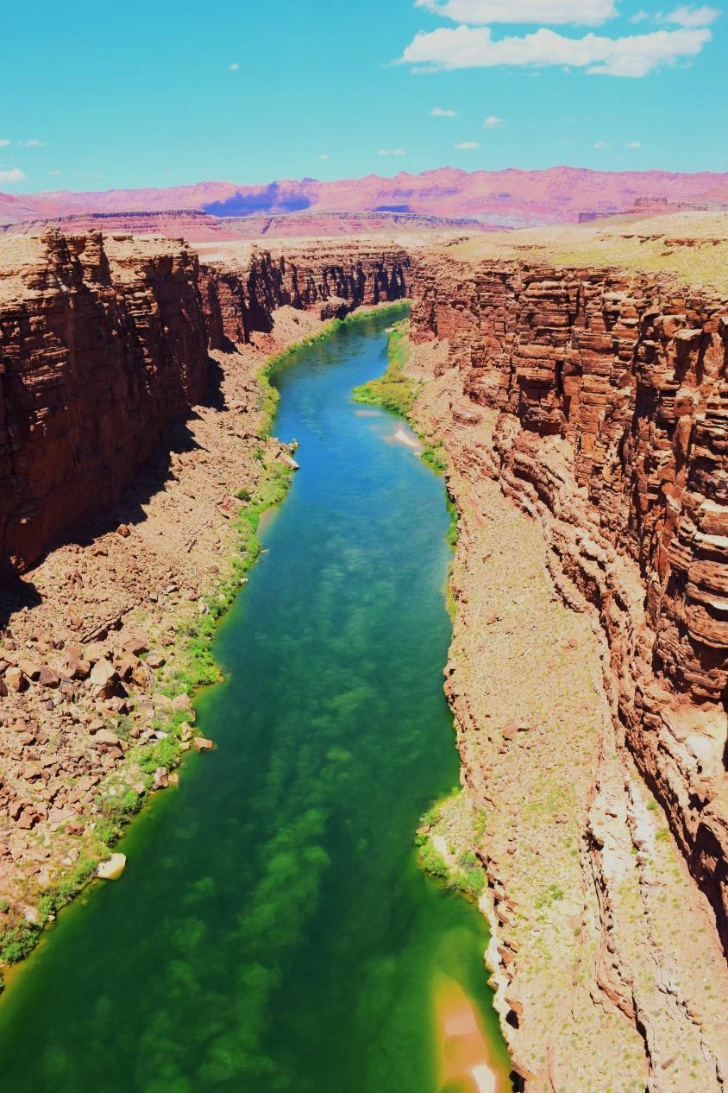
RECHARGE and RECOVERY continued
Both the RECHARGE and the RECOVERY Projects are to be completed within 5 years from approval.
Applicant is to file a proof of completion for the recharge project and receives a recharge certificate. If the project
is not completed within 5 years an extension of time to complete the project construction and file proof.
Likewise, proof of completion is to be filed for the recovery project and recovery certificate will be issued.

Slide 47
Storage Account, 73-3b-301 Monitoring and Reporting Required
The State Engineer shall establish a storage account for each groundwater recharge and recovery project for which a permit has been issued.
In accordance with specifications of the state engineer, any person holding a groundwater recharge or recovery permit shall:
Monitor the operation of the project and its impact on land, the groundwater aquifer, and water rights within the project's area of hydrologic impact; and
File reports with the state engineer regarding:
Quantity of water stored and recovered; and
Water quality of the recharged water, receiving aquifer, and recovered water.

Slide 48
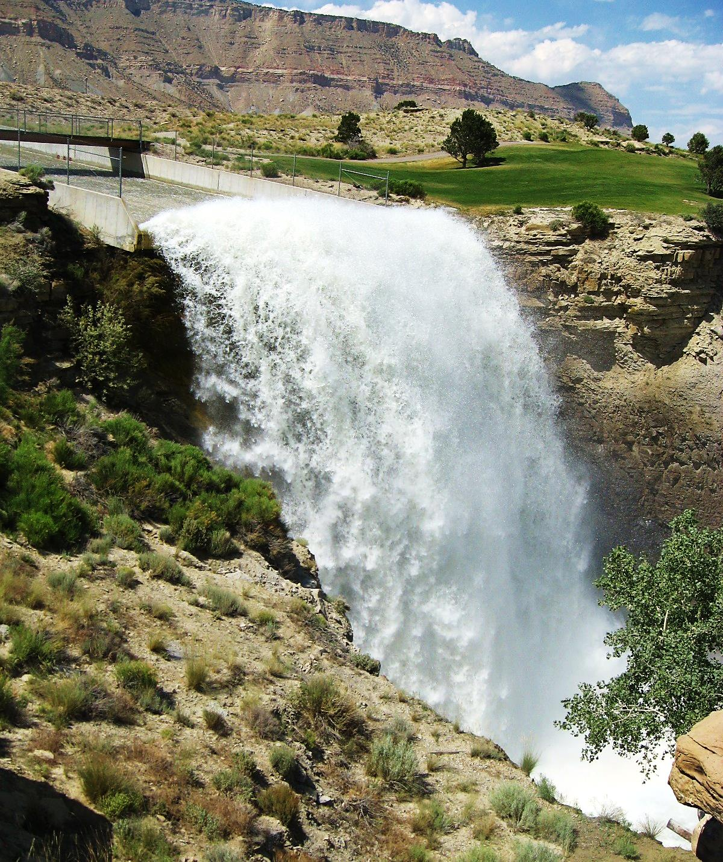
Questions? Comments?
Humorous Anecdotes?

