Slide 1


Utah Division of Water Rights
Utah Water Use Program
Gathering Data—April 2016
Frank Quintana, P.E.
June 21, 2004

Slide 2

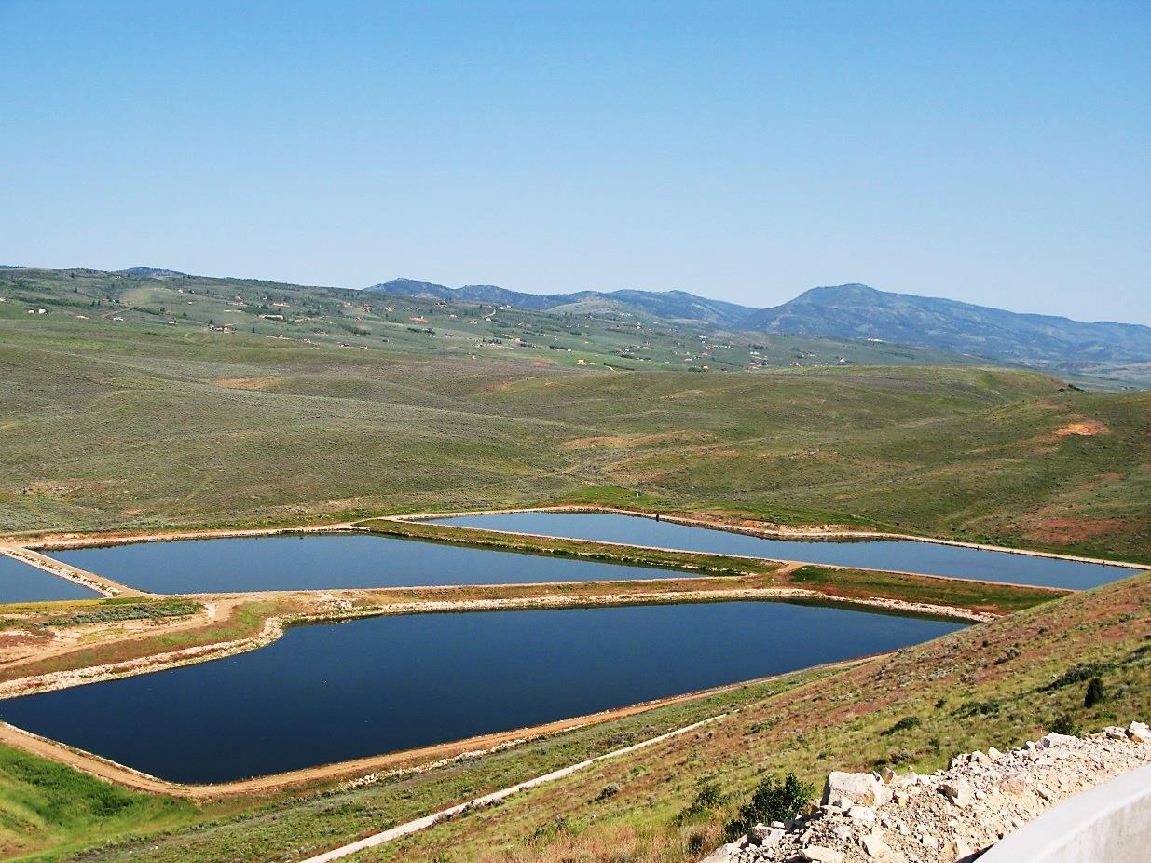
Utah Water Use Program Data
Why do we collect water use data?
How is the data used?
How do we collect the data?

Slide 3
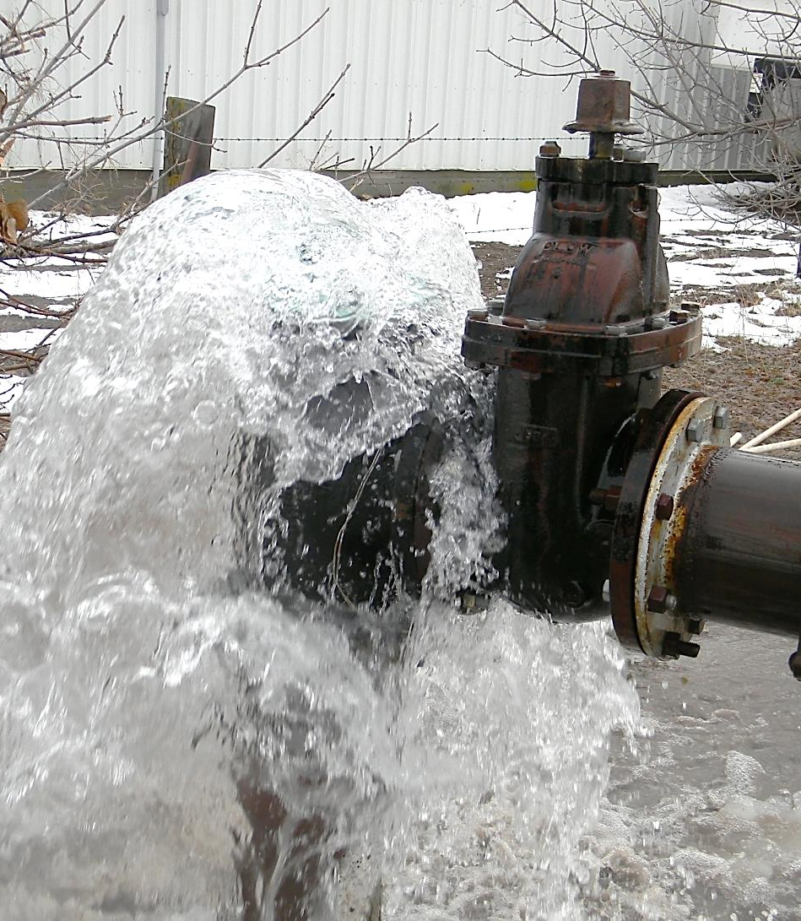
Why Do We Collect the Data?
To recognize water use challenges
To study water resources
To develop water management policies
To evaluate water right applications

Slide 4
How is the Data Used?
USGA Studies
Water Resources planning programs
State financial assistance programs
Assessment of water supply and water use
Water Rights Proof of Beneficial Use
Efficiency of systems

Slide 5
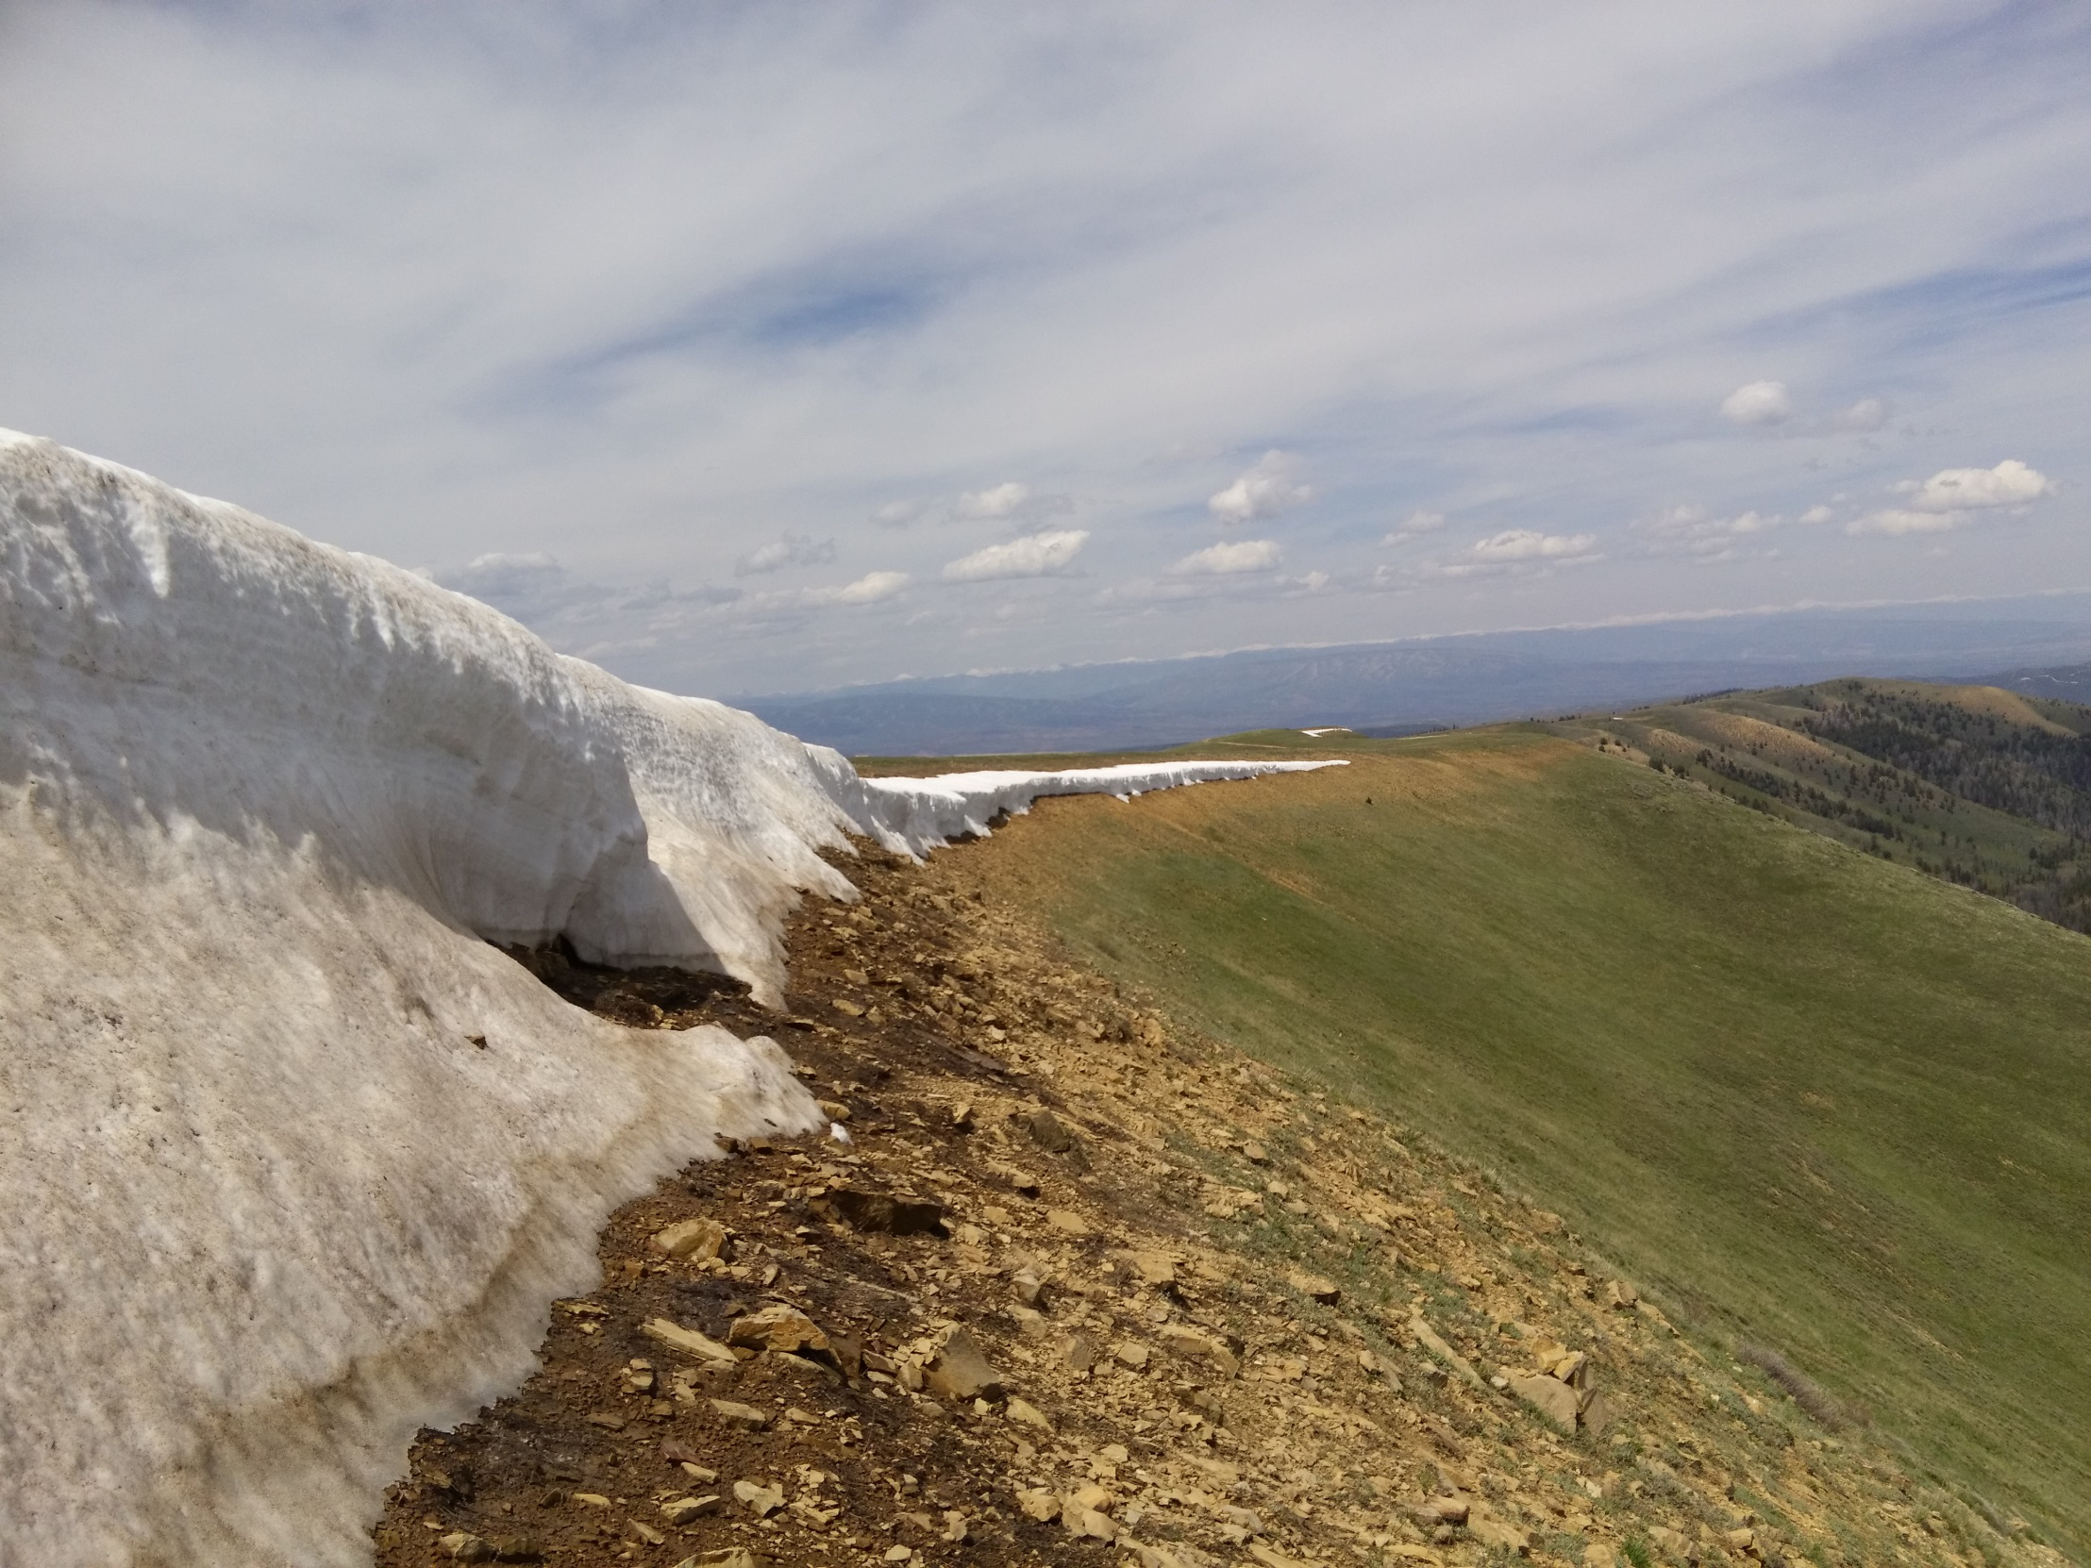
Online and Paper Forms
How Do We Collect the Data?

