Slide 1


Utah Division of Water Rights
Water Use Groups
RWUA Training—April 2016
Teresa Wilhelmsen, P.E.
Utah Lake/Jordan River Regional Engineer
June 21, 2004

Slide 2

Understanding Water Use Groups
The What, Why, and How.

Slide 3

What is a Water Use Group?
One or more water rights listed in a database ‘use group’ to describe a common use.
All water rights have them.
Why do we use them?
To define if a water right is supplemental with other rights
To define the sole supply of a water right
To define the group contribution (Beneficial Use Amount) of a water right
How would you use them?
Determine beneficial use of a water right – change application, or other need.

Slide 4
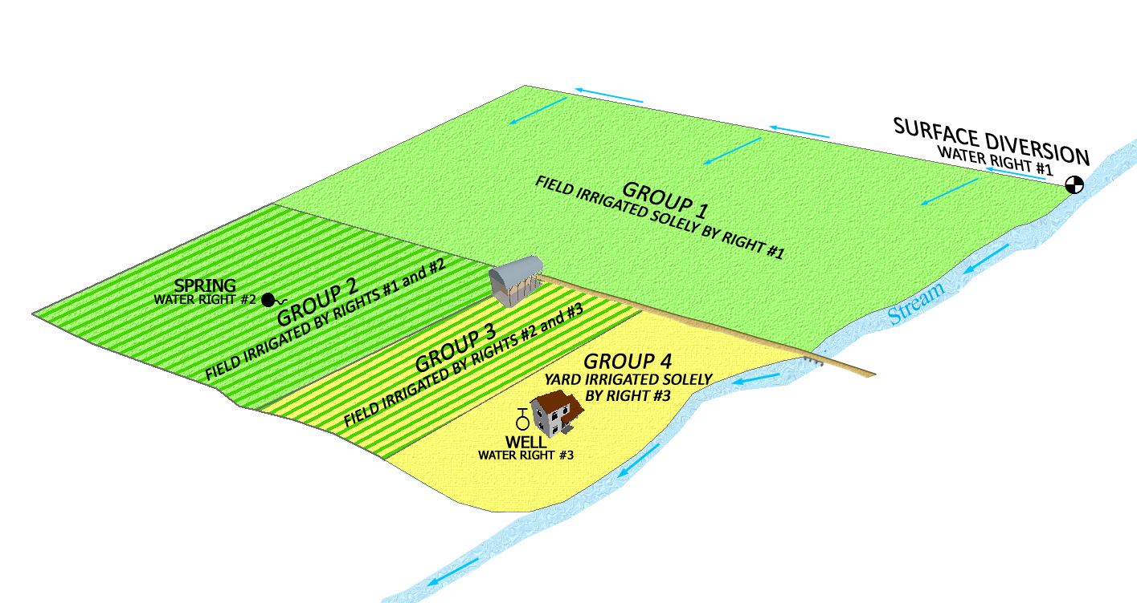

Slide 5
What documents provide information to define what is included in a Water Use Group?
Information included in a water right file
Application to Appropriate
Diligence or Underground Water Claim
Certificate of Beneficial Use
Judicial Decree
Published Proposed Determination Book / Addendum
Maps (application, claims, certificate, hydrographic survey maps)

Slide 6
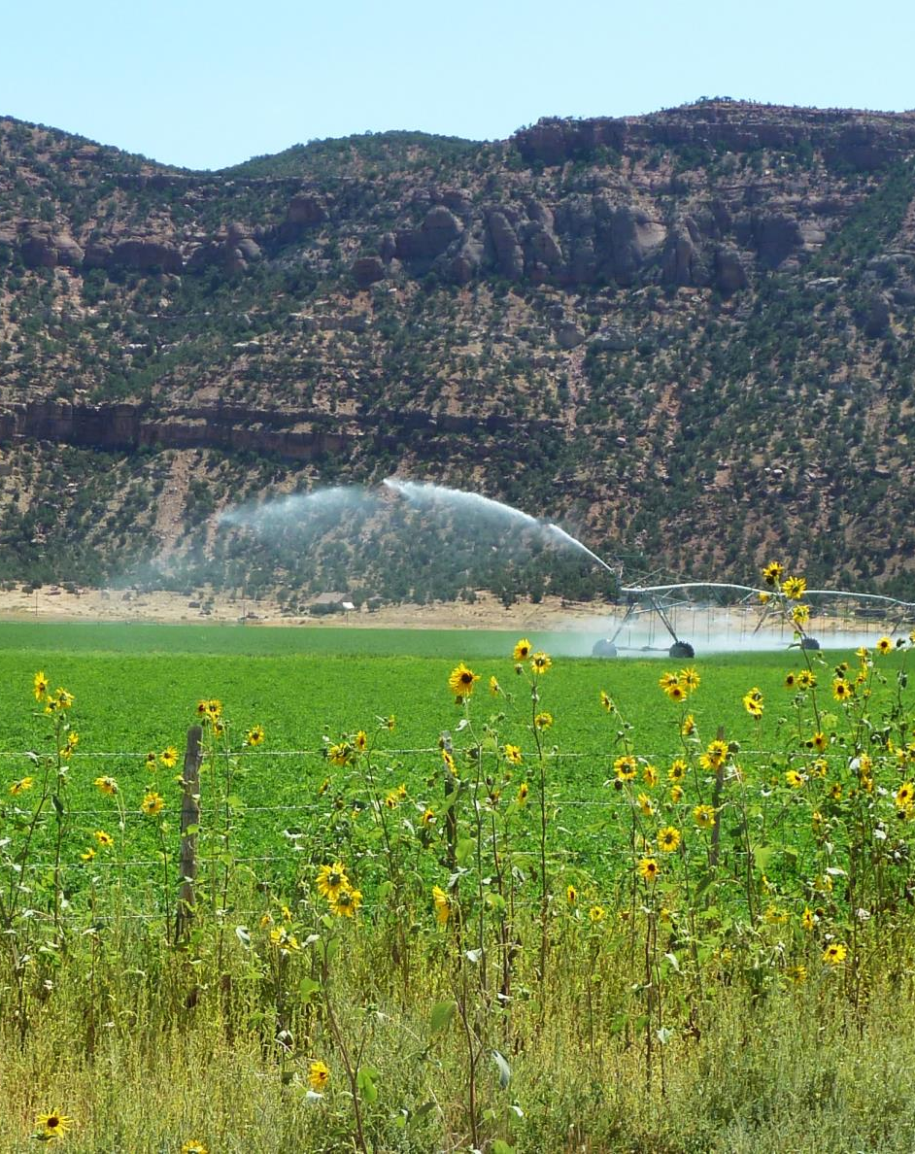
Example #1
Water Right 57-1653:
A water right group contains:
Place of Use
Period of Use
Beneficial Use(s)
Water Use Groups are dynamic – can change over time

Slide 7
Example #2
Water Right 57-7531:
Beneficial Use Amount means:
The beneficial use amount a water right contributes to a use group in which it is included.
“Beneficial Use Amount” is the same as the term “Group Contribution”

Slide 8
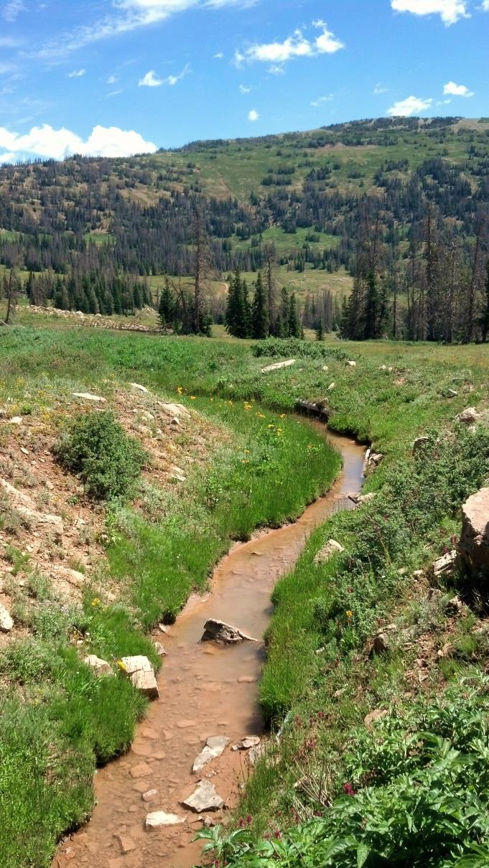
Example #3
Water Right 51-1901:
Sole Supply of a water right is:
The beneficial use amount a water right when used alone and separate from all supplement rights.
The sum of a water right’s “Beneficial Use Amount” in each group for which the water right is included.
A limitation of the water right.

Slide 9
Example #4
Water Right Number 57-69:
A water right can belong to more than one Water Use Group.
A Water Use Group can contain one water right, or it can contain several water rights.
A Water Use Group is used to define all the elements of the beneficial use – place of use, type of use, period of use, quantity of beneficial use.

Slide 10
Example #4, Continued
Ownership of a water right(s) in a Water Use Group:
A group may define one owner’s water rights.
A group may also define one or multiple water rights owned by various owners.
The use within a group can be ‘supplied’ by one, or more than one source of water – surface source, ground water well.

Slide 11
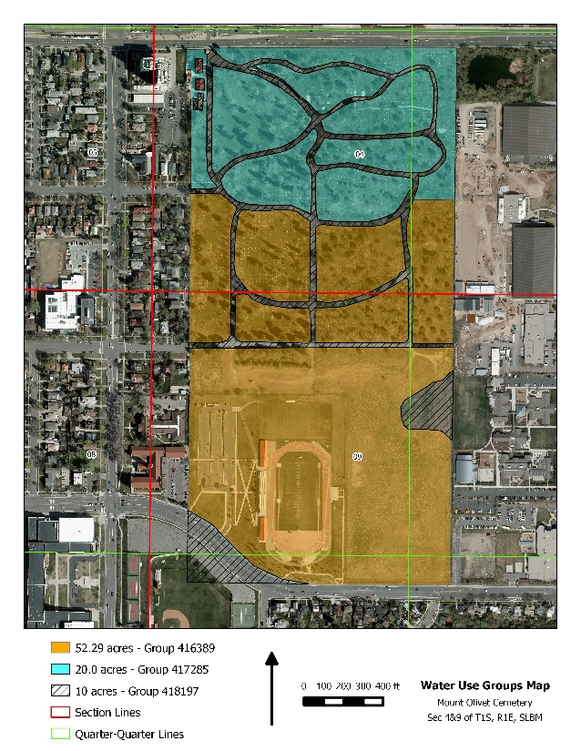
Example #4, Continued
Three sources comingled in a reservoir for irrigation system.
Some of the rights were sold, segregated and changed to other uses.
Map depicts three Water Use Groups.

Slide 12
Why do you need to define the Beneficial Use Amount (Group Contribution)?
To file a segregation.
To file a change application.
Defining the Beneficial Use Amount of a water right within a group ensures the amount of water and beneficial use of the individual water right in the group is properly defined so there won’t be confusion if the rights are used independent of each other.

Slide 13
Example #5
Water Right 55-11145:
If several water rights are owned by a farmer to irrigate a large field, all of the supplemental water rights would be listed in the same Water Use Group.

Slide 14
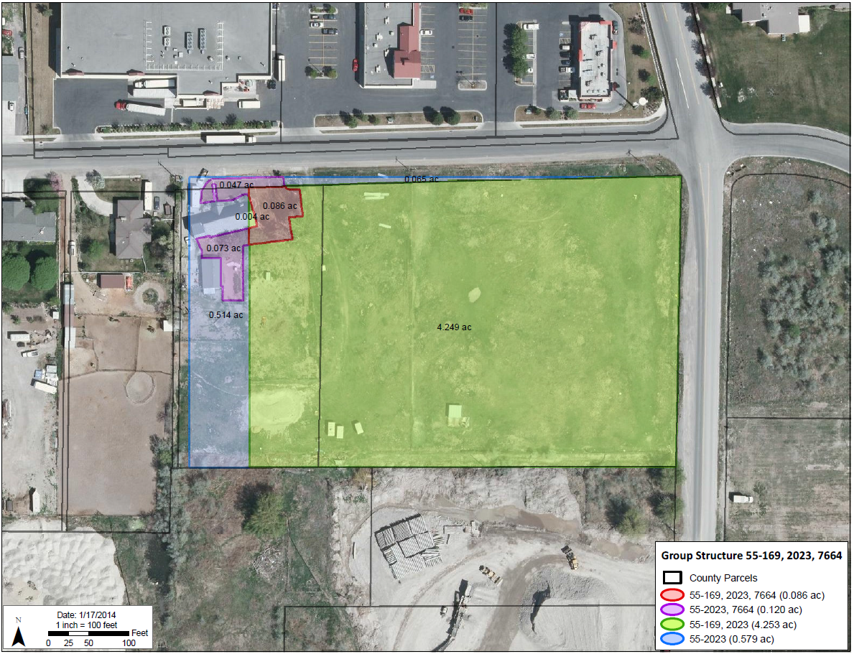
Example #6:
Example #6

Slide 15
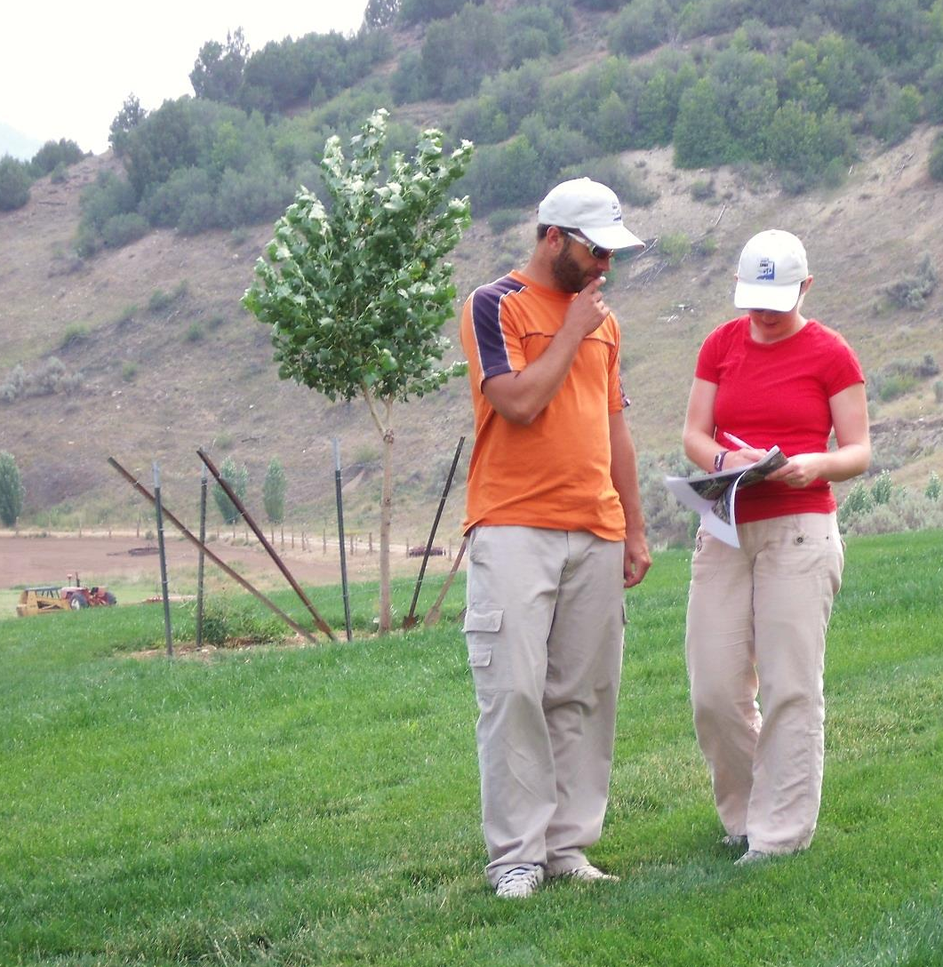
Example #7
Water Right 51-4859:
If the Beneficial Use Amounts are defined, a water right can be segregated for the purpose of filing a change application.

Slide 16
Example #8
Water Right 55-4403:
One water right is listed in a Water Use Group, but a document on the water right files says the right “helps”, or is “supplemental” to other rights. What does this mean?
There may be other rights used in conjunction with the water right to accomplish the described beneficial use and those rights have not yet been clearly defined or identified in the database. Further review will be necessary to understand the discrepancy.

Slide 17
Example #9
Water Right 55-1324:
A group contains a water right owned by an individual and the water rights for an irrigation company. What does this mean?
The use described in the group is supplemental to shares of stock in an irrigation company.
The individual right provides only a portion of the total Beneficial Use Amount.
The land is within the service area of the irrigation company.
Shares in an irrigation company are bought and sold as securities and lands served by the company may change.

Slide 18
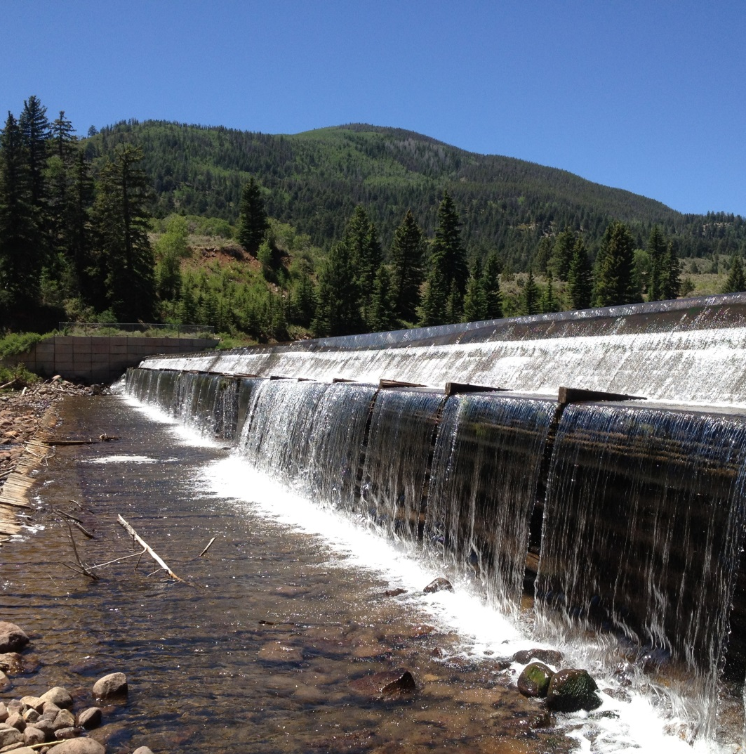
Example #9
Water Right 59-825:
Supplemental to an irrigation company
Example #9a
Water Right 59-5902:
Share statement

Slide 19
Example #10
Water Right 55-1120:
There are water rights listed from various water right areas. What does this mean?
The use may be associated with a federal project that imports water from another basin.
The Place of Use in a water use group:
Defines the authorized and recognized place of use.
Should be consistent with the file records.
May include multiple section or quarter sections of land.
Duplicate groups.

Slide 20
Water Use Groups may not be 100% correct due to data entry errors.
Duplicate groups – database conversion 2006
Identifying errors
Research records
Send a written request requesting review of the record and include statements as to how it is believed the database should be modified.

Slide 21
Example #11
Water Right 51-1486:
Research the record to ensure the documentation supports the database entry.
Groups are dynamic. They change over time.
Chronological order of occurrence.
Application to Appropriate
Certificate of Beneficial Use
Published Proposed Determination Book
Addendum to the PD Book
Change Application
Certificate of Beneficial Use

Slide 22
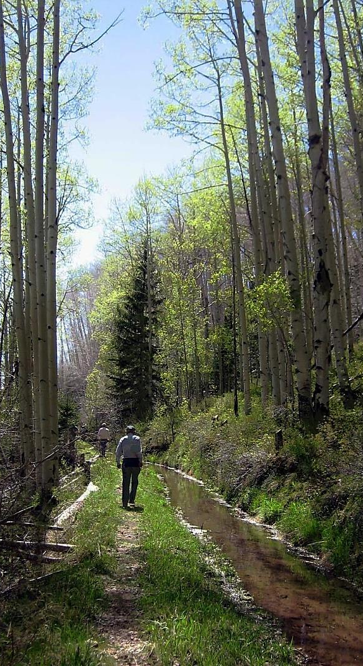
Administrative Rule R655-16
Declaring Beneficial Use Amounts
Written request for corrections to be made.
Declaration of Beneficial Use
Used to declare the beneficial use amount of a water right in a use group.
Application for Apportionment of Beneficial Use Amounts.
The applicant has exhausted all reasonable efforts to complete a Declaration of Beneficial Use.

Slide 23
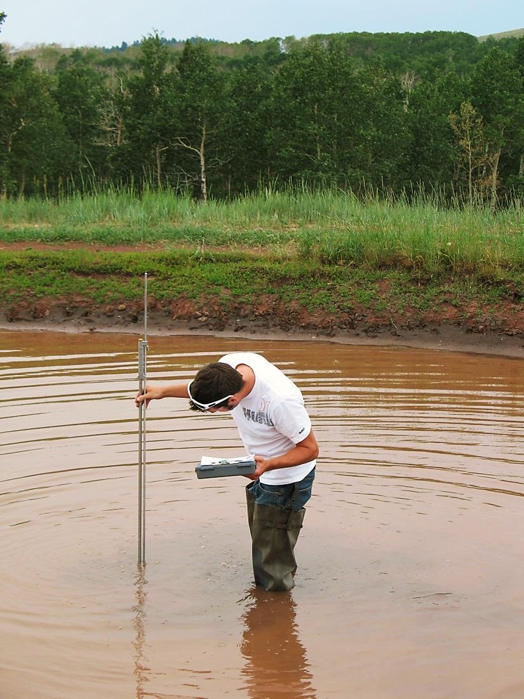
Water Use Groups May Be Altered By:
Filing a Declaration of Beneficial Use Amounts
A completed Application for Apportionment of Beneficial Use Amounts process
The Division needing to resolve errors, deficiencies, or ambiguities where the database is not consistent with the water right files.

Slide 24
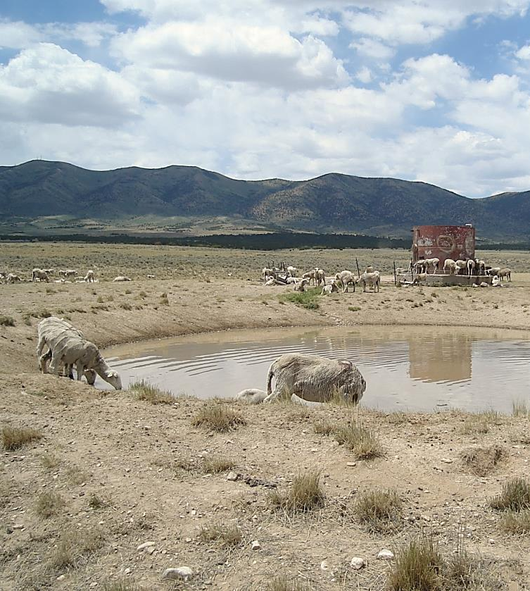
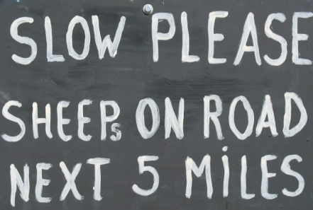
Summary
Beneficial Use Amount
Sole Supply
Examples – understand what you see
Fully research the record and compare
Need to define Beneficial Use Amounts

Slide 25

Questions?

