Slide 1


Utah Division of Water Rights
Public Water Suppliers
RWUA Training—April 2016
S. Ross Hansen, P.E., L.S.
Weber River/Western Regional Engineer
June 21, 2004

Slide 2
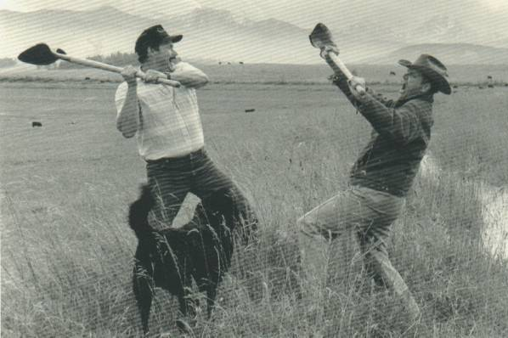
The Old Way To Handle Water Disputes May Be The Better Way?

Slide 3

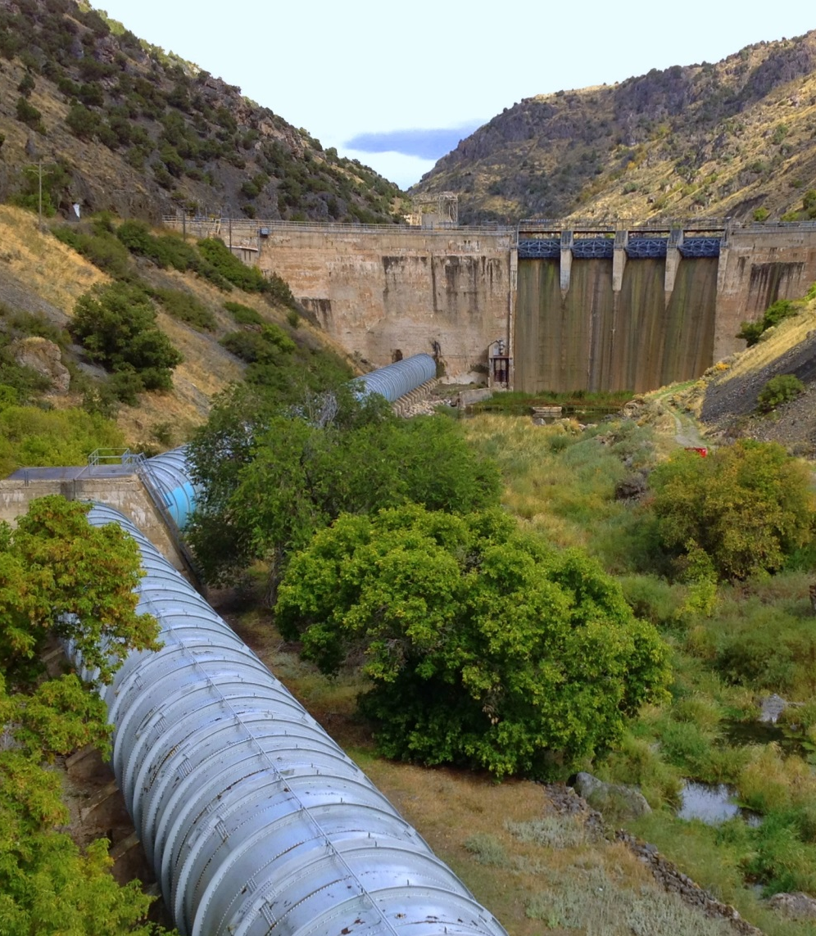
Overview
What is a Public Water Supplier? (PWS)
How are PWS water rights treated differently than other water rights?
  Extensions of time to file proof
  Nonuse/forfeiture
  Proof and Certification
Example
Notes:
How many of you represent or work for a PWS? Provide consulting services for a PWS? How many don’t know what a PWS is?
We’re going to explore treatment of PWS within 3 different adminstrative proceeding of the state engineer.

Slide 4
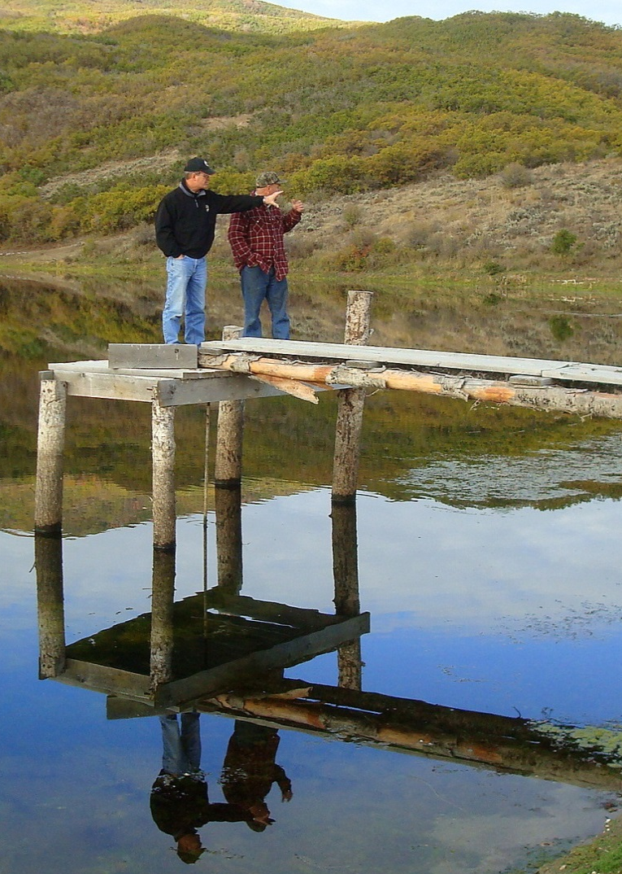
Vocabulary/Acronyms
Acre-foot - An acre of land 1’ deep water
CFS - Cubic Feet per Second
POD – Point of Diversion
S.E. – State Engineer
WR – Water Right
PWS– Public Water Supplier
Notes:
Because I find myself using acronyms terms that maybe some people are not familiar with I always like to throw up a slide that defines them prior to a presentation.
Helps stop a lot of weird looks while Im up here.
Take a look at each of these, but let me draw your attention to the bottom two bullets.
You will hear me use SE for State Engineer

Slide 5

Public Water Supplier
How Do I Become One?
Act like one
  Serve water to the public
  Be a public agency or be publically accountable
  Report to the Division PWS water use program
  Claim entitled provisions in requests/applications
There is no application process or official list

Slide 6
A Public Water Supplier (PWS):
Statute Section 73-1-4(1)(b)
Supplies water, directly or indirectly, to the public for municipal, domestic, or industrial use; and
(ii) is:
(A) a public entity;
(B) a water corporation, as defined in Section 54-2-1, that is regulated by the Public Service Commission;
(C) a community water system:
(I) that:
(Aa) supplies water to at least 100 service connections used by year-round residents; or
(Bb) regularly serves at least 200 year-round residents; and

Slide 7
A Public Water Supplier (PWS) is:
Statute Section 73-1-4(1)(b) (cont.)
(II) whose voting members:
(Aa) own a share in the community water system;
(Bb) receive water from the community water system in proportion to the member's share in the community water system; and
(Cc) pay the rate set by the community water system based on the water the member receives; or
(D) a water users association:
(I) in which one or more public entities own at least 70% of the outstanding shares; and
(II) that is a local sponsor of a water project constructed by the United States Bureau of Reclamation.

Slide 8
What’s Different With PWS Water Rights?—Extension of Time
Water right(s)/portion owned by non PWS entities:
  No extension beyond 50 years to complete works.
  Must show due diligence in completing works or
  Show reasonable cause for delay.
Statute section 73-3-12(2)(h) PWS water right:
  Simply holding an approved application for future public needs is reasonable due diligence for 50 yrs
  Can be extended beyond 50 years with a 40 yr plan.

Slide 9
Content of PWS 40 Year Plan
Show future 40 year demand for water by:
  Showing projected population growth within service area.
Show works constructed and/or expenditures.
Should be WR specific
Service area is:
  Presently areas served by water distribution facilities
  Area expands as distribution system expands
  Thus: It is the geographical area that PWS agrees to serve

Slide 10
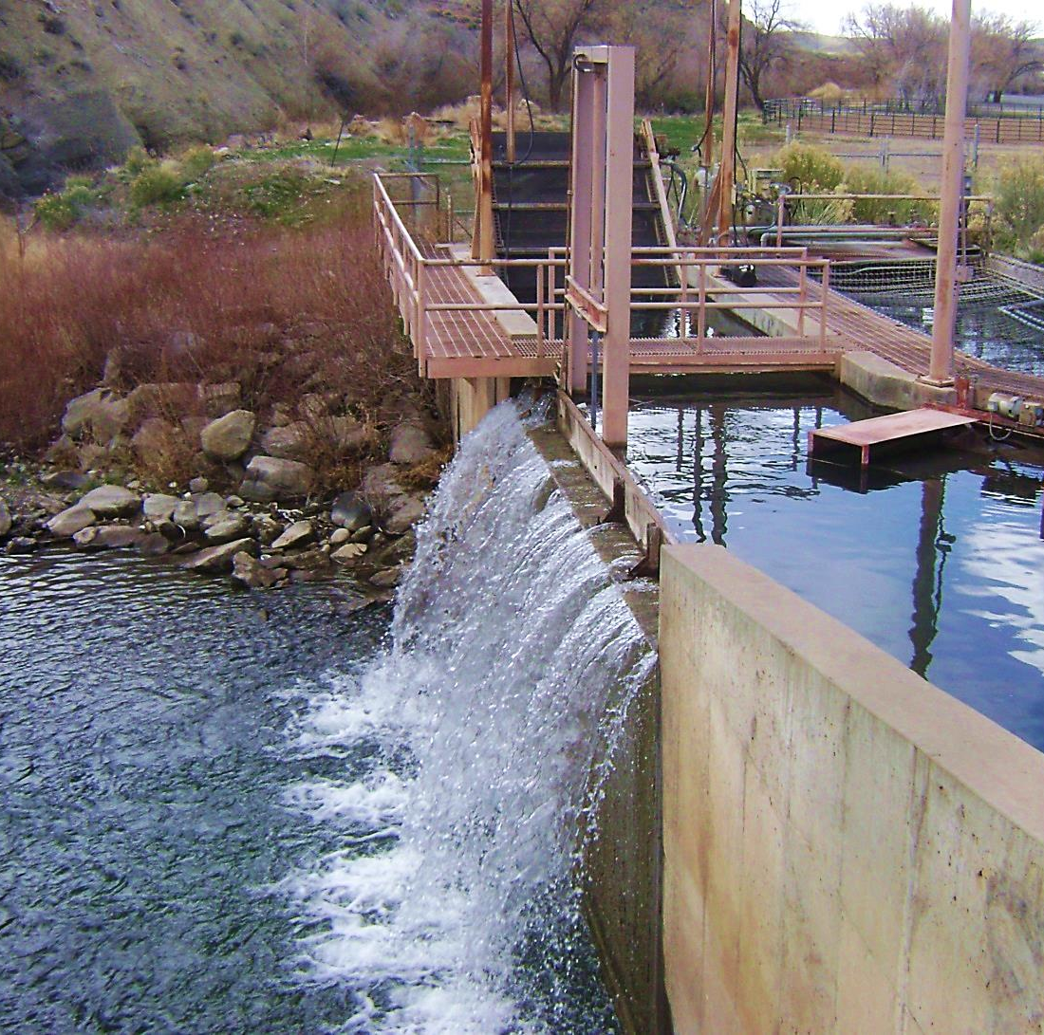
Content of PWS 40 Year Plan, Continued
Tabulation of already certificated WRs compared to future demand. Demonstrating need for extension of time.
Show works constructed and/or expenditures.
Should be WR specific

Slide 11
What’s Different With PWS Water Rights?—Forfeiture
Water right(s)/portion owned by non PWS entities are subject to forfeiture if not used for a period of 7 years.
Statute section 73-1-4(2)(e)(vii) exempts water rights owned by PWS from forfeiture
  If PWS acquires right after May 2, 2008
    A change app must be approved to move the water to the PWS to protect from nonuse.

Slide 12
What’s Different With PWS Water Rights?—Proof
Historically
Presently
PWS proofs consisted of showing the capacity of the well.
  Example: water right was for 5 cfs
  Drill well - install 5 cfs pump - submit proof.
PWS proof must show:
  Capacity of well
  An accounting of all water rights which include the well as one of its POD
  A comparison of water use reported/diverted with quantity of water being proofed.
  Service area not specific place of use.

Slide 13


Slide 14
What’s Different With PWS Water Rights?—Proof (Example)
City has 2 water rights with right to divert 4 cfs and 5 cfs totaling 6500 ac-feet volume.
Well capacities: Well A= 6 cfs; Well B= 5 cfs.
2 wells -water reporting info. diversion equals 2000 ac-feet annually.
City buys farmer’s 600 ac-feet WR and files municipal change application to divert water from city’s 2 wells.
When city files proof what can be certificated?
Answer = Nothing – 0 ac-feet.
Notes:
Beneficial Use is the limit and measure of a right.

Slide 15
PWS Proof (Example)

Slide 16
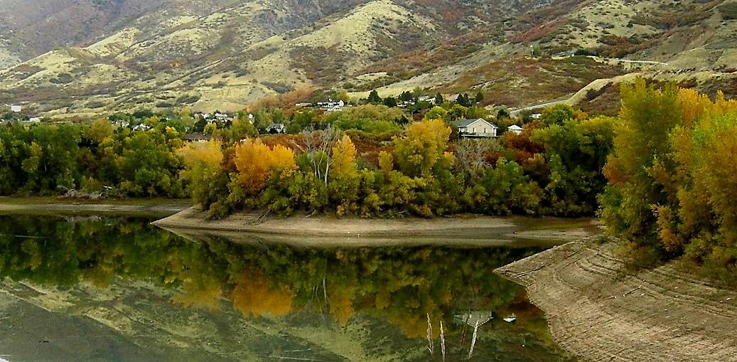
PWS Service Area
The geographic area wherein
a PWS agrees to serve water.
No Change Application is required if/when PWS expands its distribution facilities
Notes:
Beneficial Use is the limit and measure of a right.

Slide 17
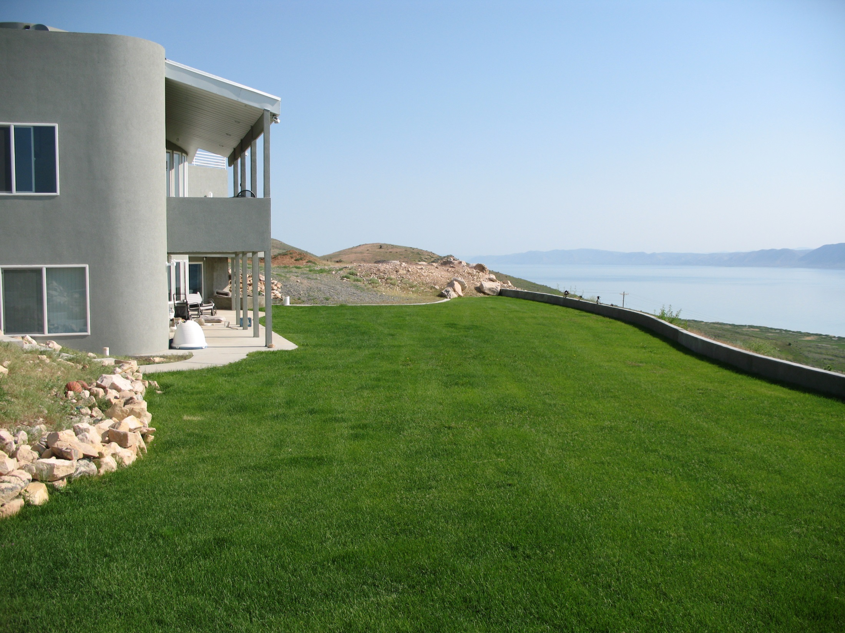
www.waterrights.utah.gov
Where to get more information
Notes:
Taken by Carl Mackley

Slide 18
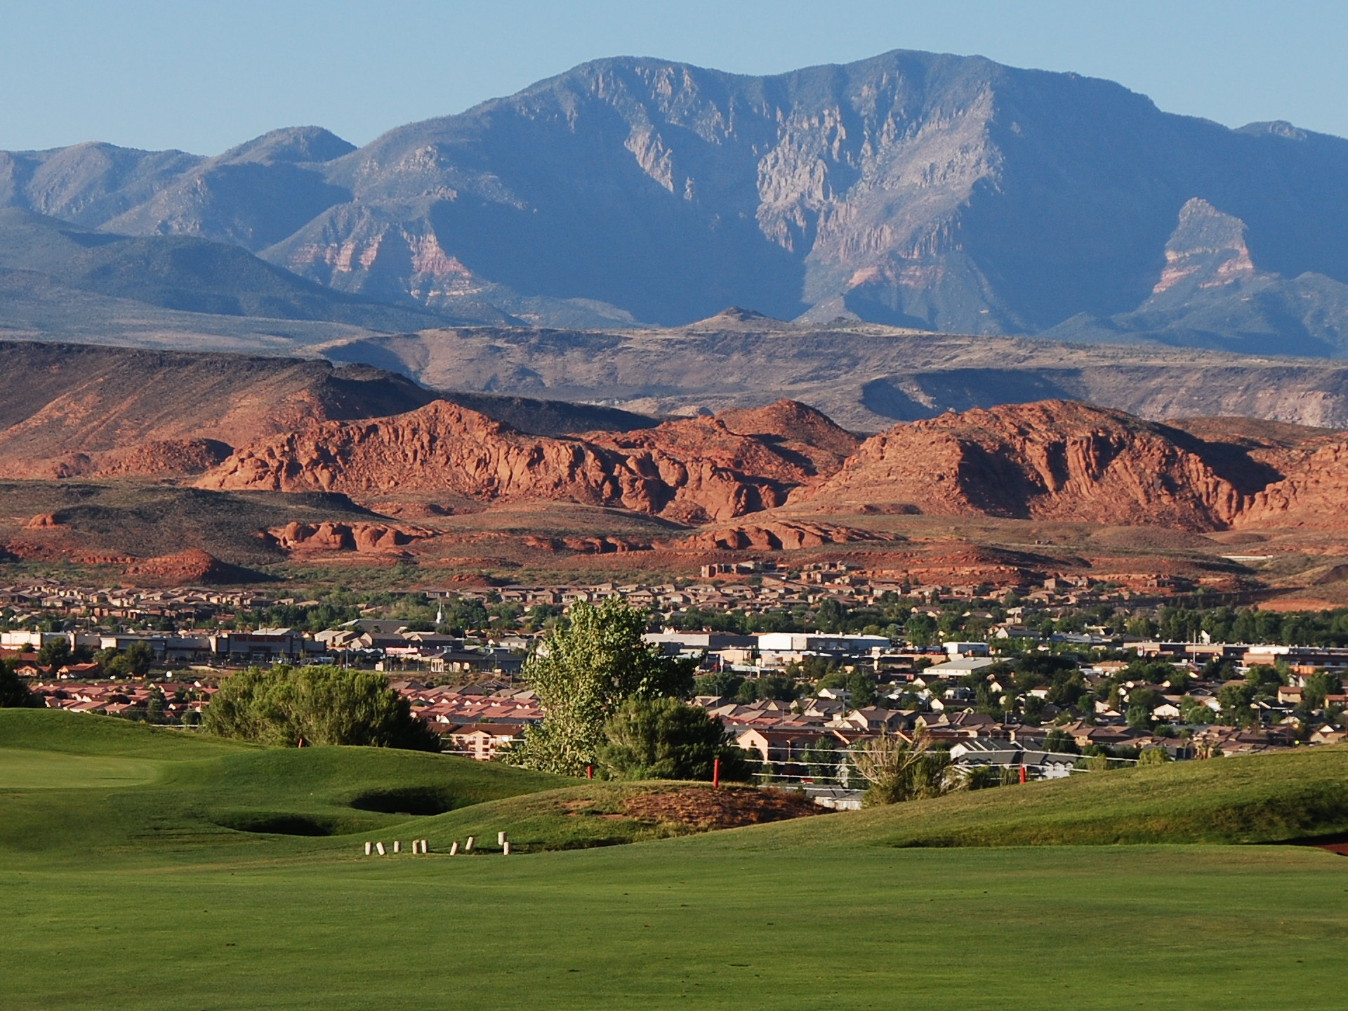
Questions?
Notes:
Taken by Kent Jones

