Slide 1


Utah Division of Water Rights
The Application Process
From Application to Certification
Clark Adams--April 2016
June 21, 2004

Slide 2
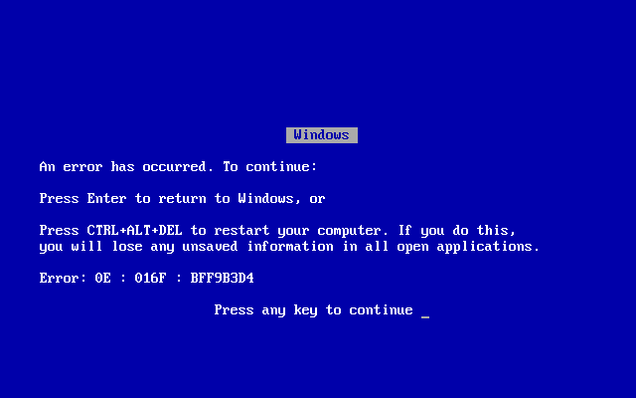

Slide 3

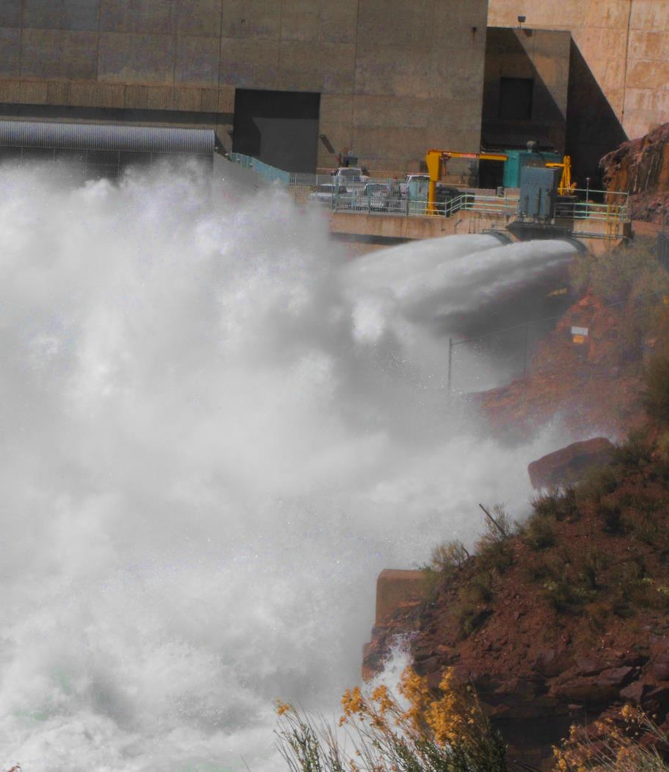
HOW DO I GET A WATER RIGHT?
Filing for a water right
  Application to Appropriate
  Diligence Claim
Purchasing property with existing rights
  Appurtenance
Purchasing all or portion of an existing right
  Change application

Slide 4
PERFECTED vs UNPERFECTED
What is a perfected water right?
  Certificated application
    “Proved” up on
  Water right awarded in court decree
    Adjudication
    Water User’s Claim
    Civil action or dispute
  Water User’s Claim issued after an Election
  Acceptably filed Diligence Claim

Slide 5
PERFECTED vs UNPERFECTED
What is an unperfected water right?
  An approved Application to Appropriate
  An unapproved Application to Appropriate
  Unpublished Water User’s Claim
  An unacceptably filed Diligence Claim

Slide 6
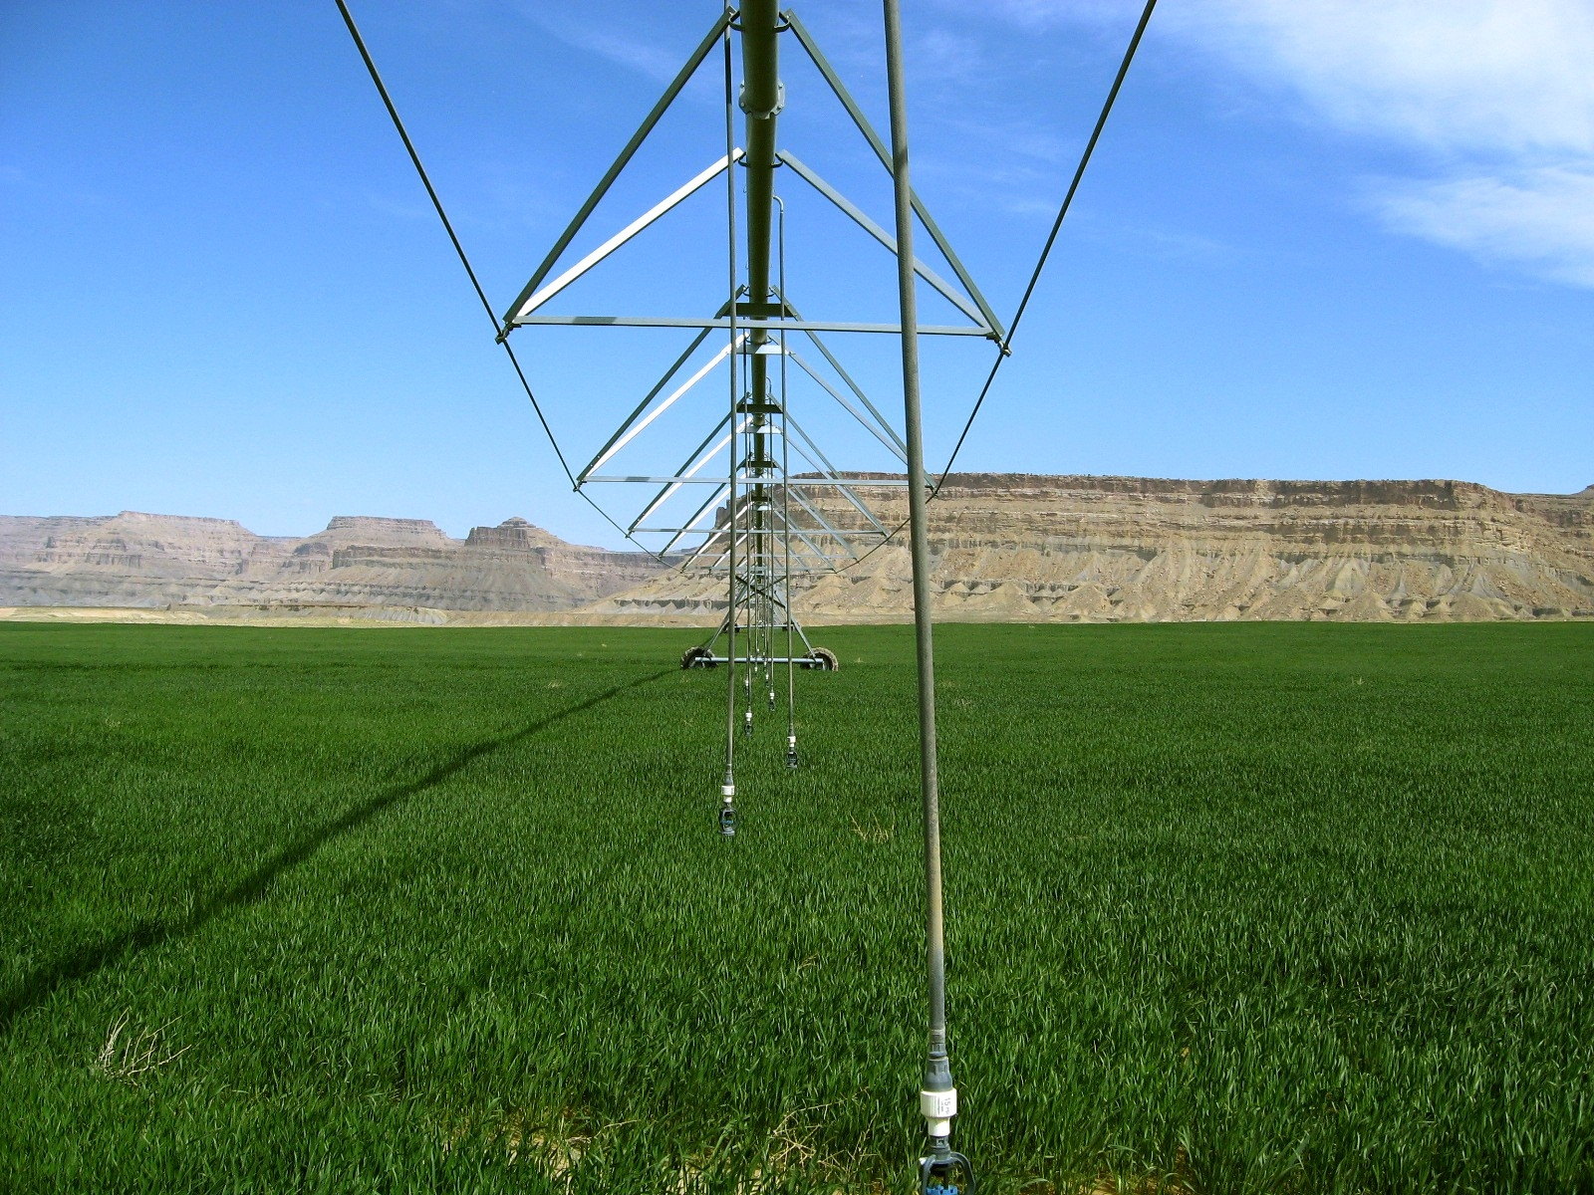
Applications
Types of Water Right

Slide 7
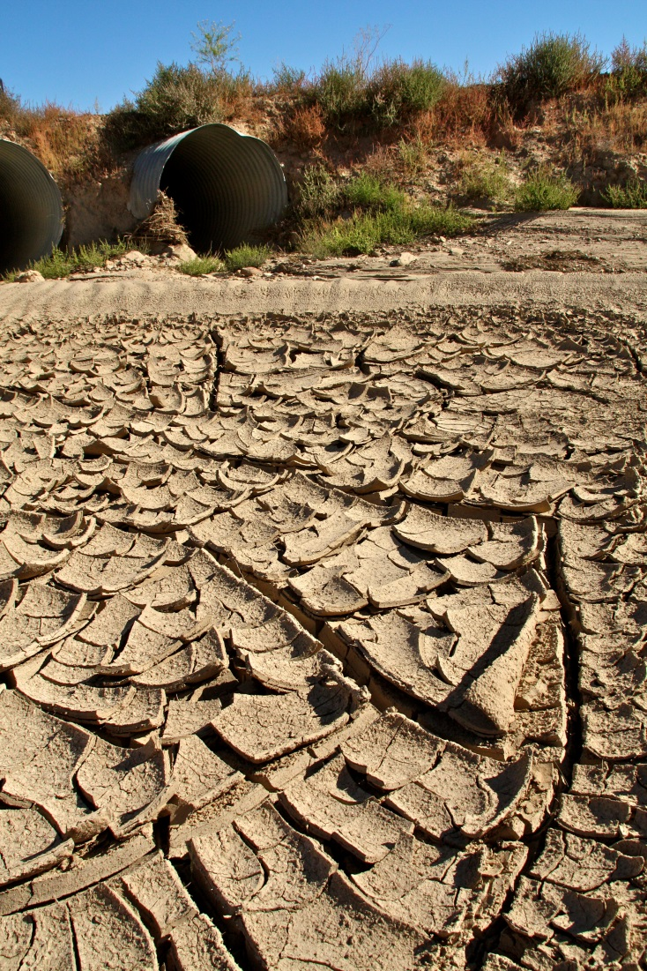
COMMONLY FILED APPLICATIONS
Application types we will discuss
  Diligence Claims
  Applications to Appropriate
  Change Applications
  Exchange Applications
  Temporary and Fixed Time Applications
There are others too

Slide 8
WHAT AN APPLICATION NEEDS
(Acceptably Complete)
  Applicant/owner’s name, address and ownership interest
  Source of water (specific spring, stream, underground well)
  Flow (cfs) or volume (acre-feet) of water to be diverted
  Point of diversion (POD) or where the water is diverted
  Existing or intended beneficial use of the water
  Place of use (POU) or location of the beneficial use
  Application map to identify where beneficial use will occur
  Signatures of all applicants/owners or legal agents
  Filing fee

Slide 9
DILIGENCE RIGHTS aka “PIONEER RIGHTS”
Filed to document beneficial uses that have been in continuous use since:
  Surface water prior to March 12, 1903
  Underground water prior to March 22, 1935
Filed with Division of Water Rights for review
Statutory procedures found in 73-5-13
Notes:
Diligence (also known as pioneer) rights are established by making beneficial use of water prior to March 12,1903 for surface water sources and prior to March 22, 1935 for underground water sources. These dates represent the time when the state legislation created the process for applying to appropriate water under the administration of the State Engineer. The application process was not made a retroactive requirement for prior water users. Water use that had started and had been continuously occurring prior to the legislation would be recognized without having to file an application. Diligence rights can be made public record as part of the State Engineer’s records by filing diligence claim forms. They can also be made of record in court documents regarding water right litigation. In order to resolve conflicts, judges issue decrees determining the rights of the involved parties. Some of the decrees are detailed in their description of the rights; others are very limited in the information provided. While many of these litigations involve rights established prior to 1903 or 1935, such rights may not be specifically called diligence rights. Following the issuance of the judges’ decisions, they are commonly referred to as decreed awards. Some diligence rights were defined in past adjudication proceedings in which the State Engineer was directed by the district court to provide a proposed determination of water rights in an area. During his investigations and mapping, water users were contacted about their use of water and how such use was authorized. Users filed water user’s claims based on diligence rights for inclusion in the water right compilation. Then these claims were published in proposed determination books, which were submitted to the court. The determination books were also provided to other water users, who could protest any of the rights if they disagreed with the information. The court eventually issues judicial orders and decrees addressing the rights. Statute 73-5-13 of Utah Code addresses the filing of diligence claims.

Slide 10
DILIGENCE RIGHTS
Must be prepared by Professional Engineer or Land Surveyor
Must provide the following:
  Who first put water to use
  How is claimant the successor in interest
  When was water first used
  Flow measurement
  Map of beneficial use
  Evidence of continuous use (affidavits, records, etc.)

Slide 11
DILIGENCE RIGHTS
Incomplete claims may be returned to claimant for additional information
After Filing
  Claim is advertised in local newspaper
  Protests must be filed with District Court
  Field investigation
  Report of diligence claim investigation prepared
  Limitations of right outlined in report

Slide 12
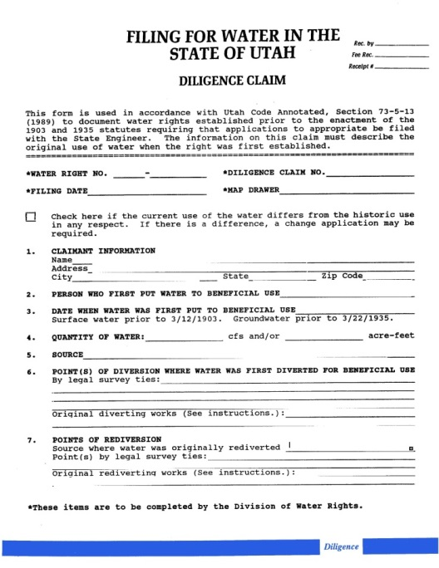
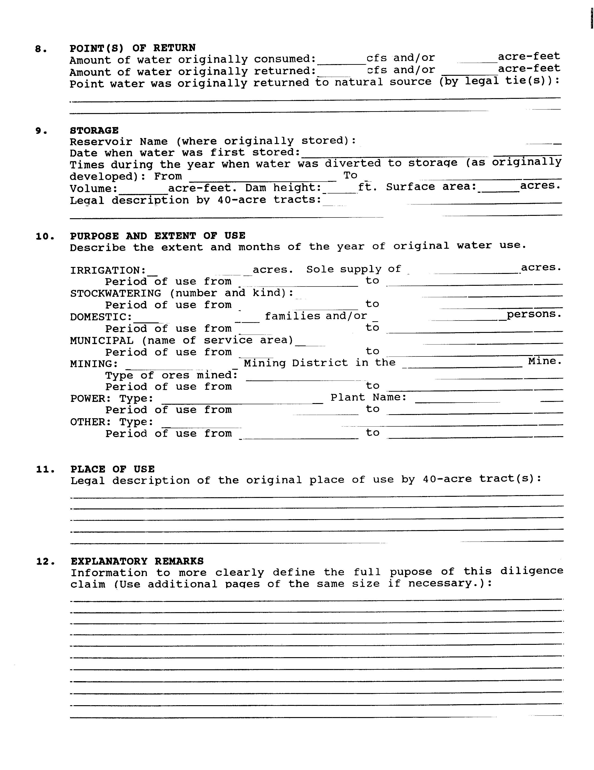
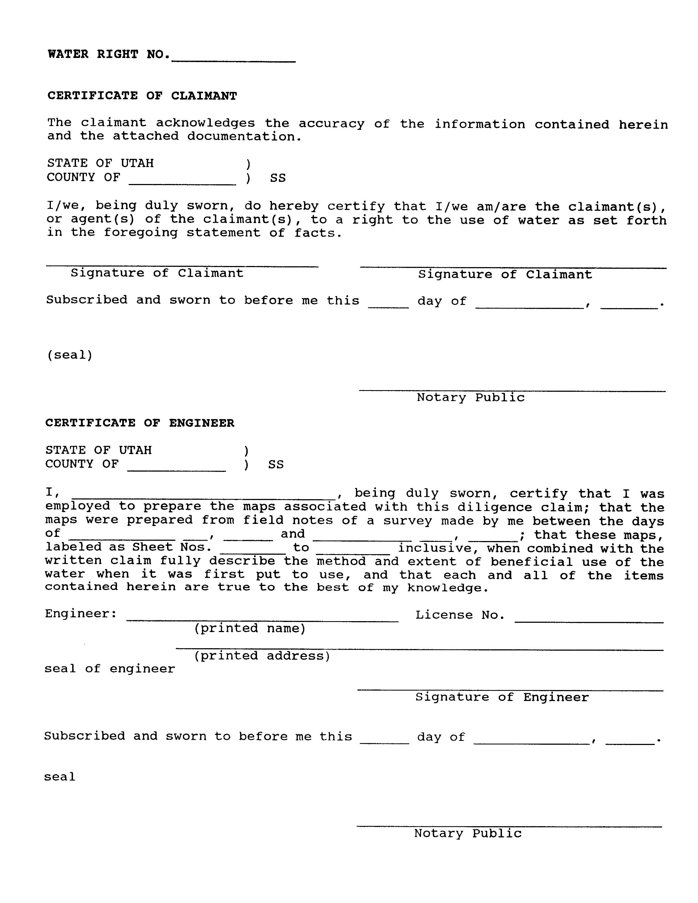
Notes:
These forms can be obtained by website, by mail, or by personal visit. Assistance in preparing the applications is also provided by the State Engineer’s staff.

Slide 13
APPLICATIONS TO
APPROPRIATE WATER
Filed to create a new water right
Much of Utah now closed or limited
Each water right area has unique policies
  Some open for large appropriations
  Some open for small domestic filings
    1 home, 10 livestock, 0.25 -1.0 acre irrigation, depending on area
  Most areas closed for new appropriations
Notes:
Applications to Appropriate Water are submitted to the State Engineer. They are subject to a process of public notice, possible protest by other users, review of the proposal and available data on water resources and other rights in the area, meetings, etc. Then, the State Engineer may approve or reject the applications. Those filings that are approved have time frames in which the water must be placed to beneficial use. Upon making such use, proof of beneficial use is filed. Upon review by the State Engineer, proof is accepted or rejected. If accepted, certificates of beneficial use are issued. Many areas of the state are now closed to or limited in new applications to appropriate due to the lack of available unappropriated water. However, even in closed areas, proposals for projects that will not consume water and will return it to the hydrologic system (such as hydropower or heat transfer) can be considered. Larger applications to appropriate can be segregated to accommodate separate rates of development, ownership by separate parties, or modification of parts of the original project.
Section 73-3 of the Utah Code addresses applications to appropriate. Applications to appropriate involving transport and use of the water in whole or part in another state must meet the special conditions required by state statutes concerning water exports (Section 73-3a, Utah Code). Applications to appropriate that involve geothermal fluids must meet the special conditions required by state statutes and rules regarding such projects (Section 73-22 of Utah Code and Rule 655-1 of Administrative Rules).

Slide 14
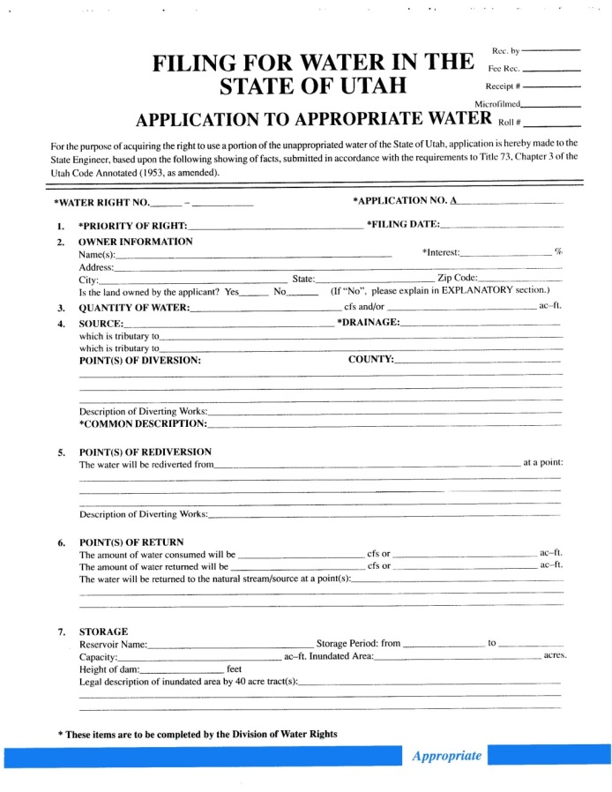
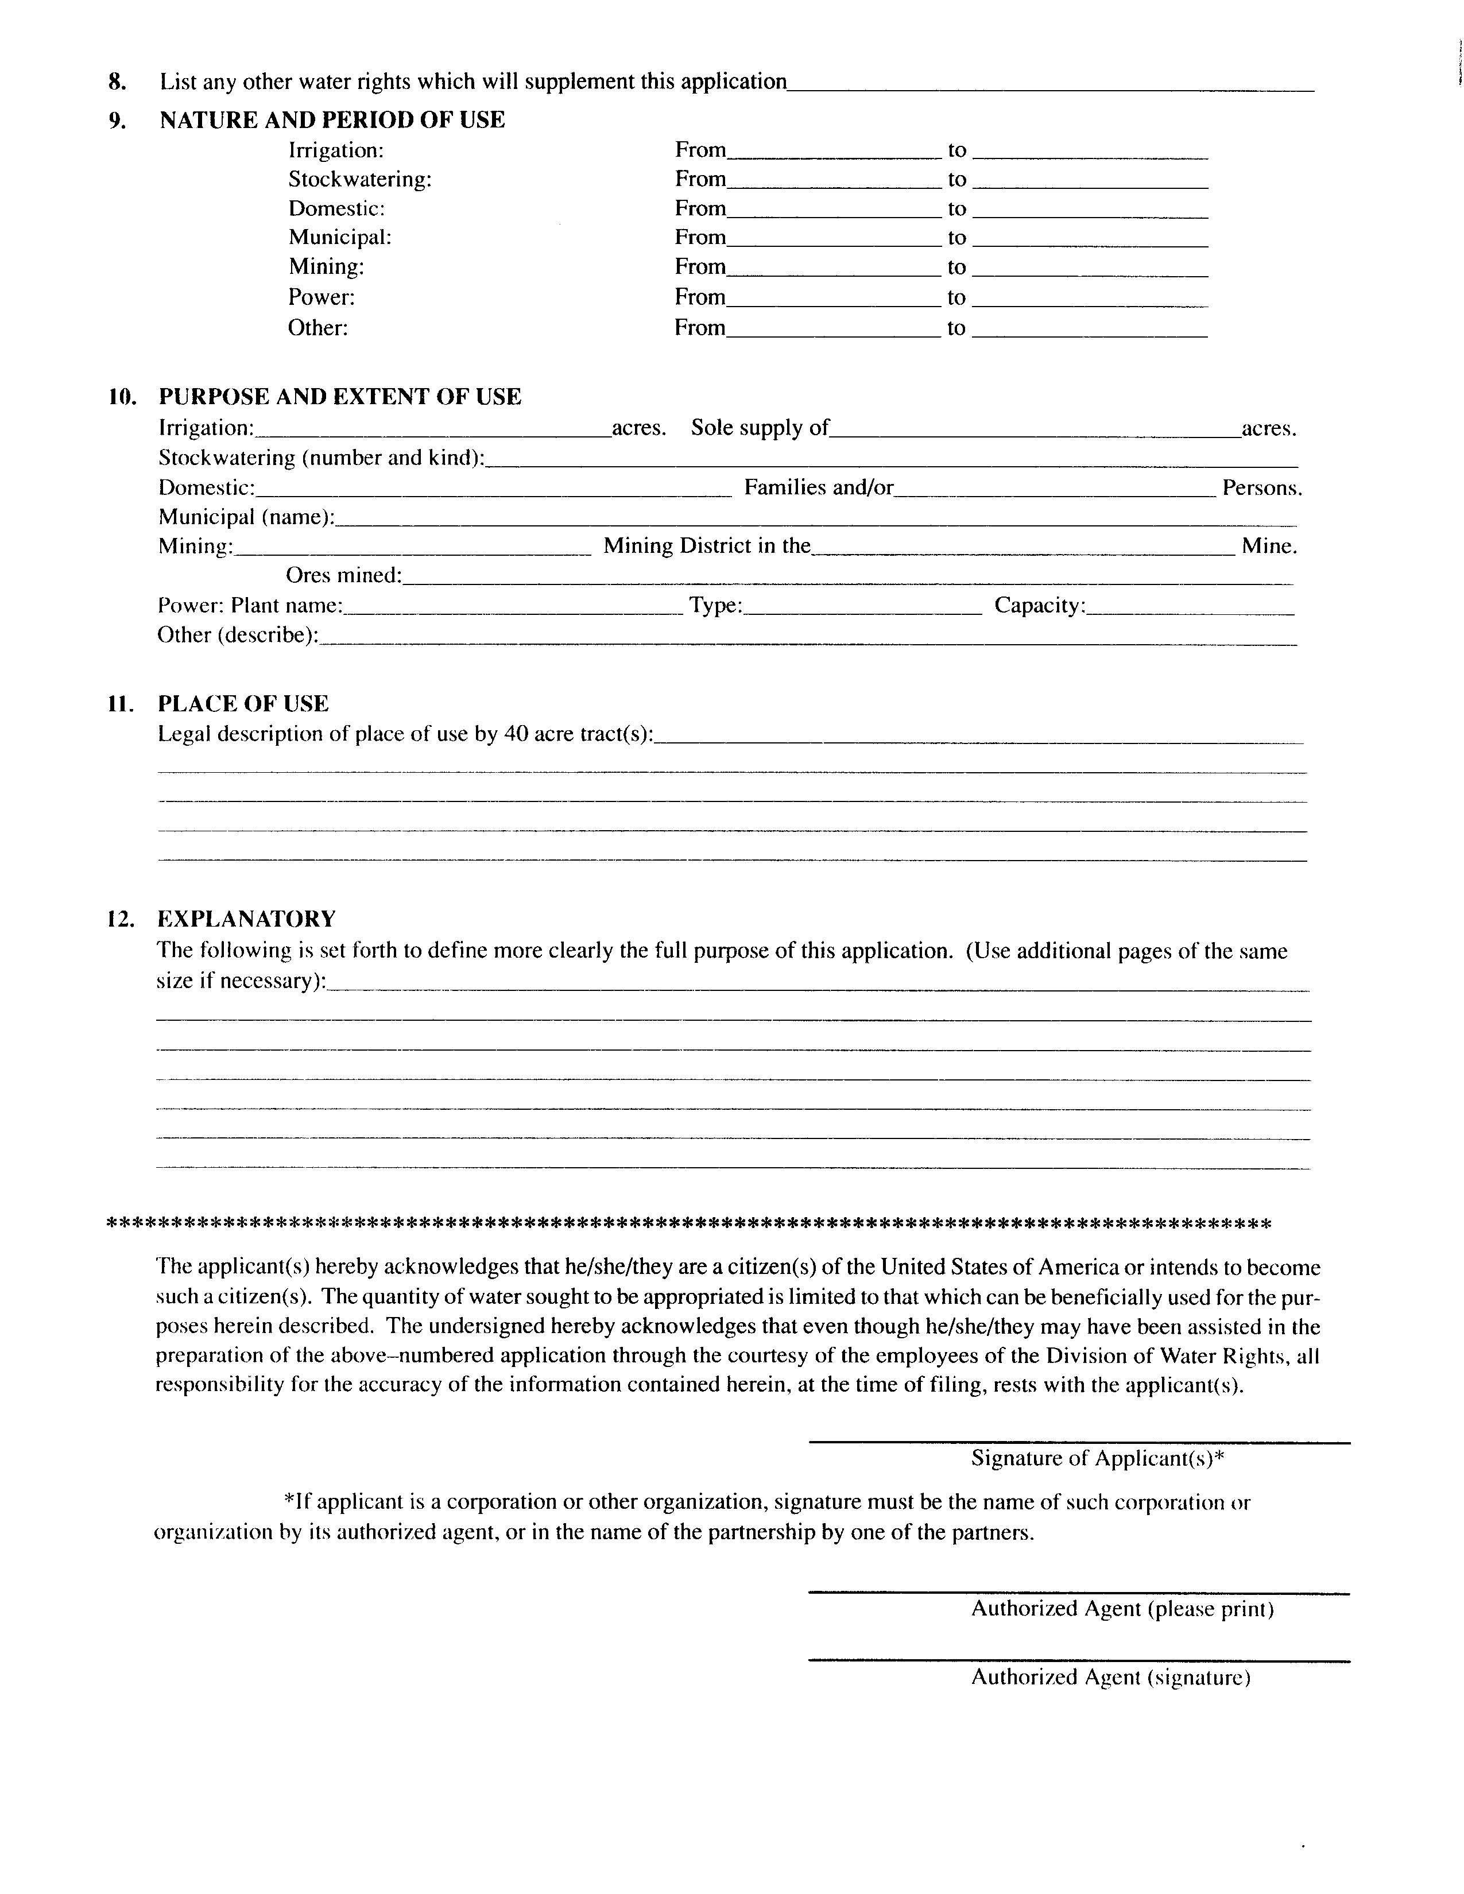
Notes:
Forms to apply for appropriation of water are available from the Division of Water Rights. They can be obtained by website, by mail, or by personal visit. Assistance in preparing the applications is also provided by the State Engineer’s staff.

Slide 15
CHANGE APPLICATIONS
Permanent changes
  Filed on established water rights to transform the parameters of original right(s):
    Point of diversion (moving more than 150 feet)
    Place of use
    Nature of use
    Period of use
Change application filed on approved applications to appropriate
  Amends the original to the proposed changes
  Does NOT extend the original proof due date
Notes:
Rights or portions of rights can be amended by permanent or temporary change applications. These filings can modify the point of diversion, nature of use, place of use, and storage of rights. They are subject to the same processes and review as applications to appropriate. Certificated permanent change applications can transform the parameters of their associated rights and thus accommodate new water projects by the retirement of original water uses. Because so many water sources and drainage areas are closed or limited for new appropriations, change applications on existing rights are a large and increasing percentage of filings with the State Engineer. Approved temporary change applications can authorize the use of permanent rights for different projects on a short-term basis. They expire after a maximum of one year from approval, and the rights return to their original parameters. Changes involving diversion or use of water in another state must meet the special conditions required by state statutes concerning water exports. Statute 73-3-3 of the Utah Code deals specifically with change applications.

Slide 16
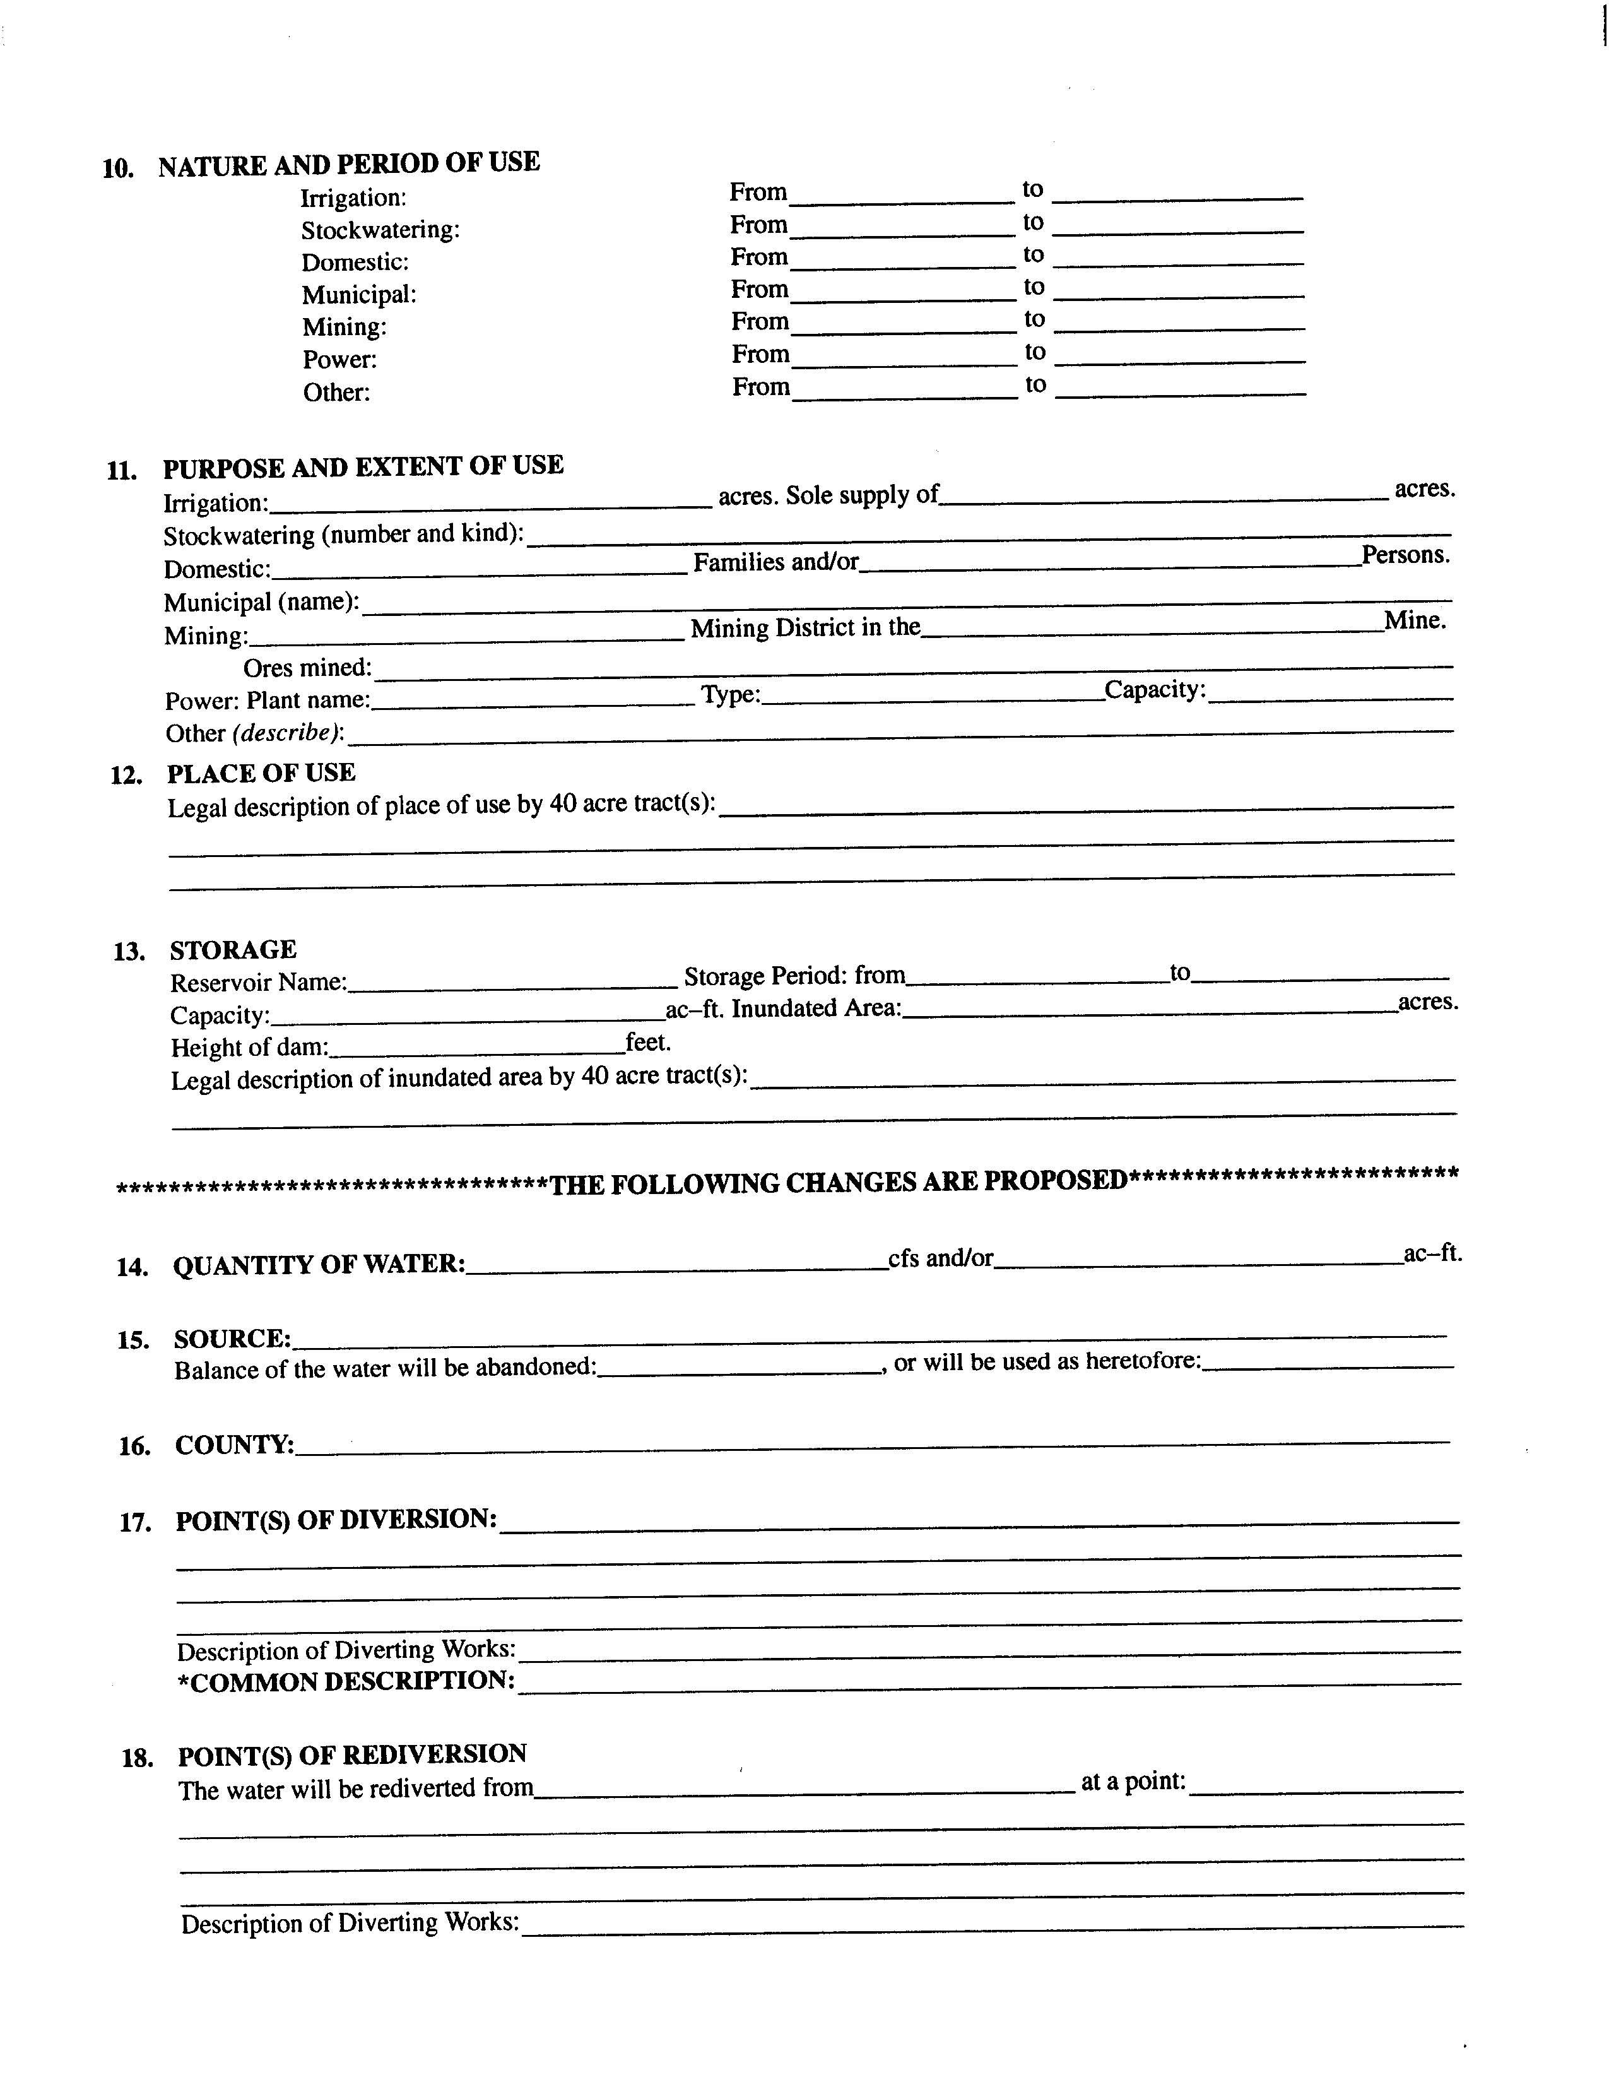
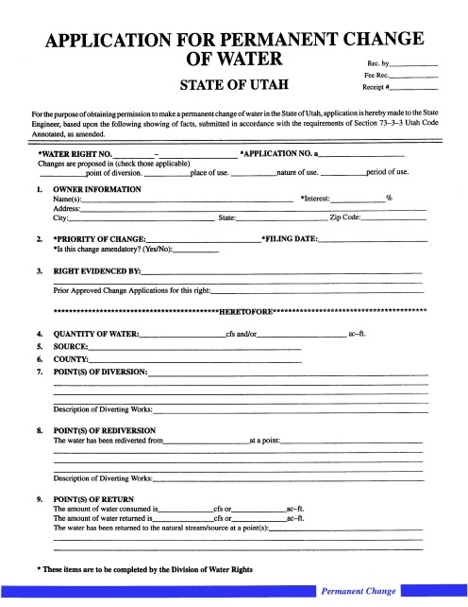
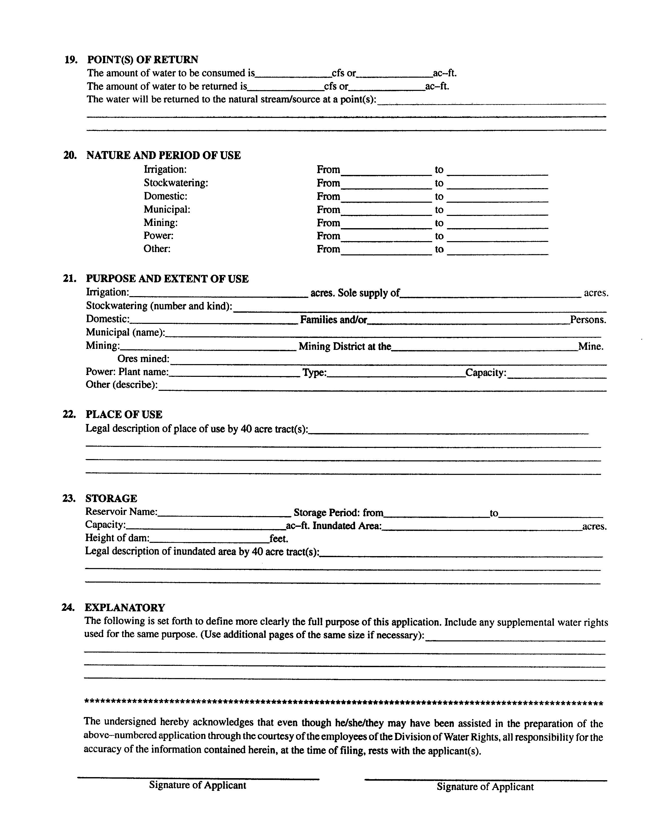
Notes:
Forms to apply to change water rights are available from the Division of Water Rights. They can be obtained by website, by mail, or by personal visit. Assistance in preparing the applications is also provided by the State Engineer’s staff.

Slide 17
EXCHANGE APPLICATIONS
Filed to exchange one source of water for another
Generally involve storage water owned by a conservancy district
Thru a contract with a district an amount of water is transferred to another source (well or spring)
Equivalent amount water released from storage
Potential reversion to original right
Notes:
Rights can be modified by exchange applications. These applications address relocation of points of diversion and uses of water rights on a conditional basis. In the event the applicants do not meet the conditions in which they hold interest in the water rights or the conditions of approval of the exchange applications, the exchanges cease. The underlying water rights revert back to their original parameters. Generally exchange applications address rights in storage reservoirs where water is released to compensate other water users in exchange for water taken and used by applicants at new locations. However, some exchange applications address flexibility in diverting water from differing locations to accommodate weather conditions, distribution issues, or facility maintenance. Statute 73-3-20 of Utah Code addresses exchange applications.

Slide 18
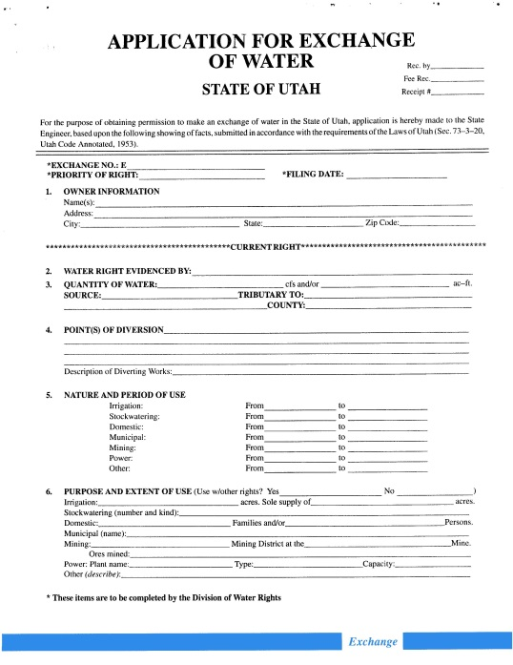
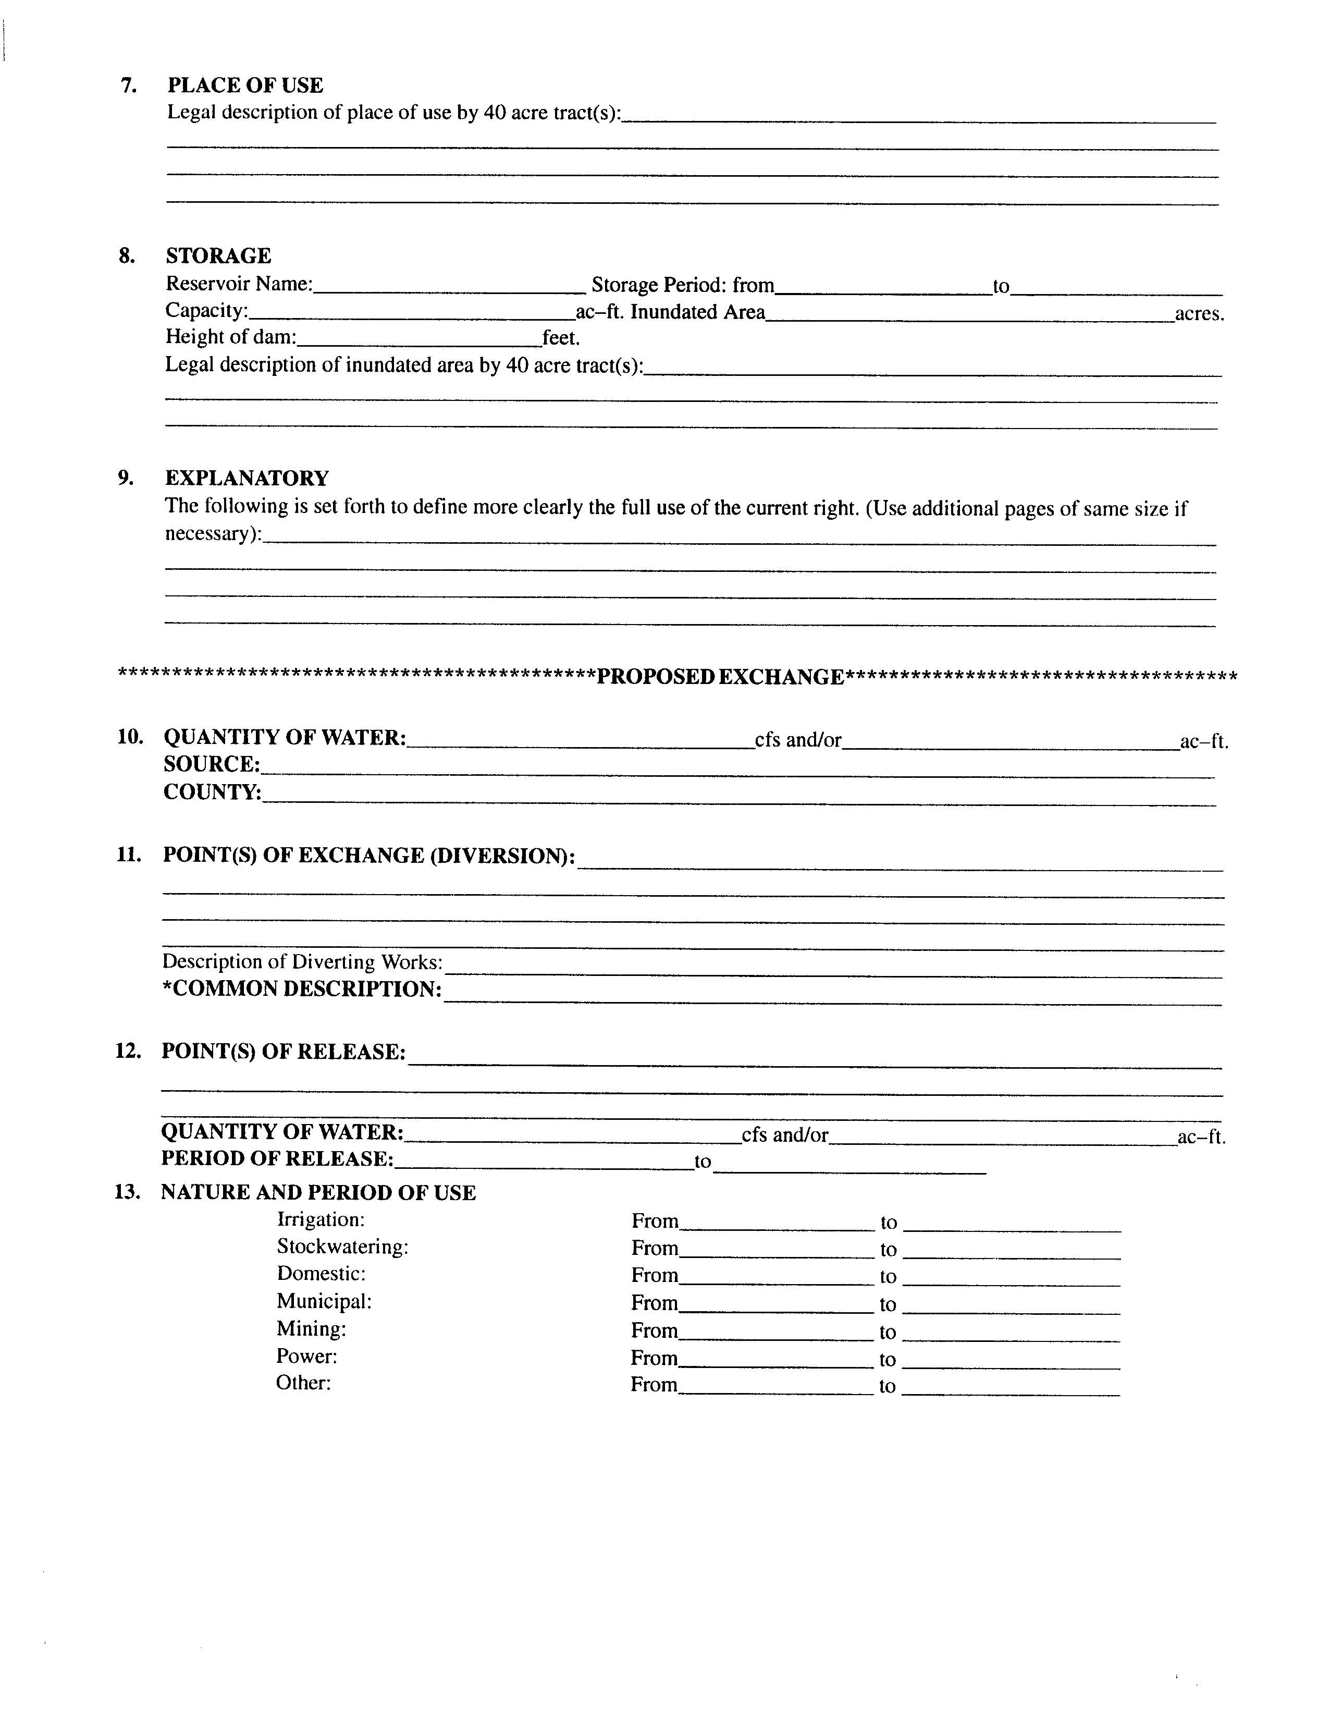
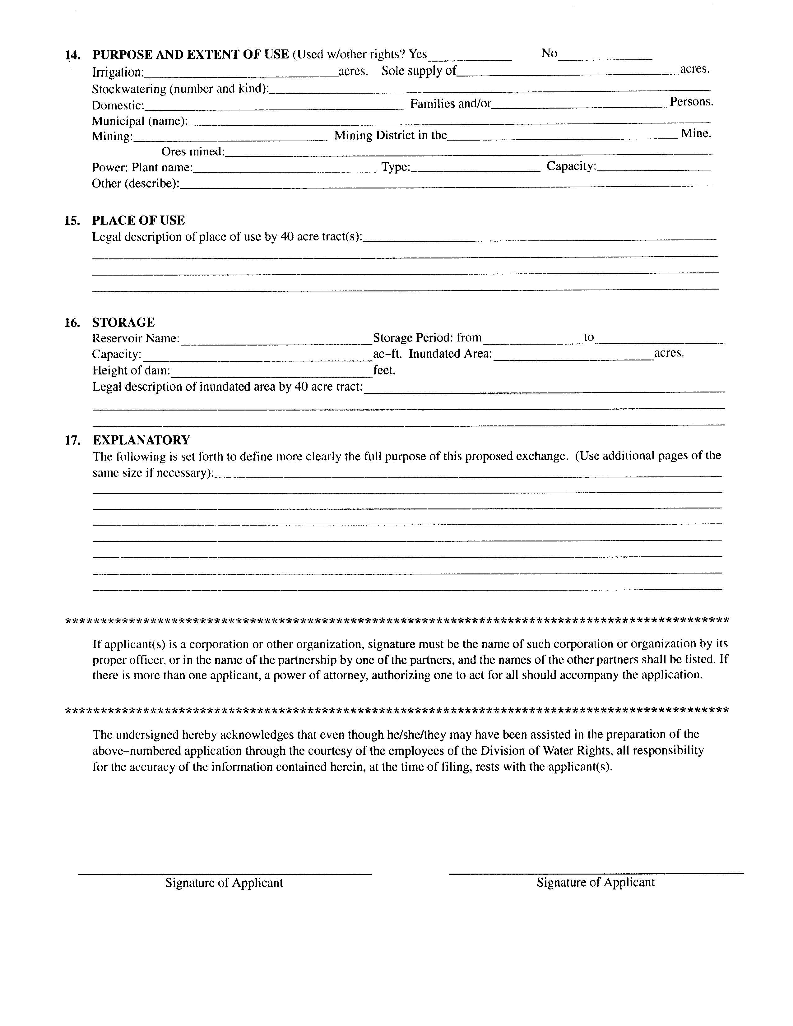
Notes:
Forms to apply to exchange water rights are available from the Division of Water Rights. They can be obtained by website, by mail, or by personal visit. Assistance in preparing the applications is also provided by the State Engineer’s staff.

Slide 19
TEMPORARY APPLICATIONS
Not many filed due to limited water availability
Temporary applications terminate after a maximum of one year
  Cannot be extended
Used for smaller, limited-life projects
  Road construction, oil or mineral exploration, etc.
Temporary Changes to lease water to other users
  To ensure continued use of water
  Cover additional use
  Water moved by Temporary Change cannot be used at the historic place of use and the proposed place of use during the time of temporary transfer
Notes:
Temporary water rights can be obtained to address limited-time projects for periods when water is available and/or to authorize use of water for a period of time while other water supply options are being pursued. Due to rather tight water supplies in several parts of the state, these filings are somewhat rare. Generally they occur in areas where there are large appropriations of water for projects that will not be completed for several years. During the time of development, water may be available on a temporary basis for smaller, limited-life projects such as road construction, oil or mineral exploration, etc. Temporary applications expire within a maximum of one year after approval. Fixed-time applications terminate at the time described in approval documents. An extension of the fixed-time period can be requested and approved under certain conditions prescribed by state statute. Statues 73-3-5.5 and 73-3-8 of the Utah Code address temporary applications and fixed-time applications.

Slide 20
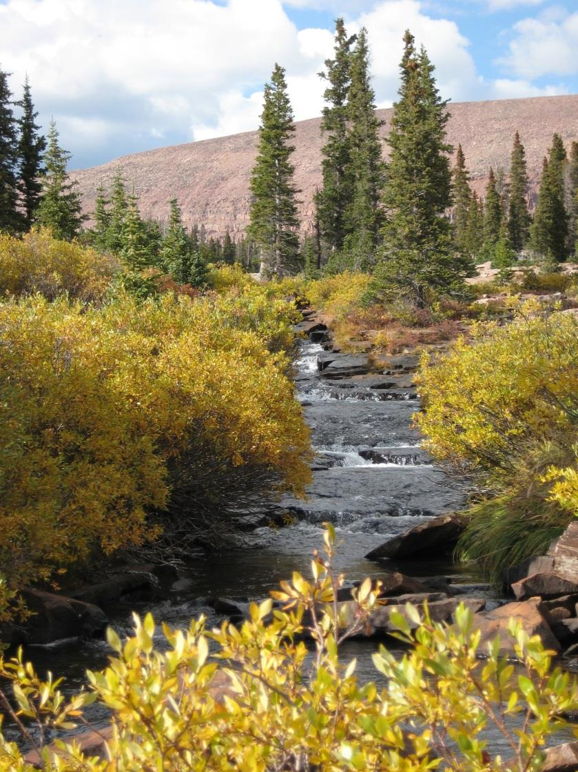
FIXED TIME APPLICATIONS
Filed for specific amount of time as determined by State Engineer
“Proof” not required
Contact with applicant and monitoring of development thru Water Use Program
Can be filed for all uses, except domestic use
Can be extended

Slide 21

THE APPLICATION PROCESS:
IT IS JUST THAT EASY!
?

Slide 22
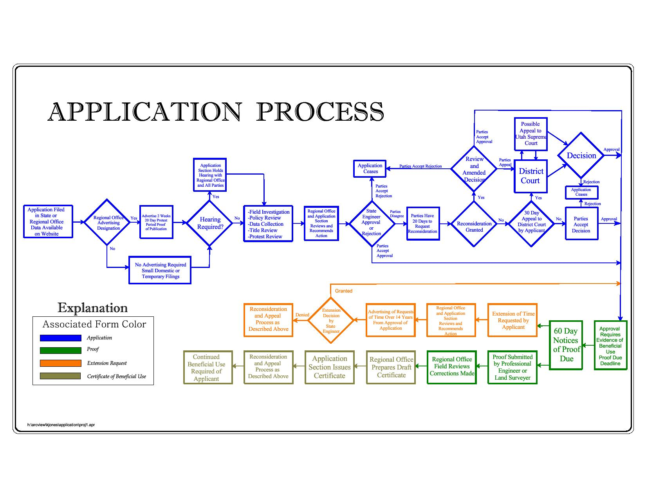

Slide 24
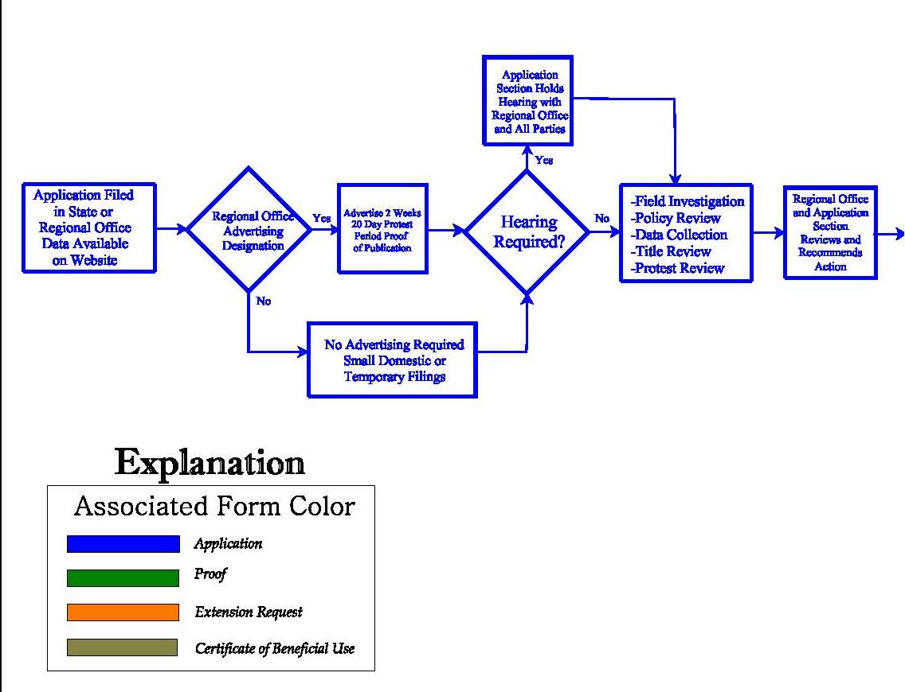
FILING AND REVIEW OF THE APPLICATION
Notes:
This diagram showing the various steps in the application process is available at the Division of Water Rights Internet website at http://waterrights.utah.gov/wrinfo/policy/apschem.pdf. I have separated it into three parts for the purposes of this discussion. The first section shows the initial filing of the application, notifying the public, addressing any protests, reviewing the proposal and its relationship to other water rights, and making an initial recommendation for the State Engineer’s action. Much of this activity heavily involves the regional offices of the Division and their personnel. The division has seven regional offices administering the different river basins in Utah.

Slide 25
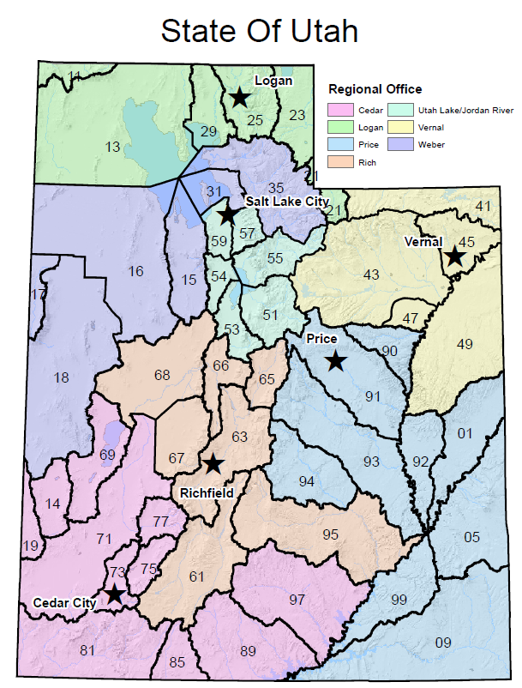
FILING AN APPLICATION
By mail or visit
Fee required
Establishes initial priority
Placed on the New Filing List
Notes:
Applications can be submitted by mail or by visit to division offices. They must be acceptably complete before they can be designated as officially filed.
A filing fee is required based on the amount of water involved. The minimum amount is $75.00 and must be provided via check or cash.
The date that the application is accepted as officially filed establishes the initial priority of the application.
The application is numbered, jacketed, scanned, and placed on the division’s website new filing list. The water right number places the application in a specific drainage area so that it can be related to other rights in the same hydrologic resource. The map shows the various drainage areas and the regional offices that oversee Division of Water Right activities in these drainages.
How to file an application will be covered in another section….this is only covering the process

Slide 26
ADVERTISING DESIGNATION
Newspaper with local circulation
  Public notice of applications being filed
Regional office action
Waiving advertising
  Temporary applications are usually not advertised
  Advertising for small domestic filings can be waived in some areas
  Application to move point of diversion less than 660 feet, the advertising can be waived
  Can still be protested if not advertised
Notes:
Applications are generally published in the legal notice section of the newspapers with local circulation in the area of the proposed diversion point(s) and place(s) of use. More complex proposals may be published in more than one newspaper.
Applications are designated by regional office personnel as complete and requiring advertising.
Some small filings, temporary applications, or limited changes of point of diversion may have advertising waived.

Slide 27
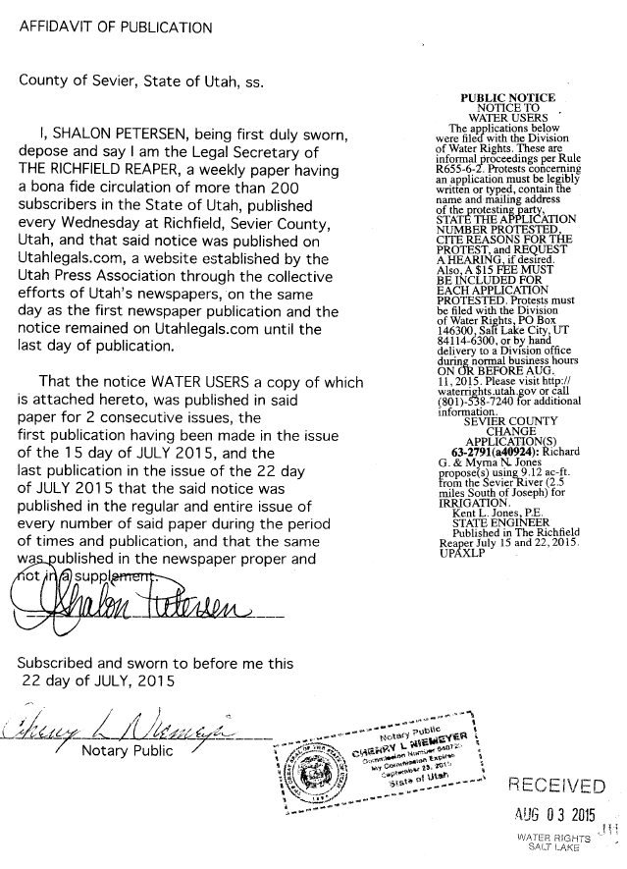
ADVERTISING PERIOD
Permanent filings
  Once a week for two weeks
Temporary filings
  Not advertised
Notices drafted by division
Proof of publication
  From Newspaper
  Required to move forward
Notes:
Permanent filings are advertised twice with a one week interval between publications; there is a statutory 20-day protest period following the second publication for informal proceedings and a 30-day period for formal proceedings. All proceedings before the State Engineer are informal unless otherwise designated.
Temporary filings (for projects lasting only one year) are advertised at the discretion of the regional engineer based on experience with water rights concerns in the area of the proposal and whether there is potential impairment of other water rights or not. If advertised, publication generally occurs once with a following protest period of ten days.
Notices to water users are drafted by the applications/records section and contain information as directed by statute. They are e-mailed to the appropriate newspapers, and the applications are placed on the division’s website advertising list. Advertising is generally placed in the legal notices section of the newspaper. Many local papers are weekly editions which circulate on Wednesday or Thursdays. For larger daily newspapers, the notices occur on Thursday editions.
After advertising, the involved newspapers provide proof of publication documents to the State Engineer. The State Engineer must receive this proof of publication before further action can be taken. The newspaper bills are then paid by the division.

Slide 28
PROTESTS
Filed by interested or affected parties
Must provide water right/application number that is being protested
Timeliness, within 20 days of advertising
Protestant information (name and address)
Relevant information
Protestant standing
Filing fee $15.00 per protestant(s)
Notes:
Protests are filed with the division by interested parties. Generally these are other water users in the area who believe their supply may be impaired by the new project. However, sometimes title or property access or environmental concerns may be the issues raised. Some people who protest applications are recent applicants themselves. Once they have their filings approved, they suddenly turn somewhat environmentalist. Even though their application was approved, they don’t think anyone else should have their proposals authorized. It’s interesting to talk through the situation of why it is okay for them but not for others. It is also interesting to see how much more water use by others will impair rights when such use is made by people without local roots as compared to those who do have a history in the area. It really gets down to statutory requirements for approval and why the application shouldn’t be approved. Protests should focus on that kind of discussion.
The protest must indicate the water right(s) being protested. General concerns about lessening water supplies throughout a basin or encroaching urbanization and its potential effects or need for a water management plan in a valley would be considered as correspondence to the division and not as a protest to any or all new filings in the area.
The protest must be submitted within the appropriate period and be considered timely in order to establish legal standing of the party in subsequent application procedures and potential court involvement.
The protest must provide the name and address of each protesting entity and be signed by the protesting party or its authorized representative or power of attorney. In addition to the signature, it is important to print the name of the protestant so that we know exactly who is submitting the protest. If the name and address aren’t readily readable, standing as a legal protestant may be jeopardized.

Slide 29
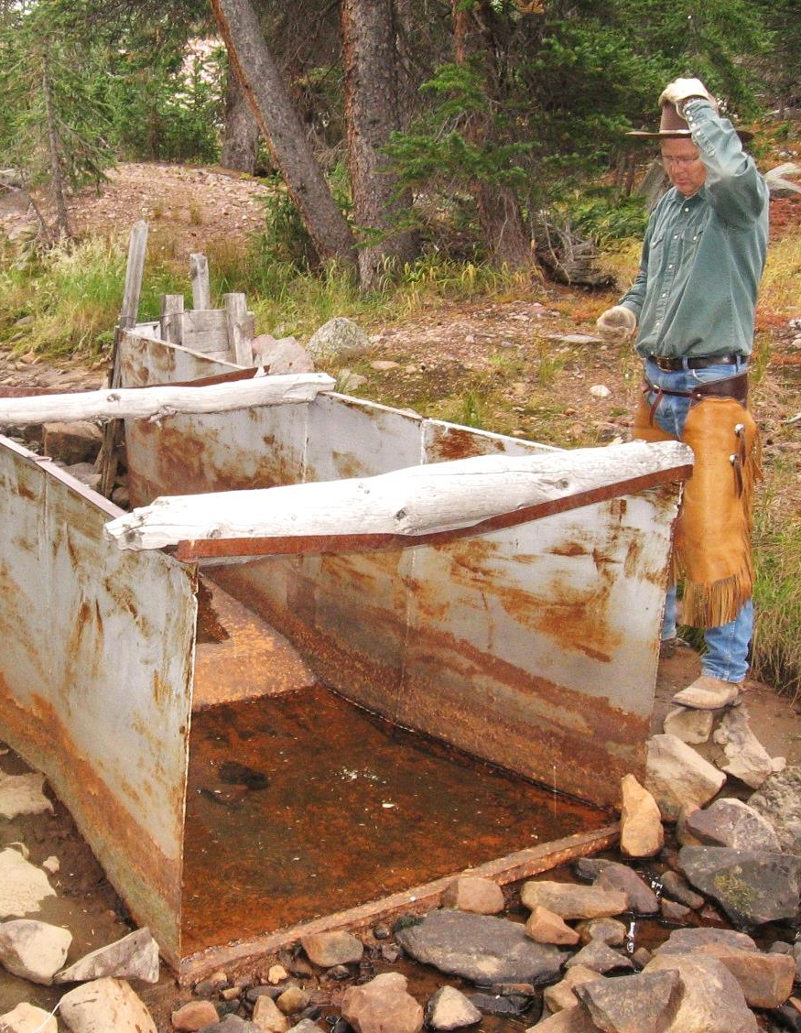
HEARINGS
Generally held locally
Usually held to address protest or to gather additional information
Usually informal proceedings
May be waived
Recorded
Notes:
Hearings are generally held in the county seats of the counties where water is to be diverted and used. However, if parties agree to some other location for greater convenience or if no facilities are available to accommodate meetings, the locations may be in other towns or in conference rooms at division offices. The usual schedule is to visit each county two times each year; the dates are about six months apart. There may be several hearings per trip.
Generally hearings are held to address protests, but they can be held to gather additional information if the applicant’s proposal is not sufficiently clear. If parties desire to have a hearing before the State Engineer, they must request the hearing. The determination as to whether a hearing should be held or not is at the discretion of the State Engineer.
Almost always, these hearings are informal proceedings. The Assistant State Engineer for Applications/Record and the regional office personnel are hearings officers who direct the meetings. Applicants are asked to provide information in support of their filings. Protestants discuss their concerns. Other interested parties may provide additional information. In some cases, hearings can also involve witnesses, consulting experts, attorneys, etc., especially in large or complex projects or where property, title, or other legal issues are involved or geologic and engineering information is helpful. Hearings are recorded, and the proceedings are made available on the division’s Internet website.
Hearings may be waived if sufficient information is available and/or if parties indicate that no hearing is needed.
Once the hearing is completed, the responsibility for the processing of the water right is assigned to the regional office to perform a review of the file.
Information gathered in hearings is used in the decision making process for the application.

Slide 30
REGIONAL OFFICE REVIEW
Regional engineer and staff assist State Engineer in administering water rights in particular regions of the state
Examine all available information
  Field examinations
  Policy analysis
  Scientific reports, etc.
Consider protest concerns
Recommend decision to State Engineer
Notes:
This review by regional office personnel can involve possible field inspections, policy analysis, study of available hydrologic information including scientific reports and water measurements and data on other rights in the area, examination of title documents, and possible requests for further information from parties. The regional staff may discuss relevant issues with the State Engineer and the Application/Records staff and may involve staff from the Attorney General’s office to help formulate recommendations.
Personnel also assess the concerns raised in any protests.
This process results in recommended action on the application.

Slide 32
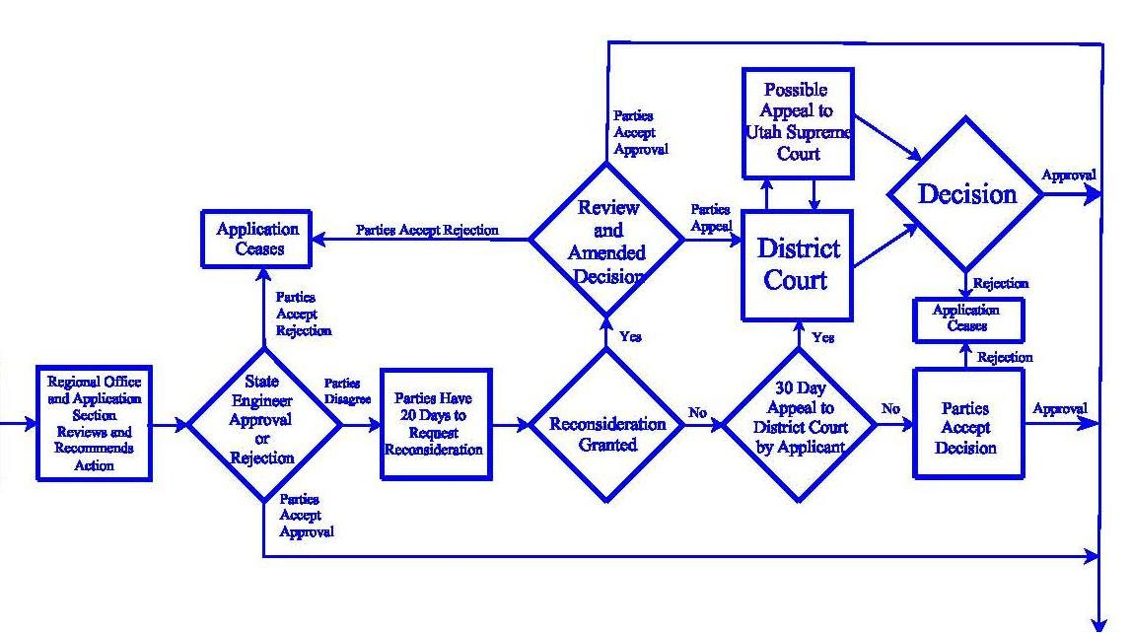
DECISION ISSUED

Slide 33

RECOMMENDED ACTIONS
Approval
Rejection
Deferral
Notes:
If approval is recommended, an initial draft of the order for this action is prepared for the State Engineer’s review and signature. Approval can only be considered if the application meets statutory criteria. Section 73-3-8 of the Utah Code states that for applications to appropriate, there must be unappropriated water in the proposed source, the proposed use will not impair existing rights or interfere with the more beneficial use of the water, the proposed plan is physically and economically feasible and would not prove detrimental to the public welfare, the applicant has the financial ability to complete the proposed works, the application was filed in good faith and not for purposes of speculation or monopoly, and the application will not unreasonably affect public recreation, the natural stream environment, or prove detrimental to the public welfare. Concerning change applications, the same criteria must be applicable, but under Section 73-3-3 of the Utah Code is a further direction that the change may not be made if it impairs any vested right without just compensation.
If the application doesn’t meet statutory requirements and rejection is recommended, an initial draft of the order for this action is prepared for the State Engineer’s review and signature.
If deferral is designated, action on the application is held pending until further information is received. This could involve the applicant’s request for additional time to submit supporting data or address other legal issues, the desire by interested parties to negotiate among themselves to address concerns, or actions concerning other rights or studies or policies in the area need to be addressed before a decision can be made.
Once the regional office has completed their recommendations, the application is designated to be reviewed by the Applications/Records section.

Slide 34
APPROVAL CRITERIA (73-3-8)
Unappropriated water in source
Will not impair existing rights
Physically and economically feasible
Not for purposes of speculation or monopoly
In the public interest / welfare
Notes:
These will be covered in more detail in a later section

Slide 35
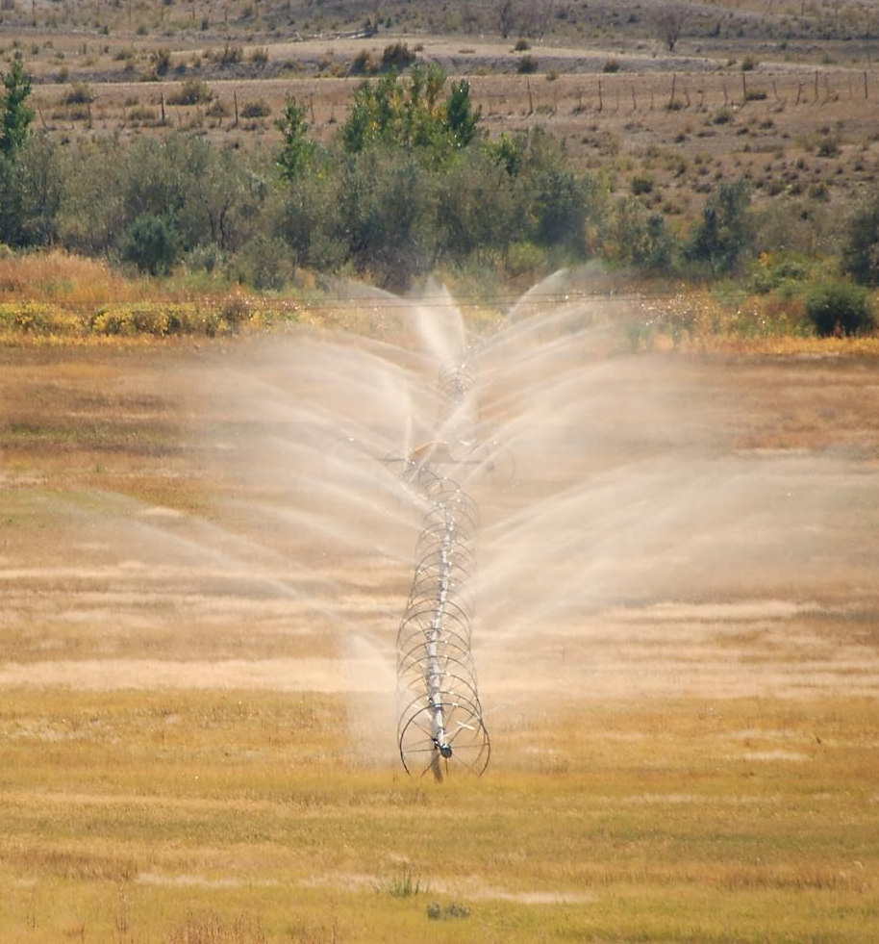
APPLICATIONS/RECORDS
SECTION REVIEW
Recommendation from regional office is reviewed for completeness, accuracy and consistency
Legal counsel
Final draft to State Engineer
Notes:
The initial draft of the order for the State Engineer is reviewed for completeness, accuracy, and consistency with division practices and policies
More complex issues may be reviewed with staff of Attorney General’s office.
Regional offices may be contacted with questions, suggested language, etc. and additions or amendments are made. Then the final draft is submitted to the State Engineer.

Slide 36
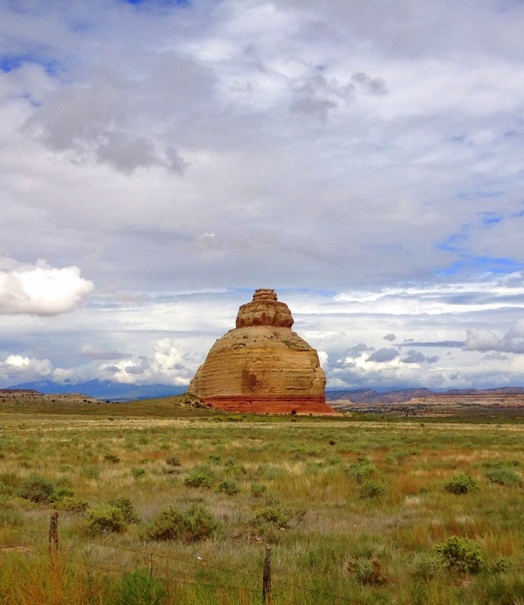
STATE ENGINEER’S ACTION
Reviews final draft
Signed orders sent to all parties
Approval listed on Division of Water Rights website
  www.waterrights.utah.gov
Rejection terminate filings
Scanned documents on website
Notes:
The State Engineer may require more information and changes to the order. The draft is then returned to involved staff for further review and possible amendment.
If the final draft order is signed, copies are sent to all involved parties on the same day of signature.
Approval information is placed on the new approvals list on Internet website. Under Section 73-3-10 of the Utah Code, if the application is approved, the applicant is authorized to proceed with construction of necessary works (subject to any conditions set forth in the State Engineer’s order) and to take any steps required to apply the water to use named in the application (subject to any other permits required such as rights of way, local health and building codes, etc.).
Rejections result in the termination of the application. The applicant cannot take any steps toward the prosecution of the proposed work or the diversion and use of the public water under the application.
The orders are scanned on the water right computer file for view at the Internet website.

Slide 37
20-DAY RECONSIDERATION PERIOD
Request changes to order
Parties with legal standing
Must be timely
If granted, order is rescinded
If denied, order remains in place
  No action on reconsideration means denied
  Can appeal to District Court
Notes:
All parties with legal standing (applicants and timely protestants) can request reconsideration if they believe the decision was arrived at incorrectly or that a condition or explanation contained in the order is not adequately or correctly addressed or that an important issue is not covered.
The request must be filed within the twenty-day period.
If granted, the decision under the order of the State Engineer is rescinded and reviewed. A later amended order is issued addressing the reconsideration request. The amended order may change requirements or quantifications in the first decision. It may indicate that review of the additional information or concerns from the reconsideration request does not indicate a need to change the original decision and thus the language in the amended order is essentially the same. In some unusual cases, the information supplied via the reconsideration request could alter negatively or positively the ability of the application to meet statutory criteria, and the original decision could be reversed. If significantly altered, the amended order would once again be subject to reconsideration and appeal. If not altered, the amended order would no longer have provisions for further reconsideration. If the parties do not agree with the amended order, timely court appeal could be pursued.
If a request for reconsideration is denied, the decision under the original order remains in place. Parties not agreeing with the original order would then pursue timely court appeal. The State Engineer receives approximately 100 requests for reconsideration each year.

Slide 38
30-DAY APPEAL PERIOD
Appeal to District Court
  De Novo review
Parties with legal standing
Must be timely
  30 days of original order
  30 days of a denied reconsideration
Judge can uphold, deny, or amend the order
Utah Supreme Court
Notes:
Parties with legal standing can appeal the State Engineer’s order to the District Court having jurisdiction in the area of the water right.
The appeal must be made within thirty days of the issuance of the original decision or thirty days after the request for reconsideration is denied or thirty days after the amended decision is issued after granting of reconsideration.

Slide 40
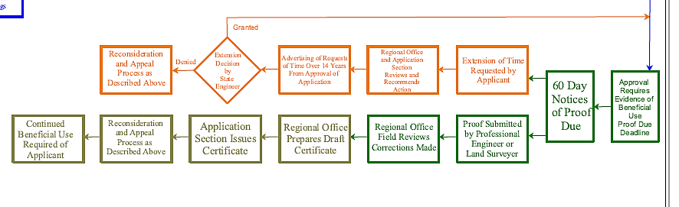
APPROVING, USING AND PROOFING
Notes:
This third section addresses development of actual physical beneficial use under an approved application and the perfection of the application by issuance of a certificate.

Slide 41
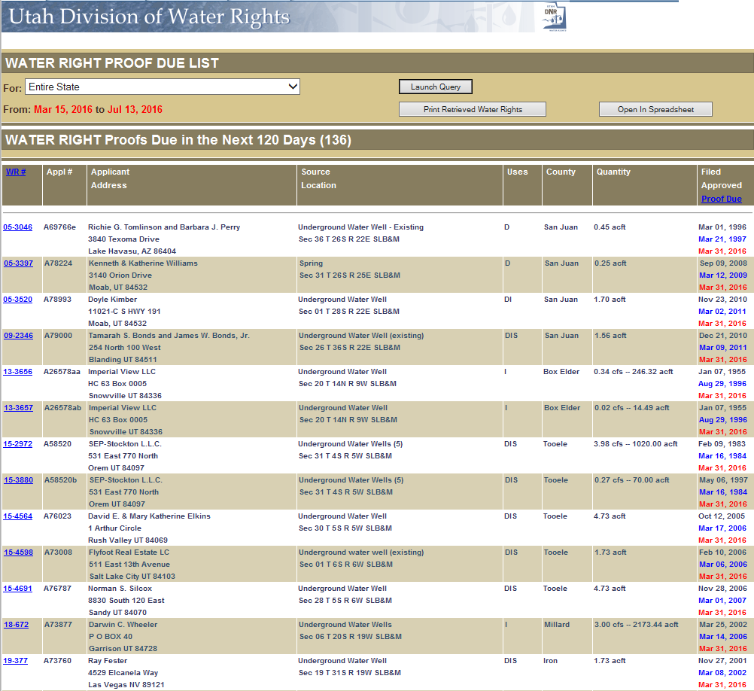
APPROVED APPLICATION
Due date for beneficial use
  Usually five years from date of approval
Sixty-day notice
Proof documents
Request for more time to develop
Timely submission or application lapses
Permanent lapsing
Notes:
Approval of an application is based in part on the understanding that the applicant has the intention and the means to pursue timely development of the proposed project. Otherwise, an application could be considered speculative and thus, under statute, not approvable. The approval order requires proof be submitted that water has been placed to beneficial use within a specified time-frame. The period varies depending on the scope of the proposed project.
Sixty days prior to the deadline, the applicant of record at the address of record is notified that proof is due and is provided an extension of time request form to facilitate possible need for more time.
If the applicant has completed as much of the project as intended (up to the limits as described in the approval of the application), the applicant can file proof of beneficial use on or before the due-date. The applicant or the applicant’s agent can file an extension of time request explaining the diligent progress made in pursuing the project and citing justifiable causes for delay. This must be done prior to or on the due-date. If neither proof of use nor an extension request is filed by the deadline, the application lapses. Documents can be filed within sixty days after the notice of lapsing, but the priority of the application will be reduced to the date the proof or request for more time is submitted. If neither proof documents nor an extension request is filed within a sixty-day period after the notice of lapsing, the application permanently lapses. Authority for the proposed use of water terminates, and any use of water as proposed under the application is not legal.

Slide 42
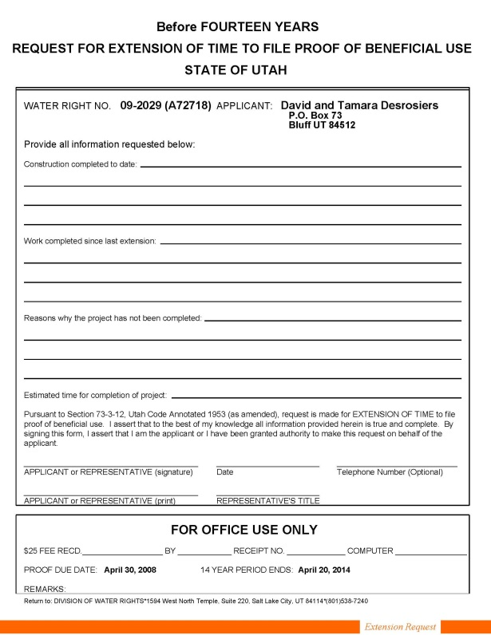
EXTENSION REQUEST
Must show diligence in completing proposed application
  For example
    Home built
    Well drilled
    Irrigation in place, etc.
More time needed to complete
Forms and fees
Advertising after fourteen years
Review and recommendation
Granted or denied
Reconsideration and/or appeal
Notes:
Request forms are available on the website or by mail or office visit. For requests for time within 14 years from the date of application approval, a $50 fee is required. For requests for time exceeding 14 years from the date of application approval, a $150 fee is required. Payment can be made by check or cash.
If over fourteen years have passed since approval of the application, any request for additional time to place the water to the proposed beneficial use must be advertised and is subject to protest. (See advertising and protest process described above.)
The request is reviewed by the regional office staff, and a recommended action is made through a draft order. The draft order is reviewed by the applications/records section for completeness, accuracy and consistency with division practices and policies. Complex issues may be reviewed with Attorney General’s staff. Section 73-3-12 of the Utah Code states that construction of the works and the application of water to beneficial use shall be diligently prosecuted to completion within the time fixed by the State Engineer. Extensions of time may be granted by the State Engineer only on proper showing of diligence or reasonable cause for delay.
If the request is granted, the applicant has an extended proof due-date, at the end of which either proof or a further request for extension is required.
If the request is denied, the application is lapsed.
The order of the State Engineer addressing extension of time is subject to request for reconsideration and appeal to district court as described for initial action described above.

Slide 43
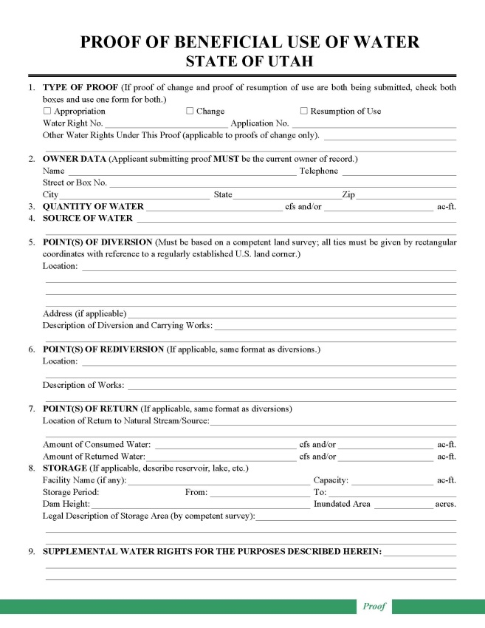
PROOF OF BENEFICIAL USE
Forms
Professional reparation
Reviewed by regional office
Amendments
Accepted or rejected
Notes:
Forms for preparing proof of beneficial use are available by visit to division offices, by mail, or on the division website.
Proof must be prepared by a professional engineer or land surveyor, who is licensed in Utah and is responsible for accuracy in depicting the completed project and use of water.
The proof form is field examined and reviewed by regional office personnel.
If significant corrections are needed, the proof is returned to the engineer or surveyor for amendment. If the constructed project is considerably different than as proposed under the application, a change application may be required to describe the differences and to advertise them to the public. (See application process described above.)
If the proof is acceptable, a draft certificate of beneficial use is prepared. The regional office staff transfer it to the Applications/Records section.
If the proof is not acceptable due to errors, lack of data or signatures, or lack of physical evidence to support the written information, it is rejected, and the application is lapsed by order of the State Engineer. This action is subject to reconsideration and appeal as described above.
If the proof document was inappropriately submitted, the applicant could potentially file a late extension request to ask for more time to address further development of the project or legal issues. This could result in reduction of the priority of the application.
If the proposed project under the application has been completed as desired by the applicant (and as limited by the application itself), the applicant of record can file evidence of this development through proof of beneficial use forms. These forms are available by visit to division offices, by mail, or on the division website. Only the applicant of record can file proof. If title has changed since the initiation of the application process, ownership documentation must be accomplished through filing of a report of conveyance to update the public record.
Proof must be prepared by a professional engineer or land surveyor, who is licensed in Utah and is accountable for accuracy in depicting the completed project and use of water.
After submission, the proof form is field examined and reviewed by regional office personnel.
If significant corrections are needed, the proof is returned to the engineer or surveyor for amendment. If the constructed project is considerably different than as proposed under the application, a change application may be required to describe the differences and to advertise them to the public. For example, sometimes the drilled well is a considerable distance away from the location proposed in the application. Sometimes all of the proposed uses have not been developed, and the remaining uses have been enlarged over the original filing in order to utilize all of the water. The amending change application must be processed in the same manner as any other application. However, if approved, it does not carry a proof-due date inasmuch as the proof documents have already been submitted.
When and if the proof is acceptable, a draft certificate of beneficial use is prepared by regional office staff for review by the Applications/Records section.
If the proof is not acceptable due to errors, lack of data or appropriate signatures, or lack of physical evidence to support the written information, it is rejected by order of the State Engineer, and the application is lapsed. No further diversion and use of water are authorized under the application and they must cease until appropriate water rights are obtained. This action is subject to reconsideration and appeal as described above.
If the proof document was inappropriately submitted, the applicant could potentially file a late extension request to ask for more time to address further development of the project or legal issues. This could result in reduction of the priority of the application.

Slide 44
BENEFICIAL USE
Beneficial use shall be the basis, the measure, and the limit of all rights to the use of water in the state (73-1-3).
Proof of Beneficial Use
Documented certification by a registered professional engineer or licensed land surveyor that the water under an application has been developed and placed to beneficial use.
Easy Definition
You are proving that you are using the water you made application to use. Done by a licensed engineer or surveyor.

Slide 45
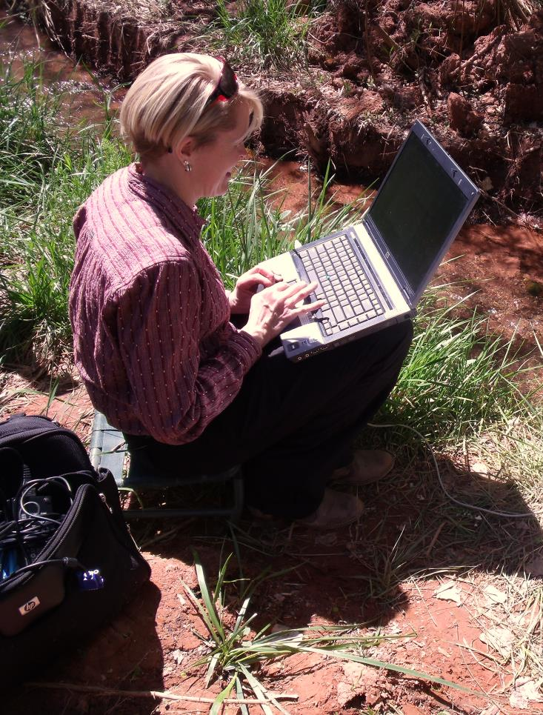
AFFIDAVIT OF BENEFICIAL USE aka PROOF AFFIDAVIT
Documentation and mapping submitted by an applicant testifying that a small domestic use application has been developed and placed to beneficial use.
Easy Definition
Applicant does all the work.

Slide 46
PROOF AFFIDAVIT
Section 73-3-5.6 made effective May 12, 2009
Water right must be associated with a residence, either full- or part-time. The residence may receive water under another water right or from a municipal connection. Irrigation or stock use on the affidavit must be associated with the residence.
The water use is for a quarter-acre of irrigation or less.
The water use is for the watering of ten head of livestock (or equivalent) or less.
The water use does not include any uses in addition to the three listed above.

Slide 47
PROOF AFFIDAVIT
Required Documents
Affidavit of Beneficial Use of Water
  This document must be filled out by the applicant and signed before a notary public.
Plat Map
  This is a map of the property that can be obtained from the County Recorder's Office, usually for a nominal fee.
Certificate of Occupancy
  This document can usually be obtained from the city, county, or other municipality that issued the building permit for the residence. Can accept tax notice showing home on the notice.
Map of Beneficial Use
  This map is created by the applicant and shows the beneficial uses and source of water.

Slide 48
PROOF AFFIDAVIT
Frequent Questions
Proof Affidavit gets a “Certificate of Beneficial Use”
You can hire a proof professional (surveyor, engineer or consultant) to help you file the Affidavit
Certificate of Occupancy - residence is ready to be occupied
  Tax Records showing a residence is being taxed or a letter from municipality
Submitted on a Application to Appropriate, Change Application, or an Exchange Application
If water right is based on shares of stock in an irrigation company, the irrigation company also needs to sign the Affidavit

Slide 49
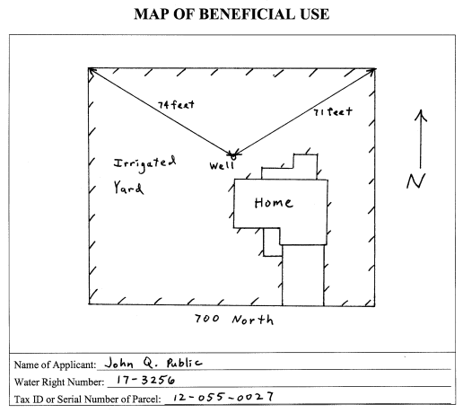
PROOF AFFIDAIVT
Map of Beneficial Use Example
0.21 acres

Slide 50
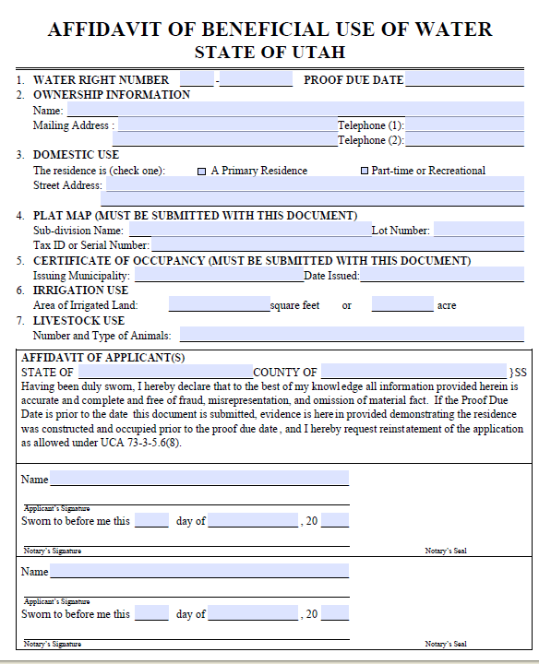
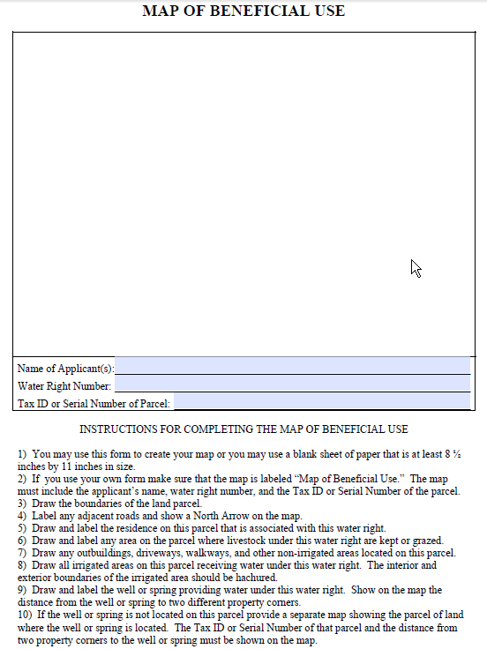
PROOF AFFIDAVIT FORM

Slide 51
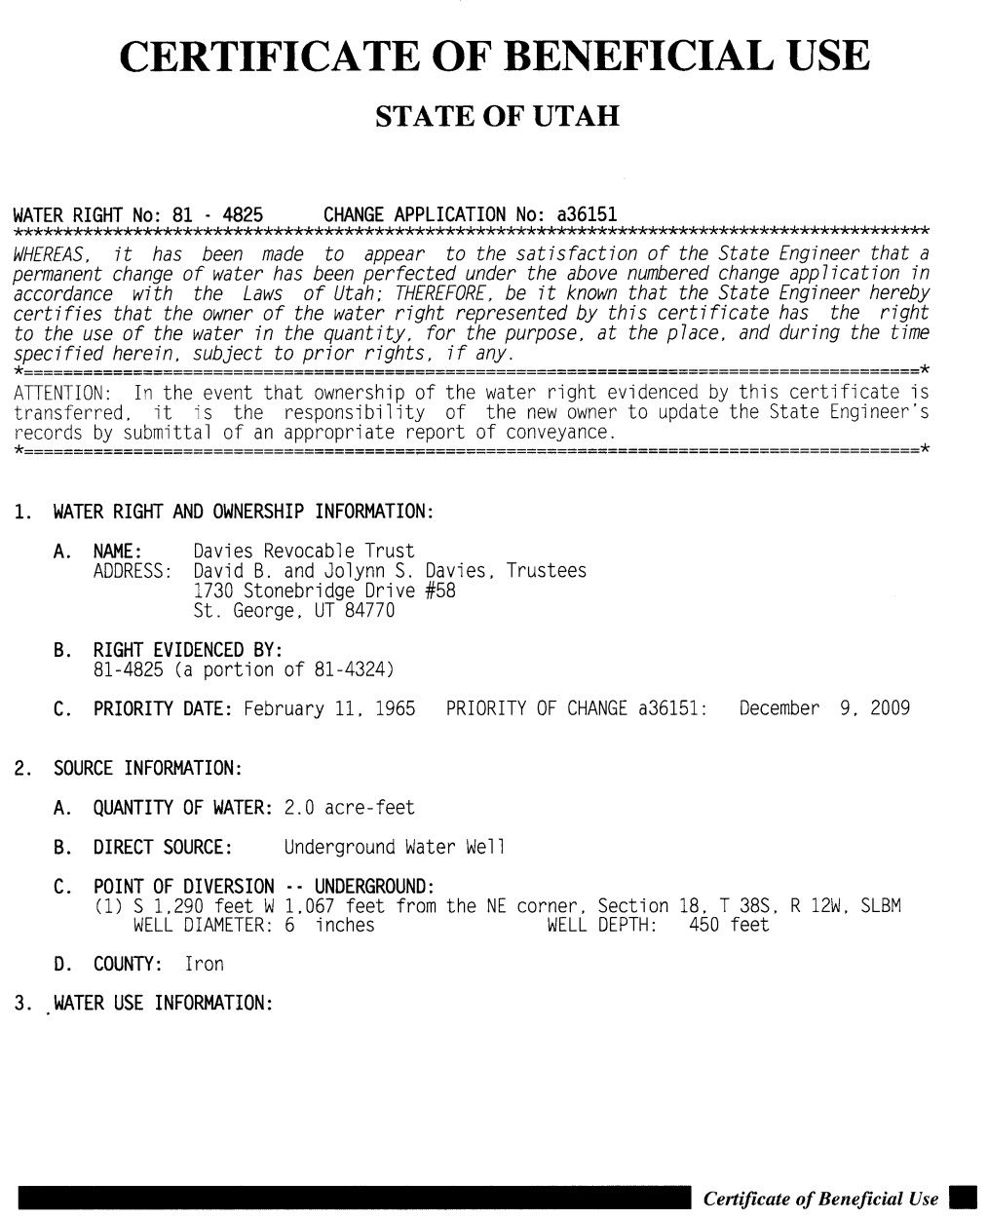
CERTIFICATION
State Engineer’s review and signature
Issued on same day as signed
Review for correctness
Record with county
  Is optional
Reconsideration and appeal
Notes:
Draft certificates are reviewed by the applications/records section for accuracy and completeness. The final certificate is submitted to the State Engineer for review and signature. If amendments are needed, it is returned to applications/records section and/or regional engineer for additional work.
When signed by the State Engineer, the certificate is sent to the applicant on the date of signature and then scanned for internet access. This is the final step in the process and is often referred to as “perfecting” the right.
If the applicant accepts the certificate, it should be recorded with the appropriate county recorder to associate the water right with the land upon which it is used.
If the applicant disagrees with it, a request for reconsideration and/or an appeal to district court can be pursued as described earlier.

Slide 52
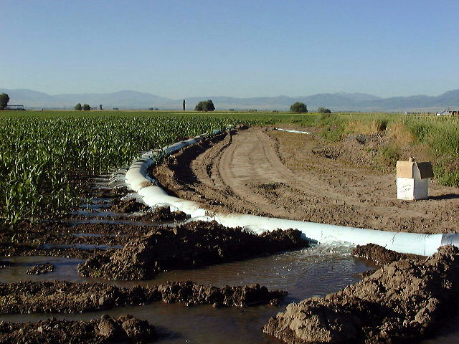
BENEFICIAL USE
Continued use as authorized
Amendments by change application
Prolonged non-use
Notes:
Once beneficial use has been certified, water rights should continue to be used as authorized.
Because water resources are limited in Utah and there is considerable competition for the available supply, state statutes provided for challenge to perfected rights if there are prolonged periods of nonuse even though the water supply is accessible to the right owners. Other water users could argue that the idle rights have been forfeited from such nonuse and that their allocation should be made available to others who have diligently continued their projects as allowed under their rights.
Also continued use of perfected rights should occur as approved. Rights used in excess of or differently than the authorized project can be challenged by other users. Such concerns could involve impairment and damages to other rights and result in litigation. If projects are later to be changed, amending change applications should be filed and processed to authorize new uses, sources, etc. and retire historical ones.
Perfected rights must then be used as authorized. Rights used in excess of the authorized project can be challenged by other users as impairment to the system due to said enlargement.
If projects are later to be changed, amending change applications should be filed and processed to authorize new uses, sources, etc. and retire historical ones.
Prolonged periods of nonuse even though the water supply is available could result in challenge by water users that the right has been forfeited.

Slide 53
QUESTIONS?

