Slide 1
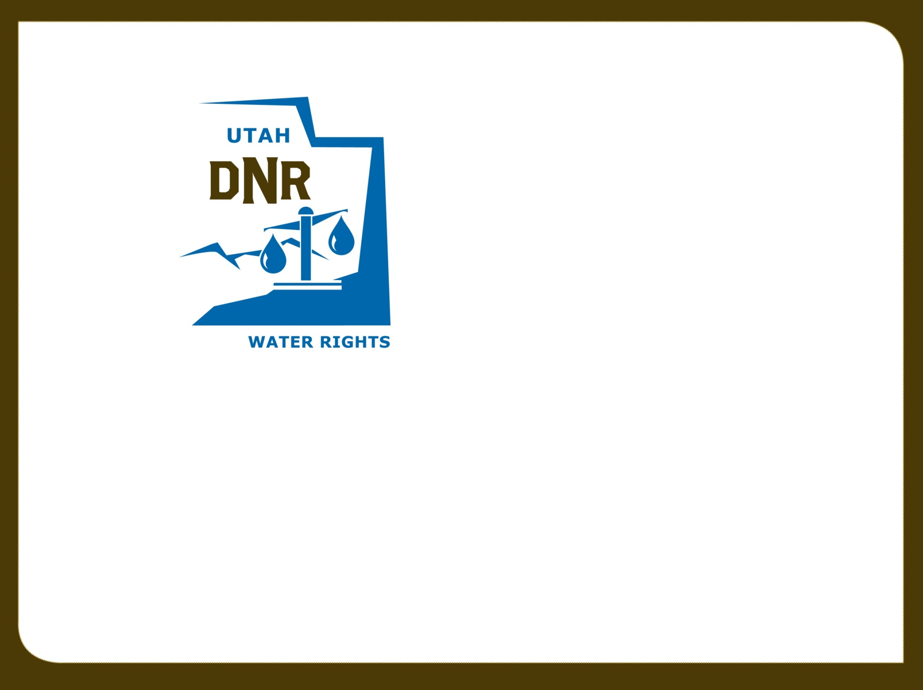
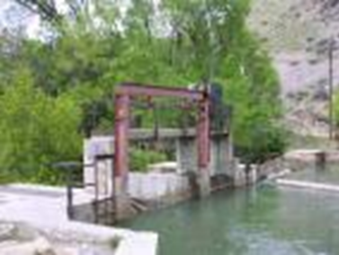
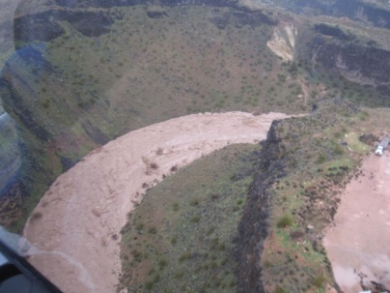
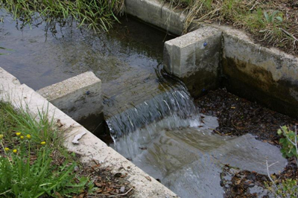

History of Water
Rights and Water Right Basics
RWUA Training—April 2016
Nathan Moses, P.E.
Regional Engineer, Southwestern Regional Office

Slide 2

History of Utah Water
Where the idea of water rights began

Slide 3

Riparian Law vs. Prior
Appropriation Doctrine
RIPARIAN DOCTRINE is a system for allocating water in the eastern United States, which gives owners of land a right to use a reasonable amount of water as it crosses their property.
The Eastern states (all those east of Texas, except Mississippi), follow the riparian doctrine, which permits anyone whose land has frontage on a body of water to use water from it. These states were the first settled by Europeans (and therefore most influenced by English Law) and have the most available water. (Wikipidia)
PRIOR APPROPRIATION DOCTRINE is a system for allocating water, used in most western states. "First in time is first in right" means that the first person to take a quantity of water and put it to beneficial use has a higher priority than a subsequent user.

Slide 4
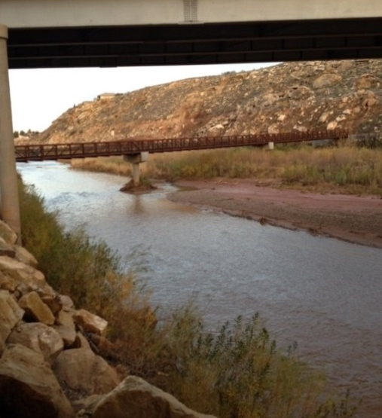
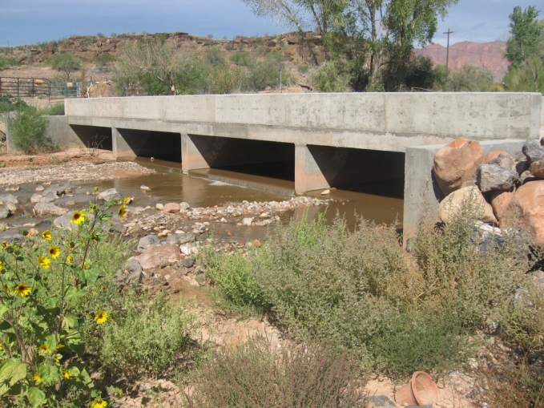
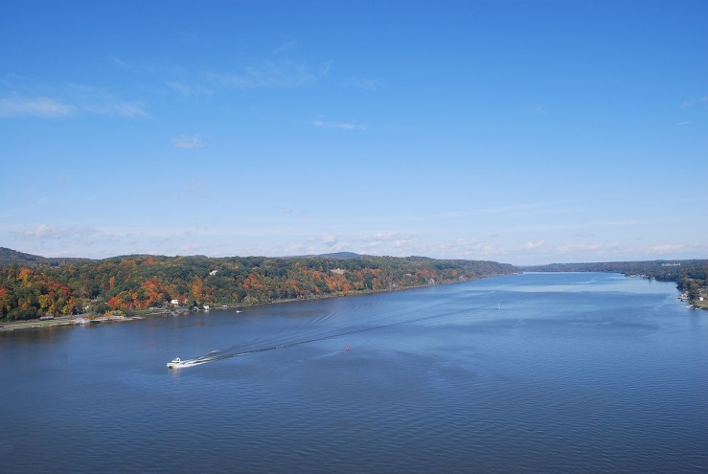
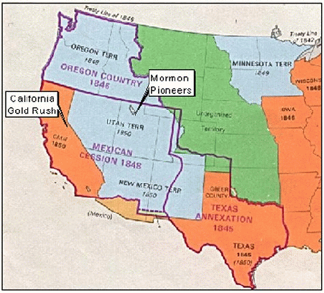
Origin of the Doctrine of Prior Appropriation
Hudson River
The West
The East
Notes:
The development of laws governing water rights in the western United States was markedly different than in the East. The most important reason for this was the difference in climate and geography. In the East precipitation is relatively abundant; water courses are numerous and generally close to areas where water is needed. In most of the west the opposite is true. Relatively slight precipitation means fewer water courses. This increases the necessity to divert water to areas of use. The doctrine of prior appropriation, which is currently used as the foundation of the water rights system in every western state, developed to respond to arid conditions.

Slide 5
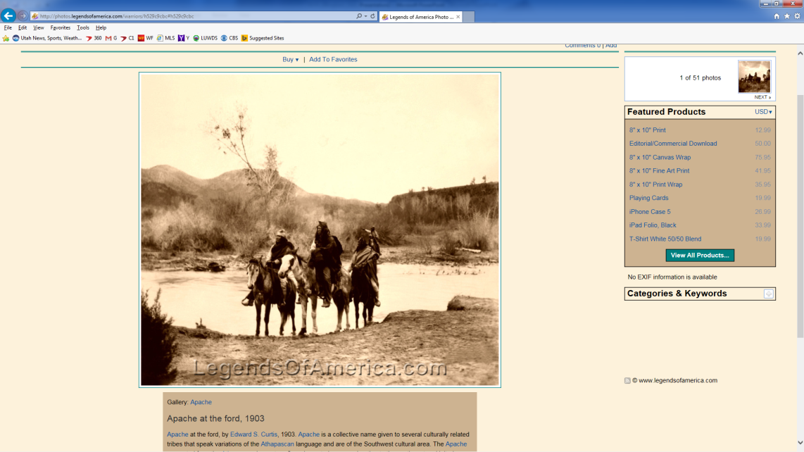

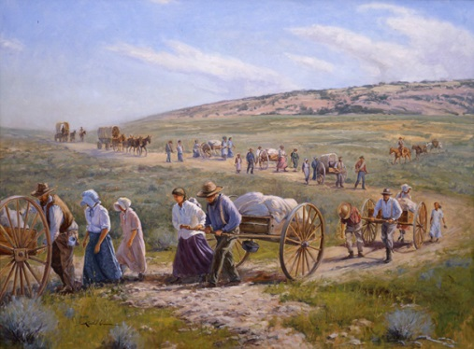
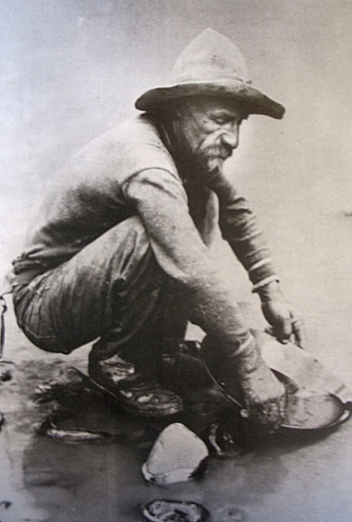
Historical “Appropriators”
Native Americans were the first
Religious and military outposts of Spaniards
Mormon pioneers
California Gold Rush
Notes:
Native Americans were the first “appropriators.” Community ditches dug by American Indians were used to divert, or “appropriate,” water in the arid southwest. The religious and military outposts of the Spaniards also required a stable supply of water. They sometimes used the canals of Native Americans and sometimes dug their own. Thus, the Spanish and Mexican settlers who established missions, agricultural pueblos, and military posts were also early appropriators. Among the later Anglo settlers of the west, Mormons have been identified as early “appropriators” of water.
Mormon Pioneers
1) They began using water upon arrival.
Water for irrigation of crops and consumption were diverted.
Precipitation alone would not be adequate.
2) There was no government or laws.
They had to make decisions to fit their environment and, as equitably as
possible, create a system to supply water to users.
3) It was evident that the west was a desert.
From their decisions, the Prior Appropriation Doctrine evolved and replaced
Riparian water law.
During the same period that the Mormons were settling the Great Basin, gold was discovered in California. Mining, particularly of placer claims, required the diversion of large amounts of water from rivers and streams and the miners applied the tenets of mining law to water use.

Slide 6
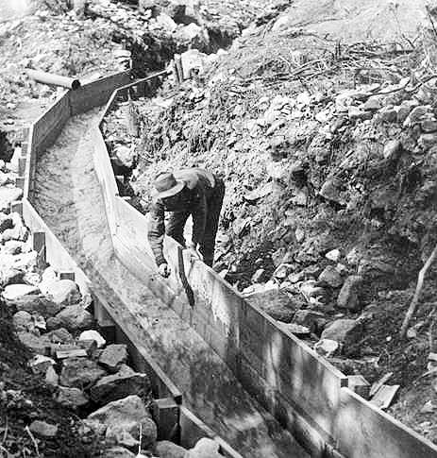
Basic Principles of Mining Law
Miner who initially staked claim
  who is “first in time”
Protected in the development of the claim against other miners
  he is “first in right”
Notes:
The concepts of prior appropriation of water which developed in the California mining camps spread to other western states as mineral discoveries led California miners to other states. A basic principal of mining law was that the miner who initially staked a claim (who is “first in time”) is protected in the development of the claim against other miners (his is “first in right”). This practice carried over to the use of water and became not only recognized as tradition, but also protected in courts of law.

Slide 7
Mining Act of 1866
Fundamental step in deference to state and territorial water law
Congress confirmed water rights for mining, agriculture, and other uses that had been acquired by private parties on public lands under local customs, laws, and court decrees
“SEC. 9. And be it further enacted, That whenever, by priority of possession, rights to the use of water for mining, agricultural, manufacturing, or other purposes, have vested and accrued, and the same are recognized and acknowledged by the local customs, laws, and the decisions of courts, the possessors and owners of such vested rights shall be maintained and protected in the same…”
Notes:
Congress took a fundamental step in deference to state and territorial water law with the passage of the Mining Act of 1866. Under this law, Congress confirmed water rights for mining, agriculture, and other uses that had been acquired by private parties on public lands under local customs, laws, and court decrees. This result obtained even though many appropriators were trespassers on federal land.

Slide 8
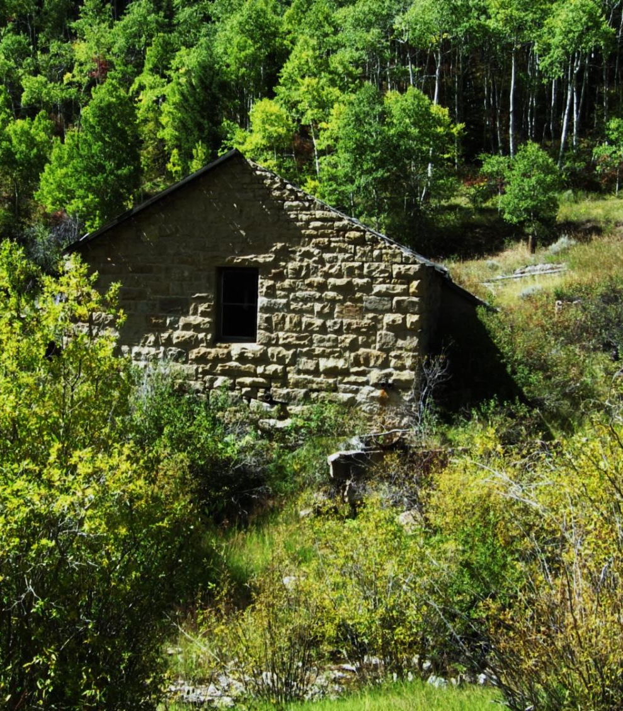
1st Appropriative Water Rights Statute 1872
Passed in California in 1872 as sections 1410 through 1422 of the California Civil Code.
Required posting at the point of diversion
Filing in county recorder’s office
“perfect” the right with “due diligence”
The rights established could be lost through nonuse
Notes:
The first appropriative water rights statute was passed in California in 1872. It allowed for creation of such rights by posting, at the point of diversion, a document stating the intended amount of the right and its purpose of use, filing for the right in the county recorder’s office where the right was located, and taking the steps necessary to “perfect” the right (put the water to beneficial use) with “due diligence.”

Slide 9
Desert Land Act of 1877
Right to use water in the western U.S. by claimants under the Act must “depend upon bonified prior appropriation.”
Effect of Act was to sever title of the water from the public land
Rights to use water be established under state and territorial laws, separately from land ownership claims
Notes:
In the Desert Land Act of 1877, Congress declared that the right to use water in the western U.S. by claimants under the Act must “depend upon bonified prior appropriation.” The U.S. Supreme Court held that the effect of the Desert Land Act was to sever title of the water from the public land. Congress directed that rights to use water be established under state and territorial laws, separately from land ownership claims.

Slide 10
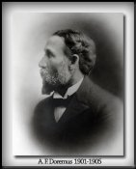
Statutes Giving State Agency
Major Role
Wyoming was the first
  Required application to be filed with state entity
  Ruling on application by the state agency
  Maintenance of a central bank of public records
Utah’s statute enacted in 1903
Notes:
State governments began to realize that a central administrative system to control appropriative water rights, as well as a centralized office of record keeping for such rights, would be preferable to the haphazard administration which occurred under the early statutes. Therefore water right law is most often regulated at a State level rather than a local or Federal level.
Wyoming was among the first states to enact statutes giving a state agency a major role in administering appropriative water rights. The key features of the Wyoming system were: (1) the requirement that an application must be filed with a state entity before a right could be created; (2) the necessity of a ruling on an application by the state agency, including denying a permit where no water was available; and (3) the maintenance of a central bank of public records containing applications which had been made.
Utah’s statute was enacted in 1903.

Slide 11
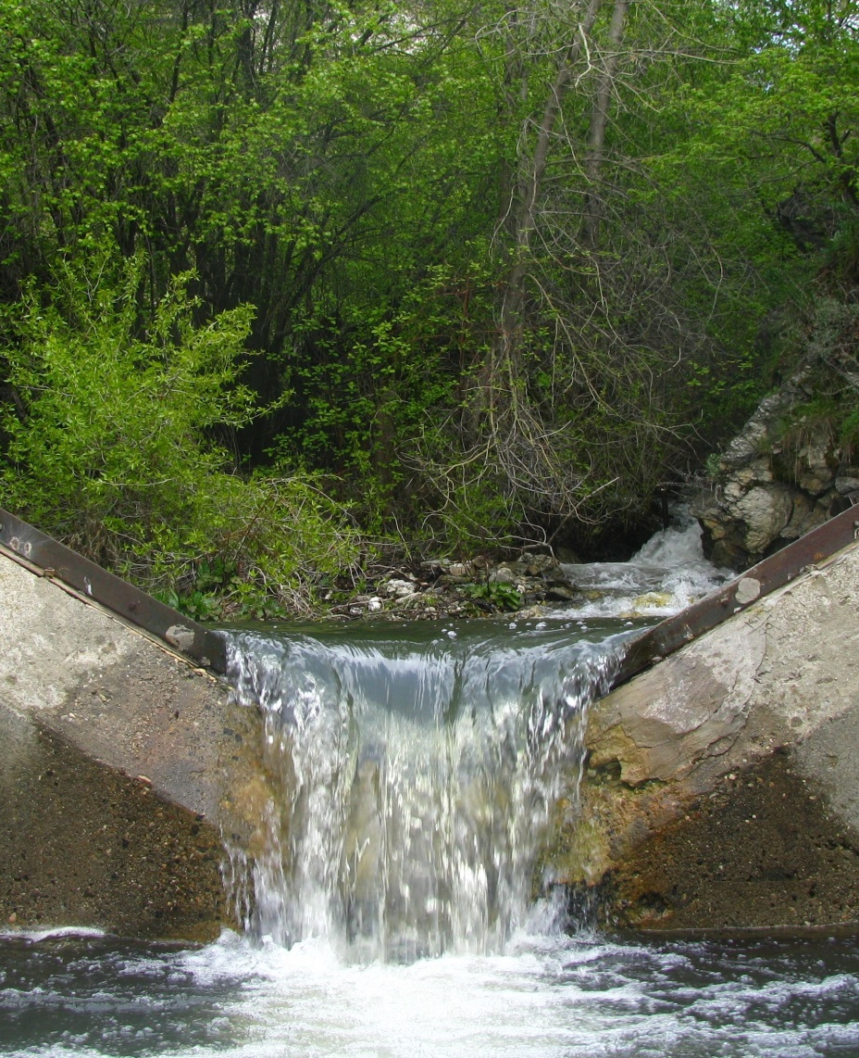
Protection of Public Interest Values
Traditional appropriation doctrine incorporated public values
  Facilitated the public purpose of making an inhabitable region out of arid lands
  The preferred uses of domestic, municipal, and agricultural needs should be met before water could be put to other uses
Notes:
In some ways, the traditional appropriation doctrine incorporated public values. A fundamental tenet of prior appropriation law was that land and water estates were separate, and that water could be removed from its natural location and used beneficially elsewhere. This facilitated the public purpose of making an inhabitable region out of arid lands. Also, there were preferred uses under traditional appropriative law which embodied a public sentiment that domestic, municipal, and agricultural needs should be met before water could be put to other uses.

Slide 12
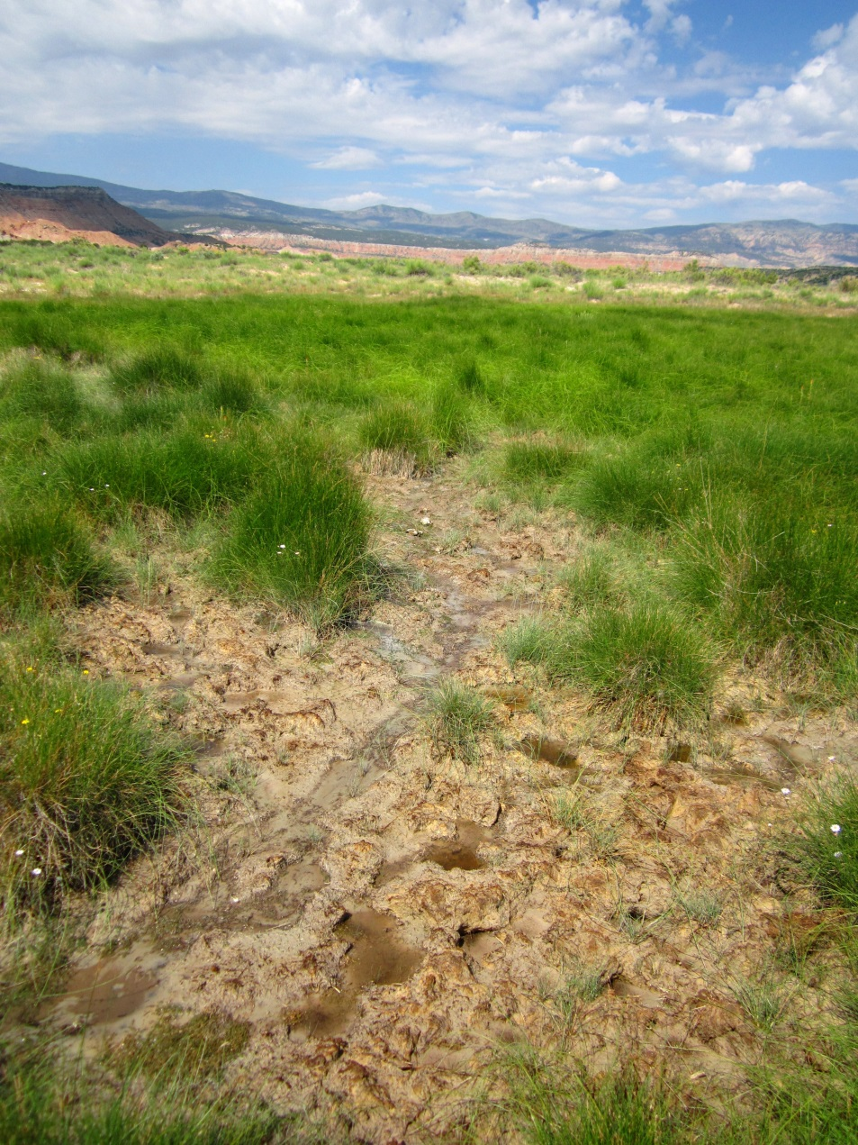
Prior Appropriation Doctrine
Divert water to beneficial use
Priority date
First in time, first in right
Loss of right
Notes:
The Prior Appropriation Doctrine as enacted in the State of Utah contains some key points. First, water must be diverted and put to beneficial use. Second, to uphold the principal of first in time, first in right, all water rights have a priority date associated with them. As we get into management of various basins, priority date will become of major importance. And third, a water right can be lost by either abandonment or forfeiture. Abandonment is determined by the intent of the water user and does not require a statutory time period. A water right is lost by forfeiture if the right is not used for 7 years.

Slide 13
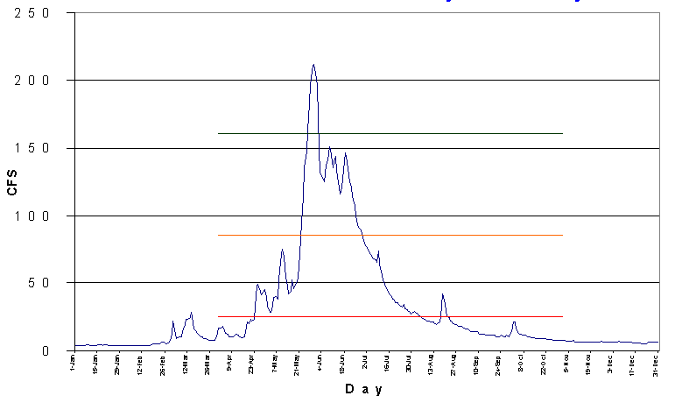
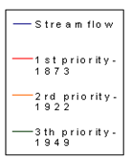
Water Distribution By Priority Date

Slide 14
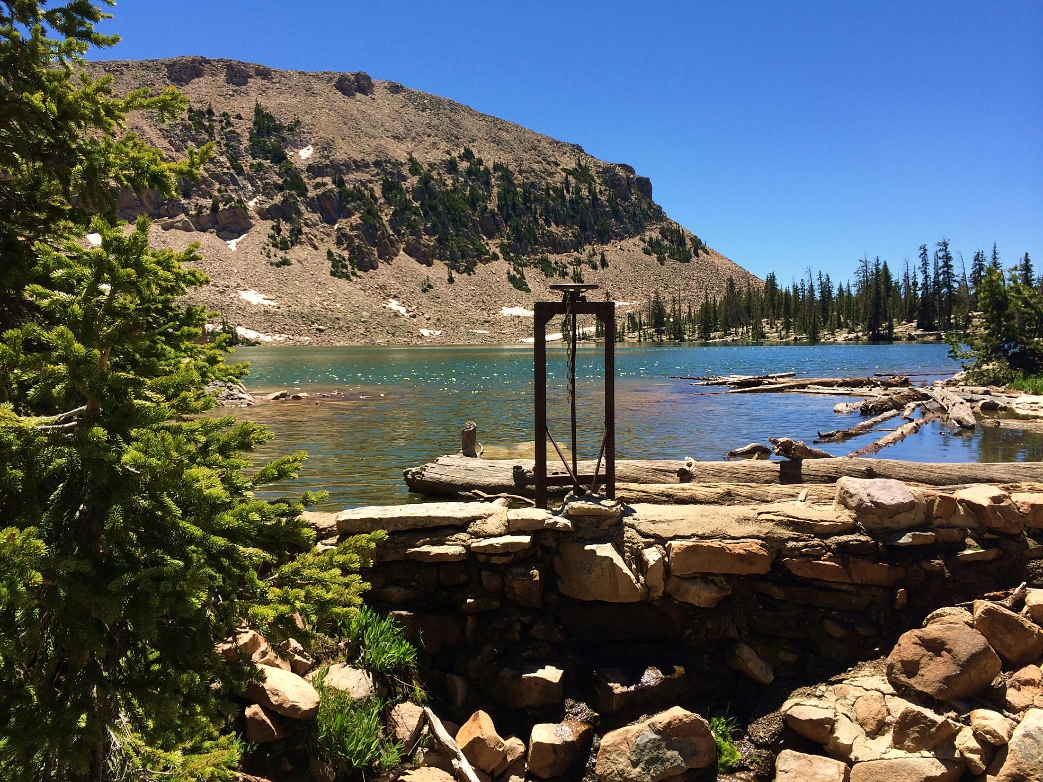
Division of Water Rights
From the past to now

Slide 15
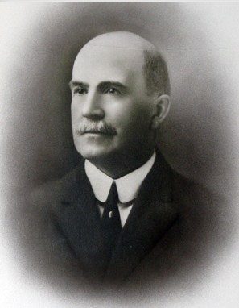

The State Engineer
The State Engineer is the individual who is responsible for administering water rights in Utah. He is the director of the Utah Division of Water Rights (sometimes also referred to as the State Engineer’s Office) and is appointed by the Governor for a four year term.
Notes:
Willard Young, first State Engineer, initial duties were to aid in planning, design and construction of water storage and conveyance facilities.
Kent L Jones

Slide 16
Division of Water Rights
Organizational Chart
State Engineer
Deputy State Engineer
Distribution
Technical Services
Appropriation
Dam Safety
Regional Offices

Slide 17
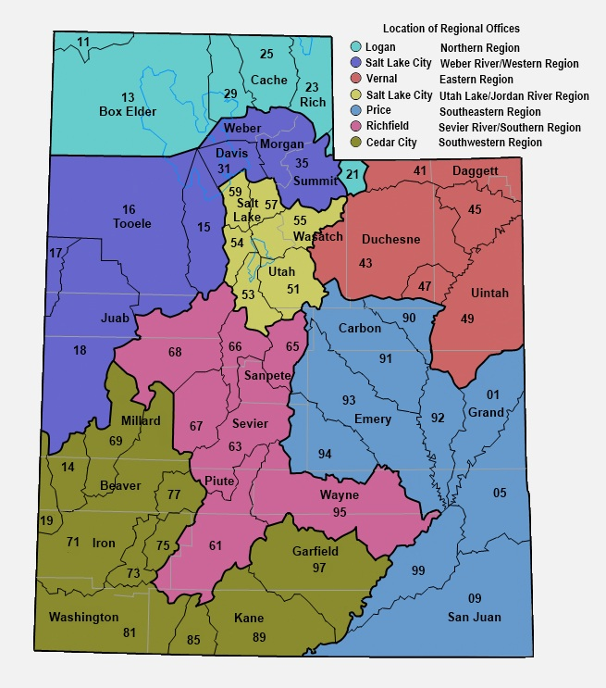
Notes:
Whatever your individual focus on water rights may be there is one point that should be clearly understood – actions on Water Rights do not make more water. Water rights only establish who gets to use the available water.
While I am on this slide there are a few things to note. The organization of the state into “regions”, being the differently colored areas, representing primarily river drainages. Note the legend in the top right.
Then within the regions there are “areas” being represented by the 2 digit numbers. These 2 digit numbers are the first 2 numbers in every water right in that area. EG: 35 for the Weber, 57 and 59 for the Jordan River in Salt Lake County. Where there is no major river system such as the west desert, the boundaries follow geographic features creating drainages.
Application numbers differ from Water Rights Numbers in that they are assigned to applications sequentially by application type. Application Numbers begin with a letter. A for applications to appropriate, a for change applications, D for diligence claims, U for underground water claims, F for fixed time applications, T for temporary appropriations, t for temporary change applications.

Slide 18

Water Right basics
Statues and other definitions

Slide 19
The Beginning of Water Rights
1903 – Legislature passed water laws that required new uses of water to be obtained by filing an application to appropriate with the state engineer. However, it was unclear if the law applied only to surface water and in some instances water was considered to belong to property owners. Surface water uses in place prior to 1903 were recognized as valid and are referred to as diligence claims.
1936 – The 1903 law was amended to include all waters of the state as subject to appropriation statutes. Rights from wells were also recognized as valid and were referred to as Underground Water Claims – sort of a sister to diligence claims.
Rights to use water are not obtained simply because water exists upon or beneath property or passes over it. Such rights would be riparian and are not recognized in Utah law.

Slide 20
Title 73 Utah Code
What is the legal framework for Utah water right law?
Basic and Fundamental Code
All waters in this state, whether above or under the ground are herby declared to be the property of the public (73-1-1).
Beneficial use shall be the basis, the measure, and the limit of all rights to the use of water in the state (73-1-3).

Slide 21
Elements of a Water Right
Ownership
Priority date
Quantity of water
  Flow rate
  Volume
Storage
Point(s) of diversion
Uses
  Irrigation, domestic, stock water, mining, municipal, etc.
Amount of use
Period of use
Place of use
Notes:
These are the elements that make up a water right. Review.

Slide 22
What is a Water Right?
All water rights have:
a point of diversion,
a source of supply,
use(s) of water,
diversion/depletion,
a priority,
and an owner(s).
Beneficial Use is the measure and limit of all water rights. UCA 73-1-3
When buying water rights, make certain that you are bargaining for a suitable right.

Slide 23
Water Right Details
Point of Diversion and Source
  Surface? Single location or point-to-point?
  Spring? Is there a box or specific location?
  Drain? How is it defined?
  Well?
  Is the source constant or ephemeral?
Uses of Water
  Is the beneficial use year-round or part-year?
  Is the water right a sole supply or supplemental right?
  Has the water been consistently used?
  Diversion and depletion of water?
Uses of Water:
Notes:
Surface right is probably a decreed right with a priority of 1903 or earlier. Remember that most of the surface water was fully appropriated by 1903.
A well or other groundwater right is probably filed after 1935 but could be and underground water claim.
Springs are often sources of supply for diligence claims filings for stockwater.

Slide 24
Water Right Details, Continued
Priority
  Surface rights are frequently regulated by priority.
  Generally, the priority of a right is the date of filing of the application for an unperfected application or a certificated filing.
  The priority of a perfected right is the date of first use for a diligence claim, the date shown in a decree, or the date shown on the certificate of appropriation.
Ownership
If you are purchasing a water right, make certain that the person selling it actually owns what is being sold. Do not rely solely on the Division’s records for this. Trust deeds on real estate can affect title to water rights.
Notes:
Beware of trust deeds. Get a warranty deed. If you are selling land that has water rights associated with it be careful that you don’t unintentionally convey the water rights by appurtenance.
Why am I emphasizing the Beneficial Use concept? It is a bedrock principle of water law.

Slide 25






Beneficial Use
The Measure and the Limit of Every Water Right
BENEFICIAL USE is the purpose to which water diverted under a water right is applied. Examples include but are not limited to irrigation; stock watering; domestic; and commercial, industrial, municipal (amounts measured in acre-feet).
The purpose to which water diverted under a water right is applied.
Examples include:
  Irrigation
  Stock watering
  Domestic
  Commercial
  Industrial
  Municipal
    Typically in acre-feet only

Slide 26
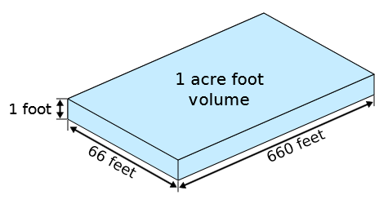
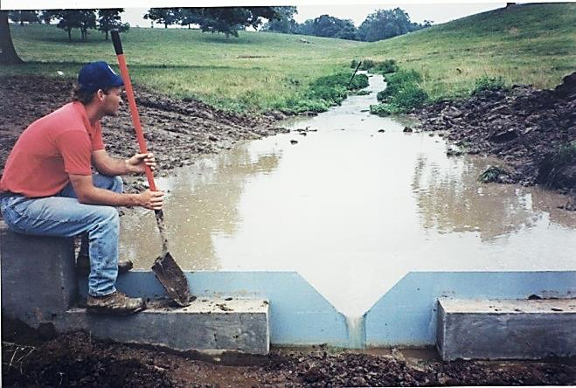
Water Right Flow and Volume
Acre-foot is a measure of volume. It is 1 foot in depth of water on 1 acre of land.
CFS (cubic feet per second) is a measure of flow similar to GPM. It is 1 cubic foot of water moving at 1 foot per second past a given point.
Notes:
UCA 73-1-2
Flow is measured in cfs.
Volume is measured in acre-feet
How does this come into play in water rights?
Why is it important to consider both flow and volume?
What if the right is for an ephemeral stream?

Slide 27
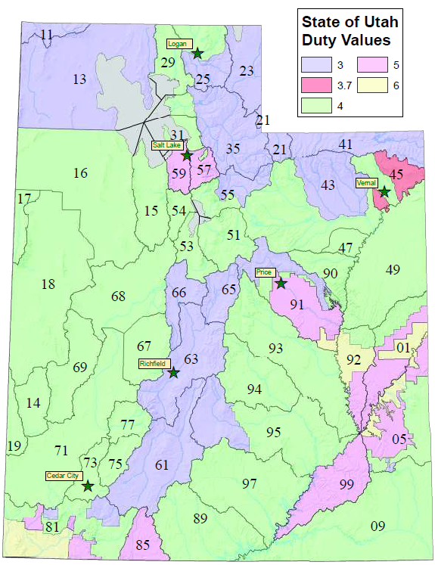
How Much Water Does It Take?
Duty is an estimate of the amount of water reasonably required for specific purposes such as irrigation or domestic use.

Slide 28
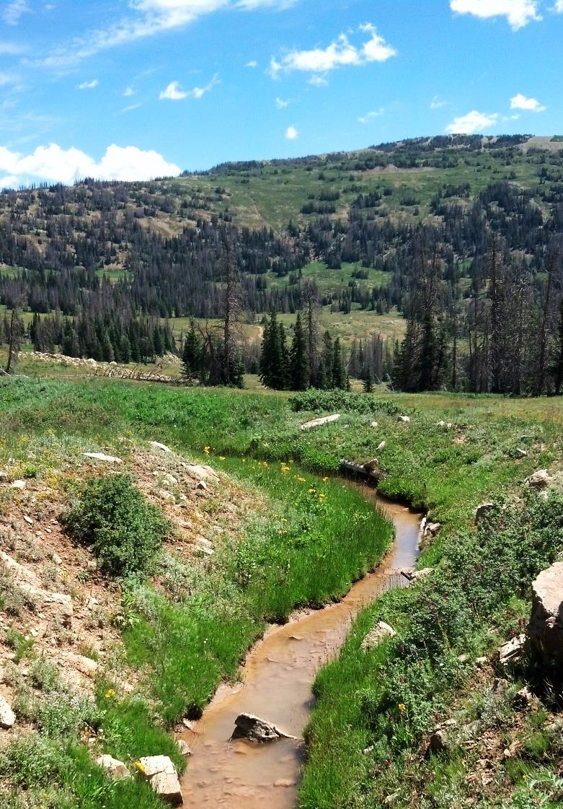
Duty of Common Uses
Domestic use
  0.45 acre-foot per residence
  0.25 acre-foot part-time (cabin)
Stockwatering
  0.028 acre-feet per large animal (25 gallons/day)
Irrigation
  Typically ranges from 3.0-6.0 acre-feet per acre
Domestic use 0.45 acre-foot per residence
0.25 acre-foot if part time (cabin)
Irrigation Ranges from 3 – 6 acre-feet per acre

Slide 29
Diversion vs. Depletion
DIVERSION is removal of water from its natural source whether it is surface or groundwater and applied for its beneficial use. It can be limited by flow or volume.
Depletion is the portion of water withdrawn from a surface or groundwater source that is consumed by a particular use and does not return to a natural water source or another body of water.
------------------------------------
Domestic 20% = 0.09 af
1 Horse 100% = 0.028
Irrigation * = ~50%
Notes:
Either amount can limit a water right. Even for municipal uses on change applications both the diversion and depletion amounts for the rights being changed are considered in approval of the change application.
Example? Haircut?

Slide 30
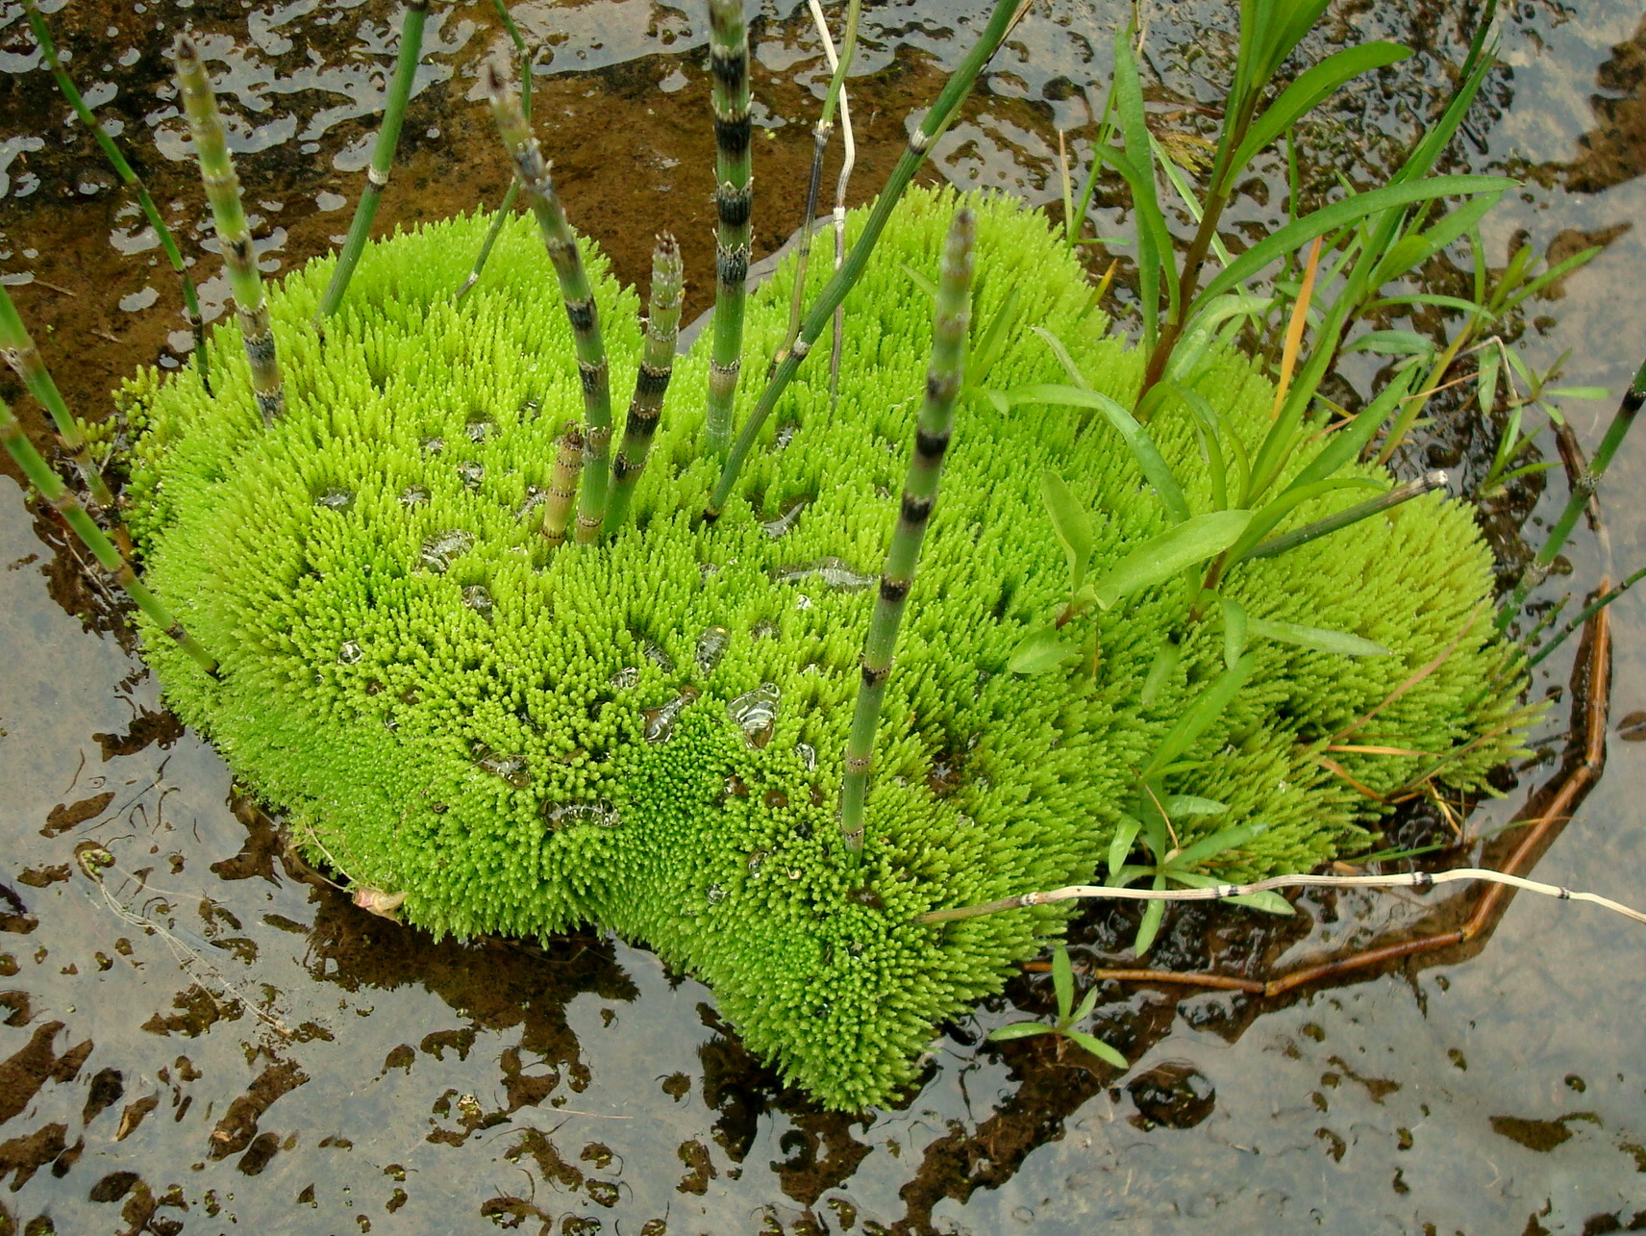
Researching Records
How to access specific information in water right files

Slide 31
Where Can You Research?
Researching Water Right Records….
Electronic Files
  Water right files available via the Divisions Website
  Notices
    New filings the past seven days
    New approvals for the past 30 days
    Proof due for the next 120 days
    Water Companies
Hard Files
  At the Salt Lake Water Right Office
    May only be reviewed in office
www.waterrights.utah.gov
Notes:
(WARNING: Water Rights makes NO claims as to the accuracy of this data.)
Scanned Documents

Slide 32

Beneficial Use of Water…
The Highest

Slide 33
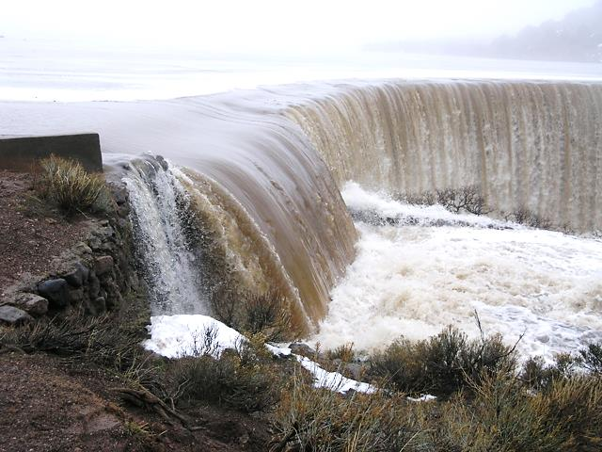


Questions?
Criticisms?

