Slide 1
Utah Division of Water Rights
Field Services
Water Right Adjudications
Mike Handy—April 15, 2016
June 21, 2004

Slide 2
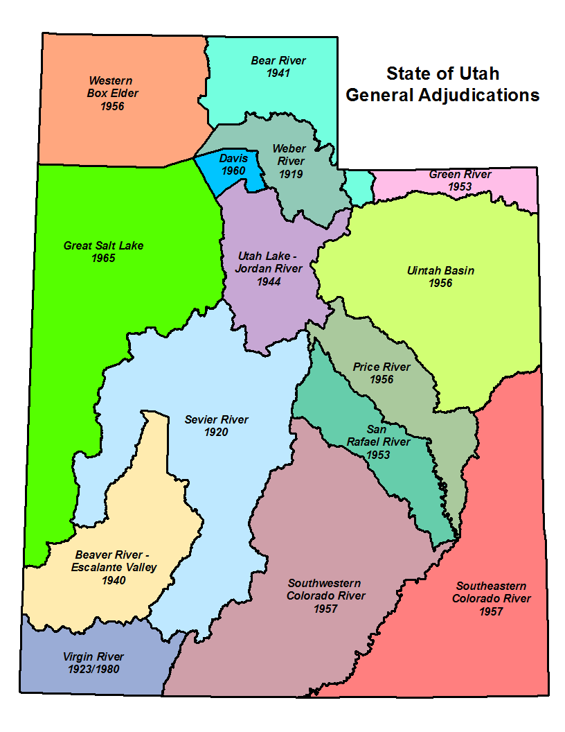
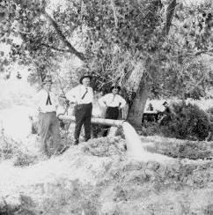
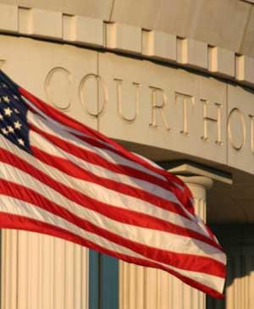
What is a General Stream Adjudication?
What it IS…
Action in District Court
Joins all water users--including State and federal agencies--and the State Engineer (Division of Water Rights)
Governed by Utah State Code: Title 73, Chapter 4.
The first General Stream Adjudications took place in the 1920s – Sevier, Weber and the Virgin River basins.
Notes:
We’ve talked about adjudication in its broadest sense and historical sense, but let’s focus on the current concept of a General Stream Adjudication. Water rights adjudication can be accomplished through simple litigation between two parties. Any decree resulting from the litigation is only applicable to the parties formally joined in the suit.
However, a General Stream Adjudication is an action in District Court which joins all water users within a stream drainage and the State Engineer as parties to the litigation. Joining all parties within a drainage is important because it helps to prevent multiple decrees among different users which might contradict each other or even miss pertinent aspects of the respective system.
For example, the Spanish Fork River has been the recipient of multiple decrees. As mentioned earlier, the original decree was a High Council Decision in 1879 which divided all of the waters of the river among 5 canal companies. However, it failed to recognize water users who diverted water from the Spanish Fork River and its tributaries up-stream from the mouth of the canyon and even failed to recognize one of the oldest canals on the river (who simply wasn’t a party to the dispute).
The General Stream Adjudication process is outlined in Title 73, Chapter 4 of the Utah State Code.
As you can see on the map, every major river drainage in the State of Utah is currently or has been under a General Stream Adjudication order. Some of these adjudications were petitioned by water users to the State Engineer (as dictated by Utah Code) such as the Weber River basin, while others were court-ordered by expanding the scope of an existing dispute among specific parties to a General Stream Adjudication, such as the Utah Lake / Jordan River basin.
Due to the size of the drainages and the growth of water development throughout the State, the main river drainages are often split into smaller areas—divisions and even subdivisions—which facilitate the ability of our staff to go into an area and proceed quickly—relatively speaking.

Slide 3
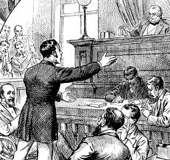
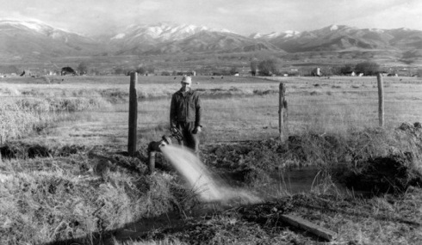
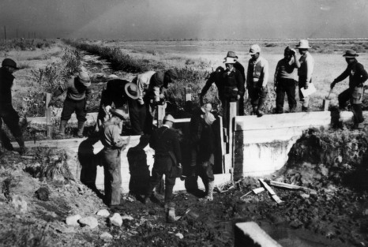
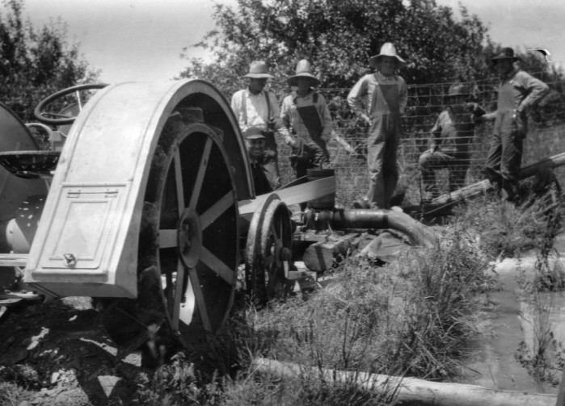
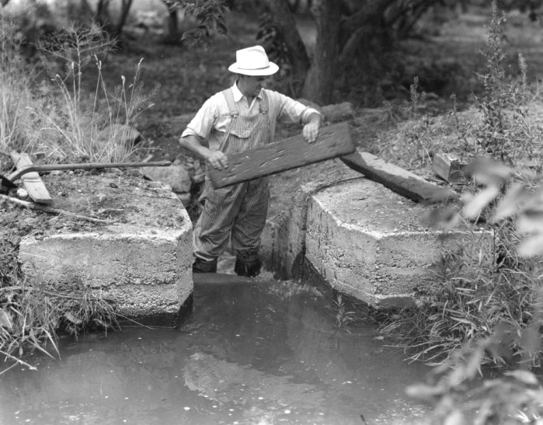
Why Do We Conduct General Adjudications?
Bring all claims on to the permanent record:
Pre-Statutory Claims
Diligence Claims
Underground Water Claims
Pending Adjudication Claims
Federal Reserve Rights
Winter’s Doctrine (1908)
McCarran Amendment (1952)
To prevent a “multiplicity of suits” and bring clarity to the water rights picture.
Remove/reduce rights which have been wholly or partially forfeited through non-use.
To obtain final comprehensive decrees on all water rights within the respective drainage.
…but what about Federal rights?
Notes:
So, in an attempt to illustrate the importance of the foregoing critical questions, let’s pose the question, “Why do we conduct general stream adjudications?” The answer is… it depends. For one thing, it probably depends on the period of history in which you asked it. Originally, general stream adjudications were utilized to bring all pre-statutory claims on to the permanent record. This is easy to understand from the perspective of water users in 1903. At the time that Utah’s first comprehensive water law was passed, it’s obvious that the number of pre-statutory claims far exceeded the number of appropriated rights since the system had yet to create any. Consequently, it was imperative to determine and quantify existing rights in order to allow the State Engineer to process future appropriations. This holds true through today, although the ratio of pre-statutory claims to certificated rights is much smaller--as will be illustrated in the next slide.
If you were to ask why we conduct general adjudications today, I think that it would be impossible to leave out the issue of Federal Reserve rights. As a result of a 1908 Supreme Court decision in Winters v. United States, the court ruled that by creation if the Fort Belknap Indian Reservation, there was an implied water right for the amount of water for the reservation to be self-sufficient. Today, federal reserved water rights can be asserted on most lands managed by the federal government. Reserved rights are, for the most part, immune from state water laws and therefore, are not subject to diversion and beneficial use requirements and cannot be lost by non-use. Federal Reserve rights are limited by the "primary purpose" and "minimal needs" of the reservation or the respective federal agency’s original congressional mandate. In addition, federal reserved water rights are nontransferable. By law, these rights can only exist on lands owned by the federal government. If a land transfer occurs, any existing federal reserved water right becomes invalid.
Although Federal Reserve rights were known to exist, there was no way to force the Federal Government to assert or quantify their claims since it possessed sovereign immunity and could not be joined involuntarily in a suit. In 1952, a senator from Nevada by the name of Pat McCarran introduced a bill that would allow states to pursue quantification of Federal Reserve rights. As it came to be known, the McCarran Amendment, waives U.S. sovereign immunity with respect to water rights and allows states to determine Federal water rights in state courts. Hence, federal water claims may be quantified in state stream adjudications, but only if such proceedings are comprehensive (meaning that all claimants to a specific water body are joined in the suit).
Some other benefits of a general adjudication is the consolidation and settlement of multiple controversies and bringing clarity to the overall water rights picture by joining all water users within a given system (as opposed to piecemeal litigation), defining supplemental relationships, removing forfeited rights from the record, and obtaining final decrees on all rights within the drainage.

Slide 4
Adjudication Process
1
2
NOTICE
3
PUBLIC MEETING
4
SUMMONS
PETITION
The State Engineer is petitioned by water users or court-ordered to initiate a General Adjudication. (UCA 73-4-1)
The State Engineer publishes notice of the pending adjudication for 2 weeks in a local newspaper.
(UCA 73-4-3)
The State Engineer holds an initial Public Meeting in the local area to inform water users about the adjudication process. (UCA 73-4-3)
The State Engineer serves Summons on claimants and publishes Summons for 5 weeks in a local newspaper. (UCA 73-4-4)
90 days
Claimants have 90 days following notice of the completion of the hydrographic survey in which to file a Water User’s Claim with the District Court or State Engineer.
(UCA 73-4-3)
5
HYDROGRAPHIC SURVEY
6
7
CLAIM
CLAIM
CLAIM
8
PUBLIC MEETING
PROPOSED DETERMINATION
The State Engineer conducts a hydrographic survey of the area and assists the claimants in completing their Water User’s Claims.
(UCA 73-4-3)
The State Engineer reviews Water User’s Claims and other records and prepares a Proposed Determination which is then distributed to the claimants and filed with the District Court. (UCA 73-4-11)
The State Engineer holds a Public Meeting to discuss the Proposed Determination with claimants.
(UCA 73-4-11)
90 days
Claimants have 90 days to file an objection to the Proposed Determination with the District Court. (UCA 73-4-11)
9
10
FINAL SUMMONS
11
OBJECTION RESOLUTION
12
DECREE
The State Engineer serves the final summons via publication for 5 weeks in a local newspaper.
(UCA 73-4-22)
The State Engineer resolves objections to the Proposed Determination with respective water users. (UCA 73-4-14)
The District Court issues a Decree (or Interlocutory Decree) on the Proposed Determination.
(UCA 73-4-15)
Notes:
This is my best attempt at an “info-graphic” of which summarizes the adjudication process. As indicated by the color coding, it can be separated into 3 phases, so to speak. The initial phase involves petitioning the State Engineer and providing notice to claimants of a pending adjudication. The second phase includes the bulk of the work, wherein the Adjudication Program conducts the hydrographic survey and works with water users to compile a proposed determination. The last phase begins following the publication of the proposed determination and includes final summons and objection resolution—hopefully culminating in a final or interlocutory decree.

Slide 5
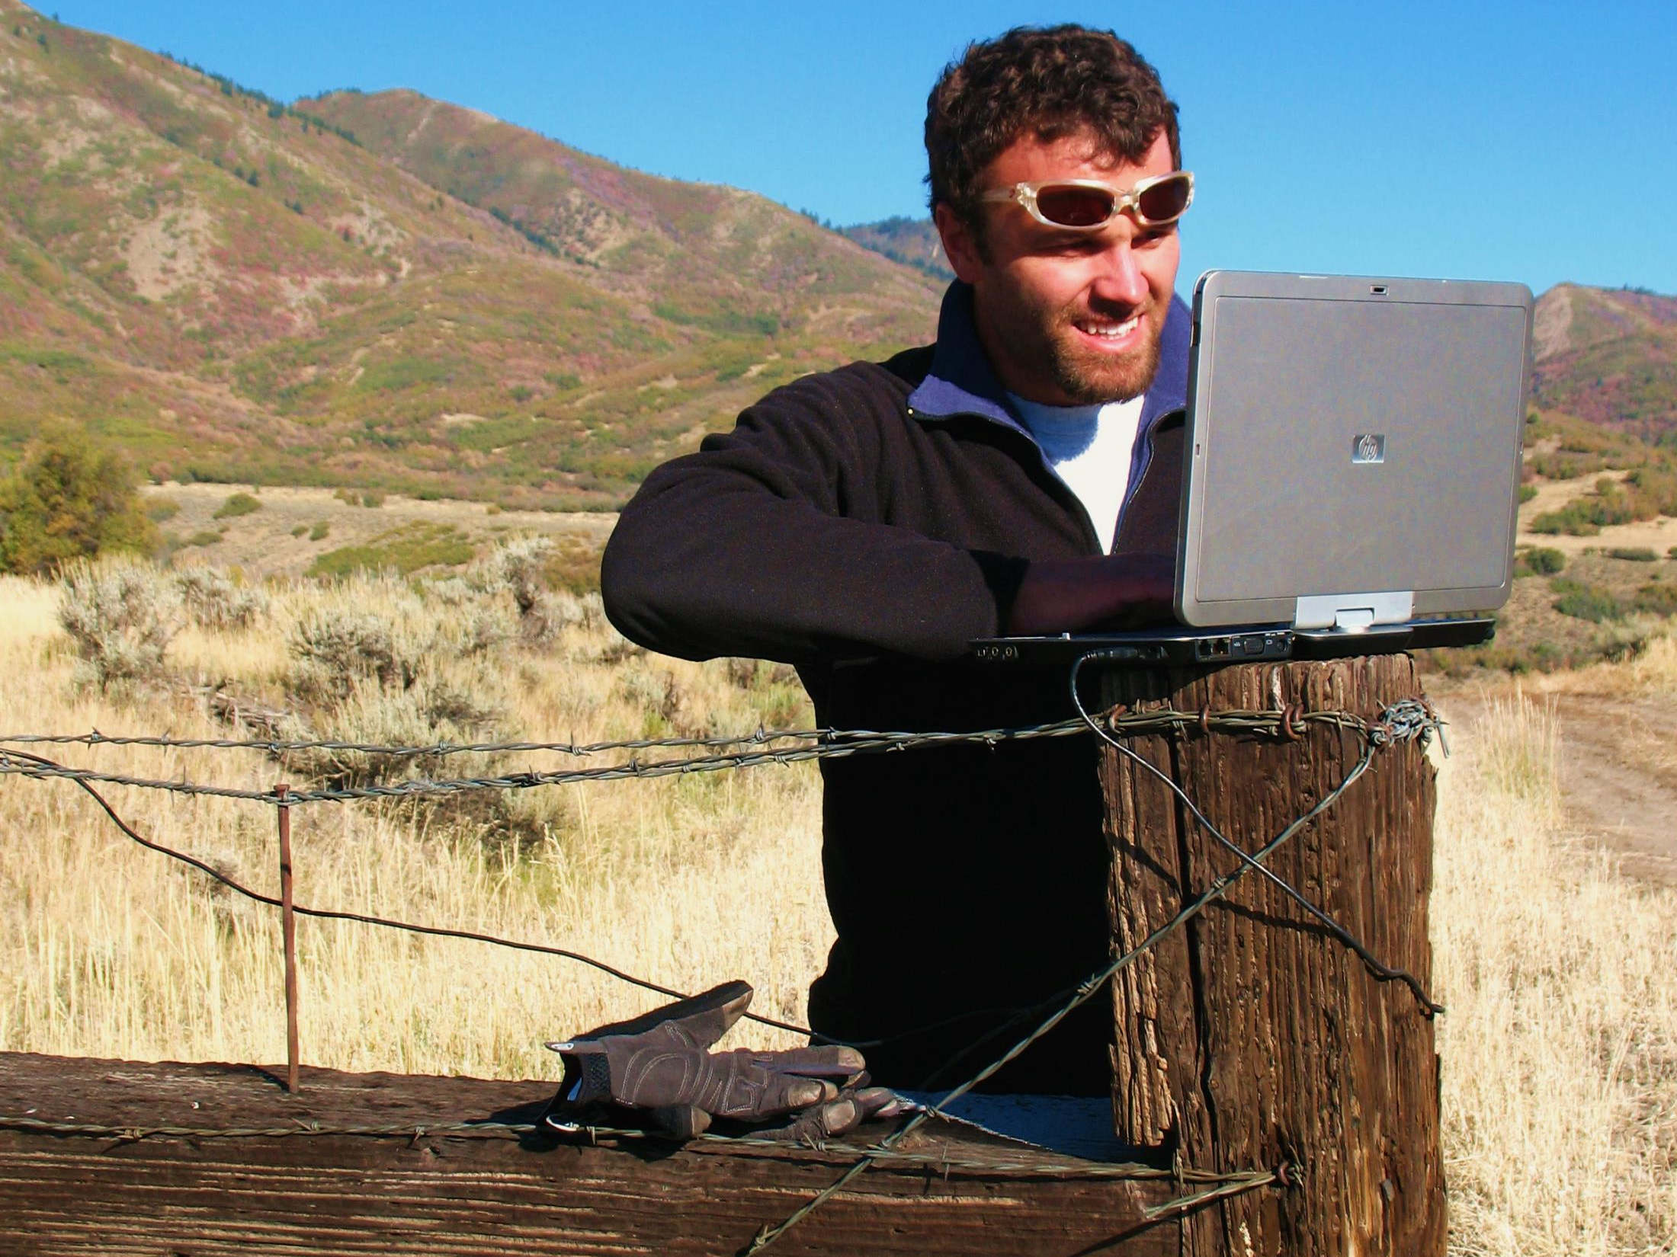
Adjudication Process
Where it begins

Slide 6
Hydrographic Survey:
Research and Field Review
Research old claims, court decrees, and other pertinent documents.
Field review claims within the area to identify pertinent features (i.e. beneficial use, diversion location, flow rate, etc.)
Meet with water users to discuss claim and observe beneficial use.
Notes:
A large portion of the Proposed Determination process is spent researching old decrees, county records, water rights files, and maps; and then reviewing the information in the field with the respective water users to ensure that we get a clear picture of the beneficial use and other facets of the water right. These include the location of the POD, the extent of the POU, and any conveyance structures.
The document shown in the slide is a water claim which was filed with in Grand County in 1892 for the use of 600 miner’s inches of water on a creek in the La Sal mountains.

Slide 7
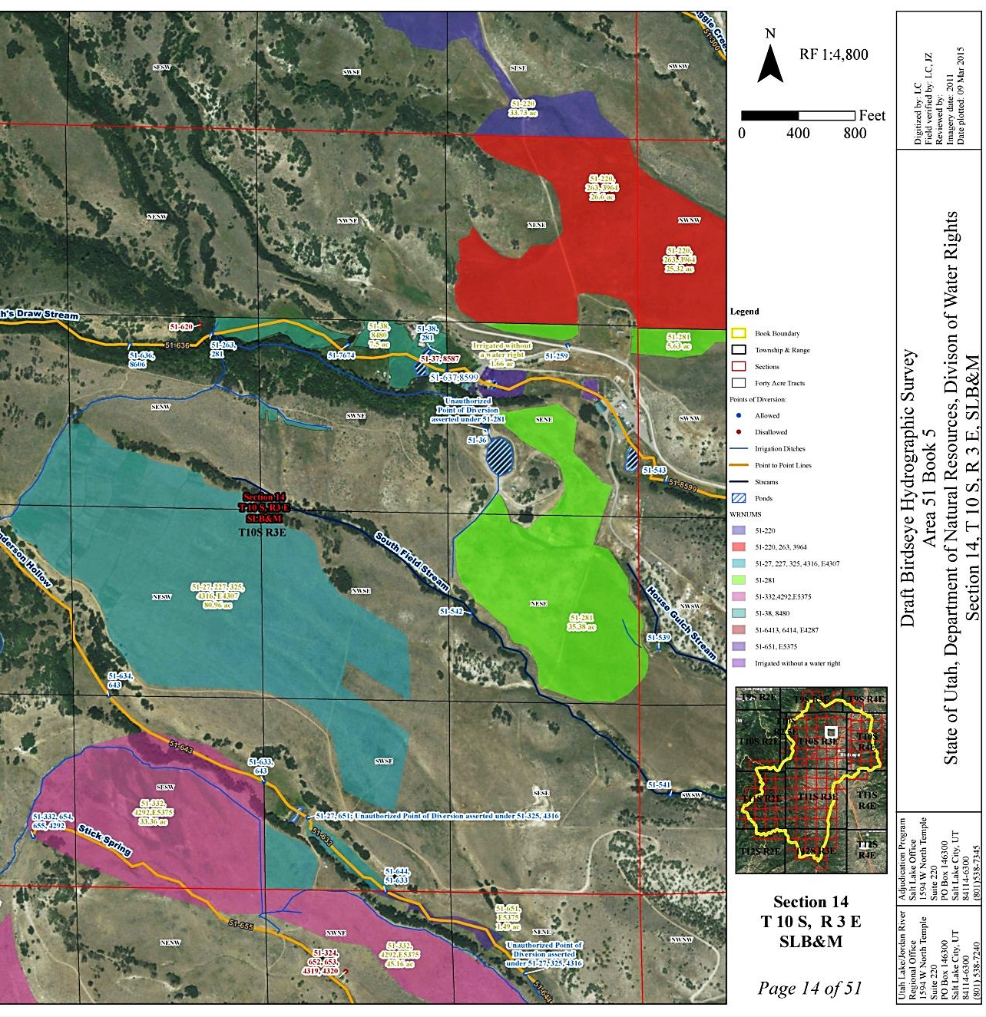
Hydrographic Survey: Mapping
Snap-shot in time
Hard copy originals on file at Salt Lake City Office and Regional Office.
Digital copies can be viewed online at the Division of Water Rights webpage.
www.waterrights.utah.gov
Adjudication
Hydrographic Survey
Pineview Reservoir
Notes:
The Adjudication staff use the information which they’ve gathered through extensive field reviews and produce a Hydrographic Survey map which identifies the location of the POD and the extent of the use.
You can view these hydrographic survey maps at the regional offices, or the Salt Lake office, or from the comfort of your own office by viewing them online at the address shown.

Slide 8
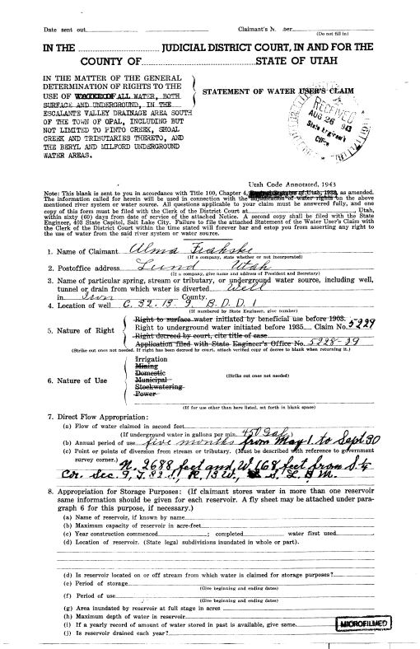
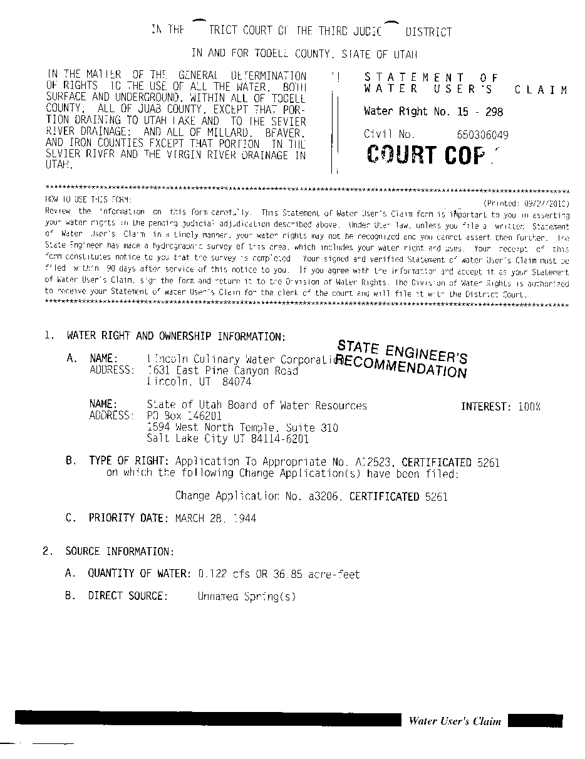
Water User’s Claims
Completed and filed by the water user with the Court or State Engineer.
Due to complexity of defining water rights, Adjudication staff typically help in completing the claim.
State Engineer files the claim with the Court on behalf of the water user as a courtesy.
Claims typically only taken on perfected rights, (i.e., certificated rights, decreed rights, and diligence claims).
Notes:
The statue states that water users are responsible for completing a Water User’s Claim and filing it with the court or the State Engineer; however, through years of experience, we’ve determined that it saves time, energy, and money to assist water users in filling out a claim due to the lack of understanding on what some of the technical terms mean or in what manner to describe their water right.
We also accept the Water User’s Claims and file them with the court at the completion of the Proposed Determination. Water User’s are welcome to opt out of the assistance of the Adjudication Staff at their leisure.
Water User’s Claims are only taken on rights which have been perfected (certificated), previously decreed, or qualify as diligence claims.
Occasionally, a water user wants to make a claim that is inconsistent with what the Adjudication Staff observe in the field. When this occurs, a “State Engineer’s Recommendation” is filed with the court and published in the proposed determination in the place of the claim. Water users will have the opportunity to object to any perceived errors in the Proposed Determination, which will be discussed shortly.

Slide 9
Moving towards a Decree

Slide 10
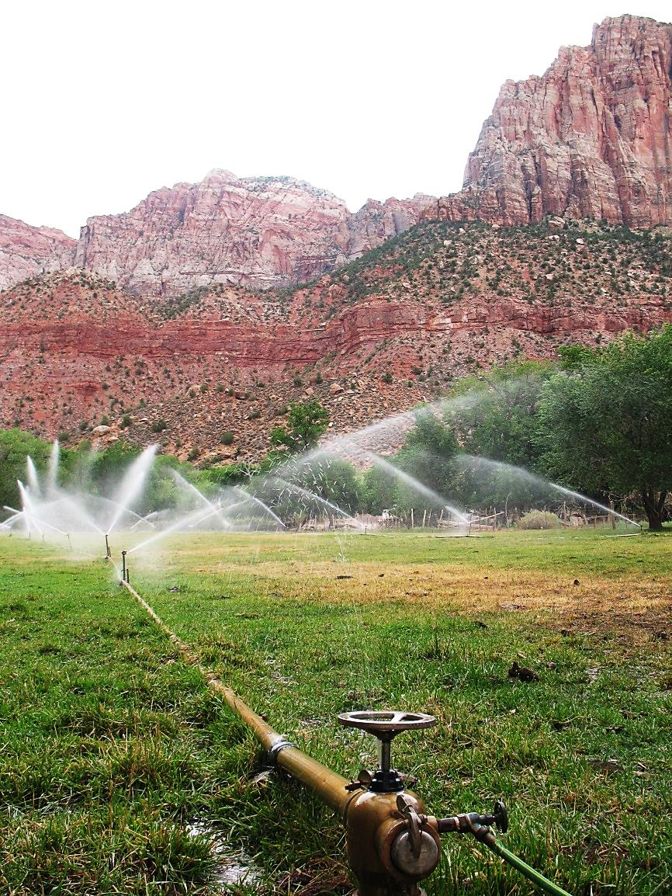
Proposed Determination
Represents State Engineer’s official recommendation of rights within an adjudication boundary.
Filed with the District Court.
Distributed to water users within the adjudication boundary.
Public meeting held to discuss the proposed determination and answer questions.
Notes:
Once the Hydrographic Survey, Water User’s Claims, and State Engineer’s Recommendations have been finalized, the Proposed Determination is published, distributed to the water users, and filed with the court. Each book has a unique name and number. The name typically incorporates some geographic aspect of the respective subdivision. The number reflects the Area number (which corresponds with the various drainage numbers used by the State Engineer’s Office) and a book number.
As shown, this is the Taylor Flat Subdivision, Book 05-3. On the right is what our current Proposed Determination format looks like. For the most part it mirrors the same information that you would see when viewing the water right on the Division’s database. Earlier Proposed Determinations have different formats depending on the vintage.

Slide 11
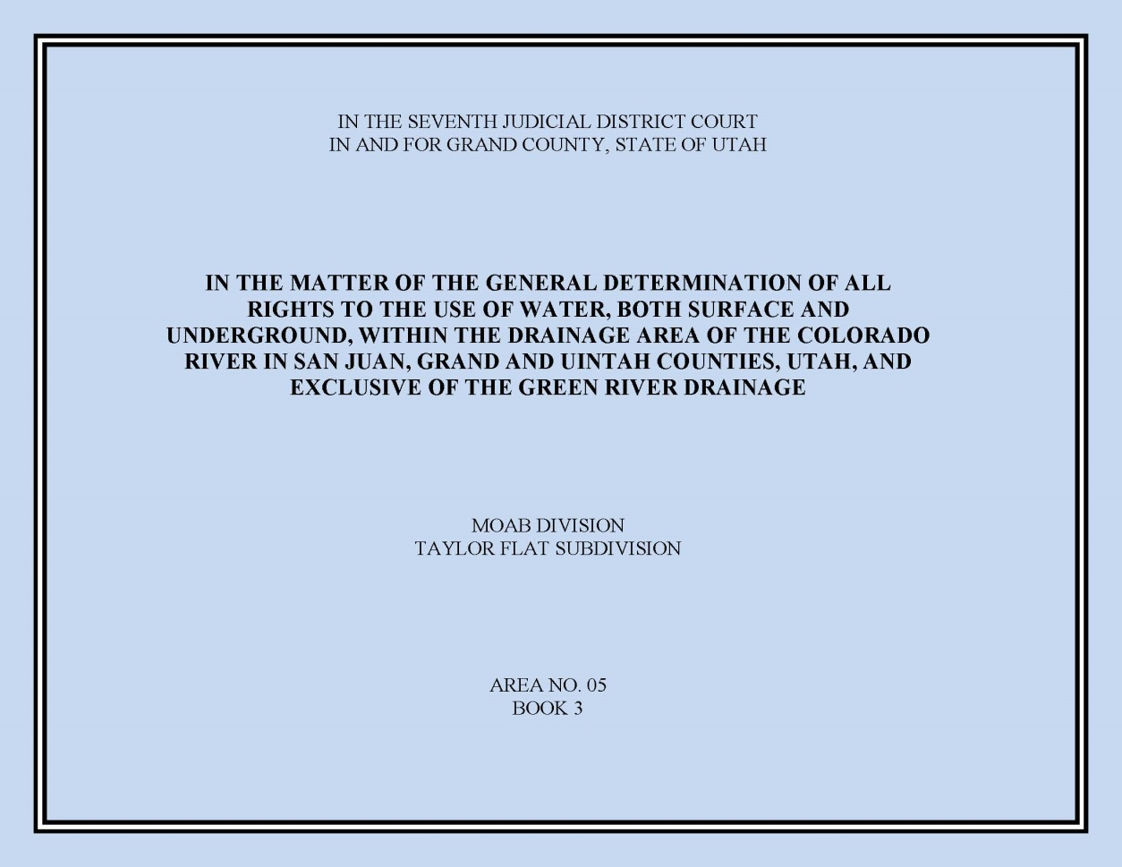
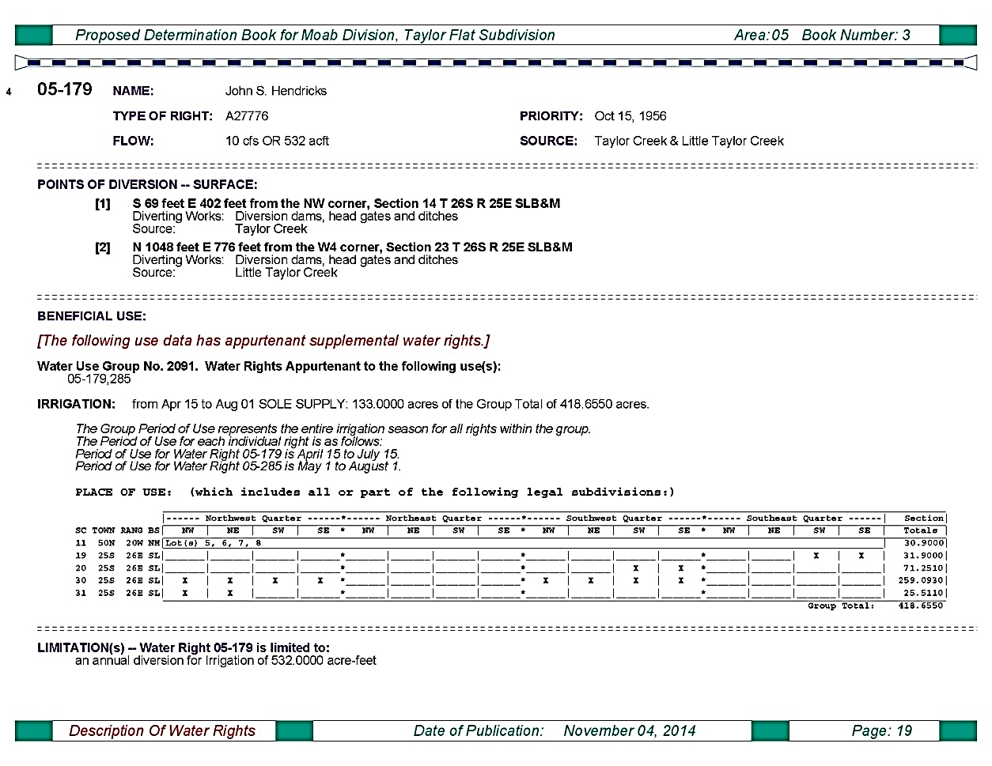
Proposed Determination, Continued
Notes:
Once the Hydrographic Survey, Water User’s Claims, and State Engineer’s Recommendations have been finalized, the Proposed Determination is published, distributed to the water users, and filed with the court. Each book has a unique name and number. The name typically incorporates some geographic aspect of the respective subdivision. The number reflects the Area number (which corresponds with the various drainage numbers used by the State Engineer’s Office) and a book number.
As shown, this is the Taylor Flat Subdivision, Book 05-3. On the right is what our current Proposed Determination format looks like. For the most part it mirrors the same information that you would see when viewing the water right on the Division’s database. Earlier Proposed Determinations have different formats depending on the vintage.

Slide 12
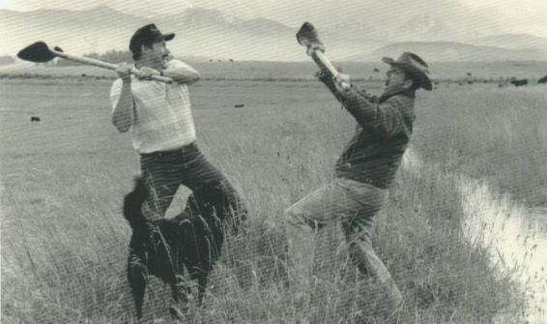
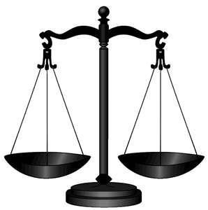
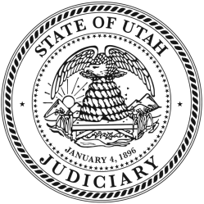
Objections
I OBJECT!
If water users disagree with a proposed determination they may file an objection with the court within 90-days.
Filed with the clerk of the respective District Court.
Court may be petitioned to allow a late objection.
ME TOO!
Appeal?
Voluntary Withdrawal
Objection Withdrawn
Objection Filed with the Court
Settlement
Court Order
Proposed Determination
Questions of Fact & Law
Litigation
Notes:
As mentioned earlier, occasionally a water user will disagree with the content of the Proposed Determination—whether it’s regarding their own water right or someone else’s water right. When this occurs, they have the option of filing an objection within 90 days of the publish date of the PD. An official objection must be verified by oath and filed with the respective District Court. Informal or defective objections failing to meet the statutory requirements may be handled through other means, but they aren’t binding on the Proposed Determination. The court may be petitioned to allow a late objection.
Once an objection is filed, there are a couple of options in how it may be handled. The State Engineer usually attempts to settle the objection without going through costly and time-consuming litigation. Often this involves meeting with the parties and attempting to stipulate a settlement in exchange for withdrawal of the objection.
If an agreement can’t be made, the objection may lead to litigation. Occasionally the objection is between two separate parties and the State Engineer will simply file a response to the objection and let the two parties battle it out in court. When the objection is litigated before a court, the Proposed Determination is reviewed in terms of questions of fact and law. Eventually the court will render a decision and issue a court order either recognizing the Proposed Determination or amending some aspect of it. The parties and the State Engineer have a 30-day window to file an appeal if they choose to.

Slide 13
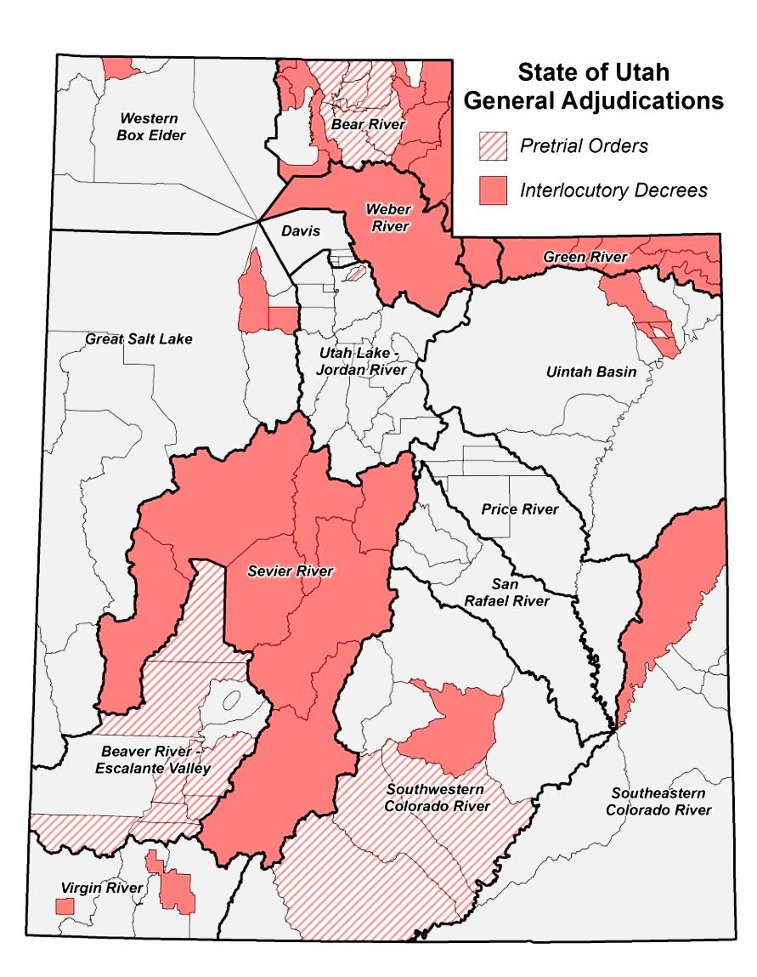
Decrees
In the “early” days, one Proposed Determination was published for one river drainage (e.g. Weber & Sevier Rivers).
Interlocutory or Partial Decrees are often issued for sub-divisions of the river drainage.
Federal Reserved Water Rights are often omitted from any interlocutory decree due to on-going negotiations or lack of Federal joinder.
Decrees often include language closing the respective basin from additional diligence claims.
…but what about Federal rights?
Notes:
As mentioned before, in the early days, there was one Proposed Determination for each large river drainage basin; however, as Utah has increased in population and natural resource development, the number of water rights has increased beyond the ability of the State Engineer to tackle each basin at a time—resulting in the smaller subdivisions. In parallel with preparation of proposed determinations for smaller geographical areas within the larger drainage, we petition the court for an Interlocutory or Partial Decree. An Interlocutory Decree is an transitional decree which is used to settle the issues within that particular book. Once all subdivisions have an interlocutory decree, the court is petitioned to issue a decree on the entire drainage.
As a result of a 1908 Supreme Court decision in Winters v. United States, the court ruled that by creation if the Fort Belknap Indian Reservation, there was an implied water right for the amount of water for the reservation to be self-sufficient. Today, federal reserved water rights can be asserted on most lands managed by the federal government. Reserved rights are, for the most part, immune from state water laws and therefore, are not subject to diversion and beneficial use requirements and cannot be lost by non-use. The federal government, however, is required to submit all reserved water rights claims to the state’s adjudication process, and are limited by the "primary purpose" and "minimal needs" requirements. In addition, federal reserved water rights are nontransferable. By law, these rights can only exist on lands owned by the federal government. If a land transfer occurs, any existing federal reserved water right becomes invalid.
The McCarran Amendment, a 1953 law, waives U.S. sovereign immunity and allows states to determine Federal water rights in state courts. Hence, federal water claims may be quantified in state stream adjudications, but only if such proceedings are comprehensive (meaning that all claimants to a specific water body are joined in the suit). As a result, the Federal Government is purposefully exempted from the Interlocutory Decrees (although their water rights are recognized in the Proposed Determination). Once an entire drainage has interlocutory decrees, the Federal Government is then joined as a party to the action just like any other water user and formally adjudicated.
When a court issues an Interlocutory Decree, it will often include language which closes the respective basin from further assertion of diligence claims… which is the primary purpose of a General Stream Adjudication.

Slide 14
Frequently Asked Questions
i.e., exam questions not otherwise covered previously
What if a water user chooses not to participate in a general adjudication?
They risk forfeiture of any rights not claimed and the loss of their right to appeal or object to the proposed determination.
What does it mean if the status of a water right says “disallowed”?
There may be many reasons, but water rights are generally disallowed based on evidence of non-use (i.e., forfeiture).
What happens following the publication of a proposed determination?
The proposed determination is distributed to water users, objections are resolved, and the proposed determination is decreed by the district court.
Lastly…
Grand Juries are typically NOT a part of the Adjudication Process
Notes:
When the Adjudication Program goes into an area, one of the most prominent questions is whether or not a water users will lose their water right. It should be noted that the State Engineer does not have the authority to take a water right away. We can only recommend to the court that the water right be disallowed in the Proposed Determination.
Ultimately, individuals who are using their water right in conformance with the records on file with the Division of Water Rights have nothing to fear.
Those who are using water without a right of record are required to submit a claim during the process or risk being barred by the court from asserting a right.
When a water right, or portion of it, has fallen out of use for more than 7 years, the water right (or the un-used portion) may be recommended to be disallowed in the Proposed Determination. This ensures that water which is not being used, returns to the public for future appropriation or sustainment of other rights. We will often give a water user the benefit of the doubt in order to prevent unnecessary constraints on water users.

Slide 15
Who Can I Contact to Discuss the
Adjudication Process?
Blake Bingham, P.E.
Adjudication Program Manager
Phone: 801-538-7345
E-mail: blakebingham@utah.gov
Chris York, E.I.T.
Adjudication Engineer
Phone: 385-226-7805
E-mail: cyork@utah.gov
Randy Tarantino
Adjudication Specialist
Phone: 801-664-8452
E-mail: randytarantino@utah.gov
Mike Handy, P.G.
Adjudication Team Leader
Phone: 801-538-7463
E-mail: mikehandy@utah.gov
Josh Zimmerman
Adjudication Team Leader
Phone: 801-946-7168
E-mail: joshzimmerman@utah.gov
Utah Division of Water Rights
1594 West North Temple
Suite 220, PO Box 146300
Salt Lake City, UT 84114-6300
www.waterrights.utah.gov

Slide 16
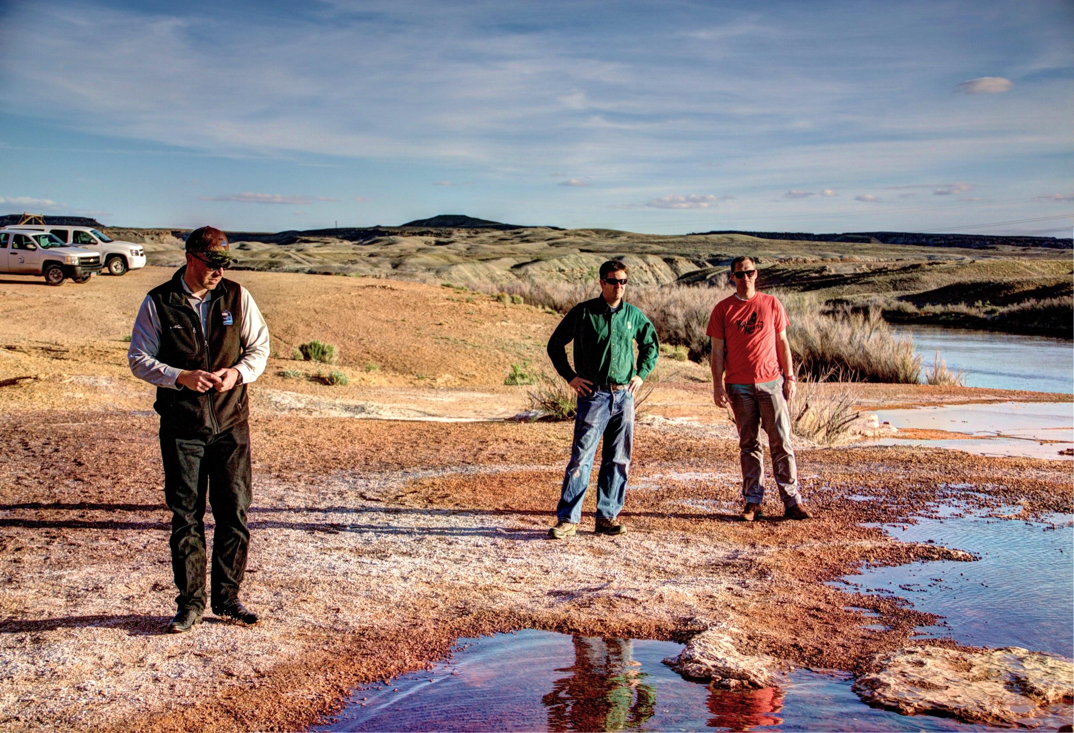
Questions?
Questions?

