Slide 1
Water Use Program
How it has changed
Why it is important!
Eric K. Klotz, P.E. Utah Water Resources
James Greer, P.E. Utah Water Rights

Slide 2
What is the Water Use Program?
Cooperative effort with the:
USGS
Utah Division of Water Rights
Utah Division of Water Resources
Utah Division of Drinking Water
for the purpose to collect and compile water supply withdrawal and diversion data, as well as customer level water use data from public water suppliers, industrial and groundwater management plan users throughout Utah.

Slide 3

The Law governing the program falls under:
73-5-8 Reports by users to engineer.
Every person using water from any river system or water source, when requested by the state engineer, shall within 30 days after such request report to the state engineer in writing: (a) the nature of the use of any such water; (b) the area on which used; (c) the kind of crops to be grown
(d) water elevations on wells or tunnels; and (e) and quantity of water used.

Slide 4
Participation is Mandatory if:
Required by an Order of the State Engineer (OSE)
Condition of Water Right approval or proof of beneficial use.
Requested by the State Engineer
To obtain State loans
Statute suggest that reporting is mandatory

Slide 5
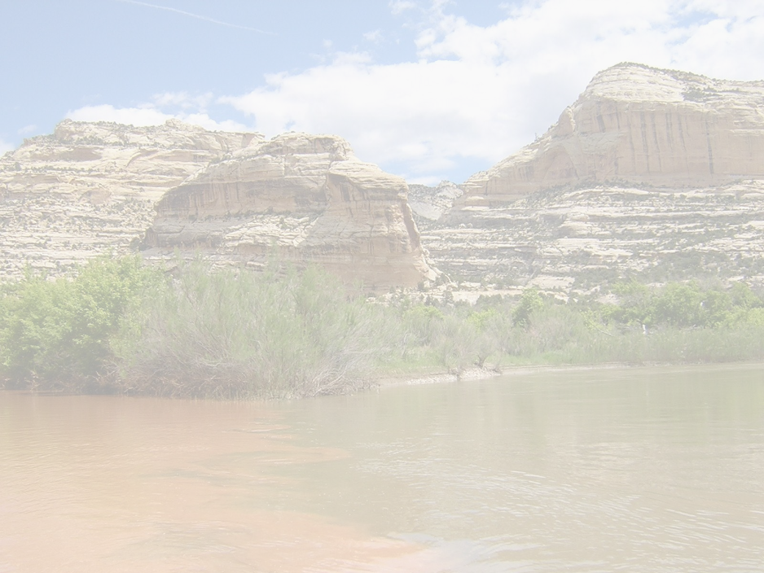
Water Use Data is Used for:
USGS studies
Water Resources Planning Programs and Efforts
Water Rights Water management policy development
State financial assistance programs
Assessment of water supply and water use.
Water Rights Proof processing
Systems to evaluate the efficiency of their own systems

Slide 6
How is the water use data collected?
The survey form is either emailed or a paper form is mailed during the first week of January.
The survey form is for the previous years reporting.
Survey is due by March 1st.
A postcard reminder is mailed.
Then a late letter is mailed.

Slide 7
Legislative Audit Overview

Slide 8
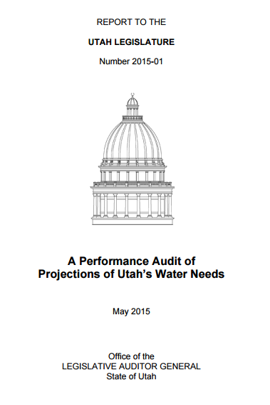
Legislative Audit Overview
Published in May 2015
Recommendations included improvements to:
Accountability
Education and Accuracy
Efficiency
Frequency

Slide 9
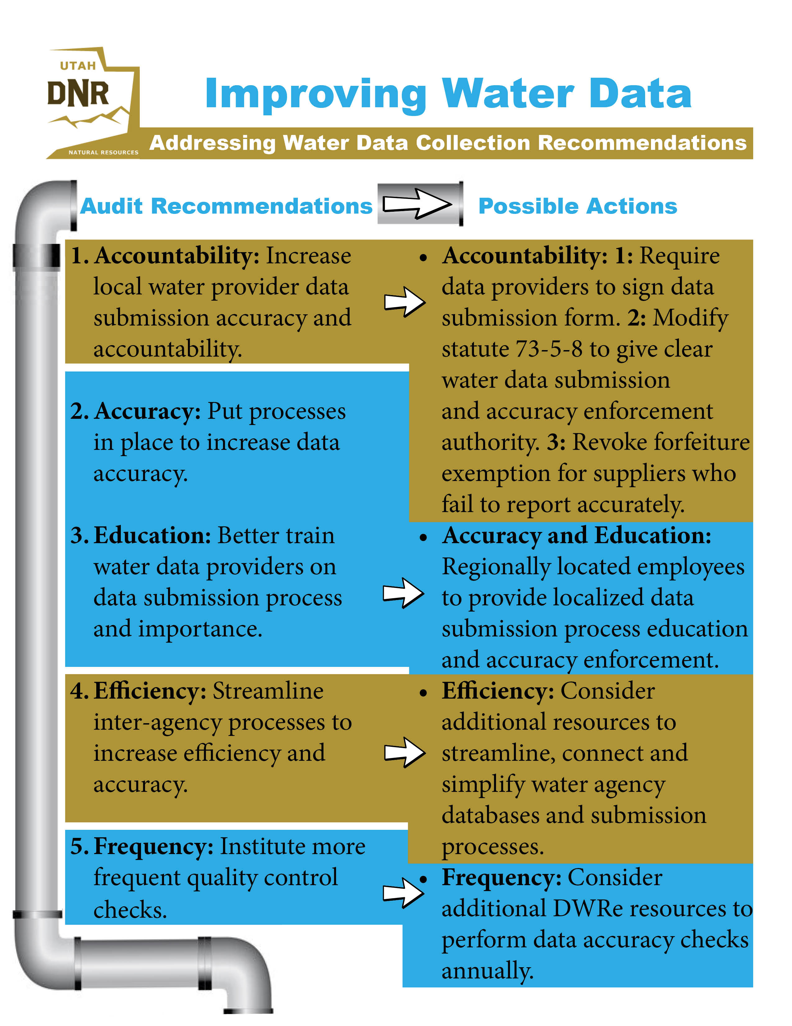

Slide 10
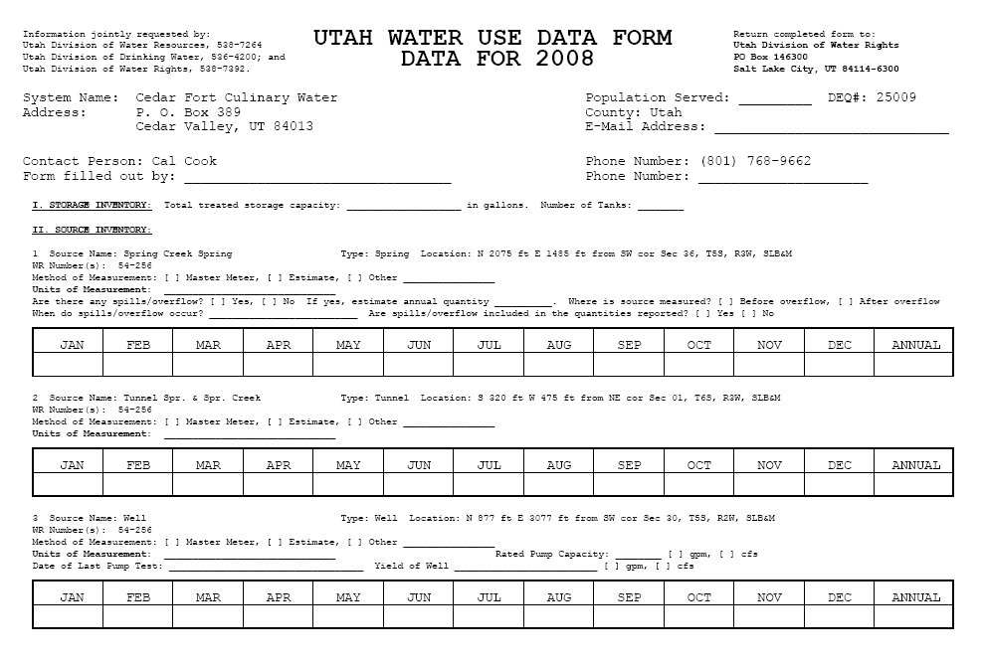

Slide 11
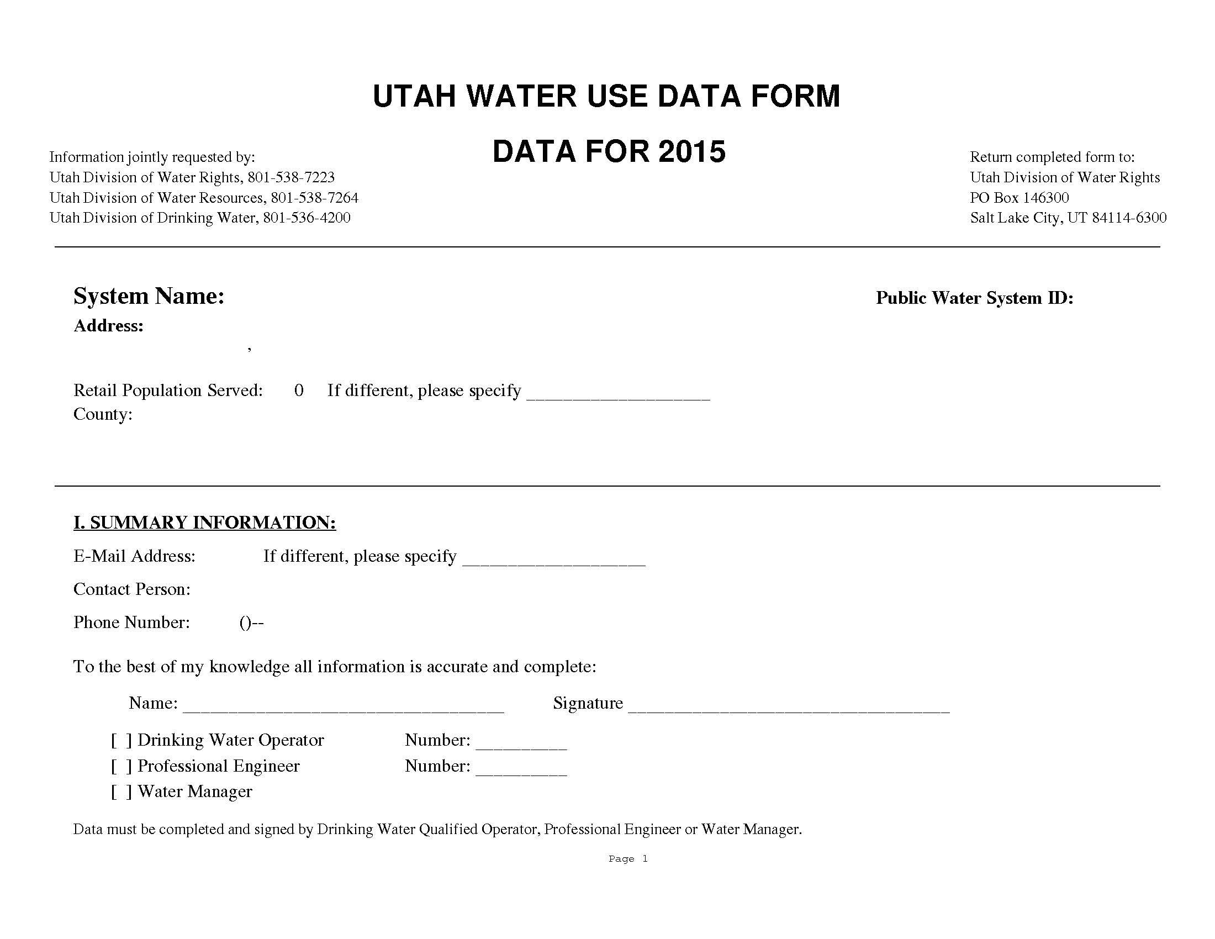

Slide 12
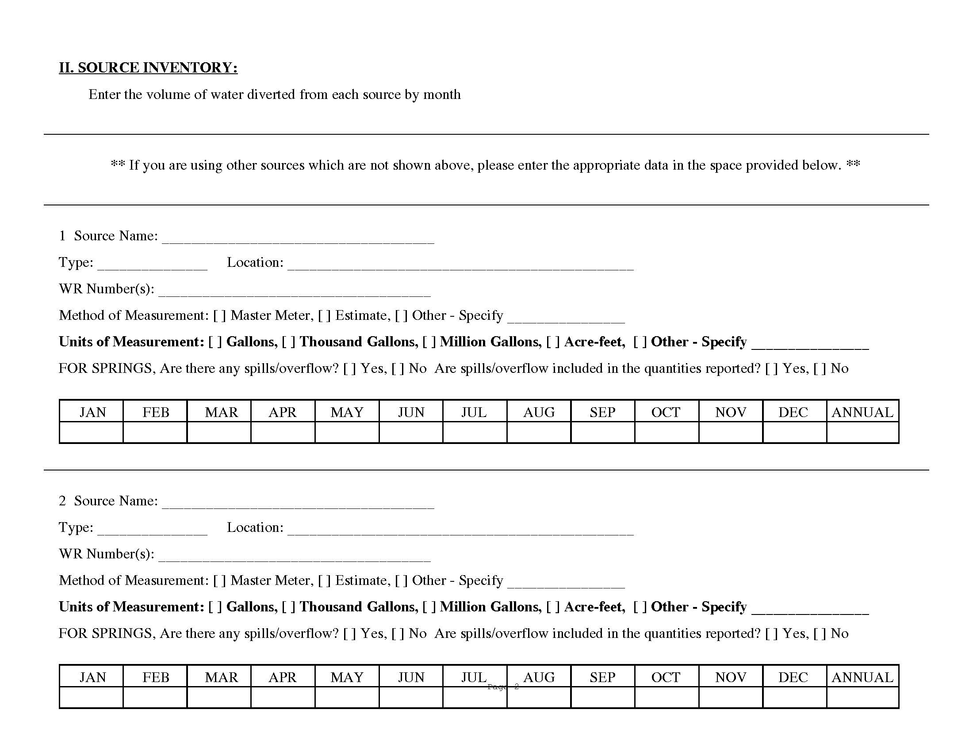

Slide 14
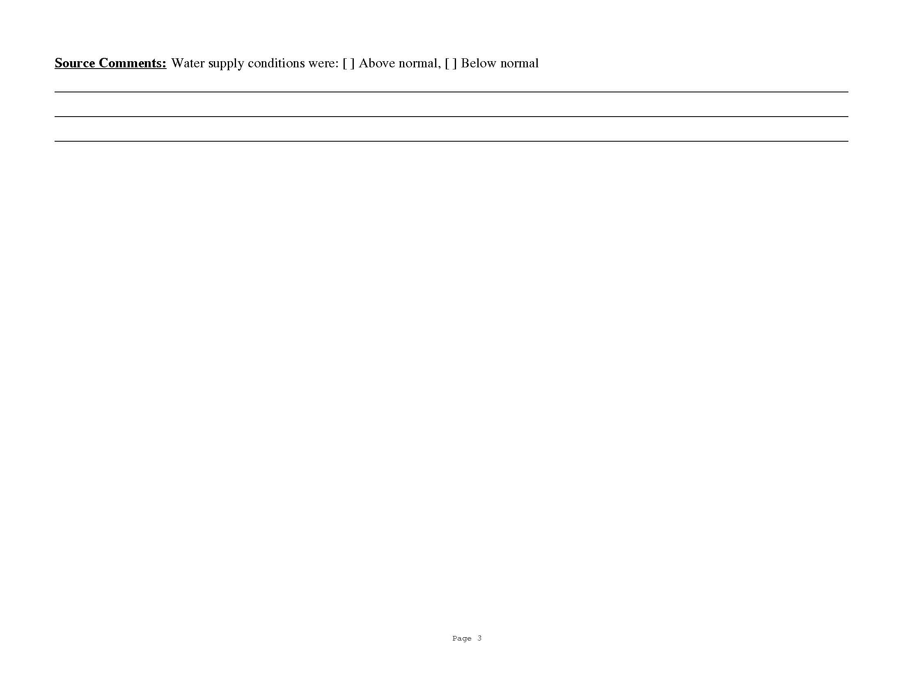

Slide 15
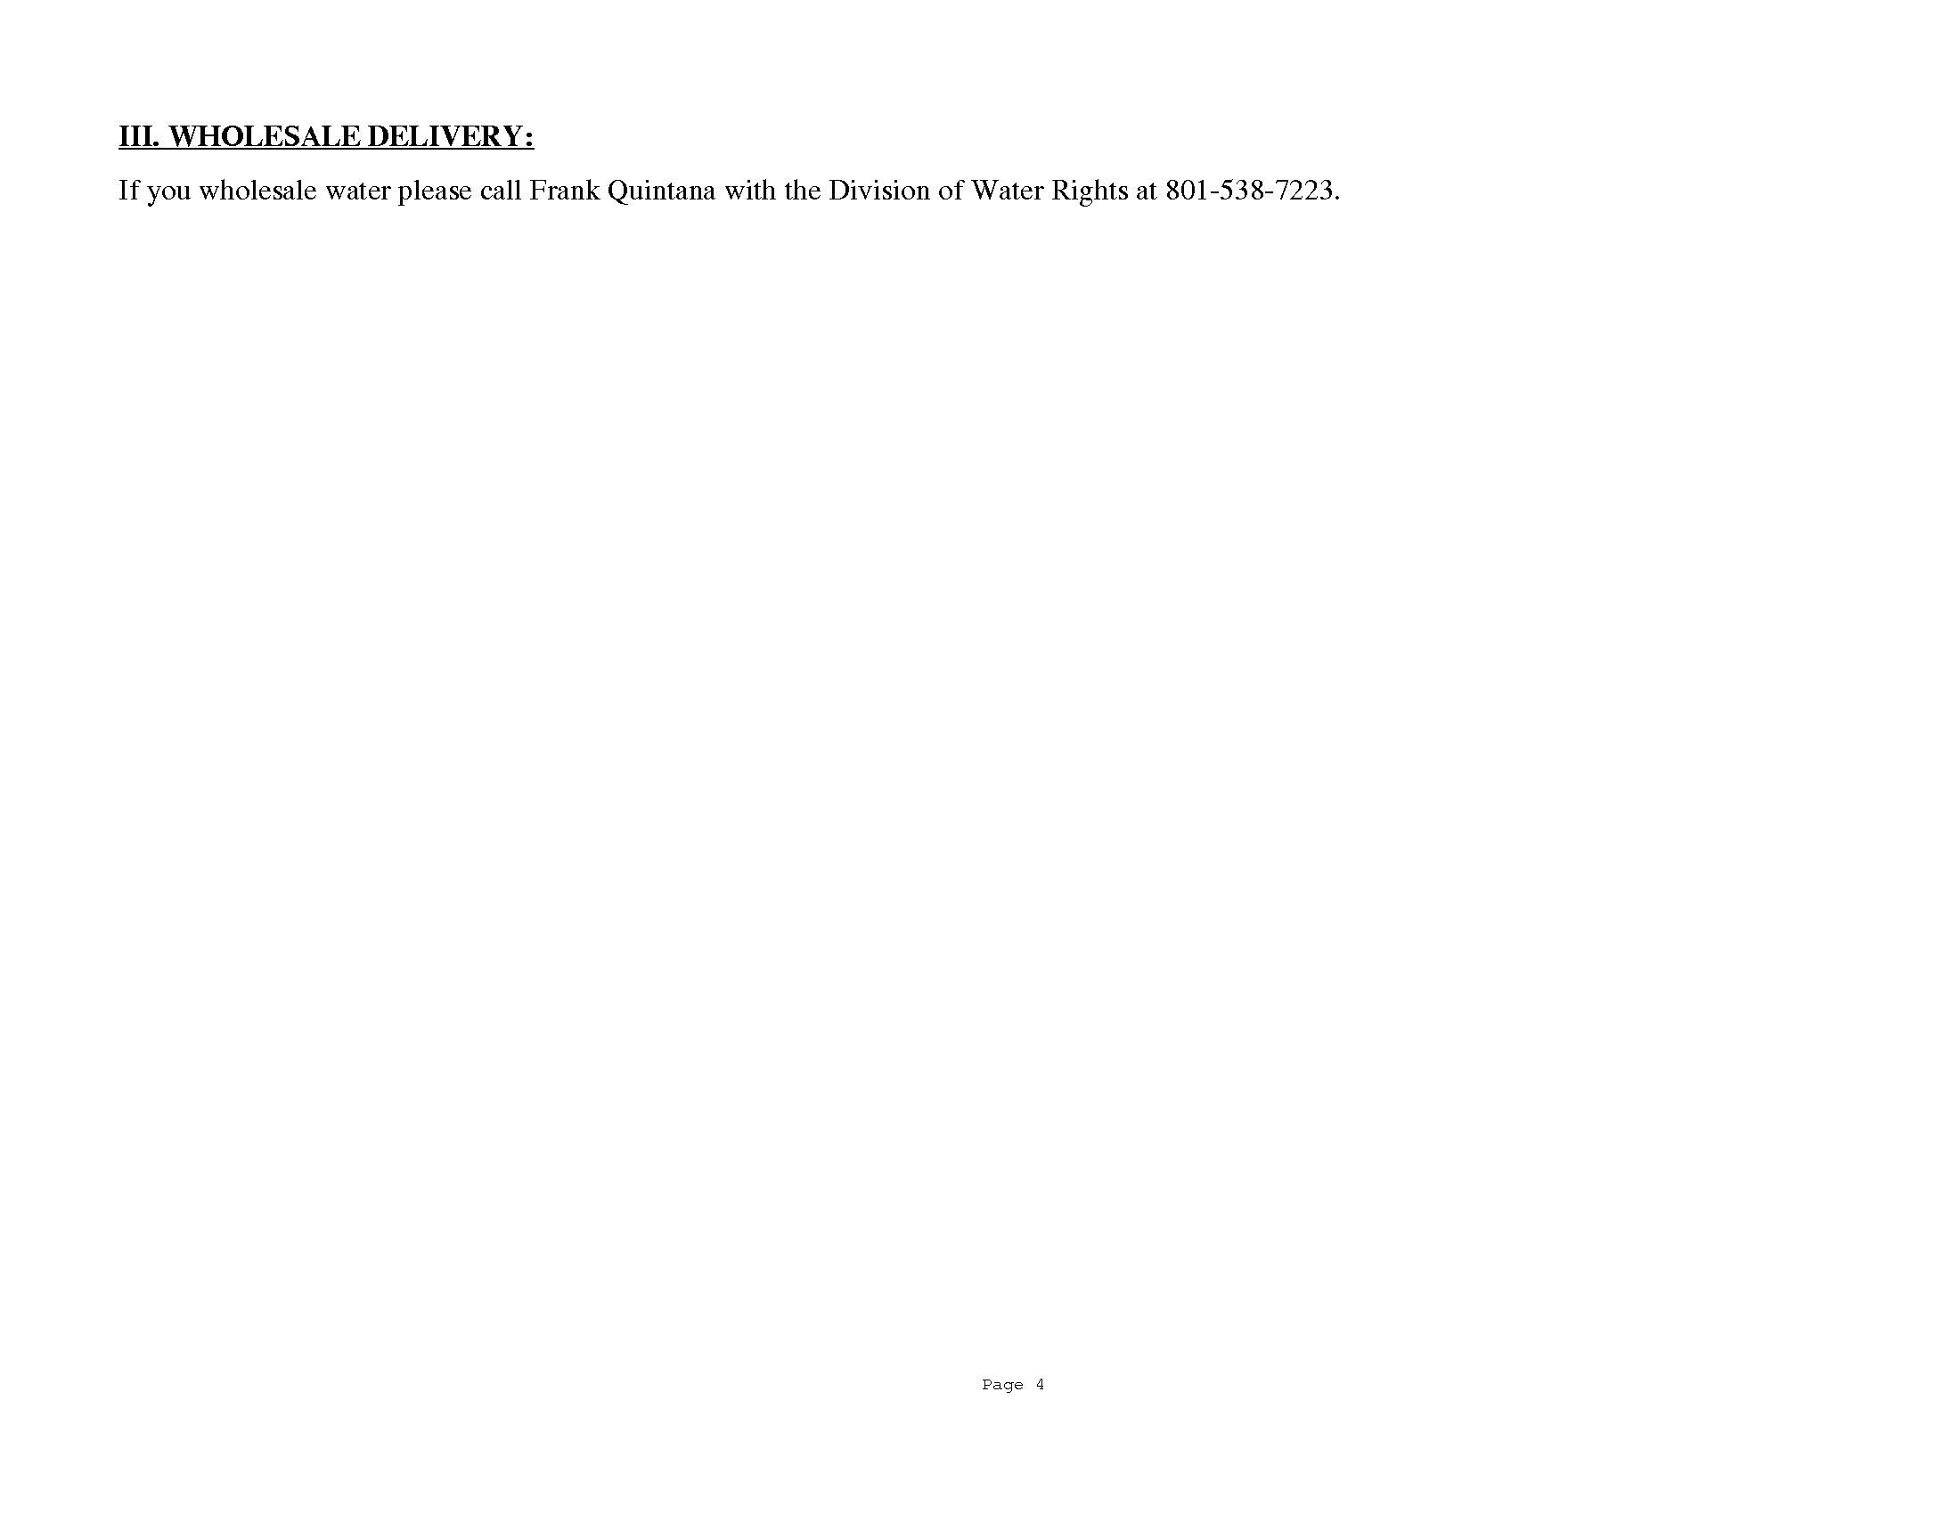

Slide 17
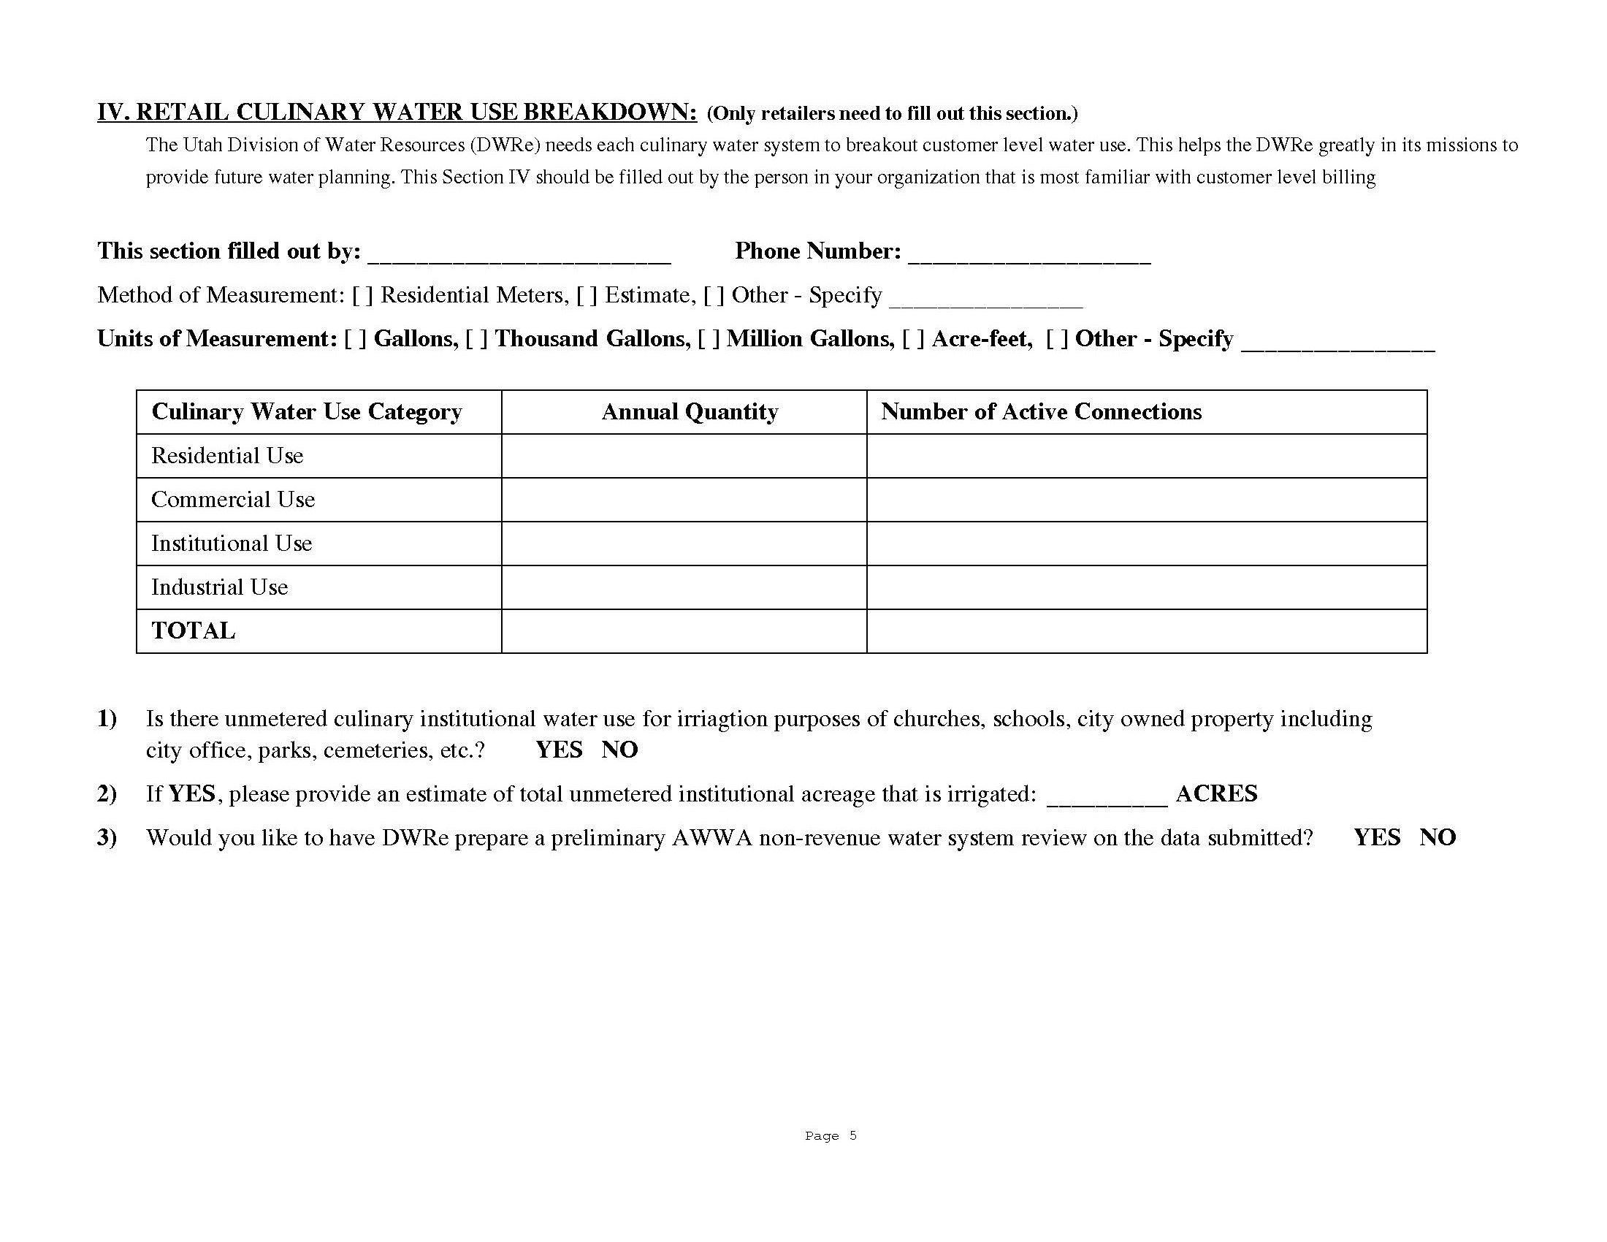

Slide 18
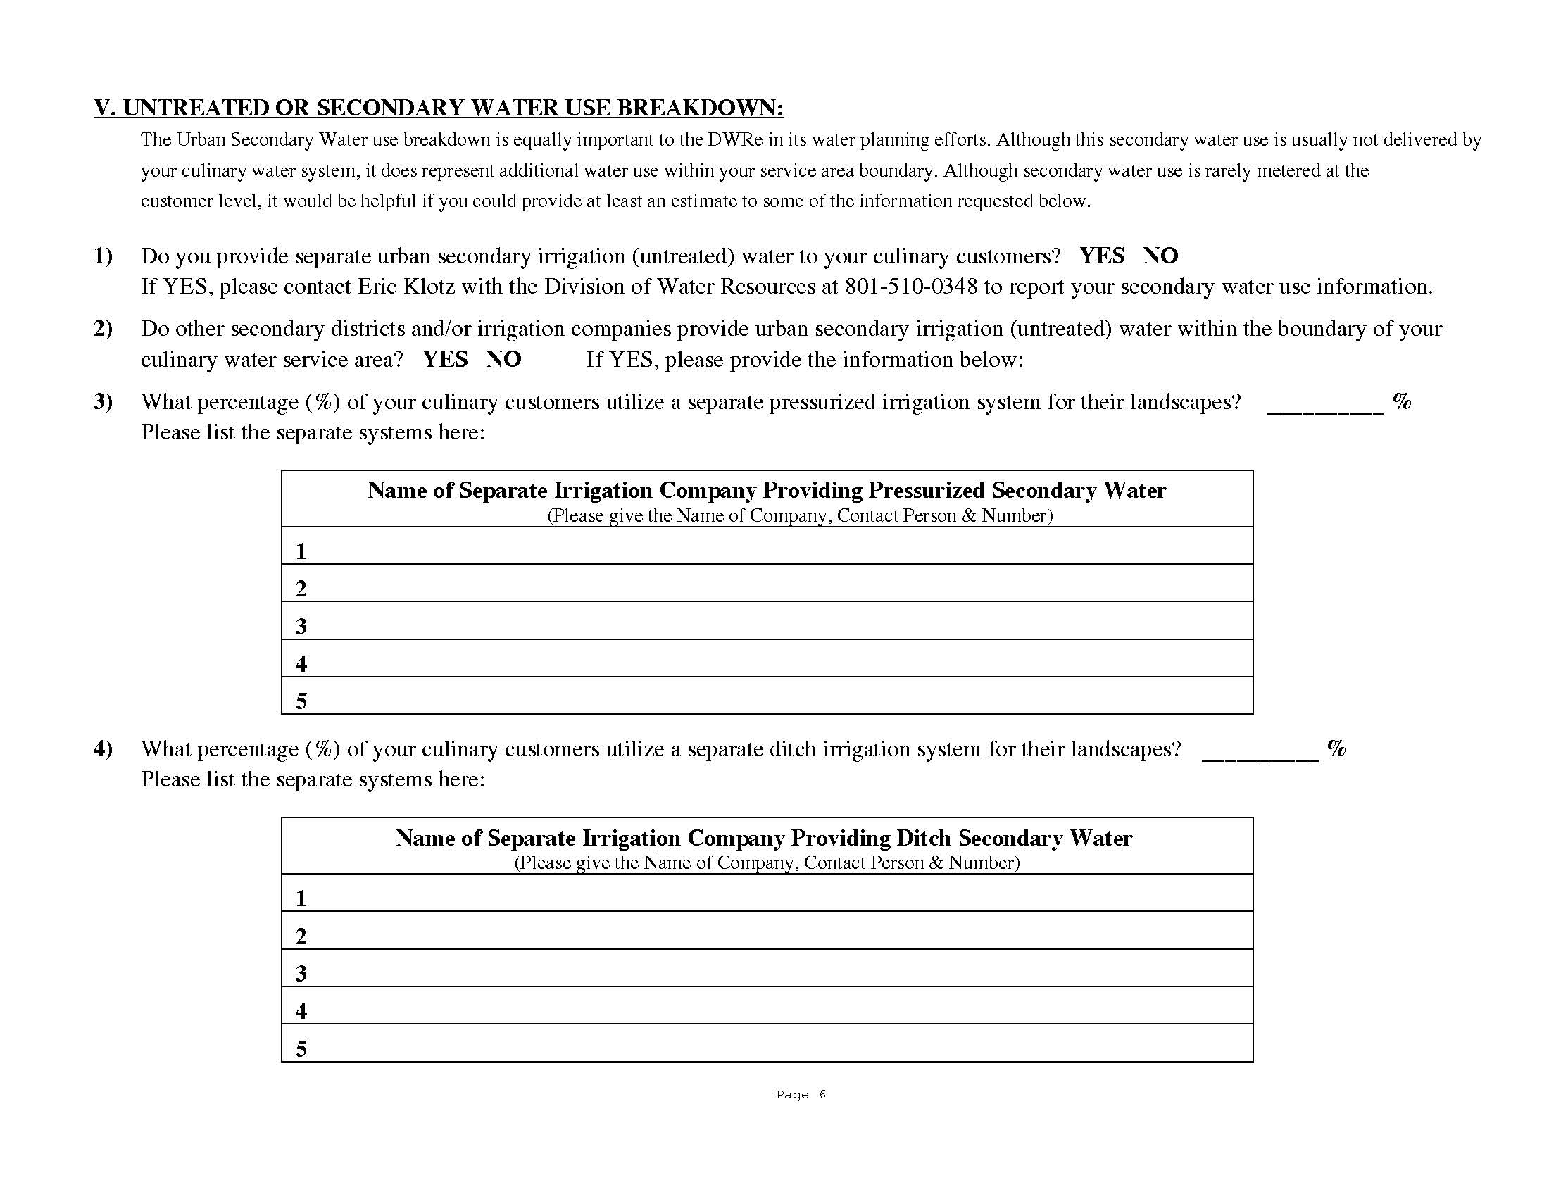

Slide 19
Along with the survey forms, detailed instructions are also mailed.
The last part of both the paper and e-form pertain to Revenues and Expenditures – this information is collected by the Division of Drinking Water. They are seeking financial information and future projected needs of your system.

Slide 20
Legislative Audit Overview
Published in May 2015
Recommendations included improvements to:
Accountability
Education and Accuracy
Efficiency
Frequency

Slide 21
H.B. 305
Water Rights and Resources Amendments
Deals with the accuracy of water use data
Requires certified operator or professional engineer to verify accuracy of submitted water data
Provides money for two FTE’s

Slide 22
S.B. 251
Water Infrastructure Funding Amendments
Modifies the duties of the Board of Water Resources, the Division of Water Resources and the State Water Development Commission

Slide 23
S.C.R. 1
Concurrent Resolution Encouraging
Universal Metering of Water Systems
Encourages Public Water Suppliers to Implement Universal Metering

Slide 24
S.B. 28
Water System Conservation Pricing
Requires retail water providers to establish an increasing rate structure for culinary water

Slide 25
S.B. 92
Water Conservation Amendments
Modifies provisions related to landscaping and water conservation plans
FAILED

Slide 26



Think Big!
Eric K. Klotz, P.E.
Water Conservation and Education Section Manager
Utah Division of Water Resources
ericklotz@utah.gov
James Greer, P.E.
Assistant State Engineer
Utah Division of Water Rights
jamesgreer@utah.gov

