Slide 1

Efforts to Make Utah’s General Adjudications More Efficient: Special Masters and Statutory Revisions

Slide 2

General Adjudication benefits
For the State
Planning and water development funding
Accurate numbers
Transparent water markets
For the water user
Transparent water markets
Solidifies “place in line”
Clarifying the limits on each water right
Water Right valuation

Slide 3
Status of general adjudications in Utah
Basin-wide Decrees
Limitations
Pre-McCarran Amendment
Groundwater?

Slide 4
Proposed Determinations

Slide 5
Areas where the Division of Water Rights is actively working

Slide 6
Historical challenges in the general adjudication
Administrative phase
Notice
Time reviewing and evaluating “all” rights of record
Judicial phase
Claimant files an objection, and then ….

Slide 7

Potential Efficiency Solutions
Administrative phase
SB 75 Statutory changes
Judicial phase
Special Master in the Utah Lake and Jordan River General Adjudication

Slide 8
SB 75 – Summary of changes
Water user responsibility
Allows for expanded summons and notice upfront
30-day extension of time to file statements of claim
List of unclaimed rights – abandonment
Duty to update ownership and address
Permits Electronic claim submission
Sequence of hydrographic survey and claim evaluation

Slide 9
SB 75 allows for expanded notice
Existing Statute
Look to SE’s records for claimants
Ongoing obligation to search for claimants
SB 75 change
SE can supplement incomplete list of potential claimants upfront (Utah Code § 73-4-3(9))
Can utilize county recorder’s records

Slide 10
SB 75 One 30-day extension
Existing statute
Only the Court can authorize extensions
SB 75 Change
SE can grant one 30-day extension of time to file claims (Utah Code § 73-4-10)
Timing
In writing
Automatically granted

Slide 11
SB 75 List of Unclaimed Rights
Consequences of not filing a claim
Rights of record (Utah Code §§ 73-4-9, -9.5)
Evidence of an intent to abandon the right
An unclaimed Water Right of record is placed on the list
Rights not of record (Utah Code § 73-4-9)
Barred and estopped
List published and notice sent similar to a Proposed Determination (Utah Code § 73-4-9.5)
Notice to potential claimants

Slide 12
SB 75 List of Unclaimed Rights
Relief if your water right is on the list (Utah Code § 73-4-9.5(2))
File a statement of claim
File an objection within 90 days
For the remaining Unclaimed Rights (Utah Code § 73-4-9.5(4))
Court decrees the unclaimed rights abandoned
Court may close the area to further diligence claims

Slide 13
SB 75 Takeaways
File a statement of claim within 90 days or seek an extension
Update address and/or title with the State Engineer’s office
Pay attention to notices in the newspaper and mail
Enter an appearance on behalf of your clients
File a statement of claim!
Review the list of unclaimed rights

Slide 14
Master in the ULJR Gen. Adj.
Who – TBD
What (will they do) – hears objections to a PD
When – TBD
Where – only in the Utah Lake and Jordan River General Adjudication, but potentially coming to other areas

Slide 16
Process of getting a Master appointed
Notice to all parties and an opportunity to be heard on:
Whether the Court should appoint a Master
What the Master should do – Order of Reference
Initial hearing
Master position advertised Jan. 4th- Feb. 3rd
(30 days)

Slide 17
Process of getting a Master appointed
The Court selects a smaller pool of qualified candidates
Parties can file comments (sealed)
Court will hold a hearing on the Proposed Masters
Appoint a Master, if a suitable and qualified candidate is found

Slide 18
What will the Master do? Order of Reference
Role limited to hearing objections to a PD
Fact Finder
Case Manager
Designate subcases and identify affected parties
Written Findings of Fact and Conclusions of Law to the Court

Slide 19
Master acts in a judicial capacity
Bound by the Code of Judicial Conduct to the same extent as a Judge Pro Tempore, plus
No ex parte communications
Master is not an employee of DNR or Water Rights
SE has no control over the Master or the Master’s priorities

Slide 20
How will a Master impact you and your clients?
More objections pushed towards litigation
Notice from the Court
Hearings
Scheduling conferences
Proposed Settlements
Old objections with outdated parties and counsel
Enter an appearance
Update title and address with the SE
Notify the Court of updated information

Slide 21
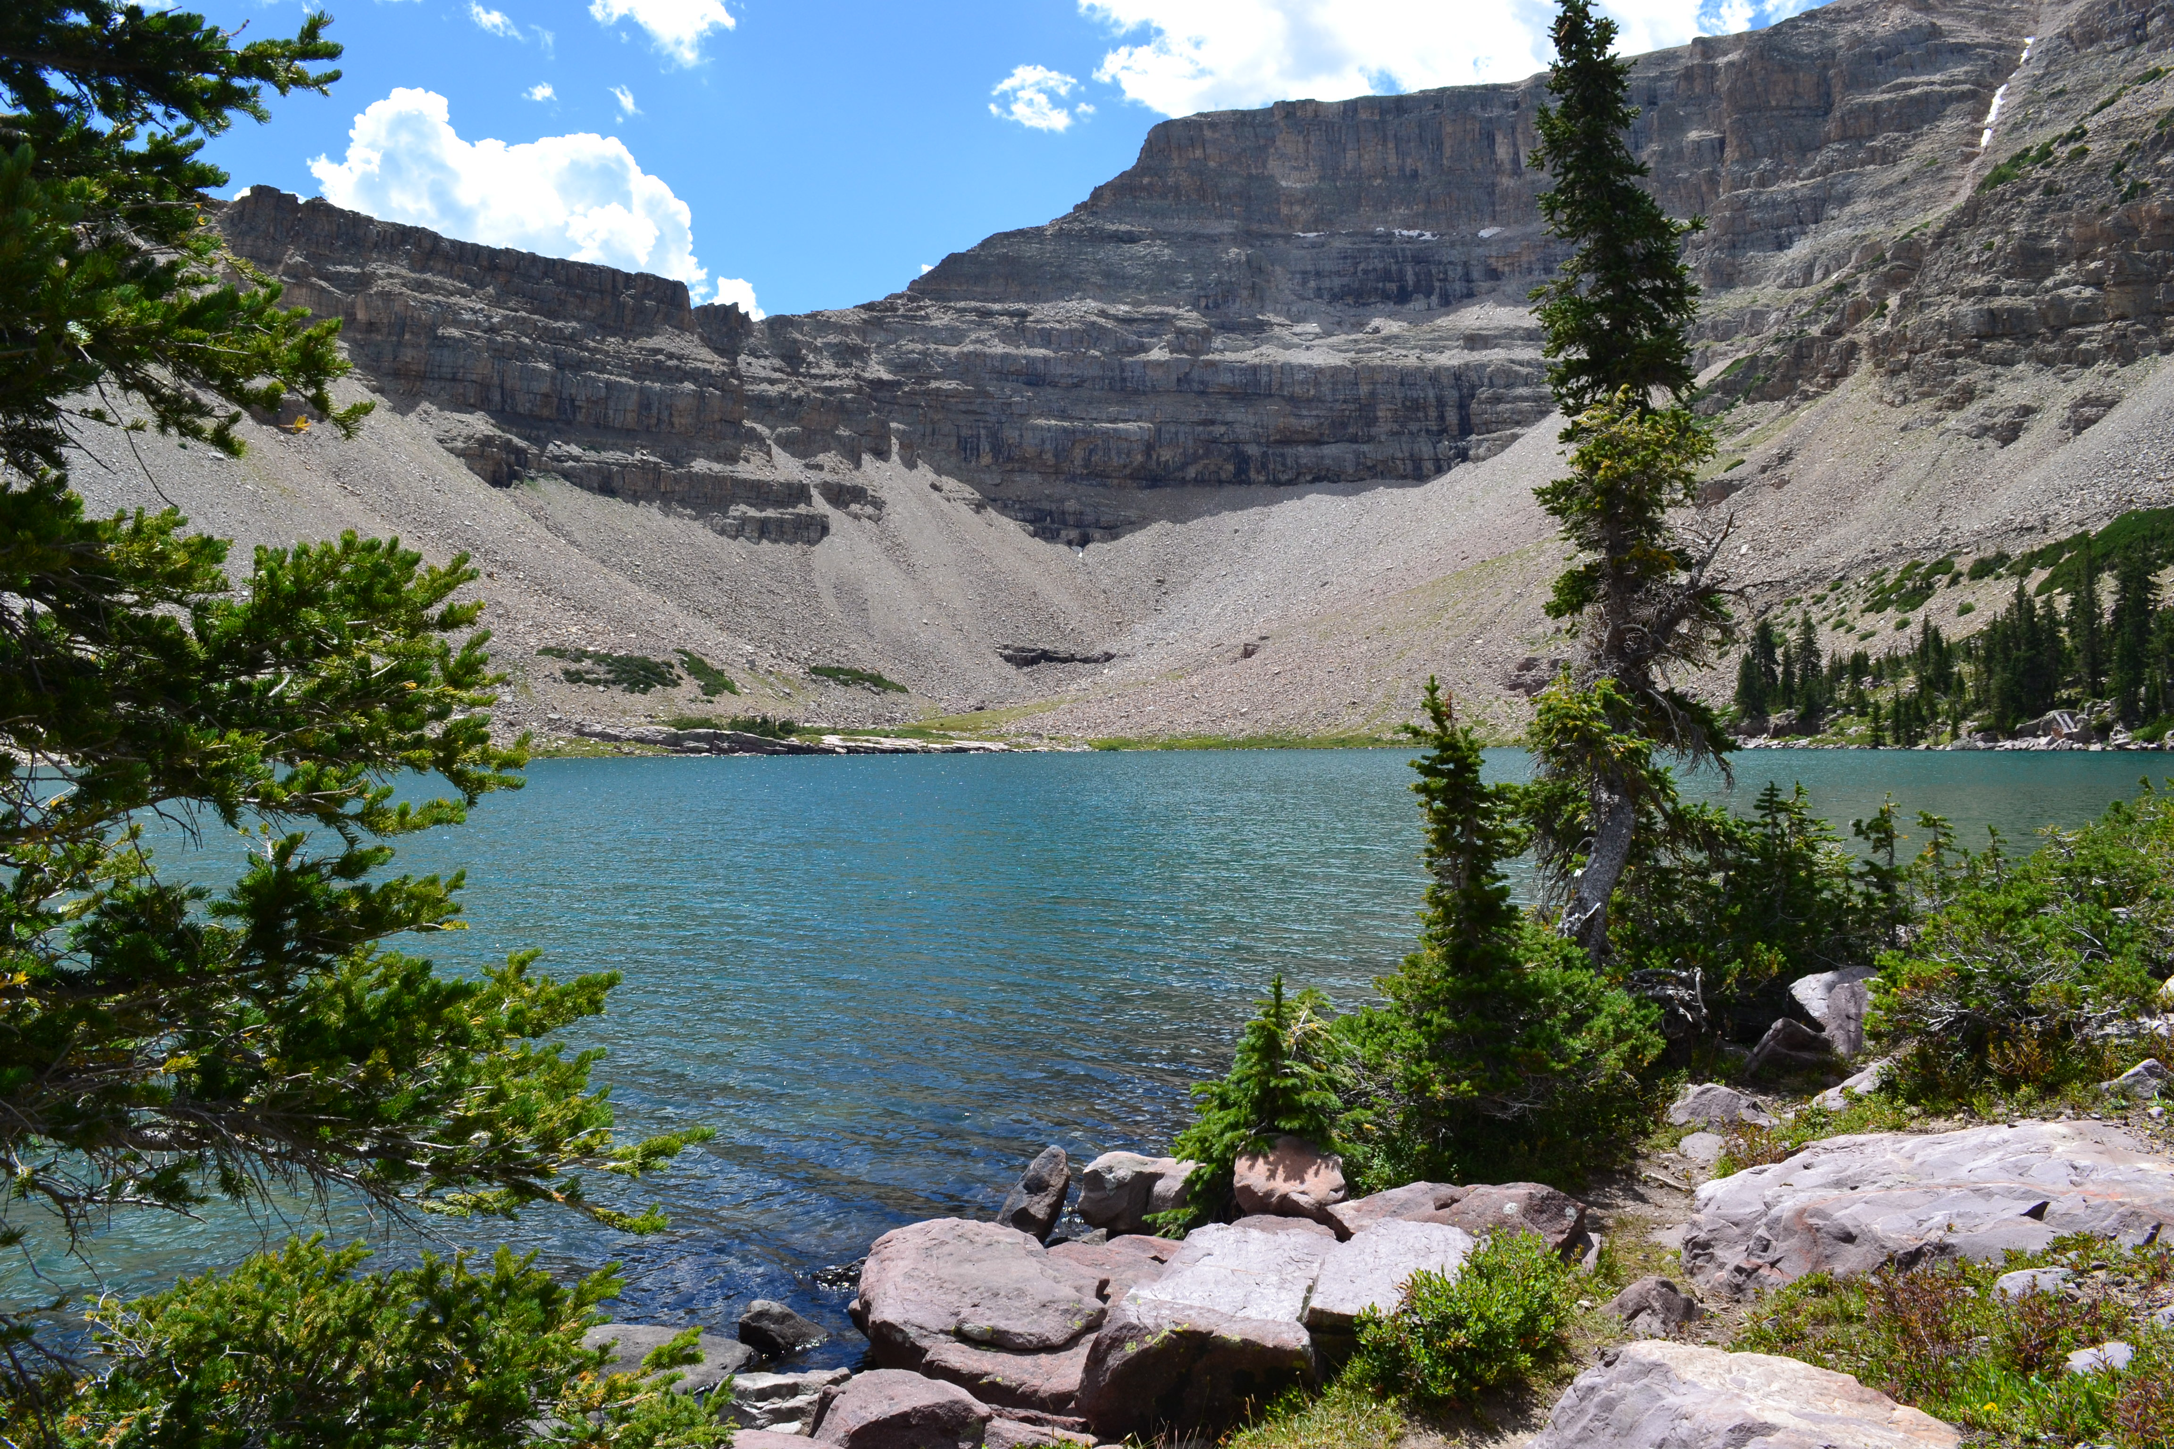
Questions?

