Slide 1
Water Use Program
How it has changed
Why it is important!
Eric K. Klotz, P.E. Utah Water Resources
Frank Quintana, P.E. Utah Water Rights
Tammy North, P.E. Utah Drinking Water

Slide 2
What is the Water Use Program?
Cooperative effort with the:
USGS
Utah Division of Water Rights
Utah Division of Water Resources
Utah Division of Drinking Water
for the purpose to collect and compile water supply withdrawal and diversion data, as well as customer level water use data from public water suppliers, industrial and groundwater management plan users throughout Utah.

Slide 3

The Law governing the program falls under:
73-5-8 Reports by users to engineer.
Every person using water from any river system or water source, when requested by the state engineer, shall within 30 days after such request report to the state engineer in writing: (1) the nature of the use of any such water; (2) the area on which used; (3) the kind of crops to be grown; and (4) water elevations on wells or tunnels and quantity of underground water used.

Slide 4
Participation is Mandatory if:
Required by an Order of the State Engineer (OSE)
Condition of Water Right approval or proof of beneficial use.
Requested by the State Engineer
To obtain State loans
Statute suggest that reporting is mandatory

Slide 5
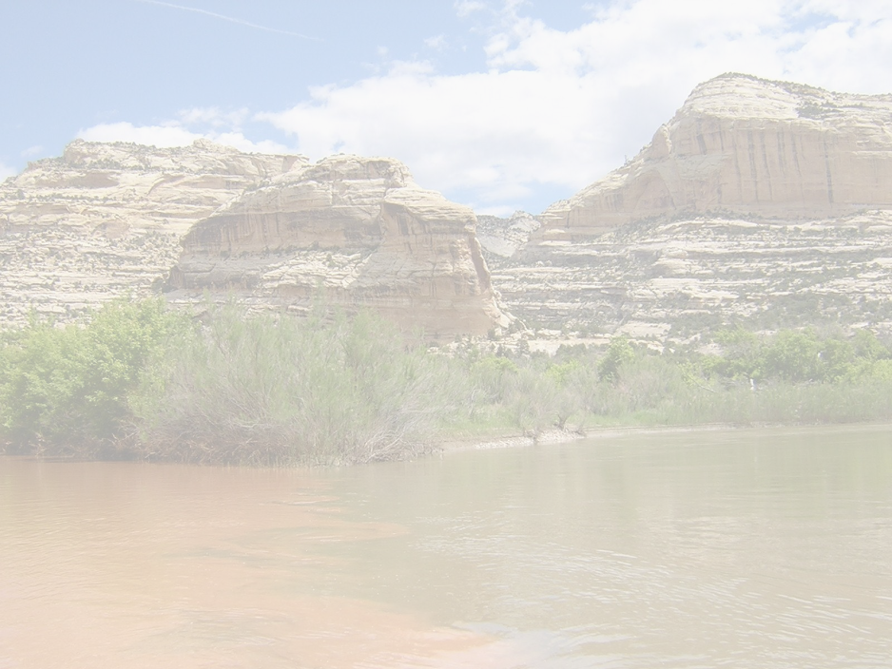
Water Use Data is Used for:
USGS studies
Water Resources Planning Programs and Efforts
Water Rights Water management policy development
State financial assistance programs
Assessment of water supply and water use.
Water Rights Proof processing
Systems to evaluate the efficiency of their own systems

Slide 6
How is the water use data collected?
The survey form is either emailed or a paper form is mailed during the first week of January.
The survey form is for the previous years reporting.
Survey is due by March 1st.
A postcard reminder is mailed.
Then a late letter is mailed.

Slide 7
Legislative Audit Overview

Slide 8
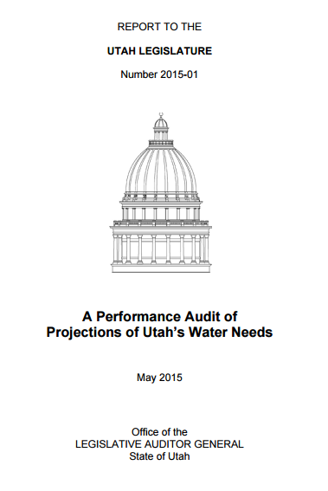
Legislative Audit Overview
Published in May 2015
Recommendations included improvements to:
Accountability
Education and Accuracy
Efficiency
Frequency

Slide 9
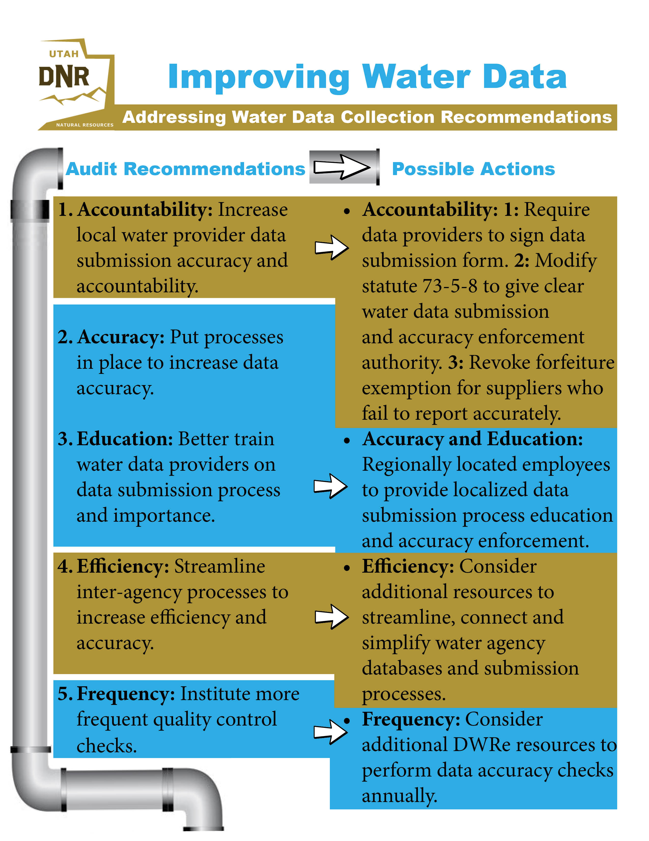

Slide 10
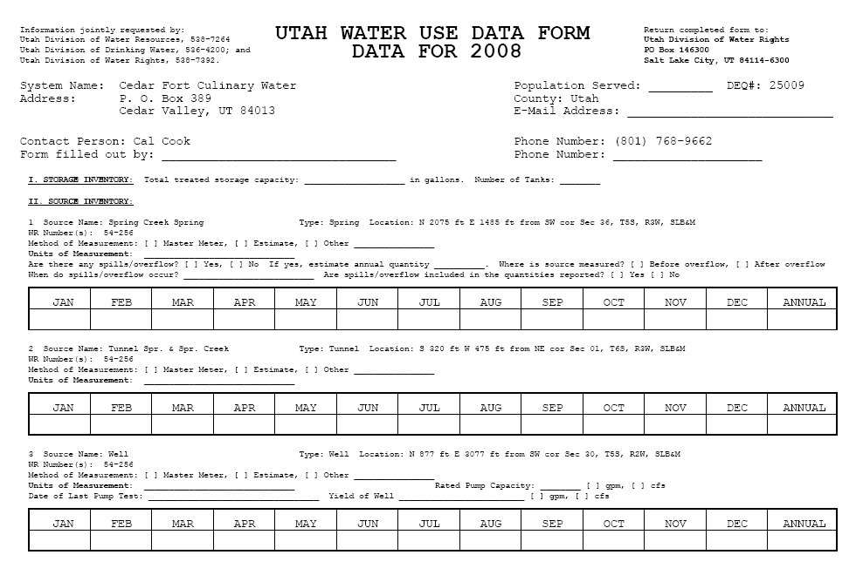

Slide 11
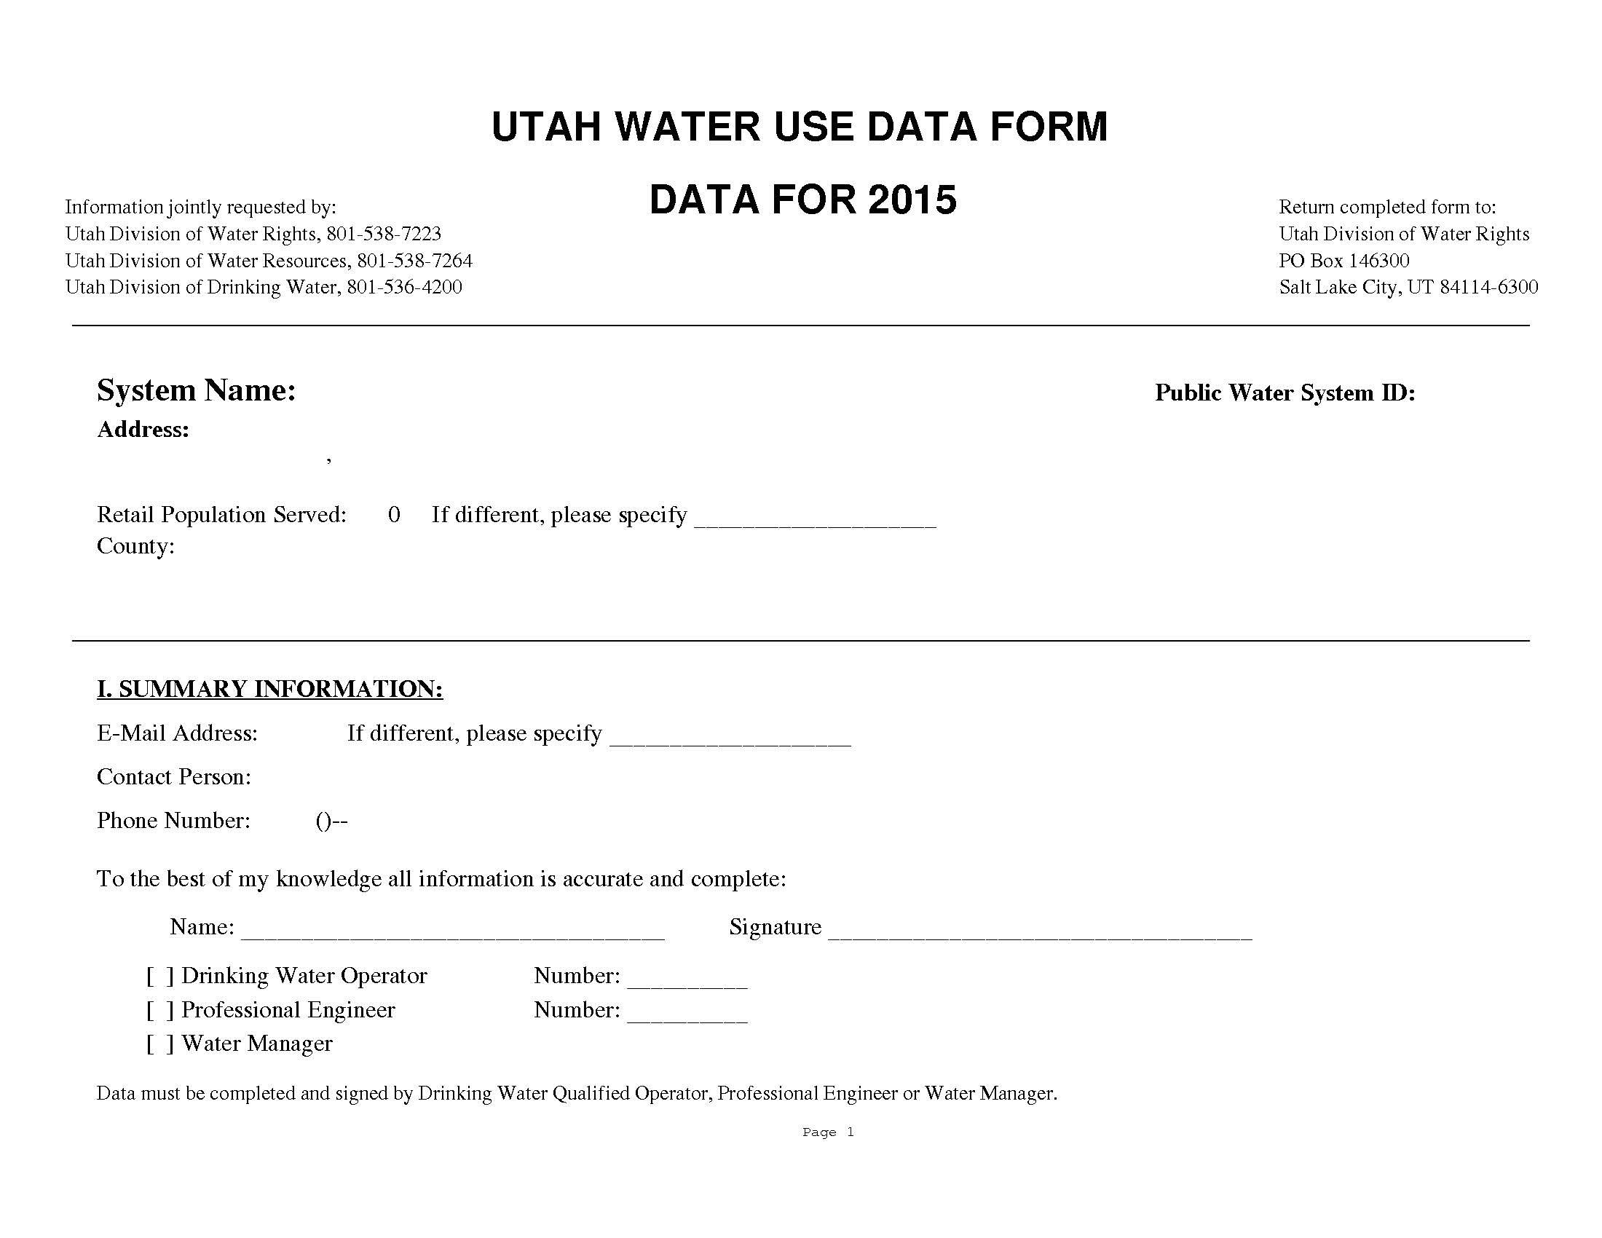

Slide 12
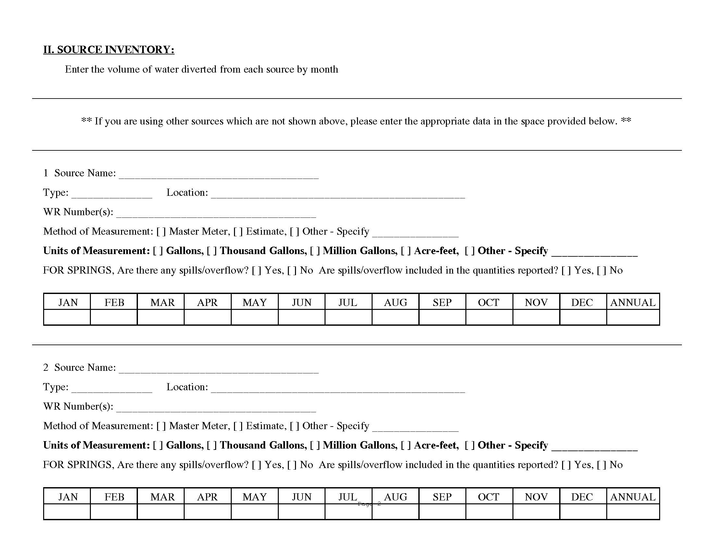

Slide 14
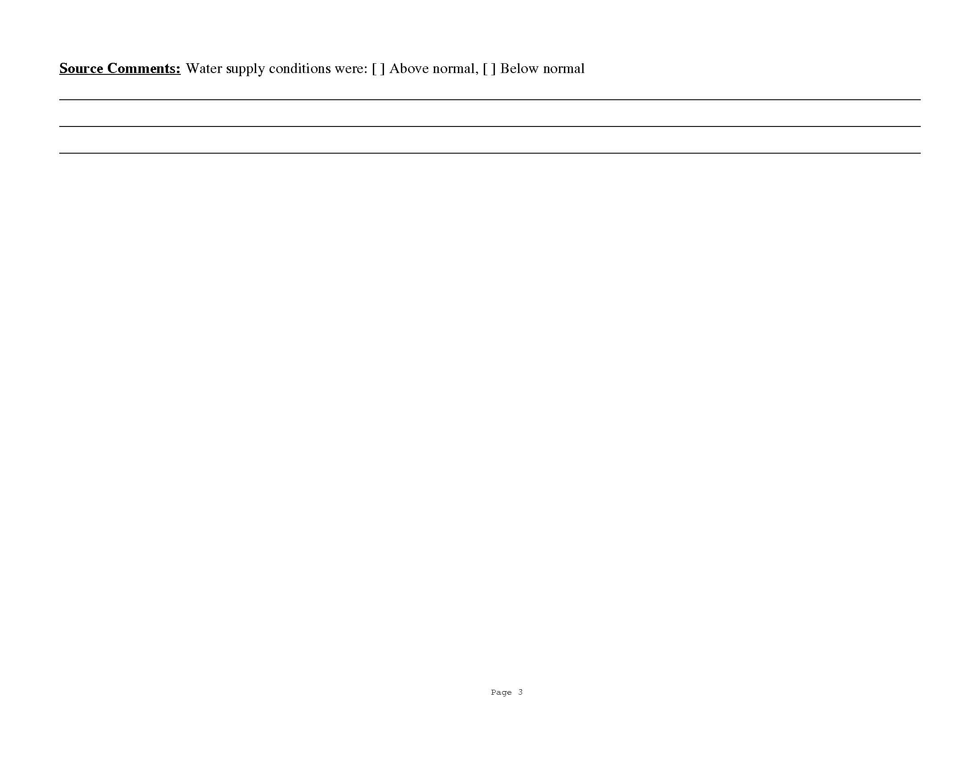

Slide 15
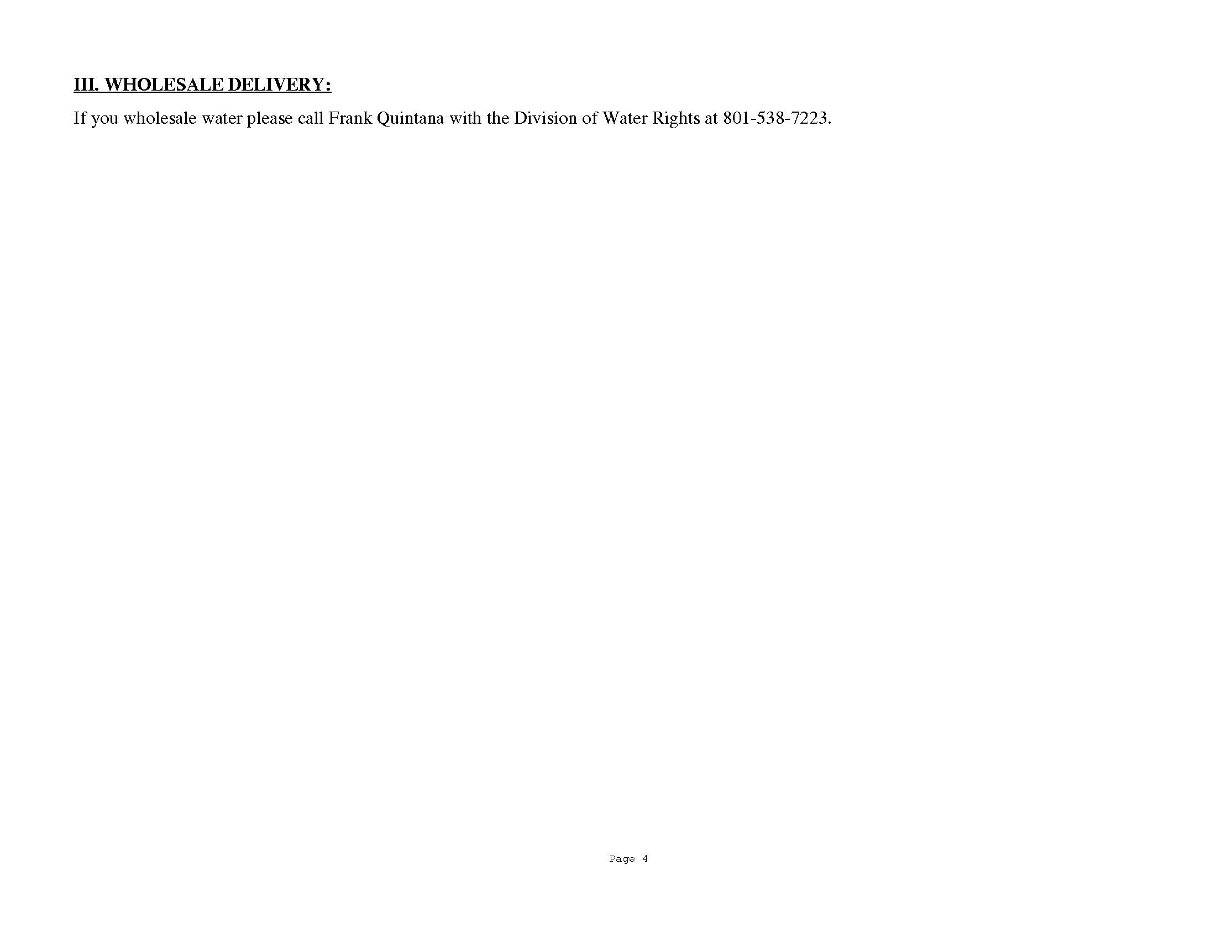

Slide 17
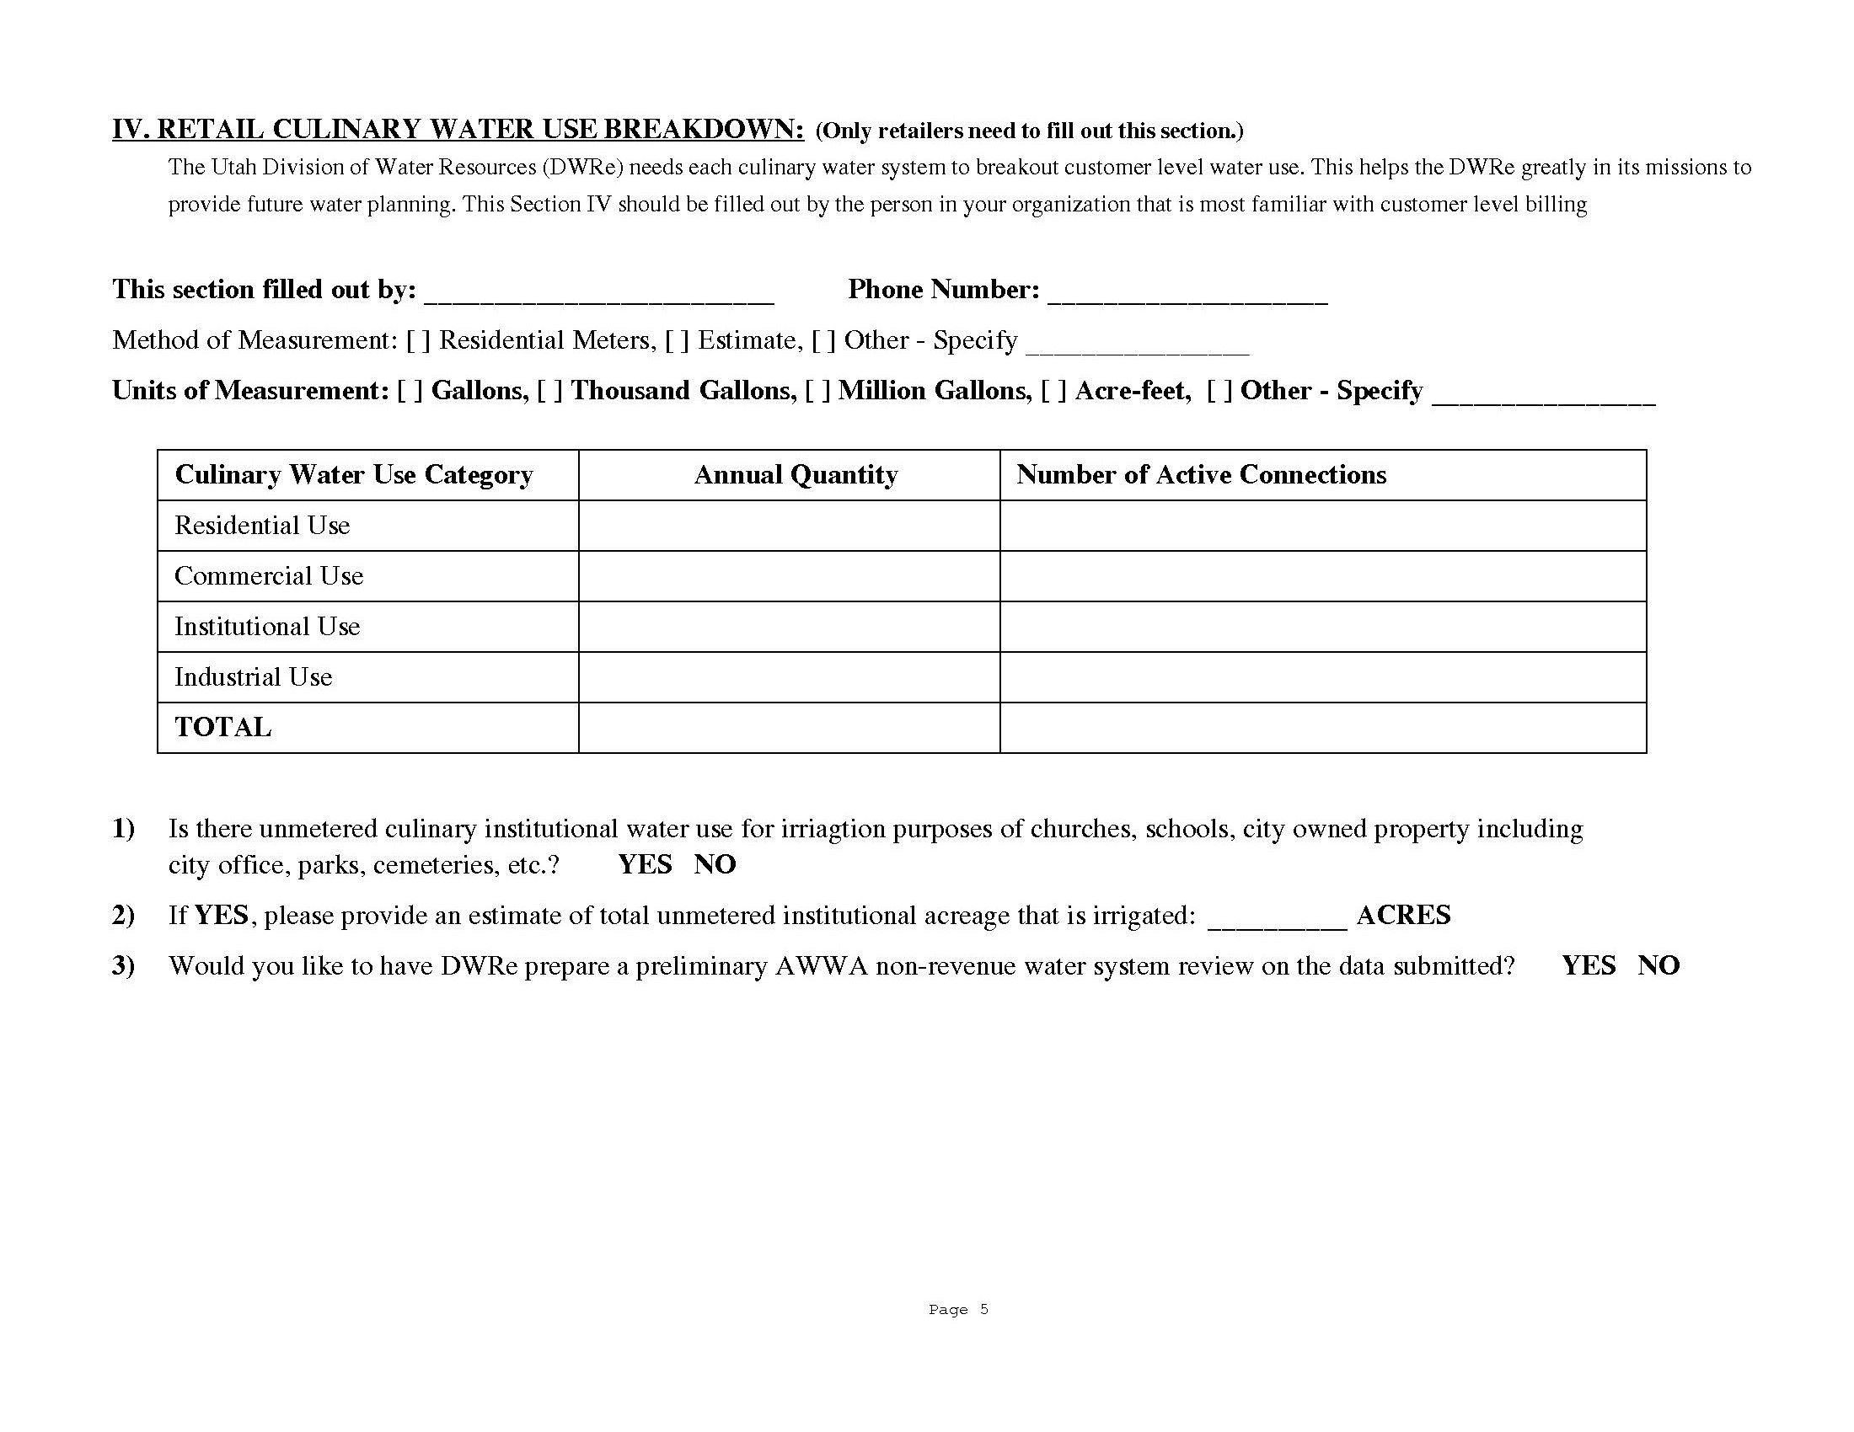

Slide 18
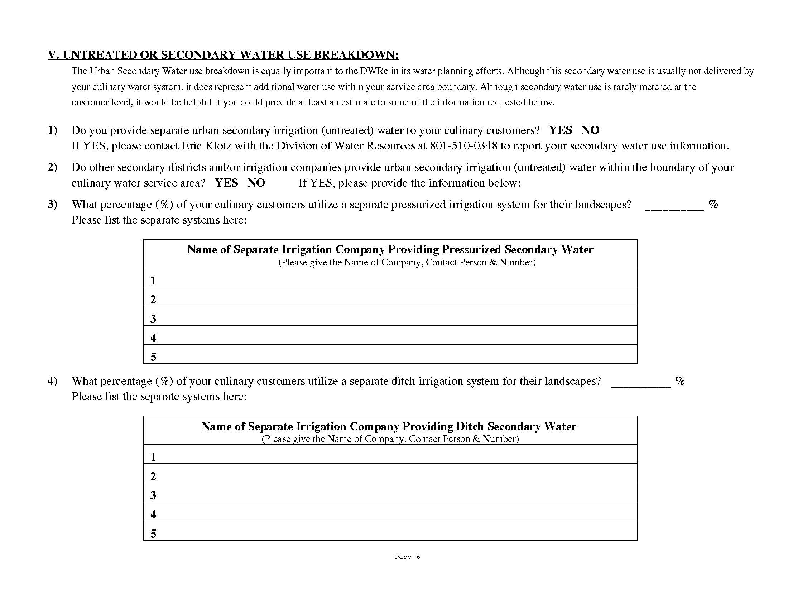

Slide 19
Along with the survey forms, detailed instructions are also mailed.
The last part of both the paper and e-form pertain to Revenues and Expenditures – this information is collected by the Division of Drinking Water. They are seeking financial information and future projected needs of your system.

Slide 20
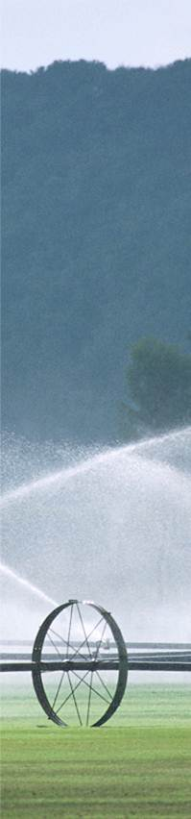
What to report
What challenges the program faces
How to report wholesale water

Slide 21
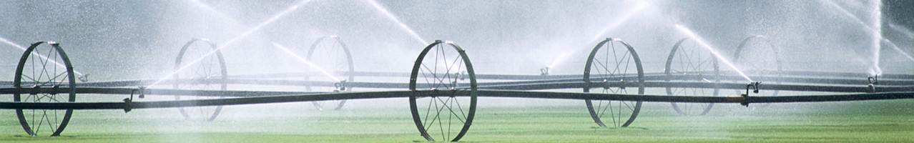



Source Data
Water Use Data
Well
In
Distribution System
Out
Spring

Slide 22
CHALLENGES
Delegation
Units of Measure

Slide 23
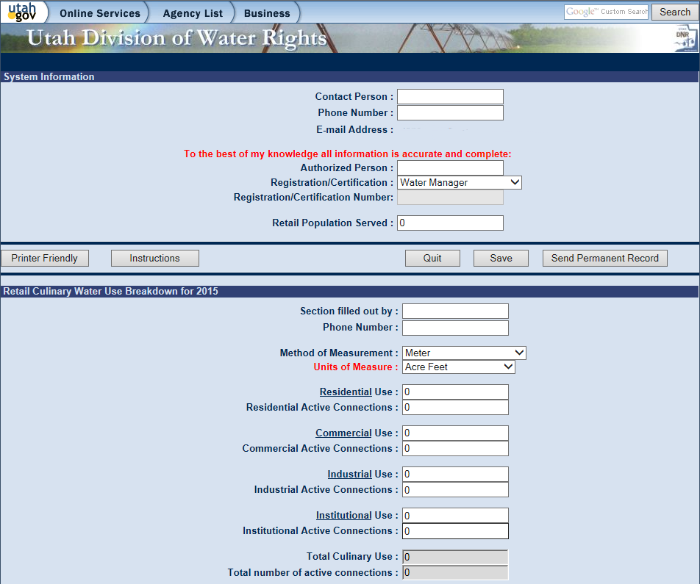

Slide 24
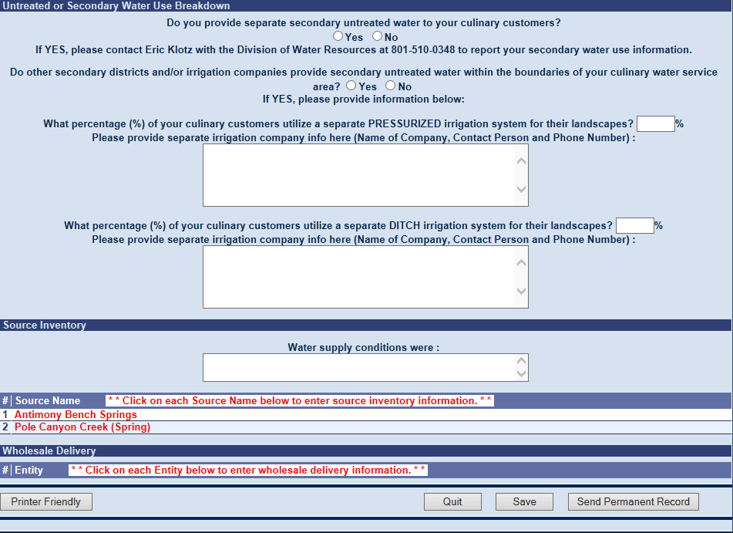

Slide 25
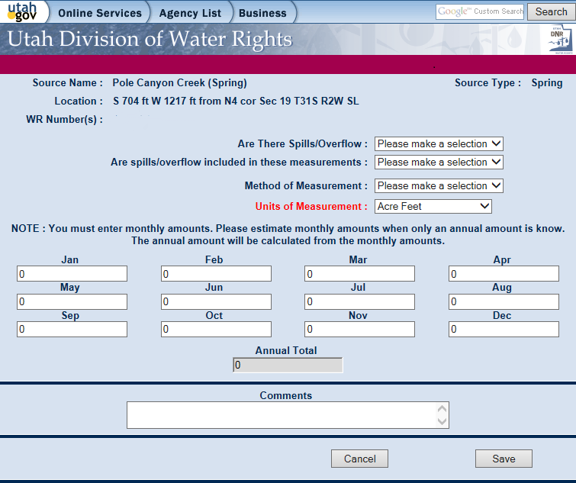

Slide 26
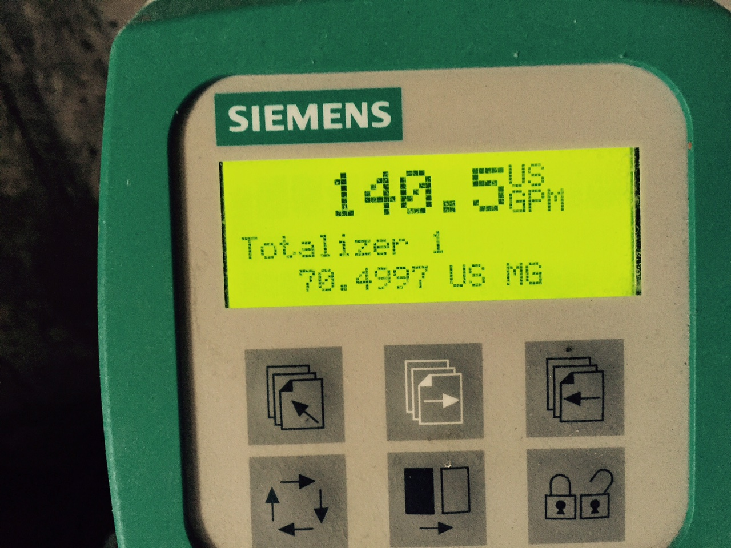

Slide 27
Source Inventory | Retail Water Use Breakdown | Wholesale Water
 |  | Sold | Bought
Cemetery Well | Residential | Murray City | Jordan Valley WCD
Liberty Park Well | Commercial | Sandy City | Salt Lake City
Jordan River | Institutional | West Jordan City
Cold Water Spring | Industrial | White City

Slide 28
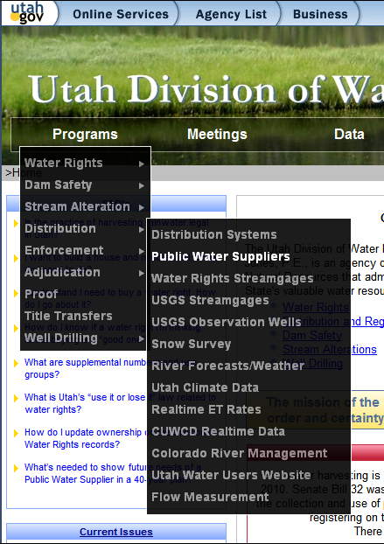
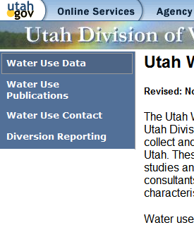
Where can I find the Water Use Data?
1.
2.

Slide 29
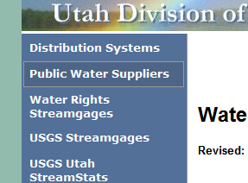
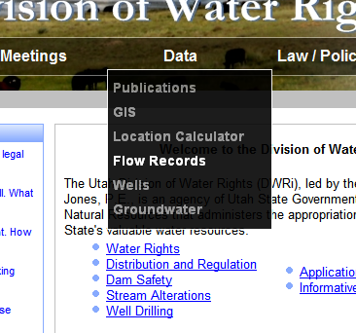
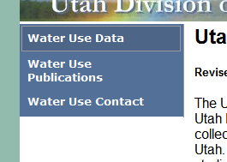
Or….
2.
1.
3.

Slide 30
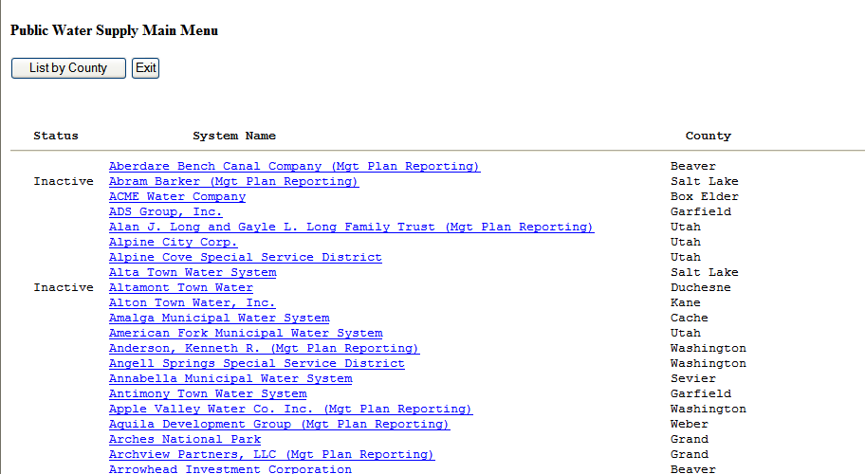

Slide 31
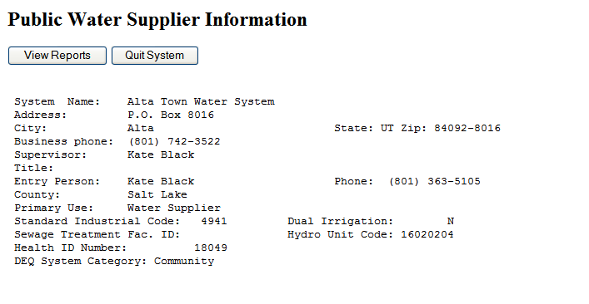

Slide 32
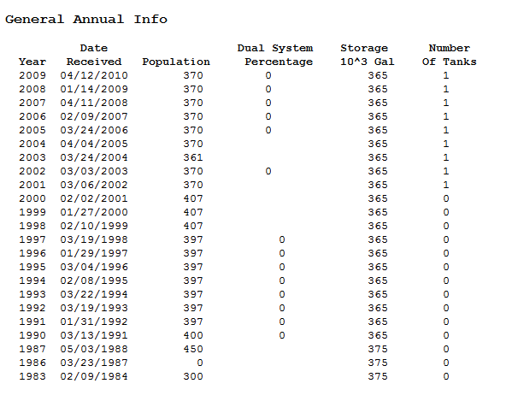

Slide 33
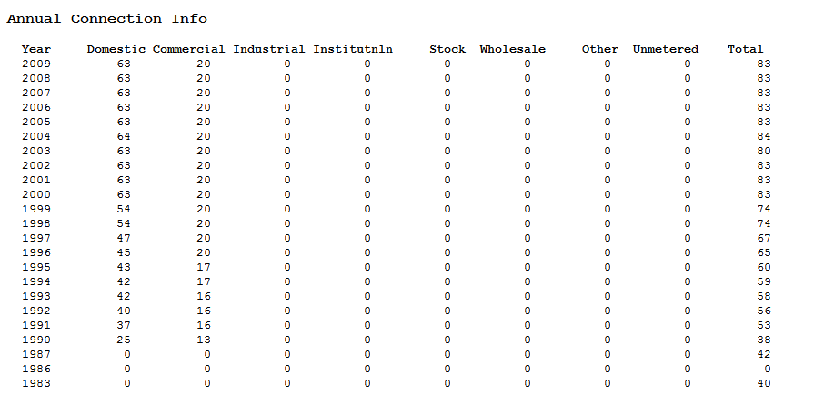

Slide 34
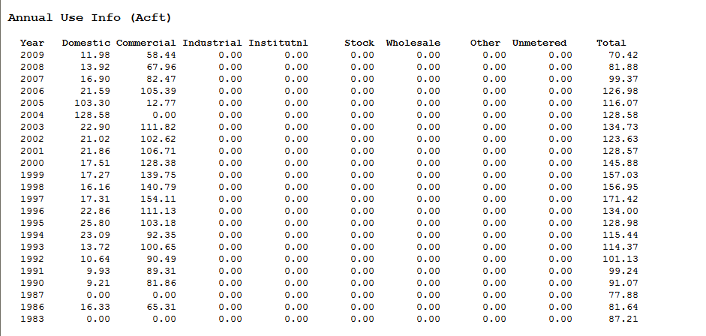

Slide 35
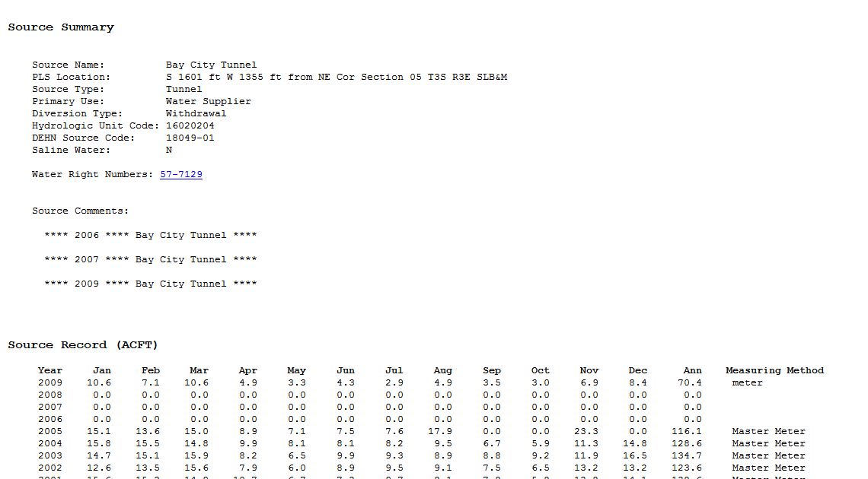

Slide 37
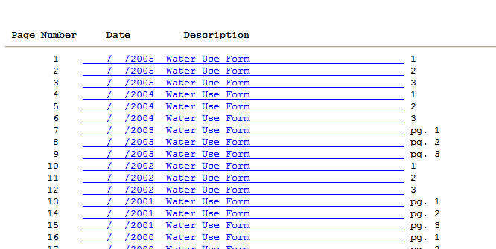

Slide 38
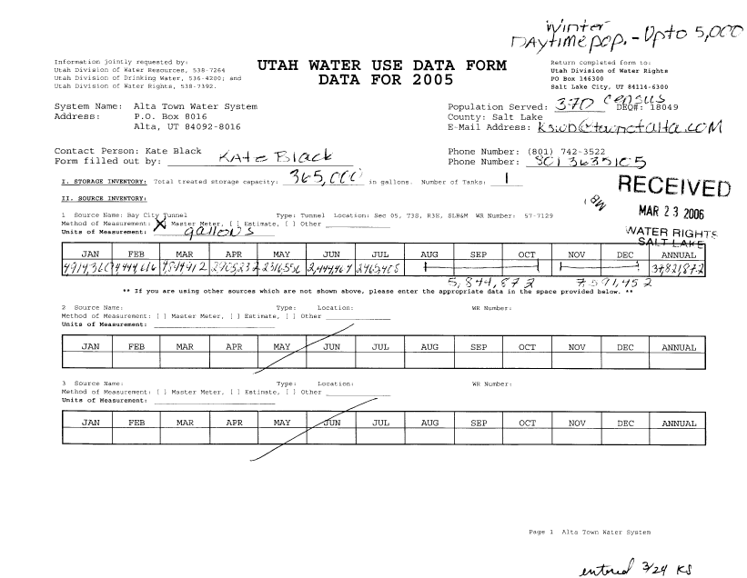

Slide 39
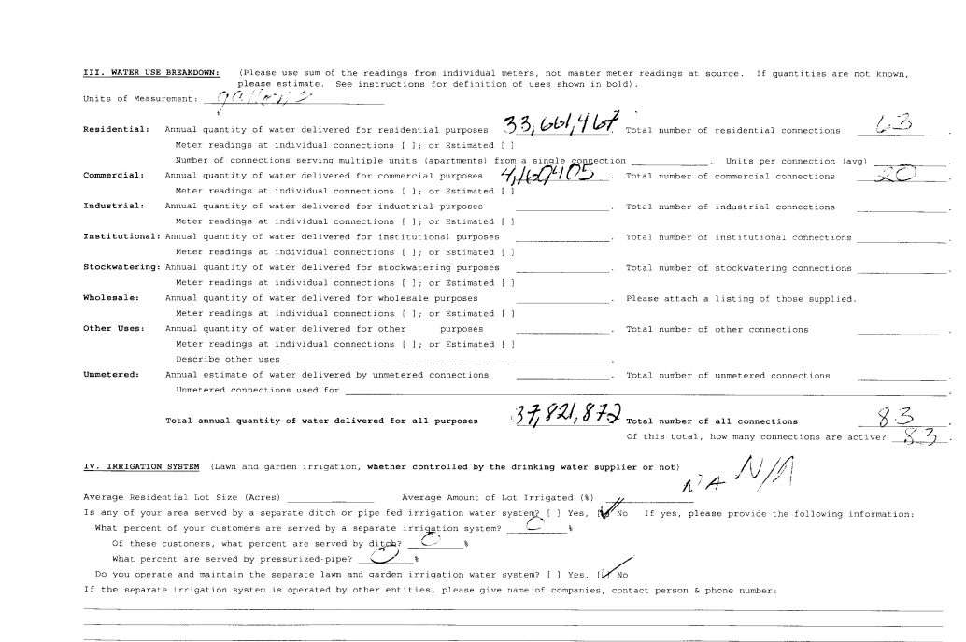

Slide 40
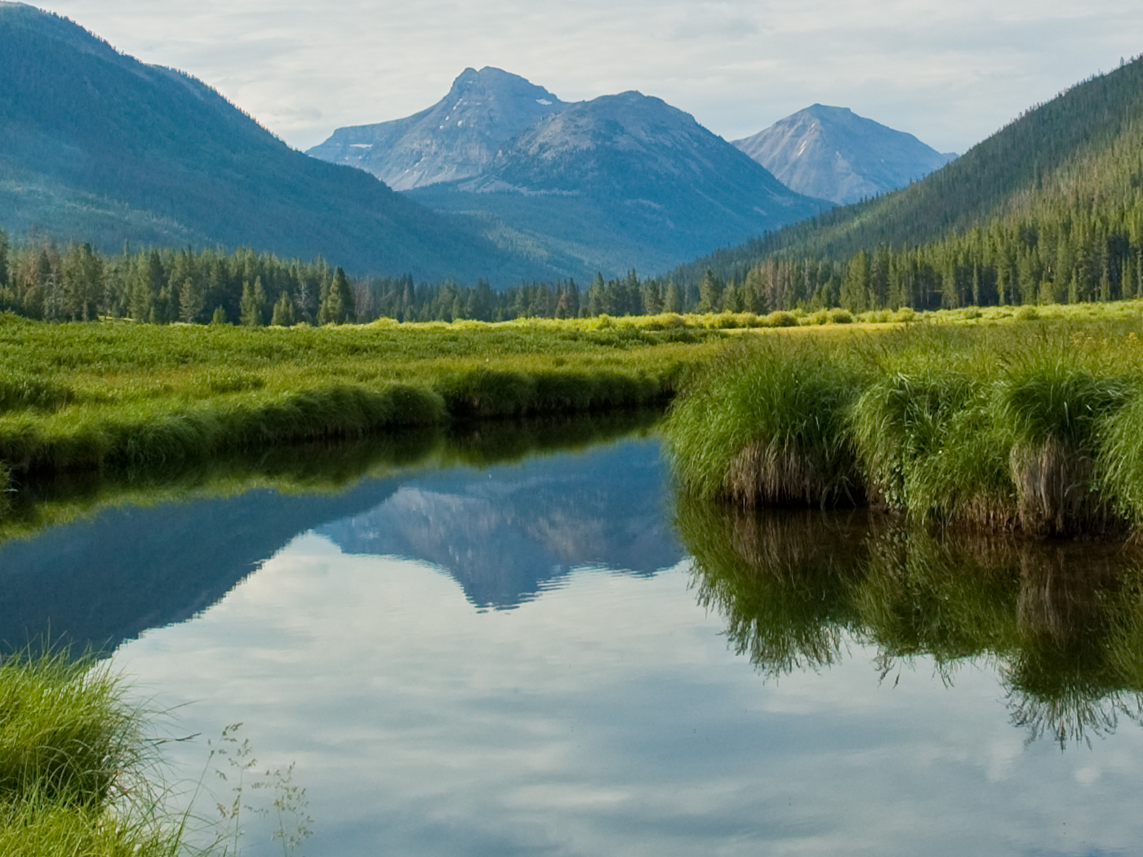

DIVISION OF DRINKING WATER
DATA COLLECTION

Slide 41
PRESENTATION TOPICS
WATER USE DATA FORM
R309-510 MINIMUM SIZING REQUIREMENTS
LEGISLATIVE AUDIT
RECENT CHANGES TO R309-510
WATER USE STUDY
SO WHAT?
Division of Drinking Water

Slide 42
PRESENTATION TOPICS
WATER USE DATA FORM
R309-510 MINIMUM SIZING REQUIREMENTS
LEGISLATIVE AUDIT
RECENT CHANGES TO R309-510
WATER USE STUDY
SO WHAT?
Division of Drinking Water

Slide 43
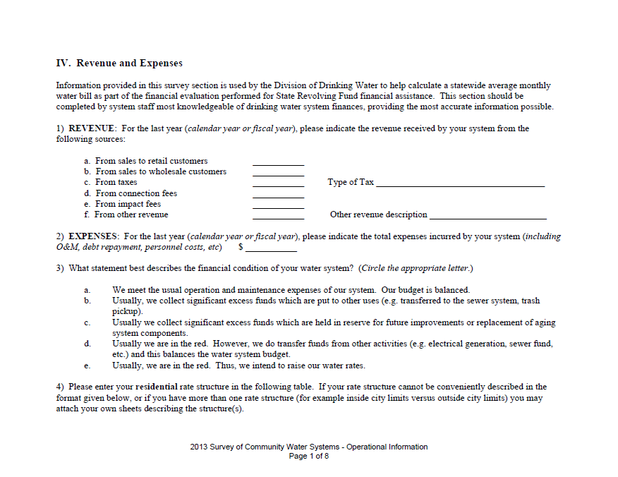
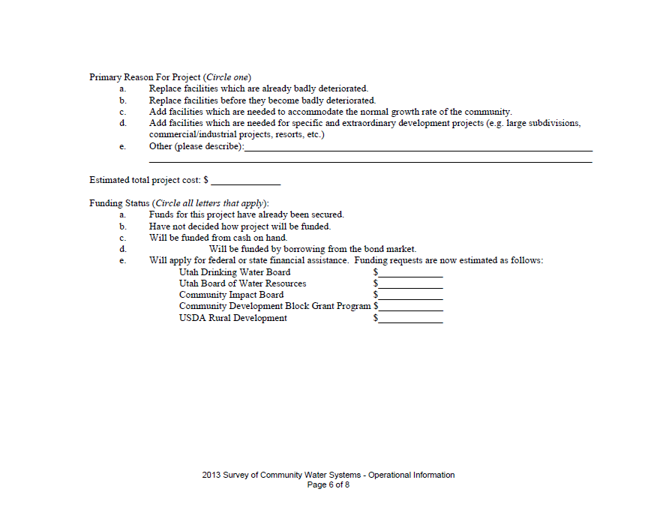
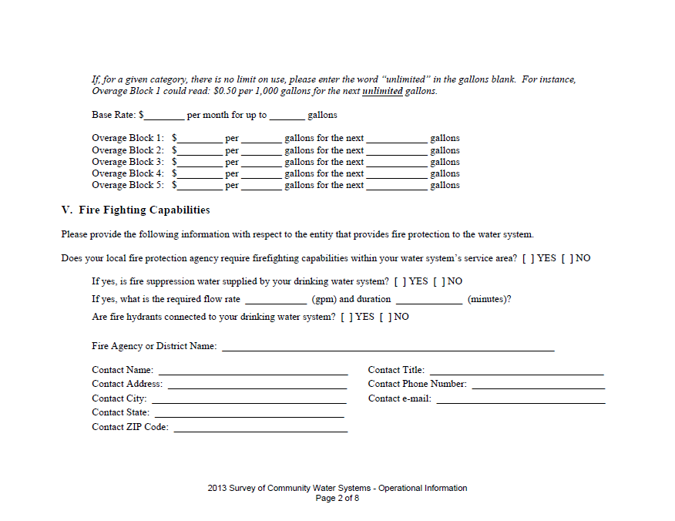
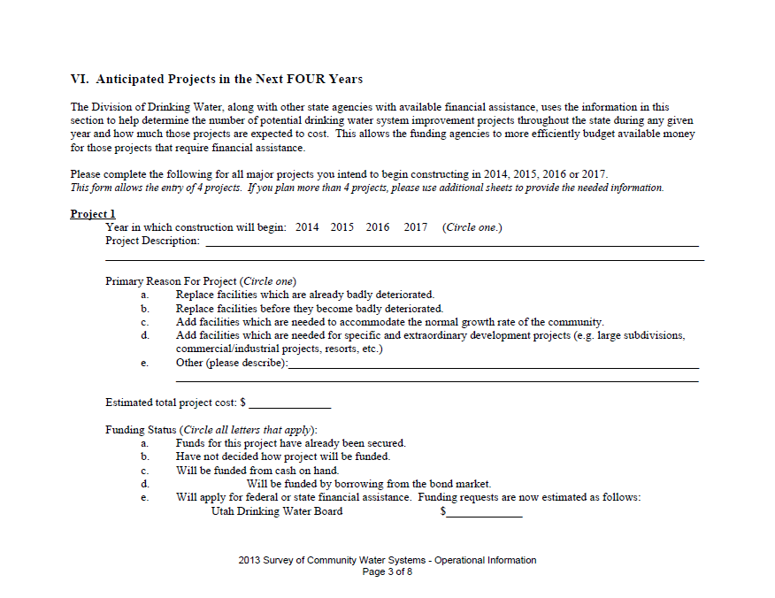
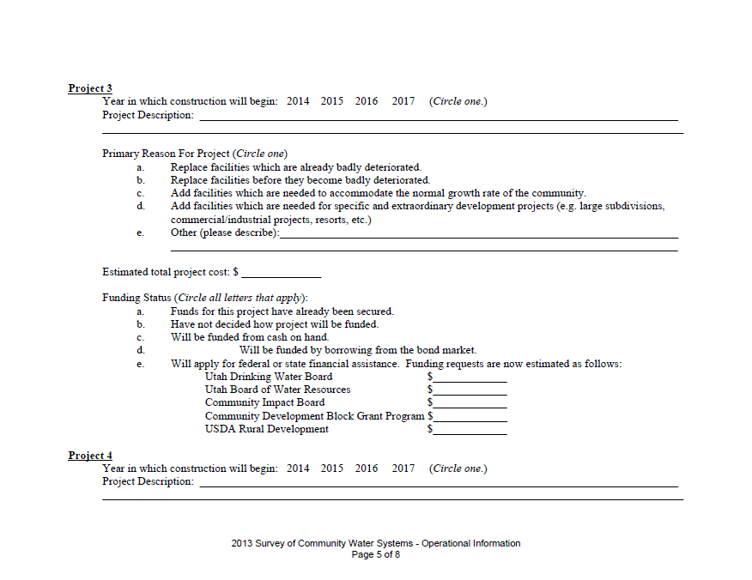
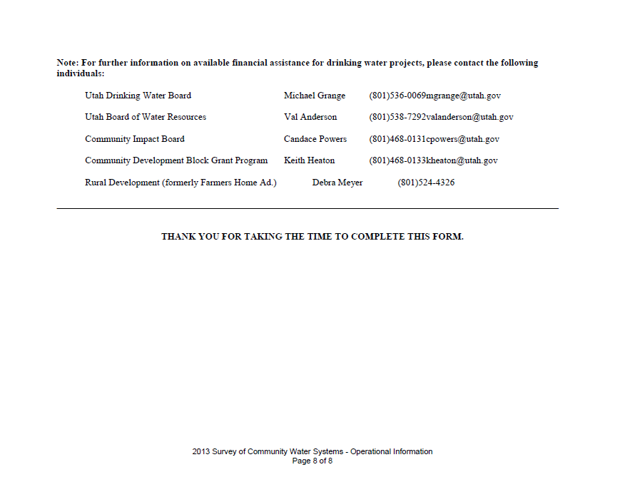
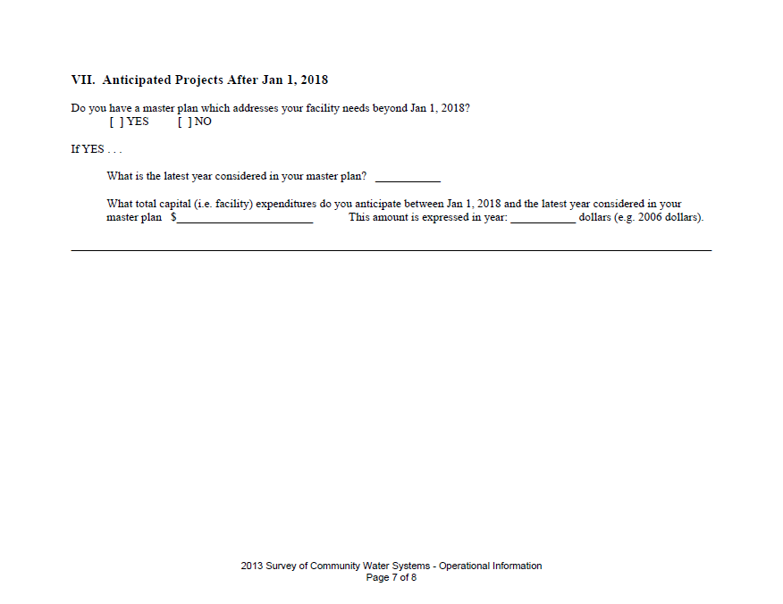
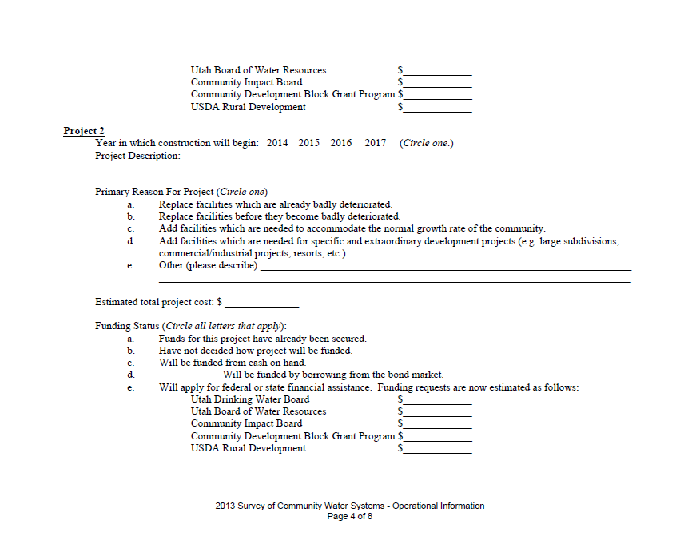
WATER USE DATA
Division of Drinking Water

Slide 44
WATER USE DATA
REVENUE AND EXPENSES- STATE AUDITORS OFF ICE
RATE STRUCTURE- NO LONGER COLLECTING
FIRE FIGHTING CAPABILITIES- SANITARY SURVEYS
ANTICIPATED PROJECTS IN THE FUTURE- REPLACED WITH NEEDS SURVEY USING A SUBSET OF SYSTEMS.
MAY BE SUPPLEMENTED BY ADDITIONAL DATA
GATHERING AS NEEDED
Division of Drinking Water

Slide 45
PRESENTATION TOPICS
WATER USE DATA FORM
R309-510 MINIMUM SIZING REQUIREMENTS
LEGISLATIVE AUDIT
RECENT CHANGES TO R309-510
WATER USE STUDY
SO WHAT?
Division of Drinking Water

Slide 46
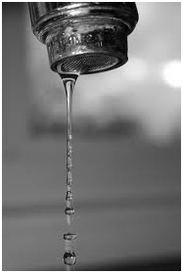
R309-510 MINIMUM SOURCE SIZING
SOURCE SIZING
“Sources shall legally and physically meet water demands under two separate conditions. First, they shall meet the anticipated water demand on the day of highest water consumption. This is referred to as the peak day demand. Second, they shall also be able to provide one year’s supply of water, the average yearly demand.”
Division of Drinking Water

Slide 47
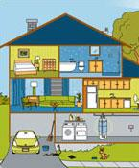
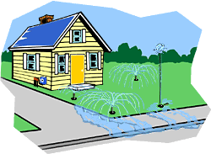
R309-510 MINIMUM SOURCE SIZING
Irrigation Use is dependent on the number of acres and irrigation zone
Indoor Water Use=
800 gpd/connection
Division of Drinking Water

Slide 48
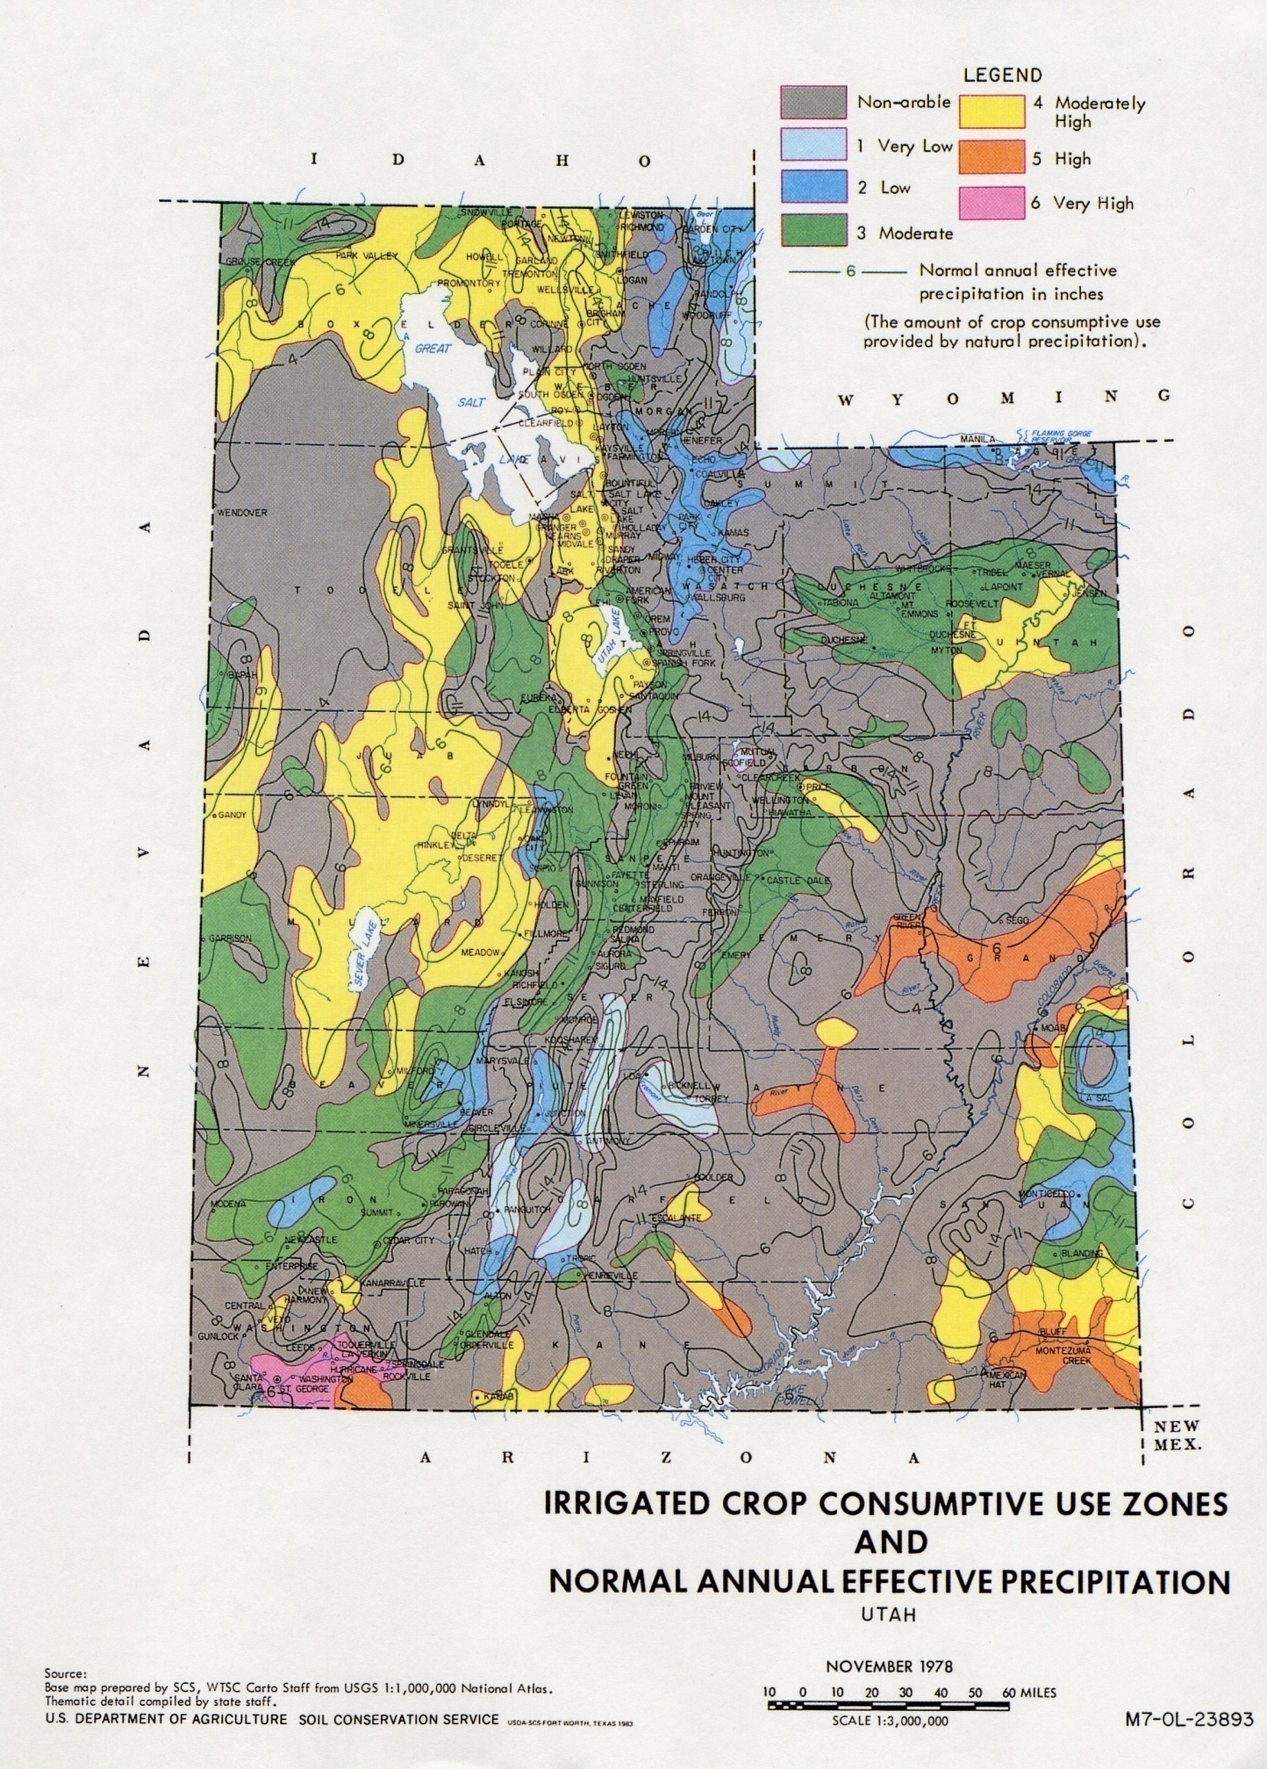
IRRIGATION ZONE MAP
Division of Drinking Water

Slide 49
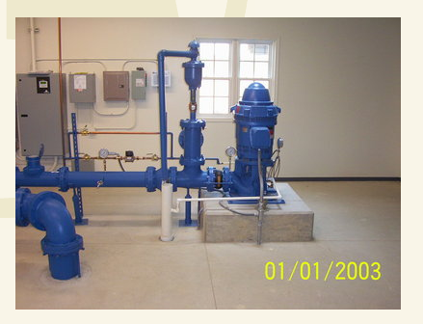
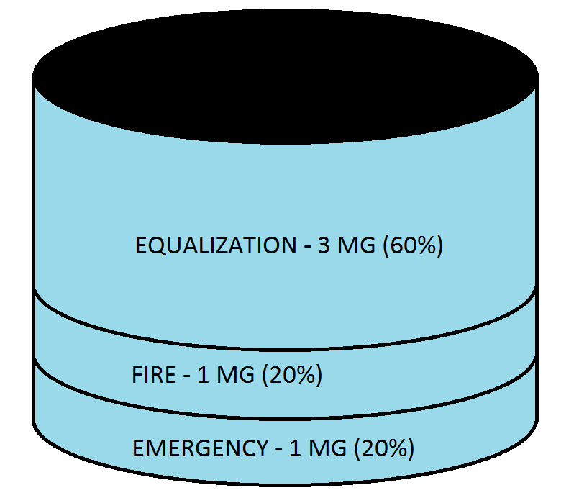
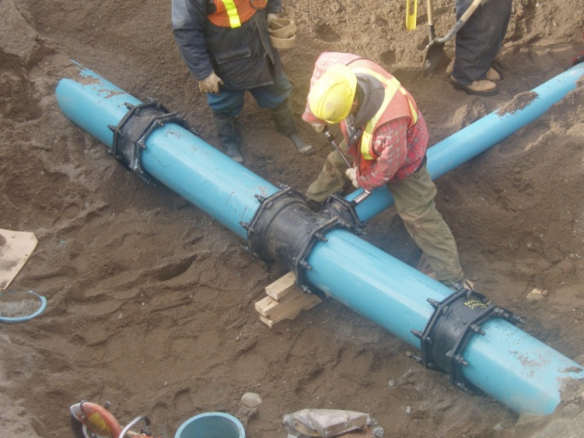
R309-510
MINIMUM SIZING REQUIREMENTS
R309-510-7 Source Capacity
R309-510-8 Storage Volume
R309-510-9 Distribution System
Division of Drinking Water

Slide 50
PRESENTATION TOPICS
WATER USE DATA FORM
R309-510 MINIMUM SIZING REQUIREMENTS
LEGISLATIVE AUDIT
RECENT CHANGES TO R309-510
WATER USE STUDY
SO WHAT?
Division of Drinking Water

Slide 51
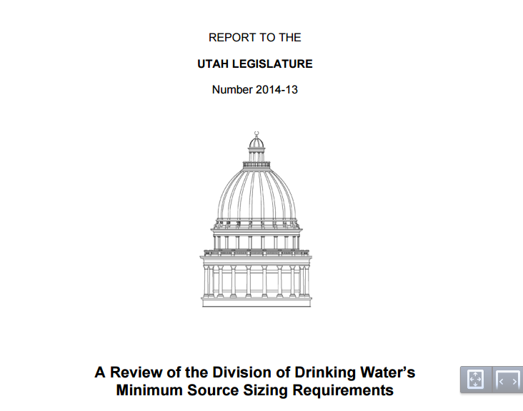
LEGISLATIVE AUDIT
Division of Drinking Water

Slide 52
LEGISLATIVE AUDIT
Summary of Report 2014-13: A Performance Review of the Division of Drinking Water’s Minimum Source Sizing Requirements
We reviewed the Division of Drinking Water’s (DDW) minimum source sizing requirements, which are designed to ensure safe and reliable public drinking water systems. Individuals from the residential development community have criticized the source sizing as excessive resulting in unnecessary water-related costs. Although we found that the indoor requirements appear too high, the state’s outdoor requirements appear too low. We also found several sections in the rule where clarification is needed. In particular, the steps for receiving a reduction to the source sizing requirements needs additional clarification. A review of and update to the state source sizing requirements is recommended to ensure that water systems are able to optimize resources as well as the adequacy of their water supply.
Division of Drinking Water

Slide 53
LEGISLATIVE AUDIT
Re-evaluate indoor use requirements
Re-evaluate outdoor use requirement
Provide clarification and protocols for those wishing to seek a reduction.
Division of Drinking Water

Slide 54
PRESENTATION TOPICS
WATER USE DATA FORM
R309-510 MINIMUM SIZING REQUIREMENTS
LEGISLATIVE AUDIT
RECENT CHANGES TO R309-510
WATER USE STUDY
SO WHAT?
Division of Drinking Water

Slide 55
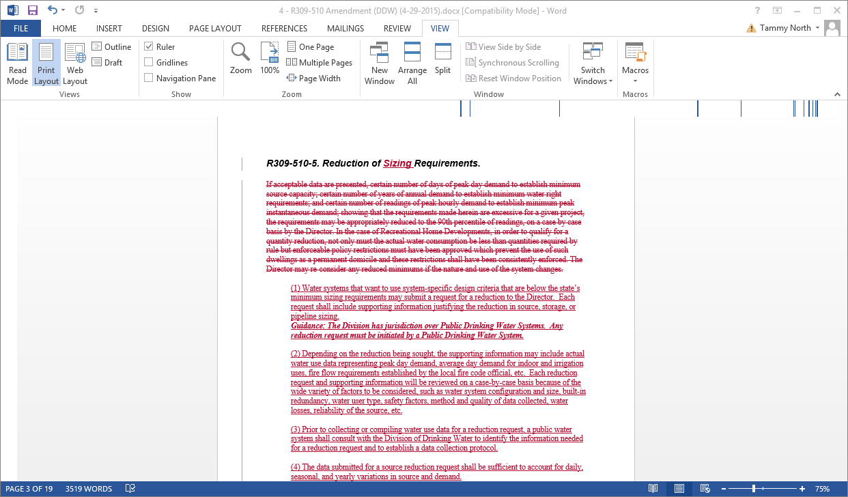
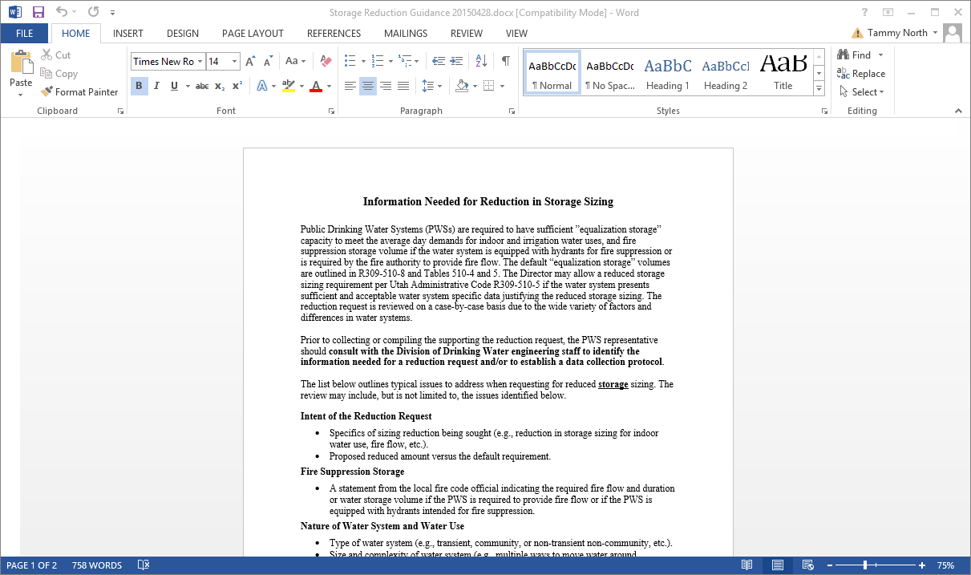
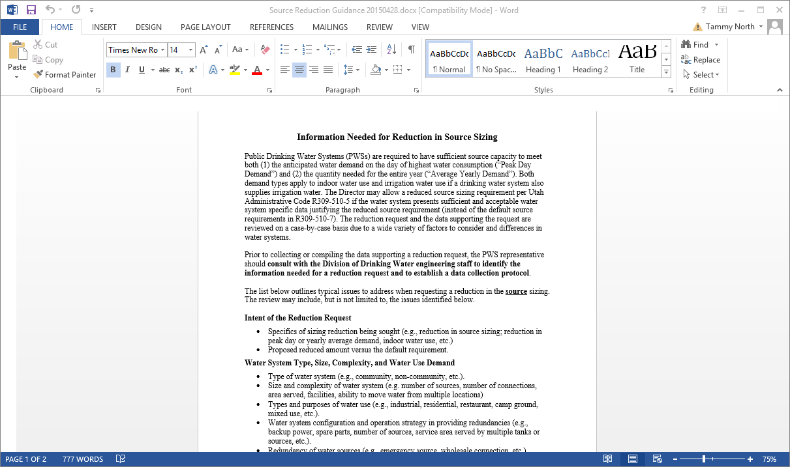
RECENT CHANGES TO R309-510
Division of Drinking Water

Slide 56
OTHER CHANGES TO R309-510
OTHER CLARIFICATIONS
Local authorities may impose more stringent requirements than the
minimum sizing requirements of R309-510.
Clarify definition of “Recreational Home Development” include limitations
on fixture units and square footage.
Note that the irrigation requirement is based on direct application of water and
that a safety factor should be considered to account for losses such as
evaporation, leaks, irrigation method, etc.
Division of Drinking Water

Slide 57
PRESENTATION TOPICS
WATER USE DATA FORM
R309-510 MINIMUM SIZING REQUIREMENTS
LEGISLATIVE AUDIT
RECENT CHANGES TO R309-510
WATER USE STUDY
SO WHAT?
Division of Drinking Water

Slide 58



WATER USE STUDY
Division of Drinking Water

Slide 59
WATER USE STUDY
Lack of existing information
Peak Day
Factoring out non-residential uses.
Storage and source usage
Losses through the system
Separating out irrigation/indoor use from dual systems
Data collection, storage, and transfer
Reliability of existing equipment
Statistically valid sample- a State-wide requirement
Division of Drinking Water

Slide 60
PRESENTATION TOPICS
WATER USE DATA FORM
R309-510 MINIMUM SIZING REQUIREMENTS
LEGISLATIVE AUDIT
RECENT CHANGES TO R309-510
WATER USE STUDY
SO WHAT?
Division of Drinking Water

Slide 61

SO WHAT?
AWARENESS OF POTENTIAL CHANGES AND HOW IT MIGHT IMPACT YOU.
IMPORTANCE OF KEEPING RECORDS
BE INVOLVED IN THE LEGISLATIVE PROCESS
DO YOU HAVE THE ABILITY TO PROVIDE DATA?
DIFFERENT AGENCIES ARE COLLECTING DIFFERENT DATA FOR DIFFERENT PURPOSES.
Division of Drinking Water

