Slide 1
INSIGHT: A Web Based Tool for Quantification of Groundwater/Surface Water Interaction
Tim Freed, M.S.
Integrated Water Management Coordinator
Nebraska Department of Natural Resources
June 9, 2015

Slide 2
Overview
Water Management Needs
Data Inputs
Output Data
INSIGHT Web Tool

Slide 3
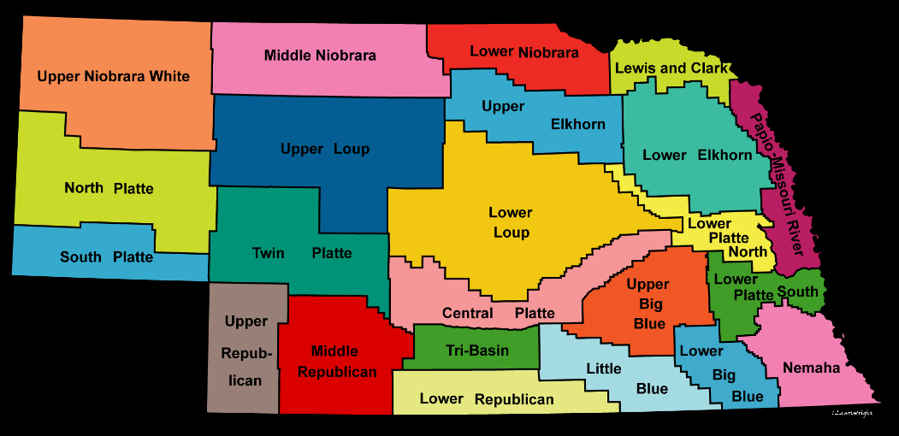
Water Management Needs
Easily accessible information
Uniform
Planning
IMPs
BWPs
Monitoring
Stream flows
Groundwater Levels
Storage/Water operations

Slide 4
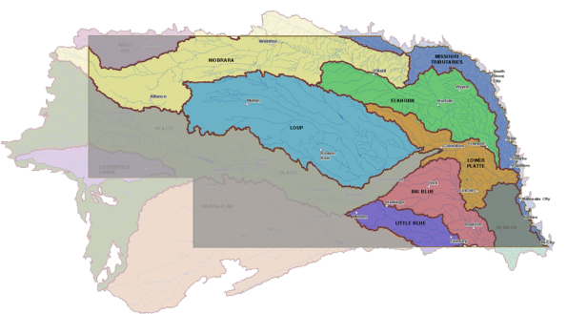
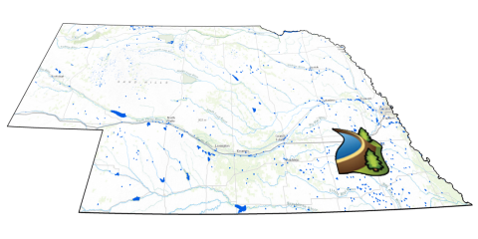
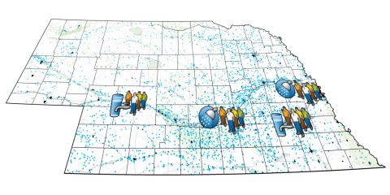
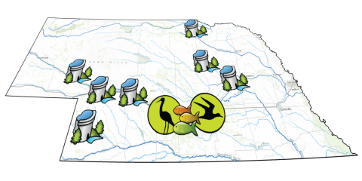
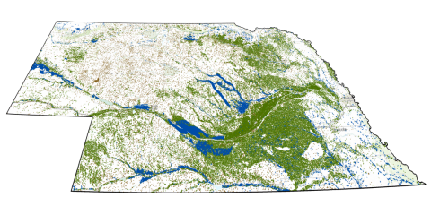
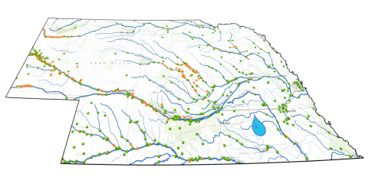
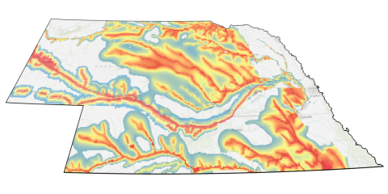
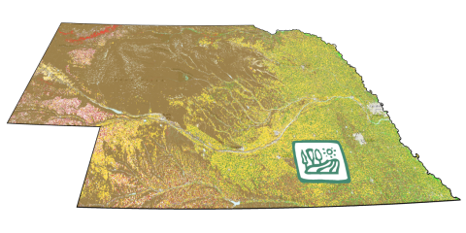
Crop data
Municipal and industrial water use
Surface water reservoir data
Groundwater depletions
Non-consumptive demands
Irrigation
Stream gages
Data Inputs
INSIGHT

Slide 5
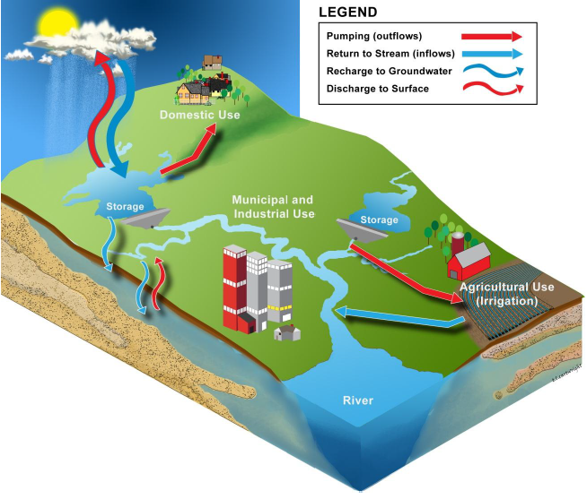
Data Inputs
Spatial Extent
Sub-basin
Basin
Statewide

Slide 6
Output Data
Depletions/Hydrological Connection
Basin Water Supplies
Demands
Balance
Balance = Basin Water Supply – Total Demand

Slide 7
Need & development
INSIGHT:

Slide 8
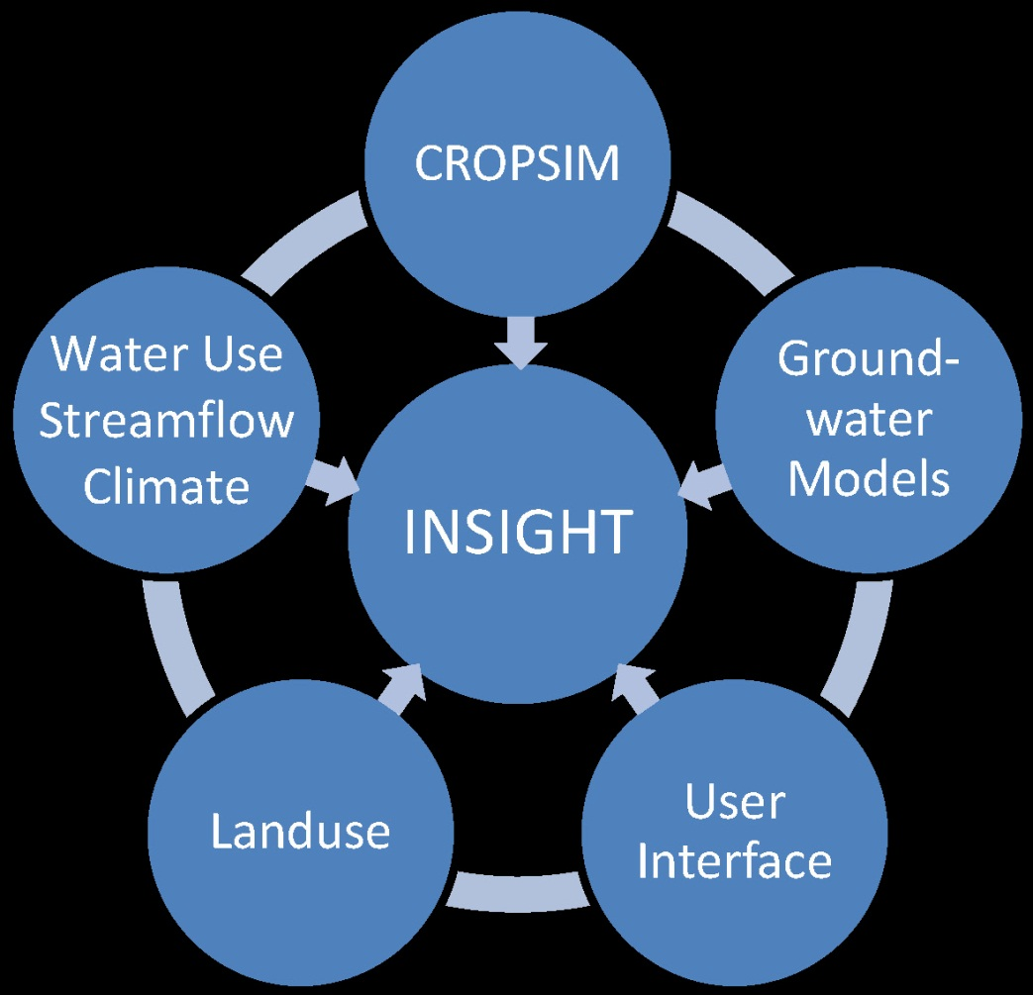
INSIGHT – Integrated Network of Scientific Information & GeoHydrologic Tools
An annual snapshot of water conditions across the state
An educational tool for water managers and the public
A tool to help evaluate water management options
Notes:
What is INSIGHT?
The primary purpose is to integrate data sources used for the purposes of the Annual Evaluation and to display the data on an interactive, map-based, website. The INSIGHT website will be made available to the public. The initial roll-out will be based on the new methodology currently under review and will be available from the DNR website by the end of the calendar year.

Slide 9
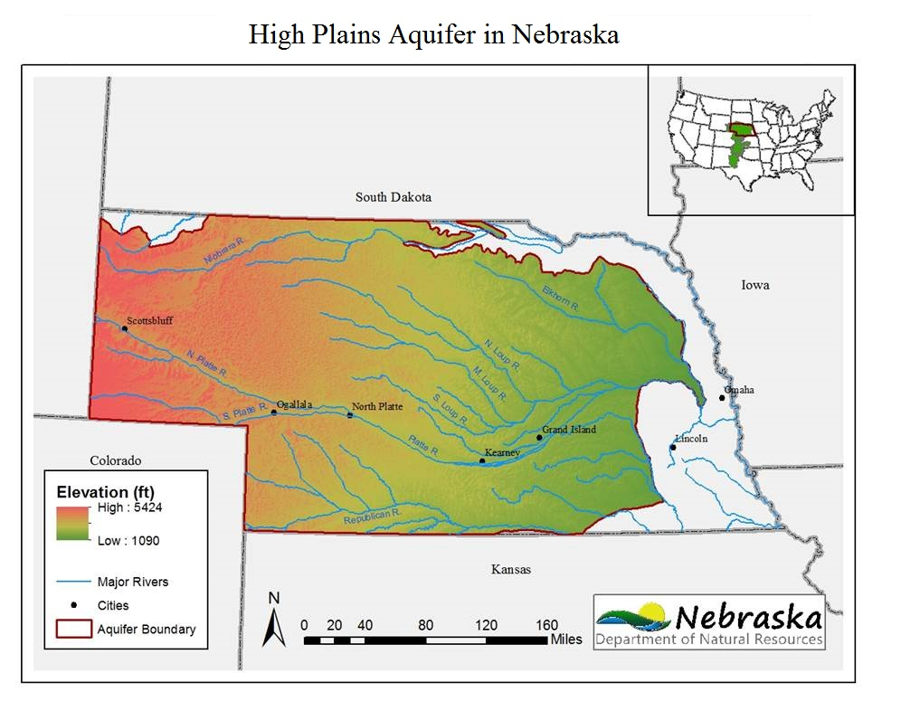
Hydrologic Connection

Slide 10
INSIGHT was developed through Consolidation of Hydrologic Data
Water Supplies
Basin water supplies
Groundwater depletions
Surface water depletions
Streamflow
Water Uses/Demands
Meter data
Diversion records
Climate data
CROPSIM outputs
Water administration data
Land use data
And more…

Slide 11
INSIGHT
Online Demonstration

Slide 12
Implementation and Use in planning and monitoring
INSIGHT:

Slide 13
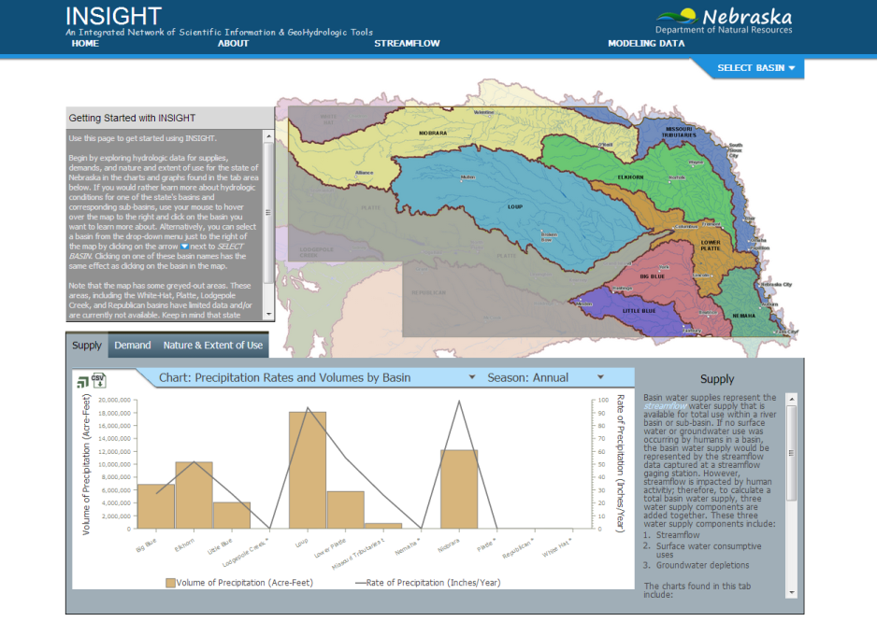
Benefits of INSIGHT
Offers an easily accessible compilation of data and information about water resources across the state

Slide 14
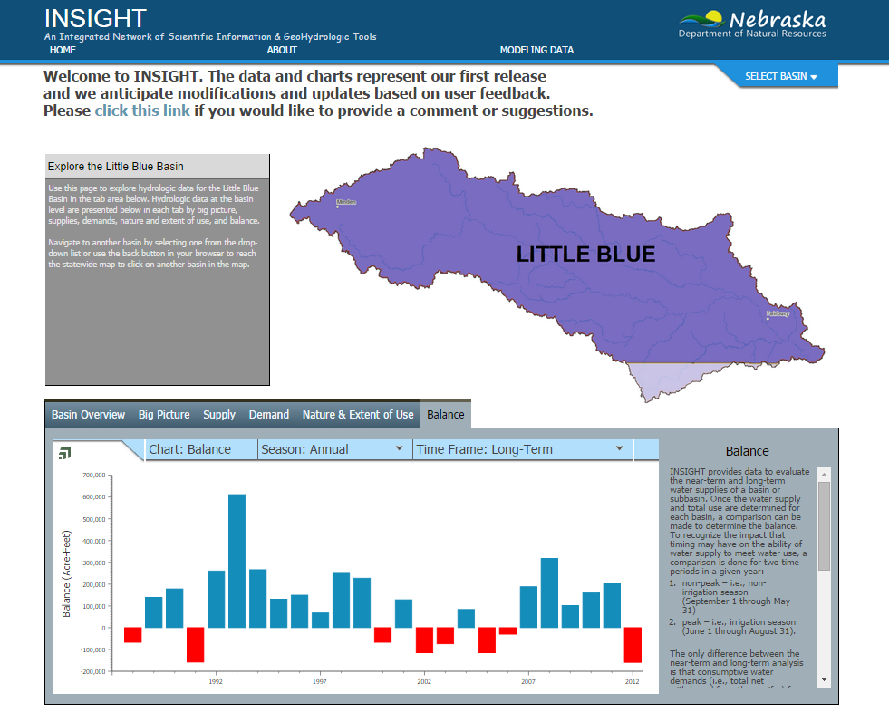
Benefits of INSIGHT
Allows users to weigh decisions based on the current and projected balance between supply and demand

Slide 15
INSIGHT and Water Management
INSIGHT can help water managers:
Understand current and future demands
Evaluate the effectiveness of water management strategies
Assess critical areas of water shortage
Identify potential problems before they occur
Make proactive water management decisions

Slide 16
Tim Freed, M.S.
Integrated Water Management Coordinator
Nebraska Department of Natural Resources

Slide 17
Backup slides in case internet down

Slide 18
What it entails
INSIGHT:

Slide 19
Statewide Data Basin-to-Basin Comparisons
Information available:
Supply
Demand
Nature & Extent of Use
Seasons available:
Annual
Peak
Non-Peak

Slide 20
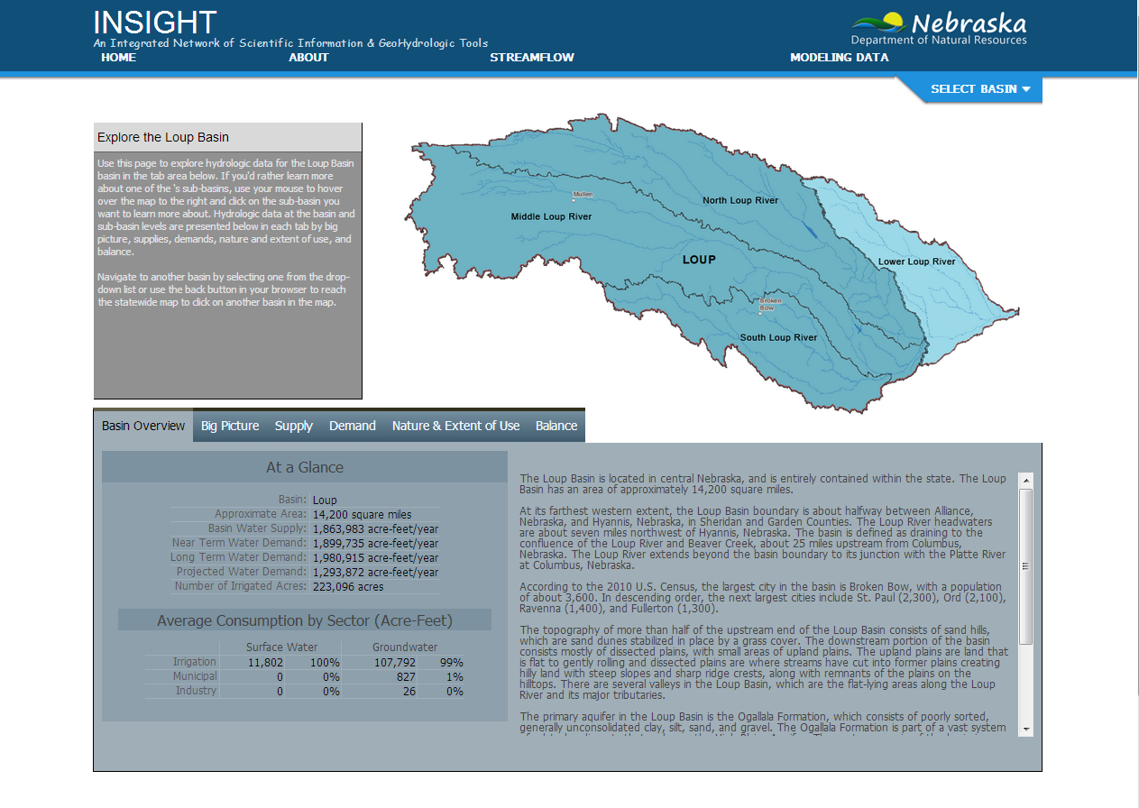
Basin & Subbasin Data A More Detailed Picture
Information available
Basin Overview
Big Picture
Supply
Demand
Nature & Extent of Use
Balance
Seasons available
Annual
Non-Peak
Peak

Slide 21
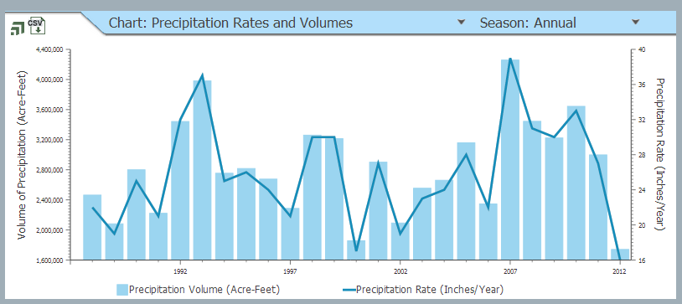
Basin/Subbasin Data: Big Picture
Precipitation Rates and Volumes by Basin

Slide 22
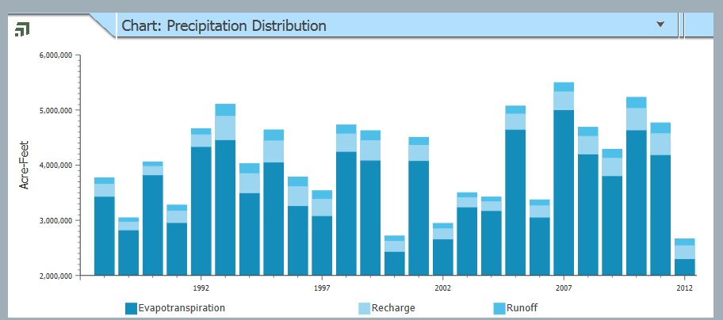
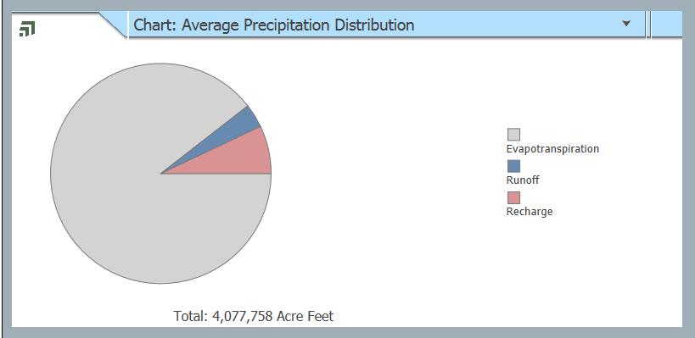
Basin/Subbasin Data: Big Picture
Precipitation Distribution
Average Precipitation Distribution

Slide 23
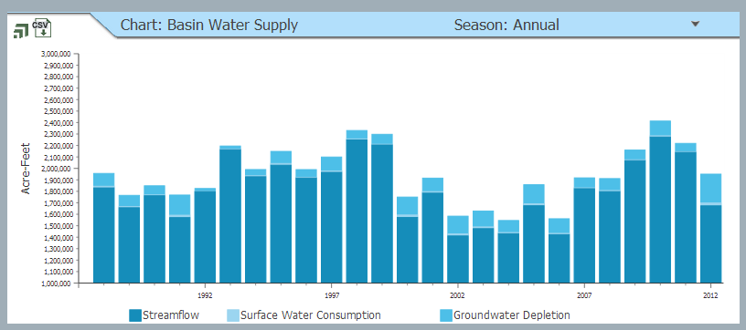
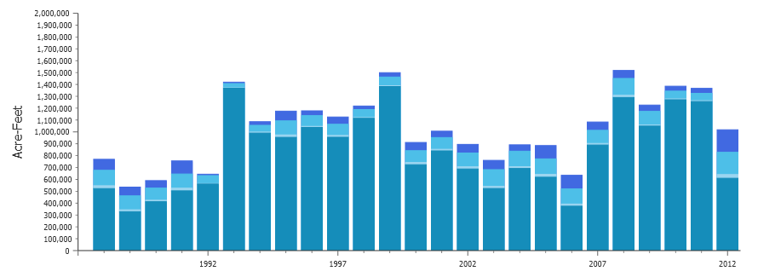
Basin/Subbasin Data: Supply
Basin Water Supply
BWS = Streamflow + Surface Water Consumption + Groundwater Depletion + Required Inflow

Slide 24
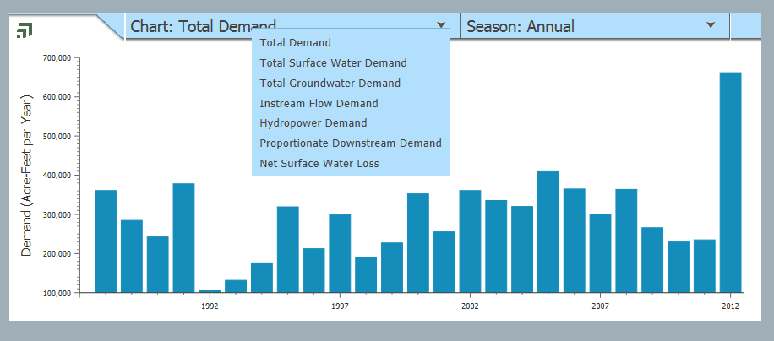
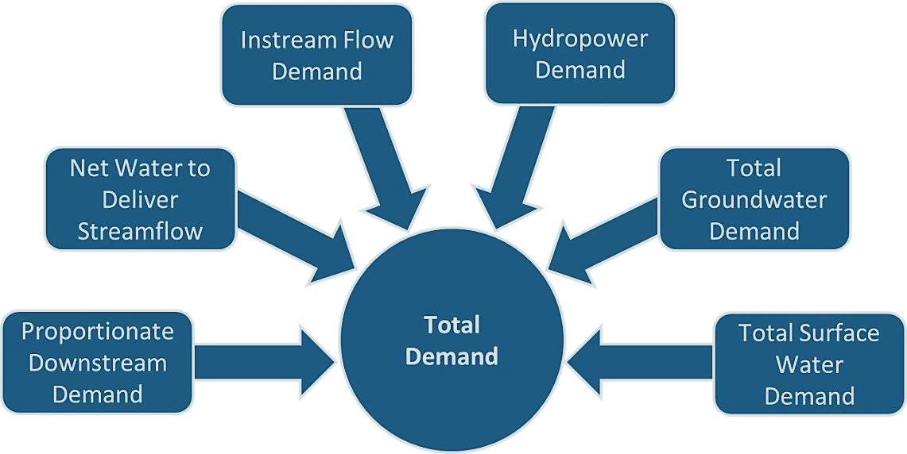
Basin/Subbasin Data: Demand
Total Demand
Includes six categories of water use

Slide 25
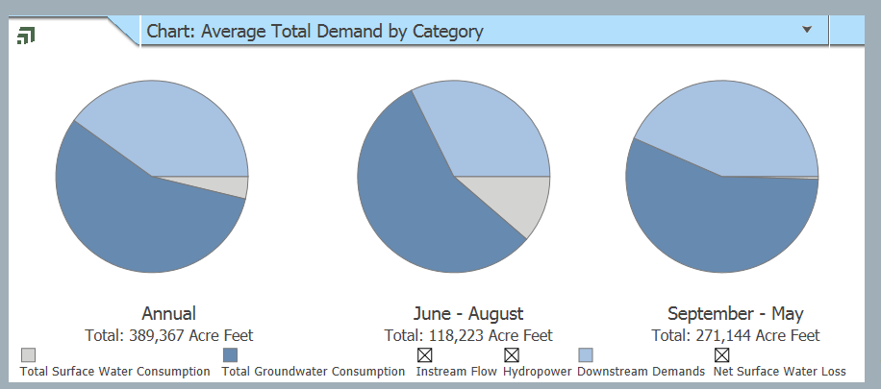
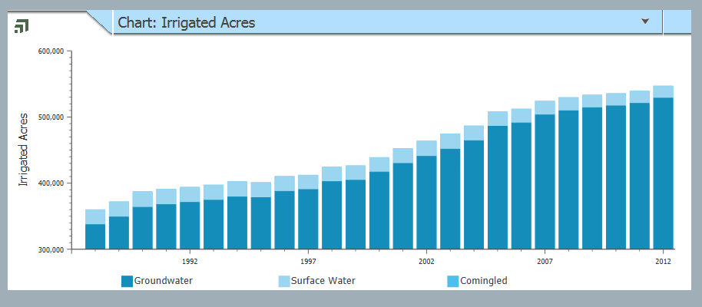
Basin/Subbasin Data: Nature & Extent of Use
Average Long-Term Total Demand by Category
Irrigated Acres by Source

Slide 26
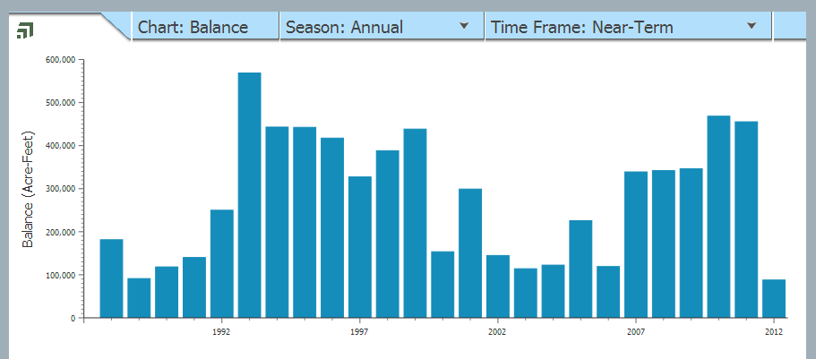
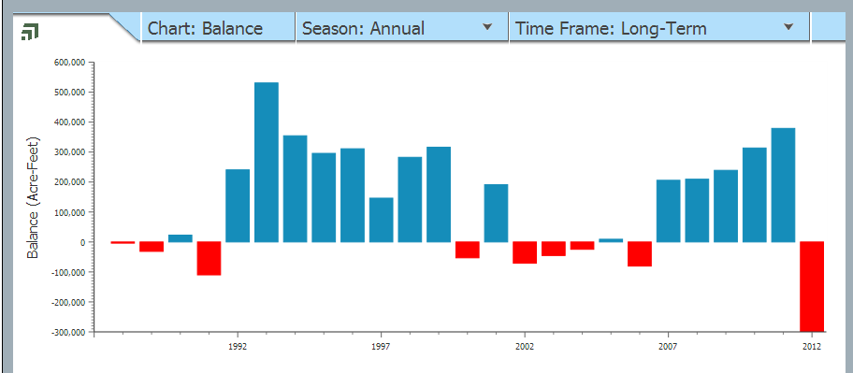
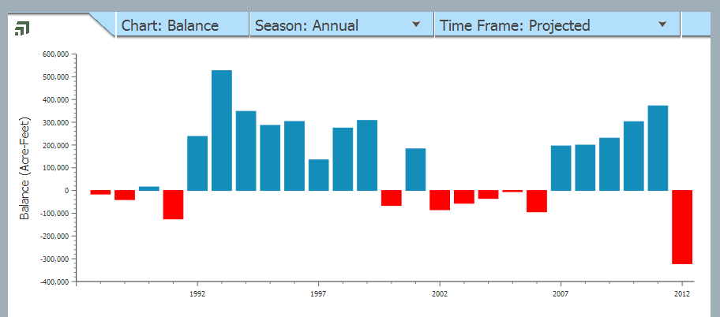
Basin/Subbasin Data: Balance of Water Supply and Demand
Balance of annual water supply and demand under three scenarios:
Near-Term
Long-Term
Projected
Long-Term
Balance =
Basin Water Supply –
Total Demand

