Slide 1
Making Applications
Tamara Prue

Slide 2
Application Agenda
Go over the most common types of applications (15 min)
Discuss water right policy by area (5 min)
Introduce the Public Land Survey system (10 min)
Discuss duty, diversion, and other use calculations (20 min)
Make an application map (15 min)
Questions
Notes:
Perhaps talk about which applications result in a start card. Also talk about surface wells and when a water right must be associated with a well.

Slide 3
Common Applications

Slide 4
Elements Common to all Applications
The applicant’s name, address and ownership interest;
Source of water;
  Specific spring, stream, or underground well
Flow (cfs), or volume (acre-feet) of water to be diverted;
Point of diversion (POD);
  Where the water will be diverted from the natural source
Beneficial use of the water;

Slide 5
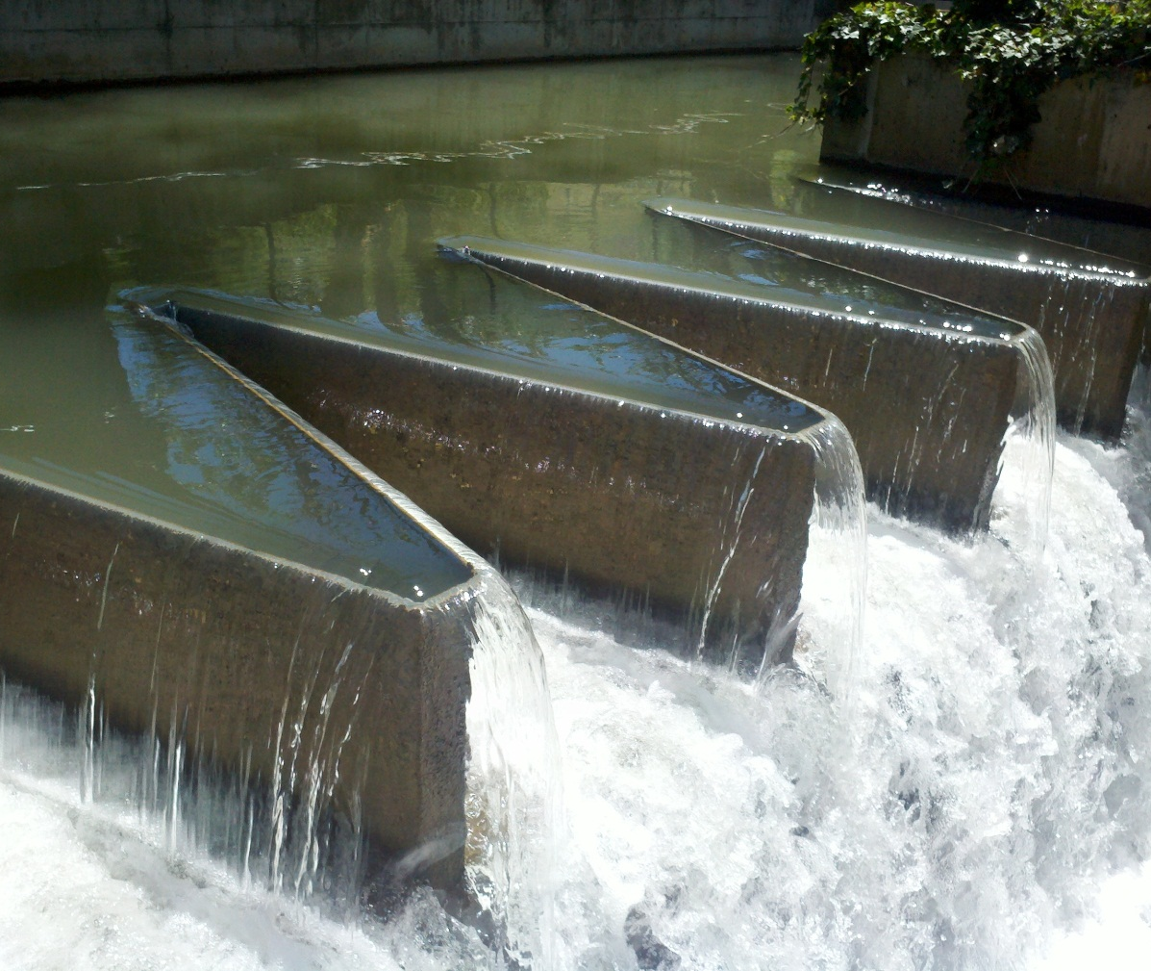
Place of use (POU);
  Location where the beneficial use will occur
Application map, to identify specific parcels on which the beneficial use will occur;
Signatures of all applicants/owners or legal agents;
Filing fee.

Slide 6
Application to Appropriate
Creates a new water right.
All areas have limitations on the amount of water that can be appropriated.
Applications to Appropriate must be completed through the certification process, by submission of proof, or the application will lapse.
Notes:
New application to appropriate program to be implemented, James Greer will demo it in the Friday session.

Slide 7
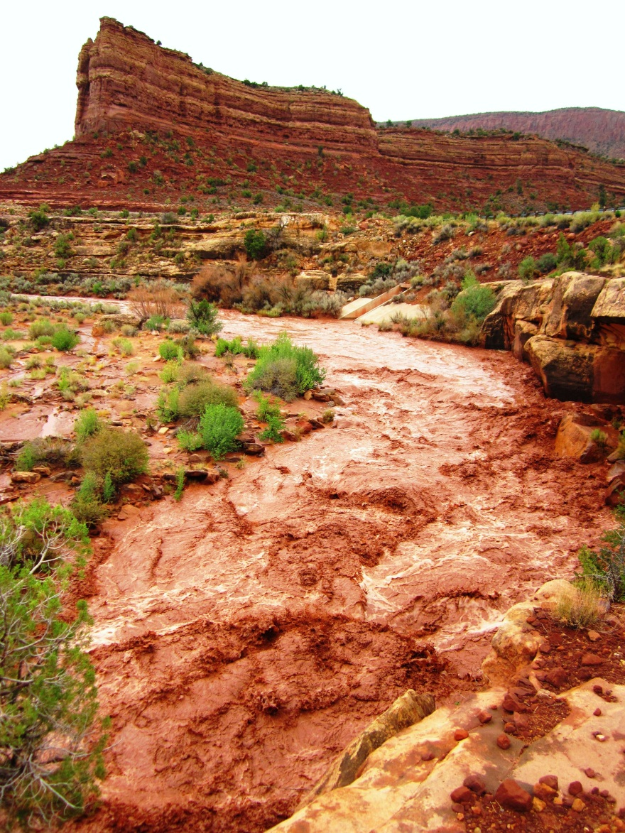
Temporary Application to Appropriate
Creates a new water right.
Amounts of water are typically based on policies for the area.
This water right will lapse one year after initial approval.
Filing of proof is not required

Slide 8
Fixed-Time Application to Appropriate
Creates a new water right.
This water right will typically be approved for no more than 14 years.
Filing of proof is not required
The Fixed-Time period may be extended
Notes:
No proof requirement
UCA 73-3-10 proof requirement was removed in 2013
Fixed-Time approvals will have a condition to report to the Division’s Water Use Program
Extended IF
1)The “essential purpose” of the original project still has not been satisfied
2)Lack of completion is not due to default or neglect of the applicant
3)Water is still available

Slide 9
Exchange Application
Exchanges are filed when an applicant has a legal contract to exchange water.
Creates a new water right filing.
The contract is the basis of the water right.
Exchange applicants are required to submit proof by the proof-due date.
Notes:
Statue broadly describes exchanges as exchanging one source of appropriated water for another.
Prior to 1992, exchanges remained valid with an “approved” status, never becoming certificated. Therefore it was often unknown to the Division if the development proposed in the exchange application had been completed or if it was completed in accord with the approved application.
Seen most commonly through Weber Basin Water Conservancy District or Central Utah Water Conservancy District.

Slide 10
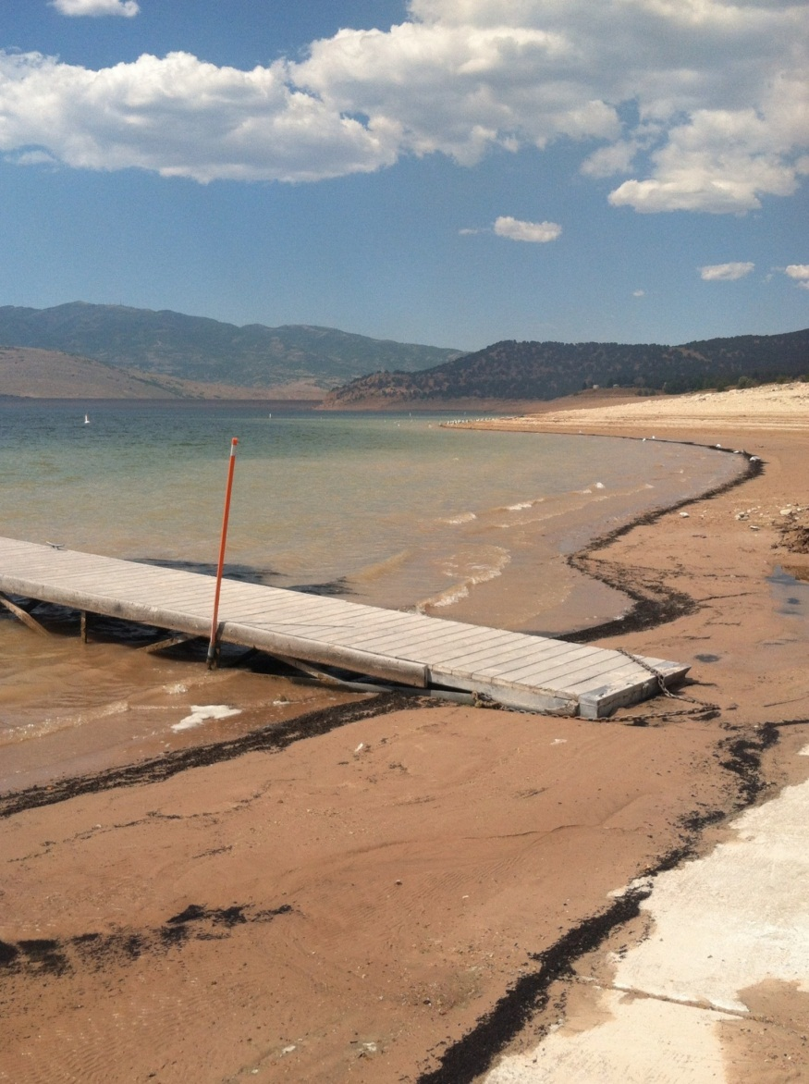
Permanent Change Application
Filed to modify some or all of a water right’s attributes.
This application uses the total flow represented by the base water right(s).
The proof will have to be completed to “perfect” the new attributes.
Notes:
All owners of record must sign the Permanent Change Application. If ownership is out-of-date on the Division’s records, a Report of Conveyance must be completed before filing the change.
If only a portion of the water right is to be changed, a Request for Ownership Segregation must be filed and processed before filing the application. At the time of segregation request it may also be required for owners to supply a Declaration of Beneficial Use prior to processing.
Changes to “approved” Applications to Appropriate may not extend the time period within which construction is to be completed, proof on such filings remains due on the underlying application and any lapsing applies to both applications.

Slide 11
Temporary Change Application
Temporary changes expire one year from the date of approval, and revert back to the original water right’s description.
This application may or may not use all of the available water under the subject water right.
Temporary changes cannot be extended and do not require filing of proof.
Notes:
It will be assumed the portion of the water right not included in the temporary change will be used as “heretofore,” as described in the records for that right.

Slide 12
Water Right Policy By Area

Slide 13
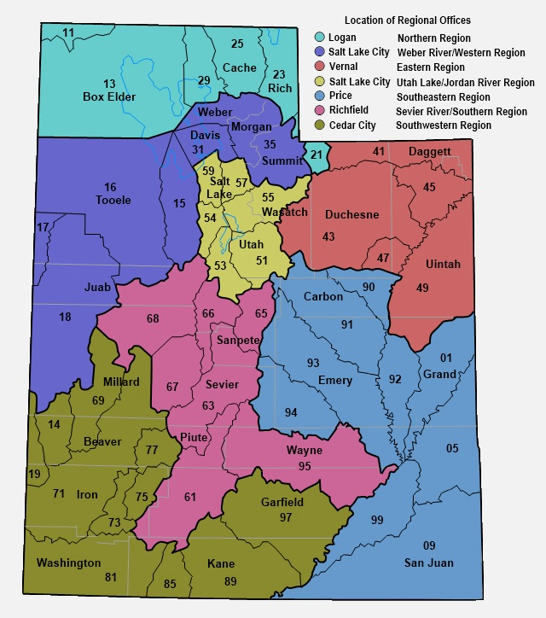
Helpful Database Tools
“Policies by Water Right Area” is located on the bottom right of the Division’s home page.
This will provide a basic overview for each water right area, including information that may be helpful for an applicant to review before filing an application.
www.waterrights.utah.gov

Slide 14
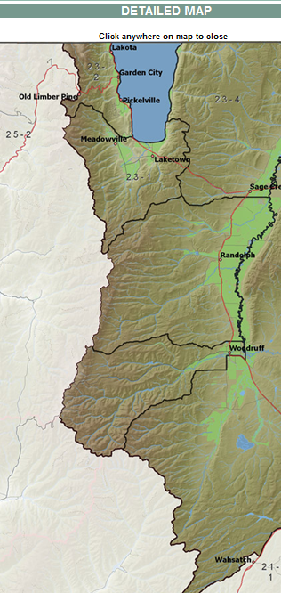
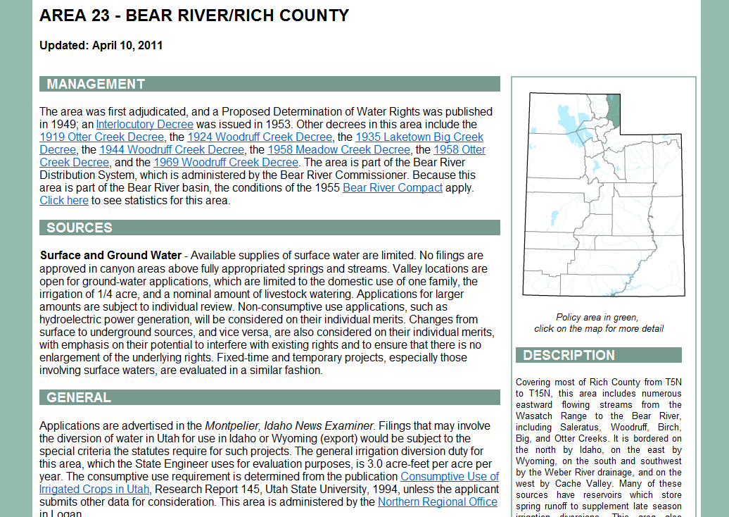
Surface and Ground Water :
…Valley locations are open for ground-water applications, which are limited to the domestic use of one family, the irrigation of .25 acre, and 10 livestock.
Notes:
Use internet (backup slide)

Slide 15
Intro to Public Land Survey

Slide 16
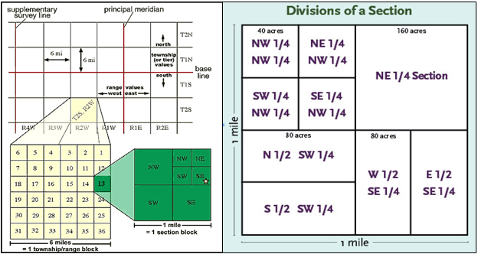
Township, Range, and Section
  Township—Typically a six-mile square area of land containing 36 sections.
  May also refer to a North-South row in the PLSS grid
  Range—An East-West row in the PLSS grid
  Section—Typically a one-mile square area, containing 640 acres.
Notes:
Typical townships and sections
Rivers, lakes, mountains, state borders are a few things that can cause irregular townships and sections

Slide 17
Typical Corner Sections and Quadrants
NW
N
NE
W
E
SW
S
SE

Slide 18
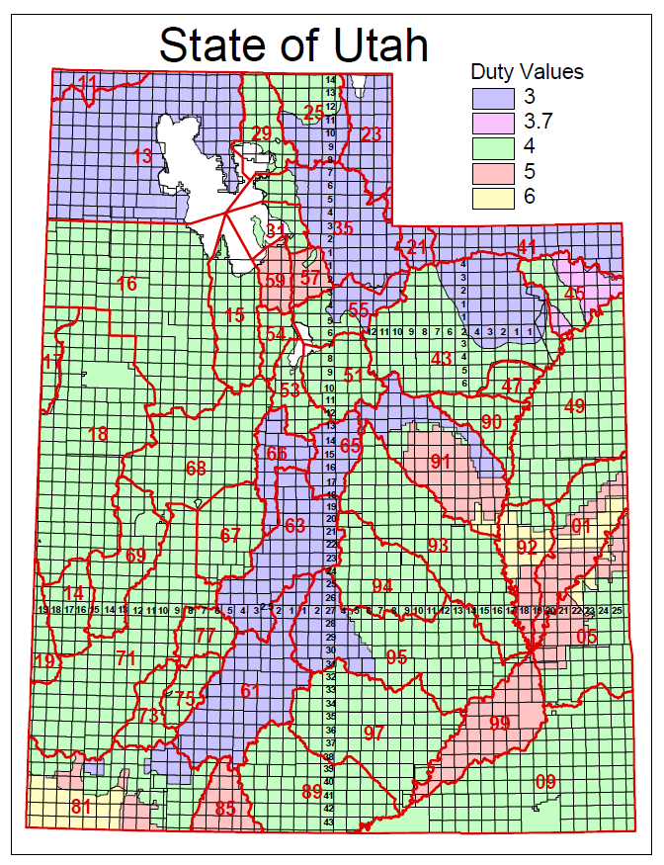
Utah Base & Meridians
Salt Lake B&M
  Beginning in Downtown Salt Lake
Uintah B&M
  Beginning about nine miles North of Roosevelt

Slide 19
Roosevelt,
Duchesne County
  Township 4 South, Range 5 West, USB&M
Stockton,
Tooele County
  Township 4 South, Range 5 West, SLB&M
Notes:
What problems this can cause:
Increase time to a decision by a month or more, if advertised incorrectly
Could require a change application to be filed to correct the description (Another filing fee for a change app and more time)

Slide 20
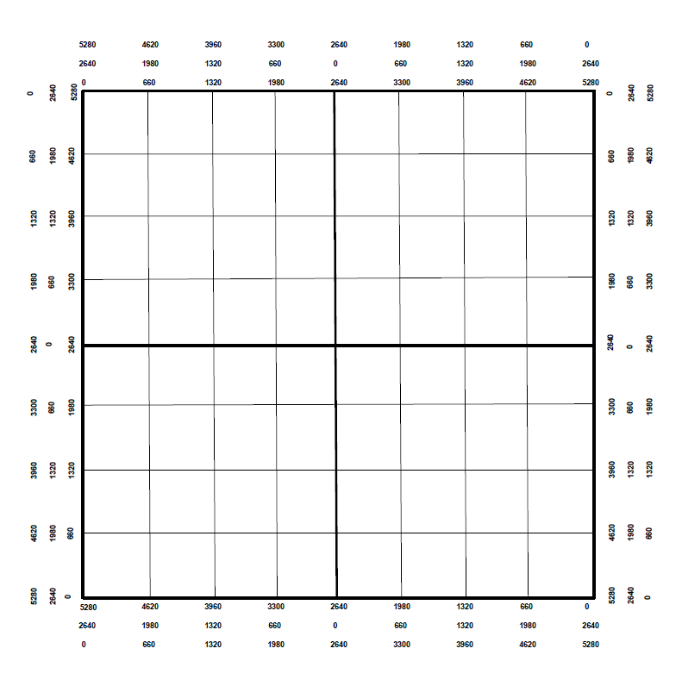
Marking a Point of Diversion
Locate the following:
  S 500’ and W 1200’, from the East Quarter Corner
  N 2000’ from the Southeast Corner
  S 1300’ and E 4000’, from the Northwest Corner
NW
E
SE

Slide 21
Marking a Place of Use
Locate the following:
  NW1/4 of the NW1/4
  S1/2 of the SW1/4
  NE1/4 of the SW1/4
  S1/2 of the NW1/4 and the S1/2 of the NE1/4

Slide 22
Water Right Calculations

Slide 23
Common Terms
Cubic Feet per Second (CFS)
  A unit of measure used to quantify the rate of flow from a water source
  Height (feet) * Width (feet) * Velocity (feet per second)
Acre-Feet (AF)
  A unit of volume defined as one acre of surface area to a depth of one foot.
  Depth of Water (feet) * Area (acres)
Notes:
CFS=Equal to a volume of water one foot high and one foot wide moving at a velocity of one foot in one second.

Slide 24
Duty Calculations
Irrigation
  Acres * Duty = AF per Year
  Irrigation duty values vary by area
Domestic
  Full time = 0.45 AF per Year
  Part time = 0.25 AF per Year
Livestock (ELU)
  1 ELU = 0.028 AF per year
  1 ELU = 1 Cow or Horse
  1 ELU = 5 Pigs, Sheep, or Goats
Notes:
The maximum volume of water allowed per year for a particular beneficial use.
For irrigation, the duty value varies from area to area within the state.

Slide 25
Sample Problem #1
A rancher wants to start a farm near Dugway, Utah (area 16). How much water does he need for 5 acres of irrigation, 50 cattle year-round, and a full-time home?
The irrigation duty in Dugway is 4 acre-feet/acre
  5 acres * 4 acre-feet/acre = 20 acre-feet
  50 cattle * 0.028 acre-foot = 1.4 acre-feet
  1 full-time home = 0.45 acre-foot
  Total diversion = 21.85 acre-feet
Notes:
These samples are diversion only, to practice converting between units

Slide 26
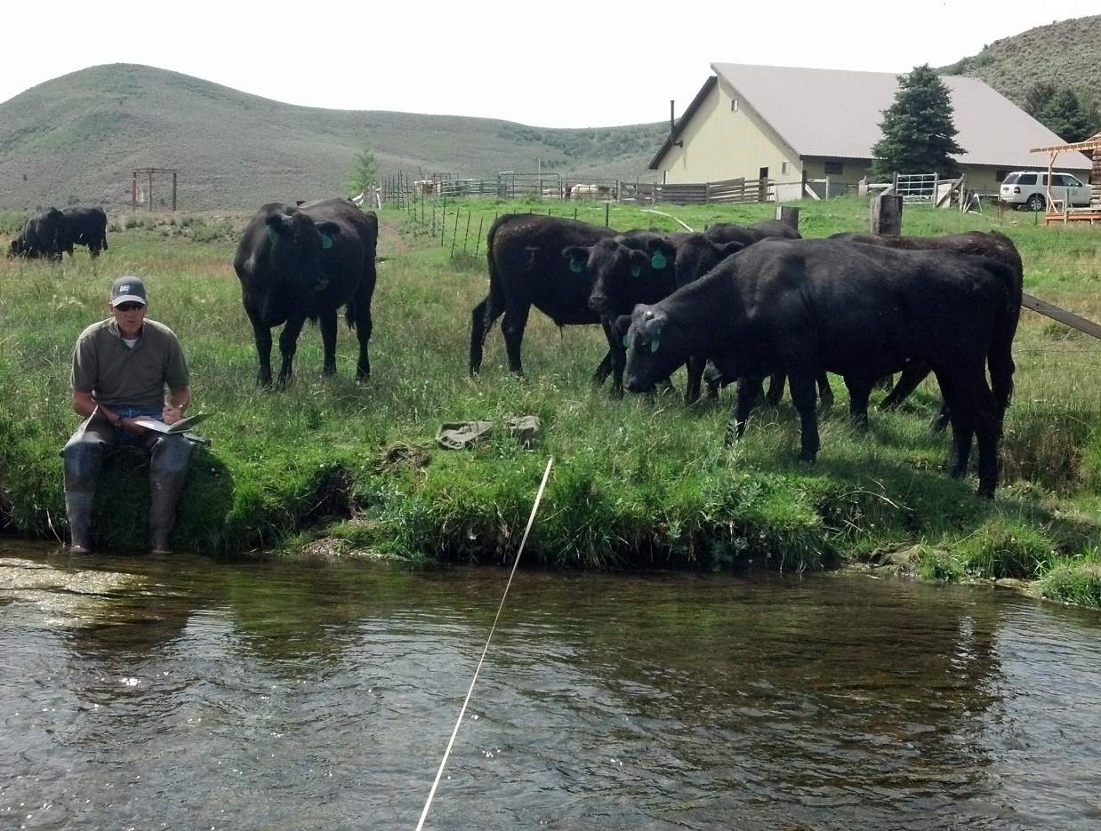
Sample Problem #2
A rancher has a water right for 300 cattle. How many sheep could he provide for with this water right?
  300 cattle * 5 = 1500 sheep

Slide 27
Sample Problem #3
A developer wants to build a 10 lot subdivision in Delta, Utah (area 68). Each lot is supposed to have enough water for 0.25 acre of irrigation, 2 horses, and a full-time home. How much diversion will the water right need to have?
  Each lot requires
    0.25 acre * 4 acre-feet/acre = 1.0 acre-foot
    2 horses * 0.028 acre-foot = 0.056 acre-foot
    Full-time home = 0.45 acre-foot
    Total of 1.506 acre-feet
  Total project requires
    1.506 * 10 lots = 15.06 acre-feet

Slide 28
Sample Problem #4
A farmer has a water right in Brigham City (area 29) that serves 100 cattle year-round. He wants to change the water right to supply one full-time home, one part-time home, 10 horses, and irrigation for his yard. What is the maximum area (in acres) that can be irrigated, after the other uses are accounted for?
  150 cattle * 0.028 acre-foot = 4.2 acre-feet
  Full-time home = 0.45 acre foot
  Part-time home = 0.25 acre foot
  10 horses * 0.028 acre-foot = 0.28 acre foot
  4.2 acre-feet - 0.98 acre-foot = 3.22 acre-feet
  3.22 acre-feet / 4 acre-feet per acre = 0.805 acre
Notes:
Sample of Diversion and Depletion
Water right is for 2.0 acres of irrigation (duty 4) = 8.0 AF
Change to livestock
8.0 with a depletion of 50% = 4.0 AF of depletion
Livestock is 100% depletive so the allowable diversion for a change app would be 4.0AF
Historic use of irrigation would have been 8.0 AF of diversion and 4.0 AF of depletion
142.86 ELU (proposed change) would allow 4.0 AF of diversion and 4.0 AF of depletion
Without diversion adjustment the historic depletion would have been exceeded, enlarging the water right.

Slide 29
Diversion vs Depletion
Diversion is the water removed from the source to be used
  E.g. Diverting 4.0 AF of water to irrigate 1.0 acre of land
Depletion is the amount of water that is consumed after application.
  E.g. After diverting 4.0 AF of water to irrigate 1.0 acre only 2.0 AF of water returns to the natural water system.
When evaluating Change Applications the State Engineer looks at the historic values for both diversion and depletion.
  Neither value can be enlarged.
Notes:
4.0 AF (Diversion)
Convert to livestock = ~143 cows
2.0 AF (Depletion)
Converts to livestock = ~71 cows
Water used up by the plants, bound to soil, and lost through evaporation, is water that doesn’t make its way back to the natural water system enabling other water rights to be satisfied.

Slide 30
Sample Problem #5
A water right owner has a water right for 3.0 acres of irrigation (duty is 4 feet per acre). He wants to change the use to include 50 cattle. How many acre-feet of water will he be able to divert after the change? Assume the rate of depletion for irrigation is 53%.
  Establish historic diversion and depletion
  3.0 acres * duty of 4 = 12.0 acre-feet (diversion)
  12.0 acre-feet * 53% = 6.36 acre-feet (depletion)
  Figure proposed uses
  50 cattle * 0.028 acre-foot = 1.4 acre-feet (100% consumptive)
  6.36 acre-feet – 1.4 acre-feet = 4.96 acre-feet depletion left
  4.96 acre-feet / 53% = 9.36 acre-feet remaining diversion
  9.36 acre-feet / duty of 4 = 2.34 acres of irrigation
  1.4 acre-feet + 9.36 acre-feet = 10.76 acre-feet of diversion
Notes:
Using Kamas Station for annual irrigation of alfalfa 19.29 inches or 1.6 feet, based on Dr. Hill’s Crop Consumption research.

Slide 31
Summary of Diversion and Depletion Limits
Historic Use | Diversion | Rate of Depletion | Amount of Depletion
Irrigation: 3.0 acres | 12.0 acre-feet | 53% | 6.36 acre-feet
Totals | 12.0 acre-feet |  | 6.36 acre-feet
Proposed Use | Diversion | Rate of Depletion | Amount of Depletion
Irrigation: 2.34 acres | 9.36 acre-feet | 53% | 4.96 acre-feet
Livestock: 50 ELU | 1.4 acre-feet | 100% | 1.4 acre-feet
Totals | 10.76 acre-feet |  | 6.36 acre-feet
Notes:
Without considering depletion the diversion would have looked like: 10.6 acre-feet for irrigation (2.65 acre)

Slide 32
Diversion Based Change Applications
Why it feels like a “haircut.”
  In this scenario depletion is exceeded by 0.66 acre-foot
Historic Use | Diversion | Rate of Depletion | Amount of Depletion
Irrigation: 3.0 acres | 12.0 acre-feet | 53% | 6.36 acre-feet
Totals | 12.0 acre-feet |  | 6.36 acre-feet
Proposed Use | Diversion | Rate of Depletion | Amount of Depletion
Irrigation: 2.65 acres | 10.6 acre-feet | 53% | 5.62 acre-feet
Livestock: 50 ELU | 1.4 acre-feet | 100% | 1.4 acre-feet
Totals | 12.0 acre-feet |  | 7.02 acre-feet
Notes:
Without considering depletion the diversion would have looked like: 10.6 acre-feet for irrigation (2.65 acre)
The State Engineer’s office evaluates diversion and depletion on all change applications. Most applications come in based on diversion only. When the final order is issued the applicant may feel like water was taken away from him because it was not expected nor understood.

Slide 33
Making an Application Map

Slide 34
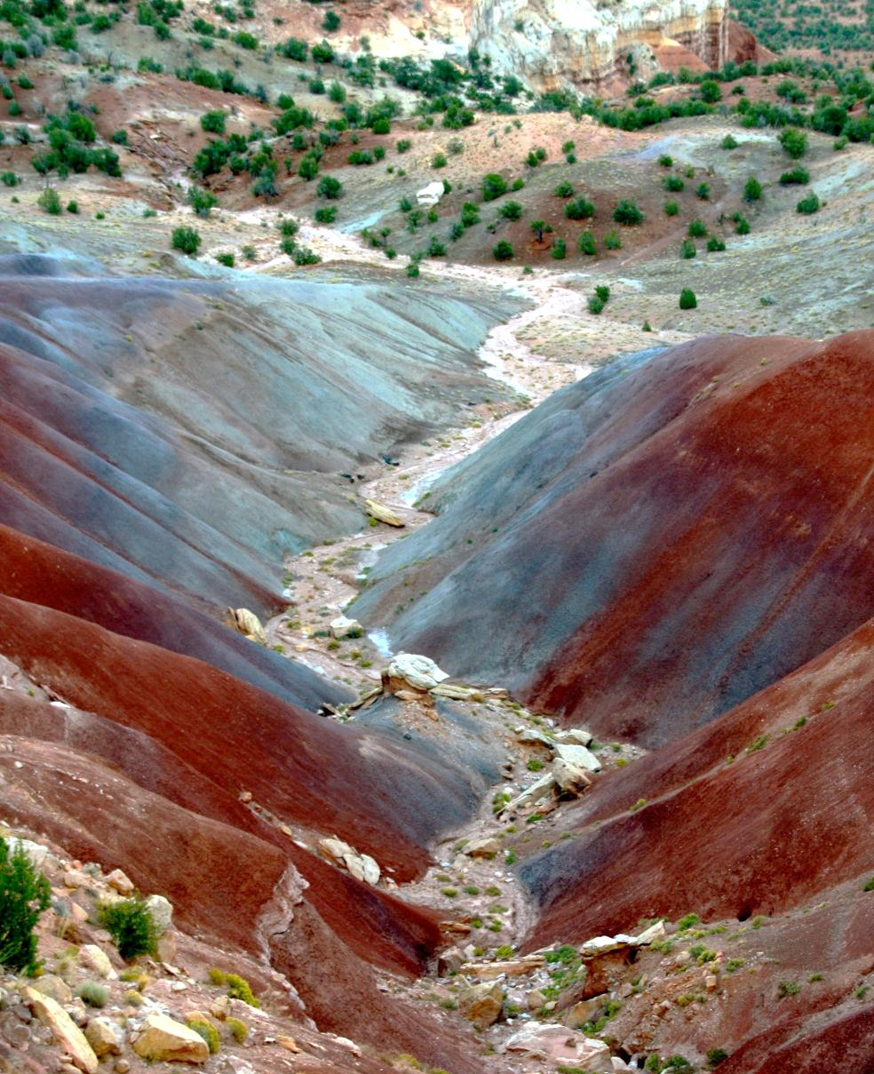
Using the Divisions Database to Get a POD
Be able to locate the property from an aerial map.
Know the approximate location where the well or point of diversion will be located

Slide 35
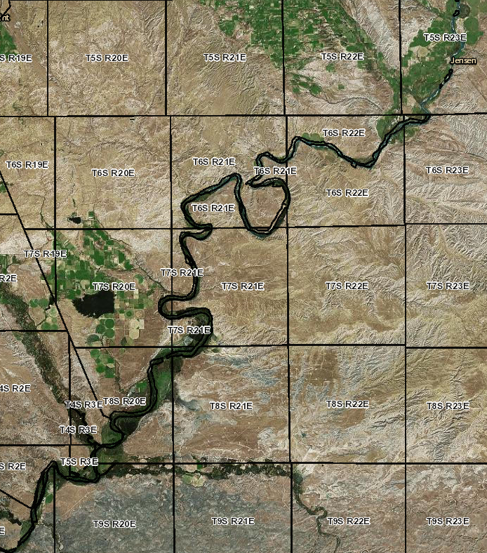
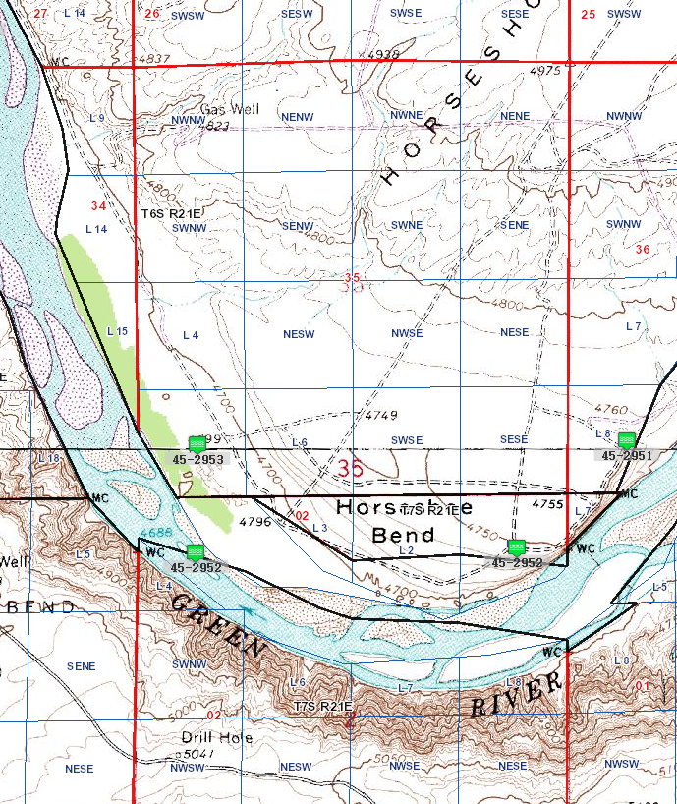
ESRI Map Features
Notes:
Show base map features
Show POD features
Show heretofore and hereafter points

Slide 36
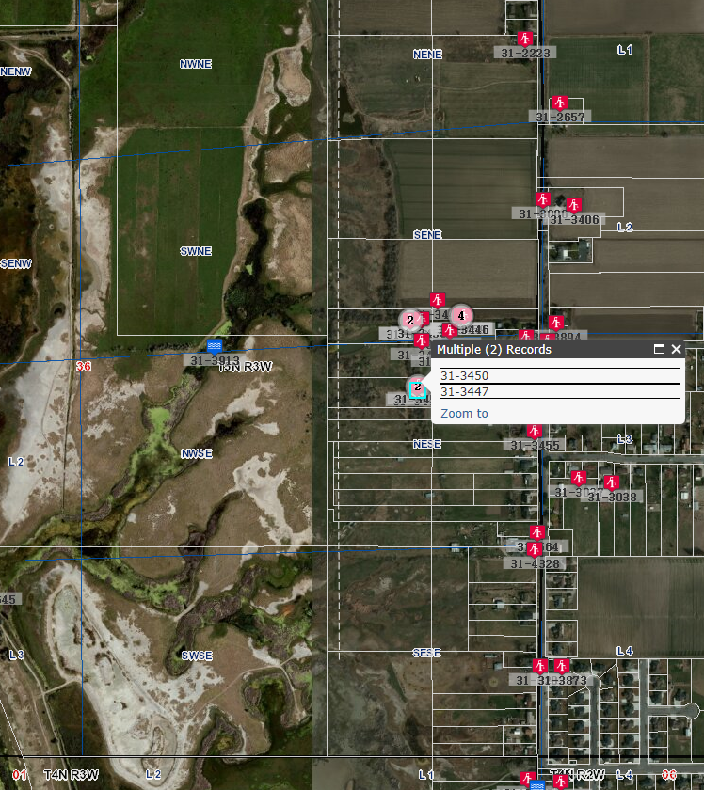
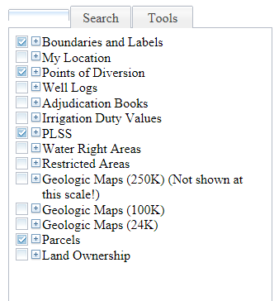

Slide 37
Application Map Wizard
Access from the application/form link on the Division’s Website.
Allows a user to select a point of diversion from an aerial photo and print a map to accompany an application.
Can be generated with signature lines.
Not acceptable as a proof map.

Slide 38
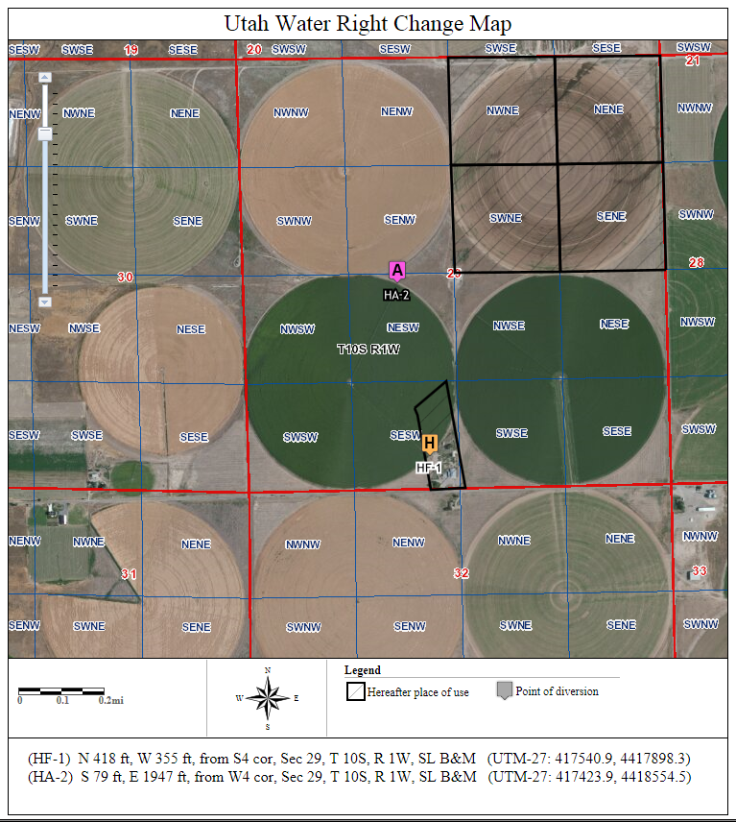
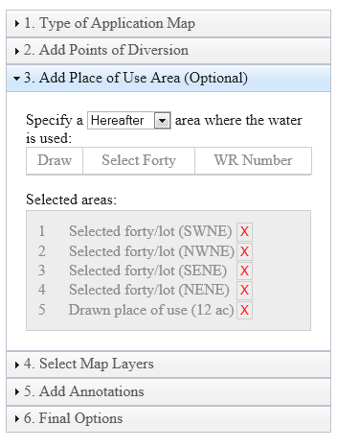

Slide 39
Summary and Wrap-Up

Slide 40
Topics Covered
Elements common to all applications
A few of the common applications that are filed
Intro to the Public Land Survey System
Basic water right calculations
How to use the Division’s website to create an Application Map

Slide 41
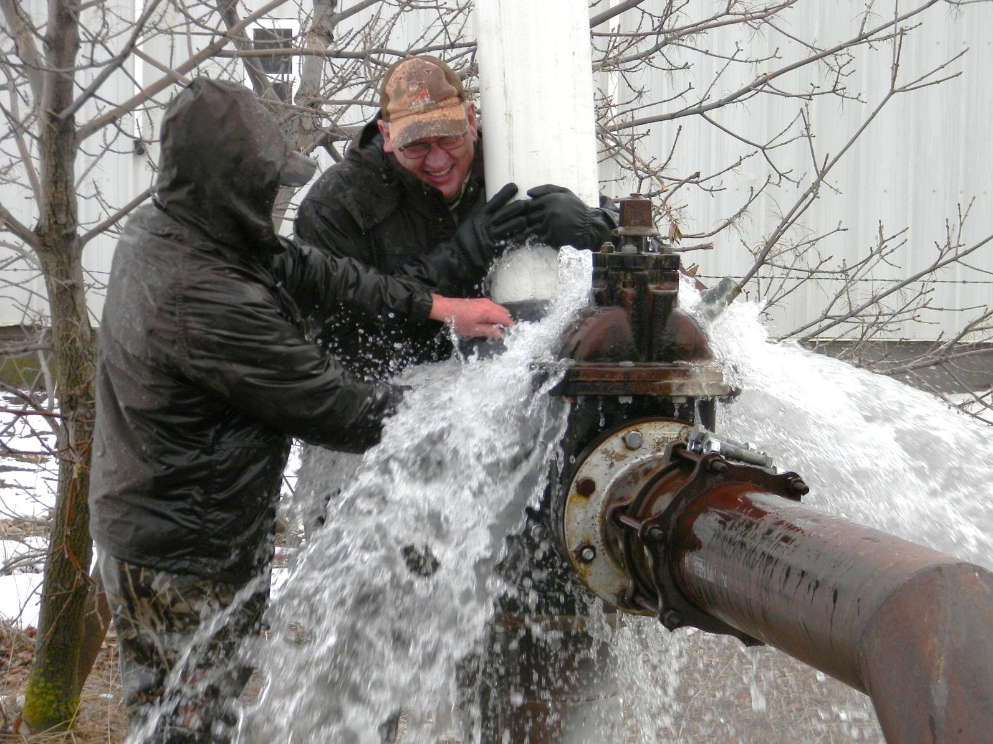
Questions?

