Slide 1
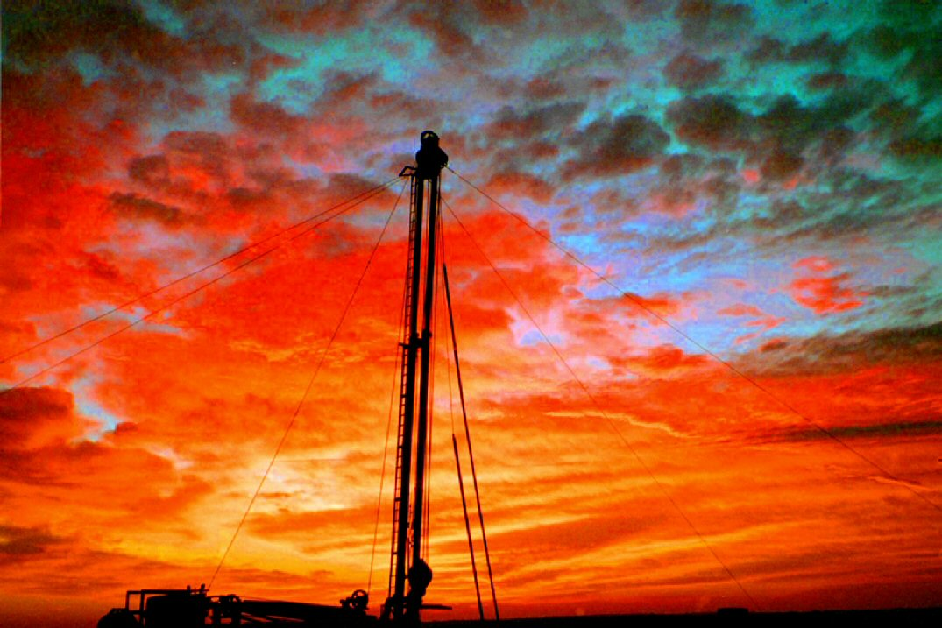
“A wise man can see more from the bottom of a well than a fool can from the top of a mountain”

Slide 2

Water Well Permitting and Rules
Jim Goddard
Utah Division of Water Rights
Water Rights Certification
April 27, 2015

Slide 3
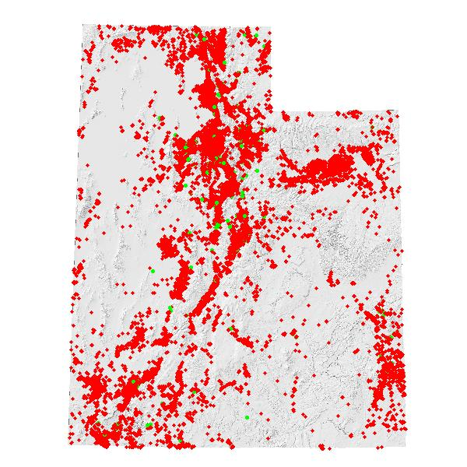
UTAH WELL DRILLING DATA
145 licensed well drillers, 133 Licensed Pump Installers, and 195 Registered Operators
1500 Non-Production Wells per year
  (most are heat exchange wells; 80% Mud)
330 Production Wells per year (51% Air,)
21% Cable Tool, 17% Mud)
  48% DOM/IRR/STK Wells
  33% Irrigation Wells
  11% Monitor/Test Wells
  5% Public Supply Wells
  3% Commercial/Industrial Wells
64% of water wells were 4-6 inch diameter

Slide 6
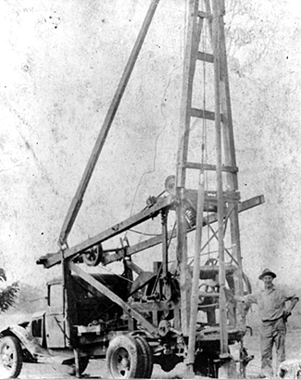

Slide 7
COMMON UTAH
DRILLING METHODS
Mud Rotary
Cable Tool
Air Rotary
  Down-hole Hammer
  Drill-through Casing Drivers
  Under-reamer Systems
  Dual Rotary
  Reverse Air Rotary
Flooded Reverse Rotary
Other Methods (Jetting, Direct Push, Sonic, Percussion Hammer, Hollow Stem Auger, Coring, Horizontal, Bucket Auger, etc.)

Slide 8
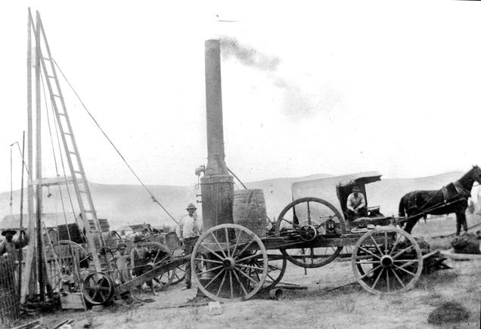

Slide 9
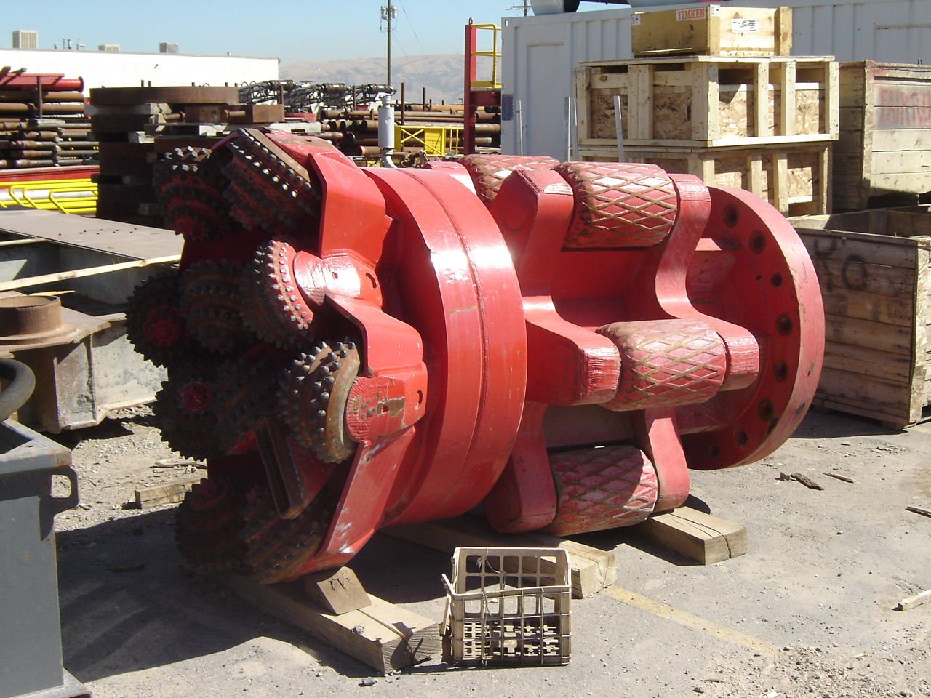
Well Drilling Activity
Permitting

Slide 10
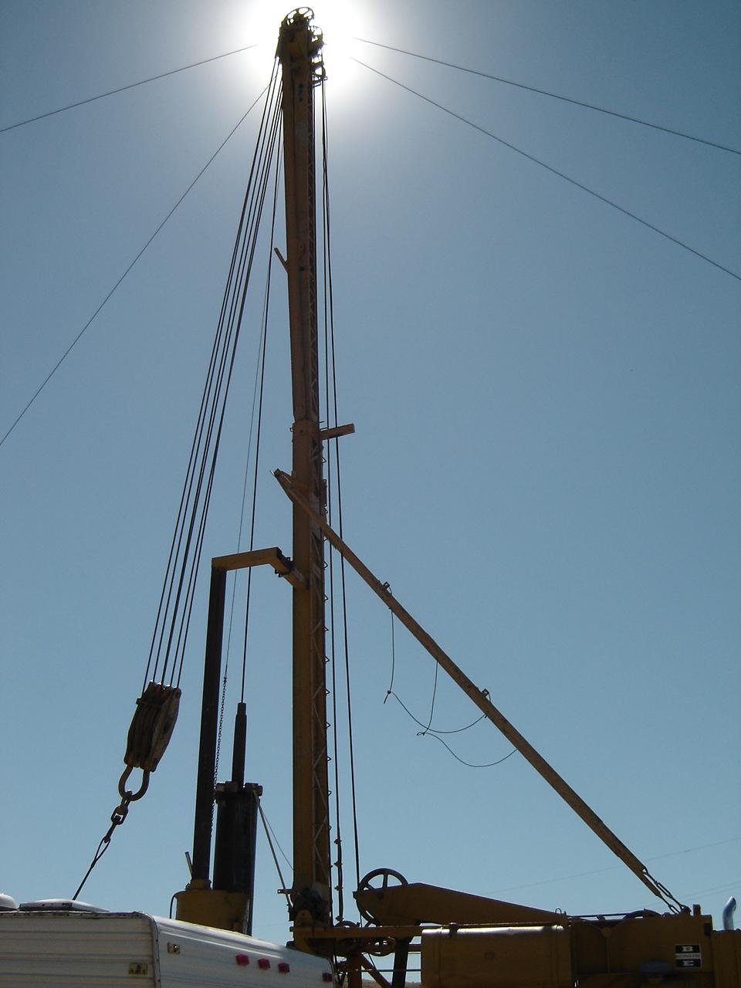
WELL PERMITTING MECHANISMS
Application to Appropriate
Change Application
Exchange Application
Temporary Change Application
Provisional (Rush Letter)
Well Renovation
Well Replacement
Non-Production Well
  Test, Monitor, Cathodic, Heat Pump, Dewater, etc.

Slide 11
APPLICATION PROCESS
(New Water Production Wells)
Approval (New, Change, Exchange)
  Application
  Review & Advertise
  Protest Period
  Hearing
  Memo Decision, Approval letter, Start Cards
  Durations varies (weeks to months…or longer)

Slide 12
WELL DRILLING FEES
Fee is based on quantity of water right for Production Wells (see table)
No fee for Non-production well permits
No fee for permit to renovate and replace a well

Slide 13
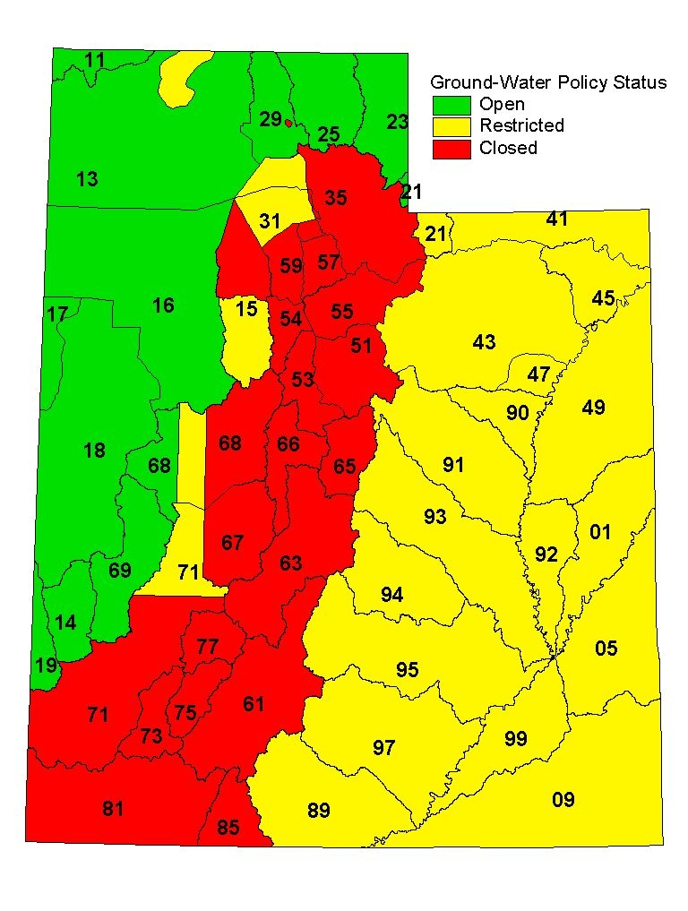
State Engineer’s
Water
Appropriation Policy

Slide 14
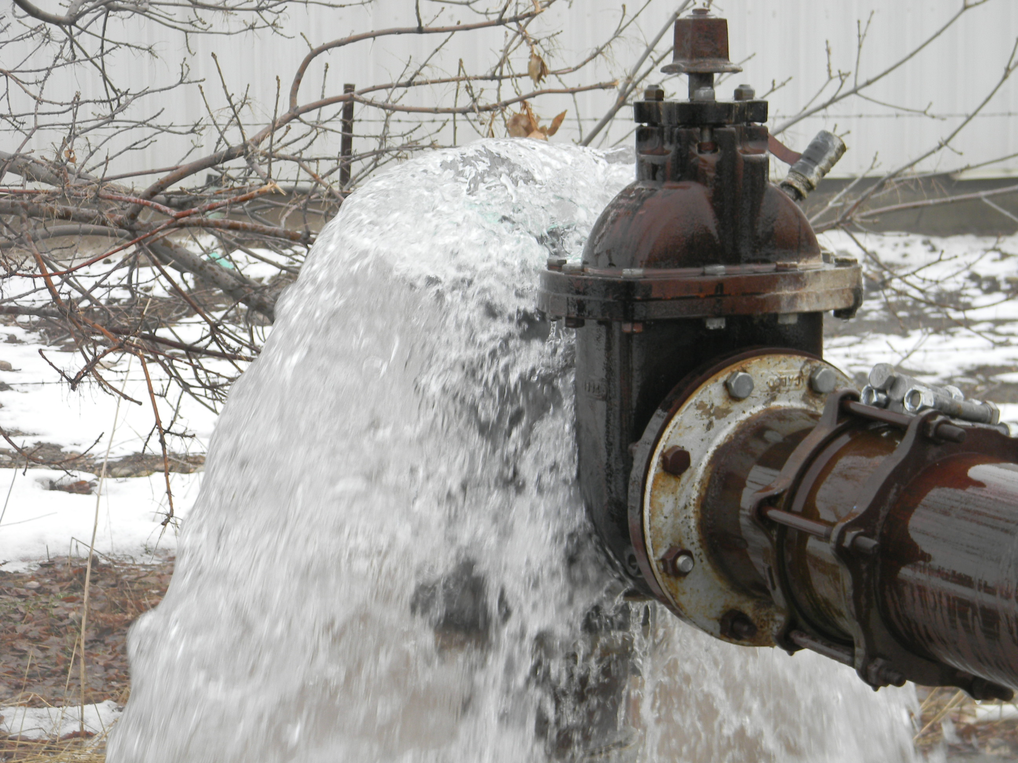

Slide 15
APPLICATION PROCESS
(Approval to Renovate)
Application to Renovate An Existing Well
  Modification to well (deepen, liners, screens, perforations, casing repair, pitless, seal, etc.)
DOES NOT grant approval to replace
No Application fee
Title and ownership must be current
Allows for repair, renovation, and/or deepening
Need separate application to replace well
Work such as cleaning, testing, development, pump related work covered under pump installation rules (No permit, but log required)

Slide 16
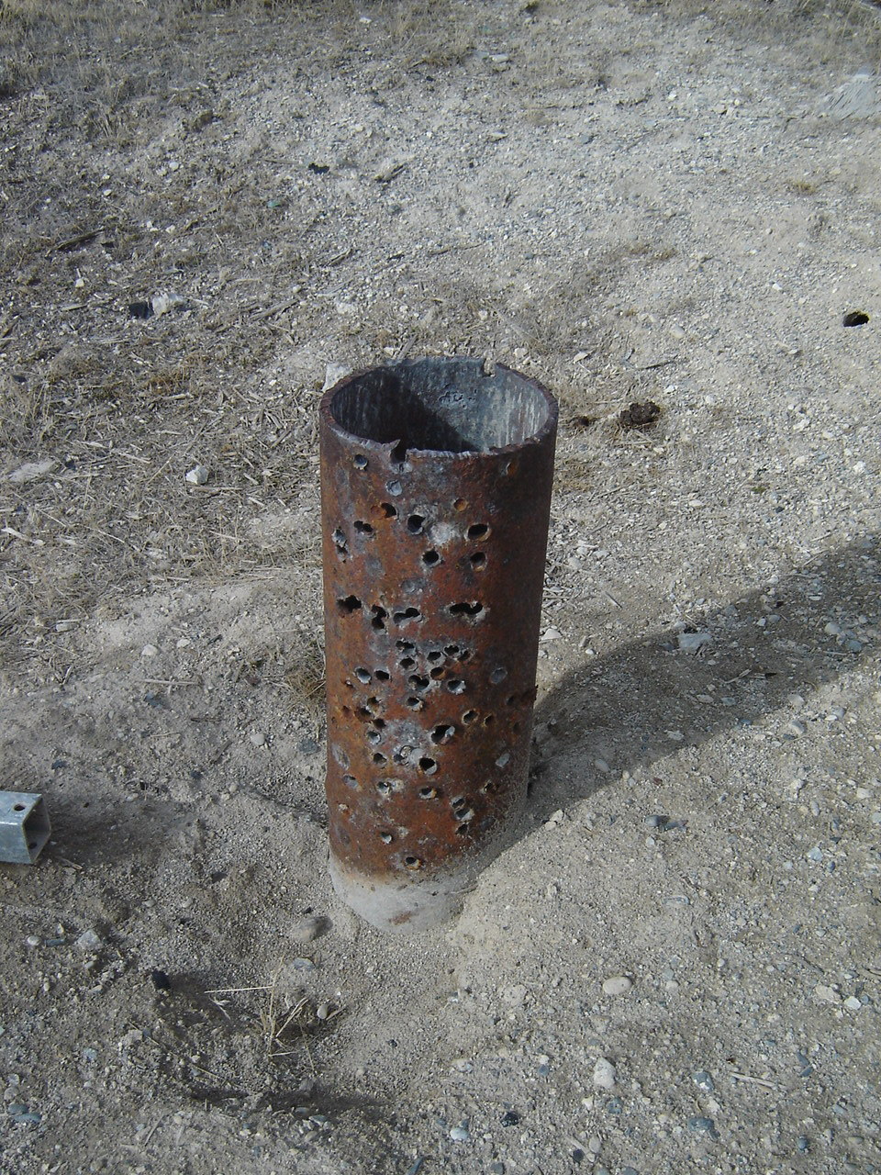
NEW WELL RENOVATION PERMIT POLICY
Renovate Permit Needed:
  Deepening
  Well Repair/Renovation
Renovate Permit Not Needed
  Cleaning
  Development
  Disinfection
  Testing
  Pump Work
Still needs to be done by a licensed Driller or Pump Installer
Still need to submit a pump log to report this information
Notes:
16

Slide 17
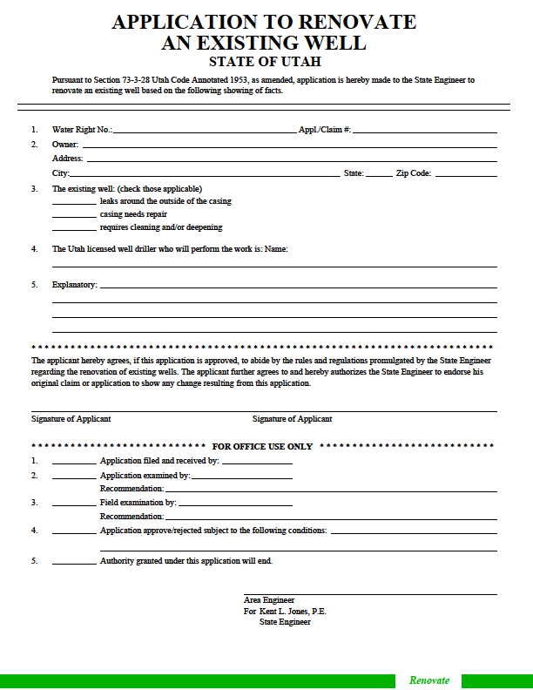

Slide 18
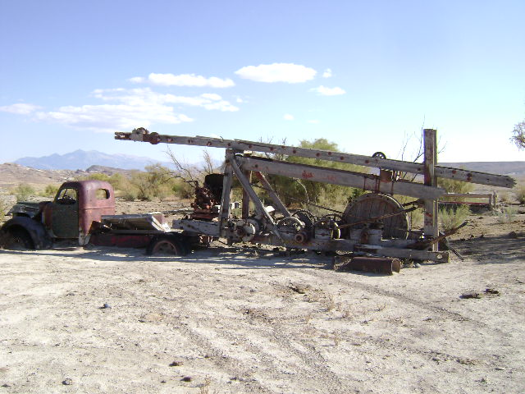

Slide 19
APPLICATION PROCESS
(Well Replacement)
“Application to Replace an Existing Well”
Replacement well must be within 150 feet of old well for this process
Over 150 feet goes to change application process
Owner responsible to have licensed driller abandon existing well
No Application fee
Title and ownership must be current
Abandonment of existing well a condition of approval
Well log and abandonment log are tracked and both must be returned by Driller

Slide 20
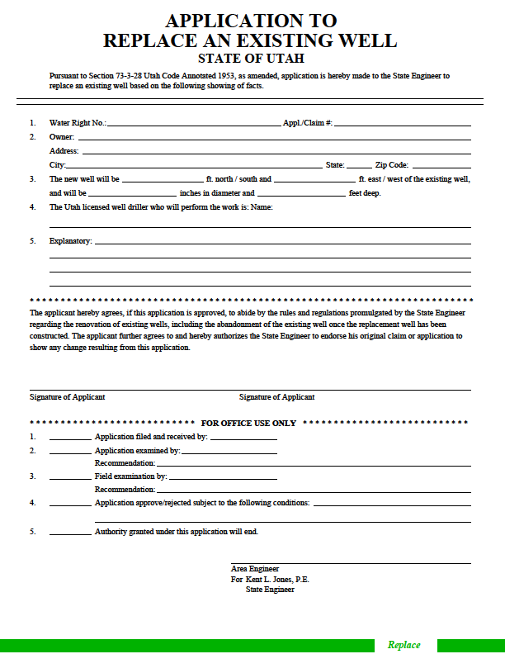

Slide 21
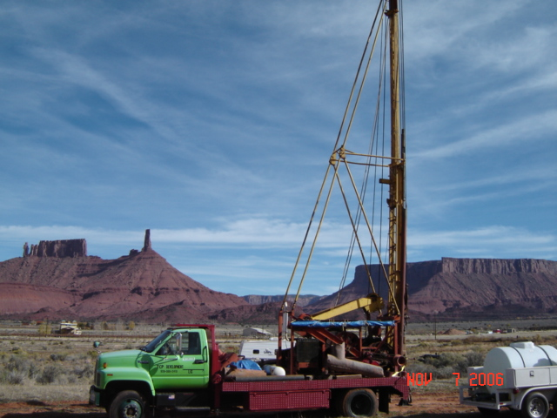

Slide 22
APPLICATION PROCESS
Non-Production Wells (NPW)
Types of wells included
  Test Wells (No WR Application filed)
    Provisional (Rush) wells do NOT use this form
  Cathodic Protection Wells (>30')
  Closed Loop Heat Exchange Wells (>30')
  Monitor Wells (>30')
Approval to construct (NPW Form; No Fee)
  Given by Well Drilling and/or Regional Offices
  Up to 14-day review
  NPW Public Listing

Slide 23
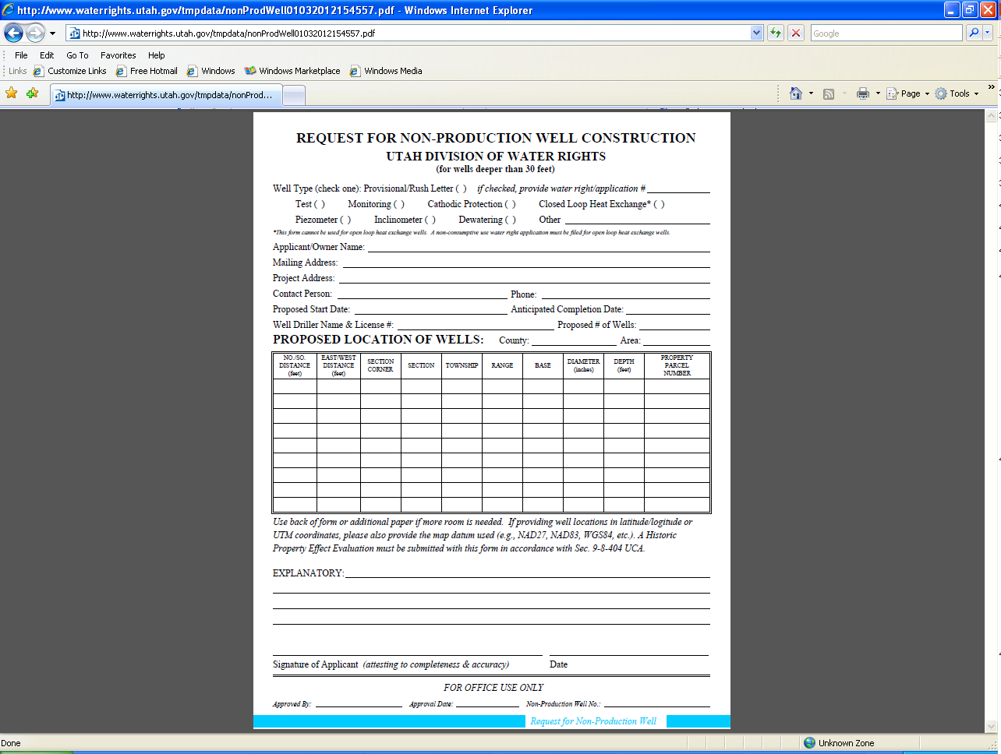

Slide 24
APPLICATION PROCESS
Provisional or “Rush Letter”
Utah Code Section 73-3-5(4) provides that the state engineer may issue a temporary receipt to drill a well at any time after the filing of an application to appropriate water therefrom... provided in the judgment of the state engineer there is unappropriated water available in the proposed source and there is no likelihood of impairment of existing rights.
Water right process must still be followed
Written request with or after WR application
Approval to drill, construct, and test, but cannot divert the well water or put to beneficial use until after the WR application has been approved

Slide 25
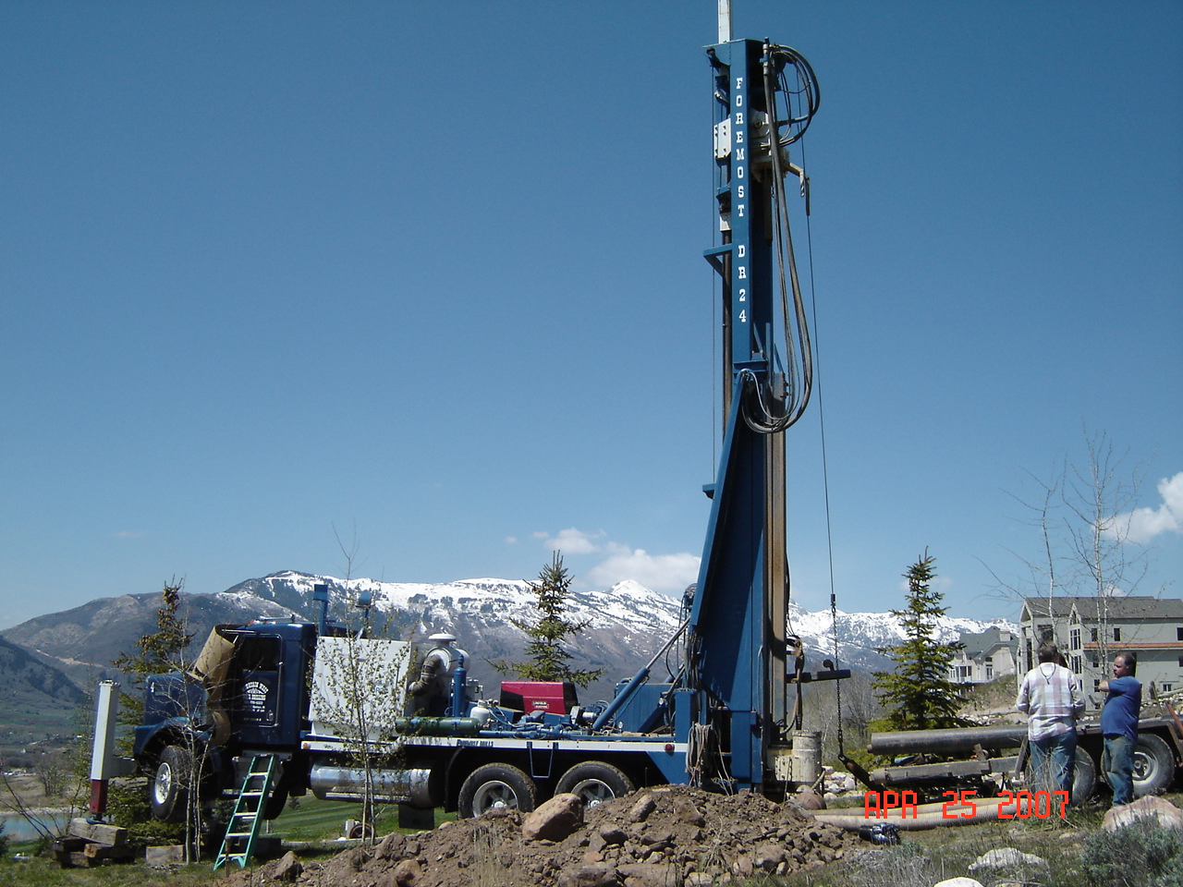

Slide 26
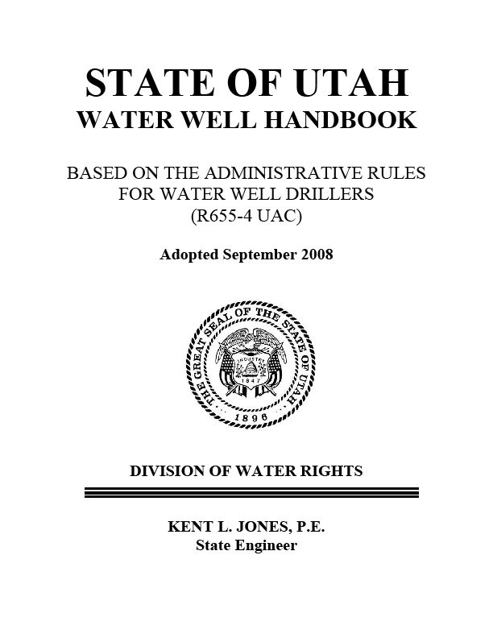
Administrative Rules for Water Wells
(R655-4 Utah Administrative Code)
  “Provide
  order and certainty
  in the beneficial use
  of Utah’s water”

Slide 27
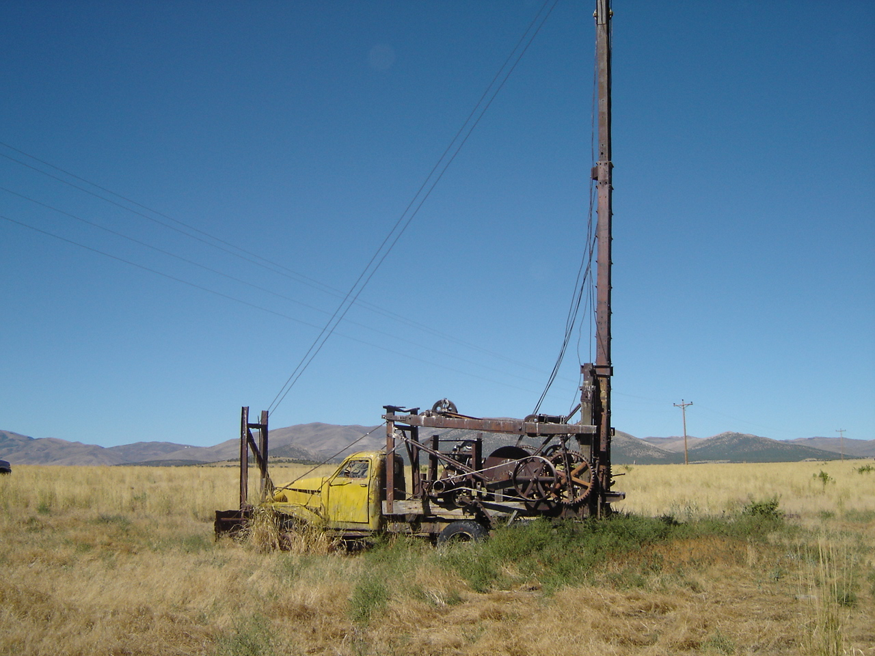
SCOPE OF RULES
(Regulated Wells/License Required)
Production Wells Greater than 30 feet deep
  Permitted through WR Process in WR database and associated with a WR#
    Domestic
    Irrigation
    Stock
    Public supply
    Commercial/industrial
    Open Loop Heat Exchange Wells
    Well Renovation & Replacement
Non-Production Wells (NPW) greater than 30 feet
  Permitted through NPW process in well drilling database and associated with a NPW number (aka M00 #)
    Test Wells
    Monitoring Wells
    Cathodic Protection Wells
    Closed Loop Heat Exchange Wells
    Misc. Wells (Piezometers, inclinometers, anode)

Slide 28
SCOPE OF RULES
(Wells Excluded from The Rules)
Any well less than 30 feet
  IMPORTANT: Production wells less than 30 feet deep still need a Water Right
Geothermal Wells (Regulated by R655-1 UAC)
Exploratory or geotechnical borings
Structure monitoring wells if aquifer not impacted
Dewatering wells if aquifer not impacted

Slide 29
WELL DRILLING DEFINITION
Well drilling means the act of drilling, constructing, repairing, renovating, deepening, cleaning, developing, or abandoning a well
Pump installation and repair is now regulated by the Rules

Slide 30
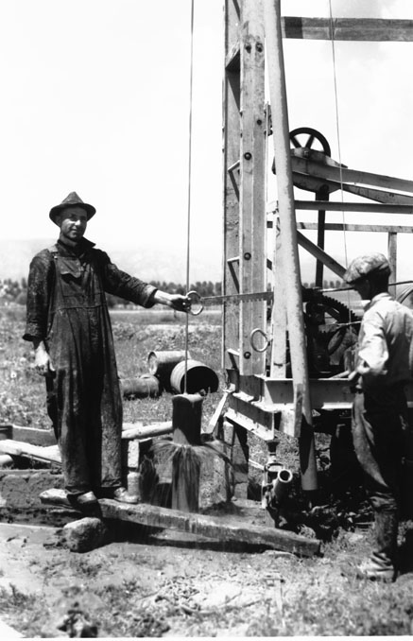

Slide 31
ADMINISTRATIVE RULES
License required for drillers and pump installers
  Experience, testing, bonding, continuing education, renewal
Registration required for rig operators
Violations, Infractions, and Enforcement
Removing Drill Rig from Site
Requirements During Construction
  License No. or Company name on rig
  Licensed driller or registered operator on site
Reporting Requirements
  Start Card Submitted for starting regulated work
  Well log - 30 days after completion of well
  Specific log for each well
  Pump Logs
  Abandonment reports

Slide 32
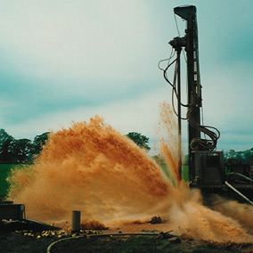

Slide 33
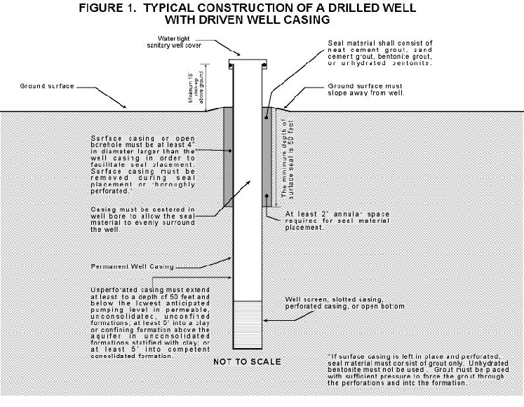
CONSTRUCTION REQUIREMENTS

Slide 34
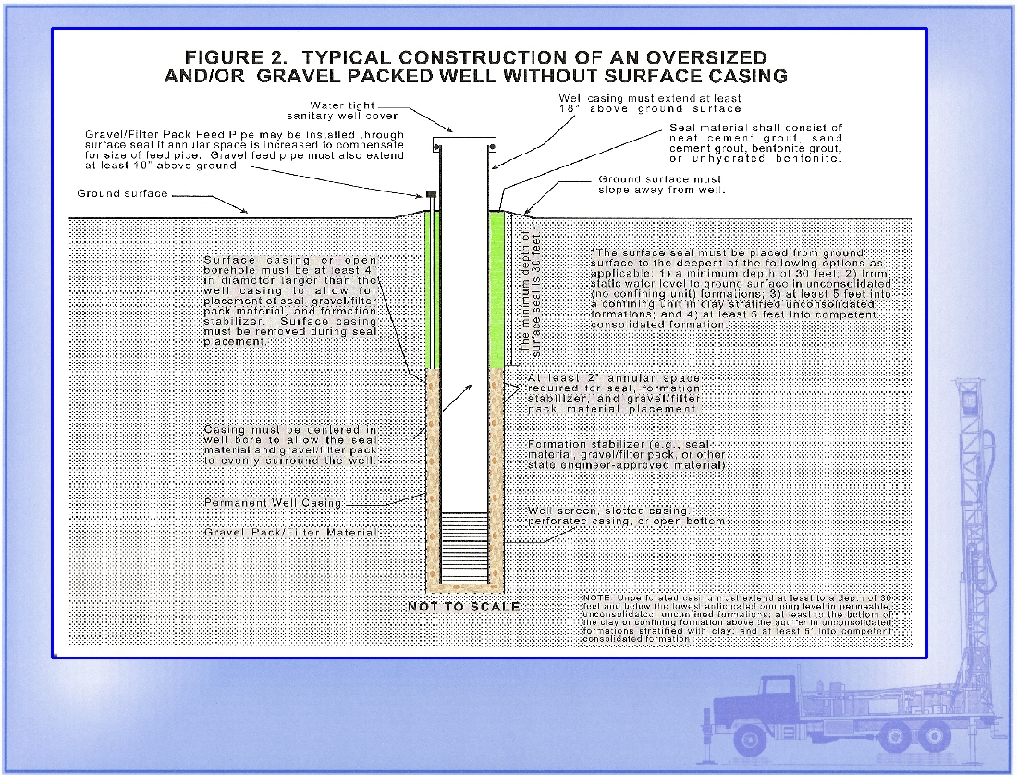

Slide 35
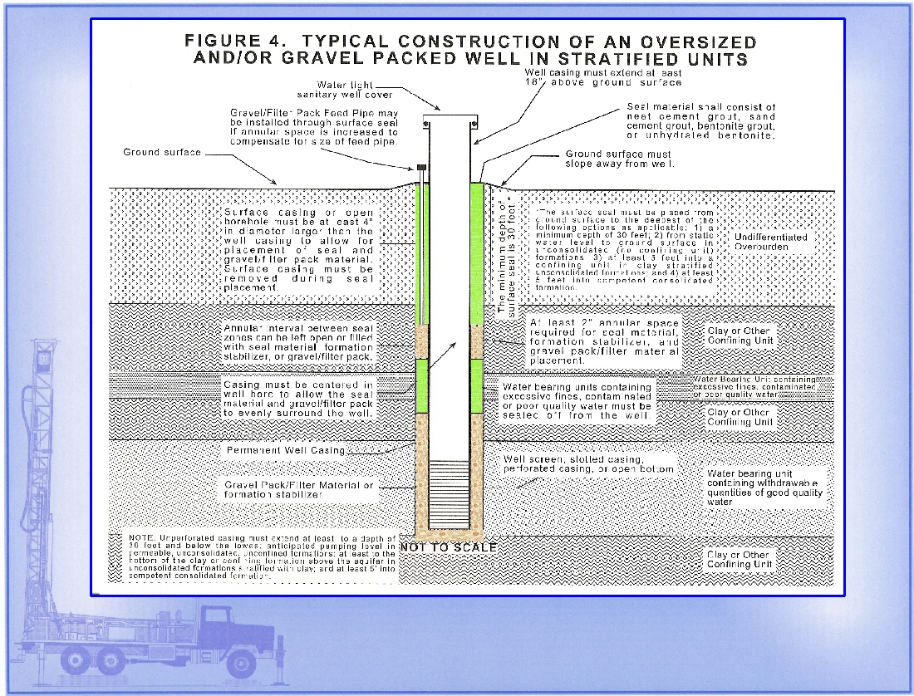

Slide 36
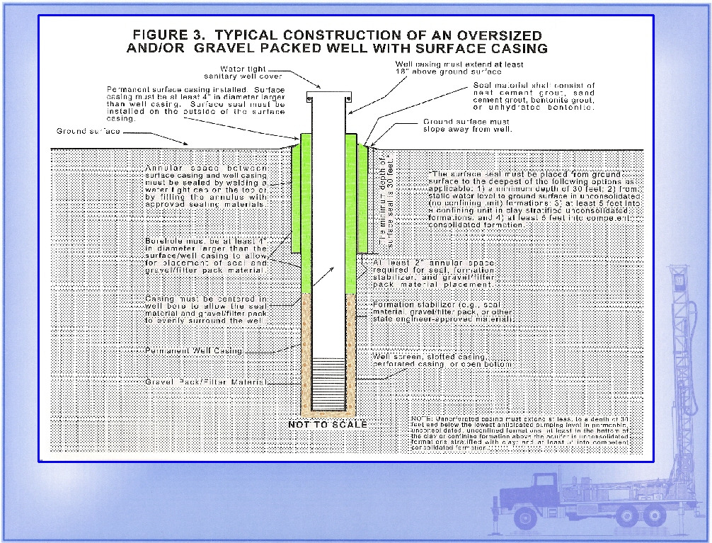

Slide 37
MAIN COMPONENTS
Well Casing, Joints, Screens, & Perforations
Surface and Interval Seals
Formation Stabilizers – Gravel (Filter) Pack
Aquifer Protection (Fluids, Chemicals, LCMs, Cross-contamination, Disinfection)
Surface Completion
Special Wells & Monitoring Wells
Deepening, Rehab, and Renovation
Well Abandonment
Pump Installation and Repair

Slide 38
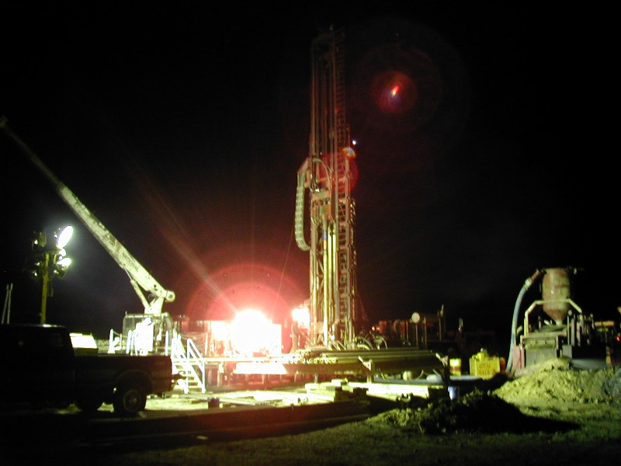

Slide 39
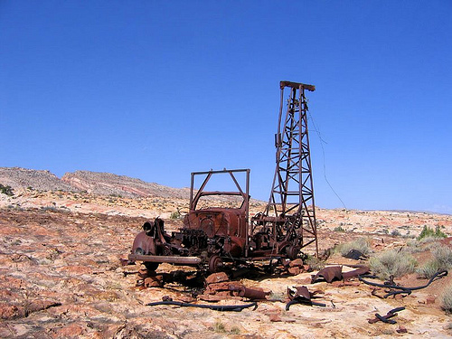
Well Drilling Web Features www.waterrights.utah.gov
Notes:
39

Slide 40
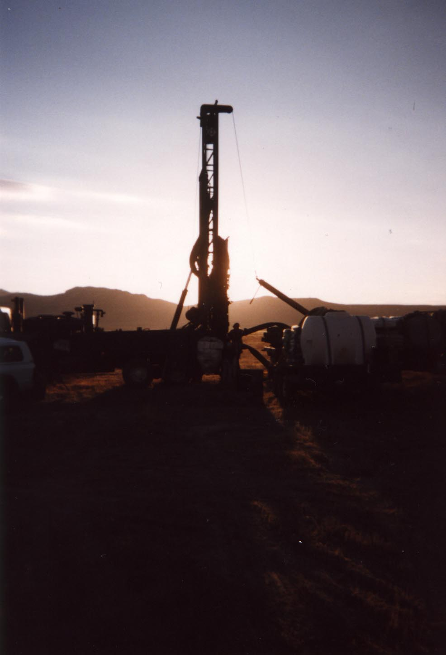
QUESTIONS?
Jim Goddard
Office: 801-538-7314
Cell: 801-505-8677
Email: jimgoddard@utah.gov
Web: waterrights.utah.gov
“When the well is dry, we know the worth of water”
…B. Franklin

Slide 41
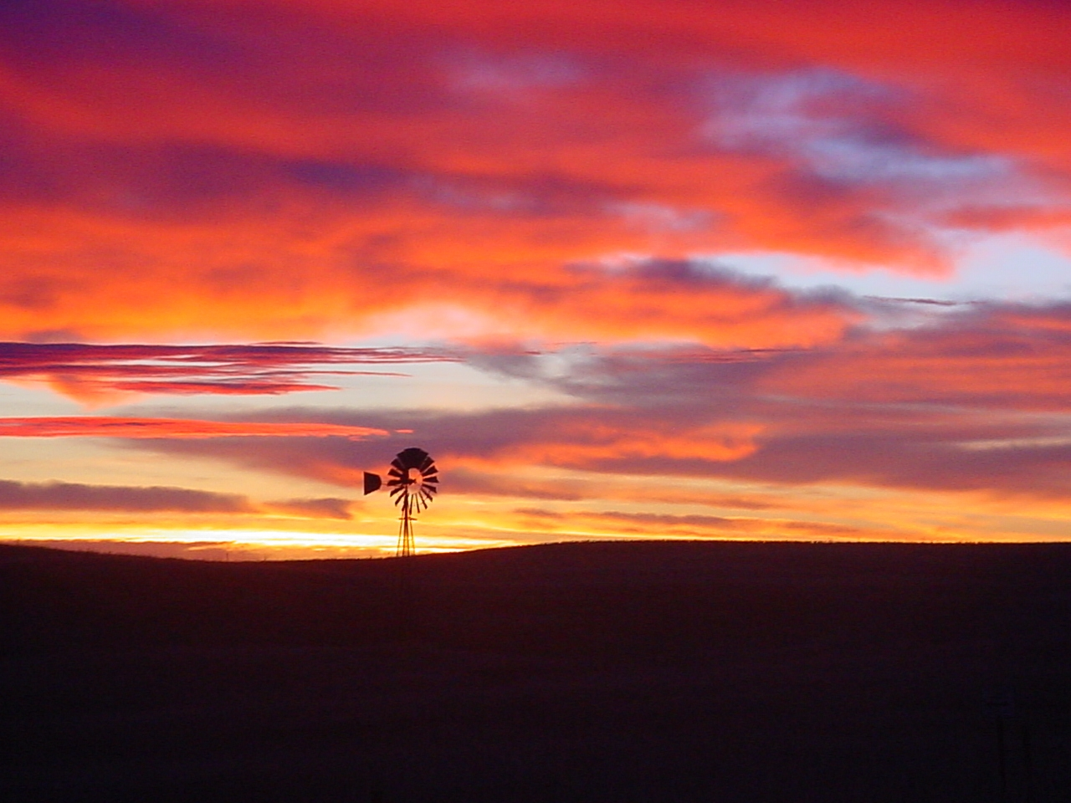
The End
41
Notes:
41

