Slide 1

Utah General Adjudications
April 27th, 2015
Utah Division of Water Rights
Blake W. Bingham, P.E.
Adjudication Program Manager
www.waterrights.utah.gov
Notes:
Introduction

Slide 2
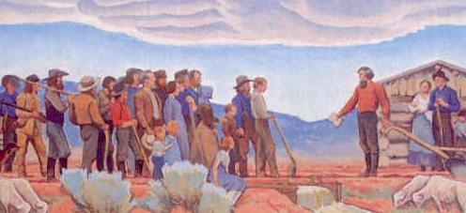
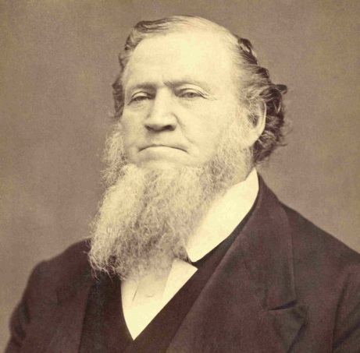
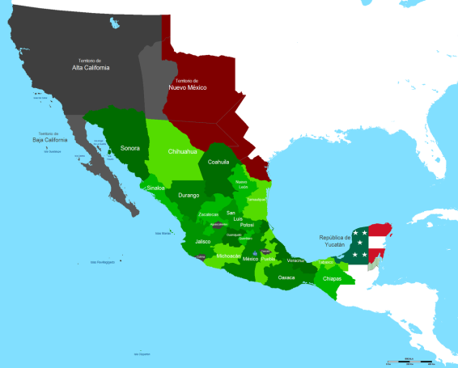
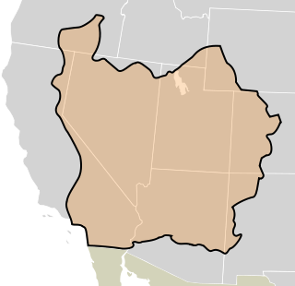
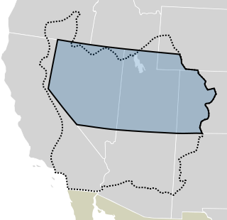

Historical Context – The Pioneer Era
July 23, 1847: Advance party of the Mormon pioneers entered the Salt Lake Valley and began breaking-up the ground to prepare the land for crops. Water from City Creek Canyon was diverted to moisten the soil for plowing and later used for irrigation.
September 30, 1848: Brigham Young declares, “There shall be no private ownership of the streams that come out of the canyons... These belong to the people: all the people.”
1847 – 1850: The pioneer settlement went from being part of Mexico to the State of Deseret to the Territory of Utah; however, government remained Church-centric.
  Diversions of water from streams were generally on a community basis to meet the immediate needs of the settlers.
  The doctrine of priority evolved from Church leaders’ recognition of groups who first put the water to beneficial use as well as later beneficiaries (primary and secondary rights).
  Conflicts were settled through ecclesiastical channels; Bishop’s Courts for local wards provided a judicial process with Stake High Councils serving as appellate courts.
This is the place…
…we will build our shopping mall.
Notes:
It’s probably easy to look at the adjudication process today and assume that it was a foregone conclusion from the beginning. However, when one compares the present-day policies and procedures against a historical backdrop, the evolution and reasoning behind the procedures becomes more understandable. So, in an effort to explain the concept of adjudication, I feel that it’s extremely instructive to crack the history books a little and review how we got to where we are. Obviously, I’ll need to paint with a pretty broad brush in order to review over 100 years of history in the next 45 minutes, so I’m just going to hit the critical points.
On July 23rd, 1847, an advance party of the Mormon Pioneers entered the Salt Lake Valley and commenced attempting to break up the soil to cultivate crops. As one might expect, the soil proved difficult to turn and they found it necessary to divert the waters of City Creek in order to soften the ground up enough to plow it.
On September 30th, 1848, Brigham Young essentially decreed that all the waters would be public and not be owned as personal property.
From 1847 to 1850 the area settled by Brigham Young and his followers transitioned from being a part of Mexico, to the State of Deseret to the Territory of Utah. At the conclusion of the U.S.-Mexican War, the Mormon pioneers found themselves part of the United States. Without an official Federal charter, Brigham Young established the State of Deseret in 1849 while they applied for statehood. In 1850, Congress officially recognized a much-small version of Deseret as the Territory of Utah.
Although new territorial laws would follow, the fundamental principles governing the allocation and distribution of water established by the Church continued to govern, namely:
Waters were diverted and distributed based on the immediate needs of the settlers and used in communal fashion.
The doctrine of prior appropriation evolved similarly as it had in mining settlements of California, but was agriculturally oriented.
Any conflicts which arose were settled through ecclesiastical means. Bishop's courts for local wards provided a judicial process, with ecclesiastical high councils serving as appellate courts.

Slide 3

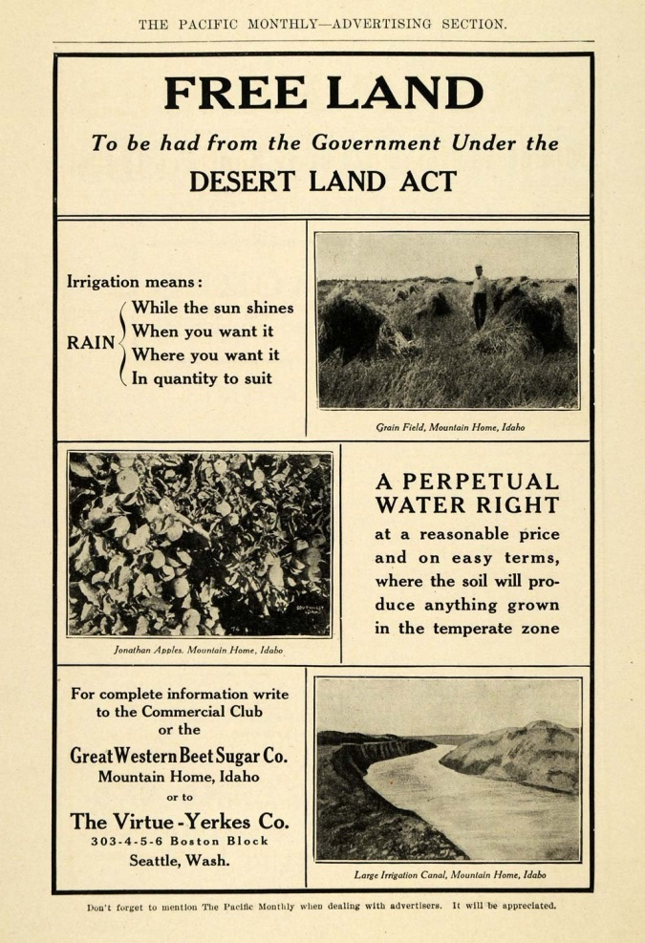
Historical Context - Territorial Era
1852: The first Territorial Legislative Assembly passed an act authorizing the County Court control of “all timber, water privileges, or any water course or creek.” Salt Lake County was the only one to assume these duties… other counties streams were diverted without public restriction.
1877: The Desert Land Act was passed to promote homesteading of arid and semiarid public land. The Act also severed the title of the water from the public land and delegated authority to the respective state or territory with regard to how water was appropriated.
1880: Due to failure to enforce the 1852 act, the legislature passed an act that replaced the County Court’s authority with County Selectmen as the ex-officio water commissioners. Allowed recognition, determination, and recording… but not appropriation. Once again, this was only enforced in a few counties and the certificates were generally considered worthless.
  Confusion over existing water rights continued in spite of the efforts of the Utah Territorial Legislature.
  The Church continued to administer and decree water rights in some areas (e.g. 1879 High Council Decision to divide the waters of the Spanish Fork River among various canal companies).
Notes:
In 1852, the first attempts to codify the administration of water was made by the Territorial Legislative Assembly. Along with various other natural resources, the act authorized the County Court as having control of all waters. As observed by Elwood Mead from the USDA, this placed an un-funded mandate on the respective County Courts which they failed to universally embrace. We can also infer from the environment of the era that the act went contrary to the tenets of religious devotees who held a firm belief that Church leadership had more authority for administering the waters of Zion than the local court.
In 1877, congress passed the Desert Land Act. The Desert Land Act is significant, because it helped spur the homesteading in areas of Utah and it effectively separated the title of the water from the public land and allowed it to be appropriated by the respective territory or state.
Due to the failure of the 1852 act, the legislature attempted to appoint County Selectmen in 1880 who were responsible for recognizing, determining, and recording existing rights by filing a certificate with the County Recorder. This act was also considered void in that it granted judicial power to an office not named in the original charter of Territorial courts. Consequently, the efforts to manage or record the existing water uses were, once again, thwarted. It should also be noted that this act was only attempted following the death of Brigham Young, since the act also incorporated a general provision that shifted from concept of water ownership from communally owned to personal property.
As a result, confusion over existing rights continued to propagate itself in spite of the efforts of the Territorial Legislature.
The Church continued to act as the governing body with regard to water rights. A prime example is the 1879 High Council decision which meted out the waters of the Spanish Fork River among various canal companies. This decision is still used as a basis for distribution and adjudication to this day.

Slide 4

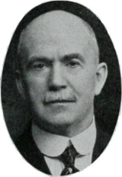
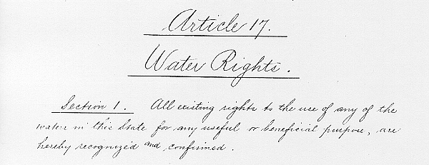
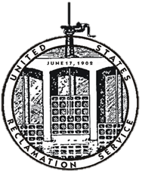

Historical Context - Statehood and Beyond
1896: Utah gains Statehood. Due to fears of possible confiscation of existing water rights by the State under a comprehensive water code, the adopted constitution only had one sentence regarding water law:
  ”All existing rights to the use of any of the waters in this State for any useful or beneficial purpose, are hereby recognized and confirmed.”
  - Constitution of the State of Utah, Article XVII
1897: Office of the State Engineer created and tasked with conducting hydrographic surveys and measuring stream sources. Appropriations were made by posting notice at the source, the nearest post office, and the county recorder… largely ignored.
1902: United States Reclamation Service (i.e. The Bureau of Reclamation) established to “reclaim” arid lands in the Western United States. To secure Federal funding for Reclamation projects, states were encouraged to adopt statutes which provided certainty regarding existing water rights and future appropriations.
1903: State legislature enacted the first Utah Water Law which provided defining and recording of all existing water rights and the adjudicating of rights by the Court. However, the Legislature failed to provide funding to the local Courts.
  ”While this law was ideal in purpose and virtue… the law failed miserably as a means of adjudicating existing water rights. As a matter of fact no rights were ever adjudicated by virtue of it.”
  - State Engineer Biennial Report 1919-20
1919: The legislature provided the “machinery” to adjudicate water rights on a given stream by directing the State Engineer to develop a “proposed determination” of water rights for the Court to consider.
Willard Young
State Engineer
Notes:
When Utah became a state in 1896, there was a push to incorporate a comprehensive water code into the State Constitution; however, friends of this movement considered it necessary to adopt a declaration that water was the property of the State—creating fear among some that the proposed change meant a confiscation of their property. As such, they preferred to leave matters as they were, maintaining that the State had no rights in the water. As a consequence, the adopted constitution only had one sentence regarding water rights. Essentially, it was back to business-as-usual.
Recognizing the need to define and record all existing water rights, in 1897 the state legislature created the office of the State Engineer and tasked him with conducting a hydrographic survey of the waters in Utah; however, no funds were actually allocated to accomplish the work. They also made another attempt at providing a means for recording existing claims and appropriating new rights by posting notice at the place of diversion and at the nearest post-office stating the volume claimed, the intended use, the place of use, the area of irrigation, the means of diversion, the date of appropriation, and the name of the appropriator. The appropriator was also to file for record at the county. This law was similar to those in other states at the time and likewise was a failure in Utah as in the other states.
In 1902, the United States Reclamation Service was created to “reclaim” the arid lands of the West. Recognizing the issues that many states had experienced with over-appropriation of stream and river sources, the Reclamation Service encouraged the states to pass laws that quantified existing appropriations and managed future ones. Anxious to be the recipient of Reclamation project funding, many states (including Utah) began implementing comprehensive water law aimed at quantifying existing rights and appropriating future ones.
In 1903, the State of Utah passed its first comprehensive water law which codified the responsibility to formally adjudicate existing water uses within Utah. The law required the District Court to take all of the claims from various water users and the hydrographic survey map generated by the State Engineer and determine a decree regarding the rights; unfortunately, the Utah Legislature failed to set up or fund the needed personnel at the District Courts to take care of the responsibilities associated with the additional work of adjudicating the water rights. Consequently, the adjudication of water rights was, once again, stalled.
By the time 1919 rolled around, the legislature had recognized their error and formally delegated the responsibility of developing a proposed determination of water rights to the State Engineer as party to the respective general stream adjudication.

Slide 5
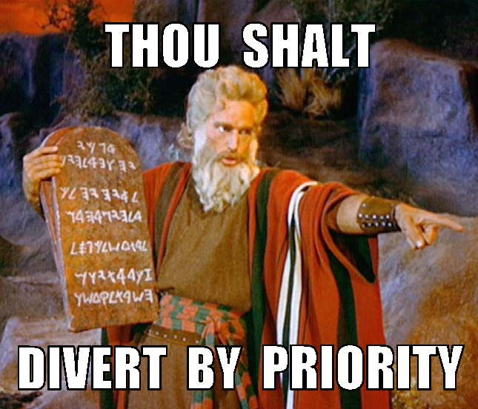
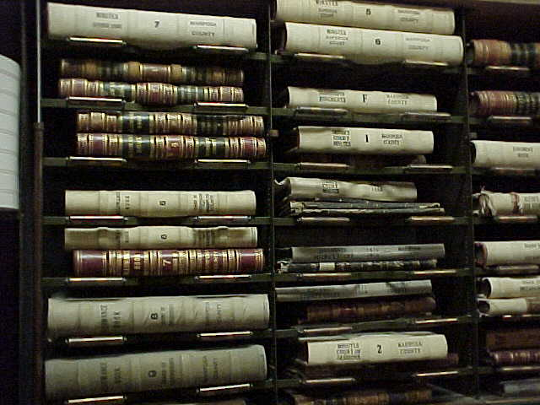



The Historical Case for Adjudication
Prior to the enactment of the comprehensive Utah Water Law in 1903, rights to the use of water typically fell into a combination of five categories:
  Rights decreed by ecclesiastical leaders.
  Claims filed for record at the county.
  Rights decreed by a court (typically involving limited parties).
  Contracts or agreements among limited parties.
  Claims never manifested in any record, but evidenced by pre-statutory use.
Consequently, the lack of a definitive water law created a number of issues:
  There was typically no public record of existing water rights.
  Since there was no record, over appropriation of streams was common.
  Often, rights weren’t defined until they came into controversy and had to be settled by ecclesiastical or court decree.
In his biennial report for 1901-02, the State Engineer made the following observation:
“The definition of existing rights appears to be of first importance. This is not only necessary to pacify
present contention, but to prevent future conflicts and encourage further progress. There can be
no safe basis for future work before existing rights are known and made of public record.”
– A.F. Doremus, Utah State Engineer
Notes:
Around the turn of the century, water rights existed in a myriad of forms:
There were those rights which were issued via ecclesiastical fiat.
There were a handful of claims which were recorded at the county in conformance with early territorial and state legislation.
There were rights which had been formally decreed by a court—usually as a result of conflicts surrounding various users on the same stream.
There were contractual agreements between entities, usually canal companies, dictating the apportionment of the respective stream.
There were claims which never manifested themselves in any record, probably because there was no apparent conflict in appropriating the source.
As a result of the confused state of water rights, there was an abundance of negative consequences.
There was no definitive record of existing water rights on any respective stream.
Since there were no records and no appropriation process, over-appropriation of water sources was common.
Over-appropriation eventually resulted in controversy among water users which had to be settled through some form of expensive and time-consuming litigation (be it ecclesiastical moderation or judicial).
In his biennial report, State Engineer A.F. Doremous described the need for adjudication of water rights throughout the State of Utah.

Slide 6
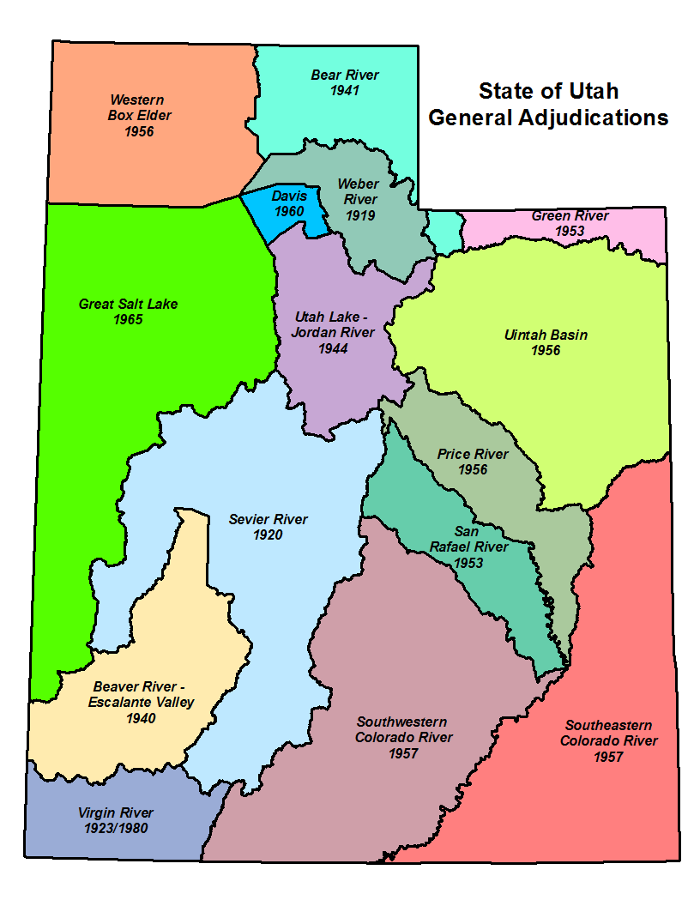
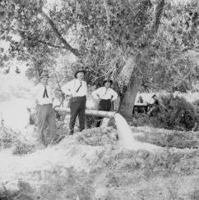
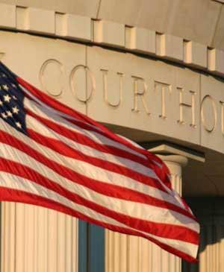
What is a General Stream Adjudication?
What it IS…
Action in District Court
Joins all water users--including State and federal agencies--and the State Engineer (Division of Water Rights)
Governed by Utah State Code: Title 73, Chapter 4.
The first General Stream Adjudications took place in the 1920s – Sevier, Weber and the Virgin River basins.
Notes:
We’ve talked about adjudication in its broadest sense and historical sense, but let’s focus on the current concept of a General Stream Adjudication. Water rights adjudication can be accomplished through simple litigation between two parties. Any decree resulting from the litigation is only applicable to the parties formally joined in the suit.
However, a General Stream Adjudication is an action in District Court which joins all water users within a stream drainage and the State Engineer as parties to the litigation. Joining all parties within a drainage is important because it helps to prevent multiple decrees among different users which might contradict each other or even miss pertinent aspects of the respective system.
For example, the Spanish Fork River has been the recipient of multiple decrees. As mentioned earlier, the original decree was a High Council Decision in 1879 which divided all of the waters of the river among 5 canal companies. However, it failed to recognize water users who diverted water from the Spanish Fork River and its tributaries up-stream from the mouth of the canyon and even failed to recognize one of the oldest canals on the river (who simply wasn’t a party to the dispute).
The General Stream Adjudication process is outlined in Title 73, Chapter 4 of the Utah State Code.
As you can see on the map, every major river drainage in the State of Utah is currently or has been under a General Stream Adjudication order. Some of these adjudications were petitioned by water users to the State Engineer (as dictated by Utah Code) such as the Weber River basin, while others were court-ordered by expanding the scope of an existing dispute among specific parties to a General Stream Adjudication, such as the Utah Lake / Jordan River basin.
Due to the size of the drainages and the growth of water development throughout the State, the main river drainages are often split into smaller areas—divisions and even subdivisions—which facilitate the ability of our staff to go into an area and proceed quickly—relatively speaking.

Slide 7

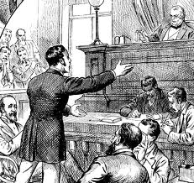
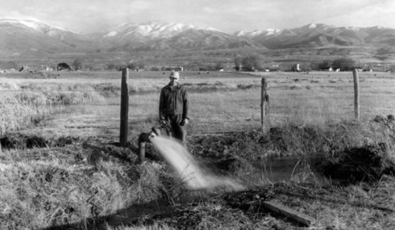
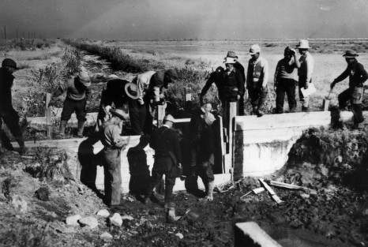
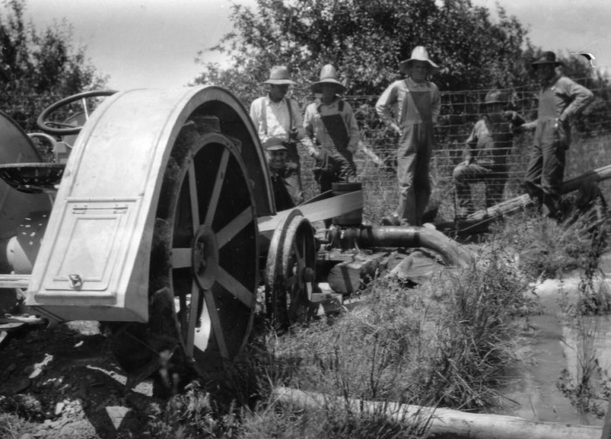
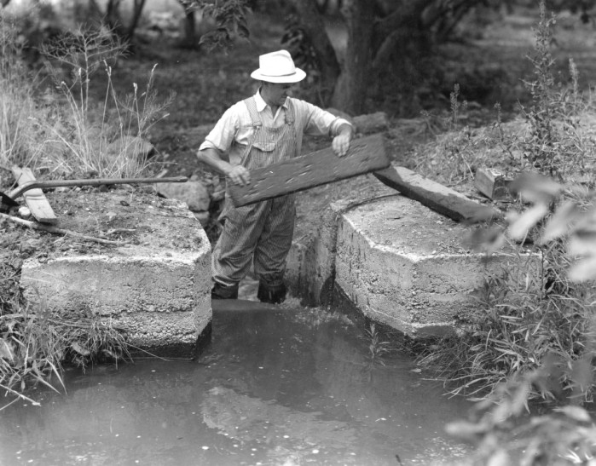
Why Do We Conduct General Adjudications?
Bring all claims on to the permanent record:
  Pre-Statutory Claims
    Diligence Claims
    Underground Water Claims
    Pending Adjudication Claims
  Federal Reserve Rights
    Winter’s Doctrine (1908)
    McCarran Amendment (1952)
To prevent a “multiplicity of suits” and bring clarity to the water rights picture.
Remove/reduce rights which have been wholly or partially forfeited through non-use.
To obtain final comprehensive decrees on all water rights within the respective drainage.
…but what about Federal rights?
Notes:
So, in an attempt to illustrate the importance of the foregoing critical questions, let’s pose the question, “Why do we conduct general stream adjudications?” The answer is… it depends. For one thing, it probably depends on the period of history in which you asked it. Originally, general stream adjudications were utilized to bring all pre-statutory claims on to the permanent record. This is easy to understand from the perspective of water users in 1903. At the time that Utah’s first comprehensive water law was passed, it’s obvious that the number of pre-statutory claims far exceeded the number of appropriated rights since the system had yet to create any. Consequently, it was imperative to determine and quantify existing rights in order to allow the State Engineer to process future appropriations. This holds true through today, although the ratio of pre-statutory claims to certificated rights is much smaller--as will be illustrated in the next slide.
If you were to ask why we conduct general adjudications today, I think that it would be impossible to leave out the issue of Federal Reserve rights. As a result of a 1908 Supreme Court decision in Winters v. United States, the court ruled that by creation if the Fort Belknap Indian Reservation, there was an implied water right for the amount of water for the reservation to be self-sufficient. Today, federal reserved water rights can be asserted on most lands managed by the federal government. Reserved rights are, for the most part, immune from state water laws and therefore, are not subject to diversion and beneficial use requirements and cannot be lost by non-use. Federal Reserve rights are limited by the "primary purpose" and "minimal needs" of the reservation or the respective federal agency’s original congressional mandate. In addition, federal reserved water rights are nontransferable. By law, these rights can only exist on lands owned by the federal government. If a land transfer occurs, any existing federal reserved water right becomes invalid.
Although Federal Reserve rights were known to exist, there was no way to force the Federal Government to assert or quantify their claims since it possessed sovereign immunity and could not be joined involuntarily in a suit. In 1952, a senator from Nevada by the name of Pat McCarran introduced a bill that would allow states to pursue quantification of Federal Reserve rights. As it came to be known, the McCarran Amendment, waives U.S. sovereign immunity with respect to water rights and allows states to determine Federal water rights in state courts. Hence, federal water claims may be quantified in state stream adjudications, but only if such proceedings are comprehensive (meaning that all claimants to a specific water body are joined in the suit).
Some other benefits of a general adjudication is the consolidation and settlement of multiple controversies and bringing clarity to the overall water rights picture by joining all water users within a given system (as opposed to piecemeal litigation), defining supplemental relationships, removing forfeited rights from the record, and obtaining final decrees on all rights within the drainage.

Slide 8

Adjudication Process
1
2
NOTICE
3
PUBLIC MEETING
4
SUMMONS
PETITION
The State Engineer is petitioned by water users or court-ordered to initiate a General Adjudication. (UCA 73-4-1)
The State Engineer publishes notice of the pending adjudication for 2 weeks in a local newspaper.
(UCA 73-4-3)
The State Engineer holds an initial Public Meeting in the local area to inform water users about the adjudication process. (UCA 73-4-3)
The State Engineer serves Summons on claimants and publishes Summons for 5 weeks in a local newspaper. (UCA 73-4-4)
90 days
Claimants have 90 days following notice of the completion of the hydrographic survey in which to file a Water User’s Claim with the District Court or State Engineer.
(UCA 73-4-3)
5
HYDROGRAPHIC SURVEY
6
7
CLAIM
CLAIM
CLAIM
8
PUBLIC MEETING
PROPOSED DETERMINATION
The State Engineer conducts a hydrographic survey of the area and assists the claimants in completing their Water User’s Claims.
(UCA 73-4-3)
The State Engineer reviews Water User’s Claims and other records and prepares a Proposed Determination which is then distributed to the claimants and filed with the District Court. (UCA 73-4-11)
The State Engineer holds a Public Meeting to discuss the Proposed Determination with claimants.
(UCA 73-4-11)
90 days
Claimants have 90 days to file an objection to the Proposed Determination with the District Court. (UCA 73-4-11)
9
10
FINAL SUMMONS
11
OBJECTION RESOLUTION
12
DECREE
The State Engineer serves the final summons via publication for 5 weeks in a local newspaper.
(UCA 73-4-22)
The State Engineer resolves objections to the Proposed Determination with respective water users. (UCA 73-4-14)
The District Court issues a Decree (or Interlocutory Decree) on the Proposed Determination.
(UCA 73-4-15)
Notes:
This is my best attempt at an “info-graphic” of which summarizes the adjudication process. As indicated by the color coding, it can be separated into 3 phases, so to speak. The initial phase involves petitioning the State Engineer and providing notice to claimants of a pending adjudication. The second phase includes the bulk of the work, wherein the Adjudication Program conducts the hydrographic survey and works with water users to compile a proposed determination. The last phase begins following the publication of the proposed determination and includes final summons and objection resolution—hopefully culminating in a final or interlocutory decree.

Slide 9
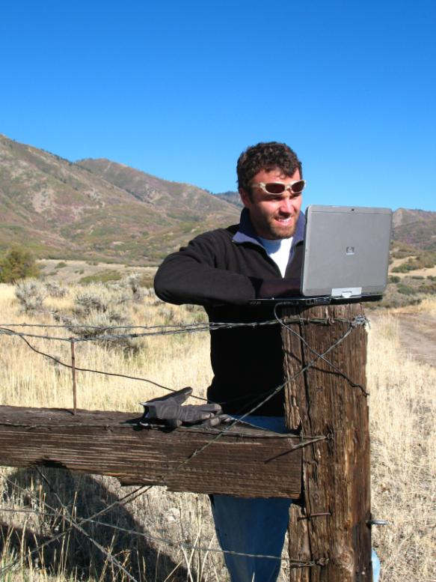
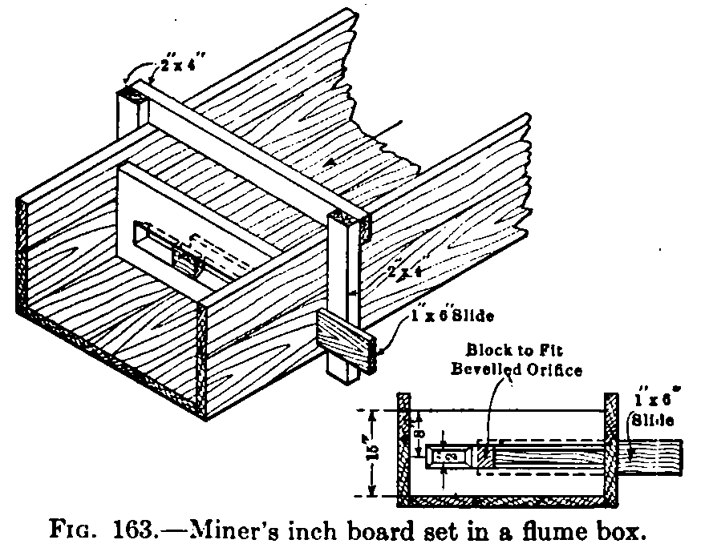

Hydrographic Survey:
Research and Field Review
Research old claims, court decrees, and other pertinent documents.
5
HYDROGRAPHIC SURVEY
Field review claims within the area to identify pertinent features (i.e. beneficial use, diversion location, flow rate, etc.)
Meet with water users to discuss claim and observe beneficial use.
The State Engineer conducts a hydrographic survey of the area and assists the claimants in completing their Water User’s Claims.
(UCA 73-4-3)
40 miner’s inches = 1 cfs (AZ, MT, OR)
50 miner’s inches = 1 cfs (ID, NE, NV, NM, ND, SD, UT)
600 miner’s inches = 12 cfs
Notes:
A large portion of the Proposed Determination process is spent researching old decrees, county records, water rights files, and maps; and then reviewing the information in the field with the respective water users to ensure that we get a clear picture of the beneficial use and other facets of the water right. These include the location of the POD, the extent of the POU, and any conveyance structures.
The document shown in the slide is a water claim which was filed with in Grand County in 1892 for the use of 600 miner’s inches of water on a creek in the La Sal mountains.

Slide 10
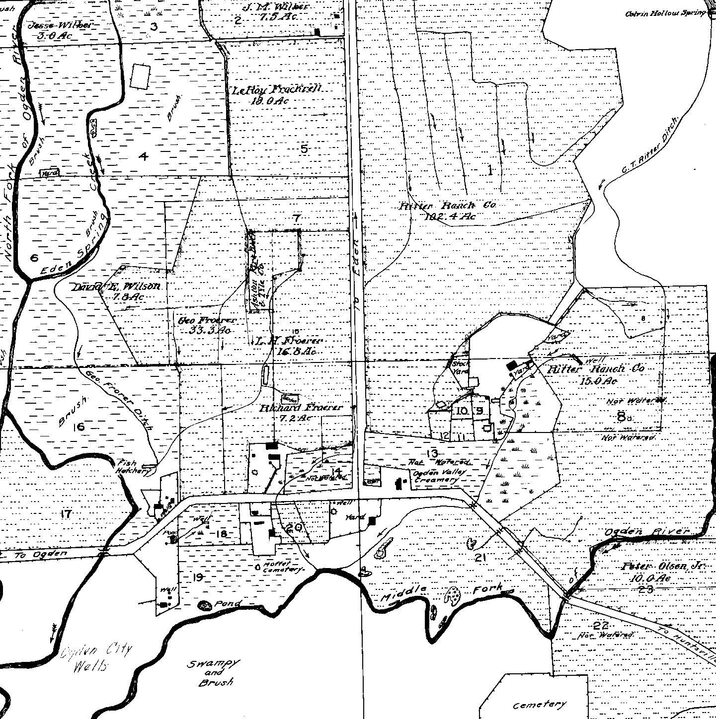
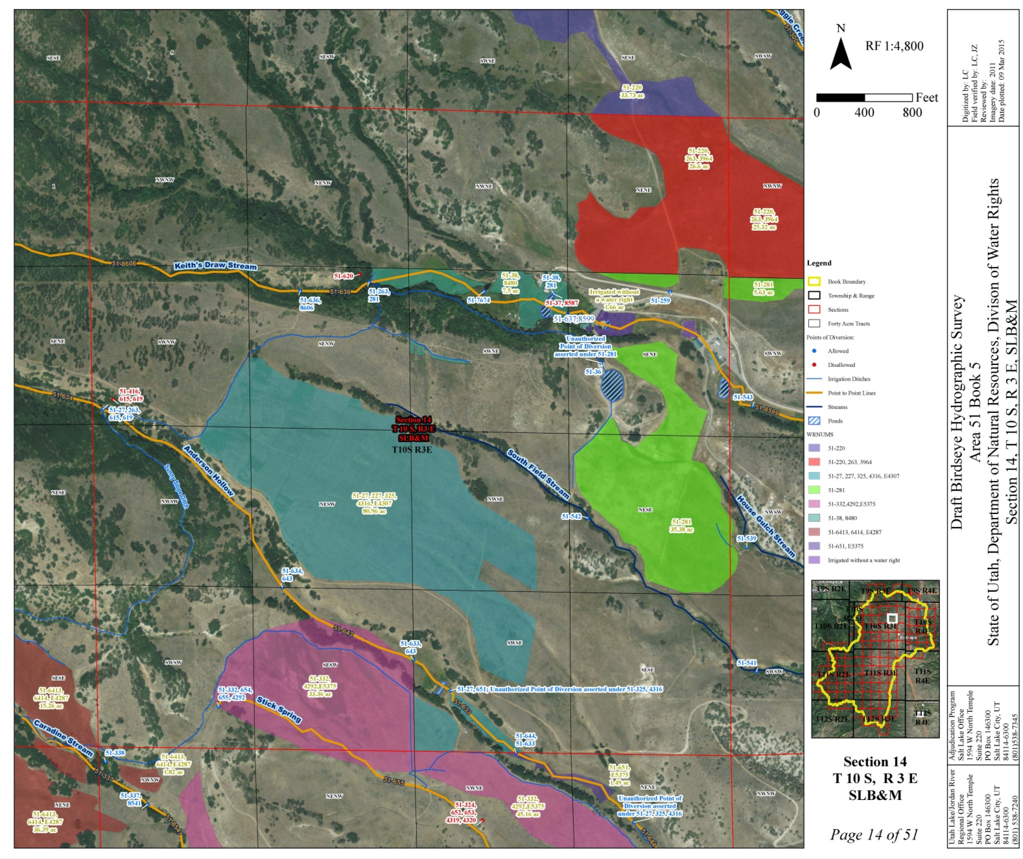
Hydrographic Survey:
Mapping
Snap-shot in time
Hard copy originals on file at Salt Lake City Office and Regional Office.
Digital copies can be viewed online at the Division of Water Rights webpage.
http://www.waterrights.utah.gov/adjdinfo/hydromap.asp
5
HYDROGRAPHIC SURVEY
The State Engineer conducts a hydrographic survey of the area and assists the claimants in completing their Water User’s Claims.
(UCA 73-4-3)
Pineview Reservoir
Notes:
The Adjudication staff use the information which they’ve gathered through extensive field reviews and produce a Hydrographic Survey map which identifies the location of the POD and the extent of the use.
You can view these hydrographic survey maps at the regional offices, or the Salt Lake office, or from the comfort of your own office by viewing them online at the address shown.

Slide 11
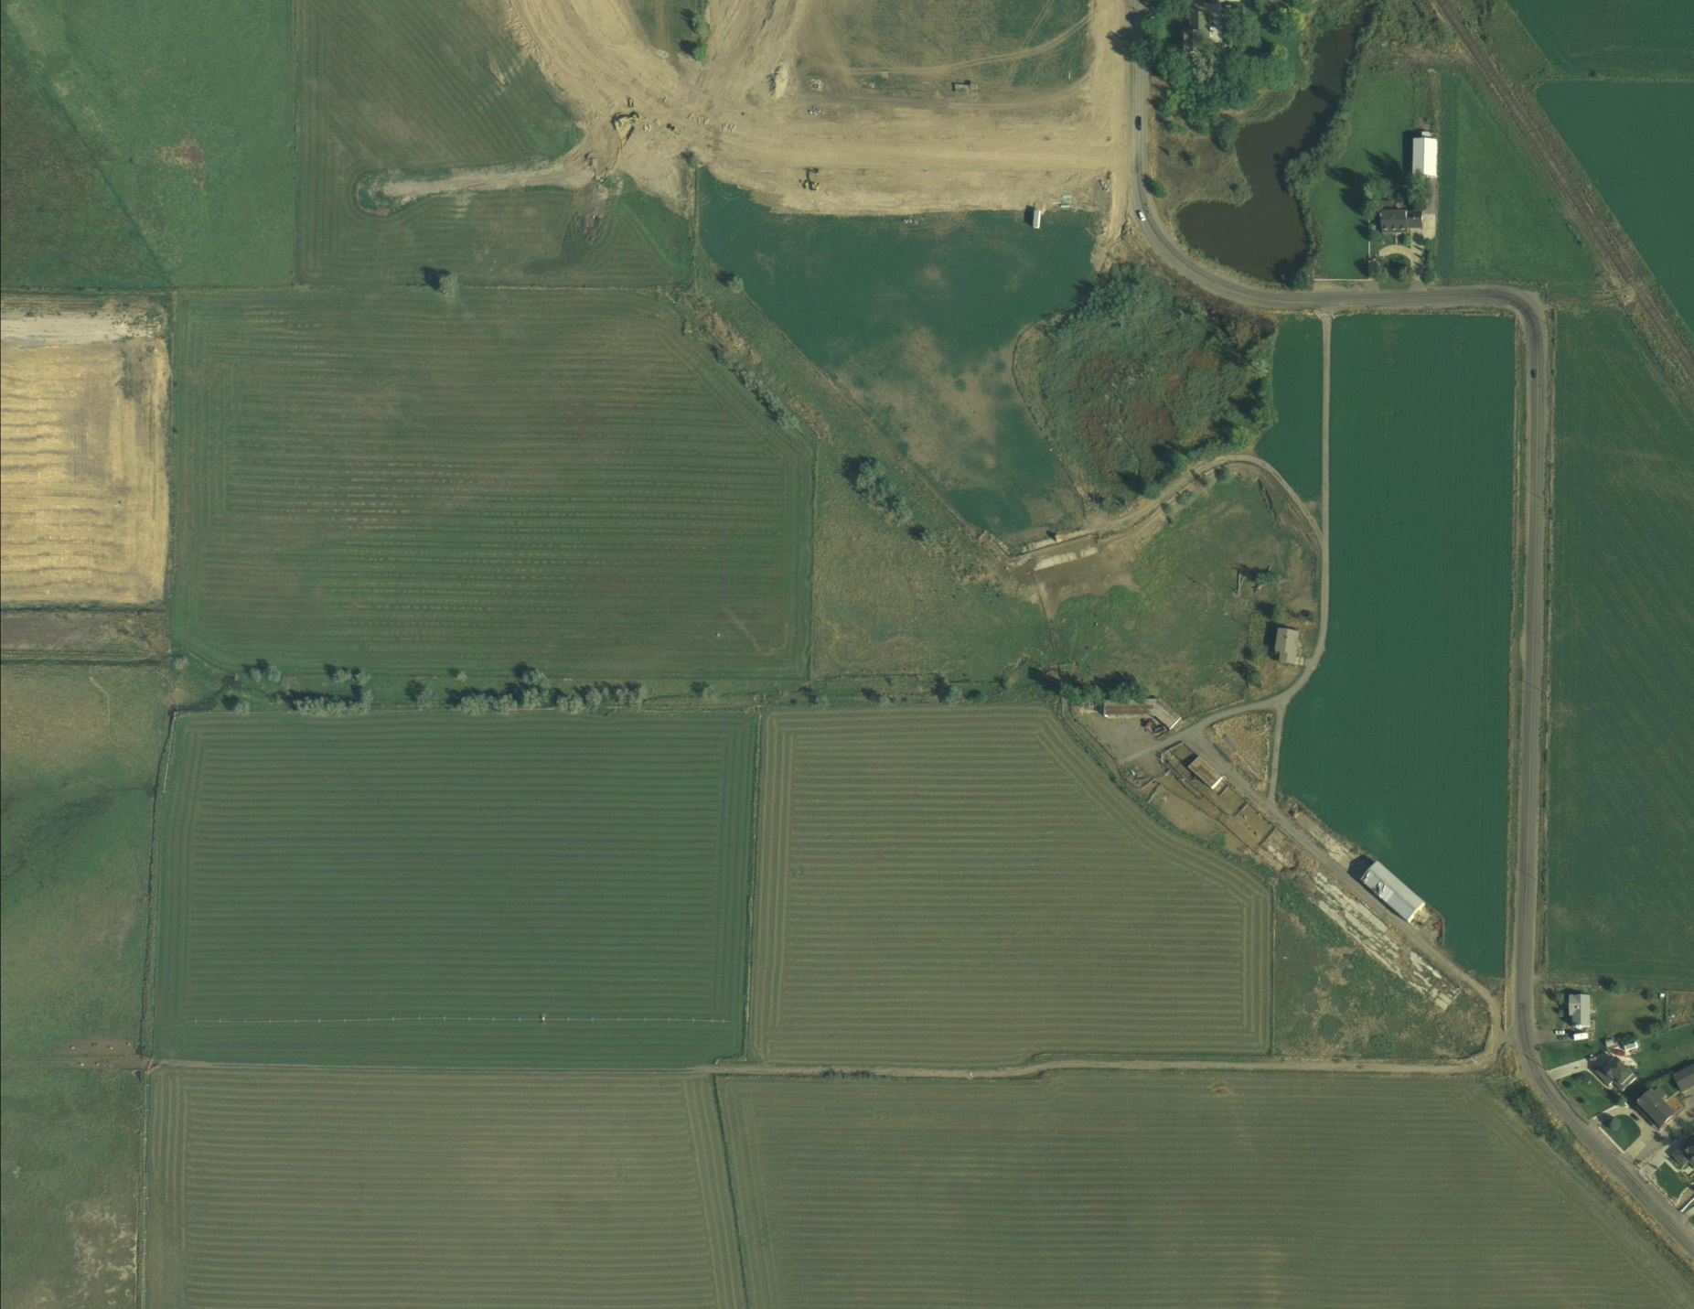
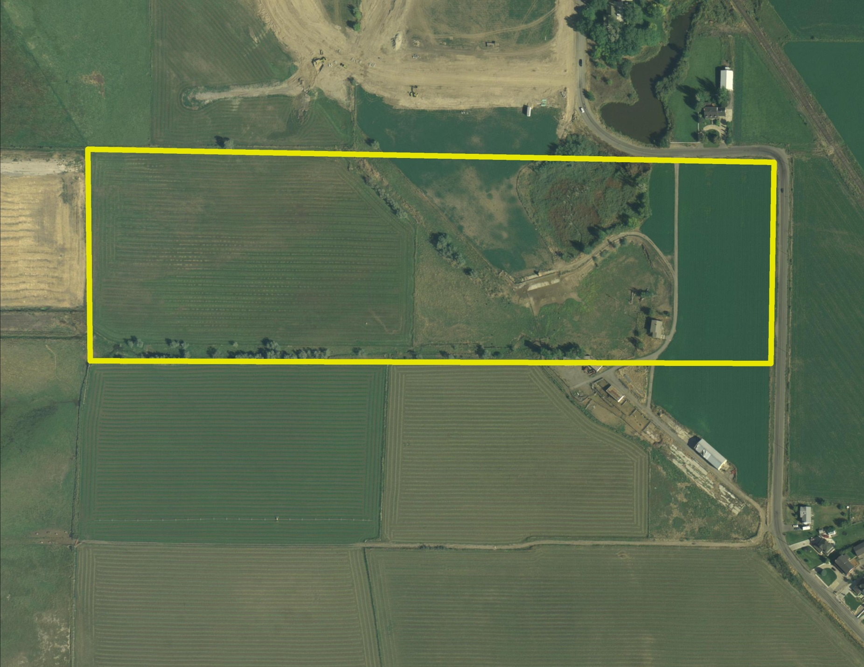
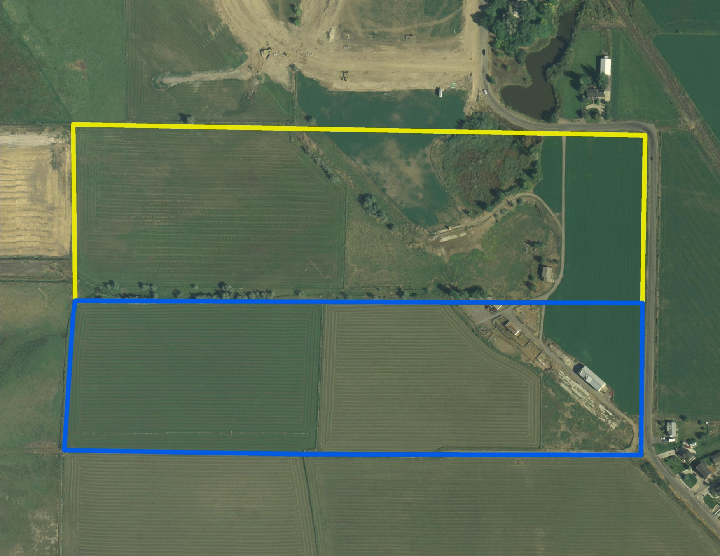
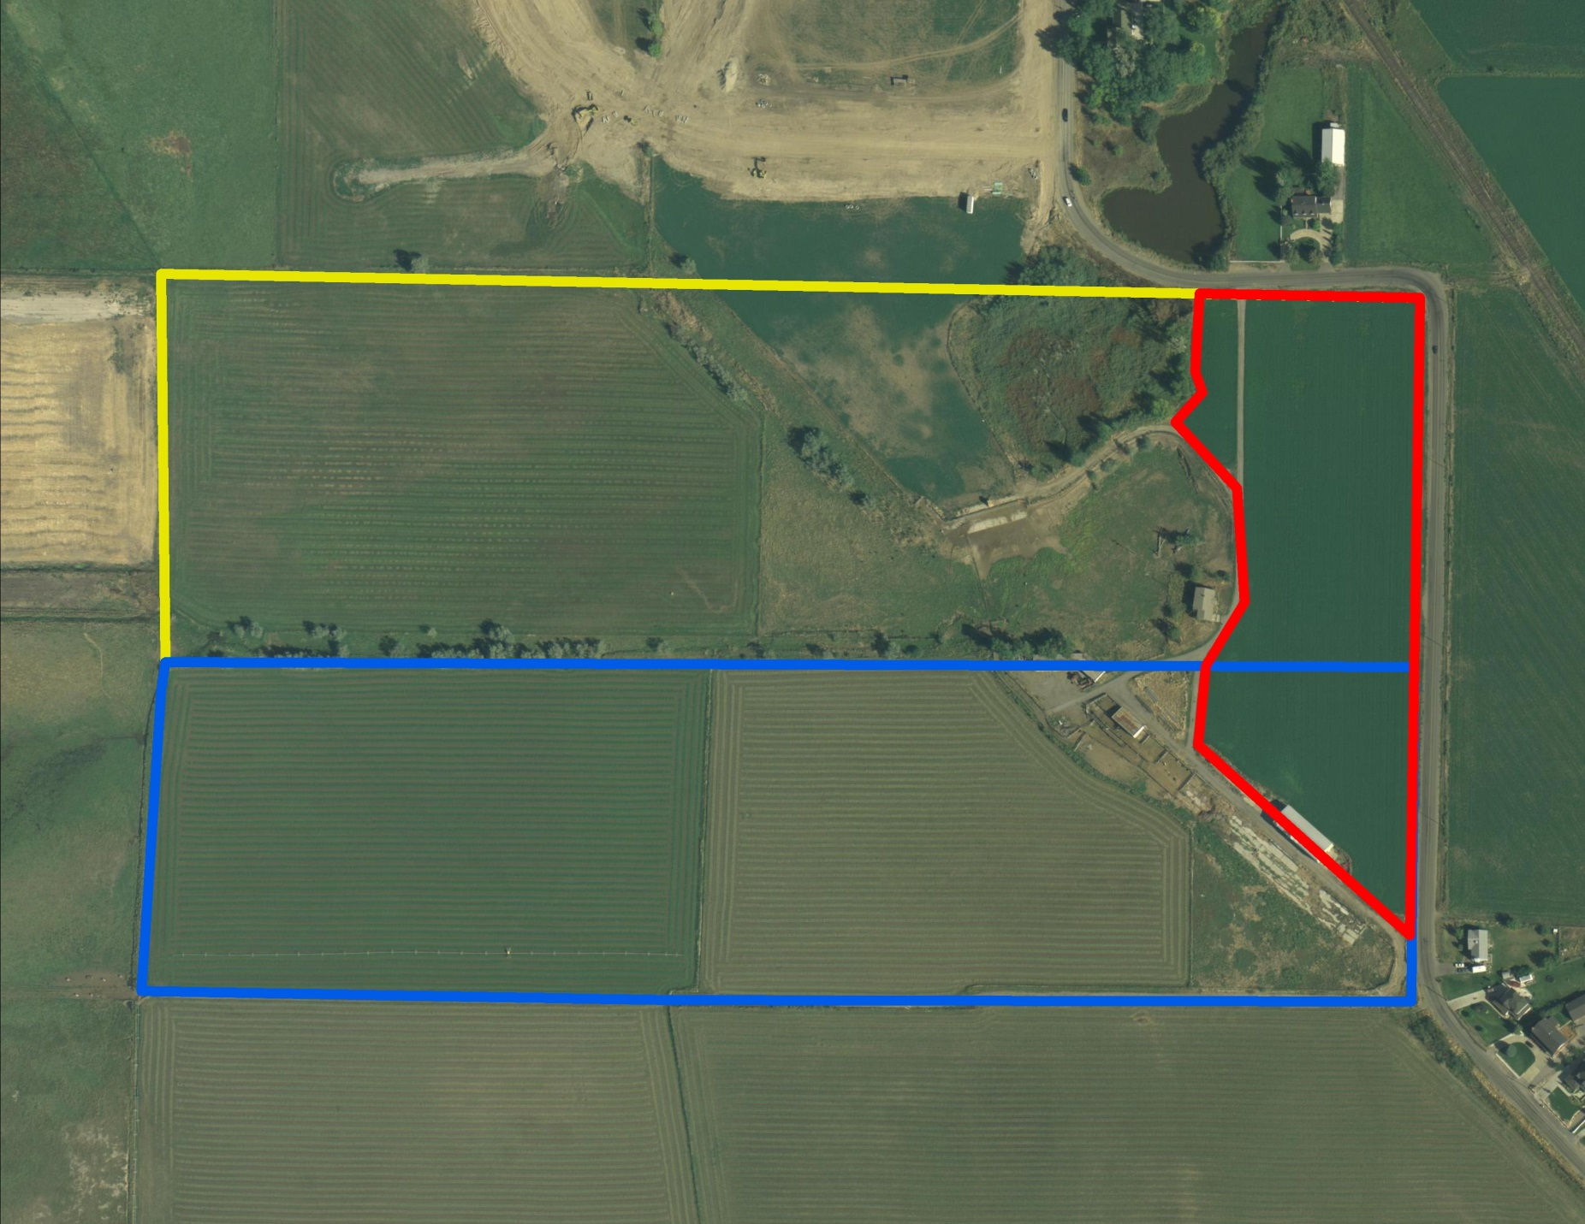
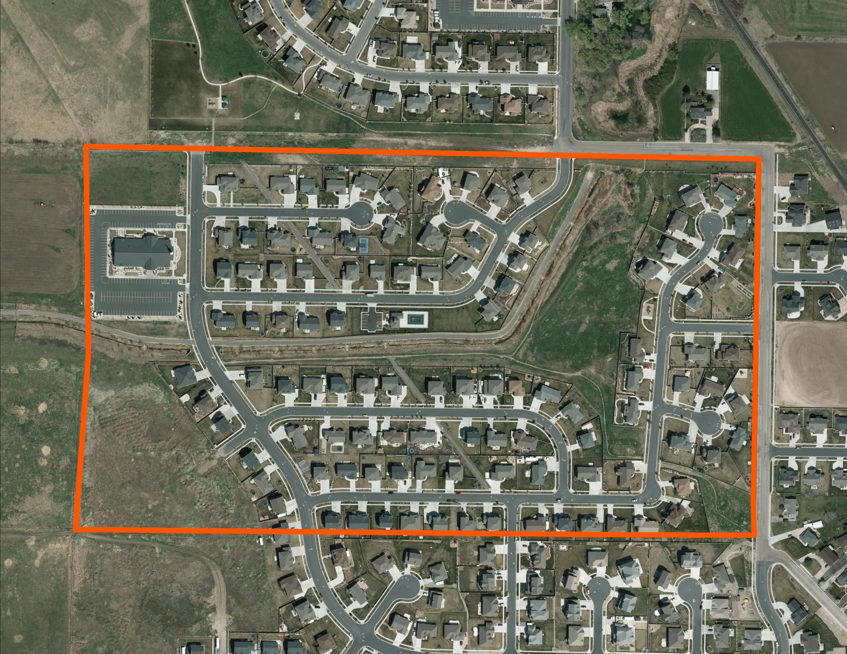
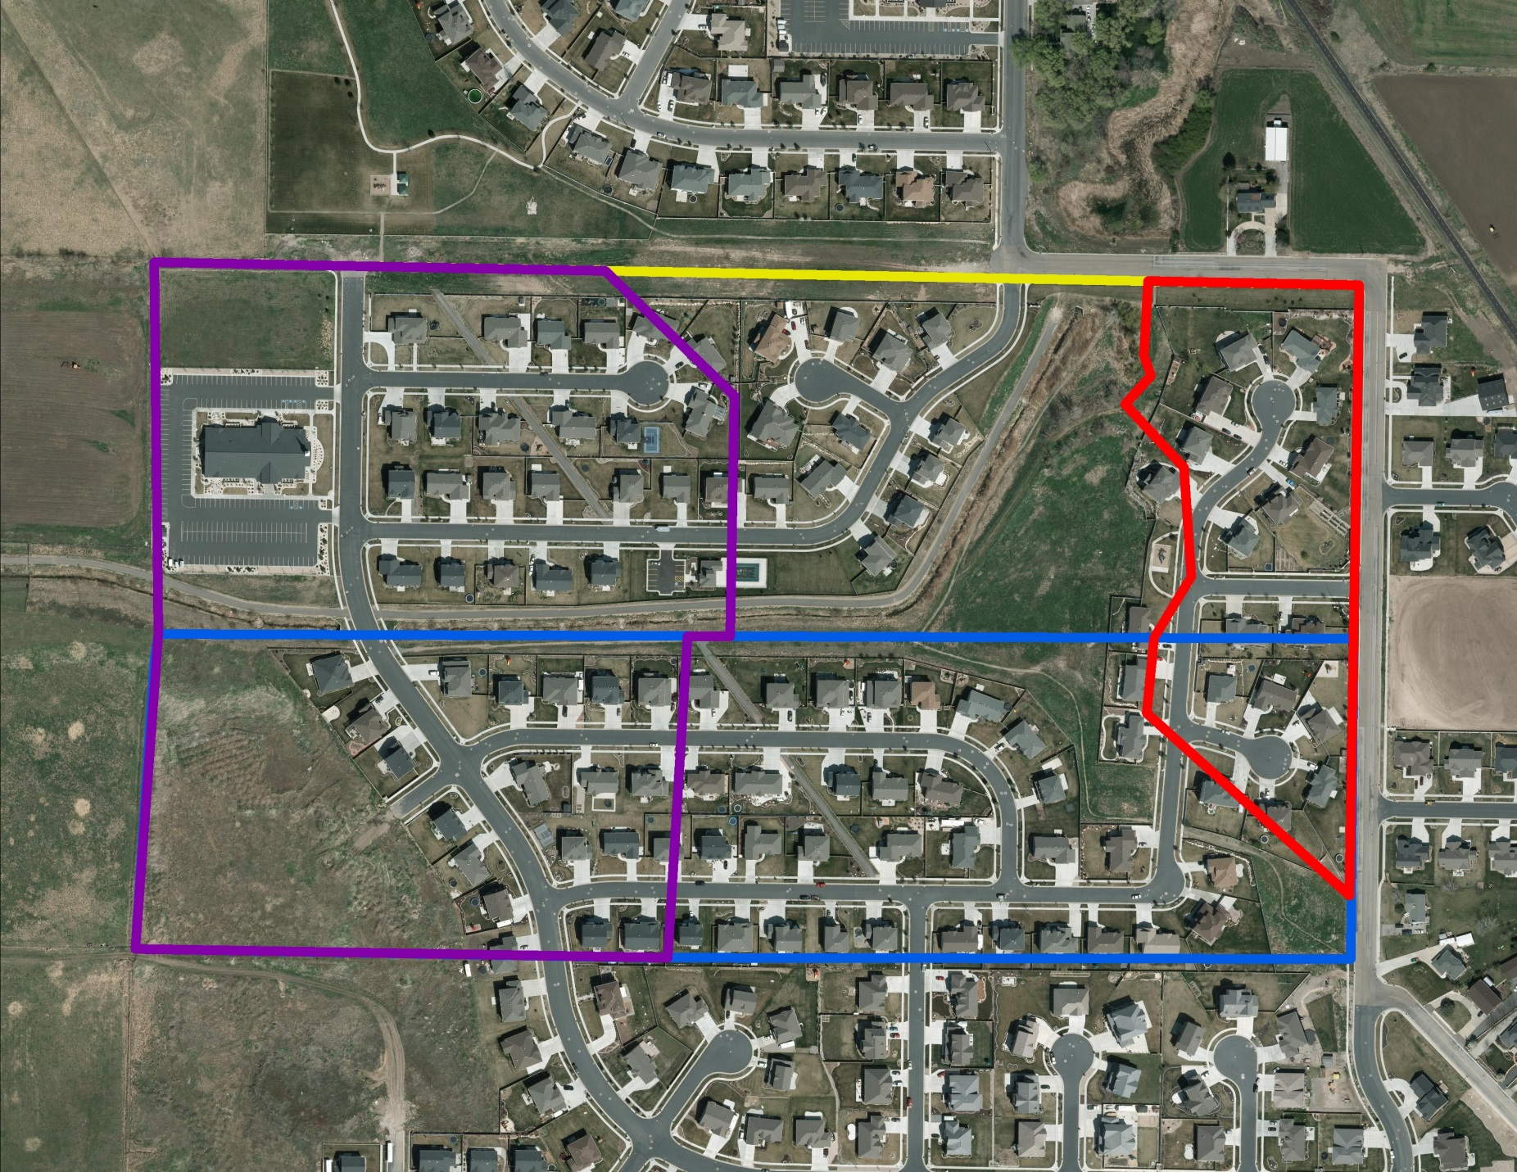
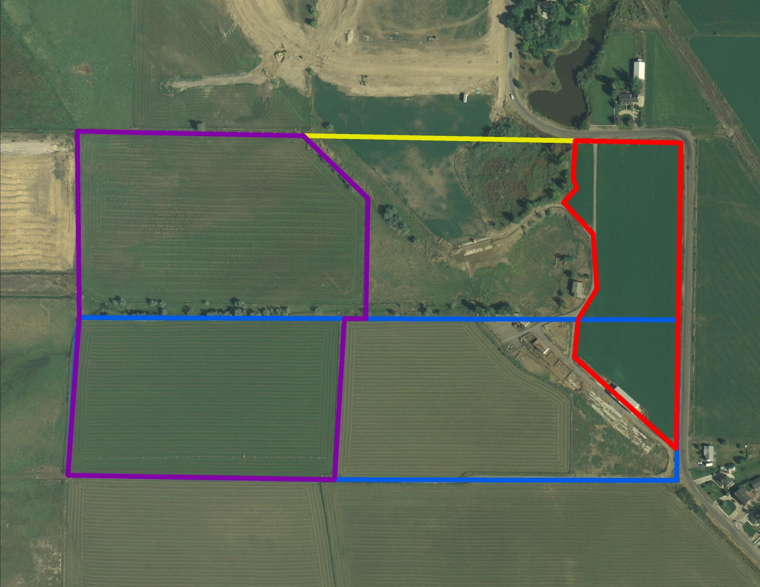
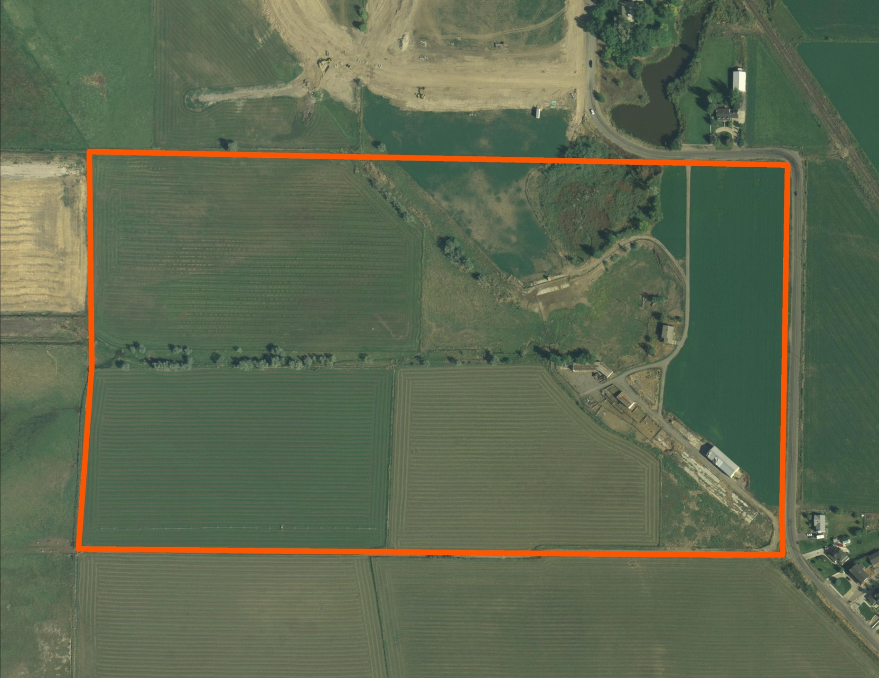
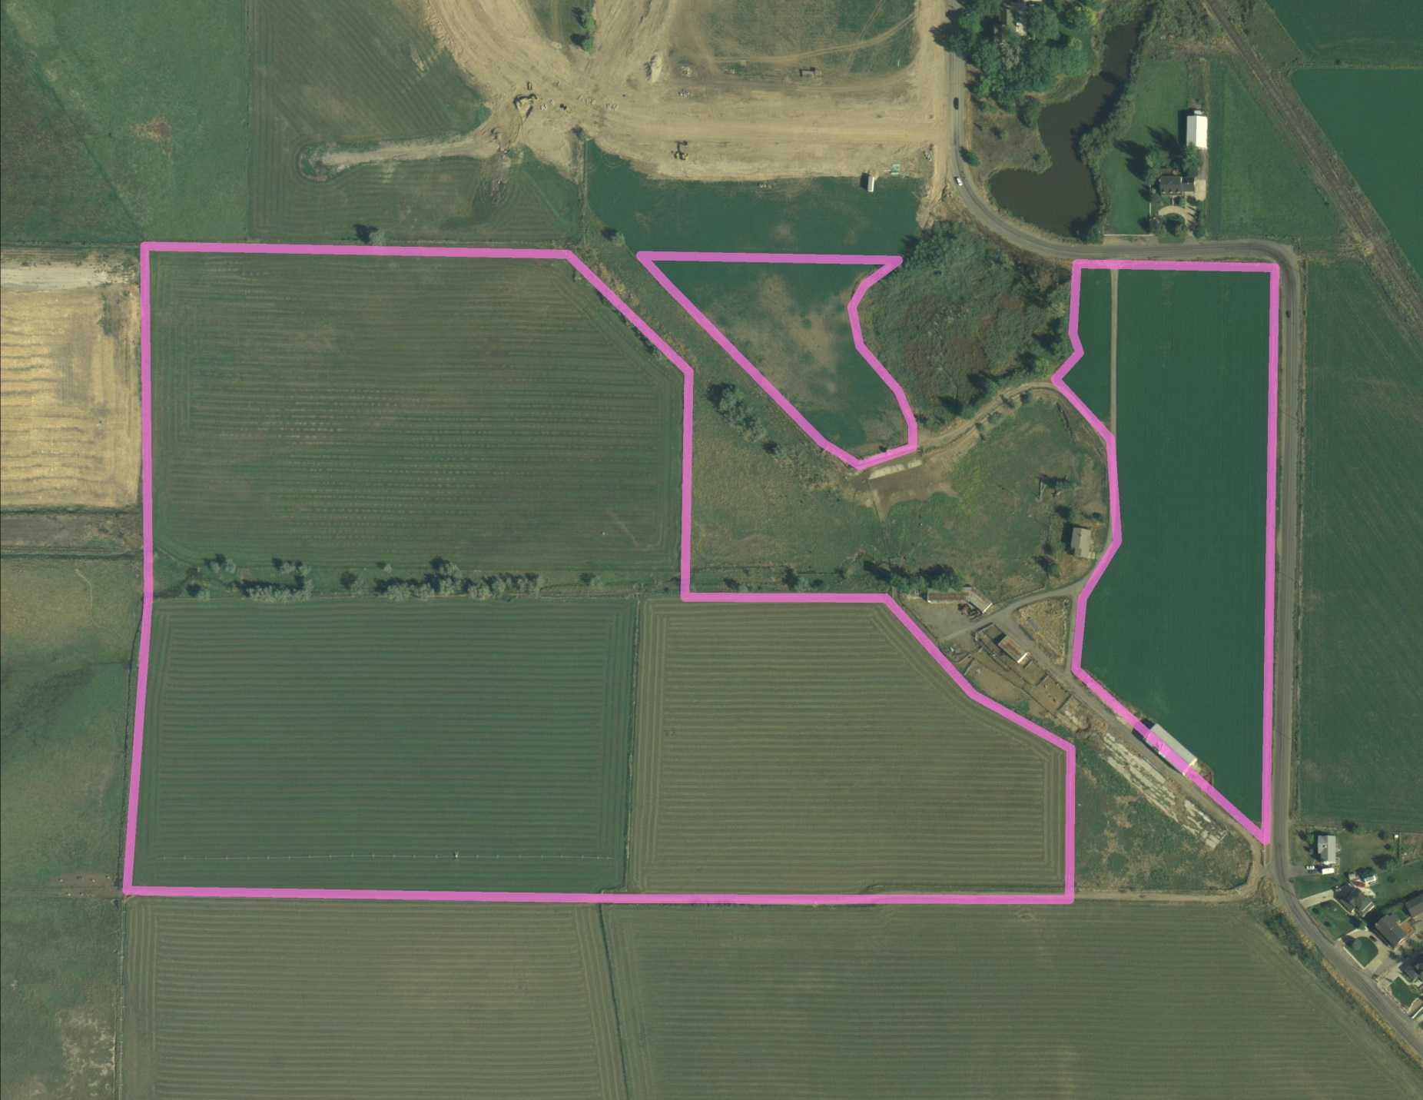
Hydrographic Survey:
Evaluating Claims
5
HYDROGRAPHIC SURVEY
33 ac
29 ac
33 acres
8 acres
8 ac
28 ac
Total 98 ac
Total 62 ac
Total 51 ac
62 acres
Total ?? ac
The State Engineer conducts a hydrographic survey of the area and assists the claimants in completing their Water User’s Claims.
(UCA 73-4-3)
Pineview Reservoir
51 acres
28 acres
29 acres

Slide 12
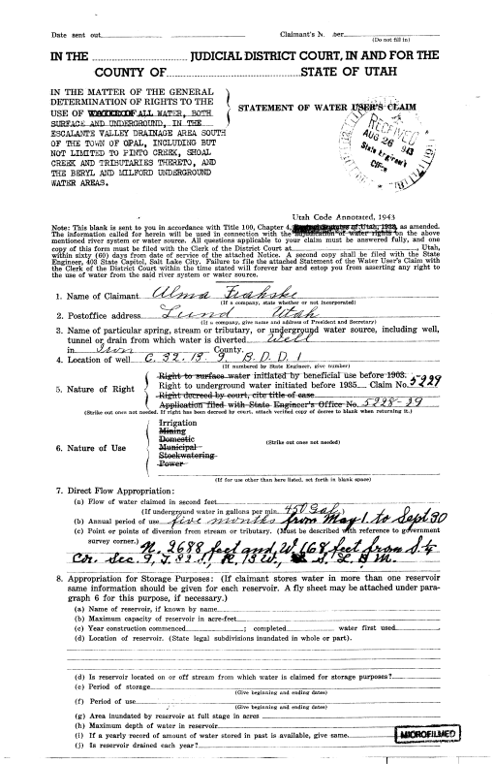
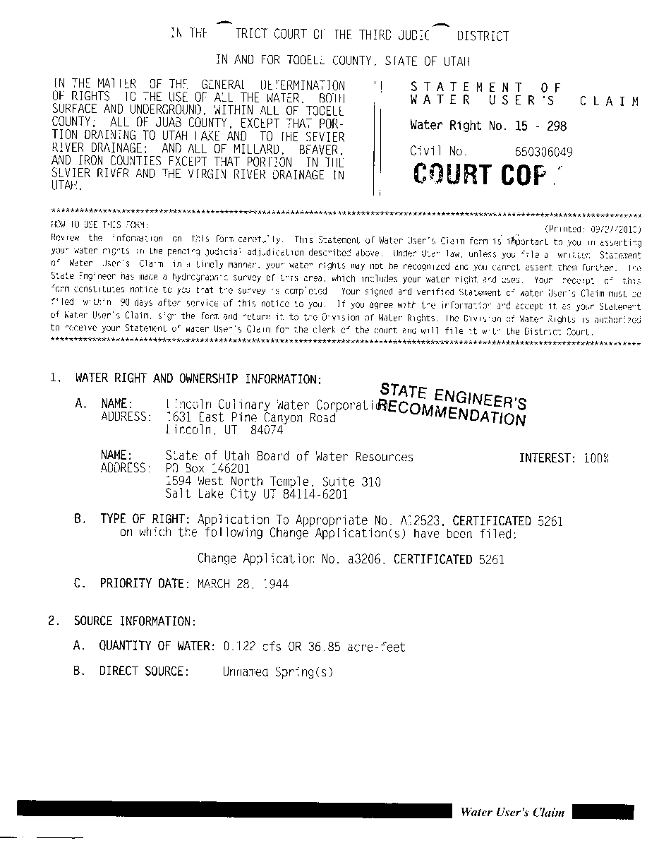
Water User’s Claims
Completed and filed by the water user with the Court or State Engineer.
Due to complexity of defining water rights, Adjudication staff typically help in completing the claim.
State Engineer files the claim with the Court on behalf of the water user as a courtesy.
Claims typically only taken on perfected rights, (i.e., certificated rights, decreed rights, and diligence claims).
7
CLAIM
CLAIM
CLAIM
PROPOSED DETERMINATION
The State Engineer reviews Water User’s Claims and other records and prepares a Proposed Determination which is then distributed to the claimants and filed with the District Court. (UCA 73-4-11)
Notes:
The statue states that water users are responsible for completing a Water User’s Claim and filing it with the court or the State Engineer; however, through years of experience, we’ve determined that it saves time, energy, and money to assist water users in filling out a claim due to the lack of understanding on what some of the technical terms mean or in what manner to describe their water right.
We also accept the Water User’s Claims and file them with the court at the completion of the Proposed Determination. Water User’s are welcome to opt out of the assistance of the Adjudication Staff at their leisure.
Water User’s Claims are only taken on rights which have been perfected (certificated), previously decreed, or qualify as diligence claims.
Occasionally, a water user wants to make a claim that is inconsistent with what the Adjudication Staff observe in the field. When this occurs, a “State Engineer’s Recommendation” is filed with the court and published in the proposed determination in the place of the claim. Water users will have the opportunity to object to any perceived errors in the Proposed Determination, which will be discussed shortly.

Slide 13
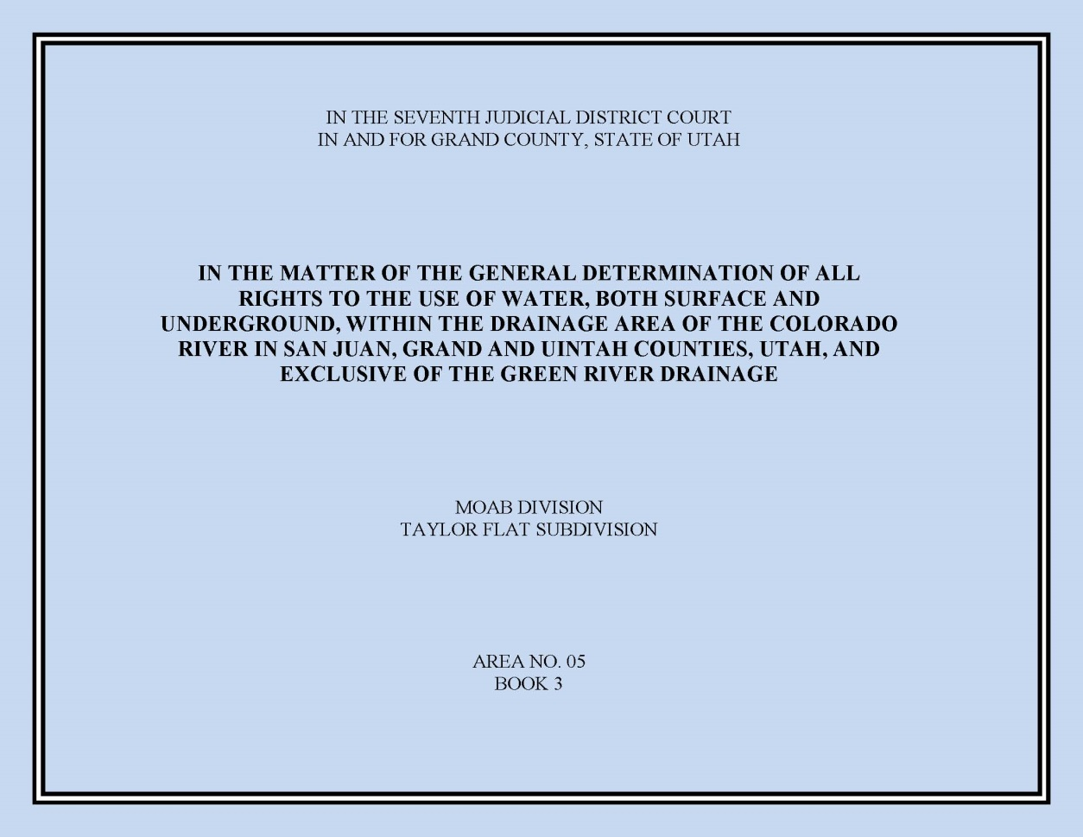
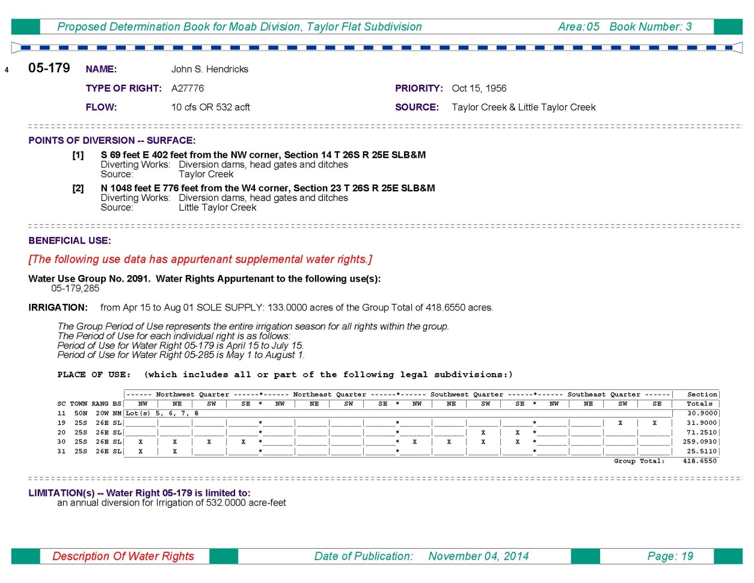
Proposed Determination
7
CLAIM
CLAIM
CLAIM
PROPOSED DETERMINATION
The State Engineer reviews Water User’s Claims and other records and prepares a Proposed Determination which is then distributed to the claimants and filed with the District Court. (UCA 73-4-11)
Represents State Engineer’s official recommendation of rights within an adjudication boundary.
Filed with the District Court.
Delivered to water users within the adjudication boundary.
Public meeting held to discuss the proposed determination and answer questions.
Notes:
Once the Hydrographic Survey, Water User’s Claims, and State Engineer’s Recommendations have been finalized, the Proposed Determination is published, distributed to the water users, and filed with the court. Each book has a unique name and number. The name typically incorporates some geographic aspect of the respective subdivision. The number reflects the Area number (which corresponds with the various drainage numbers used by the State Engineer’s Office) and a book number.
As shown, this is the Taylor Flat Subdivision, Book 05-3. On the right is what our current Proposed Determination format looks like. For the most part it mirrors the same information that you would see when viewing the water right on the Division’s database. Earlier Proposed Determinations have different formats depending on the vintage.

Slide 14
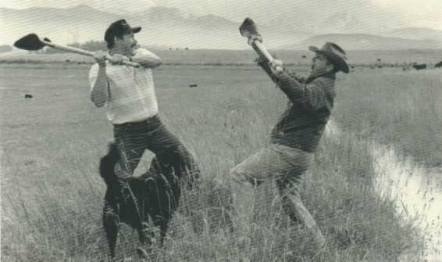
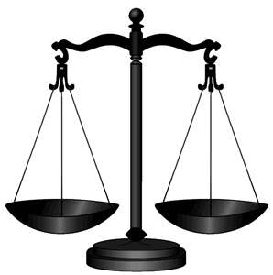
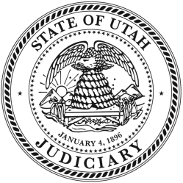
Objections
90 days
Claimants have 90 days to file an objection to the Proposed Determination with the District Court. (UCA 73-4-11)
I OBJECT!
If water users disagree with a proposed determination they may file an objection with the court within 90-days.
  Filed with the clerk of the respective District Court.
  Court may be petitioned to allow a late objection.
9
11
OBJECTION RESOLUTION
ME TOO!
I totally just ate a diaper.
The State Engineer resolves objections to the Proposed Determination with respective water users. (UCA 73-4-14)
Appeal?
Voluntary Withdrawal
Objection Withdrawn
Objection Filed with the Court
Settlement
Court Order
Proposed Determination
Questions of Fact & Law
Litigation
Notes:
As mentioned earlier, occasionally a water user will disagree with the content of the Proposed Determination—whether it’s regarding their own water right or someone else’s water right. When this occurs, they have the option of filing an objection within 90 days of the publish date of the PD. An official objection must be verified by oath and filed with the respective District Court. Informal or defective objections failing to meet the statutory requirements may be handled through other means, but they aren’t binding on the Proposed Determination. The court may be petitioned to allow a late objection.
Once an objection is filed, there are a couple of options in how it may be handled. The State Engineer usually attempts to settle the objection without going through costly and time-consuming litigation. Often this involves meeting with the parties and attempting to stipulate a settlement in exchange for withdrawal of the objection.
If an agreement can’t be made, the objection may lead to litigation. Occasionally the objection is between two separate parties and the State Engineer will simply file a response to the objection and let the two parties battle it out in court. When the objection is litigated before a court, the Proposed Determination is reviewed in terms of questions of fact and law. Eventually the court will render a decision and issue a court order either recognizing the Proposed Determination or amending some aspect of it. The parties and the State Engineer have a 30-day window to file an appeal if they choose to.

Slide 15
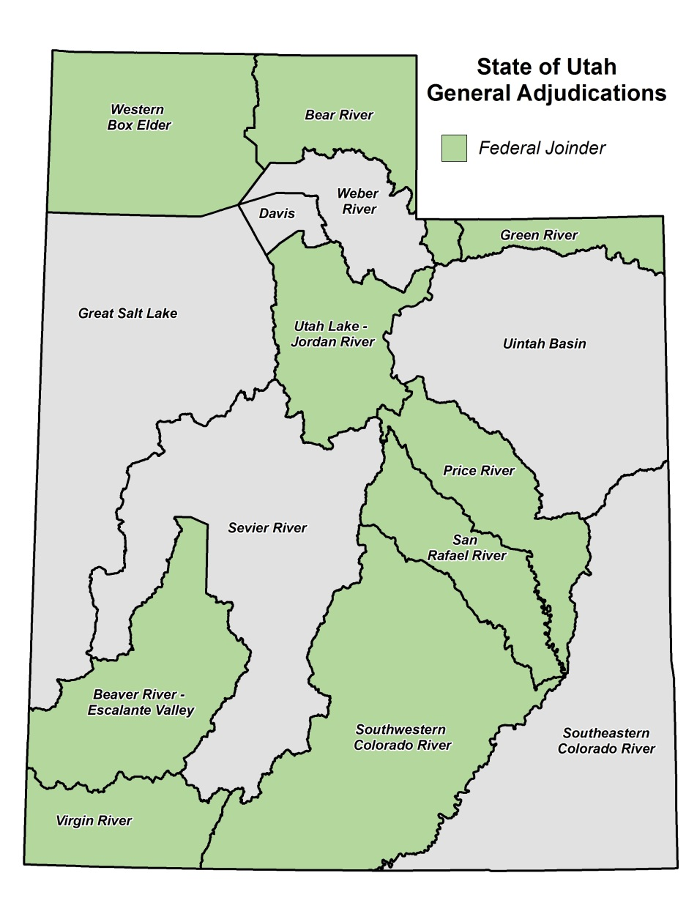
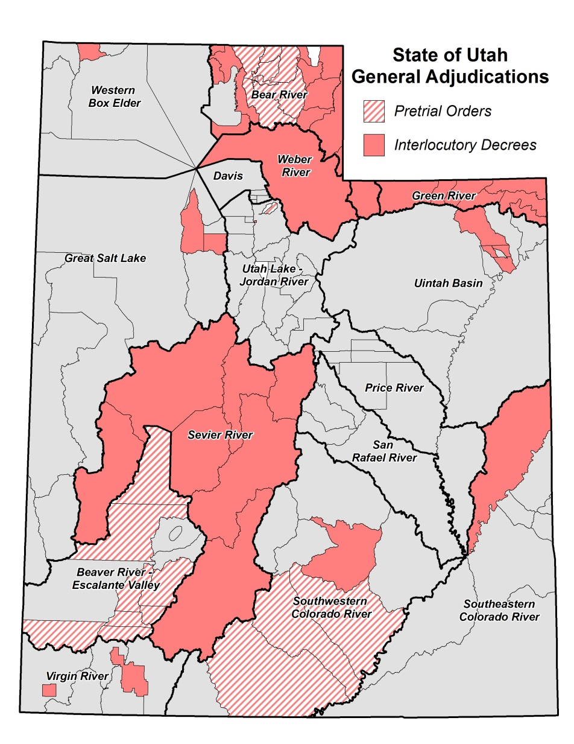
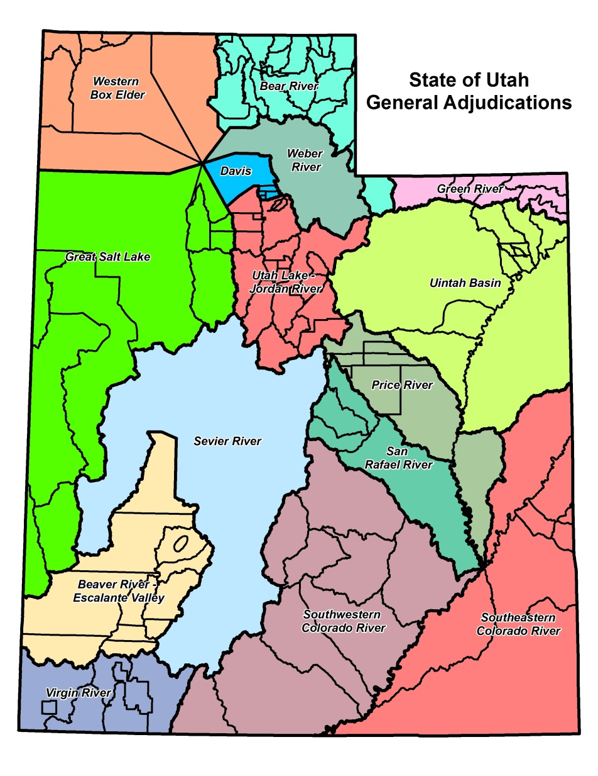
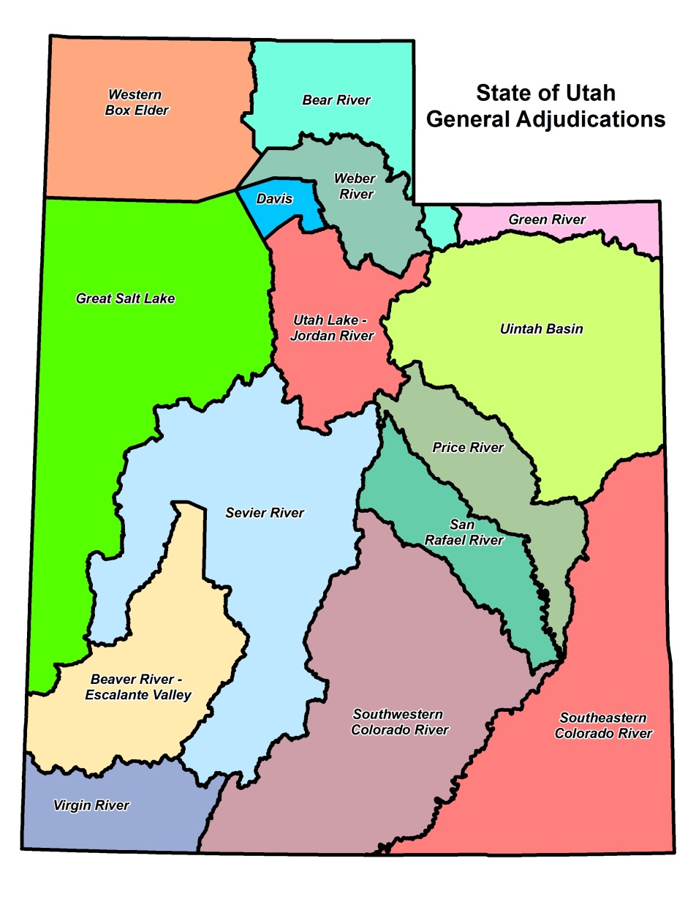
Decrees
In the “early” days, one Proposed Determination was published for one river drainage (e.g. Weber & Sevier Rivers).
Interlocutory or Partial Decrees are often issued for sub-divisions of the river drainage.
Federal Reserved Water Rights are often omitted from any interlocutory decree due to on-going negotiations or lack of Federal joinder.
Decrees often include language closing the respective basin from additional diligence claims.
12
DECREE
…but what about Federal rights?
The District Court issues a Decree (or Interlocutory Decree) on the Proposed Determination.
(UCA 73-4-15)
Notes:
As mentioned before, in the early days, there was one Proposed Determination for each large river drainage basin; however, as Utah has increased in population and natural resource development, the number of water rights has increased beyond the ability of the State Engineer to tackle each basin at a time—resulting in the smaller subdivisions. In parallel with preparation of proposed determinations for smaller geographical areas within the larger drainage, we petition the court for an Interlocutory or Partial Decree. An Interlocutory Decree is an transitional decree which is used to settle the issues within that particular book. Once all subdivisions have an interlocutory decree, the court is petitioned to issue a decree on the entire drainage.
As a result of a 1908 Supreme Court decision in Winters v. United States, the court ruled that by creation if the Fort Belknap Indian Reservation, there was an implied water right for the amount of water for the reservation to be self-sufficient. Today, federal reserved water rights can be asserted on most lands managed by the federal government. Reserved rights are, for the most part, immune from state water laws and therefore, are not subject to diversion and beneficial use requirements and cannot be lost by non-use. The federal government, however, is required to submit all reserved water rights claims to the state’s adjudication process, and are limited by the "primary purpose" and "minimal needs" requirements. In addition, federal reserved water rights are nontransferable. By law, these rights can only exist on lands owned by the federal government. If a land transfer occurs, any existing federal reserved water right becomes invalid.
The McCarran Amendment, a 1953 law, waives U.S. sovereign immunity and allows states to determine Federal water rights in state courts. Hence, federal water claims may be quantified in state stream adjudications, but only if such proceedings are comprehensive (meaning that all claimants to a specific water body are joined in the suit). As a result, the Federal Government is purposefully exempted from the Interlocutory Decrees (although their water rights are recognized in the Proposed Determination). Once an entire drainage has interlocutory decrees, the Federal Government is then joined as a party to the action just like any other water user and formally adjudicated.
When a court issues an Interlocutory Decree, it will often include language which closes the respective basin from further assertion of diligence claims… which is the primary purpose of a General Stream Adjudication.

Slide 16
Richmond
(Area 25)
Lewiston
(Area 25)
Where are we today?
State-wide Program focusing on Adjudication
Consists of 11 staff members
  Program Manager
  Adjudication Engineer
  3 Attorneys
  2 Adjudication Team Leaders
  4 Adjudication Technicians (3 interns)
Regional Offices support Adjudication efforts as available.
Continually working with the Attorney General’s office to resolve objections to previous Proposed Determinations in order to obtain interlocutory decrees. There are over 400 un-resolved objections on record.
Red Butte
(Area 57)
Ashley Central
(Area 45)
Orem
(Area 57)
Birdseye
(Area 51)
Taylor Flat (Area 05)
Ash Creek / La Verkin (Area 81)
Notes:
So, where are we today? The Adjudication Program of the Utah Division of Water Rights is a State-wide program which focusses solely on adjudication efforts. The program consists the Program Manager, an Adjudication Engineer and three Adjudication Technicians. However, we also rely on the regional offices to support the effort as their resources permit.
We work closely with the Attorney General’s office for obvious reasons throughout the Proposed Determination process, but we also continue to work closely with them to resolve objections to the various Proposed Determinations which have already been published. The back-log of un-resolved objections is fairly large—upwards of 400—however, we try to resolve them as quickly as possible and have been able to make forward progress in the past few years.
As you can see by the map, we’re actively engaged in five different adjudications throughout the state. Each adjudication is at a different stage.

Slide 17
Frequently Asked Question?
What if a water user chooses not to participate in a general adjudication?
  They risk forfeiture of any rights not claimed and the loss of their right to appeal or object to the proposed determination.
What does it mean if the status of a water right says “disallowed”?
  There may be many reasons, but water rights are generally disallowed based on evidence of non-use (i.e., forfeiture).
Why don’t all water users get notice of the proposed determination?
  Notice is sent to water users listed on the records of the State Engineer; consequently, if water users fail to update their records they may not receive notice. However, statute requires that notice be published in the local paper.
Lastly…
  Grand Juries are typically NOT a part of the Adjudication Process
Notes:
When the Adjudication Program goes into an area, one of the most prominent questions is whether or not a water users will lose their water right. It should be noted that the State Engineer does not have the authority to take a water right away. We can only recommend to the court that the water right be disallowed in the Proposed Determination.
Ultimately, individuals who are using their water right in conformance with the records on file with the Division of Water Rights have nothing to fear.
Those who are using water without a right of record are required to submit a claim during the process or risk being barred by the court from asserting a right.
When a water right, or portion of it, has fallen out of use for more than 7 years, the water right (or the un-used portion) may be recommended to be disallowed in the Proposed Determination. This ensures that water which is not being used, returns to the public for future appropriation or sustainment of other rights. We will often give a water user the benefit of the doubt in order to prevent unnecessary constraints on water users.

Slide 18
Who can I contact to discuss the
Adjudication Process?
Blake Bingham, P.E.
Adjudication Program Manager
Phone: 801-538-7345
E-mail: blakebingham@utah.gov
Chris York, E.I.T.
Adjudication Engineer
Phone: 385-226-7805
E-mail: cyork@utah.gov
Randy Tarantino
Adjudication Specialist
Phone: 801-664-8452
E-mail: randytarantino@utah.gov
Mike Handy, P.G.
Adjudication Team Leader
Phone: 801-538-7463
E-mail: mikehandy@utah.gov
Josh Zimmerman
Adjudication Team Leader
Phone: 801-946-7168
E-mail: joshzimmerman@utah.gov
Utah Division of Water Rights
1594 West North Temple
Suite 220, PO Box 146300
Salt Lake City, UT 84114-6300
www.waterrights.utah.gov

Slide 19
Questions?

