Slide 1
Reserved Water Right Settlements in Utah and Their Relationship to General Adjudications
Norman K. Johnson
Utah Water Users Workshop
March 16 – 18, 2015
St. George, Utah

Slide 2
Let’s Not Get Out of Order . . .

Slide 3
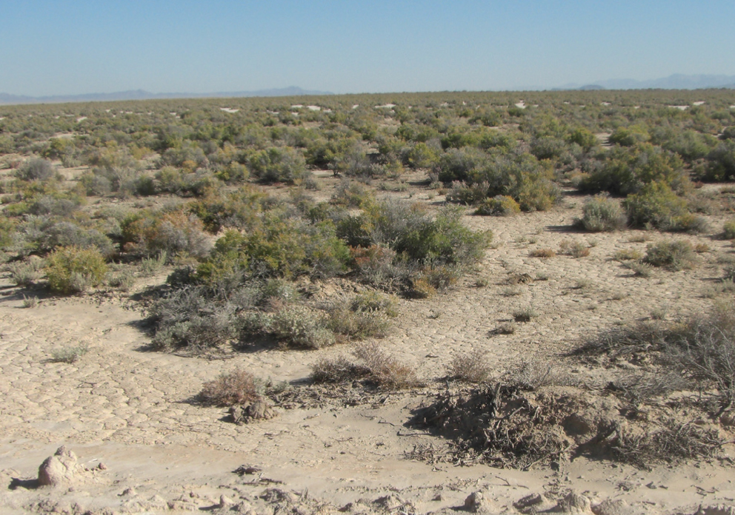
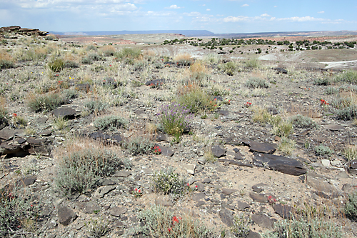
We Live in a Desert
Notes:
We live in a desert; it’s a pretty place, but . . .

Slide 4
We Live in a Desert
Notes:
In many places those who came before us have done such a good job of planning for the future, that we forget about our desert environment.

Slide 5
Eastern Water Law — Not for Arid Areas
A riparian owner has the right to the undiminished flow of a stream
“Riparian rights” turn on the physical relationship of a body of water to riparian land--they include access, use, and the opportunity to build in the water
This law would not work in a desert

Slide 6
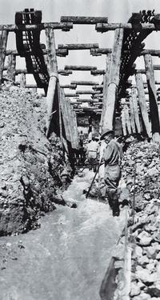
Western Water Law — Origin and History
In the arid West areas of water use were often located far from sources of supply
Miners and irrigators built diversions
and moved water to areas of need
Their “first in time/first in right”
mining principles carried over to
water rights
The doctrine of “prior appropriation” of water was born (mid to late 1800s)

Slide 7
Western Water Law — Origin and History
Appropriative water rights are given a priority based on their date of creation
In times of shortage, earlier priority rights are filled first to the limit of the right
No sharing of shortages means some uses will be met
The intent was to maximize public benefit

Slide 8
Western Water Law — Origin and History
An appropriative water right is a conditional right to use a shared resource
Conditional because water is a public resource and to get a private right to use it legislative requirements must be met
Most important is the continued beneficial use of the water

Slide 9
Western Water Law — Origin and History
The right to use is not ownership of a volume of water, but a right to use an amount of water for a beneficial purpose
Each system has a finite amount of water
Since water rights are shared, everything one right-holder does impacts others and any change in use must not harm others

Slide 10
Western Water Law — Origin and History
Appropriative water rights are constitutionally protected property rights
Their basis is the beneficial use of water
They are defined by quantity, time, and nature of use
Priority date is when beneficial use began
They can be lost by non-use
Notes:
The need for beneficial use is so important because it pays back the public for allowing a person to privatize water use and because it “keeps the system real” in terms of requiring actual use instead of simply doing paperwork.

Slide 11
Western Water Law — Origin and History
The federal government supported growth and development of this “new” water law
1866 Mining Act; 1877 Desert Land Act
The U.S. Supreme Court said these acts severed the land and water estates and directed that water rights, which merited protection, must be obtained under the laws of the territories and states

Slide 12
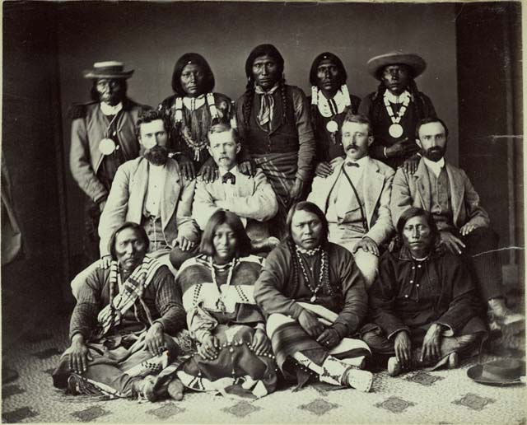
Reserved Rights Doctrine —Origin and History
At the same time the appropriation doctrine was developing with federal approval, federal reservations of land were being made
Congress and the President set aside public land
for a particular purposes,
such as Indian
reservations, but did not
create accompanying
water rights
Notes:
There is a tremendous amount of history here, particularly regarding Indian reservations, which we don’t have time for today.
Suffice it to say that the indigenous people who were parties to the treaties that created the Indian reservations had every reason to believe the promises made to them in the treaties would be honored.

Slide 13
Reserved Rights Doctrine —Origin and History
In 1906 the U. S. brought suit on behalf of the Fort Belknap Reservation Indians to secure water rights for them
Defendant farmers/ranchers protested, saying they had valid water rights created under Montana law
The suit created a genuine dilemma

Slide 14
Reserved Rights Doctrine —Origin and History
In 1908 the Supreme Court issued its Winters decision
It said Congress, when it set aside the reservation, impliedly intended to reserve water for the Indians
The “reserved rights” doctrine was born as an equitable, judicial response to a real and difficult controversy
Notes:
- A principal reason for pointing this out is – there are no “good guys” and “bad guys” when it comes to reserved water rights
- The point is the federal government essentially gave away the same water twice – leaving to western interests, Indian and non-Indian, the challenge and opportunity to resolve the resulting problems.

Slide 15
Reserved Rights Doctrine —Origin and History
In Arizona v. California (1963) the U. S. Supreme Court said the reserved rights doctrine applies to federal reservations other than Indian reservations
For Indian Reservations it said the number of practicably irrigable acres on the reservation (PIA) is used to quantify the right

Slide 16
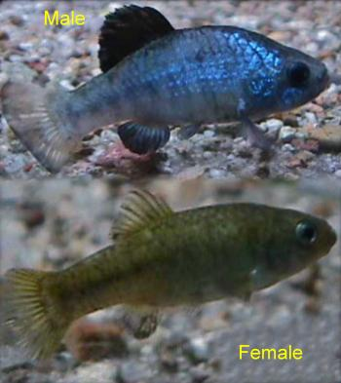
Reserved Rights Doctrine —Origin and History
Subsequent case law further defined the reserved rights doctrine
Cappaert v. U.S. (1976) – the
amount of water reserved is the
minimum amount necessary to
fulfill reservation purposes
U.S. v. New Mexico (1978) –
primary purposes only get
reserved water rights

Slide 17
Reserved Rights vs. Appropriative Water Rights
Reserved water rights are important sovereign and property interests
Their basis is the creation of reservations
The purpose of the reservation defines their quantity (PIA for Indian reservations)
Priority date is creation of the reservation
They are not lost by non-use
Notes:
Now, look at how these principals compare with appropriation doctrine principles.

Slide 18
Western Water Law — Origin and History
Appropriative water rights are constitutionally protected property rights
Their basis is the beneficial use of water
They are defined by quantity, time, and nature of use
Priority date is when beneficial use began
They can be lost by non-use

Slide 19
Reserved Rights vs. Appropriative Water Rights
In addition to having characteristics that conflict with appropriative water rights, the more pressing problem is that reserved water rights are un-quantified when created
Given their early priority dates, they compete with and can displace State-created water rights

Slide 20
Western Water Law — Origin and History
Hypothetical
Mill Valley Water System
This small water system produces +/- 400 ac/ft/yr, with variation
The rights in blue are used every year
The right in pink has not been used for decades
The rights in yellow have become supplemental to other rights and are rarely used
The rights in light green are used every year when water is available
Only 10 ac/ft of the right in dark green has been used for decades
1863 – 100 ac/ft
1890 – 100 ac/ft –0 use
1900 – 100 ac/ft
1901 – 100 ac/ft
1915 – 100 ac/ft
1920 – 100 ac/ft—10 use
1925 – 100 ac/ft
1930 – 100 af/ct
1931 – 100 ac/ft
Notes:
If an entity owns more than one right in this system, it’s own behavior towards the other rights may well harm the right it holds—say a city holds the 1930 right that gets water almost every year and someone brings this 1920 right to the city to purchase for future development. Adding that right to the city’s portfolio of rights won’t add much because it won’t make any more water available to the system than is already available to the system and the city already gets the same water, that last priority water, almost every year.

Slide 21
Reserved Rights vs. Appropriate Water Rights
1860 – 100 ac/ft
1863 – 100 ac/ft
1890 – 100 ac/ft –0 use
1900 – 100 ac/ft
1901 – 100 ac/ft
1915 – 100 ac/ft
1920 – 100 ac/ft—10 use
1925 – 100 ac/ft
1930 – 100 af/ct
1931 – 100 ac/ft
Reserved Right reorganized for 100 ac/ft/yr, with 1860 priority date
Becomes the earliest right on the system
All other rights move down in priority
Notes:
If an entity owns more than one right in this system, it’s own behavior towards the other rights may well harm the right it holds—say a city holds the 1930 right that gets water almost every year and someone brings this 1920 right to the city to purchase for future development. Adding that right to the city’s portfolio of rights won’t add much because it won’t make any more water available to the system than is already available to the system and the city already gets the same water, that last priority water, almost every year.

Slide 22
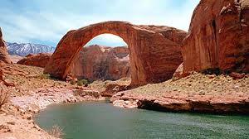
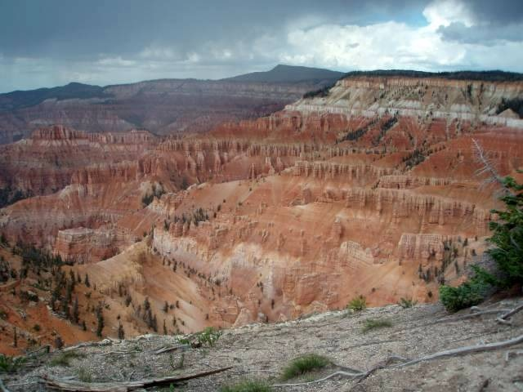
Reserved Rights vs. Appropriative Water Rights
Utah, an arid state, has many federal reservations — federal lands set aside for specific purposes, like Indian reservations, national parks and monuments, military bases, etc.
How should these rights be quantified?

Slide 23
Reserved Rights vs. Appropriative Water Rights
States have taken different approaches:
Pretend reserved rights don’t exist (mostly in times past)
Litigate about reserved rights
Negotiate such rights on a case-by-case basis
Utah has chosen to negotiate because it provides the best opportunity for a win/win result

Slide 24
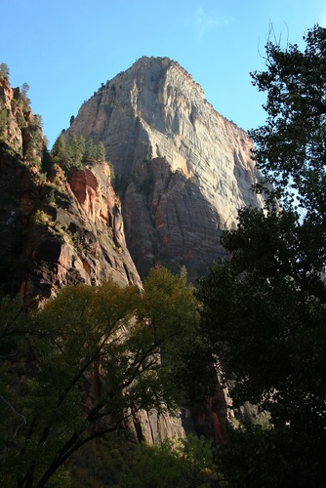
Reserved Rights vs. Appropriative Water Rights
Utah has negotiated reserved water rights for Zion National Park, Arches National Park, an important watershed in the Dixie National Forest, Cedar Breaks, Hovenweep, Promontory, Rainbow Bridge, Timpanogos, and Natural Bridges National Monuments

Slide 25
Reserved Rights vs. Appropriative Water Rights
Utah has negotiated reserved water rights for the Shivwits Reservation
Congress passed legislation settling the Uintah Ouray Tribe (Northern Ute) water right claims and we continue to work on an implementation plan with the Utes

Slide 26
Reserved Rights vs. Appropriative Water Rights
Utah has initiated reserved water right discussions for the Goshute Reservation
We are working on an agreement for Bryce Canyon National Park and others
We have been in discussions for years with the Navajo Nation on a negotiated settlement of the water right claims for part of the Nation located in Utah.
Many settlements involve the Colorado River

Slide 27
Utah/Navajo Reserved Water Right Negotiations
Navajo has substantial Winters rights
The law requires Navajo’s water rights for the portion of the reservation in Utah come from Utah’s share of the River
Utah and Navajo have worked together to resolve reserved water right issues
Utah must make a financial commitment

Slide 28
POTENTIAL LIABILITY
PIA = 166,500+ AF
Expensive, Unpredict-
able Litigation
Non-Indian Priority Conflicts
SETTLEMENT PROPOSAL
NAVAJO NATION
81,500 AF Water Depletion
About $160 Million in Projects (2010 costs)
Emphasis on Drinking Water Projects
Subordination to Existing Rights
About 5% of cost ($8M) = State Share

Slide 29
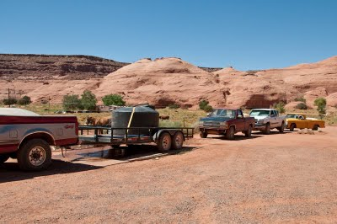
Benefits of a Navajo-Utah Settlement Agreement
Quantify a Significant Reserved Water Right
Improve Quality of Life for Utah Navajo People
Avoid Costly Litigation and Uncertain Outcomes
Provide Certainty for Water Users
Navajo Nation
CUP/Wasatch Front
Uintah Basin & San Juan County
Price River, Carbon, Emery &
Grand Counties
Lake Powell Pipeline
Solve a Colorado River Issue

Slide 30
Utah’s Colorado River Depletion
UTAH'S Allocation | 1.369 MAF
Current Use | 1.008 MAF
UNUSED ALLOCATION | .361 MAF
Future Use
Ute Tribe Reserved Water | 105 KAF
Navajo Nation Reserved Water | 81 KAF
New Ag Uses | 40 KAF
New M&I Uses | 29 KAF
Lake Powell Pipeline | 86 KAF
Total | 341 KAF
Balance | 20 KAF

Slide 31
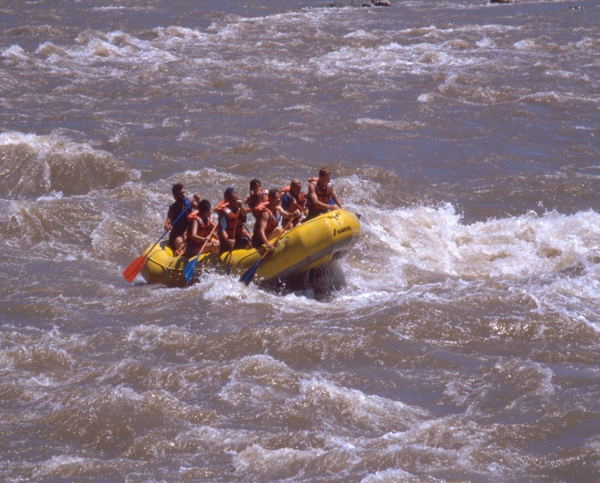
COLORADO RIVER CHALLENGES
Optimizing use of remaining allocation (and integrating federal reserved water rights)
Assuring continued river use (ESA/fish flows)
Protecting project investments (priority issues)
Dealing with drought
Maintaining power
production
Keeping peace with sister
states and Mexico

Slide 32
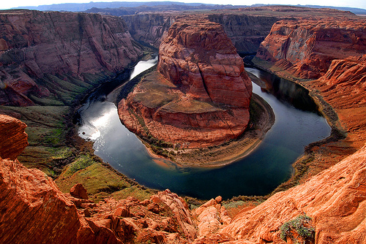
COLORADO RIVER OPPORTUNITIES
Negotiate Indian water rights
Negotiate other federal reserved water rights in the Basin
Maintain ESA compliance through RIPRAP
Pursue contracts for
Flaming Gorge storage
Implement
multipurpose projects

Slide 33
General Adjudication Considerations
In Utah, comprehensive general water right adjudications are pending in most of the State
These adjudications, typically done in sub-basin drainages, are comprehensive and qualify for the McCarran Amendment sovereign immunity waiver
They take a very long time to complete, both because they are complicated and because of resource considerations

Slide 34
General Adjudication Considerations
Once a reserved right agreement is finalized, the State Engineer will present it to the Adjudication Court as a Proposed Determination (PD)
The PD is the State Engineer’s recommendation concerning the water rights for the reservation
The PD is circulated to all parties
Parties have the opportunity to object

Slide 35
General Adjudication Considerations
To minimize controversy, parties should be educated before they receive the PD
Objections must be dealt with
Once all objections are resolved, the adjudication court enters an interlocutory decree
The Interlocutory Decree will eventually be incorporated into a basin-wide decree

Slide 36
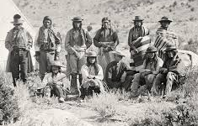
Settlement of Reserved Water Rights
We have learned State negotiators must:
Protect all federal/non-federal/tribal interests;
Realize that settlements must work for all;
Ultimately decree rights in a general adjudication;
Communicate and educate;
Focus on what matters;
Use technicians;
Build trust;
Be patient;
Put things in context.

Slide 37
THE CHALLENGE

Slide 38
QUESTIONS?
~ The End ~

