Slide 1

Taylor Flat Area
Proposed Determination of Water Rights
and Adjudication Process
Final Public Meeting – November 18, 2014
Utah Division of Water Rights
Blake W. Bingham, P.E.
Adjudication Program Manager
www.waterrights.utah.gov
Notes:
Welcome & Introduction
Introduce Adjudication Program Staff and other DWRi personnel:
Mike Handy
Carissa Brandt
Josh Zimmerman
Teresa Wilhelmsen – Utah Lake/Jordan River Regional Engineer
Jared Manning – Assistant State Engineer

Slide 2
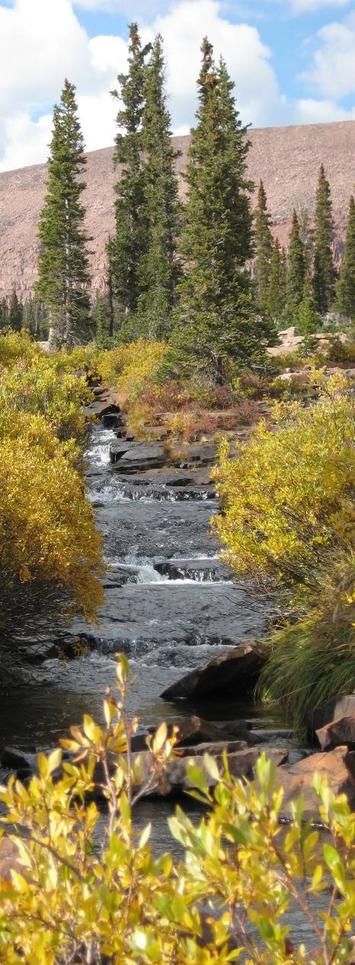
The Proposed Determination Process
The Proposed Determination
Official recommendation of the State Engineer to the District Court
The Process
Public Meeting: Hold a public meeting to inform water users.
Research: Identify, research, and field-review water rights within the proposed determination area.
Hydrographic Survey: Conduct a hydrographic survey to identify existing points of diversion, places and extent of use.
Claim Preparation: Help water users prepare and submit Water User Claims.
Publish Proposed Determination: Compile Water User Claims, publish, and distribute Proposed Determination.
File with Court: The Proposed Determination is filed with the District Court.
Resolve Objections: Resolve objections filed by water users to the proposed determination if possible.
Court Decree: The District Court hears any remaining disputes and issues a decree on the water rights within the proposed determination area.
Notes:
The Proposed Determination serves as the official recommendation of the State Engineer to the District Court. The Court takes the Proposed Determination into consideration when making a decree of the water rights.
The process includes the main components listed:
Public Meeting: We start the process off with a Public Meeting to inform water users regarding the commencement of the Proposed Determination.
Research: In parallel with the Public Meeting, the Adjudication Program begins research on the water rights within the area and may begin the field review process which includes visiting the various points of diversion and places of use to determine the characteristics of the water right.
Hydrographic Survey: The Hydrographic Survey goes hand-in-hand with the field review, resulting in a mapping of the water rights with the associated Points of Diversion, Places and Extent of Use.
Claim Preparation: Once the field-review is completed, the Adjudication Program aids water users in preparation of their claims to be included in the Proposed Determination.
Publish Proposed Determination: Once the water user claims and the Hydrographic Survey are completed, the Proposed Determination is published and distributed to the water users for review.
File PD with Court: The Proposed Determination is also submitted to the District Court.
Resolve Objections: Once the Proposed Determination is distributed and submitted to the Court, water users have a 90-day window in which to file an objection to it. Once an objection is filed with the court, the Adjudication Program works with the Attorney General’s office to resolve them. If objections can’t be resolved, the Attorney General’s Office may motion for summary judgment.
Court Decree: Once objections have been resolved, withdrawn, or dismissed and the State Engineer has conducted a final search for water users who were not included in the proposed determination, the District Court issues an Interlocutory Decree on the water rights listed in the Proposed Determination.

Slide 3
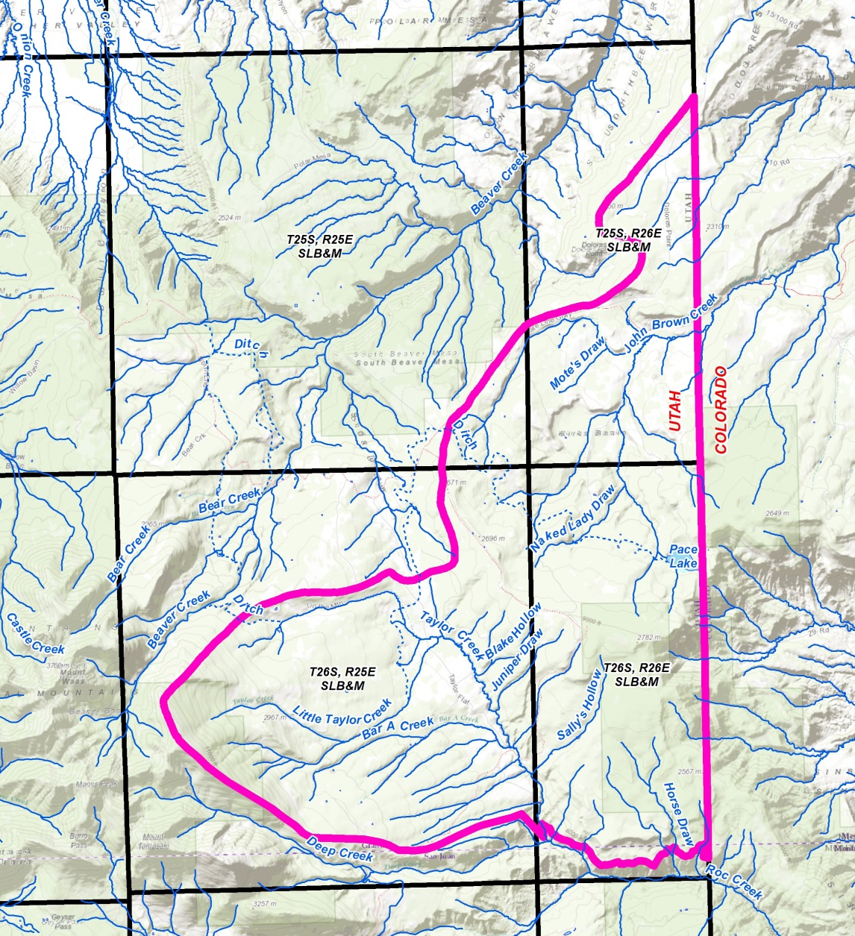
The Taylor Flat
Proposed Determination Area
Approximately 42 square-miles.
Major drainages:
  Taylor Creek
  John Brown Creek
Includes portions of Grand County and San Juan County in Utah and Mesa County in Colorado (irrigated acreage).
Includes a portion of the Manti-La Sal National Forest and the North La Sal Block of SITLA lands.

Slide 4
Taylor Flat Proposed Determination
Adjudication Statistics
Water Rights Included in the Proposed Determination: 25
          Surface: 21
          Underground: 3
          Sub-Basin: 1
          Elections: 16
          Diligence Claims: 2
              Diversion Quantities
              Domestic Use 1.75 AF
              Irrigation Use 1775.28 AF
              Stock watering 22.78 AF
              Other (evaporation) 50 AF
              Total Diversion 1,799.81 AF

Slide 5
Taylor Flat Proposed Determination
Timeline
Initiated March 14, 1961
Public Meeting October 18, 2011
Field Work May 2007 – Jun 2014
Hydrographic Survey Maps May 2007 – Jun 2014
Water User’s Claim Preparation May 2007 – July 2014
Water User’s Claim Review July – Sep. 2014
Final Review Sep. – Oct. 2014
Publication Date November 4, 2014
Public Meeting November 18, 2014

Slide 6
Taylor Flat Proposed Determination
Publication
        Water user’s listed in the Proposed Determination received a letter with instructions on how to view the Taylor Flat Proposed Determination and Hydrographic Map via the Internet.
          The Taylor Flat Proposed Determination can be accessed online at:
          http://www.waterrights.utah.gov/pdbooks/TaylorFlatsPD
          The Hydrographic Survey Maps can be accessed online at:
          http://www.waterrights.utah.gov/pdbooks/TaylorFlatsHS
        Similar notice was also published in the Times-Independent newspaper for 2 weeks for water users not identified in the Proposed Determination.
        The Proposed Determination was also filed electronically with the Seventh Judicial District Court in Moab, Utah.
        Water users can also view the Proposed Determination and Hydrographic Survey maps at the Southeastern Regional Office and the Salt Lake City office; they may also obtain additional copies from the Salt Lake office upon payment of the cost of duplication.

Slide 7
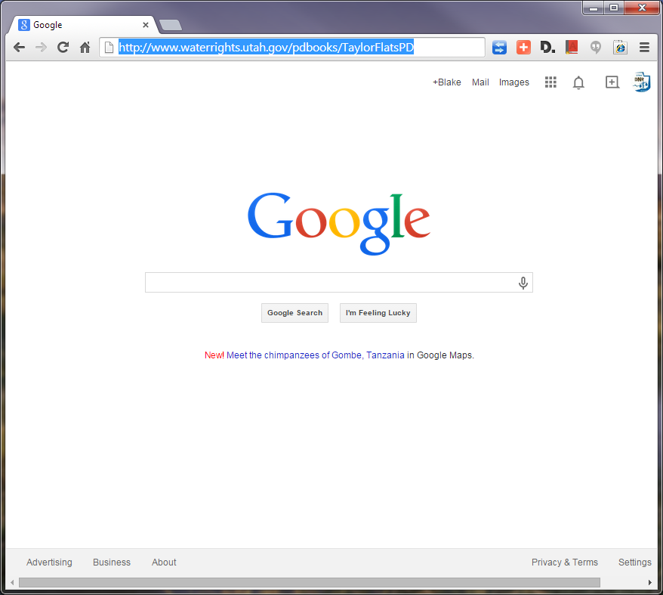
Taylor Flat Proposed Determination
Accessing the Proposed Determination
Proposed Determination
Web Address

Slide 8
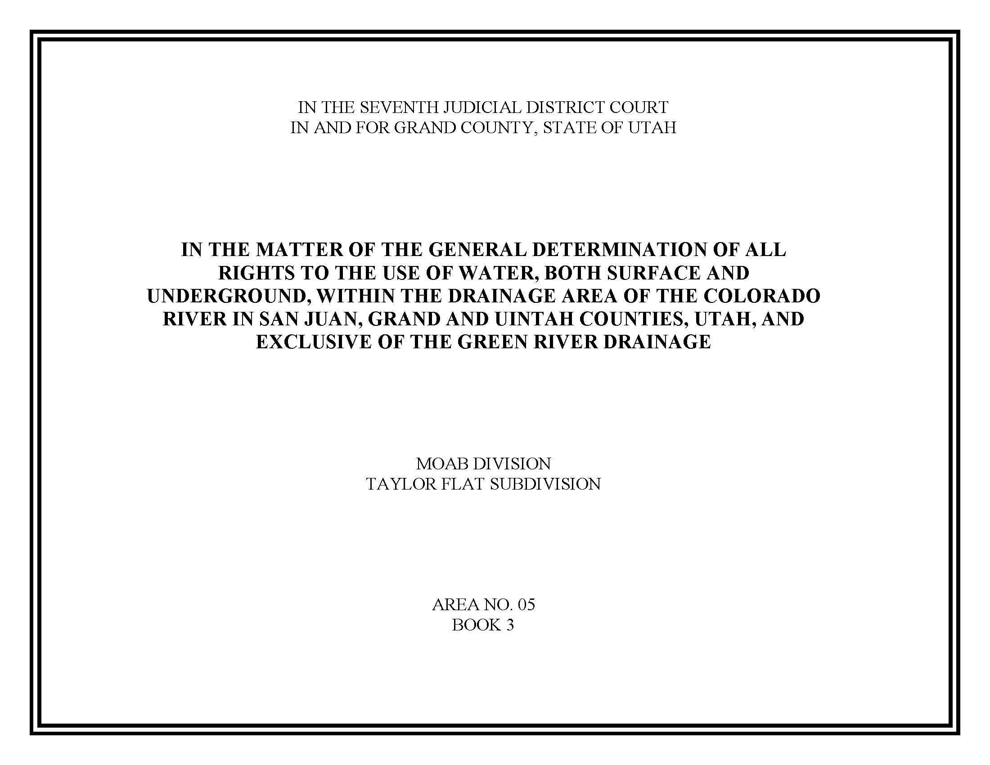
Taylor Flat Proposed Determination
Cover Sheet
District Court Jurisdiction
General Adjudication Description
Hydrologic Division & Subdivision Names
Area & Book Numbers

Slide 9
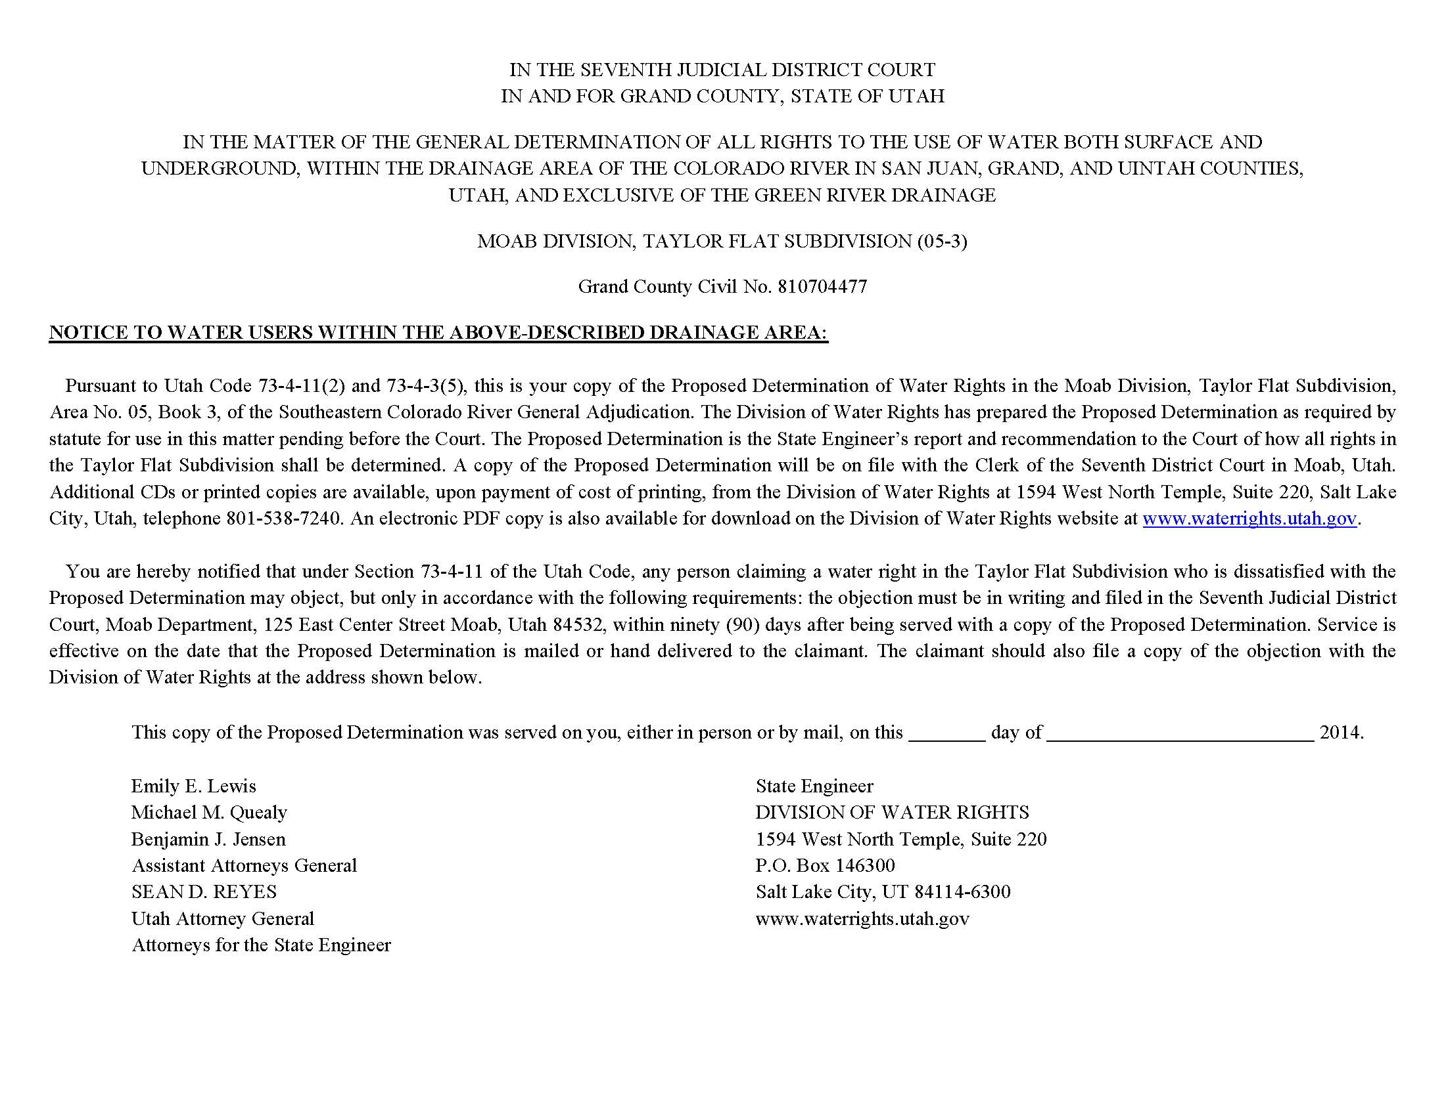
Taylor Flat Proposed Determination
Notice & Service Date
Civil Case Number
Instructions on filing an objection
Service Date

Slide 10
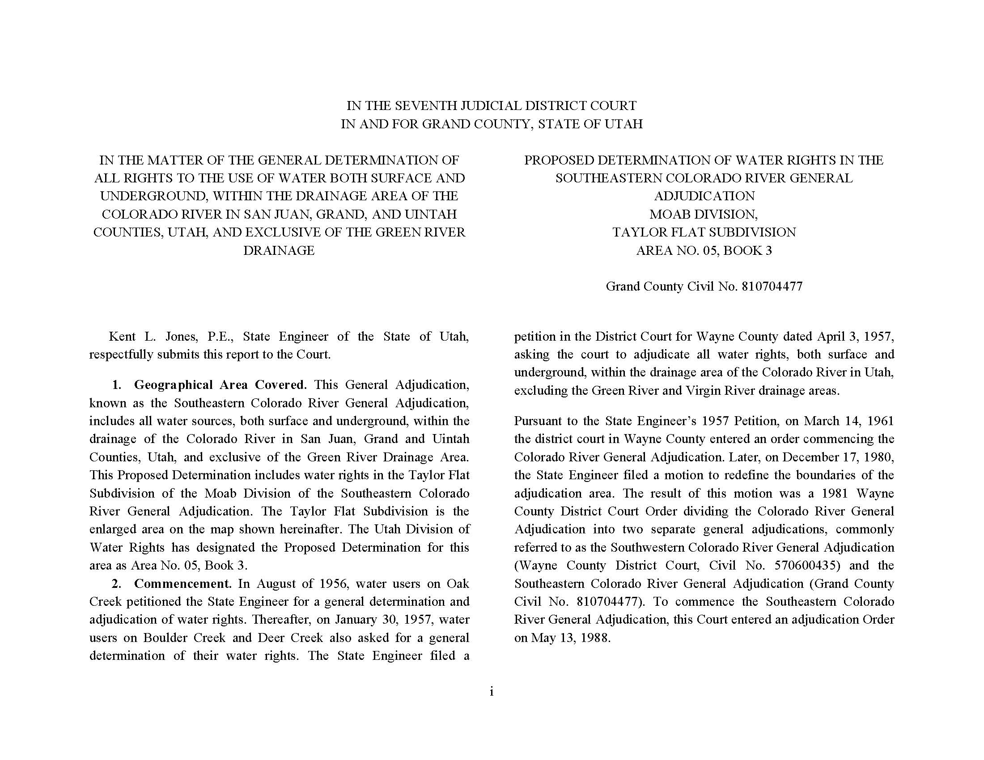
Taylor Flat Proposed Determination
Preamble

Slide 11
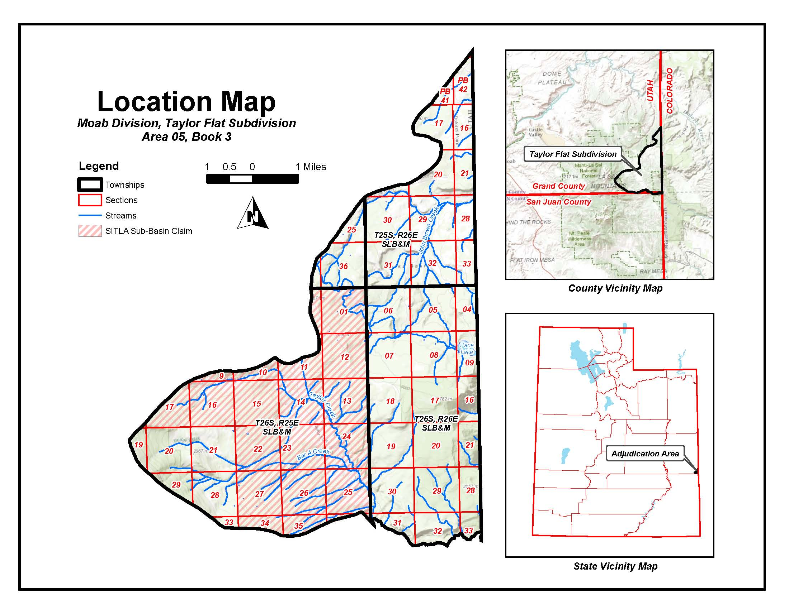
Taylor Flat Proposed Determination
Location Map

Slide 12
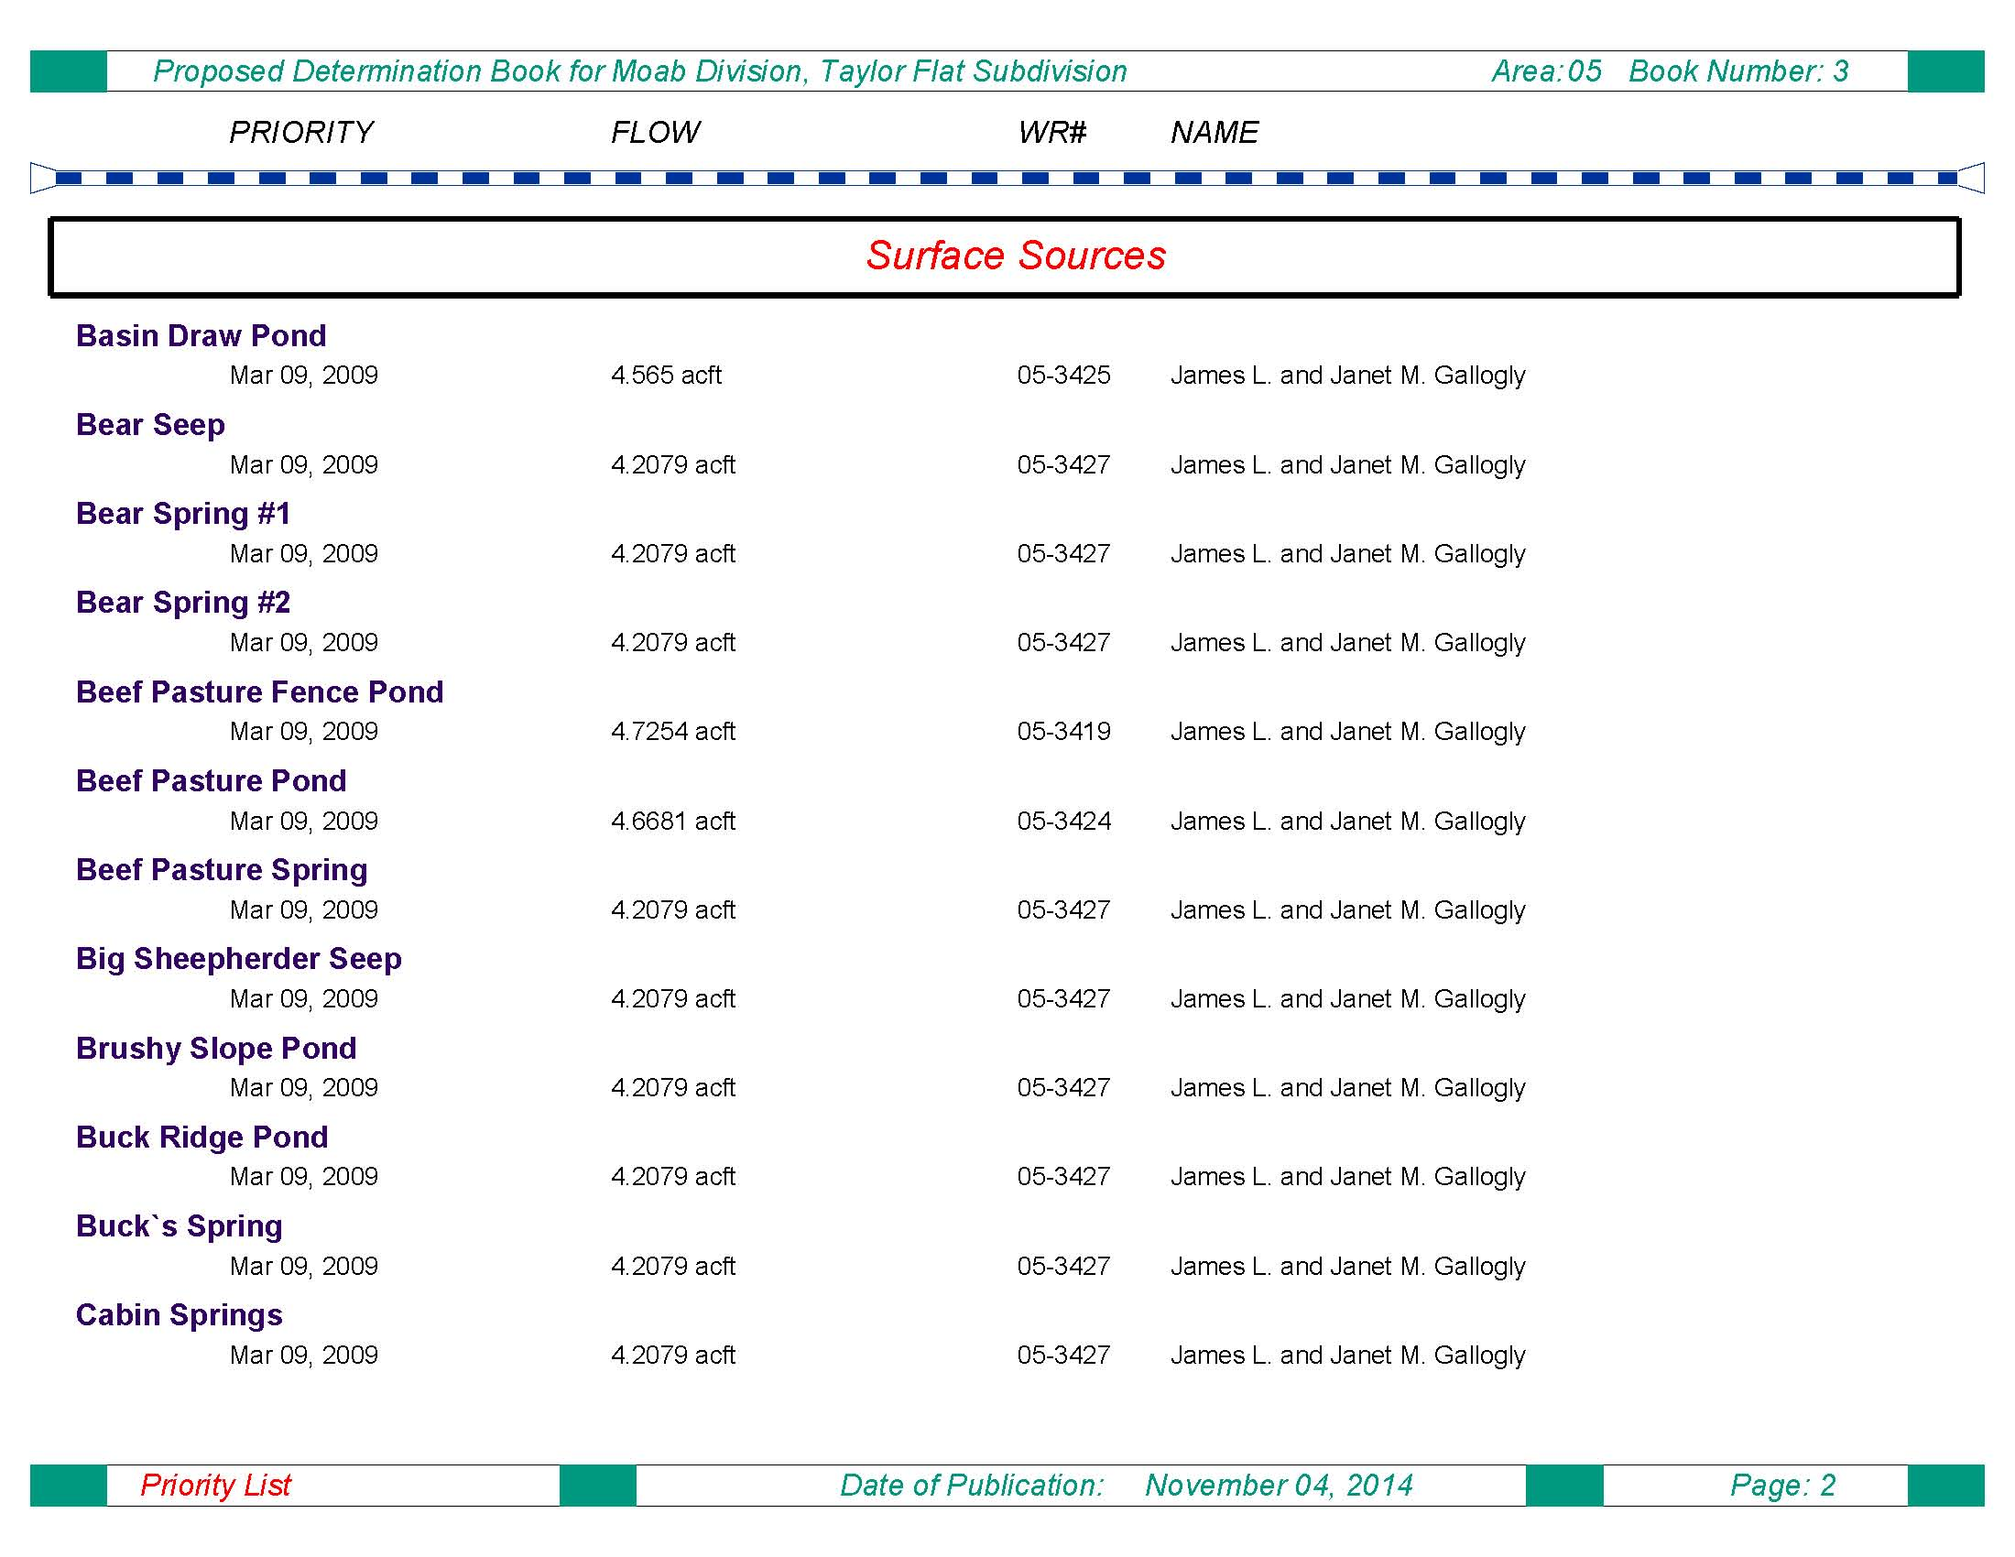
Taylor Flat Proposed Determination
Priority Schedule

Slide 13
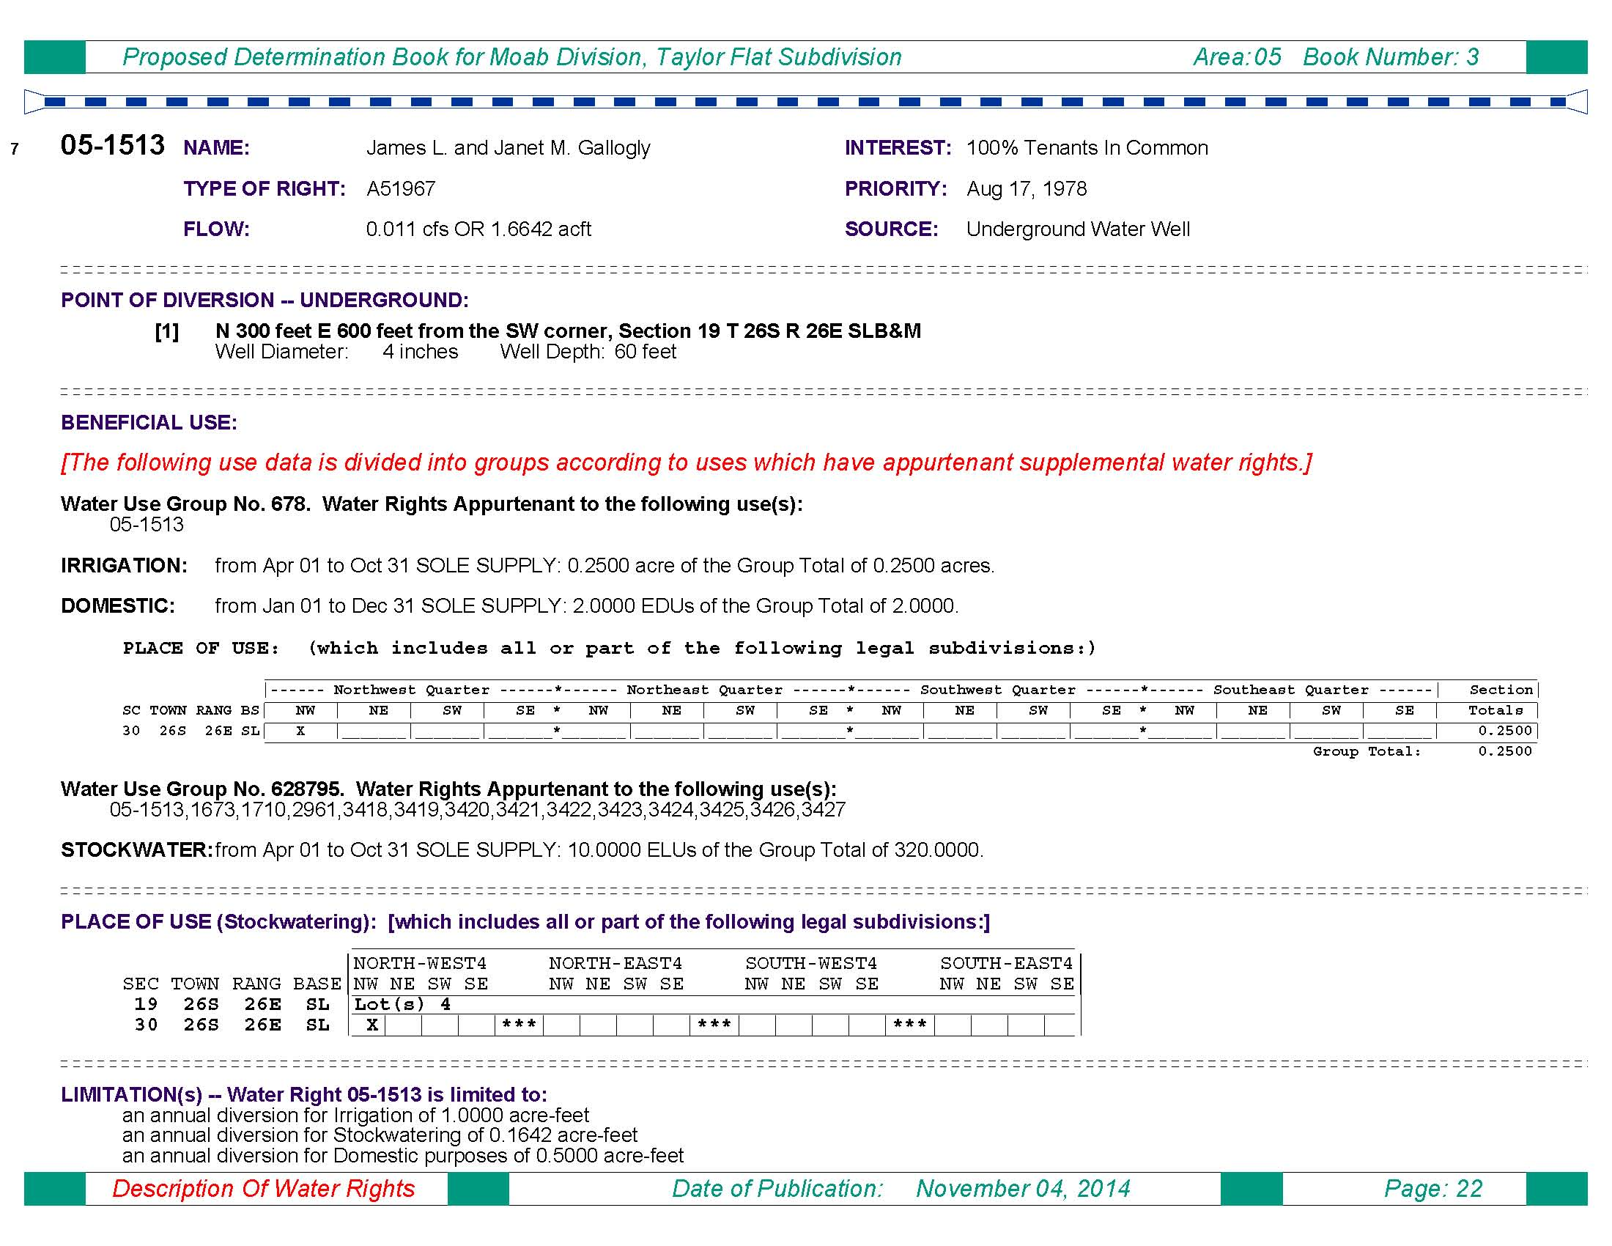
Taylor Flat Proposed Determination
Example
Water Right Number

Slide 14
Taylor Flat Proposed Determination
Example
Name (Owner of Record)
Type of Right
Flow Rate (cfs or acre-feet)

Slide 15
Taylor Flat Proposed Determination
Example
Interest
Priority Date
Source

Slide 16
Taylor Flat Proposed Determination
Example
Point of Diversion Location &
Well Data (if available)

Slide 17
Taylor Flat Proposed Determination
Example
Beneficial Use Group

Slide 18
Taylor Flat Proposed Determination
Example
Nature of Beneficial Use

Slide 19
Taylor Flat Proposed Determination
Example
Period of Use

Slide 20
Taylor Flat Proposed Determination
Example
Sole Supply

Slide 21
Taylor Flat Proposed Determination
Example
Group Total

Slide 22
Taylor Flat Proposed Determination
Example
Place of Use:
Section, Township & Range

Slide 23
Taylor Flat Proposed Determination
Example
Place of Use:
Quarter-Section

Slide 24
Taylor Flat Proposed Determination
Example
Place of Use:
Quarter-Quarter
(40-acre tract)

Slide 25
Taylor Flat Proposed Determination
Example
Place of Use:
Acreage Total per Section

Slide 26
Taylor Flat Proposed Determination
Example
Diversion Limitations

Slide 27
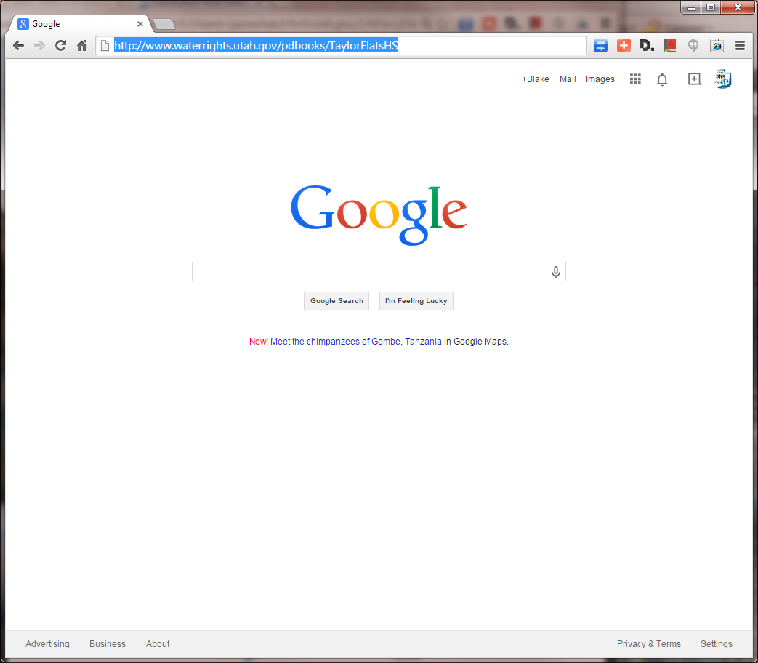
Taylor Flat Proposed Determination
Accessing the Hydrographic Survey Maps
Hydrographic Survey Web Address

Slide 28
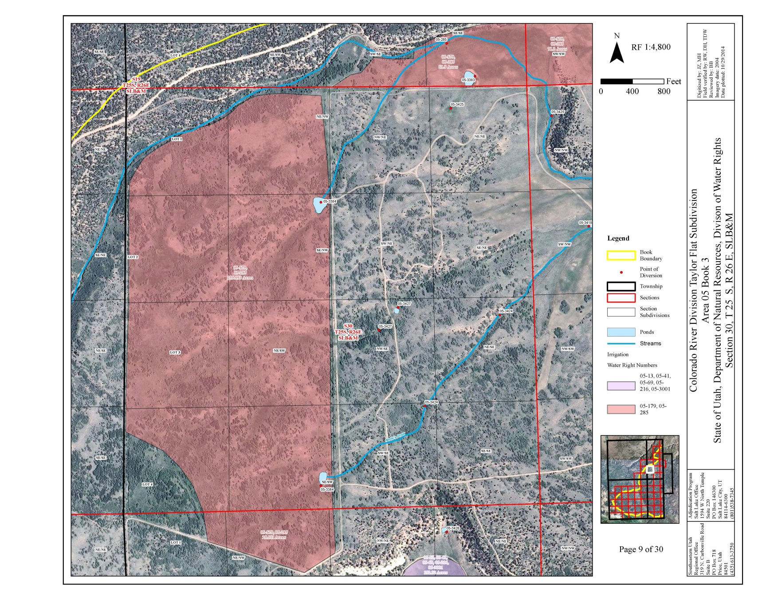
Taylor Flat Proposed Determination
Hydrographic Survey Maps
Map North Arrow & Scale
Map Legend
Map Location

Slide 29
Taylor Flat Proposed Determination
Hydrographic Survey Maps
Proposed Determination Boundary Line

Slide 30
Taylor Flat Proposed Determination
Hydrographic Survey Maps
Points of Diversion

Slide 31
Taylor Flat Proposed Determination
Hydrographic Survey Maps
Section Lines

Slide 32
Taylor Flat Proposed Determination
Hydrographic Survey Maps
Section Subdivisions
(40-acre Tracts)

Slide 33
Taylor Flat Proposed Determination
Hydrographic Survey Maps
Ponds & Streams

Slide 34
Taylor Flat Proposed Determination
Hydrographic Survey Maps
Irrigated Acreage

Slide 35
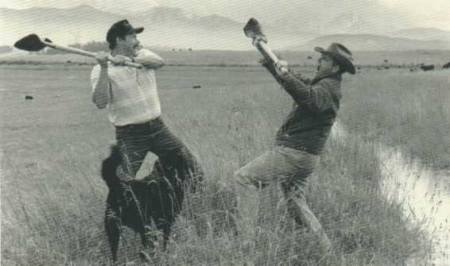
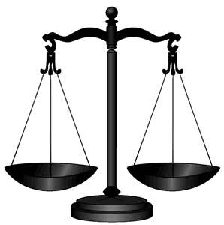

Objections
I OBJECT!
If water users disagree with a proposed determination they may file an objection with the court within 90-days of service.
  Must be verified on oath.
  Filed with the clerk of the respective District Court.
ME TOO!
SQUIRREL!
Appeal?
Voluntary Withdrawal
Objection Withdrawn
Objection Filed
Settlement
Court Order
Proposed Determination
Questions of Fact & Law
Litigation
Notes:
As mentioned earlier, occasionally a water user will disagree with the content of the Proposed Determination—whether it’s regarding their own water right or someone else’s water right. When this occurs, they have the option of filing an objection within 90 days of the publish date of the PD. An official objection must be verified by oath and filed with the respective District Court. Informal or defective objections failing to meet the statutory requirements may be handled through other means, but they aren’t binding on the Proposed Determination. The court may be petitioned to allow a late objection.
Once an objection is filed, there are a couple of options in how it may be handled. The State Engineer usually attempts to settle the objection without going through costly and time-consuming litigation. Often this involves meeting with the parties and attempting to stipulate a settlement in exchange for withdrawal of the objection.
If an agreement can’t be made, the objection may lead to litigation. Occasionally the objection is between two separate parties and the State Engineer will simply file a response to the objection and let the two parties battle it out in court. When the objection is litigated before a court, the Proposed Determination is reviewed in terms of questions of fact and law. Eventually the court will render a decision and issue a court order either recognizing the Proposed Determination or amending some aspect of it. The parties and the State Engineer have a 30-day window to file an appeal if they choose to.

Slide 36
Who can I contact to discuss the
Adjudication Process?
Blake Bingham, P.E.
Adjudication Program Manager
Phone: 801-538-7345
E-mail: blakebingham@utah.gov
Chris York, E.I.T.
Adjudication Engineer
Phone: 385-226-7805
E-mail: cyork@utah.gov
Randy Tarantino
Adjudication Specialist
Phone: 801-664-8452
E-mail: randytarantino@utah.gov
Mike Handy, P.G.
Adjudication Team Leader
Phone: 801-538-7463
E-mail: mikehandy@utah.gov
Josh Zimmerman
Adjudication Team Leader
Phone: 801-946-7168
E-mail: joshzimmerman@utah.gov
Utah Division of Water Rights
1594 West North Temple
Suite 220, PO Box 146300
Salt Lake City, UT 84114-6300
www.waterrights.utah.gov

Slide 37

Questions?
Notes:
Questions?

