Slide 1

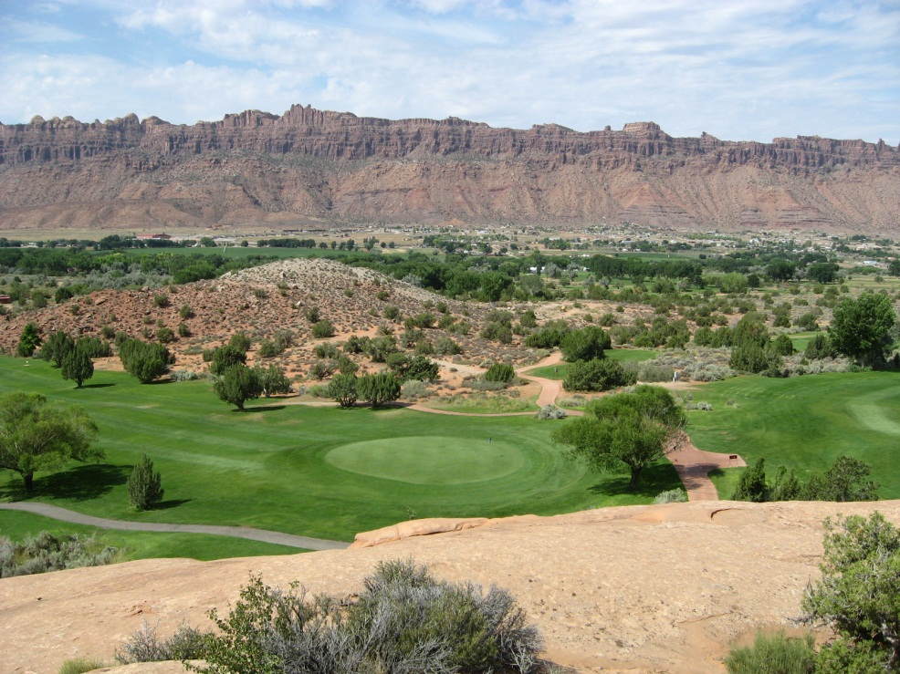

Moab/Spanish Valley
Public Meeting
April 16, 2014

Slide 2
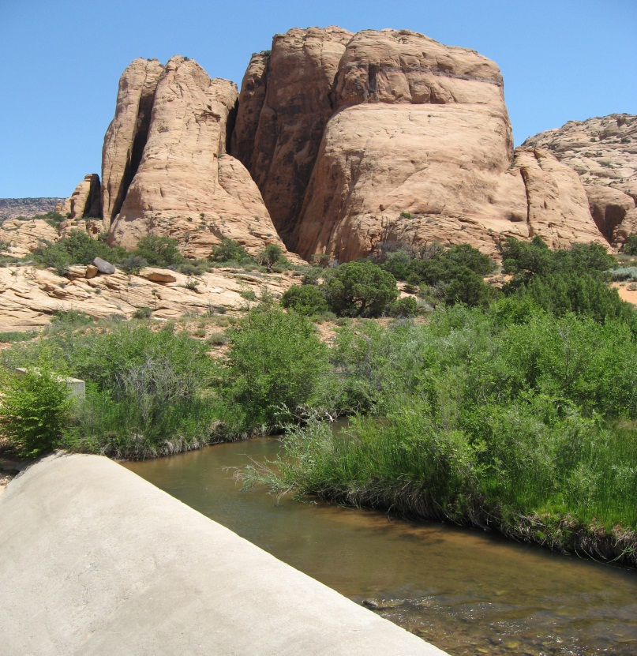
Current Water Rights Policy
Moab/Spanish Valley Public Meeting
April 16, 2014

Slide 3
Moab/Spanish Valley Drainage
Mill Creek Confluence with Colorado
4952 feet
Mount Tukuhnikivatz
12482 feet
Lasal Mtn precipitation gage (9850 ft)
35.9 inches/year
Moab precipitation
9.02 inches

Slide 4
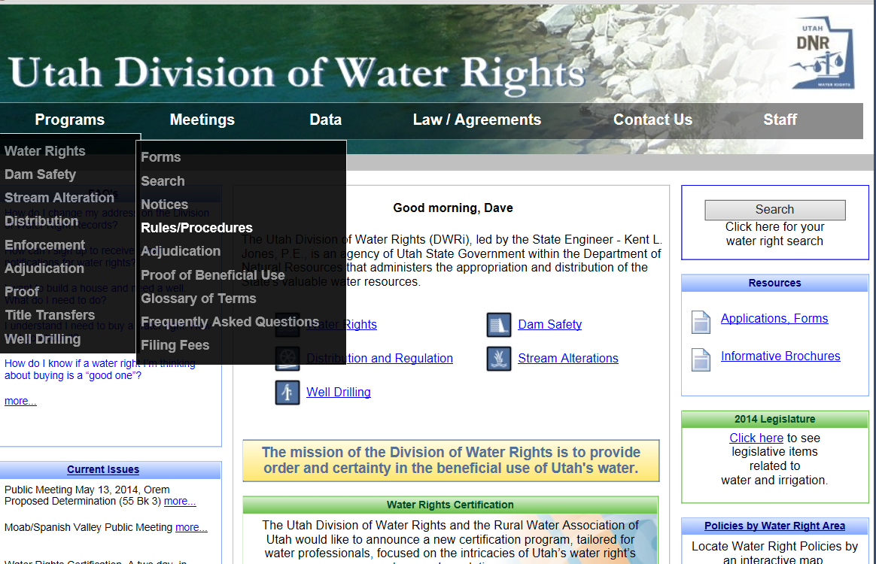
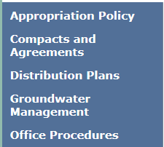
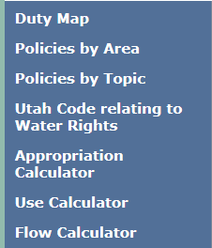
www.waterrights.utah.gov

Slide 5
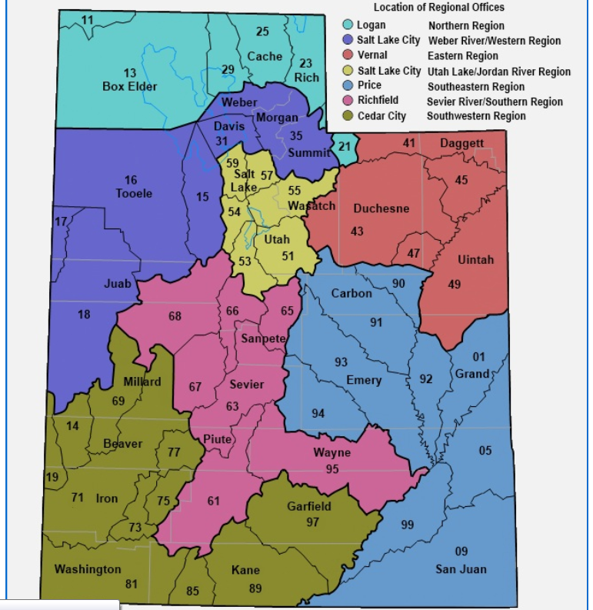
05 Area

Slide 6
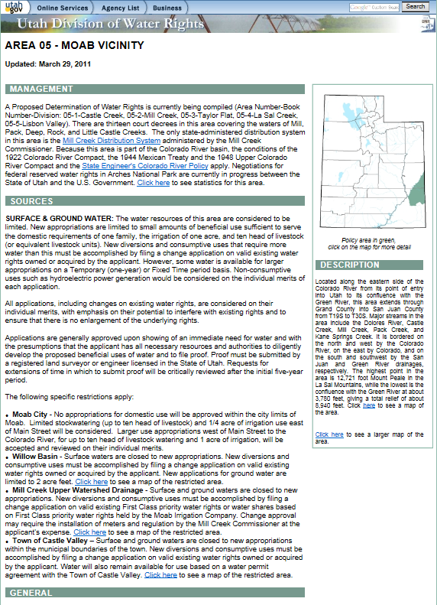
Policy Page
Moab City
Mill Creek Upper Drainage

Slide 7
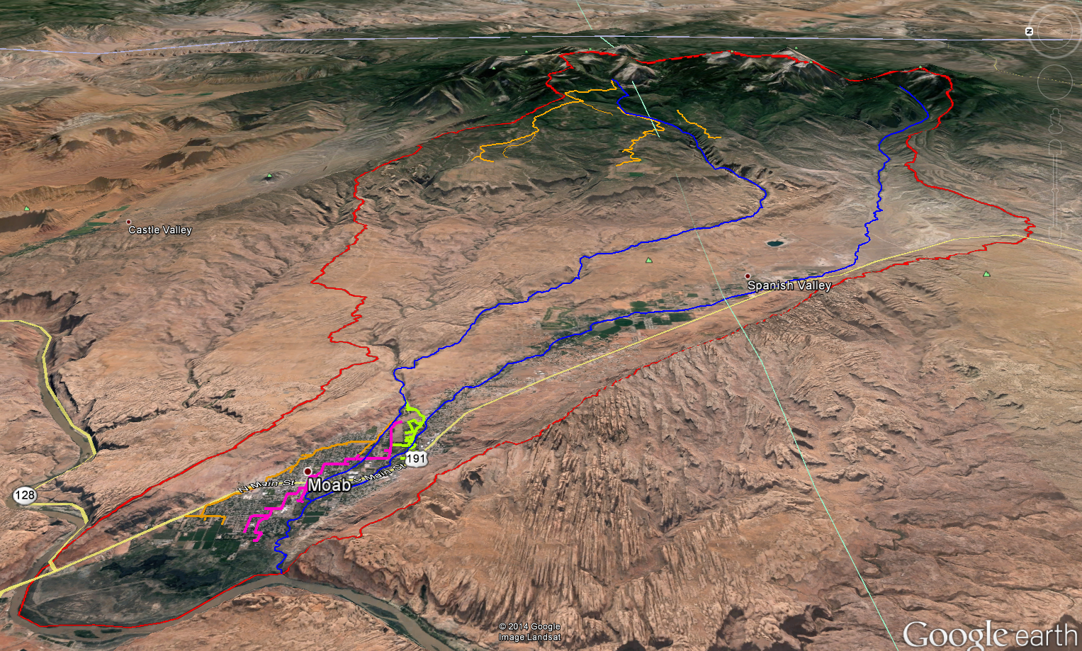
Moab/Spanish Valley Watershed
Warner Lake
Mill Creek
Kens Lake
Pack Creek
Powerhouse Dam
San Juan County
Grand County

Slide 8
Moab/Spanish Valley
Surface Water
New appropriations evaluated on own merits
Permanent change applications evaluated on own merits
May require installation of meters
May be regulated by River Commissioner
Ground Water
Open to new appropriations
1 Home, 1 acre irrigation, 10 head livestock

Slide 9
Mill Creek Drainage
Surface and Ground Water
Closed to new appropriations
Must file permanent change on a first class
May require installation of meters
May be regulated by River Commissioner

Slide 10
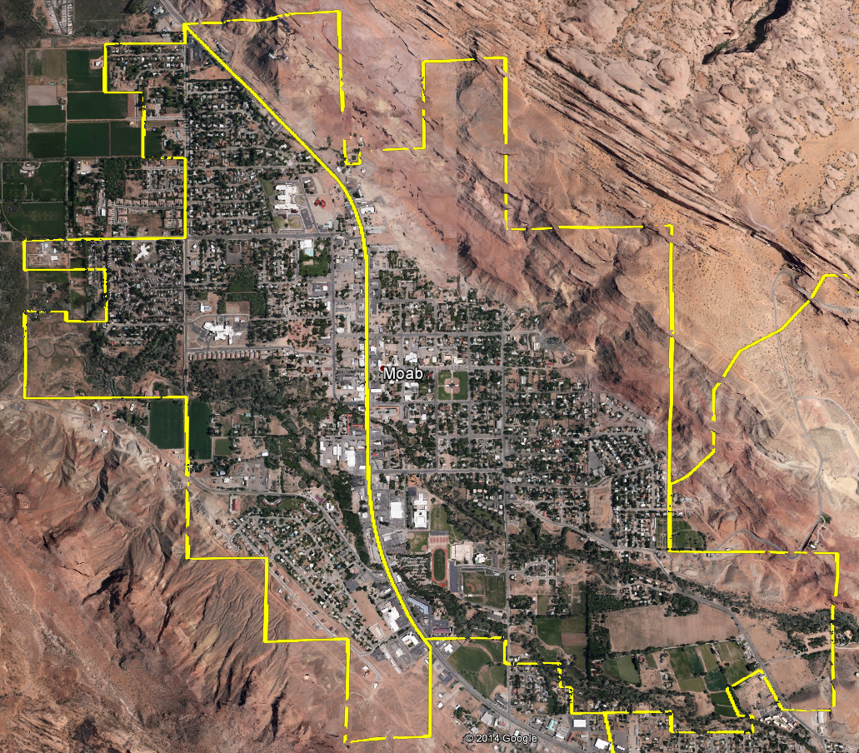
Moab City Limits
East of Main Street
No Appropriation for Homes
0.25 acre irrigation
10 head of livestock
West of Main Street
No Appropriation for Homes
1.0 acre irrigation
10 head of livestock

Slide 11
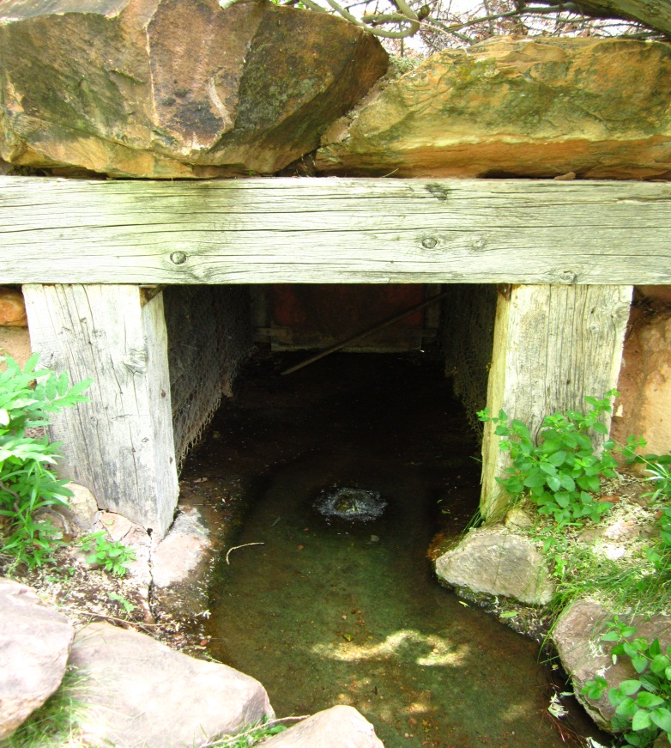
Groundwater Management Plans
Moab/Spanish Valley Public Meeting
April 16, 2014

Slide 12
Groundwater
Management Plans
Clarifying legislation enacted in 2006
Established Section 73-5-15 of Utah Code
Tool to help the State Engineer distribute groundwater

Slide 13
Section 73-5-15
(2)
  (a) The state engineer may regulate groundwater withdrawals within a specific groundwater basin by adopting a groundwater management plan in accordance with this section for any groundwater basin or aquifer or combination of hydrologically connected groundwater basins or aquifers.

Slide 14
Section 73-5-15
(2)
  (b) The objectives of a groundwater management plan are to:
    (i) limit groundwater withdrawals to safe yield;
    (ii) protect physical integrity of the aquifer; and
    (iii) protect water quality

Slide 15
Section 73-5-15
(1) As used in this section:
  (a) “Critical management area” means a groundwater basin in which the groundwater withdrawals consistently exceed the safe yield.
  (b) “Safe yield” means the amount of groundwater that can be withdrawn from a groundwater basin over a period of time without exceeding the long-term recharge of the basin or unreasonably affecting the basin’s physical and chemical integrity.

Slide 16
Section 73-5-15
(3)
  (a) In developing a groundwater management plan, the state engineer may consider:
    (i) the hydrology of the groundwater basin;
    (ii) the physical characteristics of the groundwater basin;
    (iii) the relationship between surface water and groundwater, including whether the groundwater should be managed in conjunction with hydrologically connected surface waters;

Slide 17
Section 73-5-15
(3)
  (a) In developing a groundwater management plan, the state engineer may consider:
    (iv) the conjunctive management of water rights to facilitate and coordinate the lease, purchase, or voluntary use of water rights subject to the groundwater management plan;
    (v) the geographic spacing and location of groundwater withdrawals;
    (vi) water quality;

Slide 18
Section 73-5-15
(3)
  (a) In developing a groundwater management plan, the state engineer may consider:
    (vii) local well interference; and
    (viii) other relevant factors

Slide 19
Section 73-5-15
(3)
  (b) The state engineer shall base the provisions of a groundwater management plan on the principles of prior appropriation

Slide 20
Section 73-5-15
(3)
  (c)
    (i) The state engineer shall use the best available scientific method to determine safe yield.
    (ii) As hydrologic conditions change or additional information becomes available, safe yield determinations made by the state engineer may be revised...

Slide 21
Section 73-5-15
(4)
  (a)
    (i) Except as provided in Subsection (4)(b), the withdrawal of water from a groundwater basin shall be limited to safe yield.
    (ii) Before limiting the withdrawals in a groundwater basin to safe yield, the state engineer shall:
      (A) determine the groundwater basin’s safe yield; and
      (B) adopt a groundwater management plan for the groundwater basin.

Slide 22
Section 73-5-15
Other Provisions
  Process for public notice and involvement
  Effective date of the plan
  Notice of the final plan
  Filing an appeal
  Amending a plan
  Existing plans are recognized

Slide 23
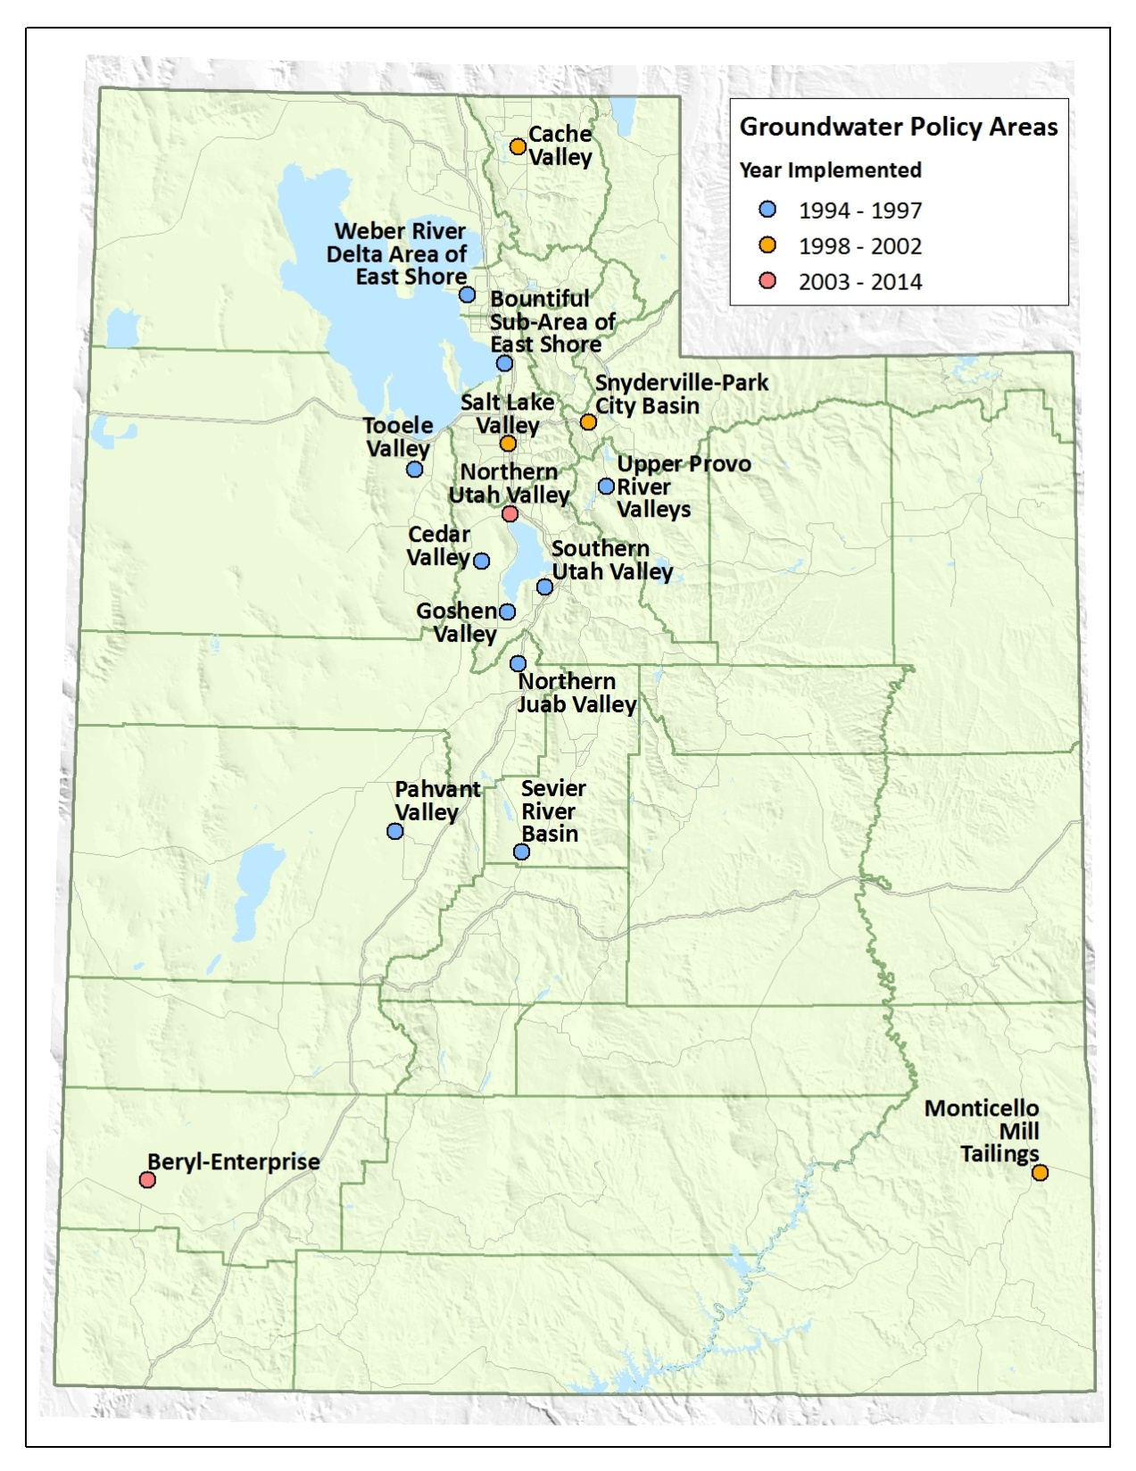

Slide 24
Recently Implemented Plans
Since enactment of 73-5-15, two groundwater management plans have been implemented
  Beryl-Enterprise (2012)
    Critical Management Area
  Cedar Valley and Northern Utah Valley (2014)
    Not a Critical Management Area
    Plan set safe yield and policies to prevent exceeding safe yield

Slide 25
Safe Yield
Recharge is a starting point
May be less than recharge to protect physical integrity of the aquifer and water quality
Recharge is verified from a water budget
  Inflows (recharge) = Outflows (discharge) + Change in storage

Slide 26
Water Budget
  Recharge
    Precipitation
    Infiltration of runoff
    Return flow from irrigation or other water uses
  Discharge
    Evapotranspiration
    Well diversions
    Discharge to springs and rivers
  Change in Storage
    Change in groundwater levels

Slide 27
Moab/Spanish Valley
Past studies
  C.T. Sumsion, USGS, 1971
  Phil Gardner, University of Utah, 2004
  Mike Lowe, Janae Wallace, Stefan M. Kirby, and Charles E. Bishop, UGS, 2007
  Several other reports

Slide 28
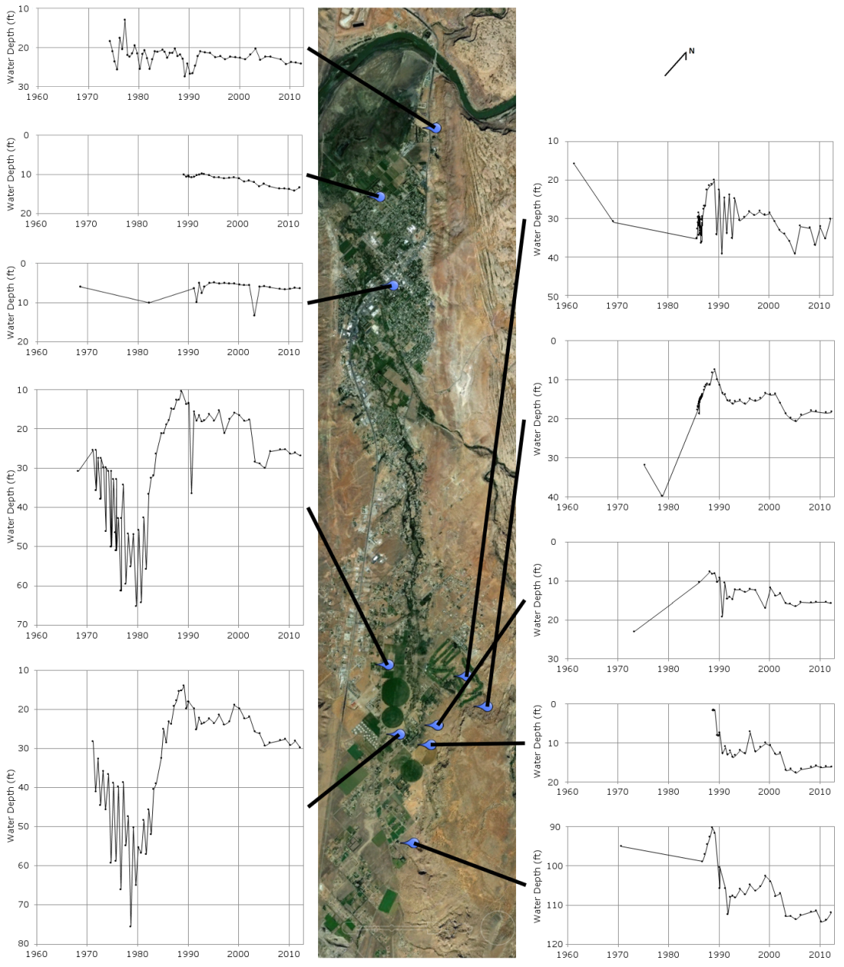
Moab/Spanish Valley
Change in storage
  Groundwater levels appear to be generally stable (little change in storage)
  Recharge = Discharge

Slide 29
Moab/Spanish Valley
Recharge
  Difficult to estimate
  Many unknown components
    Recharge boundaries
    Precipitation infiltration rate and contribution of surrounding sandstone
    Ken’s Lake seepage
  Past reports use discharge to estimate recharge rather than estimating them independently and verifying

Slide 30
Moab/Spanish Valley
Discharge
  Not directly measurable
    Recharge/discharge a small fraction of Colorado River flow
  Good estimates of:
    Evapotranspiration (Irrigation and Wetlands)
    Municipal well diversions
  Differing estimates of:
    Spring discharge
    Discharge to Colorado River

Slide 31
Moab/Spanish Valley
Discharge to Colorado River
  Sumsion 1971 – 8,000 AF
    Estimated recharge as 14,000 AF
  Gardner 2004 – 100 to 1,500 AF
    No recharge estimate
More information is needed to determine safe yield

Slide 32
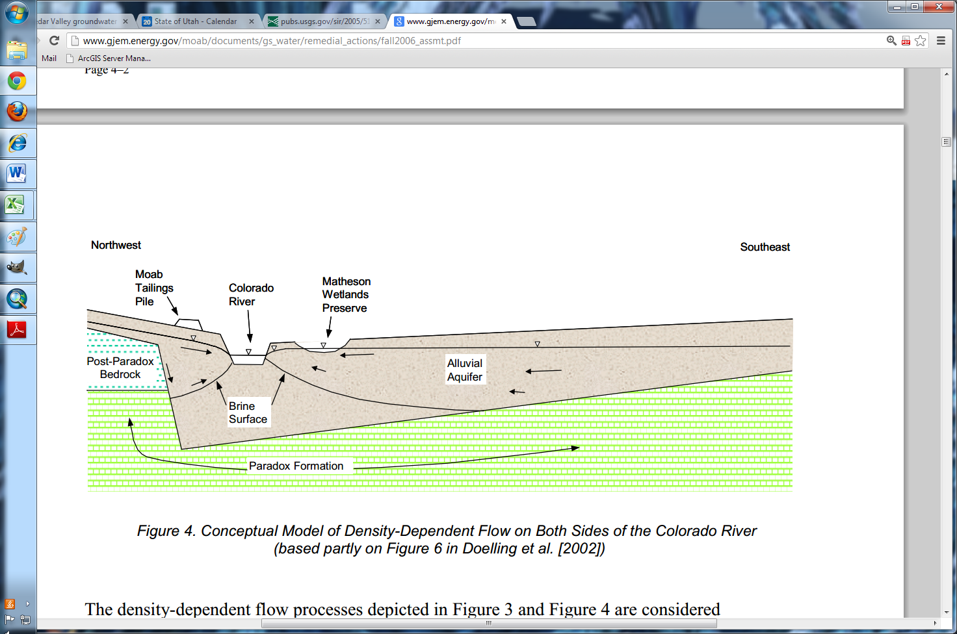
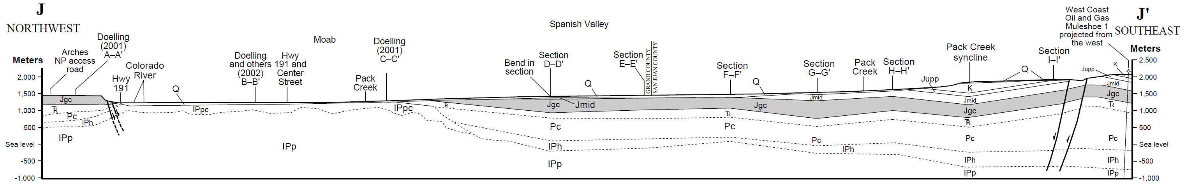
Moab/Spanish Valley
Water quality
Modified Figure 4, Fall 2006 Assessment of Matheson Wetlands Hydrogeology and Ground Water Chemistry, Moab UMTRA Project, DOE, 2007
Part of Plate 3, UGS Special Study 120

Slide 33
Moab/Spanish Valley
Depletion amounts for perfected and approved groundwater rights
    Irrigation ≈ 6,000 AF/yr
    Municipal ≈ 13,000 AF/yr
    Other Uses ≈ 2,500 AF/yr
  Total ≈ 21,500 AF/yr
  Current depletion ≈ 25%

Slide 34
Summary
  Groundwater withdrawals currently do not appear to exceed safe yield
  Potential groundwater withdrawals based on approved and perfected water rights may exceed safe yield
  A groundwater management plan will help ensure that groundwater withdrawals do not exceed safe yield
  Additional hydrologic information is needed prior to developing and implementing a groundwater management plan

Slide 35
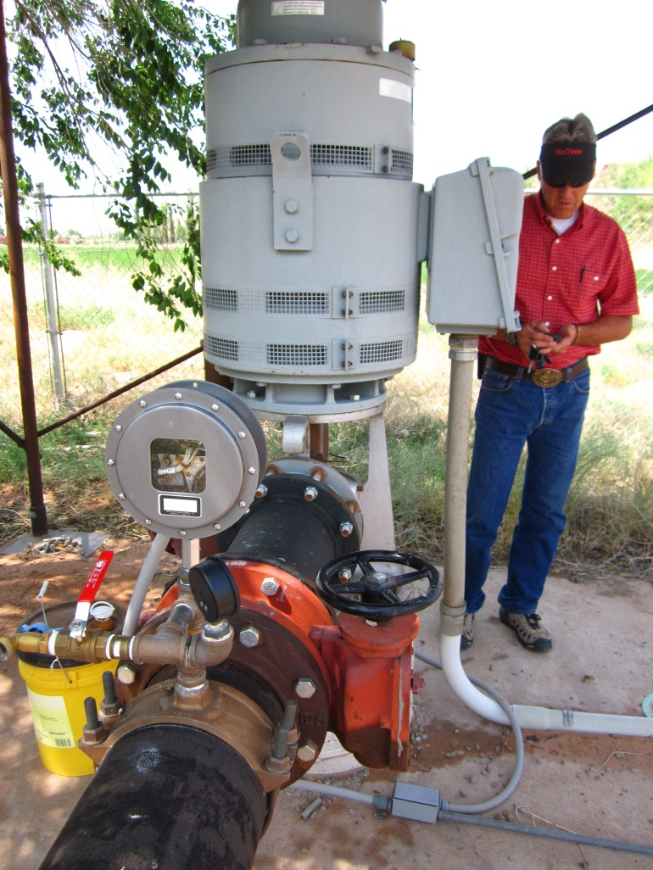
Next Steps
Moab/Spanish Valley Public Meeting
April 16, 2014

Slide 36
Next Steps:
Development of a Technical Work Group
Collection of Additional Hydrologic Data
Collection of Additional Water Quality Data
Review and Analysis of Data
Recommendations to State Engineer

Slide 37
Technical Work Group:
Suggested Involvement from:
  Division of Water Rights / Water Quality
  Grand / San Juan Counties
  Moab City
  Grand Water & Sewer Service Agency
  San Juan Spanish Valley Special Service District
  State Institutional Trust Lands Administration
  Forest Service / BLM
  Moab Area Watershed Partnership
  NGO’s / Private Well Owners

Slide 38
Technical Work Group:
Purpose:
  Provide Scope of Work for Research Studies
  Assist in Funding for Research Studies
  Receive Regular Updates from Research Studies
  Review and Provide Analysis of Completed Studies
  Provide Recommendations to State Engineer

Slide 39
Collection of Additional Data:
Hydrology
  Surface / Underground
  Recharge, Discharge, Safe Yield
Physical Characteristics of Basin Aquifers
  Alluvial, Bedrock, Faults, Divides
Water Quality
Water Rights Inventory / Current Water Use

Slide 40
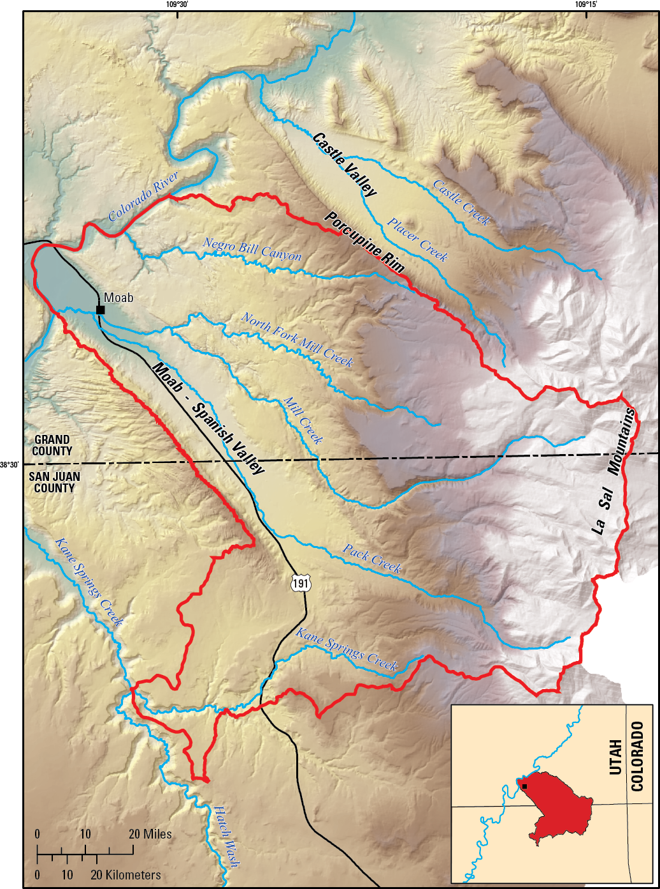
Proposed USGS Study
Objectives
  Refine estimates of selected groundwater recharge and discharge budget components
  Improve conceptual understanding of the aquifer system and hydraulic connection between aquifers
Figure 1, USGS Study Proposal

Slide 41
Collection of Additional Data:
Proposed U.S. Geological Survey Study (2015-2017)
  Develop New Estimate of Groundwater Recharge
  Estimation of Spring Discharge
  Stream Seepage Studies
  Estimation of Well Withdrawals
  Estimation of Evapotranspiration
  Estimation of Discharge to Colorado River
  Definition of Groundwater Divides
  Groundwater Chemistry and Dating

Slide 42
Final Steps:
Review and Analysis of Data
Recommendations to State Engineer
  Economic Impacts
    Individual Water Users
    Local Community
  Timing of Implementation

Slide 43
Possible Outcomes:
Stay with Current Open but Limited Appropriation Policy
Place More Restrictions on Appropriation Policy
Close the Valley to New Appropriations / Limit Change Applications to within the Valley

Slide 44
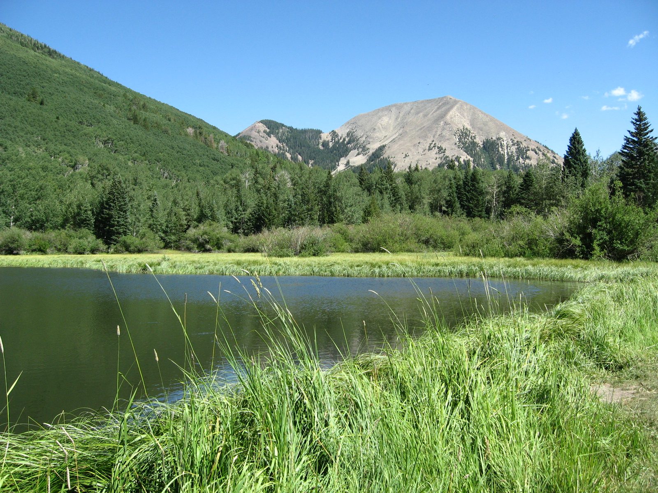
Thank You… Any Questions?
Address for written comments
  Utah Division of Water Rights
  Marc Stilson, Regional Engineer
  319 North Carbonville Road
  P.O. Box 718
  Price, UT 84501

