Slide 1

If my body were a car, this is the time I would be thinking about trading it in for a newer model. I've got bumps and dents and scratches in my finish and my paint job is getting a little dull... But that's not the worst of it. My headlights are out of focus, and it's especially hard to see things up close. My traction is not as graceful as it once was. I slip and slide and skid and bump into things even in the best of weather. My whitewalls are stained with varicose veins. It takes me hours to reach my maximum speed. My fuel rate burns inefficiently. But here's the worst of it. Almost every time I sneeze, cough or sputter, Either My Radiator Leaks or My Exhaust Backfires!

Slide 2
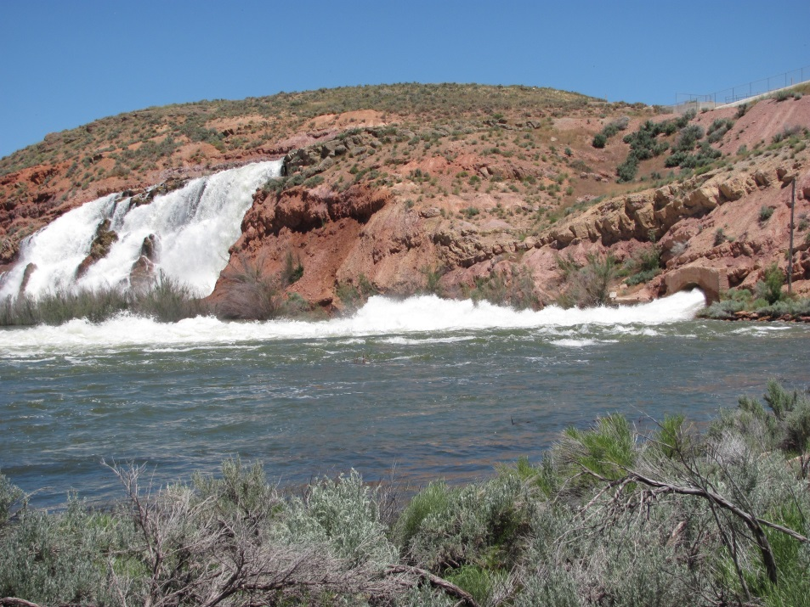
Rural Water Association
WATER RIGHT TRAINING
Water Right Basics
John Mann, P.E.
Assistant State Engineer
Utah Division of Water Rights
April 10-11, 2014

Slide 3
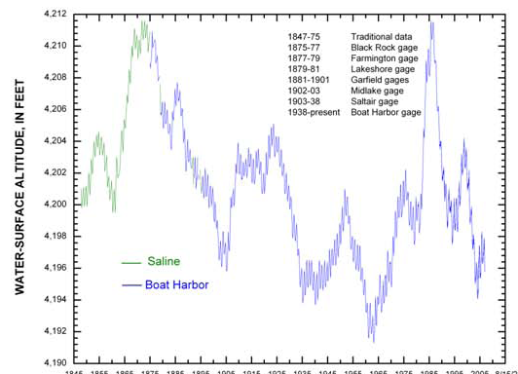
Notes:
Why are water rights important?

Slide 4
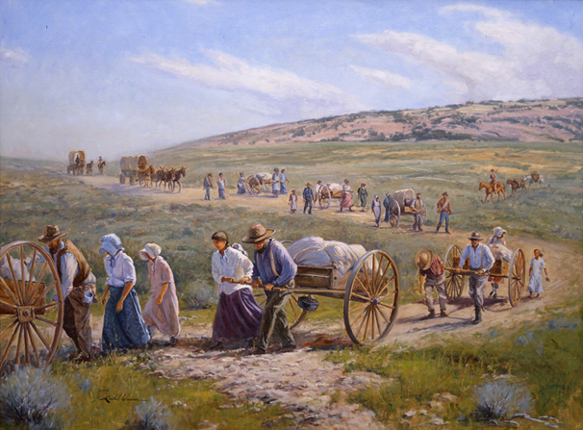
Notes:
1847 entry of Mormon pioneers into the SL Valley. 2095 emigrants in 1847. Created the state of Deseret. 5,133 acres cultivated, 450 log cabins built, a municipal council organized, and a water master appointed.
By the turn of the century most of the surface water was fully appropriated. Groundwater is also fully appropriated in most areas of the state.
Now 2010 population was 2.8 million and over 1 million in Salt Lake County alone.

Slide 5
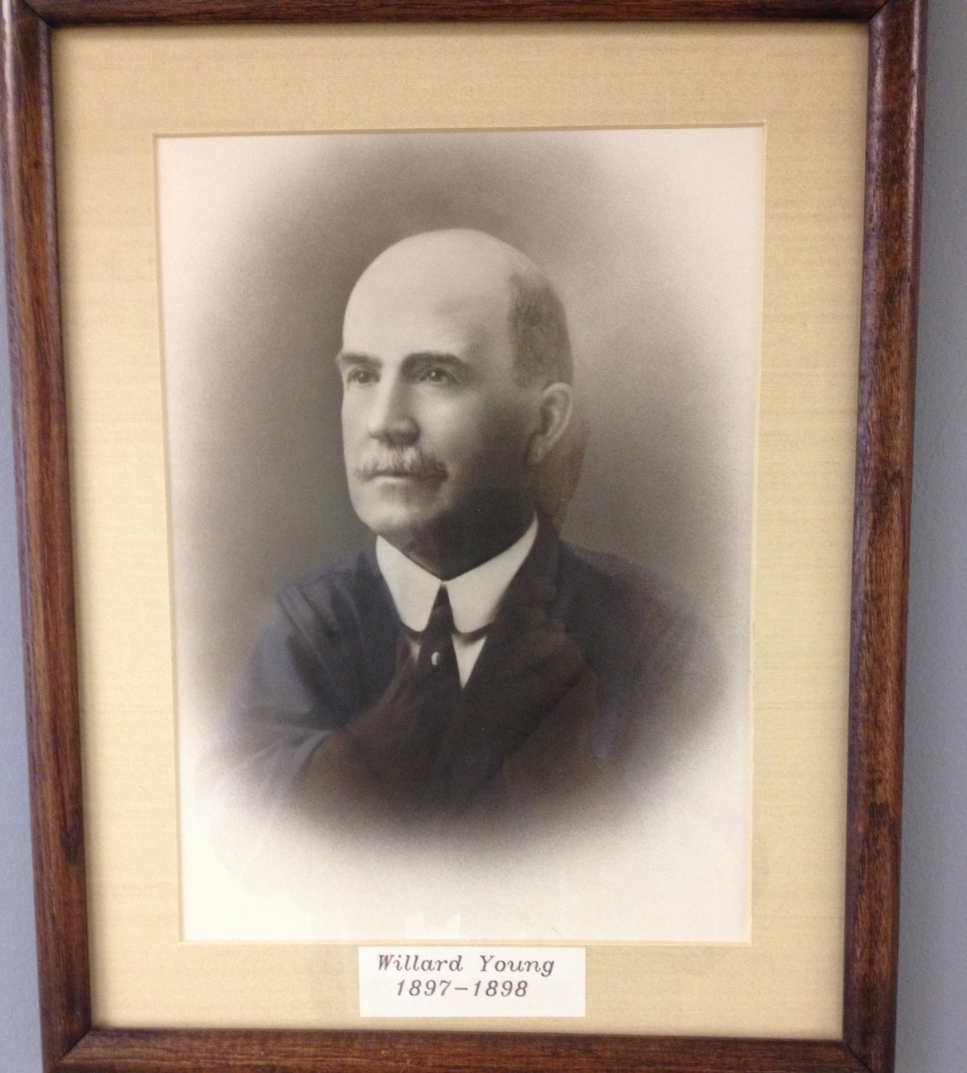
Notes:
Who is this guy? Initial duties of the state engineer were to aid in planning, design and construction of water storage and conveyance facilities.
1903 first codified water law as a state.

Slide 6
Content of RWA Training
Water Right Basics
Water Right Applications
Title to water rights
Proof
Public Water Suppliers
Well Drilling
Adjudication
Distribution
Water Use Groups
Data Base Demonstration

Slide 7
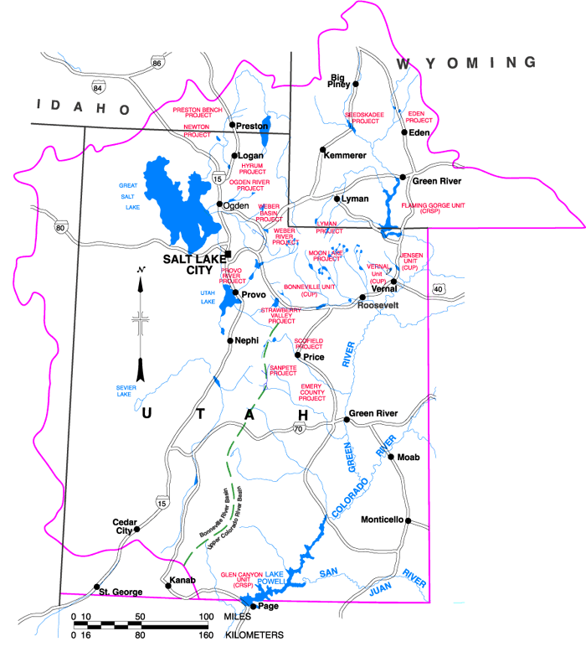
Water right issues …
Are they:
Local,
Statewide,
National?
Notes:
Water right issues that affect Utah can be local, statewide, or related to many states. Growing populations make water issues more critical. EG: Georgia, other western states such as CO, AZ, NV, CA.

Slide 8
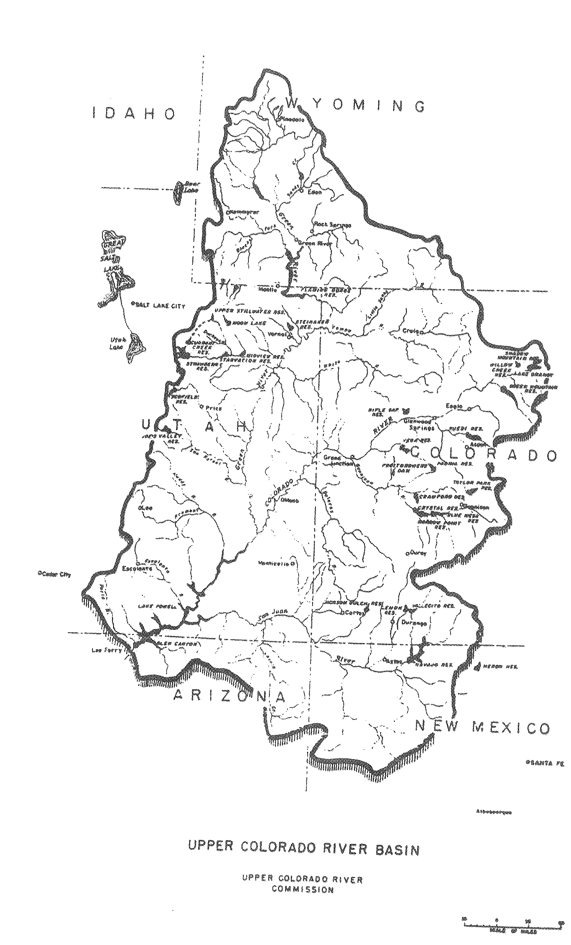

Notes:
Notice on the map of the Upper Colorado River Basin that it encompasses the eastern half of the state. What about SW Utah – St George? Virgin River? They are in the Lower Basin.
Note that the Green River, Colorado River, San Juan River, Virgin River, Bear River and others are interstate streams.

Slide 9
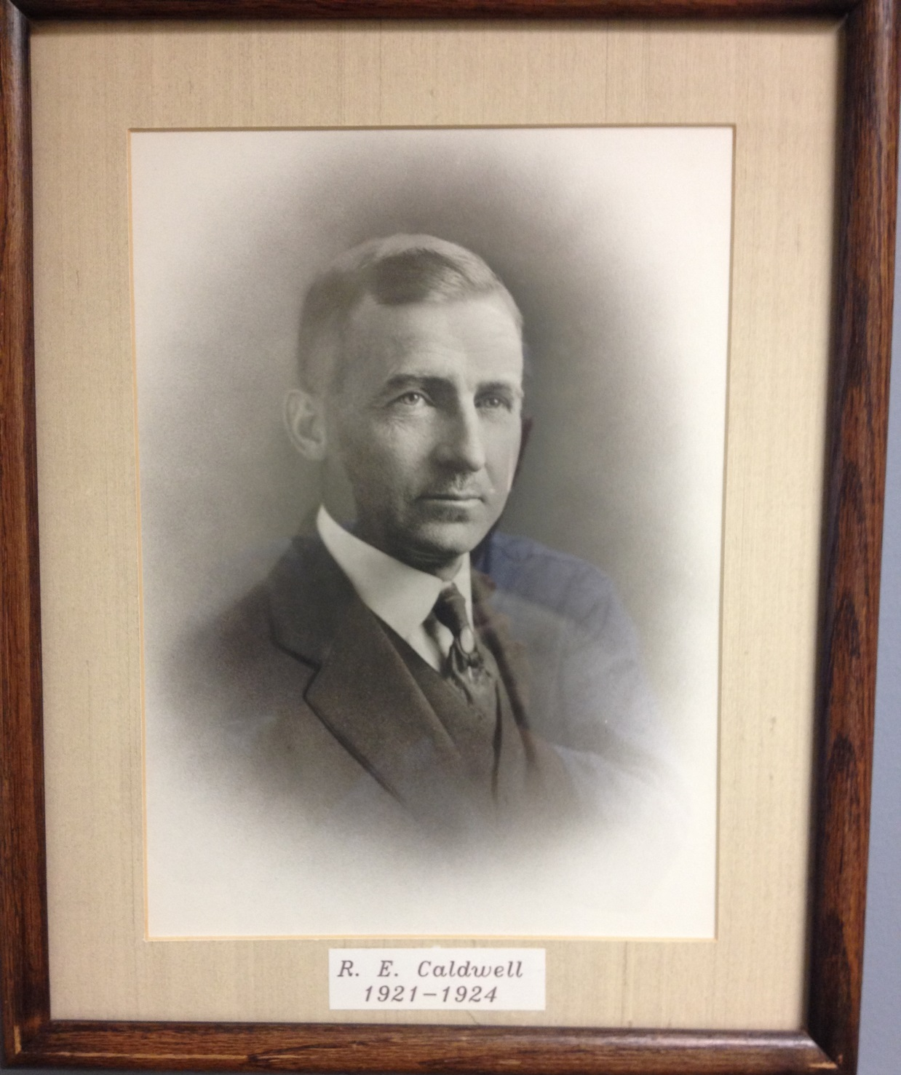
Notes:
Who is this guy? Former state engineer and signer of the Colorado Compact of 1922 – an agreement signed 92 years ago. Do you think that the individuals that made that agreement foresaw the issues we face today?
Did the NV state representative envision a Las Vegas and its 21st century water needs? The CO representative – did he realize the water needs of the front range? What might happen if the Compact is renegotiated?
The current state engineer also is involved with decisions that could have repercussions well into the future.

Slide 10
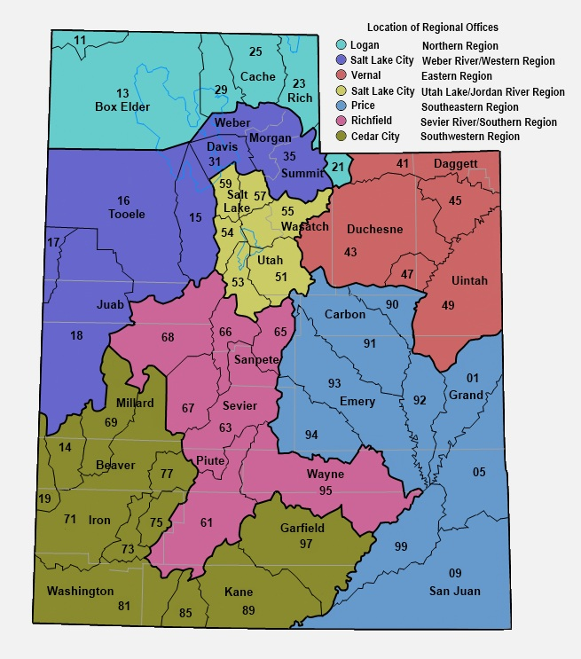
Notes:
Whatever your individual focus on water rights may be there is one point that should be clearly understood – actions on Water Rights do not make more water. Water rights only establish who gets to use the available water.
While I am on this slide there are a few things to note. The organization of the state into “regions”, being the differently colored areas, representing primarily river drainages. Note the legend in the top right.
Then within the regions there are “areas” being represented by the 2 digit numbers. These 2 digit numbers are the first 2 numbers in every water right in that area. EG: 35 for the Weber, 57 and 59 for the Jordan River in Salt Lake County. Where there is no major river system such as the west desert, the boundaries follow geographic features creating drainages.
Application numbers differ from Water Rights Numbers in that they are assigned to applications sequentially irregardless of where in the stae the water right is located. Application Numbers begin with a letter. A for applications to appropriate, a for change applications, D for diligence claims, U for underground water claims, F for fixed time applications, T for temporary appropriations, t for temporary change applications.

Slide 11
Utah Constitution
Article XI, Section 6. No municipal corporation, shall directly or indirectly, lease, sell, alien or dispose of any waterworks, water rights, or sources of water supply now, or hereafter to be owned or controlled by it; but all such waterworks, water rights and sources of water supply now owned or hereafter to be acquired by any municipal corporation, shall be preserved, maintained and operated by it for supplying its inhabitants with water at reasonable charges: Provided, That nothing herein contained shall be construed to prevent any such municipal corporation from exchanging water-rights, or sources of water supply, for other water-rights or sources of water supply of equal value, and to be devoted in like manner to the public supply of its inhabitants.

Slide 12
Utah Code Title 73
Water and Irrigation
73-1-4
(1)(b) Public Water Supplier: supplies water to the public
for municipal, domestic or industrial use.
May be a public entity, water corporation, a community
water system or a water users association.
(2)(a) When a water user ceases to use all or a portion
of a water right for a period of seven (7) years the portion
not used is subject to forfeiture.

Slide 13
Beneficial Use is the measure and limit
of all water rights. UCA 73-1-3
When buying water rights, make certain that you are bargaining for a suitable right.
All water rights have:
a point of diversion,
a source of supply,
use(s) of water,
diversion and depletion,
a priority,
and an owner(s).

Slide 14
Beneficial Use is the measure and limit
of all water rights.
Point of Diversion and Source:
Surface? Single location or point to point?
Spring? Is there a box or specific location?
Drain? How is it defined?
Well?
Is the source constant or ephemeral?
Uses of Water:
Is the beneficial use year round or part year?
Is the water right a sole supply or supplemental right?
Has the water been consistently used?
Diversion and depletion of water?
Notes:
Surface right is probably a decreed right with a priority of 1903 or earlier. Remember that most of the surface water was fully appropriated by 1903.
A well or other groundwater right is probably filed after 1935 but could be and underground water claim.
Springs are often sources of supply for diligence claims filings for stockwater.

Slide 15
Beneficial Use is the measure and limit
of all water rights.
Priority:
Surface rights are frequently regulated by priority.
Generally, the priority of a right is the date of filing
of the application for an unperfected application
or a certificated filing.
The priority of a perfected right is the date of first use for
a diligence claim, the date shown in a decree, or the date
shown on the certificate of appropriation.
Ownership:
If you are purchasing a water right, make certain that the person
selling it actually owns what is being sold. Do not rely solely on
the Division’s records for this.
Notes:
Beware of trust deeds. Get a warranty deed. If you are selling land that has water rights associated with it be careful that you don’t unintentionally convey the water rights by appurtenance.
Why am I emphasizing the Beneficial Use concept? It is a bedrock principle of water law.

Slide 16
How are Water Quantities Measured?
UCA 73-1-2 Flow is measured in cfs.
Volume is measured in acre-feet.
How does this come into play in water rights?
Why is it important to consider both flow and volume?
Notes:
Roughly 1 cfs flowing for 24 hours will deliver a volume of 2 acre-feet.
As we go through this training other presenters will talk about issues involving flow, volume and supplemental rights. EG if you have a water right that has a flow of .5 cfs and the use of water is to irrigate 10 acres, can it be done? What if the use is 200 acres? .5 cfs x7/12x2x365= 200 acre-feet +/-. Using a 4 af/ac irrigation duty .5 cfs can irrigate about 50 acres. Don’t think that a right for irrigation with a flow rate has the ability to divert a volume = the flow rate x 2 x 365. Account for the seasonal nature of the use.

Slide 17
Diversion and Depletion
Diversion is the amount of water that can be taken from a source
and applied to beneficial use. It can be limited by either the flow
(by cfs) or volume (acre-feet). The diversion of water and its
beneficial use are limited by the water right. When a diversion
amount is determined for change applications, they are usually based
on a duty for the use(s).
Depletion is the amount of water consumed in the process of
beneficially using the water. It is considered lost to the system.
The difference between the diversion and depletion is returned
to the system and should be available to other users.
Notes:
Either amount can limit a water right. Even for municipal uses on change applications both the diversion and depletion amounts for the rights being changed are considered in approval of the change application.
Example?

Slide 18
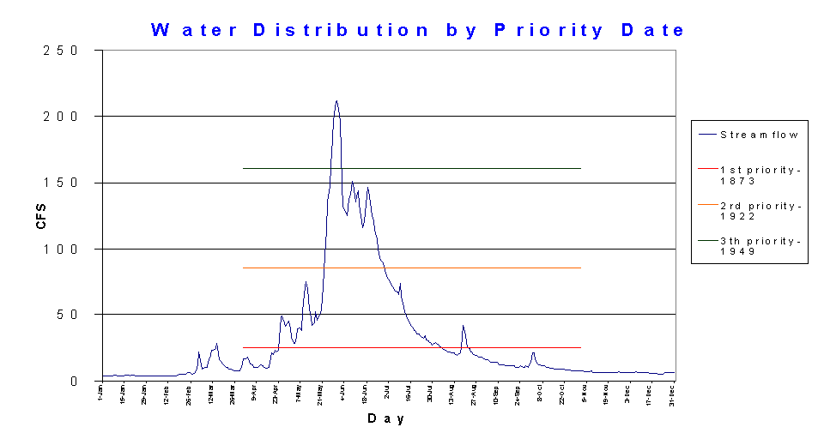
Distribution by Priority
Notes:
Jared Manning will talk more about distribution issues later today but for the sake of illustrating typical streamflow note that it peaks during snowmelt runoff May-June. What does this have to do with considerations for water right issues? Note the available supply for the priorities of the rights on the stream. Decisions and evaluations of this element of water rights occur when change applications are made.
Groundwater recharge typically follows the same pattern with a lag or attenuation due to the time for the water entering the aquifer. Yes – the water year is extremely important to both streamflows and to groundwater supply.

Slide 19
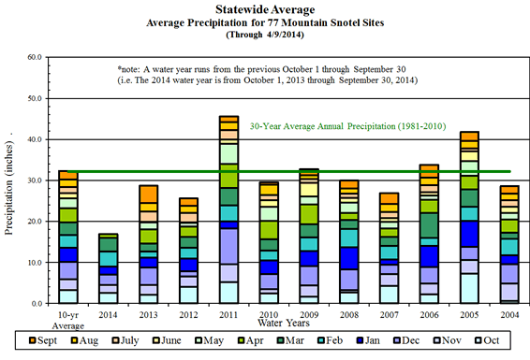

Slide 20
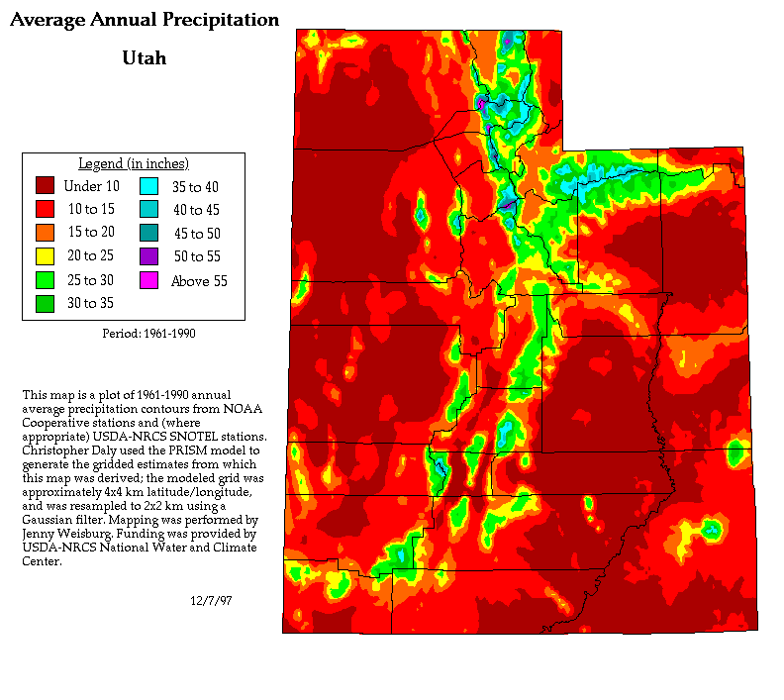

Slide 21
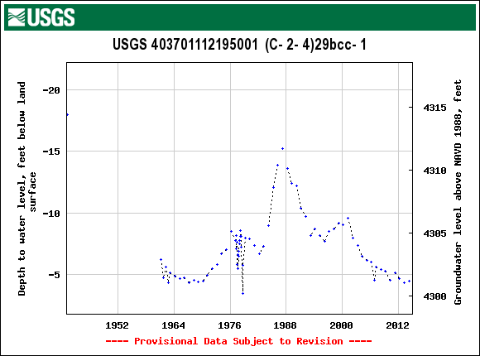
Tooele Valley graph of depth to groundwater vs time
Notes:
Note the impact of the high water years during the mid ‘80s. Typical of most, if not all, areas of the state where groundwater levels react to the water received as snow.

Slide 22
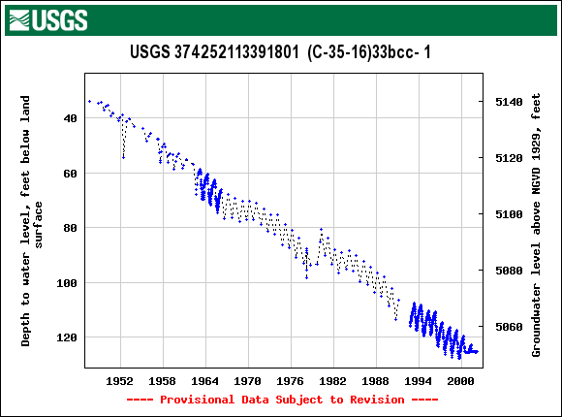
Beryl – Enterprise graph of depth to groundwater vs time
Notes:
Note the steady decline in this well. Not atypical of groundwater conditions in some of the more arid basins in the state. The consequences for over pumping groundwater can be land subsidence, loss of storage in the aquifer, and a reduction in water quality.

Slide 23
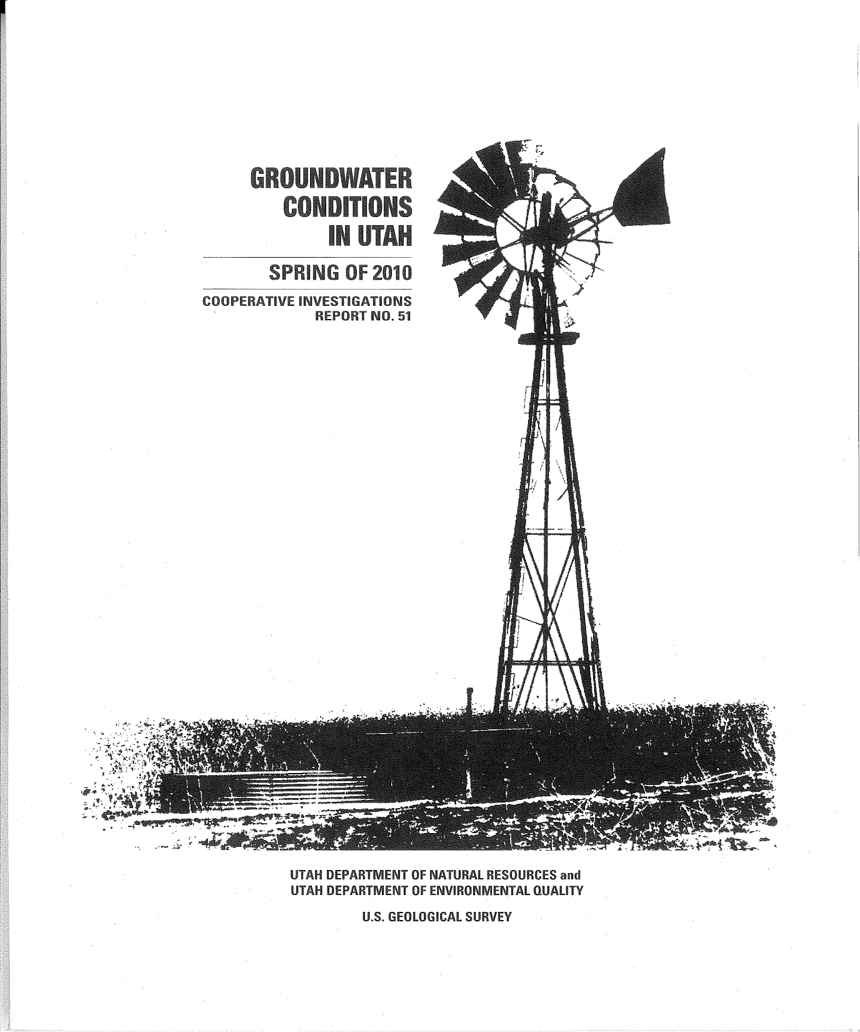

Slide 24
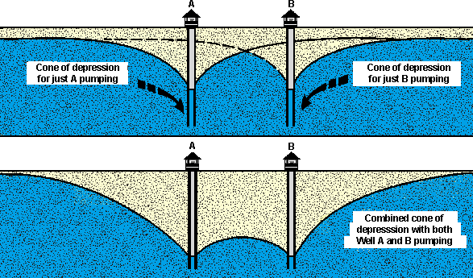
Well interference
If the cones of depression for two or more wells overlap, there is said to be well interference. This interference reduces the water available to each of the wells.

Slide 25
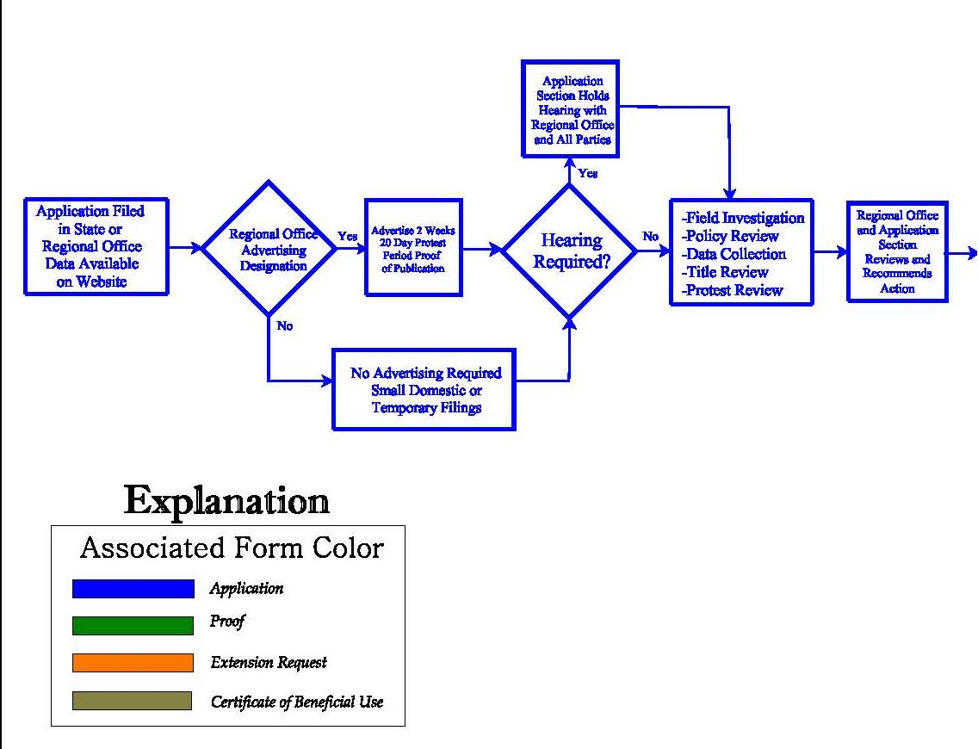
APPLICATION PROCESS
Notes:
This diagram showing the various steps in the application process is available at the Division of Water Rights Internet website at http://waterrights.utah.gov/wrinfo/policy/apschem.pdf. I have separated it into three parts for the purposes of this discussion. The first section shows the initial filing of the application, notifying the public, addressing any protests, reviewing the proposal and its relationship to other water rights, and making an initial recommendation for the State Engineer’s action. Much of this activity heavily involves the regional offices of the Division and their personnel. The division has seven regional offices administering the different river basins in Utah.

Slide 26
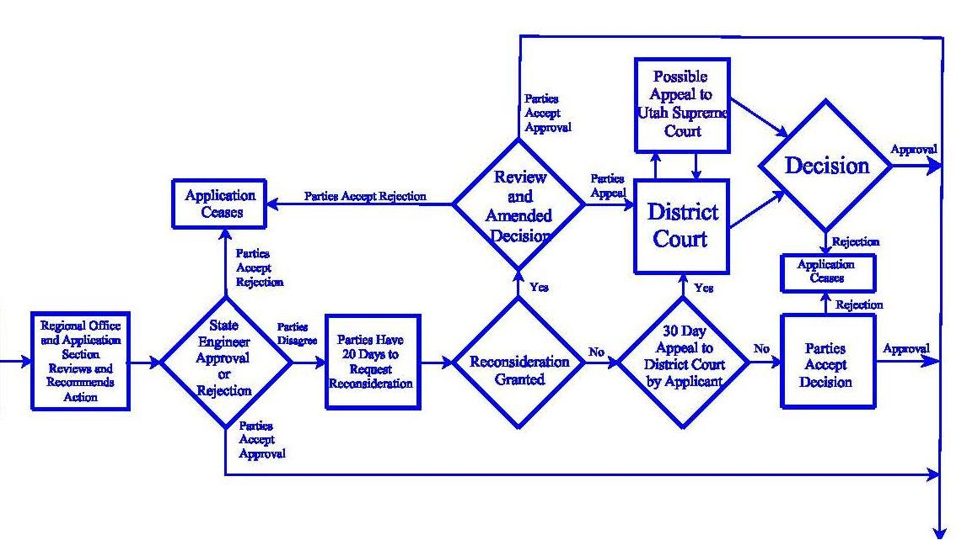
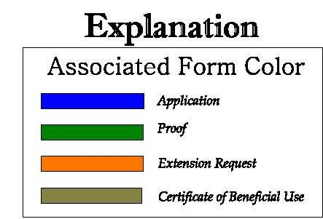
APPLICATION PROCESS
Notes:
This next section covers the activity handled in the central Salt Lake office of the Division where the recommended action on the application is reviewed and then finalized by issuance of an order by the State Engineer. Personnel also oversee activity regarding any reconsideration requests and/or appeals to district court.

Slide 27
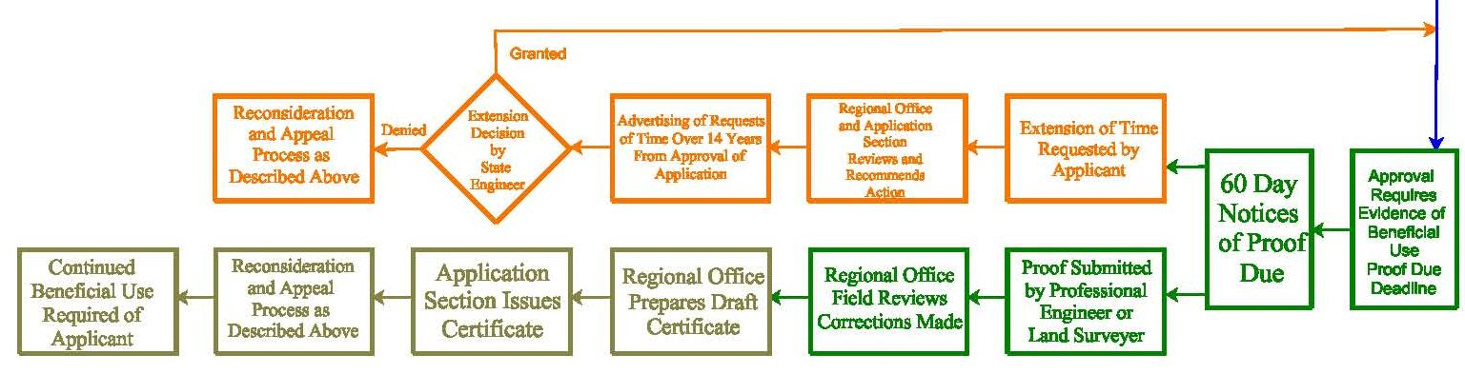
APPLICATION PROCESS
Notes:
This third section addresses development of actual physical beneficial use under an approved application and the perfection of the application by issuance of a certificate.

Slide 28
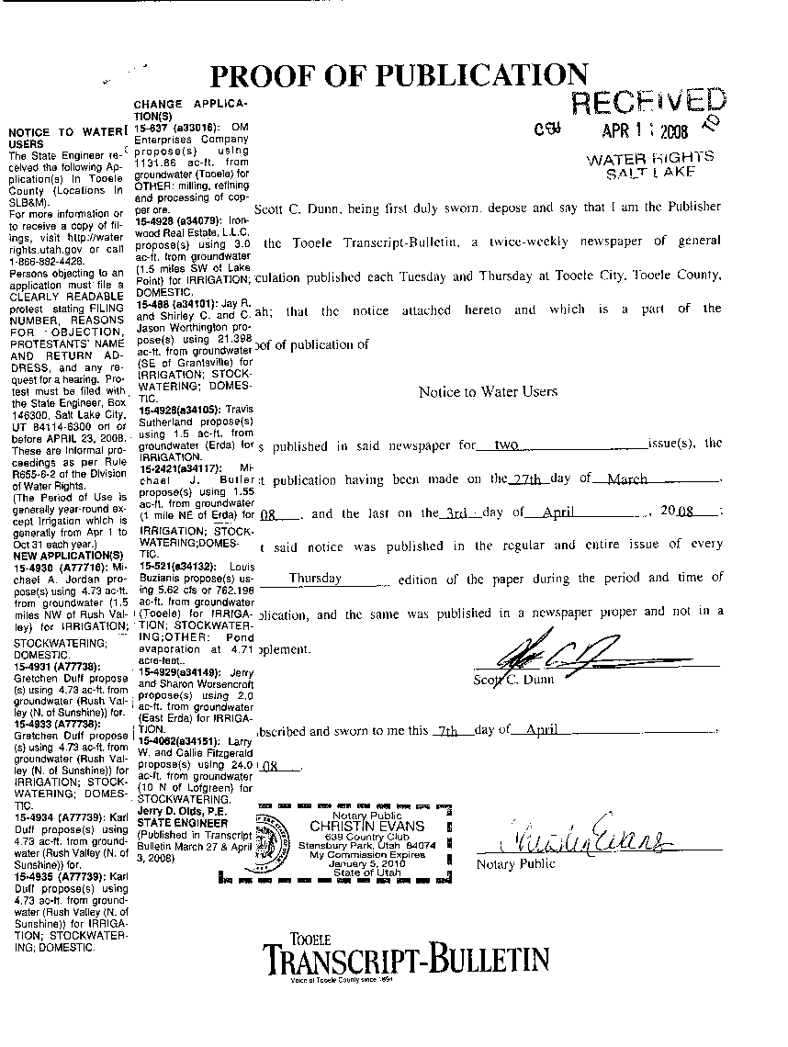
ADVERTISING PERIOD
PERMANENT FILINGS
TEMPORARY APPS AND SMALL DOMESTIC APPLICATIONS
NOTICES DRAFTED BY DIVISION
PROOF OF PUBLICATION
SEE DIVISION WEBSITE FOR A LIST OF NEW FILINGS
Notes:
Permanent filings are advertised twice with a one week interval between publications; there is a statutory 20-day protest period following the second publication for informal proceedings and a 30-day period for formal proceedings. All proceedings before the State Engineer are informal unless otherwise designated.
Temporary filings (for projects lasting only one year) are advertised at the discretion of the regional engineer based on experience with water rights concerns in the area of the proposal and whether there is potential impairment of other water rights or not. If advertised, publication generally occurs once with a following protest period of ten days.
Notices to water users are drafted by the applications/records section and contain information as directed by statute. They are e-mailed to the appropriate newspapers, and the applications are placed on the division’s website advertising list. Advertising is generally placed in the legal notices section of the newspaper. Many local papers are weekly editions which circulate on Wednesday or Thursdays. For larger daily newspapers, the notices occur on Thursday editions.
After advertising, the involved newspapers provide proof of publication documents to the State Engineer. The State Engineer must receive this proof of publication before further action can be taken. The newspaper bills are then paid by the division.

Slide 29

PROTESTS
MAY BE FILED BY JUST ABOUT ANYONE
MUST PROVIDE RELEVANT RIGHT NUMBER
TIMELY AND INCLUDE THE FILING FEE ($15)
PROTESTANT CONTACT INFORMATION
BECOME A PARTY TO THE PROCEEDING
Notes:
Protests are filed with the division by interested parties. Generally these are other water users in the area who believe their supply may be impaired by the new project. However, sometimes title or property access or environmental concerns may be the issues raised. It really gets down to statutory requirements for approval and why the application shouldn’t be approved. Protests should focus on that kind of discussion.
The protest must indicate the water right(s) being protested. General concerns about lessening water supplies throughout a basin or encroaching urbanization and its potential effects or need for a water management plan in a valley would be considered as correspondence to the division and not as a protest to any or all new filings in the area.
The protest must be submitted within the appropriate period and be considered timely in order to establish legal standing of the party in subsequent application procedures and potential court involvement.
The protest must provide the name and address of each protesting entity and be signed by the protesting party or its authorized representative or power of attorney. In addition to the signature, it is important to print the name of the protestant so that we know exactly who is submitting the protest. If the name and address aren’t readily readable, standing as a legal protestant may be jeopardized.

Slide 30
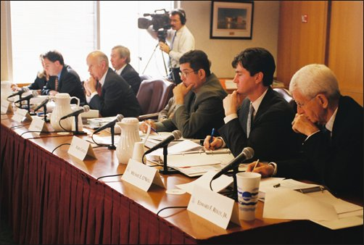
HEARINGS
Generally Held Locally
Usually Informal Proceedings
May Be Waived
Notes:
Hearings are generally held in the county seats of the counties where water is to be diverted and used. However, if parties agree to some other location for greater convenience or if no facilities are available to accommodate meetings, the locations may be in other towns or in conference rooms at division offices. The usual schedule is to visit each county two times each year; the dates are about six months apart. There may be several hearings per trip.
Generally hearings are held to address protests, but they can be held to gather additional information if the applicant’s proposal is not sufficiently clear. If parties desire to have a hearing before the State Engineer, they must request the hearing. The determination as to whether a hearing should be held or not is at the discretion of the State Engineer.
Almost always, these hearings are informal proceedings. The Assistant State Engineer for Applications/Record and the regional office personnel are hearings officers who direct the meetings. Applicants are asked to provide information in support of their filings. Protestants discuss their concerns. Other interested parties may provide additional information. In some cases, hearings can also involve witnesses, consulting experts, attorneys, etc., especially in large or complex projects or where property, title, or other legal issues are involved or geologic and engineering information is helpful. Hearings are recorded, and the proceedings are made available on the division’s Internet website.
Hearings may be waived if sufficient information is available and/or if parties indicate that no hearing is needed.
Once the hearing is completed, the responsibility for the processing of the water right is assigned to the regional office to perform a review of the file.

Slide 31
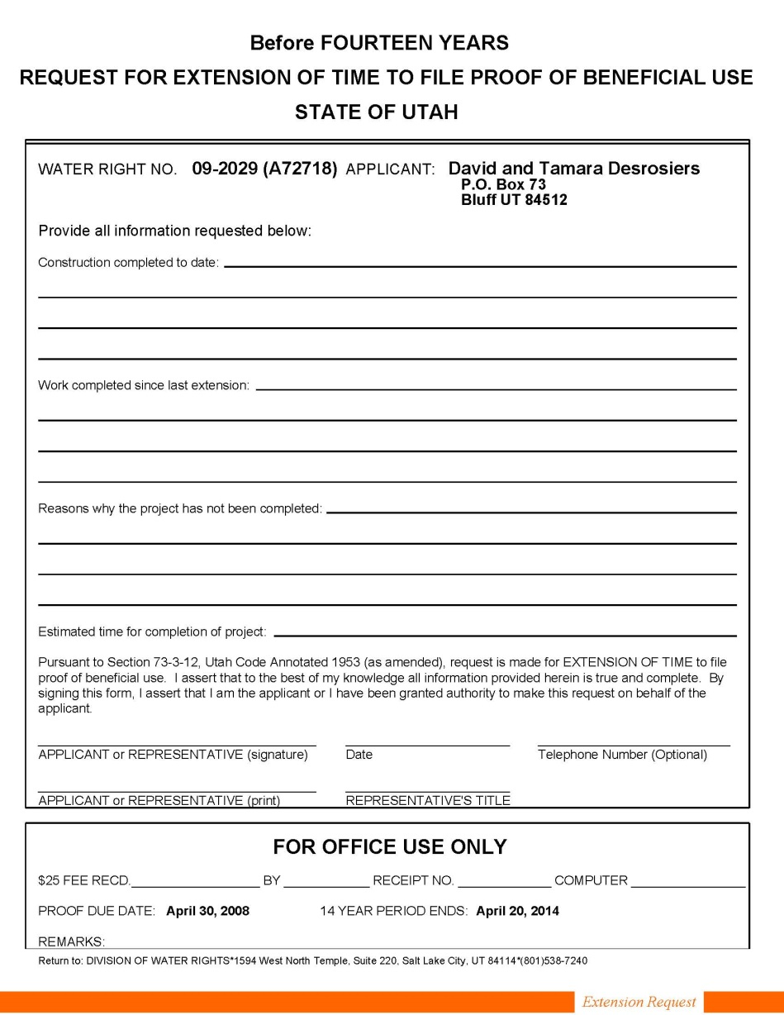
EXTENSION REQUEST
FORMS AND FEES
ADVERTISING AFTER FOURTEEN YEARS
REVIEW AND RECOMMENDATION
GRANTED OR DENIED
RECONSIDERATION AND/OR APPEAL
Notes:
Request forms are available on the website or by mail or office visit. For requests for time within 14 years from the date of application approval, a $25 fee is required. For requests for time exceeding 14 years from the date of application approval, a $75 fee is required. Payment can be made by check or cash.
If over fourteen years have passed since approval of the application, any request for additional time to place the water to the proposed beneficial use must be advertised and is subject to protest. (See advertising and protest process described above.)
The request is reviewed by the regional office staff, and a recommended action is made through a draft order. The draft order is reviewed by the applications/records section for completeness, accuracy and consistency with division practices and policies. Complex issues may be reviewed with Attorney General’s staff. Section 73-3-12 of the Utah Code states that construction of the works and the application of water to beneficial use shall be diligently prosecuted to completion within the time fixed by the State Engineer. Extensions of time may be granted by the State Engineer only on proper showing of diligence or reasonable cause for delay.
If the request is granted, the applicant has an extended proof due-date, at the end of which either proof or a further request for extension is required.
If the request is denied, the application is lapsed.
The order of the State Engineer addressing extension of time is subject to request for reconsideration and appeal to district court as described for initial action described above.

Slide 32
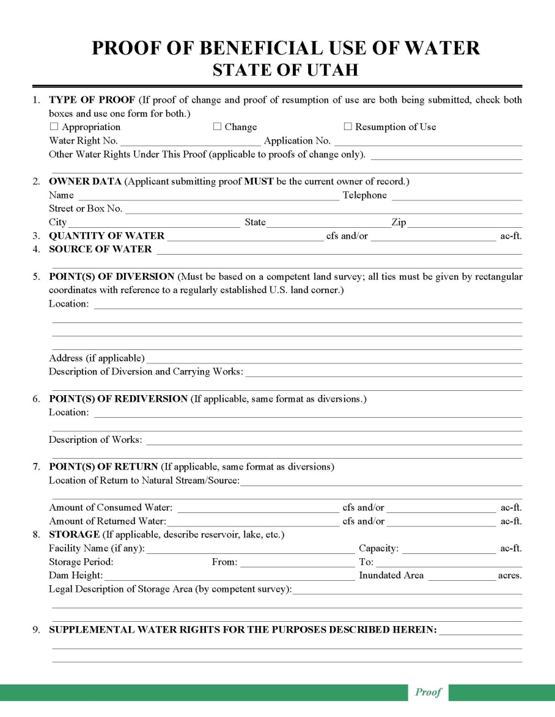
PROOF OF BENEFICIAL USE
FORMS
PROFESSIONAL PREPARATION
REVIEWED BY REGIONAL OFFICE
AMENDMENTS
ACCEPTED OR REJECTED
Notes:
Forms for preparing proof of beneficial use are available by visit to division offices, by mail, or on the division website.
Proof must be prepared by a professional engineer or land surveyor, who is licensed in Utah and is responsible for accuracy in depicting the completed project and use of water.
The proof form is field examined and reviewed by regional office personnel.
If significant corrections are needed, the proof is returned to the engineer or surveyor for amendment. If the constructed project is considerably different than as proposed under the application, a change application may be required to describe the differences and to advertise them to the public. (See application process described above.)
If the proof is acceptable, a draft certificate of beneficial use is prepared. The regional office staff transfer it to the Applications/Records section.
If the proof is not acceptable due to errors, lack of data or signatures, or lack of physical evidence to support the written information, it is rejected, and the application is lapsed by order of the State Engineer. This action is subject to reconsideration and appeal as described above.
If the proof document was inappropriately submitted, the applicant could potentially file a late extension request to ask for more time to address further development of the project or legal issues. This could result in reduction of the priority of the application.
Affidavit of Beneficial Use may be filed in lieu of proof for small domestic filings. Also may be filed to resurrect a lapsed filing if the uses were in place prior to the lapse.

Slide 33
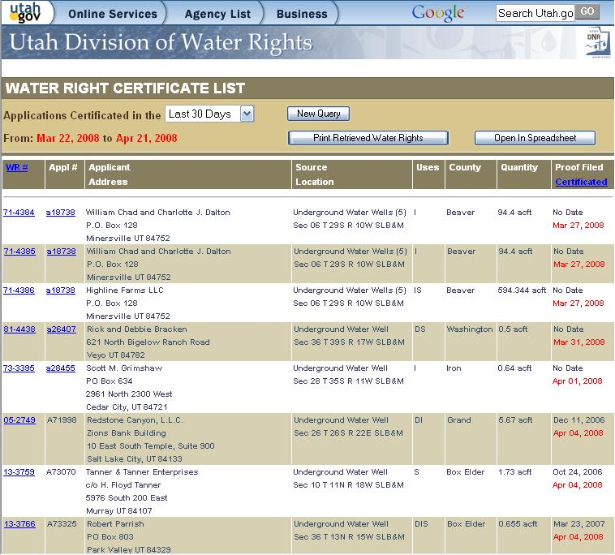
CERTIFICATION
STATE ENGINEER’S REVIEW AND SIGNATURE
ISSUED ON SAME DAY AS SIGNED
RECORDING
RECONSIDERATION AND APPEAL
Notes:
Draft certificates are reviewed by the applications/records section for accuracy and completeness. The final certificate is submitted to the State Engineer for review and signature. If amendments are needed, it is returned to applications/records section and/or regional engineer for additional work.
When signed by the State Engineer, it is sent to the applicant on the date of signature and then scanned for internet access. This is the final step in the process and is often referred to as “perfecting” the right.
If the applicant accepts it, it should be recorded with the appropriate county recorder to associate the water right with the land upon which it is used.
If the applicant disagrees with it, a request for reconsideration and/or an appeal to district court can be pursued as described above.

Slide 34
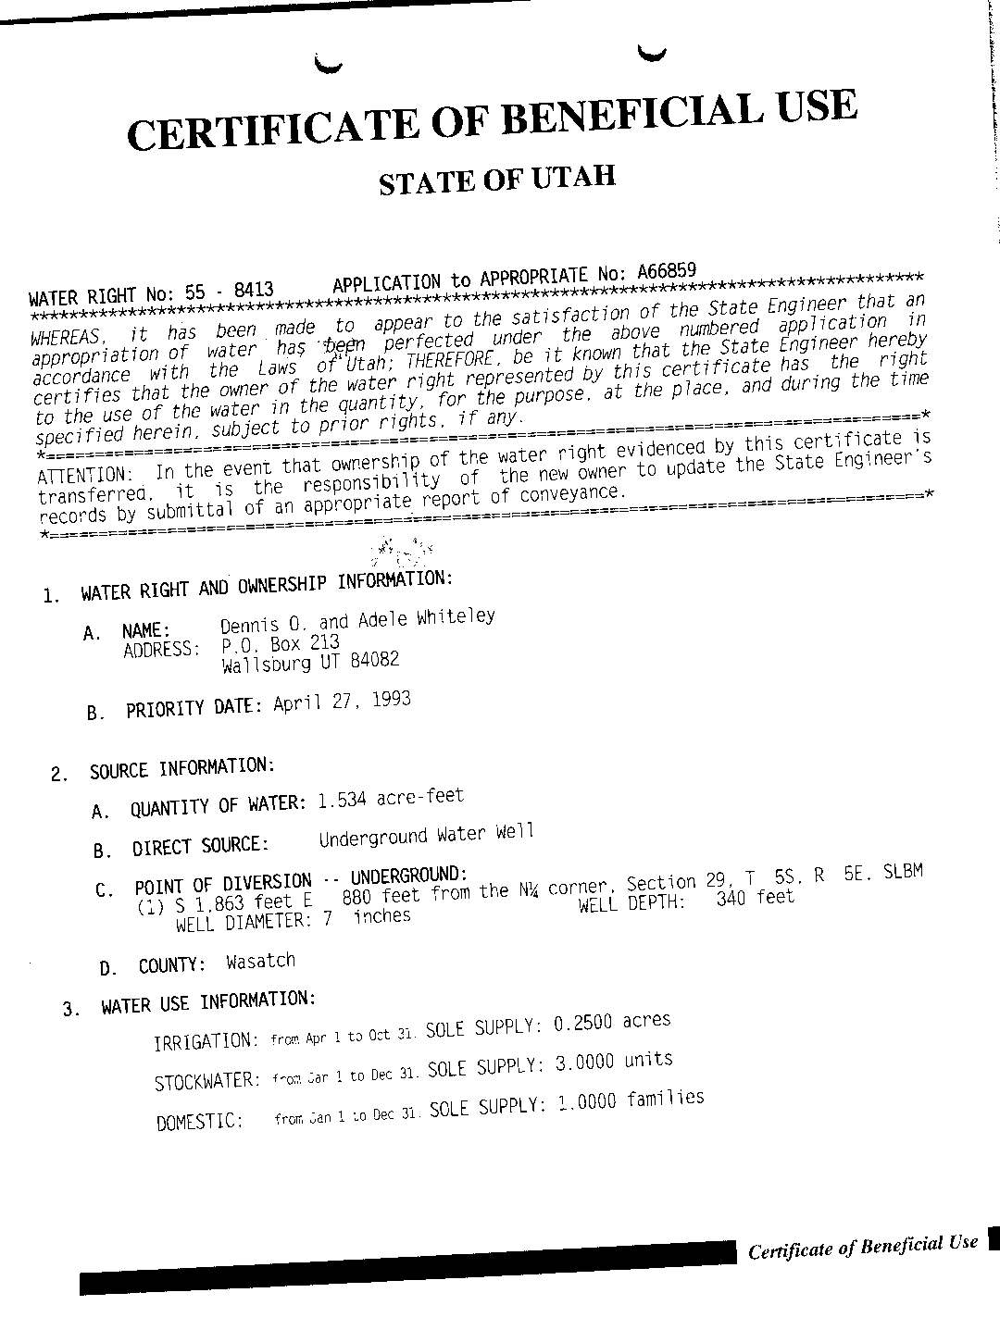
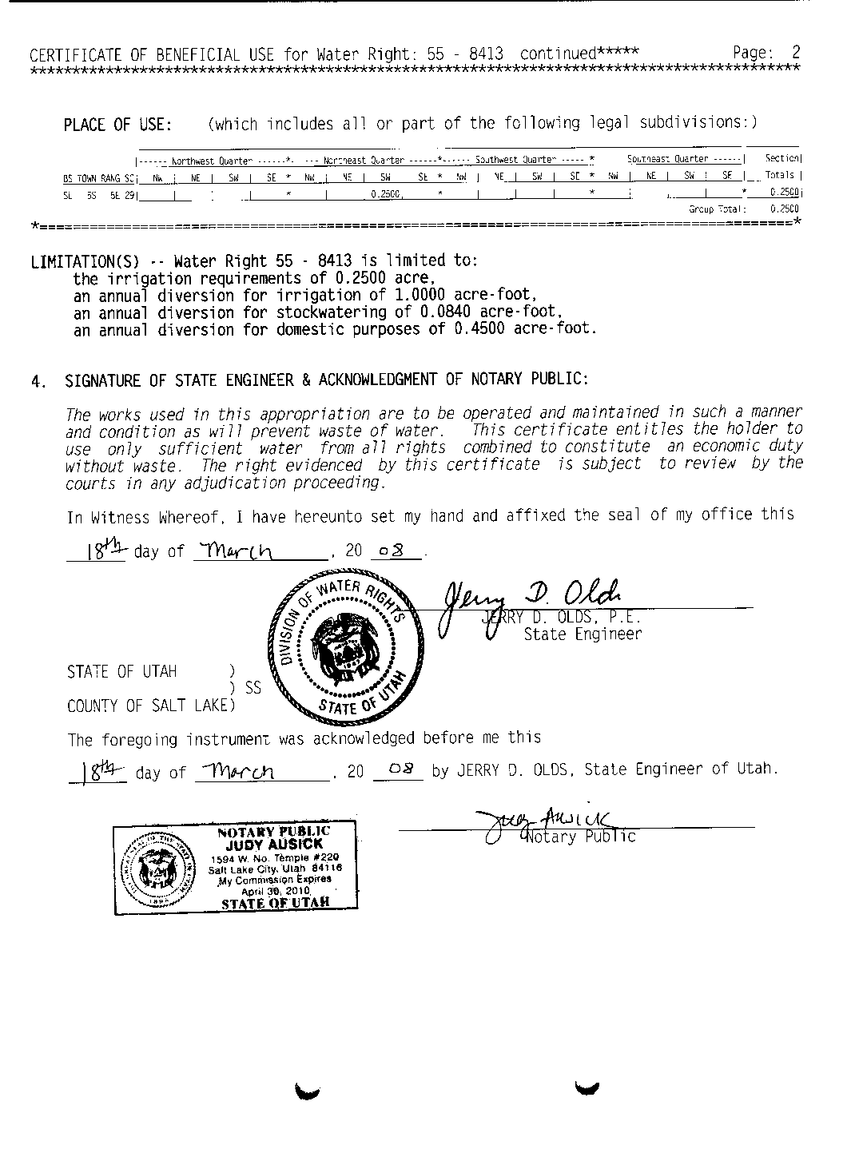
Notes:
Here is an example of the final certificate of beneficial use.

Slide 35
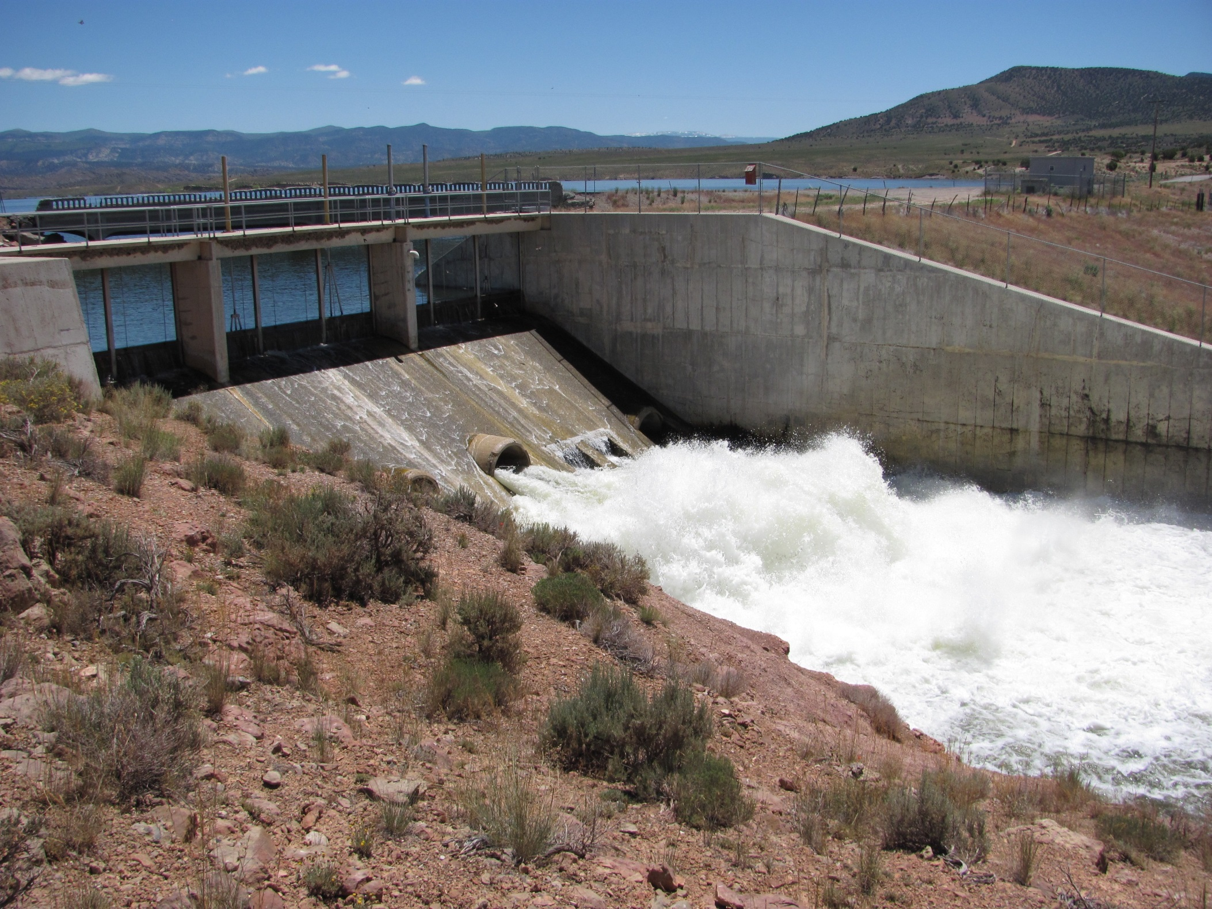
Questions? Comments?
Humorous Anecdotes?

