Slide 1
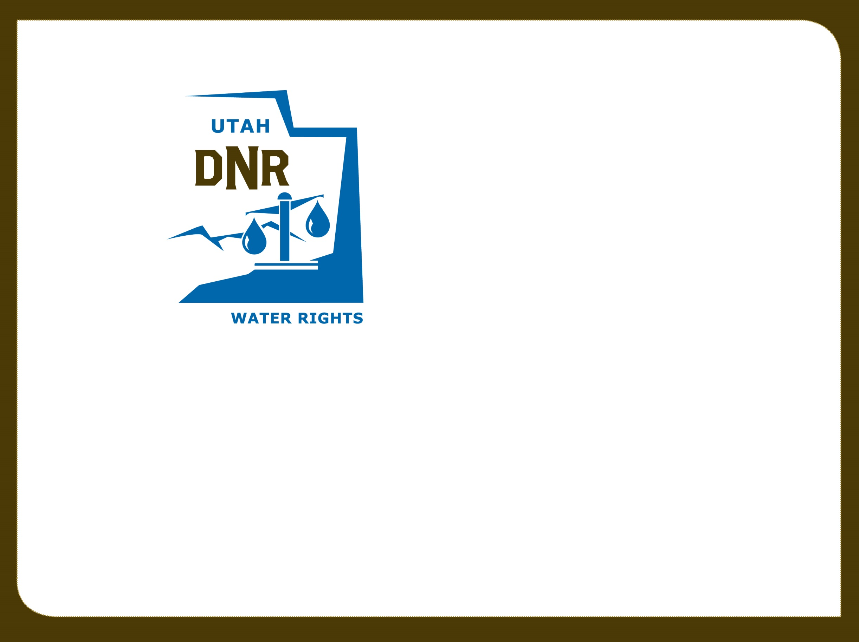

Utah Division of Water Rights
RWAU Water Right Certification Training Review
http://waterrights.utah.gov
Boyd Clayton
April 11, 2014
June 21, 2004

Slide 2

What is a Water Right?
Why do we have them?

Slide 3
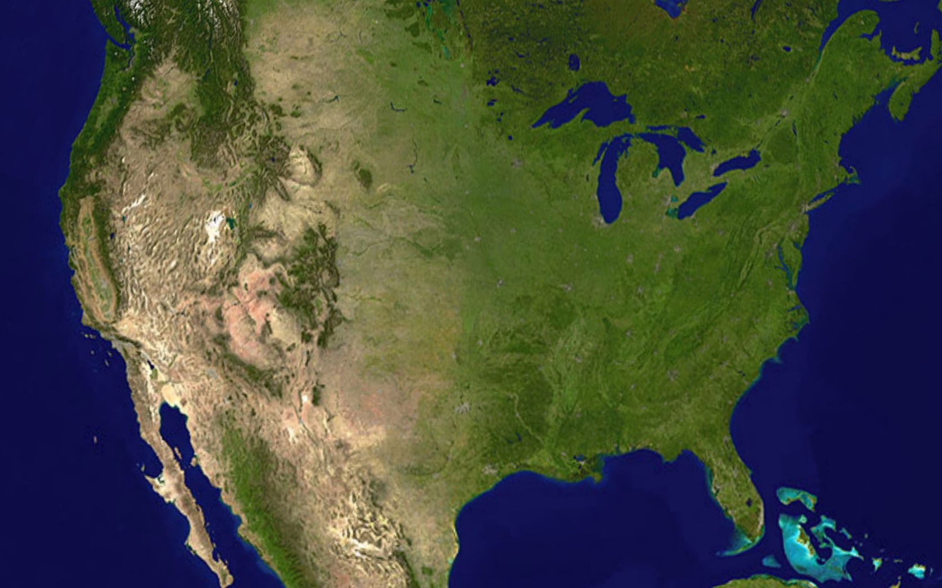
How and Why do Water Right Systems Vary
Across the United States?

Slide 4
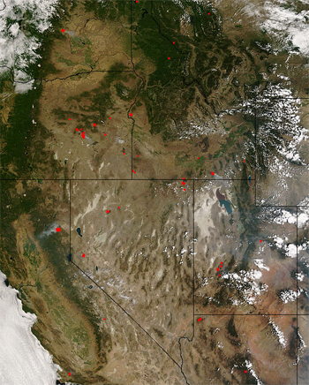
What are the Basic Principles behind Utah’s Water Right System?
Utah Code 73-1-1
Utah Code 73-1-3
Utah Code 73-1-4
Utah Code 73-1-5

Slide 5
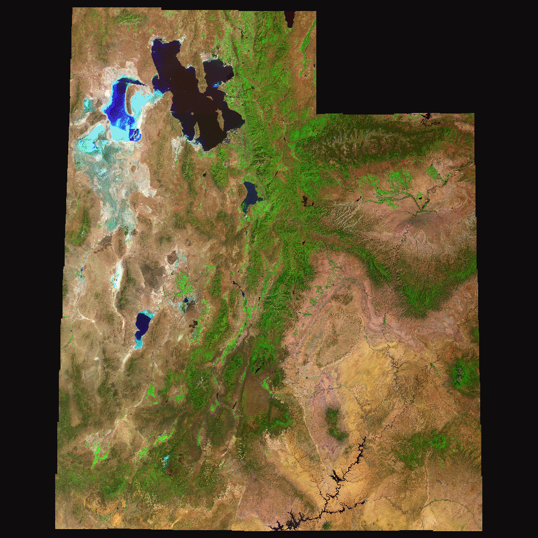
How Do you get a water right?
How don’t you get a water right?

Slide 6
Water Right Elements
Ownership
Priority
Basis of right
Diversion location
Diversion quantity
Storage
Beneficial use(s)
Period of use
Place of use

Slide 7
“The state regulates the use of water
as trustee for the benefit of the people.
Public ownership is founded on the
principle that water, a scarce and
essential resource in this area of the
country, is indispensable to the welfare
of all the people; and the state must
therefore assume the responsibility of
allocating the use of water for the
benefit and welfare of all the people of
the state as a whole.”
J. J. P. N. Co. v. State 655 P.2d 1133 (Utah 1982)

Slide 8

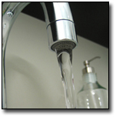


State Water Agencies
Divert and use waters of public
  State Engineer (DNR)
Control of pollutants in public waters
  Water Quality Board (Dep. of Environmental Quality)
Water Planning and Project Development
  Water Resources Board (DNR)
Public Drinking Water Safety
  Drinking Water Board

Slide 9
Utah State Engineer
Appointed by Governor for 4 year term
  Confirmed by Senate
Licensed Professional Engineer
  Knowledge of water issues, water laws, state water resources
Division of Water Rights - Support Staff
  SE serves as director of Division
  Department of Natural Resources Agency
  No connection to Water Resources (water development sister agency, same dept)
Responsible for Water Right Administration
  Policy set by legislature through statute
  Gatekeeper to provide order and certainty
    Reduces potential for conflict
    Protects investments
    Respect for existing rights
    Public waters appropriated according to policy set by legislature
  Decisions reviewed de novo in district courts

Slide 10
State Engineer Roles
Maintains public water right records
Administers water right applications
Makes proposed determinations for the court in general adjudications
Regulates water rights by priority
Permits modification of natural watercourses
Safeguards Public Welfare
  Well driller licensing
  Dam permitting and inspection

Slide 11
Administrative Process
File Application
Advertising
Protest
Hearing
Study
Decision/Reconsideration/Review
Development
Proof/Extension/Lapsing
Certificate
Water Availability
Impairment / Interfere
Feasibility / Public Welfare
Financial Ability
Good Faith Not Speculation / Monopoly

Slide 12
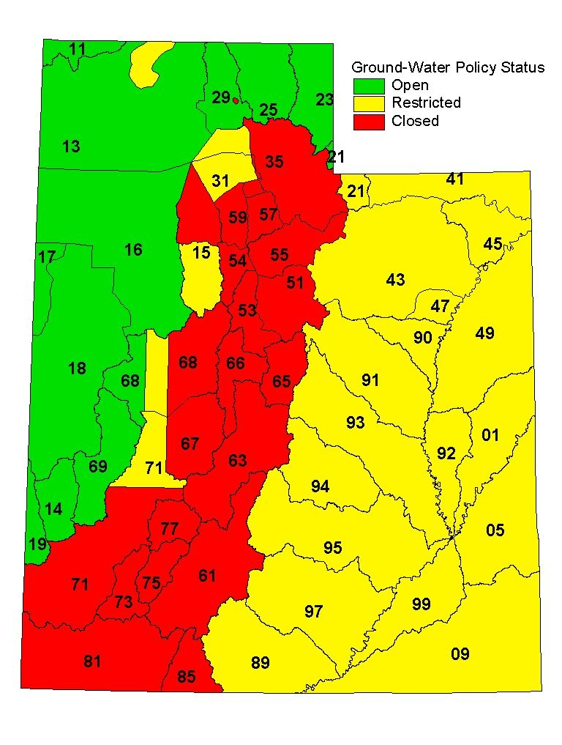
Water
Appropriation Policy

Slide 13
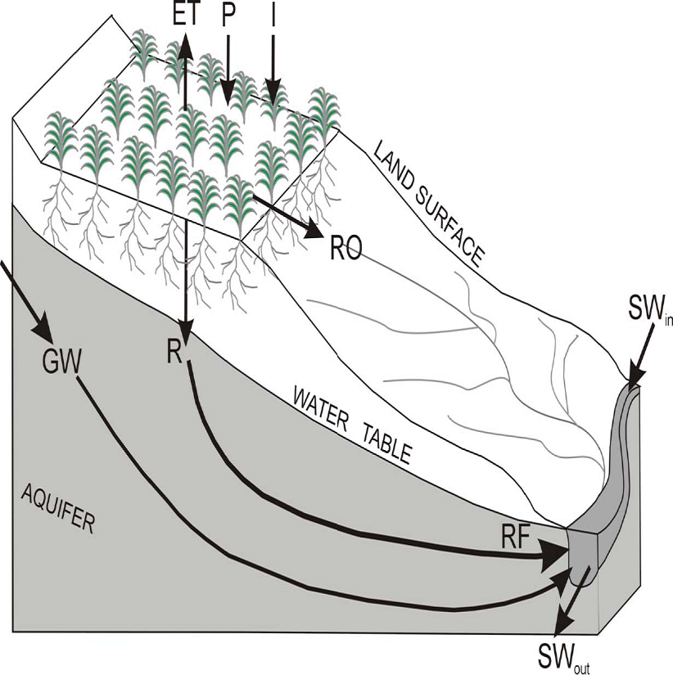
Irrigation Water Use Concepts

Slide 14
Water Use Terms
Duty (diversion requirement)
Depletion (consumptive use)
  Irrigation (generally about 0.5 x duty)
  Domestic with Septic waste (20 percent)
  Municipal (sec. water, waste treatment, reuse)

Slide 15

Questions?

