Slide 1
Making Applications
Tamara Prue

Slide 2
Application Agenda
Go over the most common types of applications (15 min)
Discuss water right policy by area (5 min)
Introduce the Public Land Survey system (10 min)
Discuss duty, diversion, and other use calculations (15 min)
Questions
Make an application map using Map Server (10 min)
Go through an application to appropriate (10 min)
Individually work through a change application (25 min)

Slide 3
Common Applications

Slide 4
Elements Common to all Applications
The applicant’s name, address and ownership interest;
Source of water;
  Specific spring, stream, or underground well
Flow (cfs), or volume (acre-feet) of water to be diverted;
Point of diversion (POD);
  Where the water will be diverted from the natural source
Beneficial use of the water;

Slide 5
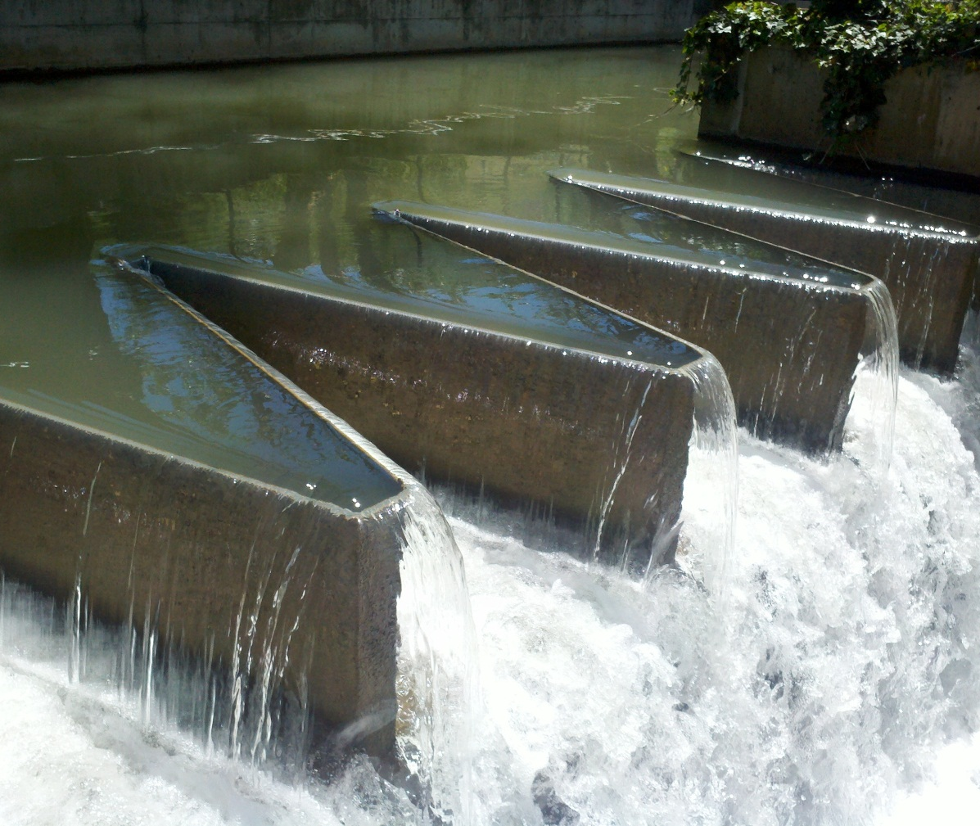
Place of use (POU);
  Location where the beneficial use will occur
Application map, to identify specific parcels on which the beneficial use will occur;
Signatures of all applicants/owners or legal agents;
Filing fee.

Slide 6
Application to Appropriate
Creates a new water right.
All areas have limitations on the amount of water that can be appropriated.
Applications to Appropriate must be completed through the certification process, by submission of proof, or the application will lapse.
Notes:
New application to appropriate program to be implemented, James Greer will demo it in the Friday session.

Slide 7
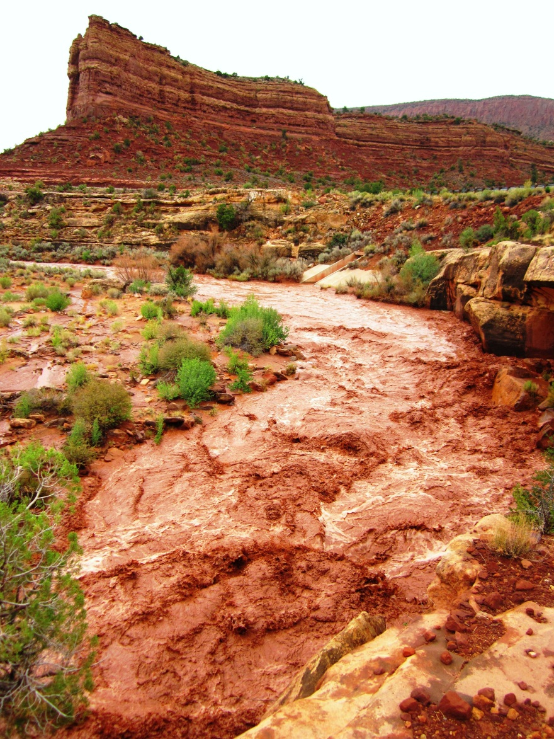
Temporary Application to Appropriate
Creates a new water right.
Amounts of water are typically based on policies for the area.
This water right will lapse one year after initial approval.
Filing of proof is not required

Slide 8
Fixed-Time Application to Appropriate
Creates a new water right.
This water right will typically be approved for no more than 14 years.
Filing of proof is not required
The Fixed-Time period may be extended
Notes:
No proof requirement
UCA 73-3-10 proof requirement was removed in 2013
Fixed-Time approvals will have a condition to report to the Division’s Water Use Program
Extended IF
1)The “essential purpose” of the original project still has not been satisfied
2)Lack of completion is not due to default or neglect of the applicant
3)Water is still available

Slide 9
Exchange Application
Exchanges are filed when an applicant has a legal contract to exchange water.
Creates a new water right filing.
The contract is the basis of the water right.
Exchange applicants are required to submit proof by the proof-due date.
Notes:
Statue broadly describes exchanges as exchanging one source of appropriated water for another.
Prior to 1992, exchanges remained valid with an “approved” status, never becoming certificated. Therefore it was often unknown to the Division if the development proposed in the exchange application had been completed or if it was completed in accord with the approved application.
Seen most commonly through Weber Basin Water Conservancy District or Central Utah Water Conservancy District.

Slide 10
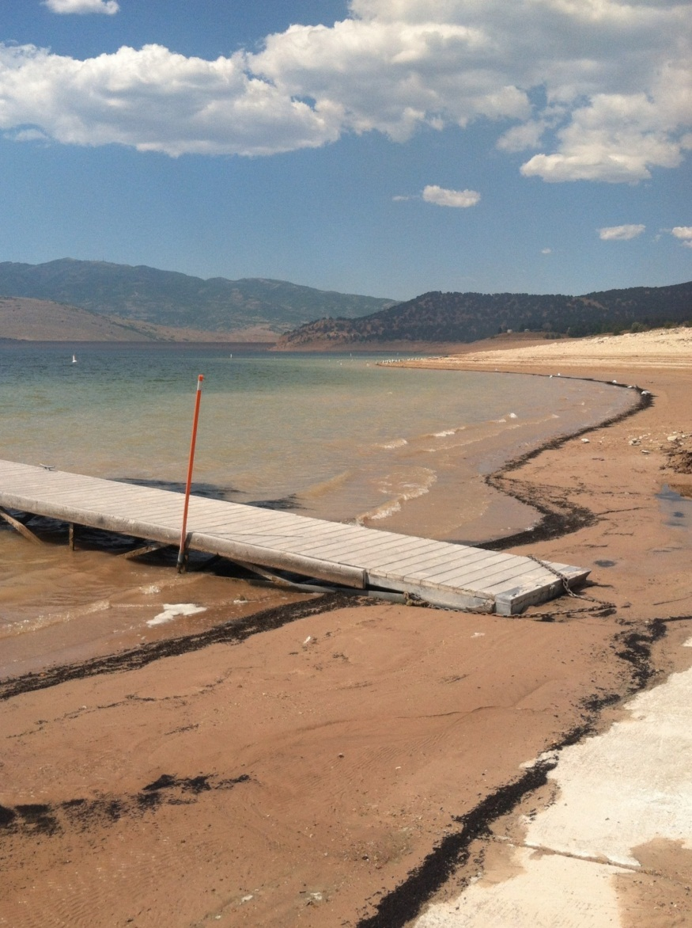
Permanent Change Application
Filed to modify some or all of a water right’s attributes.
This application uses the total flow represented by the base water right(s).
The proof will have to be completed to “perfect” the new attributes.
Notes:
All owners of record must sign the Permanent Change Application. If ownership is out-of-date on the Division’s records, a Report of Conveyance must be completed before filing the change.
If only a portion of the water right is to be changed, a Request for Ownership Segregation must be filed and processed before filing the application. At the time of segregation request it may also be required for owners to supply a Declaration of Beneficial Use prior to processing.
Changes to “approved” Applications to Appropriate may not extend the time period within which construction is to be completed, proof on such filings remains due on the underlying application and any lapsing applies to both applications.

Slide 11
Temporary Change Application
Temporary changes expire one year from the date of approval, and revert back to the original water right’s description.
This application may or may not use all of the available water under the subject water right.
Temporary changes cannot be extended and do not require filing of proof.
Notes:
It will be assumed the portion of the water right not included in the temporary change will be used as “heretofore,” as described in the records for that right.

Slide 12
Water Right Policy By Area

Slide 13
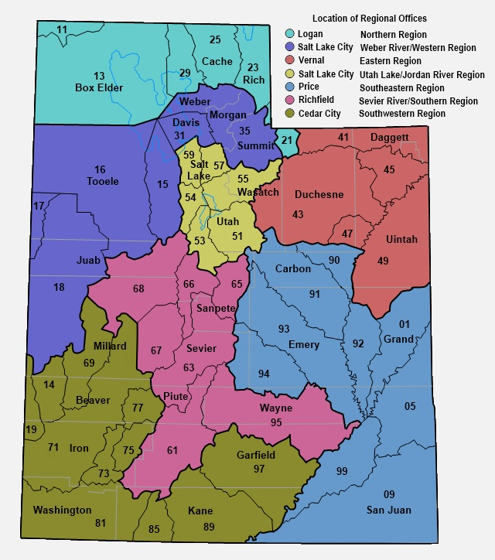
Helpful Database Tools
“Policies by Water Right Area” is located on the bottom right of the Division’s home page.
This will provide a basic overview for each water right area, including information that may be helpful for an applicant to review before filing an application.
www.waterrights.utah.gov

Slide 14
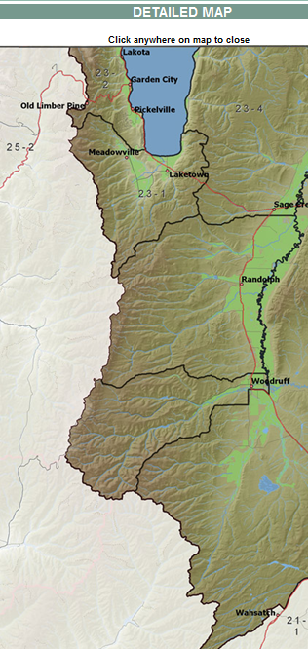
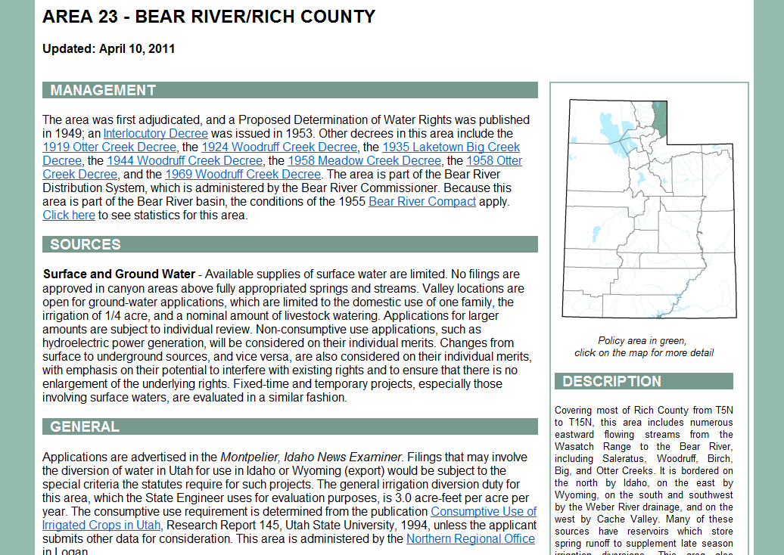
Surface and Ground Water :
…Valley locations are open for ground-water applications, which are limited to the domestic use of one family, the irrigation of .25 acre, and 10 livestock.
Notes:
Use internet (backup slide)

Slide 15
Intro to Public Land Survey

Slide 16
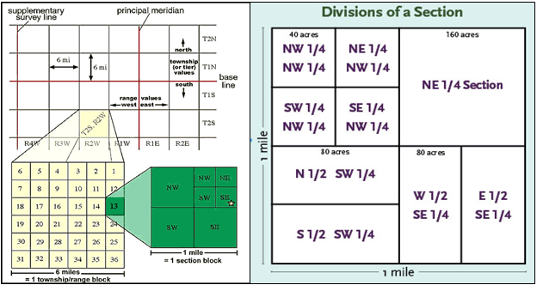
Township, Range, and Section
  Township—Typically a six-mile square area of land containing 36 sections.
  May also refer to a North-South row in the PLSS grid
  Range—An East-West row in the PLSS grid
  Section—Typically a one-mile square area, containing 640 acres.
Notes:
Typical townships and sections
Rivers, lakes, mountains, state borders are a few things that can cause irregular townships and sections

Slide 17
Typical Corner Sections and Quadrants
NW
N
NE
W
E
NE
S
SE

Slide 18
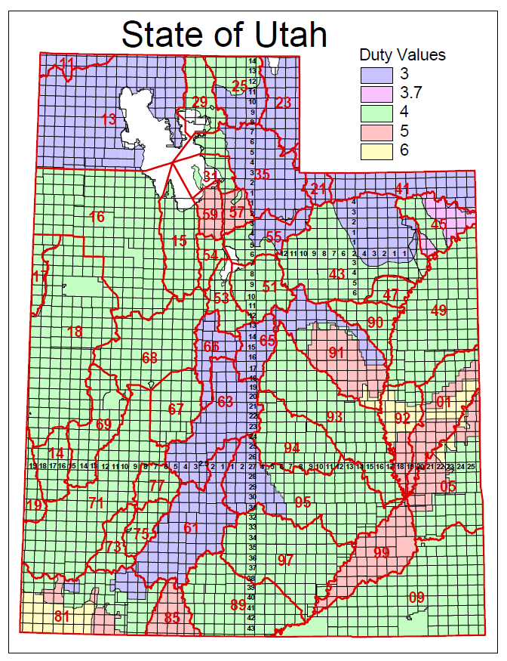
Utah Base & Meridians
Salt Lake B&M
  Beginning in Downtown Salt Lake
Uintah B&M
  Beginning about nine miles North of Roosevelt

Slide 19
Roosevelt,
Duchesne County
  Township 4 South, Range 5 West, USB&M
Stockton,
Tooele County
  Township 4 South, Range 5 West, SLB&M
Notes:
What problems this can cause:
Increase time to a decision by a month or more, if advertised incorrectly
Could require a change application to be filed to correct the description ($150 and more time)

Slide 20
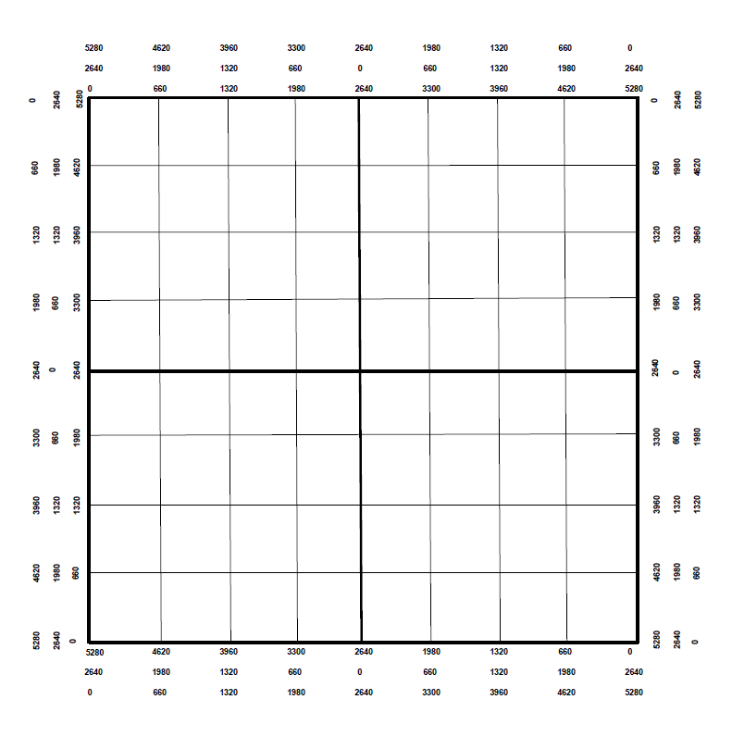
Marking a Point of Diversion
Locate the following:
  S 500’ and W 1200’, from the East Quarter Corner
  N 2000’ from the Southeast Corner
  S 1300’ and E 4000’, from the Northwest Corner
NW
E
SE

Slide 21
Marking a Place of Use
Locate the following:
  NW1/4 of the NW1/4
  S1/2 of the SW1/4
  NE1/4 of the SW1/4
  S1/2 of the NW1/4 and the S1/2 of the NE1/4

Slide 22
Water Right Calculations

Slide 23
Common Terms
Cubic Feet per Second (CFS)
  A unit of measure used to quantify the rate of flow from a water source
  Height (feet) * Width (feet) * Velocity (feet per second)
Acre-Feet (AF)
  A unit of volume defined as one acre of surface area to a depth of one foot.
  Depth of Water (feet) * Area (acres)
Notes:
CFS=Equal to a volume of water one foot high and one foot wide moving at a velocity of one foot in one second.

Slide 24
Duty Calculations
Irrigation
  Acres * Duty = AF per Year
  Irrigation duty values vary by area
Domestic
  Full time = 0.45 AF per Year
  Part time = 0.25 AF per Year
Livestock (ELU)
  1 ELU = 0.028 AF per year
  1ELU = 1 Cow or Horse
  1ELU = 5 Pigs, Sheep, or Goats
Notes:
The maximum volume of water allowed per year for a particular beneficial use.
For irrigation, the duty value varies from area to area within the state.

Slide 25
Diversion vs Depletion
Diversion is the water removed from the source to be used
  E.g. Diverting 4.0 AF of water to irrigate 1.0 acre of land
Depletion is the amount of water that is consumed after application.
  E.g. After diverting 4.0 AF of water to irrigate 1.0 acre only 2.0 AF of water returns to the natural water system.
When evaluating Change Applications the State Engineer looks at the historic values for both Diversion and Depletion.
  Neither value can be enlarged.
Notes:
4.0 AF (Diversion)
Convert to livestock = ~143 cows
2.0 AF (Depletion)
Converts to livestock = ~71 cows
Water used up by the plants, bound to soil, and lost through evaporation, is water that doesn’t make its way back to the natural water system enabling other water rights to be satisfied.

Slide 26
Sample Problem #1
A rancher wants to start a farm near Dugway, Utah (area 16). How much water does he need for 5 acres of irrigation, 50 cattle year-round, and a full-time home?
The irrigation duty in Dugway is 4 acre-feet/acre
  5 acres * 4 acre-feet/acre = 20 acre-feet
  50 cattle * 0.028 acre-foot = 1.4 acre-feet
  1 full-time home = 0.45 acre-foot
  Total diversion = 21.85 acre-feet
Notes:
These samples are diversion only, to practice converting between units

Slide 27
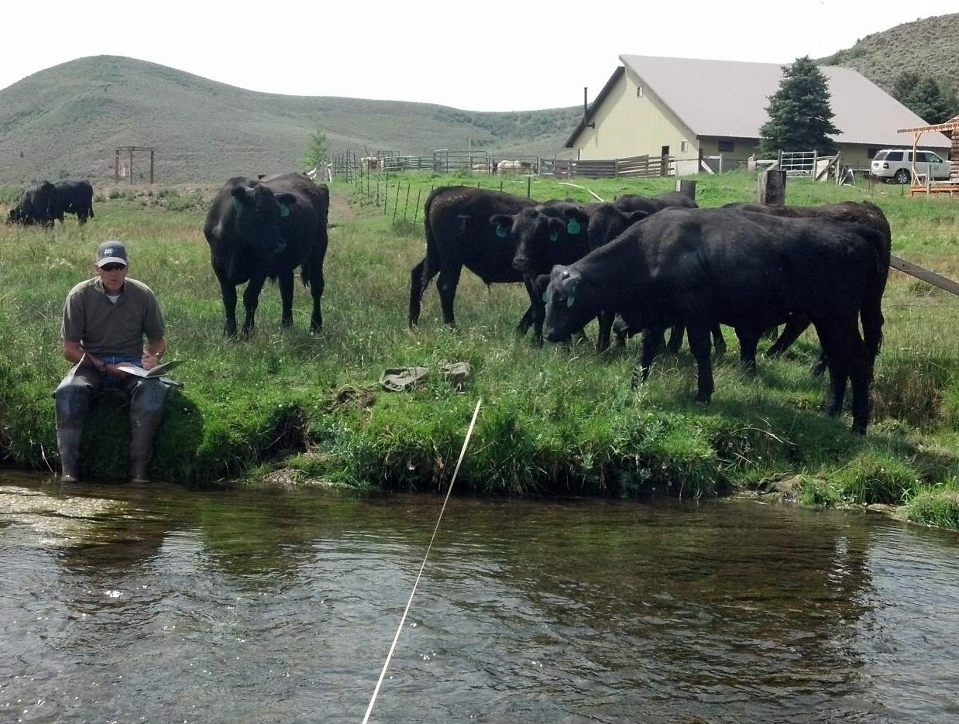
Sample Problem #2
A rancher has a water right for 300 cattle. How many sheep could he provide for with this water right?
  300 cattle * 5 = 1500 sheep

Slide 28
Sample Problem #3
A developer wants to build a 10 lot subdivision in Delta, Utah (area 68). Each lot is supposed to have enough water for 0.25 acre of irrigation, 2 horses, and a full-time home. How much diversion will the water right need to have?
  Each lot requires
    0.25 acre * 4 acre-feet/acre = 1.0 acre-foot
    2 horses * 0.028 acre-foot = 0.056 acre-foot
    Full-time home = 0.45 acre-foot
    Total of 1.506 acre-feet
  Total project requires
    1.506 * 10 lots = 15.06 acre-feet

Slide 29
Sample Problem #4
A farmer has a water right in Brigham City (area 29) that serves 100 cattle year-round. He wants to change the water right to supply one full-time home, one part-time home, 10 horses, and irrigation for his yard. What is the maximum area (in acres) that can be irrigated, after the other uses are accounted for?
  100 cattle * 0.028 acre-foot = 2.8 acre-feet
  Full-time home = 0.45 acre foot
  Part-time home = 0.25 acre foot
  10 horses * 0.028 acre-foot = 0.28 acre foot
  2.8 acre-feet - 0.98 acre-foot = 1.82 acre-feet
  1.82 acre-feet / 4 acre-feet per acre = 0.455 acre
Notes:
Sample of Diversion and Depletion
Water right is for 2.0 acres of irrigation (duty 4) = 8.0 AF
Change to livestock
8.0 with a depletion of 50% = 4.0 AF of depletion
Livestock is 100% depletive so the allowable diversion for a change app would be 4.0AF
Historic use of irrigation would have been 8.0 AF of diversion and 4.0 AF of depletion
142.86 ELU (proposed change) would allow 4.0 AF of diversion and 4.0 AF of depletion
Without diversion adjustment the historic depletion would have been exceeded, enlarging the water right.

Slide 30
Making an Application Map

Slide 31
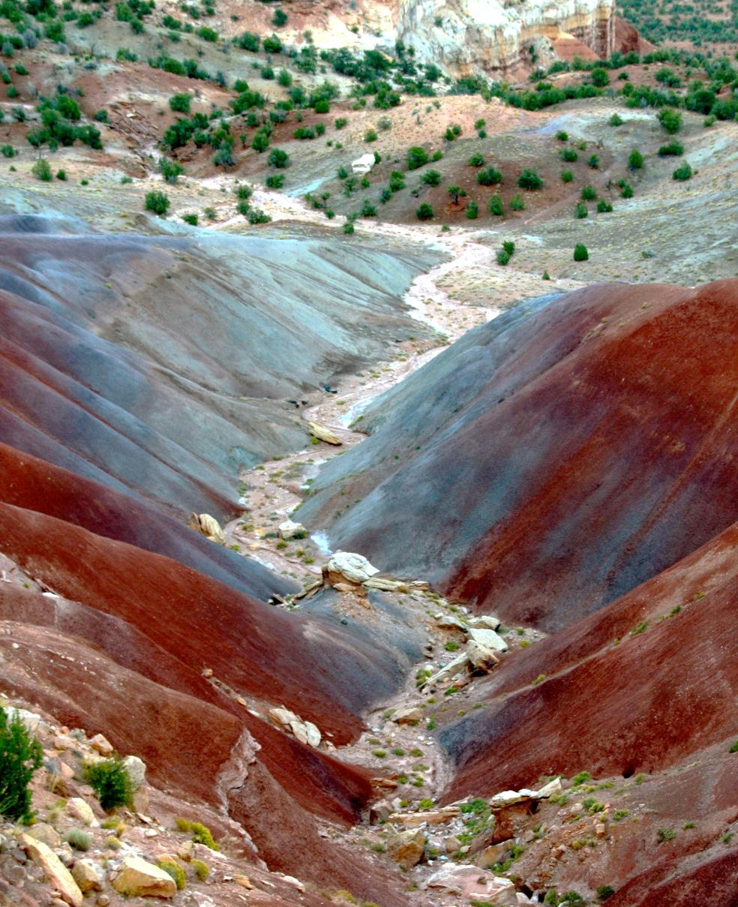
Using the Divisions Database to Get a POD
Be able to locate the property from an aerial map.
  Know the approximate location where the well or point of diversion will be located
    Section 36, T3S, R5W, USBM
    Parcel ID 00-0000-8221
Notes:
n130 w796 from the s4 sec 36

Slide 32
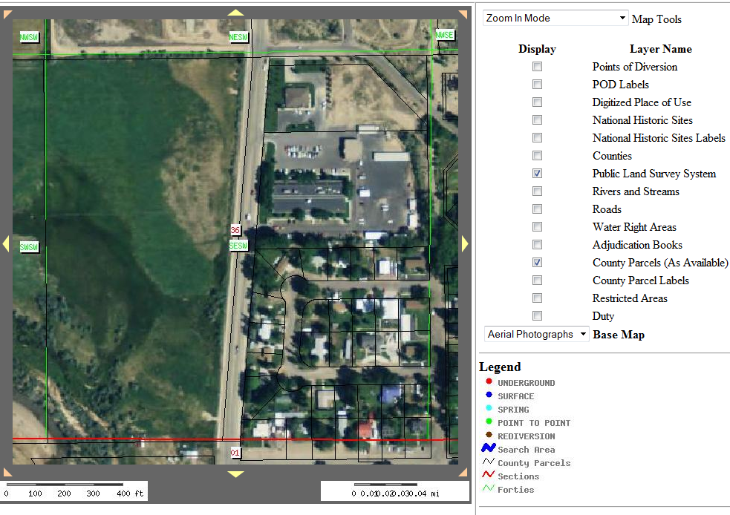
Notes:
Use the database to create the map (2 backup slides if net is not working)

Slide 33
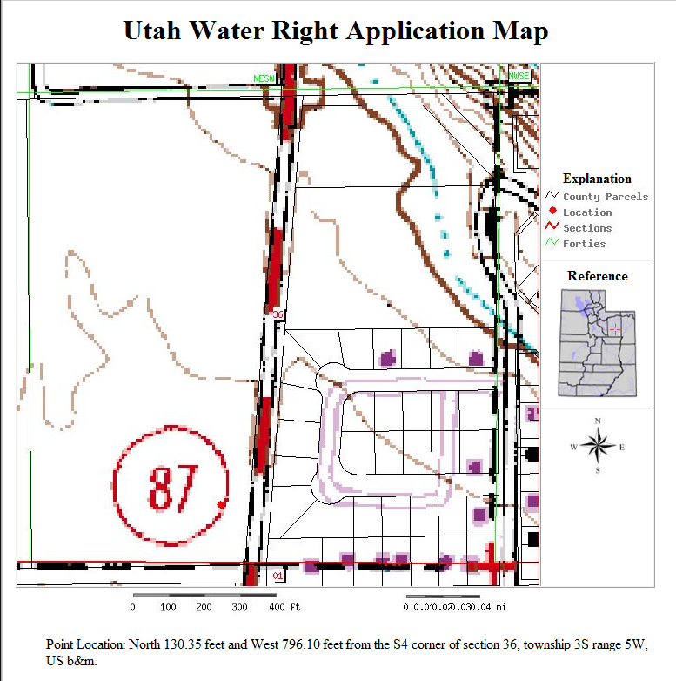
Parcel ID
00-0000-8221
Notes:
Round to the nearest whole number.

Slide 34
Application to Appropriate
Walk-Through

Slide 35
What You Need to Know
Applicant wants to drill a new well in Duchesne so he can build a home.
Check the policies for the 43 area (Duchesne).
Decide how much water will be asked for.
Determine all the uses of the water.
Flow will be 1.73 AF
Point of Diversion
  N130, W796, S4 of Section 36, T3S, R5W, USB&M
Place of Use
  SE of the SW of Sec 36, T3S, R5W, USB&M
  Parcel ID #00-0000-8221
Uses will be
  Full-time home
  10 livestock
  0.25 acre of irrigation
Notes:
Check the policies by area
Use online form and fill it out step by step

Slide 36
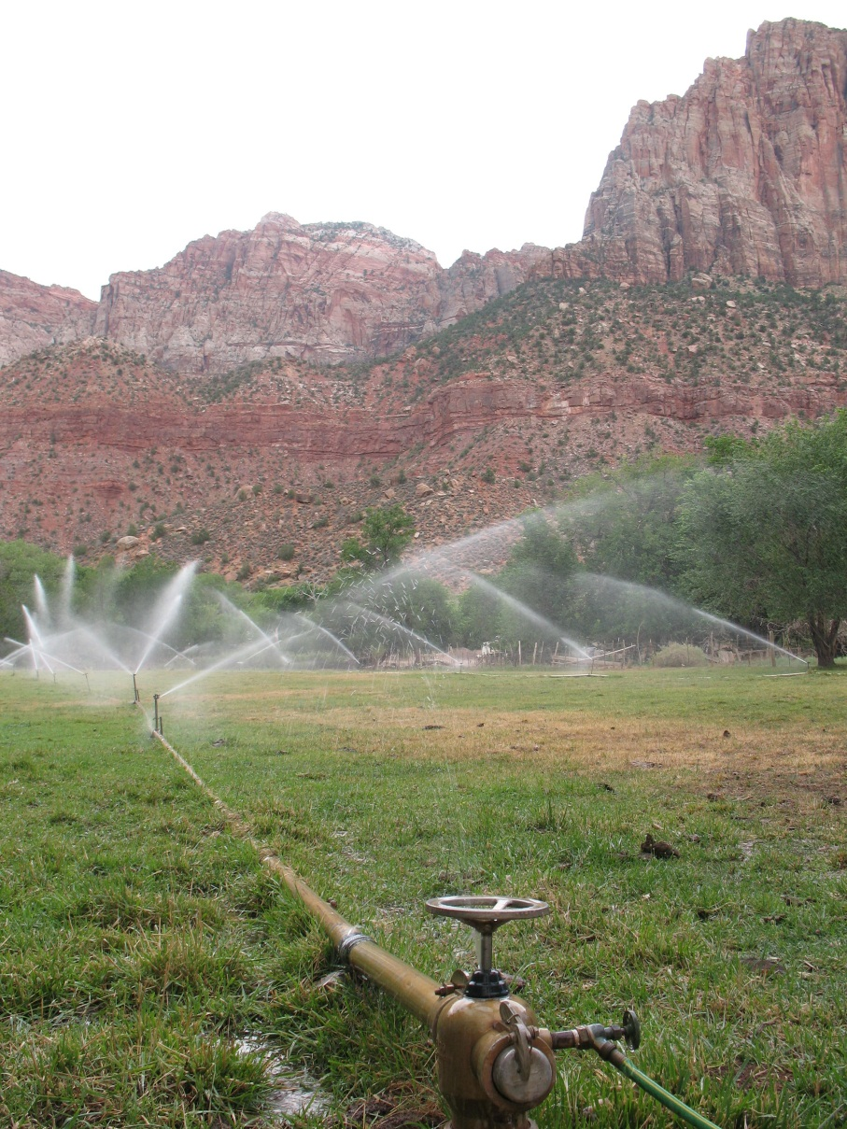
What You File
The completed and signed application
The application map
The fee

Slide 37
Change Application Practice

Slide 38
What You Need to Know
Heretofore
The water right you are beginning with (16-187)
Hereafter
Use the property and point of diversion from the sample map
Check the policies for the 16 area (Dugway)
Decide how all of the water will be used
  Hints
  Calculate the quantity of acre-feet of the base water right.
  Figure out the acre-foot value for each use.
    The acre-foot/acre duty for irrigation in this area is 4.
  For this example the home and livestock will be year-round use, and the irrigation will be 4/01-10/31.
Notes:
Check the policies by area
Use online form and fill it out step by step

Slide 39
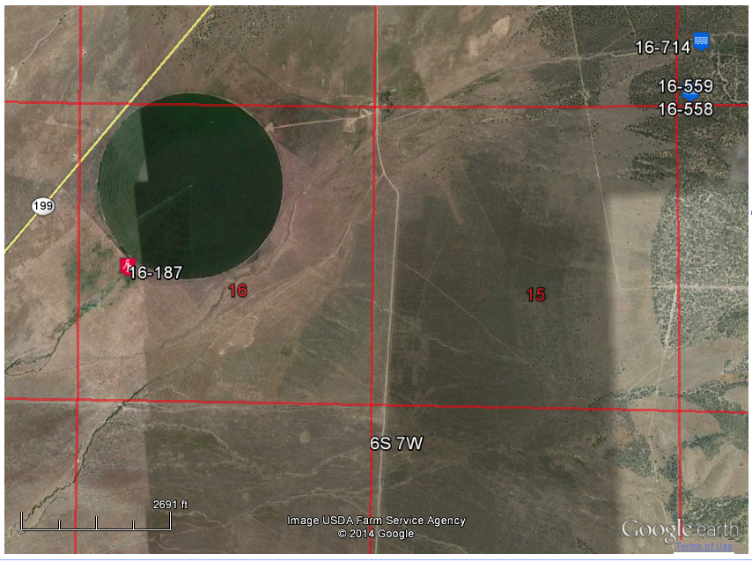
Hereafter
POD: S 175’ and E 188’ from the NW corner of Section 15, T6S, R7W, SLB&M
POU: NW4 of Section 15, T6S, R7W, SLB&M
Uses: 2 full-time homes, 4 livestock, and the remainder as irrigation.
Parcel ID # 06-104-0-0020
6 miles NE of Dugway

Slide 40
Summary and Wrap-Up

Slide 41
Topics Covered
Elements common to all applications
A few of the common applications that are filed
Intro to the Public Land Survey System
Basic water right calculations
How to use the Division’s website to create an Application Map
Walk-through: Preparing an Application to Appropriate
Practice exercise: Preparing a Permanent Change Application

Slide 42
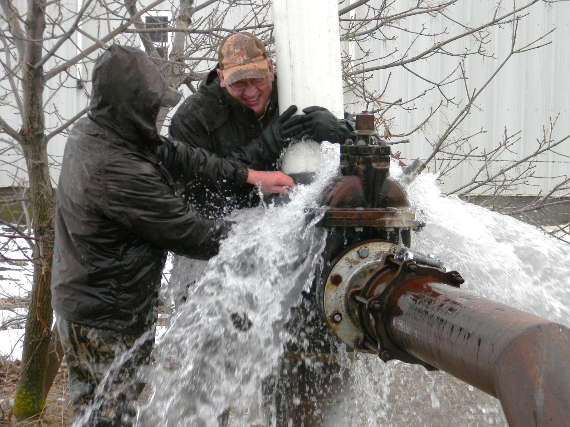
Questions?

