Slide 1
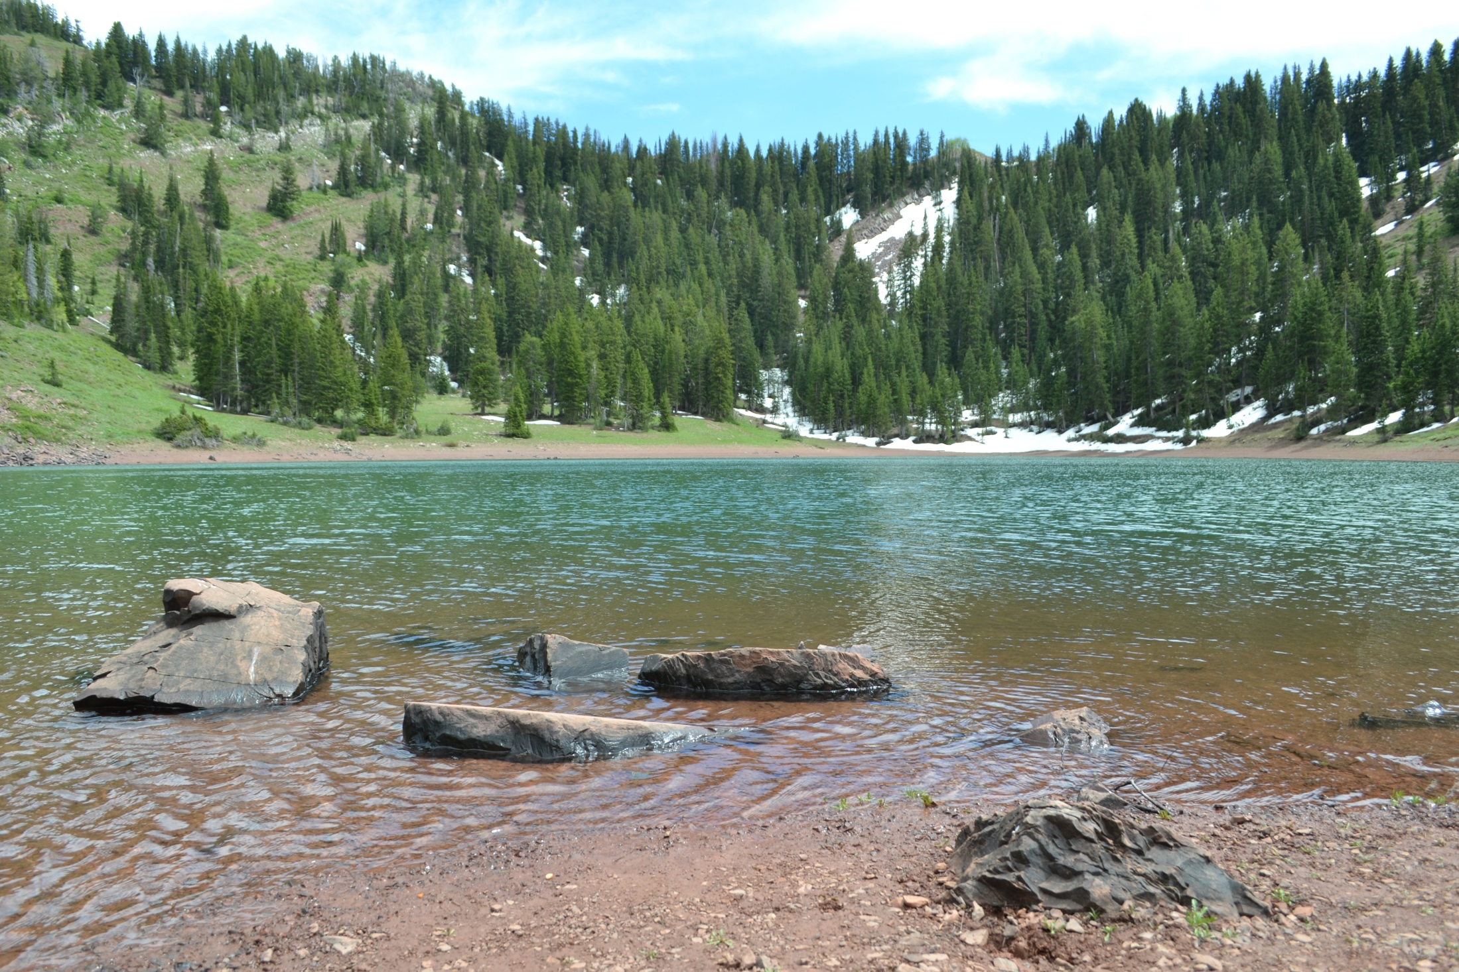
The Application
Process
Judicial Review
Protests, Appeals and Intervention

Slide 2
The Application Process: An Overview
1. Application filed.
2. Advertised.
3. Protest period.
4. Potential for hearing and post hearing information requests.
5. State Engineer Order.
6. Potential for Reconsideration.
7. Potential for Judicial Review.
The larger process: Application approval, Proof of Beneficial Use, Extensions of time to submit proof, Proof review, and Certificate.
Notes:
T

Slide 3
Common Protest Questions
Where do I get notice of the application?
How long is the protest period?
How specific must the protest be?
What is the impact of not protesting?
Who can file a protest?
Will a hearing be held?
Must I file a response to a protest?

Slide 4
Protests: Notice of Applications
Advertising – for two successive weeks
Officially:
In the newspaper of general circulation for the county where the water is diverted and used. Utah Code Ann. § 73-3-6.
Check with the Division’s Water Right Policy by Area http://www.waterrights.utah.gov/wrinfo/policy/wrareas/default.asp
Informally: The Division’s Advertising list
http://www.waterrights.utah.gov/forms/advertListByCounty.asp?Startup=Now
Republishing the application for amendments or corrections.

Slide 5
Protests: Timing, Substance, and the Impact of Not Protesting
Protest Period
20 days after the notice is published.
Utah Code Ann. § 73-3-7(1)(a).
Substance
Must raise the issues to the level of consciousness of the fact finder.
Badger v. Brooklyn Canal Co., 996 P.2d 844 (1998).
Failing to protest
A prerequisite to file judicial review.
S & G, Inc., v. Morgan, 797 P.2d 1085 (1990).
Not a prerequisite for intervention in a judicial review action, but it could limit the issues.
Taylor-West Weber Water Improvement Dist. v. Olds, 224 P.3d 709 (2009).

Slide 6
Protests: Standing, Hearings, Pleadings, and Intervention
Standing
Any person interested.
Utah Code Ann. § 73-3-7(1).
Protesting an extension requires one to own a water right or hold an application from the water source.
Utah Code Ann. § 73-3-12(2)(f).
Hearings
Role of the protest, response, and answer.
Considered pleadings and form part of the record which the State Engineer considers in making the decision.
Utah Admin. Code R655-6-6(A).
Intervention prohibited in an informal administrative hearing.

Slide 7
SE Order: Approval or Rejection of the Application
Do I need to request reconsideration to exhaust my administrative remedies?
No, reconsideration is not a prerequisite for seeking judicial review.
Utah Code Ann. § 63G-4-302; Utah Admin. Code R655-6-17(A).
Stay of the order after filing for judicial review.
Requested with the agency and the request will be acted on by order.
Utah Code Ann. § 63G-4-405.

Slide 8
Petition for Judicial Review: When, Who, and Where
Timing
Petition the District Court within 30 days of the final agency action.
Utah Code Ann. § 63G-4-401(3)(a);
Bonded Bicycle Couriers v. Dept. of Employment Sec., 844 P.2d 358 (1992).
Statutory Standing – the “aggrieved person.”
Washington County Water Conservancy District v. Morgan, 82 P.3d 1125 (2003).
Exhaustion of administrative remedies.
Utah Code Ann. § 63G-4-401(2).
Venue.
Utah Code Ann. § 73-3-14(1)(b).

Slide 9
Petition for Judicial Review: Who is a party?
State Engineer is a party.
Utah Code Ann. § 73-3-14(3)(a).
Provide notice to all parties that submitted a protest.
Utah Code Ann. § 73-3-14(b).

Slide 10
Judicial Review: Level of Review and Scope
Level of Review
The District Court has jurisdiction to review the State Engineer’s Order by trial de novo.
Utah Code Ann. § 63G-4-402(1)(a).
Scope
Statutory factors.
Issues that can be considered by the Court.
Deference
The Order receives no formal deference.
Archer v. Board of State Lands and Forestry, 907 P.2d 1142 (1995).

Slide 11
Judicial Review: Standard of Proof and Burden of Persuasion
Standard of Proof
Reason to Believe not preponderance.
Searle v. Milburn Irr. Co., 133 P.3d 382 (2006).
Burden of Persuasion
An applicant bears the burden of persuasion throughout the application process which includes judicial review.
Searle v. Milburn Irr. Co., 133 P.3d 382 (2006).

Slide 12
Intervention During Judicial Review
A party seeking to intervene is only required to meet rule 24 of the Utah Rules of Civil Procedure.
Taylor-West Weber Water Improvement Dist. v. Olds, 224 P.3d 709 (2009).
Limited status based on the party bringing judicial review.
Taylor-West Weber Water Improvement Dist. v. Olds, 224 P.3d 709 (2009).

Slide 13
Ultimate Decision by the District Court

Slide 14
Points to Remember
Notes:
Once the District Court has held a trail de novo of application, it creates a formal record and enters an order or remands the matter to the agency for further proceedings . Now this order becomes appealable to the Utah Supreme Court. Utah Code Ann. § 78A-3-102(3)(f).

Slide 15
Questions?

