Slide 1
Cedar Valley/ Northern Utah Valley
July 9, 2013

Slide 2
Agenda
Background
Groundwater Hydrology
Current Conditions
Water Rights
Proposed Draft Policies
Monitoring Safe Yield

Slide 3
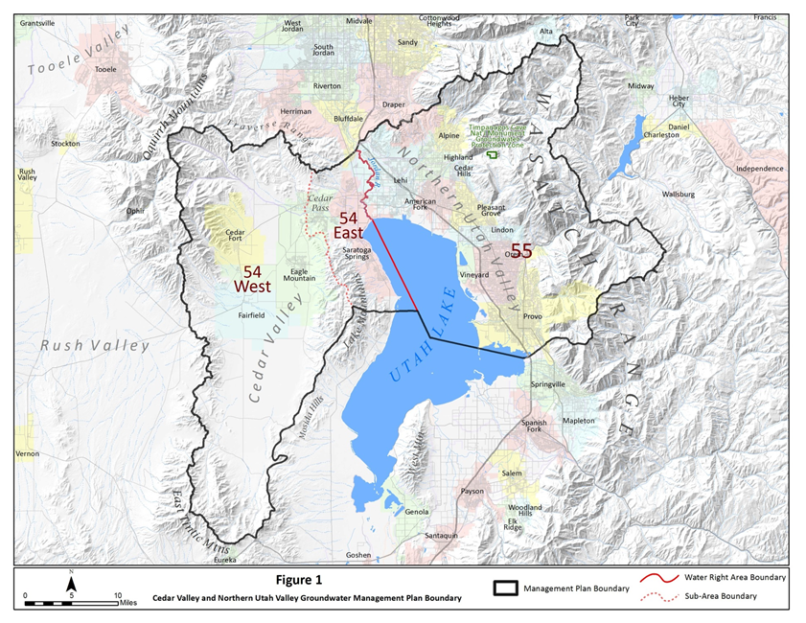
Area
Cedar Valley
Northern Utah Valley

Slide 4
Recent Studies
USGS – Hydrology of the Northern Utah Valley (2009)
UGS – Hydrogeology and Simulation of Groundwater flow in Cedar Valley (2012)

Slide 5
Previous Meeting
1995 – Utah Valley and Cedar Valley
Groundwater Management Plans
2004 – Cedar Valley
Cedar Valley Groundwater Policy
Filings transferring into Cedar Valley will be held

Slide 6
Previous Meeting
2010 – Northern Utah Valley
Presented Data from USGS Study & water rights
Interim Policy
Applications which represent a new groundwater withdrawal from the Northern Utah County Groundwater Management Area filed after September 30, 2010, will be held
2013 – Cedar Valley
Presented Data from UGS Study & water rights

Slide 7
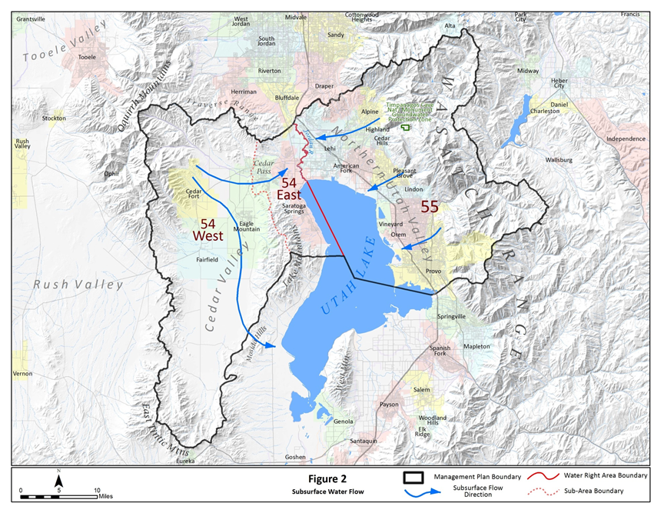
Hydrology

Slide 8
Water Resources
Area 54
Recharge 26,000 ac-ft/year
Cedar Pass Underflow 10,000 ac-ft/year
Mosida Hills Underflow 4,700 ac-ft/year
Area 55
Recharge 145,000 ac-ft/year

Slide 9
Actual Use
Area 54
Wells 6,700 ac-ft/year
Drains & Springs 3,700 ac-ft/year
Total 10,400 ac-ft/year
Area 55
Wells 68,600 acft
Drains & Springs 69,000 acft
Total 137,600 ac-ft/year

Slide 10
Hydrology
Actual Use: 137,600 acft
Actual Use: 10,400 acft

Slide 11
Potential Withdrawal
Area 54
West 19,500 ac-ft/year
East 20,000 ac-ft/year
Total 39,500 ac-ft/year
Area 55
Total 245,000 ac-ft/year
Approved and Perfected Water rights

Slide 12
Hydrology
Potential Use: 245,000 acft
Potential use: 39,500 acft

Slide 13
Area 54
Recharge, Potential and Actual Use
Recharge 26,000 ac-ft/yr
Potential Use 39,500 ac-ft/yr
Difference -13,500 ac-ft/yr
Actual Use 10,400 ac-ft/yr
Difference 15,600 ac-ft/yr

Slide 14
Area 55
Recharge, Potential and Actual Use
Recharge 145,000 ac-ft/yr
Potential Use 245,000 ac-ft/yr
Difference -100,000 ac-ft/yr
Actual Use 137,600 ac-ft/yr
Difference 7,400 ac-ft/yr

Slide 15
Area
Recharge: 145,000 acft
Potential Use: 245,000 acft
Difference: -100,000 acft
Actual Use: 137,600 acft
Difference: 7,400 acft
Cedar Valley
Northern Utah Valley
Recharge: 26,000 acft
Potential Use: 39,500 acft
Difference: -13,500 acft
Actual Use: 10,400 acft
Difference: 15,600 acft

Slide 16
Proposed Policies
Effective date of this proposed policy will be the date this plan is implemented by the State Engineer.
30-day comment period.

Slide 17
Proposed Policies
All areas will remain closed to new consumptive appropriations
All pending applications representing a new withdrawal of groundwater in area 55 (that portion within the plan area) and 54 East filed after September 30, 2010 are subject to this plan.

Slide 18
Area
Cedar Valley
Northern Utah Valley

Slide 19
Proposed Policies
Pending applications in area 55 (that portion within the plan area) and all of area 54 filed prior to September 30, 2010 will be evaluated on their individual merits.

Slide 20
Proposed Policies
Surface water rights may not be changed to underground
Unless:
Replace Spring/Drain
Report required
Aquifer Storage and Recovery
Within area 54 West
Heretofore and hereafter diversions within 54 West
Canyon Areas

Slide 21
Area
Cedar Valley
Northern Utah Valley

Slide 22
Proposed Policies
Existing groundwater rights may only be moved within the water right area in which it is currently approved. An exception is made for rights within the Central Zone defined in this plan. All change applications will be evaluated on their individual merits.

Slide 23
Proposed Policies
The 2004 policy amendment limiting transfers of groundwater into Cedar valley is rescinded. However, transfers will be limited to rights with an existing approved groundwater point of diversion in the 54 Area.

Slide 24
Area
Cedar Valley
Northern Utah Valley

Slide 25
Proposed Policies
Groundwater transfers between water right areas will not be approved unless:
Point of Diversion is within the Central Zone (2 mile buffer) as of June 4, 2013 and,
Hereafter point must remain in the Central Zone

Slide 26
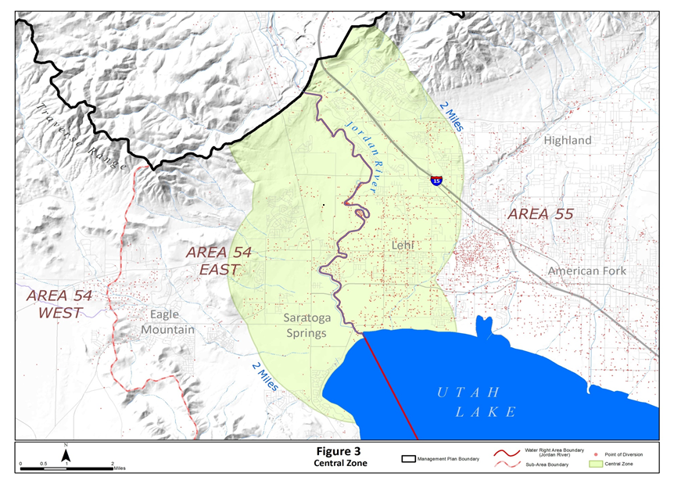

Slide 27
Proposed Policies
Timpanogos Cave National Monument Protection Zone

Slide 28
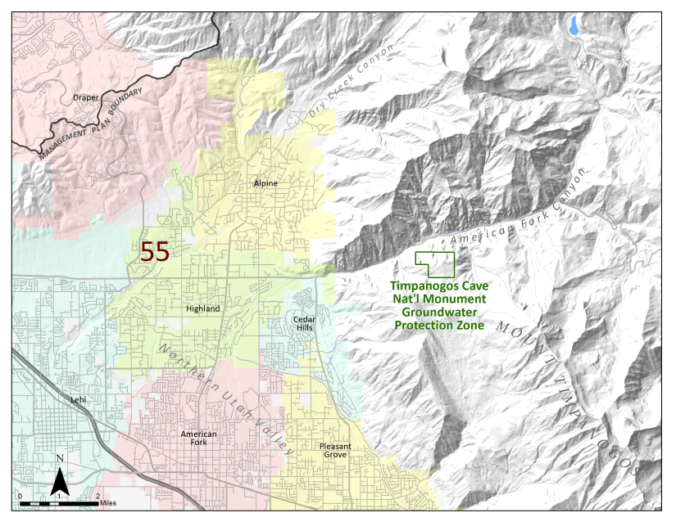

Slide 29
Safe Yield
Area 55 145,000 ac-ft/year
Area 54 26,000 ac-ft/year
Water Use Reporting
100 ac-ft/year
Install, operate, maintain, report
Notices to be sent
Continued Adjudication Efforts

Slide 30
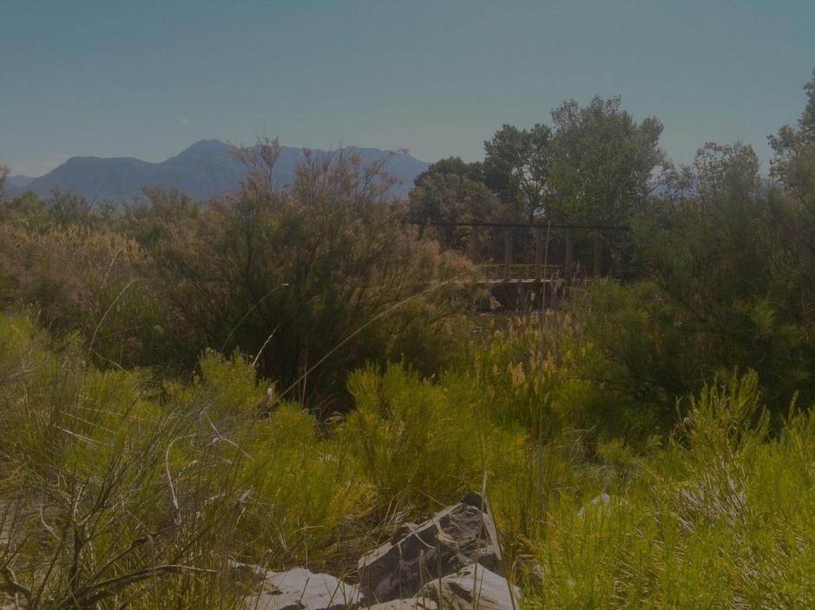
Questions?
30 Day Comment Period
Address:
Utah Division of Water Rights
Teresa Wilhelmsen
1594 W. North Temple, Suite 220
PO Box 146300
Salt Lake City Utah 84114

