Slide 1
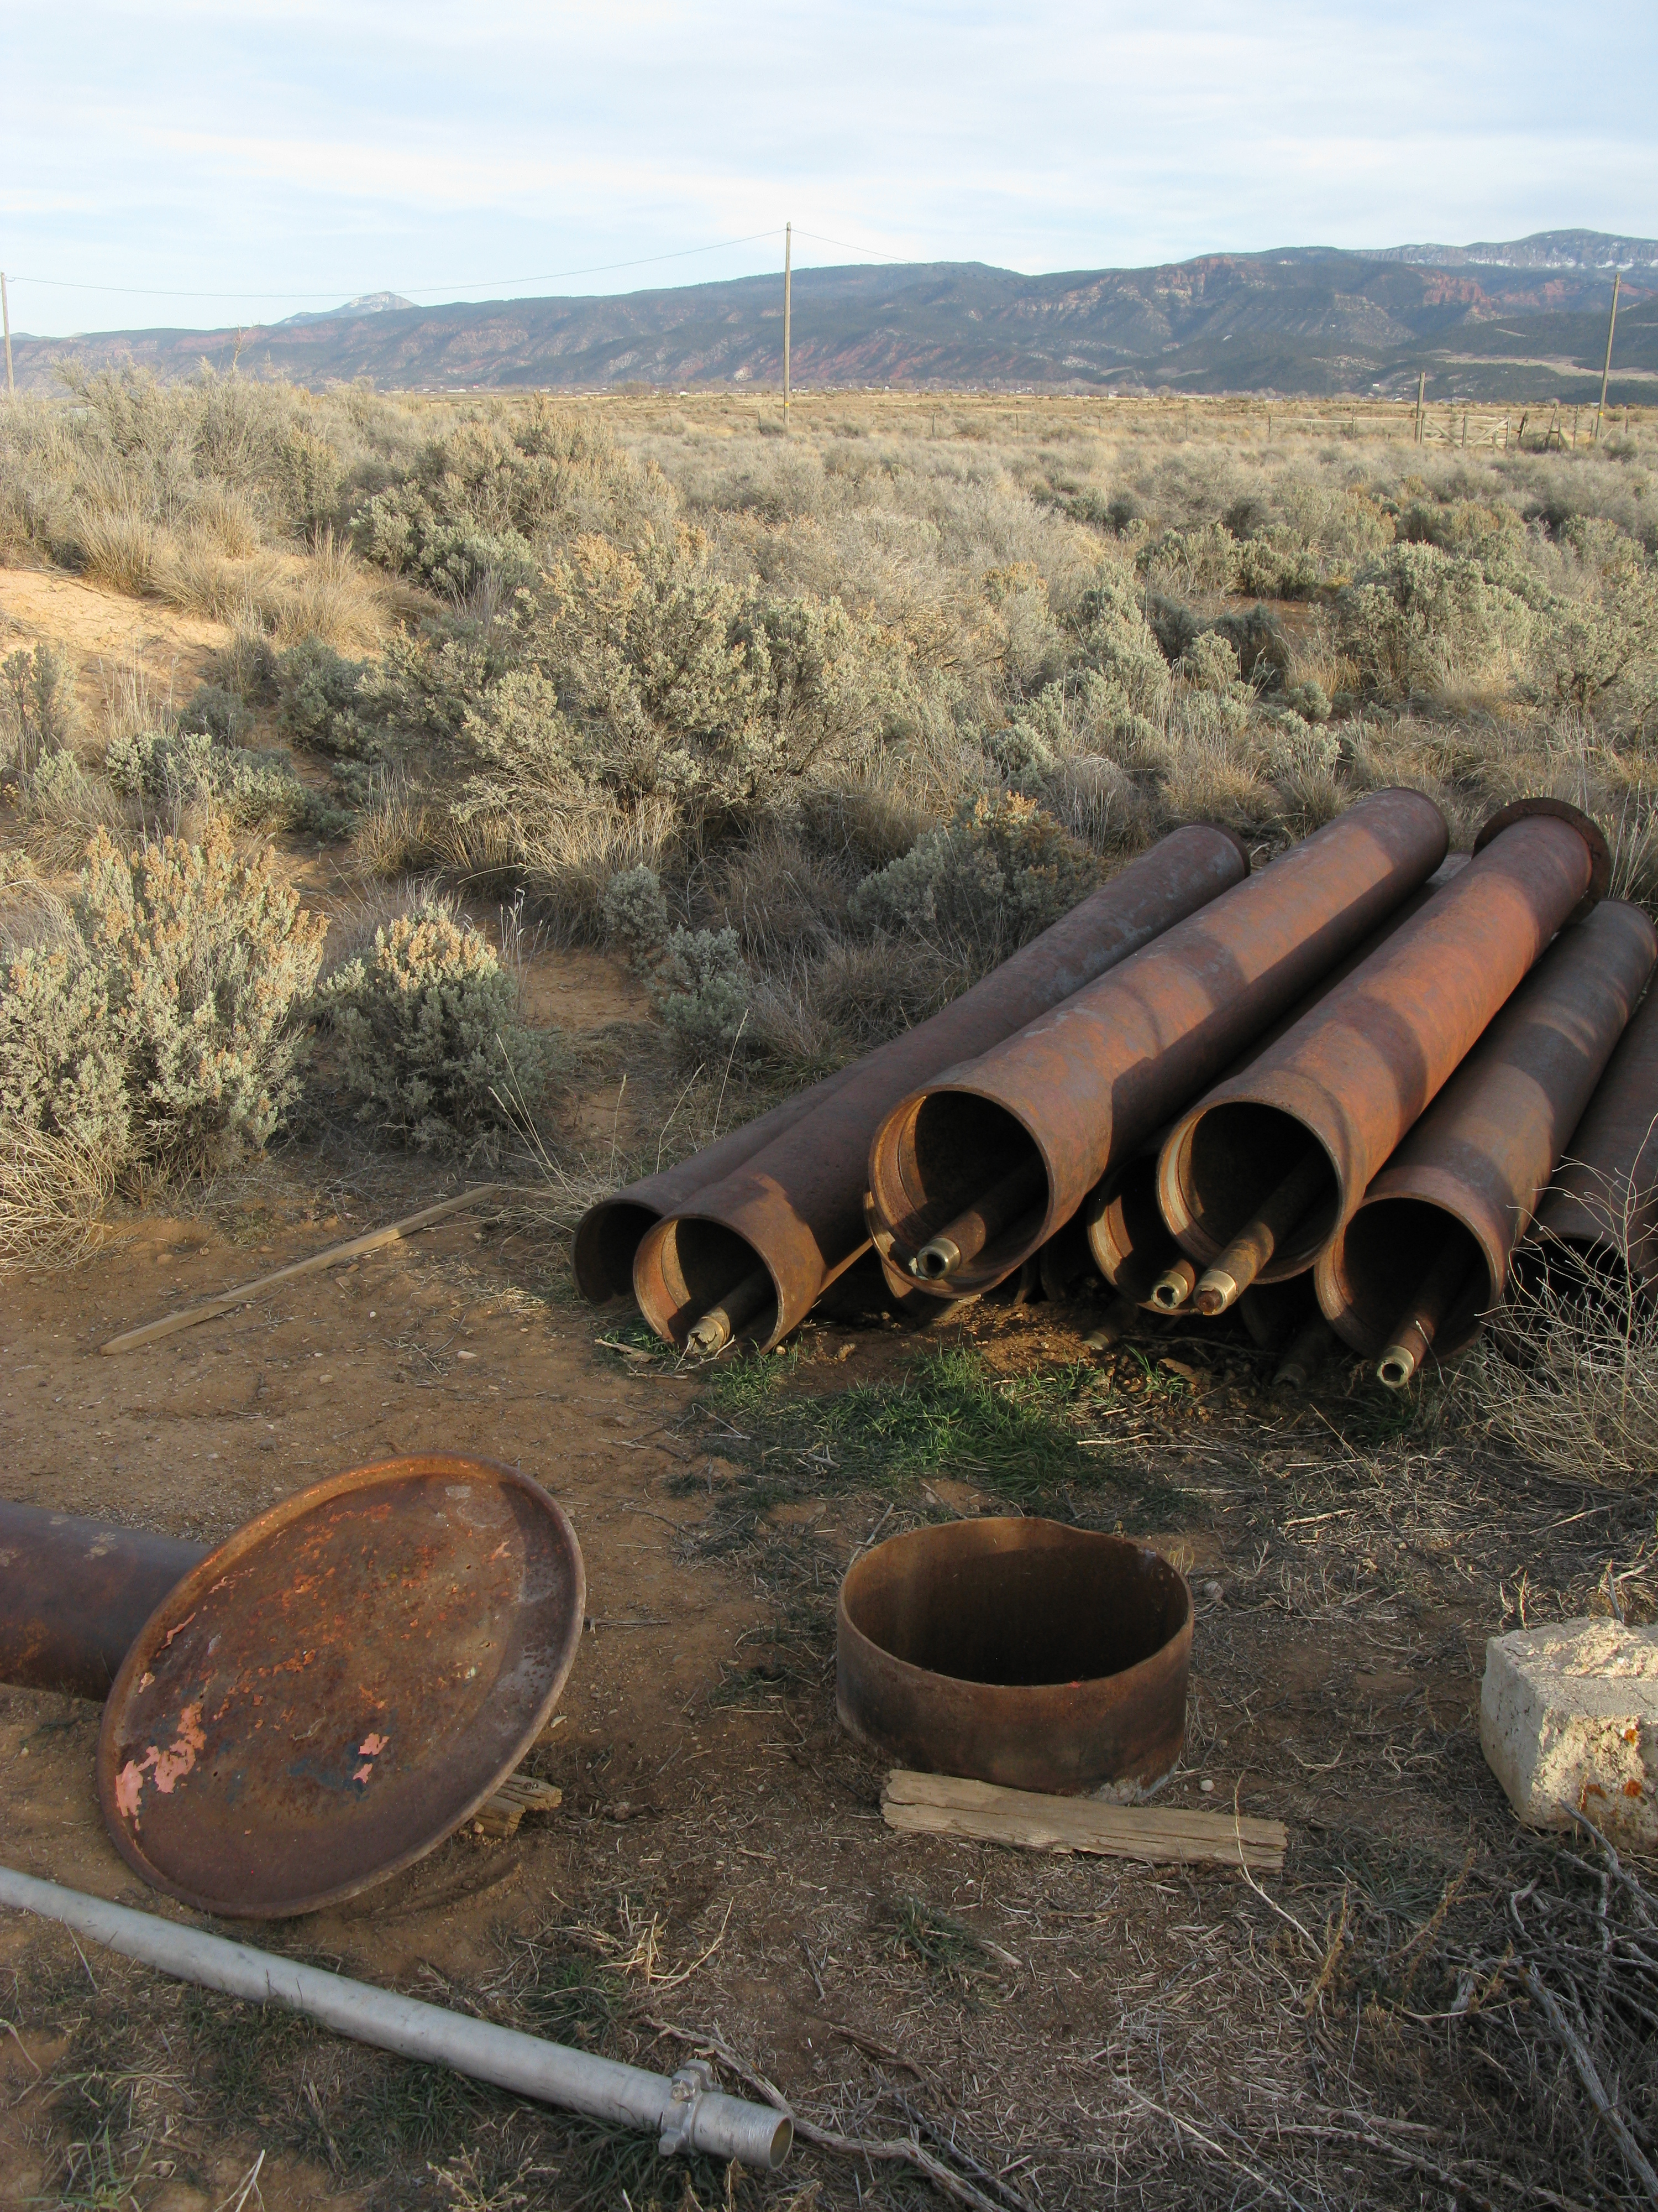
Groundwater Resources of Parowan Valley
Tom M. Marston, U. S. Geological Survey
In cooperation with the
Utah Division of Water Rights

Slide 2
Background
Parowan Valley
Approx. 160 mi²
Structural depression between Hurricane fault and the Red Hills
Closed surface-water basin (aside from Winn Gap)
  Little Salt Lake (playa)
  Parowan Gap
Historically flowing/artesian conditions for large area of central portion of valley
Unconsolidated fill deposits are 1,000+ ft thick

Slide 3
Background
Previous investigations
  Thomas, H. E., and Taylor, G.H., 1946, Geology and ground-water resources of Cedar City and Parowan Valleys, Iron County, Utah: U.S. Geological Survey Water-Supply Paper 993.
    Approximately 6,000 acre-ft of annual groundwater withdrawal
    Water-levels relatively stable
  Bjorklund, L. J., Sumsion, C. T., and Sandberg, G. W., 1978,
  Ground-water Resources of the Parowan-Cedar City Drainage Basin, Iron County, Utah: Utah Department of Natural Resources Technical Publication No. 60.
    Approximately 34,000 acre-ft of annual groundwater withdrawal
    Water-levels in decline since early 1960’s

Slide 4
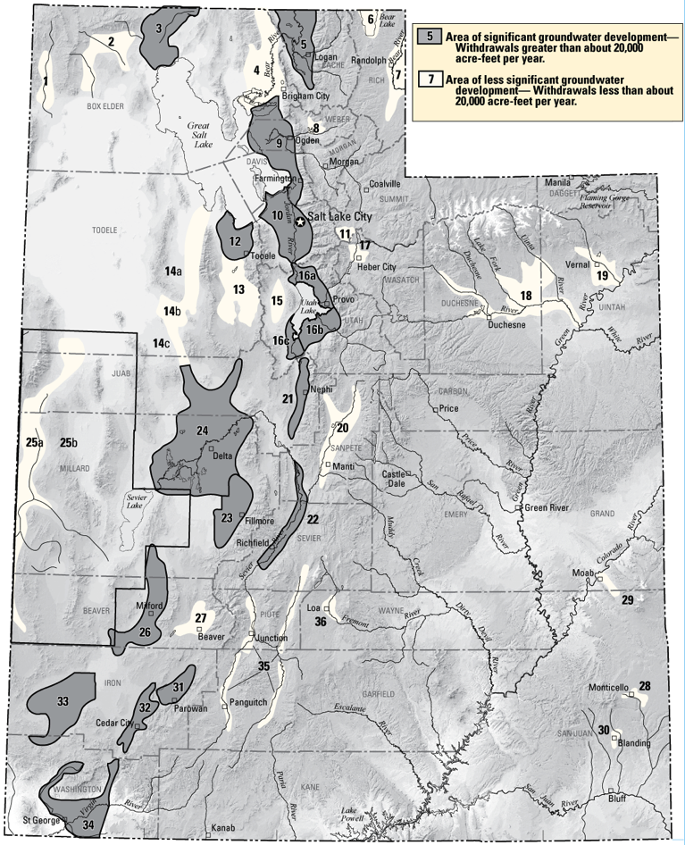
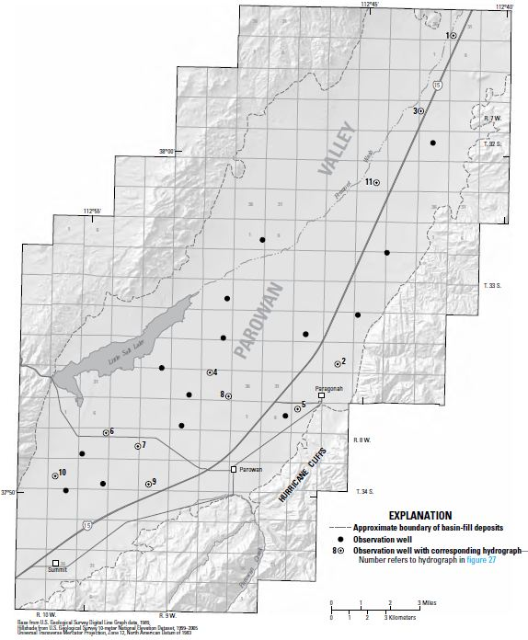
Ongoing Monitoring in Parowan Valley

Slide 5
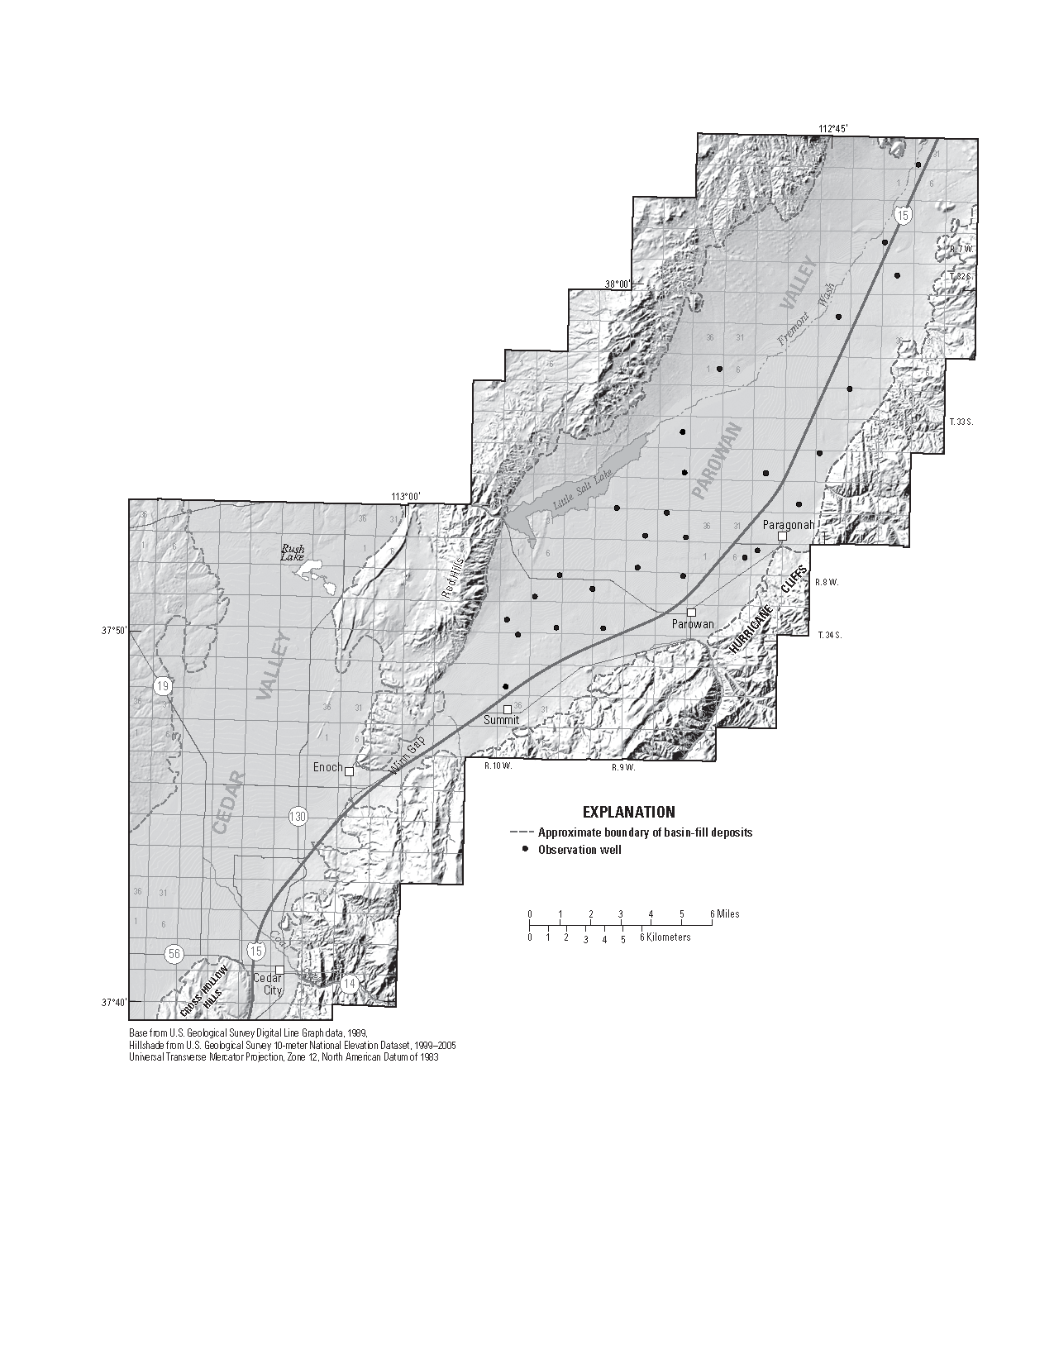
Ongoing Monitoring in Parowan Valley
(Water-Levels)

Slide 6
Ongoing Monitoring in Parowan Valley
(Withdrawals)
Withdrawal totals based on discharge/power use ratings (1963-present)
Estimates of yearly withdrawals from 1940’s to present

Slide 7
Objectives
Development of an updated groundwater budget for the valley fill aquifer
Evaluation of current groundwater level and storage conditions, and changes since 1975
Evaluation of effects from historic changes in aquifer water levels and storage

Slide 8
The Water Budget
Basic Components
Recharge
  Mountain Infiltration
  Stream seepage on alluvial fans (non-growing season)
  Irrigation
  Valley precip (negl.)
Change in storage
Discharge
  Springs
  Evapotranspiration (mountain and valley)
  Captured runoff
  Withdrawals

Slide 9
Recharge
Estimates of infiltration and runoff will be made using the Basin Characteristics Model (Flint and others, 2007; Flint and others, 2011)
  Most valley recharge likely occurs as seepage on alluvial fans and subsurface mountain block groundwater
Steam seepage to alluvial fans will be evaluated by using historically USGS stream gages on Summit, Parowan, Red, and Little Creeks.
  Additionally discharge measurements will be made on the four creeks
  Need assistance in understanding timing and placement of irrigation distributions

Slide 10
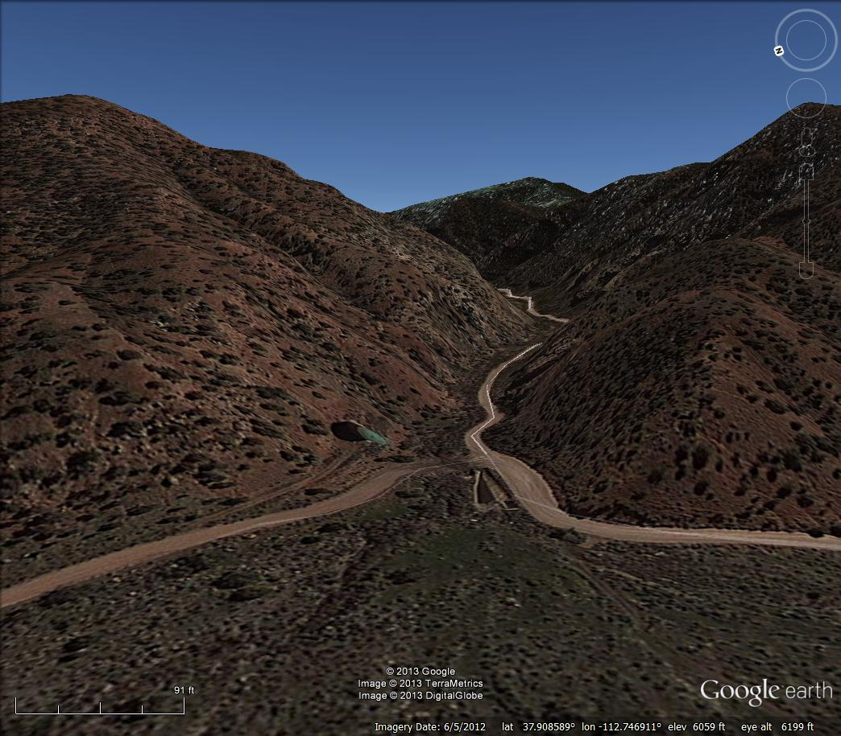
Little Creek
USGS 375432112445401
Little Creek Diversion and Distribution Structure
Natural Channel

Slide 11
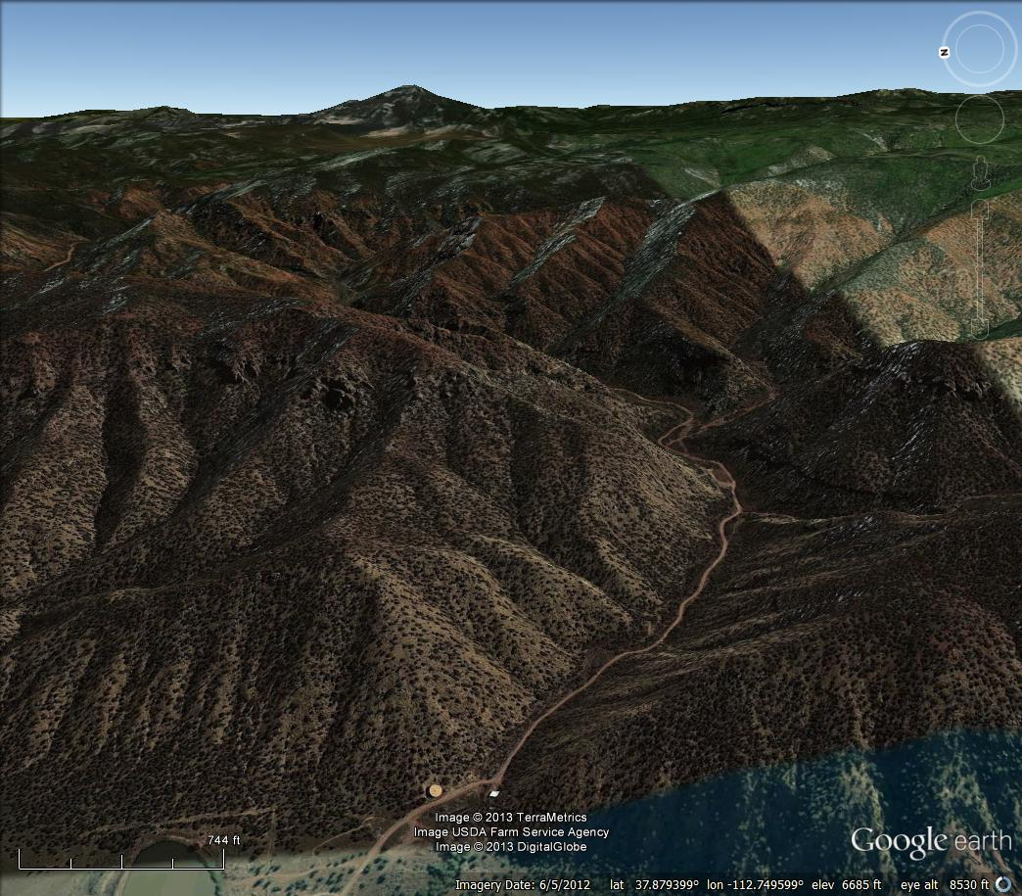
Red Creek
Red Creek Reservoir
Paragonah Culinary Spring
North Fork Power Diversion
South Fork Power Diversion
Penstock
Penstock
Red Creek Diversion and Distribution Structure
Power Plant

Slide 12
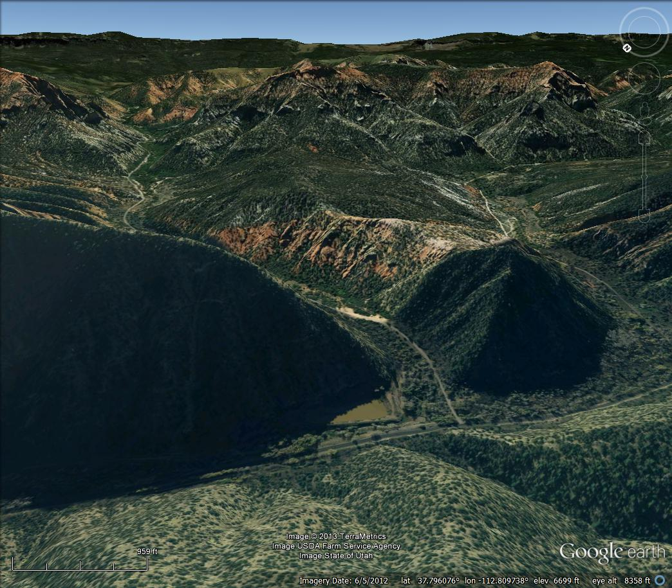
Parowan and Bowery Creeks
Yankee Meadows Reservoir
USGS 374747112483901
USGS 374754112485501
Penstock
Parowan Creek Diversion Structure

Slide 13
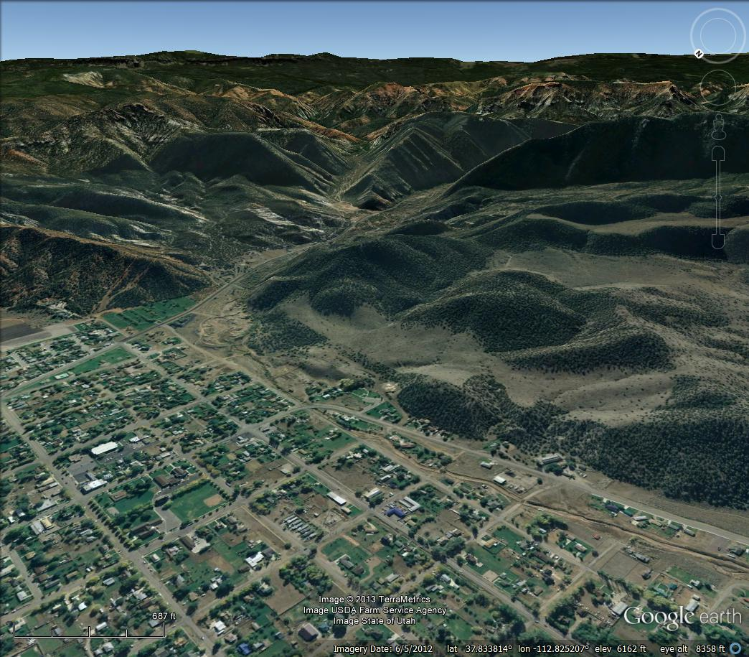
Parowan Power Plant and Distribution
Penstock
Parowan Creek Diversion Structure
Natural Channel
Parowan Creek Distribution Structure
Power Plant

Slide 14
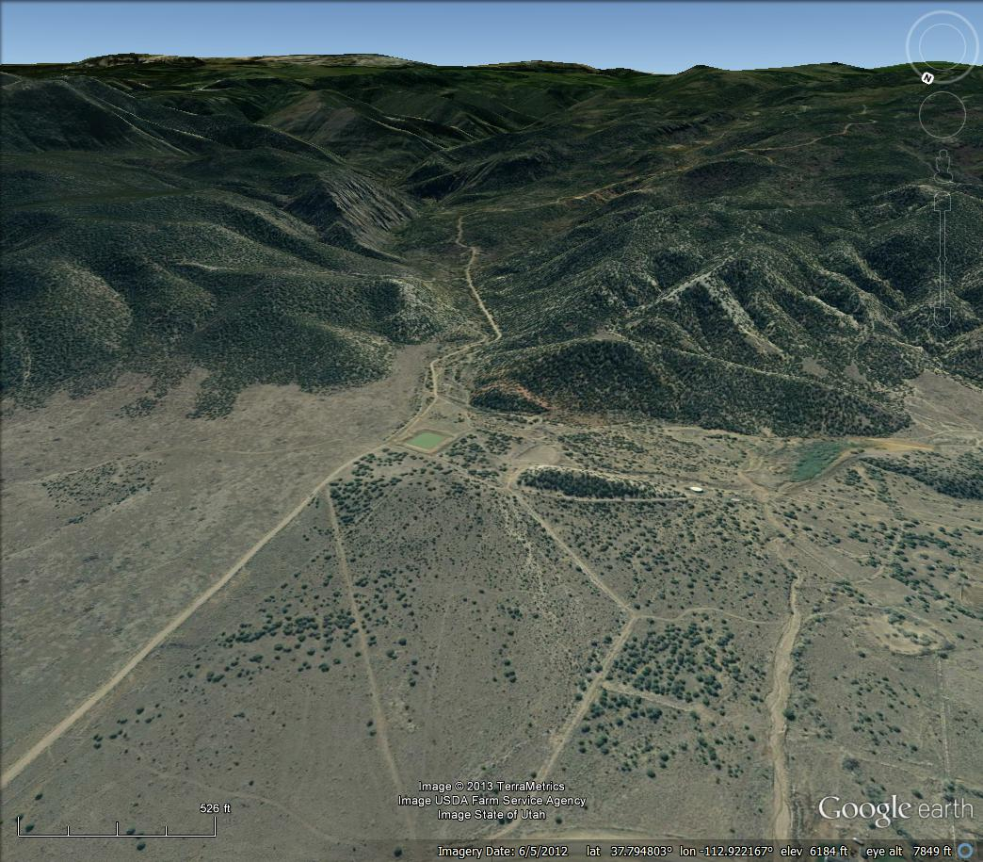
Summit Creek
USGS 374722112550701
Summit Creek Diversion Structure
Red Creek Distribution Structure
Natural Channel

Slide 15
Changes in Storage
Rates of storage change will be made on calculated changes in water-levels and estimated aquifer storage properties
  Most valley recharge likely occurs as seepage on alluvial fans and subsurface mountain block groundwater
Potentiometric map for Nov. 2012 (complete)
Change maps
  Water year 2013
  1974-2013
MODFLOW model (GBCAAS) to estimate storage properties

Slide 16
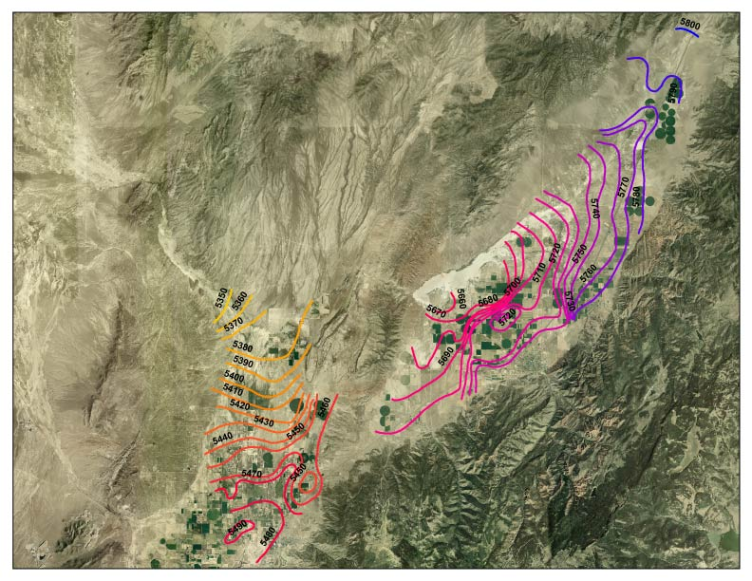
Water-Levels Oct-Nov 1974

Slide 17
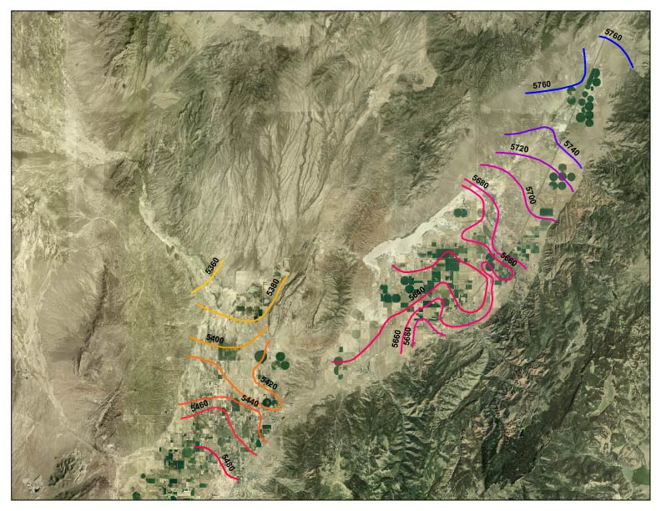
Water-Levels November 2012

Slide 18
Discharge
Withdrawals from wells
  Principally irrigation wells
  1965 through 2008 110 irrigation wells were visited triennially under the state-wide groundwater use monitoring program
  New consumption estimates will be made on these wells (Summer 2013)
  Flow meters installed on a portion of irrigation wells
Evapotranspiration
  Natural and Irrigation
Water Quality
  Irrigation wells – pH, SpC, Temp
  Selected 25 wells – Major-ion chemistry, nutrients, stable isotopes

Slide 19
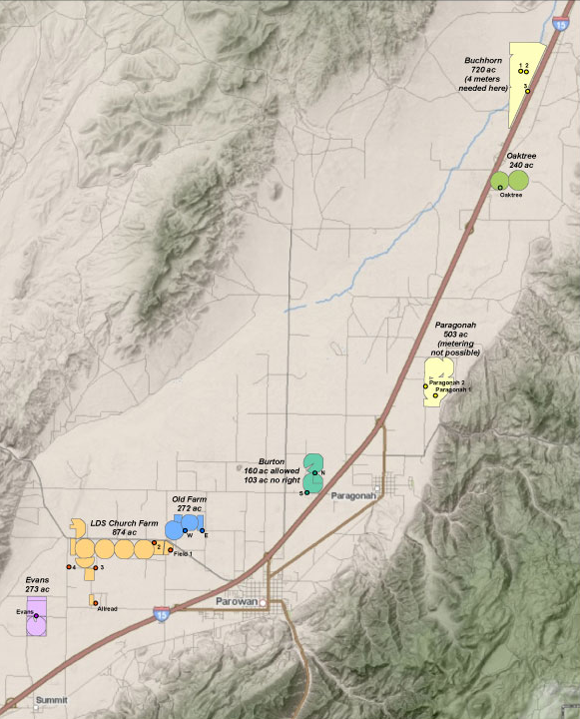
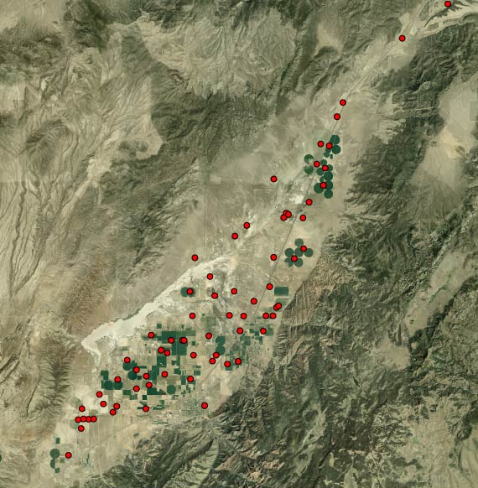
Irrigation Withdrawals
Rated Wells
Metered Wells

Slide 20
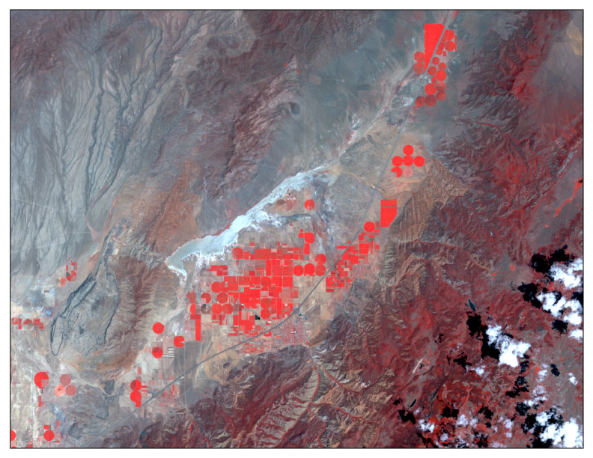
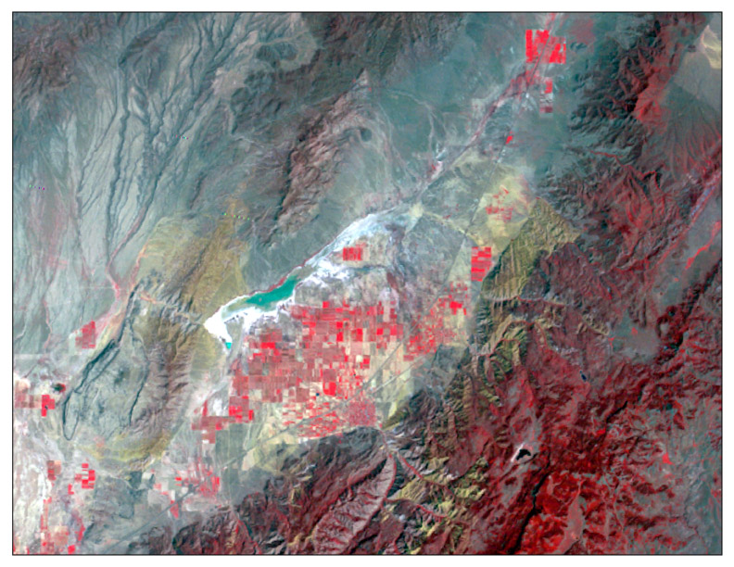
Evapotranspiration
1974
2004

Slide 21
Summary
Long-term groundwater declines since the mid-1960s
Updated groundwater budget
Re-characterization of aquifer chemistry
Evaluation of effects of decreased water-levels
Accurate measurements imperative to quality of data and decreased uncertainty

Slide 22
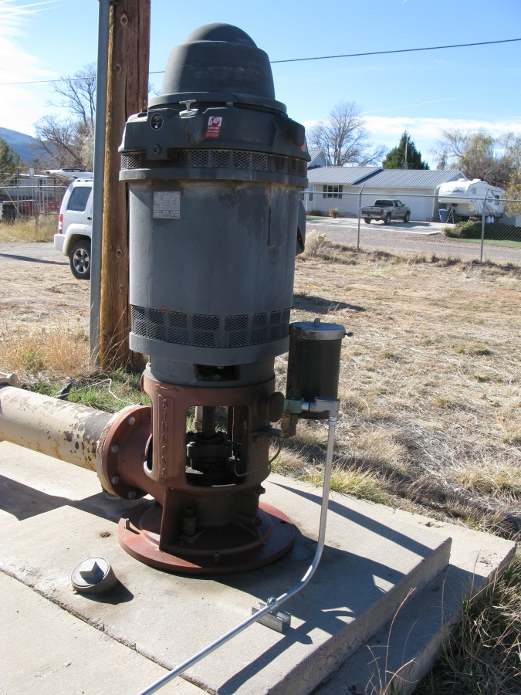
Acknowledgements
William Wilson – Summit Creek Irrigation
Kelly Stones – Parowan City Public Works
Frank Lister – Red Creek Irrigation
Tony Dalton – Little Creek Irrigation

Slide 23
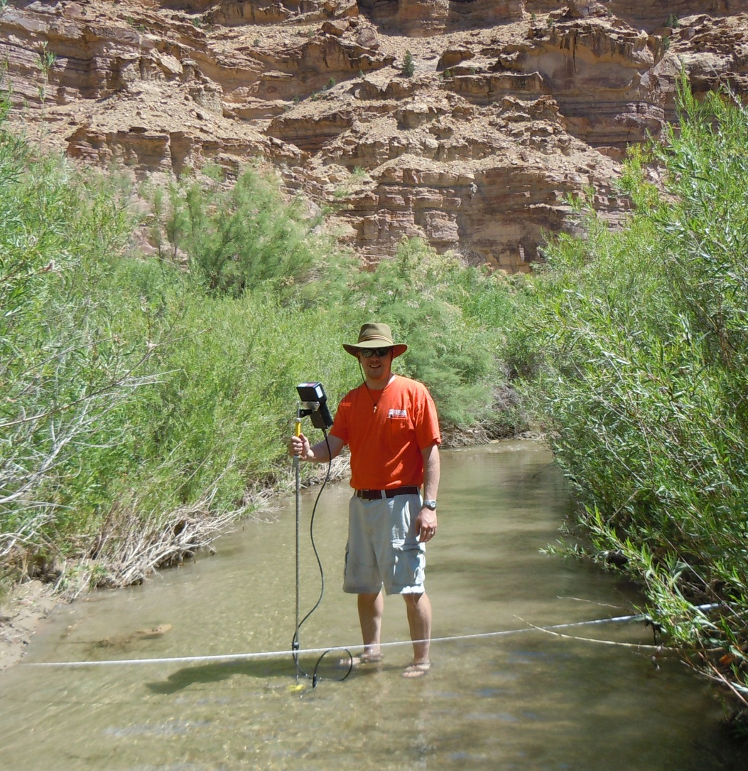
Tom Marston
U. S. Geological Survey
Utah Water Science Center
801-908-5030
tmarston@usgs.gov

