Slide 1

General Adjudication
and
The Way Ahead
Utah Water & Law Policy Seminar
March 18th, 2013
Utah Division of Water Rights
Blake W. Bingham, P.E.
Adjudication Program Manager
www.waterrights.utah.gov
Notes:
Introduction

Slide 2
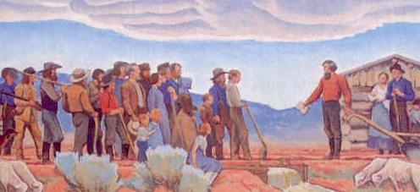
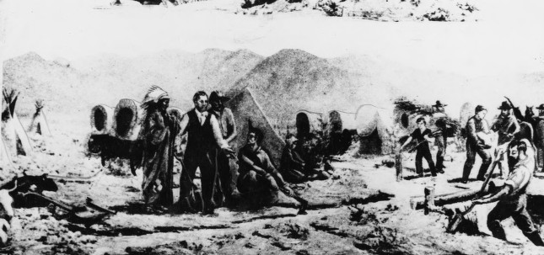
Historical Context – The Pioneer Era
July 23, 1847: Advance party of the Mormon pioneers entered the Salt Lake Valley and began breaking-up the ground to prepare the land for crops. Water from City Creek Canyon was diverted to moisten the soil for plowing and later used for irrigation.
September 30, 1848: Brigham Young declares, “There shall be no private ownership of the streams that come out of the canyons... These belong to the people: all the people.”
1847 – 1850: The pioneer settlement went from being part of Mexico to the State of Deseret to the Territory of Utah; however, government remained Church-centric.
  Diversions of water from streams were generally on a community basis to meet the immediate needs of the settlers.
  The doctrine of priority evolved from Church leaders’ recognition of groups who first put the water to beneficial use as well as later beneficiaries (primary and secondary rights).
  Conflicts were settled through ecclesiastical channels; Bishop’s Courts for local wards provided a judicial process with Stake High Councils serving as appellate courts.
Notes:
It’s probably easy to look at the adjudication process today and assume that it was a foregone conclusion from the beginning. However, when one compares the present-day policies and procedures against a historical backdrop, the evolution and reasoning behind the procedures becomes more understandable. So, in an effort to explain the concept of adjudication, I feel that it’s extremely instructive to crack the history books a little and review how we got to where we are. Obviously, I’ll need to paint with a pretty broad brush in order to review over 100 years of history in the next 45 minutes, so I’m just going to hit the critical points.
On July 23rd, 1847, an advance party of the Mormon Pioneers entered the Salt Lake Valley and commenced attempting to break up the soil to cultivate crops. As one might expect, the soil proved difficult to turn and they found it necessary to divert the waters of City Creek in order to soften the ground up enough to plow it.
On September 30th, 1848, Brigham Young essentially decreed that all the waters would be public and not be owned as personal property.
From 1847 to 1850 the area settled by Brigham Young and his followers transitioned from being a part of Mexico, to the State of Deseret to the Territory of Utah. At the conclusion of the U.S.-Mexican War, the Mormon pioneers found themselves part of the United States. Without an official Federal charter, Brigham Young established the State of Deseret in 1849 while they applied for statehood. In 1850, Congress officially recognized a much-small version of Deseret as the Territory of Utah.
Although new territorial laws would follow, the fundamental principles governing the allocation and distribution of water established by the Church continued to govern, namely:
Waters were diverted and distributed based on the immediate needs of the settlers and used in communal fashion.
The doctrine of prior appropriation evolved similarly as it had in mining settlements of California, but was agriculturally oriented.
Any conflicts which arose were settled through ecclesiastical means. Bishop's courts for local wards provided a judicial process, with ecclesiastical high councils serving as appellate courts.

Slide 3
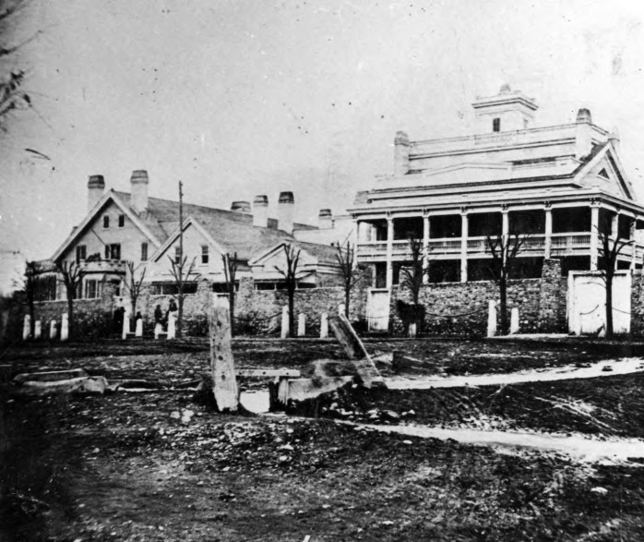
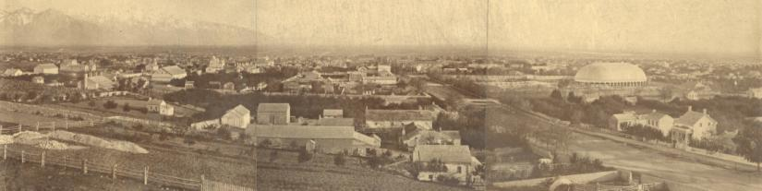
Historical Context - Territorial Era
1852: The first Territorial Legislative Assembly passed an act authorizing the County Court control of “all timber, water privileges, or any water course or creek.” Salt Lake County was the only one to assume these duties… other counties streams were diverted without public restriction.
1877: The Desert Land Act was passed to promote homesteading of arid and semiarid public land. The Act also severed the title of the water from the public land and delegated authority to appropriate the water to the respective state or territory.
1880: Due to failure to enforce the 1852 act, the legislature passed an act that replaced the County Court’s authority with the County Selectmen as the ex-officio water commissioners. Allowed recognition, determination, and recording… but not appropriation. Once again, this was only enforced in a few counties and the certificates were generally considered worthless.
  Confusion over existing water rights continued in spite of the efforts of the Utah Territorial Legislature.
  The Church continued to administer and decree water rights in some areas (e.g. 1879 High Council Decision to divide the waters of the Spanish Fork River among various canal companies).
Notes:
In 1852, the first attempts to codify the administration of water was made by the Territorial Legislative Assembly. Along with various other natural resources, the act authorized the County Court as having control of all waters. As observed by Elwood Mead from the USDA, this placed an un-funded mandate on the respective County Courts which they failed to universally embrace. We can also infer from the environment of the era that the act went contrary to the tenets of religious devotees who held a firm belief that Church leadership had more authority for administering the waters of Zion than the local court.
In 1877, congress passed the Desert Land Act. The Desert Land Act is significant, because it helped spur the homesteading in areas of Utah and it effectively separated the title of the water from the public land and allowed it to be appropriated by the respective territory or state.
Due to the failure of the 1852 act, the legislature attempted to appoint County Selectmen in 1880 who were responsible for recognizing, determining, and recording existing rights by filing a certificate with the County Recorder. This act was also considered void in that it granted judicial power to an office not named in the original charter of Territorial courts. Consequently, the efforts to manage or record the existing water uses were, once again, thwarted. It should also be noted that this act was only attempted following the death of Brigham Young, since the act also incorporated a general provision that shifted from concept of water ownership from communally owned to personal property.
As a result, confusion over existing rights continued to propagate itself in spite of the efforts of the Territorial Legislature.
The Church continued to act as the governing body with regard to water rights. A prime example is the 1879 High Council decision which meted out the waters of the Spanish Fork River among various canal companies. This decision is still used as a basis for distribution and adjudication to this day.

Slide 4
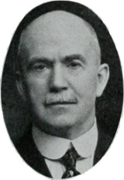
Historical Context - Statehood and Beyond
1896: Utah gains Statehood. Due to fears of possible confiscation of existing water rights by the State under a comprehensive water code, the adopted constitution only had one sentence regarding water law:
  ”All existing rights to the use of any of the waters in this State for any useful or beneficial purpose, are hereby recognized and confirmed.”
  - Constitution of the State of Utah, Article XVII
1897: Office of the State Engineer created and tasked with conducting hydrographic surveys and measuring stream sources. Appropriations were made by posting notice at the source, the nearest post office, and the county recorder… largely ignored.
1902: United States Reclamation Service (i.e. The Bureau of Reclamation) established to “reclaim” arid lands in the Western United States.
    To secure Federal funding for Reclamation projects, states were encouraged to adopt statutes which provided certainty regarding existing water rights and future appropriations.
1903: State legislature enacted the first Utah Water Law which provided for (among others):
    The definition and public recording of all existing water rights and the adjudicating of rights by the Court. Legislature failed to provide funding to the local Courts.
  ”While this law was ideal in purpose and virtue… the law failed miserably as a means of adjudicating existing water rights. As a matter of fact no rights were ever adjudicated by virtue of it.”
  - State Engineer Biennial Report 1919-20
1919: The legislature provided the “machinery” to adjudicate water rights on a given stream by directing the State Engineer to develop a “proposed determination” of water rights for the Court to consider.
Willard Young
State Engineer
Notes:
When Utah became a state in 1896, there was a push to incorporate a comprehensive water code into the State Constitution; however, friends of this movement considered it necessary to adopt a declaration that water was the property of the State—creating fear among some that the proposed change meant a confiscation of their property. As such, they preferred to leave matters as they were, maintaining that the State had no rights in the water. As a consequence, the adopted constitution only had one sentence regarding water rights. Essentially, it was back to business-as-usual.
Recognizing the need to define and record all existing water rights, in 1897 the state legislature created the office of the State Engineer and tasked him with conducting a hydrographic survey of the waters in Utah; however, no funds were actually allocated to accomplish the work. They also made another attempt at providing a means for recording existing claims and appropriating new rights by posting notice at the place of diversion and at the nearest post-office stating the volume claimed, the intended use, the place of use, the area of irrigation, the means of diversion, the date of appropriation, and the name of the appropriator. The appropriator was also to file for record at the county. This law was similar to those in other states at the time and likewise was a failure in Utah as in the other states.
In 1902, the United States Reclamation Service was created to “reclaim” the arid lands of the West. Recognizing the issues that many states had experienced with over-appropriation of stream and river sources, the Reclamation Service encouraged the states to pass laws that quantified existing appropriations and managed future ones. Anxious to be the recipient of Reclamation project funding, many states (including Utah) began implementing comprehensive water law aimed at quantifying existing rights and appropriating future ones.
In 1903, the State of Utah passed its first comprehensive water law which codified the responsibility to formally adjudicate existing water uses within Utah. The law required the District Court to take all of the claims from various water users and the hydrographic survey map generated by the State Engineer and determine a decree regarding the rights; unfortunately, the Utah Legislature failed to set up or fund the needed personnel at the District Courts to take care of the responsibilities associated with the additional work of adjudicating the water rights. Consequently, the adjudication of water rights was, once again, stalled.
By the time 1919 rolled around, the legislature had recognized their error and formally delegated the responsibility of developing a proposed determination of water rights to the State Engineer as party to the respective general stream adjudication.

Slide 5
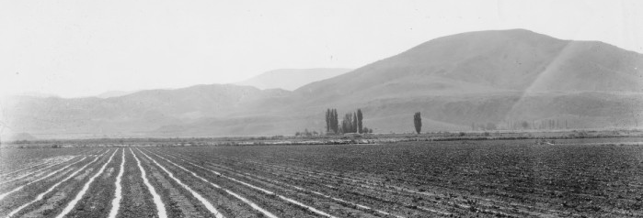
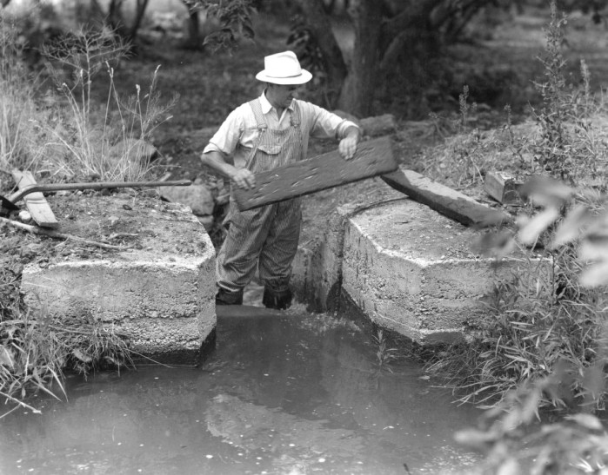
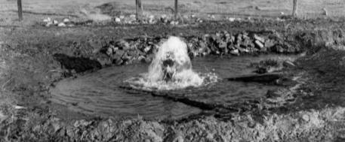
The Historical Case for Adjudication
Prior to the enactment of the comprehensive Utah Water Law in 1903, rights to the use of water typically fell into a combination of five categories:
  Rights decreed by ecclesiastical leaders.
  Claims filed for record at the county.
  Rights decreed by a court (typically involving limited parties) and recorded at the Courthouse.
  Contractual agreements between various entities.
  Claims never manifested in any record, but evidenced by pre-statutory use.
The lack of a definitive water law created a number of issues:
  There was typically no public record of existing water rights.
  Since there was no record, over appropriation of streams was common.
  Often, rights weren’t defined until they came into controversy and had to be settled by ecclesiastical or court decree.
In his biennial report for 1901-02, the State Engineer made the following observation:
“The definition of existing rights appears to be of first importance. This is not only necessary to pacify present contention, but to prevent future conflicts and encourage further progress. There can be no safe basis for future work before existing rights are known and made of public record.”
– A.F. Doremous, Utah State Engineer
Notes:
Around the turn of the century, water rights existed in a myriad of forms:
There were those rights which were issued via ecclesiastical fiat.
There were a handful of claims which were recorded at the county in conformance with early territorial and state legislation.
There were rights which had been formally decreed by a court—usually as a result of conflicts surrounding various users on the same stream.
There were contractual agreements between entities, usually canal companies, dictating the apportionment of the respective stream.
There were claims which never manifested themselves in any record, probably because there was no apparent conflict in appropriating the source.
As a result of the confused state of water rights, there was an abundance of negative consequences.
There was no definitive record of existing water rights on any respective stream.
Since there were no records and no appropriation process, over-appropriation of water sources was common.
Over-appropriation eventually resulted in controversy among water users which had to be settled through some form of expensive and time-consuming litigation (be it ecclesiastical moderation or judicial).
In his biennial report, State Engineer A.F. Doremous described the need for adjudication of water rights throughout the State of Utah.

Slide 6
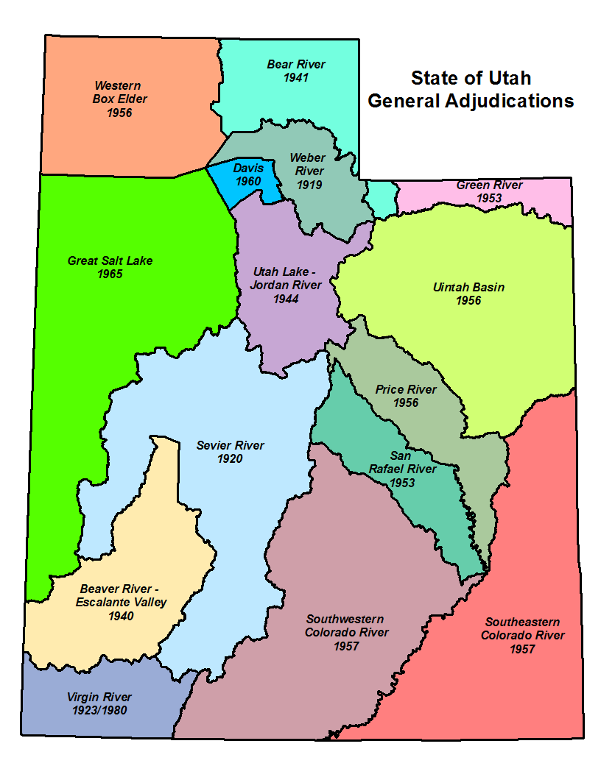
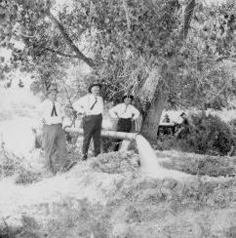
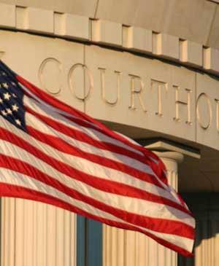
What is a General Stream Adjudication?
What it IS…
Action in District Court
Binds water users and the State Engineer (Division of Water Rights)
Governed by Utah State Code: Title 73, Chapter 4.
The first General Stream Adjudications took place in the 1920s – Sevier, Weber and the Virgin River basins.
Notes:
So, we’ve talked about adjudication in its broadest sense, but what I really want to talk about is the concept of a General Stream Adjudication. Water rights adjudication can be accomplished through simple litigation between two parties. Any decree resulting from the litigation is only applicable to the parties formally joined in the suit.
However, a General Stream Adjudication is an action in District Court which joins all water users within a stream drainage and the State Engineer as parties to the litigation. Joining all parties within a drainage is important because it helps to prevent multiple decrees among different users which might contradict each other or even miss pertinent aspects of the respective system.
For example, the Spanish Fork River has been the recipient of multiple decrees. As mentioned earlier, the original decree was a High Council Decision in 1879 which divided all of the waters of the river among 5 canal companies. However, it failed to recognize water users who diverted water from the Spanish Fork River and its tributaries up-stream from the mouth of the canyon and even failed to recognize one of the oldest canals on the river (who simply wasn’t a party to the dispute).
The General Stream Adjudication process is outlined in Title 73, Chapter 4 of the Utah State Code.
As you can see on the map, every major river drainage in the State of Utah is currently or has been under a General Stream Adjudication order. Some of these adjudications were petitioned by water users to the State Engineer (as dictated by Utah Code) such as the Weber River basin, while others were court-ordered by expanding the scope of an existing dispute among specific parties to a General Stream Adjudication, such as the Utah Lake / Jordan River basin.
Due to the size of the drainages and the growth of water development throughout the State, the main river drainages are often split into smaller areas—divisions and even subdivisions—which facilitate the ability of our staff to go into an area and proceed quickly—relatively speaking.

Slide 7

Adjudication Process
90 days
Claimants have 90 days to notify the State Engineer of their names and addresses; at the conclusion of the 90 days, the State Engineer submits a list of claimants to the District Court. (UCA 73-4-3)
1
2
NOTICE
3
4
SUMMONS
PETITION
The State Engineer is petitioned by water users or court-ordered to initiate a General Adjudication. (UCA 73-4-1)
The State Engineer publishes notice of the pending adjudication for 2 weeks in a local newspaper.
(UCA 73-4-3)
The State Engineer serves Summons on claimants and publishes Summons for 5 weeks in a local newspaper. (UCA 73-4-4)
5
PUBLIC MEETING
6
HYDROGRAPHIC SURVEY
7
CLAIM
CLAIM
CLAIM
8
PUBLIC MEETING
PROPOSED DETERMINATION
The State Engineer holds an initial Public Meeting in the local area to discuss the adjudication process. (UCA 73-4-3)
The State Engineer conducts a hydrographic survey of the area and assists the claimants in completing their Water User’s Claims.
(UCA 73-4-3)
The State Engineer reviews Water User’s Claims and other records and prepares a Proposed Determination which is then distributed to the claimants and filed with the District Court. (UCA 73-4-11)
The State Engineer holds a Public Meeting to discuss the Proposed Determination with claimants.
(UCA 73-4-11)
90 days
Claimants have 90 days to file an objection to the Proposed Determination with the District Court. (UCA 73-4-11)
9
10
FINAL SUMMONS
11
OBJECTION RESOLUTION
12
DECREE
The State Engineer serves the final summons via publication for 5 weeks in a local newspaper.
(UCA 73-4-22)
The State Engineer resolves objections to the Proposed Determination with respective water users. (UCA 73-4-14)
The District Court issues a Decree (or Interlocutory Decree) on the Proposed Determination.
(UCA 73-4-15)
Notes:
This is my best attempt at an “info-graphic” of which summarizes the adjudication process. As indicated by the color coding, it can be separated into 3 phases, so to speak. The initial phase involves petitioning the State Engineer and providing notice to claimants of a pending adjudication. This phase has been completed for each separate adjudication in the State at one time or another; however, we typically repeat it at the onset of each subdivision proceeding. The second phase includes the bulk of the work, wherein the Adjudication Program conducts the hydrographic survey and works with water users to compile a proposed determination. The last phase begins following the publication of the proposed determination and includes final summons and objection resolution—hopefully culminating in a final or interlocutory decree.

Slide 8


Destination Matters…
Would you tell me, please, which way I ought to go from here?
That depends a good deal
on where you want to get to.
I don't much care where.
Then it doesn't matter which way you go.
Notes:
I think that it’s obvious why destination matters, but I think that it’s especially important to review the destination on a regular basis with respect to government programs. As the Cheshire Cat points out, that if we don’t know, or care, where we’re going, than the approach becomes moot. So, before we can discuss methods, techniques, or approaches, I think we need to answer a few critical questions.

Slide 9
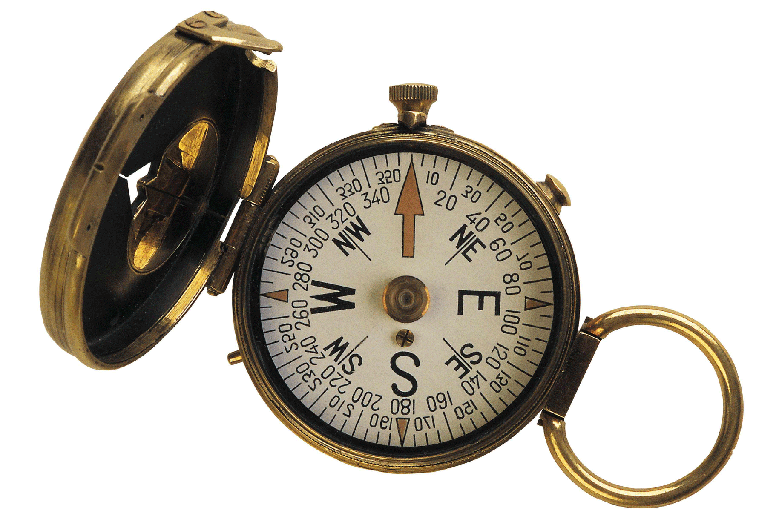
Azimuth Check
Some Critical Questions
    What is the primary objective of the Adjudication Program?
      What is the single most critical aspect that a general adjudication must achieve when completed?
      Are we getting wrapped-around-the-axles on ancillary issues and failing to achieve the primary objective?
    What are the respective priorities of secondary objectives?
      General adjudications can accomplish multiple tasks… so, what are the other objectives and in what order of importance should they be placed.
    How important to the State of Utah are those objectives?
      What value are the residents of Utah willing to place on the accomplishment of those objectives?
Notes:
It’s always a good idea to step back and do an azimuth check every once in a while. Without a clear understanding of our ultimate objective, the approach to any task can get mired by “mission creep” and hampered by unnecessary obstacles as a result.
In my opinion, these three questions strike at the heart of the matter. If we can get definitive answers to these questions, the approach to general adjudication is greatly simplified and becomes a matter of formulating a legal and administrative framework necessary to accomplish the objectives.

Slide 10
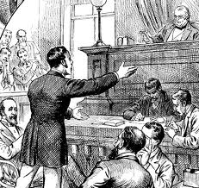
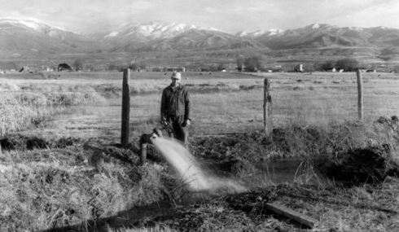
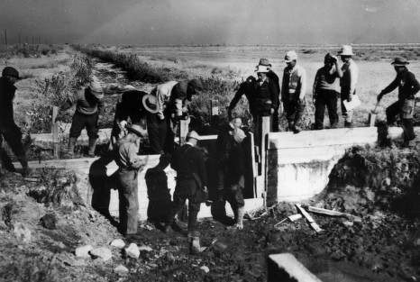
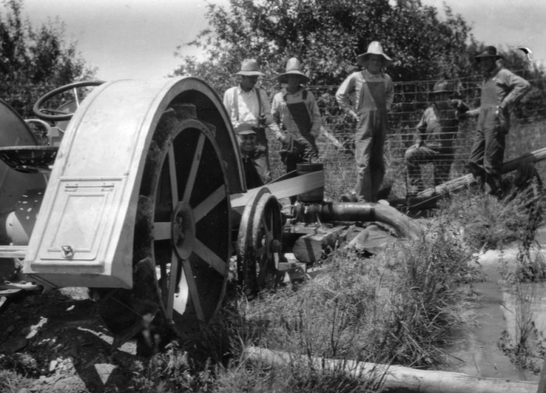
Why Do We Conduct General Adjudications?
Bring all claims on to the permanent record:
  Pre-Statutory Claims
    Diligence Claims
    Underground Water Claims
    Pending Adjudication Claims
  Federal Reserve Rights
    Winter’s Doctrine (1908)
    McCarran Amendment (1952)
To prevent a “multiplicity of suits” and bring clarity to the water rights picture.
Remove/reduce rights which have been wholly or partially forfeited through non-use…?
To obtain decrees on all water rights—including certificated rights…?
…but what about Federal rights?
Notes:
So, in an attempt to illustrate the importance of the foregoing critical questions, let’s pose the question, “Why do we conduct general stream adjudications?” The answer is… it depends. For one thing, it probably depends on the period of history in which you asked it. Originally, general stream adjudications were utilized to bring all pre-statutory claims on to the permanent record. This is easy to understand from the perspective of water users in 1903. At the time that Utah’s first comprehensive water law was passed, it’s obvious that the number of pre-statutory claims far exceeded the number of appropriated rights since the system had yet to create any. Consequently, it was imperative to determine and quantify existing rights in order to allow the State Engineer to process future appropriations. This holds true through today, although the ratio of pre-statutory claims to certificated rights is much smaller--as will be illustrated in the next slide.
If you were to ask why we conduct general adjudications today, I think that it would be impossible to leave out the issue of Federal Reserve rights. As a result of a 1908 Supreme Court decision in Winters v. United States, the court ruled that by creation if the Fort Belknap Indian Reservation, there was an implied water right for the amount of water for the reservation to be self-sufficient. Today, federal reserved water rights can be asserted on most lands managed by the federal government. Reserved rights are, for the most part, immune from state water laws and therefore, are not subject to diversion and beneficial use requirements and cannot be lost by non-use. Federal Reserve rights are limited by the "primary purpose" and "minimal needs" of the reservation or the respective federal agency’s original congressional mandate. In addition, federal reserved water rights are nontransferable. By law, these rights can only exist on lands owned by the federal government. If a land transfer occurs, any existing federal reserved water right becomes invalid.
Although Federal Reserve rights were known to exist, there was no way to force the Federal Government to assert or quantify their claims since it possessed sovereign immunity and could not be joined involuntarily in a suit. In 1952, a senator from Nevada by the name of Pat McCarran introduced a bill that would allow states to pursue quantification of Federal Reserve rights. As it came to be known, the McCarran Amendment, waives U.S. sovereign immunity with respect to water rights and allows states to determine Federal water rights in state courts. Hence, federal water claims may be quantified in state stream adjudications, but only if such proceedings are comprehensive (meaning that all claimants to a specific water body are joined in the suit).
Another benefit of a general adjudication is the consolidation and settlement of multiple controversies and bringing clarity to the overall water rights picture by joining all water users within a given system, as opposed to piecemeal litigation.
The last two items are, I believe, a result of “mission creep” and that’s why I have question marks associated with them. I don’t believe that the original intent of general adjudications had much to do with forfeiture, and much less with obtaining decrees on certificated water rights. Interestingly enough, in the State Engineer’s Eleventh Biennial Report (page 12, line 21) he made the following statement regarding certificates:
“Such a certificate or title when once issued is good as against the State, and the State cannot thereafter question the appropriator’s right unless the certificate was secured by fraud or misrepresentation. It is this reason that proofs of appropriation are so carefully checked.”

Slide 11
1,350 per Year
300 per Year
Notes:
Now that we have a clear idea of why we adjudicate, let’s take a look at how we’re doing. This chart shows the rate at which certificated rights & diligence claims are being created versus the rate at which claims are being published in proposed determinations. Currently, only certificated rights and pre-statutory claims are included in proposed determinations. The various colored “wedges” represent the number of diligence claims (including underground claims) in blue, the number of certificated rights in green, and the number of segregations from certificated rights in red.
The dashed line represents the number of claims published in proposed determinations over the years. As you can see, the trend between the rate at which rights are being certificated and the rate at which claims are being published is a diverging one.
This makes the question of why we conduct general adjudications all the more critical, because if we are to include every certificated water right in a proposed determination, this graphic suggests that we are losing ground, as opposed to gaining it. It further suggests that we probably need to take a fresh look at our overall objectives and how we approach them.

Slide 12
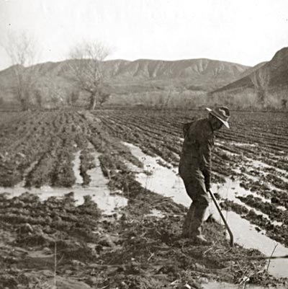
Water Rights/Adjudication in Western States
  The Colorado System (1881/1969):
  Courts adjudicate rights without any administrative water rights appropriation system (Water Courts established in 1969).
  Water rights are not considered “perfected” until decreed by the Court.
  Pre-statutory claims don’t exist due comprehensive and on-going adjudication approach.
  Majority of Federal Reserve Rights have been adjudicated in the state courts in the context of Colorado’s on-going general stream adjudication process.
  An “Abandonment List” is published by the State Engineer every 10 years.
  Other states: Unique to Colorado.
  The Wyoming System (1890) :
  Individual water rights are appropriated via permit through the State Engineer and then adjudicated by the Board of Control (similar to Utah’s certification process).
  All pre-statutory claims which existed prior to statehood were adjudicated by the Board of Control.
  Abandonment (forfeiture) can be adjudicated by the Board of Control after 5 years of non-use.
  Wyoming’s administrative system was deemed inadequate to satisfy McCarran Amendment jurisdiction requirements for General Stream Adjudications.
  Other states: Nebraska and Alaska (Texas & Nevada adopted the Wyoming System but Court deemed it unconstitutional so they subsequently adopted the Oregon System)
Notes:
In order to gain some perspective on general adjudication approaches, it might be helpful to evaluate how other western states do it, just to see if there are other approaches. Generally speaking, general stream adjudications in the Western United States take the form of one of four different systems. I’m going to quickly summarize each system in the order that they were developed:
Colorado was the first state to codify a comprehensive water law in 1881. The Colorado System remains completely within the jurisdiction of the Courts and subsequently the Water Courts. In essence, all rights are appropriated and adjudicated within the Court. No right is considered perfected until it is decreed; consequently, Colorado does not have any pre-statutory claims which have not been asserted and decreed. Unfortunately, without input from a State Engineer, the Courts typically over-appropriated various rivers—awarding rights which exceeded the capacity of the respective stream by several times (more on that later). Although the Federal Government resisted Colorado’s piecemeal system of adjudicating water rights, the U.S. Supreme Court ruled that it satisfied the comprehensive requirements due to it’s on-going approach. Colorado addresses forfeiture by publishing an “Abandonment List” every 10 years. This system is unique to Colorado.
Elwood Mead was a professor at the Colorado Agricultural College (current-day Colorado State University) in the 1880’s and witnessed first-hand the absurdity of the Colorado Courts’ over-appropriation of various rivers. In 1888, he defected to the Territory of Wyoming and became its first Territorial and State Engineer (he would later become the Chairman of the Bureau of Reclamation and build Hoover Dam, hence the name “Lake Mead”). On the eve of its statehood, Elwood Mead proposed a system which was purely administrative, which allowed the State Engineer and the Board of Control to issue permits to appropriate water, thus infusing a technical understanding into the appropriation process. The State Engineer and Board of Control also retained power to adjudicate water rights. This system was deemed inadequate to determine Federal Reserve Rights and Wyoming was forced to file a General Adjudication Suit in District Court to pursue quantification of the Wind River Indian Tribe reserve rights. Forfeiture can be asserted and adjudicated by the Board of Control after 5 years of non-use. The permit system that Elwood Mead devised would subsequently be adopted in many other states, including Utah.

Slide 13
Water Rights/Adjudication in Western States
  The Bien Code (1905):
  Based largely on Utah statute at the time of its inception.
  Incorporates administrative permitting system for appropriations but retains water rights adjudication jurisdiction in the Court.
  Administrative agency (e.g. State Engineer’s Office) prepares a hydrographic survey.
  Hydrographic survey is delivered to the state’s Attorney General who files suit with the respective District Court and prosecutes it.
  The Court is required to interpret the hydrographic survey and issue a decree based on evaluation of the data and water users’ claims.
  Other states: North Dakota, New Mexico, South Dakota, Oklahoma, and Montana.
  Oregon System (1909):
  Very similar to Bien System with regard to appropriations.
  Water rights are adjudicated in the Court.
  Administrative agency (e.g. State Engineer’s Office) prepares a hydrographic survey.
  State Engineer develops a proposed determination of water rights (in conjunction with the hydrographic survey) and files it with the Court.
  The Court reviews the proposed determination, addresses objections, and issues a decree.
  Other states: Arizona, California, Washington, Nevada, Texas, Utah, and Idaho
Notes:
As mentioned earlier, the U.S. Reclamation Service had great interest in having the western states develop comprehensive water law in order to avoid potential liabilities associated with the projects they were attempting to build. Consequently, they made the adoption of water right laws a condition of any Reclamation project approval. Washington and Oregon both petitioned Reclamation to help them develop a system which would ensure project approval. In answer to their request, Federick Newell (director of Reclamation) assigned his legal expert, Morris Bien, to draft a model which later came to be known as “The Bien Code.” It’s been said that the Bien Code was largely based on Utah statute at the time, and it’s easy to see a lot of the same components that existed in our first water code. It essentially incorporates Wyoming’s permit system of appropriation with a hydrographic survey and a court decree.
Oregon took the Bien Code and made some simple modifications (probably based on observations from the lack of adjudication success in Utah and elsewhere). The main difference was the inclusion of the Proposed Determination, which allowed the Court a sound technical basis from which to issue a decree.

Slide 14
Federal Reserve Rights Success Stories
Colorado: Due to unique statute structure, Colorado is able to adjudicate water rights in a piecemeal, on-going basis (including federal claims). The majority of federal reserve water right litigation has taken place.
Idaho: After nearly 25 years of intense work, Idaho is on the verge of wrapping up the Snake River Basin Adjudication. They initiated the Northern Idaho Adjudication in 2006. Idaho assesses fees as part of the water user claim process, enabling them to allocate extensive resources to the program.
Utah: Various federal reserve rights have successfully been quantified via negotiations as opposed to litigation. They include Zion National Park, Shivwits, Natural Bridges, Cedar Breaks, Hovenweep, Golden Spike, Rainbow Bridge, portions of Dixie National Forest, and Timpanogos Cave.
Oregon: Oregon has been very successful at adjudication having completed 75% of the state. The first federal reserve claims adjudicated were in the Klamath Basin. Oregon only adjudicates pre-statutory claims (i.e. diligence claims).
Notes:
With those approaches in mind, let’s take a look at some of the successes stories across the West.
Colorado’s unique approach to appropriation and adjudication has led to significant success in adjudicating federal reserve water rights. The Federal Government actually filed suit against Colorado, claiming that its piecemeal adjudication didn’t satisfy McCarran Amendment requirements (among other things), but the US Supreme Court in held that:
“…[the adjudication] reaches all claims, perhaps month by month but inclusively in the totality; and, as we said in the other case, if there is a collision between prior adjudicated rights and reserved rights of the United States, the federal question can be preserved in the state decision, and brought here for review.” United States v. District Court for Water Dvision No. 5 (1971).
Idaho has seen relative success in defining federal reserve rights via their Snake River Basin Adjudication. After 25 years, they’re on the cusp of finishing it. They’ve been so successful at defining water rights in the Snake River Basin that they commenced the Northern Idaho Adjudication back in 2006. Idaho has been able to allocate a lot of money to their program due, in part, to the fact that they assess fees with processing of claims (similar to how Utah once did). The number of staff dedicated to adjudication is approximately 4 times the size of Utah’s current staff levels.
Utah has also been notably successful in quantifying federal reserve rights through a separate process of negotiated settlement. However, these settlements don’t happen entirely outside of the general adjudication, but within its framework. Ultimately, the agreements will be recognized in the final decrees associated with the respective general adjudications. The existence of a general adjudication serves as the incentive which brings the federal government to the negotiating table.
Oregon has been very successful in its adjudication proceedings. Although it didn’t seek to quantify federal reserve rights until relatively recently (1991) they’ve been able to obtain decrees for three-quarters of the state. A great deal of their success is due to the fact that they only adjudicate pre-statutory claims (pre-1909). The Federal Government filed suit against Oregon when they first attempted to quantify federal reserve rights, claiming that since Oregon only adjudicated pre-statutory claims, the adjudication failed to satisfy the comprehensive requirements of the McCarran Amendment. Nevertheless, the 9th Circuit U.S. Court of Appeals held that Oregon’s administrative certification process in tandem with the general adjudication was adequate.
“The comprehensiveness standard requires the consolidation of existing controversies, not
the reopening of settled determinations.” United States v. Oregon, 44 F.3d 758,767-68 (9th Cir. 1994).

Slide 15
Thoughts on Closing the Gap
  Do Nothing:
    Advantages:
    No modifications to Utah statute or internal protocol.
    Allows State Engineer to continue addressing forfeiture, sole supply, and clarity of older perfected rights.
    Disadvantages:
    Rate of adjudication remains un-changed.
    Certificated rights continue to be vulnerable to legal challenges.
    Water rights continue to be appropriated/certificated after proposed determination and decree.
  Increase staff & redouble efforts:
    Advantages:
    Same as “Do Nothing” approach.
    Increased rate of proposed determination publication.
    Disadvantages:
    Requires a significant increase in program funding (i.e. costs to tax payer).
    Same as “Do Nothing” approach.
  Adopt “Ongoing Adjudication” statute:
    Advantages:
    Federal reserve claims might be subject to immediate determination?
    Provides an avenue for certificated/perfected rights to be decreed individually?
    Disadvantages:
  Immense overhaul to Utah statute required.
  Creates additional burden to Court system.
  Increases the amount of water rights litigation.
  Limit general adjudications to pre-statutory or un-quantified claims:
    Advantages:
    Increase the speed of adjudications.
    Reduce the number of objections required to be resolved for a decree.
    Allows Federal reserve claims to be quantified.
    Disadvantages:
    May require some modifications to Utah statute?
    Reduces State Engineer ability to address forfeiture, delineate sole supply, and clarify older perfected rights.
Notes:
With the foregoing success stories in mind, I’ve given considerable thought to what approaches could be taken to move the Utah general adjudication effort along. I’ve come up with a few alternatives that might spark some thought and further conversation with regard to how to tackle the issue. Keep in mind that this list is far from being exhaustive and some of the ideas are even further from being realized in any shape or form.
First off, we can always take the “Do Nothing” approach. I wouldn’t consider myself a very good engineer if I didn’t consider the “do nothing” approach as a viable option. Although this might mean embracing the status quo, it also has its advantages when compared to the other options. Obviously, no modifications to the statute would be necessary and the State Engineer would be able to continue using adjudication as a way to address forfeiture, assign sole supplies, and bring clarity to older perfected rights. Some of the disadvantages would be that the rate at which we adjudicate would remain largely un-changed; certificated rights will continue to be vulnerable to legal challenges by people who failed to submit a valid protest during the application process and who view the proposed determination as an easy avenue to call someone else’s rights into question; and the adjudication process will most likely never get a decree on all certificated water rights.
The next approach is simply to “Increase staff & redouble efforts.” The advantages to this approach are the same as the “Do Nothing” approach with the exception that the rate at which proposed determinations are published will be enhanced… although the rate at which they are decreed would probably remained unchanged due to the fact that the number of objections per proposed determination would likely remain constant. The disadvantages are also similar to the “Do Nothing” approach except that the funding requirements for the program would probably need to be raised considerably just to keep pace with the certification rate—if that is indeed our goal.
We could also attempt to radically reform our current water law—just as Colorado did in 1969—and provide some legal framework which would allow water rights to be decreed in an ongoing, piecemeal fashion as part of the appropriation process. Depending on the statutory provisions, this approach might allow Federal reserve rights to be quantified immediately and would possibly provide an avenue for certificated and perfected rights to obtain decrees (if that is desired). Some of the obvious challenges would be that any radical changes to Utah statute are typically resisted (for better or for worse); the new system would potentially create a giant burden on the Court system; and it would probably result in an increased amount of water rights litigation if Colorado is any indication of that trend.
Lastly, we could take a look at limiting general adjudications to pre-statutory claims as—in my opinion—was originally intended. This would easily reduce the number of claims by 50% along with a commensurate number of objections; also, based on the 9th Circuit Court of Appeals, it would satisfy McCarran Amendment requirements. Some of the disadvantages is that it may possibly require some modification to State statute; it would limit the State Engineer’s ability to address forfeiture, assign sole supplies, and clarify older perfected rights in proposed determinations.
Obviously, these are thumbnail sketches. As always, the devil is in the details and these courses of action—along with others—probably deserve a more exhaustive review and much more consideration. However, before anything is pursued at length, I think that we must first answer those critical questions: What is the primary objective of the adjudication program? What are the respective priorities of secondary objectives? How important to the State of Utah are these objectives?

Slide 16
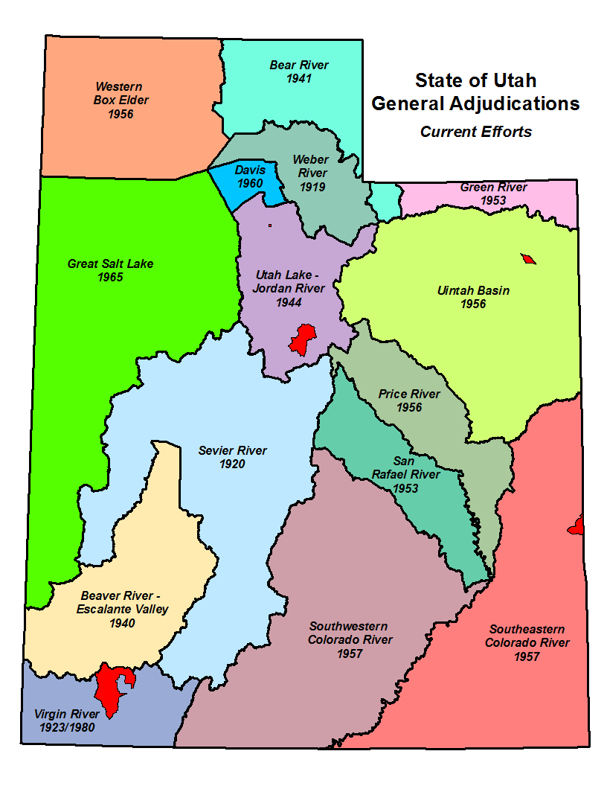
Where are we today?
State-wide Program focusing on Adjudication
Consists of 5 staff members
  Program Manager
  Adjudication Engineer
  3 Adjudication Technicians
Regional Offices support Adjudication efforts as available.
Continually working with the Attorney General’s office to resolve objections to previous Proposed Determinations in order to obtain interlocutory decrees. There are over 500 un-resolved objections on record.
Ashley Central
(Area 45)
Harmony Park
(Area 57)
Birdseye
(Area 51)
Taylor Flat (Area 05)
Ash Creek / La Verkin (Area 81)
Notes:
So, where are we today? The Adjudication Program of the Utah Division of Water Rights is a State-wide program which focusses solely on adjudication efforts. The program consists the Program Manager, an Adjudication Engineer and three Adjudication Technicians. However, we also rely on the regional offices to support the effort as their resources permit.
We work closely with the Attorney General’s office for obvious reasons throughout the Proposed Determination process, but we also continue to work closely with them to resolve objections to the various Proposed Determinations which have already been published. The back-log of un-resolved objections is fairly large—upwards of 500—however, we try to resolve them as quickly as possible and have been able to make forward progress in the past few years.
As you can see by the map, we’re actively engaged in five different adjudications throughout the state. Each adjudication is at a different stage.
Harmony Park (57-2): Published last summer. No objections. Expect a decree in April 2013.
Taylor Flat (05-3): Ready to be published. Awaiting some last minute legal challenges to be resolved prior to publication.
Ashley Central (45-6): Most of the claims are complete. Review of PD underway.
Birdseye (51-5): In the process of taking claims. Would like to have claims wrapped up by the end of summer 2013.
The Ash Creek (81-3): Will commence field work near the end of Summer 2013.

Slide 17
Who can I contact to discuss the
Adjudication Process?
Blake Bingham, P.E.
Adjudication Program Manager
Phone: 801-538-7345
E-mail: blakebingham@utah.gov
Lindsey Carrigan, E.I.T.
Adjudication Engineer
Phone: 385 226-7805
E-mail: lindseycarrigan@utah.gov
Carissa Brandt
Adjudication Technician
Phone: 801-664-8452
E-mail: carissabrandt@utah.gov
Mike Handy, P.G.
Adjudication Team Leader
Phone: 801-538-7463
E-mail: mikehandy@utah.gov
Josh Zimmerman
Adjudication Technician
Phone: 801-946-7168
E-mail: joshzimmerman@utah.gov
Utah Division of Water Rights
1594 West North Temple
Suite 220, PO Box 146300
Salt Lake City, UT 84114-6300
www.waterrights.utah.gov

Slide 18
Questions?

