Slide 1
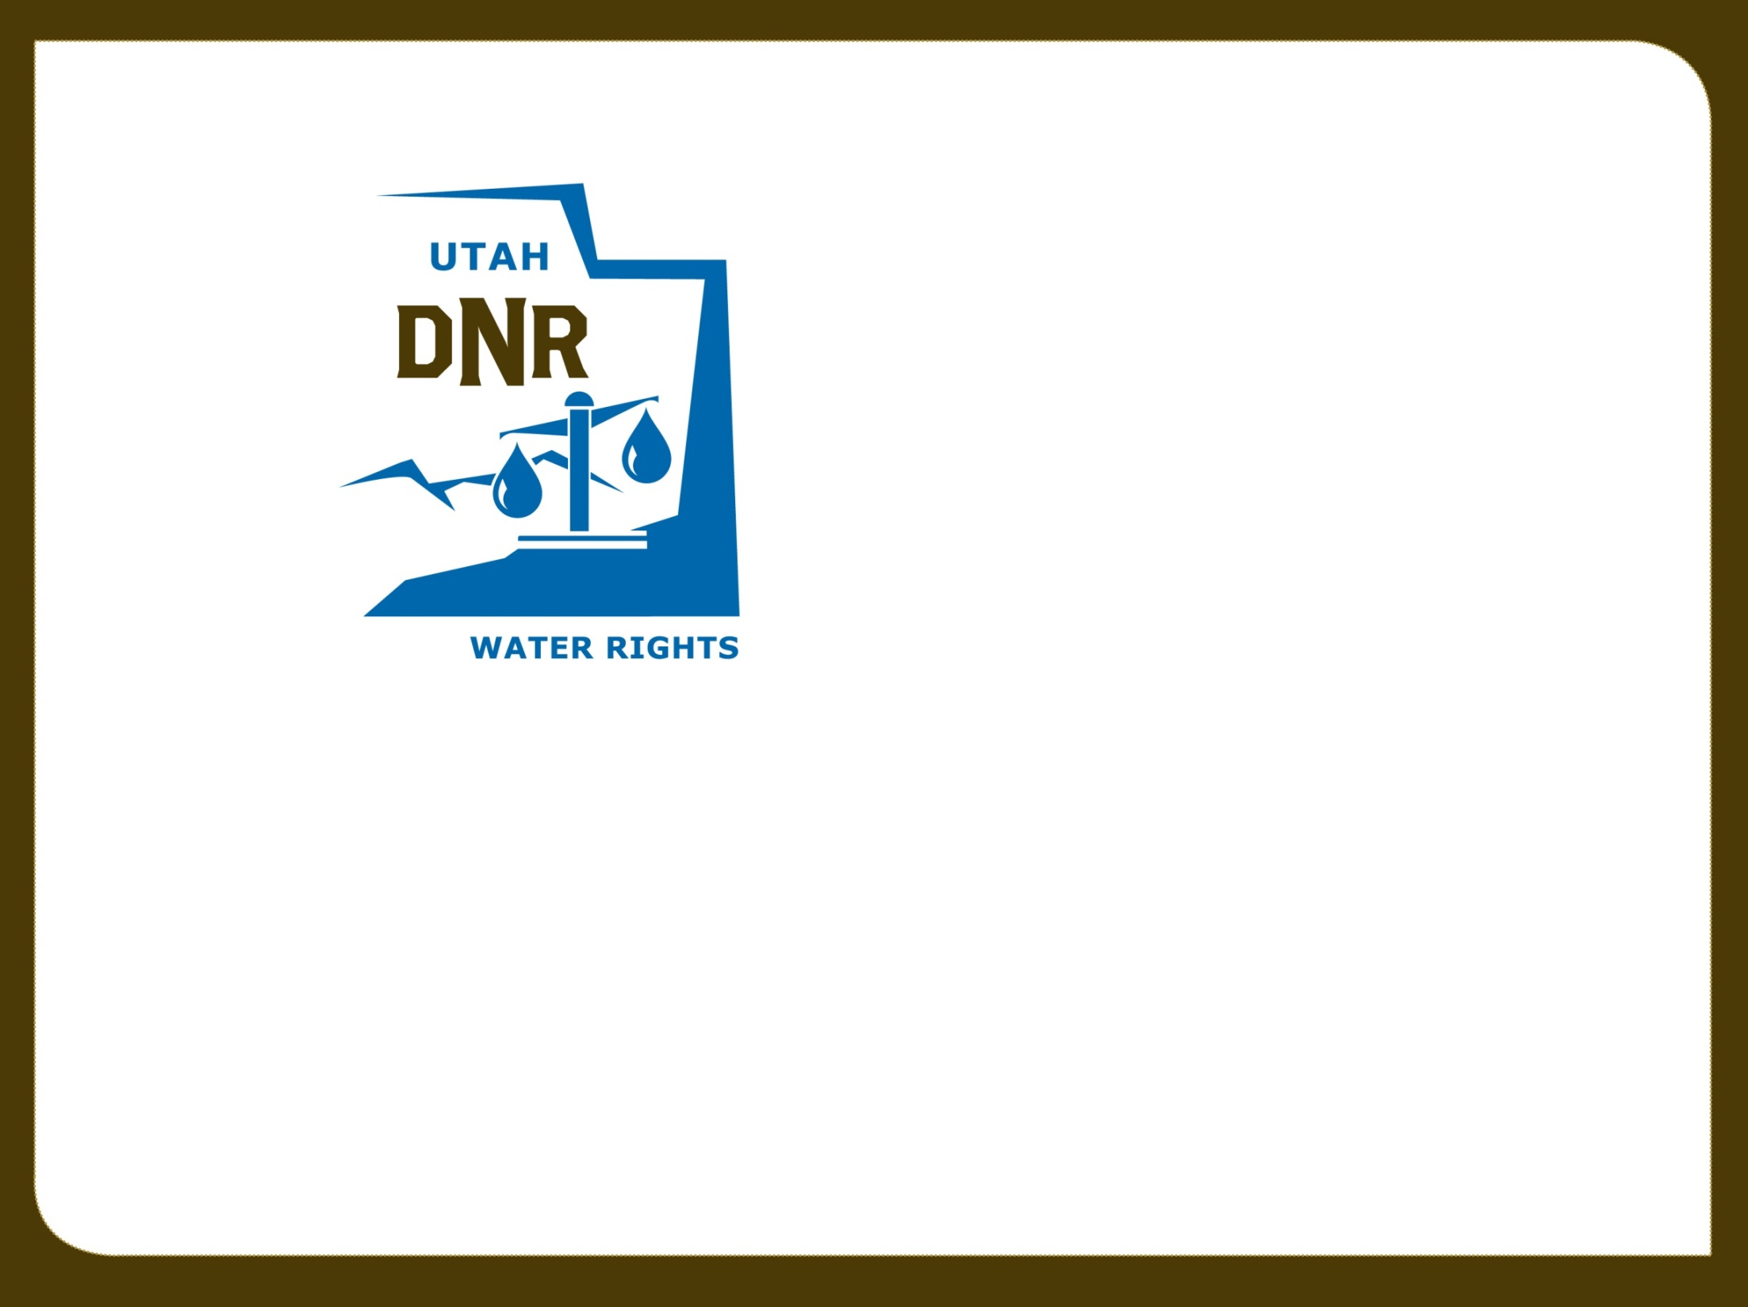

Utah Division of Water Rights
Water Wells
Permitting & Regulation
Jim Goddard—April 2019
June 21, 2004

Slide 2

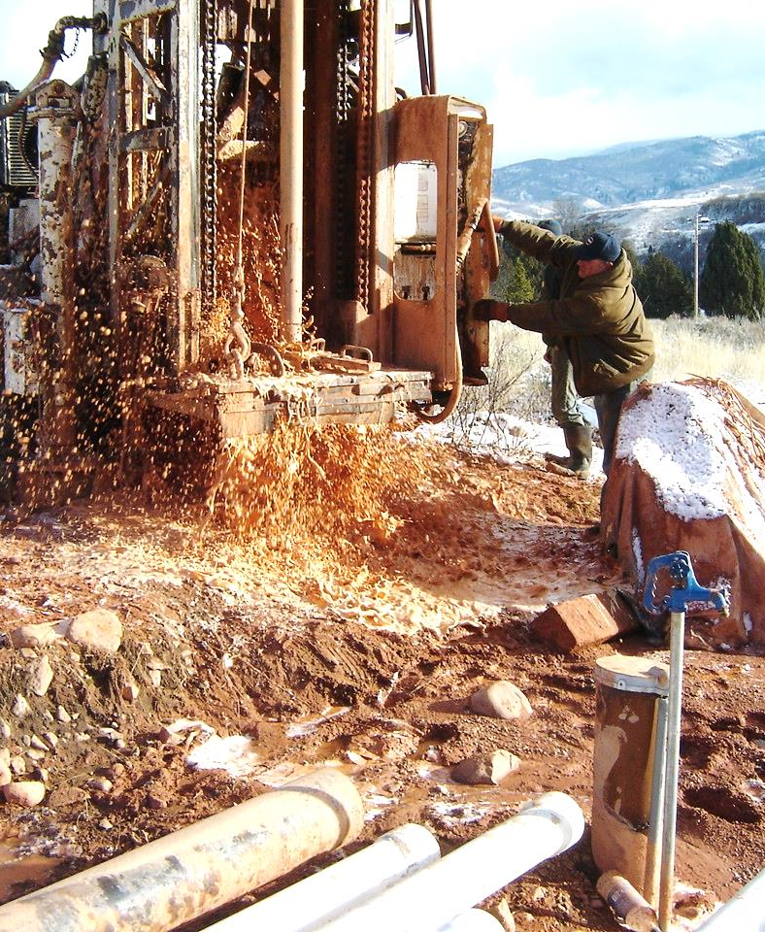
Well Drilling Topics
Status of Well Drilling in Utah
Well Permitting Mechanisms and Process
Well Renovation, Replacement, & Abandonment Process
Non-Production Well Permitting
Pump Installation Requirements
General Administrative Rules
General Construction Rules
Well Info On Our Website

Slide 3
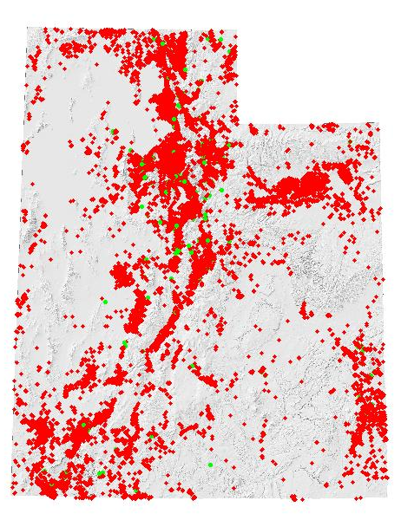
Utah Well Drilling Data
152 licensed well drillers, 127 Licensed Pump Installers, and 251 Registered Operators
508 Non-Production Wells in 2018 (41% heat pump)
475 Production Wells in 2018 (51% Air,
19% Cable Tool, 21% Mud)
  84% DOM/IRR/STK Wells
  6% Irrigation Wells
  4% Stockwater Wells
  4% Public Supply Wells
  2% Commercial/Industrial Wells
71% of water wells were 4-6 inch dia.
19% were 8-inch

Slide 4
http://www.waterrights.utah.gov/wellinfo/stats2k/default.asp

Slide 6
Common Utah Drilling Methods
Mud Rotary
Cable Tool
Air Rotary
  Down-hole Hammer
  Drill-through Casing Drivers
  Under-reamer Systems
  Dual Rotary
  Reverse Air Rotary
Flooded Reverse Rotary
Other Methods (Jetting, Direct Push, Sonic, Percussion Hammer, Hollow Stem Auger, Coring, Horizontal, Bucket Auger, etc.)

Slide 7
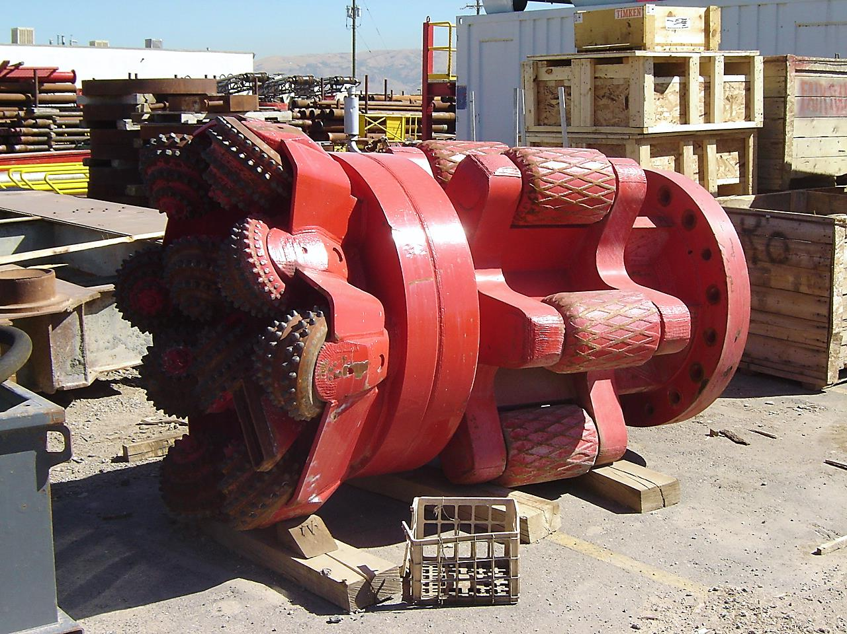
Activity Permitting
Well Drilling

Slide 8
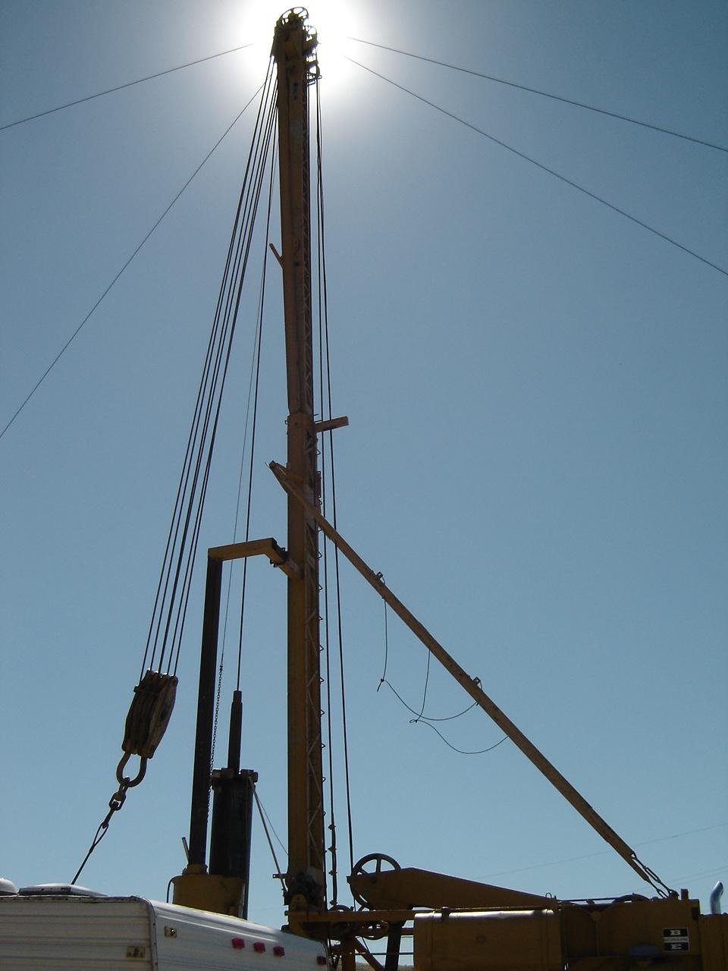
Well Permitting Mechanisms
Application to Appropriate
Change Application
Exchange Application
Temporary Change Application
Provisional (Rush Letter)
Well Renovation
Well Replacement
Non-Production Well
  Test, Monitor, Cathodic, Heat Pump, Dewater, etc.

Slide 9
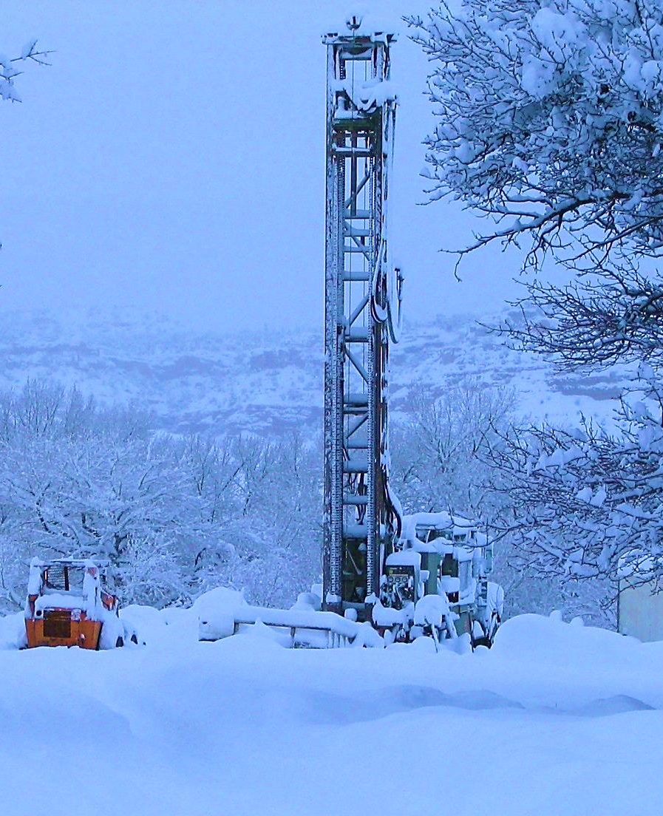
Application Process
New Water Production Wells
Approval (New, Change, Exchange)
  Application
  Review & Advertise
  Protest Period
  Hearing
  Memo Decision, Approval letter, Start Cards
  Durations varies (weeks to months…or longer)

Slide 10
Well Drilling Fees
Fee is based on quantity of
water right for Production
Wells (see table)
No fee for Non-production
well permits
No fee for permit to
renovate and replace a well

Slide 11
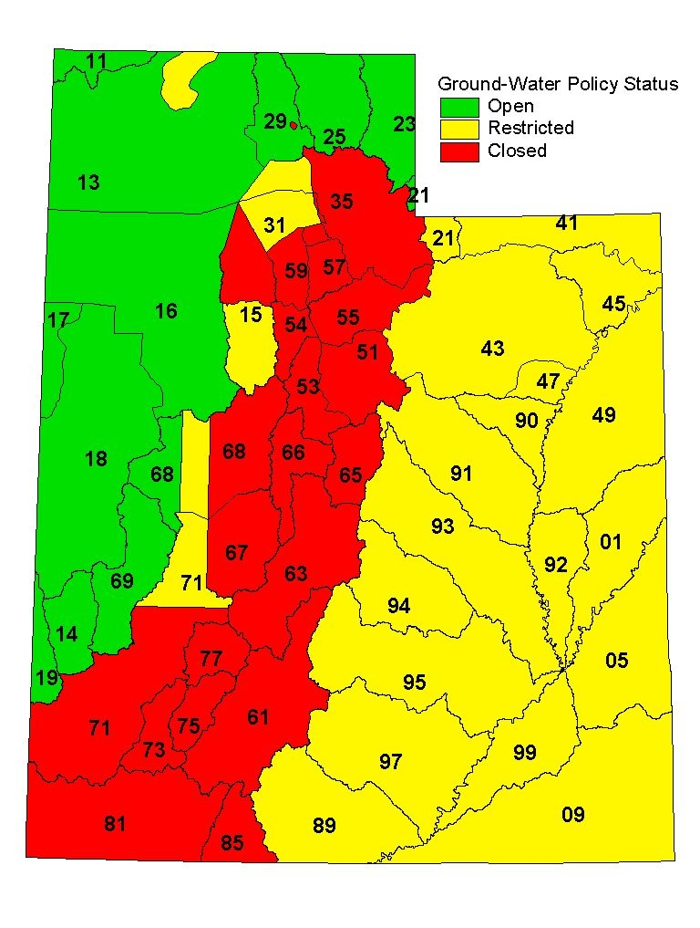
State Engineer’s
Water
Appropriation Policy

Slide 12
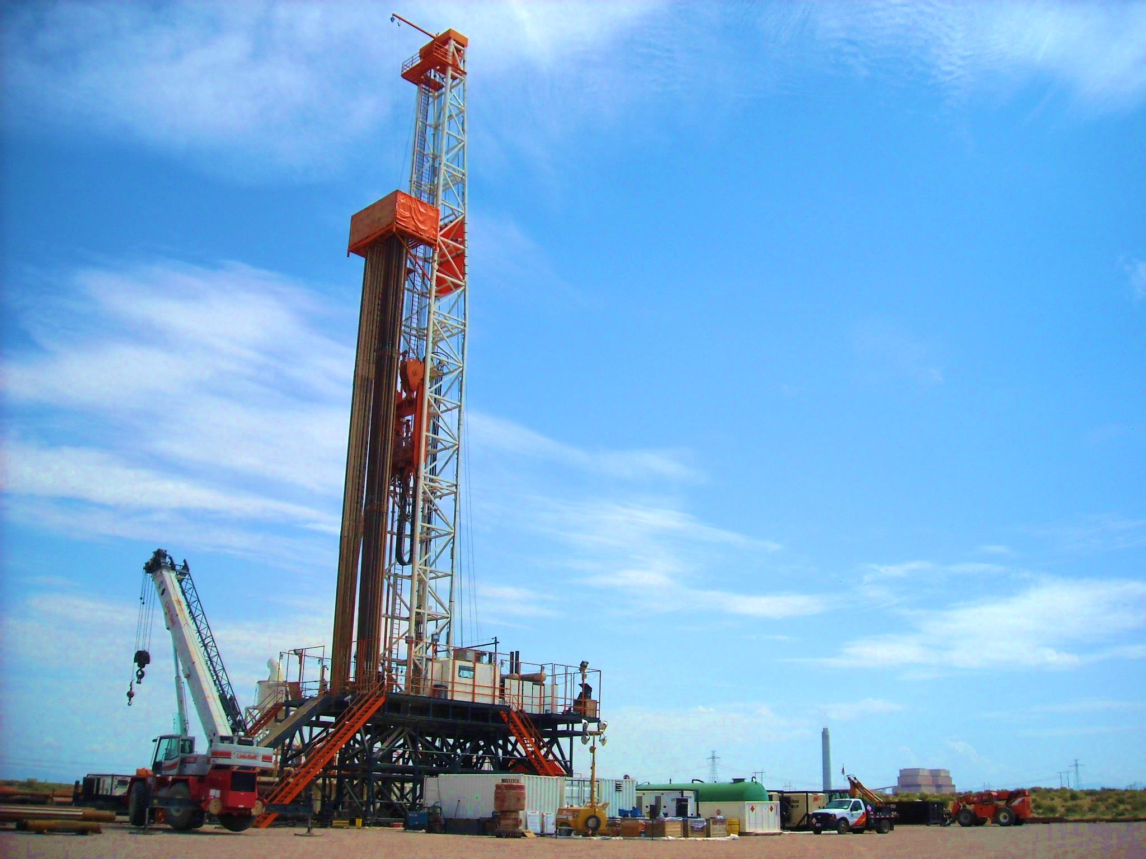
Application Process
When and what forms are filed

Slide 13
Application to Renovate
Application to Renovate An Existing Well
  Modification to well (deepen, liners, screens, perforations, casing repair, pitless, seal, etc.)
DOES NOT grant approval to replace
No Application fee
Title and ownership must be current
Allows for repair, renovation, and/or deepening
Need separate application to replace well

Slide 14
When a Renovation Permit is Needed
Renovate Permit Needed
  Deepening
  Well Repair/Renovation
  Anytime the well itself is modified
Renovate Permit Not Needed
  Cleaning
  Development
  Disinfection
  Testing
  Pump Work
Still needs to be done by a licensed Driller or Pump Installer
Still need to submit a pump log to report this information

Slide 15
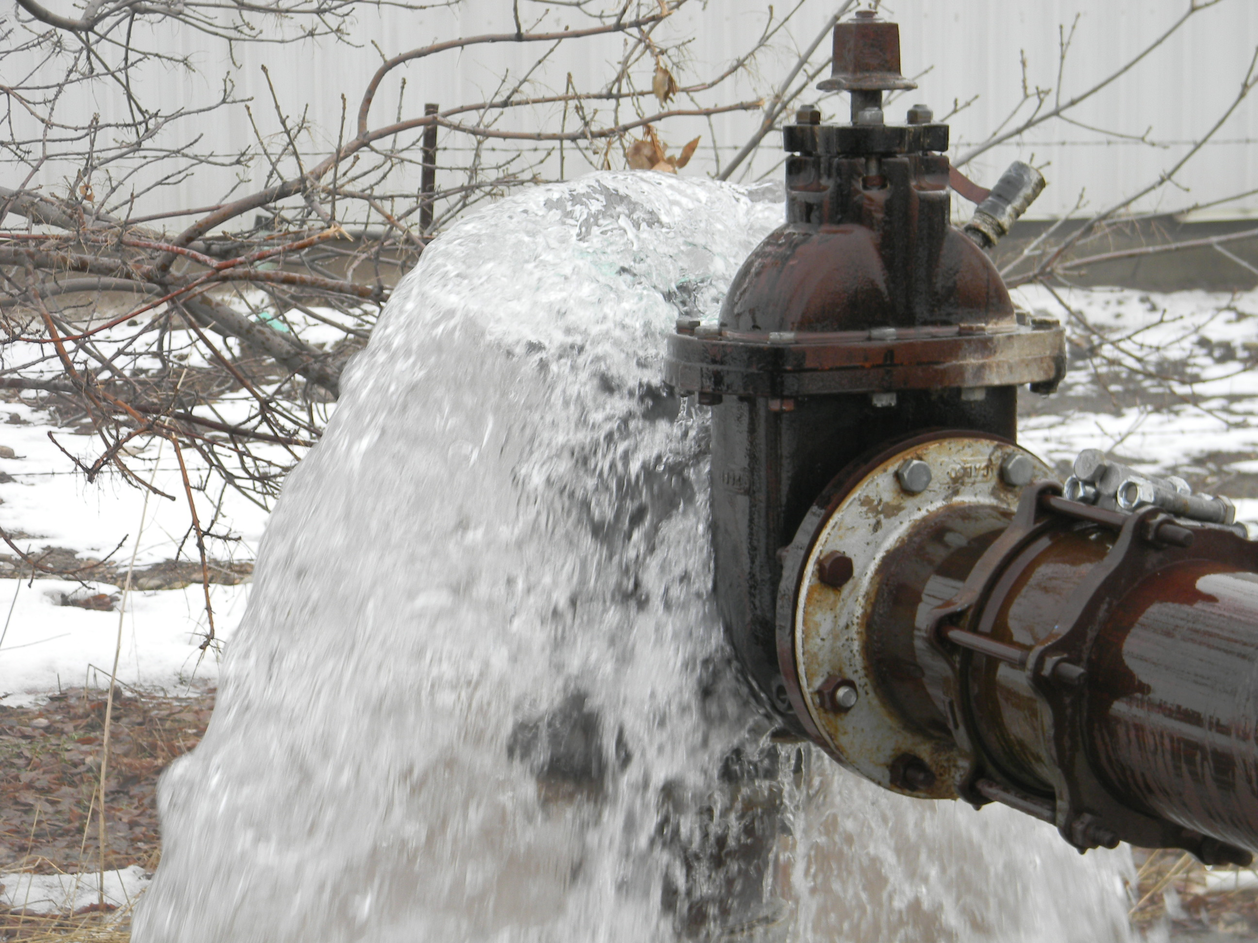

Slide 16
Application for Well Replacement
“Application to Replace an Existing Well”
Replacement well must be within 150 feet of old well for this process
Over 150 feet goes to change application process
Owner responsible to have licensed driller abandon existing well
No Application fee
Title and ownership must be current
Abandonment of existing well a condition of approval
Well log and abandonment log are tracked and both must be returned by Driller

Slide 17
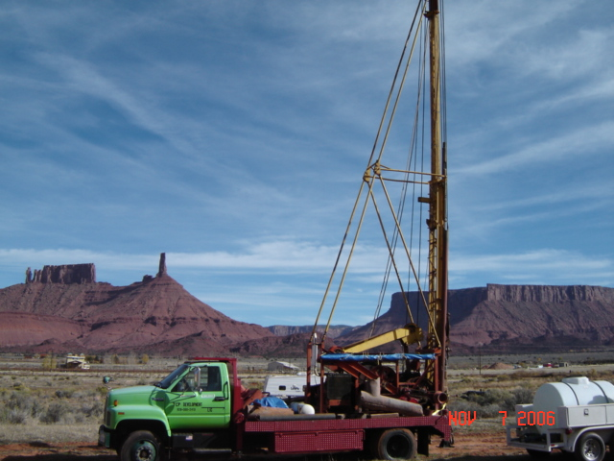

Slide 18
Well Abandonment Process
To abandon means to seal the well bottom to top with approved sealing materials
A well must be abandoned by a licensed well driller
Temporary versus Permanent Abandonments
When a well is replaced, the old well must be abandoned as a condition of approval
For a stand-alone abandonment, a permit is not required
  However, Water Rights must be notified prior to abandonment by the licensed driller
The licensed driller submits a certified abandonment log to Water Rights which becomes part of the water right record

Slide 19
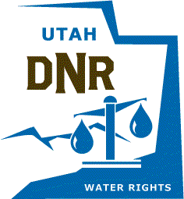
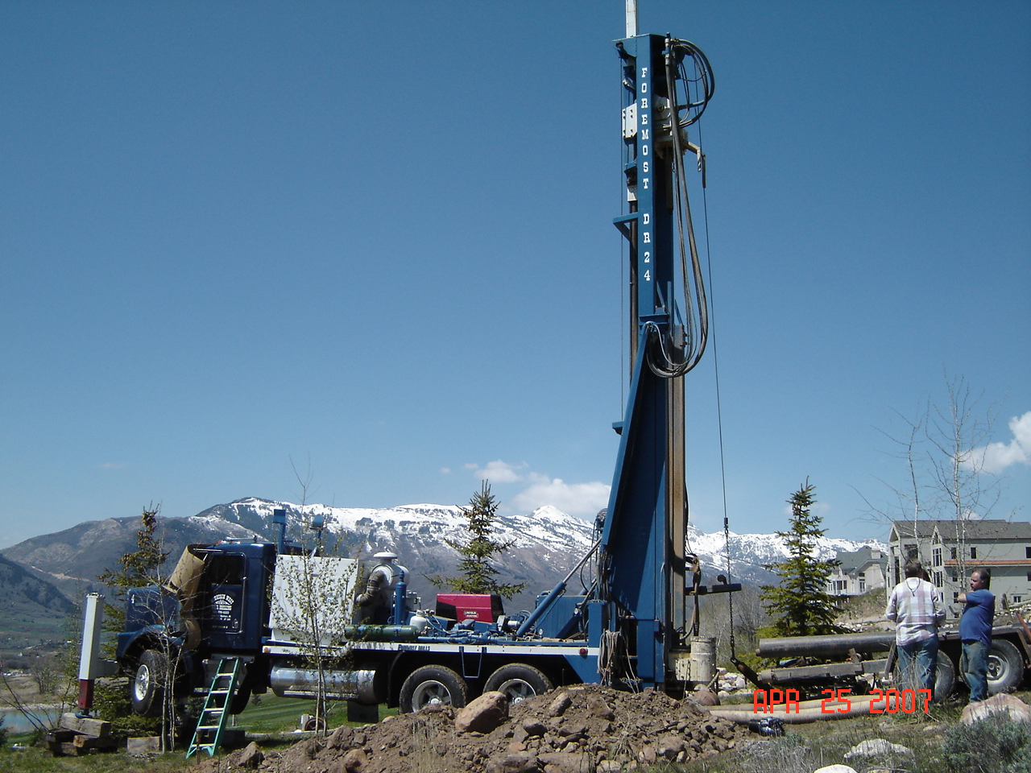

Slide 20
Application for Non-Production Wells (NPW)
Types of wells included:
  Test Wells (No WR Application filed)
    Provisional (Rush) wells do NOT use this form
  Cathodic Protection Wells (>30')
  Closed Loop Heat Exchange Wells (>30')
  Monitor Wells (>30')
Approval to construct (NPW Form; No Fee)
  Given by Well Drilling and/or Regional Offices
  Up to 14-day review
  NPW Public Listing

Slide 21
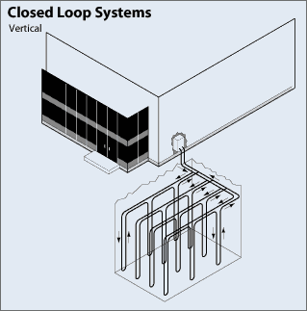
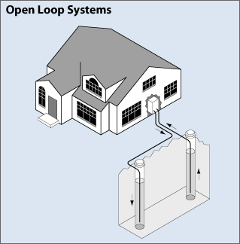
HEAT EXCHANGE WELLS: CLOSED VS. OPEN LOOP SYSTEMS
Closed-loop System
  Groundwater not removed or re-injected
  A closed loop of poly pipe is installed into
  boring and grouted top to bottom, then glycol
  solution is circulated through loops
  Application with no fee required – no water right required
  Large projects issued one permit with one well log
Open-loop System
  Groundwater is removed from aquifer via well,
  circulated through heat exchange system, then
  re-injected back into aquifer
  A non-consumptive use water right is required
  Approval from the Division of Water Quality is also needed

Slide 22
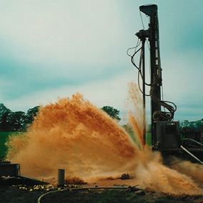

Slide 23
Provisional Wells
A.K.A. “RUSH LETTER”
Permission to drill before WR-related application approved
Granted at owners risk
Authorization to drill, construct, and test, but not put into production or beneficial use
Linked to WR application and processed through WR database
Owner files application (e.g., new, change, exchange) first, then submits written request to start drilling
Requests reviewed and approved by Regional Engineer

Slide 24
Utah Code Section 73-3-5(4) provides that the state engineer may issue a temporary receipt to drill a well at any time after the filing of an application to appropriate water therefrom... provided in the judgment of the state engineer there is unappropriated water available in the proposed source and there is no likelihood of impairment of existing rights.
Water right process must still be followed
Written request with or after WR application
Approval to drill, construct, and test, but cannot divert the well water or put to beneficial use until after the WR application has been approved

Slide 25
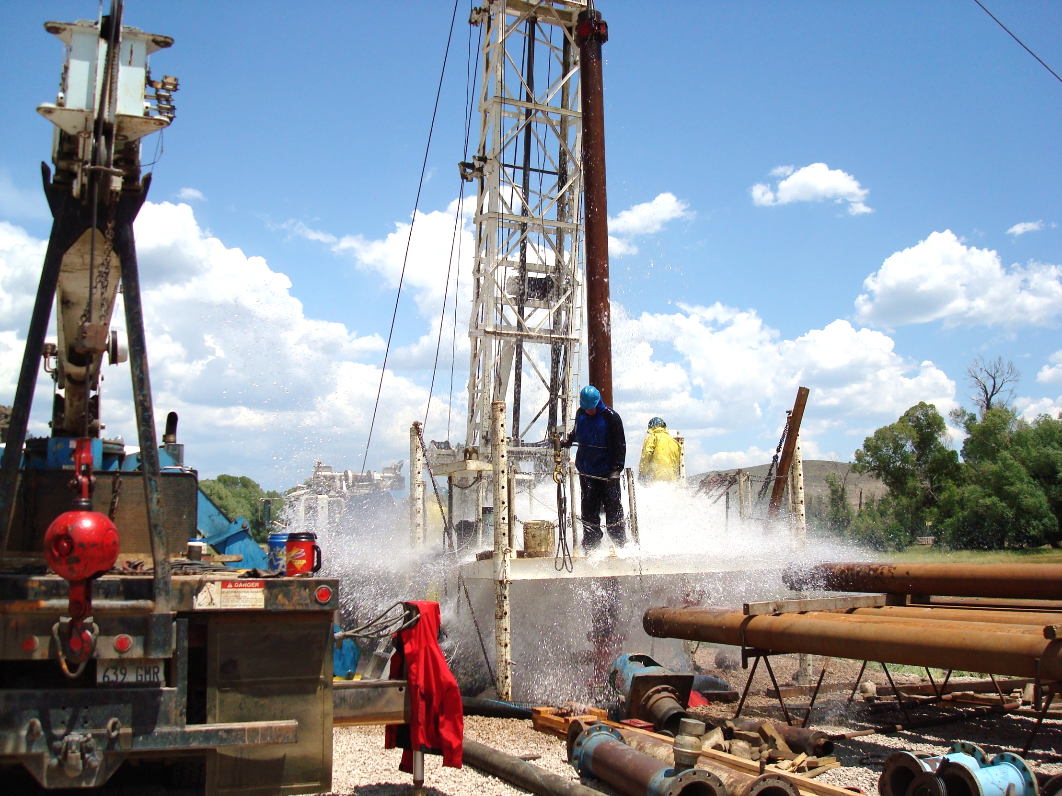
Well Drilling Rules

Slide 26
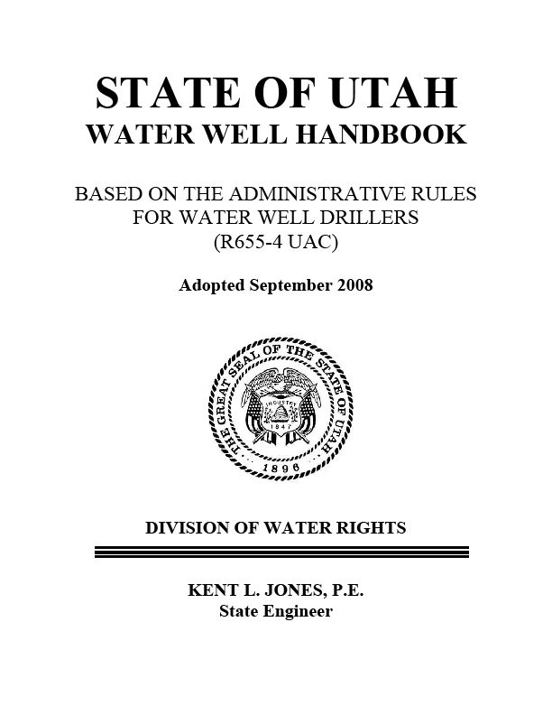
Administrative Rules for Water Wells
R655-4 Utah Administrative Code
  “Provide
  order and certainty
  in the beneficial use
  of Utah’s water”

Slide 27
Scope of Rules
Regulated Wells/License Required
Production Wells Greater than 30 feet deep
  Permitted through WR Process in WR database and associated with a WR#
    Domestic
    Irrigation
    Stock
    Public supply
    Commercial/industrial
    Open Loop Heat Exchange Wells
    Well Renovation & Replacement
Non-Production Wells (NPW) greater than 30 feet
  Permitted through NPW process in well drilling database and associated with a NPW number (aka M00 #)
    Test Wells
    Monitoring Wells
    Cathodic Protection Wells
    Closed Loop Heat Exchange Wells
    Misc. Wells (Piezometers, inclinometers, anode)

Slide 28
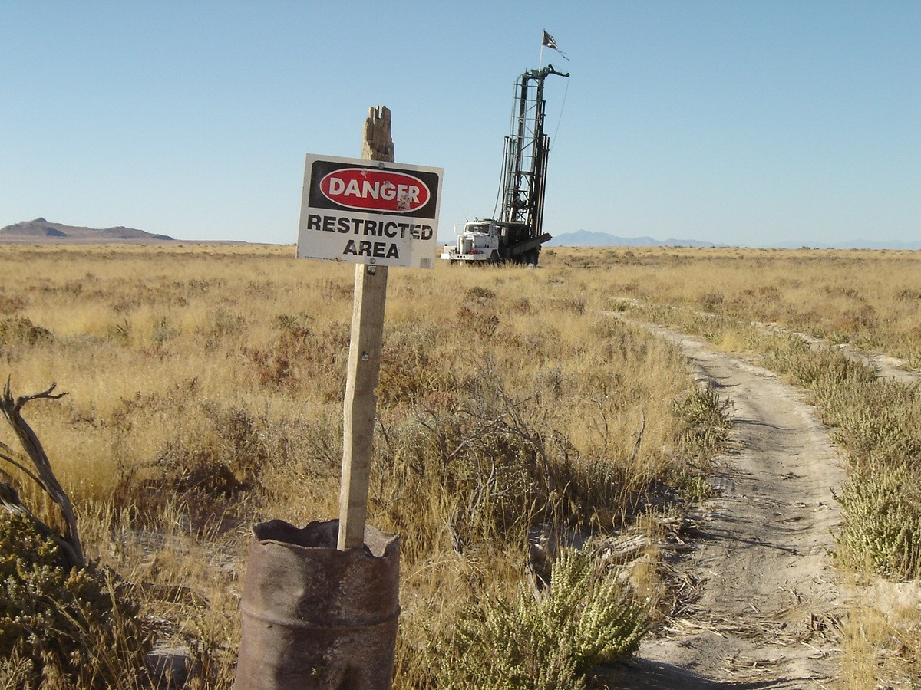

Slide 29
Wells Excluded from the Rules
Any well less than 30 feet
  IMPORTANT: Production wells less than 30 feet deep still need a Water Right
Geothermal Wells (Regulated by R655-1 UAC)
Exploratory or geotechnical borings
Structure monitoring wells if aquifer not impacted
Dewatering wells if aquifer not impacted

Slide 30
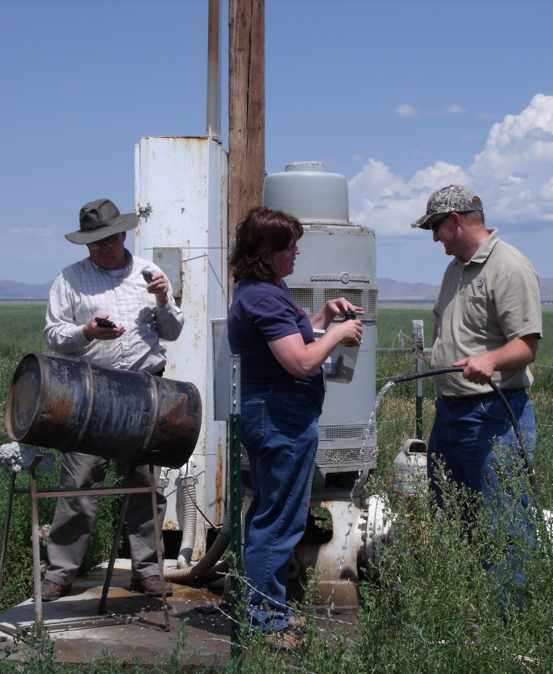
“Well Drilling”
Regulatory Definition
Well drilling means the act of drilling, constructing, repairing, renovating, deepening, cleaning, developing, or abandoning a well
Pump installation and repair is now regulated by the Rules

Slide 31
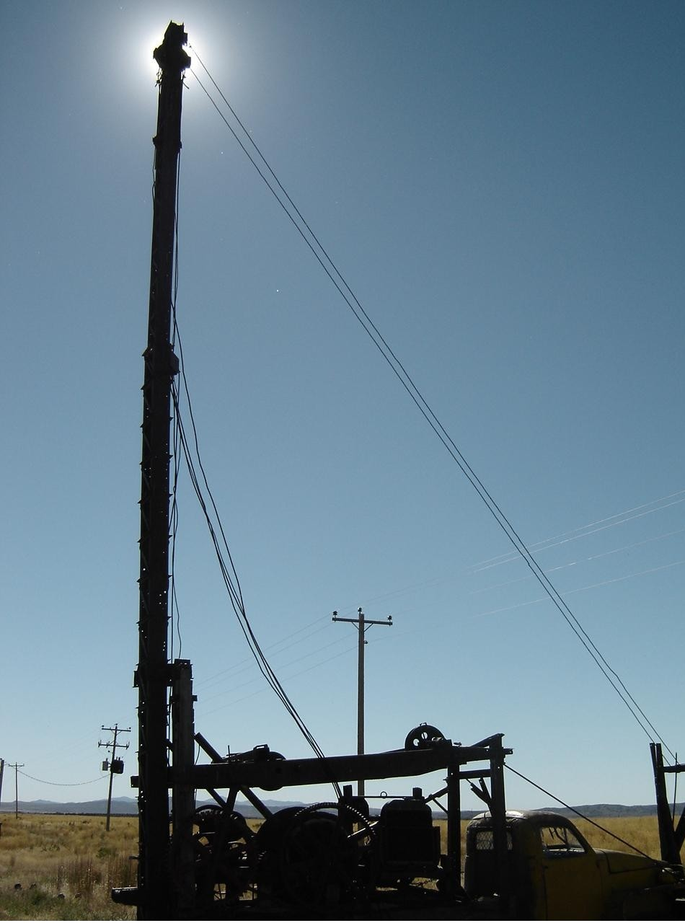

Slide 32
Administrative Rules
License required for drillers and pump installers
  Experience, testing, bonding, continuing education, renewal
Registration required for rig operators
Violations, Infractions, and Enforcement
Removing Drill Rig from Site
Requirements During Construction
  Drill at approved location
  License No. or Company name on rig
  Licensed driller or registered operator on site
Reporting Requirements
  Start Card Submitted for starting regulated work
  Well log - 30 days after completion of well
  Specific log for each well
  Pump Logs
  Abandonment reports
  APPLICANT CARD

Slide 33
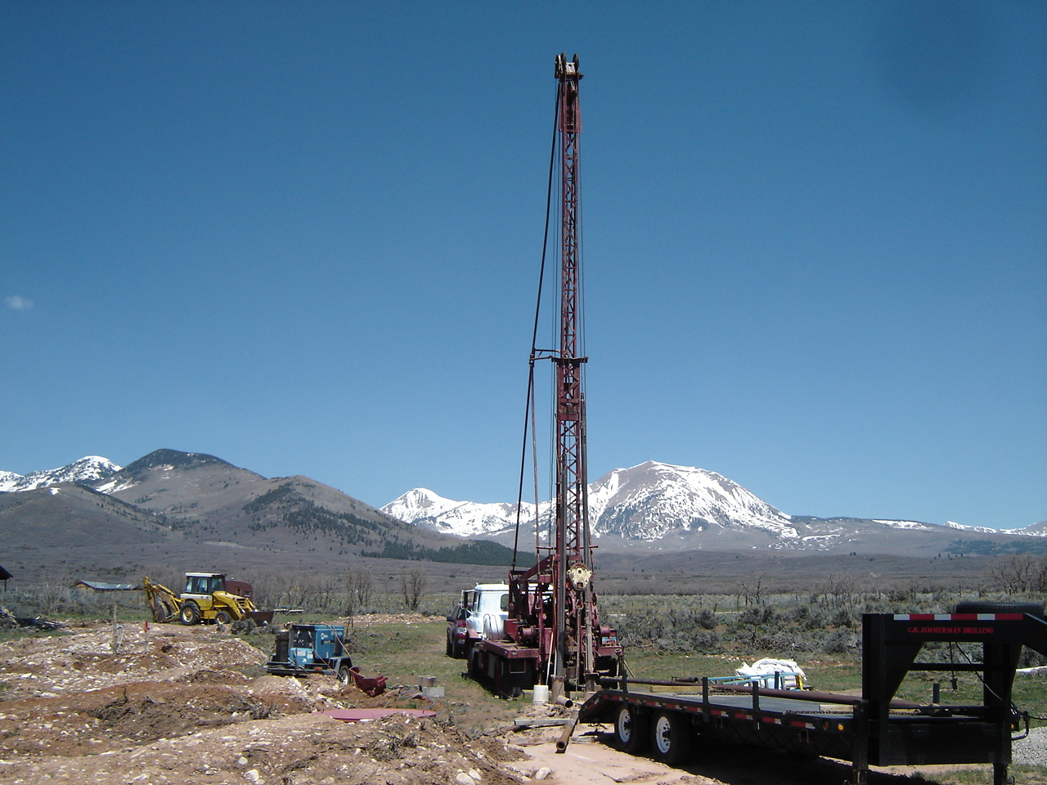

Slide 34
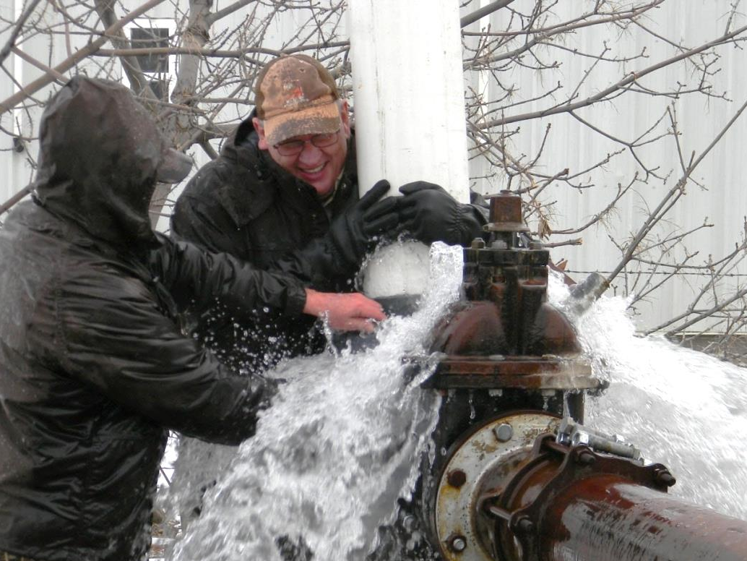
Pump Installation Rules
License required of those doing work professionally for compensation
Doing own work on own property on own well does not require a license
No permits or start cards
required
Required reporting to
include a Pump Log

Slide 35
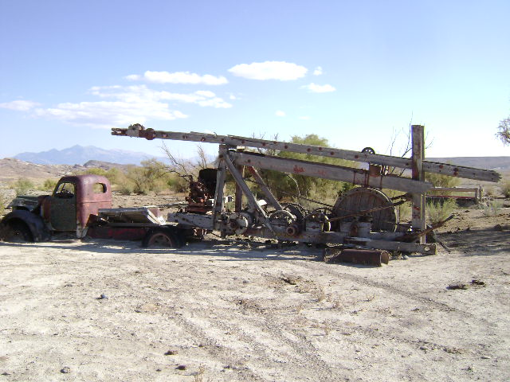

Slide 36
Additional Permitting for
Public Supply Wells
Regulated through the Division of Drinking Water (R309-515)
Project Notification
Preliminary Evaluation Report/Drinking Water Source Protection Plan
Preapproval of Plans/Specifications
  Drilling/Construction Materials and Methods
  Certified Sealing
  Pump Testing and Water Quality
  Disinfection
  Submitted by Licensed Driller, Professional Engineer, or Professional Geologist
  Fines for submitting this info after the fact

Slide 37
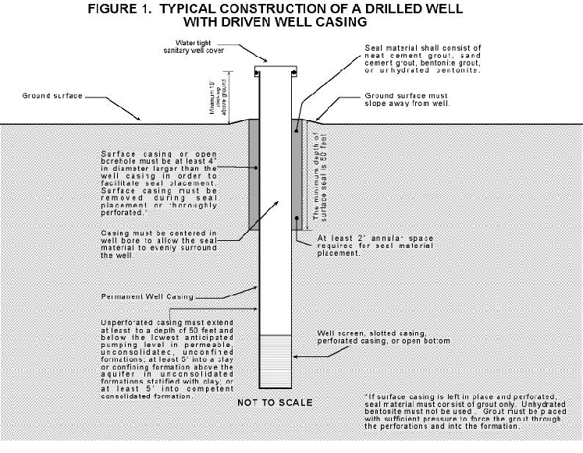
Construction Requirements

Slide 38
Main Components
Well Casing, Joints, Screens, & Perforations
Surface and Interval Seals
Formation Stabilizers – Gravel (Filter) Pack
Aquifer Protection (Fluids, Chemicals, LCMs, Cross-contamination, Disinfection)
Surface Completion
Special Wells & Monitoring Wells
Deepening, Rehab, and Renovation
Well Abandonment
Pump Installation and Repair

Slide 39
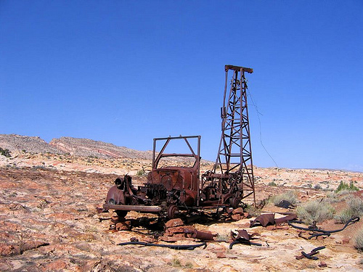
Well Drilling Web Features www.waterrights.utah.gov

Slide 40
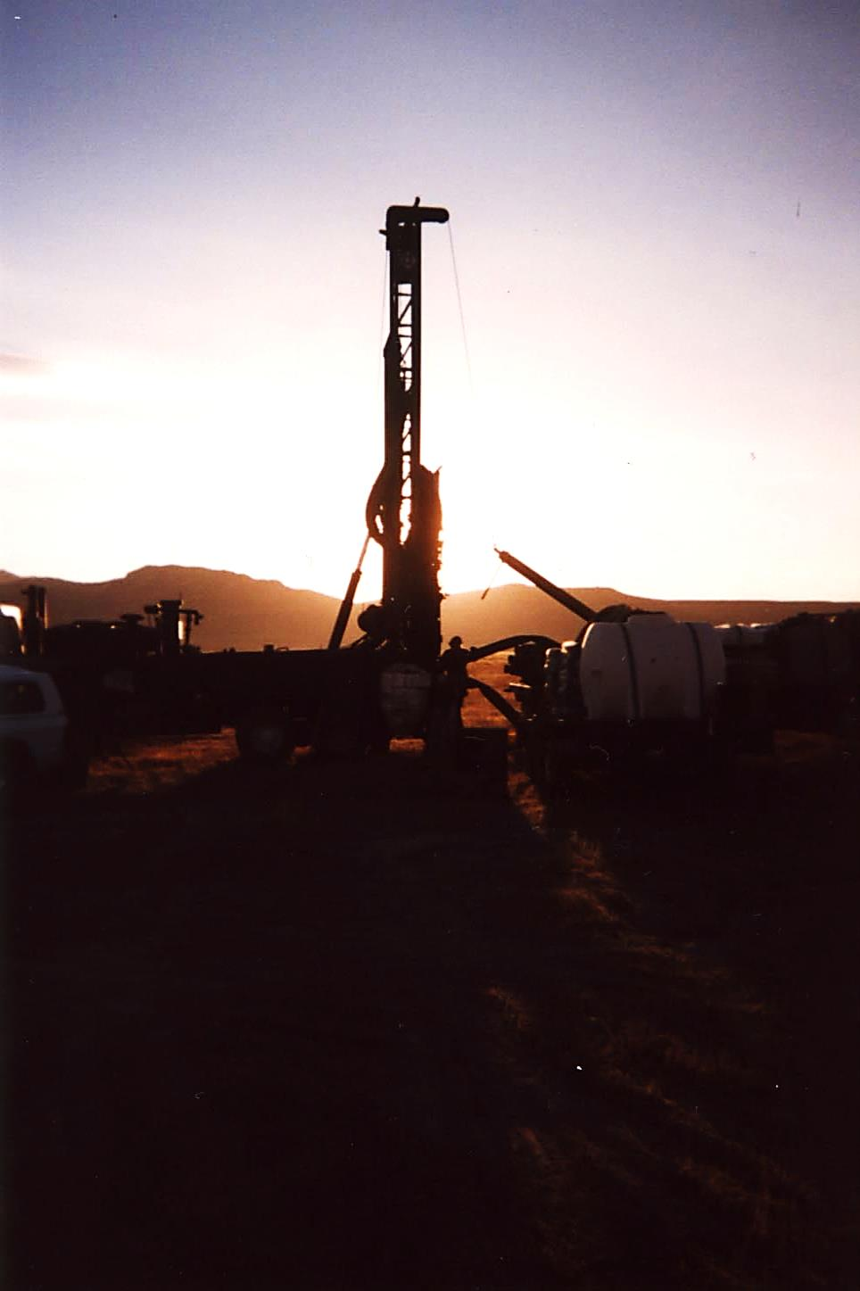
QUESTIONS?
Jim Goddard
Office: 801-538-7314
Cell: 801-505-8677
Email: jimgoddard@utah.gov
Web: waterrights.utah.gov
“When the well is dry, we know the worth of water”
…B. Franklin

