Slide 1
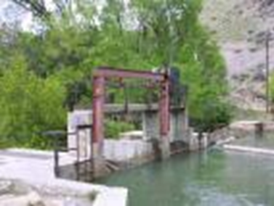
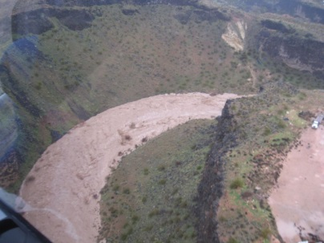
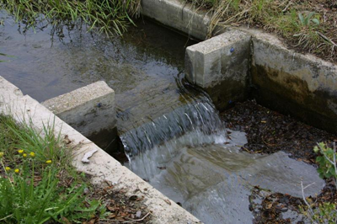
History of Water
Rights and Water Right Basics
RWAU Training—April 2021
Marc Stilson, P.E.
Regional Engineer, Southeastern Regional Office
Notes:
Welcome to our training today. I am (Name & Title) and in our first module, we will be discussing the history of how water rights came into being, learn the basics of what defines a water right and talk briefly about how to obtain a water right.

Slide 2
History of Utah Water rights
Where the idea of water rights began
Kelly Horne
Notes:
This is a picture of the Great Salt Lake taken by Kelly Horne, a retired Division employee. As Mormon pioneers first began to settle the beautiful valleys of our Great State, there soon developed a rich and interesting history of fighting over water! Violent confrontations were rare but more often there was an often unspoken awareness of who could or could not be trusted to take his fair share of water. Ed Geary, a prominent local historian from Emery County remembered his mother, speaking of a prominent rancher in town, say “He wasn’t the kind of man you’d want to have upstream from you, if you know what I mean.” These type of fights over water led to the development of Utah Water Law.

Slide 3
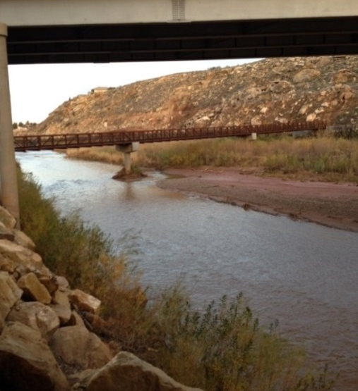
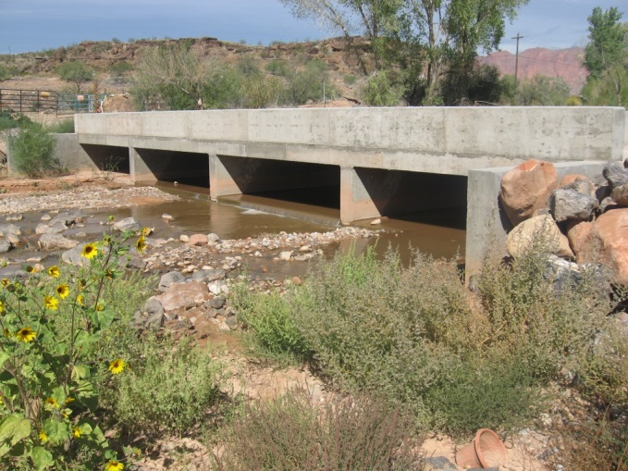
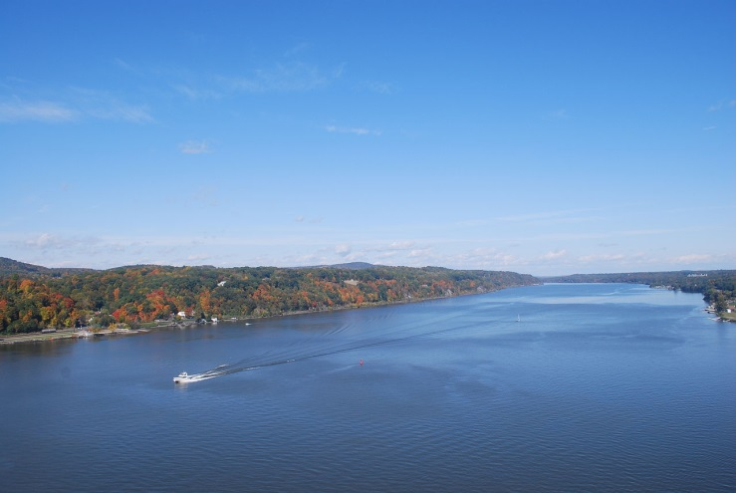
Origin of the Doctrine of Prior Appropriation
Hudson River
The West
The East
DRY
WET
Notes:
So let’s take a closer look now at how Utah water law come into being? The development of laws governing water rights in the western United States was markedly different than in the East. The most important reason for this was, of course, the difference in climate and geography. In the East precipitation is relatively abundant; water courses are numerous and generally close to areas where water is needed. In most of the west the opposite is true. Relatively slight precipitation means fewer water courses. This increases the necessity to divert water to areas of use. The doctrine of prior appropriation, which is currently used as the foundation of the water rights system in every western state, developed to respond to arid conditions.

Slide 4
Riparian Law vs. Prior
Appropriation Doctrine
RIPARIAN DOCTRINE (Eastern States – except Mississippi)
Land Owner - Right to use a reasonable amount of water as it crosses their property
Influenced by English Law
Lots of Available Water
PRIOR APPROPRIATION DOCTRINE (Western States)
Water Right Owner – “First in Time is First in Right”
Influenced by Western Mining Law
Scarcity of Water
Defined amount of water
Notes:
The Eastern States operate under a what is known as the Riparian Doctrine, wherein a land owner has the right to use a reasonable amount of water as it crosses his property. This system was influenced by English law and works in regions that have significant amounts of precipitation. All of the Western States operate under what is known as the Prior Appropriation Doctrine, also known as First in Time, First in Right. This system was influenced by Western mining law and is adapted for climates with a scarcity of water. It also requires defining the amount of water one can use.

Slide 5
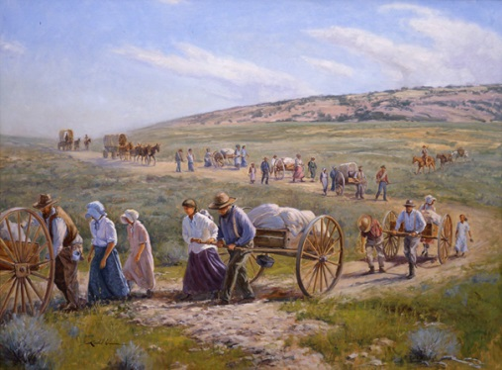
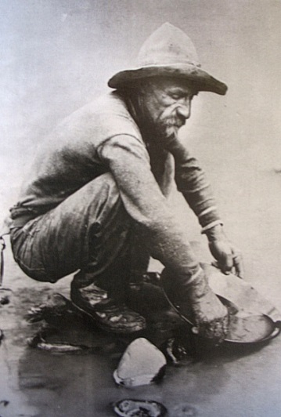
Historical “Appropriators”
Native Americans
Religious and Military Outposts: Spanish, American, et.al.
Mormon Pioneers
California Gold Rush / Cattle Barons
Homesteaders
Notes:
Native Americans were the first “appropriators.” Community ditches dug by American Indians were used to divert, or “appropriate,” water in the arid southwest. The religious and military outposts of the Spaniards also required a stable supply of water. They sometimes used the canals of Native Americans and sometimes dug their own. Thus, the Spanish and Mexican settlers who established missions, agricultural pueblos, and military posts were also early appropriators. Among the later Anglo settlers of the west were the Mormon Pioneers that settled the Great Salt Lake Valley in 1847.
They began using water immediately upon arrival their arrival to the valley. They knew from descriptions of the area that precipitation alone would not be enough to raise crops. During the same period that the Mormons were settling the Great Basin, gold was discovered in California. Mining, particularly of placer claims, required the diversion of large amounts of water from rivers and streams and the miners applied the tenets of mining law to water use.

Slide 6
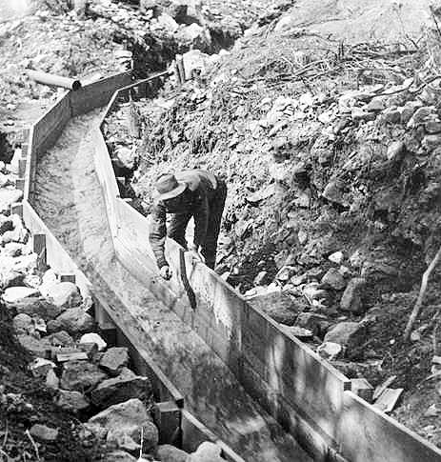
Basic Principles of Mining Law
Miner who initially staked claim
who is “first in time”
Protected in the development of the claim against other miners
he is “first in right”
Notes:
The concepts of prior appropriation of water which developed in the California mining camps spread to other western states as mineral discoveries throughout the West led California miners to other states. A basic principal of mining law was that the miner who initially staked a claim (who is “first in time”) is protected in the development of the claim against other miners (his is “first in right”). This practice carried over to the use of water and became not only recognized as tradition, but also protected in courts of law.

Slide 7
Mining Act of 1866
Congressional Act - Fundamental First Step
Deference to State and Territorial Water Law
Confirmed Water Rights for Mining, Agriculture, Other Uses
Acquired by Private Parties on Public Lands under Local Customs, Laws, and Court Decrees
“SEC. 9. And be it further enacted, That whenever, by priority of possession, rights to the use of water for mining, agricultural, manufacturing, or other purposes, have vested and accrued, and the same are recognized and acknowledged by the local customs, laws, and the decisions of courts, the possessors and owners of such vested rights shall be maintained and protected in the same…”
Notes:
Congress took a fundamental step in deference to State and Territorial water law with the passage of the Mining Act of 1866. Under this law, Congress confirmed water rights for mining, agriculture, and other uses that had been acquired by private parties on public lands under local customs, laws, and court decrees. This result was obtained even though many appropriators were trespassers on Federal land.

Slide 8
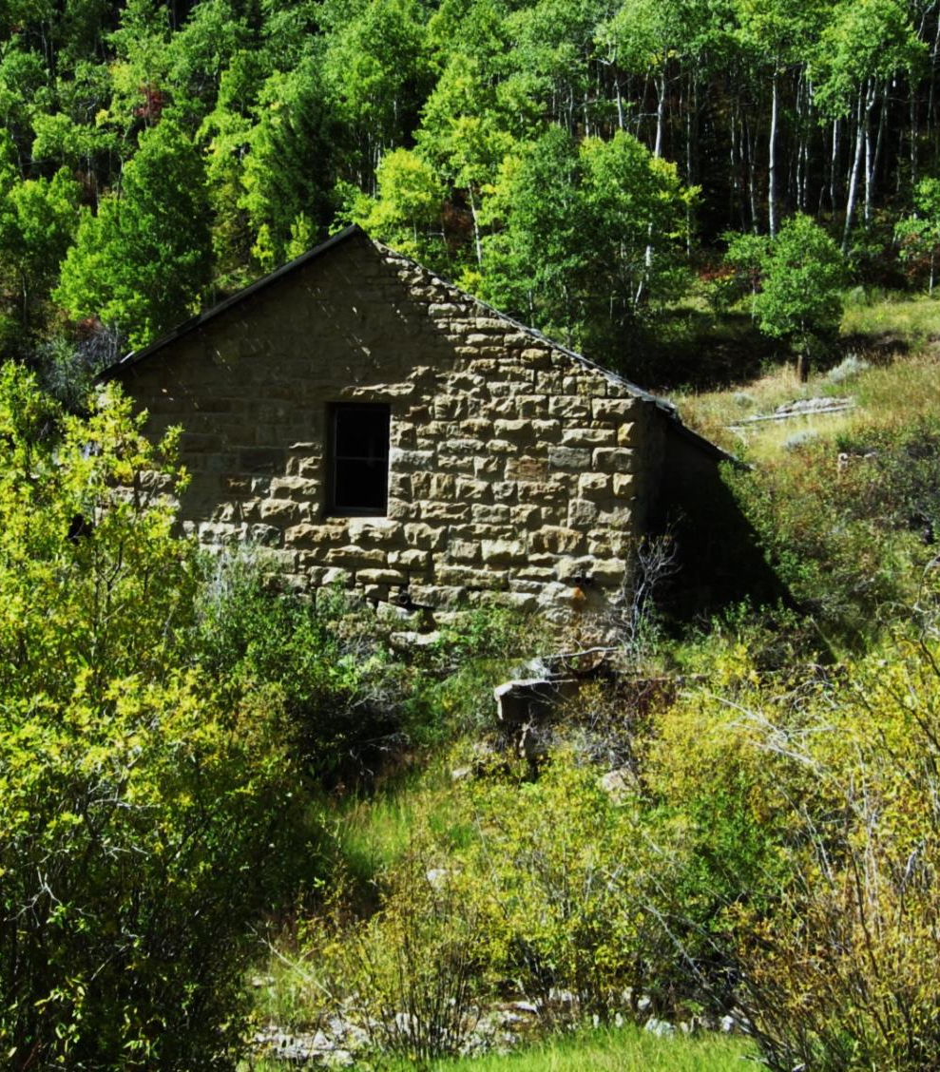
1st Appropriative Water Rights Statute 1872
Passed in California
Required Posting at the Point of Diversion
Filing in County Recorder’s Office
“Perfect” the Right with “Due Diligence”
The rights established could be lost through nonuse
Notes:
The first appropriative water rights statute was passed in California in 1872. It allowed for creation of such rights by posting, at the point of diversion, a document stating the intended amount of the right and its purpose of use, filing for the right in the county recorder’s office where the right was located, and taking the steps necessary to “perfect” the right (put the water to beneficial use) with “due diligence.” The right could not be lost due to nonuse.

Slide 9
Desert Land Act of 1877
Right to Use Water - must “depend upon bonafide prior appropriation.”
Effect of Act: Severed title of the water from the public land
Rights to Use Water established under State and Territorial laws, separate from land ownership claims
Notes:
The next development was passage of the Desert Land Act in 1877, Congress declared that the right to use water in the western U.S. by claimants under the Act must “depend upon bonified prior appropriation.” The U.S. Supreme Court held that the effect of the Desert Land Act was to sever title of the water from the public land. Congress directed that rights to use water be established under state and territorial laws, separately from land ownership claims.

Slide 10
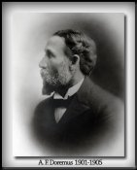
Statutes Giving State Agency Major Role
Wyoming was the First
Required application to be filed with state entity
Ruling on application by the state agency
Maintenance of a central bank of public records
Utah’s Statute Enacted in 1903
Notes:
State governments began to realize that a central administrative system to control appropriative water rights, as well as a centralized office of record keeping for such rights, would be preferable to the haphazard administration which occurred under the early statutes. Therefore water right law is most often regulated at a State level rather than a local or Federal level.
Wyoming was among the first states to enact statutes, with a comprehensive set of water laws enacted in 1890, giving a state agency a major role in administering appropriative water rights. The key features of the Wyoming system were: (1) the requirement that an application must be filed with a state entity before a right could be created; (2) the necessity of a ruling on an application by the state agency, including denying a permit where no water was available; and (3) the maintenance of a central repositotry of public records containing applications which had been made.
Utah’s soon followed suit enacting a statewide water law statute in 1903.

Slide 11
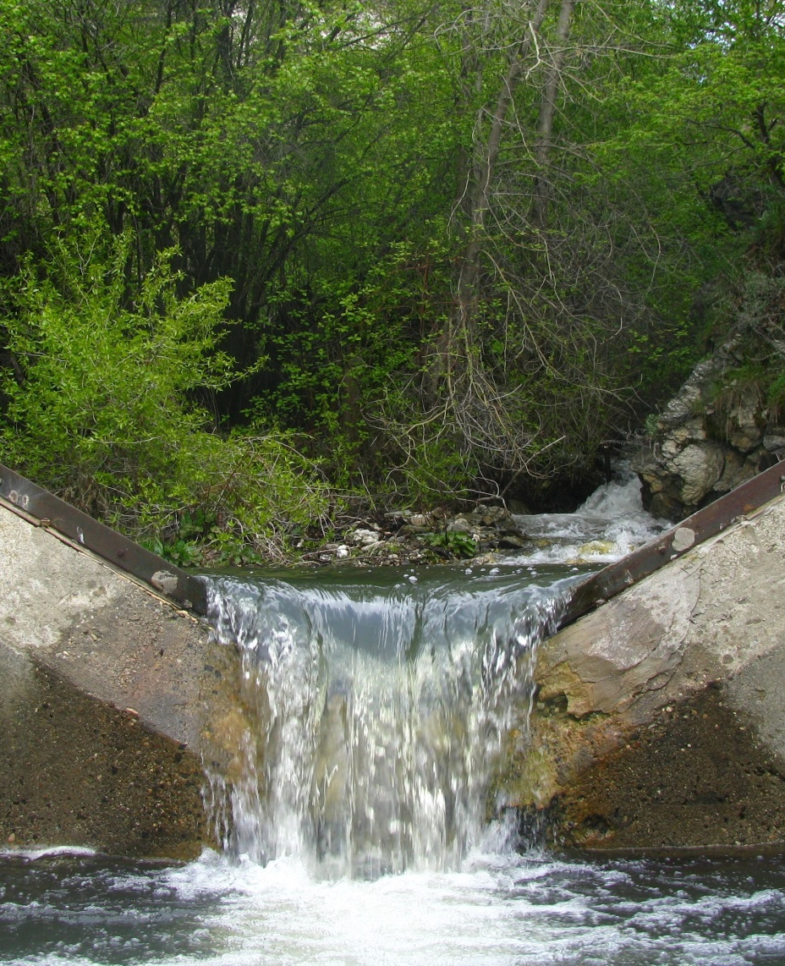
Facilitated Development of Arid Lands
Land & Water Estates established as Separate
Water can be moved for Beneficial Use elsewhere
Provided protection for Domestic, Municipal and Agricultural Uses
Notes:
A fundamental tenet of prior appropriation law was that land and water estates were separate, and that water could be removed from its natural location and used beneficially elsewhere. This facilitated the public purpose of making an inhabitable region out of arid lands. Also, there were preferred uses under traditional appropriative law which embodied a public sentiment that domestic, municipal, and agricultural needs should be met before water could be put to other uses.

Slide 12
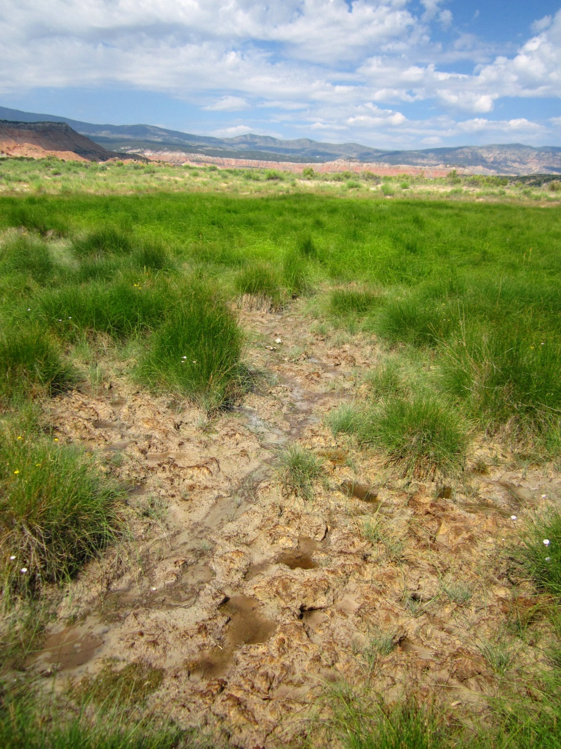
Prior Appropriation Doctrine
Divert Water to Beneficial Use
Priority Date
First in Time, First in Right
Loss of Right
Notes:
The Prior Appropriation Doctrine as enacted in the State of Utah contains some key points. First, water must be diverted and put to beneficial use. Second, to uphold the principal of first in time, first in right, all water rights have a priority date associated with them. And third, a water right can be lost by either abandonment or forfeiture. Abandonment is determined by the intent of the water user and does not require a statutory time period. A water right is lost by forfeiture if the right is not used for 7 consecutive years and some type of adjudicative action is taken to decree the right has indeed been forfeited.

Slide 13
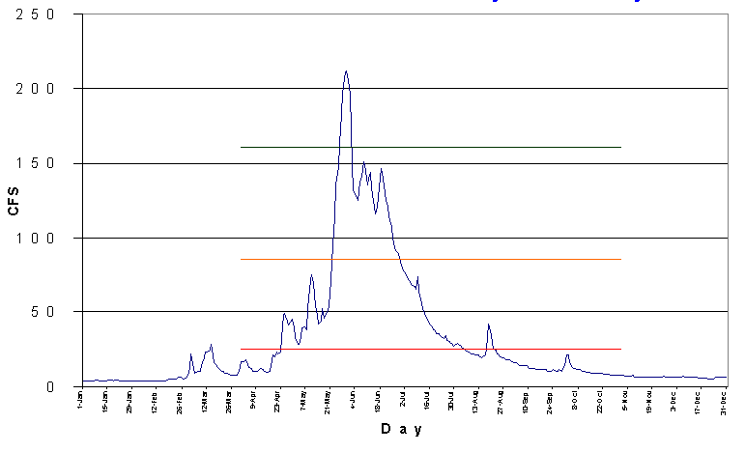
Water Distribution By Priority Date
Stream Flow
160 cfs
3rd Priority 1949
90 cfs
2nd Priority 1922
25 cfs
1st Priority 1873
Apr 1
Oct 31
Notes:
So, let’s take a little closer look at what first in time, first in right really means. Shown on screen is a stream hydrograph with three priority dates representing water rights appropriated on this stream. Below 25 cubic feet per second, all first priority water rights would be regulated and reduced proportionally, for instance, if the stream flow was 12.5 cfs, all first priority water rights would only receive 50% of their right. Once the stream reaches a flow rate of 25 cfs, all first priority water rights would have a full allocation of water, 100%. As the stream flow exceeds 25 cfs, second priority water rights can begin to take water, again on a prorated basis until the stream flow reaches 90 cfs. At that flow rate, all second priority rights would have a full, 100% allocation of water. Above 90 cfs, third priority water rights begin to kick in, again prorated until the flow reaches 160 cfs whereupon all third priority rights would have a full allocation.
Question: What about the water above 160 cfs? Who has the right to use it? It is unallocated but only lasts a few days and then it is gone.

Slide 14
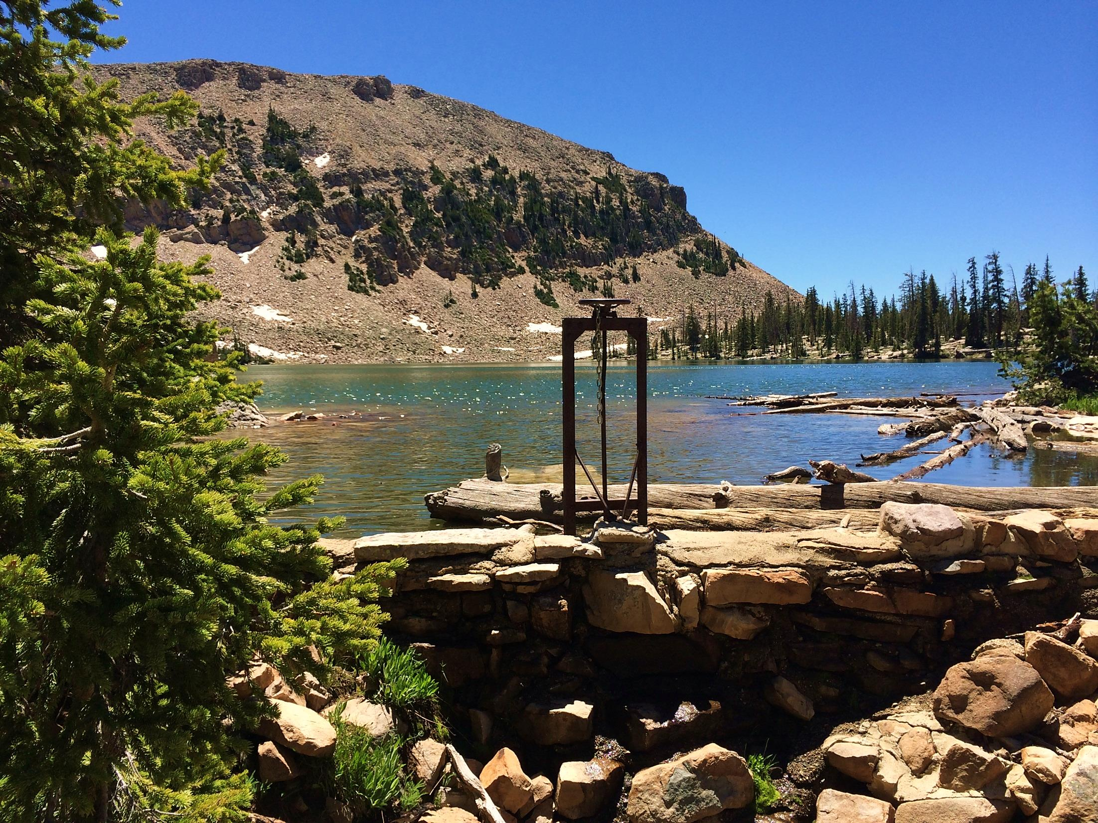
Division of Water Rights
From the past to now

Slide 15
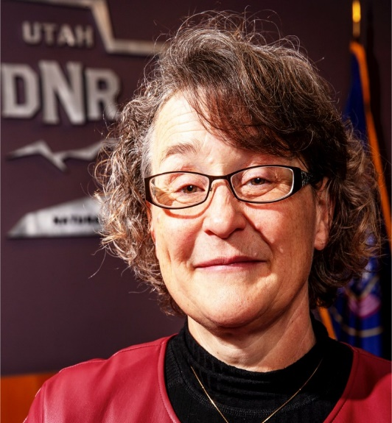
The State Engineer
The State Engineer
Responsible for Administering Water Rights in Utah
Director of the Utah Division of Water Rights
Appointed by the Governor for a Four Year Term.
Willard Young
First State Engineer
Teresa Wilhelmsen
Current State Engineer
Notes:
Willard Young, a son of Brigham Young, was the first State Engineer. He graduated from West Point in 1875 and was an officer with the Army Corp of Engineers. He was also city engineer for Salt Lake City. He was appointed State Engineer in 1897. His initial duties were to aid in planning, design and construction of water storage and conveyance facilities.
Teresa Wilhelmsen is the current State Engineer and was appointed in February 2020. Ms. Wilhelmsen has worked for the division for the past 23 years and held the positions of assistant state engineer over applications and records, regional engineer at the Utah Lake and Jordan River Regional Office, and adjudication program manager. Before joining the division, Ms. Wilhelmsen worked for the School and Institutional Trust Lands Administration. She is a professional engineer and graduated from the University of Utah with a bachelor’s degree in civil engineering.

Slide 16
Division of Water Rights Organizational Chart
State Engineer
Deputy State Engineer
Field Services
Technical Services
Applications and Records
Dam Safety
Regional Offices
Adjudication Services
Well Drilling
Enforcement
Distribution
Stream Alterations
Public Inquiry
Front Desk
Notes:
The Division also has a Deputy State Engineer, five assistant state engineers over Field Services, Technical Services, Application and Records, Dam Safety and Adjudication Services, seven regional engineers, and various other administrative and managerial staff.

Slide 17
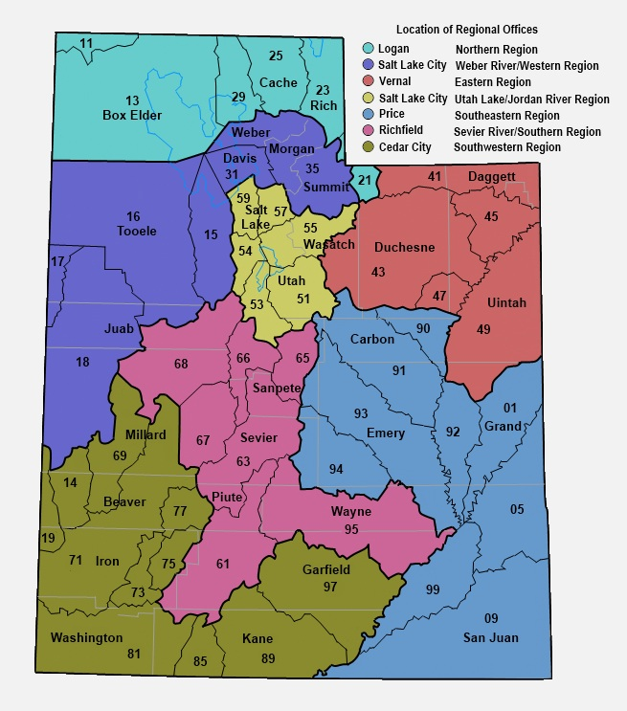
Notes:
Whatever your individual focus on water rights may be there is one point that should be clearly understood – actions on Water Rights do not make more water. Water rights only establish who gets to use the available water.
The organization of the state into “regions”, being the differently colored areas, representing primarily river drainages. Note the legend in the top right.
Then within the regions there are “areas” being represented by the 2 digit numbers. These 2 digit numbers are the first 2 numbers in every water right in that area. EG: 35 for the Weber, 57 and 59 for the Jordan River in Salt Lake County. Where there is no major river system such as the west desert, the boundaries follow geographic features creating drainages.
Application numbers differ from Water Rights Numbers in that they are assigned to applications sequentially by application type. Application Numbers begin with a letter. A for applications to appropriate, a for change applications, D for diligence claims, U for underground water claims, F for fixed time applications, T for temporary appropriations, t for temporary change applications.

Slide 18
Water Right basics
Statutes and other definitions

Slide 19
The Beginning of Water Rights
1903 – Water Laws enacted by Utah State Legislature
Required filing an Application to Appropriate for new uses
Review and Approval/Rejection of Application by State Engineer
Uses prior to 1903 recognized as Valid referred to as Diligence Claims
Recognized all existing rights established by court Decree
Uncertainty Regarding Groundwater Uses
Uncertainty Regarding Land Owner Riparian Doctrine Claims

Slide 20
The Beginning of Water Rights
1936 – Water Law Amended by Utah State Legislature
Clarified All Waters of the State Subject to Appropriation Statutes
Rights from Wells in use prior to 1936 Recognized as Valid referred to as Underground Water Claims (UGW) – sister to Diligence Claims
New uses from groundwater require Application to Appropriate
Riparian Doctrine Claims Not Recognized
“Rights to use water are not obtained simply because water exists upon or beneath property or passes over it. Such rights would be riparian and are not recognized in Utah law”

Slide 21
Title 73 Utah Code
What is the legal framework for Utah water right law?
Basic and Fundamental Code
All waters in this state, whether above or under the ground are herby declared to be the property of the public (73-1-1)
A person may acquire a right to the use of the unappropriated public waters in this state only as provided for in this title (73-1-1)
Beneficial use shall be the basis, the measure, and the limit of all rights to the use of water in the state (73-1-3)

Slide 22
Elements of a Water Right
Ownership
Priority Date
Quantity of Water
Flow Rate (cfs)
Volume (acre-feet)
Storage
Point(s) of Diversion
Nature of Use
Irrigation, Domestic, Stock Water, Mining, Municipal, etc.
Amount of use
Period of Use
Place of Use
Notes:
These are the elements that make up a water right. Review.

Slide 23
Ownership
Ownership
Established by Application, Claim or Decree
Transferred by Deed, Assignment or Decree
Appurtenant to Land unless Specifically Reserved by Deed
Recorded by County – Official Record of Ownership
Updated on Division Records – Unofficial & Often Inaccurate
(Do Your Research – Use Professionals – Title Companies, Attny, etc…)
Note: Trust Deeds on Real Estate can affect title to water rights
Notes:
If you are purchasing a water right, make certain that the person selling it actually owns it. Do not rely on Division records. Beware of trust deeds. Get a warranty deed. If you are selling land that has water rights associated with it be careful that you don’t unintentionally convey the water rights by appurtenance.

Slide 24
Priority
Generally:
Priority Date is Date of Filing (Application) or,
Priority Date is Date of First Use (Diligence & UGW Claims) or,
Priority Date is Date of First Use or Date Set by Decree or Decree Issue Date (Decrees)
Surface Rights are Regulated by Priority
Groundwater Rights are Generally Regulated by Priority in Conjunction with a Groundwater Management Plan

Slide 25
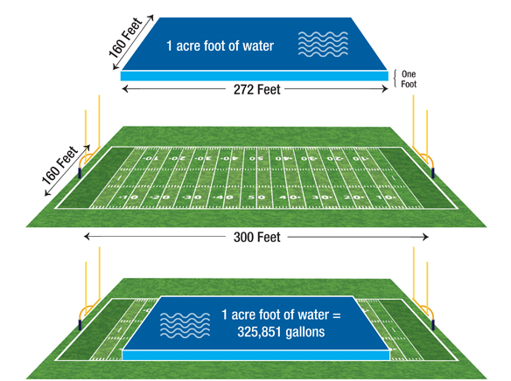
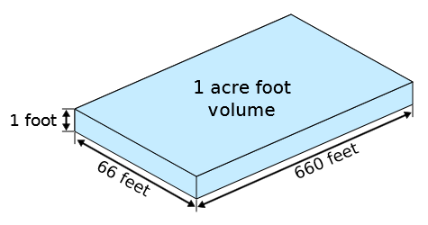
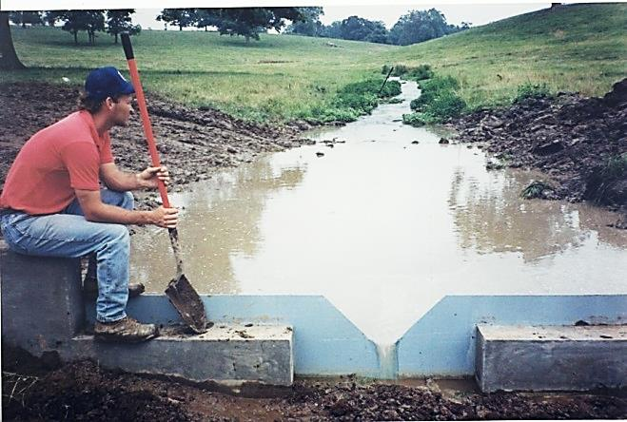
Water Right Flow and Volume
Acre-Foot is a measure of volume. It is 1 foot in depth of water on 1 acre of land.
CFS (cubic feet per second) is a measure of flow similar to GPM (gallons per minute). It is 1 cubic foot of water moving at 1 foot per second past a given point.
Notes:
UCA 73-1-2
Flow is measured in cfs.
Volume is measured in acre-feet
How does this come into play in water rights?
Why is it important to consider both flow and volume?
What if the right is for an ephemeral stream?

Slide 26
Point of Diversion
Source of Water
Surface: Single or Multiple Locations or Point-to-Point
Spring: Developed or Natural
Drain: How is it defined?
Well: Diameter and Depth
Location Defined by a Metes and Bounds Description
Uses of Water:
Notes:
Surface right is probably a decreed right with a priority of 1903 or earlier. Remember that most of the surface water was fully appropriated by 1903.
A well or other groundwater right is probably filed after 1935 but could be and underground water claim.
Springs are often sources of supply for diligence claims filings for stockwater.

Slide 27
Beneficial Use The Measure and the Limit of Every Water Right
BENEFICIAL USE is the purpose to which water diverted under a water right is applied. Examples include but are not limited to irrigation; stock watering; domestic; and commercial, industrial, municipal (amounts measured in acre-feet).
The purpose to which water diverted under a water right is applied.
Examples include:
Irrigation
Stock Watering
Domestic
Commercial
Industrial
Municipal
Power

Slide 28
Beneficial Use
Additional Considerations
Sole Supply / Group Total
Sole Supply – Amount of Use allowed under a particular water right when used alone and separate from all supplemental rights
05-5000 05-5123 05-5486 Group Total
Irrigation (ac): 125 45 25 195
Diversion (Duty) and Depletion (Consumptive Portion)
Year-Round or Seasonal
Uses of Water:
Notes:
Surface right is probably a decreed right with a priority of 1903 or earlier. Remember that most of the surface water was fully appropriated by 1903.
A well or other groundwater right is probably filed after 1935 but could be and underground water claim.
Springs are often sources of supply for diligence claims filings for stockwater.

Slide 29
How Much Water Does It Take?
Duty - Estimate of the amount of water reasonably required for specific purposes such as irrigation or domestic use.

Slide 30
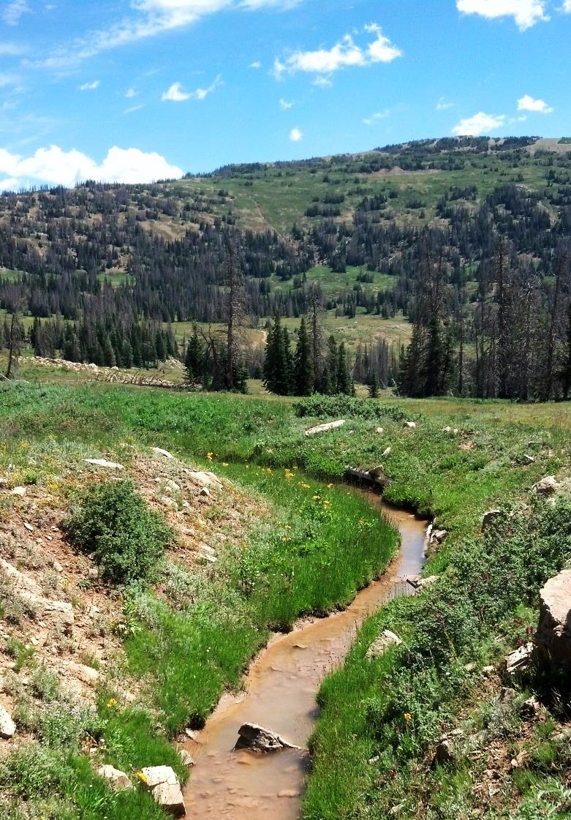
Diversion Duty of Common Uses
Domestic Use
0.45 acre-foot per residence
0.25 acre-foot part-time (cabin)
Livestock Watering
0.028 acre-feet per large animal (25 gallons/day)
Irrigation
Typically ranges from 3.0-6.0 acre-feet per acre
0.25 acre-foot if part time (cabin)

Slide 31
Diversion vs. Depletion
DIVERSION is removal of water from its natural source whether it is surface or groundwater and applied to some beneficial use. It can be limited by flow (cfs) or volume (ac-ft).
DEPLETION is the portion of water withdrawn from a surface or groundwater source that is consumed by a particular use and does not return to a natural water source or another body of water.
------------------------------------
Domestic 20% = 0.09 af
1 Horse 100% = 0.028
Irrigation ≈ 50%
Notes:
Either amount can limit a water right. Even for municipal uses on change applications both the diversion and depletion amounts for the rights being changed are considered in approval of the change application.
Example? Haircut?

Slide 32
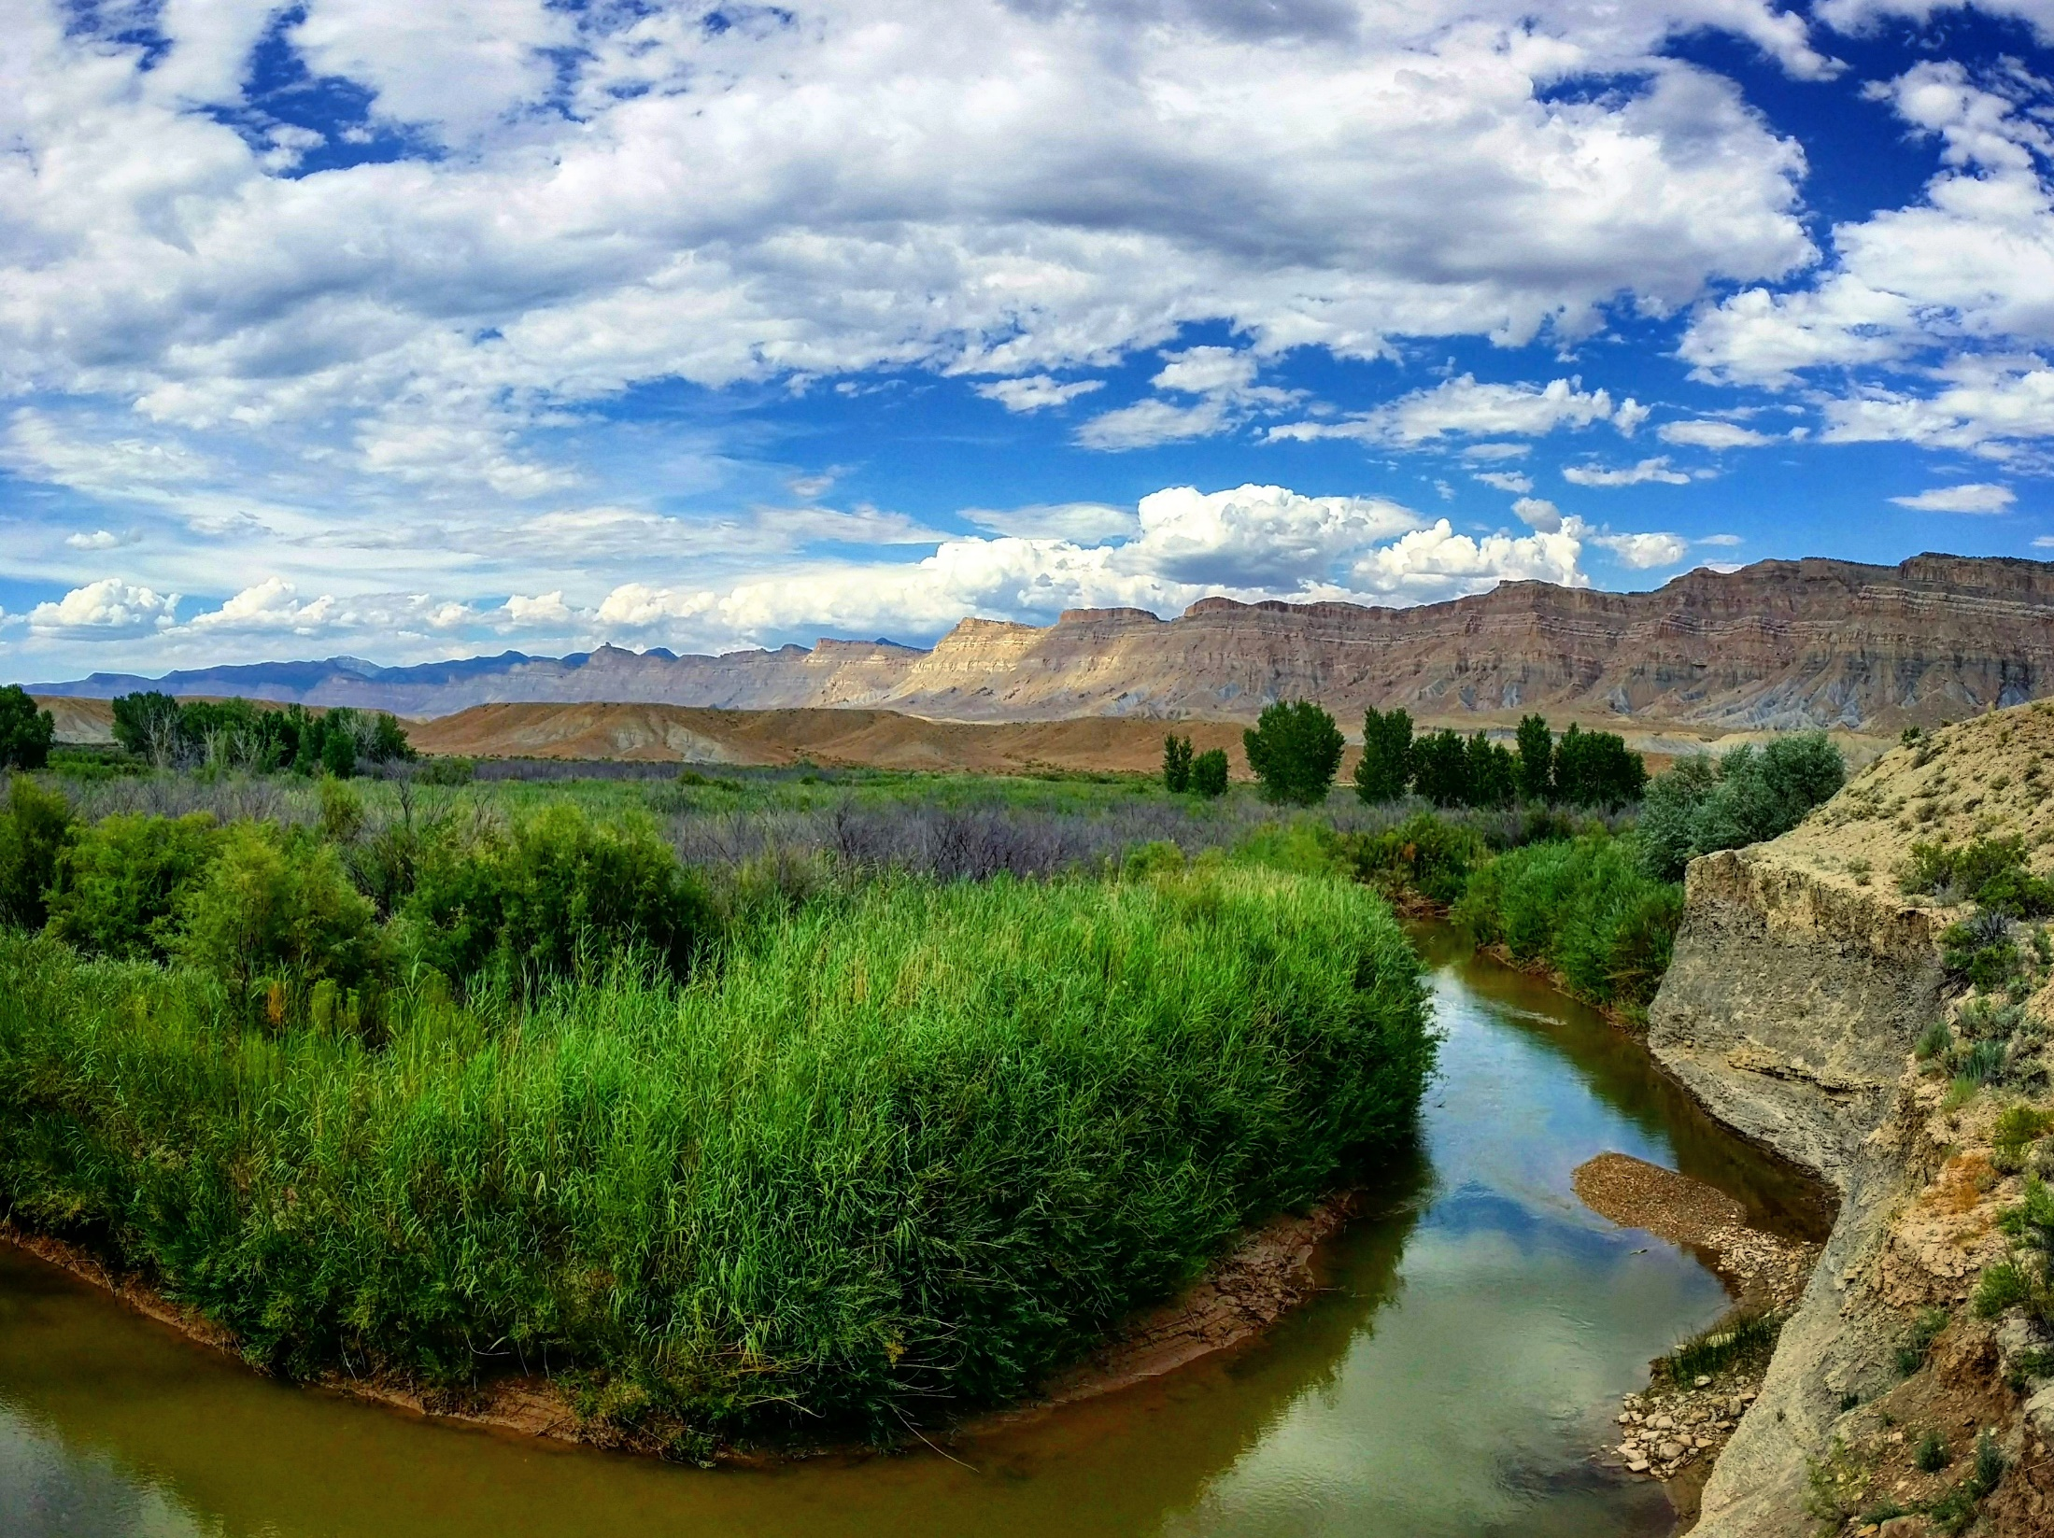
OBTAINING WATER RIGHTS & Researching Records
Marc Stilson

Slide 33
HOW DO I GET A WATER RIGHT?
Filing for a water right
Application to Appropriate
Diligence Claim
Fixed Time Application
Purchasing all or portion of an existing right
Change application
Exchange Application
Note: Research Possible Issues Related to Forfeiture
Purchasing property with existing rights
Appurtenance
Note: Research Possible Issues Related to Trust Deeds
Notes:
A lot of people would like to come to our office and in five minutes have an approved application in their hands. There are numerous reasons why this cannot happen. We will discuss our processes that we are mandated by Utah State law to follow.
To begin a process, we need to have something to process. In this case a water right application
How do we obtain a water right?
Several ways to obtain a water right
These will be covered here very briefly.
Do not use for Water User’s Workshop Presentation:
[I will discuss later the “why” you would want to file several of the most common applications and the “how” will be discussed in a later presentation]
Filing for a water right:
When we talk about filing for a water right, it is done through the State Engineers Office or the Division of Water Rights.
Filing for water in an area of the state that is open for appropriation.
Filing Diligence claims showing that the water has been in continuous use prior to when the state legislation created the process for applying for surface and underground water.
Purchasing property with existing water rights
If the selling party does not reserve or keep the existing water rights then the water rights can transfer to the buyer by appurtenance.
Water can be considered to be an appurtenance to the property.
Purchasing all or portion of an existing water right
Can purchase a valid water right without the land on one piece of property and then transfer it to another property. Transfer is subject to administrative policies of where the water originates and to where it is being proposed to be transferred to.
Purchasing water or land is a private transaction that our office would not be involved in. (and we usually do NOT want to be involved in)
Our office is usually notified after the deeds transferring title to the water right has been recorded and then the new owner provides copies of those deeds with a Report of Water Right Conveyance to our office to update the ownership records of the water right.

Slide 34
WHERE CAN YOU RESEARCH?
Researching Water Right Records….
Electronic Files
Water right files available via the Division’s Website
Notices
New filings the past seven days
New approvals for the past 30 days
Proof due for the next 120 days
Water Companies
Hard Files
At the Salt Lake or Regional Water Right Offices
May only be reviewed in office
www.waterrights.utah.gov
Notes:
(WARNING: Water Rights makes NO claims as to the accuracy of this data.)
Scanned Documents

