Slide 1
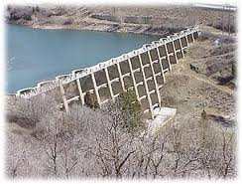
Utah Dam Safety
“The State Engineer has the authority to regulate dams for the purpose of protecting public safety.”
To protect life and property, the State Engineer may make rules controlling the construction and operation of dams…”

Slide 2
Administrative Rules
Design
Maintenance
Repair
Removal
Abandonment

Slide 3
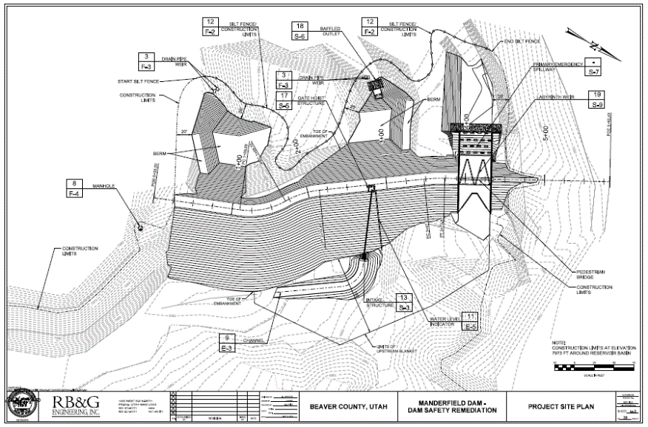
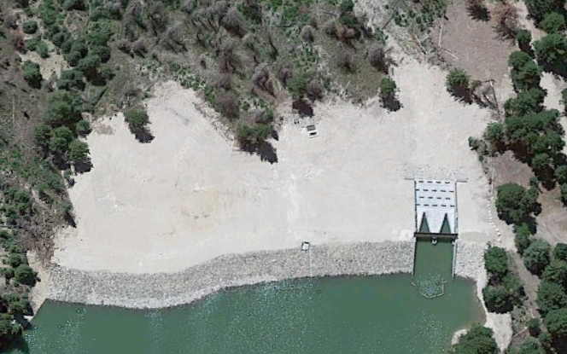
Design & Construction
“No person may construct, enlarge, repair, alter, remove, or abandon any dam or reservoir without obtaining written approval from the state engineer.”

Slide 4
Submission of Plans
Two processes for approval
“Small Dam Application”
Reservoir Volume is less than 20 ac-ft
Does not constitute a threat to human life
“Formal submission of plans”
Design Report(s), Drawings, Specifications
Allowed 90 days for review

Slide 5
Qualifications
Plans for the construction, enlargement, repair, alteration, or removal shall be prepared by a qualified engineer who is:
Licensed in Utah
Experienced in dam design and construction

Slide 6
Construction Inspections
The state engineer, his staff, or an independent consultant shall make periodic inspections of the work for the purpose of ascertaining compliance with the approved plans and specifications
The engineer who is supervising the work is required to submit a report weekly to the state engineer.

Slide 7
Inspection & Maintenance
The state engineer shall inspect each dam that if it failed:
Poses a threat to human life
could cause significant property damage
Following an inspection, the state engineer shall specify what maintenance is necessary

Slide 8
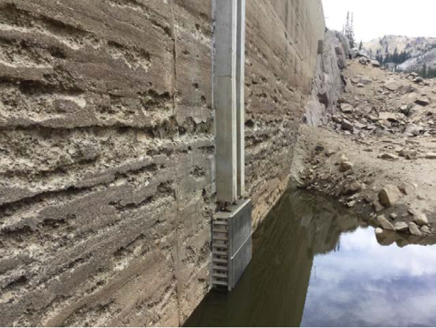
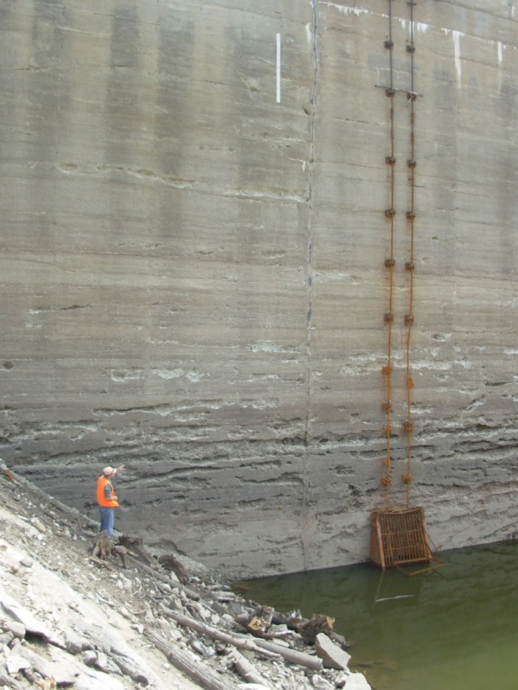
Inspection Results
Observe the condition of the dam
Specify necessary maintenance, repair, or other needs to protect life & property
The owner of the dam shall be responsible for that maintenance

Slide 9
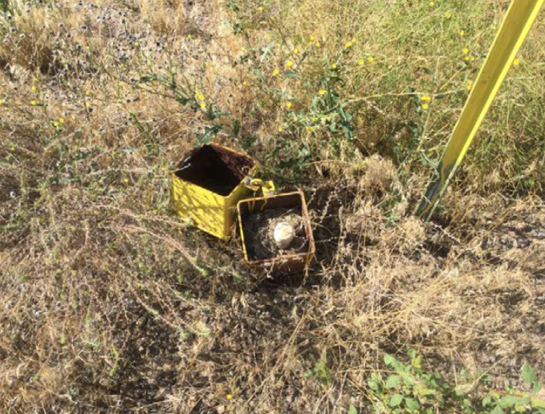
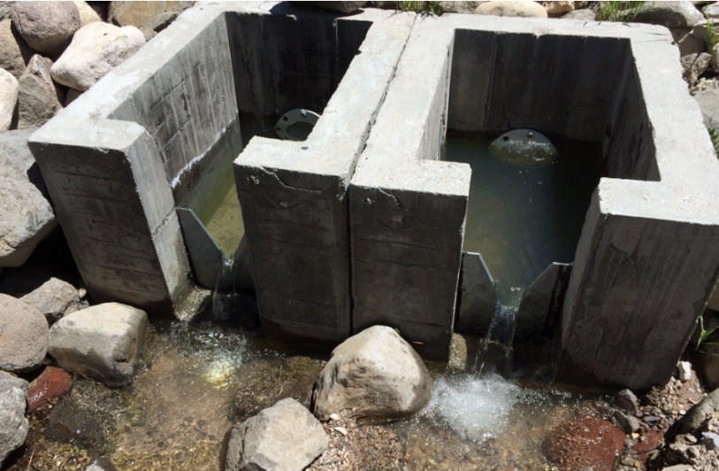
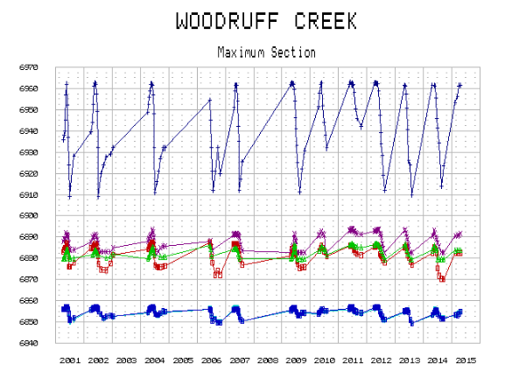
Instrument Monitoring
Piezometers
Drains

Slide 10
Questions?

Slide 11
Utah Stream Alterations
“A state agency, county, city, corporation, or person may not relocate any natural stream channel or alter the beds and banks of any natural stream without first obtaining the written approval of the state engineer”

Slide 12
Application Process
An application to relocate any natural stream channel or alter the beds and banks of any natural stream shall be submitted to the state engineer
Application may be downloaded from our website
Fee based upon the applicant:
Non-Commercial….$100
Governmental…….…$500
Commercial……….….$2000
Processing time is approximately 30 days

Slide 13
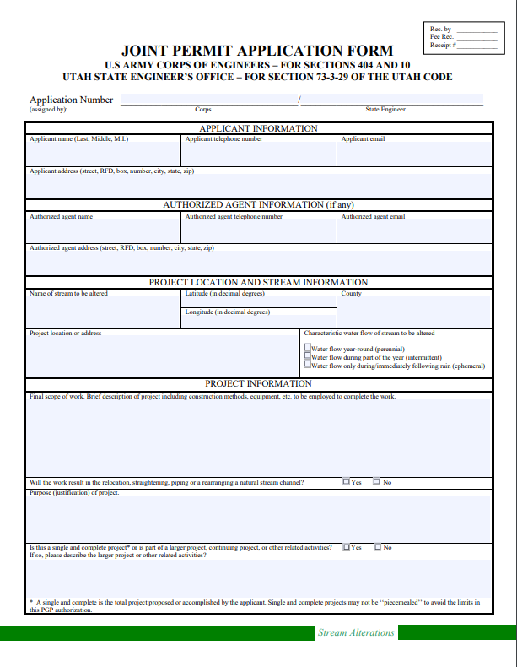
USACE Joint Application
The U.S. Army Corps of Engineers issued Programmatic General Permit 10 (PGP-10) which allows an applicant to obtain both state approval and authorization under Section 404 of the Clean Water Act though a single application process

Slide 14
Failure to Acquire a Permit
“The state engineer may issue an order for the repair and restoration of the bed and banks of a natural stream channel altered contrary to, or without, a permit issued for that purpose”

Slide 15
Emergency Action
The state engineer may issue an emergency permit if an emergency situation arises which involves:
Immediate or actual flooding
or
Threatens the health or well-being of a person
Contact the state engineer as soon as possible
Submit application within 2 days following the emergency
The state engineer will inspect the alteration and may impose additional requirements

Slide 16
Questions?

