Slide 1
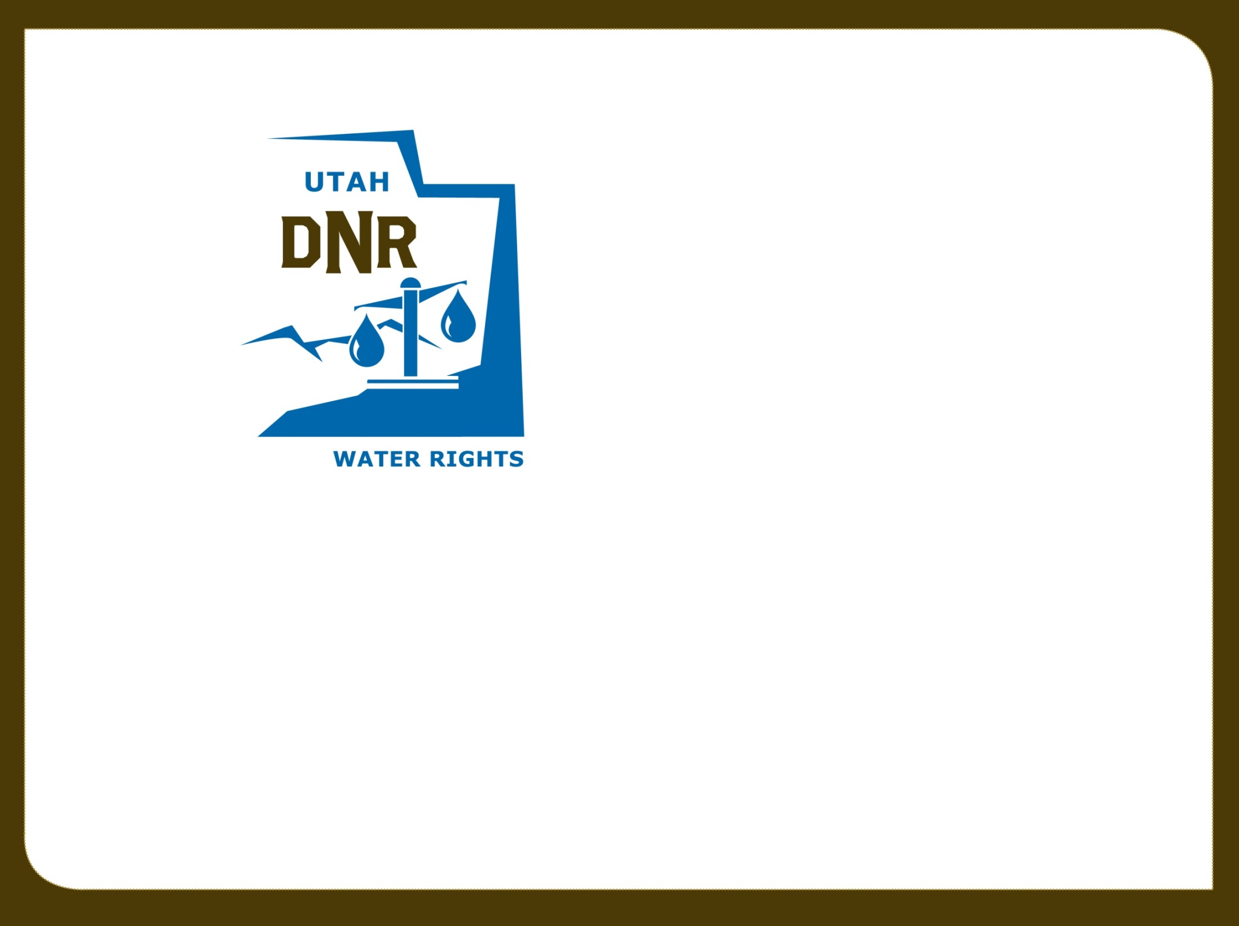

Utah Division of Water Rights
RWAU Water Right Training
Other State Engineer Roles
Ryan Hamilton, P.E.
June 21, 2004

Slide 2
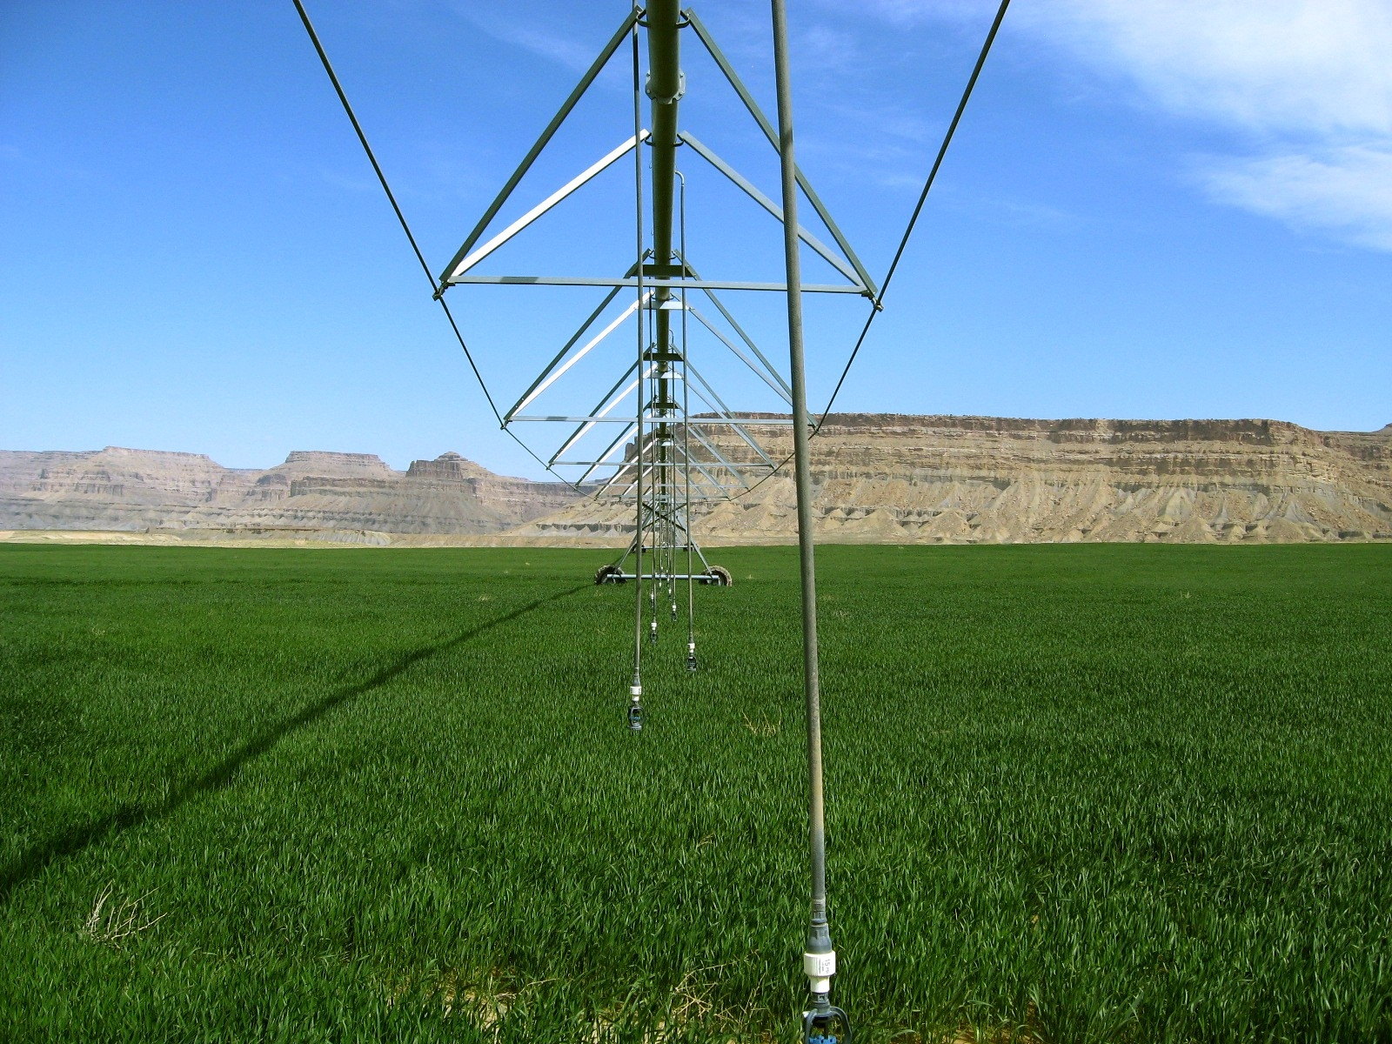
EnforcEment

Slide 3

History and Background
Prior to 2005:
  State Engineer had no direct enforcement authority
  Persistent violations were addressed by:
    Criminal complaints when allowed by statute
    Civil litigation
    Lacking civil litigation, violators suffered no penalties
Notes:
Prior to 2005 there was no direct enforcement authority by the state engineer. Violations were addressed by
criminal complaints filed in civil court followed by civil litigation
Without civil litigation, there were no penalties for violations.

Slide 4

The 2005 Statutes
Section 73-2-25: State Engineer enforcement powers
Section 73-2-26: Administrative penalties
Section 73-2-27: Criminal penalties
Section 73-2-28: Cost and fees in civil actions
The 2005 Administrative Rules
Rule R655-14: Administrative Procedures for Enforcement Proceedings Before the Division of Water Rights
Notes:
In 2005, Sections 73-2-25 through 28 were adopted to provide:
the State Engineer with enforcement powers ;
define criminal penalties and
Associate cost and fees in civil actions
Administrative Rule 14 was adopted to detail procedures for enforcement proceedings

Slide 5
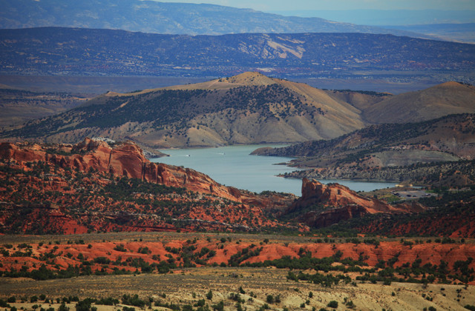
When is an “enforcement action” authorized?
  Taking water without right or in excess of the approval conditions
  Failure to comply with statutes, orders or notices regarding headgates, measuring devices, etc.
  Failure to comply with dam safety or natural stream channel alteration orders
Notes:
An “enforcement action” is authorized when:
A water user is using water without an existing water right or exceeding the conditions of the approval
Violating an existing right be exceeding their water right or violating any of the limiting characteristics of a water right – (POD, POU, Period of Use, Nature of Use, Flow Rate)
Failure to comply with a requirement to install or repair headgates and measuring devices.
Failure to comply with an order regarding dam safety or natural stream channel alteration

Slide 6

When is an enforcement action not authorized:
  One year or more has passed since violation
  Civil disputes between water users
  Internal disputes in water or irrigation companies
  Right-of-way, easement or trespass disputes
Notes:
An “enforcement action” is not authorized when:
More than 12 months has passed since the violation ended
The situation involves private water related agreements between water users or internal disputes within water or irrigation companies.
Right-of-way or trespass violations are not water right violations even though it may involve a water related structure such as a canal.

Slide 7
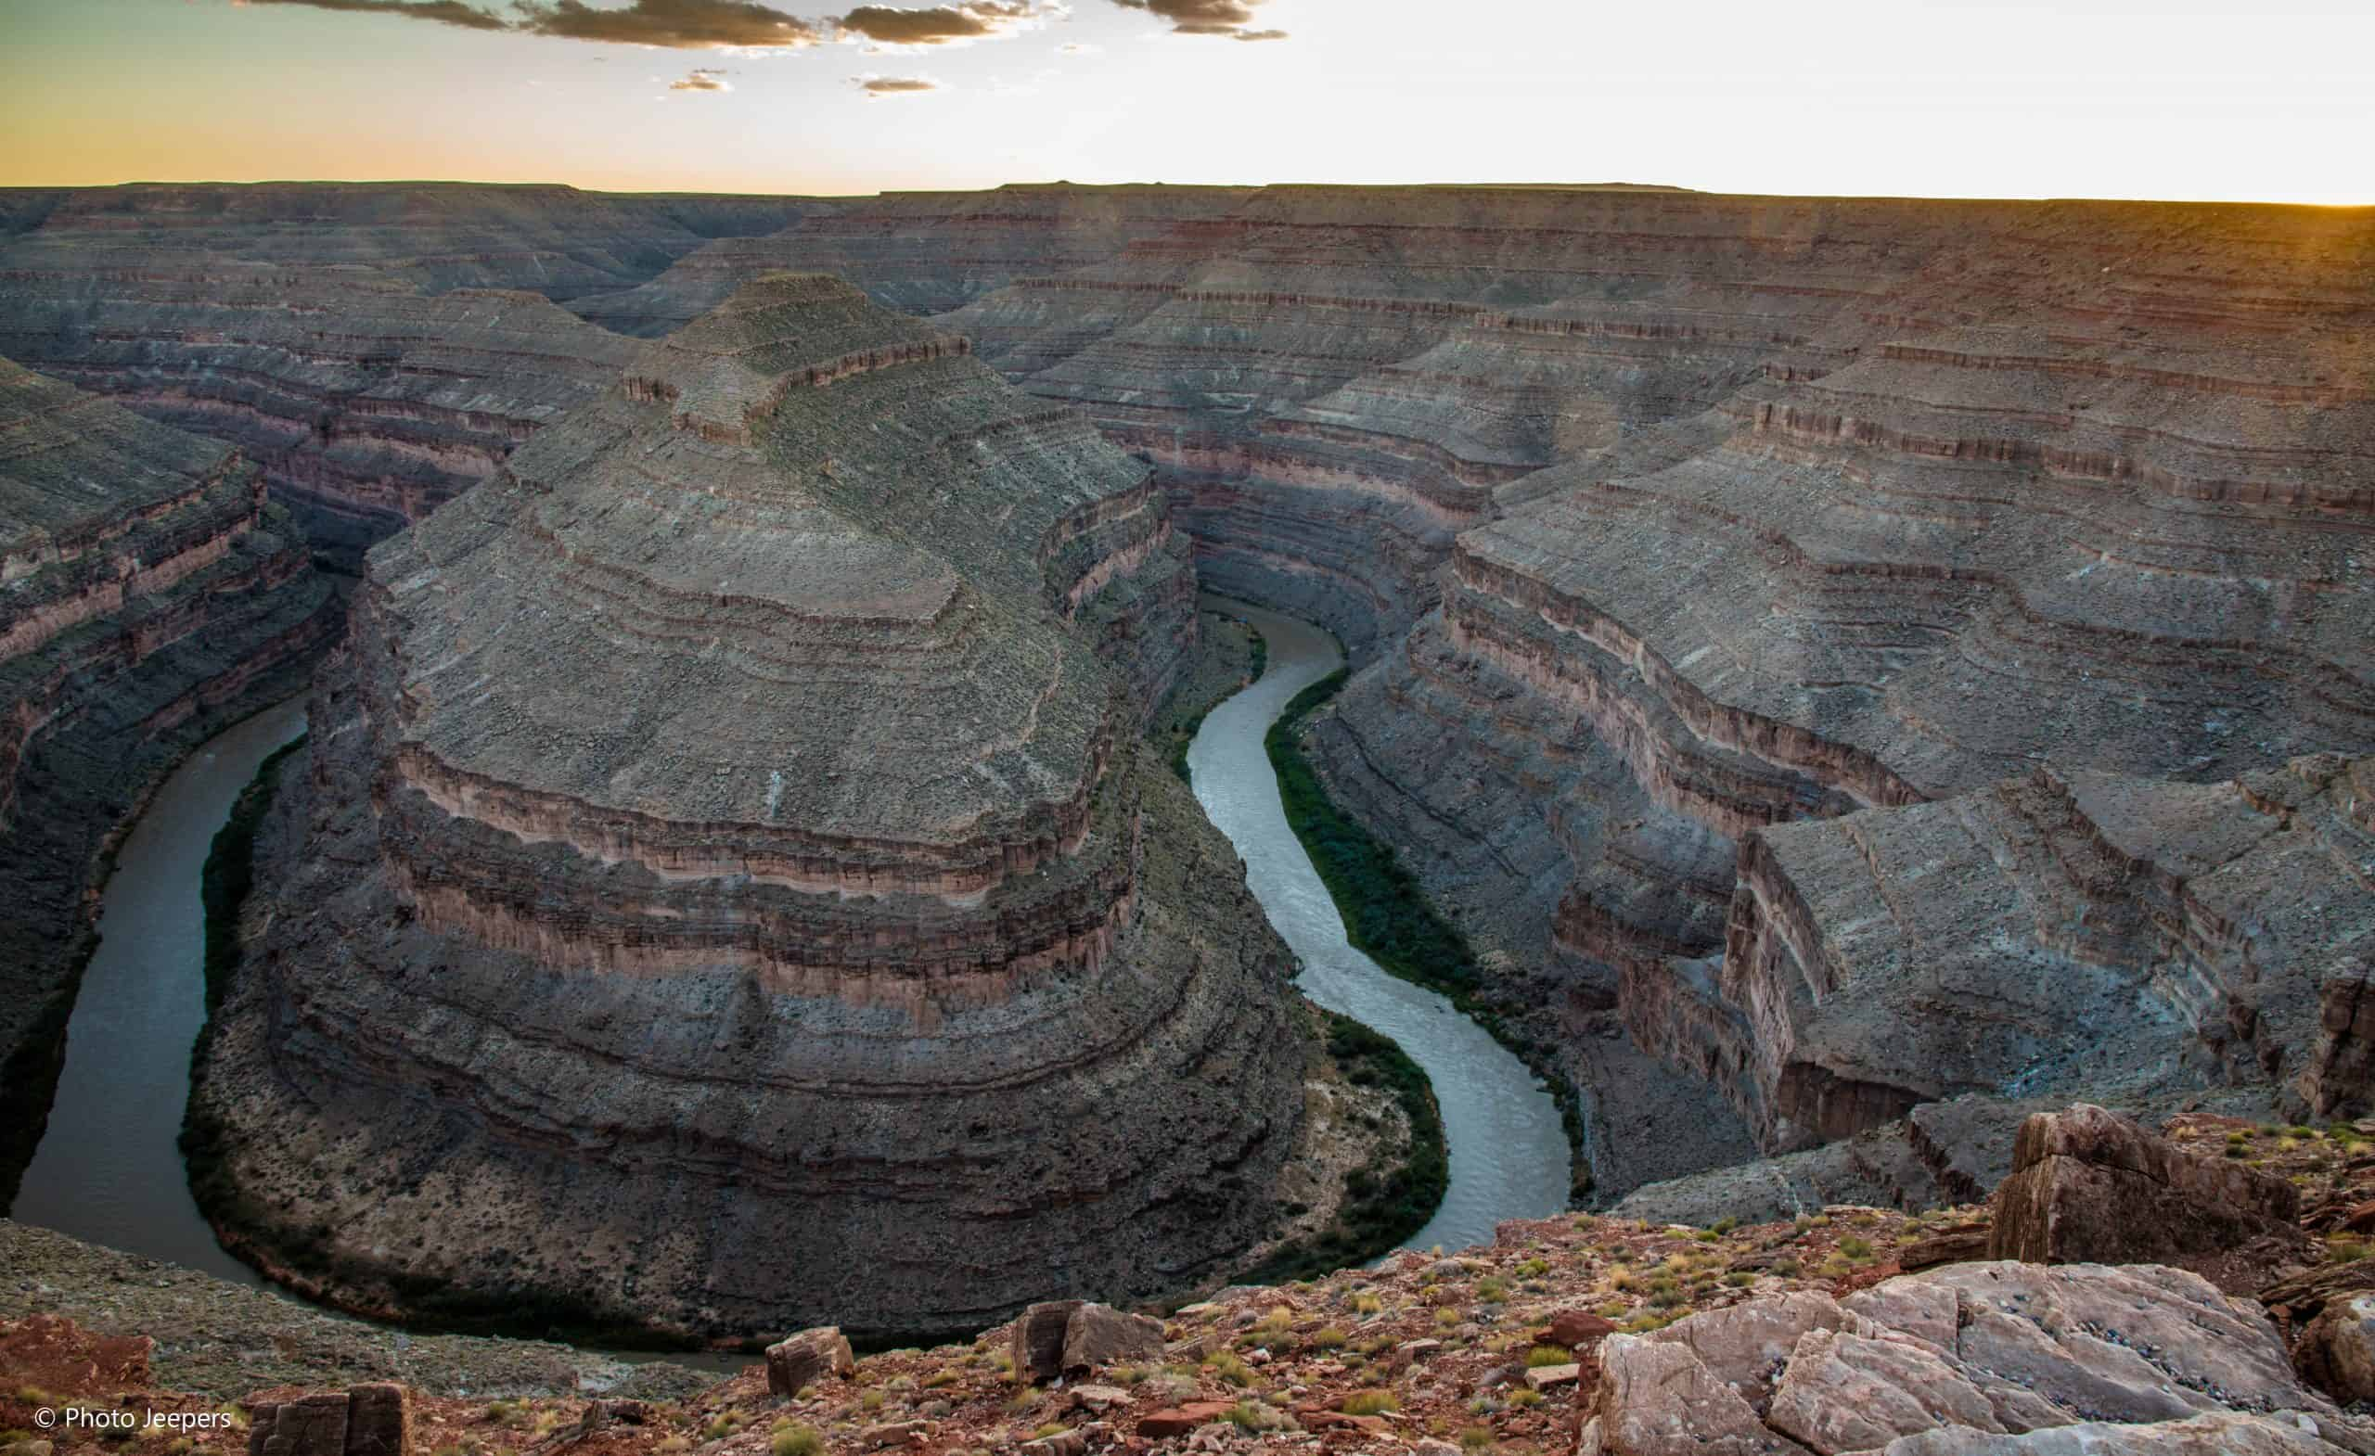
Initial Order
A description of the violation;
Notice of any penalties to which person may be subject to; and
Notice that each day’s violation may be treated as a separate violation.
Notes:
To begin enforcement the State Engineer issues an initial order that will include a:
Description of the violation
Notice of potential penalties AND
Notice that each day’s violation may be treated separately

Slide 8
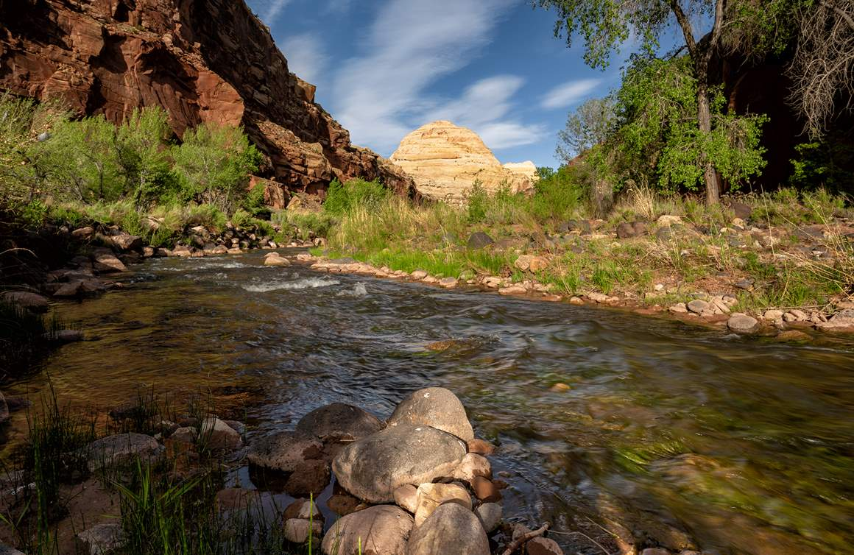
Final Order
Pay an administrative fine not to exceed:
  (A) $5,000 for each knowing violation; or
  (B) $1,000 for each violation that is not knowing;
Replace up to 200% of water taken; and
Be liable for any expenses incurred by the SE or Division in investigating and stopping the violation.
Notes:
Enforcement is may result in:
A fee assessment of ($5,000 for each knowing violation), or ($1,000 for each violation that is not knowing);
A water user may be required to replace up to 200% of the water taken without authorization
An assessment of expenses incurred by the State Engineer for investigating and stopping the violation may also be part of a final order.

Slide 9

Considerations
The value or quantity of water;
Economic injury or impact to others;
Whether the person subject to fine attempted to comply with the orders; and
The violator’s economic benefit from the violation.
Notes:
Considerations made before imposing a fine or ordering replacement may include:
the value or quantify of the water taken without authorization,
The gravity of the violation including the economic injury or impact to other water users,
Whether the person subject to penalties attempted to comply with the orders AND
the economic benefit to the violator.

Slide 10

Goals of Enforcement Program
  Resolve all 1st time offenses informally.
  2nd offenses will result in an enforcement action.
Notes:
Goals of the enforcement program include:
Resolution of 1st time offenses informally. If violations are considered egregious they may still be considered for formal enforcement.
Any 2nd time offenses will result in an enforcement action.

Slide 11

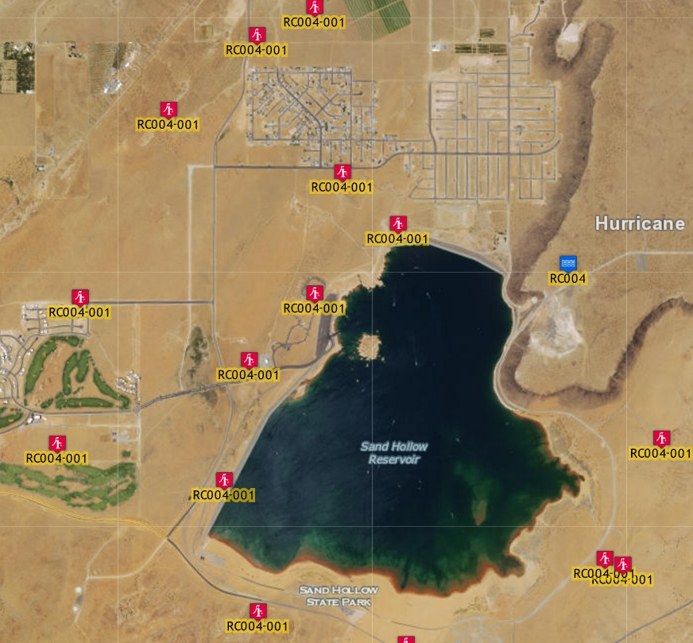
Groundwater Recharge and Recovery
Notes:
Photo of recovery wells around Sand Hollow Reservoir
The reservoir is constructed in a high permeability sandstone unit (Navajo Sandstone). Recovery wells are used to recover a portion of the the water leaking from storage and use the water for municipal purposes.
Other examples of recharge and recovery operations include storage of excess water in an aquifer for recovery at a later date or to supplement points of diversion that may be unable to meet demand. OR
To increase water quality when an aquifer has quality , the recharged water may be used to stabilize or increase the quality of the aquifer.

Slide 12

Groundwater Recharge and Recovery
Separate permits are required for both recharge and recovery.
An applicant proposing to recharge an aquifer must have:
  A valid water right; or
  An agreement with a water user holding a valid water right.
A person who holds a recovery permit may recover the quantity of water within the radius of influence of the recovery well.
Notes:
An applicant proposing recharge or recovery must apply with separate applications.
An applicant proposing to recharge an aquifer must have a valid water right or an agreement with a water right holder
A person who holds a recovery permit may only recover the water the quantity of water within a well or pumps zone of influence

Slide 13

Recharge Application
The name of the groundwater basin;
A description of the proposed project;
The source and amount of water;
Water Right Number;
Water quality evaluation;
Impact and feasibility study;
Plan of operation
Notes:
The recharge permit application will include:
Name of the groundwater basin
A legal description of the proposed recharge project
The source and quantity of water
The Water right number
Quality of recharged water vs quality of receiving aquifer
Hydrolic Impact and feasibility study AND
An operating plan

Slide 14
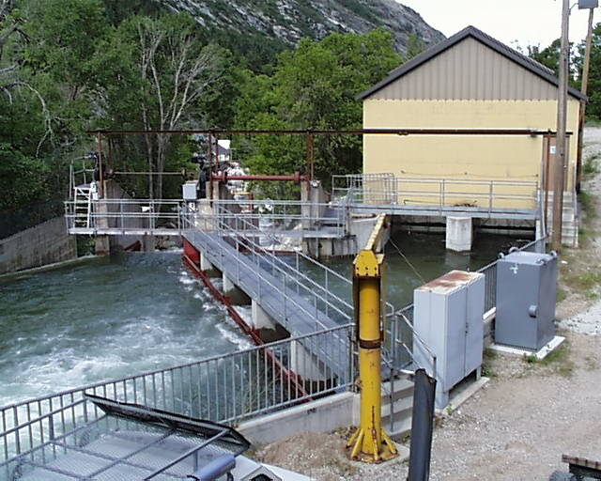
Recovery Application
May be filed with a recharge permit application;
Description of the recovery well(s);
Source name;
The purpose of water recovery;
Well details;
Place of use description;
The pump specifications;
The filing fee for a recovery application is $2500
Notes:
The recovery may be filed alongside the recharge application and will include:
A Legal description of the recovery well(s);
The name of the aquifer or source of recovery;
Purpose of the project;
The depth, diameter, and screened interval of the wells;
A legal description of the land where the water will be used;
Pump technical specifications
The recovery application filing fee is $2500

Slide 15
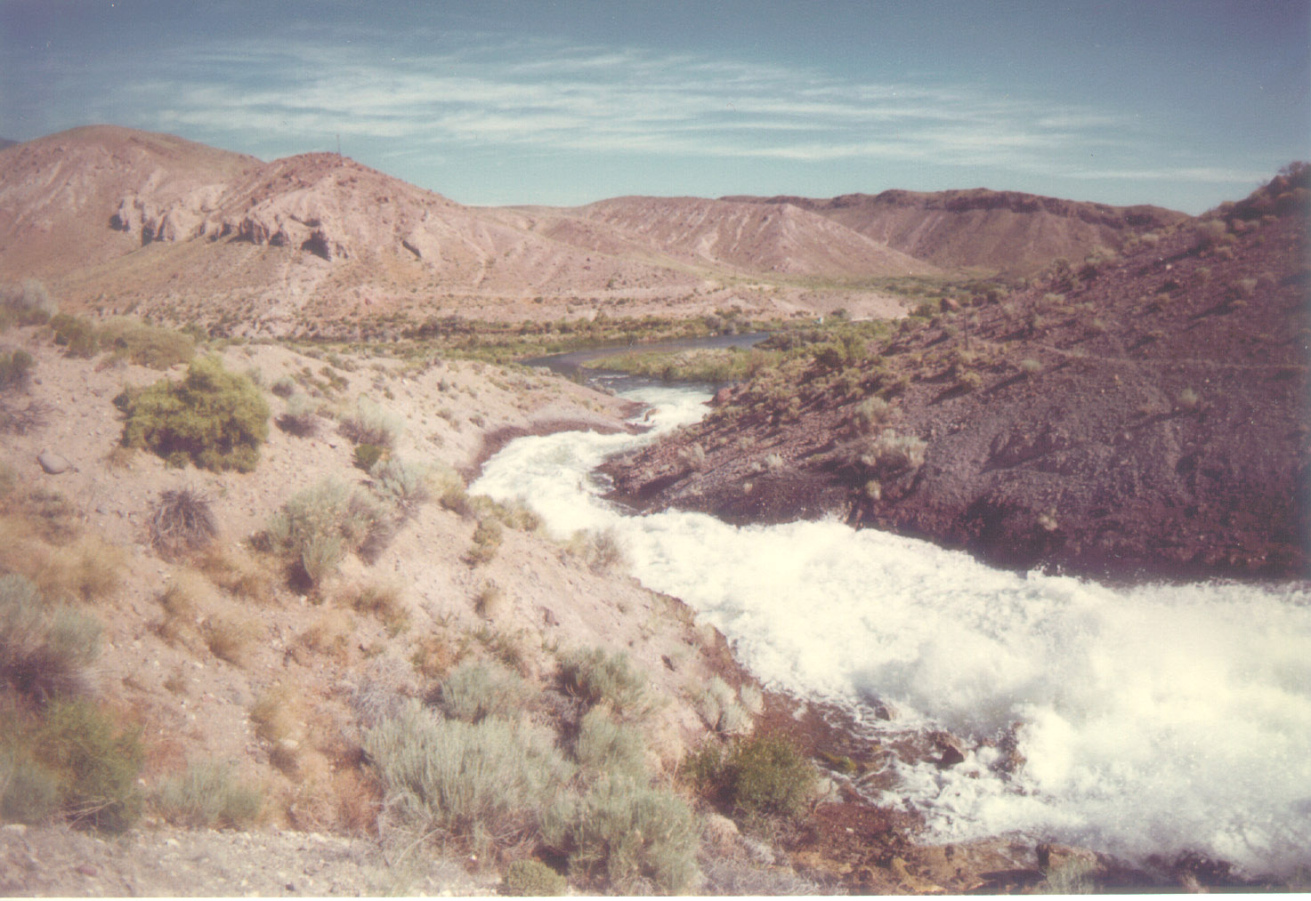
Continued Monitoring
Conditions of the recharge and recovery approval may require the water user to:
  Monitor the operation of the project and its impacts; and
  File reports regarding water quantity of recharge vs recovery or water quality data
An annual fee may be assessed to cover the Division’s costs to review and file monitoring data.
Notes:
A recharge and recovery permit may require the water user to
Continually monitor for water quality and potential impacts
Monitor the balance between recharge to recovery
File reports of the data collected on water quality and flow rates.
An annual fee may be assessed to cover the Division’s costs to review and file monitoring data.

Slide 16
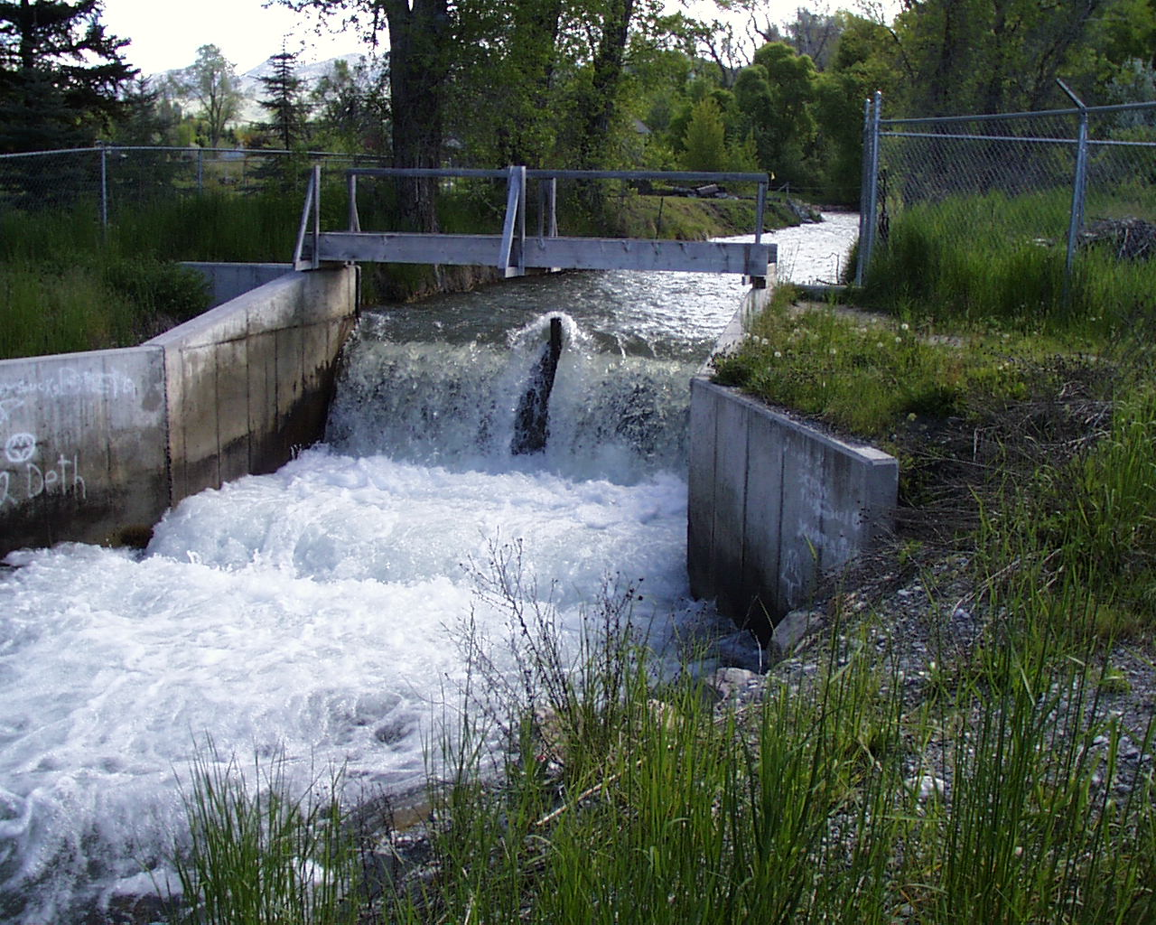

Reuse of Wastewater

Slide 17
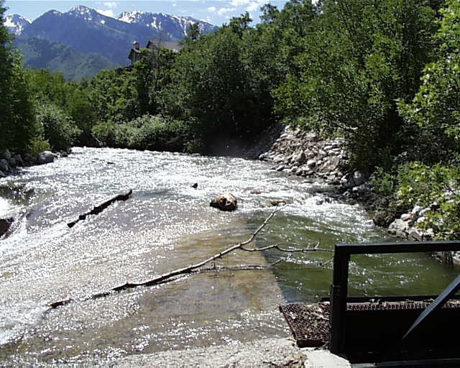
Reuse
Publicly Owned Treatment Works (POTW) that treat domestic wastewater supplied under a water right may reuse, or contract for the reuse of water if:
  The water right is approved for municipal use;
  The reuse is consistent with the approved uses of the water right; and
  The public agency receives approval from the Water Quality Board and State Engineer
Notes:
Publicly owned treatment works that treat water supplied under a water right may reuse water if:
The water right is approved for municipal use,
The nature of reuse is consistent with the uses approved under the water right
The public agency receives approval from the water quality board and State Engineer

Slide 18
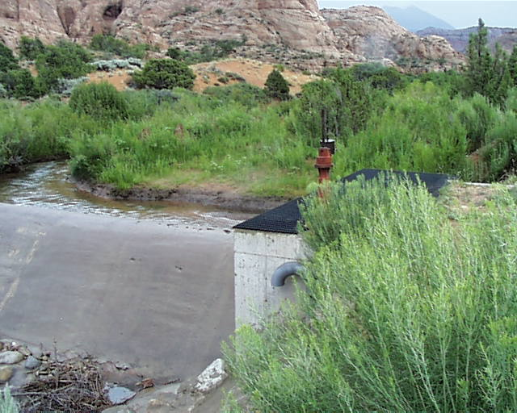
Application
An application for water reuse will include:
  A description of the water right;
  The diversion, depletion, and return flow requirements;
  The quantity of water
Notes:
An Application for reuse will include:
A description of the underlying water right
An evaluation of the diversion, depletion, and return flow requirements
The proposed Quantity of water to be reused

Slide 19
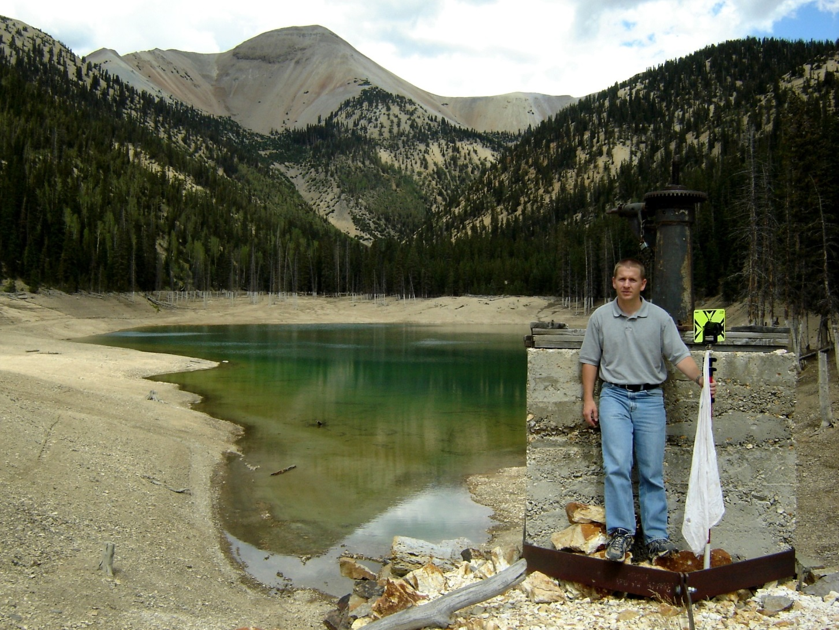
QUESTIONS?

