Slide 1



Utah Division of Water Rights
Distribution
RWAU Training—April 2021
David Horsley
Distribution Engineer, Field Services

Slide 2

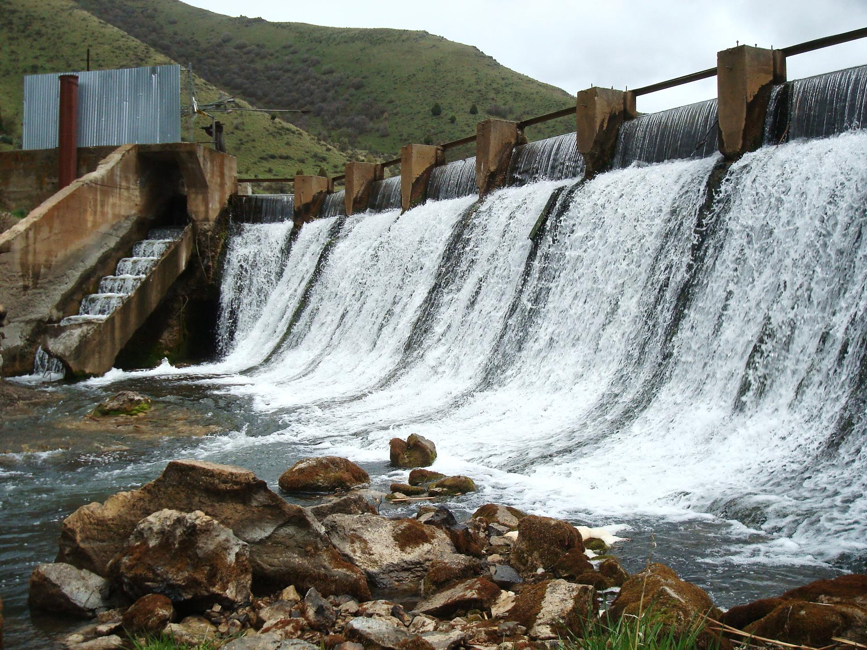
Distribution Systems

Slide 3
Distribution System
Definition:
A geographic area in which a water user receives water from a natural source, from which they are legally entitled to (i.e. a water right based on prior appropriation doctrine) , under the direction of a state appointed river commissioner, in quantities of acre feet or cubic feet per second.

Slide 4
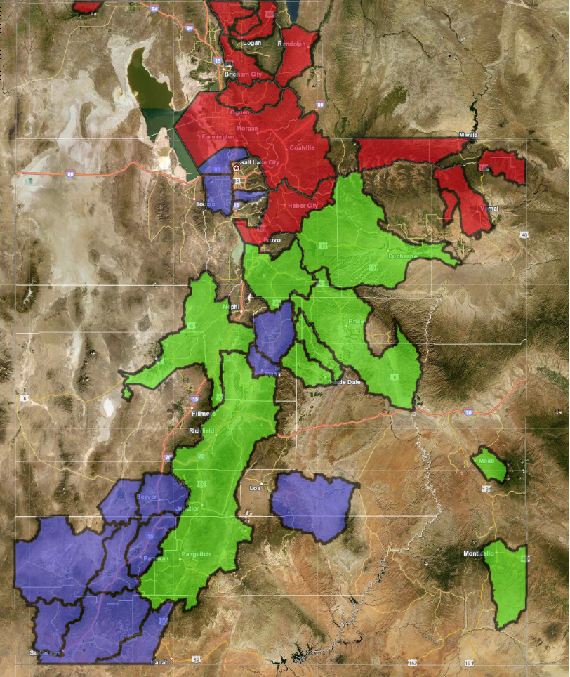
Distribution
System
Distribution Engineers:
Sue Odekirk
Mike Silva
Dave Horsley

Slide 5
Distribution System
Authority:
Composition:
Counties and Cities
District Courts
State Engineer (since 1919)
Water Users
Distribution System Committee
Water Commissioner(s)
State Engineer

Slide 6
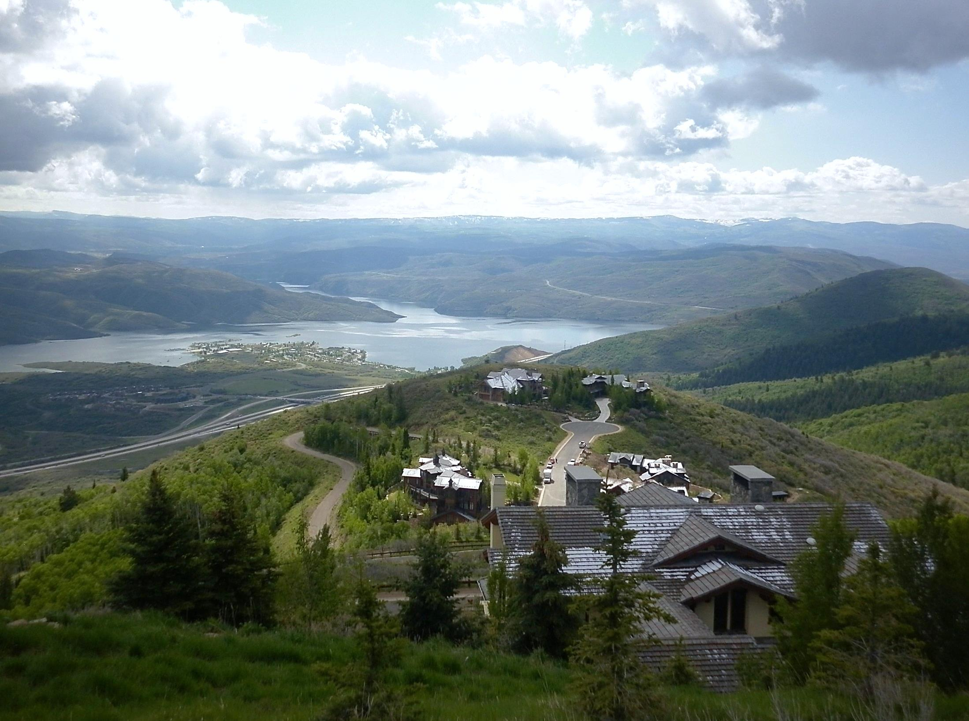
Responsibilities

Slide 7
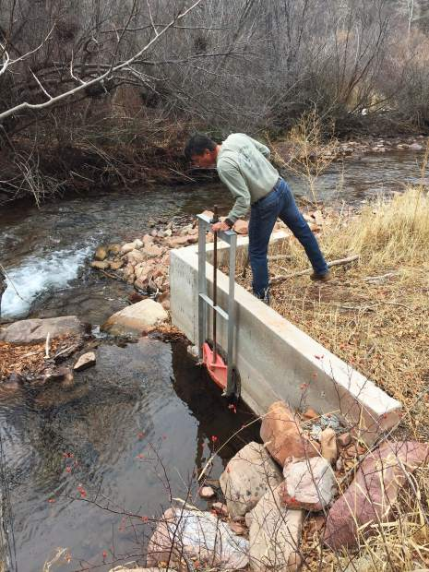
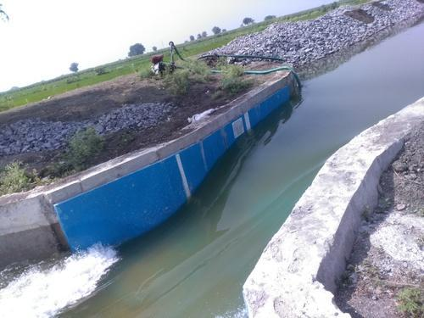
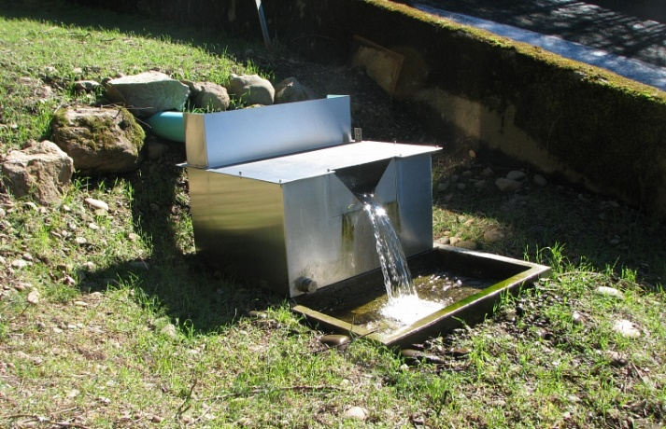
Water Users Responsibilities
Maintain an adequate measuring device and controlling works (head gate)

Slide 8

Water Users Responsibilities
Elect Distribution System Committee representative

Slide 9

Water Users Responsibilities
Pay annual assessment to help cover distribution system costs
(i.e. a user fee based on service received from a water commissioner)
- salary for commissioner
- mileage
- supplies

Slide 10

Committee Responsibilities
Represent water users at annual distribution meeting
(i.e. municipal, industrial, upper, middle, lower)

Slide 11

Committee Responsibilities
Set annual budget
- commissioners salary
- commissioners mileage
- various supplies

Slide 12

Committee Responsibilities
Set annual assessment amount
Assessment spread across all water users
- typically percentage based on either
1) water right 2) yearly usage 3) five yr. rolling avg.

Slide 13

Committee Responsibilities
Select new water commissioner (if necessary)
- by distribution committee majority
- appointed on a four year term
- approved by state engineer

Slide 14
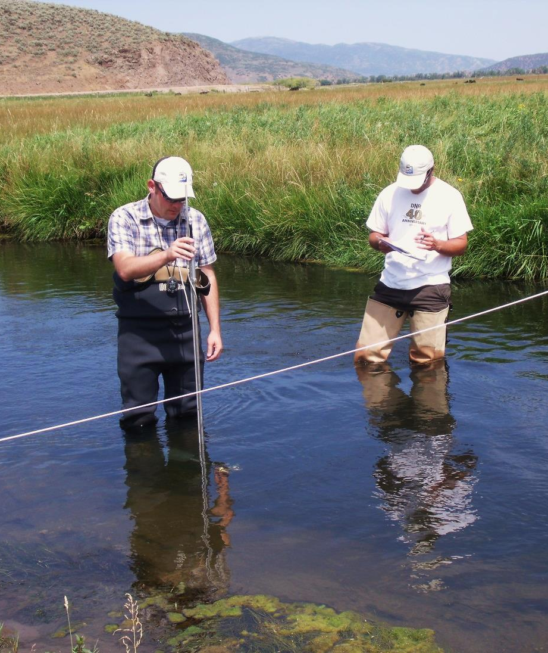
Commissioner Responsibilities
Distribute water in accordance with water rights and prior appropriation doctrine
(first in time, first in right)

Slide 15
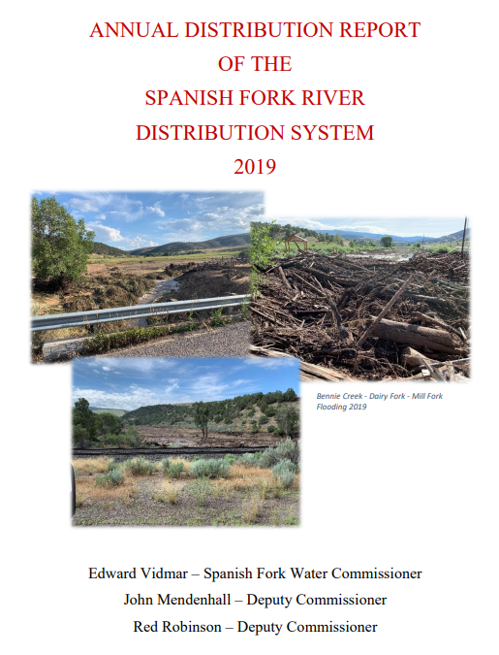
Commissioner Responsibilities
Keep a record of diversions and produce an annual report showing a record of diversions and decisions made

Slide 16
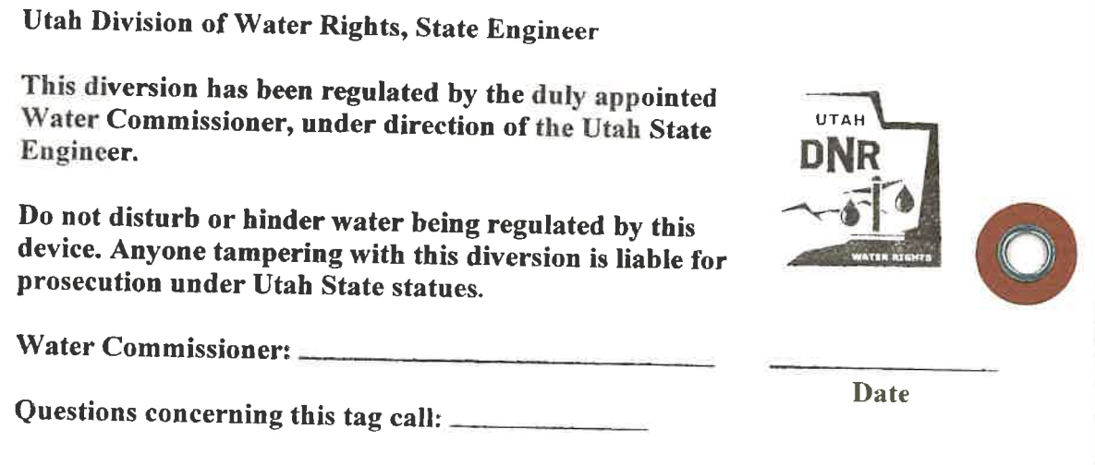
Commissioner Responsibilities
Lock and/or tag diversion structures
The White Tag

Slide 17
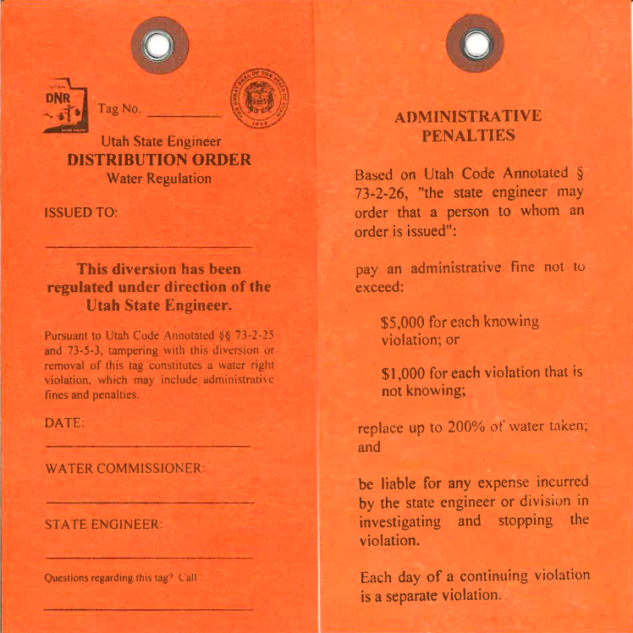
Commissioner Responsibilities
Lock and/or tag diversion structures
The Red Tag
Front Back

Slide 18
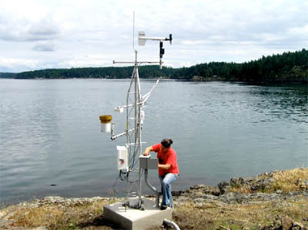

Commissioner Responsibilities
Perform other duties as agreed upon by the water users and state engineer
(Telemetry, internet models)

Slide 19
State Engineer Responsibilities
Appoint commissioner upon recommendation of a majority distribution committee members
Manage the water commissioner fund
Bill and collect the assessments
Train and direct commissioner in distributing water in accordance with water rights

Slide 20
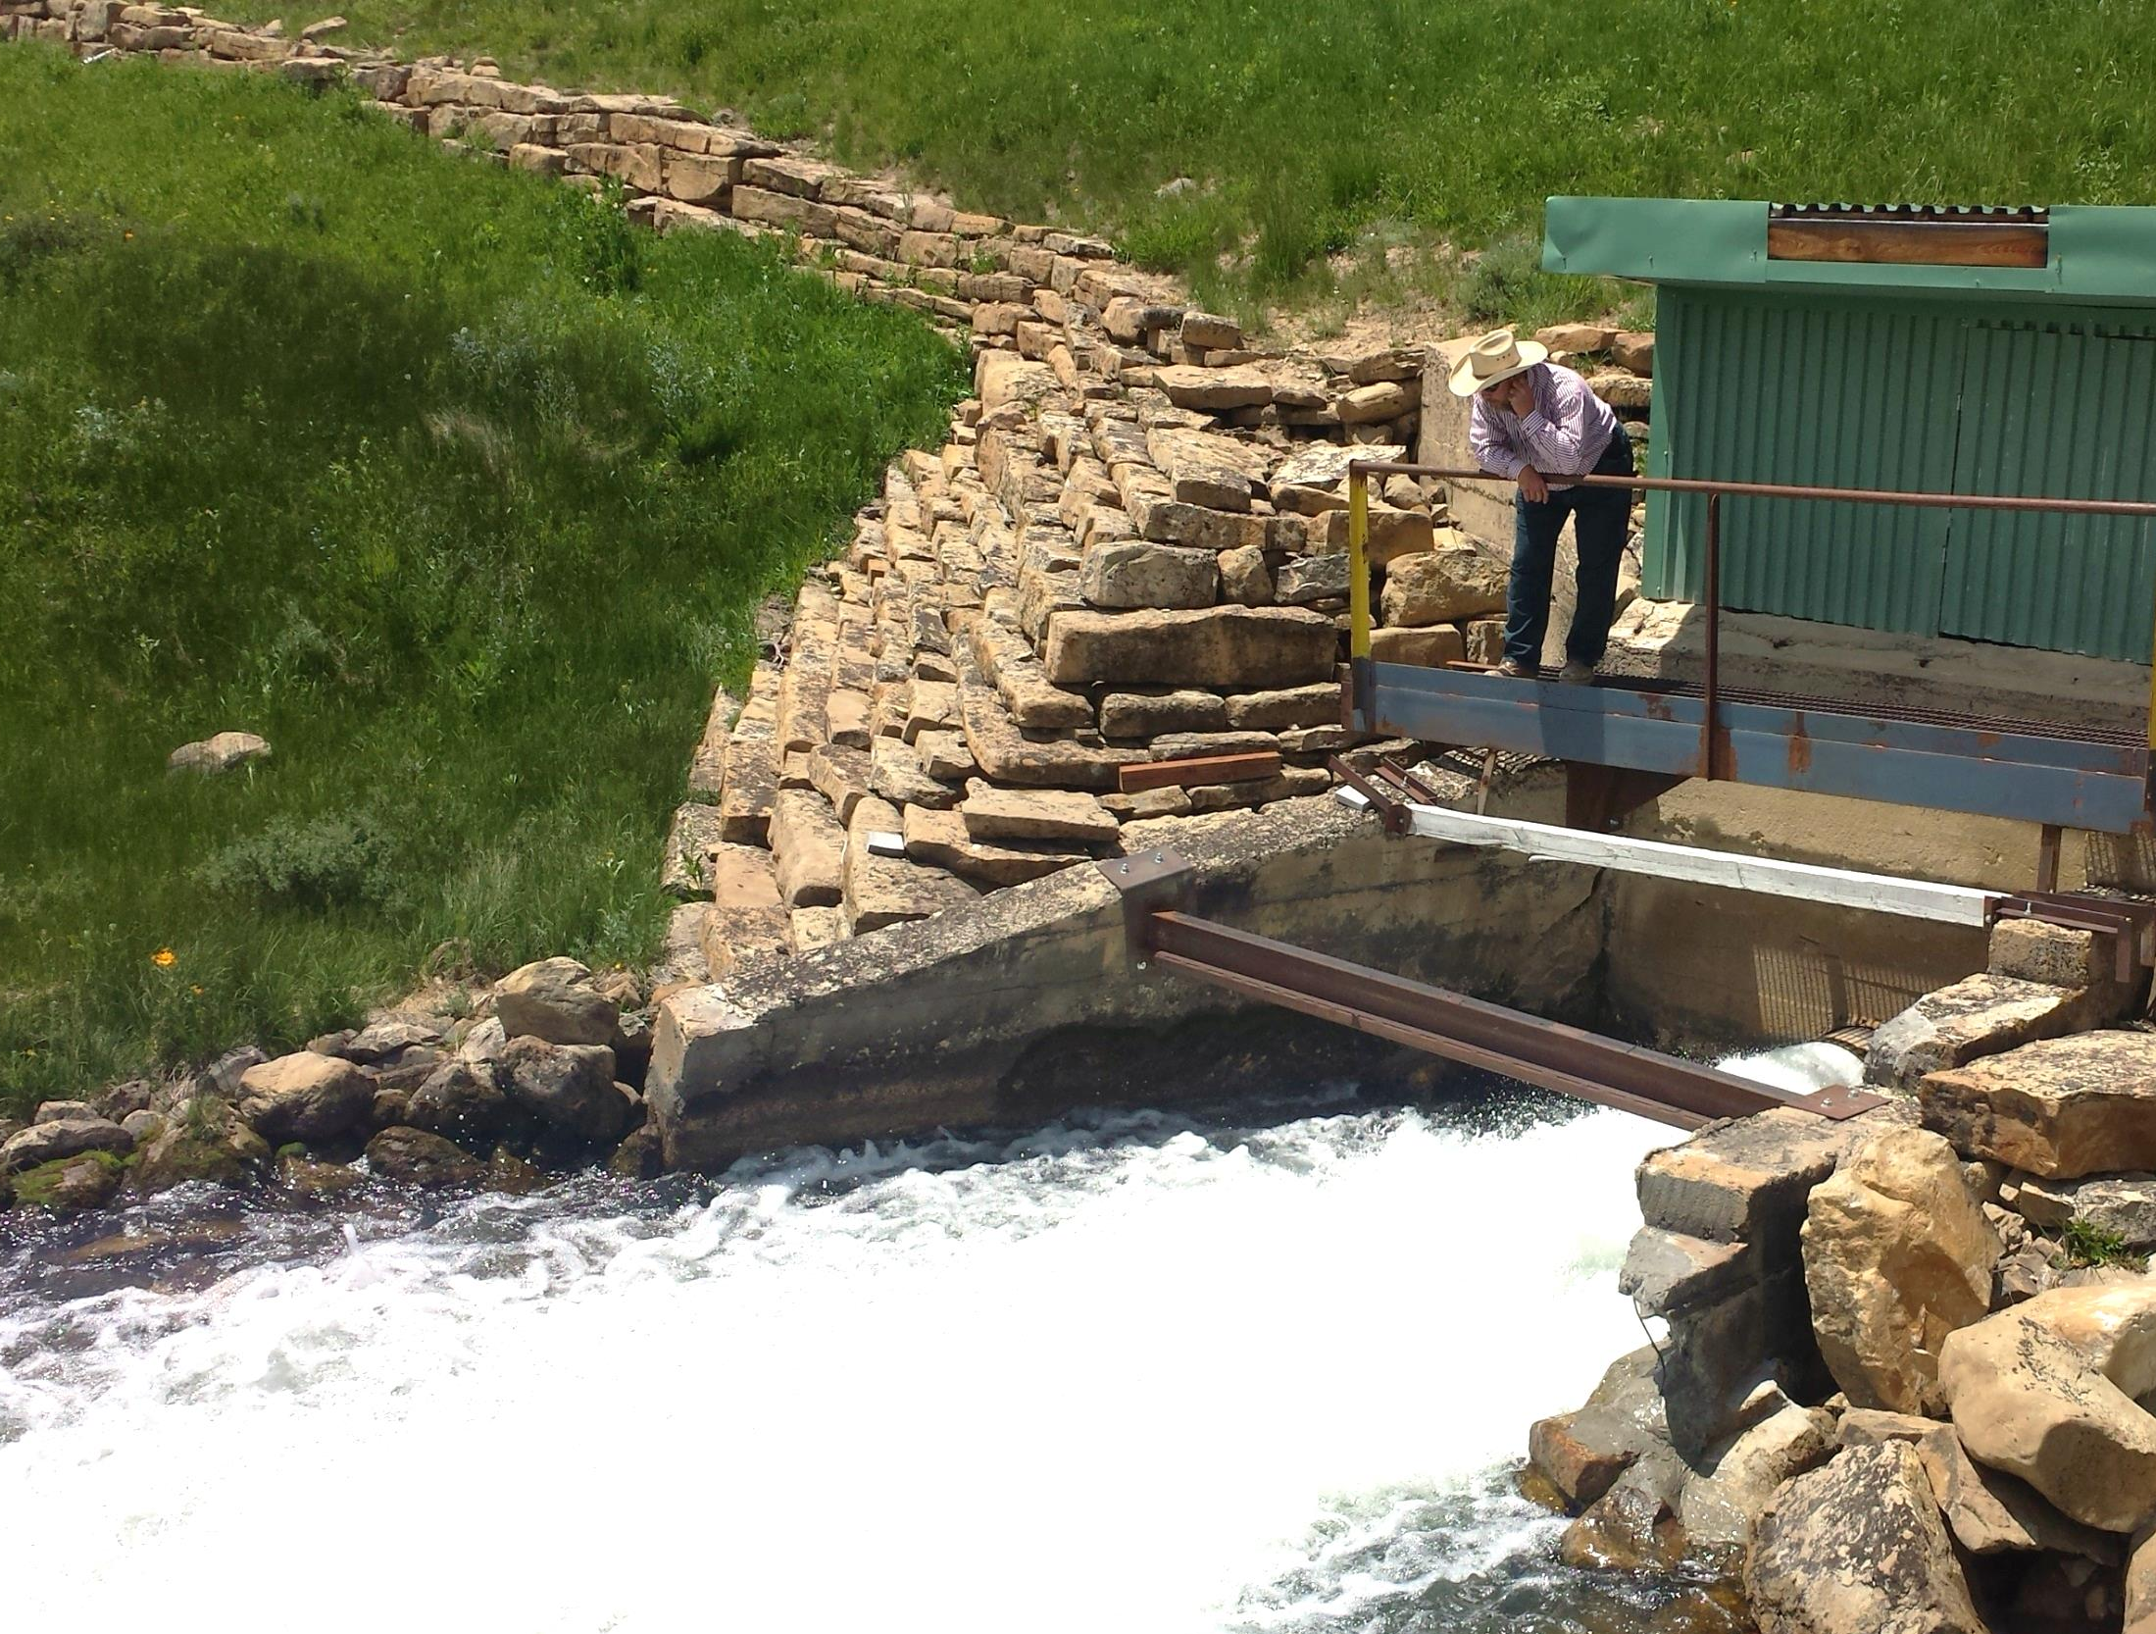
Questions?

