Slide 1


Utah Division of Water Rights
Advanced Water Right Topics
Rural Water Training—April 2021
Eric Jones, P.E.
Weber River / Western Regional Engineer
June 21, 2004
Notes:
Introduction

Slide 2
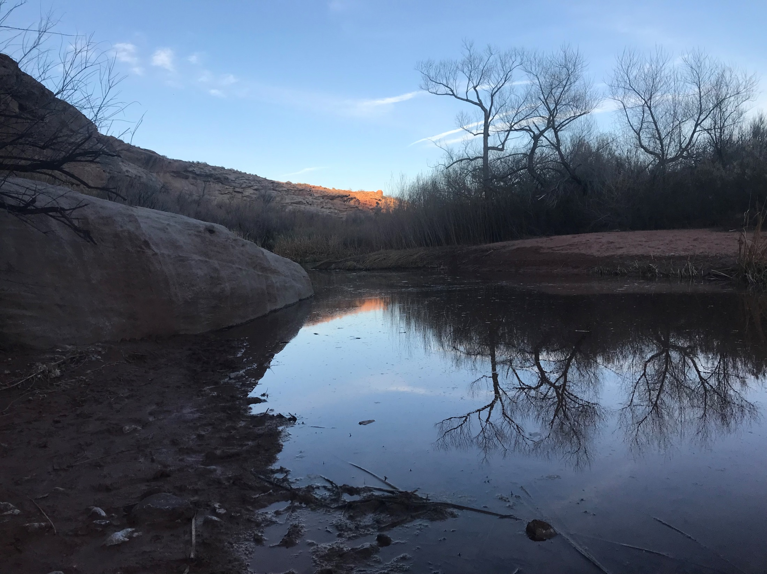
Advanced Water Right Topics
Not the day-to-day
Notes:
We’re going to talk about some advanced water rights topics.
These are topics that don’t come up on every application and only come into play in certain circumstances.

Slide 3
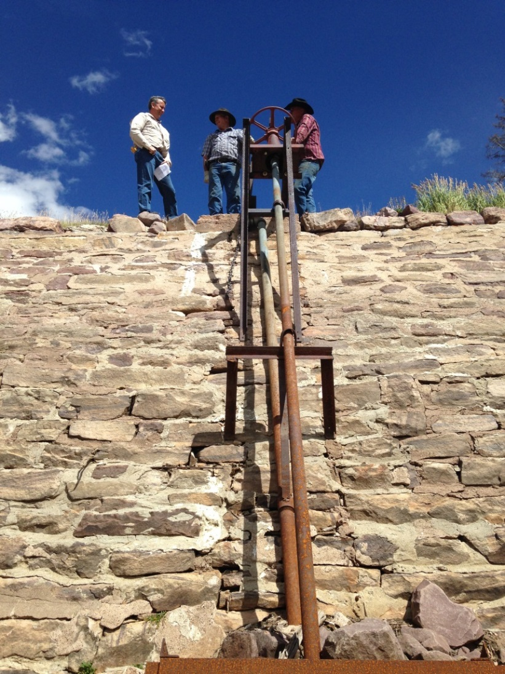
Topics to be Covered:
Forfeiture
Nonuse
  Nonuse Application
Rebuttable Presumption of Quantity Impairment due to Nonuse
Notes:
These are the topics that we will cover.
We’re going to talk about Forfeiture.
We’re going to talk about nonuse and the nonuse application.
Rebuttable Presumption of Quantity Impairment due to Nonuse.
These topics revolve around the concept of nonuse.

Slide 4
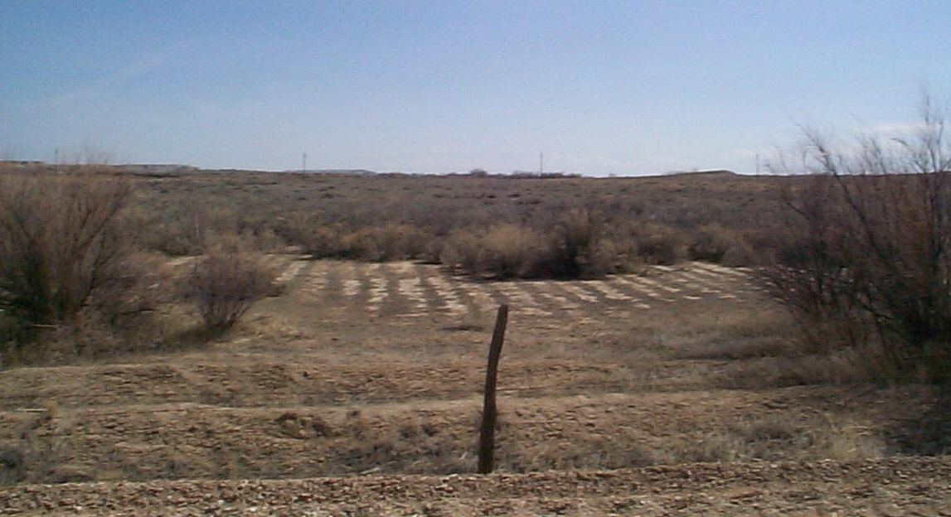
Nonuse Leads to Forfeiture
UC 73-1-4(2)(a)
…when an appropriator…abandons or ceases to beneficially use all or a portion of a water right for a period of seven years, the water right or the unused portion of that water right is subject to forfeiture.
Notes:
UC 73-1-4 is where you go to find statutes regarding forfeiture and nonuse
Forfeiture is a fundamental concept of the doctrine of prior appropriation.
This concept is sometimes referred to by the phrase “Use it or lose it”
However, there are many misunderstandings that revolve around that phrase and this concept.
Let’s see if we can dispel some of them
In subsection (2)(a) we find the relationship between nonuse and forfeiture.
I’ve underlined two parts of this statute.
First we get a definition of nonuse
Statutorily nonuse only becomes a problem when it is done for 7 years.
Next we get the phrase “Subject to forfeiture”
The phrase “subject to…” teaches an important principle as it relates to the State Engineer.
*Test Question on how many years to be “subject to forfeiture.”*
NEXT SLIDE

Slide 5
Forfeiture
UC 73-1-4
  Key Facts:
    Forfeiture is a judicial proceeding.
      Administrative vs Judicial Action
    The State Engineer does not declare water rights forfeited. (A judge does)
    Forfeiture proceeding must be filed within 15 years of the latest period of nonuse of at least 7 years.
      Plus any approved nonuse periods.
    If forfeited, the lost water right reverts to the public.
      Available in priority
      Available to appropriate
    Database Status: Terminated or Disallowed
Notes:
Forfeiture is a judicial proceeding
Administrative means actions taken by the State Engineer.
There are some administrative actions where the concept of nonuse applies. Forfeiture is not one of these. We will discuss these later.
*Test question about whether forfeiture is an administrative action.* 15 YEARS
The State Engineer does not have power to declare water rights forfeited.
Only a judge does.
In adjudications, forfeiture does occur, but again, this is with the involvement of the judiciary.
Even with judicial forfeiture, there are timeline limitations.
Water rights aren’t forever subject to forfeiture because of a period of nonuse.
Must be filed within 15 years of the latest period of nonuse.
***Plus any approved nonuse application periods.
*Test question about number of years*
What happens when a water right is forfeited?
Reverts to the public.
It is available in priority. (i.e. others that would have limited diversion may not now)
Available to appropriate (if the area is open)
Important: The winner of the forfeiture suit does not get the water right.
Possible Questions:
What happens in the database when a right is forfeited?
Isn’t having a forfeited right available in priority an enlargement of other rights? No. We over-appropriate to allow the maximum use of water.

Slide 6
Forfeiture
UC 73-1-4
  Who files the lawsuit?:
    An aggrieved party (i.e. an adjacent water user)
    The State Engineer, most typically in the course of a general adjudication.
  Forfeiture in Adjudication
    Water User’s Claim may be disallowed by court
    Same result as forfeiture
    A decree bars claims of forfeiture for prior nonuse for rights determined to be valid in the decree
Notes:
A bit more about forfeiture.
Who typically files a forfeiture lawsuit?
An aggrieved party
State Engineer can file a forfeiture lawsuit. Most typically this is in an adjudication.
Forfeiture in adjudication
More on this in another section.

Slide 7
Exceptions to Nonuse
UC 73-1-4(2)(e)
  Approved Nonuse Application
  Lease
  Government Fallowing Program
  Insufficient Water
    Reduced flow due to drought
  Priority Cuts
Notes:
MOVE QUICK
State Statute recognizes several instances where nonuse is excused.
These are very important, because they touch several aspects of water law as it relates to nonuse and to the Rebuttable Presumption of Quantity impairment.
What is the precise definition for all of these? IDK. All are open for interpretation. This is why forfeiture is a judicial action. Get a good attorney.
Approved Nonuse Application – more on this next
Lease
Fallowing Program
Insufficient Water – reduced flow due to drought *Test Question – Explain this one well* IF YOU CAN PROVE THAT WATER IS NOT AVAILABLE FOR SAY 10 YEARS AND THE WATER IS USED WHEN AVAILABLE YOU ARE PROTECTED FROM NONUSE
Priority Cuts – Similar to #4 above, but suggests a distribution system where commissioner cuts rights by priority.

Slide 8
Exceptions to Nonuse, Cont’d
UC 73-1-4(2)(e)
  Water Storage (surface or groundwater recharge project)
  Substantially all of the water was used
  Public Water Supplier
    Must have been acquired before May 5, 2008 or if not, had change application approved.
  Supplemental Water Rights
  Diligently Pursuing a Change Application
Notes:
MOVE QUICK
Water storage (surface or groundwater recharge project) – some conditions on this one.
Substantially all of the water was used (doesn’t apply to adjudications)
Public Water Supplier – water right must have been acquired prior to May 5, 2008 (Ross talked about this one in the last presentation)
This applies for water rights acquired after May 5, 2008 if a change application has been approved by the S.E.
Supplemental Water Rights – This one was brought up yesterday.
Diligently Pursuing a Change Application.

Slide 9
Nonuse Applications
UC 73-1-4(2)(b)
Approved nonuse application:
  Protects from nonuse during the period from filing to expiration.
  Does not protect a water right that is already subject to forfeiture.
  Does not constitute beneficial use.
Notes:
I’ve mentioned the nonuse application and it was the first exception in the list we just covered.
Statute recognizes that there may be times, not covered by the list of exceptions, when a water user can not use a water right.
What does a nonuse application do? Approved nonuse application:
Protects from nonuse – Only for period from filing to expiration.
*Test Question* Repeat this point A NONUSE APPLICATION PROTECTS A WATER RIGHT FROM THE DATE OF FILING
Does not protect a right that is already subject to forfeiture.
Remember the time criteria? 15 years plus the period covered by a nonuse application.
*Test Question* IF A WATER RIGHT IS ALREADY SUBJECT TO FORFEITURE NONUSE APPLICATION DOES NOT PROTECT IT
Does not constitute beneficial use. (Maybe this is reference to submitting proof? Can’t submit proof unless there is bene. Use.)
Proof due date remains (if applicable). Must submit proof or for extension of time.

Slide 10

Nonuse Applications
UC 73-1-4(2)(b)
Nonuse applications may be filed on all or a portion of the right by:
  An Appropriator or the appropriator’s successor in interest
  Application does not constitute beneficial use
  A Shareholder
    on the water represented by the stock owned after giving written notice to the company.
Notes:
Nonuse applications can be filed by
An Appropriator
Appropriator’s successor in interest
Cannot file nonuse application after nonuse application to constitute beneficial use of water
A shareholder – must give written notice to company

Slide 11

UC 73-1-4(4)
The state engineer shall grant a nonuse application…if the applicant shows a reasonable cause for nonuse.
Notes:
The State Engineer may approve or reject nonuse applications.
For the State Engineer to approve, the applicant must demonstrate a reasonable cause for nonuse.
Statute has defined what reasonable cause includes: (NEXT SLIDE)

Slide 12
Reasonable causes for nonuse include:
Demonstrable financial hardship or economic depression;
Physical causes that render use beyond reasonable control
Water conservation or efficiency practices or a groundwater Recharge / recovery program;
Operation of legal proceedings;
Water held by any water supply entity to meet the reasonable future requirements of the public;
Where nonuse will assist implementation of a water management plan;
Loss of capacity due to deterioration of the water supply equipment if accompanied by plan to restore use.
Notes:
Statute has defined what reasonable cause includes:
Please note that this slide replaces two in your packet and it is slightly different. The old slides were incomplete and didn’t precisely follow statute.
*TEST QUESTION*
Financial Hardship or Economic Depression
Physical Causes that render use beyond reasonable control
Water Conservation/Efficiency or Groundwater Recharge and Recovery Program
Legal Proceedings
Water held by a water supply entity for future requirements of public
Where nonuse will assist implementation of a water management plan
Loss of capacity due to deterioration of water supply equipment. Must include plan.
It is not is a someone no longer wants to operate the farm.
The way the statute is worded, these are examples of reasonable causes, but there may be others.

Slide 13
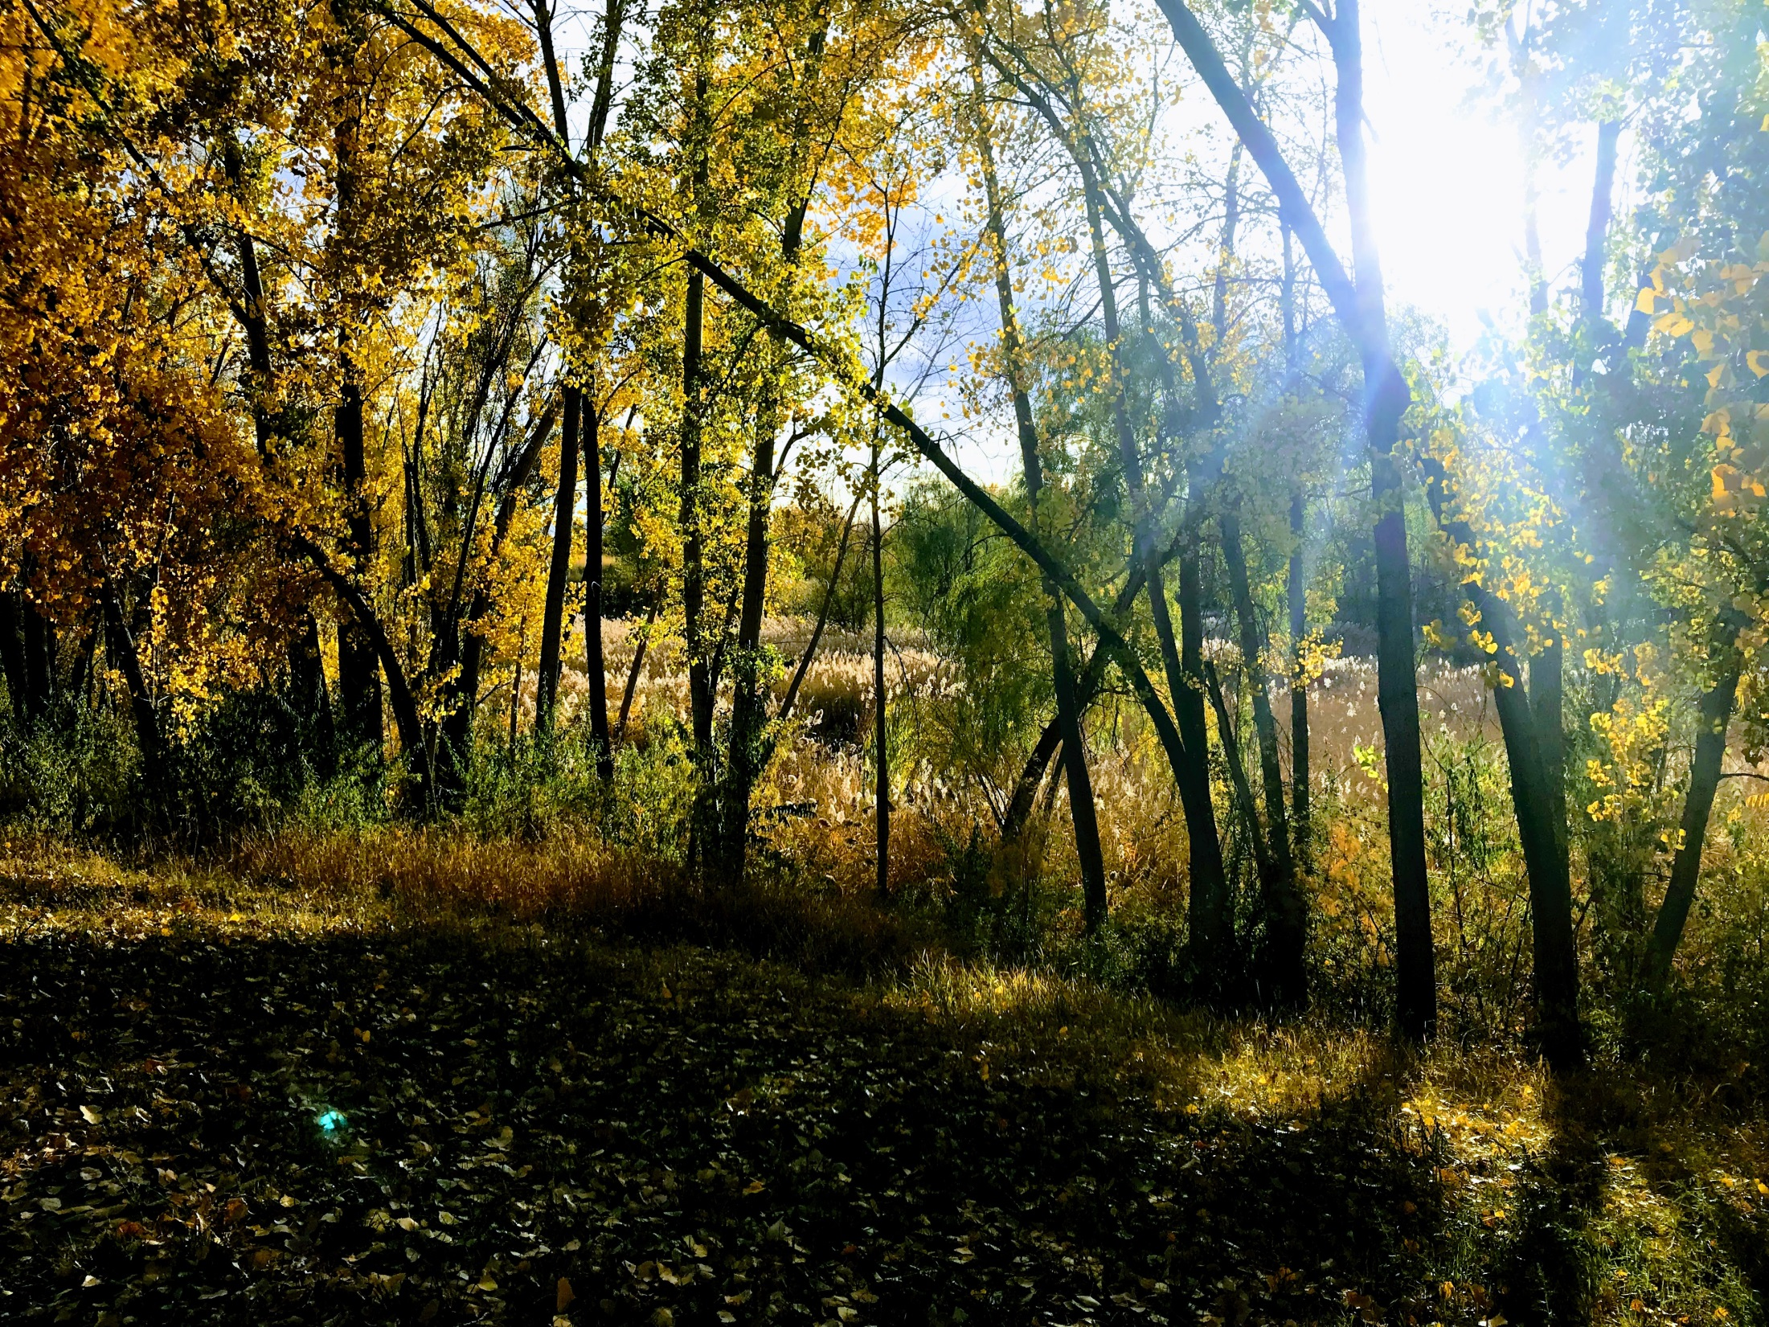
Quantity impairment

Slide 14
Approval Criteria
  for Change Applications
    Statutory Basis Utah Code 73-3-3 and 73-3-8
Quantity Impairment – a reduction in the amount of water available to an existing right if the change application were approved. (UC 73-3-3(1)(c))
  Diminished quantity of water
  Change in timing of water
  Enlarged the quantity of water depleted
Notes:
Let’s do a little review of what quantity impairment is. This was talked about yesterday when discussing approval criteria for change applications.
Note that quantity impairment is limited to change applications.
Quantity Impairment is a new term that came into the statute in 2015, but represents an concept that has been part of the State Engineer’s practice for a long time.
Other similar terms: Simply “Impairment” or “Interference”.
This slide takes us back to the very fundamental definition of quantity impairment.
Quantity impairment is
diminishing quantity of water,
change in timing
Enlarging the depletion
Does not say anything about nonuse…yet.
Quantity impairment and nonuse are not interchangeable terms.
Note that this is talking about quantity impairment of an existing right.
As defined, basic quantity impairment protects senior priority rights from the effect a junior right may have in a change application proceeding.
In short, this says that, in a change application, you can’t do something that will detrimentally harm someone who was already there.

Slide 15
In a Change Application Proceeding:
  Statutory Basis: Utah Code 73-3-3 and 73-3-8
  73-3-3(5) The applicant bears the burden of producing evidence that the change can be made including…
    Change will not cause a specific right to experience quantity impairment.
    Rebutting the presumption of quantity impairment.
Notes:
Let’s talk about quantity impairment and how it affects a typical change application proceeding:
This is a key fact to understand:
The applicant bears the burden of showing the change can be made, but it also brings two additional criteria into play.
Change will not cause a specific right to experience QI – (For example, the change will not impair a senior right)
What sort of evidence?
Show that there is enough water for you and the senior water right.
Rebutting the presumption of QI. (This second criteria is where the idea of nonuse comes in)
What sort of evidence?
We’ll get into this later.
Before we go deeper, it is really important to understand that we have two separate ideas presented in this statute. (NEXT SLIDE)

Slide 16
Quantity Impairment
Applicant’s Burden to
Produce Evidence
A
B
Quantity Impairment:
Standard Approval Criteria for
all Change Applications
Rebuttable Presumption
of Quantity Impairment:
Due to Nonuse
Notes:
This is a graphical representation of the statute we just read.
We talked about how A is a more generalized type of impairment. It has nothing to do with nonuse.
B is where we’re going to be spending the rest of our time.
The Blinking B is there to reinforce the idea that we are talking about “Rebuttable Presumption of Quantity Impairment Due to Nonuse”
Any questions?

Slide 17
The Rebuttable Presumption of Quantity Impairment is how the State Engineer can consider nonuse during the change application process.
UC 73-3-8(6)(c)
  There is a rebuttable presumption of quantity impairment…to the extent that, for a period of at least seven consecutive years, a portion of the right identified in a change application has not been:
    Diverted from the approved point of diversion; and
    Beneficially used at the approved place of use.
In short:
  If you haven’t been using the water like you should, the presumption of quantity impairment may apply.
Notes:
So what is the Rebuttable Presumption of Quantity Impairment?
This is how the S.E. can evaluate nonuse during the change application process.
This is also how a junior water right can experience quantity impairment from a senior water right that is not being used.
This seems contrary to water rights basics.
Priority is everything…right? Not when it comes to nonuse.
As Will Atkin presented yesterday, priority doesn’t have absolute power in the State of Utah. It is tempered by the idea of beneficial use.
When there isn’t beneficial use, even of a senior water right, the rights of a junior water right might need to be protected.
Rebuttable Presumption of Quantity Impairment is how this is done.
Why can’t a senior right be impaired by a junior water right that is not being used?
The senior right has priority over the junior water right anyway.
However, a junior water right may have come to rely on the senior water right’s nonuse.
Thus in this case there is a presumption of quantity impairment.
Let’s read the statute that defines when a rebuttable presumption of QI arises.
IN SHORT: If you haven’t been using the water like you should be, the presumption of quantity impairment may apply.

Slide 18
Who can raise the rebuttable presumption of quantity impairment?
  State Engineer within 90 days of filing.
  Protestant in a timely protest.
  Must identify water right that will experience quantity impairment.
Administrative proceedings:
  Letter sent advising applicant of rebuttable presumption.
  Hearings may be held
Notes:
Administrative Procedures for Rebuttable Presumption of Quantity Impairment
Who can raise it?
State Engineer
Protestant
Must identify water right. Water right must be a junior right.
What the Division does:
If raised by the S.E., a letter is sent stating so and applicant is advised that they must respond. They bear the burden.
If raised by a protestant, a letter will be sent stating that it is the S.E. opinion that the rebuttable presumption of QI has been raised.
May hold hearings.
Response is necessary – Perhaps a discussion of standard of proof. Varies according to the strength of the allegation.
Let’s dive into an example to help with our understanding:

Slide 19
How do you Rebut?
The Rebuttable Presumption of Quantity Impairment does not apply if excused by:
  Subsection 73-1-4 (2)(e) - Exceptions to Nonuse
  An approved nonuse application
  Subsection 73-3-30(7) – Instream Flow
  Passage of Time 73-1-4(2)(c)(i) – Remember this from earlier? Nonuse period of 7 consecutive years must have occurred within the last 15 years (or 15 years prior to the filing of a nonuse application)
Notes:
I told you earlier we would talk about how one would rebut the presumption:
Statute tells us:
Exceptions: remember these from earlier? Just a minute and we’ll see them again.
Nonuse Application: We already talked about this one too.
Instream Flow: Not going to go too deep into this one.
Passage of Time: Can’t go back in time for decades to dig up old skeletons. 15 years is the limit.
The one exception is 15 years prior to a nonuse application.
Now, let’s go into detail on the exceptions: (EXCEPTIONS BLINK)

Slide 20
The Rebuttable Presumption of Quantity Impairment does not apply if excused by:
  Subsection 73-1-4(2)(e) – Exceptions to Nonuse; Remember these from earlier?
Lease
Fallowing Program
Insufficient Water
Priority Cuts
Water Storage
Substantial use
Public Water Supplier
Supplemental Water Right
Diligently Pursuing a Change Application
  More on next slide…
Notes:
We discussed these previously. Any questions on any of them?
Some exceptions are more common than others.
Some exceptions are more rare and I don’t have much experience with.
Let’s talk about two of them. (NEXT SLIDE)

Slide 21
More on a couple exceptions:
  Leases - A common response when presumption is raised. Items to consider:
    Written documentation is required.
    Can the use be terminated?
  Public Water Supplier – UC 73-1-4(2)(g)
    Must have been acquired prior to May 5, 2008.
    If so, protected from forfeiture and rebuttable presumption of quantity impairment.
    If not, rebuttable presumption may apply.
Notes:
These are two of the more common responses to Presumption of QI
Leases:
Common response
Written best
Can use be terminated?
This one is a recognition that applicants sometimes move water rights without a change application.
While the move might be illegal use, it may rebut the presumption of quantity impairment due to nonuse.
Remember, the presumption is premised on causing quantity impairment
diminished quantity
Changed timing
Increased depletion
If none of those have occurred, the presumption may be rebutted.
Public Water Supplier:
This is one of those nonuse protections that Public Water Supplier’s have.
Let’s test your understanding with some scenarios.

Slide 22
Scenario 1: Farmer Bob files a change application on a water right with an 1890 priority date. The historical place of use is now a Walmart parking lot and has been for 10 years. A protest has been submitted alleging quantity impairment due to nonuse. Protestant’s water right has an 1910 priority.
Has a rebuttable presumption of quantity impairment been raised?
Could basic quantity impairment be an issue?
Notes:
Let’s test your understanding with some scenarios.
Answer: Rebuttable presumption of QI has been raised.
Answer: Basic quantity impairment could be an issue.

Slide 23
Scenario 1a: Farmer Bob files a change application on a water right with an 1940 priority date. The historical place of use is now a Walmart parking lot and has been for 10 years. A protest has been submitted alleging quantity impairment due to nonuse. Protestant’s water right has an 1910 priority.
Has a rebuttable presumption of quantity impairment been raised?
Could basic quantity impairment be an issue?
Notes:
Let’s test your understanding with some scenarios.
Answer: Rebuttable presumption of QI has not been raised.
Answer: Basic quantity impairment could be an issue.

Slide 24
Scenario 2: A change application is filed on a water right in 2021. An approved nonuse application was filed in 2015. It is clear and obvious the water right had not been used for more than seven years prior to 2015.
Can someone raise rebuttable presumption of quantity impairment?
Notes:
Let’s test your understanding with some scenarios.
Answer: Yes
The nonuse application does not constitute beneficial use. The seven-year period is seven years prior to the filing of the nonuse application.
The applicant should submit evidence of use either with the nonuse application or the change application.

Slide 25
Things to Consider: Let’s say someone files a change application today on a water right appurtenant to land that is now a big box store built in 1996.
The big box store may own the water right, check the deeds.
A person can verify if a nonuse application has been filed by checking the records of the State Engineer
It’s been more than 7 years, we may raise the flag of rebuttable presumption of quantity impairment

Slide 26
What to do?
  Don’t ignore. Applicant bears the burden.
  Is nonuse excused? UC 73-1-4
  Preemptive Strike - Make your case in the change application.
    Explanatory – was there a lease?
    Heretofore Map – what will be retired?
Notes:
What to do….
Don’t ignore. Applicant bears the burden
Is nonuse excused?
Has any water been used. Sometimes these result in partial approvals
Preemptive Strike
Explanatory
Heretofore Map

Slide 27
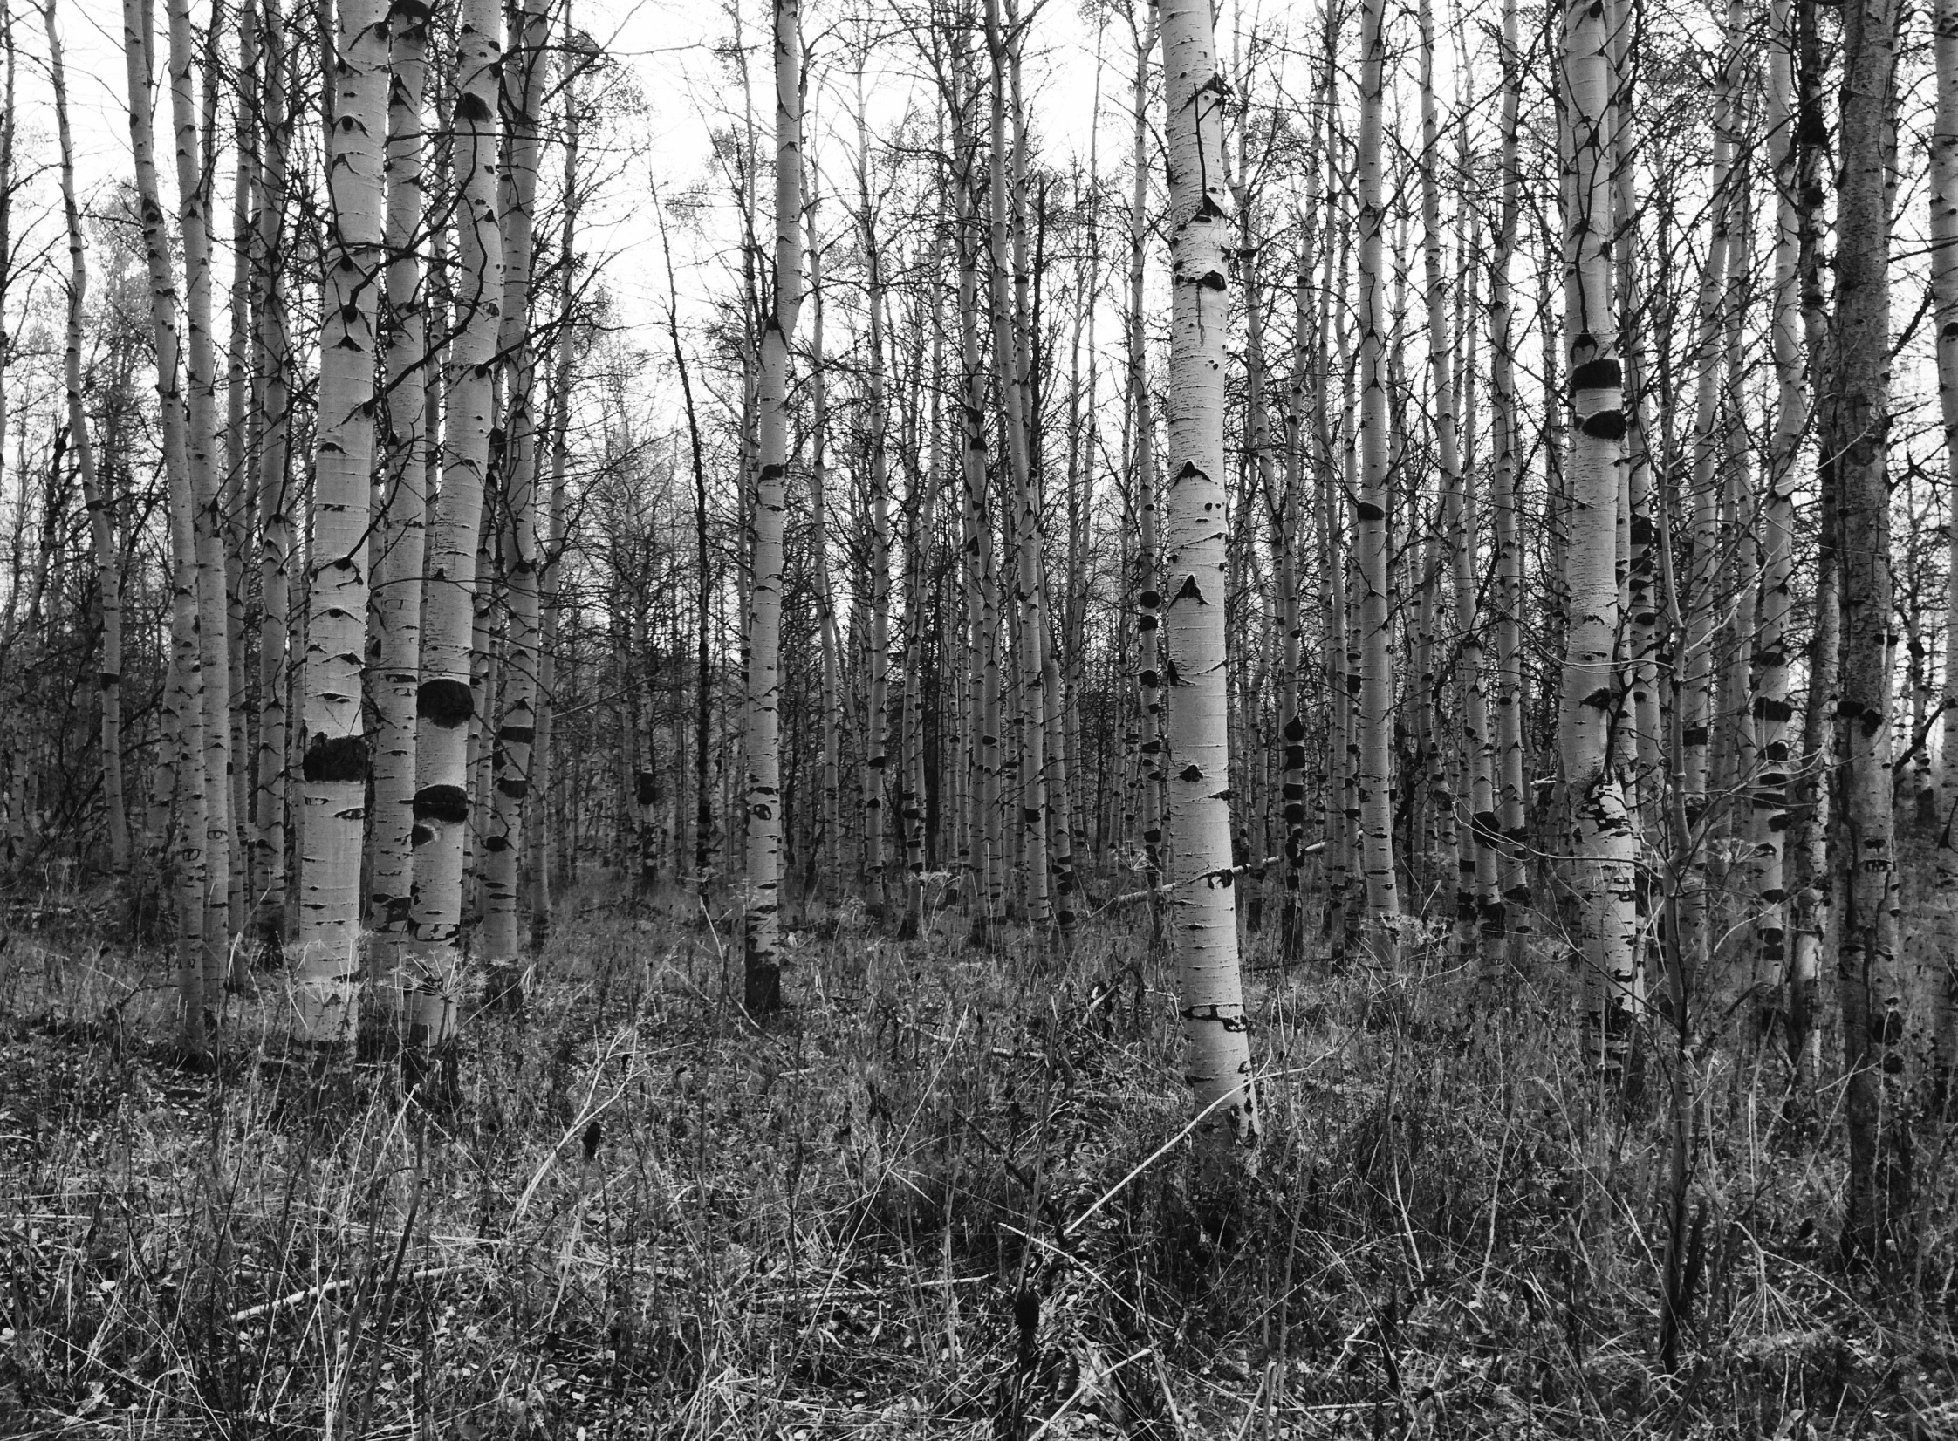
Questions?

