Slide 1


Utah Division of Water Rights
Water Use Groups and Supplemental Rights
RWAU Training—April 2019
Clark Adams, N.I.B.M.N.
June 21, 2004

Slide 2
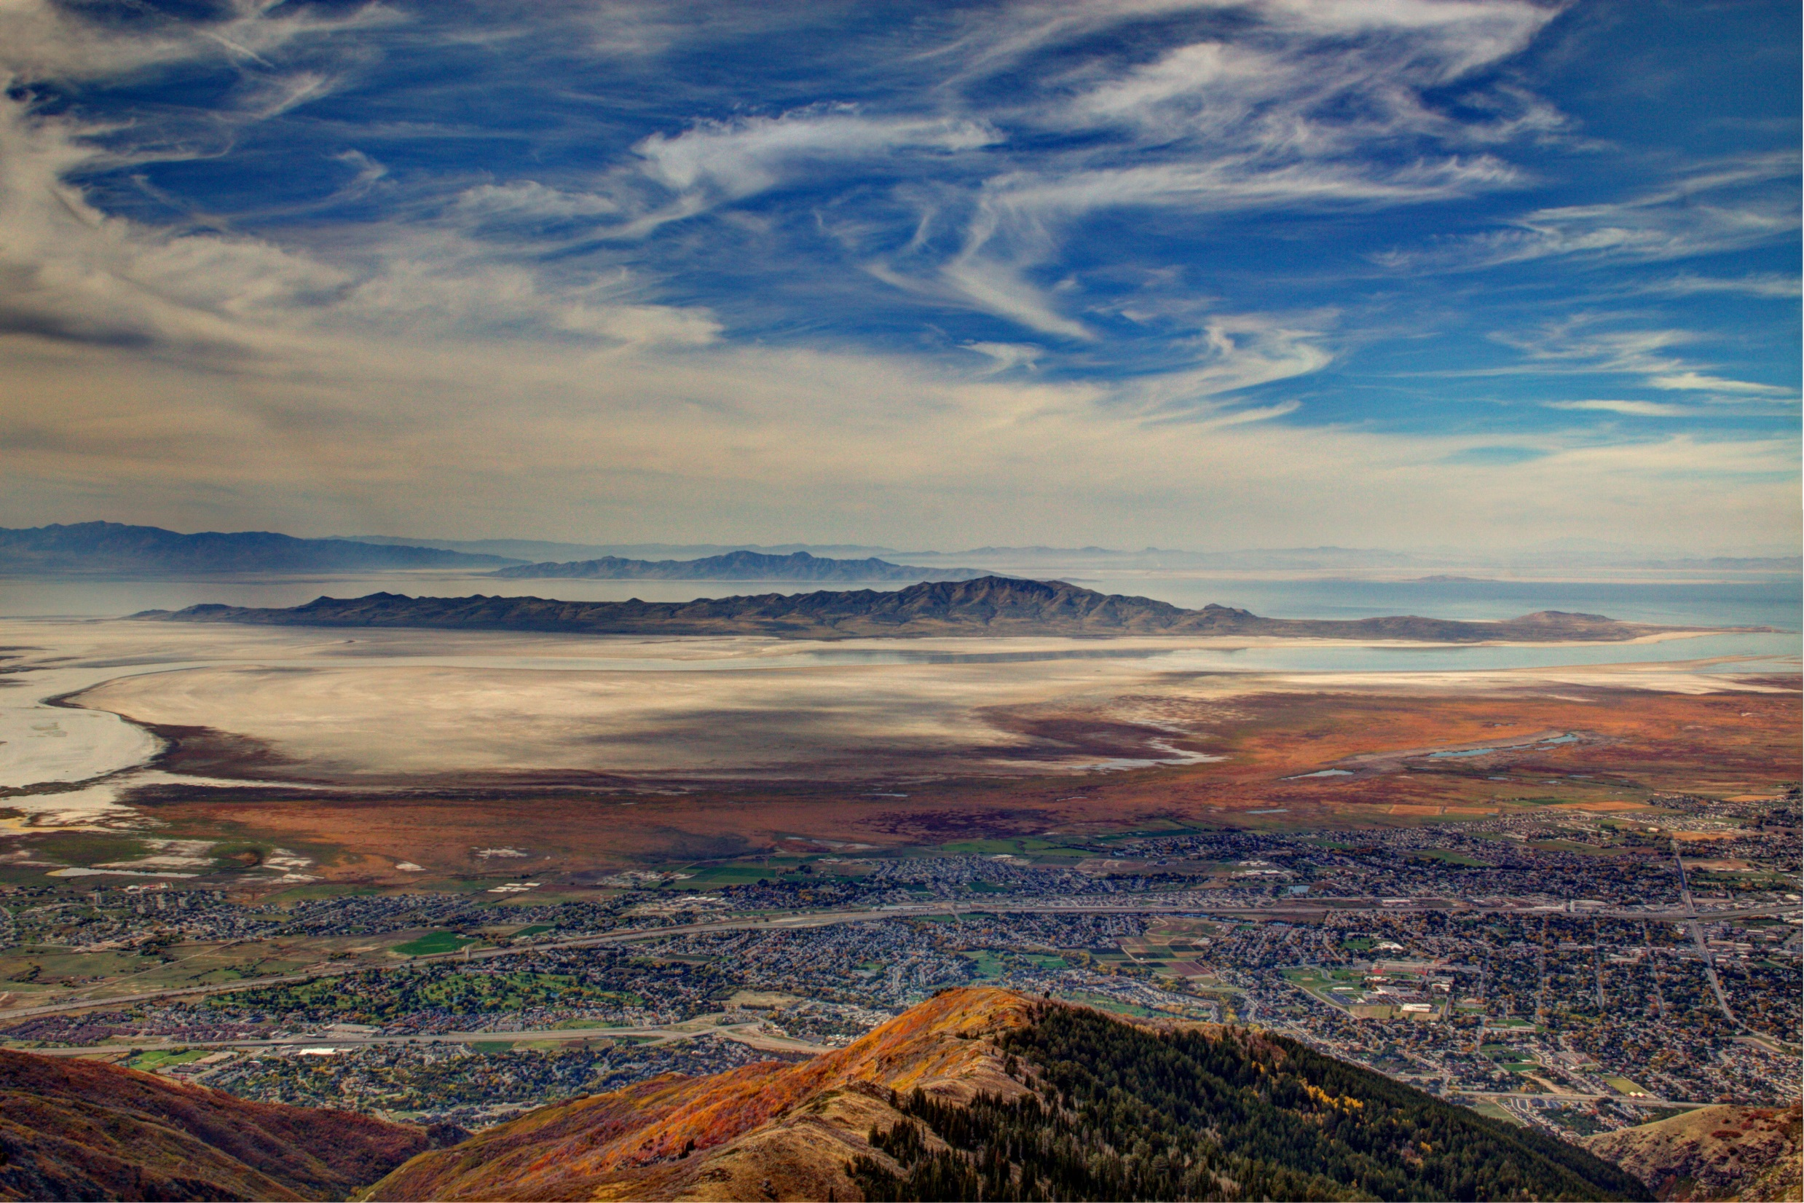
Understanding Water Use Groups AND SUPPLEMENTAL WATER RIGHTS
The What, Why, and How.

Slide 3

Terms that have been used interchangeably, but are they?
Supplemental
Supplemental Rights
Supplemental Groups
Water Use Groups

Slide 4
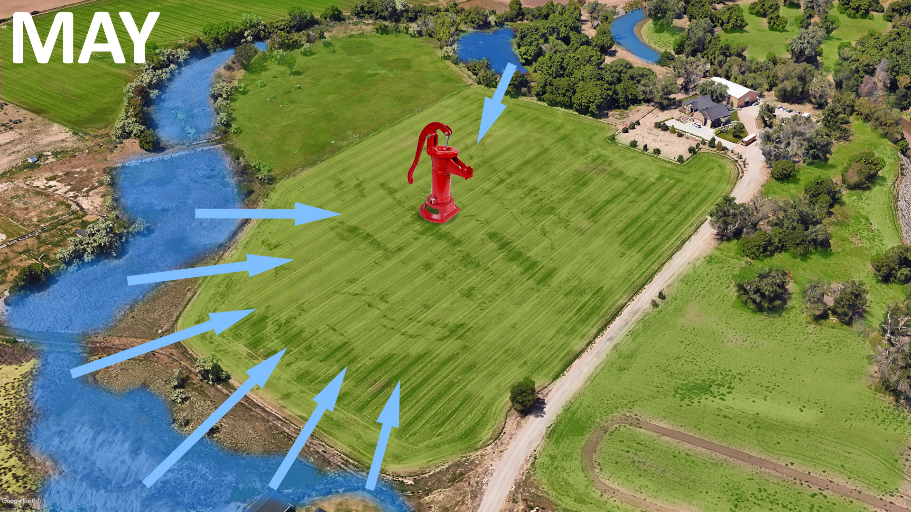
Insert slide on supplemental use from Sean

Slide 5
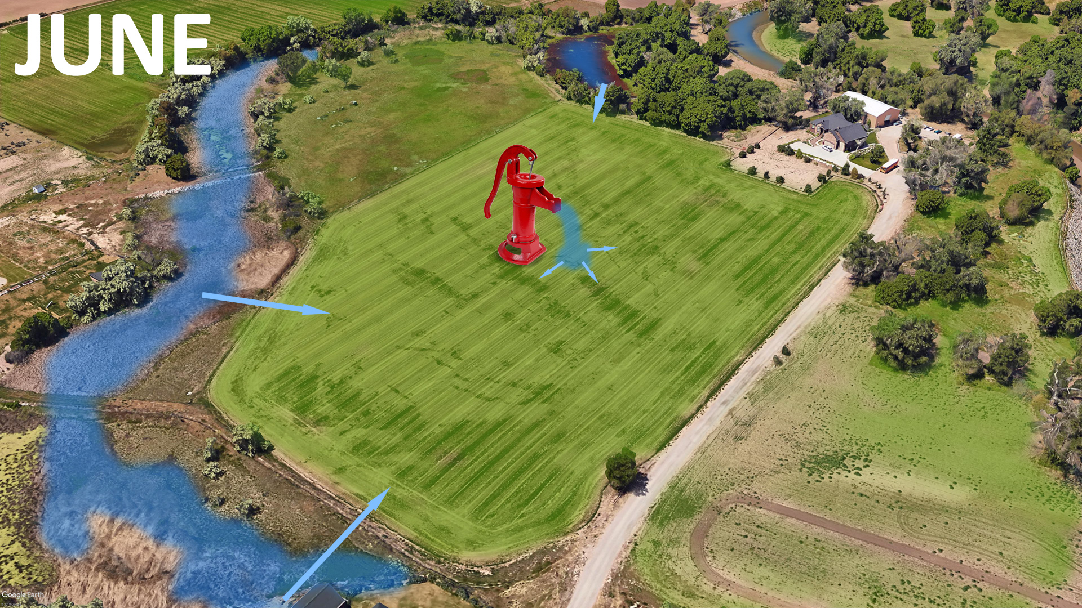
Insert slide on supplemental use from Sean

Slide 6
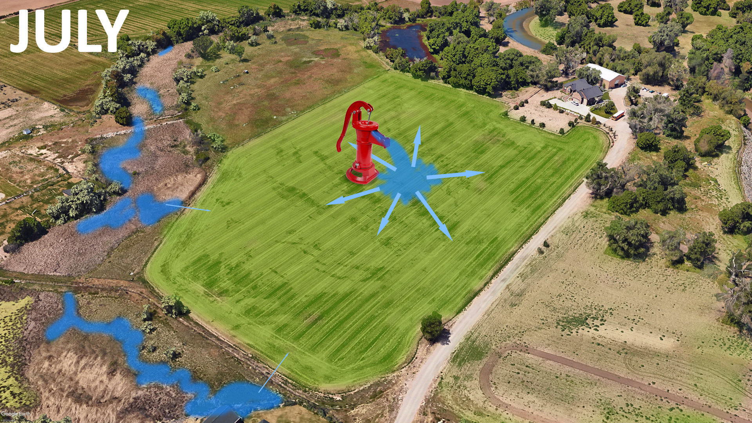
Insert slide on supplemental use from Sean

Slide 7
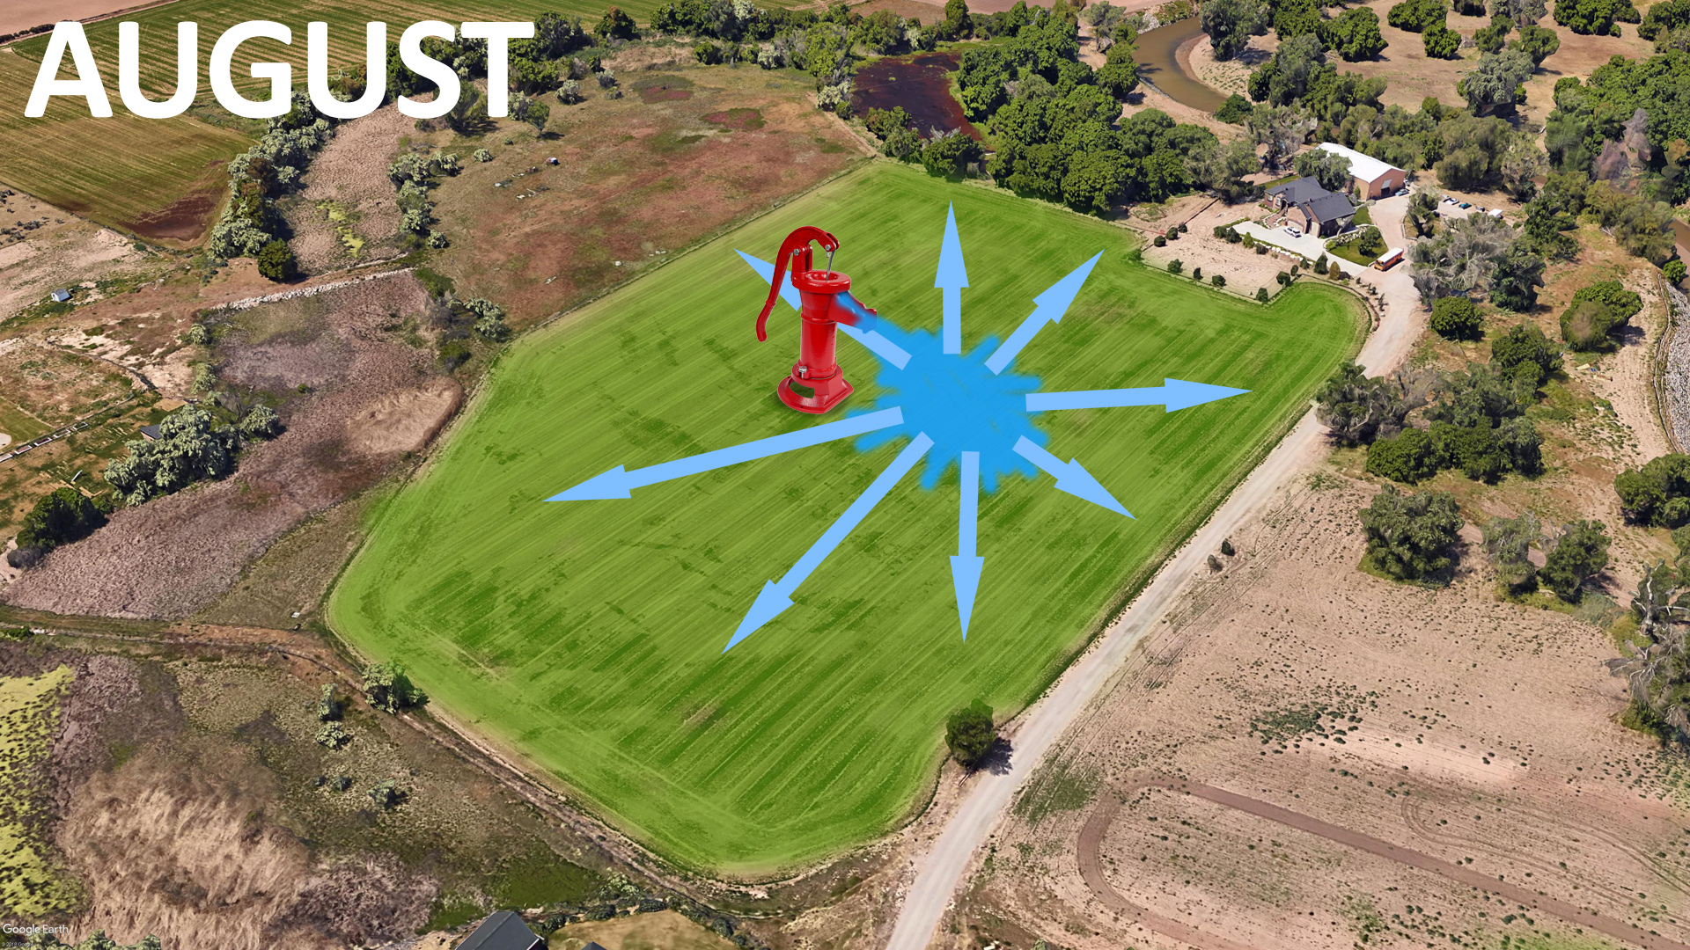
Insert slide on supplemental use from Sean

Slide 8
Grouping Water Rights together
Water Rights can be grouped together based on common place, period, and type of uses.
If two Water Rights share the same point of diversion should they be in the same water use group?

Slide 9
What is a Water Use Group?
  A grouping of Water Right(s) that have a common use at the same place of use.
  A Water Right must belong to at least one water use group.
  Each water use group represents a unique beneficial use of water and ties together the water rights that serve that use.
    Beneficial use is the basis, measure, and limit of a water right.

Slide 10
A Water Use Group Defines
  The place(s) of use
  The period(s) of use
  The beneficial use(s)
  Of one or more water right(s).
  A single water right can belong to more than one water use group.

Slide 11
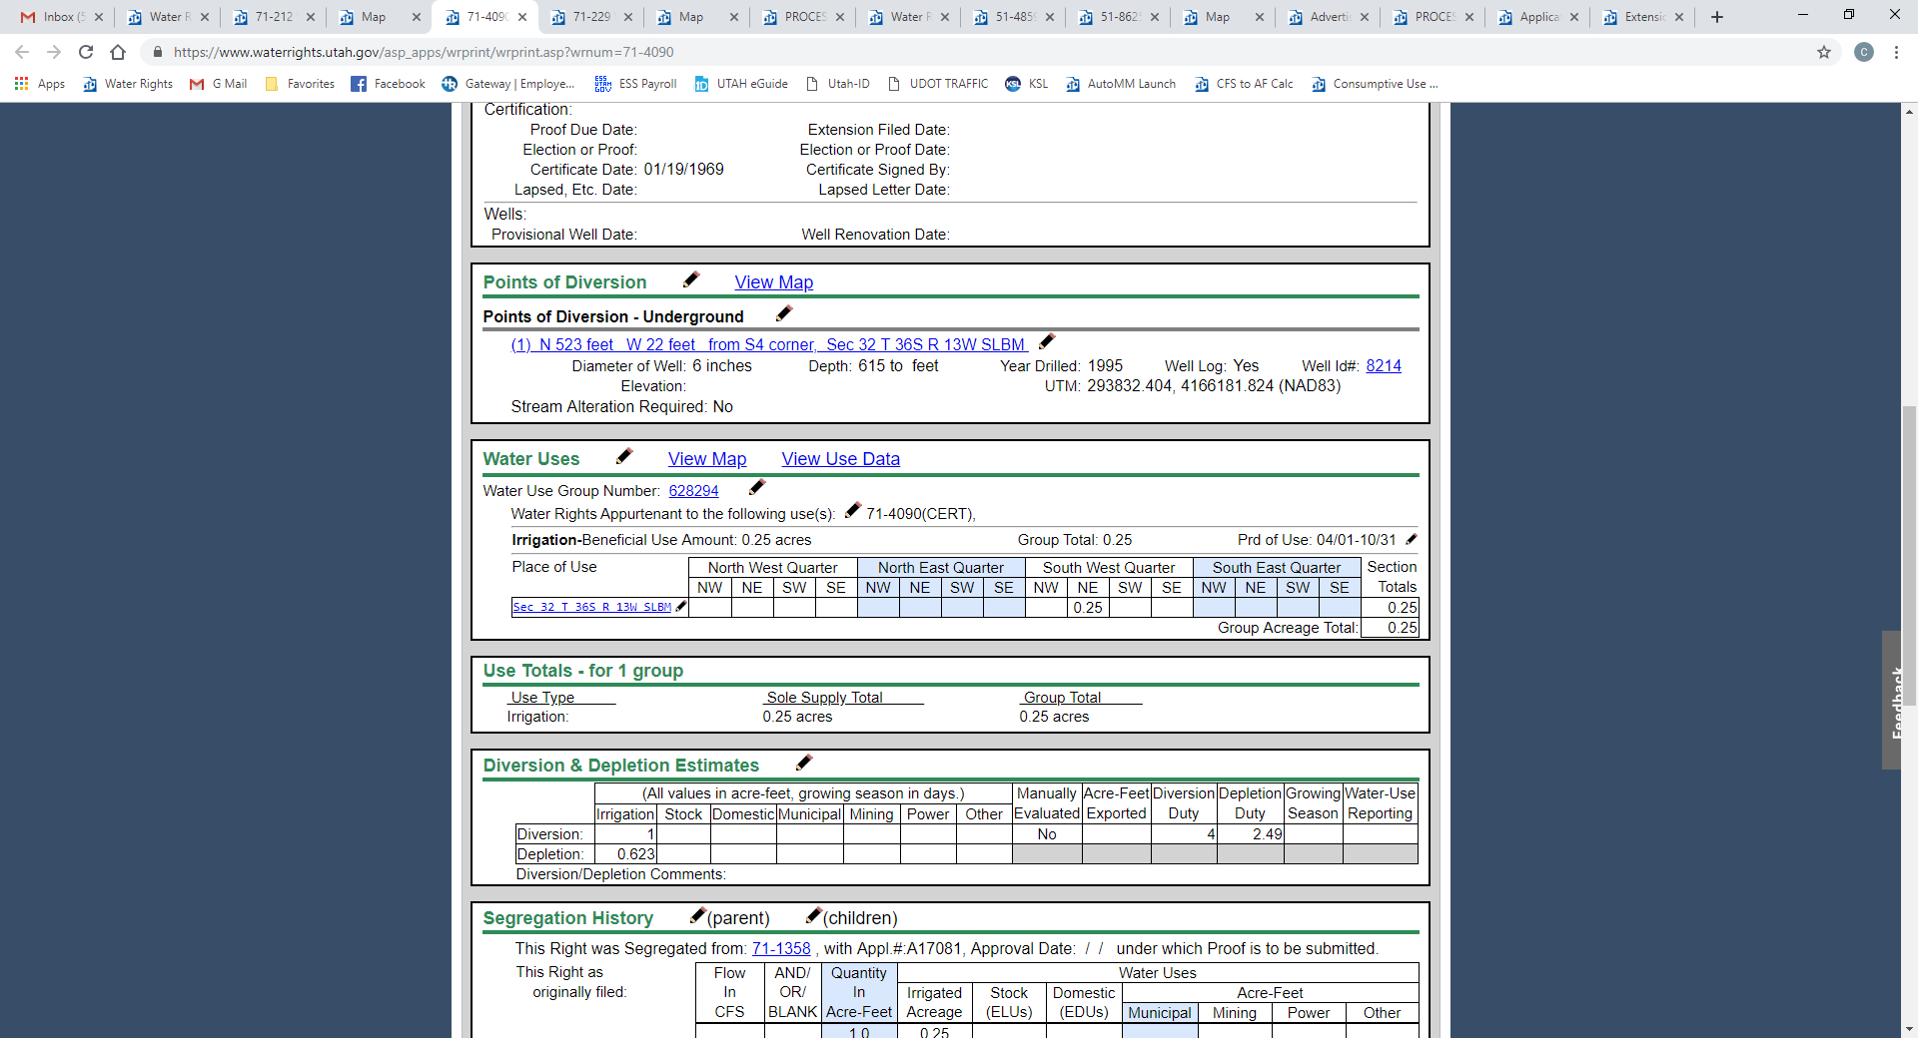
All Water Use Groups are
identified by a group number

Slide 12
Place of Use
  The place of use
    Defines the authorized and recognized place of use for the use of water described in the group.
    Should be consistent with the information contained in the State Engineer’s records.
    May include more than one Section or Quarter Section of land

Slide 13
PLACE of Use
0.25 acres of irrigation in the NE¼ SW¼ of Section 32, Township 36 South, Range 13 West SLB&M.

Slide 14
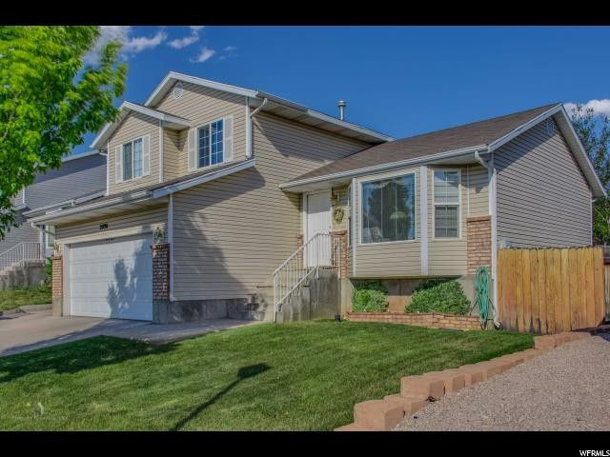
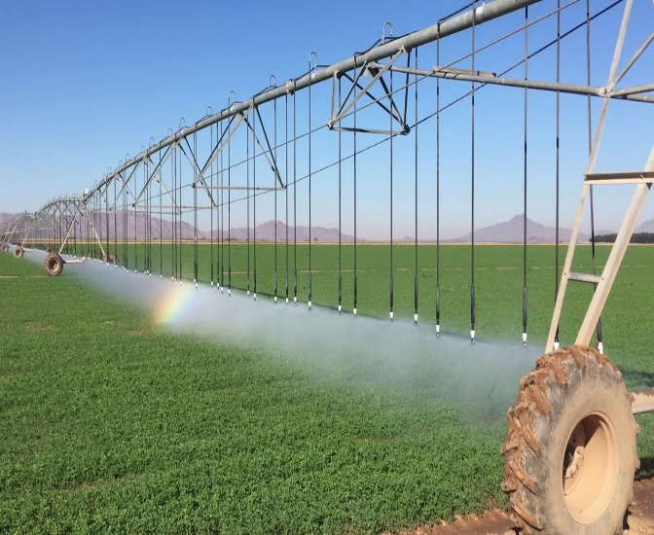
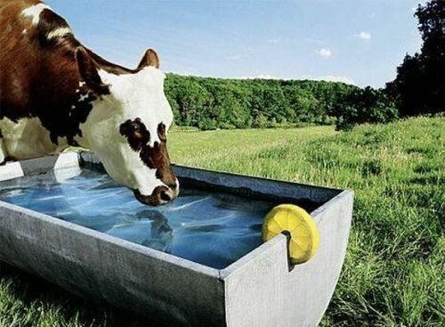
Period of Use
  The period of use is the time period a beneficial use takes place
Homes
yEAR-ROUND
irrigation
April 1 to October 31
Stock
yEAR-ROUND

Slide 15
Period of Use
Irrigation used from
April 1st to October 31st.

Slide 16
Beneficial Use
Water Right used for the
irrigation of 0.25 acre.

Slide 17
Beneficial Use
  The beneficial use is
    The basis, measure, and limit of a water right.
    Some of the most common types of beneficial use
      Irrigation ― Municipal
      Domestic ― Mining
      Stock watering ― Power Generation
      “Other” water uses
        ▪ Commercial ▪ Recreation
        ▪ Fish Culture ▪ Road Maintenance
        ▪ Geothermal ▪ Oil Exploration
        ▪ Industrial ▪ Wildlife
        ▪ Instream Flow ▪ Other

Slide 18
Other Terms to Understand
  Sole Supply
    May be expressed as a limit of use of a water right
    May also refer to a water right limit in a group
  Group Total
    The total use in this particular water use group
  Beneficial Use Amount
    The amount of beneficial use a water right contributes to a Water Use Group in which it is included. May be referred to as “Group Contribution”.

Slide 19
Why do we use Water Use Groups?
  To account for the limits and measure of each water right.
  As an index to the water rights that serve a use.
  To uniquely account for all uses of water in the state.

Slide 20
How will you use and interact with Water Use Groups?
  As a key indicator of value when acquiring a right.
  As an issue to be reconciled when changing a right.*
  As a limit to be observed when using a right alone.
  *Since many of the water use groups which relate to more than one water right are not completely quantified you will likely become involved in an effort to complete that work in water right processes.

Slide 21
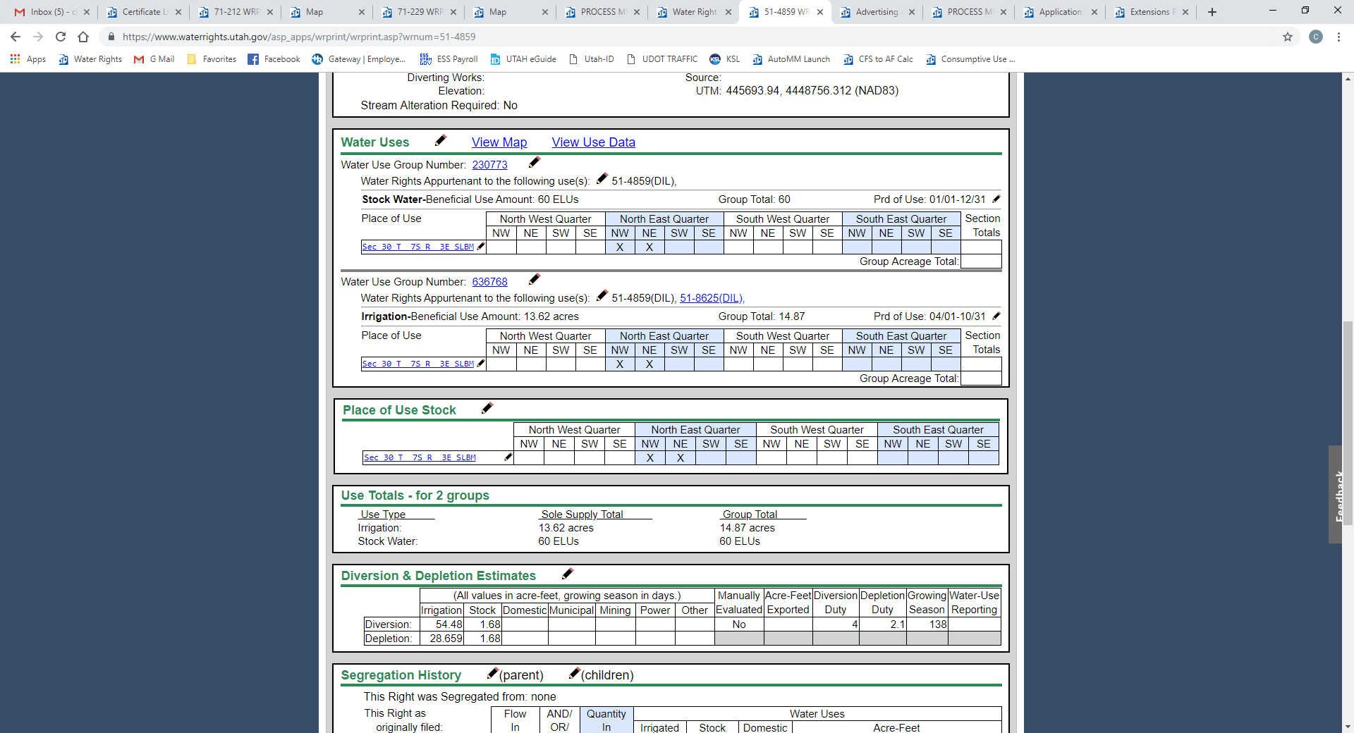
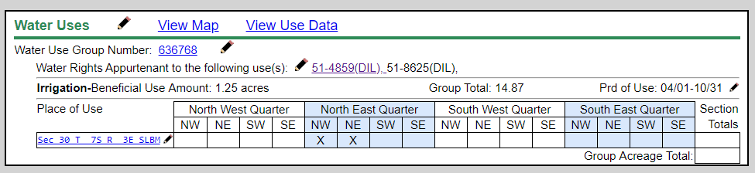
How TWO WATER RIGHTS ARE REPRESENTED IN ONE GROUP

Slide 22
How TWO WATER RIGHTS ARE REPRESENTED IN ONE GROUP

Slide 23
How TWO WATER RIGHTS ARE REPRESENTED IN ONE GROUP
51-

Slide 24
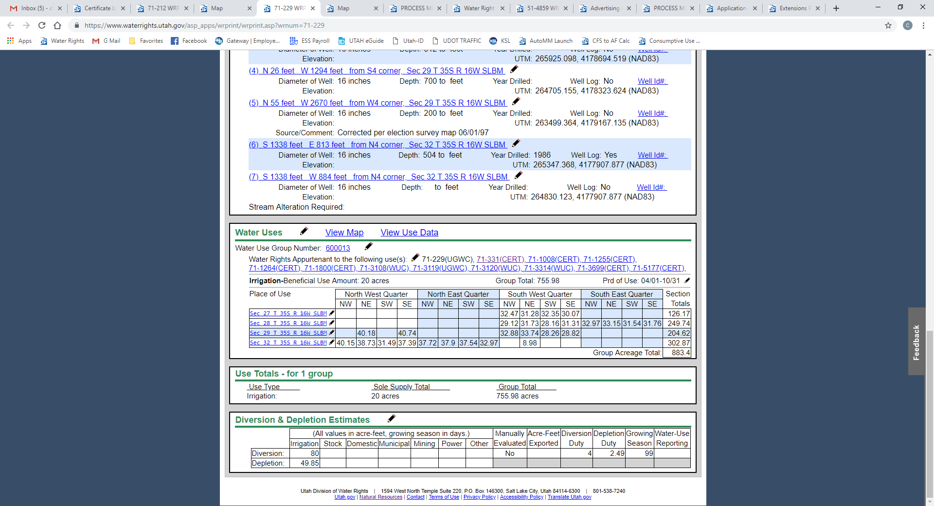
Multiple WATER RIGHTS and multiple places of use

Slide 25
Multiple WATER RIGHTS and multiple places of use

Slide 26
Multiple WATER RIGHTS and multiple places of use

Slide 27
Multiple WATER RIGHTS and multiple places of use

Slide 28
Multiple WATER RIGHTS and multiple places of use

Slide 29
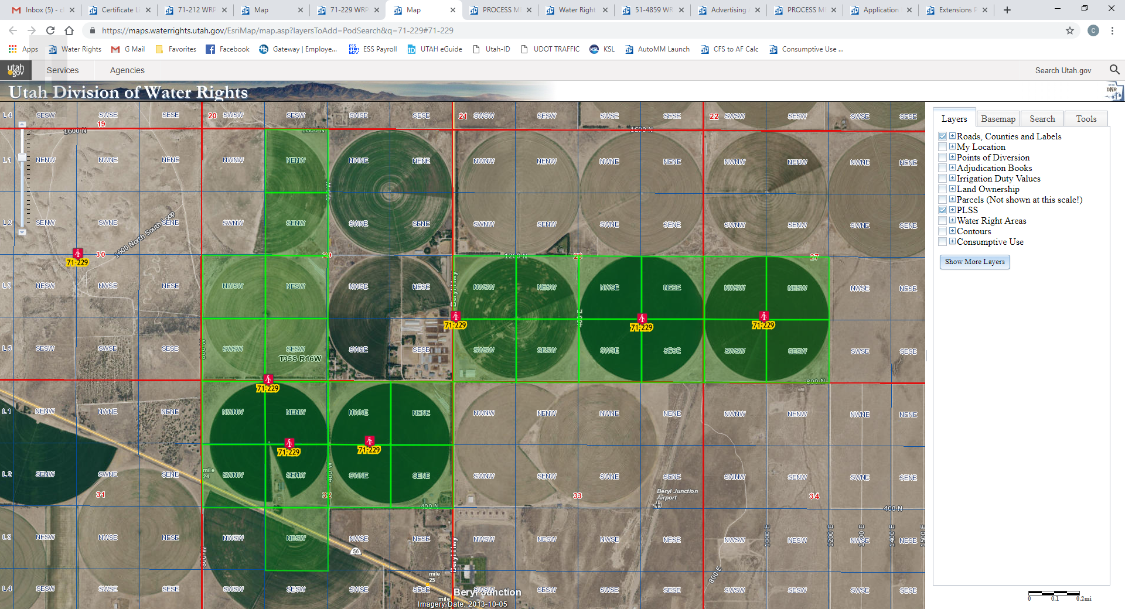
Place of Use for Water Use Group 600013

Slide 30
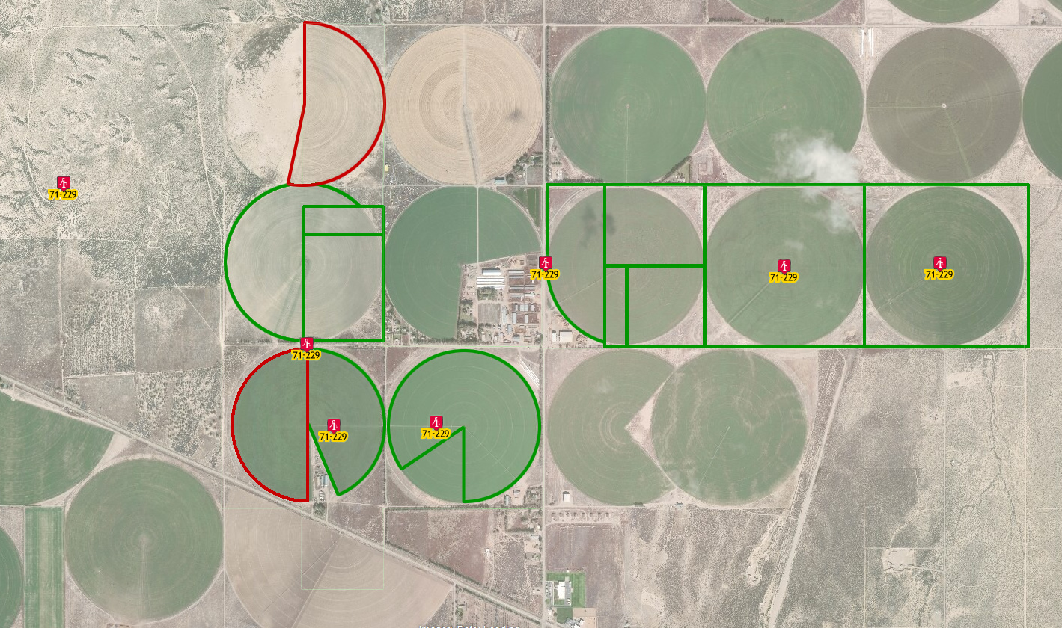
Sole supply for water rights in WUG 600013

Slide 31
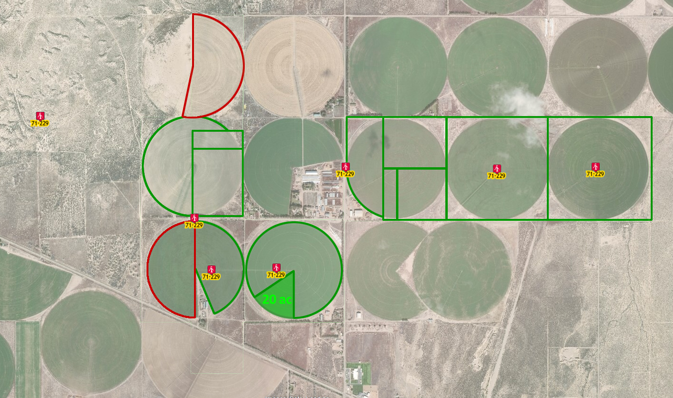
Sole supply for water right 71-229

Slide 32
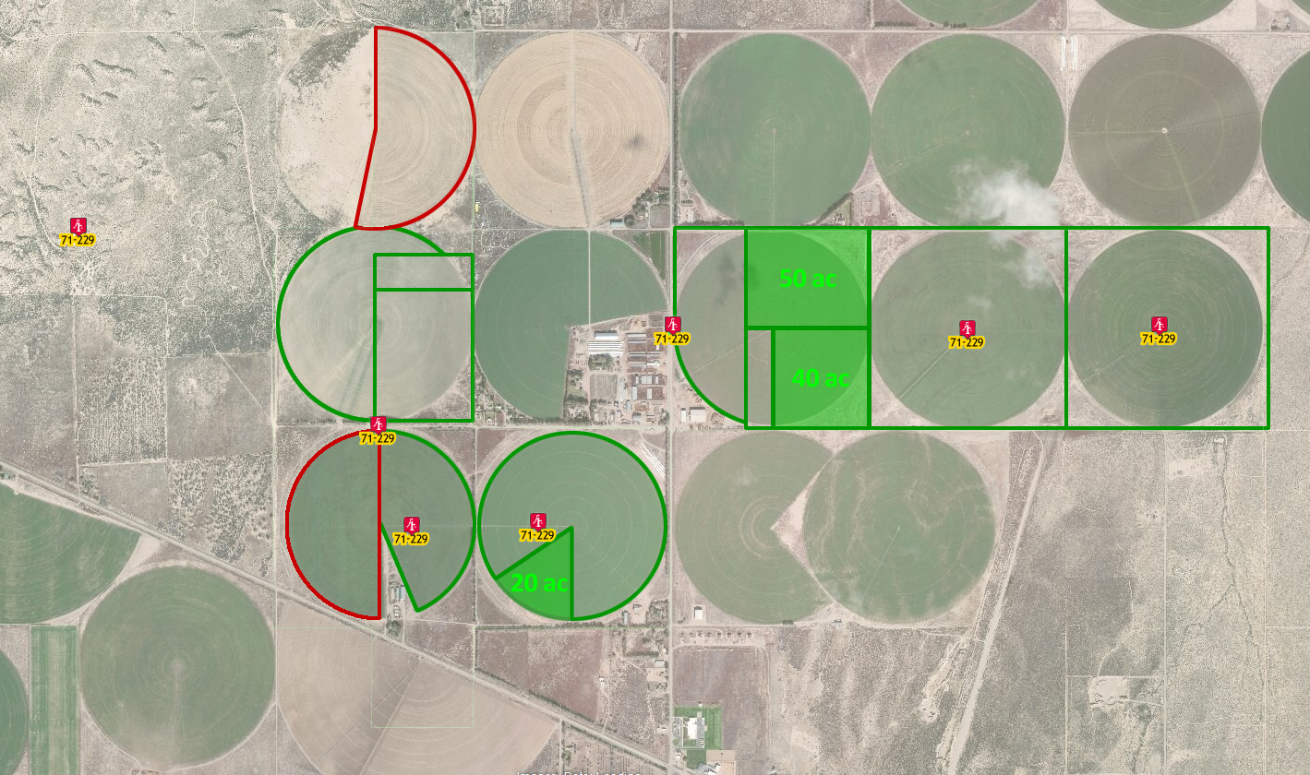
Sole supply for other water rights in WUG

Slide 33
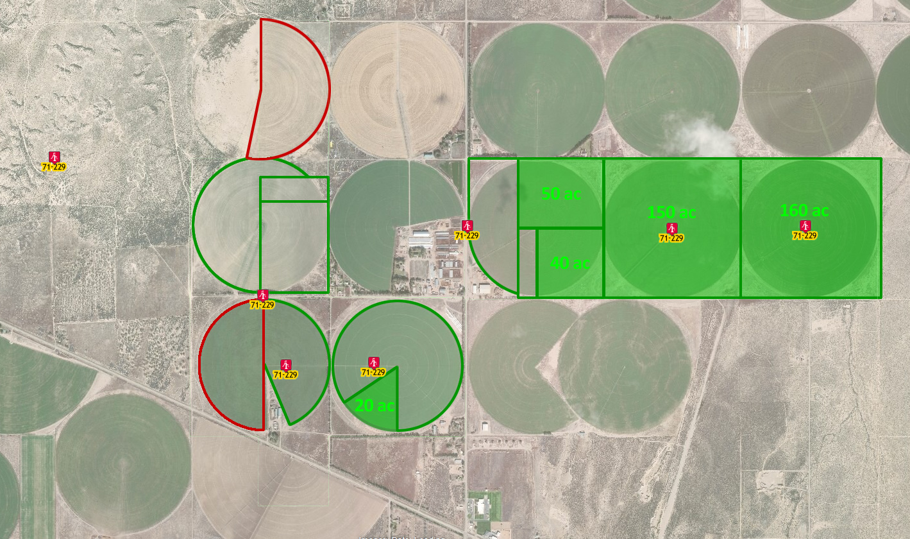
Sole supply for other water rights in WUG

Slide 34
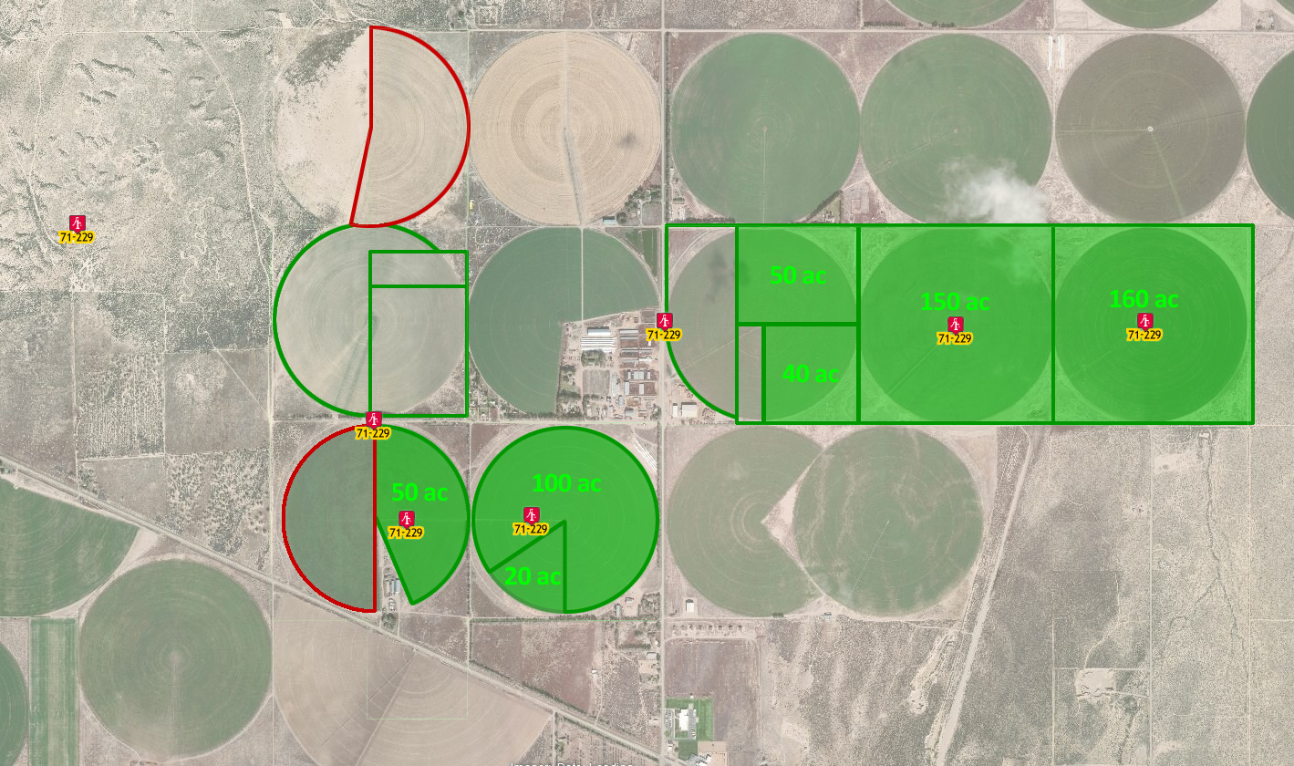
Sole supply for other water rights in WUG

Slide 35
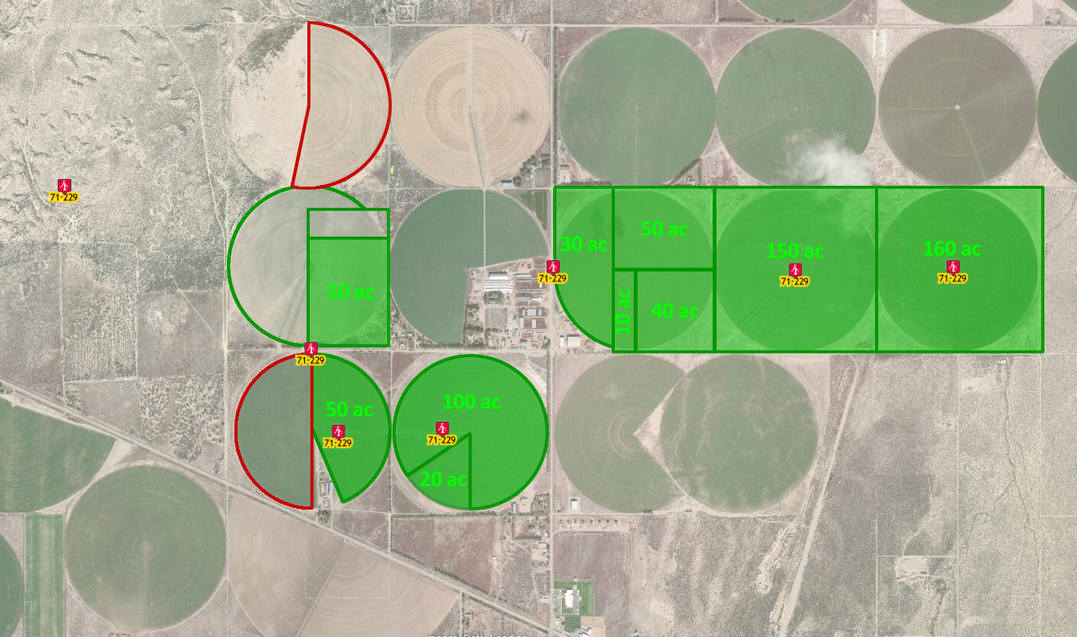
Sole supply for other water rights in WUG

Slide 36
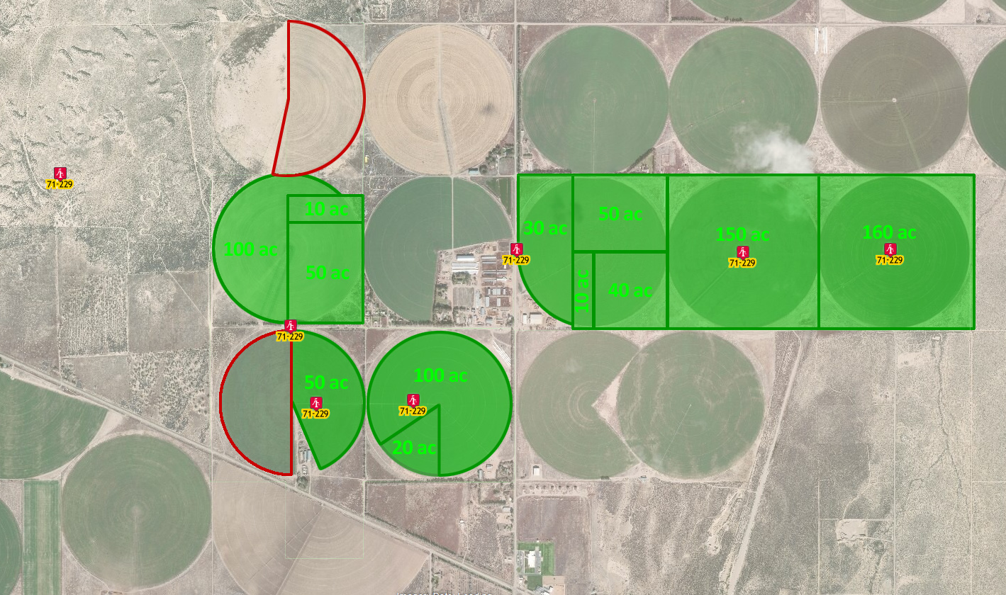
Sole supply for other water rights in WUG

Slide 37
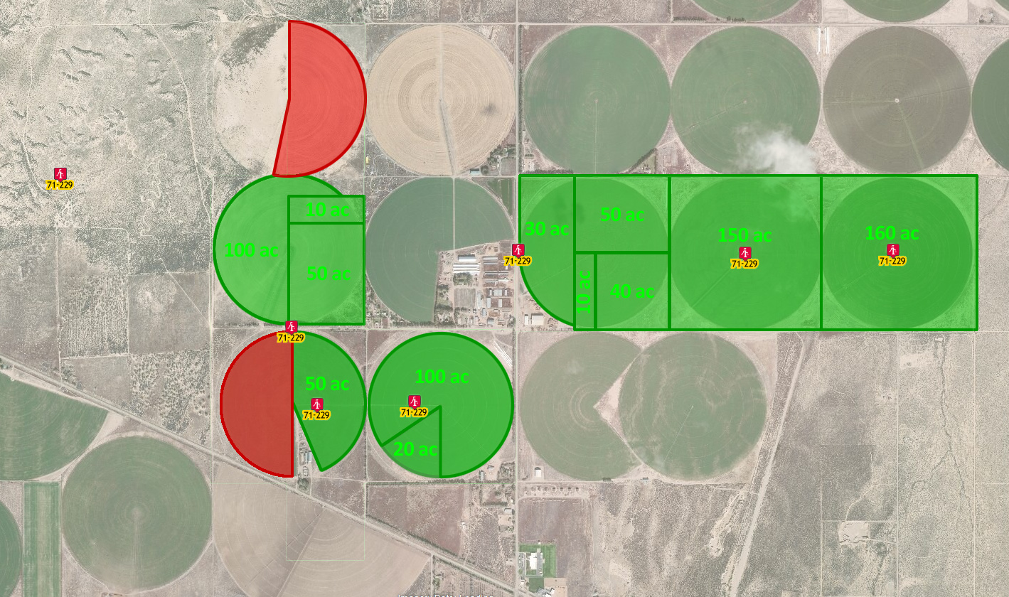
Acreage not covered by
water rights in the WUG

Slide 38
Acreage not covered by
water rights in the WUG
WHY?

Slide 39
Water Use Group Total = 755.98 acres
Group Total Acreage = 883.40 acres
Difference of 127.42 acres

Slide 40
Why the difference?
Water Use Group Total = 755.98 acres
Group Total Acreage = 883.40 acres
Difference of 127.42 acres

Slide 41
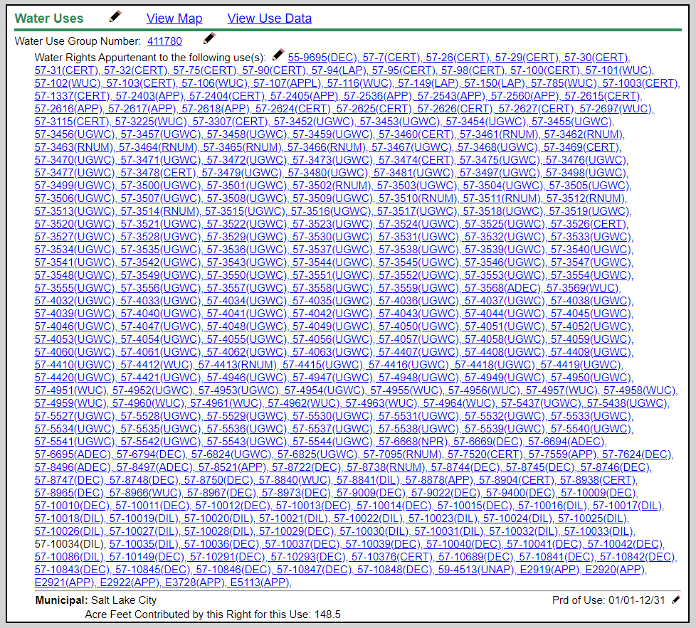
Municipal Use Water Rights

Slide 42
Municipal Use Water Rights

Slide 43
Municipal Use Water Rights

Slide 44
Municipal Use Water Rights
Water Use Group includes all water rights used within the service area of the municipality.

Slide 45
What documents provide information to help clarify what is included in a Water Use Group?
  Information included in a water right file
    Application to Appropriate
    Diligence or Underground Water Claim
    Certificate of Beneficial Use
    Judicial Decree
    Published Proposed Determination Book / Addendum
    Maps (application, claims, certificate, hydrographic survey maps)

Slide 46
  A group contains a water right owned by an individual and the water rights for an irrigation company. What does this mean?
    The use described in the group is supplemental to shares of stock in an irrigation company.
    The individual right provides only a portion of the total Beneficial Use Amount.
    The land is within the service area of the irrigation company.
    Shares in an irrigation company are bought and sold as securities and lands served by the company may change.
    This is an error that you can ask the Division to correct. We no longer include irrigation company rights in groups with private rights.

Slide 47
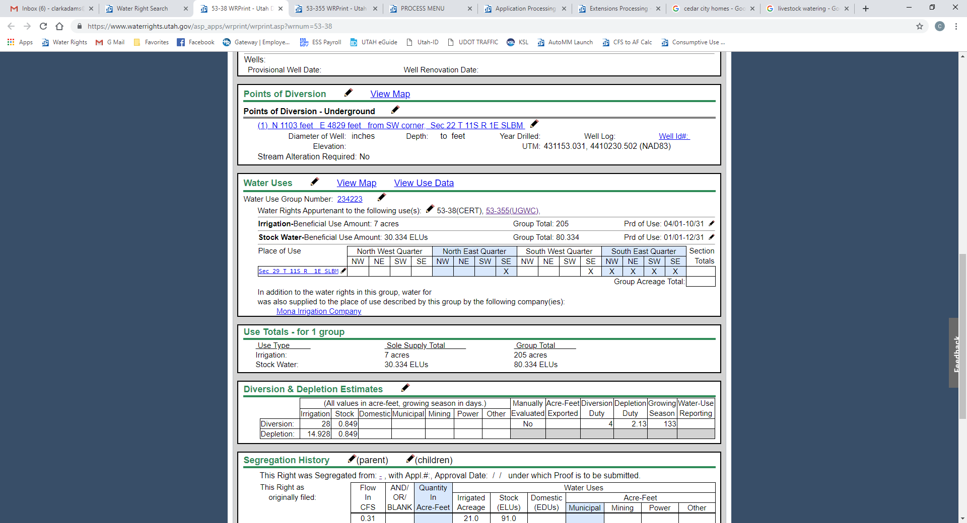
IRRIGATION COMPANY USE NOTE

Slide 48
Water Use Groups may not be 100% correct
Duplicate groups and incomplete groups may exist due to database conversions and entry errors which have occurred over time.
Identifying errors
  Research records
  Send a written request to review the record and include statements as to how it is believed the groups should be modified.

Slide 49

How do you fix database errors

Slide 50
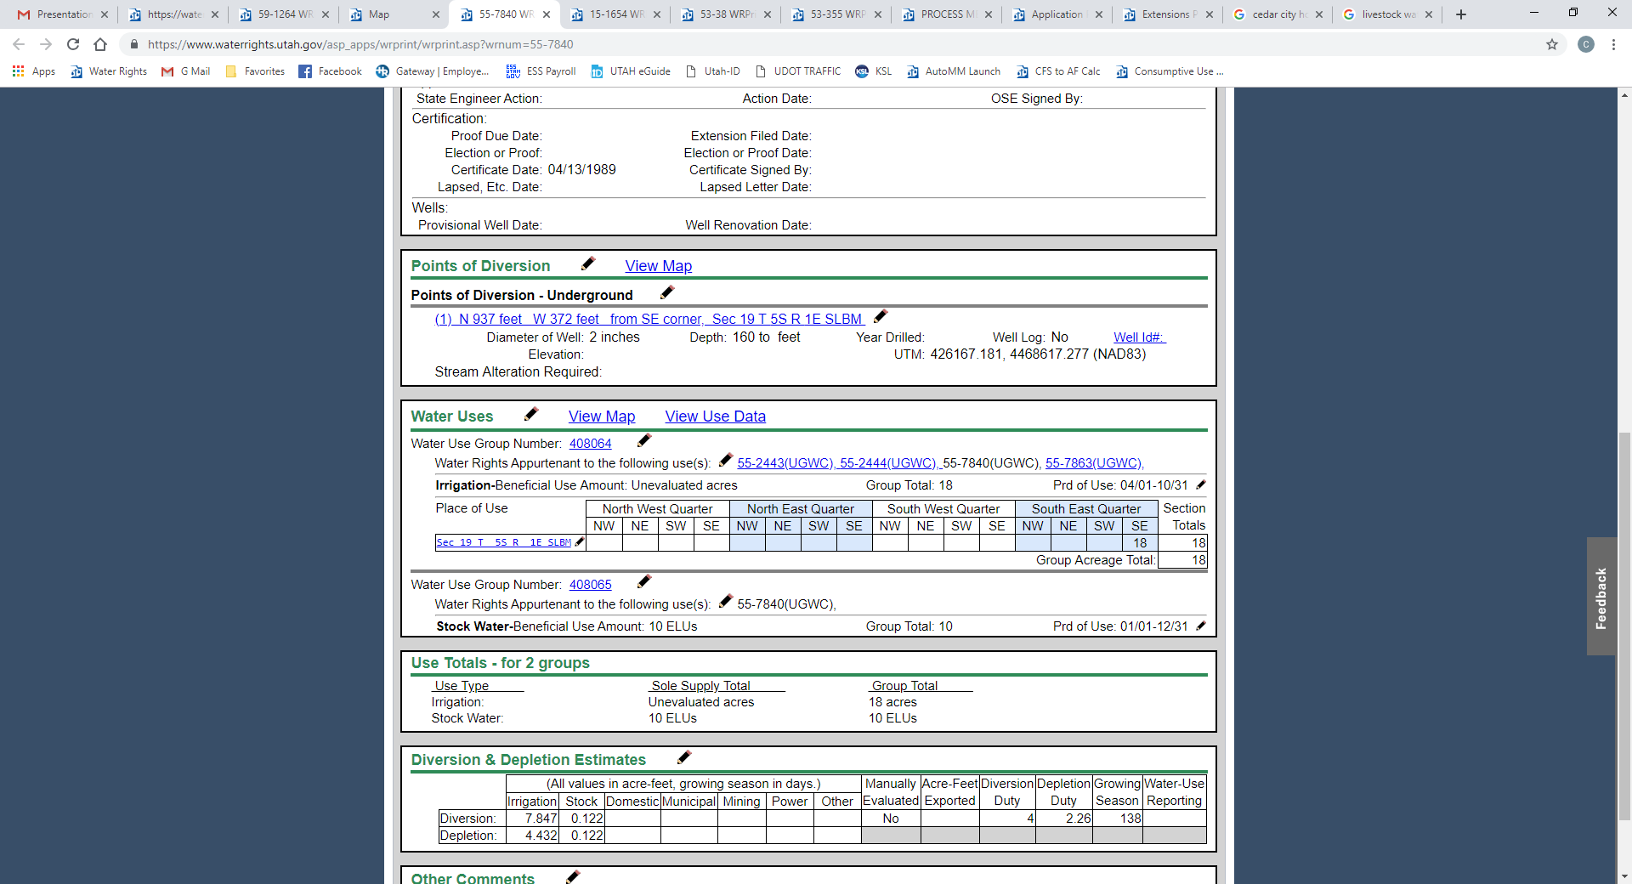
EVALUATING UNEVALUATED
WATER USE GROUPS

Slide 51
EVALUATING UNEVALUATED
WATER USE GROUPS

Slide 52
EVALUATING UNEVALUATED
WATER USE GROUPS

Slide 53
EVALUATING UNEVALUATED
WATER USE GROUPS
How does a group or
water right get evaluated?

Slide 54
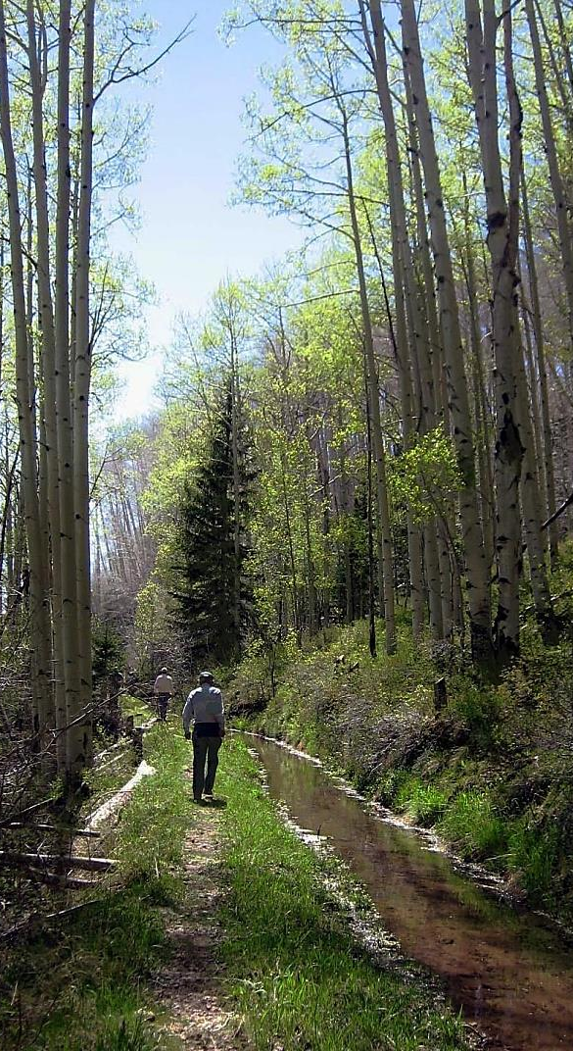
Administrative Rule R655-16
  Declaring Beneficial Use Amounts
    Written request for corrections to be made.
    Declaration of Beneficial Use
      Used to declare the beneficial use amount of a water right in a use group.
    Application for Apportionment of Beneficial Use Amounts.
      The applicant has exhausted all reasonable efforts to complete a Declaration of Beneficial Use.

Slide 55
  Why do you need to define the Beneficial Use Amount (Group Contribution)?
    To file a segregation.
    To file a change application.
  Defining the Beneficial Use Amount of all water rights within a group ensures the amount of water and beneficial use of the individual water rights in the group is properly defined so there won’t be confusion if the rights are used independent of each other.

Slide 56
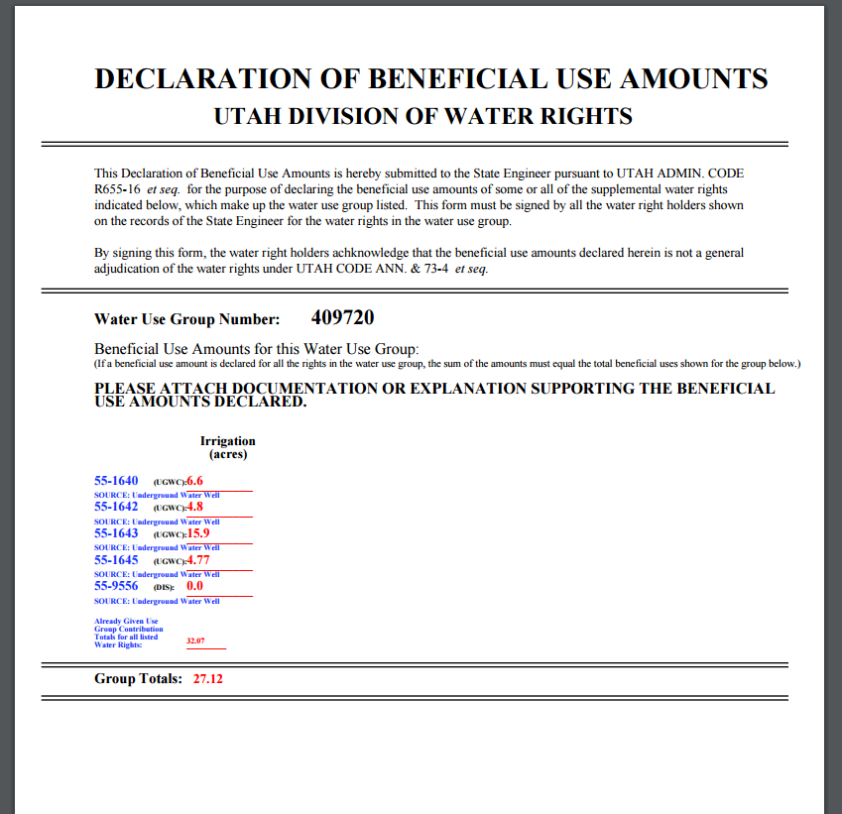
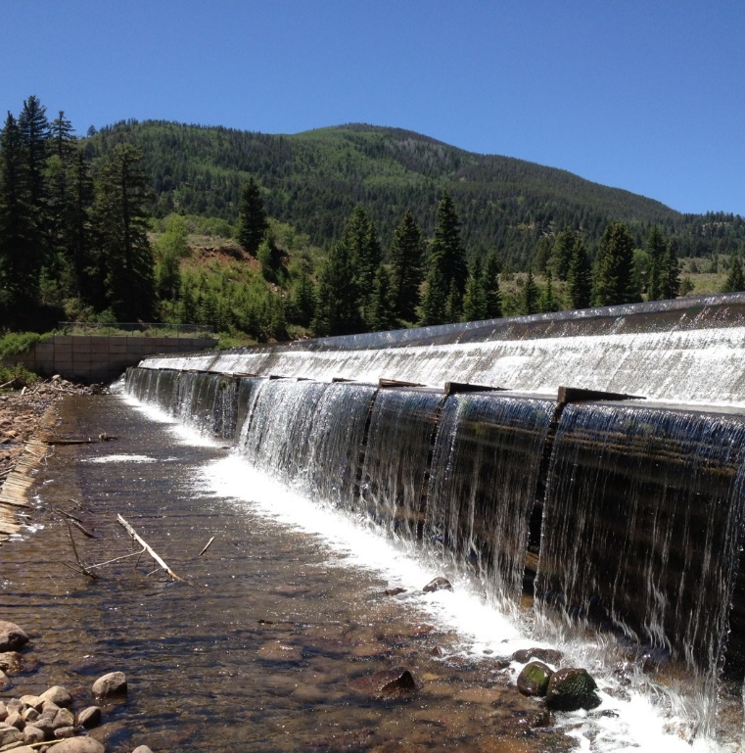

Slide 57
APPLICATION FOR APPORTIONMENT
OF BENEFICIAL USE
When to use
Have exhausted all efforts to complete a Declaration of Beneficial Use
Owner does not believe water right database correctly reflects his right to use water
Immediate need for an administrative action on an application or Proof of Beneficial Use

Slide 58
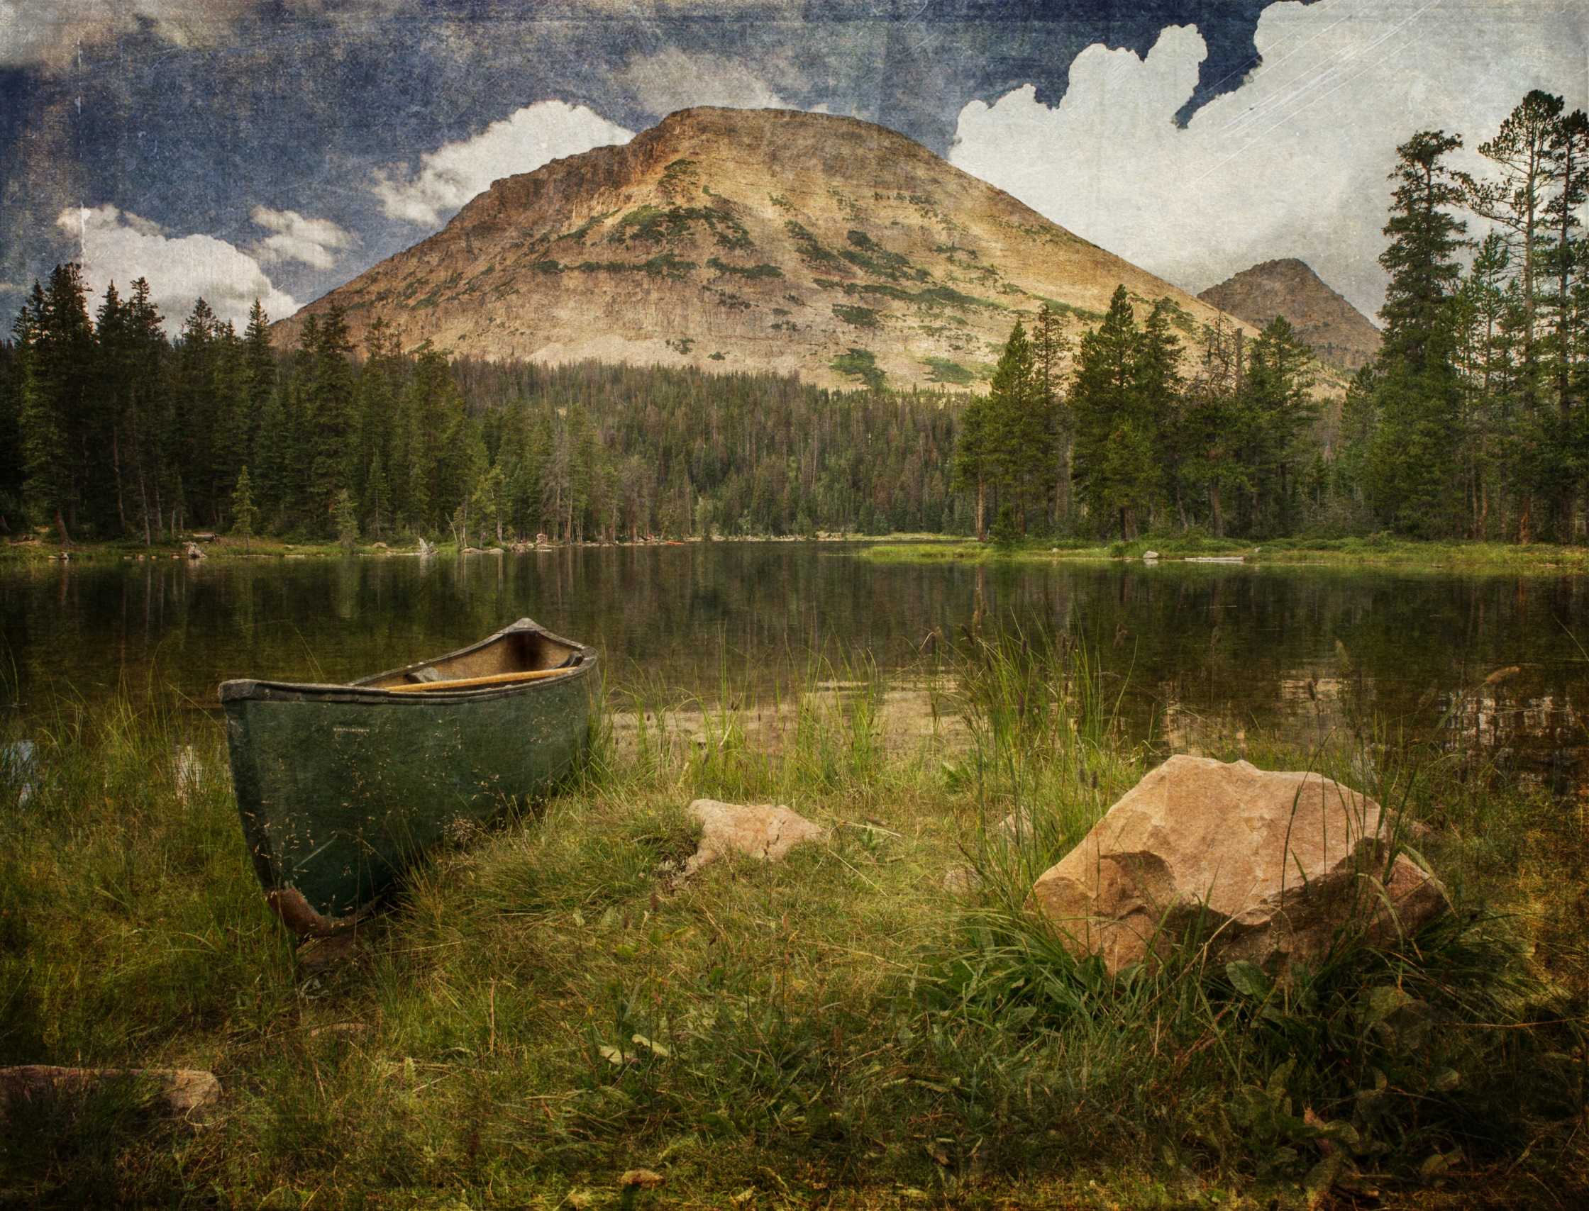
Questions?

