Slide 1


Utah Division of Water Rights
Making Applications
What You Need to Know
Willa Knight—April 2019
June 21, 2004

Slide 2

Application Agenda
Discuss water right policy by area;
Readiness for filing a complete application;
Introduce the Public Land Survey system;
Discuss duty, diversion, and other use calculations, and;
Make an application map.
Questions
Notes:
Perhaps talk about which applications result in a start card. Also talk about surface wells and when a water right must be associated with a well.

Slide 3
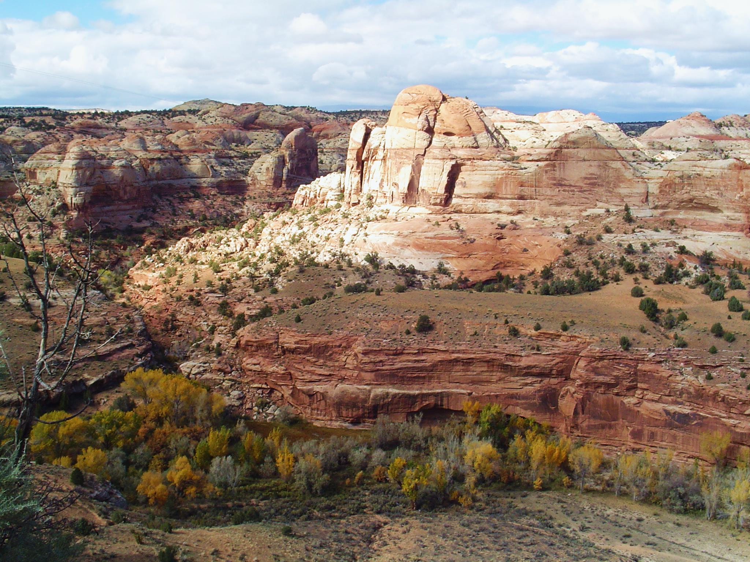
Policy By Area
Water Right

Slide 4
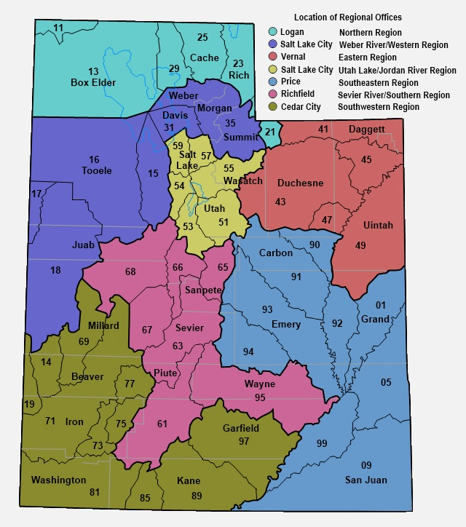
Helpful Database Tools
“Policies by Water Right Area” is located on the bottom right of the Division’s home page.
This will provide a basic overview for each water right area, including information that may be helpful for an applicant to review before filing an application.
www.waterrights.utah.gov

Slide 5
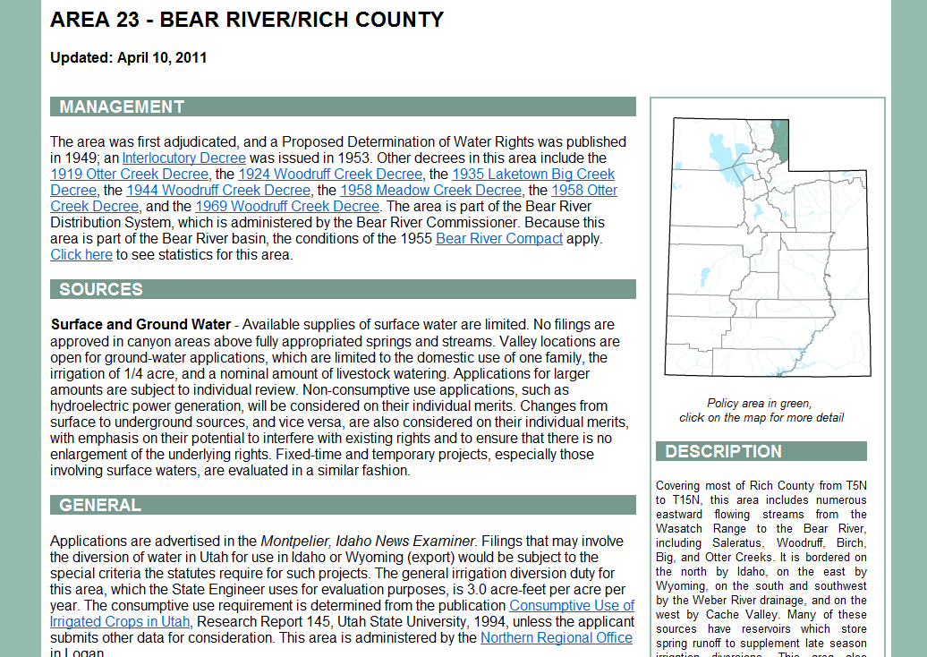
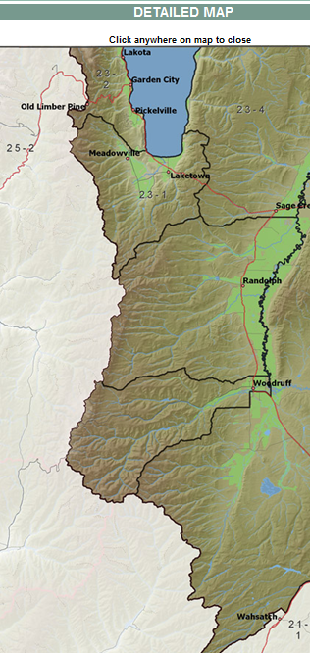
Surface and Ground Water :
…Valley locations are open for ground-water applications, which are limited to the domestic use of one family, the irrigation of .25 acre, and 10 livestock.
Notes:
Use internet (backup slide)

Slide 6

The Details of
Filing Applications

Slide 7
Elements Common to all Applications
The applicant’s name, address and ownership interest;
Source of water;
  Specific spring, stream, or underground well
Flow (cfs), or volume (acre-feet) of water to be diverted;
Point of diversion (POD);
  Where the water will be diverted from the natural source
Beneficial use of the water;

Slide 8
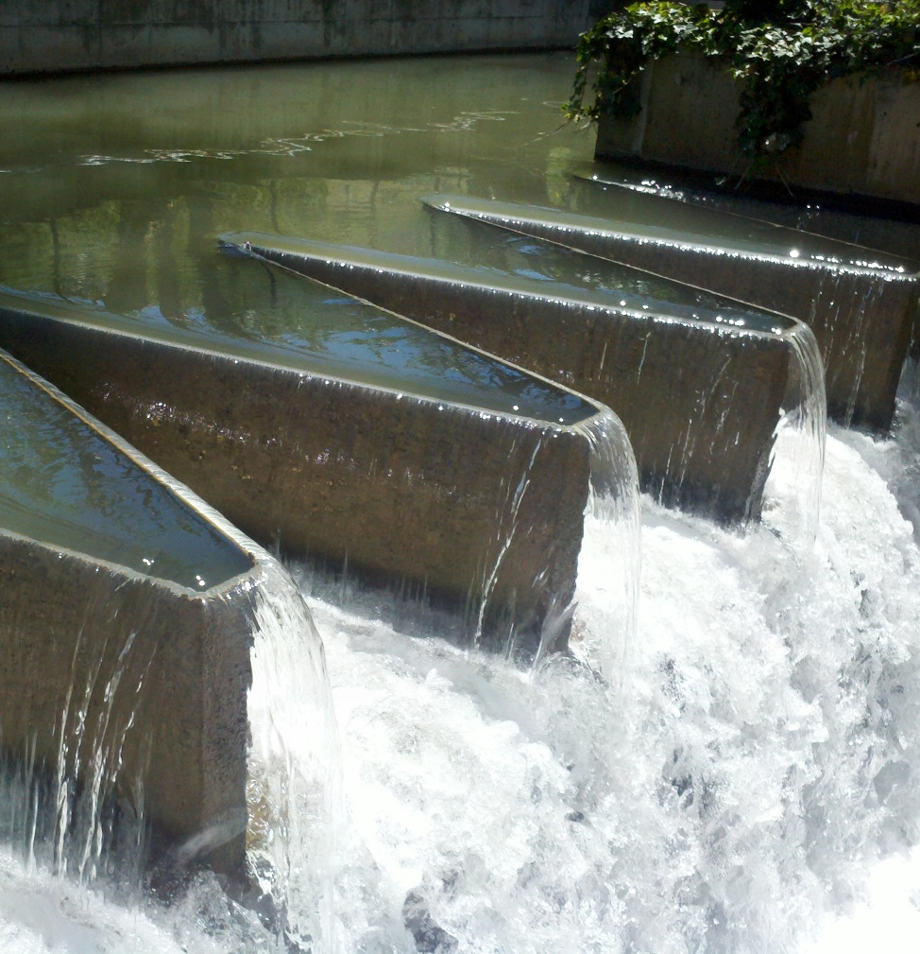
Place of use (POU);
  Location where the beneficial use will occur
Application map, to identify specific parcels on which the beneficial use will occur;
Signatures of all applicants/owners or legal agents;
Filing fee.

Slide 9
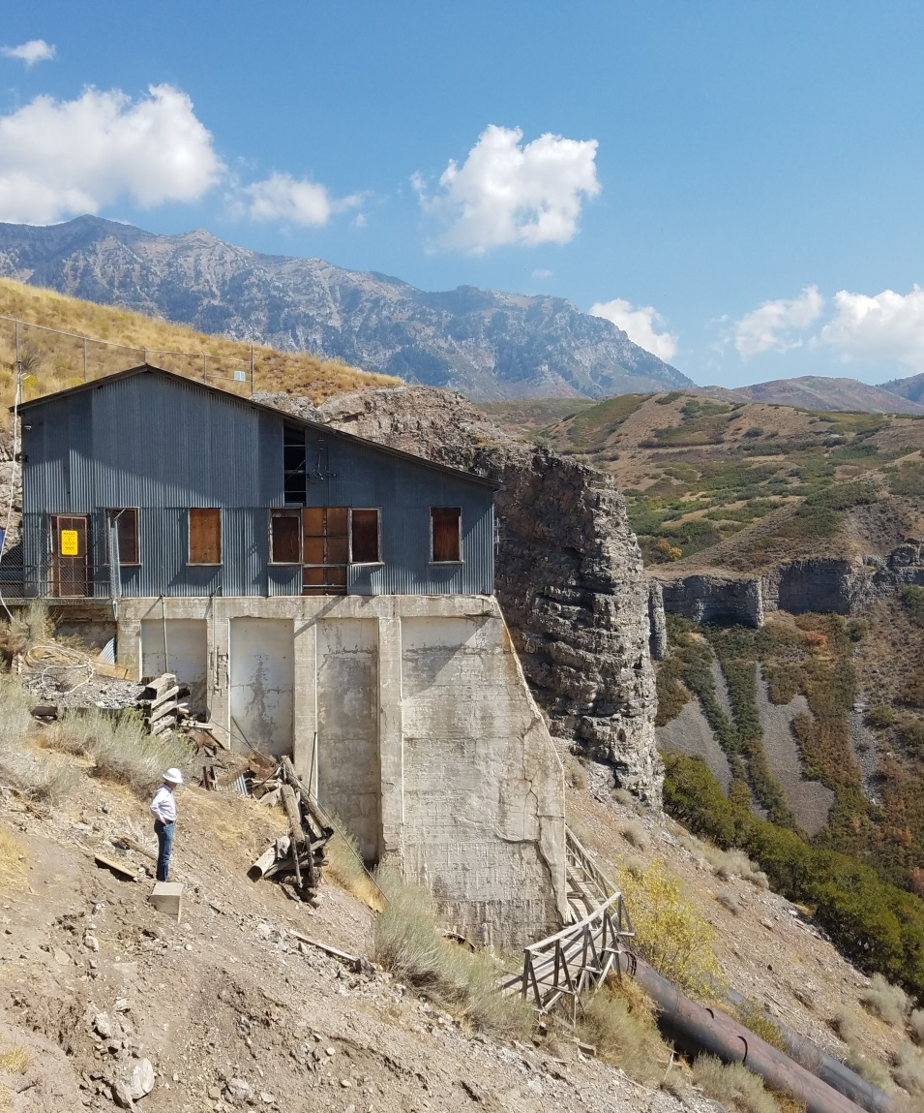
What You Need to Know
Basis of the water right
  New water right
  Existing water right
  Contract
  Shares in a company
Points of diversion
Places of use
Uses of the water
Notes:
Do a sample walk through of applications to tie this idea to Clark’s ppt.
“You want to file a change application. Great. What existing water right will you use? Where will you divert? Where will you use the water? How will you use the water?”

Slide 10
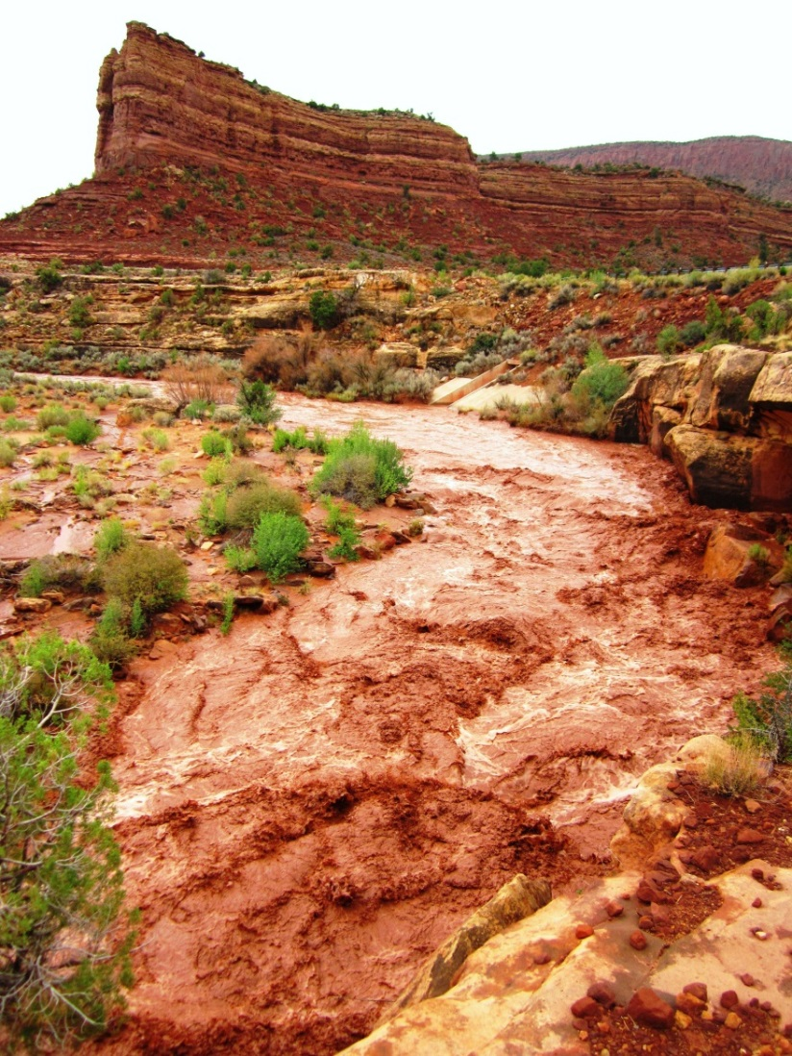
Common Filing Mistakes
Proper ownership
  Division’s records
  Share holder
  Contract owner
Need to complete a segregation
Proper evaluation of the water right

Slide 11


SEGREGATING WATER RIGHTS
73-3-27
  Split an existing water right into one or more separate water rights.
  Separate interest of an owner to file an application on their portion only.
  Divide up a water right to file proof on the developed portion only.
  Irrigation shares
  Just because
Notes:
Statute 73-3-27 of Utah Code addresses Segregations.
Perfected rights are increasingly being broken into separate pieces due to ownership changes or other reasons.
Requests to Segregate a Water Right are filed with the State Engineer and have a $50 processing fee. When completed, a separate water right number is given to the new segregated portion.
Since many areas of the state are closed to new appropriations of water, water rights are obtained by purchase of all or portions of existing filings or water rights. The new owners may desire their own water right numbers for clarity in record keeping and maintenance of independent responsibility for water right notices and other administrative functions.
New owners may also wish to amend their portions of the rights to facilitate different projects separate from the original water right.
Segregations are done: To split an existing water right into one or more separate water rights.
Segregations are done: To separate interest of an owner in a water right to file an application on their portion only.
Many times segregations are done as part of filing a change application or as required by what the applicant has requested to be part of an application.
This can also occur when a portion of the right has been sold, and the new owner wants to pursue development of his portion separately or differently from the original party.
Segregations are done: To divide up a portion of water right to file proof on the developed portion of the right.
This can occur when an applicant wants to prove beneficial use on the portion that is done but retain more time to complete the remainder of the right in the future.
Irrigation Shares
Some perfected water rights are in the names of irrigation or water companies. These private entities serve a number of water users through company diversion and transmission systems. Access to and use of the water is based on ownership of shares within the company. Some companies have policies that allow some shareholders to develop their own diversion and distribution systems separate from the main company facilities to handle somewhat independent projects. While the historical water rights remain in the companies’ names, these separate developments have their own water right numbers to administer these individual projects. Separation of these types of filings is handled administratively by the State Engineer by share statements.
Just because
Sometimes an owner just wants their own water right number

Slide 12
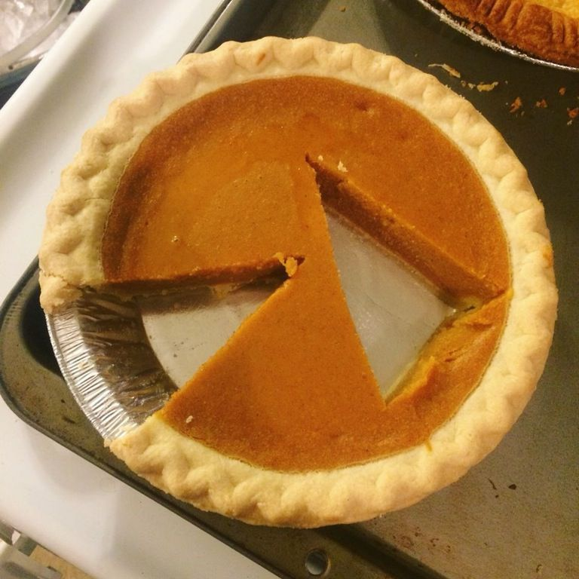
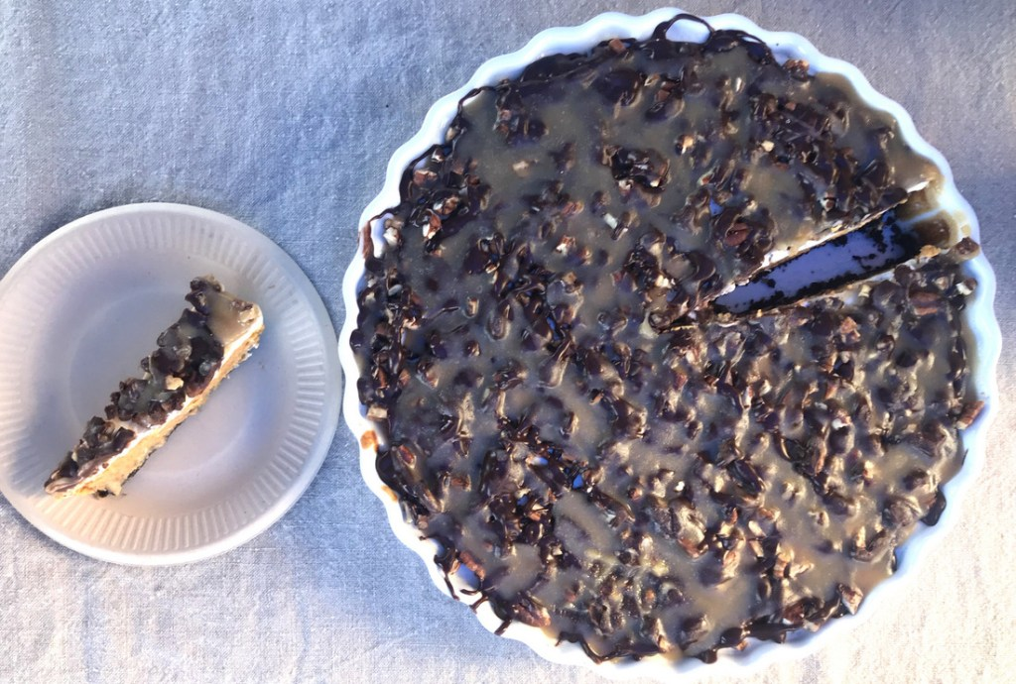
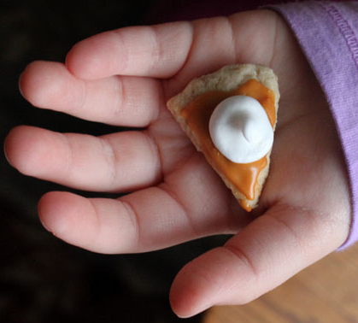

SEGREGATING WATER RIGHTS
Not all segregations are equal, easy or clean-cut
Notes:
Not all segregations are equal, easy or clean
There may be times that a segregation request cannot be processed.
Some of the reasons may be:
Segregation Request must be signed by all owners requesting the segregation
Ownership or title has not been updated to the current owner
Sole supplies have not been established on the water right or on the water use group
Pending applications are not addressed
If there is a pending change application on a water right; any portion requested to be segregated from the water right must also be segregated from the change application.
If the water right has a CFS and acre-foot portion, the segregation request must describe what portion is to come each and the uses.

Slide 13
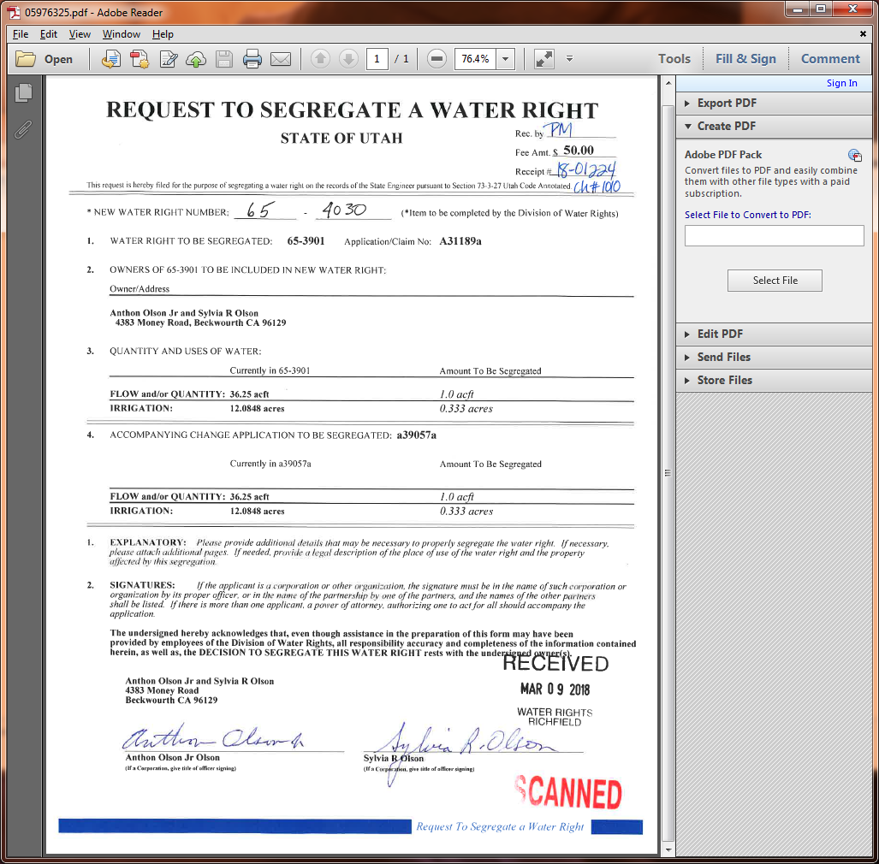
SEGREGATING WATER RIGHTS
New water right number after segregation
(Assigned by Division of Water Rights)
Original or parent water right number
Amount requested to be segregated
Acre-feet and uses in parent water right prior to segregation
Acre-feet and uses in change application prior to segregation
Amount requested to be segregated from change application
Owners requesting segregation and their signatures
Notes:
What a Request to Segregate a Water Right Needs

Slide 14
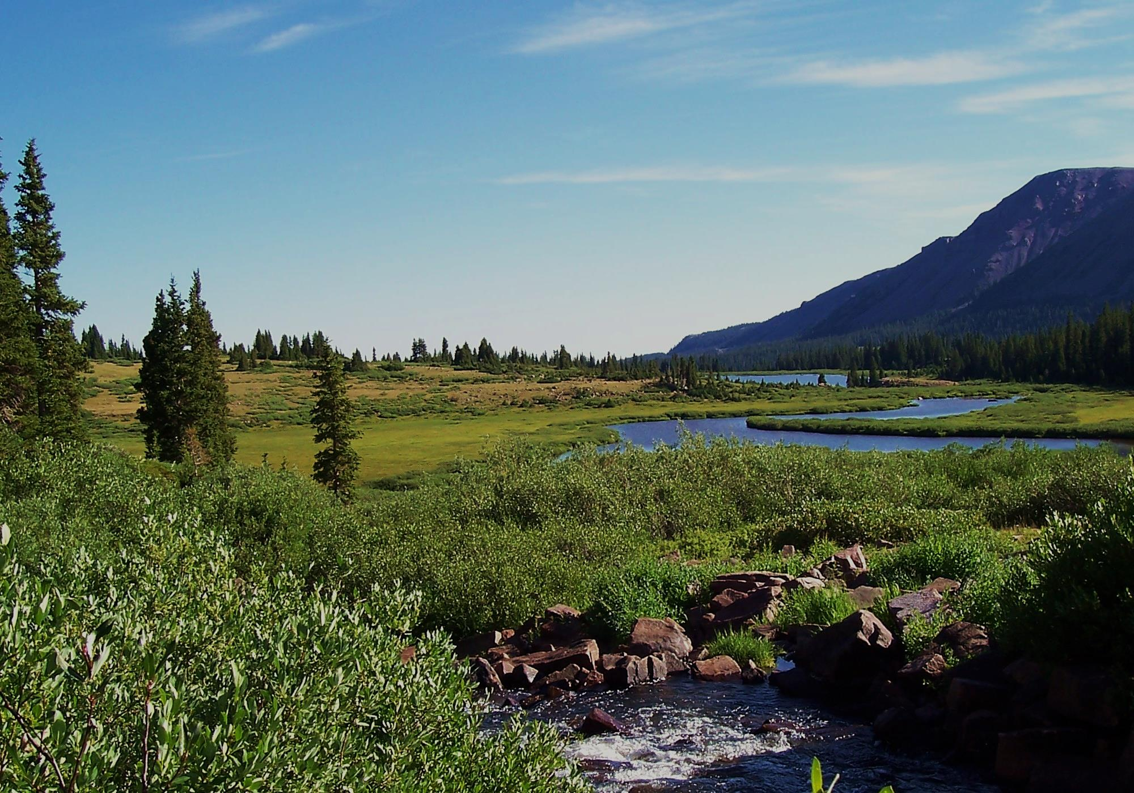
Intro to Public Land Survey

Slide 15
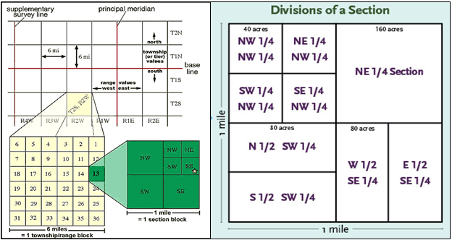
Township, Range, and Section
  Township—Typically a six-mile square area of land containing 36 sections.
  May also refer to a North-South row in the PLSS grid
  Range—An East-West row in the PLSS grid
  Section—Typically a one-mile square area, containing 640 acres.
Notes:
Typical townships and sections
Rivers, lakes, mountains, state borders are a few things that can cause irregular townships and sections

Slide 16
Typical Corner Sections and Quadrants
NW
N
NE
W
E
SW
S
SE

Slide 17
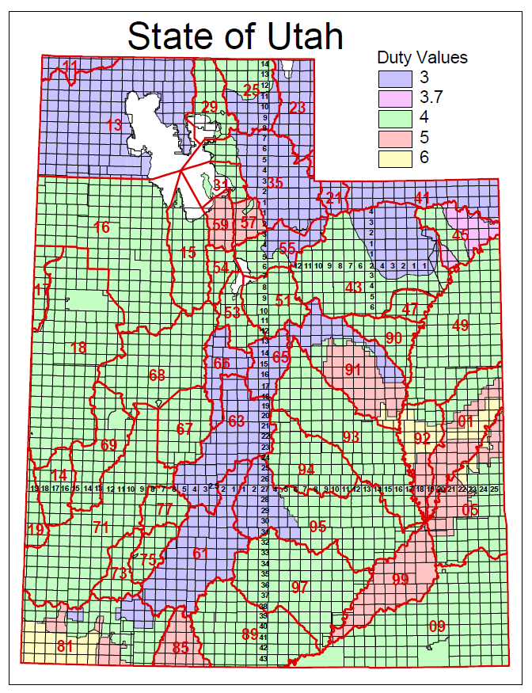
Utah Base & Meridians
Salt Lake B&M
  Beginning in Downtown Salt Lake
Uintah B&M
  Beginning about nine miles North of Roosevelt

Slide 18
Roosevelt,
Duchesne County
  Township 4 South, Range 5 West, USB&M
Stockton,
Tooele County
  Township 4 South, Range 5 West, SLB&M
Notes:
What problems this can cause:
Increase time to a decision by a month or more, if advertised incorrectly
Could require a change application to be filed to correct the description (Another filing fee for a change app and more time)

Slide 19
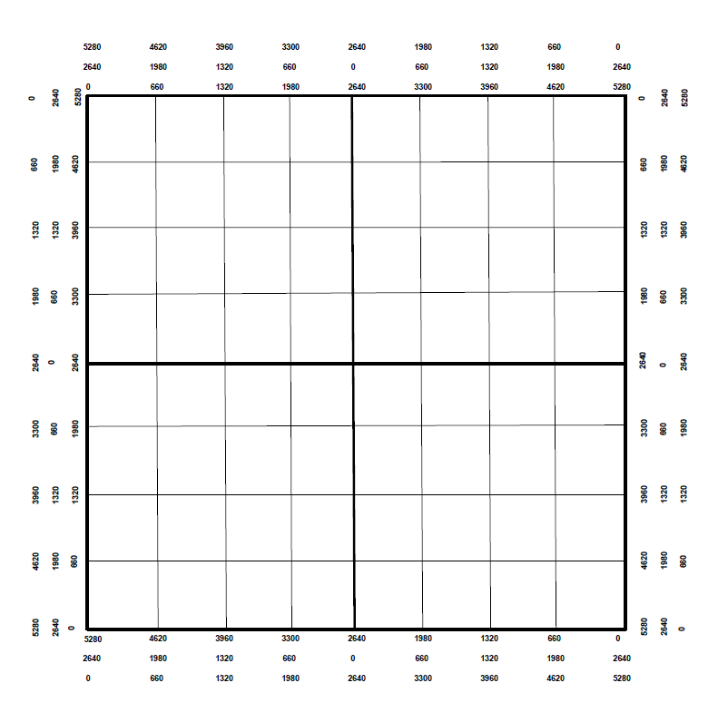
Marking a Point of Diversion
Locate the following:
  S 500’ and W 1200’ from the East Quarter Corner
  N 2000’ from the Southeast Corner
  S 1300’ and E 4000’ from the Northwest Corner
NW
E
SE

Slide 20
Marking a Place of Use
Locate the following:
  NW1/4 of the NW1/4
  S1/2 of the SW1/4
  NE1/4 of the SW1/4
  S1/2 of the NW1/4 and the S1/2 of the NE1/4

Slide 21
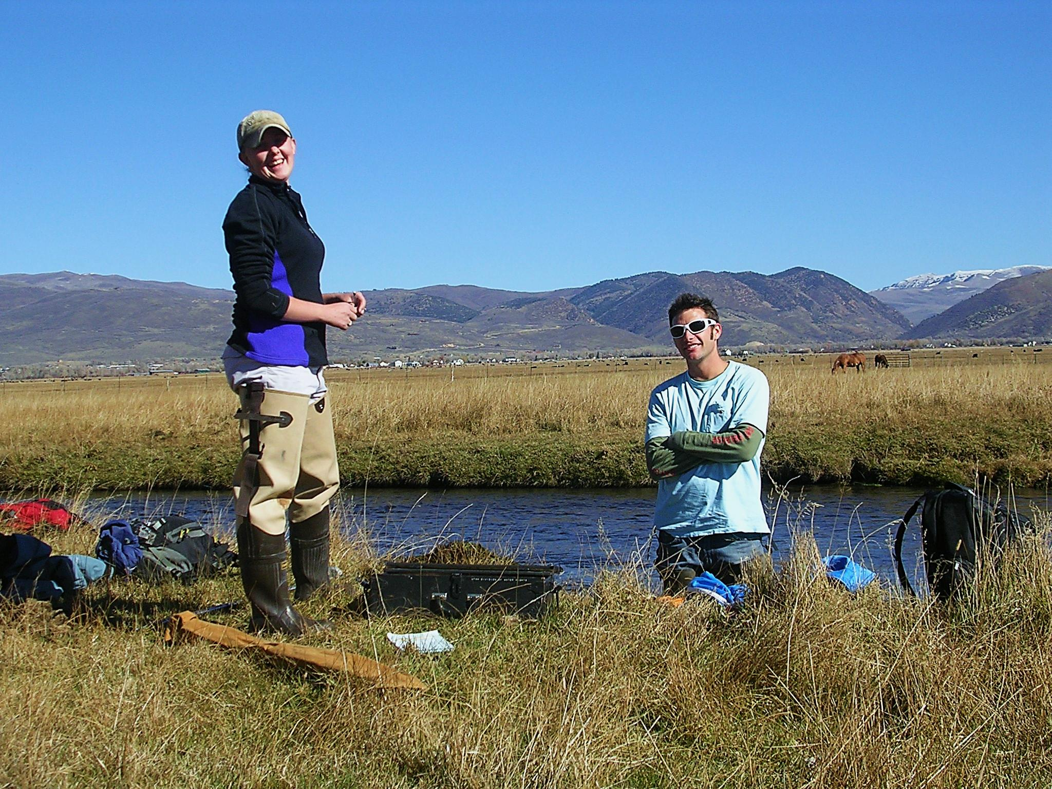
Water Right Calculations

Slide 22
Common Terms
Cubic Feet per Second (CFS)
  A unit of measure used to quantify the rate of flow from a water source
  Area(feet²) * Velocity (feet per second)
Acre-Feet (AF)
  A unit of volume defined as one acre of surface area to a depth of one foot.
  Depth of Water (feet) * Area (acres)
Notes:
CFS=Equal to a volume of water one foot high and one foot wide moving at a velocity of one foot in one second.

Slide 23
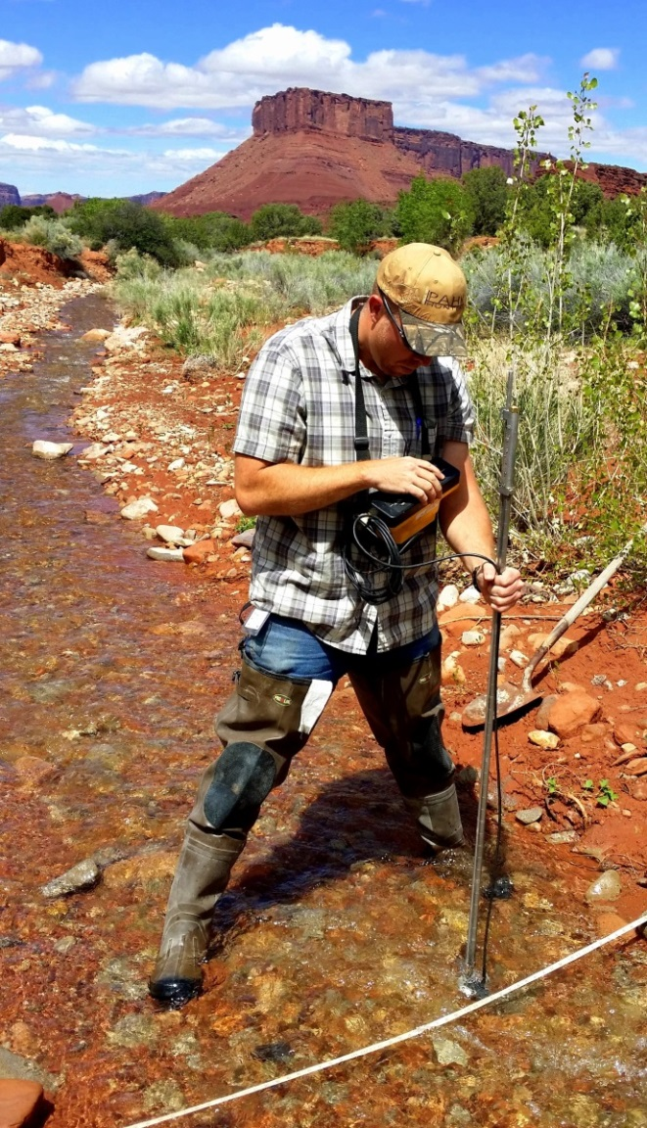
Duty Calculations
Irrigation
  Acres * Duty = AF per Year
  Irrigation duty values vary by area
Domestic
  Full time = 0.45 AF per Year
  Part time = 0.25 AF per Year
Livestock (ELU)
  1 ELU = 0.028 AF per year
  1 ELU = 1 Cow or Horse
  1 ELU = 5 Pigs, Sheep, or Goats
Notes:
The maximum volume of water allowed per year for a particular beneficial use.
For irrigation, the duty value varies from area to area within the state.

Slide 24
Sample Problem #1
A rancher wants to start a farm near Dugway, Utah (area 16). How much water does he need for 5 acres of irrigation, 50 cattle year-round, and a full-time home?
The irrigation duty in Dugway is 4 acre-feet/acre
  5 acres * 4 acre-feet/acre = 20 acre-feet
  50 cattle * 0.028 acre-foot = 1.4 acre-feet
  1 full-time home = 0.45 acre-foot
  Total diversion = 21.85 acre-feet
Notes:
These samples are diversion only, to practice converting between units

Slide 25
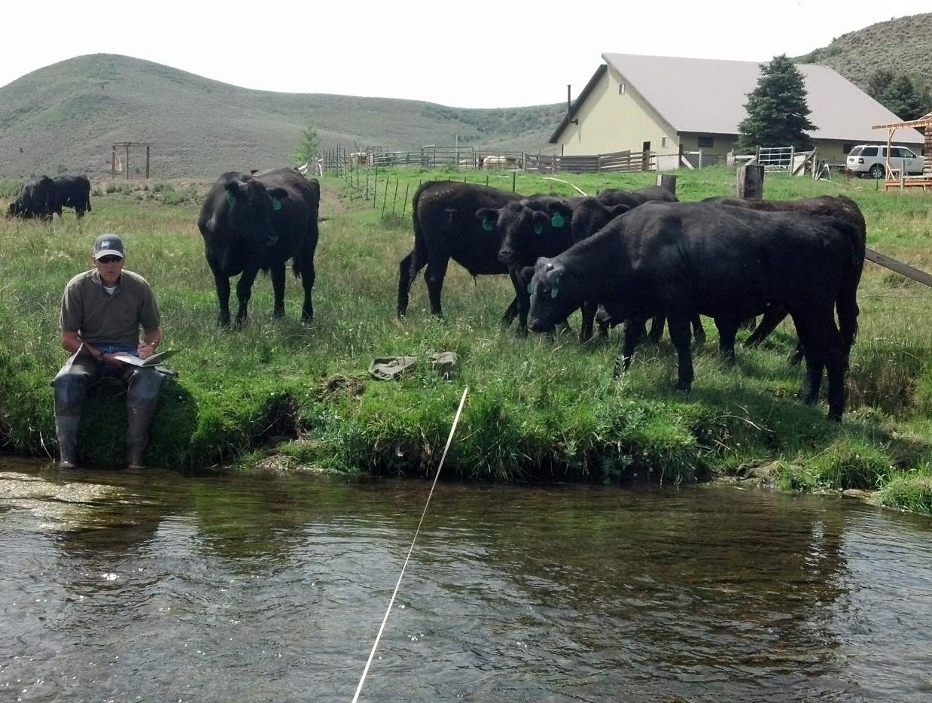
Sample Problem #2
A rancher has a water right for 300 cattle. How many sheep could he provide for with this water right?
300 cattle * 5 = 1500 sheep

Slide 26
Sample Problem #3
A developer wants to build a 10 lot subdivision in Delta, Utah (area 68). Each lot is supposed to have enough water for 0.25 acre of irrigation, 2 horses, and a full-time home. How much diversion will the water right need to have?
  Each lot requires
    0.25 acre * 4 acre-feet/acre = 1.0 acre-foot
    2 horses * 0.028 acre-foot = 0.056 acre-foot
    Full-time home = 0.45 acre-foot
    Total of 1.506 acre-feet
  Total project requires
    1.506 * 10 lots = 15.06 acre-feet

Slide 27
Sample Problem #4
A farmer has a water right in Brigham City (area 29) that serves 150 cattle year-round. He wants to change the water right to supply one full-time home, one part-time home, 10 horses, and irrigation for his yard. What is the maximum area (in acres) that can be irrigated, after the other uses are accounted for?
    150 cattle * 0.028 acre-foot = 4.2 acre-feet
    Full-time home = 0.45 acre foot
    Part-time home = 0.25 acre foot
    10 horses * 0.028 acre-foot = 0.28 acre foot
    4.2 acre-feet - 0.98 acre-foot = 3.22 acre-feet
    3.22 acre-feet / 4 acre-feet per acre = 0.805 acre
Notes:
Sample of Diversion and Depletion
Water right is for 2.0 acres of irrigation (duty 4) = 8.0 AF
Change to livestock
8.0 with a depletion of 50% = 4.0 AF of depletion
Livestock is 100% depletive so the allowable diversion for a change app would be 4.0AF
Historic use of irrigation would have been 8.0 AF of diversion and 4.0 AF of depletion
142.86 ELU (proposed change) would allow 4.0 AF of diversion and 4.0 AF of depletion
Without diversion adjustment the historic depletion would have been exceeded, enlarging the water right.

Slide 28
Diversion vs Depletion
Diversion is the water removed from the source to be used.
  E.g. Diverting 4.0 AF of water to irrigate 1.0 acre of land
Depletion is the amount of water that is consumed after application.
  E.g. After diverting 4.0 AF of water to irrigate 1.0 acre only 2.0 AF of water returns to the natural water system.
When evaluating Change Applications the State Engineer looks at the historical values for both diversion and depletion.
  Neither value can be enlarged.
Notes:
4.0 AF (Diversion)
Convert to livestock = ~143 cows
2.0 AF (Depletion)
Converts to livestock = ~71 cows
Water used up by the plants, bound to soil, and lost through evaporation, is water that doesn’t make its way back to the natural water system enabling other water rights to be satisfied.

Slide 29
Sample Problem #5
A water right owner has a water right for 3.0 acres of irrigation (duty is 4 feet per acre). He wants to change the use to include 50 cattle. How many acre-feet of water will he be able to divert after the change? Assume the rate of depletion for irrigation is 53%.
  Establish historic diversion and depletion
  3.0 acres * duty of 4 = 12.0 acre-feet (diversion)
  12.0 acre-feet * 53% = 6.36 acre-feet (depletion)
  Figure proposed uses
  50 cattle * 0.028 acre-foot = 1.4 acre-feet (100% consumptive)
  6.36 acre-feet – 1.4 acre-feet = 4.96 acre-feet depletion left
  4.96 acre-feet / 53% = 9.36 acre-feet remaining diversion
  9.36 acre-feet / duty of 4 = 2.34 acres of irrigation
  1.4 acre-feet + 9.36 acre-feet = 10.76 acre-feet of diversion
Notes:
Using Kamas Station for annual irrigation of alfalfa 19.29 inches or 1.6 feet, based on Dr. Hill’s Crop Consumption research.

Slide 30
Summary of Diversion and
Depletion Limits
Historical Use | Diversion | Rate of Depletion | Amount of Depletion
Irrigation: 3.0 acres | 12.0 acre-feet | 53% | 6.36 acre-feet
Totals | 12.0 acre-feet |  | 6.36 acre-feet
Proposed Use | Diversion | Rate of Depletion | Amount of Depletion
Irrigation: 2.34 acres | 9.36 acre-feet | 53% | 4.96 acre-feet
Livestock: 50 ELU | 1.4 acre-feet | 100% | 1.4 acre-feet
Totals | 10.76 acre-feet |  | 6.36 acre-feet
Notes:
Without considering depletion the diversion would have looked like: 10.6 acre-feet for irrigation (2.65 acre)

Slide 31
Diversion Based Change Applications
Why it feels like a “haircut”
  In this scenario depletion is exceeded by 0.66 acre-foot
Historical Use | Diversion | Rate of Depletion | Amount of Depletion
Irrigation: 3.0 acres | 12.0 acre-feet | 53% | 6.36 acre-feet
Totals | 12.0 acre-feet |  | 6.36 acre-feet
Proposed Use | Diversion | Rate of Depletion | Amount of Depletion
Irrigation: 2.65 acres | 10.6 acre-feet | 53% | 5.62 acre-feet
Livestock: 50 ELU | 1.4 acre-feet | 100% | 1.4 acre-feet
Totals | 12.0 acre-feet |  | 7.02 acre-feet
Notes:
Without considering depletion the diversion would have looked like: 10.6 acre-feet for irrigation (2.65 acre)
The State Engineer’s office evaluates diversion and depletion on all change applications. Most applications come in based on diversion only. When the final order is issued the applicant may feel like water was taken away from him because it was not expected nor understood.

Slide 32
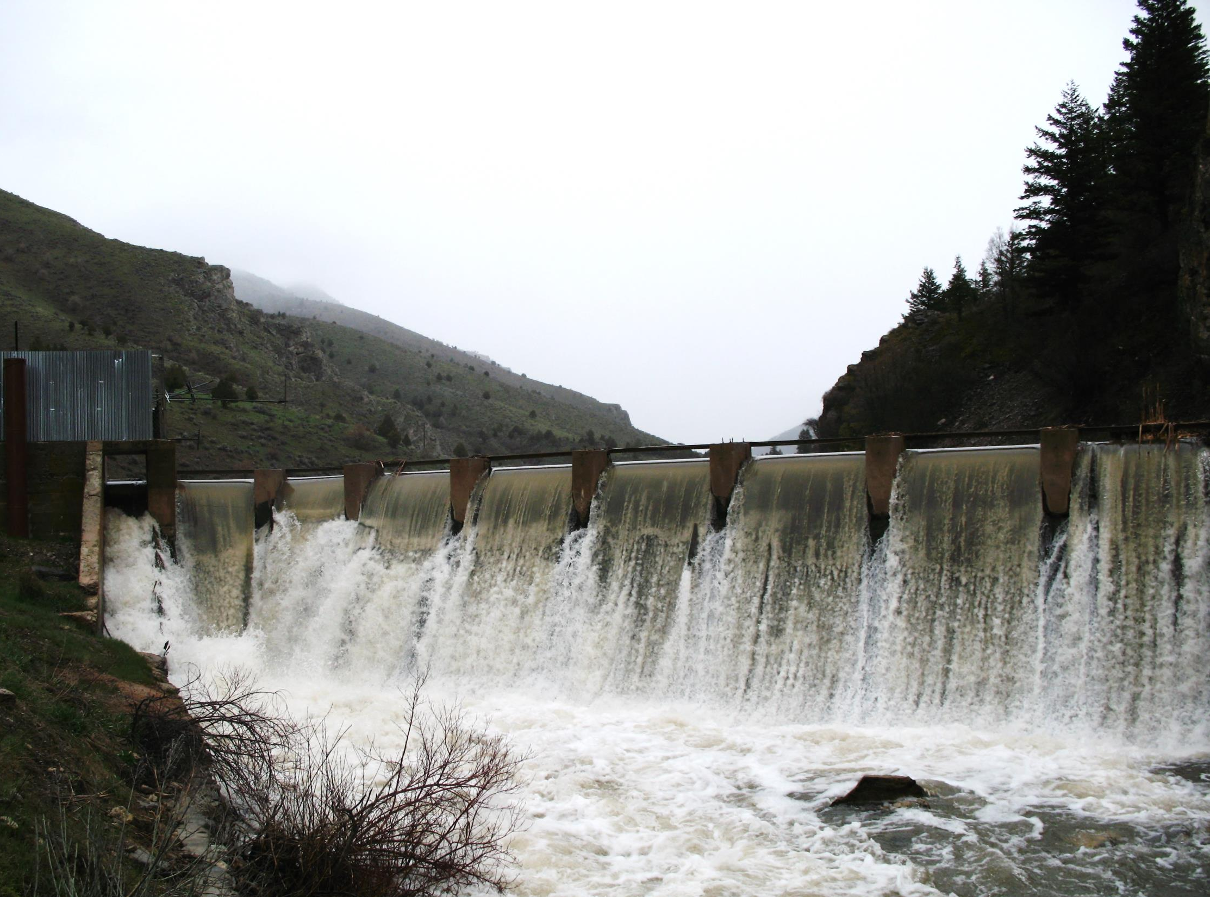
Making an Application Map

Slide 33
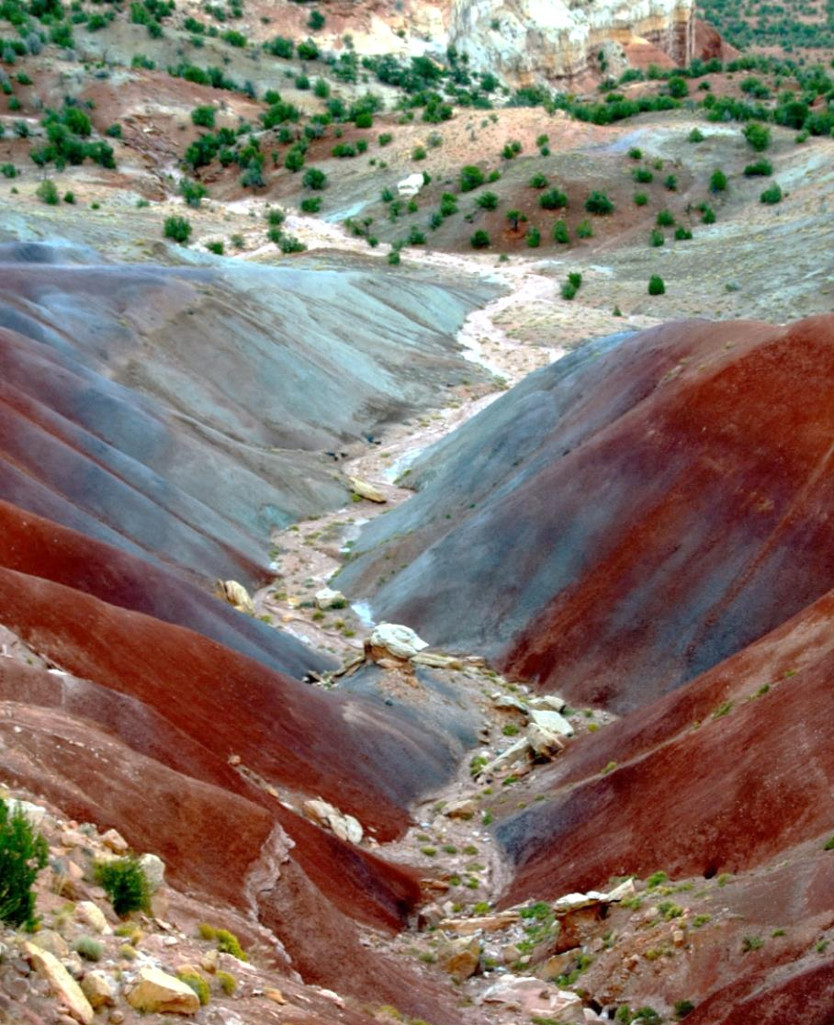
Using the Division’s Website to Get a Point of Diversion (POD)
Be able to locate the property from an aerial map.
Know the approximate location where the well or point of diversion will be located

Slide 34
Application Map Wizard
Access from the application/form link on the Division’s Website.
Allows a user to select a point of diversion and place of use from an aerial photo and print a map to accompany an application.
Can be generated with signature lines.
Not acceptable as a proof map.

Slide 35
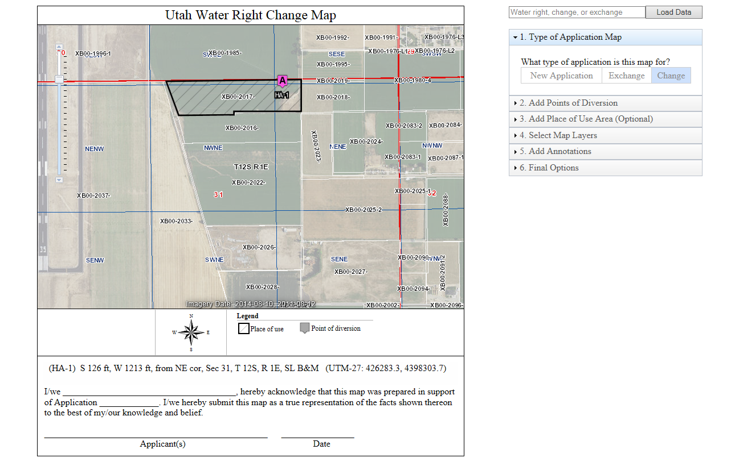
Sample Application Map

Slide 36
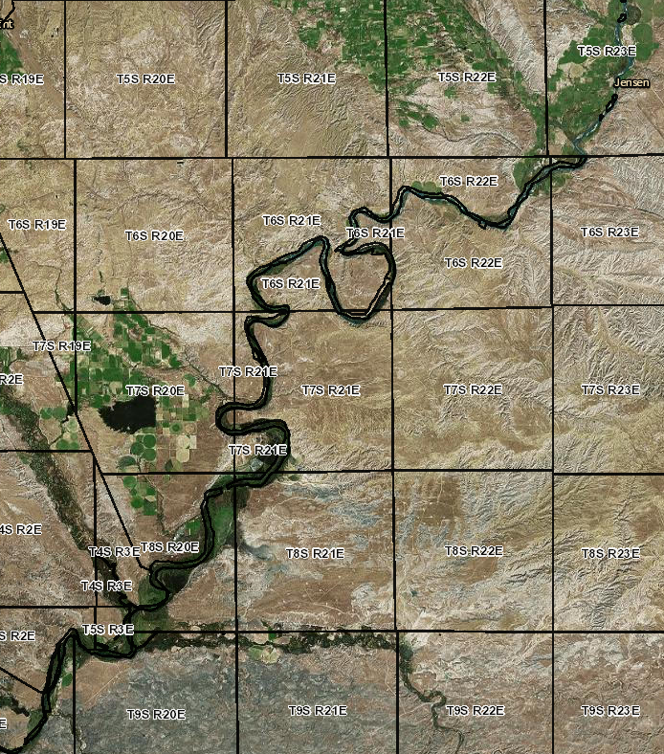
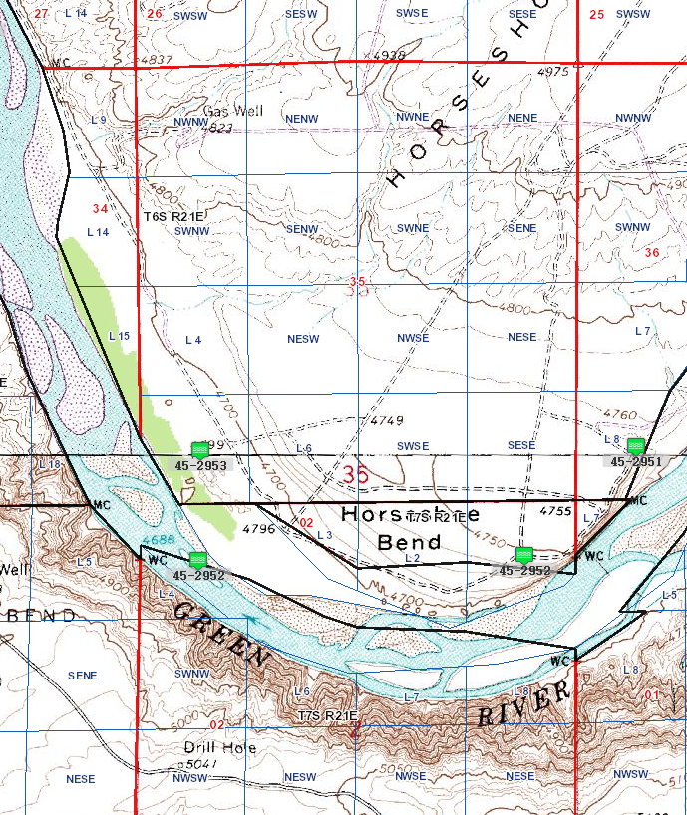
Researching with Map Search (ESRI)
Ranges on Aerial
Sections on Topo
Notes:
Show base map features
Show POD features
Show heretofore and hereafter points

Slide 37
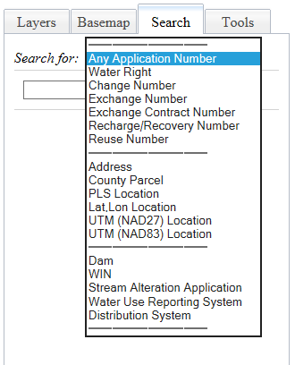
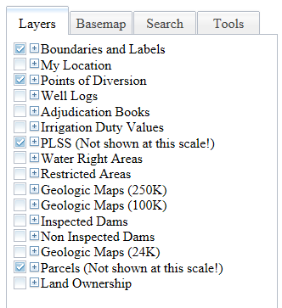
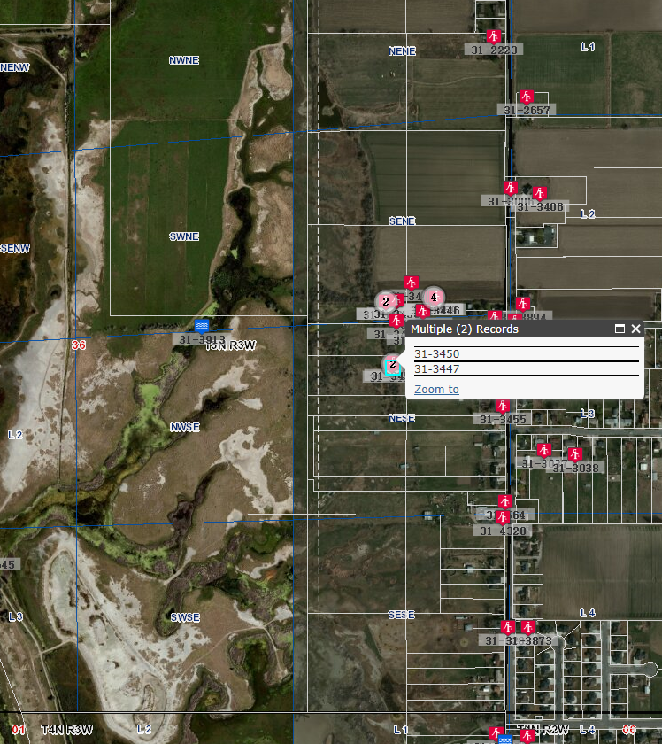
Layers and Search Tools

Slide 38
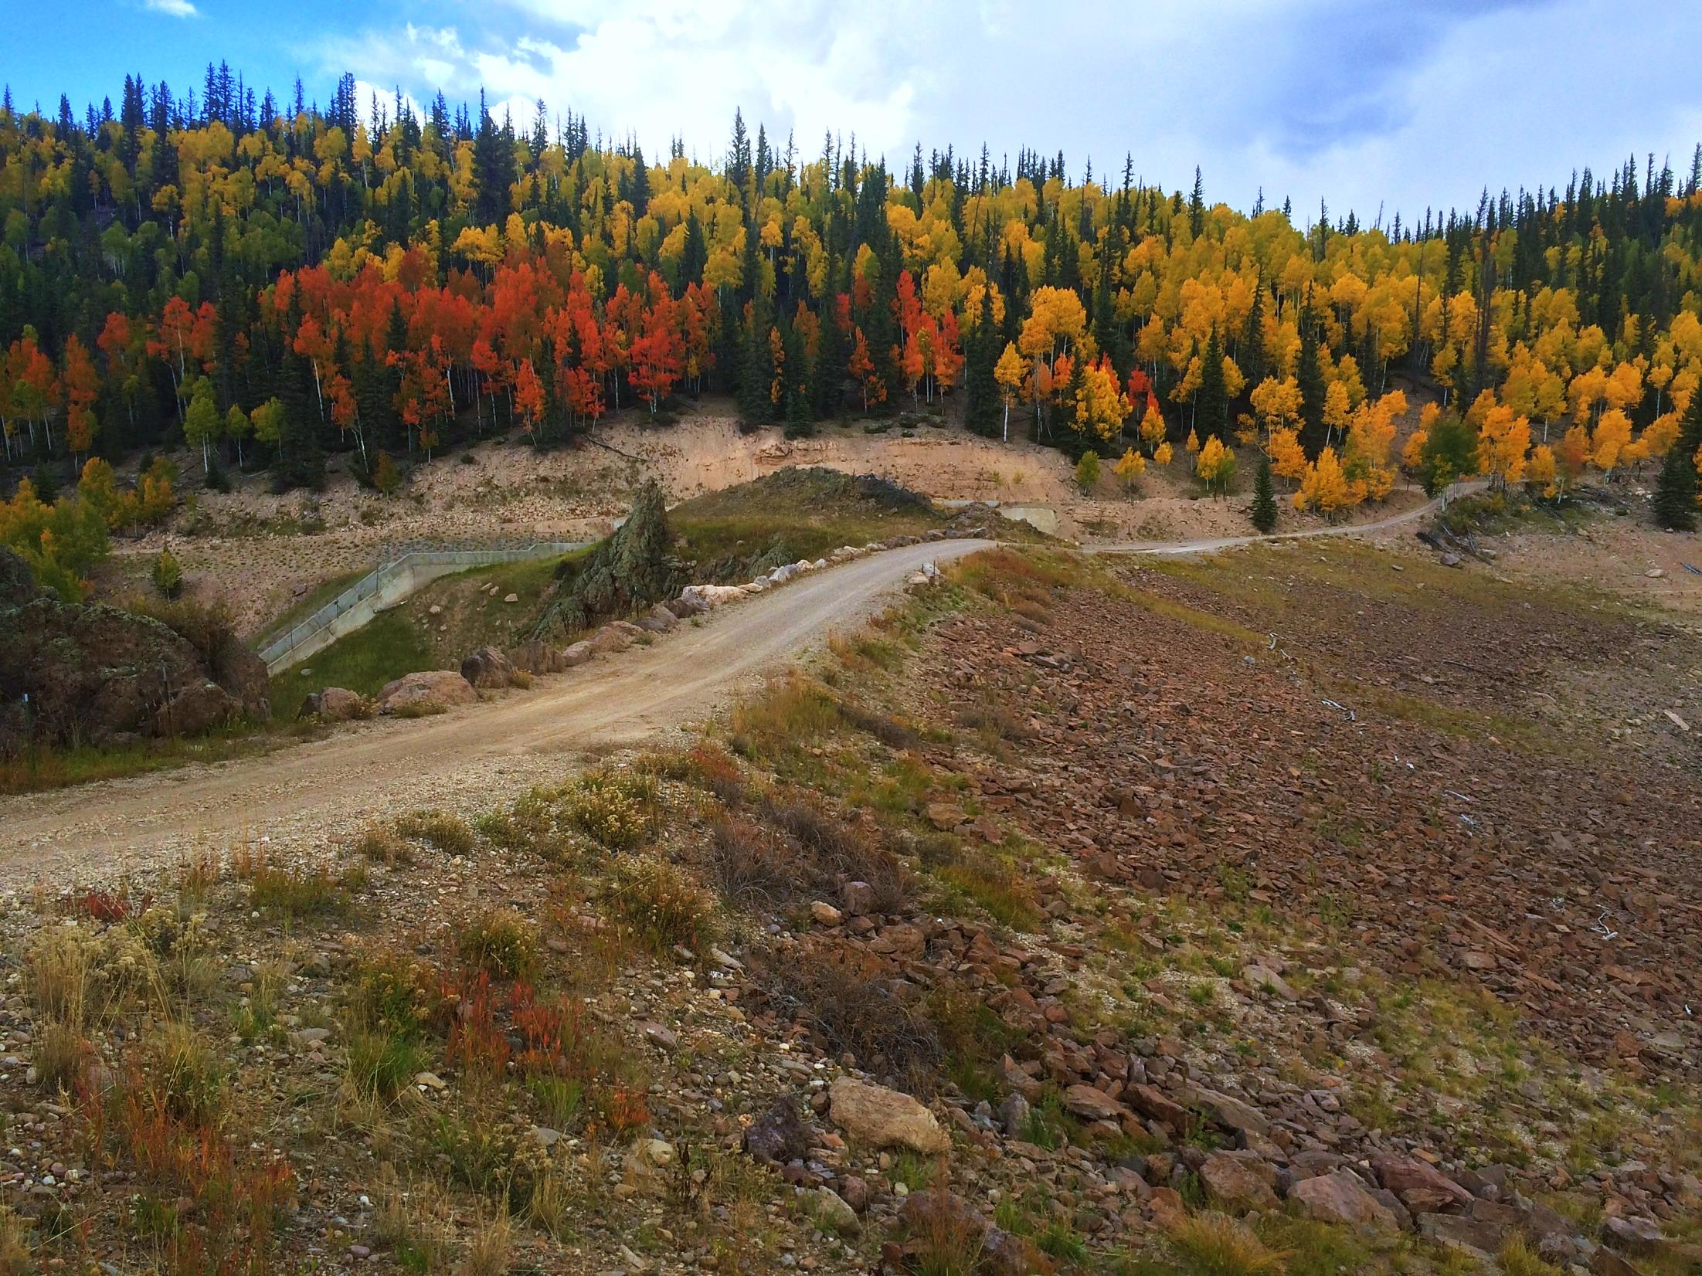
Summary and Wrap-Up

Slide 39
Topics Covered
Elements common to all applications
Intro to the Public Land Survey System
Basic water right calculations
How to use the Division’s website to create an Application Map

Slide 40
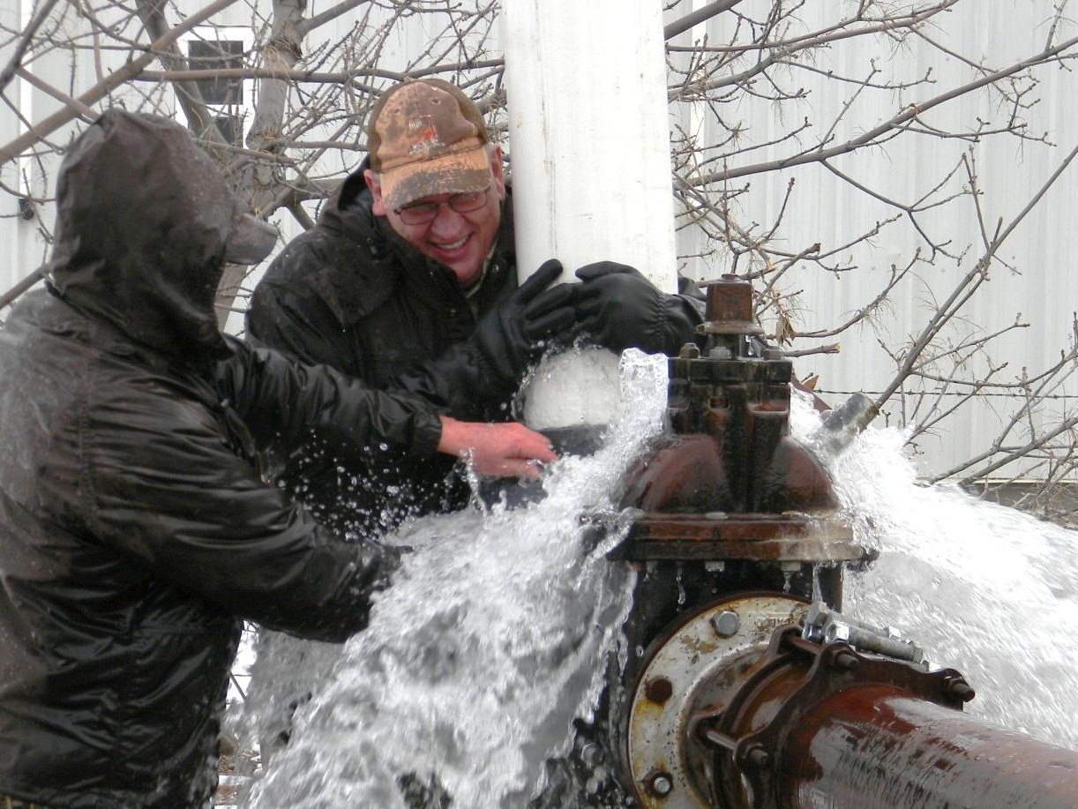
Questions?

