Slide 1
Utah Division of Water Rights
RWAU Water Right Training
Other State Engineer Roles
Kurt Vest, P.E.
Enforcement Engineer
June 21, 2004

Slide 2
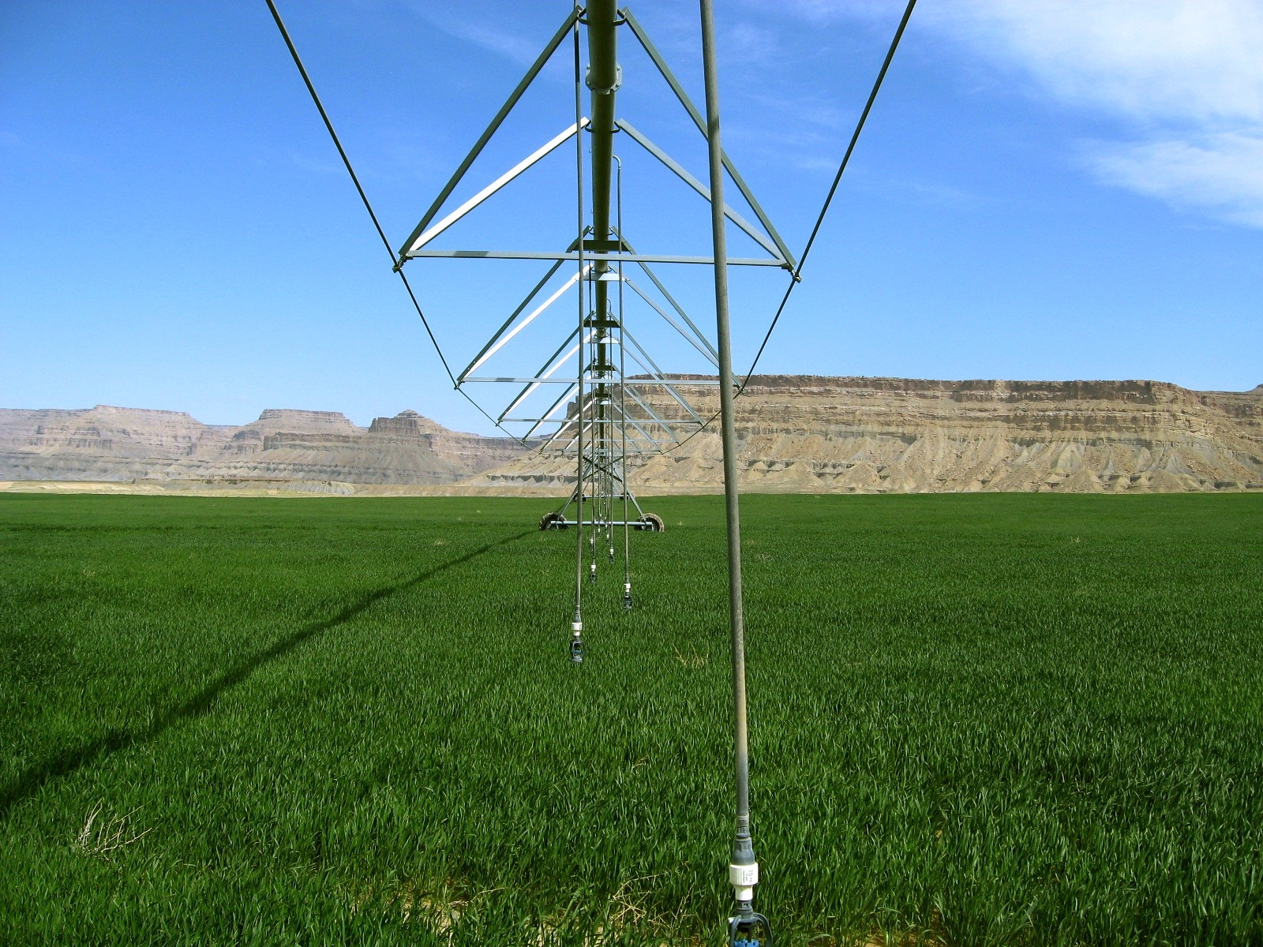
EnforcEment

Slide 3
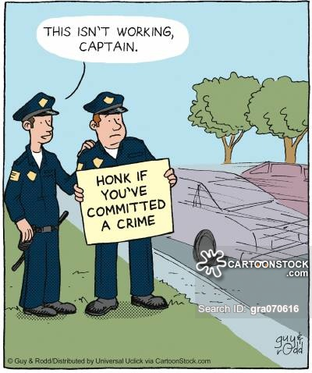

Slide 4
History and Background
Prior to 2005:
State Engineer had no direct enforcement authority
Persistent violations were addressed by:
Criminal complaints when allowed by statute
Civil litigation in pursuit of a court order
Lacking civil litigation by injured parties, violators suffered no penalties

Slide 6
The 2005 Statutes
Section 73-2-25: State Engineer enforcement powers
Section 73-2-26: Administrative penalties
Section 73-2-27: Criminal penalties
Section 73-2-28: Cost and fees in civil actions
The 2005 Administrative Rules
Rule R655-14: Administrative Procedures for Enforcement Proceedings Before the Division of Water Rights

Slide 7
§ 73-2-25: Powers
When is an “enforcement action” authorized?
Taking water without right or in violation of an existing right
Failure to comply with statutes, orders or notices regarding headgates, measuring devices, etc.
Notes:
Slide 8 – When is an “enforcement action” authorized?
Taking water without a right
Violating an existing right means to exceed or violate any of the limiting characteristics of a water right - POD, POU, Period of Use, Nature of Use, Flow Rate, etc.
Failure to comply with a requirement to install or repair headgates and measuring devices.

Slide 8
§ 73-2-25: Powers
Failure to comply with an order or notice regarding dam safety or natural stream channel alteration
Notes:
Slide 9 – continued
Orders and notices regarding stream alteration or dam safety

Slide 9
§ 73-2-25: Powers
When is an enforcement action not authorized:
One year or more has passed since violation
Civil disputes between or among water users
Internal disputes in water or irrigation companies
Right-of-way, easement or trespass disputes
Notes:
Slide 10 – When is an “enforcement action” not authorized?
12 month statute of limitations
The State Engineer can only enforce based upon the water rights of record in the office of the Division of Water Rights – therefore he has no authority, responsibility or information to enforce in situations involving private water related agreements between water users or internal disputes within water or irrigation companies.
Right-of-way or trespass violations are not water right violations even though it may involve a water related structure such as a canal.

Slide 10
To commence enforcement action SE issues an initial order, which includes:
A description of the violation;
Notice of any penalties to which person may be subject; and
Notice that SE may treat each day’s violation as a separate violation.

Slide 11
Final Order; the SE may order that person:
Pay an administrative fine not to exceed:
(A) $5,000 for each knowing violation; or
(B) $1,000 for each violation that is not knowing;
Replace up to 200% of water taken; and
Be liable for any expenses incurred by the SE or Division in investigating and stopping the violation.
Each day of a continuing violation is a separate violation.
A penalty may not be imposed for a violation occurring more than 12 months before a NOV issued.

Slide 12
Before imposing a fine or ordering replacement the SE shall consider:
The value or quantity of water unlawfully taken;
The gravity of the violation, including the economic injury or impact to others;
Whether the person subject to fine attempted to comply with the SE’s orders; and
The violator’s economic benefit from the violation.
R655-14. Administrative Procedures for Enforcement (25 pages single spaced)

Slide 13
Goal of Enforcement Program (My instructions)
Resolve all 1st time offenses informally without having to resort to formal enforcement proceedings and/or levy any fines.
If violation is egregious enough can still consider formal enforcement on 1st time offense.
Any 2nd time offenses will result in commencement of an enforcement action.

Slide 14
Remember I Still Carry a Big Stick

Slide 15
Dam Safety

Slide 17
Power of SE to regulate dams
SE has authority to regulate dams for public safety
SE may make rules controlling construction and operation of dams, including:
Design;
Maintenance;
repair;
Removal; and
Abandonment.
SE may exempt any dam that:
Impounds less than 20 AF and if fails threatens no human life; or
Does not threaten human life and if fails only minor damage to owners property.

Slide 18
Qualifications of persons designing dams
Each plan for the construction, enlargement, repair, alteration, or removal of any dam shall be prepared by a qualified engineer who is:
Licensed in Utah; and
Experienced in dam design and construction.
Written approval must be obtained from SE prior to commencing work.

Slide 19
Owners required to perform maintenance
After inspection, SE specifies maintenance necessary for dam
SE may issue orders for:
Engineering studies;
Repairs;
Storage limitations;
Removal of dam;
Breaching of dam; or
Any other remedy SE determines appropriate.
Owner of dam responsible for maintenance.

Slide 20
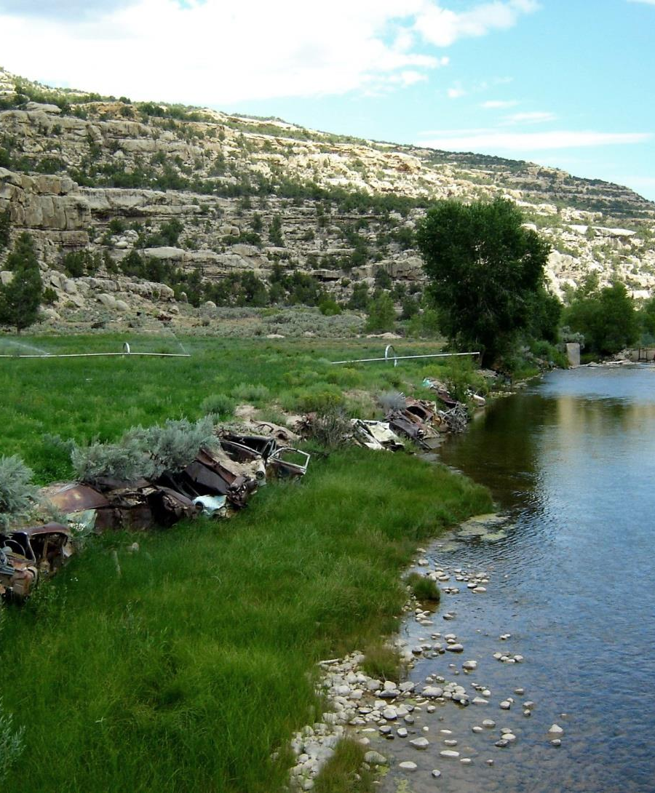
Stream Alterations
Natural Source
To divert you need a water right
To alter you need a state stream alteration permit
Federal permission under clean water act (404 permit)

Slide 21
Relocate or Alter Natural Streams
May not relocate any natural stream channel or alter beds and banks without first obtaining written approval of SE
Fee based upon the entity applying for permit:
Non-Commercial applicant….$100
Governmental applicant………$500
Commercial applicant………….$2000

Slide 22
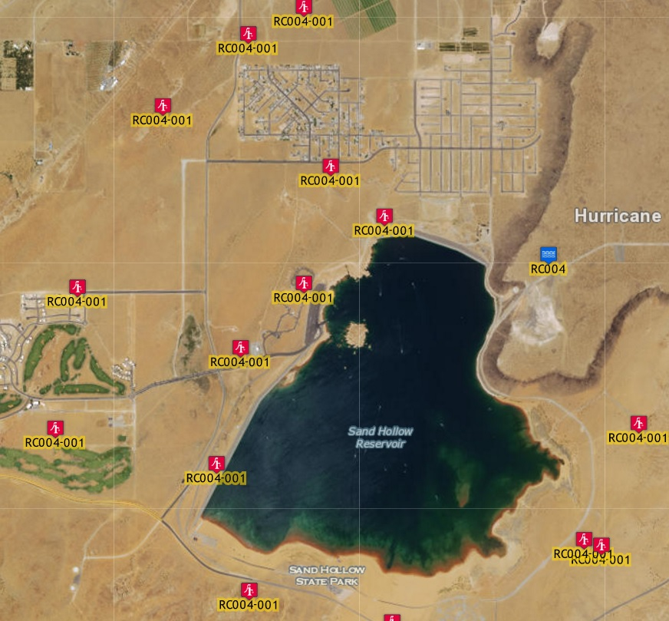
Groundwater Recharge and Recovery

Slide 23
Groundwater Recharge and Recovery
A person may not artificially recharge an aquifer without first obtaining a recharge permit.
A person may not recover from an aquifer water that has been artificially recharged unless the person first obtains a recovery permit.
A person proposing to artificially recharge water into an aquifer must have:
A valid water right; or
An agreement to use the water with a person who has a valid water right.
A person who holds a recovery permit may recover the amount of water stored that remains within the hydrologic area of influence.

Slide 24
Application for a Recharge Permit
The name of the groundwater basin;
A legal description of the proposed recharge project;
The source and amount of water proposed to be recharged;
A valid water right for project;
Quality of water recharged and water quality of receiving aquifer;
Have applied for all applicable water quality permits;
A plan of operation which shall include:
Design capacity;
A detailed monitoring program; and
Proposed duration of the project.

Slide 25
Application for a Recharge Permit continued
Copy of a study demonstrating:
The area of hydrologic impact of project;
The recharge project is hydrologically feasible;
The recharge project will not:
Cause unreasonable harm to land; or
Impair any existing water right; and
The percentage of anticipated recoverable water;
Evidence of financial and technical capability.
A filing fee is submitted based on the amount of water proposed to be recharged.

Slide 26
Application for a Recovery Permit
May be filed with a recharge permit application;
Legal description of well(s) intended to recover water;
Name of groundwater aquifer which is the source of supply;
The purpose for which water will be recovered;
The depth and diameter of well(s);
A legal description of land where water will be used;
The designed pumping capacity of the well(s).
A filing fee must be submitted with the application - $2500

Slide 27
Storage account - Monitoring
The SE will establish a storage account for each groundwater recharge and recovery project;
Person holding a groundwater recharge or recovery permit shall:
Monitor the operation of the project and its impacts; and
File reports with the SE regarding:
The Quantity of water stored and recovered; and
The Water quality of the recharge water, receiving aquifer, and recovered water.
Annual fee assessed that covers Division’s costs to administer.

Slide 28
Reuse of wastewater

Slide 29
Reuse by public agency owning WR
A public agency owning or operating a POTW that treats domestic wastewater consisting of water supplied under a WR the agency owns may use, or contract for the use of, reuse water if:
The WR is administered by the SE as a municipal WR;
The reuse is consistent with underlying WR; and
The public agency receives approval from Water Quality Board and SE

Slide 30
Reuse by public agency under contract
A public agency may use or contract for the use of reuse water if:
The domestic wastewater consists of water for which the agency has a reuse authorization contract;
The WR is administered by the SE as a municipal WR;
The reuse is consistent with underlying WR; and
The public agency receives approval from Water Quality Board and SE

Slide 31
Application to the State Engineer
A public agency proposing water reuse shall apply to the SE.
An application for water reuse shall include:
A description of the underlying WR;
An evaluation of the underlying WR’s diversion, depletion, and return flow requirements;
The estimated quantity of water to be reused; and
An evaluation of depletion from hydrologic system caused by water reuse.
The SE shall conclude that reuse is consistent with WR if:
The use does not enlarge the underlying WR; and
Any return flow requirements of underlying WR is satisfied.

Slide 33
QUESTIONS?

