Slide 1
Utah Water Users Workshop
Water Right Issues of the State Engineer
Kent L. Jones, P.E.
March 19, 2019 State Engineer
kentljones@utah.gov
Notes:
Watching 4 bills…. Turned into 20 bills.

Slide 2
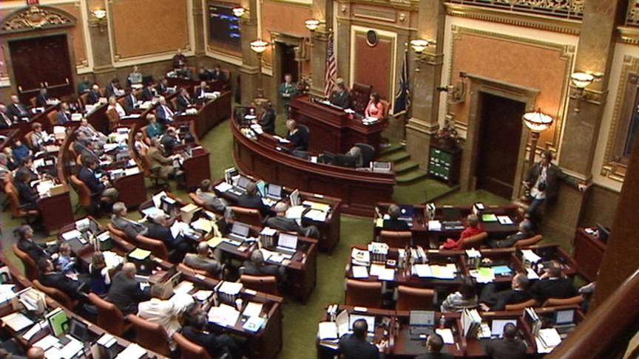
Legislative Bills 2019
HB125 Quantity Impairment Modifications (Albrecht) – “and” to “or”
HB355 Water General Adjudication Amendments (Ferry) – Summons, small domestic reinstatements, and appeals
SB66 Dam Safety Amendments (Sandall) – Regulate safety of dams not what is around them.
Notes:
HB125 To the extent that, for a period of at least seven consecutive years, a protion of the right identified in a change application has not been: diverted from the approved point of diversion AND beneficially used at the approved place of use. “AND” changing to “OR”
HB355 Summons, small domestic application reinstatements, and appeals can be finalized through the adjudication process.
SB66 Clarifies that the State Engineer’s role is to regulate the safety of dams for the purpose of protecting the public should it fail.

Slide 3
Legislative Bills 2019
HJR5 Joint Resolution Approving Notes to Water Rights Addendums (Owens) – Adopts notes to water right addendums
HB31 Water Supply and Surplus Water Amendments (Coleman); SB17 Extraterritorial Jurisdiction Amendments (Okerlund); and HJR1 Proposal to Amend Utah Constitution – Municipal Water (Stratton)
Notes:
HJR5 … 2011 Deed Addendums adopted by Legislature. 2013 Deed Addendums authorized as ROCs. Instructions, as part of the 2011 adoption were not updated and there was an inconsistency between the statute and the instructions. This fixes that. 11,000 Addenda filed since 2011.

Slide 4
Legislative Bills 2019
SCR9 Concurrent Resolution Regarding Navajo Water Rights Settlement Agreement (Hinkins) – Declares support for the negotiated settlement agreement of the federal reserved water rights claims
HB12 Instream Flow Water Rights Amendments (Hawkes) - Repeals the repeal date for an instream flow for trout habitat
SB52 Secondary Water Requirements (Anderegg) – New secondary water to be metered April 1, 2020; Secondary water suppliers to develop a plan for metering by December 2019; requires reporting to Water Rights; Requires a study of issues relating to metering secondary water by the Utah Water Task Force.
Notes:
SCR9 Settlement Agreement agreed to by the State, Navajo Nation, and Federal Government. Romney to sponsor, Bishop already filed a House bill.

Slide 5
Legislative Bills 2019
SJR1 Joint Resolution Supporting the Study of Water Banking in Utah (Iwamoto) – Encourages the study of possible options to create and develop water banks to further the 2017 State Recommended Water Strategy and prepare recommendations to consider for the 2020 legislative general session
HCJ10 Concurrent Resolution to Address Declining Water Levels of the Great Salt Lake (Hawkes) – Recognizes the critical importance of continued water flows to Great Salt Lake and its wetlands and the need for solutions to address declining levels while appropriately balancing economic, social, and environmental needs. Urges development of policy recommendations
Notes:
SJR1 Many parts of the state are practicing what could be considered a bank as water shares are interchanged and users decide amongst themselves who is going to use the water where. Change applications have been filed to all for the movement of water between companies and different places of use.
Banking is done in other states. It seems to work real well when you have a reservoir to bank the water in.
It doesn’t seem like a good idea if the only reason a bank is established is to protect it from nonuse. It seem like there are better ways to do that … like using the water or filing nonuse applications. But we’re real interested in being involved in studies to see if they can help meet our future demands for water. I get concerned about senior right holders who aren’t using their water so that a junior user now gets to use it. If the senior right is banked, the junior user may be out of luck for getting what he used to get unless some type of concessions can be made. I am concerned about timing issues on the river systems if water is banked and I think of all the downstream users who are dependent on return flows that may not be there if water is banked and sent in different directions or used in different times of the year. Timing is critical on some of our river systems. These are just some of the fun things we get to look at and study. There are ways that this can be a great tool but we have to be careful how systems interact and are so dependent on one another’s actions. This will be a fun process.
HCJ10 The Great Salt Lake is a critical resource for the state. It is important to preserve what we can. It is something we need to study and be aware of. But every time I think about it I wonder where is the water going to come from? We’re dealing with a lake that has been on the decline for over 15,000 years. Even though it can be demonstrated that man caused effects have definitely caused a steeper decline than if people weren’t here, it was still declining and what now can we do to help stabilize it as much as we can and preserve the resource. It’s a difficult task but needs to be studied and actions taken to do what we can. There is water there, but most of it is appropriated. What steps can be taken to reclaim some of that water or what concessions do we need to make to help maintain the ecosystem? It’s a very important issue to study and to take some kind of action to address the problem.

Slide 6
Southern Utah/Goshen Valley Ground-Water Management Plan
A contaminated site has been identified near the mouth of Spanish Fork Canyon.
The contamination plume is dynamic.
The identified contaminated area boundary will be defined as the area inside a 1000-foot buffer around a contamination concentration contour.
Applicants seeking to move water rights into the identified contaminated area are cautioned that the water within this area must still be adequately treated before the water is used.
Notes:
A contaminated site has been identified near the mouth of Spanish Fork Canyon with high levels of nitrate and explosive compounds. The contamination plume is dynamic and the area defining its location as reported in Ensign-Bickford’s Ground Water Annual Report will be reviewed and periodically updated as needed on the Division of Water Rights’ website mapping tool. The identified contaminated area boundary will be defined as the area inside a 1000-foot buffer around the contamination concentration contour derived from water sample data where the explosive compound commonly referred to as RDX is found in concentrations greater than 2.0 ppb. Through consent agreements the state of Utah has provided to the entity responsible for cleaning up the contamination assurances which have allowed the process to proceed. Applicants seeking to move water rights into the identified contaminated area are cautioned that the water within this area must still be adequately treated before the water is used. Applicants shall acknowledge their proposed point of diversion is located within the contaminated area and shall demonstrate in the change application filing that the future withdrawal of water will not interfere with the clean-up process or be detrimental to public welfare.

Slide 7
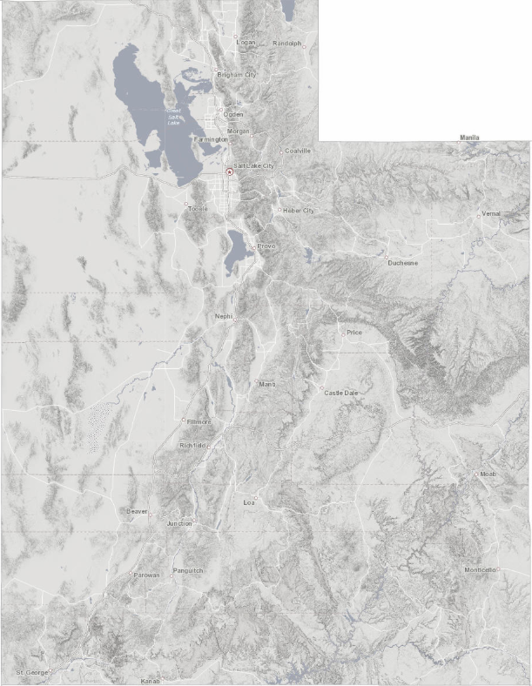
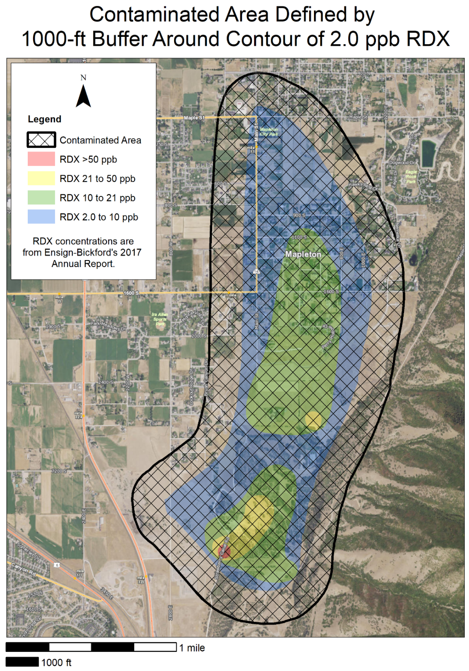
Notes:
There has been significant cleanup and we don’t want to cause a deterrent to the cleanup efforts.

Slide 8
Southern Utah/Goshen Valley Ground-Water Management Plan
Applicants shall acknowledge their proposed point of diversion is located within the contaminated area and shall demonstrate in the change application filing that the future withdrawal of water will not interfere with the clean-up process or be detrimental to public welfare.

Slide 9
Policy for Depletion Limitations on Certificates
New Certificates set new limitations for the right concerning diversion, depletion, nature of use, place of use, point of diversion, and period of use as detailed in the Certificate.
These limitations are the basis for future considerations of the right.
If you want to go back to original uses, a change application will have to be filed.
Notes:
Example of irrigation to home use. Certificated and wanted to go back to irrigation. Could only irrigate less acres because of the new depletion limitations.

Slide 10
Policy for Depletion Limitations on Certificates
Certificates issued for a more depletive use than the original use sometimes have the diversions cut back to the depletion limitation.
Even though diversions have been cut back to the depletion limitation in a new Certificate, the original flow rate can be reestablished through a change application process assuming depletions stay the same and impairment of other rights is not an issue.

Slide 11
Policy for Depletion Limitations on Certificates
If a change application is approved and not certificated, a new change application can be filed to replace the approved change application using the last certificated diversion and depletion limitations associated with the right.

Slide 12
Diversion vs Depletion
Diversion is the water removed from the source to be used.
Diverting 4.0 AF of water to irrigate 1.0 acre of land
Depletion is the amount of water that is consumed after application.
After diverting 4.0 AF of water to irrigate 1.0 acre only 2.0 AF of water returns to the natural water system.
When evaluating Water Rights the State Engineer looks at the historical values for both diversion and depletion.
Neither value can be enlarged.
Notes:
4.0 AF (Diversion)
Convert to livestock = ~143 cows
2.0 AF (Depletion)
Converts to livestock = ~71 cows
Water used up by the plants, bound to soil, and lost through evaporation, is water that doesn’t make its way back to the natural water system enabling other water rights to be satisfied.
Depletion needs to remain the basis for evaluating application that come before us. Quantity Impairment in statute means any reduction in the amount of water a person is able to receive in order to satisfy an existing right to the use of water that would result from an action proposed in a change application including: Diminishing the quantity of water in the source of supply; A change in timing of availability of water from the source of supply; enlarging the quantity of water depleted by the nature of the proposed use when compared with the nature of the current approved use.
We have to keep these base principles in mind as we consider solutions to meet our ever growing demands for water in this state.

Slide 13
Policy for Issuing Corrected Certificates
Section 73-3-17, Certificate of Appropriation:
“Upon the satisfaction of the state engineer that an appropriation … has been put to a beneficial use … the state engineer shall issue a certificate…”
The certificate sets the limitations of the right in both diversion and depletion based on the beneficial use of the water.

Slide 14
Policy for Issuing Corrected Certificates
There are times when errors or omissions occur in the proof and certificate process.
Corrected Certificates can be issued to correct those deficiencies.
The primary effort should be to issue Certificates accurately and carefully to reflect the actual beneficial use of water.
There is no obligation under statute to correct Certificates based on errors or omissions but seems appropriate to reflect actual beneficial use.
Notes:
Town had one well. Filed change to go to two wells. Submitted proof on only the new well
Proof on a home for house, animals, and irrigation in wrong township and range.
Historic acreage didn’t show up on certificate but was referenced on proof and shown to be in actual use at the time of proof.

Slide 15
Policy for Issuing Corrected Certificates
Corrected Certificates should only be issued to reflect actual beneficial uses that existed at the time of proof where such uses were consistent with the application.
Corrections should only occur on a Clear Showing of Error.
Certificates are prima facie evidence of a right and Corrected Certificates are not preferred and may lead to problems
Issuing correct Certificates the first time is and should remain our aim.

Slide 16
Policy for Domestic Duty Considerations
Since the early 1980’s, the State Engineer has used indoor domestic duties based on 400 gallons/connection/day which is about 0.45 ac-ft/year.
With continuing conservation efforts, studies have shown that 70 gallons per person per day may be a more reasonable estimate for indoor domestic use in Utah. With an estimated average of 3.6 people per connection that equals about 250 gallons/connection/day or about 0.28 ac-ft/year on average for a full-time, year-round residence. Part-time recreational usage may only require 0.14 ac-ft/connection or less based on those numbers.
Based on the conservation numbers, 0.45 ac-ft would supply the annual inside domestic needs of 5.7 people. While some homes exceed that number, on the average there are less people per connection than 5.7.
Notes:
Ann and I, 3000 gal./month max some times 2000 gal/month; 50 gal/person/day 34 gal/person/day at 2000. Ann will be excited we don’t have to shower together any more to save water… we’ll be just fine. Sometimes we water people are pretty tricky! Sometimes it’s good to be the State Engineer!

Slide 17
Domestic Duty
While 0.45 ac-ft/connection is a safe number that will cover a large usage per connection, that amount of water may not be needed to meet the projected needs of the residential users in any particular situation. It is a number we will continue to used if there is no evidence that it should be different.
The State Engineer will consider reduced amounts of water required per connection in applications filed if the projected usage rate numbers are based on scientific evaluations and the water used is measured and reported to the Division of Water Rights through the Water Use Program.

Slide 18
Municipal Rights
Since 2010 the Division of Water Rights has extended the “Municipal Use” type of use to “Public Water Suppliers” as defined in 73-1-4(1)(b)UCA
Systems serving 100 connections or 200 year-round residents
Municipal water right holders in this category have statutory protections under 73-1-4 and 73-3-12 and the ability to prepare 40-year plans to help preserve their underlying water rights to meet reasonable future needs.
These protections apply to claims of forfeiture and for having extensions of time granted to prove up on their water rights
Notes:
This action expanded the use of qualifying entities to include water corporation regulated by the PSC and community water systems serving at least 100 connections or 200 year round residents.

Slide 19
Policy for Extending the List of Those Allowed to Hold Municipal Water Rights
Typically “Municipal Rights” have been limited to those entities defined as “Public Water Suppliers” in Section 73-1-4 UCA. Applications filed for municipal rights must have a mechanism for leaving the municipal use designation in control of one of these public water suppliers.
The Utah Division of Drinking Water has a reference in rule to “Public Water Systems.” These systems are either publicly or privately owned and provide water for human consumption or other domestic uses and have at least 15 service connections or serve an average of at least 25 individuals daily at least 60 days out of the year.

Slide 20
Municipal Use Rights Extended
These smaller systems don’t fit the protection criteria in Section 73-1-4 UCA but the option of having “Municipal Use” as a recognized use is extended to these smaller public water systems to allow these entities to submit applications to cover the universe of uses under the umbrella of municipal use under a change application process.
This use is extended with the conditions that all water use must be metered and the use must be reported to the Division of Water Rights through the Water Use Program.
Submitting proof on all municipal rights will include measurements of the quantity of water diverted over the amount of water rights already certificated and must show that diversion and depletion limitations of the rights have not been exceeded.

Slide 21
Municipal Use Rights Extended
It is important to note that while “Municipal Use” is extended to these smaller “Public Water Systems”, they do not meet the qualifications given under 73-1-4 and 73-3-12 for “Public Water Suppliers” and do not have the special protections under statute provided to “Public Water Suppliers”.

Slide 22
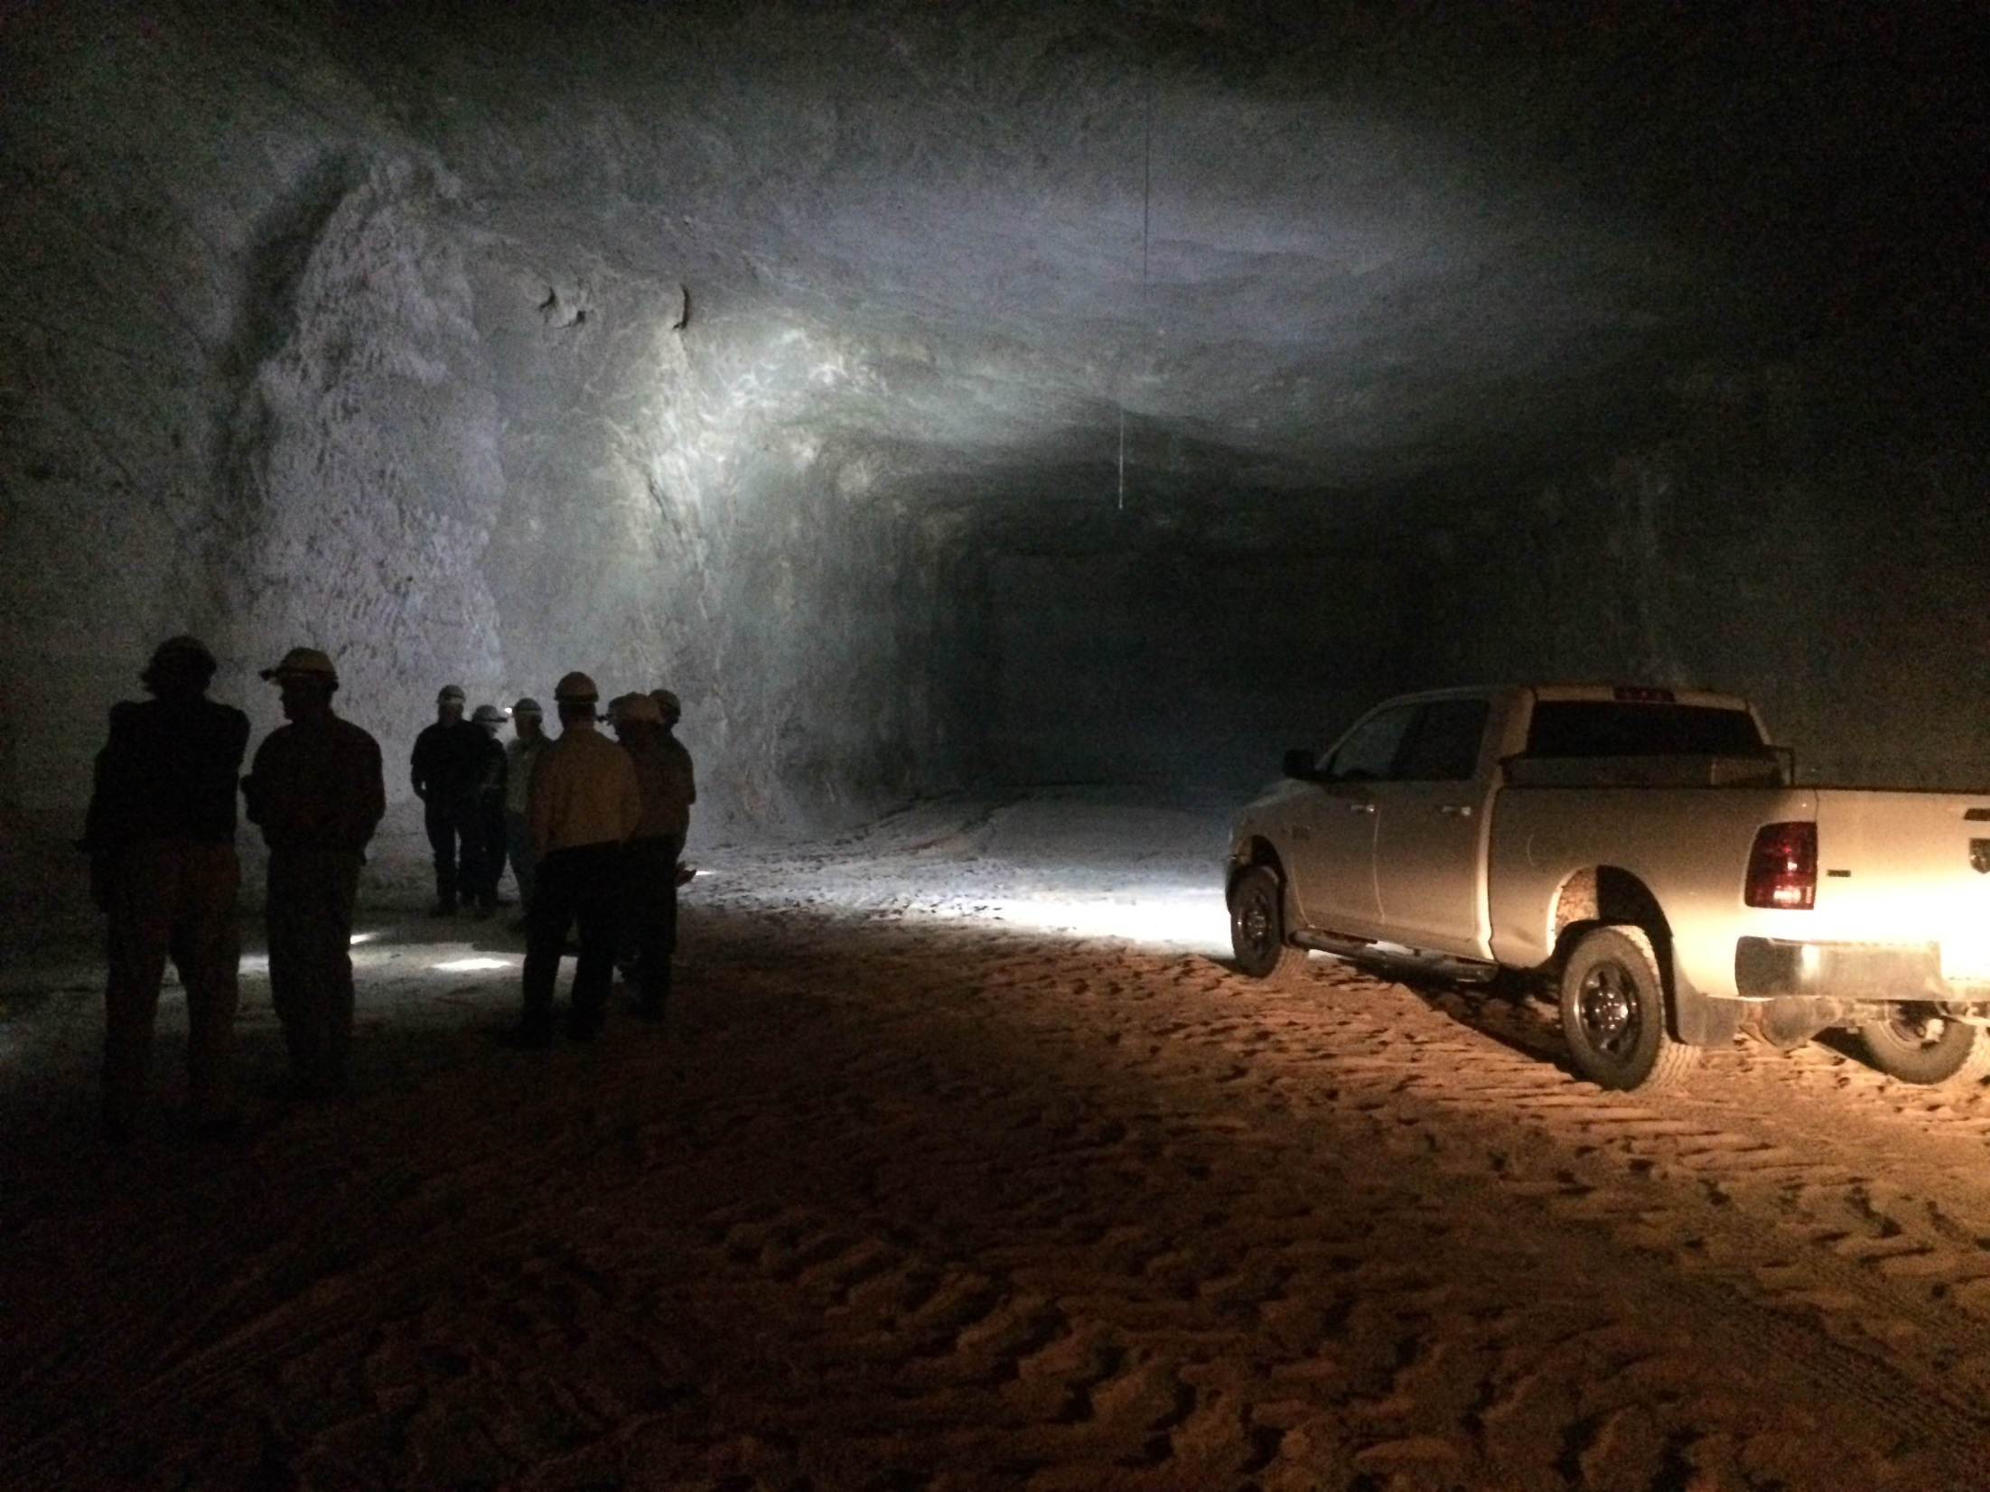
Questions?

