Slide 1
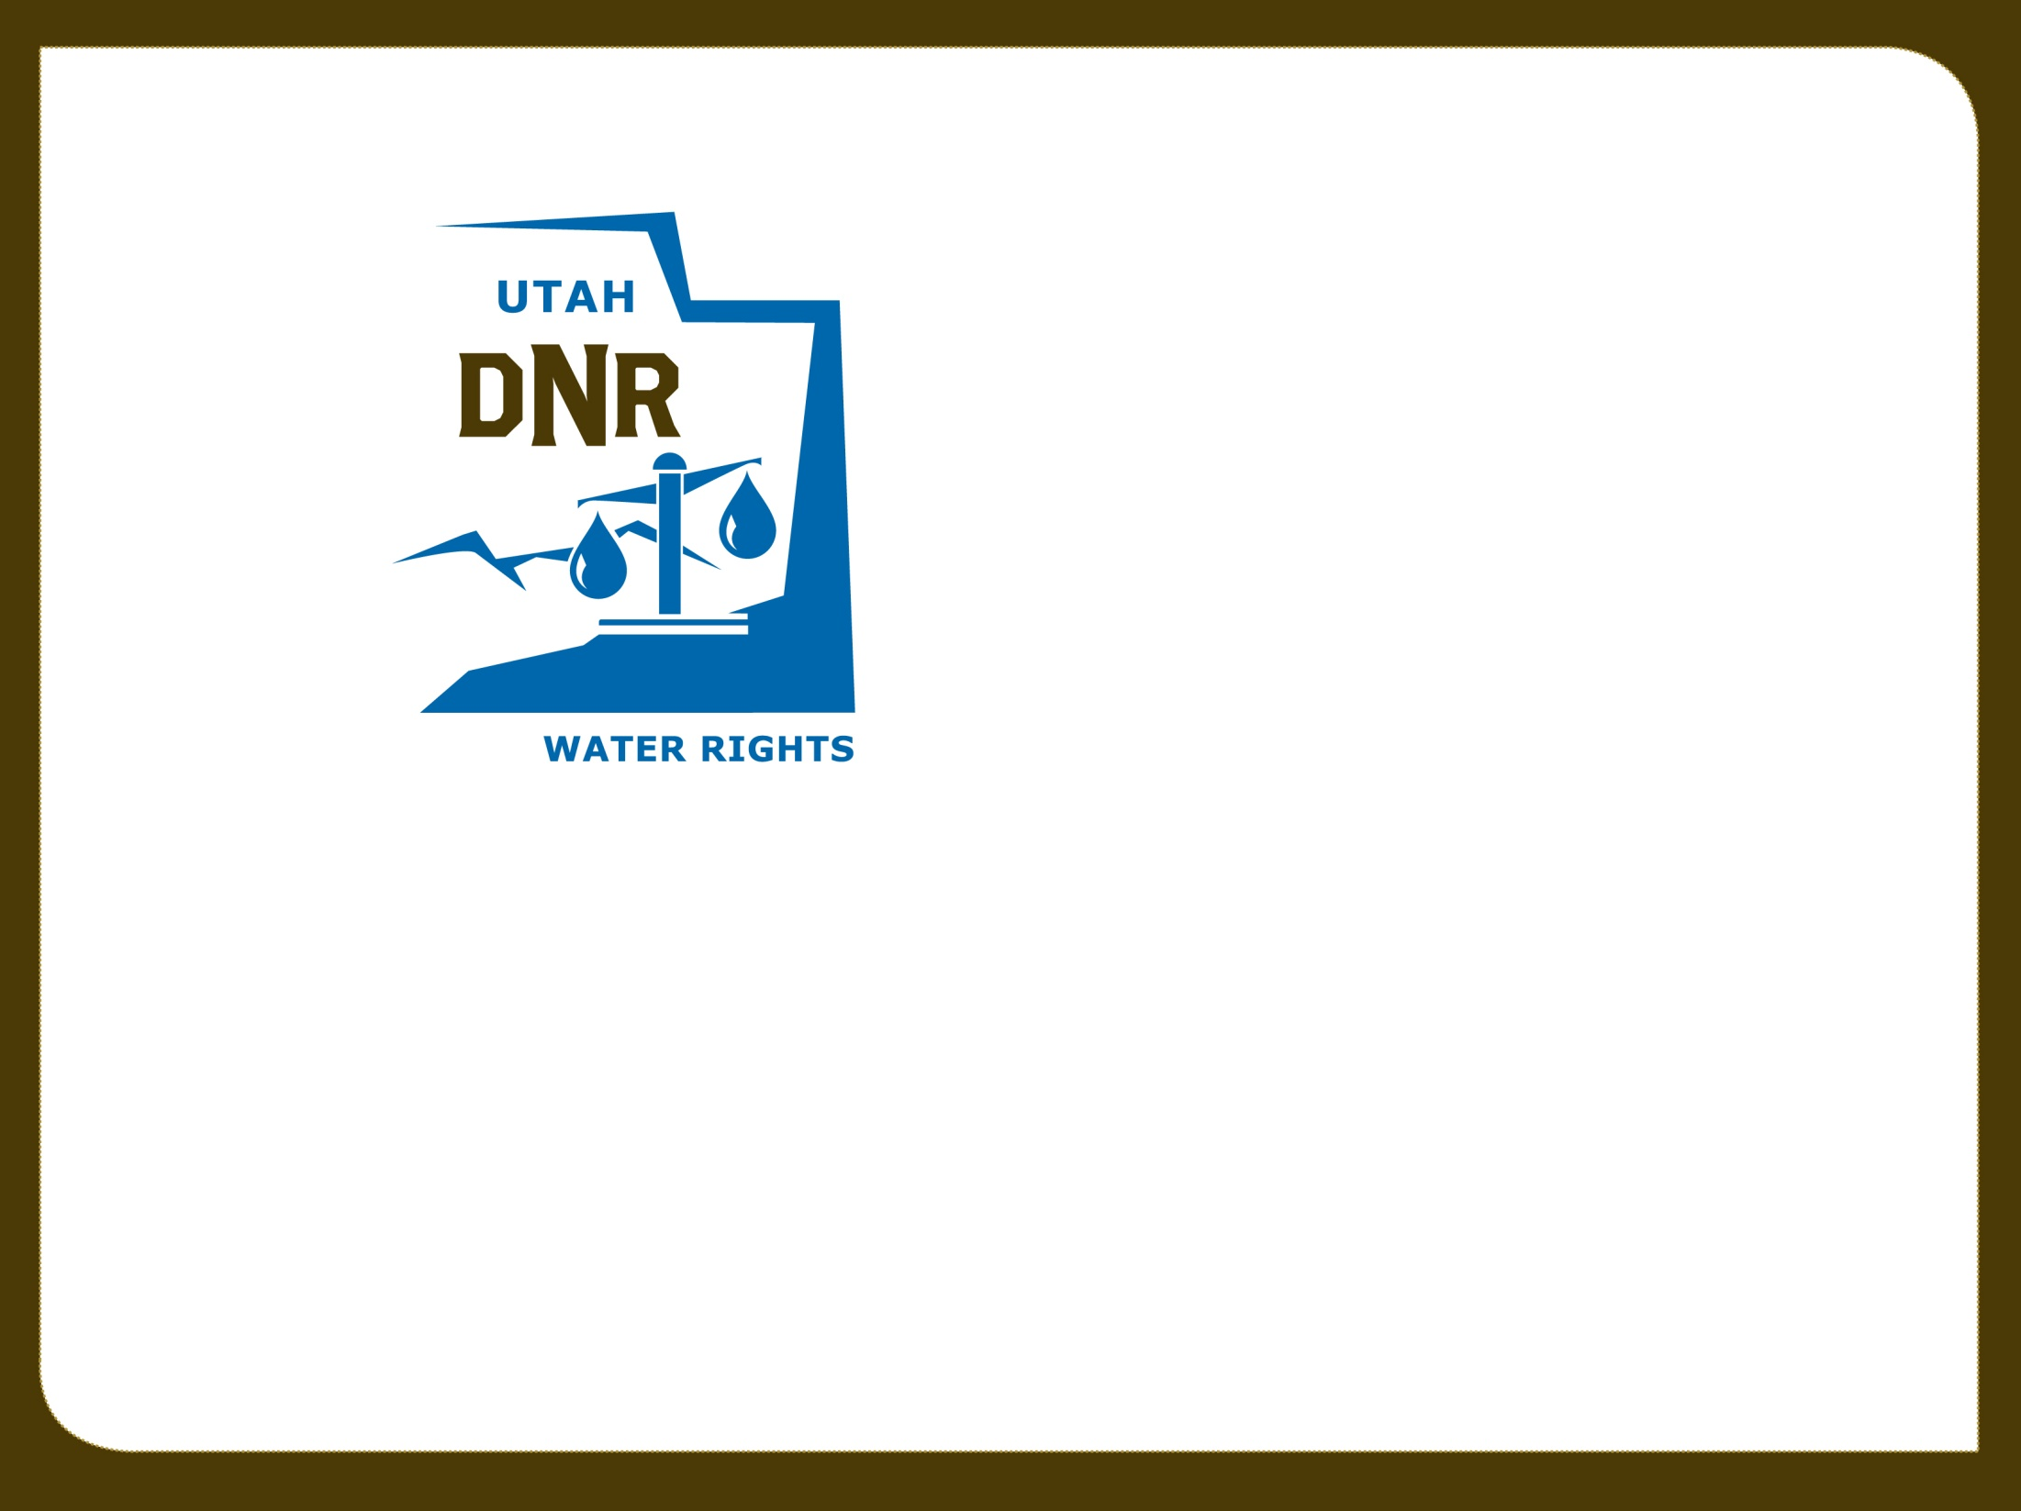

Water Law & Policy Seminars
Recent Policies Published by the State Engineer
Kent L. Jones, P.E.
March 18, 2019 State Engineer
kentljones@utah.gov
Notes:
Policies can be found on the division of Water Rights home page. Sometimes we are all on the same page and sometimes we are on the same page … but some of us are in the wrong book. So I wanted to clarify some things so we can all move forward together.

Slide 2
Municipal Rights
Since 2010 the Division of Water Rights has extended the “Municipal Use” type of use to “Public Water Suppliers” as defined in 73-1-4(1)(b)UCA
Systems serving 100 connections or 200 year-round residents
Municipal water right holders in this category have statutory protections under 73-1-4 and 73-3-12 and the ability to prepare 40-year plans to help preserve their underlying water rights to meet reasonable future needs.
These protections apply to claims of forfeiture and for having extensions of time granted to prove up on their water rights
Notes:
This action expanded the use of qualifying entities to include water corporation regulated by the PSC and community water systems serving at least 100 connections or 200 year round residents.

Slide 3
Policy for Extending the List of Those Allowed to Hold Municipal Water Rights
Typically “Municipal Rights” have been limited to those entities defined as “Public Water Suppliers” in Section 73-1-4 UCA. Applications filed for municipal rights must have a mechanism for leaving the municipal use designation in control of one of these public water suppliers.
The Utah Division of Drinking Water has a reference in rule to “Public Water Systems.” These systems are either publicly or privately owned and provide water for human consumption or other domestic uses and have at least 15 service connections or serve an average of at least 25 individuals daily at least 60 days out of the year.

Slide 4
Municipal Use Rights Extended
These smaller systems don’t fit the protection criteria in Section 73-1-4 UCA but the option of having “Municipal Use” as a recognized use is extended to these smaller public water systems to allow these entities to submit applications to cover the universe of uses under the umbrella of municipal use under a change application process.
This use is extended with the conditions that all water use must be metered and the use must be reported to the Division of Water Rights through the Water Use Program.
Submitting proof on all municipal rights will include measurements of the quantity of water diverted over the amount of water rights already certificated and must show that diversion and depletion limitations of the rights have not been exceeded.

Slide 5
Municipal Use Rights Extended
It is important to note that while “Municipal Use” is extended to these smaller “Public Water Systems”, they do not meet the qualifications given under 73-1-4 and 73-3-12 for “Public Water Suppliers” and do not have the special protections under statute provided to “Public Water Suppliers”.

Slide 6
Policy for Domestic Duty Considerations
Since the early 1980’s, the State Engineer has used indoor domestic duties based on 400 gallons/connection/day which is about 0.45 ac-ft/year.
With continuing conservation efforts, studies have shown that 70 gallons per person per day may be a more reasonable estimate for indoor domestic use in Utah. With an estimated average of 3.6 people per connection that equals about 250 gallons/connection/day or about 0.28 ac-ft/year on average for a full-time, year-round residence. Part-time recreational usage may only require 0.14 ac-ft/connection or less based on those numbers.
Based on the conservation numbers, 0.45 ac-ft would supply the annual inside domestic needs of 5.7 people. While some homes exceed that number, on the average there are less people per connection than 5.7.
Notes:
Ann and I, 3000 gal./month max some times 2000 gal/month; 50 gal/person/day 34 gal/person/day at 2000. Ann will be excited we don’t have to shower together any more to save water… we’ll be just fine. Sometimes we water people are pretty tricky! Sometimes it’s good to be the State Engineer!

Slide 7
Domestic duty
While 0.45 ac-ft/connection is a safe number that will cover a large usage per connection, that amount of water may not be needed to meet the projected needs of the residential users in any particular situation. It is a number we will continue to used if there is no evidence that it should be different.
The State Engineer will consider reduced amounts of water required per connection in applications filed if the projected usage rate numbers are based on scientific evaluations and the water used is measured and reported to the Division of Water Rights through the Water Use Program.

Slide 8
Policy for Issuing Corrected Certificates
Section 73-3-17, Certificate of Appropriation:
    “Upon the satisfaction of the state engineer that an appropriation … has been put to a beneficial use … the state engineer shall issue a certificate…”
    The certificate sets the limitations of the right in both diversion and depletion based on the beneficial use of the water.

Slide 9
Policy for Issuing Corrected Certificates
There are times when errors or omissions occur in the proof and certificate process.
Corrected Certificates can be issued to correct those deficiencies.
The primary effort should be to issue Certificates accurately and carefully to reflect the actual beneficial use of water.
There is no obligation under statute to correct Certificates based on errors or omissions but seems appropriate to reflect actual beneficial use.
Notes:
Town had one well. Filed change to go to two wells. Submitted proof on only the new well
Proof on a home for house, animals, and irrigation in wrong township and range.
Historic acreage didn’t show up on certificate but was referenced on proof and shown to be in actual use at the time of proof.

Slide 10
Policy for Issuing Corrected Certificates
Corrected Certificates should only be issued to reflect actual beneficial uses that existed at the time of proof where such uses were consistent with the application.
Corrections should only occur on a Clear Showing of Error.
Certificates are prima facie evidence of a right and Corrected Certificates are not preferred and may lead to problems.
Issuing correct Certificates the first time is and should remain our aim.

Slide 11
Policy for Depletion Limitations on Certificates
New Certificates set new limitations for the right concerning diversion, depletion, nature of use, place of use, point of diversion, and period of use as detailed in the Certificate.
These limitations are the basis for future considerations of the right.
If you want to go back to original uses, a change application will have to be filed.
Notes:
Example of irrigation to home use. Certificated and wanted to go back to irrigation. Could only irrigate less acres because of the new depletion limitations.

Slide 12
Policy for Depletion Limitations on Certificates
Certificates issued for a more depletive use than the original use sometimes have the diversions cut back to the depletion limitation.
Even though diversions have been cut back to the depletion limitation in a new Certificate, the original flow rate can be reestablished through a change application process assuming depletions stay the same and impairment of other rights is not an issue.

Slide 13
Policy for Depletion Limitations on Certificates
If a change application is approved and not certificated, a new change application can be filed to replace the approved change application using the last certificated diversion and depletion limitations associated with the right.

Slide 14
Policy for Beaver Dam Analogue (BDA) Construction
BDA Construction Kit

Slide 15
State Engineer Policy for BDA Construction
BDA construction in the state will require that a stream channel alteration permit be filed with and approved by the Division of Water Rights.
Regional Engineer responsible for the area where construction will occur shall make a determination if water rights will be impacted.
If it is determined that a water right will be impacted, a Temporary Change Application will have to be filed and approved to compensate those impacted.

Slide 16
State Engineer Policy for BDA Construction (cont.)
The Temporary Change Application is in place for one year but will be considered adequate to cover impacts to the system as it stabilizes over the year and may extend to the expiration of the Stream Channel Alteration Permit that authorizes the work
If the BDA becomes nonfunctional and the desire is to rebuild it, a new Temporary Change Application will have to be filed and approved if required by the Regional Engineer. Stream Channel Alteration permits are authorized for two years. At the end of the two-year period if it is desired to do additional work in the stream, the appropriate Stream Alteration Permit and Temporary Change Application (as required) will have to be filed and approved.
Notes:
Stream Alts good for two years. A new temporary change will not be required until the stream alt expires unless required by the regional engineer every year.

Slide 17
State Engineer Policy for BDA Construction (cont.)
If it is determined that no water right will be impaired, the only permit required from the Division of Water Rights is a Stream Channel Alteration Permit.
The person doing the project shall have the responsibility and liability for the installed BDA

Slide 18
State Engineer Policy for BDA Construction (cont.)
In areas affected by wildfire events or other similar incidences where it is critical to stabilize channels and help diminish debris flows, no water right will be required. In these instances, a Stream Channel Alteration approval is all that will be required from the Division of Water Rights prior to doing the work.
A contingency for emergency work may be utilized as directed in Section 73-3-29(2).

Slide 19
State Engineer Policy for BDA Construction (cont.)
Policy does not preclude anyone from asserting damages for claims of impaired water rights due to the BDA construction.

Slide 20
Southern Utah/Goshen Valley Ground-Water Management Plan
A contaminated site has been identified near the mouth of Spanish Fork Canyon.
The contamination plume is dynamic.
The identified contaminated area boundary will be defined as the area inside a 1000-foot buffer around a contamination concentration contour.
Applicants seeking to move water rights into the identified contaminated area are cautioned that the water within this area must still be adequately treated before the water is used.
Notes:
A contaminated site has been identified near the mouth of Spanish Fork Canyon with high levels of nitrate and explosive compounds. The contamination plume is dynamic and the area defining its location as reported in Ensign-Bickford’s Ground Water Annual Report will be reviewed and periodically updated as needed on the Division of Water Rights’ website mapping tool. The identified contaminated area boundary will be defined as the area inside a 1000-foot buffer around the contamination concentration contour derived from water sample data where the explosive compound commonly referred to as RDX is found in concentrations greater than 2.0 ppb.
Through consent agreements the state of Utah has provided to the entity responsible for cleaning up the contamination assurances which have allowed the process to proceed. Applicants seeking to move water rights into the identified contaminated area are cautioned that the water within this area must still be adequately treated before the water is used. Applicants shall acknowledge their proposed point of diversion is located within the contaminated area and shall demonstrate in the change application filing that the future withdrawal of water will not interfere with the clean-up process or be detrimental to public welfare.

Slide 21
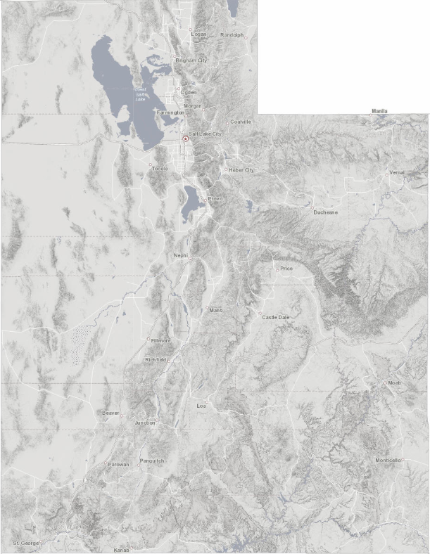
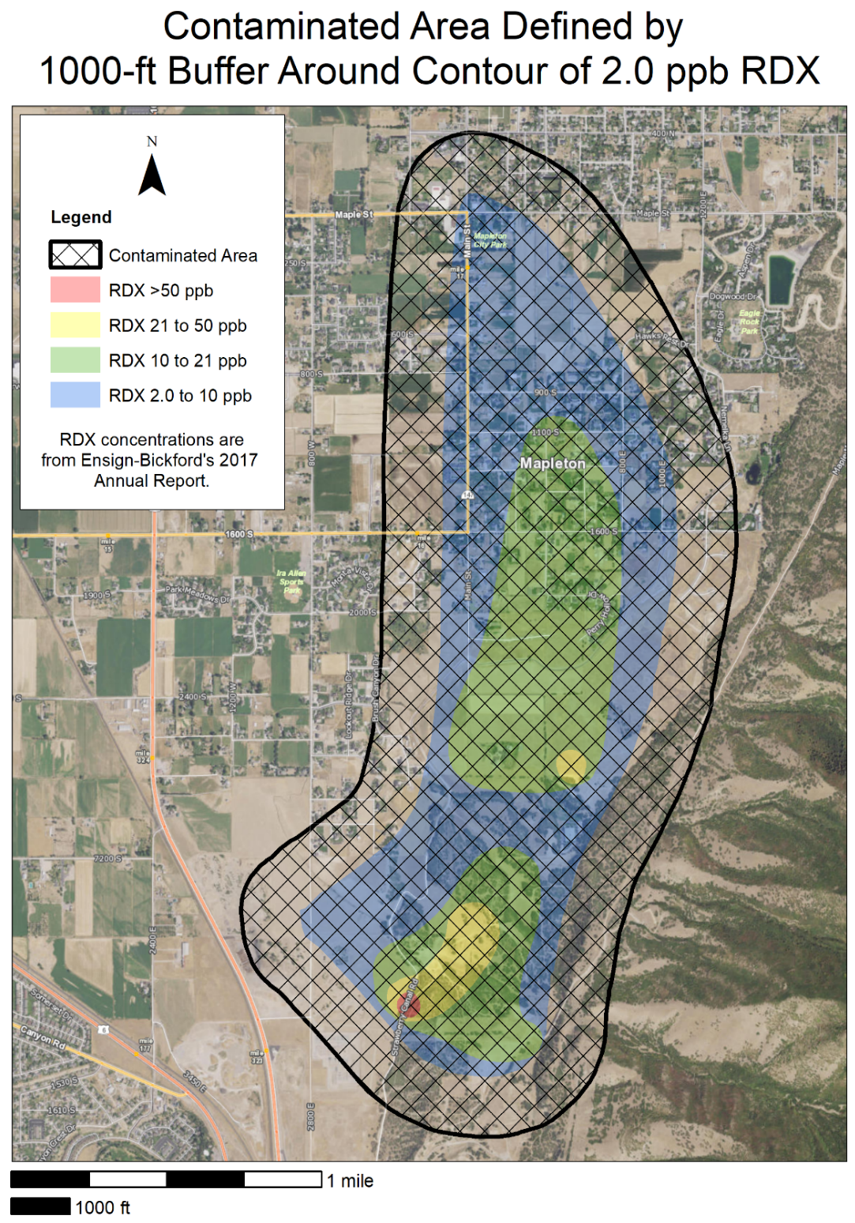
Notes:
There has been significant cleanup and we don’t want to cause a deterrent to the cleanup efforts.

Slide 22
Southern Utah/Goshen Valley Ground-Water Management Plan
Applicants shall acknowledge their proposed point of diversion is located within the contaminated area and shall demonstrate in the change application filing that the future withdrawal of water will not interfere with the clean-up process or be detrimental to public welfare.

Slide 23
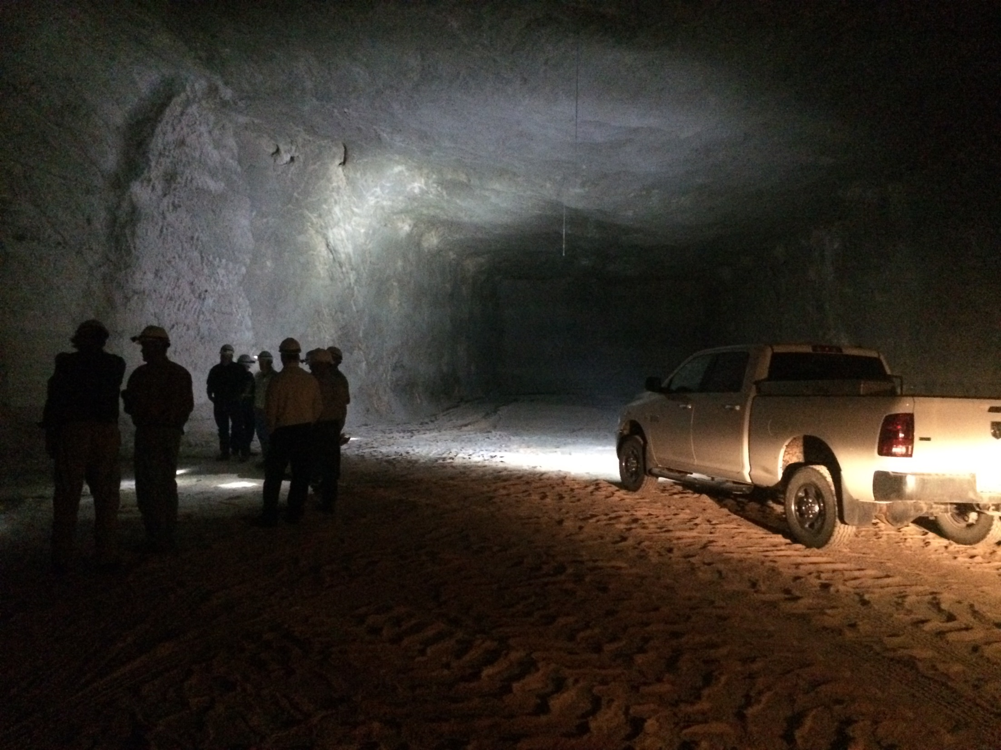
Questions?

