Slide 1
WaterSMART Grants: Water Marketing Strategy Grants
Avra Morgan
Policy and Administration, Water Resources and Planning
October 29, 2018

Slide 2
Agenda Overview
Introductions
WaterSMART Program Overview
Water Marketing Overview
Eligible Applicants and Projects
Required Project Components
Water Marketing Strategy Document Requirements
Evaluation Criteria
Post Selection
Data Visualization Tool

Slide 3
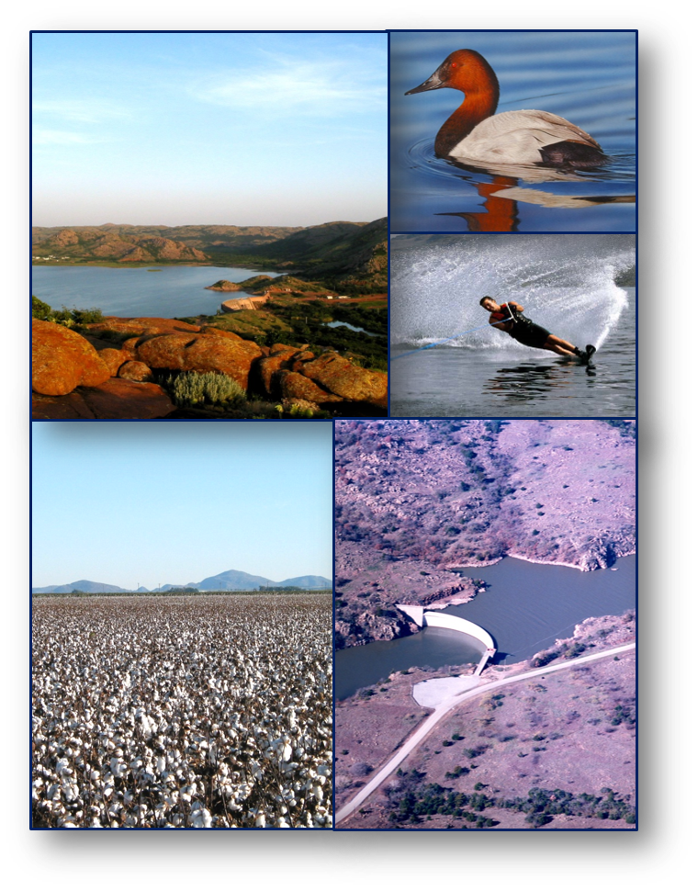
WaterSMART Program - Overview
Departmental initiative established in 2010
Provides a framework for Interior to support water supply reliability for multiple water users
WaterSMART supports Reclamation’s mission through collaboration with stakeholders to improve water management, increase water reliability, and optimize limited supplies
Authorized under section 9504 of the SECURE Water Act

Slide 4
Reclamation’s Mission
The mission of the Bureau of Reclamation is to manage, develop, and protect water and related resources in an environmentally and economically sound manner in the interest of the American public.

Slide 5
WaterSMART Program

Slide 6
Water Marketing Strategy Grants – Overview
Program Purpose: Through WaterSMART Water Marketing Strategy Grants, Reclamation provides cost-shared financial assistance to states, tribes, and local governments to develop water marketing strategies to establish or expand water markets, or water marketing activities between willing participants
Projects Funded: Collaborative planning efforts to develop water markets that will proactively address water supply reliability and increase water management flexibility. Pilot activities integral to the development of a strategy – e.g. the movement of water on a pilot basis in compliance with applicable laws – can also be included
Program Objective: Water markets between willing buyers and sellers can be used to help water users meet demands efficiently in times of shortages, thereby helping prevent conflicts

Slide 7
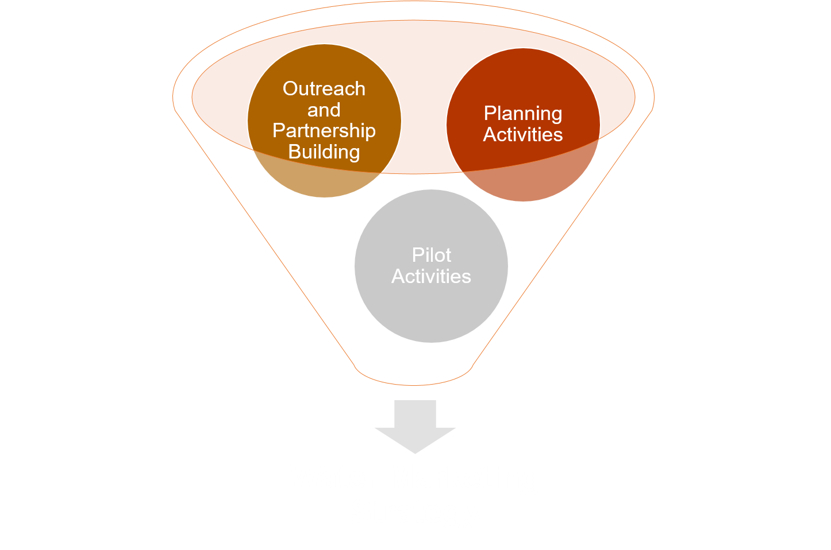
Water Marketing Strategy Grants – Overview
A water marketing strategy is a framework for the implementation of water marketing and can include these 3 elements:

Slide 8
Water Marketing Strategy Grants – Project Eligibility
Eligible Applicants:
States, Tribes, irrigation districts, water districts, or other organizations with water or power delivery authority
Ineligible Applicants:
Federal government entities
Institutes of higher education
Individuals
501(c)4 and 501(c)6 organizations
Eligible Projects:
Development of a water marketing strategy to establish or expand current water markets or water marketing activities
Ineligible Projects:
Other types of planning studies
Construction activities
Water conservation projects
OM&R
Title XVI Projects
Water purchases
Administrative construction costs
On-farm improvement projects

Slide 9
Water Marketing Strategy Grants – Award Information
Funding Group I:
Up to $200,000 in Federal funds
Completed within 2 years
Smaller project scope
Can be less complex
Few partners involved
Smaller geographic area
Builds on prior work
Funding Group II:
Up to $400,000 in Federal funds
Completed within 3 years
Large project scope
More partners
Larger geographic area
More complex water markets
*50% or greater non-Federal cost share is required regardless of Funding Group

Slide 10
Water Marketing Strategy Grants – Required Project Components
Development of a Water Marketing Strategy must include the following types of eligible activities:
Outreach and partnership building
Scoping and planning activities
Development of a water marketing strategy document
Pilot activities (optional)

Slide 11
Water Marketing Strategy Grants – Outreach and Partnership Building
Conducting outreach to potential partners, participants, and interested or affected stakeholders in the area through public meetings, webinars, notices, or other forms of communication and outreach
Hosting workshops to gather information on the development of the water marketing strategy
Providing a meaningful opportunity for stakeholders to provide input to the development of a strategy

Slide 12
Water Marketing Strategy Grants – Scoping and Planning Activities
Conducting financial or economic analyses to identify potential buyers and sellers, assess demands for the water market, and research the cost of implementing the water market
Researching different water marketing approaches
Analyzing water rights issues or legal requirements*
Quantifying water rights, consumptive use, diversions or return flows
Conducting hydrologic or engineering studies related to water supply, use of infrastructure, or hydrologic impacts of water marketing
Analysis of decision support tools*
Notes:
*Funding for this type of work may not exceed 30 percent of the project’s cost
*Some work that would be considered “development” or “modification” of decision support tools to support water marketing activities may be considered eligible for funding so long as this work is integral to the development of a water marketing strategy and comprises a minor part of the work described in the proposal.*

Slide 13
Water Marketing Strategy Grants – Development of a Water Marketing Strategy Document
A water marketing strategy is a written document that describes a proposed approach to establish or expand a new water market or water marketing activities based on the results of outreach and partnership building, planning and scoping activities, and any pilot activities
A Water Marketing Strategy must address the required elements

Slide 14
Water Marketing Strategy Grants – Pilot Activities (optional)
Development of a Water Marketing Strategy may include associated pilot activities integral to the development of a strategy (e.g., the movement of water on a pilot basis in compliance with applicable laws)
Caution that this will trigger environmental compliance requirements

Slide 15
Water Marketing Strategy Document Requirements
1. Implementation Plan
How the water market/water marketing activities will be implemented.
How stakeholder support and input is incorporated into the water marketing strategy
Water Marketing Strategy Document
4. Stakeholder Support and Input
2. Legal Framework
There are 4 required elements that must be included in the water marketing strategy document.
Description of the legal framework for the water market/marketing activities.
How water marketing activities will be monitored.
3. Monitoring
Notes:
Decision support tools and pilot activities are optional. Strategy should include documentation of stakeholder input
includes outreach to and input from stakeholders and addresses the required strategy elements

Slide 16
Scored based on the extent that the proposal supports the DOI priorities.
Applications will be evaluated against the evaluation criteria which comprise a total of 100 points
Evaluation criteria can change year to year, be sure to read the funding opportunity announcement
Scored based on the extent to which the proposal supports the applicants financial ability.
Scored based on the extent to which the proposed water marketing strategy will result in significant benefits to water supply reliability.
Scored based on the extent to which the proposal demonstrates the strategy is supported by a diverse set of stakeholders.

Slide 17
Water Marketing Strategy Grants – Post Selection
After the applicant is informed of being selected, Reclamation will enter into a financial assistance agreement:
The financial assistance agreement documents the milestones, project, and reporting requirements

Slide 18
Water Marketing Strategy Grants – Post Selection Project Requirements
Development of a Project Work Plan
Explains how the project components will be performed
Detailed work schedule, roles and responsibilities
Development of a Communication and Outreach Plan
How will stakeholders and the public be involved in the planning process?
Participation includes public meetings, webinars, public notices, or other approaches
Development of a Water Marketing Strategy Document
A written Water Marketing Strategy Document consisting of required elements (see slide 15)
Submitted to Reclamation within 60 days of award
Required Reporting:
Quarterly Progress and financial reports
Final report upon conclusion of project
Notes:
Water Marketing Strategy Grants Requirements: Development of a Water Marketing Strategy that includes outreach to and input from stakeholders and addresses the required strategy elements, and includes the required planning steps (i.e., development of a detailed workplan and an outreach and communication plan)
Additional requirements if selected for funding

Slide 19
Water Marketing Strategy Grants – FY2017 Project Examples
The New Cache La Poudre Irrigating Company, Inc., Colorado
Partnering with Ducks Unlimited to develop a water marketing strategy that facilitates the temporary transfers of agricultural water to meet the demands of municipalities, rural economic development, and wildlife habitat
Emphasizes temporary water leases over permanent transfers to sustain Front Range agriculture while meeting other needs during shortages
Multiple stakeholders and collaborators

Slide 20
Water Marketing Strategy Grants – FY2017 Project Examples
Central Oregon Irrigation District, Redmond, Oregon
Developing a water transaction program to facilitate the trading of water between irrigation districts and for environmental flows on the Deschutes River
The Oregon Spotted Frog has accelerated the need to restore flows in the Deschutes River
Increases the reliability for irrigators (especially Junior users), protects flows in the river, and meets the needs of both agricultural users and municipalities

Slide 21
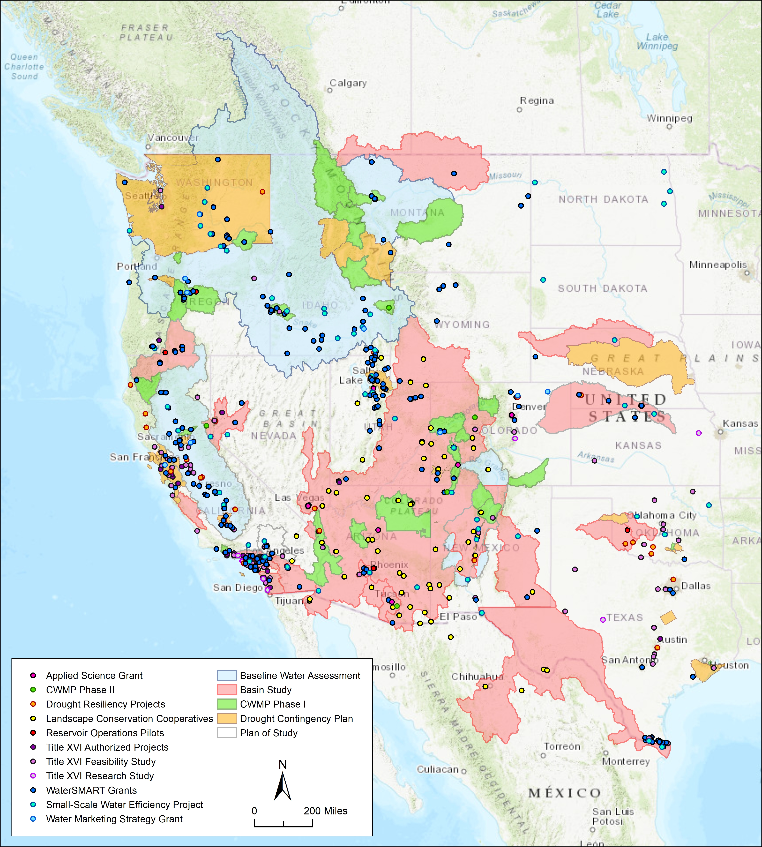
WaterSMART - Data Visualization
Provides users with interactive maps of each WaterSMART Program and project
Includes Featured Project tours
Allows for data export
Shows program growth since 2010
Recently updated with new application features
WaterSMART Data Visualization Tool

Slide 22
Water Marketing Strategy Grants - Program Requirements Summary
Eligible Applicants
States, Tribes, irrigation districts, water districts, or other organizations with water or power delivery authority in the western United States.
Funding Groups
Funding Group I: Up to $200,000 for strategies completed within 2 years
Funding Group II: up to $400,000 for strategies completed within 3 years
Cost Share
50% or more non-Federal cost-share is required.
Required Project Components
Outreach and Partnership Building
Scoping and Planning Activities
Development of a Water Marketing Strategy
Pilot Activities (optional)
Evaluation Criteria
Applications will be evaluated against the evaluation criteria which comprise a total of 100 points.
FOA Deadline: FOA expected in January 2019

Slide 23
Katie Schultz
303-445-2188
kschultz@usbr.gov
Avra Morgan
303-445-2906
aomorgan@usbr.gov

