Slide 1
Parowan Valley Public Meeting
December 11, 2018

Slide 2
Welcome & Introduction
Introduction
Parowan Valley Policy History
Hydrologic Data
Groundwater Management Plans
Questions & Comments

Slide 3
Parowan Valley Policy History

Slide 4
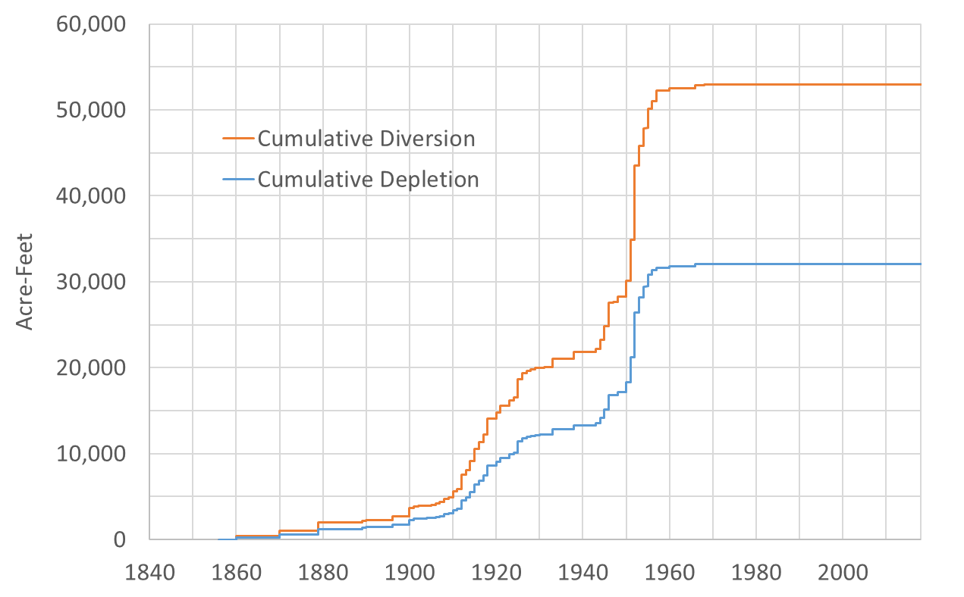
Parowan Valley Policy History

Slide 5
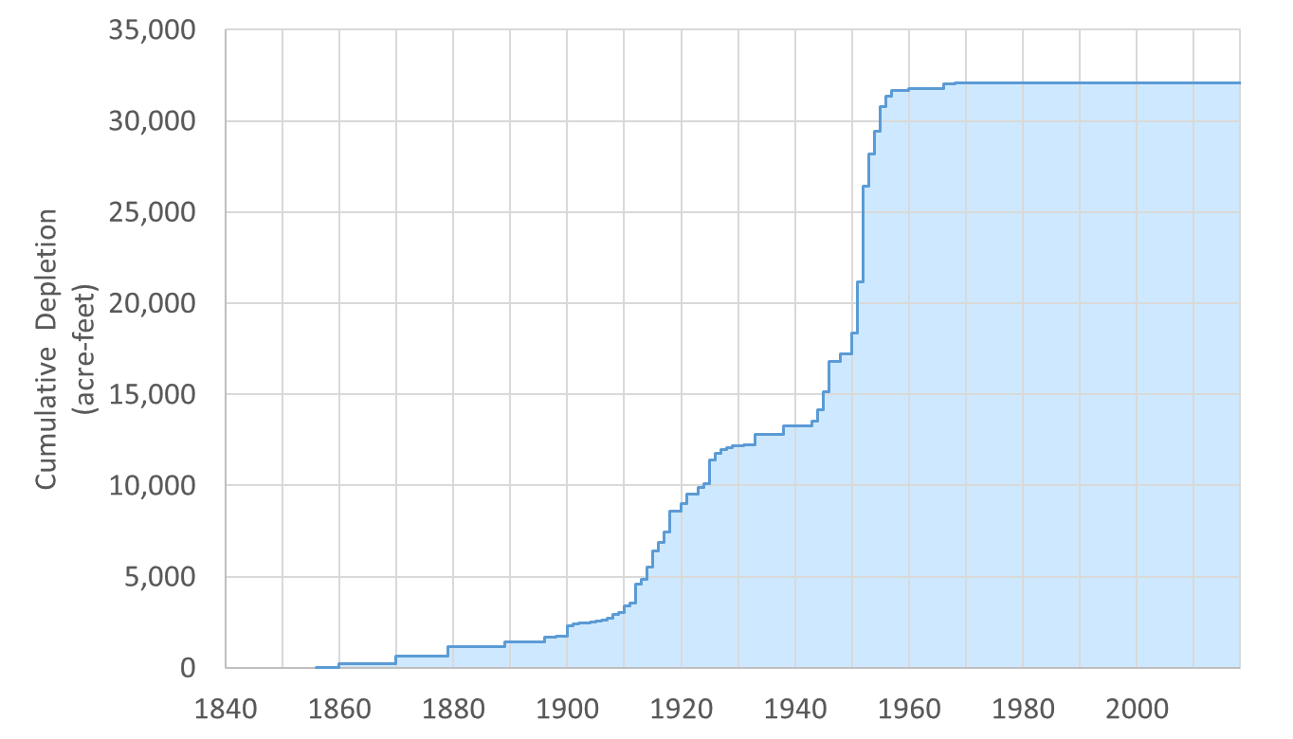
Parowan Valley Policy History

Slide 6
Parowan Valley Policy History
September 30, 1970, Hubert C. Lambert State Engineer: “…the policies that will be set forth here at this meeting will be the way the State Engineer will operate until another meeting is held.”
Gerald Stoker Regional Engineer: “…a summary on the wells in Parowan Valley; You have a total number of unapproved applications of 7,754.28, your approved applications of 21,000 for a total number of 28,761.27 ac.-ft. You have perfected, 37,354.32 ac.-ft. for a total number of 66,115.79 ac.-ft. You can see that with all the unapproved applications, and approved applications were perfected to their full amount you could almost double the ac.-ft. allowed in the valley.”
Note: The majority of the 21,000 acre-feet of approved and unperfected water rights was irrigation, at a depletion rate of 60.33% that is nearly 17,000 acre-feet of water depleted from the aquifer.

Slide 7
Parowan Valley Policy History
Woody Sandberg USGS: “It seems the water level came up in the whole area in about the 1930’s up until about 1950 and then they more less leveled off and started down. And so you can see through the whole valley that the water level is going down as near as you get to the heavily pumped areas the more they go down which is to be expected.
Lambert: “I think these two presentations illustrates to you some of the problems that we have in Parowan Valley. We have a large number of approved applications that…have not been perfected and if all of them were perfected up to the approved amount we could double to [sic] draw from Parowan Valley.”
Mr. Sandberg noted during the meeting that much of the “pump development” occurred following the end of WWII (September 2, 1945) with many people returning home during that period.

Slide 8
Parowan Valley Policy History
1970 Policy
All applications to appropriate filed prior to September 30, 1970 for individual domestic/stockwatering use would be approved. Further appropriations of that type would be rejected.
No action would be taken on pending unapproved applications for irrigation, municipal, industrial and subdivisions until another public meeting.
Change applications for individual domestic and stockwatering wells would be approved treating the valley as one hydrologic unit.
For all other change applications there would be no approval for changes between the four distinct sub-basins within the Parowan Valley, namely the Buckhorn Flat, Parowan Center Creek, Paragonah, and Summit.
Approved applications to appropriate for irrigation, municipal, industrial and subdivisions were granted until December 31, 1971 to perfect their applications after which there would be no further extensions.
Approved applications for individual domestic/stockwatering wells were granted until December 31, 1972 to perfect their applications after which there would be no further extensions.

Slide 9
Parowan Valley Policy History
Some users were not able to perfect their rights in the allotted time and petitioned the State Engineer for additional time to finish…
The State Engineer extended the time to perfect the approved rights and established a final policy

Slide 10
Parowan Valley Policy History
February 7, 1972

Slide 11
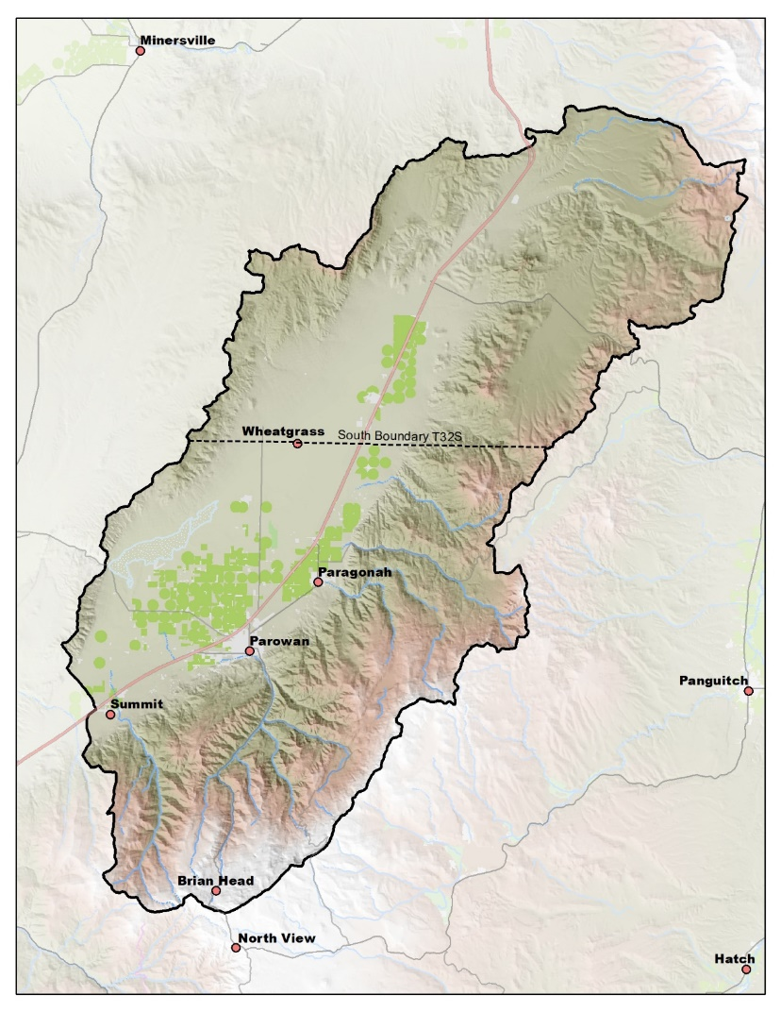
Parowan Valley Policy History
Sometime after February 7, 1972 until today:
Surface and Ground Water
All waters of the basin are considered to be fully appropriated. New diversions and uses must be accomplished by change applications based on valid existing water rights. Fixed-time projects must be accomplished by temporary change applications on valid existing water rights, which require annual renewal.
The basin is divided into two subareas. The boundary is generally delineated by the southern boundary line of T32S. No change applications between subareas are allowed.
Change applications proposing a change from surface to underground sources or vice versa will be critically reviewed to assure hydrologic connection, that there are no enlargements of the underlying right(s), and that there will be no impairments of other rights.
Water rights for the mountain headwaters and Brian Head resort area are generally restricted to change applications on existing "first priority" rights already on Parowan/Main Creek or Summit Creek. Applications proposing transfers of rights between the Parowan/Main Creek and Summit Creek drainages are not approved.

Slide 12
Hydrologic Data

Slide 13
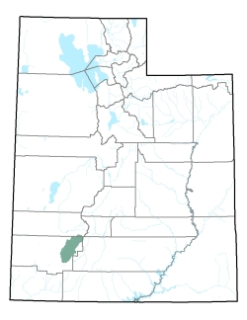

Slide 14
Water Level Map
Water level contour map, Nov 2013
(Figure 9, from SIR 2017-5033)
Transmissivity map
(Plate 2, from TP 60)

Slide 15
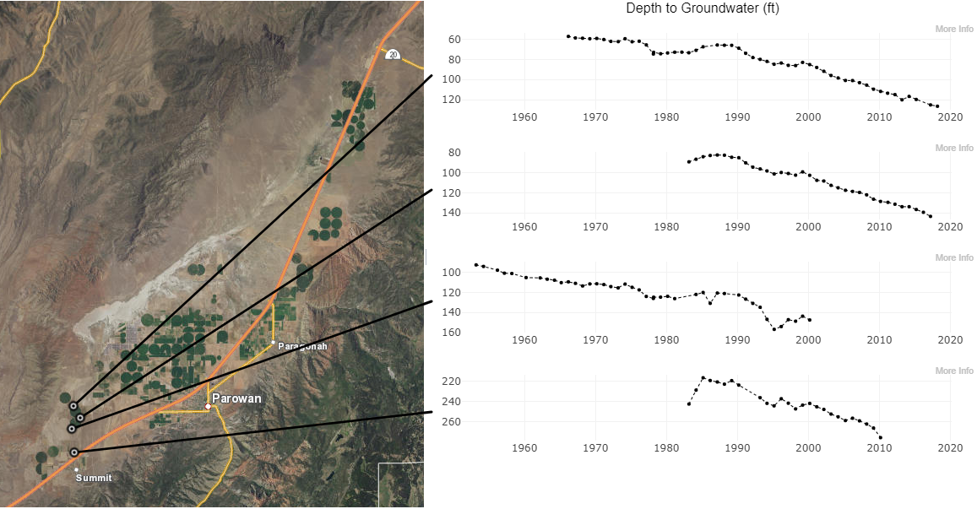
Groundwater Level Changes (1/7)
Depth: 360 ft
Depth: 162 ft
Depth: 203 ft
Depth: 505 ft
https://maps.waterrights.utah.gov/EsriMap/gw-graphs.asp#-112.98670,37.76175,-112.58433,38.14832

Slide 16
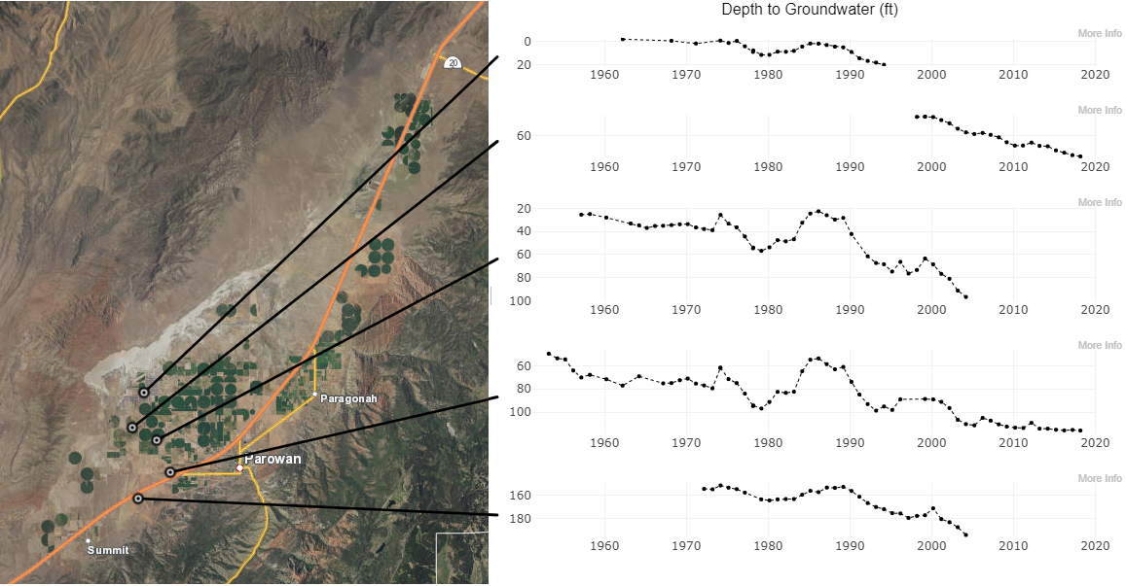
Groundwater Level Changes (2/7)
Depth: Unknown
Depth: 435 ft
Depth: Unknown
Depth: 352 ft
Depth: Unknown
https://maps.waterrights.utah.gov/EsriMap/gw-graphs.asp#-112.98670,37.76175,-112.58433,38.14832

Slide 17
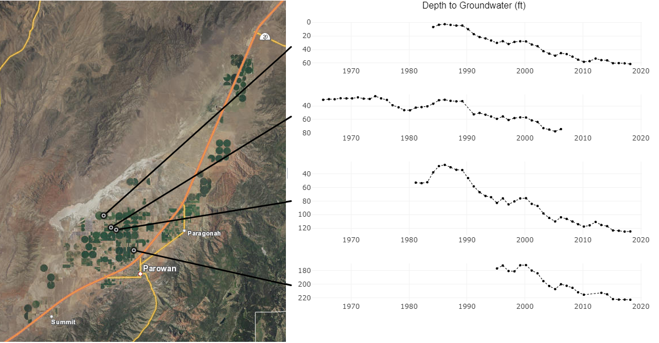
Groundwater Level Changes (3/7)
Depth: 632 ft
Depth: Unknown
Depth: 595 ft
Depth: 820 ft
https://maps.waterrights.utah.gov/EsriMap/gw-graphs.asp#-112.98670,37.76175,-112.58433,38.14832

Slide 18
Groundwater Level Changes (4/7)
Depth: 180 ft
Depth: 905 ft
Depth: 500 ft
Depth: 555 ft
https://maps.waterrights.utah.gov/EsriMap/gw-graphs.asp#-112.98670,37.76175,-112.58433,38.14832

Slide 19
Groundwater Level Changes (5/7)
Depth: 270 ft
Depth: 320 ft
Depth: 216 ft
Depth: 499 ft
Depth: 300 ft
https://maps.waterrights.utah.gov/EsriMap/gw-graphs.asp#-112.98670,37.76175,-112.58433,38.14832

Slide 20
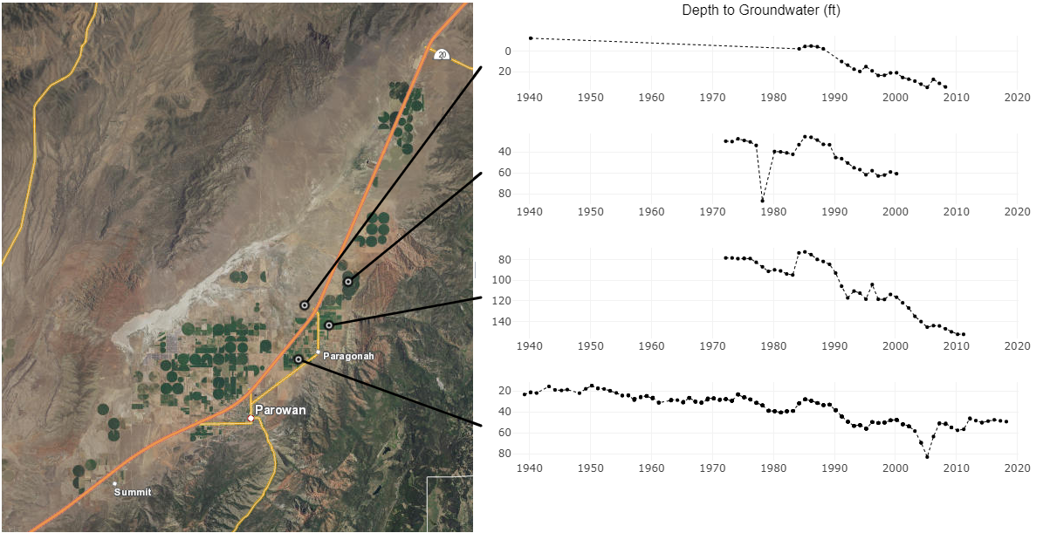
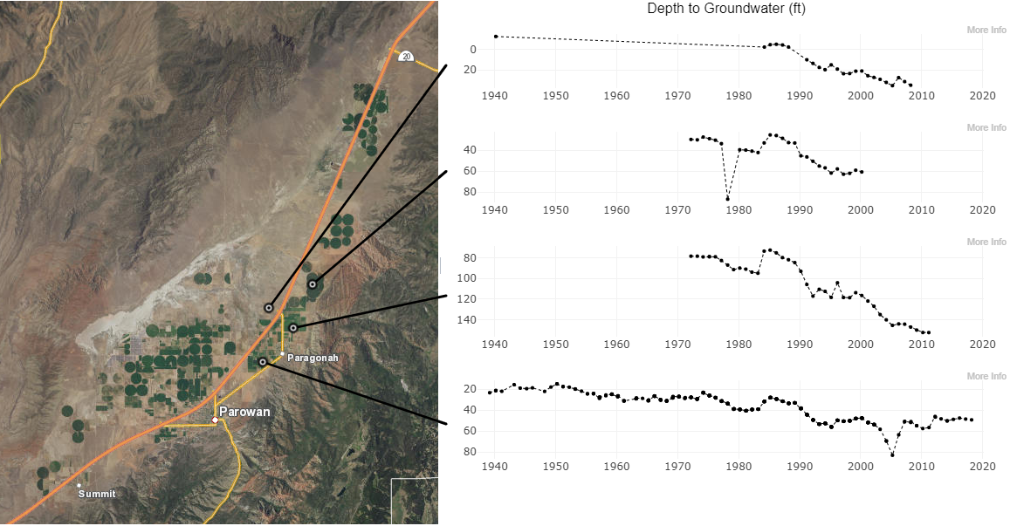
Groundwater Level Changes (6/7)
Depth: 125 ft
Depth: Unknown
Depth: Unknown
Depth: 420 ft
https://maps.waterrights.utah.gov/EsriMap/gw-graphs.asp#-112.98670,37.76175,-112.58433,38.14832

Slide 21
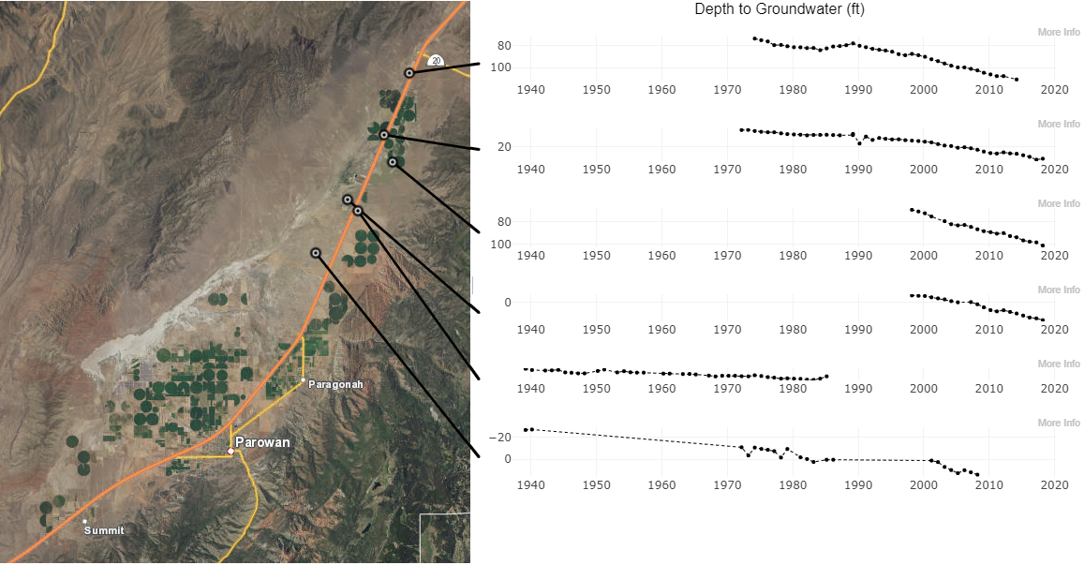
Groundwater Level Changes (7/7)
Depth: Unknown
Depth: 160 ft
Depth: 503 ft
Depth: 200 ft
Depth: 250 ft
Depth: Unknown
https://maps.waterrights.utah.gov/EsriMap/gw-graphs.asp#-112.98670,37.76175,-112.58433,38.14832

Slide 23
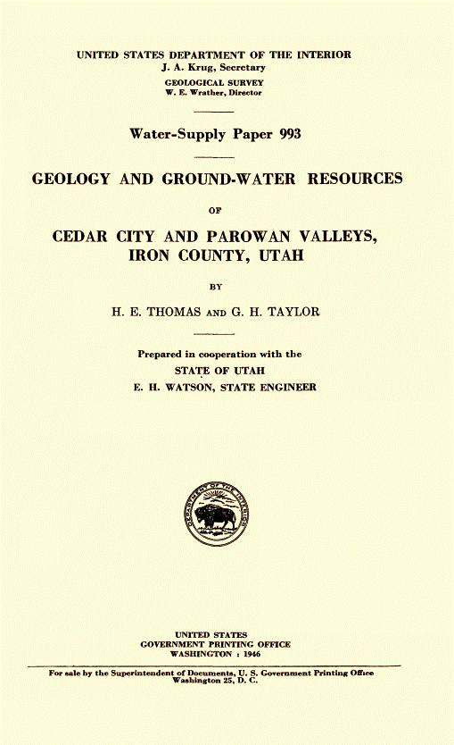
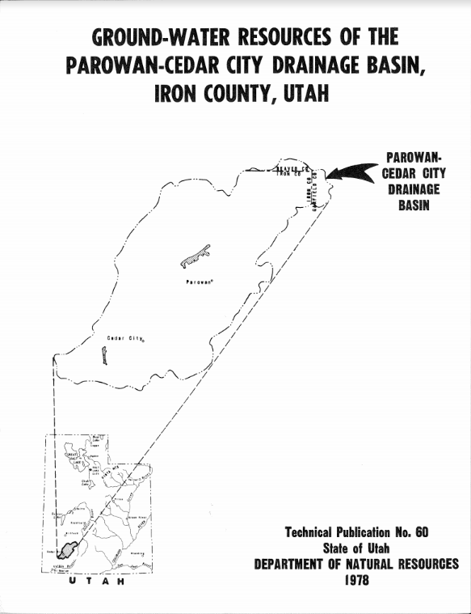
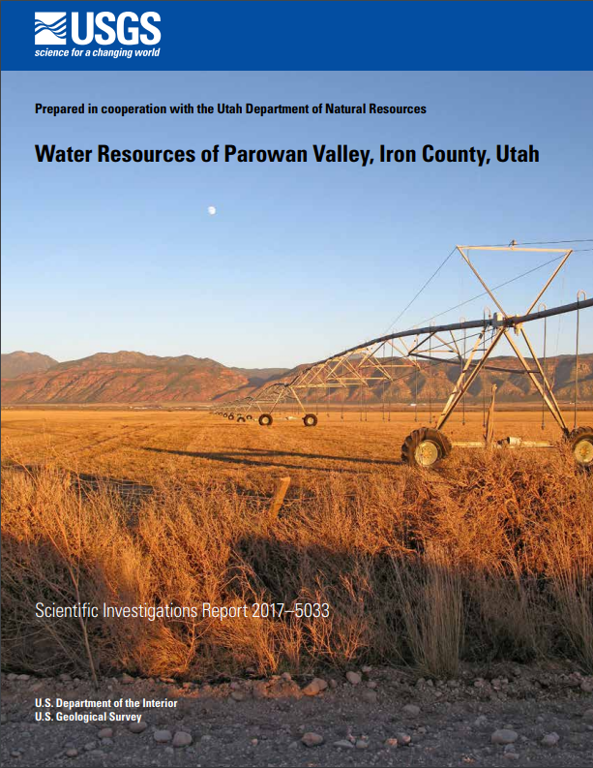
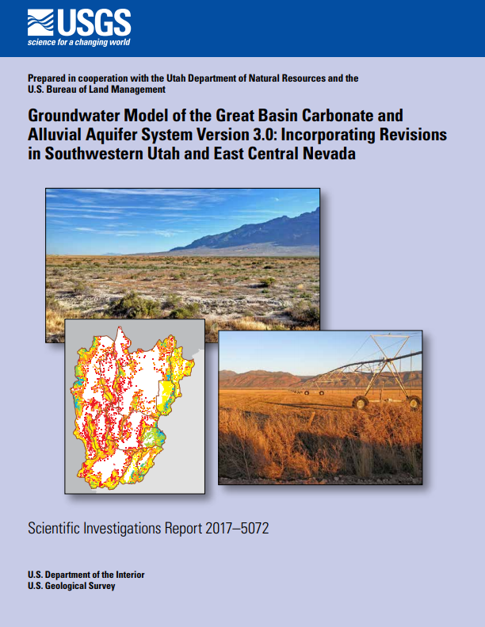
Major Hydrologic Studies
1946: Thomas, H.E., and Taylor, G.H., Geology and groundwater resources of Cedar City and Parowan Valleys, Iron County, Utah: U.S. Geological Survey Water-Supply Paper 993, 210 p.
1978: Bjorklund, L.J., Sumsion, C.T., and Sandberg, G.W., Ground-water resources of the Parowan-Cedar City drainage basin, Iron County, Utah: Utah Department of Natural Resources Technical Publication No. 60, 93 p.
2017: Marston, T.M., Water resources of Parowan Valley, Iron County, Utah: U.S. Geological Survey Scientific Investigations Report 2017–5033, 45 p., https://doi.org/10.3133/sir20175033.
2017: Brooks, L.E., Groundwater model of the Great Basin carbonate and alluvial aquifer system version 3.0: Incorporating revisions in southwestern Utah and east central Nevada: U.S. Geological Survey Scientific Investigations Report 2017–5072, 77 p., 2 appendixes, https://doi.org/10.3133/sir20175072.

Slide 24
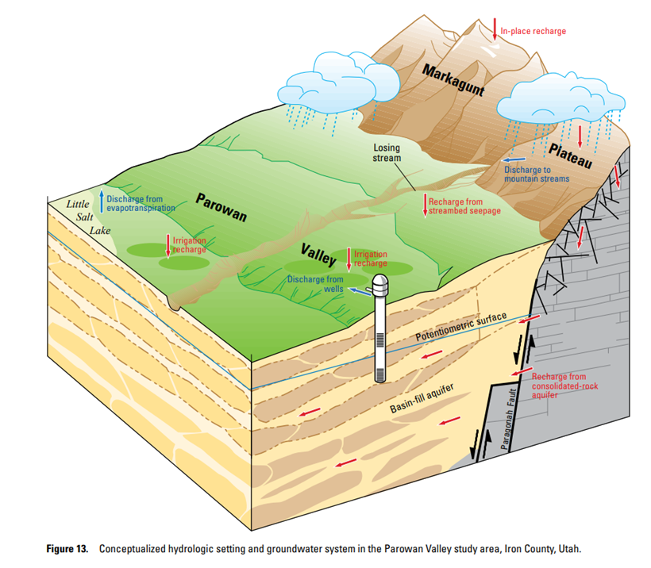
Groundwater Balance
Recharge
Precipitation
Seepage from irrigation
Seepage from streams
Subsurface inflow
Discharge
Well pumping
Evapotranspiration (Lake evaporation and plant transpiration)
Valley springs
Subsurface outflow
Figure 13 from SIR-2017–5072

Slide 25
Groundwater Balance Info from Most Recent Studies
Budget Study
Estimated recharge from precipitation, streambed seepage, irrigation return flows
Estimated discharge to mountain streams, wells, ET
Estimated the aquifer is loosing 15,100 acre-feet in storage each year
Did not estimate subsurface inflow or outflow
Model Study
Estimated subsurface inflow and outflow
“reducing withdrawals in Parowan Valley … to about 22,000 acre-ft/yr would likely stabilize groundwater levels in the valley…”

Slide 26
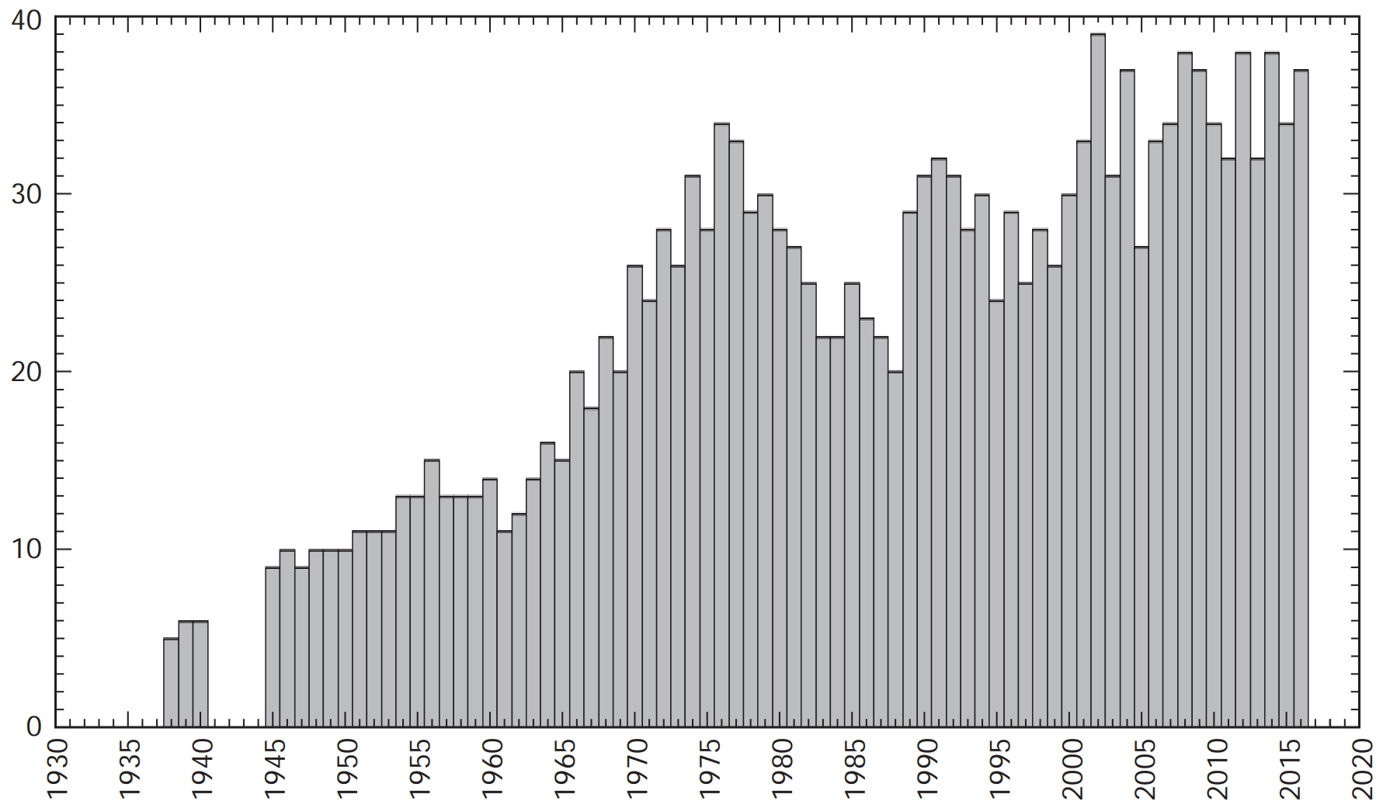
Well Diversions
32,000 acre-feet
1994-2013 average
Well Diversions (thousands of acre-feet)

Slide 27
Well Depletions
Methods of irrigation are line sprinklers and center pivots (not flood irrigation)
Pipelines are used to deliver the water (not earth-lined canals)
Majority of irrigation occurs on fine-grained sediments
Recharge from irrigation returns:
20% on the alluvial fans near the mountains (surface sources)
5% in the central part of the valley (wells)
So depletion from irrigation wells is estimated to be 95% or 30,400 acre-feet/yr on average from 1994-2013

Slide 28
Groundwater Source Availability
1994-2013 averages
Inflow to groundwater source | 36,000 acre-feet
from mountain precipitation | 24,800 (budget study)
from precipitation in Beaver mountains | 5,500 (model study)
from streambed seepage | 1,300 (budget study)
from irrigation with surface water | 4,400 (budget study)
Outflow to other sources | 17,600 acre-feet
discharge to baseflow in mountain streams | 15,000 (budget study)
subsurface outflow to Cedar City Valley | 2,600 (model study)
Remaining | 18,400 acre-feet

Slide 29
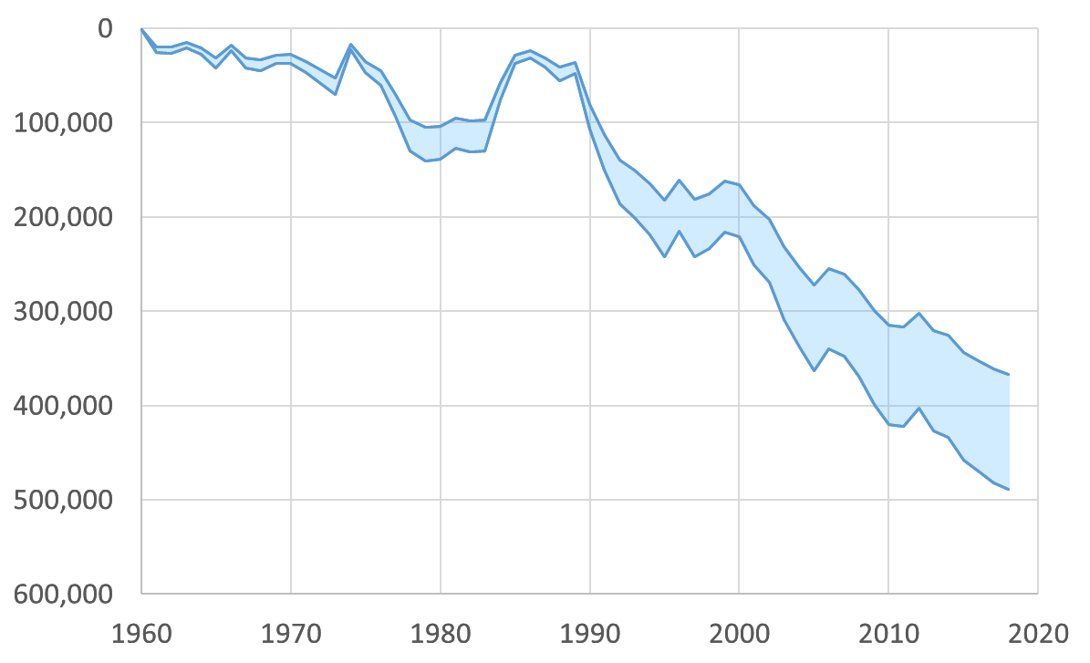
Change in Storage
8,000 ac-ft/yr
Loss in Storage Volume
(acre-feet)
11,000 ac-ft/yr
Change in storage calculated using:
Specific yield of 0.09 to 0.12
Basin-fill area of 80,000 acres
Interpreted groundwater levels

Slide 30
Water Rights
32,100 acre-feet Depletion
53,000 acre-feet Diversion
 | Diversion (acft) | Depletion (acft) | Use
Irrigation | 50,200 | 30,200 | 12,600 acres
Stock | 500 | 500
Domestic | 100 | 20
Municipal | 1,200 | 1,200
Power | 800 | 0
Other | 160 | 80
TOTAL | 53,000 | 32,100

Slide 31
Hydrologic Data Summary
Groundwater is being used faster than it is replenished by natural recharge
Multiple estimates of how much groundwater can be used sustainably:
Model study: 22,000 acre-feet/year
Budget study: 18,400 acre-feet/year (after including inter-basin flows)
Change in storage estimates
8,000 to 11,000 acre-feet

Slide 32
Hydrologic Data Summary
Approximately all the existing water rights are being used:
 | Well Diversion (acr-ft/yr) | Well Depletion (ac-ft/yr)
Average Use (Actual) | 32,000 | 30,400
Allowed (Water Rights) | 53,000 | 32,100
Sustainable |  | 18,400 to 22,000
Reduction |  | 8,000 to 12,000
Change in Storage |  | 8,000 to 11,000

Slide 33
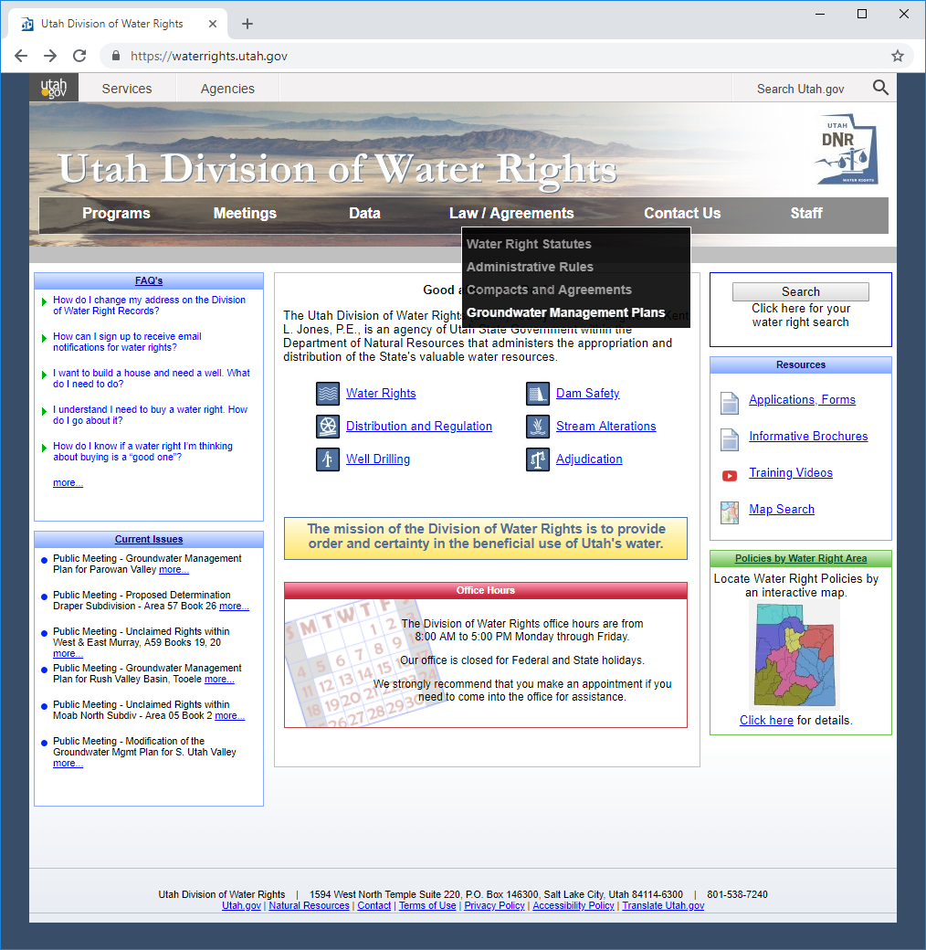

Slide 34
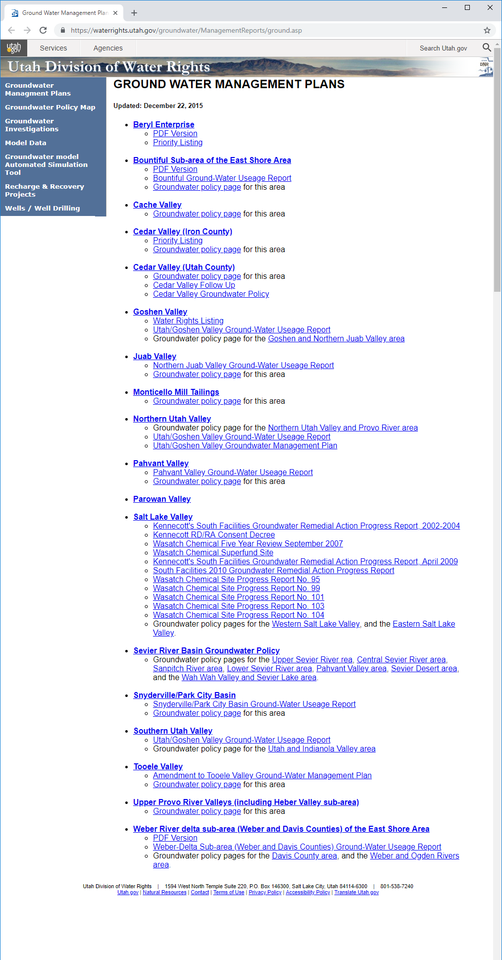

Slide 35
Groundwater Management Plans

Slide 36
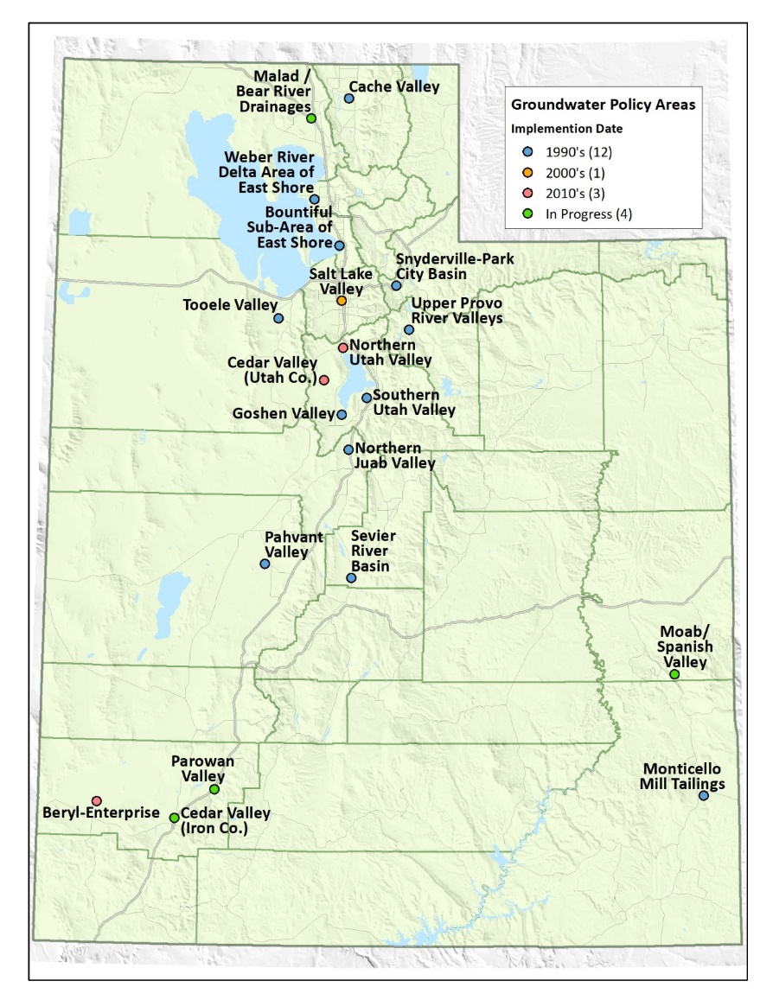
Groundwater Management Plans
Legislation enacted in 2006
Established Section 73-5-15 of Utah Code
Tool to help the State Engineer distribute groundwater

Slide 37
Section 73-5-15
(2)
(a) The state engineer may regulate groundwater withdrawals within a specific groundwater basin by adopting a groundwater management plan in accordance with this section for any groundwater basin or aquifer or combination of hydrologically connected groundwater basins or aquifers.

Slide 38
Water Distribution
Seeing Underground

Slide 39
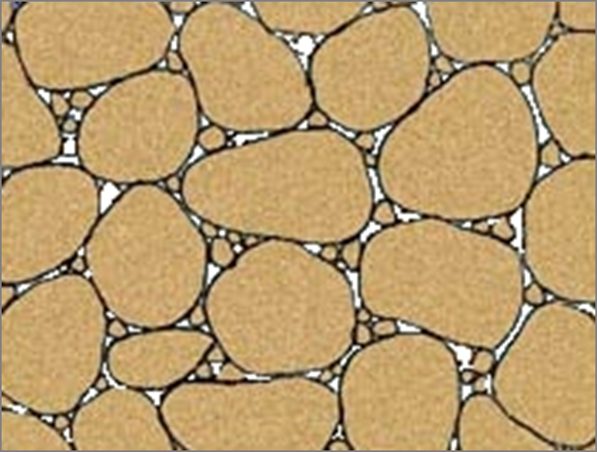
Managing a Renewable Resource

Slide 40
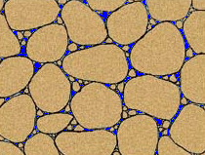
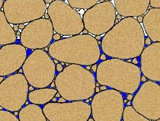
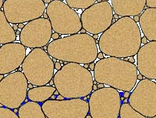
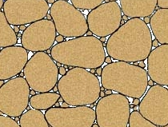
Groundwater Flow in Soil

Slide 41
Section 73-5-15
(2)
(b) The objectives of a groundwater management plan are to:
(i) limit groundwater withdrawals to safe yield;
(ii) protect physical integrity of the aquifer; and
(iii) protect water quality

Slide 42
Section 73-5-15
(1) As used in this section:
(a) “Critical management area” means a groundwater basin in which the groundwater withdrawals consistently exceed the safe yield.
(b) “Safe yield” means the amount of groundwater that can be withdrawn from a groundwater basin over a period of time without exceeding the long-term recharge of the basin or unreasonably affecting the basin’s physical and chemical integrity.

Slide 43
Safe Yield
Recharge is a starting point
May be less than recharge to protect physical integrity of the aquifer and water quality
Recharge is verified from a water budget
Inflows (recharge) = Outflows (discharge) + Change in storage

Slide 44
Section 73-5-15
(3)(b) The state engineer shall base the provisions of a groundwater management plan on the principles of prior appropriation
(4)(c) but may consider voluntary arrangements

Slide 45
Implementing A Groundwater Management Plan Will
Require Significant Scientific Research and Reporting
Require Meetings and Notice
Be Open to Comments and Suggestions
Respect all Existing Water Rights and Uses
Be subject to Judicial Review

Slide 46
What A Groundwater Management Plan is NOT
An administrative forfeiture action
The creation of a new taxing entity
Adopted by popular vote
Interference without due process

Slide 47
Conclusion

Slide 48
Questions/Comments
Send written comments to:
Utah Division of Water Rights
646 North Main St
PO Box 506
Cedar City UT 84721-0506
waterrights@utah.gov

