Slide 1
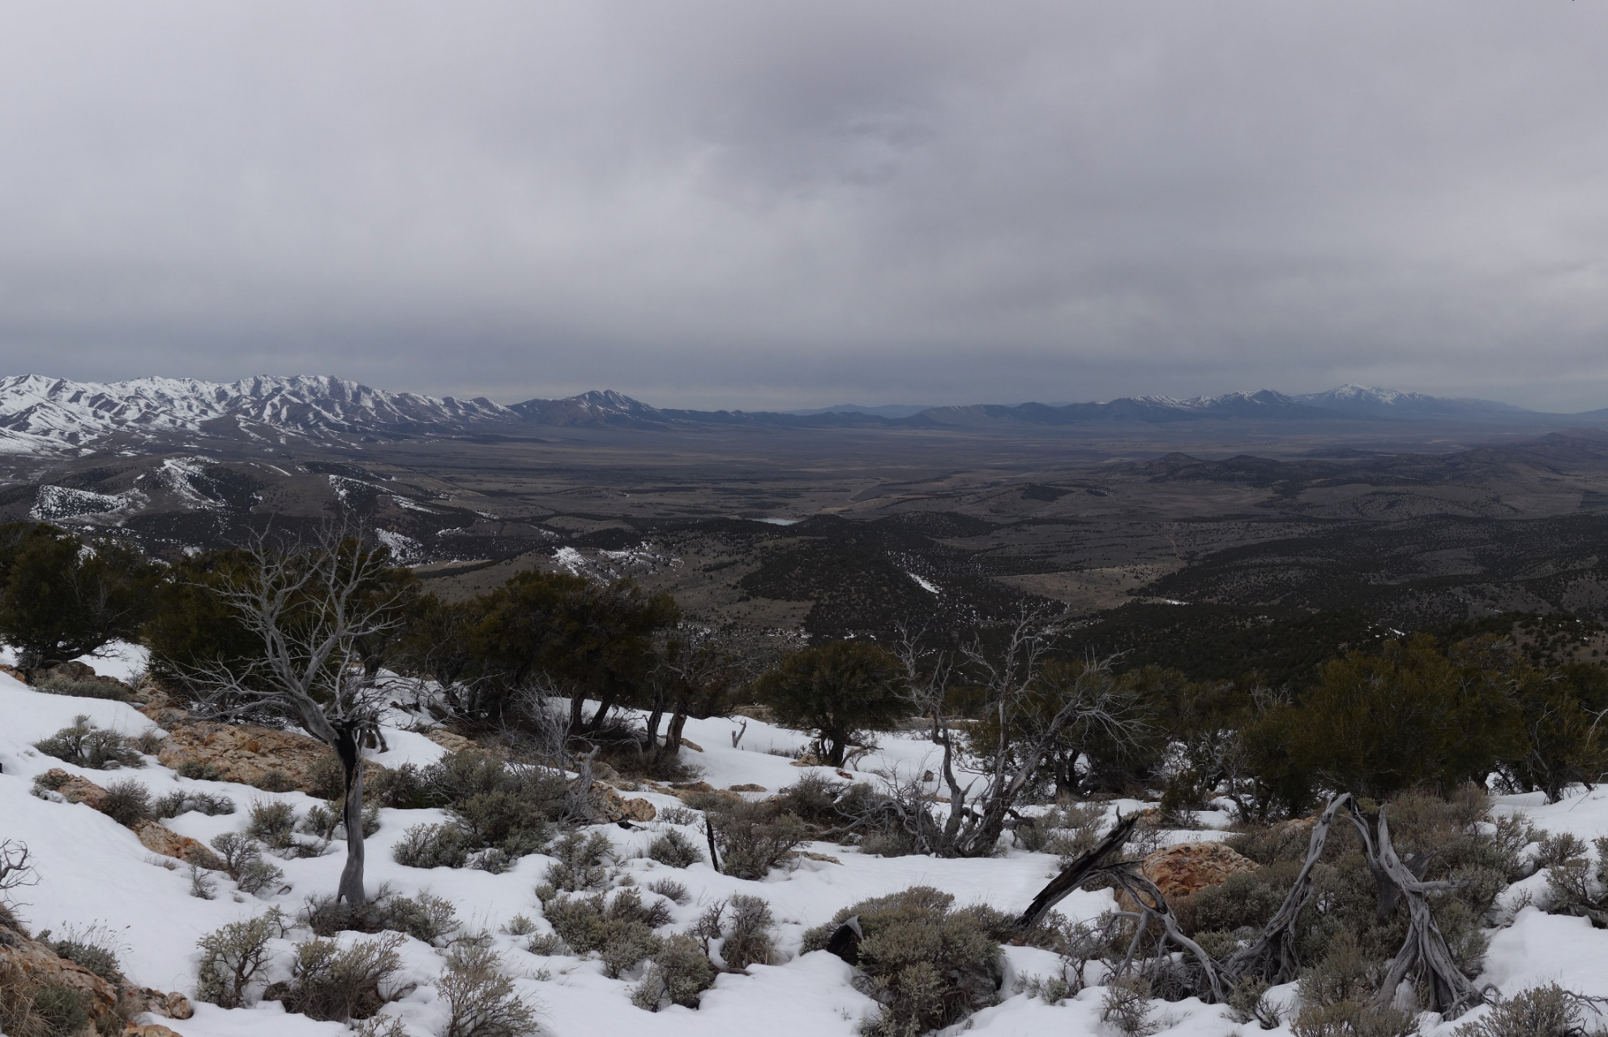
Rush Valley Water Rights Policy Meeting
November 8, 2018

Slide 2
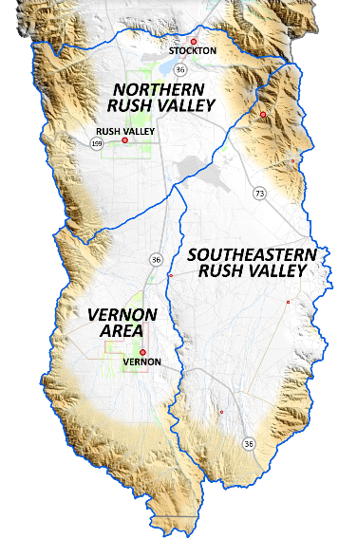
Overview
Introduction
Hydrogeology of Rush Valley
Groundwater Budget
Proposed Policy
Questions
Notes:
TS10

Slide 3
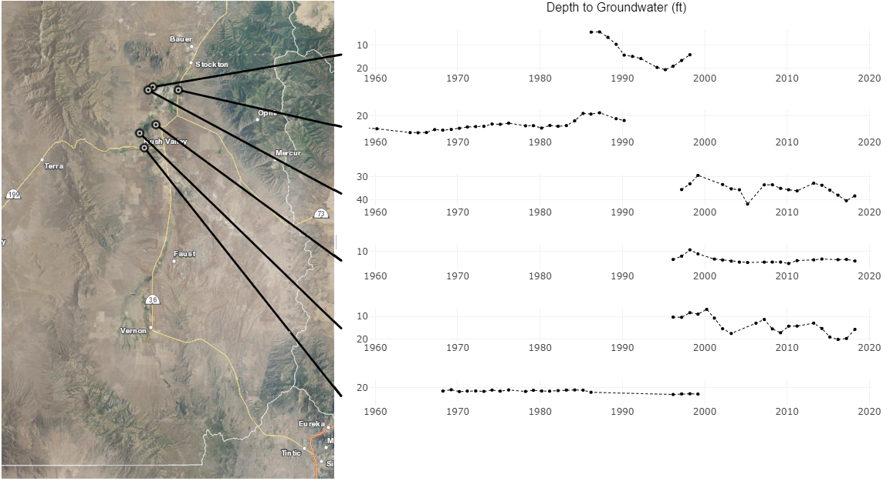
Depth 96 ft
Depth 34 ft
Depth 200 ft
Depth 35 ft
Depth 21 ft
Depth 73 ft
https://maps.waterrights.utah.gov/EsriMap/gw-graphs.asp
All displayed measurements were taken during March.

Slide 4
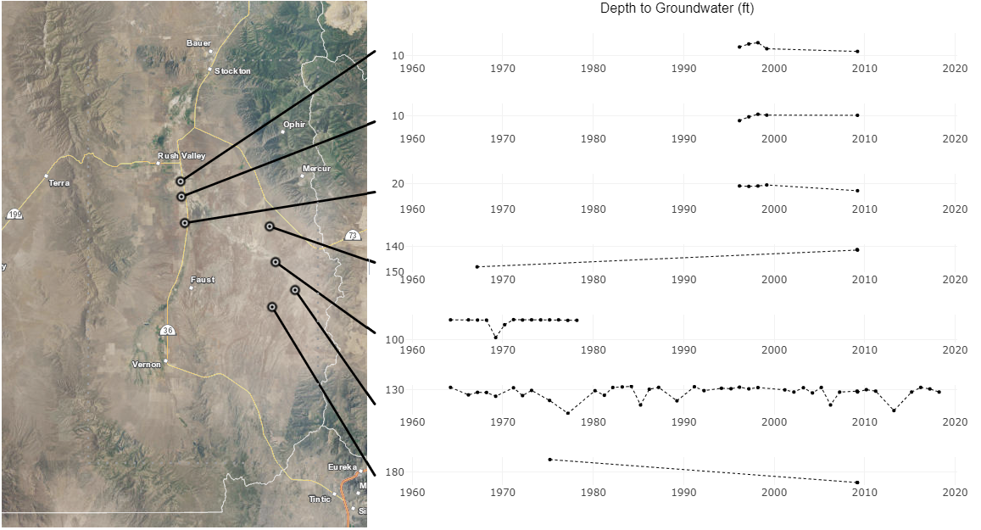
Depth 31 ft
Depth 38 ft
Depth 30 ft
Depth 365 ft
Depth 875 ft
Depth 300 ft
Depth 325 ft
https://maps.waterrights.utah.gov/EsriMap/gw-graphs.asp
All displayed measurements were taken during March.

Slide 5
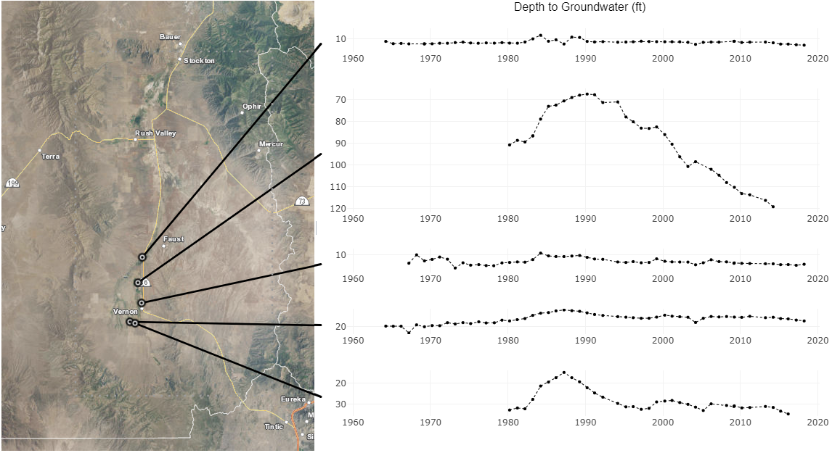
Depth 360 ft
Depth 547 ft
Depth 212 ft
Depth 60 ft
Unknown
Depth
https://maps.waterrights.utah.gov/EsriMap/gw-graphs.asp
All displayed measurements were taken during March.
Notes:
The USGS report identified the aquifer units which each of these wells are completed in:
The graph on top is in the “lower basin-fill aquifer unit”
Next, the well that shows the declines (WIN 13086), is completed in (or just above) the “upper carbonate aquifer unit”
The lower 3 wells are completed in the “upper basin-fill aquifer unit”
(see figures 12 & 13 on pages 30-32; also see figure 5 on page 10 of the USGS report).
All of these wells are confined:
1. (C-7-5)32bdd-1 (lower basin-fill, confined condition)
2. (C-8-5)7ddd-2 (upper carbonate aquifer & upper basin-fill, confined condition)
3. (C-8-5)20cdd-1 (upper basin-fill, confined condition)
4. (C-8-5)31ccd-5 (upper basin-fill, confined condition)
5. (C-9-5)6aab-1 (upper basin-fill, confined condition)

Slide 6
Actual Water Use in Rush Valley USGS Ground Water Conditions
Notes:
This is from the Groundwater Conditions in Utah reports.

Slide 7
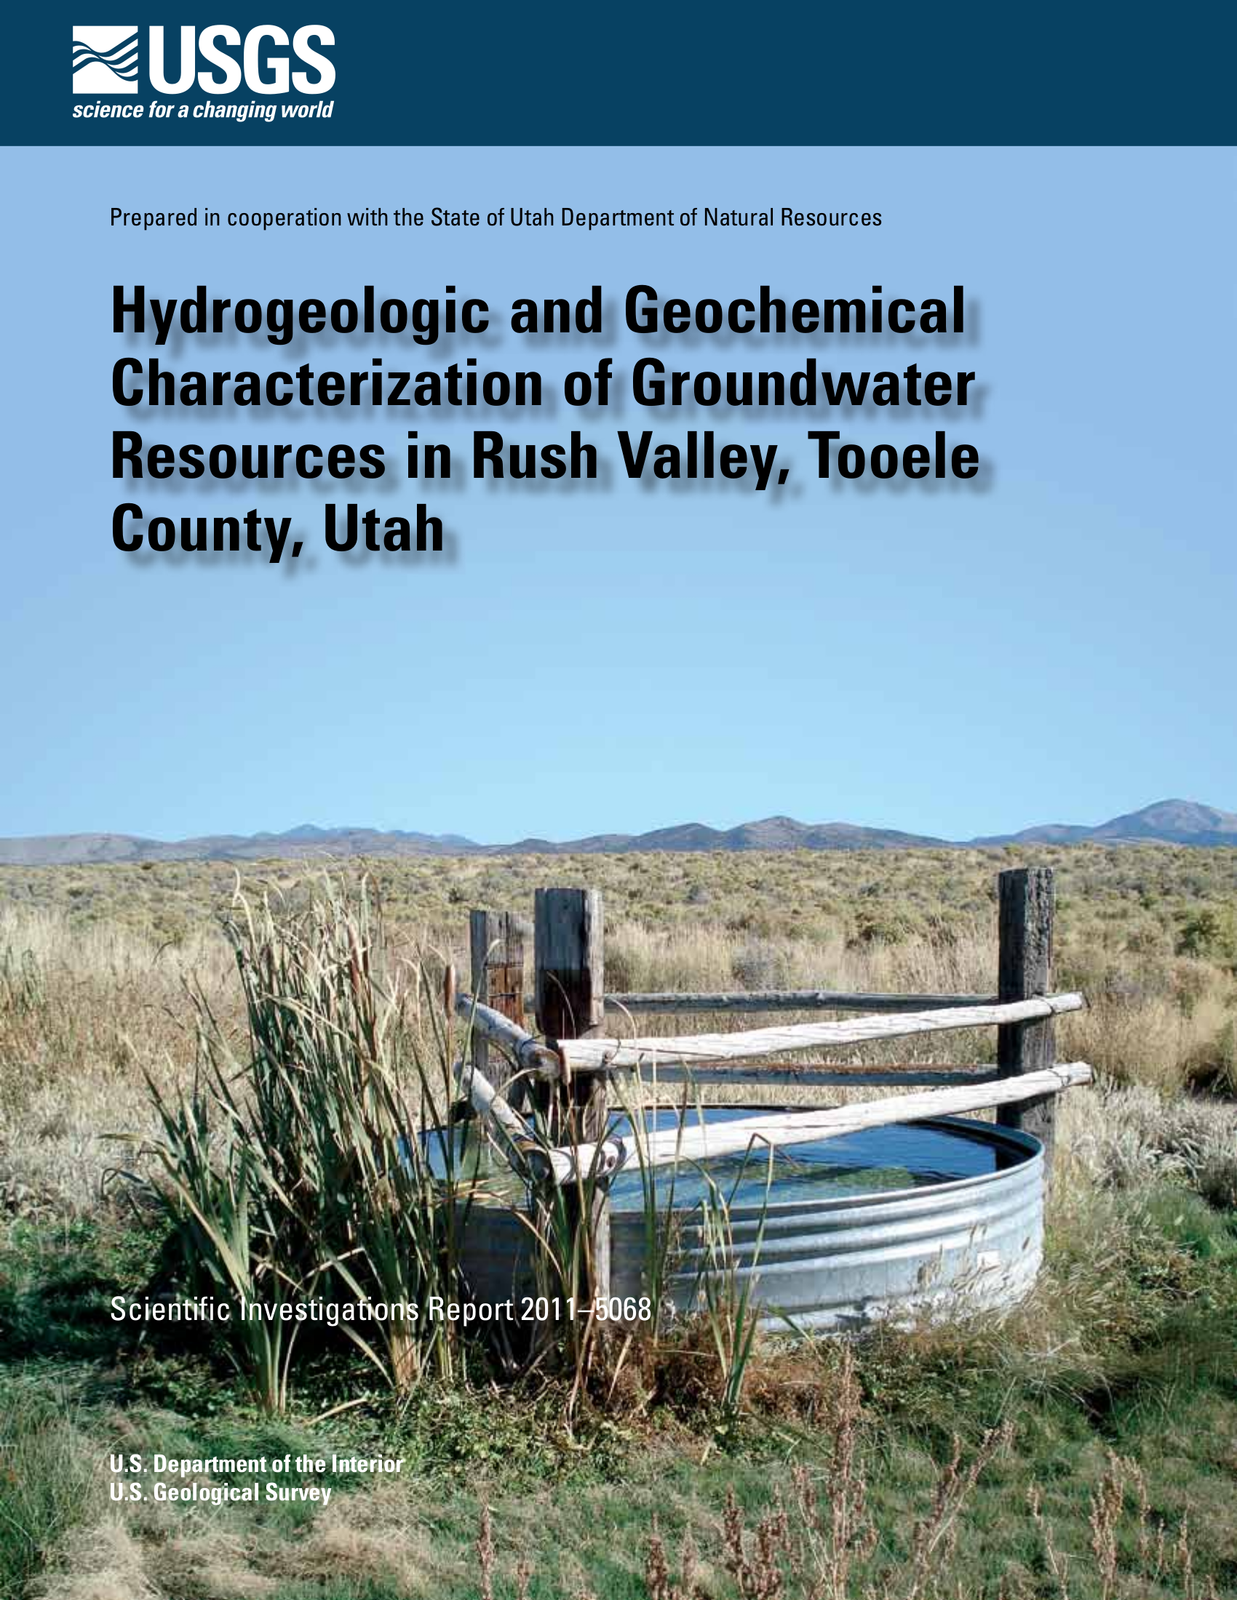
Most Recent Study
Scientific Investigations Report 2011–5068
Discussed groundwater level trends
Described hydrogeologic aquifer units
Estimated recharge
Estimated discharge
Reported uncertainty of recharge and discharge estimates
Technical Publication 23 - the previous study for this area
Notes:
The previous study was Technical Publication 23, published in 1969.
A lot of what it says is consistent with the new study, like
There are regions where recharge from the mountains does not enter the valley fill;
discussions about clay layers and less permeable deeper layers of the basin-fill;
most high-producing wells being located in certain areas of fractured bedrock or buried alluvium.
Estimates of recharge from precip, ET, well withdrawals are similar
Some things are different:
like subsurface outflow estimates

Slide 8
Hydrogeologic Conceptualization
In General, Rush Valley’s Vertical Units are considered single, interconnected hydrologic systems
Recharge in the mountains is transmitted to the valley-fill
Hydrogeolgic units are differentiated because they have different hydraulic characteristics, not because they are disconnected
Localized conditions may be important in some areas
Clay layers (Clover/St. John, Vernon areas)
Fractured bedrock zones (South Mountain, Vernon areas)
Coarse-grained zones, may be remnants of old fluvial channels (Clover, Vernon)
Notes:
“Well log data indicate that most wells in the Rush Valley study area produce groundwater from discrete layers or lenses of coarse-grained sediments in the basin fill and from fracture zones in bedrock. In basin fill, these coarse-grained zones may be the buried remnant of old fluvial channels. One example comes from a driller’s log of a well located in T. 8 S., R. 5 W., section 30 along the Vernon Creek-Faust Creek trend that notes drilling was terminated at only 53 ft when gravel continued to fill the hole as fast as it could be removed. Another example is well (C–5–5)32dbb–2, drilled to a depth of 112 ft in sands and gravels along the Clover Creek drainage. This reportedly is one of the best producing wells in the Clover-St. John area (James Schlosser, oral commun.). The basin fill also contains thick zones of fine-grained, low-permeability deposits.
Data are not sufficient to accurately estimate the extent of these permeable zones in the bedrock or basin-fill aquifers. Furthermore, the contributing thickness (b) of the aquifer in equation 1 is rarely well known. Because of the uncertainty in b, aquifer-test data were used to estimate values of T rather than K in Rush Valley (table 3).” (p.16)

Slide 9
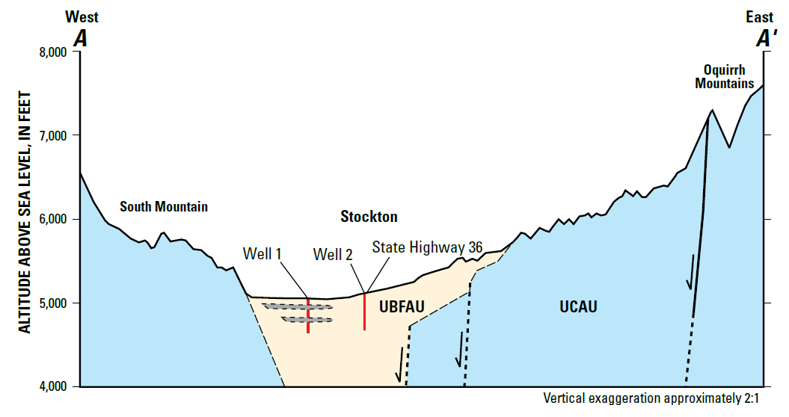
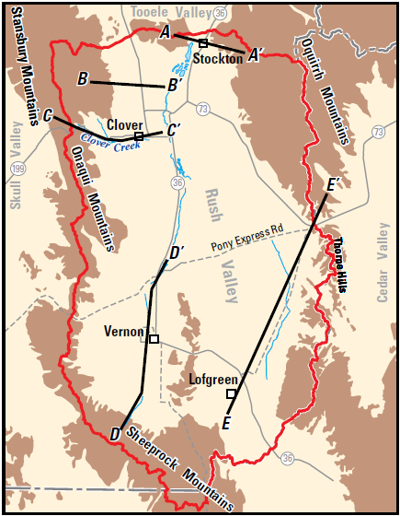
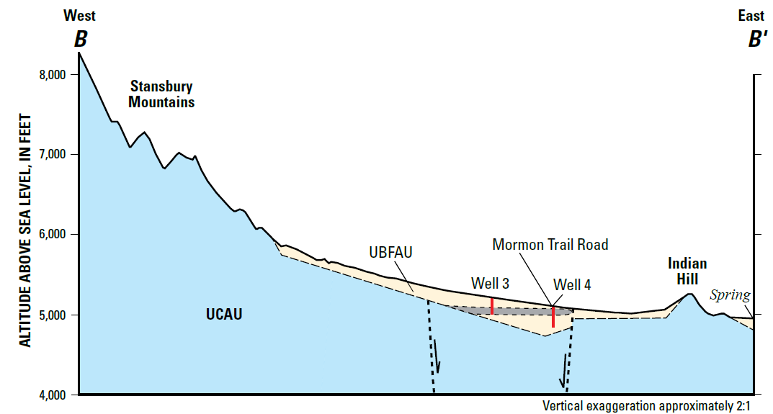
The bedrock aquifer (UCAU) is heavily fractured in locations near South Mountain and the mouth of Soldier Canyon, and wells that intersect the fracture zones are high producers. (p. 13)
Subsurface flow to Tooele Valley occurs only through the basin-fill, not the bedrock unit. (p. 20)
Notes:
“[The rocks of the UCAU bedrock aquifer] readily yield water where wells intersect fracture systems … along the north and south flanks of South Mountain, and near the mouth of Soldier Canyon east of Stockton.” (p. 13)
“Groundwater movement through the UCAU is likely impeded by the near vertically dipping bedding oriented perpendicular to the direction of groundwater movement where it underlies the UBFAU throughout this area.” (p. 20)
“Water-level altitudes in three of four wells penetrating the UCAU along the south slope of South Mountain are about 140 to 240 ft lower than in the neighboring UBFAU. Although this indicates the potential for groundwater to move from the UBFAU into the UCAU of South Mountain, the complicated geologic structure of South Mountain likely prevents flow in this direction and may only allow flow eastward around the bedrock block and through the UBFAU toward Tooele Valley at the Stockton Bar.” (p. 20)
“Cross section A–A’ extends west to east from bedrock on South Mountain to bedrock on the Oquirrh Mountains (fig. 6A). The central third of the cross section is drawn through the UBFAU near Stockton. Bedrock of the Oquirrh Group (UCAU) lies along much of the cross section. These rocks consist of nearly equal amounts of interbedded sandstone and limestone. Bedding in the Oquirrh Group is steeply north dipping and strikes parallel or subparallel to the line of section. On the basis of gravity data and available well logs, it is assumed that the UBFAU directly overlies the UCAU with no intervening LBFAU along the line of section. Gravity data indicate that the total thickness of the UBFAU is at least 450 ft and possibly much thicker near the center of the section. The UBFAU thins towards bedrock exposures at South Mountain and thinly mantles Oquirrh Group bedrock east of Stockton. Bedrock of the UCAU and unconsolidated basin fill of the UBFAU may be partially offset across a series of concealed down-to-the west normal faults near Stockton.”
“Cross section B–B' extends west to east from bedrock of the Oquirrh Group (UCAU) exposed in the eastern Stansbury Mountains to UCAU exposures at Indian Hill and a perennial spring at the eastern edge of the cross section (fig. 6A). Eastward sloping alluvial fans comprising the UBFAU probably mantle bedrock east of the Stansbury Mountains. A pair of prominent fault scarps with opposing offset defines a small graben between Indian Hill and the Stansbury Mountains. On the basis of well logs, the total thickness of the UBFAU in the graben based on well logs is at least 240 ft but likely not much greater than 300 ft. Gravity data suggest that the UBFAU thinly mantles bedrock both east and west of Indian Hill. Bedding in the UCAU is steeply dipping or overturned and strikes perpendicular to the line of section west of the graben. Bedrock near Indian Hill is west dipping and nearly perpendicular to the line of section.”

Slide 10
The flow of Clover Creek is more than expected for its watershed size and elevation. The report suggests faulting and the steep dip of the mountain bedrock redirects some groundwater that would otherwise flow into the valley aquifer into the springs that feed Clover Creek. (p. 7)
“The UBFAU contains spatially extensive clay layers in several areas including … near Clover and Saint John. Where present, these clay layers may form important confining layers within the basin-fill aquifer.”
“Permeability of the UBFAU is highly variable but generally decreases toward fine-grained deposits along the central axis of Rush Valley.”
Notes:
“Cross section C–C' extends west to east across Johnson Pass, paralleling Clover Creek and State Highway 199 toward the center of Rush Valley (figs. 5 and 6A). Gently folded and faulted Paleozoic bedrock of the LCAU is encountered along the western third of the cross section. The east-dipping UCAU overlies the LCAU between the projected location of Clover Spring and the UBFAU that covers bedrock across the eastern two-thirds of the cross section (fig. 6A). Total thickness of the UBFAU is unconstrained by well logs, but gravity data and correlation with areas of known thickness to the south indicate a dramatic eastward thickening across the cross section. Thickness of the UBFAU likely increases eastward to at least 500 to 600 ft. Beneath the UBFAU, the older LBFAU is inferred to account for most of the deep basin fill. Available data indicate that the LBFAU has a limited lateral extent in the subsurface, leaving a zone where the UBFAU directly overlies bedrock along the eastern flank of the southern Stansbury Mountains.”
“Directly north of the groundwater divide in Rush Valley, groundwater moves eastward from recharge areas in the northern Onaqui and southern Stansbury Mountains and westward from the southern Oquirrh Mountains toward the center of the valley (fig. 7). Near the divide, groundwater moves through the UBFAU under generally unconfined conditions. The UBFAU reaches a thickness of at least 500 to 600 ft, and possibly as much as 1,000 ft, east of Clover along the boundary between T.5 S. and T.6 S., and it thins to the north where it directly overlies the UCAU near Indian Hill (cross section B–B', fig. 6A). Groundwater movement through the UCAU is likely impeded by the near vertically dipping bedding oriented perpendicular to the direction of groundwater movement where it underlies the UBFAU throughout this area. Assuming most groundwater moves through the UBFAU, the active groundwater-flow system in northern Rush Valley is likely constrained to within about 1,000 ft of the land surface.” (p. 20)

Slide 11
The aquifer is unconfined near the mountains south and west of Vernon. Moving to the north and west, the upper basin-fill aquifer thins and becomes confined beneath clay layers. (p. 20)
There is a high transmissivity area in the UCAU bedrock aquifer just north of Vernon. The basin fill overlying this area has thick clay layers separating the bedrock aquifer from the shallow basin fill aquifer. (p. 13, 20)
This is the well with
declining water levels
Notes:
“Cross section D–D' extends northward from the Sheeprock Mountains through the community of Vernon roughly parallel to State Highway 36 (figs. 5 and 6B). Precambrian-age rocks of the NCCU are shown in the southernmost part of the cross section. North-dipping rocks of the LCAU and the UCAU overlie the NCCU, with the Oquirrh Group of the UCAU forming the uppermost bedrock across most of the section. The UBFAU covers all bedrock north of the Sheeprock Mountains. The UBFAU gradually thickens north of the Sheeprock Mountains to the Vernon area, where the log of well 13 indicates just over 1,000 ft of unconsolidated deposits lying directly on the UCAU (table 2; figs. 5 and 6B). North of this well, a down-to-the south/southwest fault that may be the northwestward continuation of the Vernon Creek fault is inferred to offset bedrock. North of this structure, the UBFAU gradually thins northward from nearly 650 to 200 ft near the intersection of State Highway 36 and the Pony Express Road. Northward-thickening LBFAU overlies the UCAU along the north end of the cross section.”
“South of the groundwater divide in the Vernon area, groundwater moves north from the recharge area in the Sheeprock Mountains toward a large area of discharge that extends from south of Vernon (near the boundary between T. 8 S. and T. 9 S.) northward to the vicinity of Atherley Reservoir (fig. 7). Groundwater conditions in the UBFAU are unconfined in the southern and westernmost parts of the valley near the basin-fill boundary and transition to confined conditions near the discharge area. The UBFAU thickens north of the Sheeprock Mountains to just over 1,000 ft near Vernon where it directly overlies the UCAU (cross section D–D', fig. 6B). From this point, the UBFAU thins northward, first abruptly to around 650 ft, then more gradually to around 200 ft near the intersection of State Highway 36 and the Pony Express Road. This northward thinning of the UBFAU is likely responsible for discharge in the Vernon area as groundwater is forced upward by the underlying low-permeability parts of UCAU and semiconsolidated LBFAU. Discharge in this area occurs by ET, to focused and diffuse springs and flowing wells, and as baseflow to Faust Creek. Groundwater not consumed by ET continues to move northward past the Vernon Hills and then eastward toward Cedar Valley at Fivemile Pass.
A few high-yield wells produce water from the UCAU north of Vernon. Drillers’ logs from five wells [(C–8–5)6ccd–1, 6ddb–1, 6ddb–2, 7ddd–2, and 17ccc–1] indicate the presence of a highly fractured UCAU zone directly underlying a 20-to-100-ft thick zone of highly permeable quartzite cobbles and boulders. The UCAU is confined in this area by thick sequences of clay in the UBFAU. The quartzite cobbles and boulders may be fluvial deposits from the Sheeprock Mountains to the south. Water-level altitudes (October 2009) in wells (C–8–5)6ccd–1, 7ddd–2, and 17ccc–1 are approximately 5,241–5,246 ft, (table A1–1), indicating a very low hydraulic gradient in this deep aquifer over a minimum distance of at least 2 mi north to south and 1 mi east to west (fig. 7). Although these water-level altitudes are higher than the altitude of the clay confining units in the overlying UBFAU, signifying nonflowing artesian conditions, they are about 70 to 165 ft below water levels measured during October 2009 in wells finished in the overlying UBFAU.” (p. 20)
Note: Well 15 (WIN 13086) is the one that has a history of significantly declining water levels. It is completed in the basin fill, but bellow several clay layers and just above the bedrock aquifer.

Slide 12
The aquifer is unconfined in the southeastern area (p. 20), and “the UBFAU is less than 300 ft thick and overlies the older Salt Lake Formation of the LBFAU.” (p. 9)
“..attempts to drill productive wells in UCAU or LCAU bedrock occasionally result in abandonment because they yield little to no water. Examples are in Ophir Canyon … and in the Thorp Hills…” (p. 18)
Notes:
“Groundwater in the southern part of southeastern Rush Valley moves in a north-to-northeast direction from a relatively small recharge area in the West Tintic Mountains (fig. 7). In the southernmost part of this sub area, the UBFAU occurs only as a thin mantle overlying the low-permeability LBFAU and is assumed to thicken toward the north-northeast (cross section E–E', fig. 6B). Unconfined conditions probably exist throughout most of southeastern Rush Valley. Water-level contours indicate that no significant recharge moves into the valley from the East Tintic Mountains or from the hills extending north of them. This is likely due to low precipitation rates combined with geologic structures that prevent westward groundwater movement out of these highlands, where the bedrock is extremely faulted and folded (fig. 5). In the northern part of southeastern Rush Valley, groundwater moves south-southeasterly away from the valley groundwater divide, paralleling the southern Oquirrh Mountain range front. Water-level contours in this area also indicate that no significant recharge moves into the valley from the neighboring Oquirrh Mountains. Hood and others (1969) and Feltis (1967) noted an area in the southern Oquirrh Mountains within the Rush Valley surface-water drainage where geologic structural features direct groundwater recharge toward Cedar Valley. This is described in more detail in the “Recharge” subsection of this report. No discharge occurs at the surface in southeastern Rush Valley, where water levels are more than 120 ft below land surface near the valley bottom. Small amounts of groundwater from the Vernon area converge with the northerly and southerly flow paths and move toward Cedar Valley.” (p. 20-21)

Slide 13
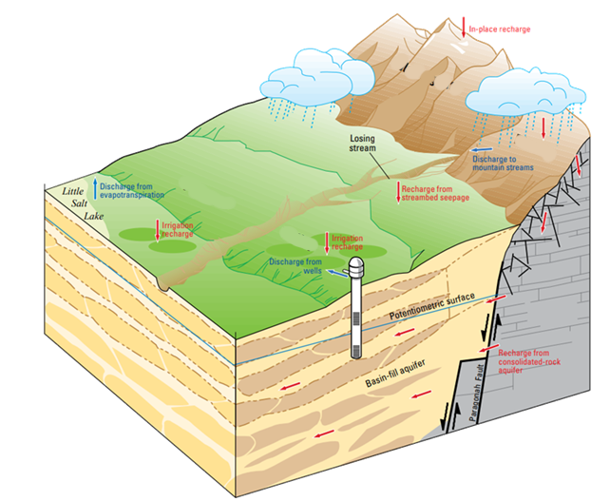
Groundwater Balance
Recharge
Precipitation
Seepage from irrigation
Seepage from streams
Subsurface inflow
Discharge
Well pumping
Evapotranspiration (Lake evaporation and plant transpiration)
Valley springs
Subsurface outflow
Figure 13 from SIR-2017–5072

Slide 14
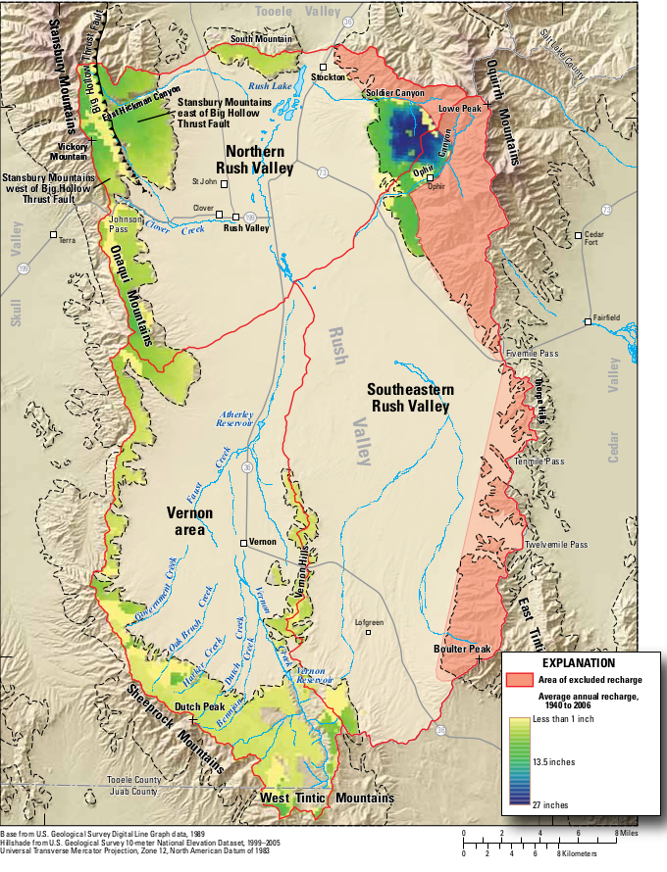
USGS Water Budget -Recharge
Recharge from Precipitation
BCM Estimate (67-yr avg)
No precipitation recharge on valley floor
Large rates of recharge on mountains
Area of no recharge – east mountains
Measured water levels does not show a gradient from these mountains to the valley
Faults along these mountains likely block the flow of water to the valley
High uncertainty (50%)
Recharge from Irrigation Returns
Assumed 30% of surface water used for irrigation becomes recharge
Assumed all of the estimated streamflow is applied for irrigation

Slide 15
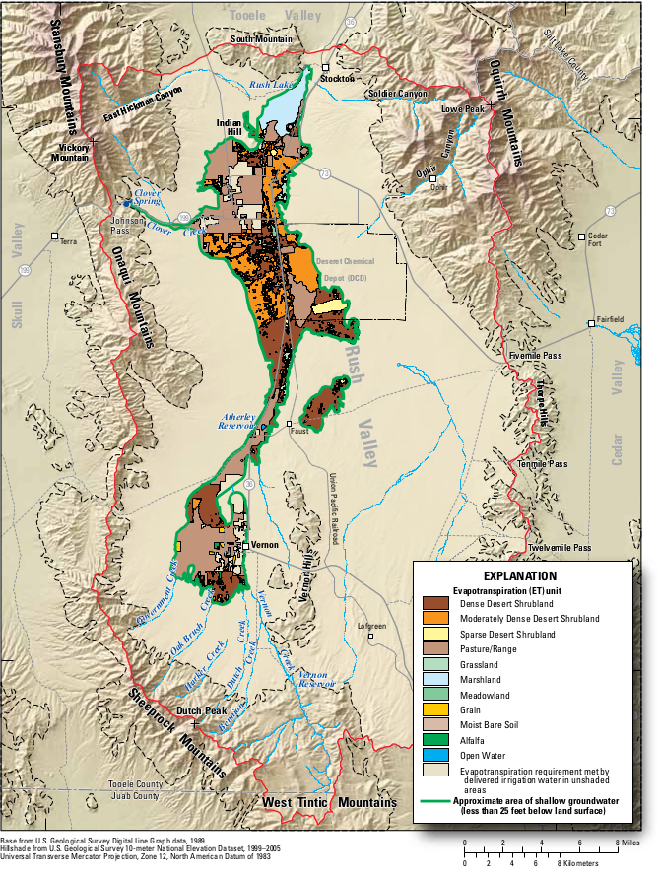
USGS Water Budget -Discharge
Evapotranspiration
Mountain Springs
Well Withdrawals
Subsurface Outflow
600 ac-ft/yr to Tooele Valley
300 ac-ft/yr to Cedar Valley
Notes:
(The previous study estimated 5,000 ac-ft/yr of subsurface outflow to Cedar Valley, and a “small but significant” amount to Tooele Valley.)

Slide 16
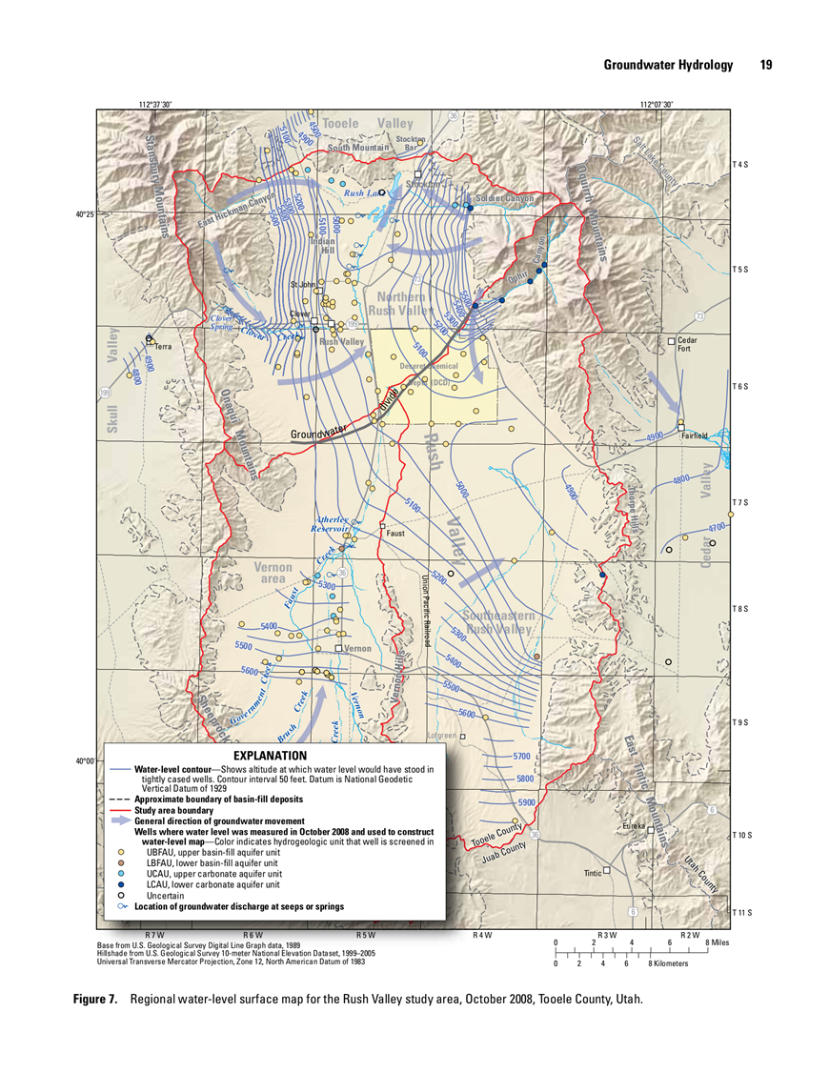
General Findings
Report defined three subareas
North Rush Valley
Vernon Area
Southeastern Rush Valley

Slide 17
General Findings
Report defined three subareas
North Rush Valley
Vernon Area
Southeastern Rush Valley

Slide 18
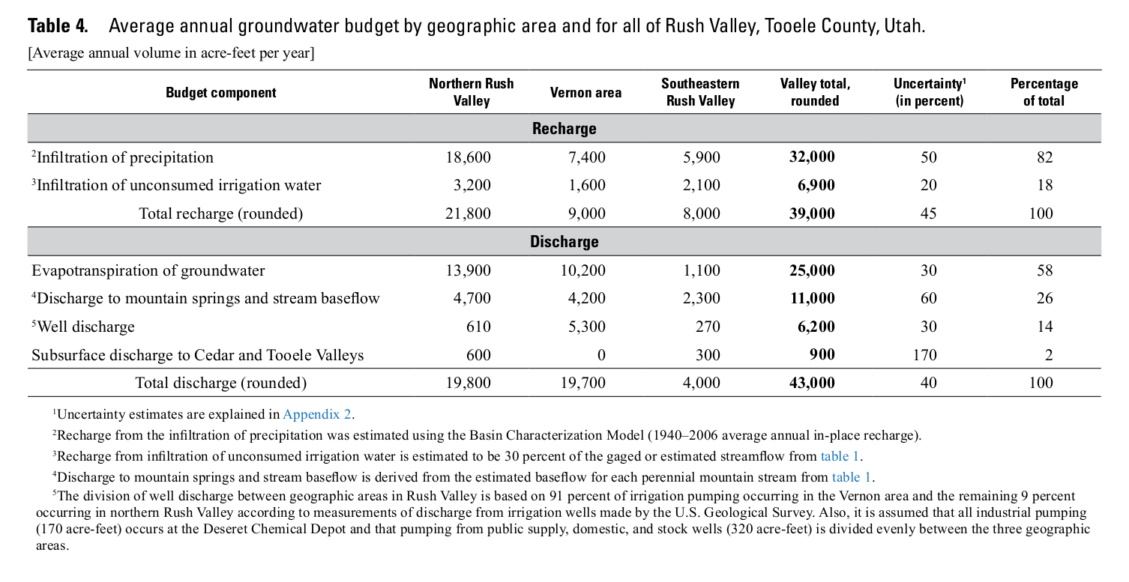
Recharge & Discharge Estimates
 | Northern Area | Vernon Area | SE Area
Infiltration of precipitation | 18,600 | 7,400 | 5,900
Infiltration of unconsumed irrigation water | 3,200 | 1,600 | 2,100
Total Recharge: | 21,800 | 9,000 | 8,000
Evapotranspiration | 13,900 | 10,200 | 1,100
Discharge to mountain springs and stream baseflow | 4,700 | 4,200 | 2,300
Well withdrawals | 610 | 5,300 | 270
Subsurface outflow | 600 | 0 | 300
Discharge: | 19,800 | 19,700 | 4,000

Slide 19
Subarea Breakdowns – Northern Area
 | Mountain and Valley (SIR 2011-5068) | Mountain and Valley (Interpreted) | Valley Only (Interpreted)
Precipitation | 9,300 to 27,900 | 18,300 | 13,500
Irrigation and Streams | 2,600 to 3,800 | 3,200 | 3,200
TOTAL RECHARGE | 11,900 to 31,700 | 21,500 | 16,700
ETg | 9,700 to 18,100 | 14,000 | 14,000
Mountain Springs | 1,900 to 7,500 | 4,800 | -
Wells | 400 to 800 | 2,000 | 2,000
Subsurface outflow | 0 to 1,600-5,000 | 600 | 600
TOTAL DISCHARGE | 11,600 to 29,200 | 21,500 | 16,700

Slide 20
Subarea Breakdowns - Vernon
 | Mountain and Valley (SIR 2011-5068) | Mountain and Valley (Interpreted) | Valley Only (Interpreted)
Precipitation | 3,700 to 11,100 | 10,600 | 8,600
Irrigation and Streams | 1,300 to 1,900 | 1,900 | 1,900
TOTAL RECHARGE | 5,000 to 13,000 | 12,500 | 10,400
ETg | 7,100 to 13,300 | 7,600 | 7,600
Mountain Springs | 1,700 to 6,700 | 2,000 | -
Wells | 3,700 to 6,900 2,500 to 6,900 | 2,900 | 2,900
TOTAL DISCHARGE | 12,500 to 26,900 | 12,500 | 10,400

Slide 21
Subarea Breakdowns – Southeastern Area
 | Mountain and Valley (SIR 2011-5068) | Mountain and Valley (Interpreted) | Valley Only (Interpreted)
Precipitation | 3,000 to 8,900 | 3,800 | 500
Irrigation and Streams | 1,700 to 2,500 | 1,800 | 1,800
TOTAL RECHARGE | 4,600 to 11,400 | 5,600 | 2,300
ETg | 800 to 1,400 | 1,300 | 1,300
Mountain Springs | 900 to 3,700 | 3,300 | -
Wells | 200 to 400 | 300 | 300
Subsurface Outflow | 0 to 800 | 700 | 700
TOTAL DISCHARGE | 1,900 to 6,300 | 5,600 | 2,300

Slide 22
Comparison: Recharge vs. Well Withdrawal
 | Groundwater Levels | Balanced Recharge/Discharge | Estimated Well Withdrawal | Estimated Water Surplus
Northern | Steady | 16,700 | 2,000 | 14,700
Vernon | Mostly Steady | 10,400 | 2,900 | 7,500
Southeastern | Steady | 2,300 | 300 | 2,000
All numbers are in acre-feet
Notes:
Slide Objective: Actual pumping numbers show that there is a surplus.

Slide 23
Subarea Summary – Overview
SUBAREA | Balanced Recharge/ Discharge | Surplus Based on Well Withdrawal | Potential Water Right Diversion | Surplus Based on Diversion | Potential Water Right Depletion | Surplus Based on Depletion | Potential Diversion of Unapproved Applications
NORTHERN | 16,700 | 14,700 | 15,164 | 1,536 | 8,561 | 8,139 | 4,510
VERNON | 10,400 | 7,500 | 14,719 | None | 8,087 | 2,313 | 1,600
SOUTHEASTERN | 2,300 | 2,000 | 3,200 | None | 2,436 | None | 5,356
Notes:
All numbers are in acre-feet
All of the unapproved applications are potentially 100% depletive.
Notes:
Table 2 – A lot of data on this page. We’ll take our time.
Subarea (From last page)
Balanced Recharge/Discharge – (From last page)
Surplus Based on Well Withdrawal – (From last page)
Potential Water Right Diversion – Derived from inventory. What is diversion?
Surplus based on Diversion – Surplus is much smaller.
Potential Water Right Depletion – Derived from inventory of existing water rights.
Surplus based on Depletion – Surplus is in between Well-based and Depletion-based.
Unapproved Applications.
Conclusions:
There are a lot of existing water rights not being fully used.
On basis of potential diversion, Rush Valley basin is either over or approaching calculated recharge.
On basis of potential depletion, there is still additional water.
Unapproved applications diminish the calculated surpluses.
Discussion:
So which one of these surpluses is “right”?
None are right but none are wrong either.
Groundwater policy is challenging because of uncertainty.
There seems to be water available, more so in the northern area, less so in the other two.
If there is water, (as shown by Div and Dep) Utah water law dictates that we provide means to appropriate it.

Slide 24
State Engineer’s Concerns
Levels of uncertainty in recharge and discharge estimates.
Inaccuracy of well withdrawal estimates.
Unknown outflow to Tooele Valley
Brackish water – is the available water usable?
Possible interference between wells
Difference between actual use and approved/perfected water rights.
Possibility of Increased Speculation
Still reason to be cautious.
Notes:
State Engineer’s Concerns:
Levels of uncertainty – Some of this is inherent, but additional data and study can reduce uncertainty.
Inaccuracy of well withdrawal estimates – refine methodology
Unknown outflow to Tooele Valley
Brackish water – is the water usable?
Possible interference between wells.
Difference between actual use and paper water – why? Is there a physical constraint preventing full use of the water rights?
Speculation – was one of the main reasons for initial policy. Will speculation be a problem again?
While the study shows there is more water available….
STILL REASON TO BE CAUTIOUS

Slide 25
Current Policy Background
1982 – New applications limited to 0.1 cfs
Responding to: Many Large Applications, Well Interference, Brackish Water
Policy Objectives: Limit Speculation, Ordered Development
1999 – Defined policy to 1 house, 1.0 acre of irrigation and limited stockwatering.
2008 – Present Policy: 4.73 acre-feet limitation
1 house, 1.0 acre of irrigation and 10 animals.

Slide 26
Proposed Policy Changes
Subdivide Rush Valley into 3 Subareas
Southeastern Rush Valley
Vernon Area
Northern Rush Valley
Notes:
Subdivide Rush Valley into 3 Subareas

Slide 27
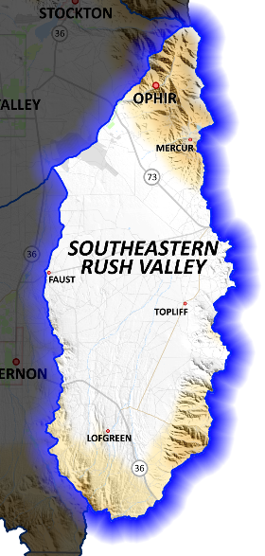
Proposed Policy Changes – Southeast Area
Open only to small domestic applications:
1.73 acre-feet: 1 house, 10 animals, 0.25 acres of irrigation
Closed to change applications moving water from outside of the subarea.

Slide 28
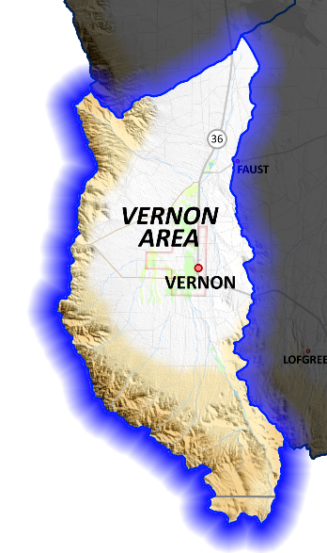
Proposed Policy Changes – Vernon Area
No change - 4.73 acre-feet per application.
1.0 acre of irrigation
1 house
10 animals
Closed to change applications moving water from outside of the subarea.

Slide 29
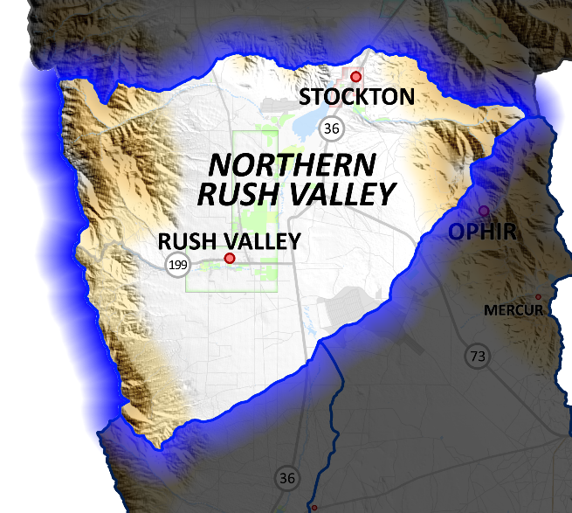
Proposed Policy Changes – Northern Rush Valley
New appropriation limit of 20 acre-feet per application.
Example 1: 5 acres of irrigation
Example 2: 1 house, 20 animals, 4.75 acres of irrigation
Closed to change applications moving water from outside of the subarea.

Slide 30
Proposed Policy Changes – Final Details
Pending applications will be processed based on this new policy (if adopted).
Applications filed from this date forward will be processed based on this new policy (if adopted).

Slide 31
Policy Adoption Process
30 Day Comment Period
December 10, 2018
Final Policy will be posted to:
www.waterrights.utah.gov
Division of Water Rights
Attn: Rush Valley Groundwater Policy
PO Box 146300
Salt Lake City, Utah 84114-6300
801-538-7240
waterrights@utah.gov

Slide 32
Comment Period
Guiding Questions:
What is your experience with the water supply in the Rush Valley area?
What concerns do you have if the proposed policy is adopted?

