Slide 1
Utah Division of Water Rights
RWAU Water Right Training
Overview/Review—April 2018
Boyd Clayton
Deputy State Engineer
June 21, 2004

Slide 2
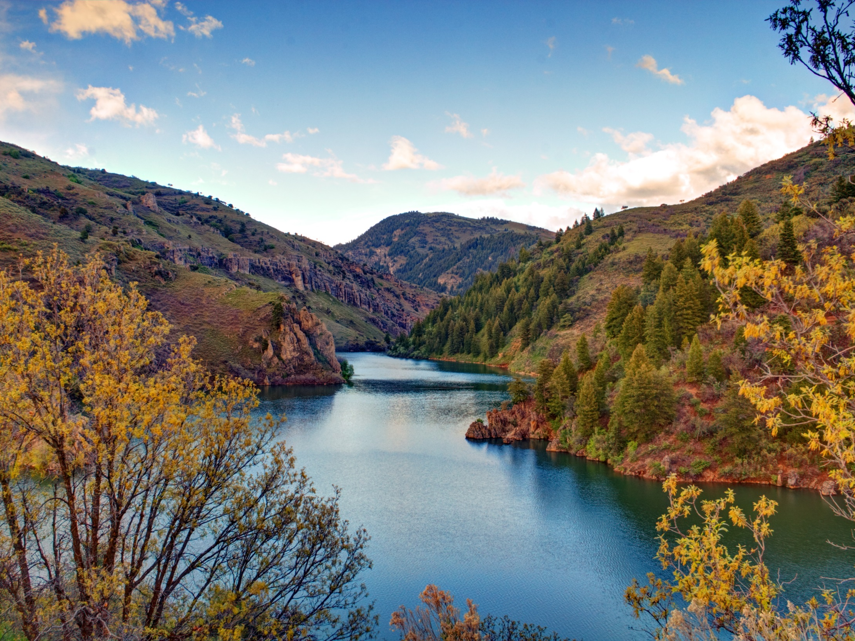
What is a Water Right and Why Do we have them?
Riparian Rights and the West

Slide 3
How and why do water rights vary
Across the United States

Slide 4
73-1-1 Water is a Public Resource 73-1-3 Rights are limited by Beneficial Use 73-1-4 Right is revocable if not used 73-1-5 Beneficial use is a public use 73-1-6,7 Riparian control defeatable 73-1-8 Duty to not waste or injure 73-1-10 Water rights conveyable
Basic Principles

Slide 5
When do you need a water right? How do you get a water right? How don’t you get a water right? What else might you get?

Slide 6
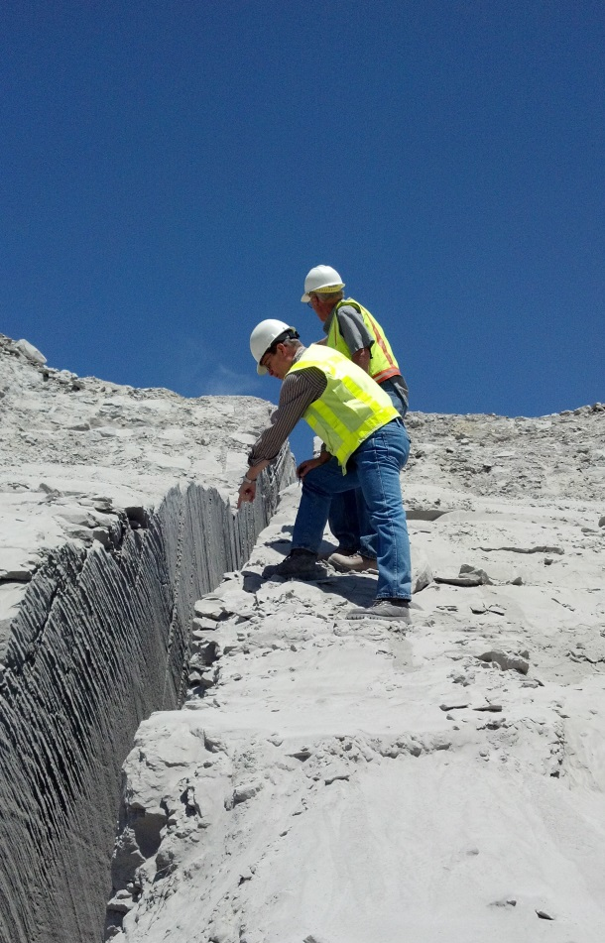
State Water Agencies
Divert and use waters of public
State Engineer
DNR, Division of Water Rights
Water Planning and Project Development
Water Resources Board
DNR, Division of Water Resources
Control of pollutants in public waters
Water Quality Board
DEQ, Division of Water Quality Drinking Water Safety
Drinking Water Board (DEQ, Division of Drinking Water)

Slide 7
Utah State Engineer
Appointed by Governor for 4 year term
Confirmed by Senate
Licensed Professional Engineer
Knowledge of water issues, water laws, state water resources
Division of Water Rights - Support Staff
SE serves as director of Division
Department of Natural Resources Agency
Responsible for Water Right Administration
Serves without a board / No superior agency review
Gatekeeper to provide order and certainty
Reduces potential for conflict
Protects investments
Respect for existing rights
Public waters appropriated according to policy set by legislature
Decisions reviewed de novo in district courts

Slide 8
Informal Administrative Process (Governed by UAPA)
Application Filing (Request for Agency Action)
Notice
Protests
Hearing (optional)
Study
Decision
Reconsideration/ de novo review
Development
Proof/Extension/Lapsing
Issuance of Certificate (Vested Right)

Slide 9
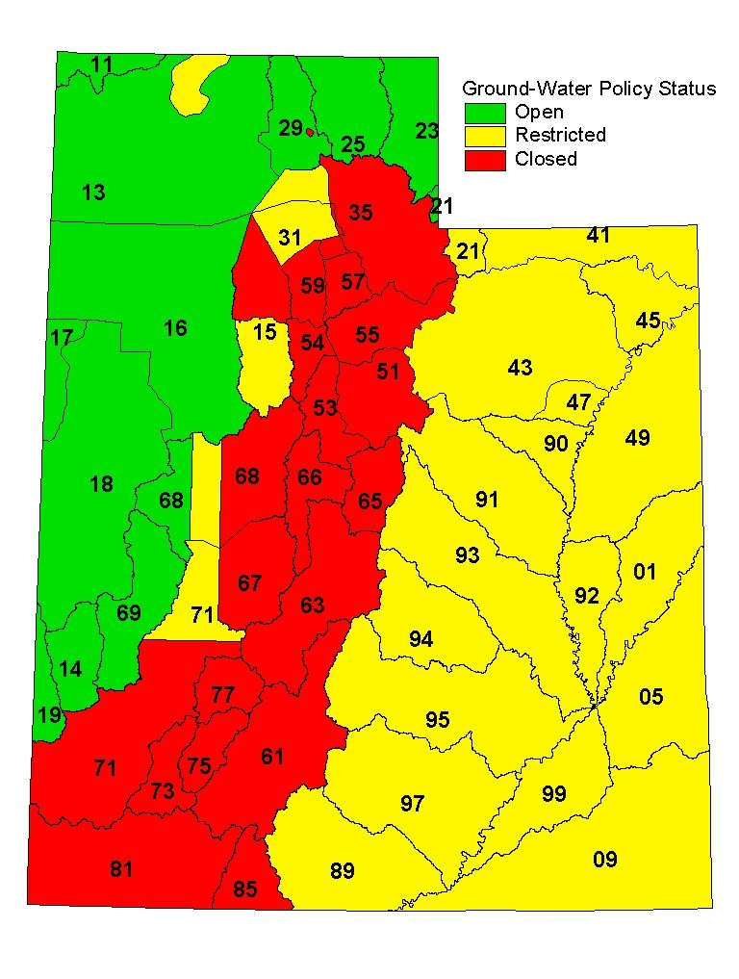
Water
Appropriation Policy
And Resource Studies

Slide 10
Water Use Terms
Duty (maximum reasonable diversion amount)
Depletion (consumptive use)
Irrigation (generally about 0.5 x duty)
Domestic with Septic waste (20 percent)
Municipal (sec. water, waste treatment, reuse)

Slide 11
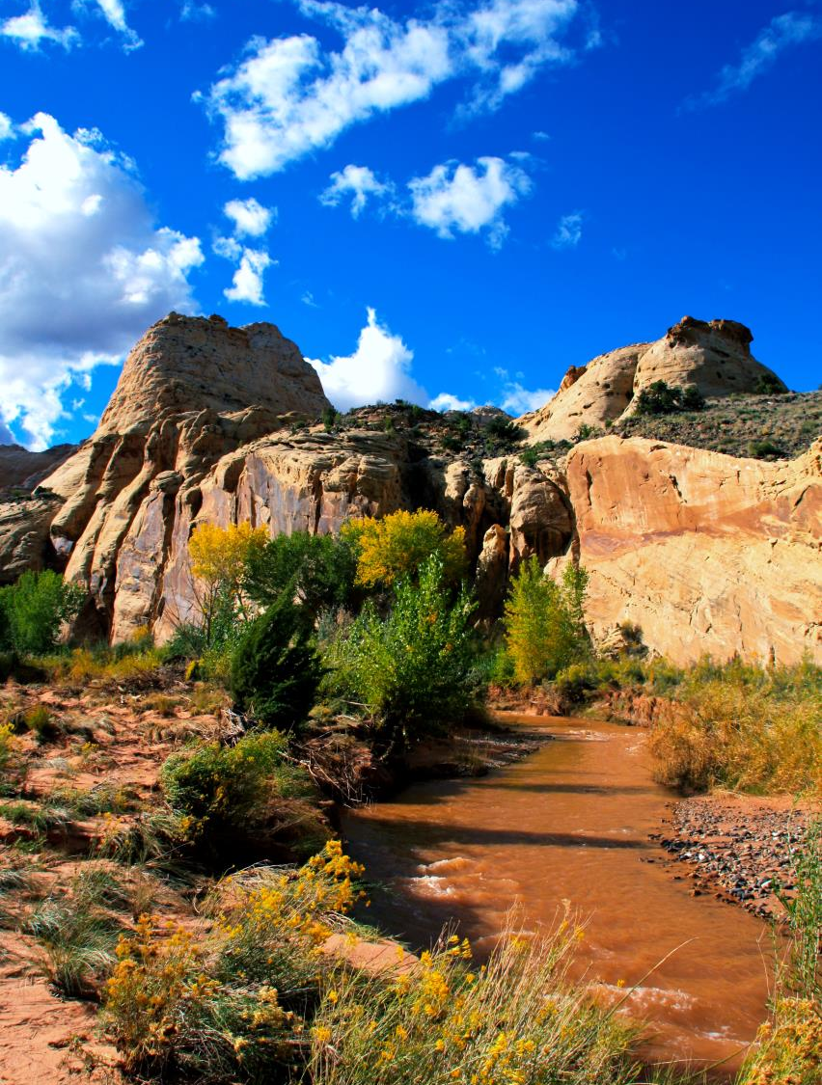
Where Do Water Rights Come From?
Applications
Pre-statutory use (Diligence Claim)
Decrees
Federal Reservations

Slide 12
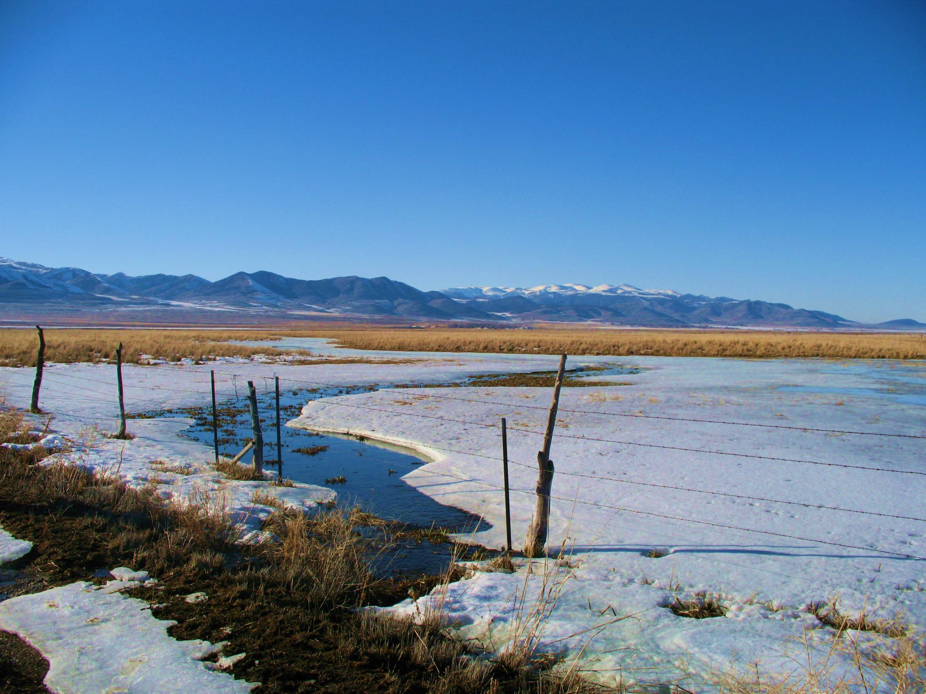
Questions?

