Slide 1
Utah Division of Water Rights
Distribution
RWAU Training—April 2018
Jared Manning, P.E.
Assistant State Engineer of Field Services
June 21, 2004

Slide 2
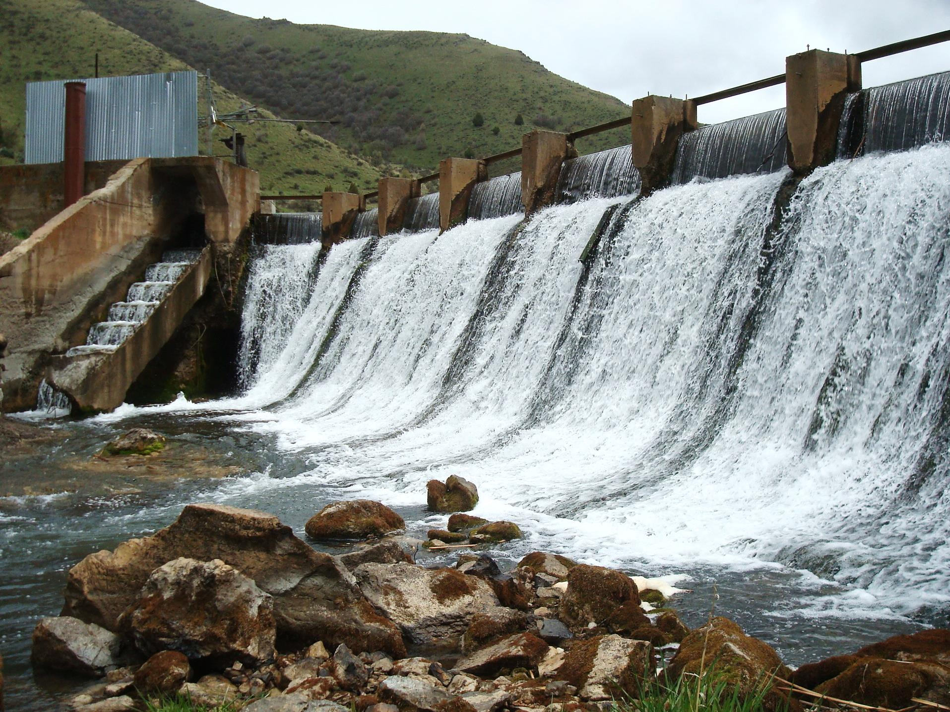
Distribution Systems

Slide 3
Distribution System
Authority:
Composition:
Counties and Cities
District Courts
State Engineer (since 1919)
Water Users
Distribution System Committee
Water Commissioner(s)
State Engineer

Slide 4
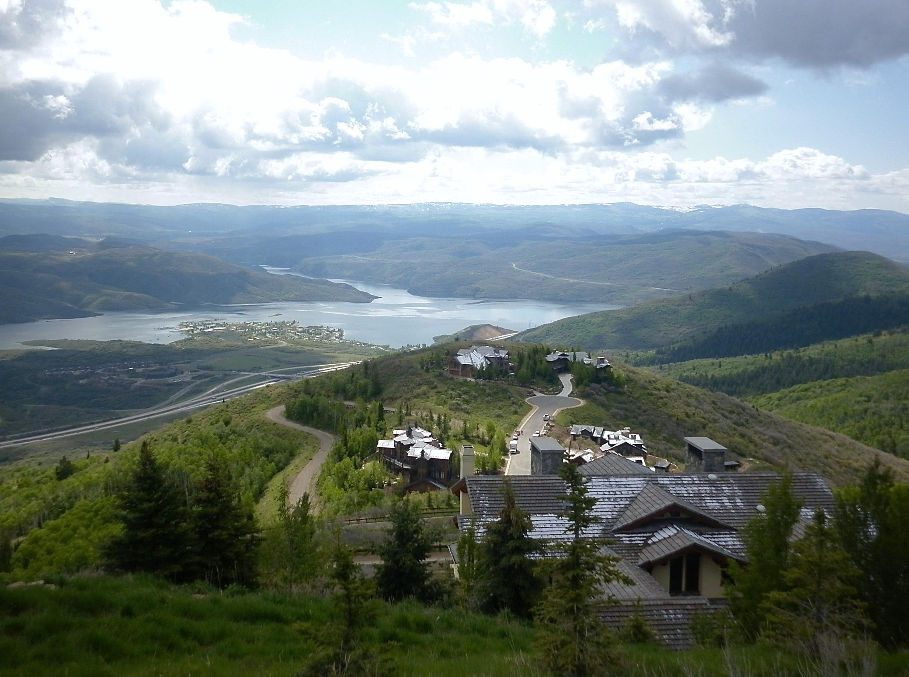
Responsibilities

Slide 5
Water Users Responsibilities
Maintain an adequate measuring device and controlling works (head gate)
Elect Distribution System Committee representative
Pay annual assessment to help cover distribution system costs

Slide 6
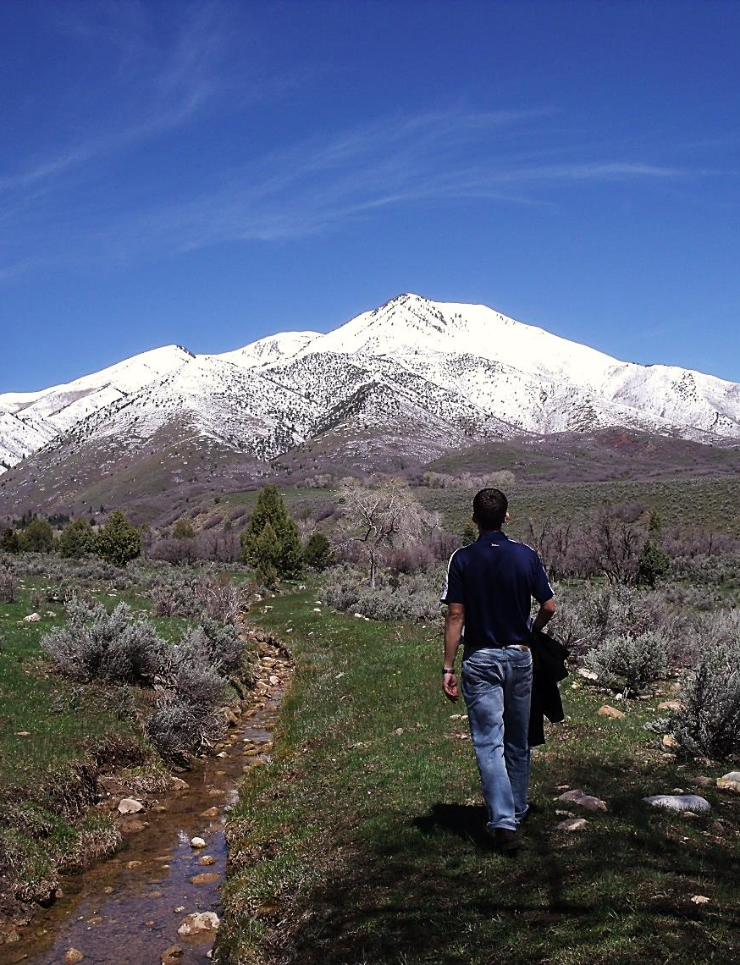
Committee Responsibilities
Represent water users at annual distribution meeting
Set annual budget
Set annual assessment amount
Select new water commissioner if necessary (four-year term)

Slide 7
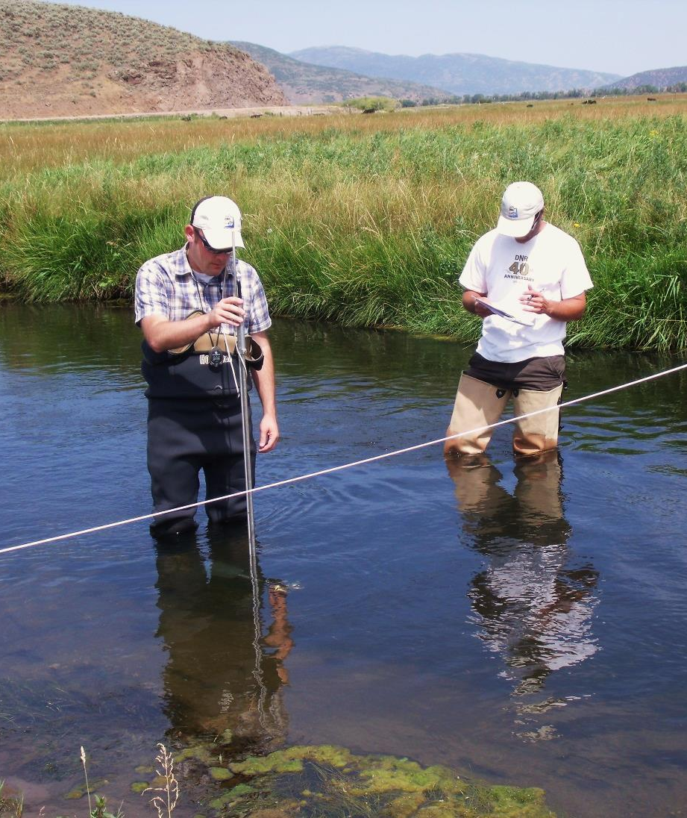
Commissioner Responsibilities
Distribute water in accordance with water rights and prior appropriation doctrine
Keep a record of diversions
Produce an annual report showing a record of diversions and decisions made
Perform other duties as agreed upon by the water users and state engineer

Slide 8
State Engineer Responsibilities
Appoint commissioner upon recommendation of a majority of water users
Manage the water commissioner fund
Train and direct commissioner in distributing water in accordance with water rights

Slide 9
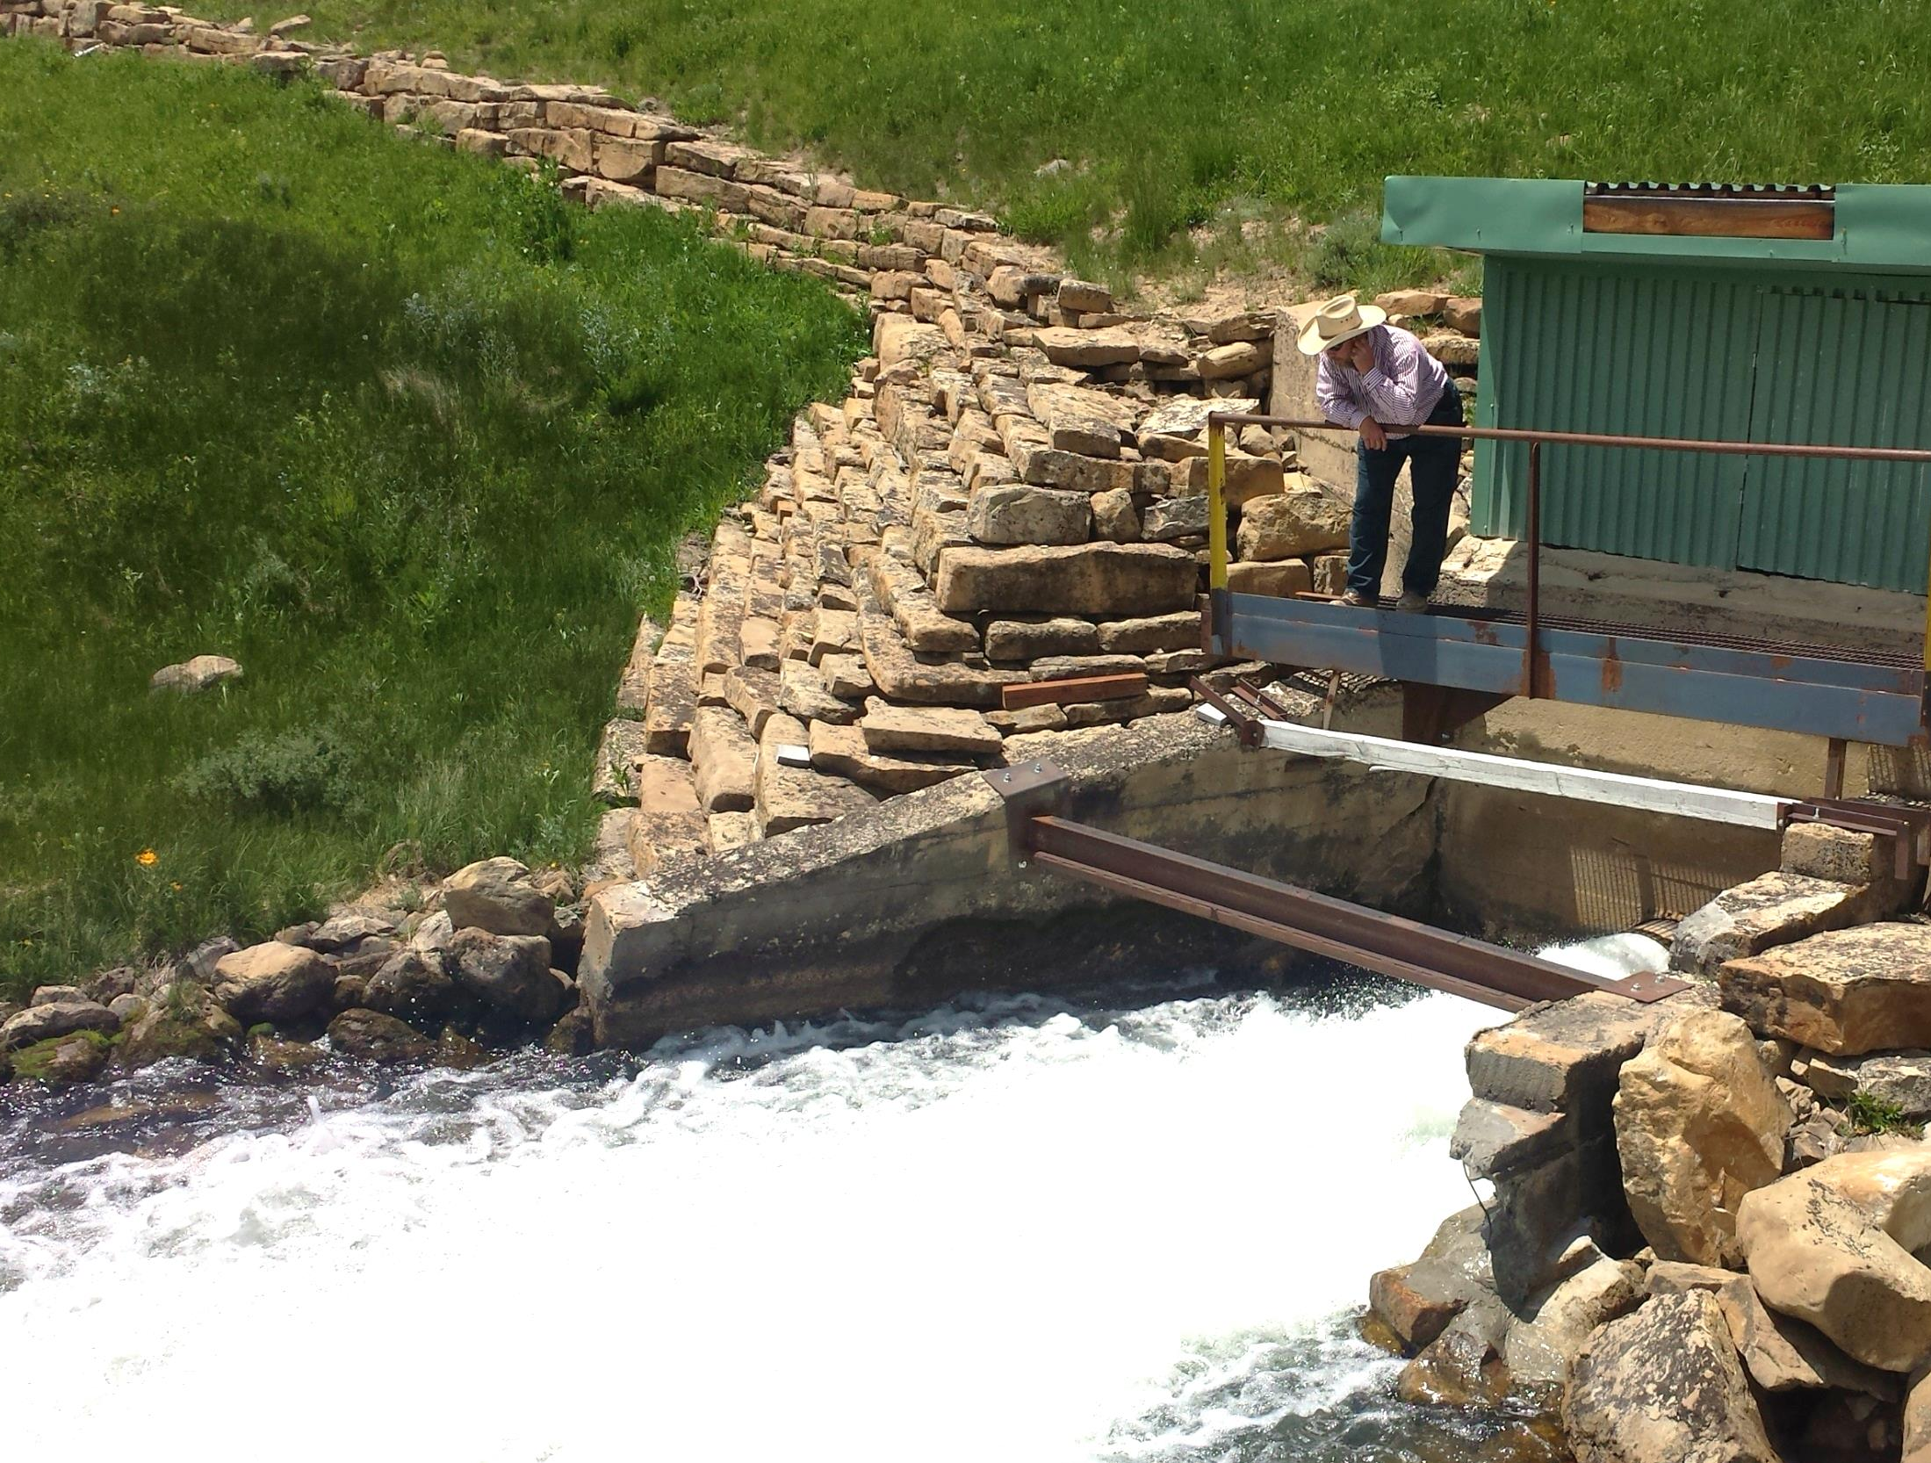
Questions?

