Slide 1
Utah Division of Water Rights
Advanced Water Right Topics
Rural Water Training—April 2018
Michael Drake, P.E.
Regional Engineer
June 21, 2004

Slide 2
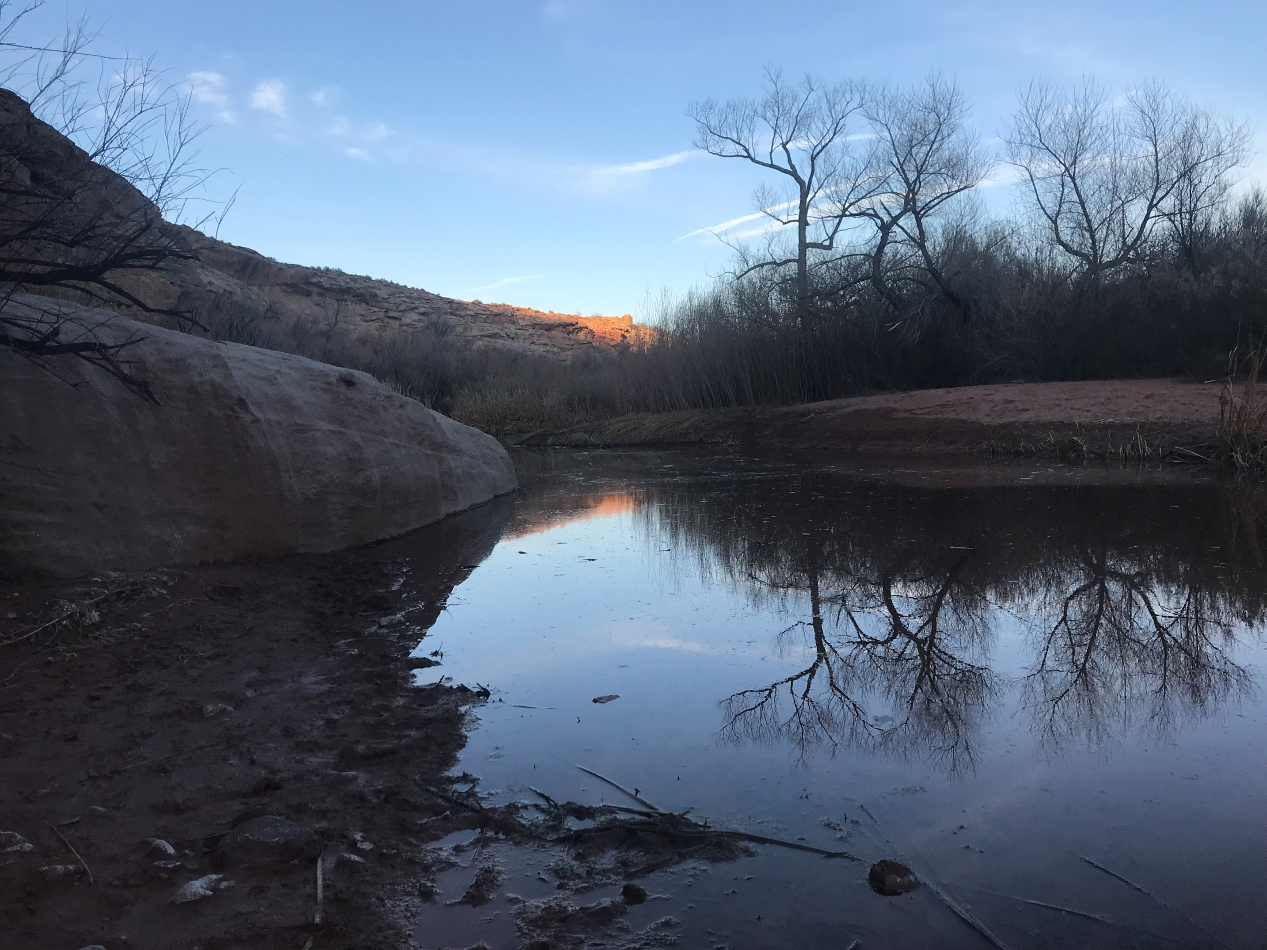
Advanced Water Right Topics
Not the day-to-day
Notes:
We’re going to talk about some advanced water rights topics. These are topics that don’t come up on every application and only come into play in certain circumstances.

Slide 3
Topics to be Covered:
Forfeiture
Nonuse
Nonuse Application
Rebuttable Presumption of Quantity Impairment due to Nonuse
Notes:
We’re going to talk about Forfeiture.
We’re going to talk about the water right principle that leads to forfeiture…nonuse.
Finally, we’re going to talk about a mouthful of a topic…Rebuttable Presumption of Quantity Impairment due to Nonuse. We haven’t figured out a good abbreviation for that yet. RPQIDTNU
These topics revolve around the idea of nonuse.

Slide 4
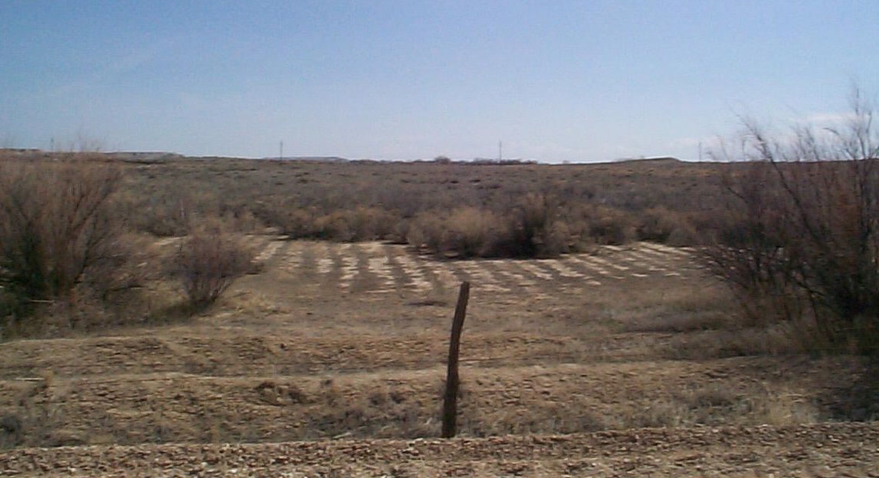
Nonuse Leads to Forfeiture UC 73-1-4
When a water user abandons or ceases to use all or a portion of a water right for a period of seven (7) years, the portion not used is subject to forfeiture.

Slide 5
Forfeiture UC 73-1-4
Key Facts:
Forfeiture is a judicial proceeding.
Administrative vs Judicial Action
The State Engineer does not declare water rights forfeited. (A judge does)
Forfeiture proceeding must be filed within 15 years of the latest period of nonuse of at least 7 years.
If forfeited, the lost water right reverts to the public:
Available in priority
Available to appropriate (if the area is open)
The winner of the forfeiture suit does not get the water right.

Slide 6
Forfeiture UC 73-1-4
Who files the lawsuit?:
An aggrieved party (i.e. an adjacent water user)
The State Engineer, most typically in the course of a general adjudication.
Forfeiture in Adjudication
Water User’s Claim may be disallowed by court
Same result as forfeiture
A decree bars claims of forfeiture for prior nonuse for rights determined to be valid in the decree

Slide 7
Exceptions to Nonuse UC 73-1-4(2)(e)
Approved Nonuse Application
more on this next
Lease
Written lease is best, but some sort of documentation is necessary
Government Fallowing Program
Insufficient Water
For example: Reduced flow due to drought
Priority Cuts

Slide 8
Exceptions to Nonuse, Cont’d UC 73-1-4(2)(e)
Water Storage (surface or groundwater recharge project)
Stored for present or future use
Substantially all of the water was used
Public Water Supplier
Must have been acquired before May 5, 2008 or if not, had change application approved.
Supplemental Water Rights
Diligently Pursuing a Change Application

Slide 9
Nonuse Applications 73-1-4(2)(b)
Approved nonuse application:
Stops the clock for nonuse during the period from filing to expiration.
Does not protect a water right that is already subject to forfeiture.
Does not constitute beneficial use.

Slide 10
Nonuse Applications 73-1-4(2)(b)
Nonuse applications may be filed on all or a portion of the right by:
An Appropriator or the appropriator’s successor in interest
A Shareholder
on the water represented by the stock owned after giving written notice to the company.

Slide 11
Nonuse applications may be either approved or rejected by the State Engineer.

Slide 12
73-1-4(4)
The state engineer shall grant a nonuse application…if the applicant shows a reasonable cause for nonuse.
Reasonable causes for nonuse include:
Demonstrable financial hardship or economic depression;
Water conservation or efficiency practices or a groundwater Recharge / recovery program;
Operation of legal proceedings;
continued

Slide 13
73-1-4(4)
The state engineer shall grant a nonuse application…if the applicant shows a reasonable cause for nonuse.
Reasonable causes for nonuse include:
Water held by a public water supplier for the reasonable future needs of the public;
Loss of capacity due to deterioration of the water supply or
Loss of capacity if a plan to resume full use of the water by replacing, restoring or improving equipment.

Slide 14
Example: Where’s Nonuse Waldo?

Slide 15
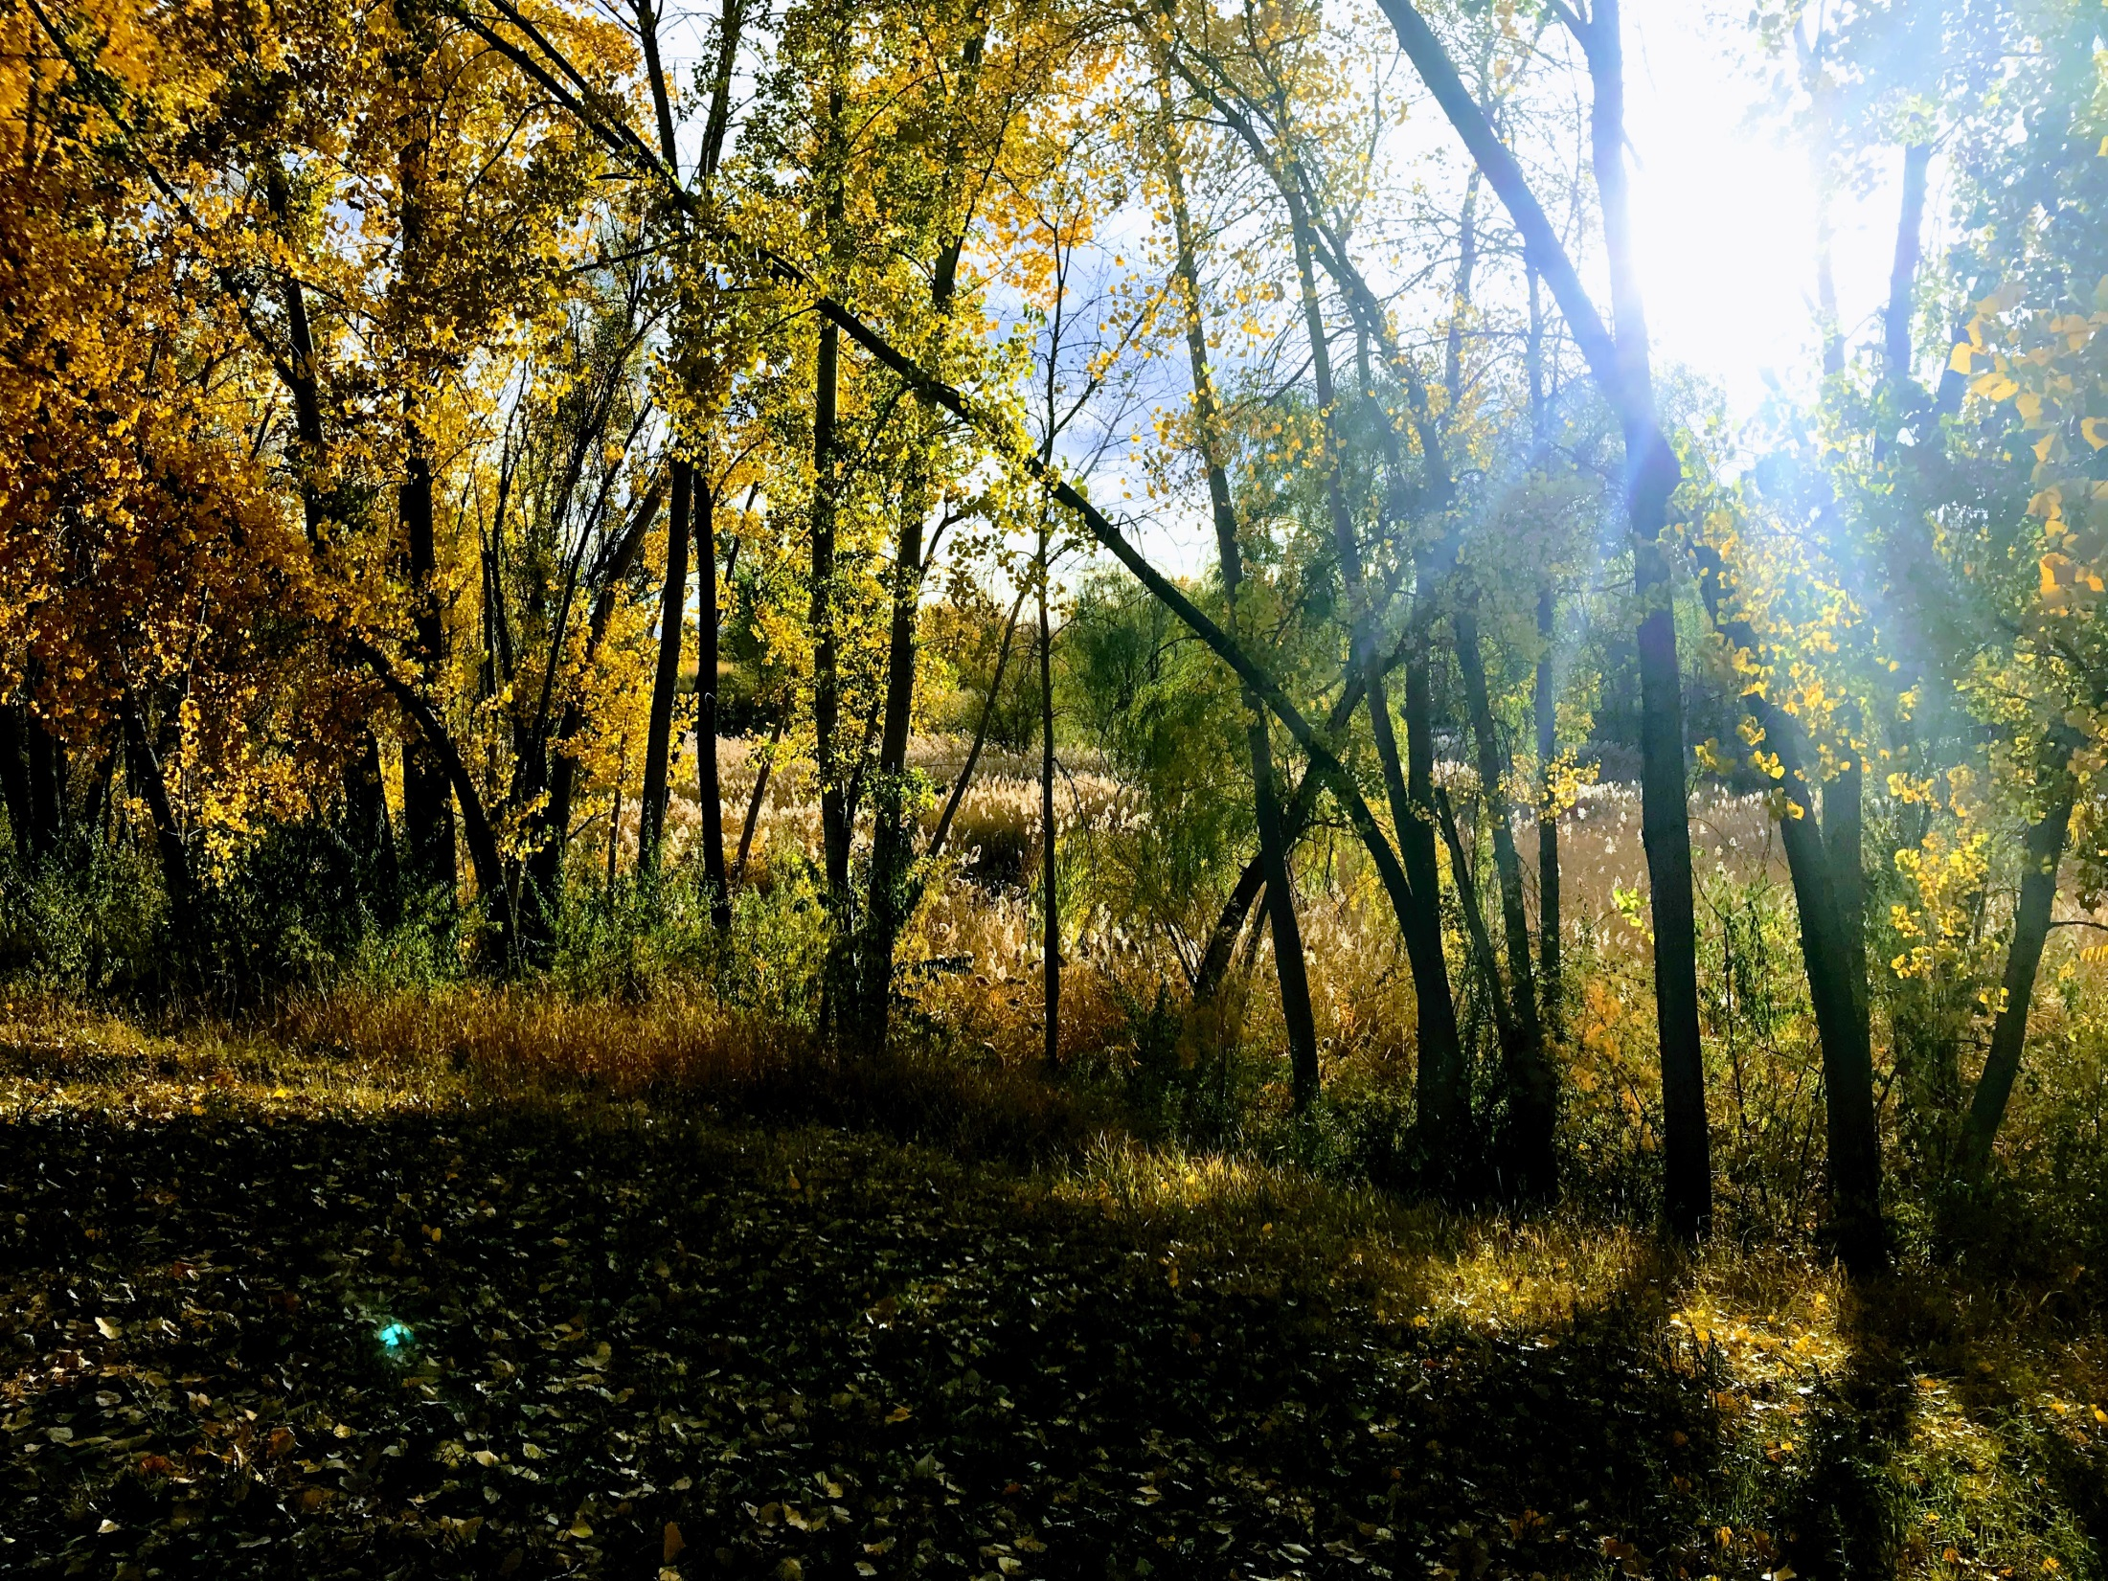
Quantity impairment

Slide 16
Approval Criteria
for Change Applications
Statutory Basis Utah Code 73-3-3 and 73-3-8
Quantity Impairment – a reduction in the amount of water available to an existing right if the change were approved.
Diminished quantity of water
Change in timing of water
Enlarged the quantity of water depleted
Notes:
Let’s do a little review of what quantity impairment is. This slide takes us back to the very fundamental definition of quantity impairment. It’s important to note that quantity impairment and nonuse are not interchangeable terms. Quantity impairment can and does come into effect even when there is no evidence or allegation of nonuse.
Boyd: “Quantity impairment is just impairment” It is a new term that came into the statute fairly recently, but represents and idea that has been in place for a long time.
Other similar terms: Simply “Impairment” or “Interference”.

Slide 17
In a Change Application Proceeding:
Statutory Basis: Utah Code 73-3-3 and 73-3-8
The applicant bears the burden of producing evidence that the change can be made including…
Change will not cause a specific right to experience quantity impairment.
Rebutting the presumption of quantity impairment.
Notes:
Now we talk about how this term of quantity impairment becomes a concept that it tied in with nonuse of a water right.

Slide 18
Quantity Impairment
Applicant’s Burden to
Produce Evidence
A
B
Rebuttable
Presumption of Quantity Impairment:
Due to Nonuse
Quantity Impairment:
Standard Approval Criteria for
all Change Applications
Notes:
We are talking about B.

Slide 19
The Rebuttable Presumption of Quantity Impairment is how the State Engineer can consider nonuse during the change application process.
UAC 73-3-8(6)(c)
There is a rebuttable presumption of quantity impairment…to the extent that, for a period of at least seven consecutive years, a portion of the right identified in a change application has not been:
Diverted from the approved point of diversion; and
Beneficially used at the approved place of use.
This section is not, not a little confusing.
Notes:
This is how the State Engineer can evaluate nonuse during the change application process.
Let’s go and read the statute.
Now, how many of you feel like the dog on the following slide?

Slide 20
Interpretation Tip:
Point of Diversion and Place of Use are not mutually dependent factors.
They are a starting point for evaluating a presumption of quantity impairment due to nonuse.
In short:
If you haven’t been using the water like you should, presumption may apply.

Slide 21
How do you Rebut?
The Rebuttable Presumption of Quantity Impairment does not apply if excused by:
Subsection 73-1-4 (2)(e) - Exceptions to Nonuse
An approved nonuse application
Subsection 73-3-30(7) – Instream Flow
Passage of Time 73-1-4(2)(c)(i) – Remember this from earlier? Nonuse period of 7 consecutive years must have occurred within the last 15 years (or 15 years prior to the filing of a nonuse application)

Slide 22
The Rebuttable Presumption of Quantity Impairment does not apply if excused by:
Subsection 73-1-4(2)(e) – Exceptions to Nonuse; Remember these from earlier?
Lease
Fallowing Program
Insufficient Water
Priority Cuts
Water Storage
Substantial use
Public Water Supplier
Supplemental Water Right
Diligently Pursuing a Change Application
More on next slide…

Slide 23
More on a couple exceptions:
Leases - A common response when presumption is raised. Items to consider:
Written documentation is preferred.
Can the use be terminated?
Public Water Supplier – UAC 73-1-4(2)(g)
Must have been acquired prior to May 5, 2008.
This applies to the Presumption of Quantity Impairment due to Nonuse.

Slide 24
What to do?
Don’t ignore. Applicant bears the burden.
Is nonuse excused? UAC 73-1-4
Preemptive Strike - Make your case in the change application.
Explanatory – was there a lease?
Heretofore Map – what will be retired?

Slide 25
EXAMPLES

Slide 26
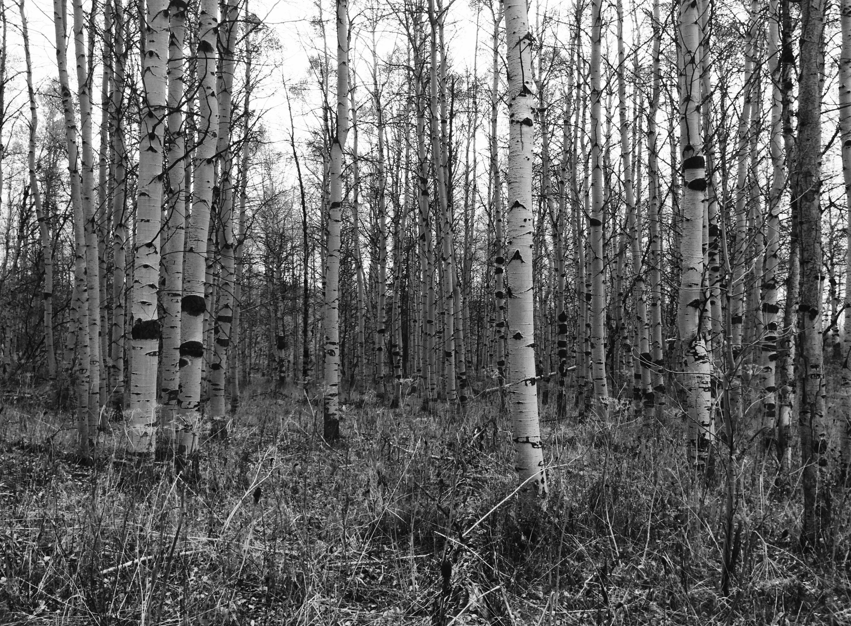
Questions?

